Slide 1

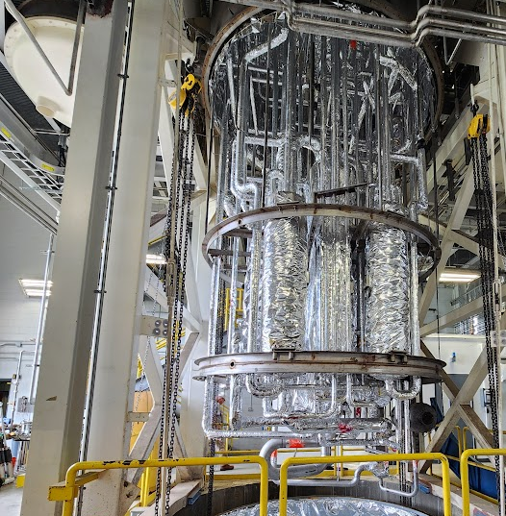
C3Or2B-04
Performance Testing of the 4kW ESR2 Refrigerator at JLab
5/21/2025
Chris Perry
Notes:
Tip: Keep titles under 60 characters for readability
To change the photo: Right-click on photo and select change photo

Slide 2
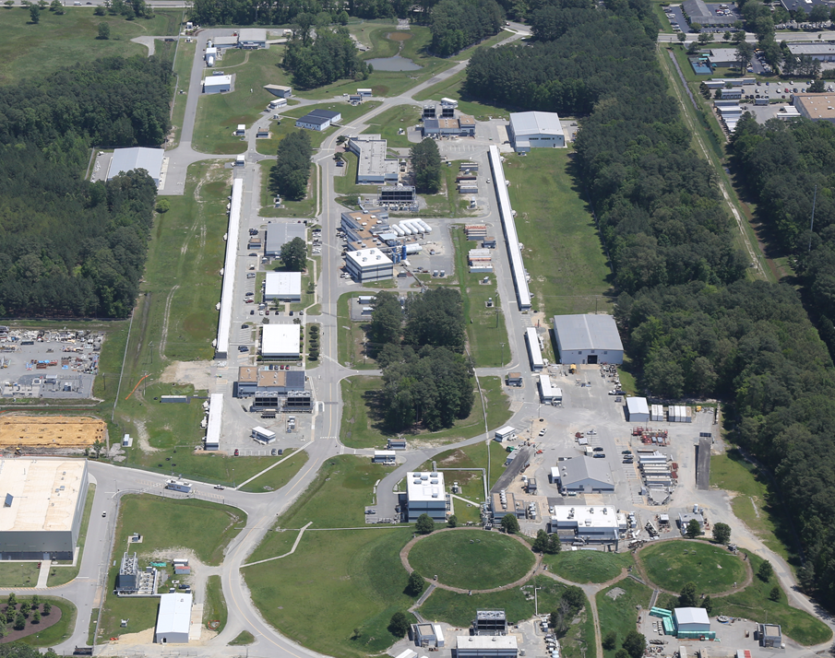
Background
D
Continuous Electron Beam Accelerator Facility
(CEBAF) at JLab
CHL
South LINAC
North LINAC
A
B
C
Injector
A
B
C
Notes:
Guidelines: 6-8 bullets per slide; Use sentence fragments for bullets

Slide 3
Background
End Station Refrigerator 1 (ESR1)
- ~1800 W plant
- Used in mid-1970s at LBNL (ESCAR)
- Installed at JLab in 1995
- ~ 800W Refrigeration at 4.5K
~ 8 g/s Liquefaction at 4.5K
~ 1000W at 15K
- as 15K target loads increased through the years, frequently required 4K support flow from the Central Helium Liquefier (CHL)
CHL
CHL
A
B
C
ESR1
A
B
C
Notes:
Guidelines: 6-8 bullets per slide; Use sentence fragments for bullets

Slide 4
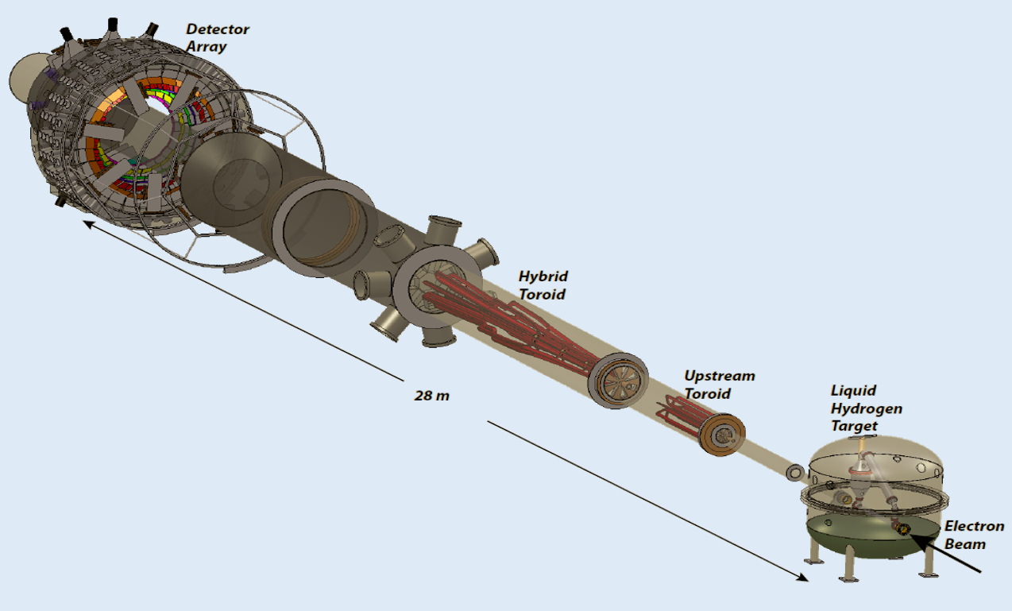
Background
MOLLER project in Hall A
4000W 15K load, returning at 20K
Expected to have an additional ~1000W 15K load in Hall C
Existing 1800W (@4K) plant could not support the proposed load from MOLLER.
~500W and 5 g/s 4K loads from existing magnets
Measurement Of a Lepton-Lepton Electroweak Reaction (MOLLER)
Notes:
Guidelines: 6-8 bullets per slide; Use sentence fragments for bullets

Slide 5
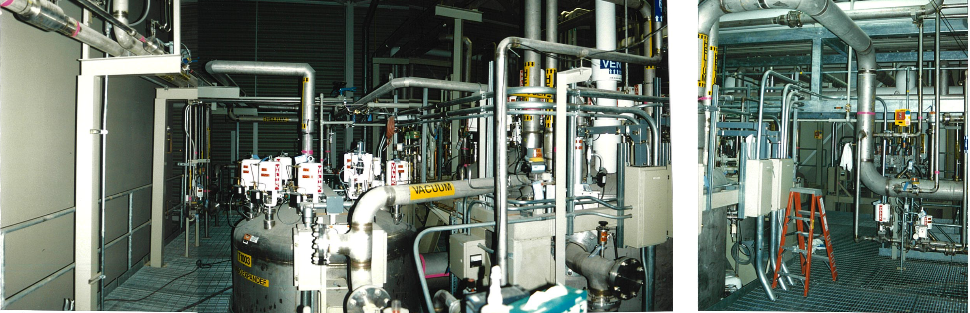

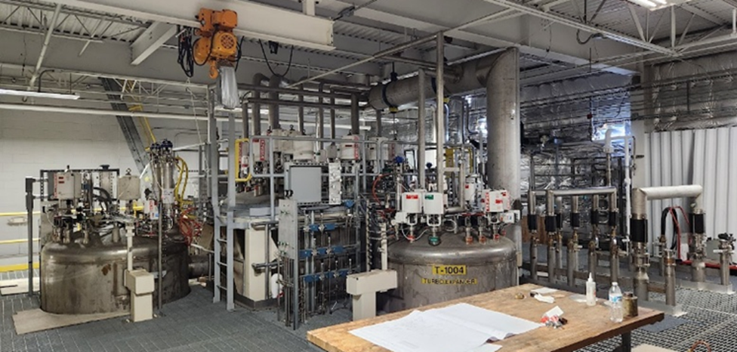

Background
1993
Accelerator Systems String Test (ASST)
2024
End Station Refrigerator 2 (ESR2)
Notes:
Guidelines: 6-8 bullets per slide; Use sentence fragments for bullets

Slide 6
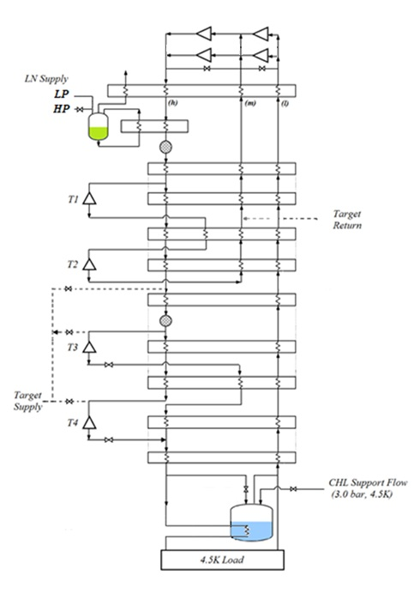
Modifications
15K, high pressure target supply
12K and 8K supplies added for increased flexibility with current target infrastructure.
T3 and T4 exhaust operate at a lower pressure:
3.1 Atm at JLab vs 4 Atm at SSC
Return Injection header used during target load testing to keep target supply temp cold and better utilize cold end turbines due to low 4k load
Return injection for 15K and 12K target testing
Notes:
Guidelines: 6-8 bullets per slide; Use sentence fragments for bullets

Slide 7
Test Plan
-50% Capacity:
-One 1st stage compressor, one 2nd stage compressor.
100% Refrigeration
100% Liquefaction
50% Refrigeration /50% Liquefaction
Max 15K –with assumed 4K load (500 W, 5 g/s)
* All target loads are returned at 20K
-100% Capacity:
-Two 1st stage compressors, two 2nd Stage compressors.
100% Refrigeration
100% Liquefaction
50% Refrigeration /50% Liquefaction
Max 15K- with assumed 4K loads
Max 12K – with assumed 4K loads
Max 8K – with assumed 4K loads
Notes:
Guidelines: 6-8 bullets per slide; Use sentence fragments for bullets

Slide 8
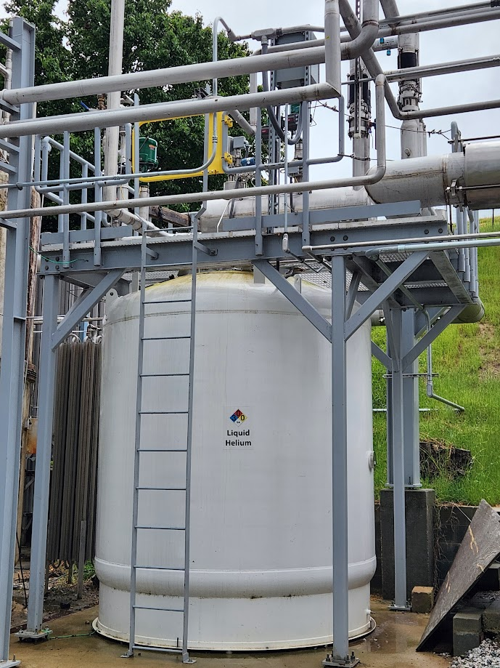
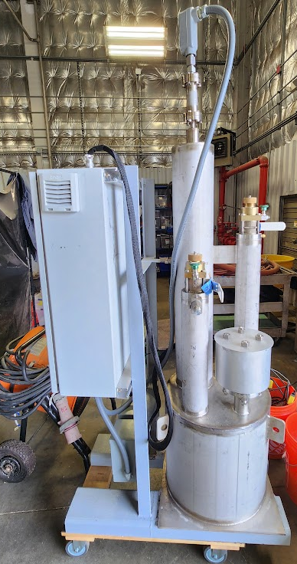
Test Plan
-A 6kW heater installed in the LHe dewar was used to simulate the 4K load.
-Liquefaction loads were tested by filling the LHe dewar and level measured via a differential pressure liquid level gauge, a superconducting probe, and by the mass-in flow meter.
-A 7kW test heater was built to test the 15K, 12K, and 8K load tests, target return is at 20K.
Notes:
Guidelines: 6-8 bullets per slide; Use sentence fragments for bullets

Slide 9
Results and comparison
JLab 50% Capacity
SSC 50% Capacity
Mode | 4K Capacity (W) | Liquefaction rate (g/s) | LN2 Consumption (g/s) | Target Power (W) | Power Usage (kW)
100% Ref | 2038 | - | 11.6 | - | 654.2
100% Liq | - | 21 | 60.6 | - | 615.1
50/50 | 1061 | 12.5 | 34.5 | - | 598.7
Max 15K | 486 | 4.3 | 18.5 | 1496 | 618.8
Mode | 4K Capacity (W) | Liquefaction rate (g/s) | LN2 Consumption (g/s) | Target Power (W) | Power Usage (kW)
100% Ref | 1450 | - | 8.9 | - | 664.6
100% Liq | - | 18 | 58 | - | 693.5
50/50 | 795 | 7.4 | 24.9 | - | 649.1
Notes:
Guidelines: 6-8 bullets per slide; Use sentence fragments for bullets

Slide 10
Results and comparison
JLab 100% Capacity
SSC 100% Capacity
Mode | 4K Capacity (W) | Liquefaction rate (g/s) | LN2 Consumption (g/s) | Target Power (W) | Power Usage (kW)
100% Ref | 4244 | - | 15.3 | - | 1258*
100% Liq | - | 47.3 | 111.6 | - | 1357
50/50 | 2420 | 31 | 88.7 | - | 1366
Max 15K | 509 | 3.8 | 25.7 | 3718 | 1328*
Max 12K | 517 | 5.5 | 24.5 | 4143 | 1348*
Max 8K | 537 | 5.5 | 23.5 | 4930 | 1327*
Mode | 4K Capacity (W) | Liquefaction rate (g/s) | LN2 Consumption (g/s) | Power Usage (kW)
100% Ref | 4026 | - | 17.1 | 1333.1
100% Liq | - | 34.3 | 105.6 | 1370.1
50/50 | 2235 | 22.8 | 79.3 | 1335.6
* Indicates that at least 1 compressor was not at full load during the test
Notes:
Guidelines: 6-8 bullets per slide; Use sentence fragments for bullets

Slide 11
Results and comparison
JLab Turbine Efficiencies
SSC Turbine Efficiencies
Mode | T1 | T2 | T3 | T4*
50% Ref | 0.748 | 0.835 | 0.423 | 0.125
50% Liq | 0.760 | 0.714 | 0.549 | 0.530
50% 50/50 | 0.760 | 0.753 | 0.558 | 0.418
100% Ref | 0.762 | 0.872 | 0.605 | 0.137
100% Liq | 0.760 | 0.828 | 0.551 | 0.498
100% 50/50 | 0.769 | 0.873 | 0.539 | 0.226
Max 15K | 0.759 | 0.789 | 0.549 | 0.524
Max 12K | 0.759 | 0.786 | 0.584 | 0.301
Max 8K | 0.761 | 0.826 | 0.555 | 0.520
Mode | T1 | T2 | T3 | T4
50% Ref | 0.636 | 0.736 |  | 0.635
50% Liq | 0.738 | 0.760 |  | 0.599
50% 50/50 | 0.705 | 0.748 |  | 0.621
100% Ref | 0.719 | 0.753 | 0.591 | 0.547
100% Liq | 0.744 | 0.766 | 0.514 | 0.576
100% 50/50 | 0.744 | 0.767 | 0.554 | 0.638
*Low efficiency calculations may be due to errors in low temperature measurements, still under investigation.
Notes:
Guidelines: 6-8 bullets per slide; Use sentence fragments for bullets

Slide 12
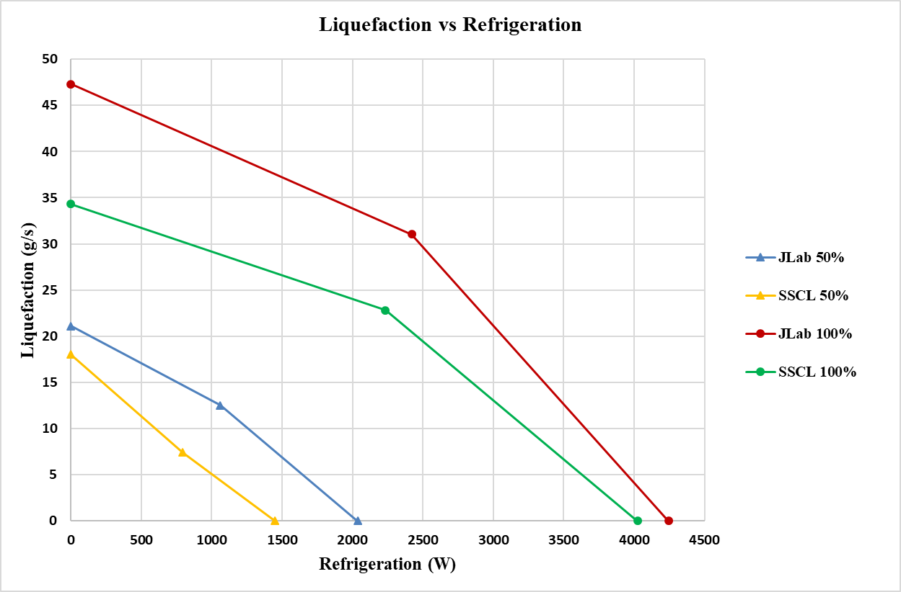
Results and comparison
Notes:
Guidelines: 6-8 bullets per slide; Use sentence fragments for bullets

Slide 13
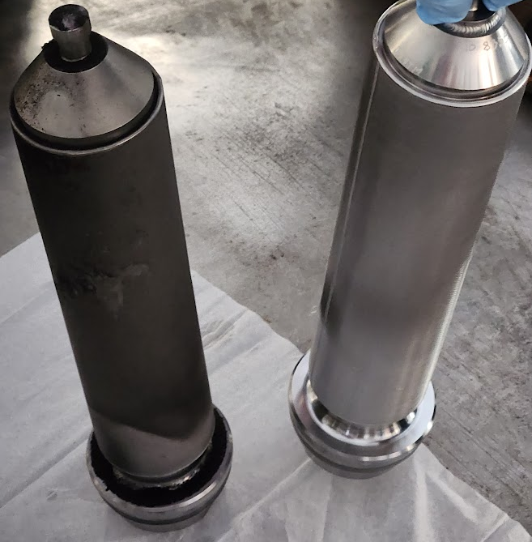
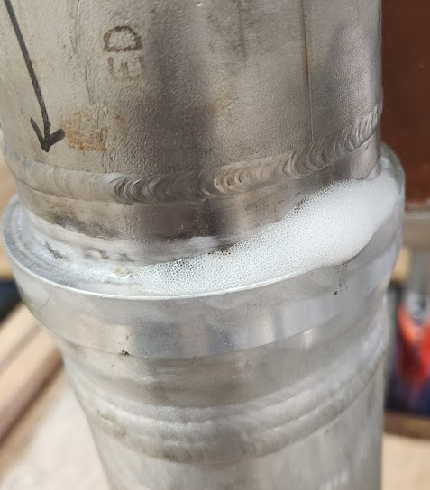
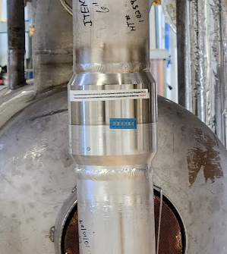
Issues
80K carbon bed dust filter
-Dust accumulation on 80K bed filter created a significant pressure drop during testing. Beds seemed to be under-sized and were run in parallel during testing.
Transition joint leak
-A Helium to vacuum leak was discovered during initial commissioning run. Leak located with helium time-of-flight, and confirmed to be a brazed SS-Al transition joint that had cracked, replaced with an explosion bonded joint.
Notes:
Guidelines: 6-8 bullets per slide; Use sentence fragments for bullets

Slide 14
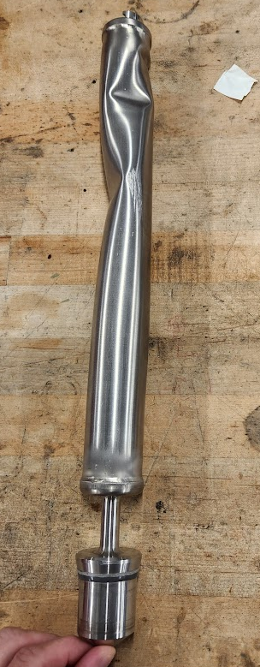
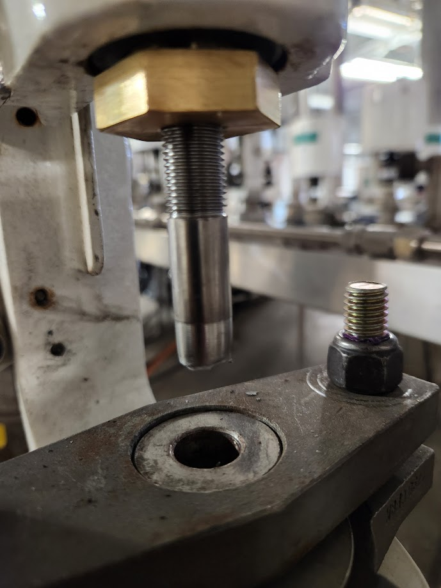
Issues
Crushed valve stem
-A cold return injection valve did not seal during operation, stem was removed and found to be crushed. The forces needed to do this far exceed what the actuator is capable of and must have occurred during shipping and handling of cold box. Replaced with spare stem.
Broken Turbine inlet valve stem
-Valve stem threads were slightly damaged during cold box transport, attempted repair via welding prior to commissioning, stem failed during operation and replaced with spare.
Notes:
Guidelines: 6-8 bullets per slide; Use sentence fragments for bullets

Slide 15
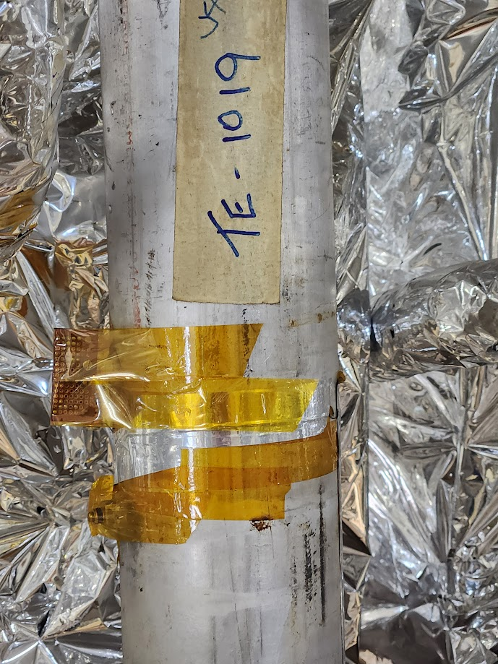
Issues
Failed temperature diodes in cold box
-Several cold end diodes failed during the first cooldown, inspection following warmup revealed the wires had come loose and were re-soldered.
Sub-optimal turbine speed
-Turbines did not achieve optimum speed in most tests. In fact, the brake valves stayed on their minimum (fully closed) positions. It is possible that the minimum flow orifice in the valves may be too large. This issue did not seem to affect T1 and T2 performance substantially.
Notes:
Guidelines: 6-8 bullets per slide; Use sentence fragments for bullets

Slide 16
QUESTIONS?
Notes:
Before sharing your presentation, confirm:
Fonts are consistent
Images meet quality standards
Charts use template colors
Footer information is current
Spell check completed
Links are working
File size is optimized

Slide 17
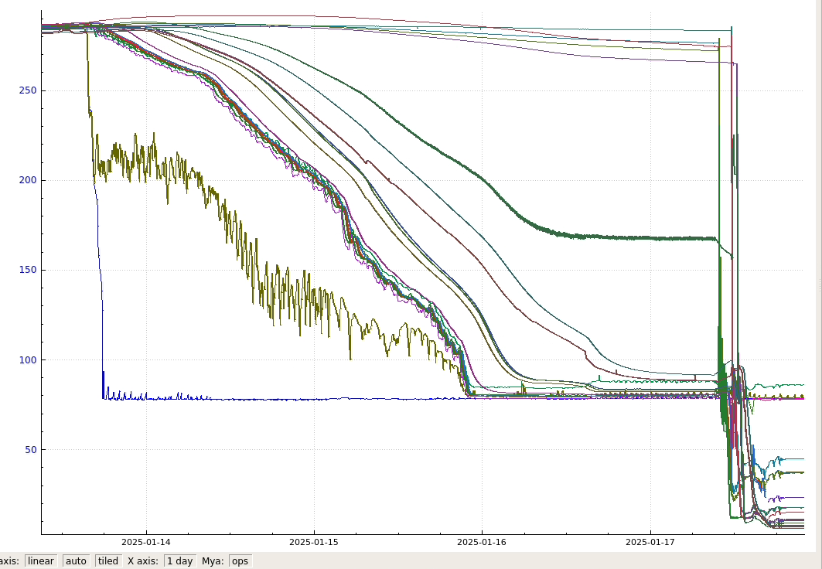
Cooldown
Notes:
Guidelines: 6-8 bullets per slide; Use sentence fragments for bullets

Slide 18
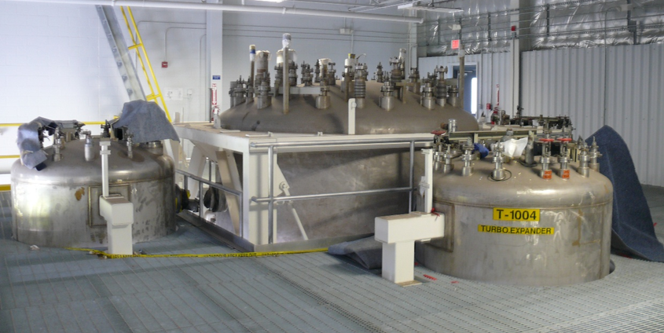


Background
2019
2024
Notes:
Guidelines: 6-8 bullets per slide; Use sentence fragments for bullets

Slide 19
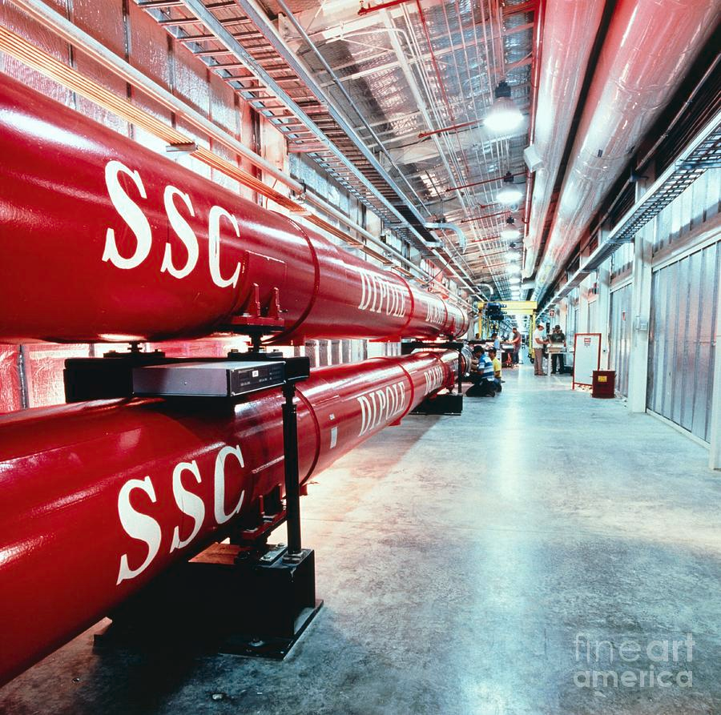
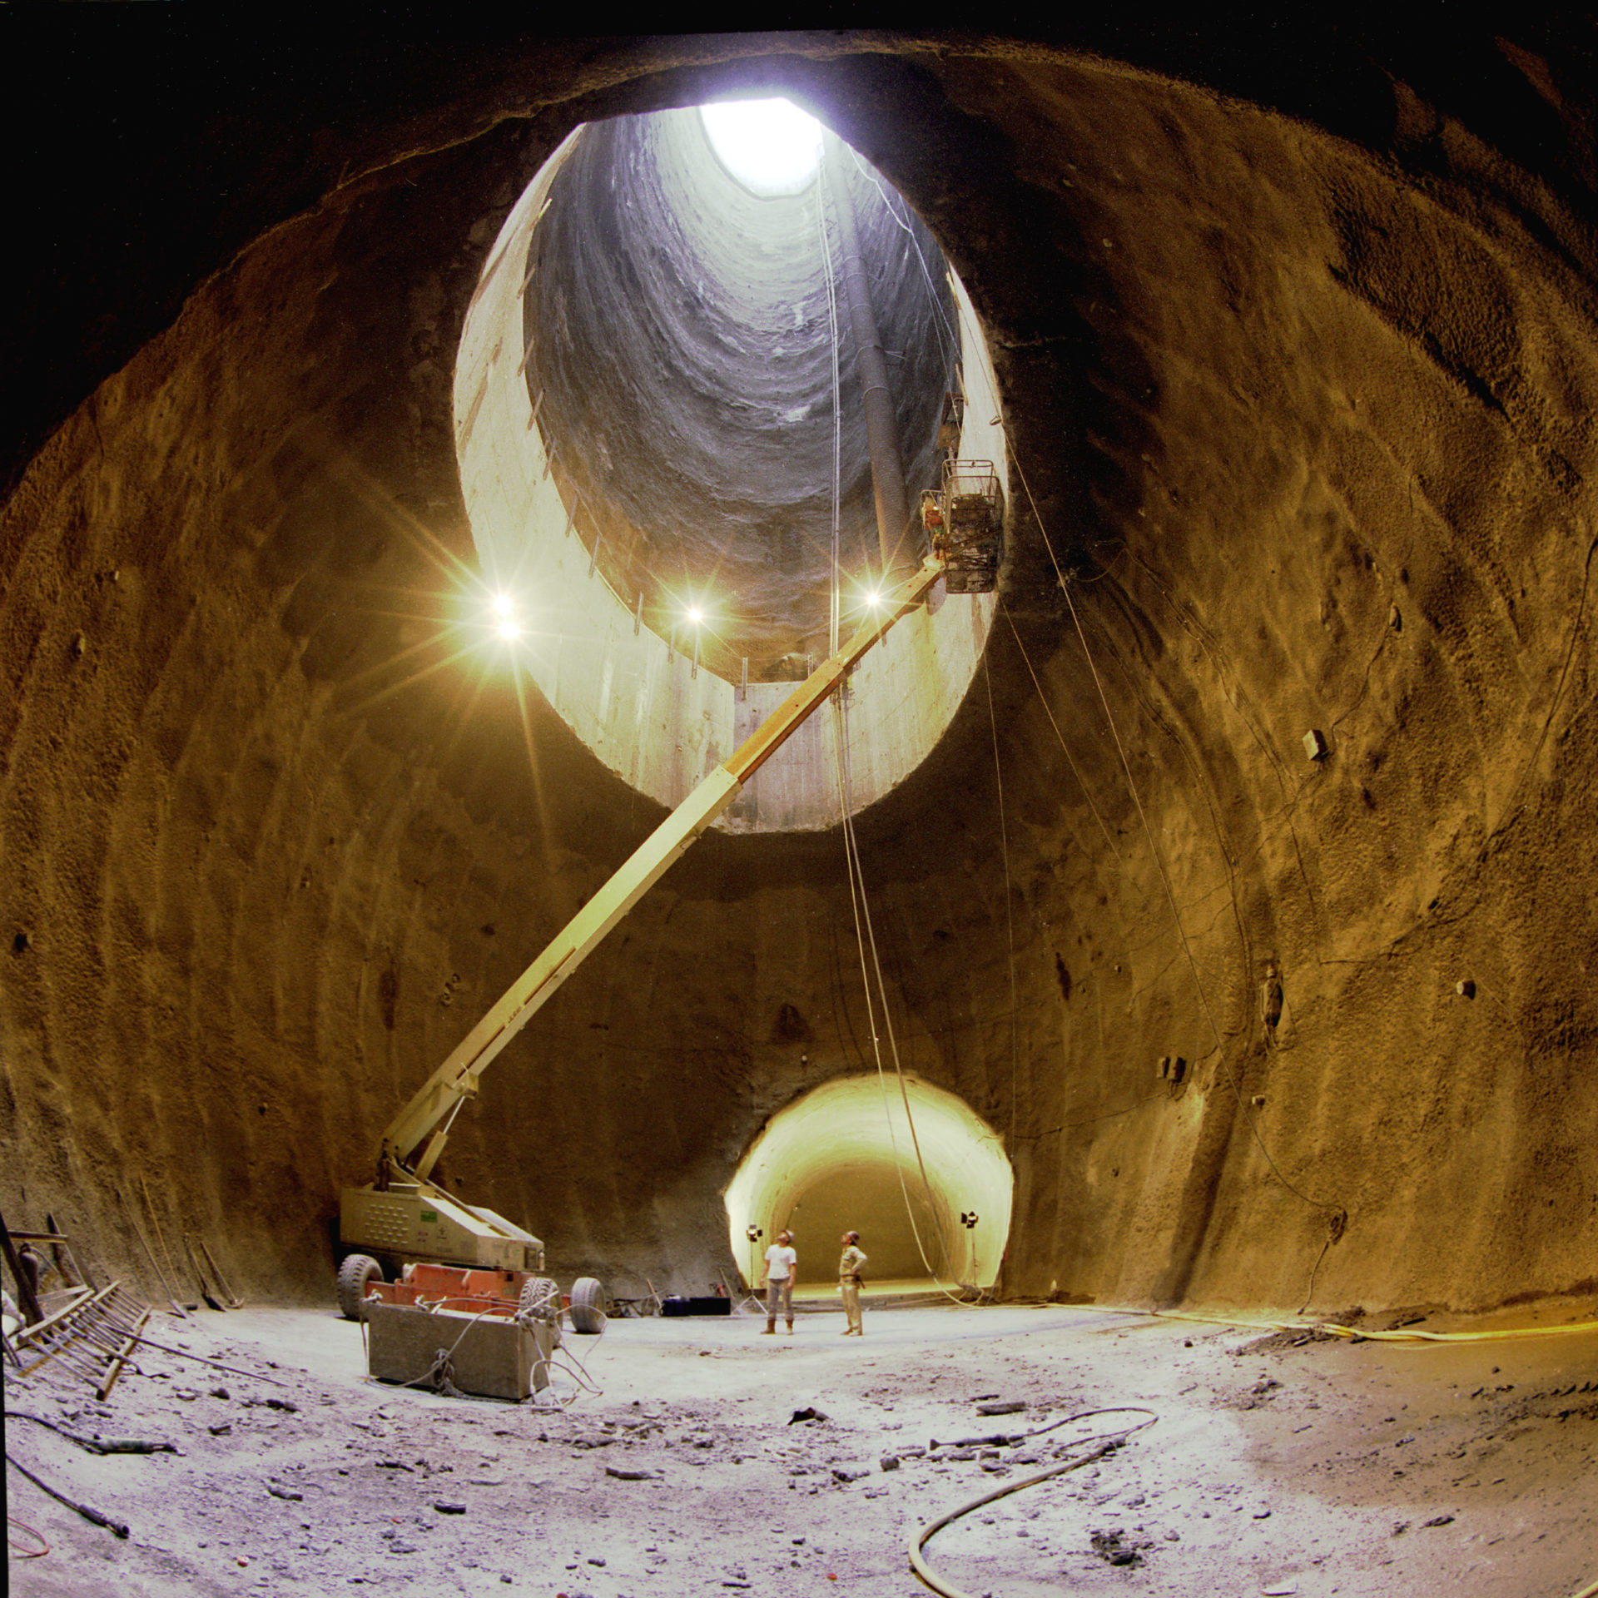
Background
Accelerator Systems String Test (ASST)
-4000W Cryoplant built to support the Magnet Test Facility at SCCL
-Operated for a very brief time in for commissioning of the refrigerator prior to cancellation of the project.
Superconducting Super Collider (SSC)
Notes:
Guidelines: 6-8 bullets per slide; Use sentence fragments for bullets

