Slide 1


Parasitic Heat Load
Reduction of
Cryocoolers
W. Stautner¹, V. Soni¹, A. Wu¹, J. Ricci¹
¹ GE HealthCare – Technology & Innovation Center, Niskayuna, NY, 12309, USA
C1Or2B-04, May 19th

Slide 2
Effect of shutting down
a Cryocooler in a Multicooler arrangement

Slide 3
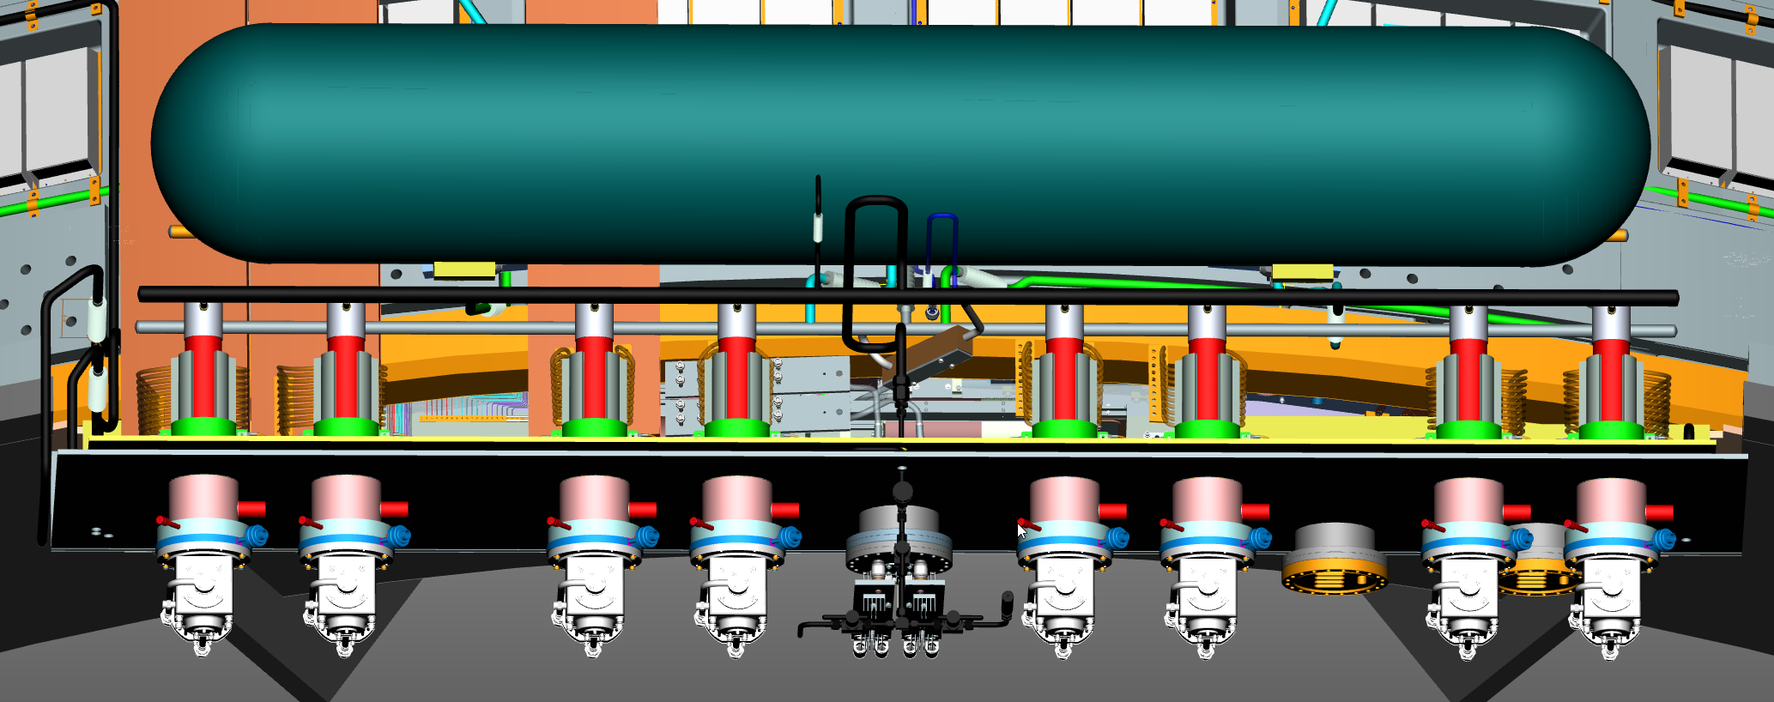
SC generator – Multicoolers
Coldbox with cryocoolers in confined, minimized space
High pressure liquid helium tank, low pressure during operation – thermomechanical effects in tubing
Optimize manifold to ensure all coolers liquefy equally – 8 condensers with feed and return
6 SHI 412 RDE A4s for steady state operational mode
2 on standby and for thermal transients/maintenance

Slide 4
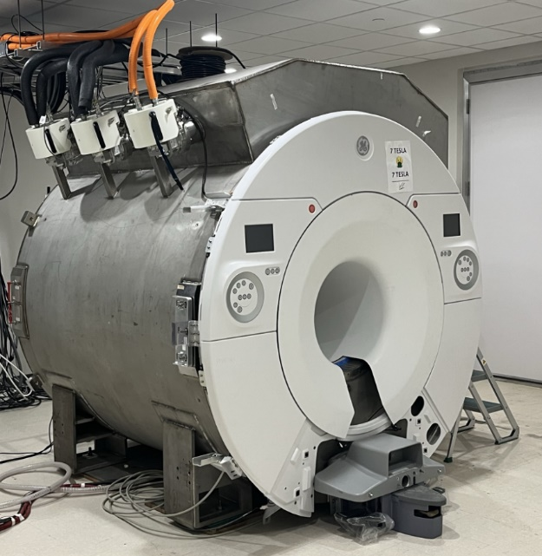
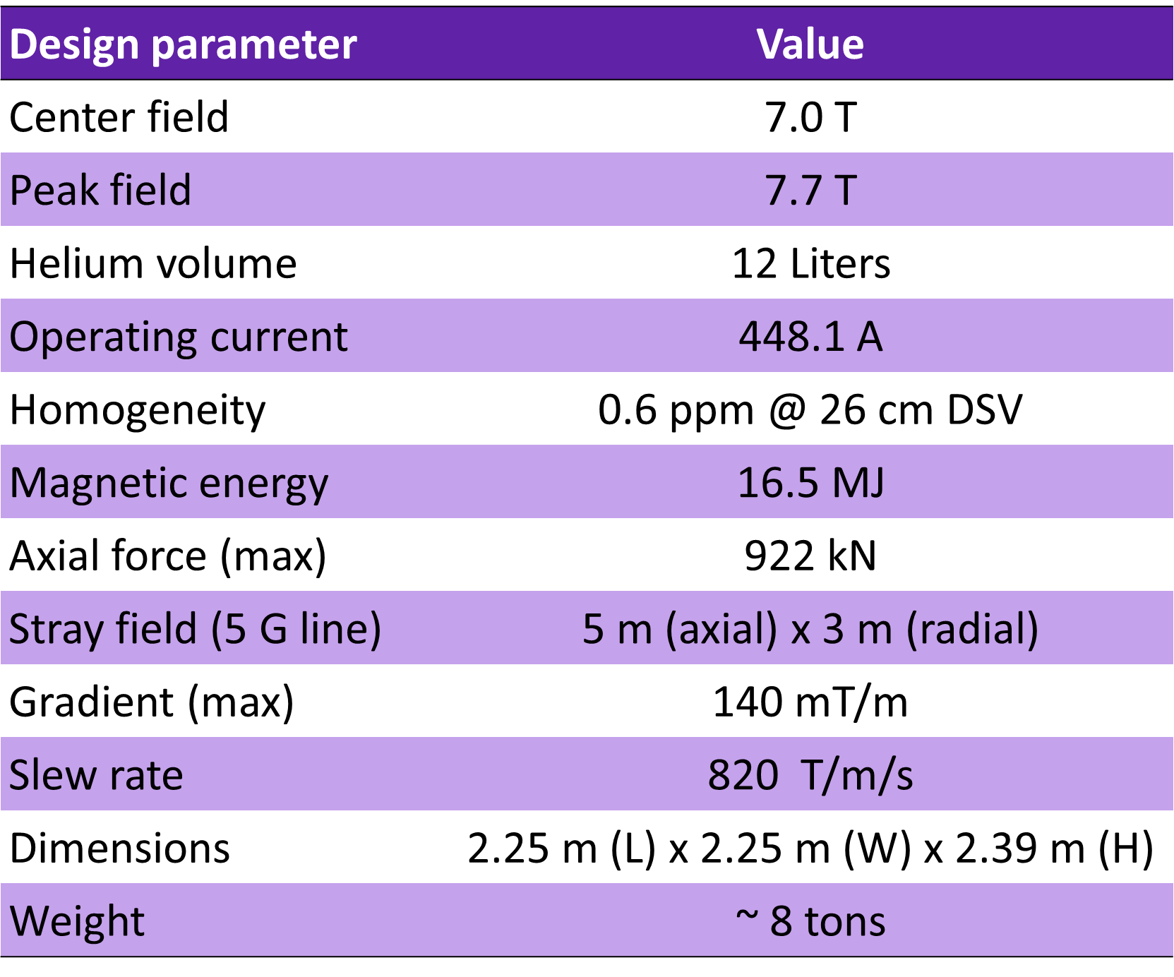
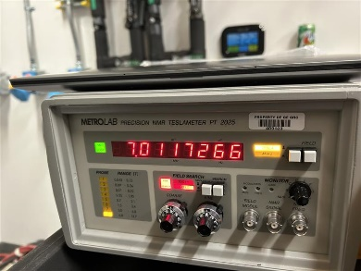
World’s first Sealed
Compact 7 Tesla Scanner
1
2
3
Actively shielded, low-cryogen human brain scanner
See also: Soni V Stautner W C2Po3A-08 Cryogenic Cooldown Performance of the GE (HTIC) Compact 7 T MRI Magnet CEC/ICMC Reno NV 2025

Slide 5
Effect of shutting down
a Cryocooler

Slide 6
Any relation to a helium gas filled tube in Cryogenics?

Slide 7
Cryogenic tubes in vacuum with top to bottom heat flux and in contact with a thermal shield (TS)
300 K
300 K
300 K
Helium
45 K
TS
45 K
TS
45 K
TS
4 K
4 K
4 K
Stainless steel tube as shown above filled with gaseous helium results in instable stratification.
Reason: Tube receives heat flux from thermal shield connection.
Annular stainless-steel tube, with outer wall thickness and same inner wall thickness filled with gaseous helium does not result in stratification. Gas column movement from top to bottom and from outer to inner wall. Movement pronounced if one wall thicknesses varies.
Reason: Inner and outer tube with different temperature profile due to diameter change.
Annular stainless-steel tube with outer wall thickness and same inner wall thickness filled with gaseous helium does not result in stratification. Gas column movement from top to bottom and from outer to inner wall.
Reason: Inner and outer tube with different temperature profile and thermal conduction length due to diameter change, inclination and different thermal tube length (application dependent).

Slide 8
Does a shut down
Cryocooler
behave like an inclined tube ?

Slide 9
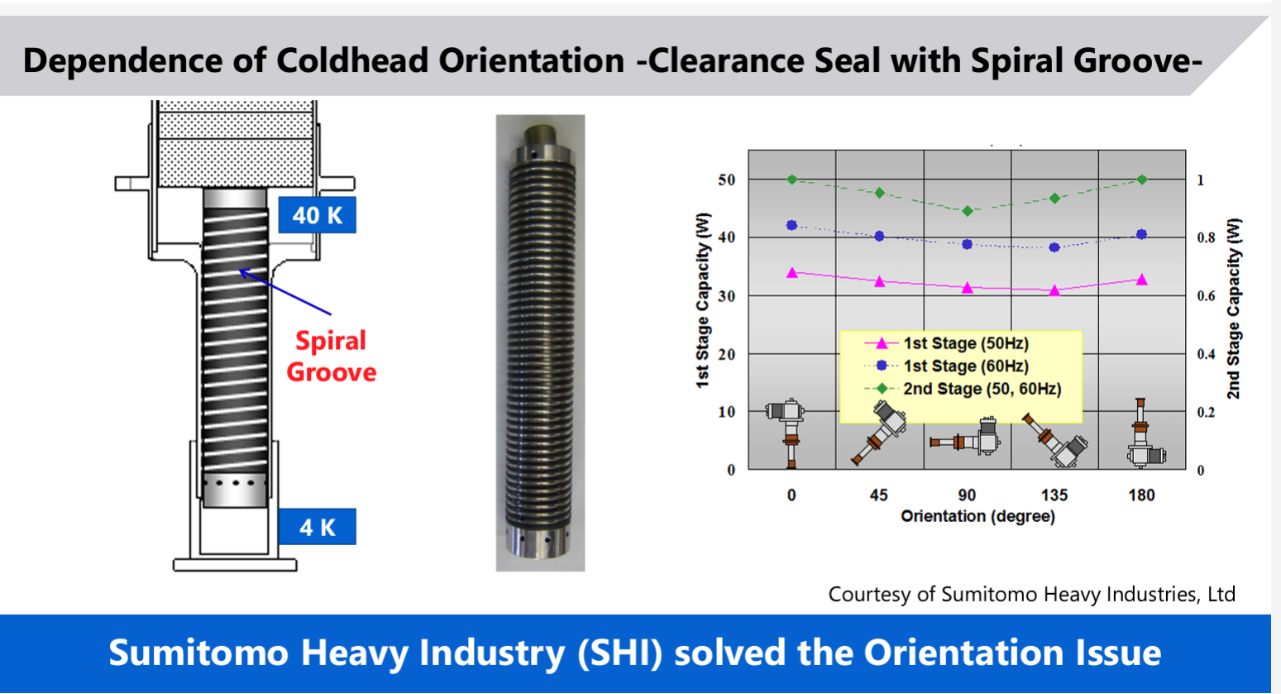
ICEC29-ICMC2024 Kuriyama / Toshiba

Slide 10
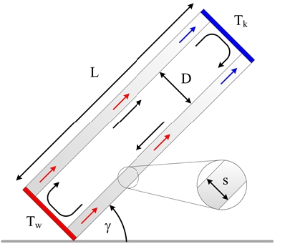
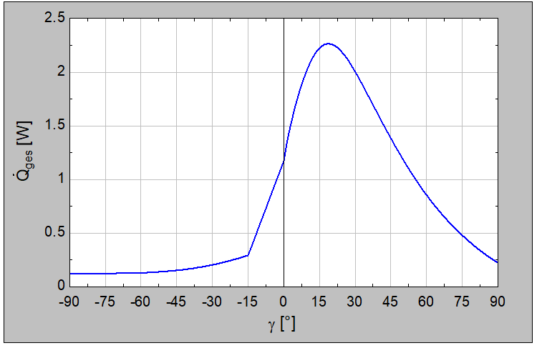
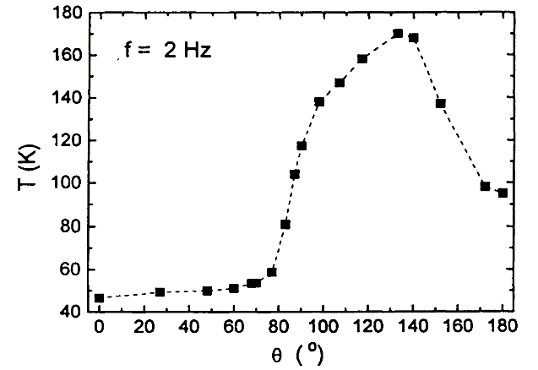
Simulation Effort
Pipe: Closed at both ends
(rotary valve closed)
Medium: Helium
Raleigh number: Ra_{D}: = 4.86 10⁵
Input parameters for 1.5 MPa equalization pressure
T_{wall} = 270 K D = 0.006 m
T_{cold} = 7 K L = 0.405 m
λ_{wall} = 3 W/mK s = 0.002 m
EES Engineering Equation Solver
Thummes G Heiden C et al
γ = -90º = cold end down
γ = +90º = cold end top
θ = 0º = cold end down
θ = 180º = cold end up
Langebach R Haberstroh C et al

Slide 11
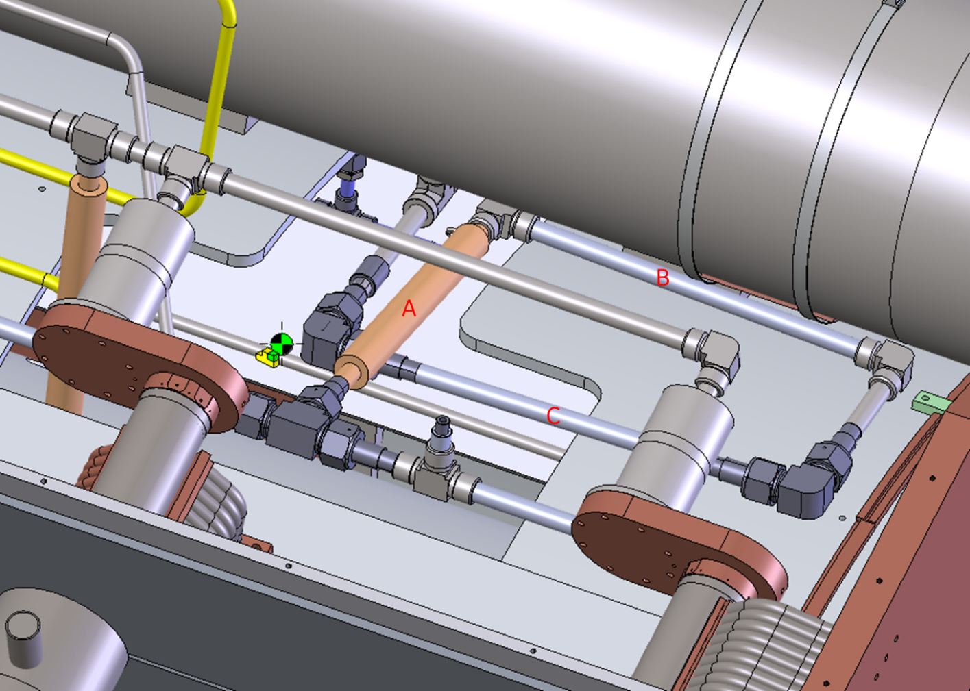
20 degree inclination
Shut down
2
1
Part of cooling circuit
3 GM Cryocoolers

Slide 12
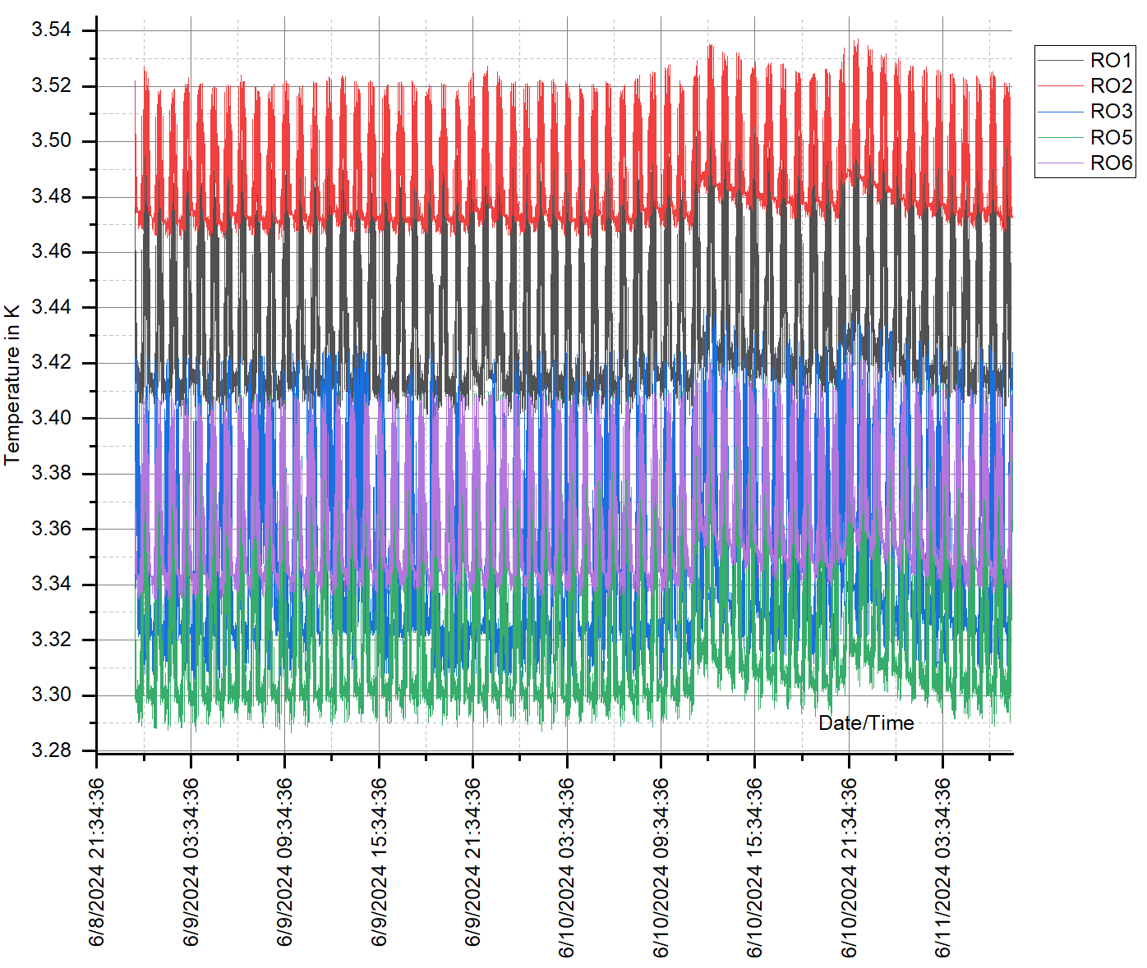
Experiment
Coolers 1 to 3:
temperature profile
before shutdown
Averaged base temperature
of coolers: 3.32 K

Slide 13
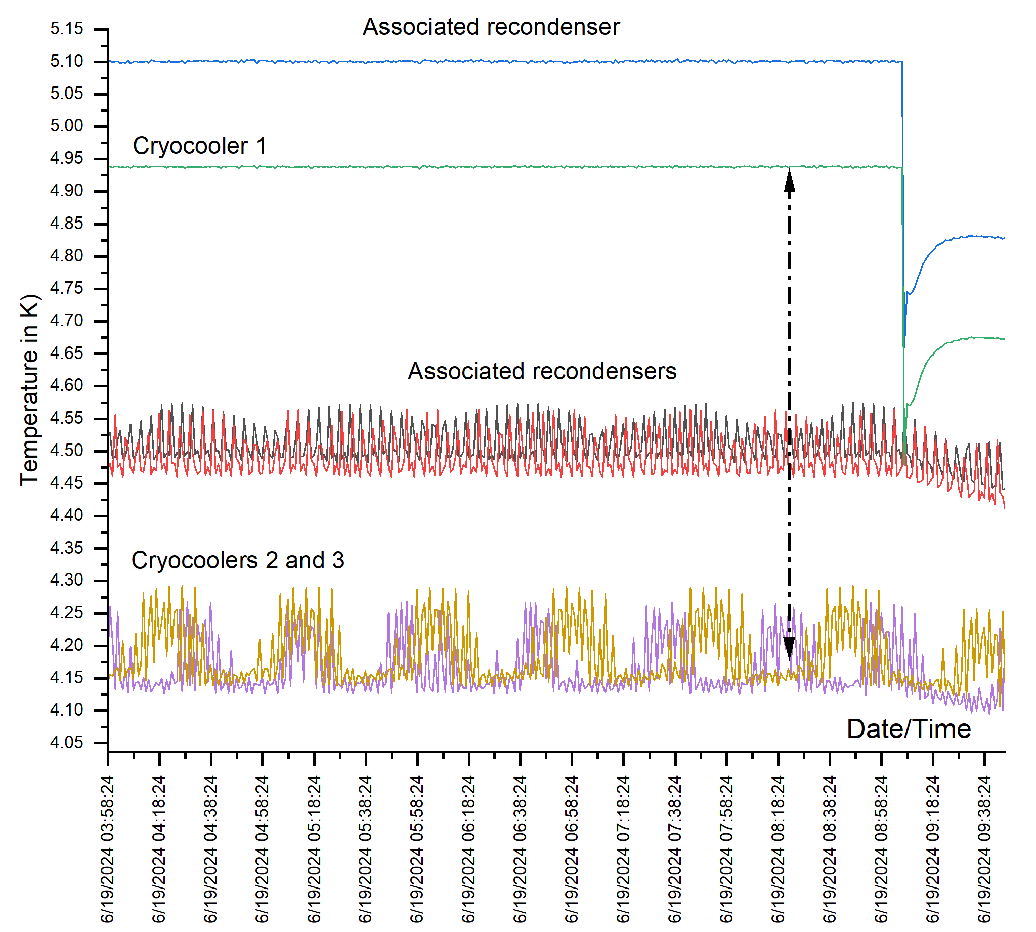
Experiment
Cooler 1 does not recondense
Cooler 1 shutdown:
The horizontal line on the top shows the temperature of the cold end of Cooler 1 with attached recondensing part (above line) when shut down
(a ΔT of 1.45 K).
Parasitic heat load on the attached condenser cup creates a pressure gradient in the connecting lines to coolers 2 & 3 causing a temperature rise, now assuming a new averaged temperature baseline of 4.2K.

Slide 14
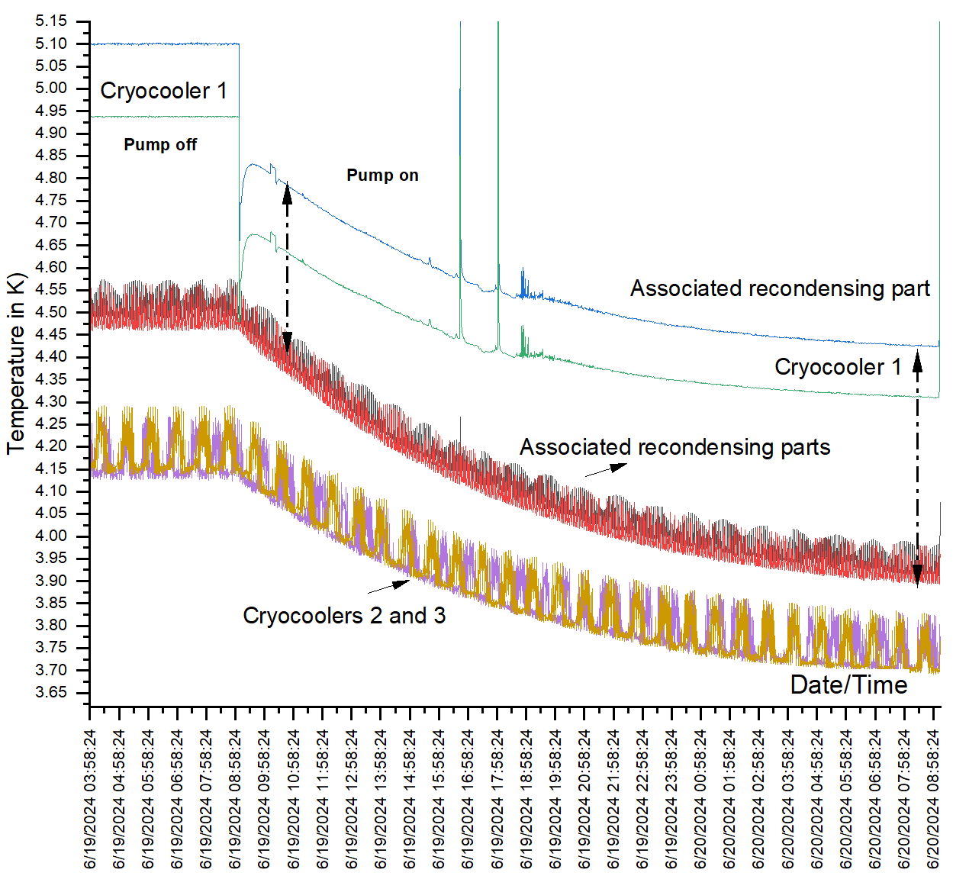
Experiment
Cooler 1 does not recondense
Cooler 1 evacuation - Pump “On”:
Eliminates the main parasitic heat flux. Pressure gradient in the cryogenic circuit reduces and Cooler 1 starts to cool down again.
Recooling effect also propagates through both running coolers 2 & 3 resulting in a heat burden shift from an average of 4.2 K (Pump off) to
< 3.7 K (Pump on).
Consequently, more helium can now be recondensed.

Slide 15
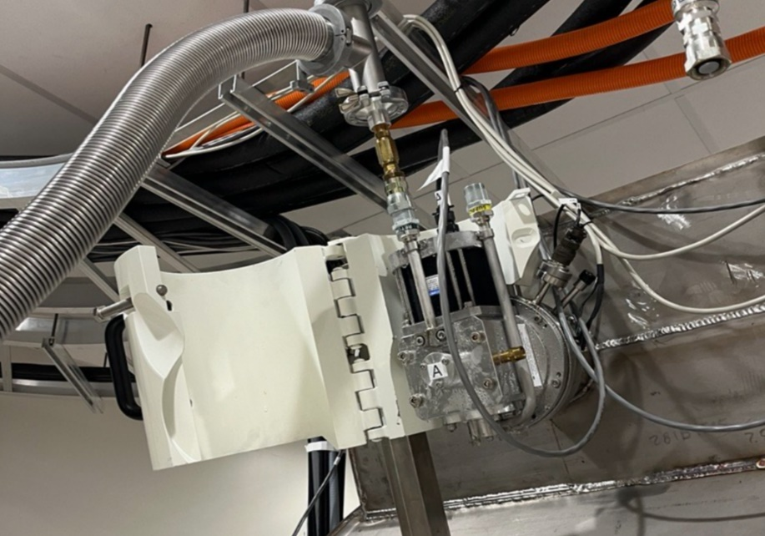
Experiment
Pump attached to cryocooler motor (shown with open motor shielding),
@ 20-degree inclination;
flexlines disconnected from cryocooler
Part of cooling circuit
TMP on cryocooler

Slide 16
Summary
Achieving a low base temperature is key for increasing the ridethrough time
for sealed low cryogen or conduction-cooled magnet systems
(for extended cryocooler service time for the field engineer to arrive on site, or from benefitting from a larger time window for any magnet field rundown or other).
We found that cryocooler shutdown severely increases the total cryogenic loss balance reducing ridethrough times due to intrinsic parasitic losses.
Shut down cryocoolers show cryogenic thermal regimes related to inclined tubes.
By evacuating the cryocooler we removed a parasitic heat load of approx. 1.4 W from the cryogenic circuit.
Cryocooler evacuation is seen as a simple, safe and efficient means to substantially delay magnet/coldmass warmup times in the event of a cooler failure or any service outage.

Slide 17
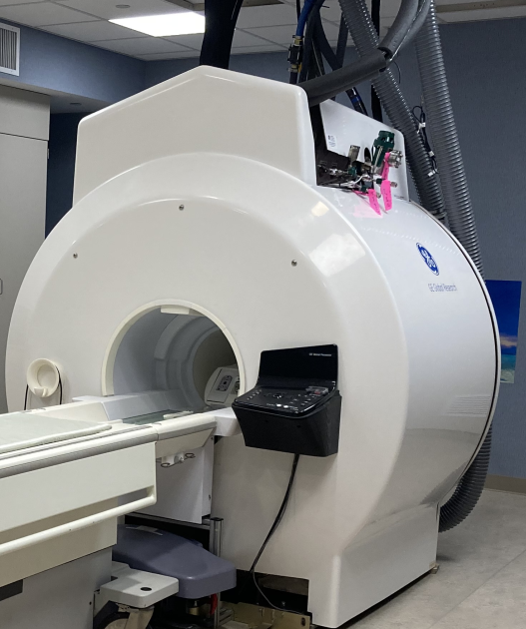
Compact Sealed 7 T
Compact Sealed 3 T
Acknowledgment
for NIH contract award NIH U01EB027696

Slide 18
Literature
Stautner W Cryocoolers for Superconducting Generators Chapter 6 in Atrey M (ed.), Cryocoolers – Theory and Applications, International Cryogenics Monograph Series Springer Publishing 2020
Stautner W Cryocoolers for Healthcare Chapter 9 in Atrey M (ed.) Cryocoolers – Theory and Applications International Cryogenics Monograph Series Springer Publishing 2020
Stautner W Torrey D Xu M Wu A Parizh M Soni V Cryogenic aspects of a 20 MW class low-temperature superconducting generator for the renewables industry 2024 IOP Conf. Ser.: Mater. Sci. Eng. 1301 012048
Stautner W Aircraft Cryogenics International Cryogenics Monograph Series Springer 2024
Stautner W Soni V Wu A 2025 patent pending
Soni V Stautner W C2Po3A-08 Cryogenic Cooldown Performance of the GE (HTIC) Compact 7 T MRI Magnet CEC/ICMC Reno NV 2025
GE 7 T Signa https://www.gehealthcare.com/products/magnetic-resonance-imaging/7t-mri-scanner
Wu A Ricci J Conte G van Epps C Xu M Bai Y Parizh M Stautner W Hua Y Vermilyea M Soni V Foo T Design and Construction of a Low-Cryogen, Lightweight, Head-Only 7 T MRI Magnet in IEEE Transactions on Applied Superconductivity vol 34 no 5 pp 1-5 2024 doi:10.1109/TASC.2024.3352551
Kuriyama T Development of a 4 K-GM cryocooler and its applications for superconducting magnets ICEC29/ICMC2024 Geneva 2024
Foo T Laskaris E et al Lightweight, compact, and high-performance 3 T MR system for imaging the brain and extremities Magn Reson Med 2018 Nov 80(5):2232-2245 doi: 10.1002/mrm.27175. Epub 2018 Mar 13
Ikeya Y Expanding market of a 4 K GM cryocooler International Congress of Refrigeration 24 Yokohama Japan 2015
Xu M Y Morie T Numerical Simulation of a 4 K GM Cryocooler International Cryocooler Conference Inc. 17 Boulder CO 2012
Langebach R Haberstroh C Natural convection in inclined pipes - A new correlation for heat transfer estimations AIP Conf. Proc. 1573 pp 1504–1511 2014 https://doi.org/10.1063/1.4860885 and private communication
EES Engineering Equation Solver V11 http://fChartSoftware.com
Thummes G Schreiber M Landgraf R Heiden C Convective Heat Losses in Pulse Tube Coolers: Effect of Pulse Tube Inclination Cryocoolers 9 Plenum Press NY 1997 pp 393-396
Shiraishi M Murakami M Nakano A Iida T Visualization of Secondary Flow in an Inclined Double-Inlet Pulse Tube Refrigerator Cryocoolers 14 International Cryocooler Conference Boulder 2007

Slide 19
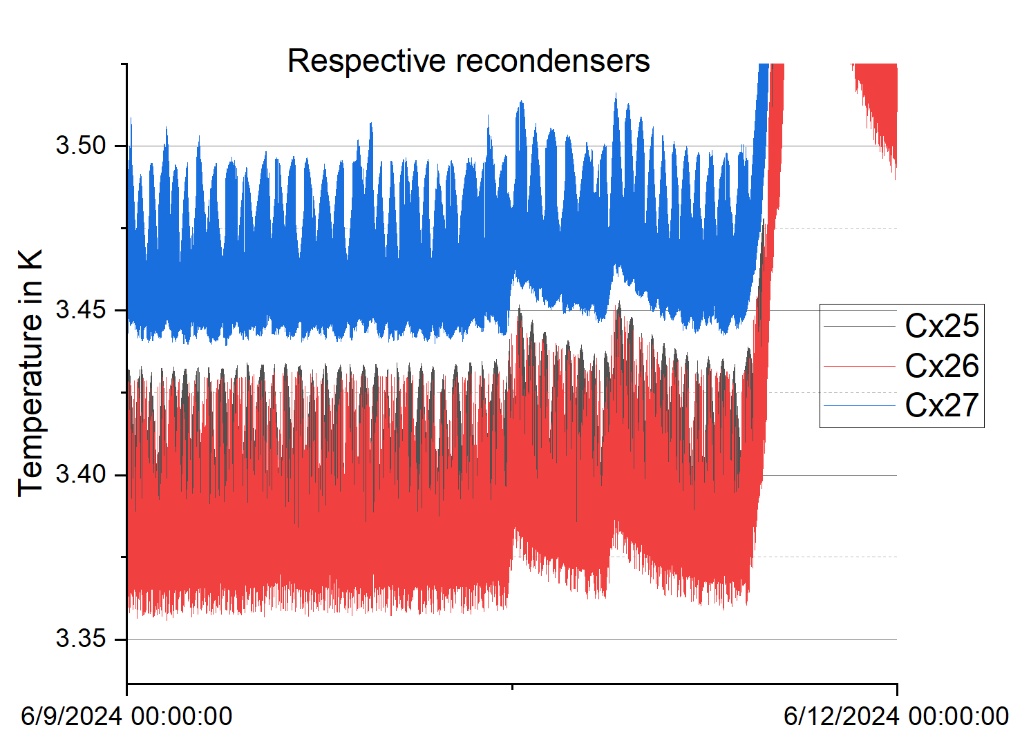
Base temp average 3.34 K

Slide 20
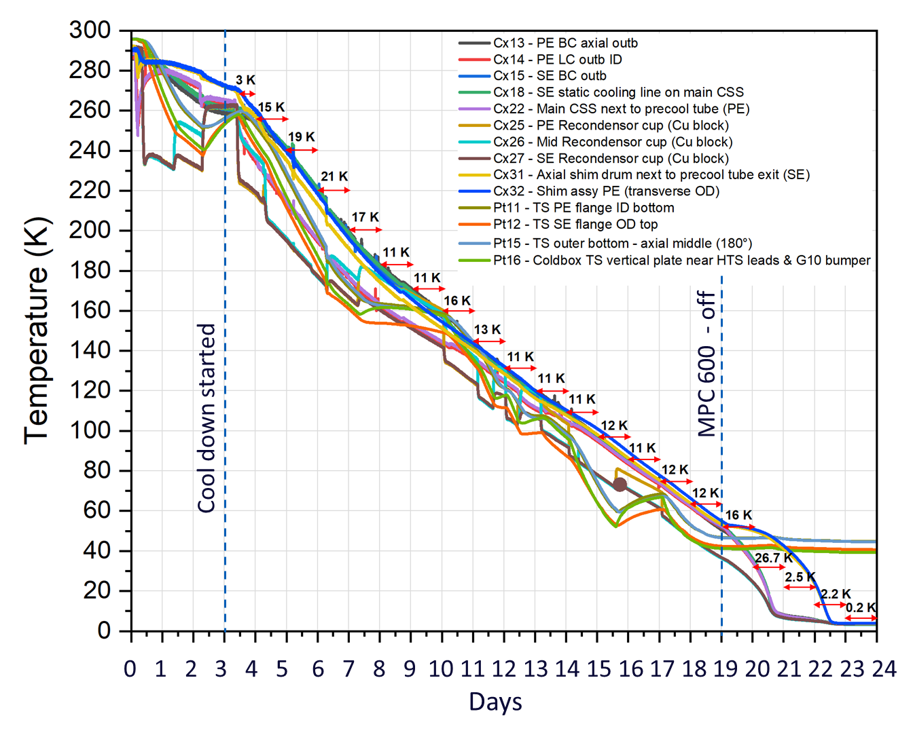
Base temp average 3.34 K
Cooldown history

Slide 21
