Slide 1
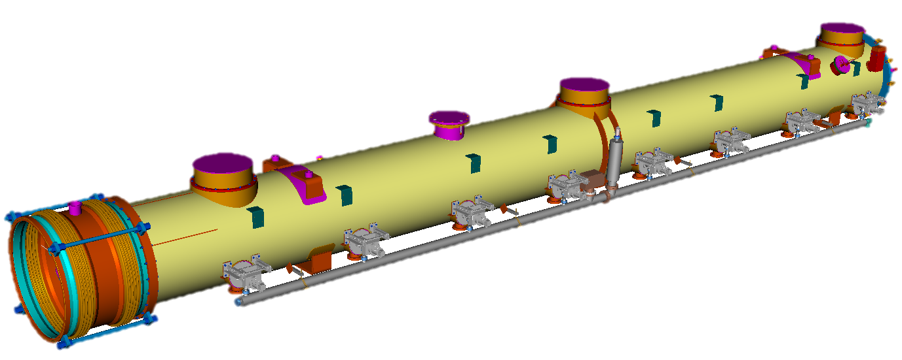

Modelling two-phase He II flow for heat load limits in XFEL Cryomodules for CW operation
Heat Load Threshold Identification and Flow Modeling for the EuXFEL HDC Upgrade
Aman Kumar Dhillon
Reno, NV, 20/05/2025

Slide 2
Presentation Overview
A preview of main ideas and takeaways
01 Introduction
Motivation for EuXFEL HDC upgrade
HDC upgrade from cryogenic perspective
Challenges
02 Two-Phase Flow Model
Velocity maps and flow distribution
Transition Criteria
Impact of inclination angle and filling grade
Flow Regime Transition: SS–SW vs. S–NS Criteria
03 Heat Load Limit for XFEL like Cryomodule
Heat load limits based on distinct flow regimes
Recommendations
04 Summary

Slide 3
Introduction

Slide 4
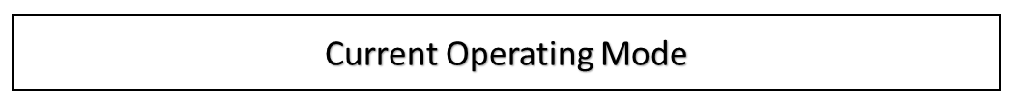
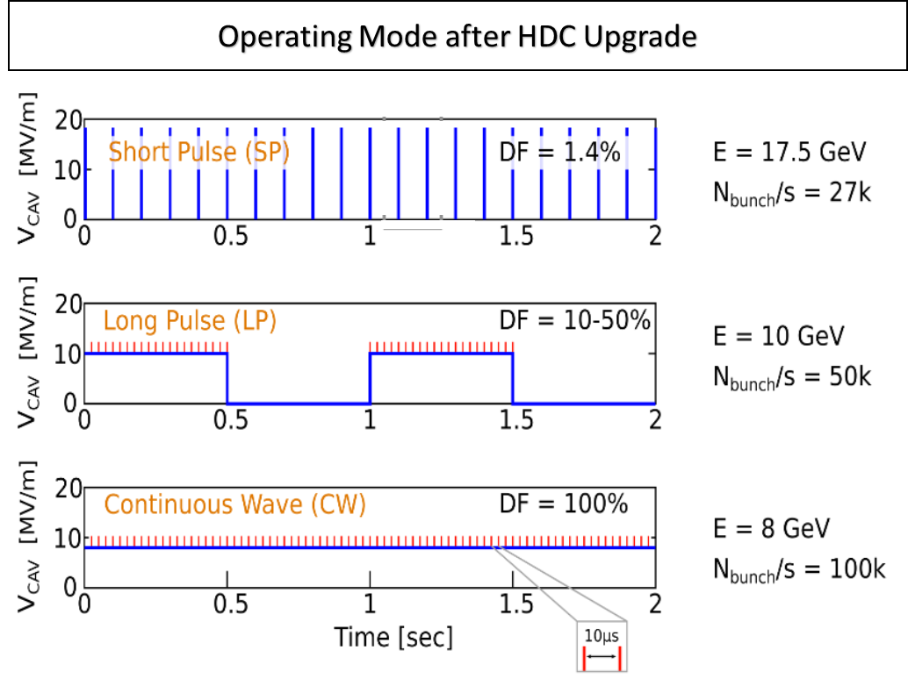
Motivation for EuXFEL HDC upgrade
High Duty Cycle (HDC) operating mode of EuXFEL
The XFEL-Linac
  Operating Mode: Short Pulse → Short Pulse, Long Pulse and Continous Wave
  Accelerator modules: 96 → 112 (16 HDC optimized)
  Cryo Plant Capacity: 1.9 kW @ 2 K → ~6 kW @ 2 K

Slide 5
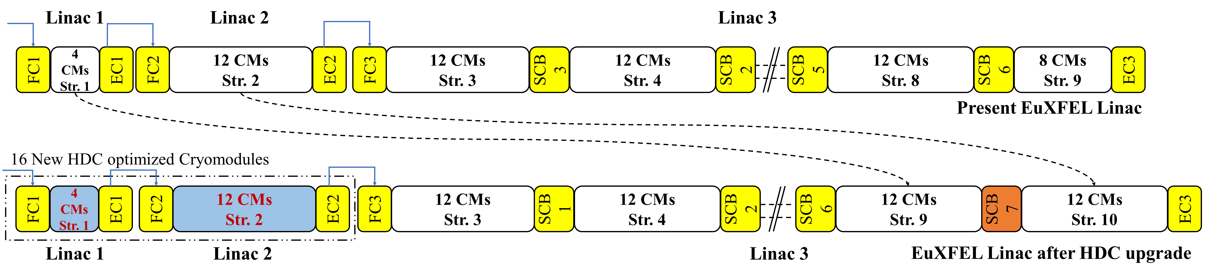
HDC upgrade: Cryogenic Perspective
Cryogenic infrastructure: upgrade
LINAC 1 & 2
  16 New HDC optimized Cryomodule
LINAC 3
  96 Existing CMs
Total Cryo Plant Capacity: 6 kW @ 2 K
  Additional new Cryoplant is required

Slide 6
Challenges
Heat Load in LINAC 1, 2 & 3
LINAC 1 & 2
16 new CW optimized cryomodules
LINAC 3
96 existing cryomodule (No modification)
 | HDC upgrade
Parameter | Requirement
Dynamic Heat Load per CM | ~110 W
Static Heat Load per CM | ~10 W
Total Heat Load per CM | ~120 W
Total Heat Load (L1 & L2) | ~1.9 kW
 | HDC upgrade
Parameter | Requirement
Total Heat Load per Nominal String | ~384 W
Total Heat Load per CM | ~32 W
Total Heat Load (L3) | ~3.0 kW
*Additional ~300 W for injector cryomodule
Flow instabilities: microphonic vibrations, potentially compromising stable RF operation
Key challenge: operating the CMs with increased heat loads

Slide 7
Two-Phase Flow Model

Slide 8
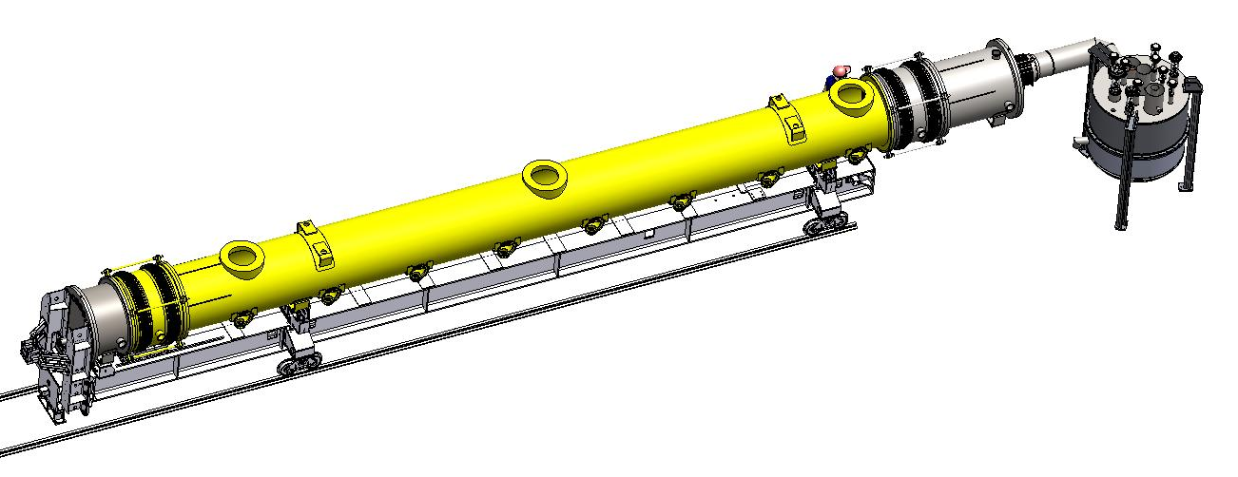
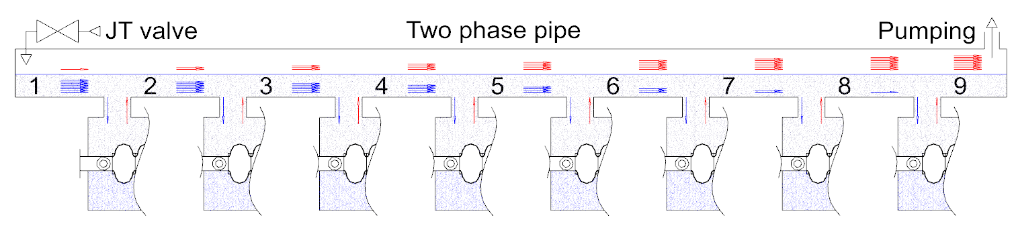
Velocity maps and flow distribution
Feed Box
Feed Cap
Cryomodule test stand (AMTF)
AMTF
JT valve & connection to Gas Return Pipe (GRP) in the opposite side -> Co-current flow
Model
Design of cryomodule test stand is used for the theoretical model
Cryomodule
End Cap
Liquid flow
Vapor flow
(2PP)
Expansion to 31 mBar

Slide 9
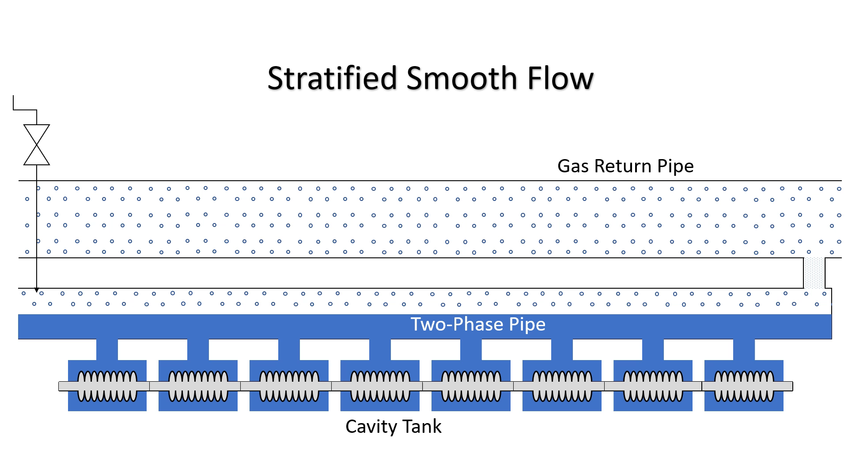
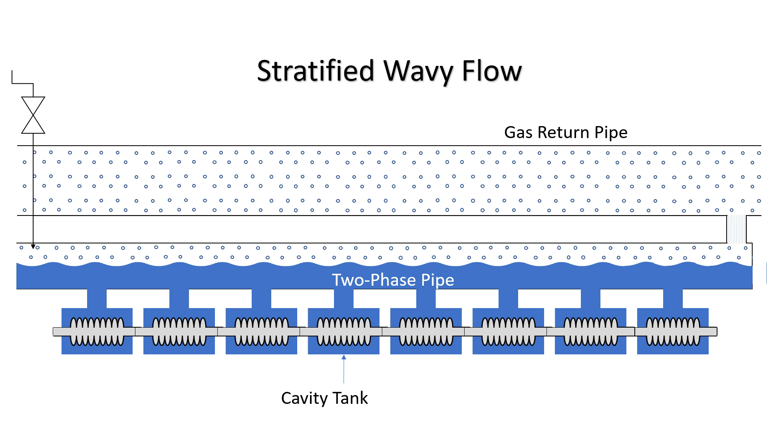
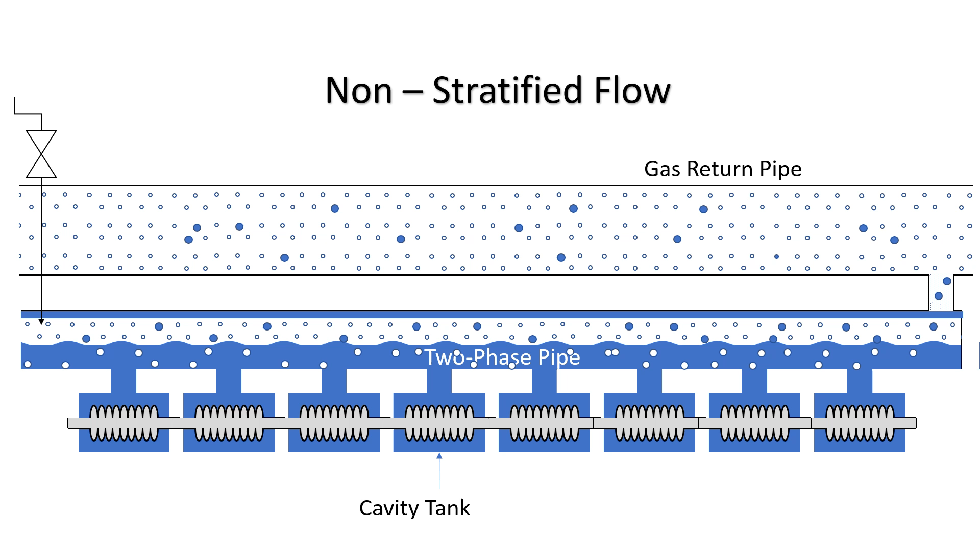
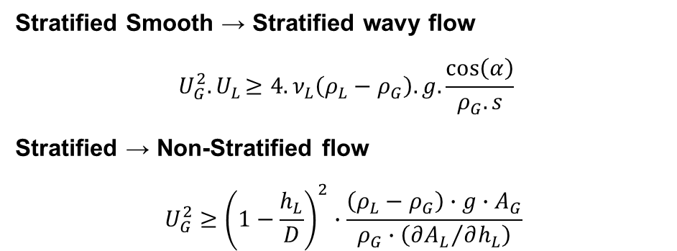
Transition Criteria
Stratified wavy flow and Non-Stratified flow
Stratified Smooth → Stratified wavy flow
$$U_{G}^{2}{. U}_{L}≥4.ν_{L}\left(ρ_{L}−ρ_{G}\right).g.\frac{\cos\left(α\right)}{ρ_{G}. s}$$
Stratified → Non-Stratified flow
$$U_{G}^{2}≥{\left(1−\frac{h_{L}}{D}\right)}^{2}∙\frac{\left(ρ_{L}−ρ_{G}\right)∙g∙A_{G}}{ρ_{G}∙\left({∂A_{L}}/{∂h_{L}}\right)}$$

Slide 10
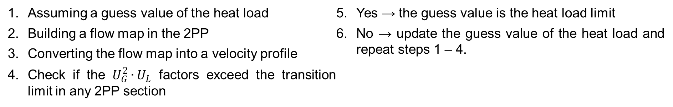

Finding heat load limit
Stratified Smooth – Stratified Wavy flow
Assuming a guess value of the heat load
Building a flow map in the 2PP
Converting the flow map into a velocity profile
Check if the $U_{G}^{2}∙U_{L}$ factors exceed the transition limit in any 2PP section
Yes → the guess value is the heat load limit
No → update the guess value of the heat load and repeat steps 1 – 4.
$$0.007337 m³/sec³$$
Liquid Velocity
Gas Velocity
reaches the limiting value in the section 6 at 68.1 W
Velocity map from mass flow distribution in 2PP (half filled)

Slide 11
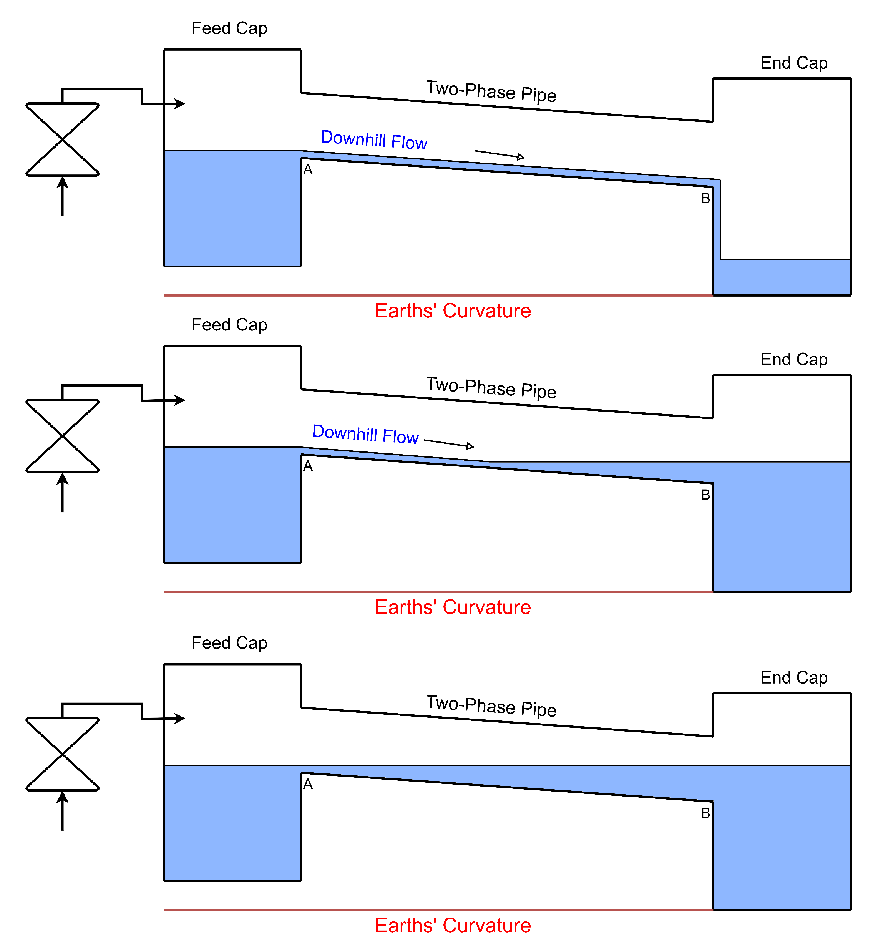
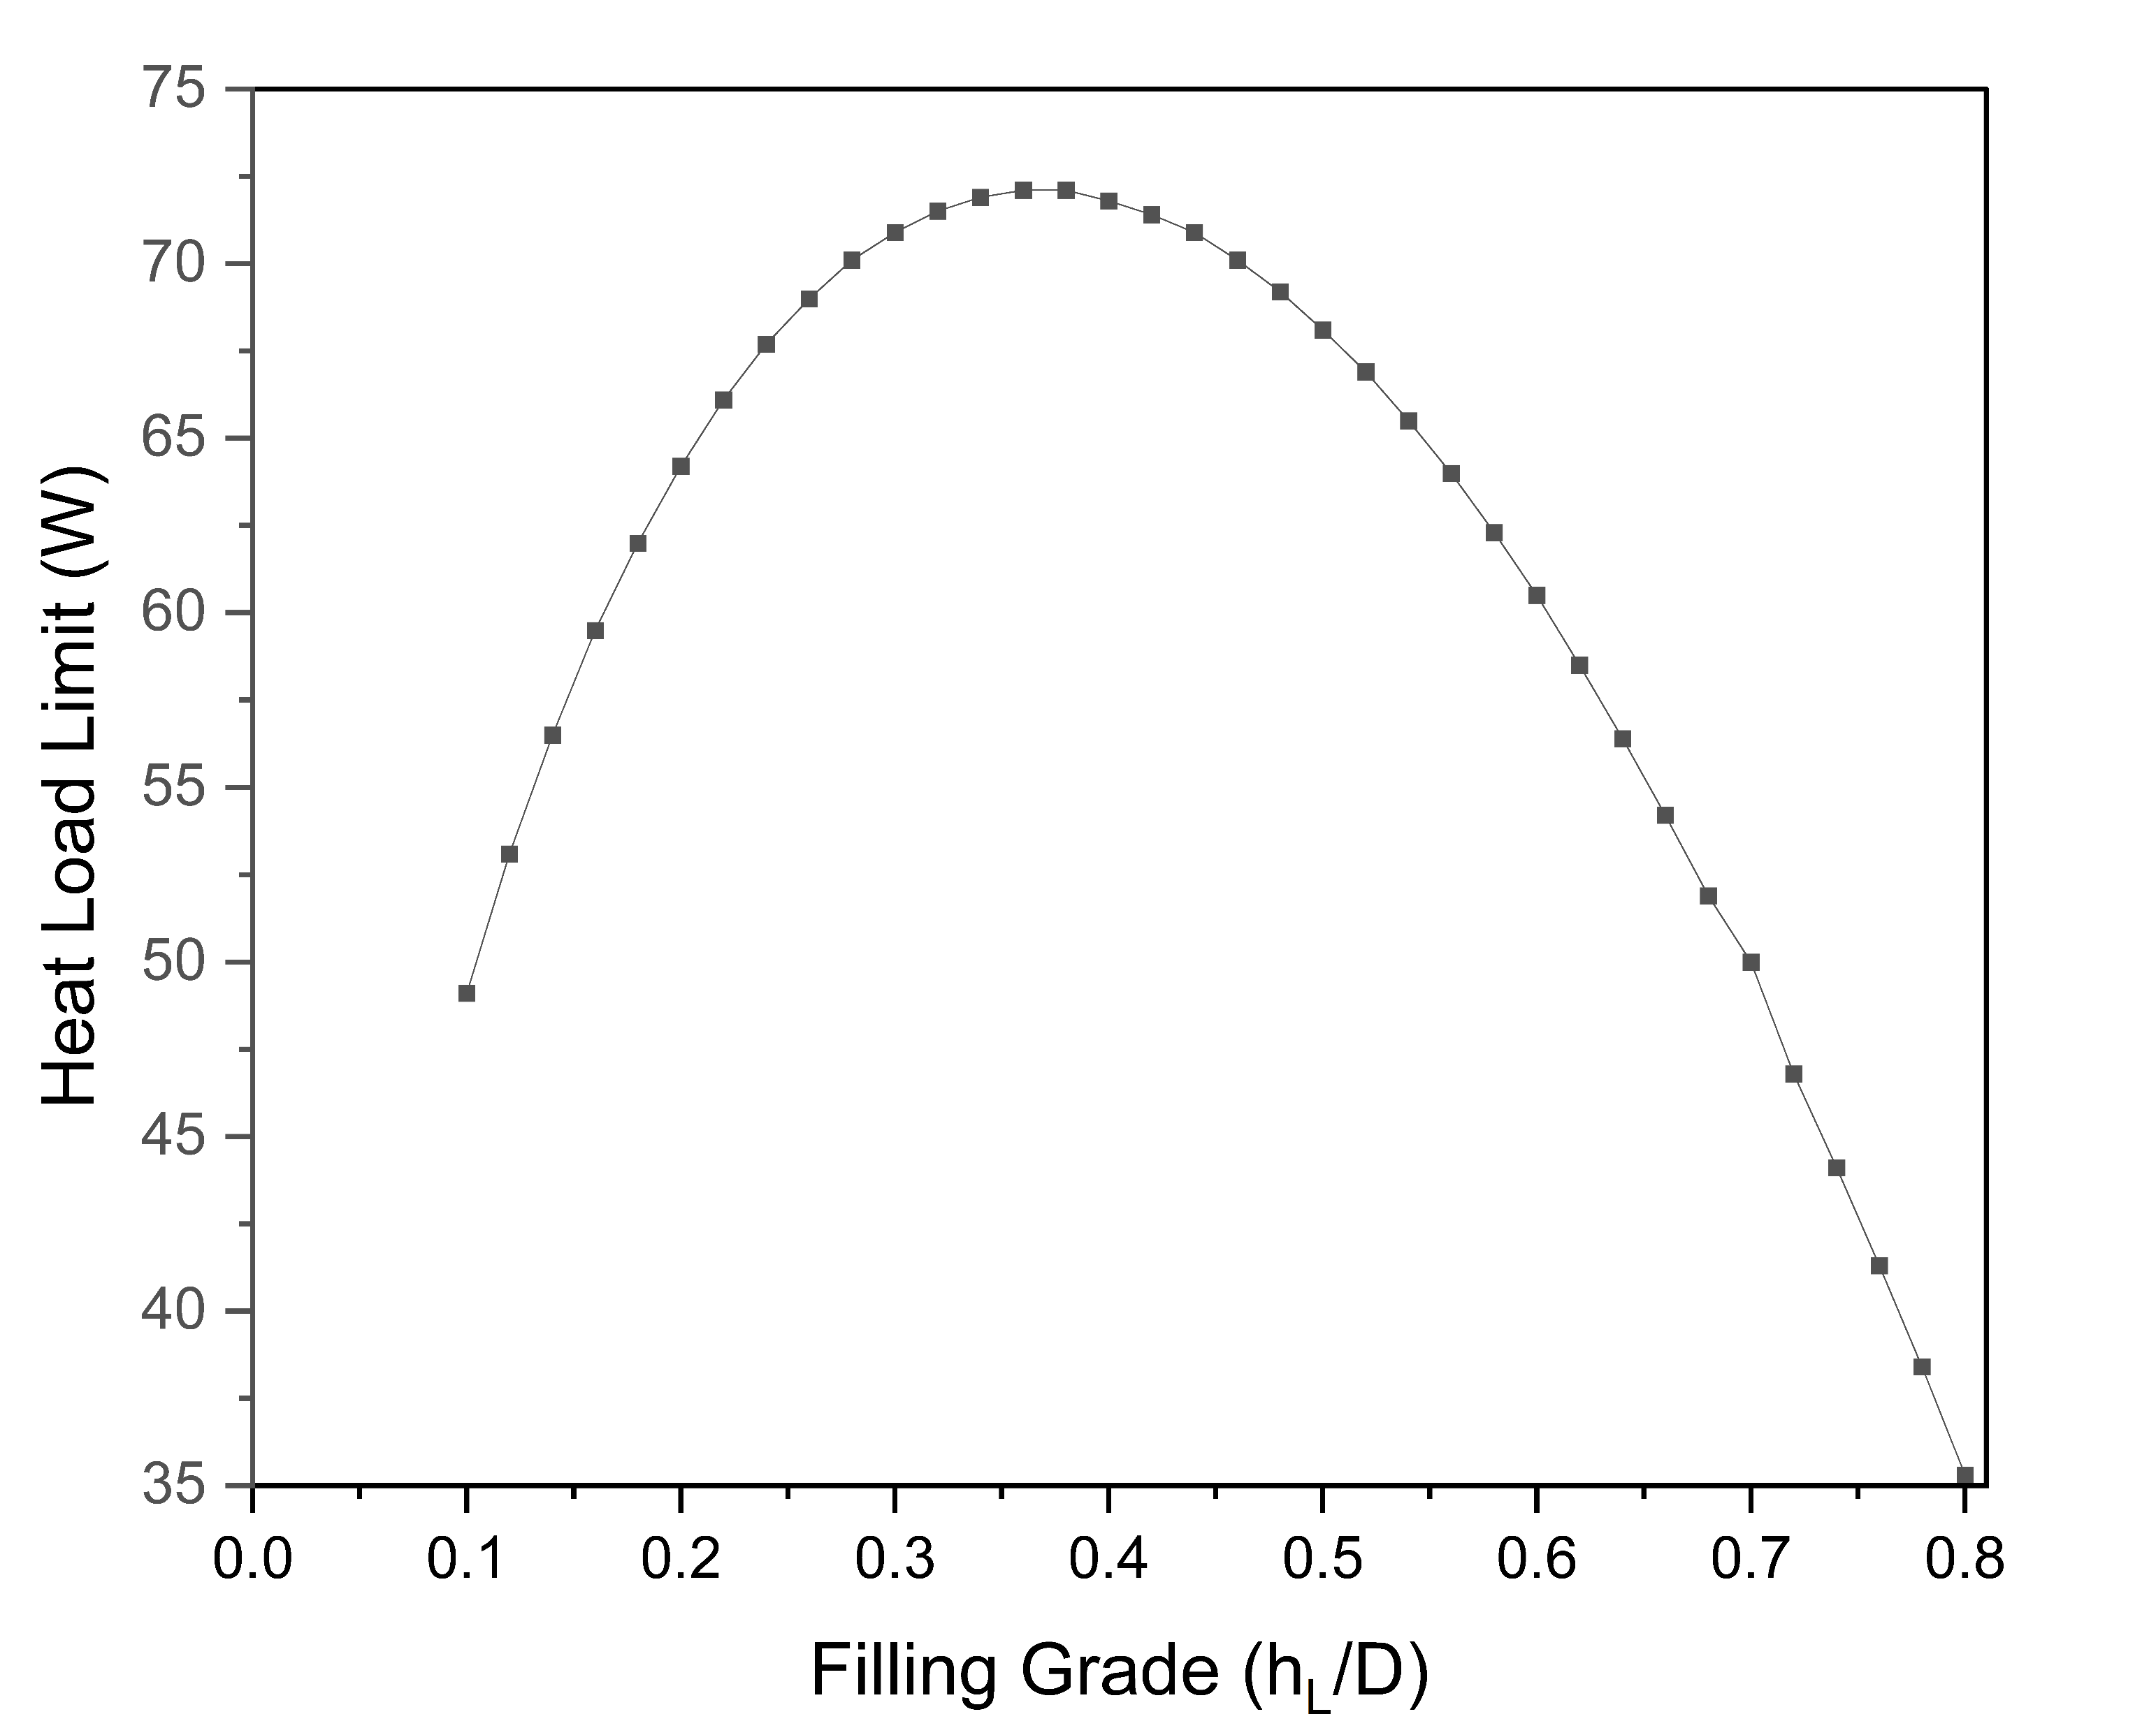
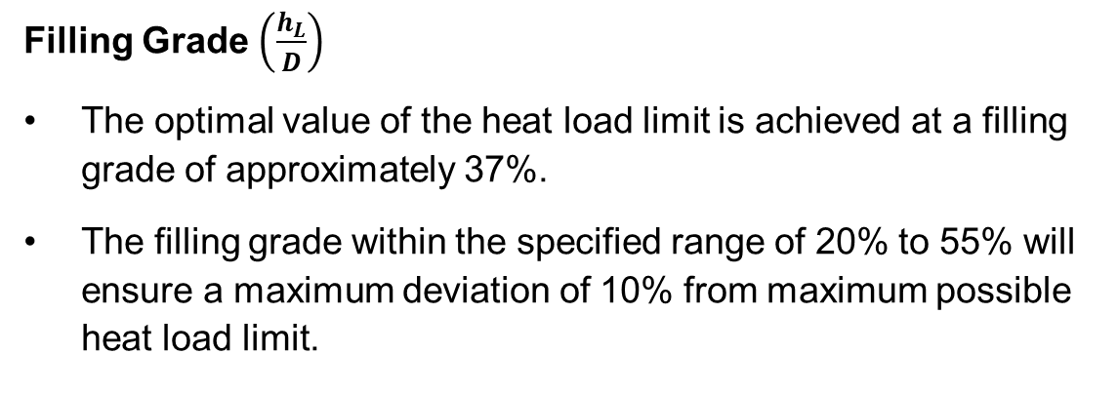
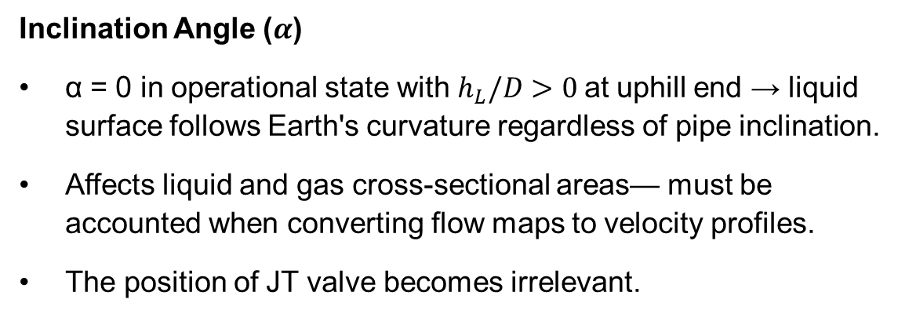
Inclination Angle & Filling Grade
Impact of inclination angle and filling grade
Inclination Angle ($α$)
α = 0 in operational state with $h_{L}/D>0$at uphill end → liquid surface follows Earth's curvature regardless of pipe inclination.
Affects liquid and gas cross-sectional areas— must be accounted when converting flow maps to velocity profiles.
The position of JT valve becomes irrelevant.
Filling Grade $\left(\frac{h_{L}}{D}\right)$
The optimal value of the heat load limit is achieved at a filling grade of approximately 37%.
The filling grade within the specified range of 20% to 55% will ensure a maximum deviation of 10% from maximum possible heat load limit.

Slide 12
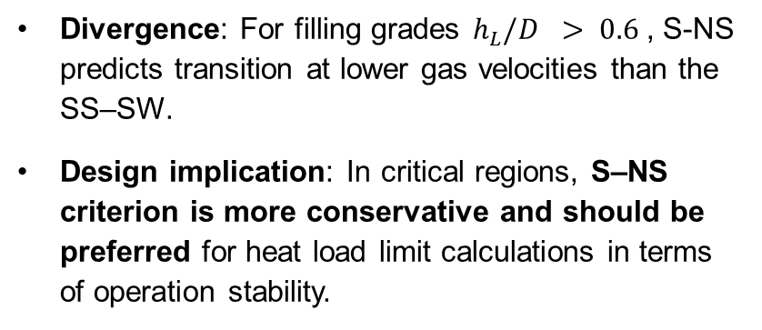
Flow Regime Transition: SS–SW vs. S–NS Criteria
Comparison of SS–SW and S–NS Flow Transition Criteria
Divergence: For filling grades $h_{L}/D > 0.6$, S-NS predicts transition at lower gas velocities than the SS–SW.
Design implication: In critical regions, S–NS criterion is more conservative and should be preferred for heat load limit calculations in terms of operation stability.
Limiting Gas Velocity for DN65

Slide 13
Heat Load Limit for XFEL like Cryomodule

Slide 14
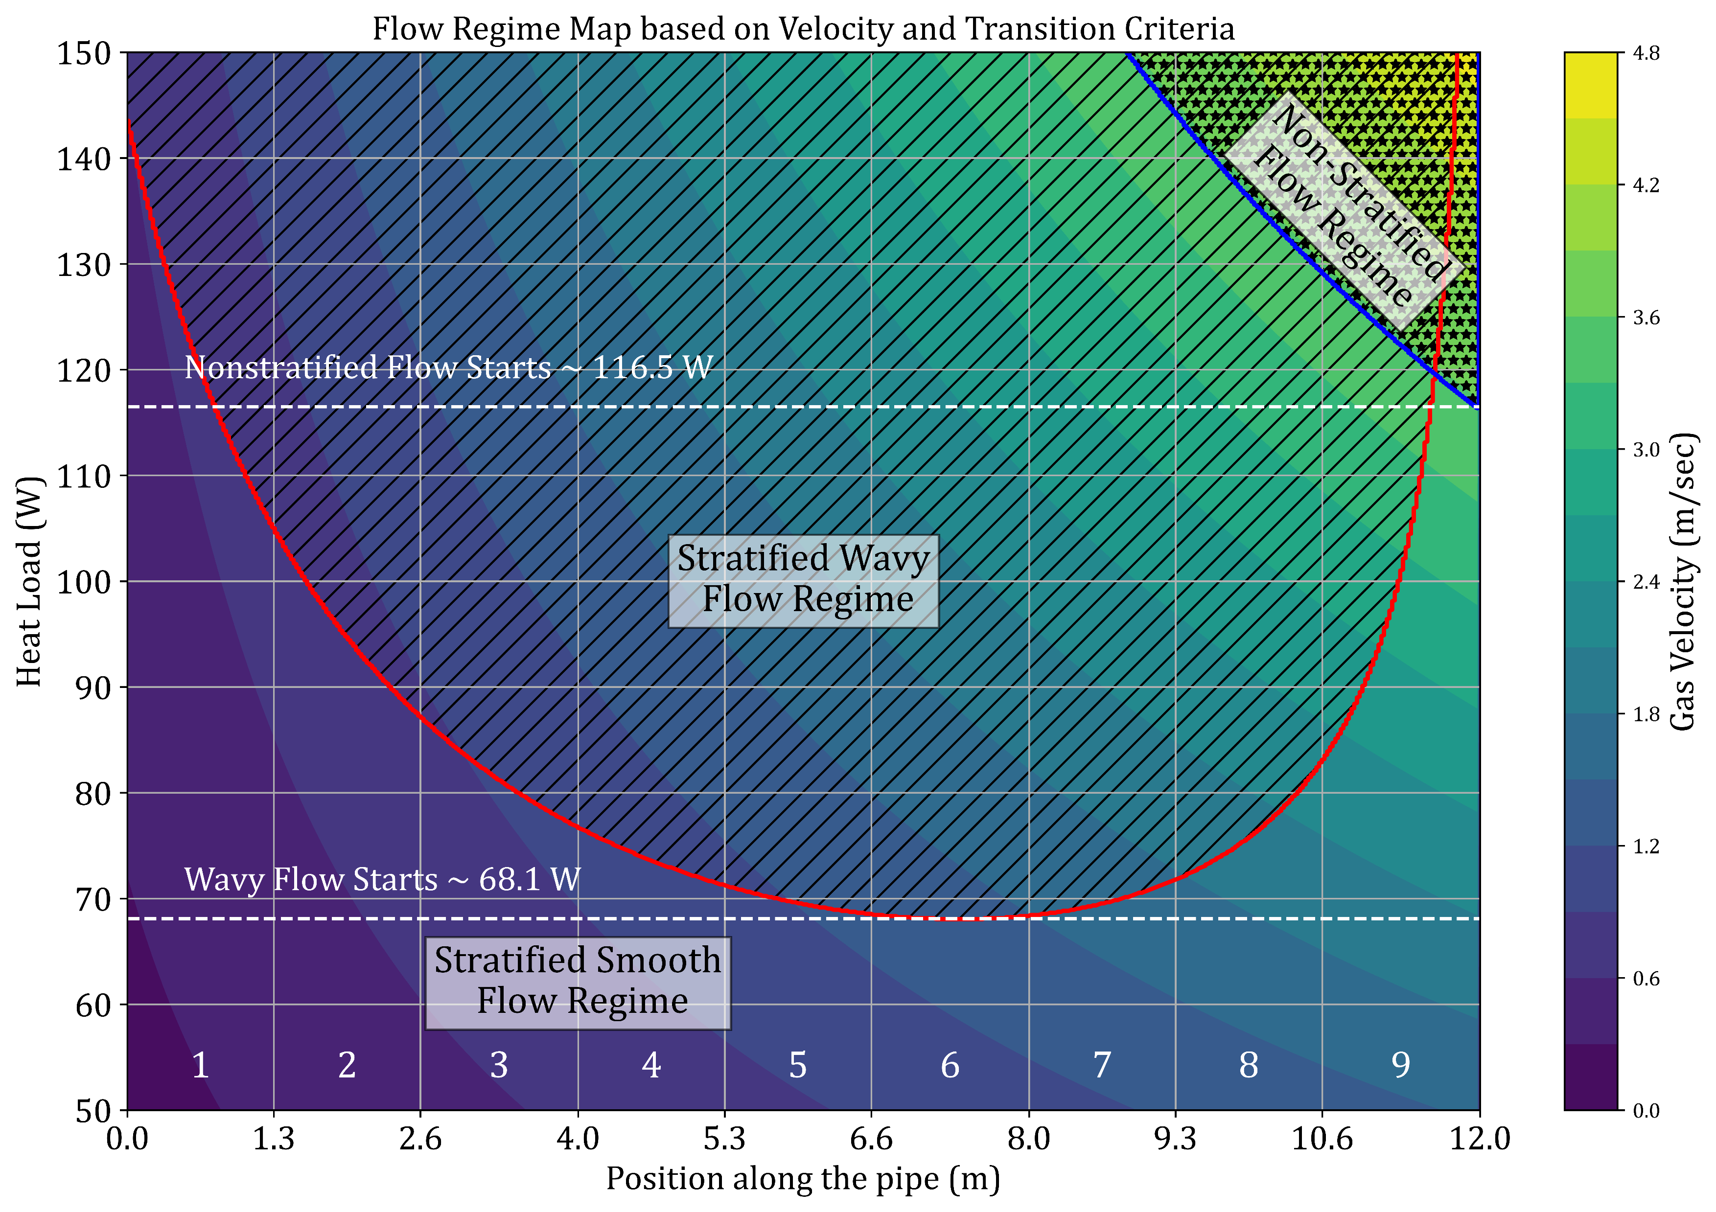
Heat Load Limit for XFEL-like Cryomodule
Dependence of transition criteria on the heat load of XFEL-like CM at cryomodule test stand in AMTF
First onset of wavy flow observed in section 6 at ~68.1 W (for x=0.135); wavy regime expands as heat load increases.
At 75 W – Multiple wavy sections (>4)
Non-stratified flow emerges beyond ~116.5 W, leading to higher turbulence
Stable CM operation
  Is stratified smooth flow essential?
  Impact of filling grade & JT valves arrangement in a nominal string?
Experimental validation is planned at AMTF

Slide 15
Recommendations
To maintain the smooth flow without entering into the wavy regime
JT Valve & GRP Connection Arrangement
Placing both on the opposite end leads to max. heat load limit
AMTF case: 41 W (same end) vs. 68.1 W (Opp. end)
Add more JT Valves in string
More valves = lower gas and liquid velocity
Option: single JT valve with branched outlets
Watch for liquid level control complexity
Increase 2PP Diameter
Reduces LHe II and vapor velocity
Stabilizes flow regime under higher loads
Use Multiple 2PP-GRP Connections
Example: One per cavity aligned with chimney
Reduces vapor velocity
Limiting heat load: ~155 W (vs. 73.3 W with single-end)
These recommendations are critical:
    for suppressing the propagation of wavy flow along the 2PP
    for preventing the transition to non-stratified regimes (below h_{L}/D < 0.6)
Note: In case of a divergence between criteria -> recommendations should be re-evaluated in consideration of the S–NS criterion.

Slide 16
Summary

Slide 17
Summary
EuXFEL HDC upgrade – SP mode, LP mode & CW mode
Cryogenic Infrastructure
  New Cryo-plant to achieve ~6kW @2K
  16 New CW-optimized cryomodule for L1 & L2 and 96 existing cryomodules in L3
  L1 & L2 – 120 W per CM
  L3 – 32 W per CM
Conservative Design & Operational Limits
  Currently, opted for most conservative transition criterion
  Observed onset of wavy flow ~ 68.1 W
  Inclination have impact on the liquid and vapor flow cross-section area
  Optimum value of liquid level – 20% – 55% of 2PP
A series of tests at AMTF are planned to validate and reinforce the reliability of the model.
Stability Threshold
  Divergence between SS–SW and S–NS criteria at high filling grade
  Emergence of non-stratified flow ~ 116.5 W
  RF Stability Limits: Experiment validation required

Slide 18
Thank you
Aman Kumar Dhillon
Maschine-Kryogenik-Supraleitung
aman.kumar.dhillon@desy.de

Slide 19
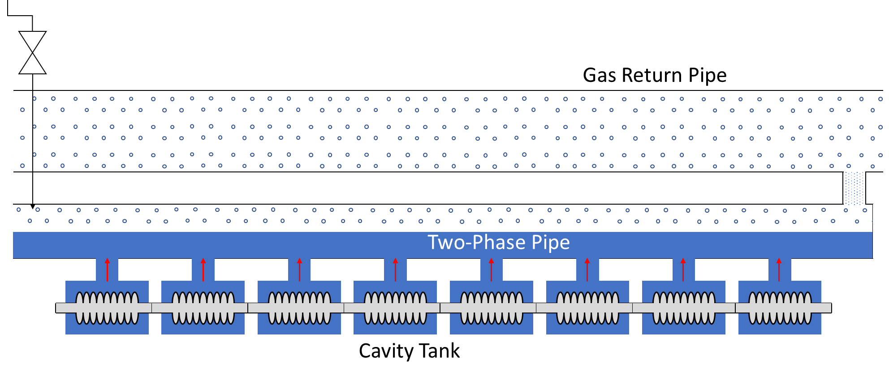
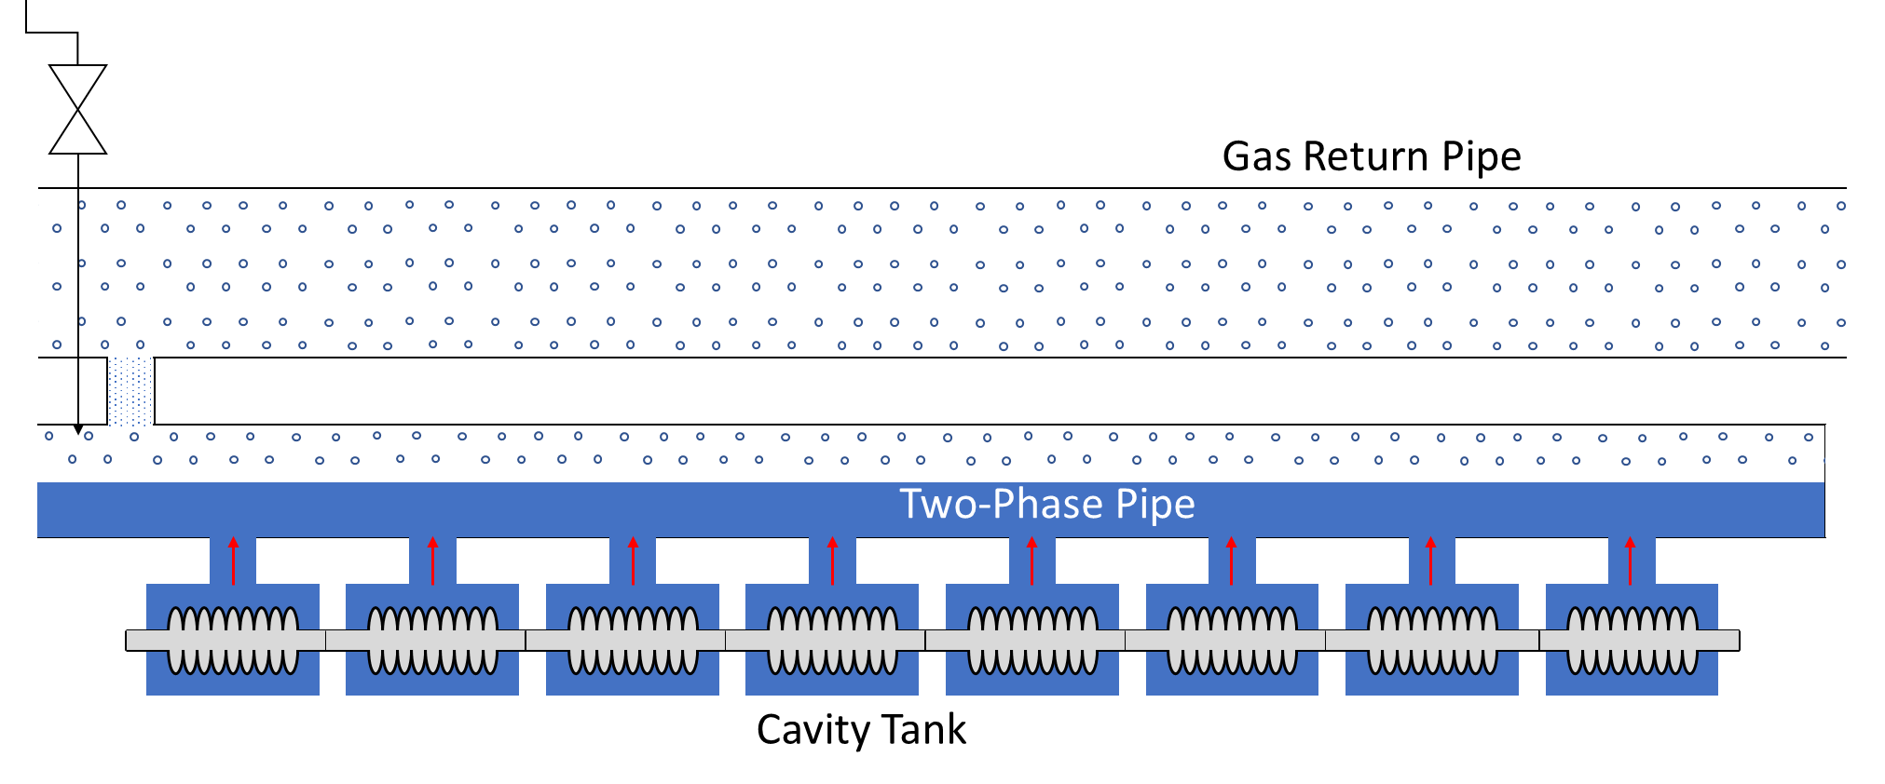
JT Valve & GRP Connection Arrangement
Placing both on the opposite end leads to max. heat load limit
Placing both on oppsite end
Heat Load Limit – 68.1 W
Putting both on same end
Heat Load Limit – 41 W

Slide 20
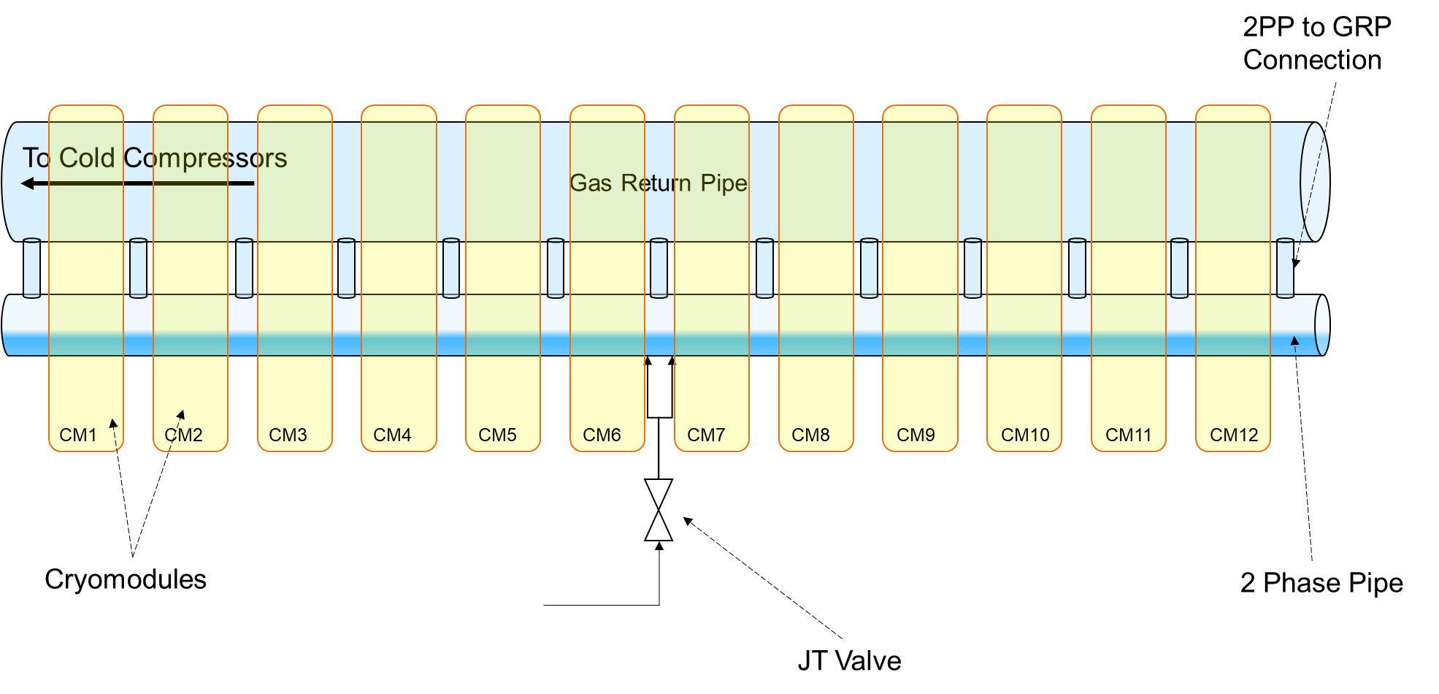
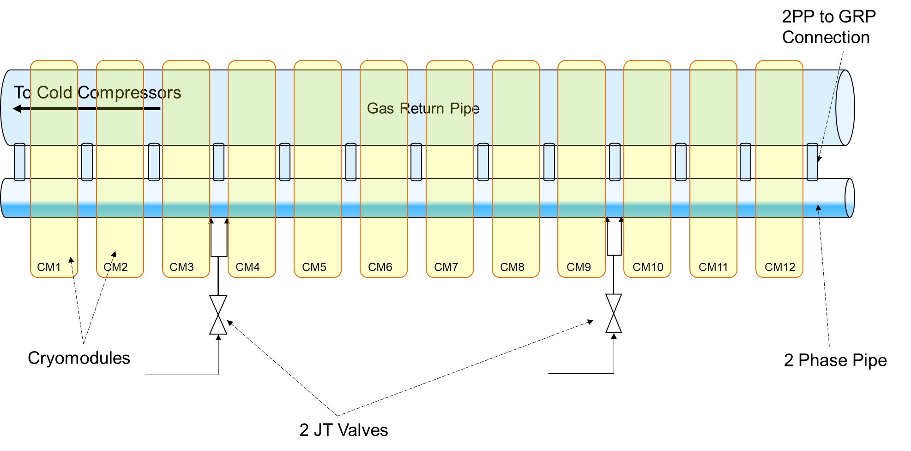
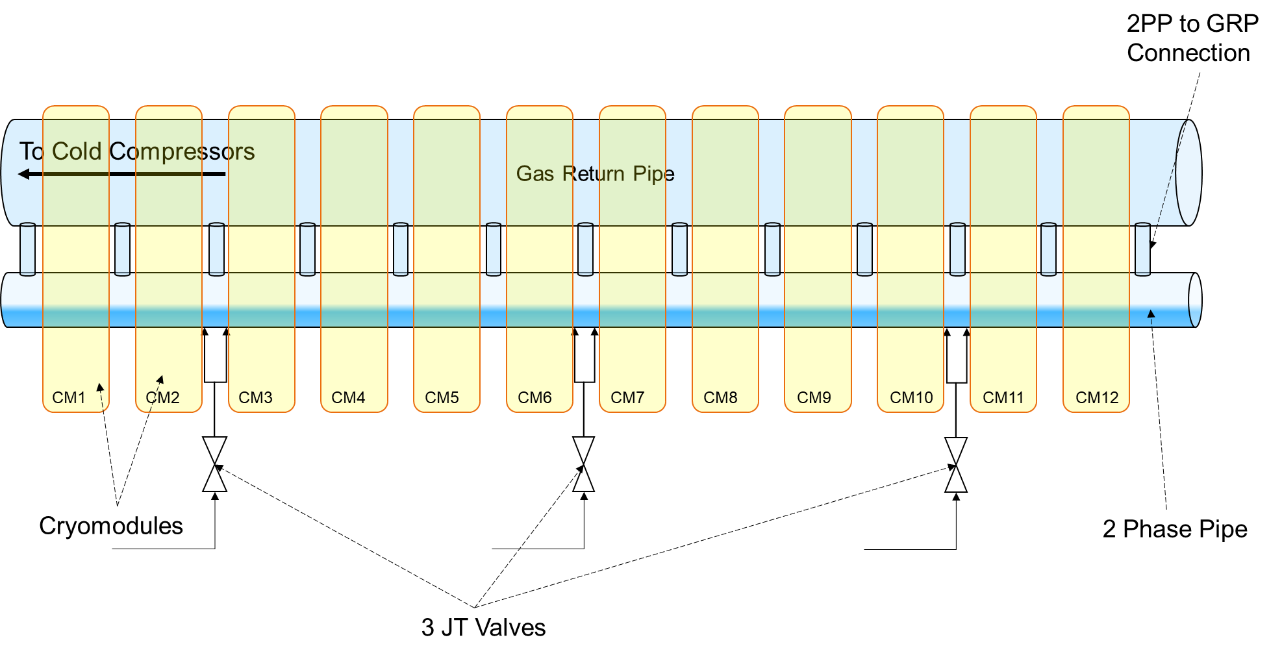

Add more JT Valves in string
More valves = lower gas and liquid velocity

Slide 21
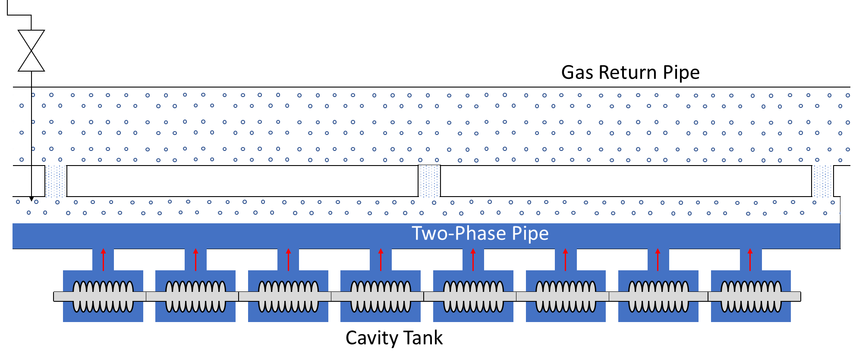

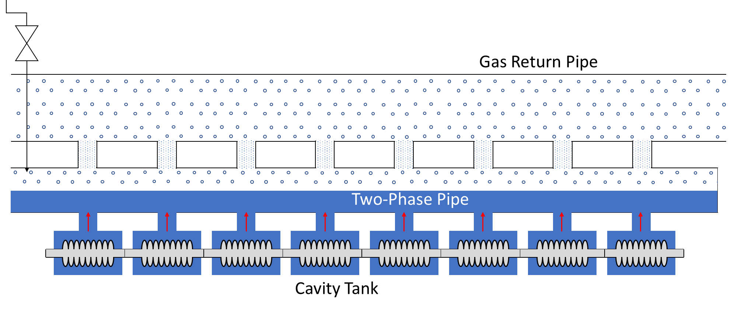
Use Multiple 2PP-GRP Connection
One per cavity aligned with chimney

Slide 22
HDC upgrade: Cryogenic Perspective
Cryogenic system – existing
Parallel operation of two XFEL cryo plants at DESY + Cold compressor box & distribution box
LINAC 1 & 2 – 16 CMs
LINAC 3 – 80 CMs
Cryo Plant Capacity: 1.9 kW @ 2 K
Warm Units
(Compressor & purification)
Cryo-plant 1
CBX41
Cryo-plant 2
CBX43
Shaft
Distribution Box
DB54
XTL
Building 54
Distribution Box
XLVB
Cold Compressor
CB44
XRTL
FC1
4 CMs
Str. 1
EC1
FC2
12 CMs
Str. 2
EC2
FC3
12 CMs
Str. 3
SCB3
12 CMs
Str. 4
SCB2
SCB5
12 CMs
Str. 8
SCB6
8 CMs
Str. 9
EC3
Linac 1
Linac 2
Linac 3
6 – full strings & 1 – partial string

Slide 23
HDC upgrade: Cryogenic Perspective
New
Existing
Cryogenic system – upgrade
Parallel operation of Three XFEL cryo plants at DESY/Osdorf + Cold compressor box & distribution box
LINAC 1 & 2 – 16 New HDC optimized Cryomodule
LINAC 3 – 96 Existing CMs
Total Cryo Plant Capacity: 6 kW @ 2 K
Two possibilities are under investigation
Warm Units
(Compressor & purification)
Warm Units
(Compressor & purification)
Cryo-plant 1
CBX41
Cryo-plant 2
CBX43
Cryo-plant 3
Shaft
Distribution Box
DB54
Building 54
New Cold Compressor
XTL
New Distribution Box (XLVB)
New Cold Compressor (CB44)
XRTL
New Connection Box
New JT-HX Box
16 New HDC optimized Cryomodules
FC1
4 CMs
Str. 1
EC1
FC2
12 CMs
Str. 2
EC2
FC3
12 CMs
Str. 3
SCB3
12 CMs
Str. 4
SCB2
SCB6
8 CMs
Str. 9
EC3
12 CMs
Str. 9
4 CMs
Str. 1
12 CMs
Str. 2
SCB7
12 CMs
Str. 10
Linac 1
Linac 2
8 – full strings
Linac 3
Existing Feed Cap (FC), End Cap (EC) or String Connection Box (SCB)
Strings with existing Cryomodules (CMs)
New String Connection Box (SCB)
Strings with new Cryomodules (CMs)

