Slide 1

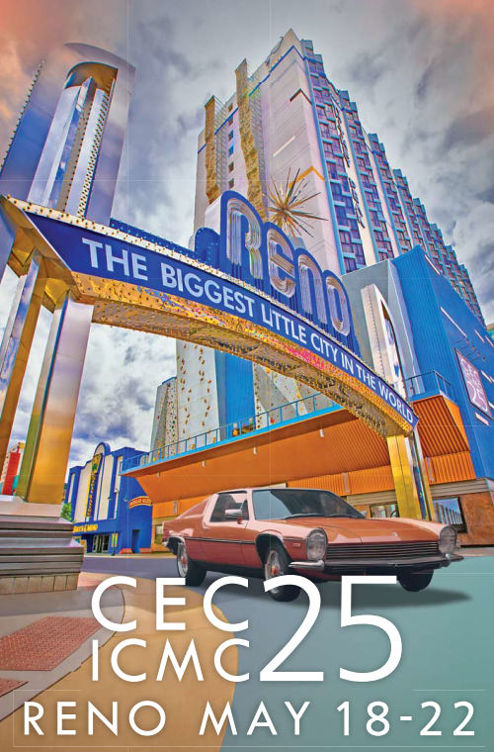
CEC/ICMC - 2025 – Reno (Nevada, USA)
[C3Or4B-01] Large-Scale: Systems, Facilities, and Testing
Operation of CERN’s major tests facility
with upgraded cryogenic infrastructure
for superconducting magnets, power links,
inner triplets String and radio-frequency cavities
for HL-LHC
T. Barbe, T. Dupont, F. Ferrand, V. Gahier, J. Gery, N. Guillotin, R. Mauny, A. Perin, A. Onufrena, O. Pirotte.
Author: Remi Mauny
CERN, Technology Department, Cryogenics group, Geneva 23, CH-1211, Switzerland, remi.mauny@cern.ch.

Slide 2
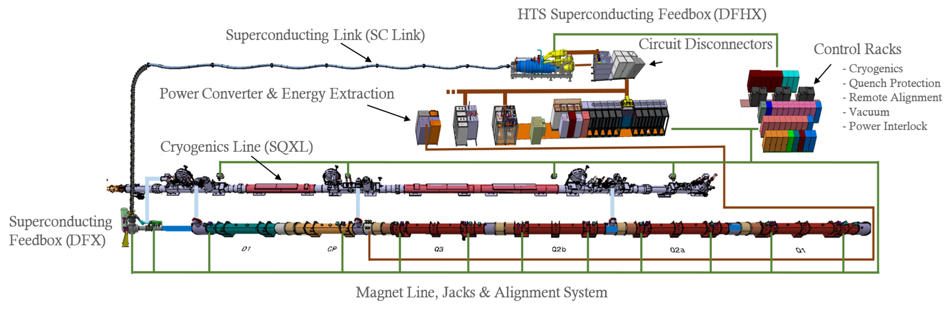
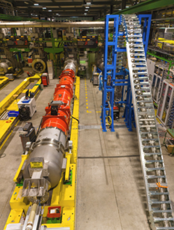
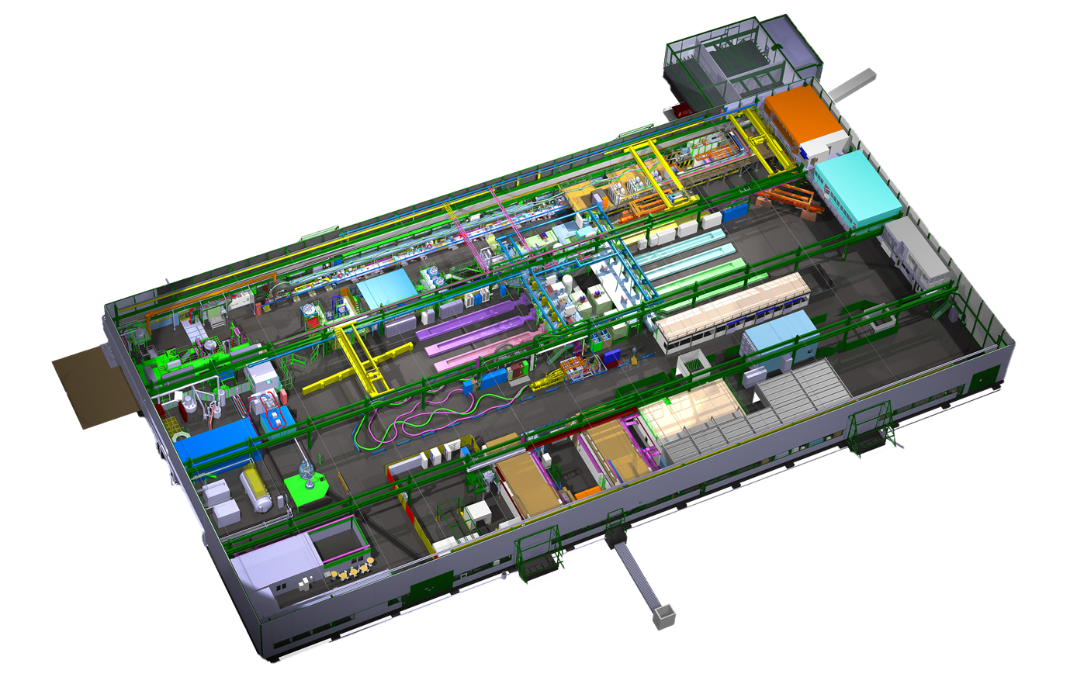
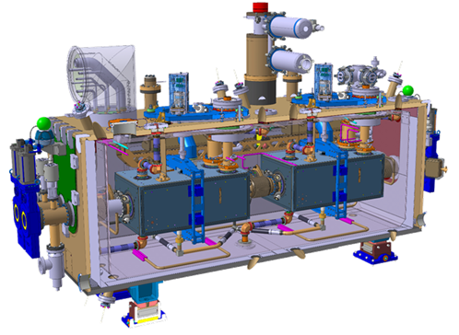
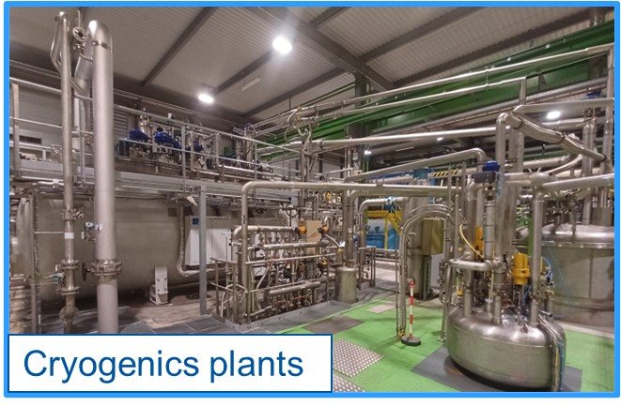
SM18 presentation
SM18: CERN’s major test facility for superconducting magnets, power links, and radio-frequency cavities
(Inner Triplet) IT Magnet
(Inner Triplet) IT-STRING test bench
Power Link
SM18 hall surface : 7200 m²
RF Crab Cavities Cryo-Module

Slide 3
SM18 Cryogenics infrastructure
SM18: CERN’s major test facility for superconducting magnets, power links, and radio-frequency cavities
CRPL-A (Cryoplant)
Compressor Station
Cold Box
[25 g/s]
[4.5 K ; 3.5 bar]
precooler
New IT-String : 6 magnets + Link
8x 80m³ GHe buffers
Back-up
*CPS : Cold Powering System
10 Horizontal Magnet & CPS* test benches
CRPL-B (cryoplant)
Compressor Station
Cold Box
[35 g/s]
[20 K ; 1.2 bar]
5 Vertical MAGNET test benches
[4.5 K
1.6 bar]
Dewar
LHe
25 kL
4 Vertical RF Cavities test benches
2 RF Cryomodule test benches (in bunker)
Warm Pumping Unit 1
Primary pumps
Roots pumps
Pumping Line [ ~30 K ; ~15 mbar ]
Primary pumps
Warm Pumping Unit 2
Roots pumps
New Cold Compressor Unit
(for IT-STRING)
IT-STRING Pumping Line
[ ~3.3 K ; ~15 mbar ]

Slide 4
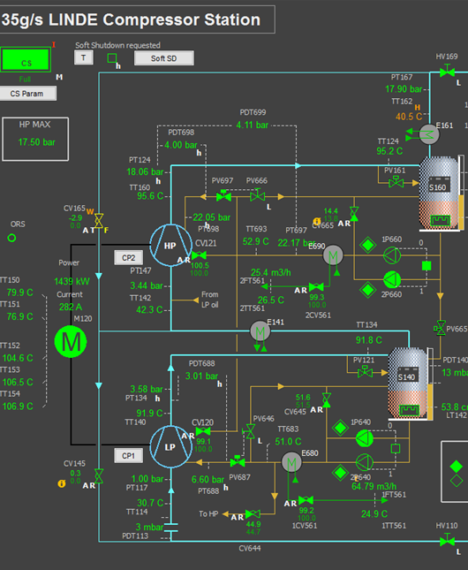
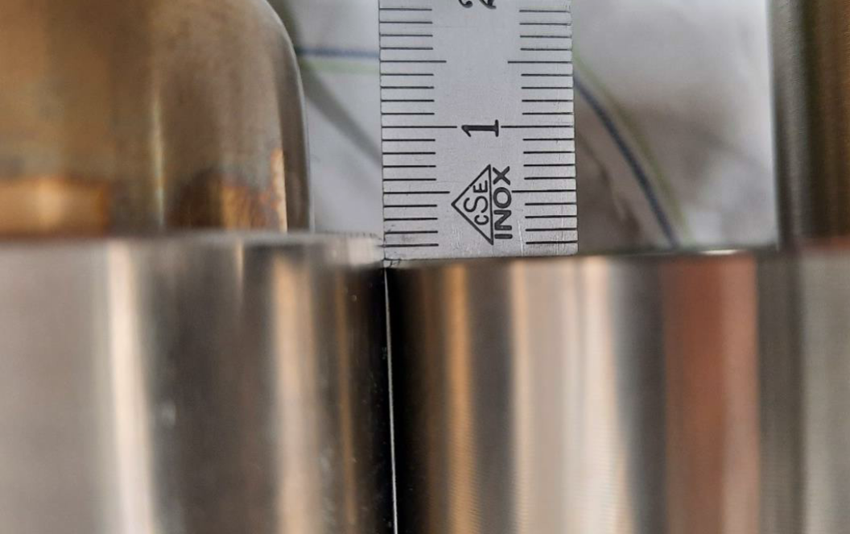
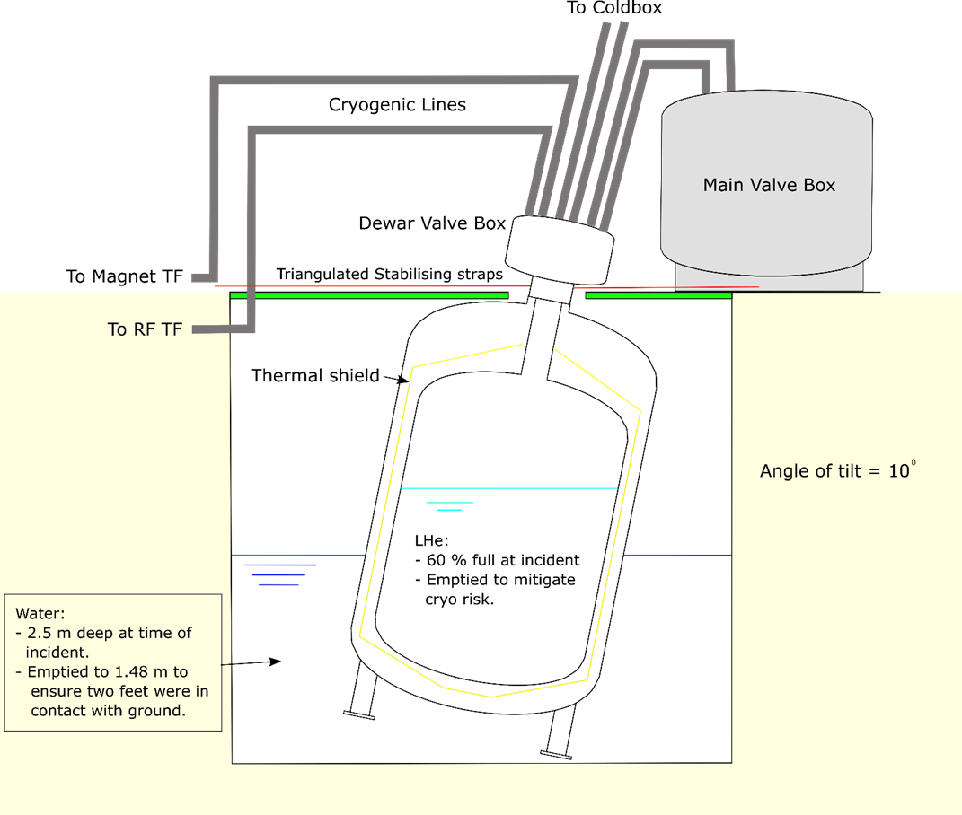
SM18 Cryogenics infrastructure - issues
New Compressor station (CS-B)
New cold box (CB-B)
CS - HP oil injection issue :
Observation : HP oil bypass valve (CV665) kept going out of adjustment during starting up process.
Consolidation:
HP sensor added
Starting up sequence to start HP oil pump revised
Synchronisation between PV697 & PV666 optimized
DPT(Oil/He) Setpoint decreased from 4 bar to 3 bar.
Cold Box - Issue:
inlet & outlet valves of Adsorbers 80 K not tight in line after 1 thermal cycle.
Manufacturer intervention to replace valve heads
Photo 1 : Comparison old vs. new valve head
25 kL Dewar – Issue (2021):
Flooding in the pit – Dewar tilted by 10°
MAIN Lhe storage
ICEC28-ICMC2022, April 25th – 29th, 2022
nicolas.guillotin@cern.ch
2

Slide 5
Test Benches upgrade - CONTEXT
SM18: CERN’s major test facility for superconducting magnets, power links, and radio-frequency cavities
HL-LHC project => increase Luminosity (= increase collisions) in the Large Hadron Collider
HL-LHC : High Luminosity – Large Hadron Collider
*CPS : Cold Powering System
RF CRAB Cavities
Cryomodule
=> To maximize overlap of bunches
Material : Niobium
New Inner Triplet magnets
=> To focus beam
Material : Nb3Sn - NbTi
New CPS
=> To power magnet
Material : MgB2
Test
in
SM 18
IT-STRING
test bench
To validate collective behavior
Integration in LHC during next Long Shut Down

Slide 6
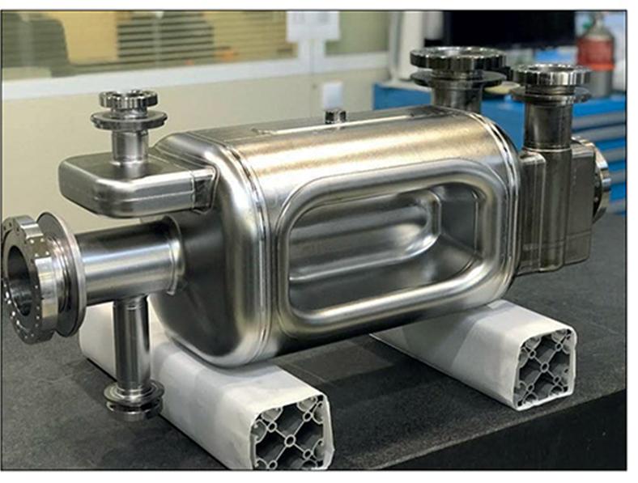
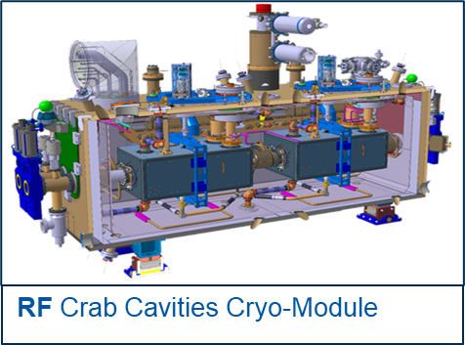
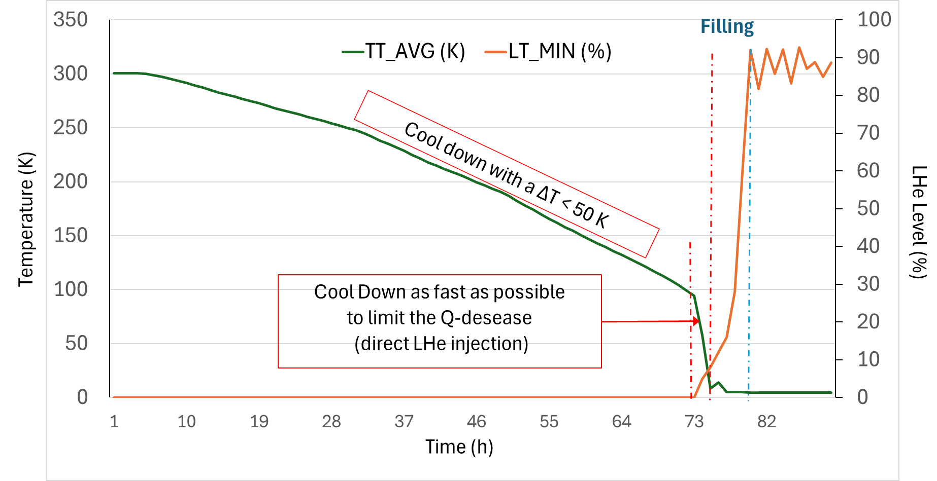

1. Radio Frequency (RF) Crab Cavities – Test benches upgrades
RF Dipole Crab cavity
made in pure Niobium
300 K – 130 K :
Sensitive to mechanical stress during thermal transition
=> ∆T = 50 K max
130 K – 4.5 K :
Must limit Q-Disease => Cool Down as fast as possible
Nominal operation : 2 K
Proto RFD C3M cool down in M7 bunker in August 2024
RF Test benches upgraded to fulfill with requirements
Cryogenics process improved
Ready to test RF Crab cavities series

Slide 7
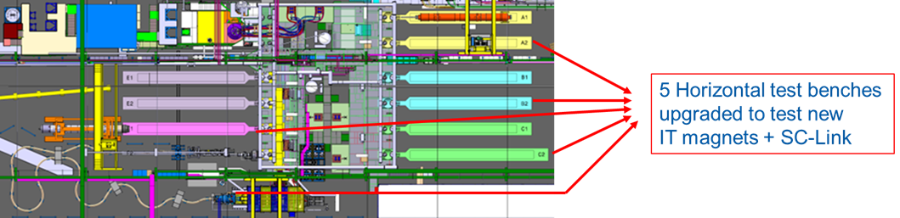
2. Magnet test benches upgrades for Magnets & CPS (Sc-link)
From 2022, 5 Horizontal benches for magnets upgraded :
4 with a shuffling module to test new Inner Triplet magnets
1 to test the new HL-LHC Cold Powering System (72 m long)

Slide 8
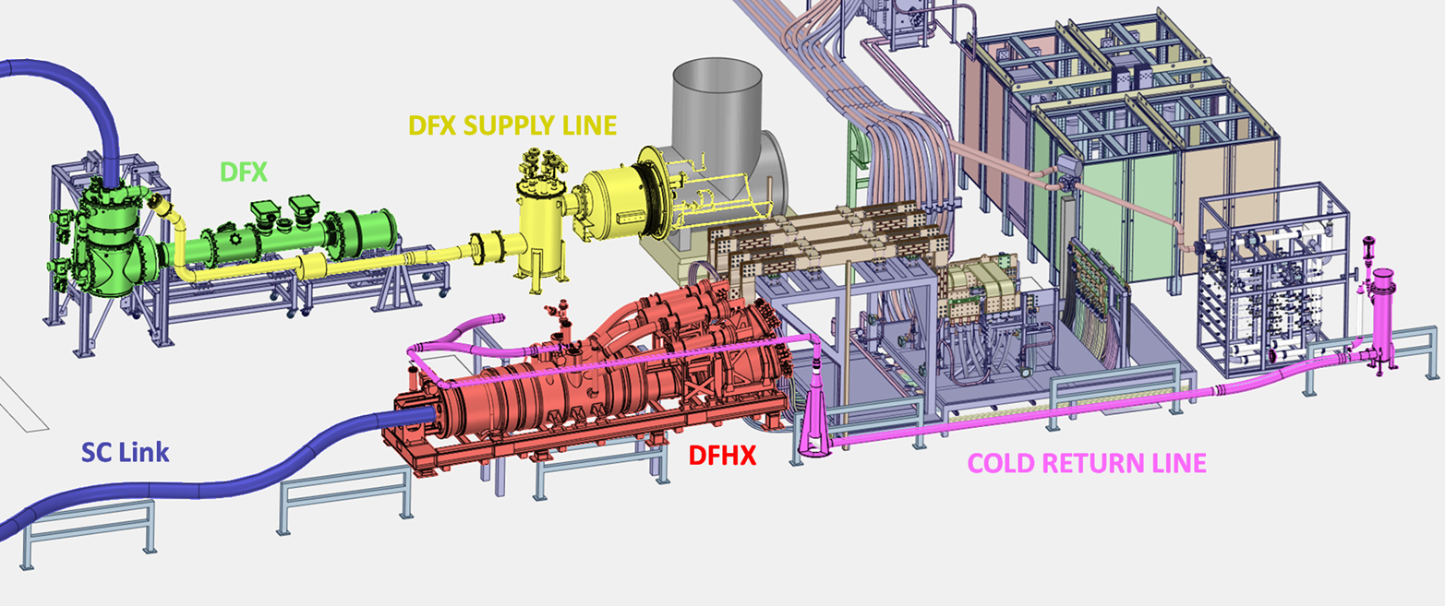
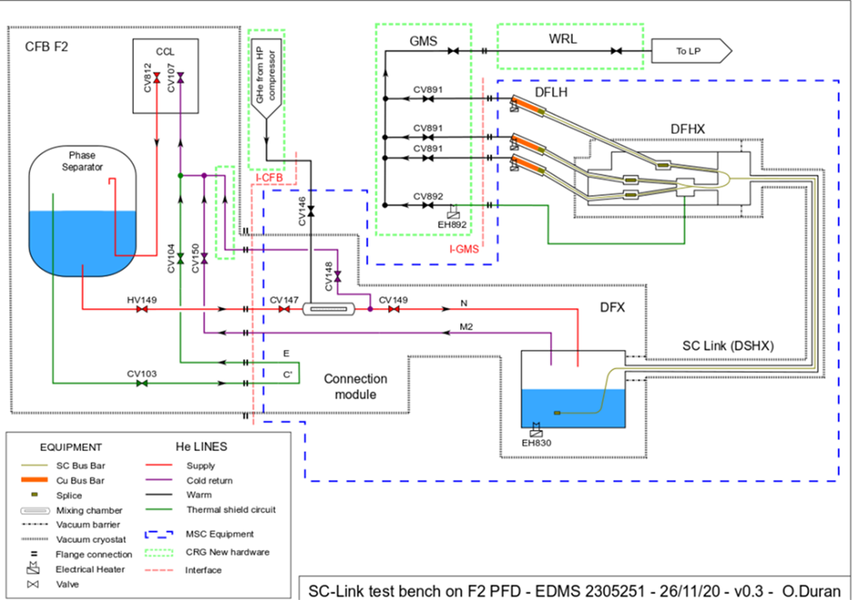
2. Cold Powering System - test bench
Current Leads (x19)
1
2
~ 290 K
< 60 K
4
~ 290 K
3
Bypass
< 20 K
4
In Yellow : upgrade added to the original Magnet test bench
In green : Distribution Feed Box (DFX) : at 4.5 K – it’s where the Link ends-up with connections (splice) between the link in MgB2 to the busbars in Nb-Ti
In Blue : Superconducting (SC) Link; ~72 m ; 19 cables in MgB2
In red : Distribution feed box high (DFHX): where the link starts up with splices MgB2 / HTS < 20 K + 19 Current Leads HTS/Copper
1
2
He flow
3
4.5 K

Slide 9
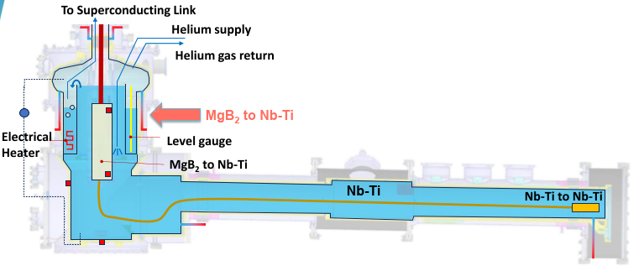
Cold He flow
generated by Heater : 6 g/s
2. Cold Powering System – DFX & Results
Superconducting wires to supply current to magnets :
Link (in MgB2)
Bus-bar (in Nb-Ti)
MAGNETS (theoretical position)
Lesson learnt:
15 W permanently
Constant generated flow of 6 g/s with and without current.
Cryogenic conditions OK with powering up to 94 kA !
a DFX drawing with the 2 Helium bath in cascade

Slide 10
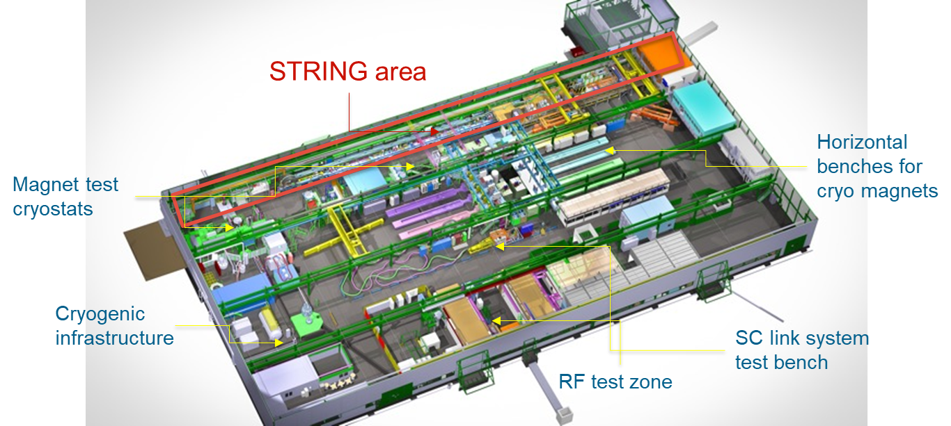
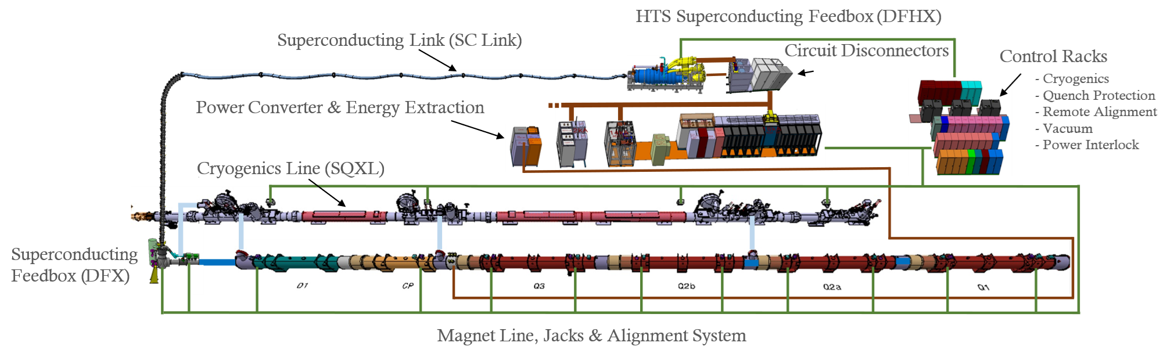
3. IT String test bench (1/4)
SM18 facility
to STUDY and VALIDATE the COLLECTIVE BEHAVIOUR
of a string if inner triplet magnets with their powering system.
(+ other non-cryogenics systems).
~ 100 m

Slide 11
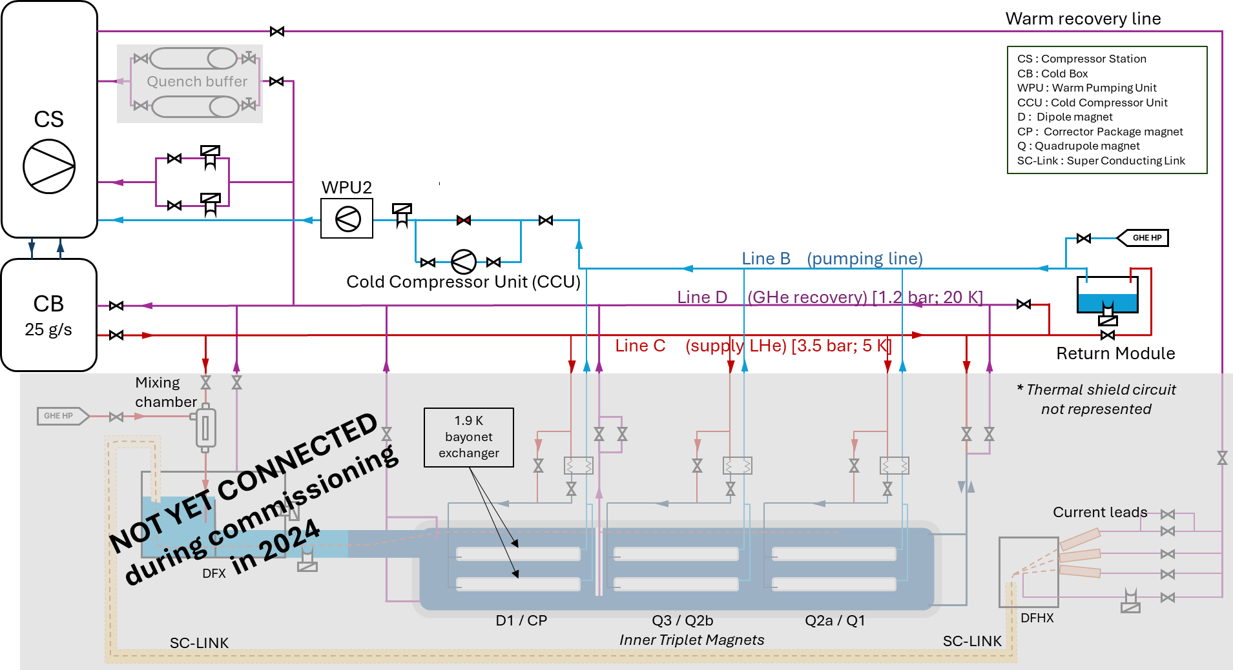
3. IT String test bench (2/4)
3 cool down done for :
SQXL validation
Cooldown procedure
Heat load check
New CCU operation
[6 kW]
25 g/s

Slide 12
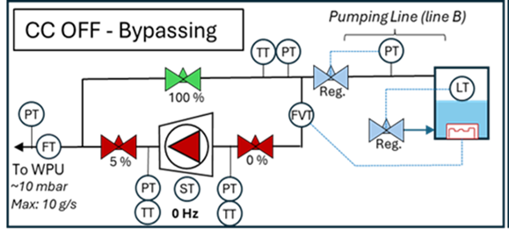
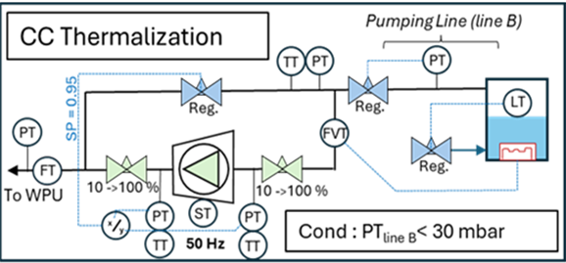
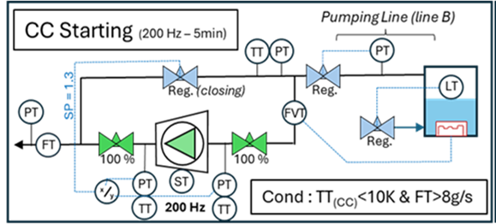
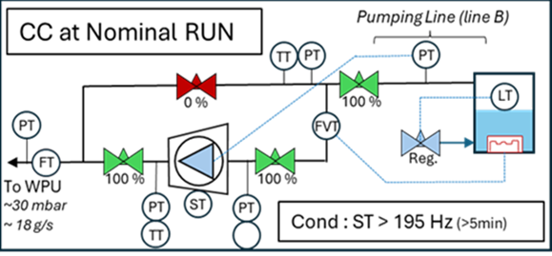

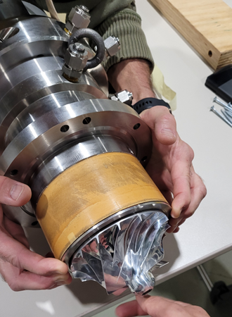
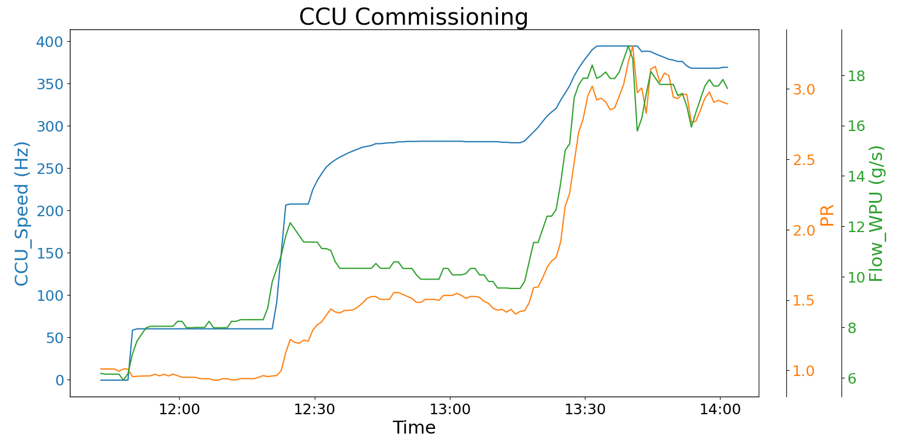
3. IT String test bench 3/4
CC off
Thermalization
Bearing Wup
Nominal operation
Cold Compressor

Slide 13
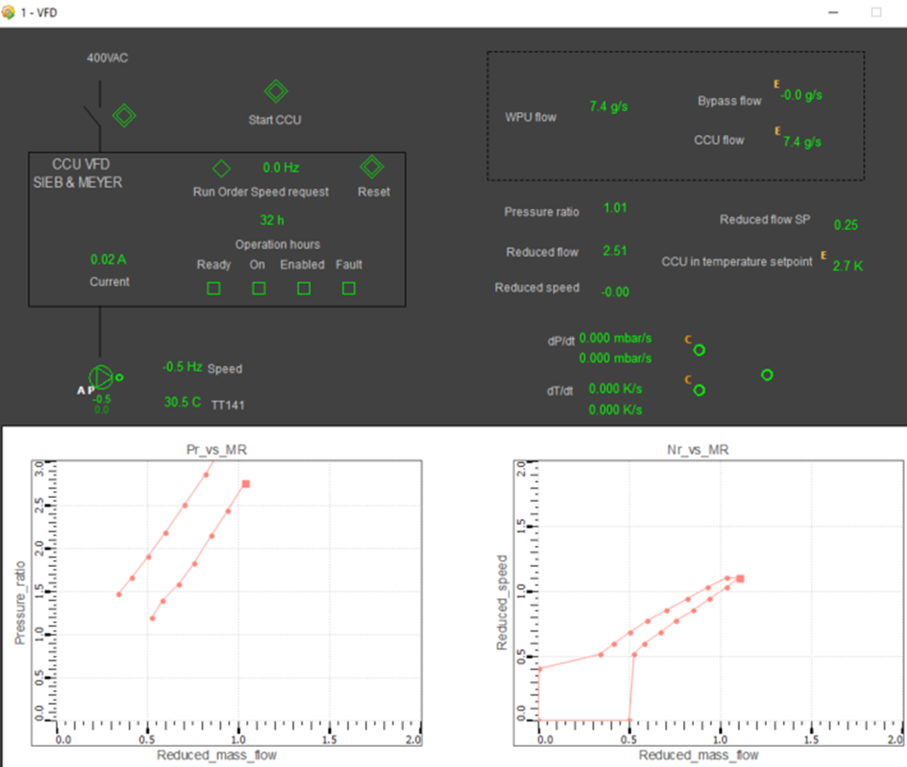
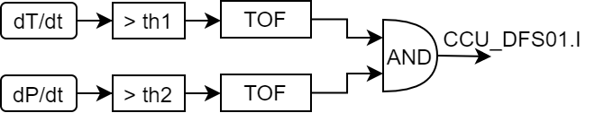
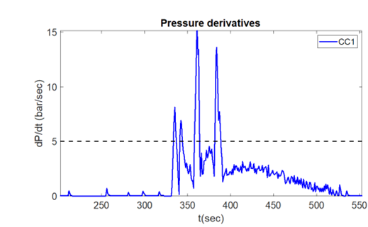

3. IT String test bench 4/4
Surge detection
Cold Compressor - Control panel
Interlock :
Cold Compressor operation & control system

Slide 14
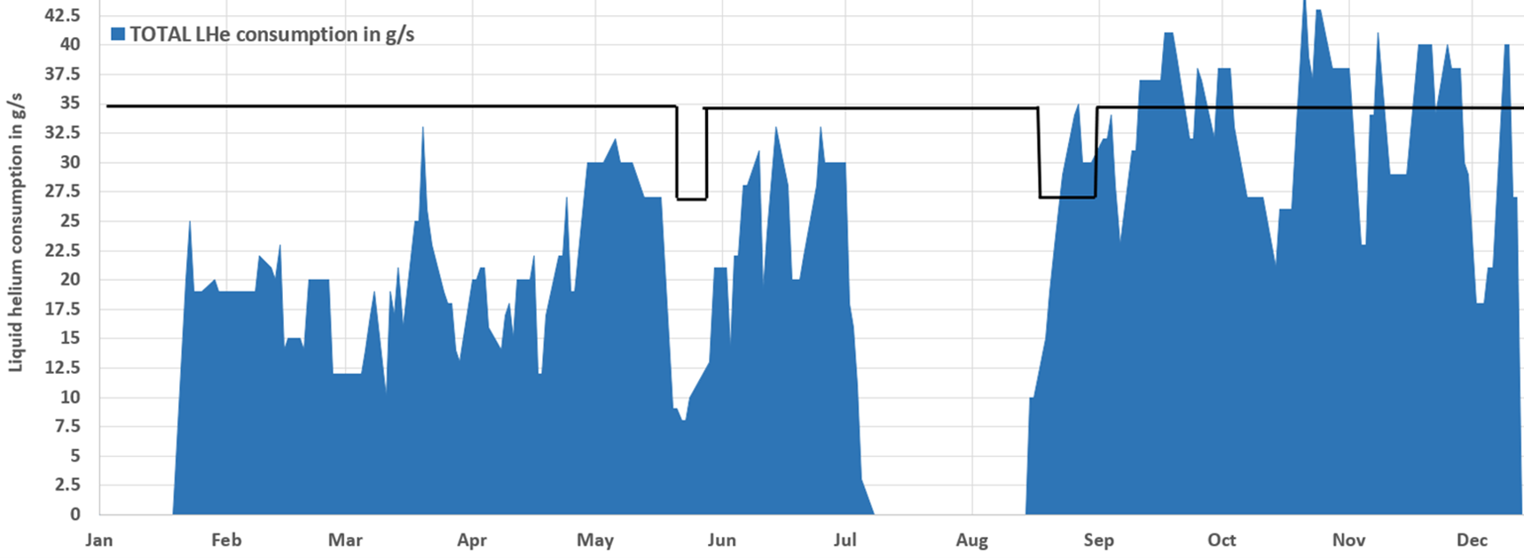
CONCLUSION 1/2
Today status :
Test benches upgraded & validated
Cryogenics infrastructure upgraded
Cryogenics process optimized
LHe @ 4.5 K demand (2024)
Max Liquefaction
capacity: 35 g/s

Slide 15
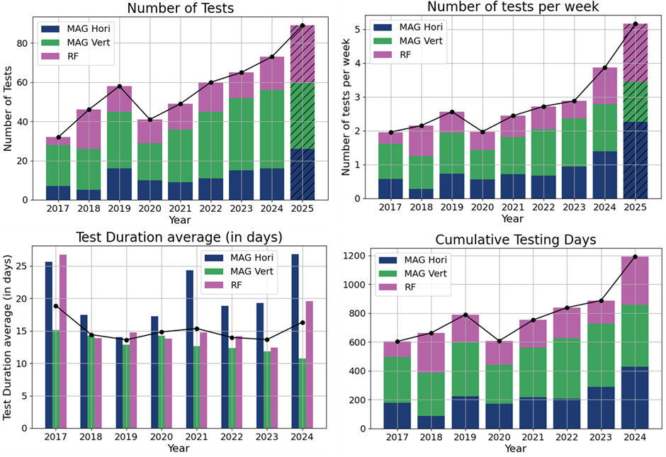
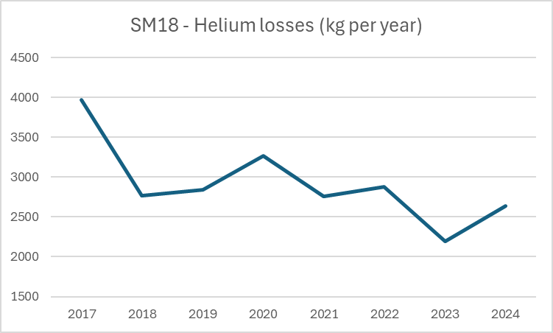
CONCLUSION 2/2
Next challenge :
Operation of the IT String test bench with magnets and SC link, scheduled to start in September 2025.
Thank you!

Slide 16
Thank you!

Slide 17
Test Facility building (SM18) – Presentation
SM18: CERN’s major test facility for superconducting magnets, power links, and radio-frequency cavities
Precooling / Warming-up [300-80K]
3 Compressors [1 - 170 bar]
2 Purifiers
ImPure Warm He gas recovery (purges)
CWS
CWU
8 GHe buffers 80 m3
CWU1
GHe / LN2
Comp.
Quench buffer
80 m3
Comp.
CWU2
GHe / LN2
Pure Warm He gas recovery
Comp.
[300 - 80 K ]
CRPL-A (Cryoplant)
[4.5 K ; 3.5 bar]
New IT-String : 6 magnets + SC-Link
Compressor Station
Cold Box
[25 g/s]
precooler
Back-up
8 Horizontal Magnet & SC-Link test benches
New CRPL-B
Compressor Station
Cold Box
[35 g/s]
[20 K ; 1.2 bar]
[4.5 K
1.6 bar]
5 Vertical MAGNET test benches
Dewar
LHe
25 kL
4 Vertical RF Cavities test benches
2 RF Cryo-module test benches (in bunker)
Warm Pumping Unit 1
Primary pumps
Roots pumps
Pumping Line [ ~30 K ; ~15 mbar ]
New Cold Compressor Unit
(for IT-STRING)
Warm Pumping Unit 2
Primary pumps
Roots pumps
IT-STRING Pumping Line [ ~3.3 K ; ~15 mbar ]

Slide 18
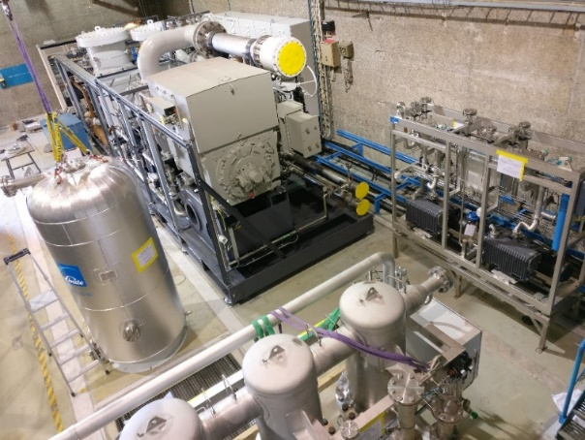
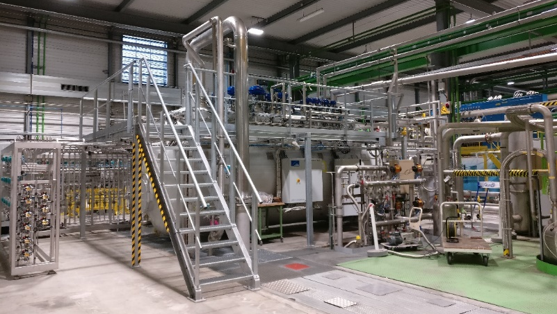
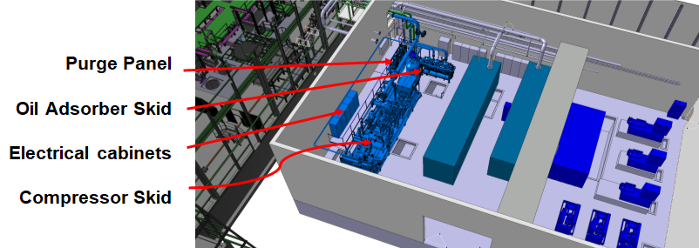
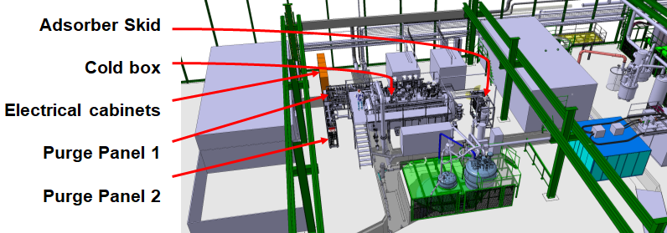
Cryogenics Infrastructure upgrade : new cryogenics plant (Linde B)
New Compressor station (CS-B)
New cold box (CB-B)
MAIN CARACTERISTICS
1 motor stahl (1.6 MW)
1 double stage compressor Mycom
8 turbines
8 exchangers
2 adsorbers 80 K
1 adsorber 20 K
No precooler LN2
No phase separator
Inlet flow at full capacity : 350 g/s
Liquefaction flow : 35 g/s (Lhe @ 4.5 K, 1.6 bar)
Installation (Q2 2019 – Q4 2019)
Commissioning (Q4 2019 – Q3 2020)
Operation (Q4 2020 – now)
ICEC28-ICMC2022, April 25th – 29th, 2022
nicolas.guillotin@cern.ch
2

Slide 19
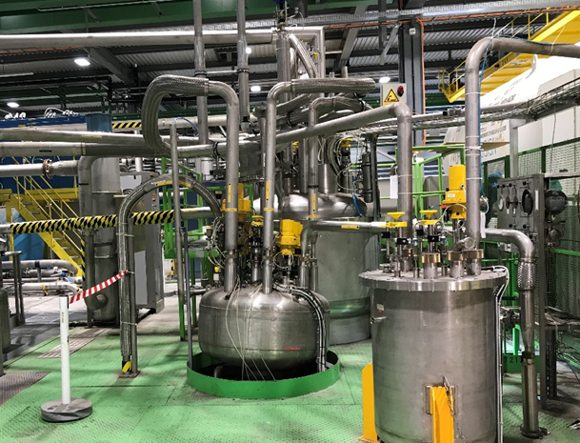
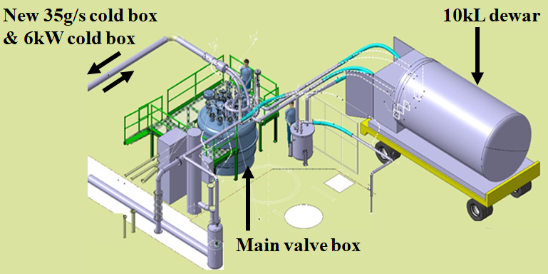
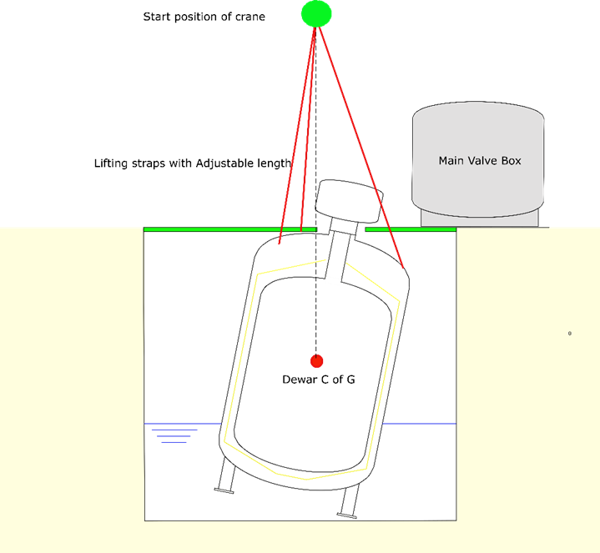
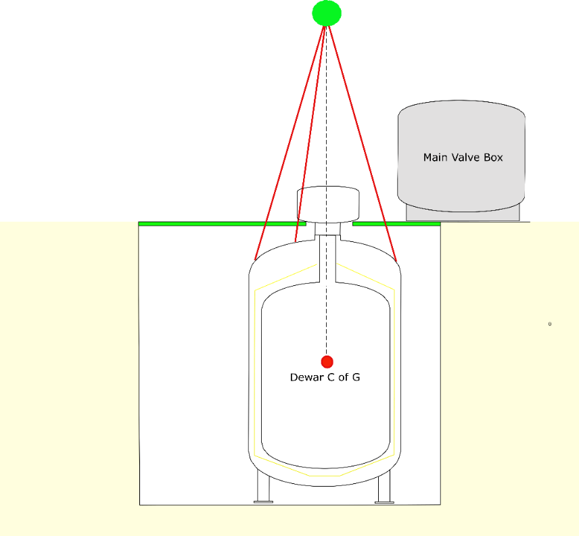
1. Cryogenics Infrastructure upgrade : 25 kl DEWAR ISSUE
Event (June 2021): Flooding in the pit – Dewar tilted by 10°
1.Emptying
2.Dewar lifted to maintain Center of gravity to avoid swinging.
3.Water drained from the pit.
4.Investigation: dye penetrant test + high resolution 3D laser scan of the neck, endoscopy => experts agreed damage is minor – OK for re-use.
5. Leak test + pressure test
6. Back in service in August 2024

Slide 20
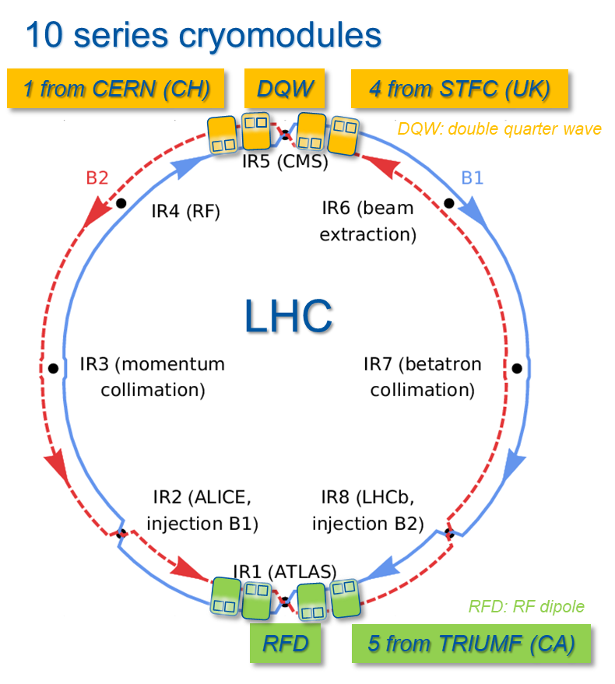
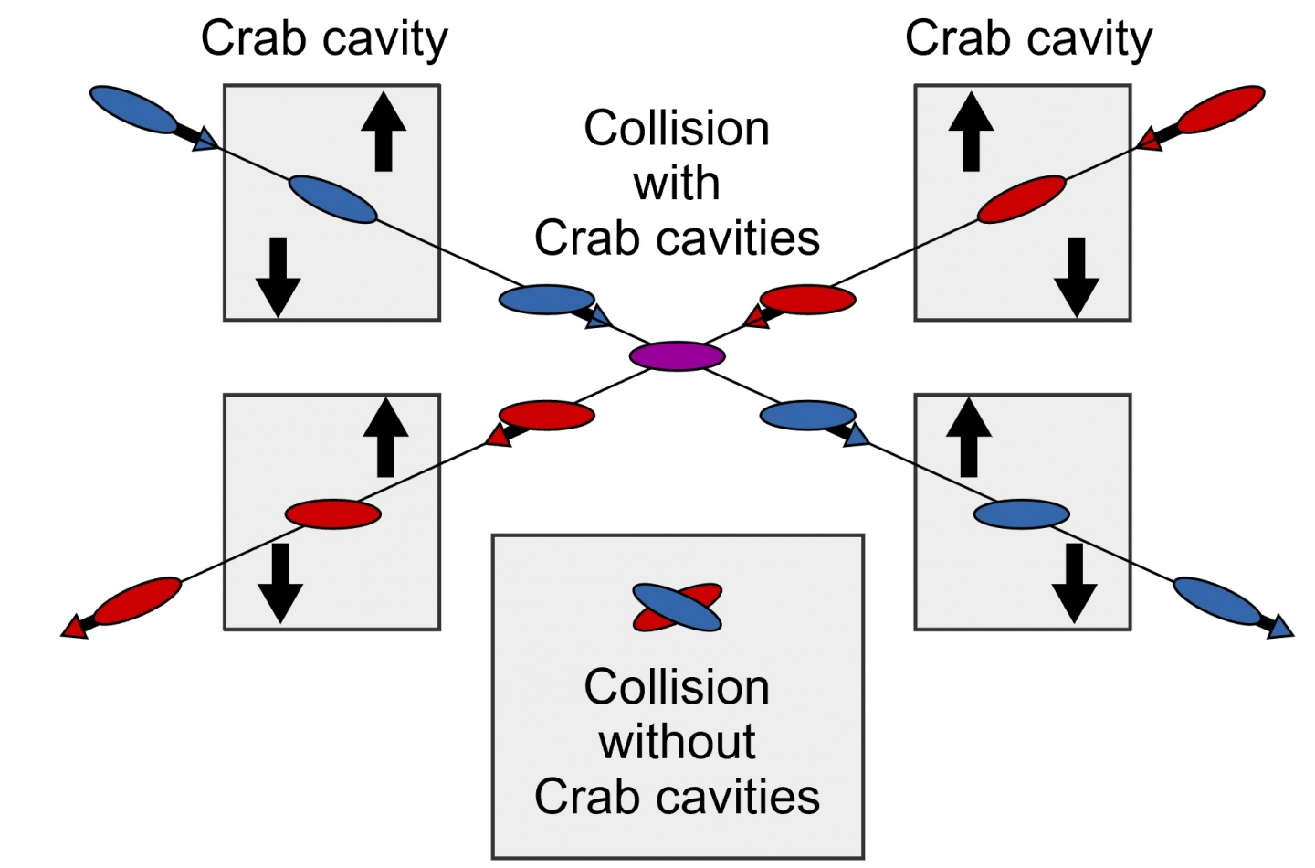
2.0 Radio Frequency (RF) Crab Cavities Cryogenics Module (C3M) upgrade
Introduction & Context
Crab cryo-module cavities location in future LHC
Crab cryo-module cavities' principle

