Slide 1

Upgrades and initial weathering test results of the liquefied natural gas testbed at NASA Kennedy Space Center
Cryogenic Engineering Conference
Wednesday May 21st, 2025
Adam Swanger¹, Mai Harrison², Andrew Kelly¹, Julie Foroosh¹, and Will Reaves³
  ¹NASA Kennedy Space Center, Cryogenics Test Laboratory, KSC, FL 32899 USA
  ²Astrion LASSO2, Kennedy Space Center, Cryogenics Test laboratory, KSC, FL 32899 USA
  ³Noetic Strategies LASSO2, Kennedy Space Center, Cryogenics Test laboratory, KSC, FL 32899 USA
C3Or4A-01

Slide 2
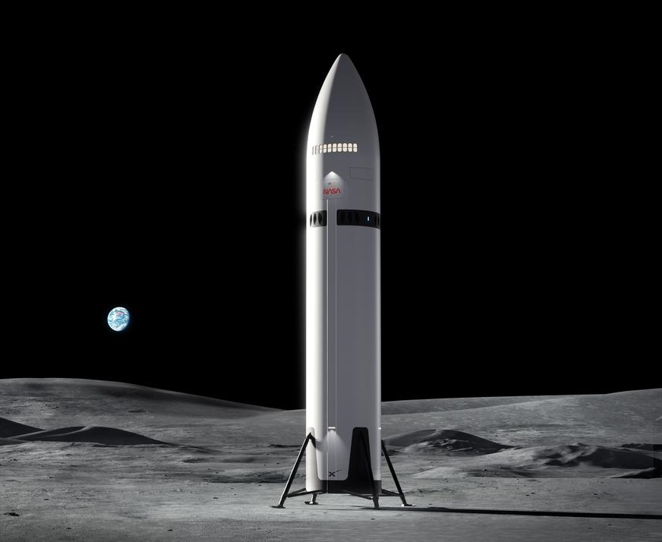
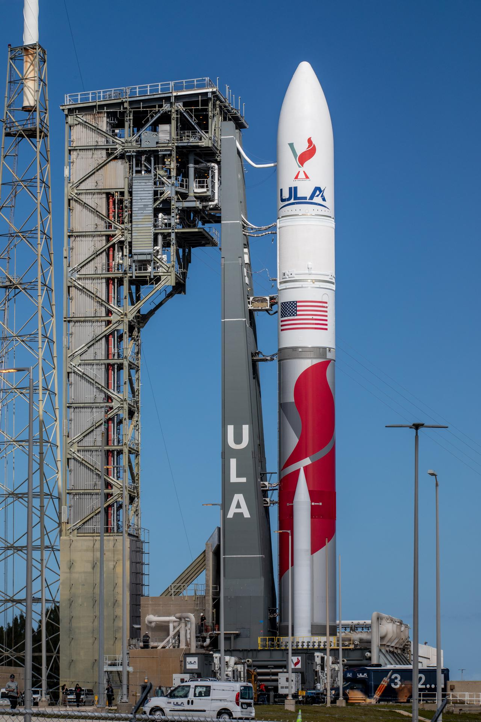
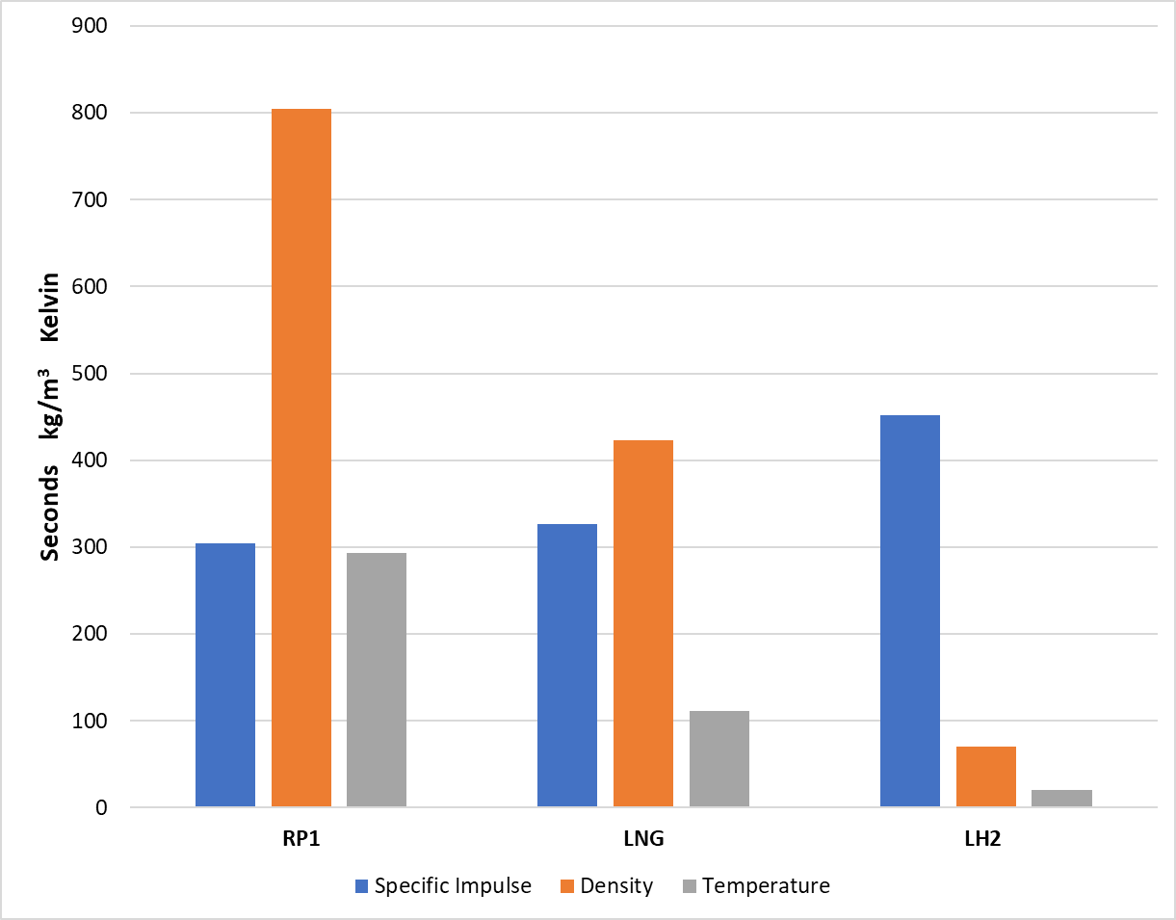
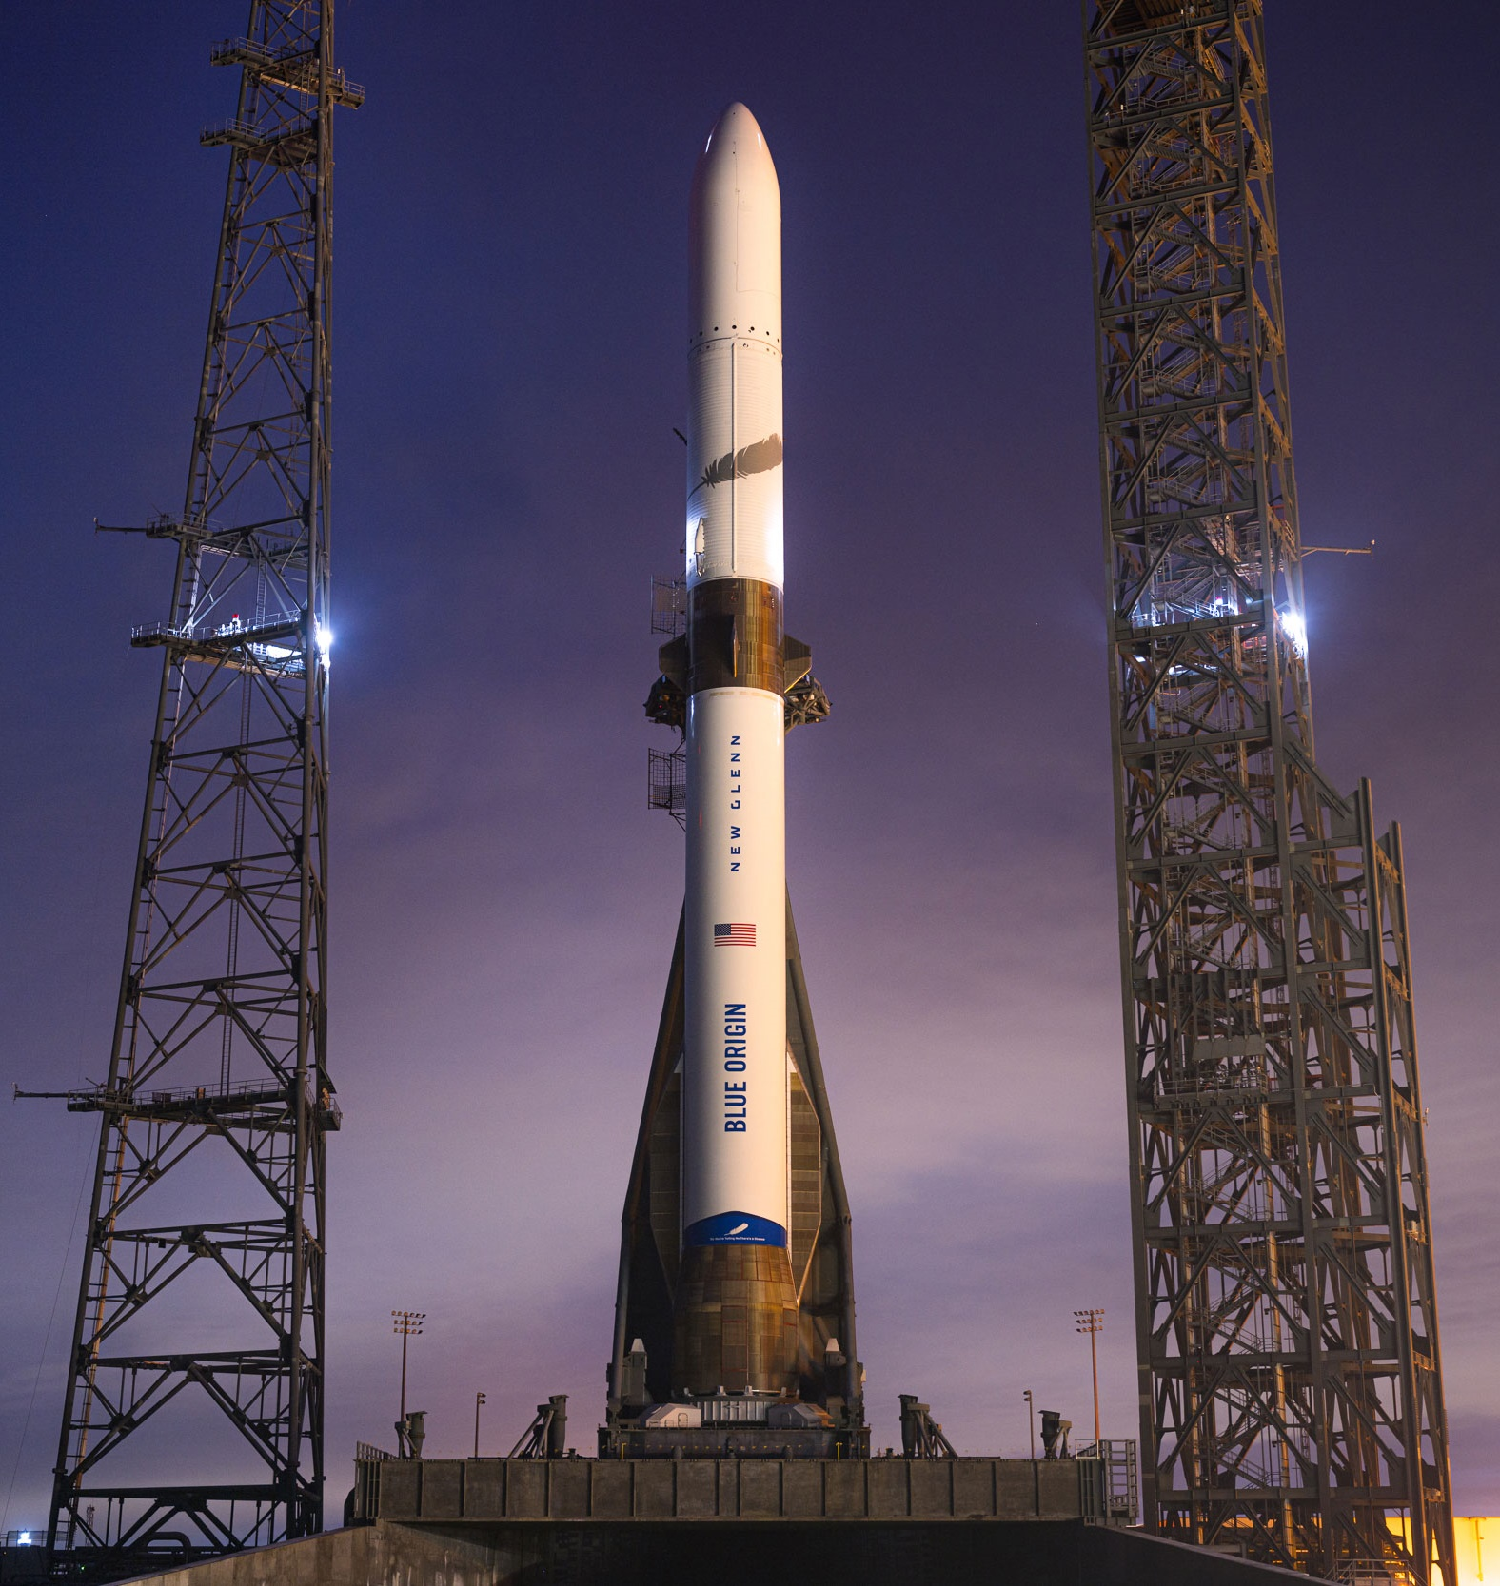
INTRODUCTION
2
Historically, only liquid hydrogen (LH₂) and kerosene (RP1) have been used as rocket fuels
Recently, Blue Origin, ULA, and SpaceX have all switched to liquefied natural gas (LNG) or “liquid methane”
Image: NASA
Image: NASA
Image: Blue Origin

Slide 3
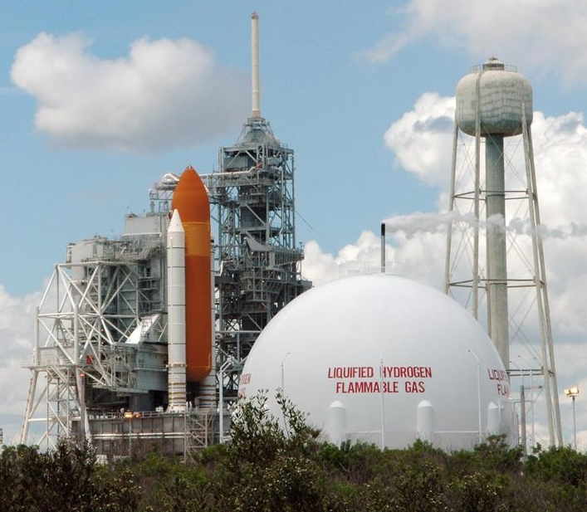
INTRODUCTION
3
Unlike LH₂ and RP1, LNG is susceptible to “weathering”
  Weathering = preferential evaporation of lower boiling point constituents over time, leading to a change in the bulk liquid composition
Typical operation of cryogenic storage tanks at launch pads is problematic
  Long delays between launches historically → propellants sit idle in storage tanks for long durations, with the boiloff vented to atmosphere
Image: NASA
Weathering of LNG could affect engine performance or cause a violation of launch commit criteria
Image: NASA

Slide 4
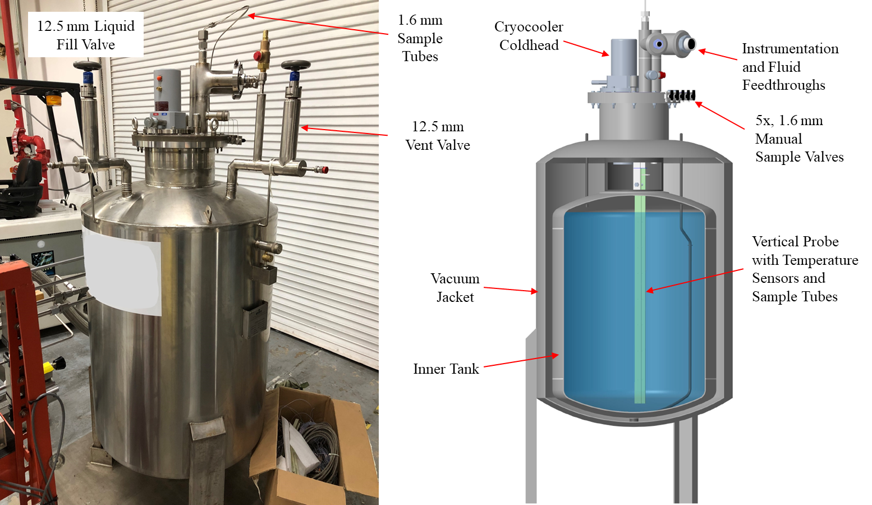
LNG Testbed — phase 1
4
In 2017, Cryogenics Test Lab at NASA Kennedy Space Center began building an LNG test capability to examine weathering and other storage-related topics
Testbed Configuration
400 L dewar (repurposed)
New top plug assembly
Vertical probe with five sample tubes at 0%, 25,%, 50%,75%, and 100% fill levels
Five corresponding RTD temp sensors
MKS Precisive® 5 gas analyzer
Integrated coldhead
Image: NASA
Images: NASA

Slide 5
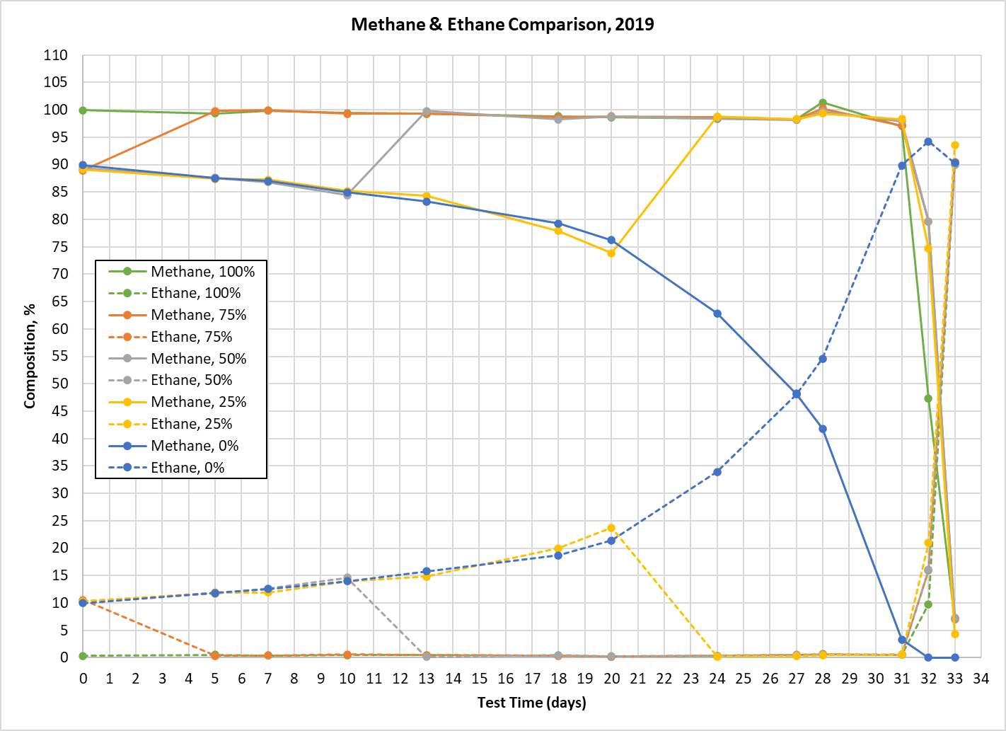
LNG Testbed — phase 1
5
A single LNG weathering test was conducted in 2019 on the original testbed setup
Good results, but much room for improvement!
  Completely manual
  Course compositional data
  No boiloff data
  Finicky pressure control
Image: NASA
System was mothballed after 2019

Slide 6
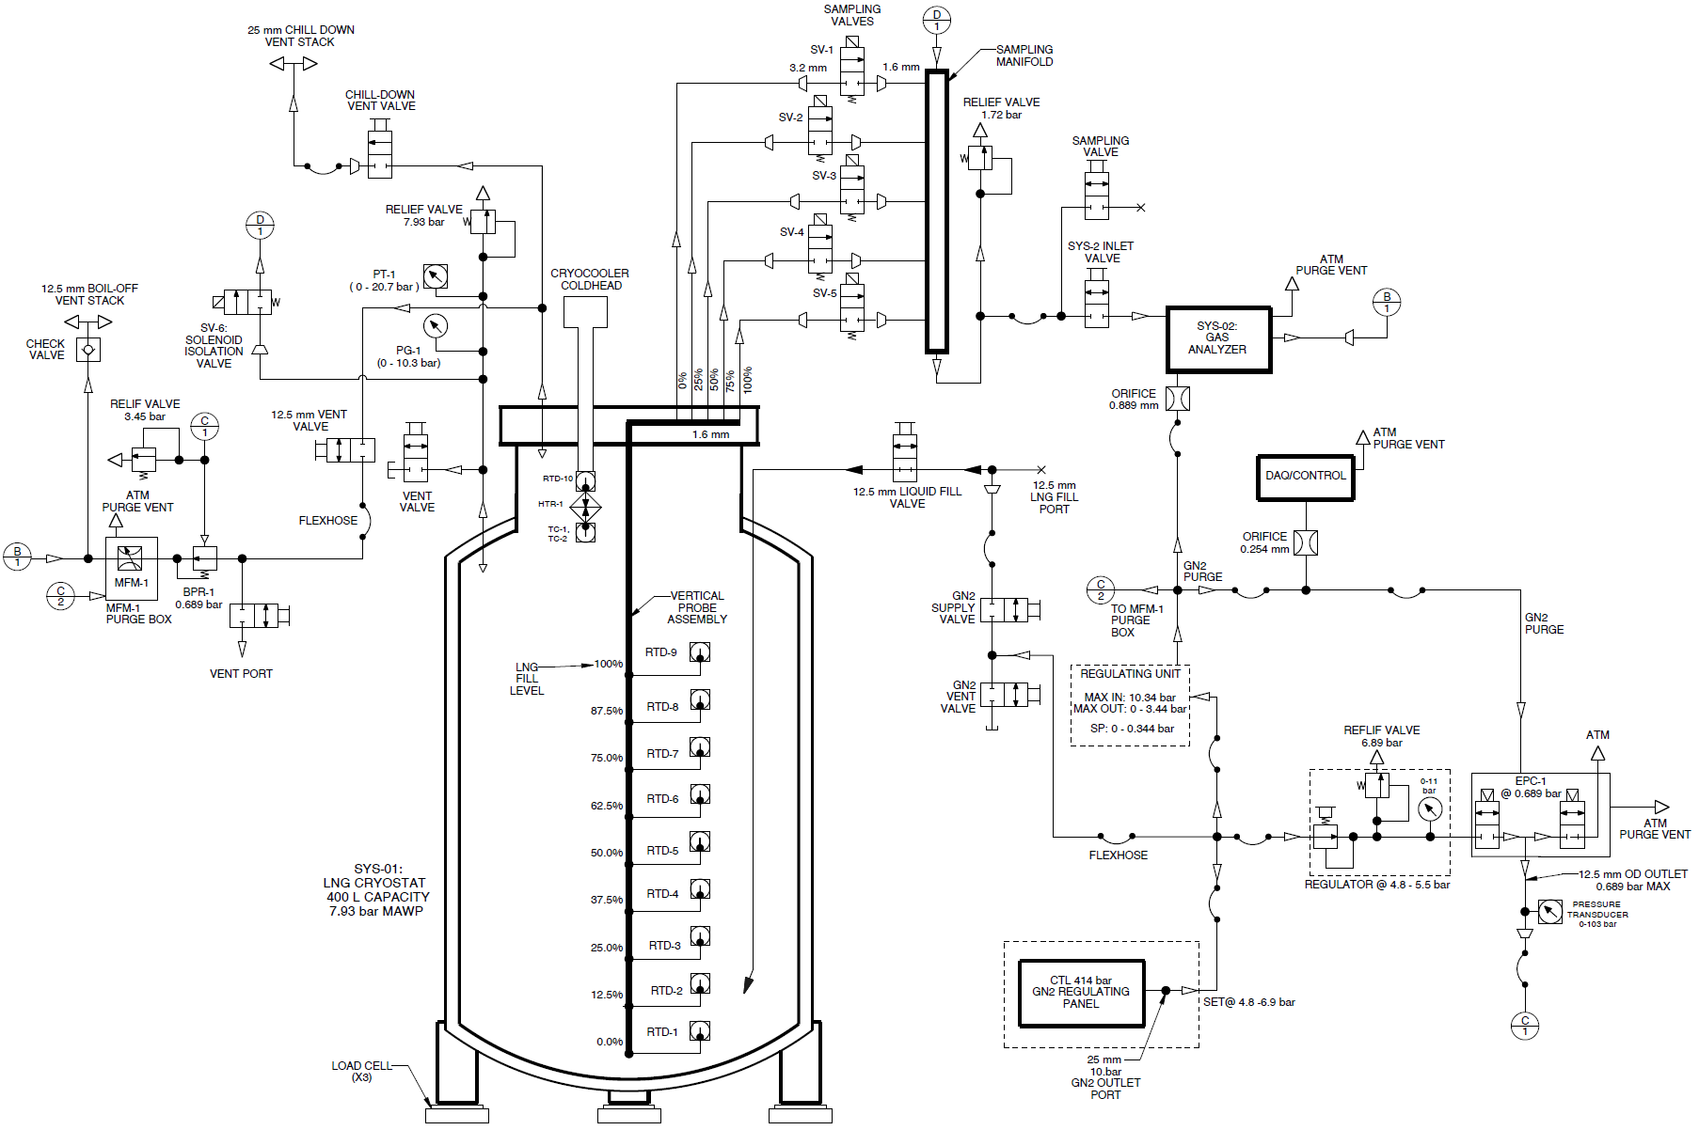
LNG Testbed — phase 2
6
In 2022, NASA Rocket Propulsion Test (RPT) program funded effort to resurrect the system, make improvements, and conduct more testing
Testbed Upgrades
100% automated sampling
Boiloff mass flow meter
Load cells
Additional vertical temperature sensors
Precise tank pressure control
Image: NASA

Slide 7
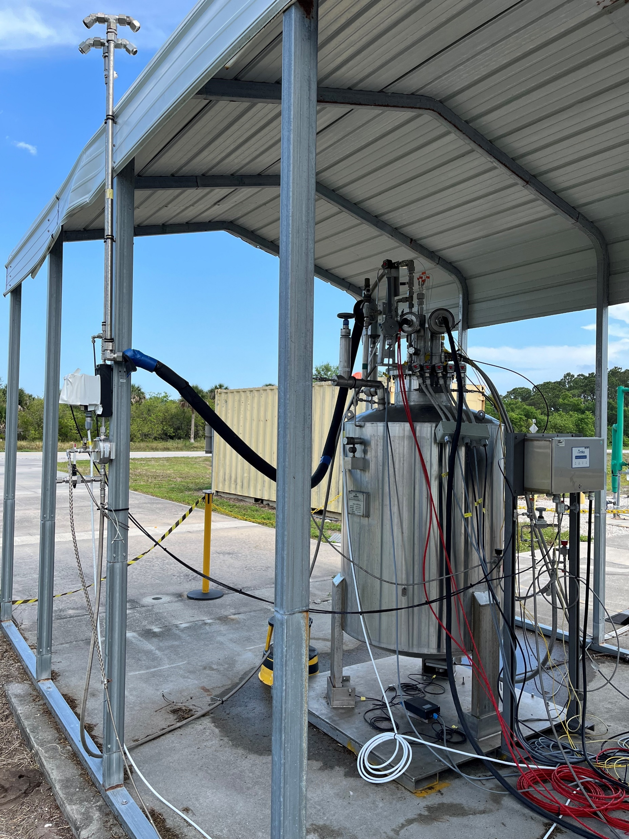
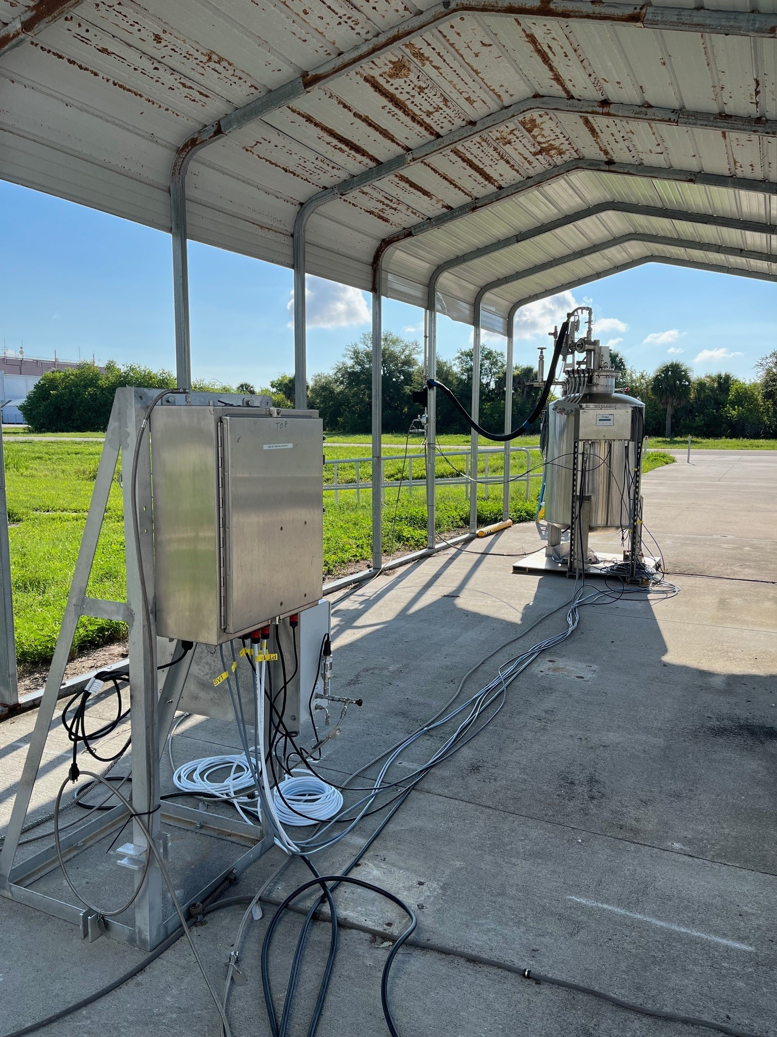
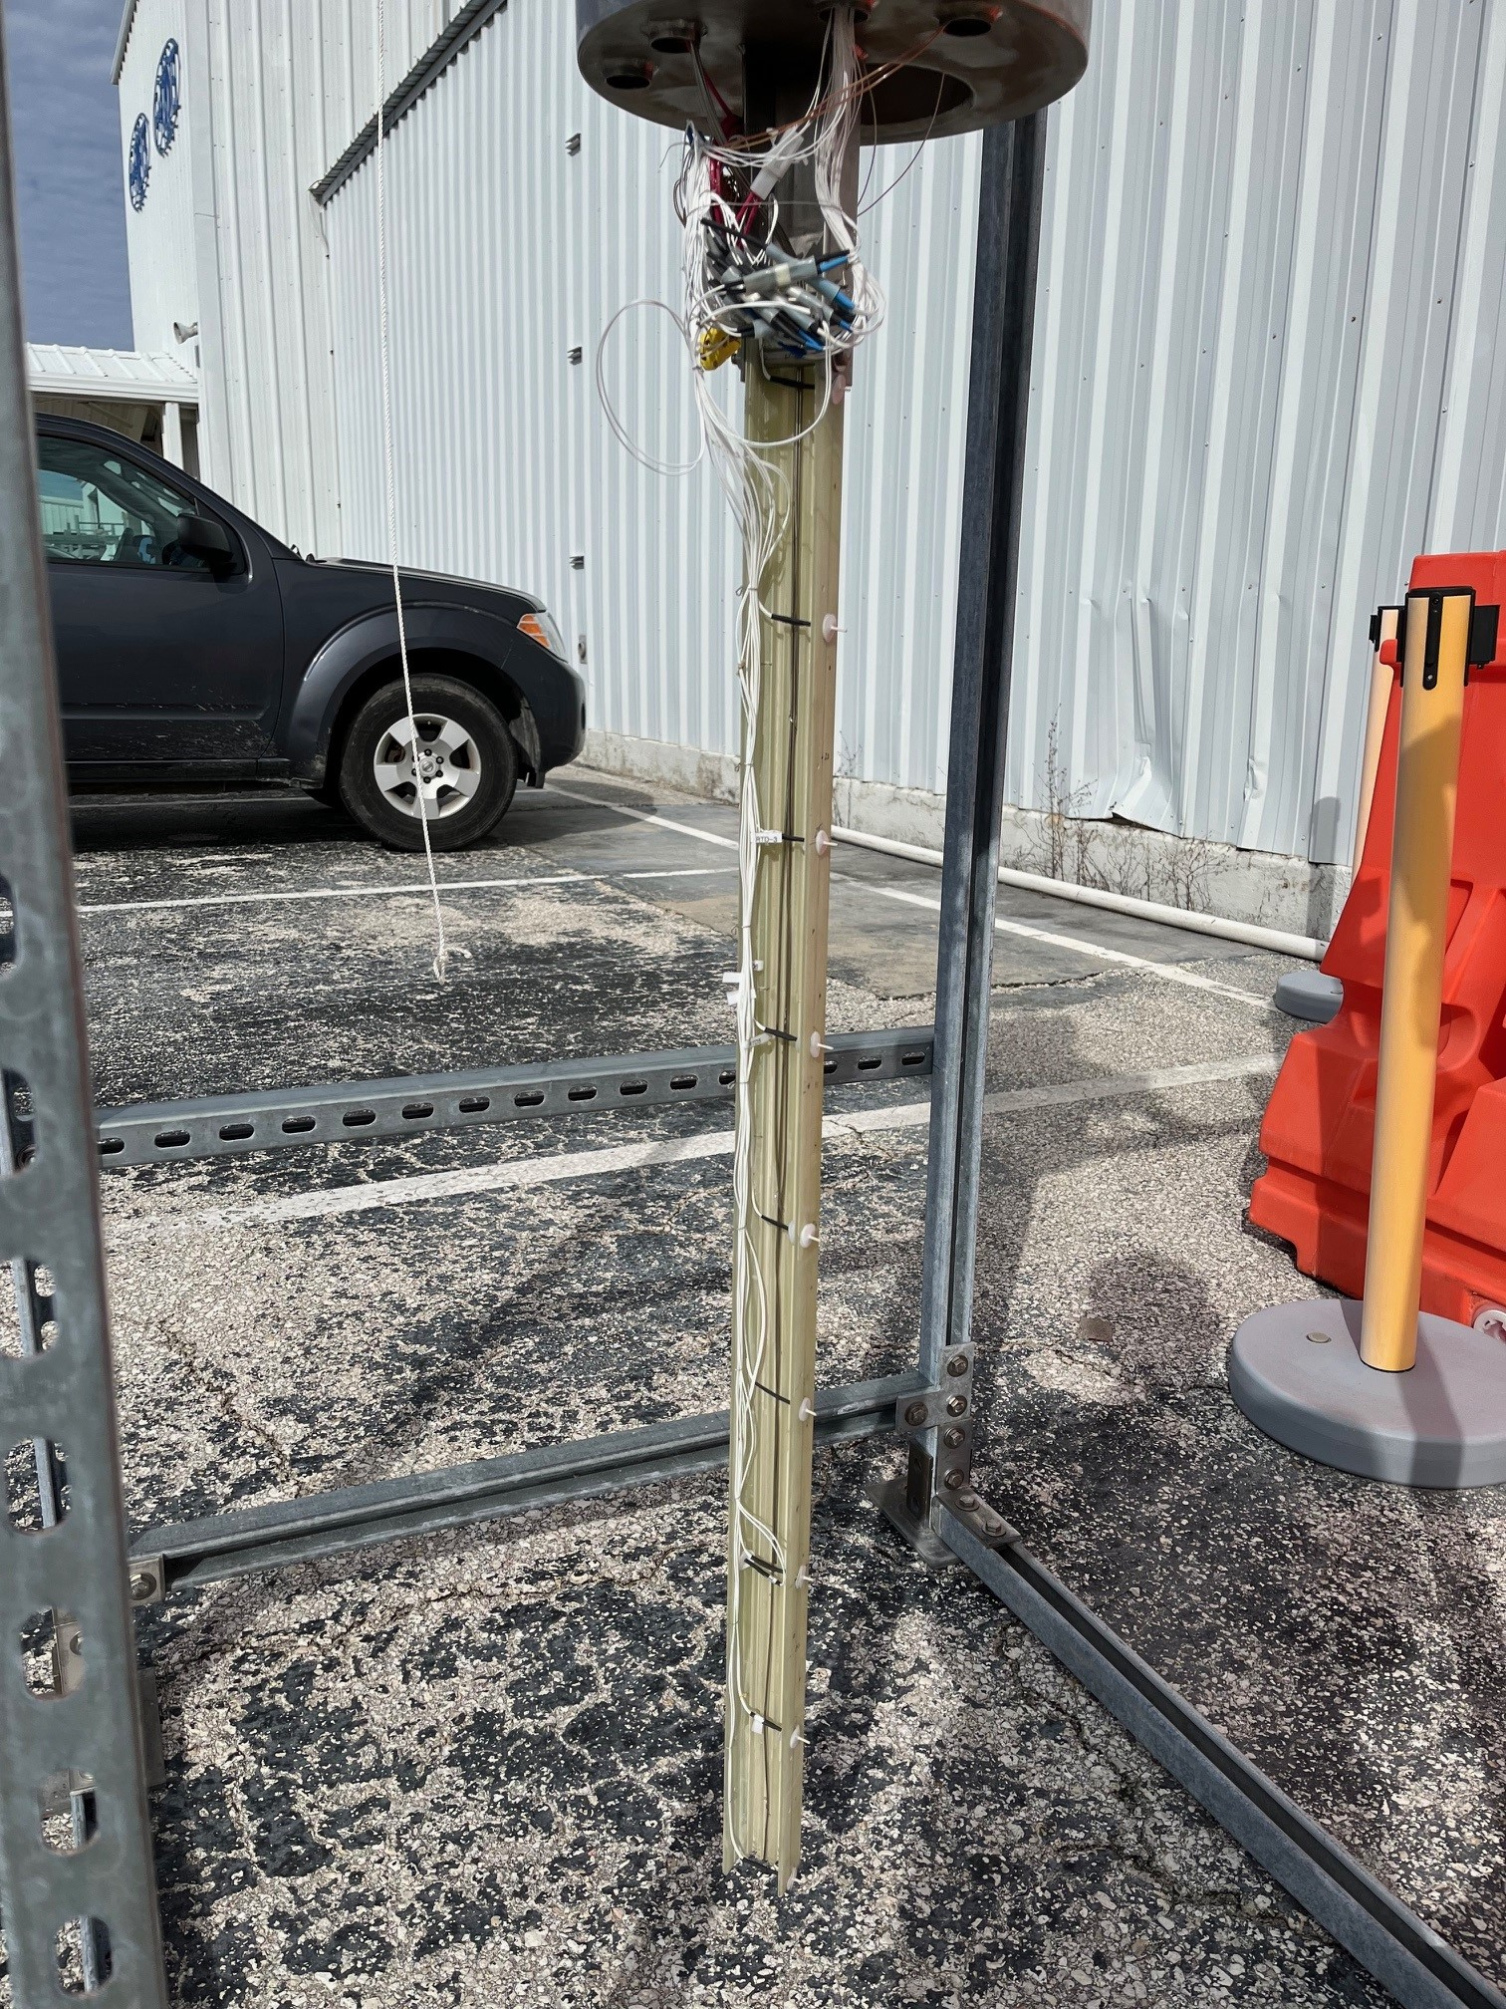
LNG Testbed — phase 2
7
Chill-Down & Boiloff Vent Stacks
Mass Flow Meter & Back Pressure Regulator
Unclassified Electrical Equipment
Vertical Probe Assembly
G-10
C-Channel
Top Plug Assembly
Image: NASA
RTDs
1.6 mm Diameter Sample Tubes
4.6 m
Images: NASA

Slide 8
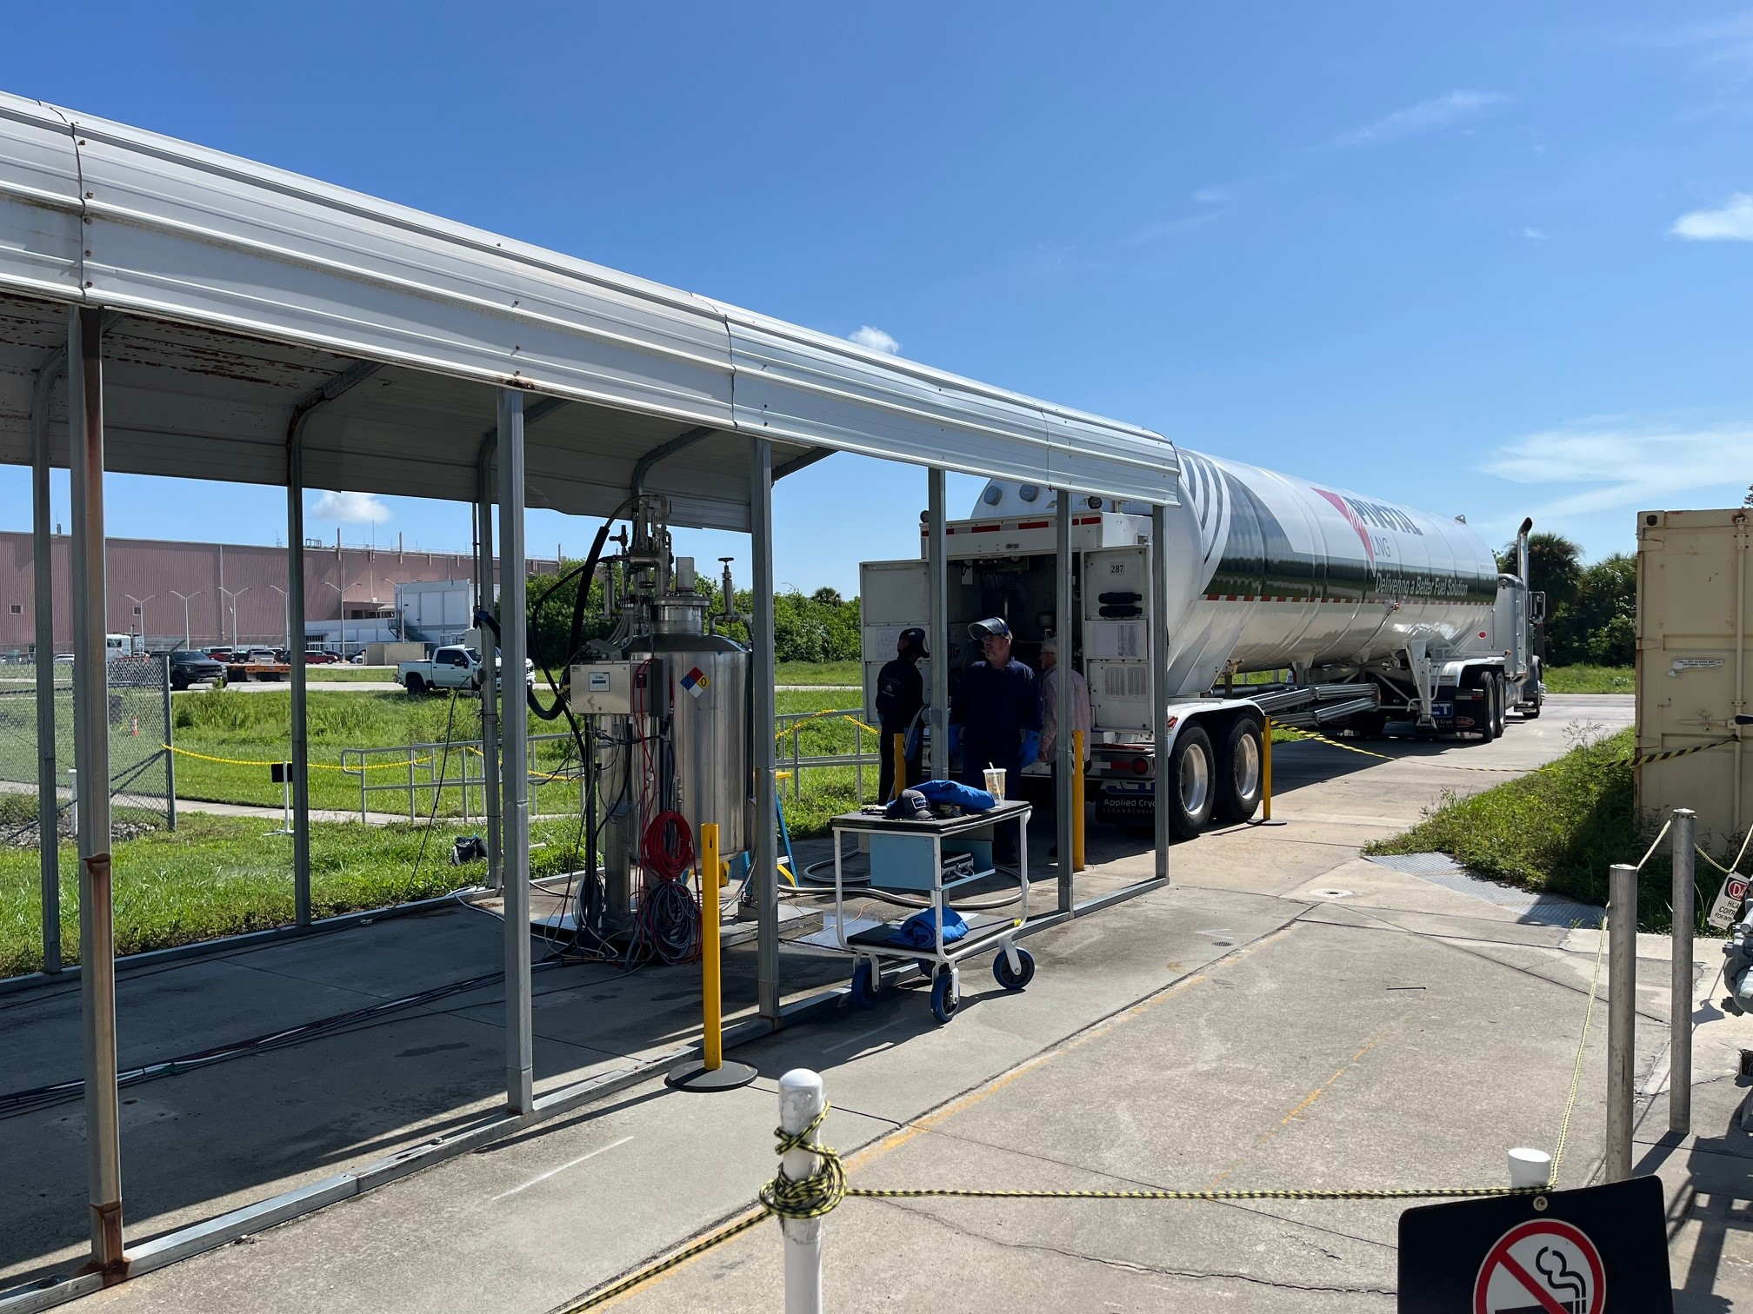
LNG Testbed — phase 2
8
Two more LNG weathering tests conducted in 2024-2025
LNG provided by Pivotal LNG out of
Jacksonville, Florida
Constituent | Tanker #1 | Tanker #2
Methane | 96.058% | 96.874%
Ethane | 3.772% | 2.723%
Propane | 0.170% | 0.176%
Isobutane | 0% | 0.030%
Nitrogen | 0% | 0.197%
Total | 100% | 100%
System outperformed expectations!
  Virtually flawless data collection
  100% automated sampling every 30 min
  Boths tests ran for roughly 46 days
Image: NASA

Slide 9
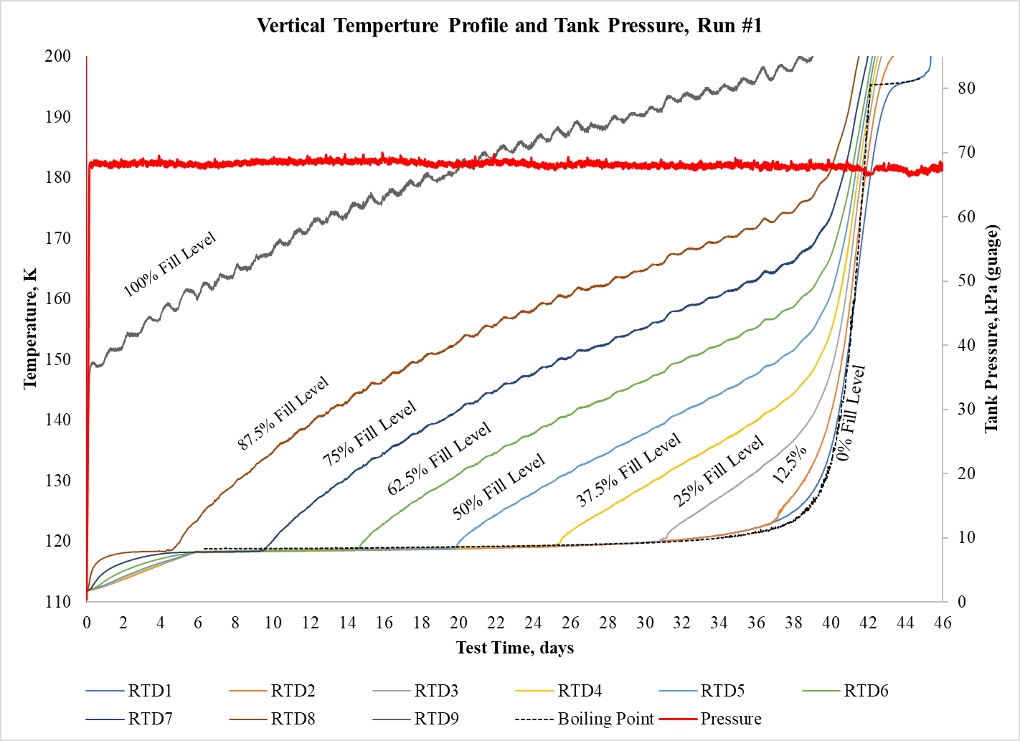
LNG Testbed — phase 2 Results
9
Tank pressure control to ±1.45 kPa on average for both test runs
Minimal thermal stratification in the liquid
Subcooled for first ~6 days due to prechilling tank with liquid nitrogen before LNG offload
Image: NASA

Slide 10
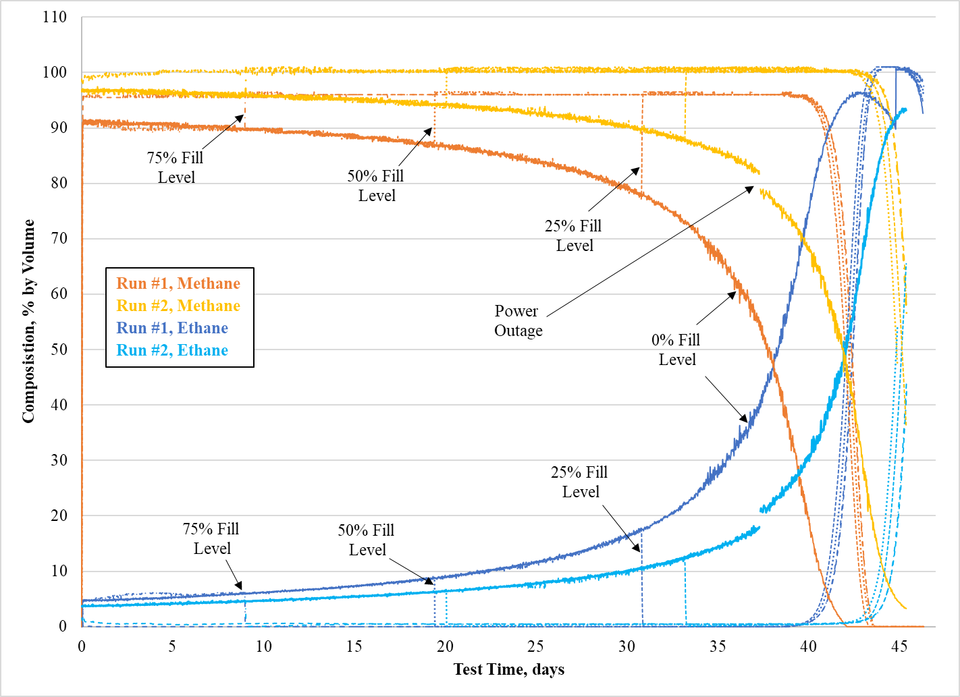
LNG Testbed — phase 2 Results
10
Weathering is nonlinear
Boiloff gas is ~100% methane for most of the test
  Not 100% for Run #1 due to gas analyzer calibration
  Re-zeroed for Run #2
Abrupt methane-to-ethane boiloff transition late in the process
Run #2 took ~6 days longer to completely boiloff
Image: NASA

Slide 11
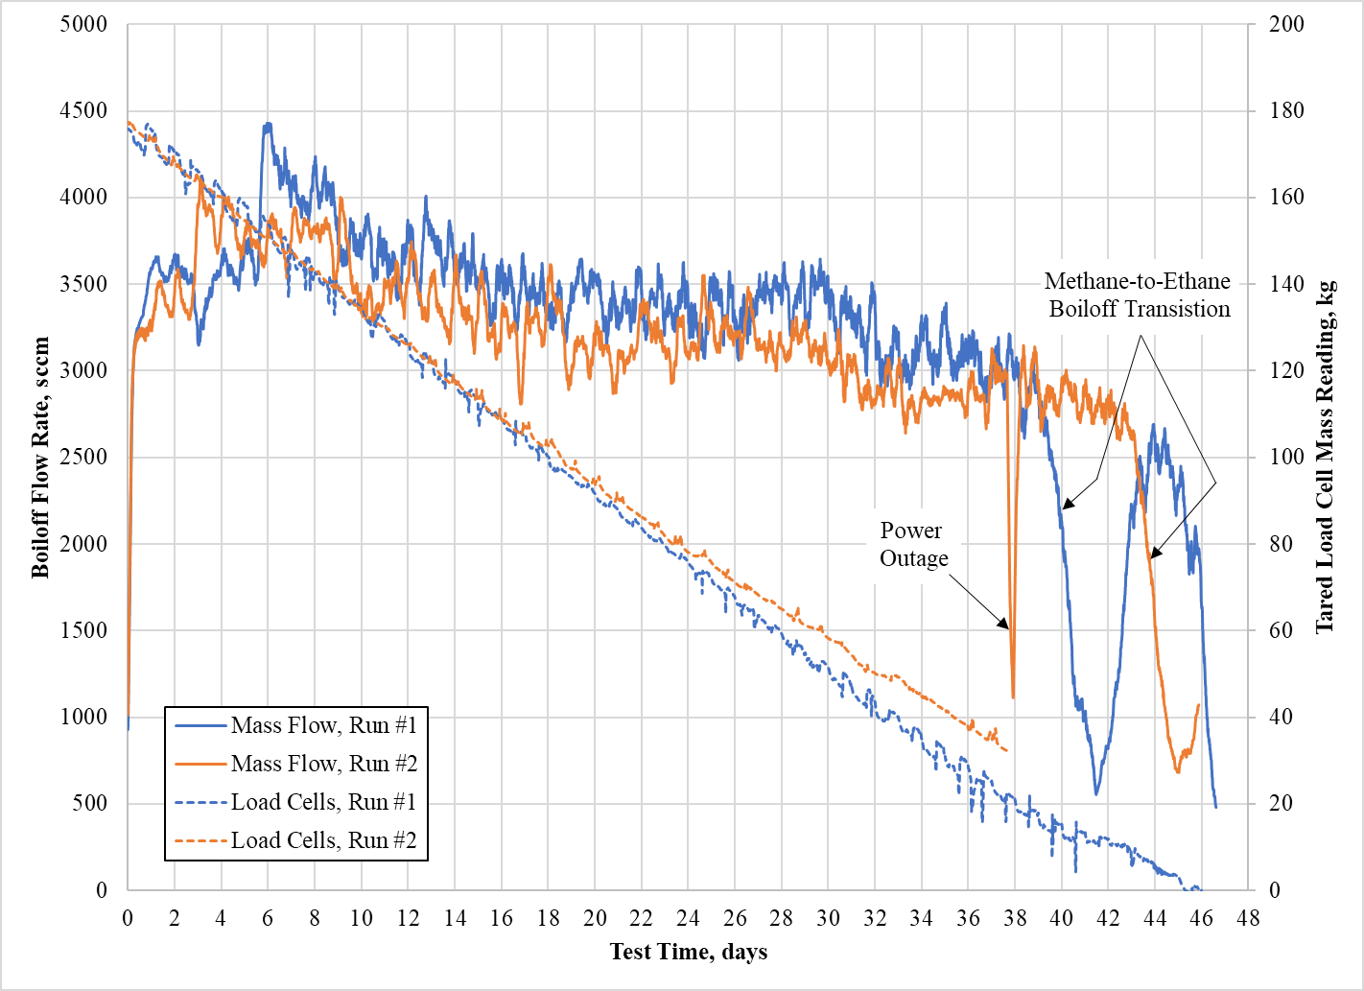
LNG Testbed — phase 2 Results
11
Run #2 boiloff reduction likely due to lower ambient temperature in the winter months
Average heat load on the system = 22.1 ± 2 W across all tests
Boiloff drops dramatically following methane-to-ethane boiloff transition, and then recovers
Image: NASA

Slide 12
Current status & forward work
12
System currently in a stand-by configuration, awaiting further funding
Plans are being prepared for additional testing, with a focus on three primary goals:
  Zero boiloff (ZBO) testing using the cryocooler
  Weathering with LNG refills at partial fill levels
  Weathering with refills following LNG flows out of the tank.
Image: NASA

Slide 13
13
THANK YOU FOR YOUR ATTENTION!
QUESTIONS?

