Slide 1
Comparison of liquid hydrogen tank performance at different storage pressures and operational scenarios using a reduced-order model
C1Or4C-02
Kyle Appel, Professor Jacob Leachman, Professor Konstantin Matveev
Cryogenic Engineering Conference
Reno, Nevada
May 19th, 2025
Storage Background
Liquid Hydrogen Modeling
Model Validation
Parametric Analysis

Slide 2

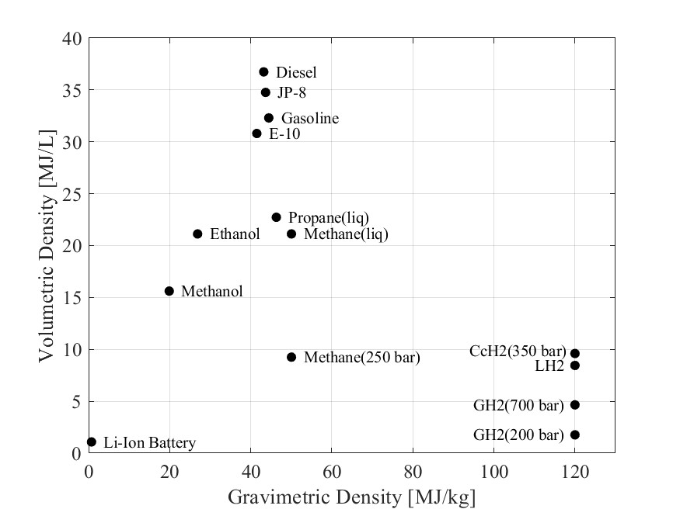

Hydrogen, The Universal Currency
Hydrogen is the most abundant atom in the universe.
  92% of all atoms
  62% of the atoms in the average human body
1 kg expands to occupy 12 m³ at room temperature and ambient pressure.
Primary hydrogen storage methods for increased density:
  High-pressure gas (H35, H70)
  Liquid (LH2, SLH2)
  Cryo-compression (CcH2)
Storage methods are compared via volumetric and gravimetric energy.
Volumetric Energy [MJ/L]
Gravimetric Energy [MJ/kg]
LH2 is a prime subject for bulk hydrogen storage, but daily system losses can exceed 3%.
Investigation of storage tank configurations and internal conditions via reduced-order models is important in reducing boil-off losses.
[1] “Abundance of the chemical elements.” https://en.wikipedia.org/wiki/Abundance_of_the_chemical_elements
[2] “Composition of the human body.” https://en.wikipedia.org/wiki/Composition_of_the_human_body
Notes:
Hydrogen storage discussions and comparison, conclusion of liquid hydrogen due to convenience and distribution. Losses and how to start understanding the losses

Slide 3



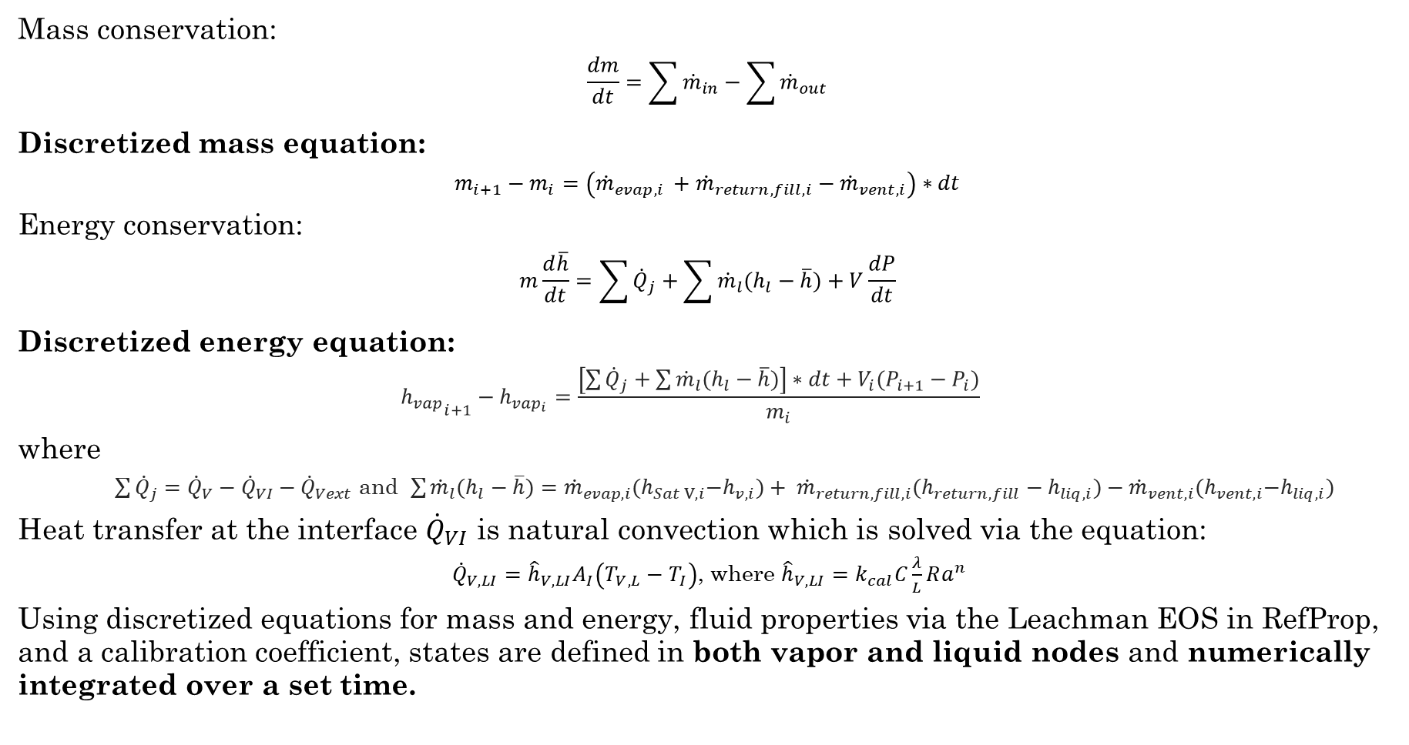








Vapor Node Discretization
$${\dot{Q}}_{V}$$
$$Vent Tube$$
$${\dot{m}}_{return,fill}$$
Mass conservation:
$$\frac{dm}{dt}=\sum{{\dot{m}}_{in}}−\sum{{\dot{m}}_{out}}$$
Discretized mass equation:
$$m_{i+1}−m_{i}=\left({\dot{m}}_{evap, i }+{\dot{m}}_{return,fill,i}−{\dot{m}}_{vent,i}\right)∗dt$$
Energy conservation:
$$m\frac{d\overline{h}}{dt}=\sum{{\dot{Q}}_{j}}+\sum{{\dot{m}}_{l}(h_{l}−\overline{h})}+V\frac{dP}{dt}$$
Discretized energy equation:
  $${h_{vap}}_{i+1}−h_{{vap}_{i}}=\frac{\left[\sum{{\dot{Q}}_{j}}+\sum{{\dot{m}}_{l}(h_{l}−\overline{h})}\right]∗dt+V_{i}(P_{i+1}−P_{i})}{m_{i}}$$
where
  $\sum{{\dot{Q}}_{j}}={\dot{Q}}_{V}−{\dot{Q}}_{VI}−{\dot{Q}}_{Vext}$ and $\sum{{\dot{m}}_{l}(h_{l}−\overline{h})}={\dot{m}}_{evap,i}{(h}_{Sat V,i}−h_{v,i})+ {\dot{m}}_{return,fill,i}(h_{return,fill}−h_{liq,i})−{\dot{m}}_{vent,i}{(h}_{vent,i}−h_{liq,i})$
Heat transfer at the interface ${\dot{Q}}_{VI}$ is natural convection which is solved via the equation:
${\dot{Q}}_{V,LI}={\hat{h}}_{V,LI}A_{I}\left(T_{V,L}−T_{I}\right)$, where ${\hat{h}}_{V,LI}=k_{cal}C\frac{λ}{L}Ra^{n}$
Using discretized equations for mass and energy, fluid properties via the Leachman EOS in RefProp, and a calibration coefficient, states are defined in both vapor and liquid nodes and numerically integrated over a set time.
$${\dot{Q}}_{Vext}$$
$$Vapor$$
$${\dot{m}}_{vent}$$
$${\dot{Q}}_{VI}$$
$$Interface$$
$${\dot{m}}_{evap}$$
$$Liquid$$
Notes:
NTEMs use discretized mass and energy equations to solve for hydrogen properties. The specific enthalpy form of the energy equation is shown, calculating the enthalpy in the next time step. These equations and other correlations are implemented in MATLAB. The model is verified that it doesn’t create mass or energy, so validation can begin.

Slide 4
Model Validation
Validation of the model with experimental data sets.

Slide 5
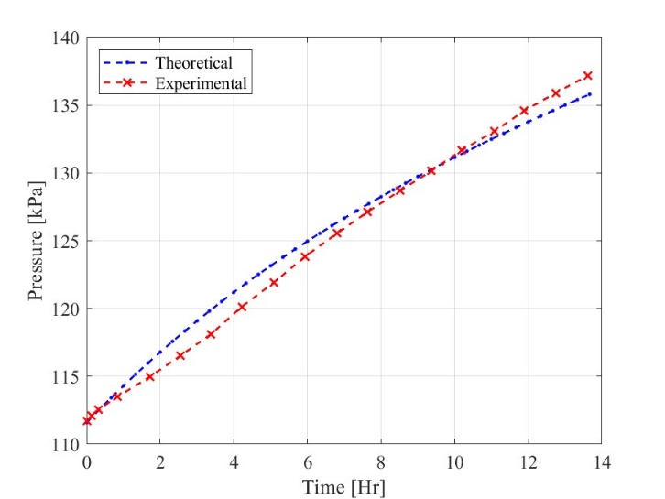

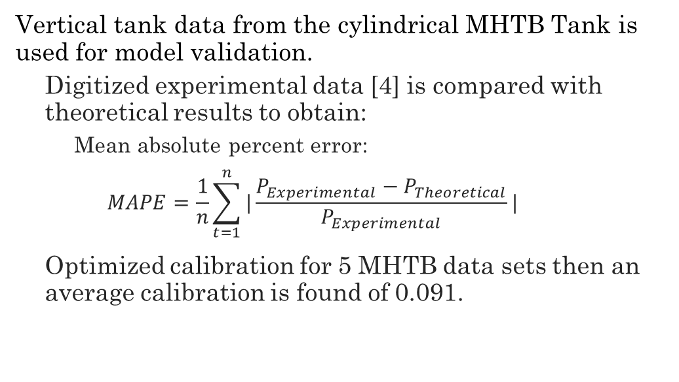




Multi-Purpose Hydrogen Test Bed Validation
$${\dot{Q}}_{V}$$
Vertical tank data from the cylindrical MHTB Tank is used for model validation.
  Digitized experimental data [4] is compared with theoretical results to obtain:
    Mean absolute percent error:
    $$MAPE=\frac{1}{n}\sum_{t=1}^{n}{|\frac{P_{Experimental}−P_{Theoretical}}{P_{Experimental}}|}$$
  Optimized calibration for 5 MHTB data sets then an average calibration is found of 0.091.
$$Vapor$$
$${\dot{Q}}_{VI}$$
$${\dot{m}}_{evap}$$
$${\dot{Q}}_{L}$$
$$Liquid$$
Optimal prediction of 50% fill level with
51.8 W total heat leak using calibration coefficient of 0.065.
Fill Level [%] | Heat Leak [W] | Initial Pressure [kPa] | Initial Temperature [K] | Average Calibration Coefficient [-] | MAPE [%]
90% | 54.1 | 113.3 | 20.9 | 0.091 | ±3.23
50% | 51.8 | 111.6 | 24.4 | 0.091 | ±1.64
90% | 20.2 | 111.9 | 22 | 0.091 | ±4.31
50% | 18.8 | 122 | 21.2 | 0.091 | ±1.21
25% | 18.7 | 122 | 21.3 | 0.091 | ±0.62
[4] Hastings LJ, Flachbart RH, Martin JJ, Hedayat A, Fazah M, Lak T, Nguyen H, Bailey JW, Marshall GC. Spray Bar Zero-Gravity Vent System for On-Orbit Liquid Hydrogen Storage. Alabama; 2003.
Notes:
First the model is validated with a vertical cylindrical tank known as the multipurpose hydrogen test bed. Operated by NASA this tank is often used for model validation. Five test cases are used with varied heat leak and fill levels. For each case the optimal calibration coefficient is found be determining the average deviation between the experimental and theoretical pressure curves. An average of the five optimal coefficients is used to evaluate the expected error for the model for future tanks using this calibration.

Slide 6
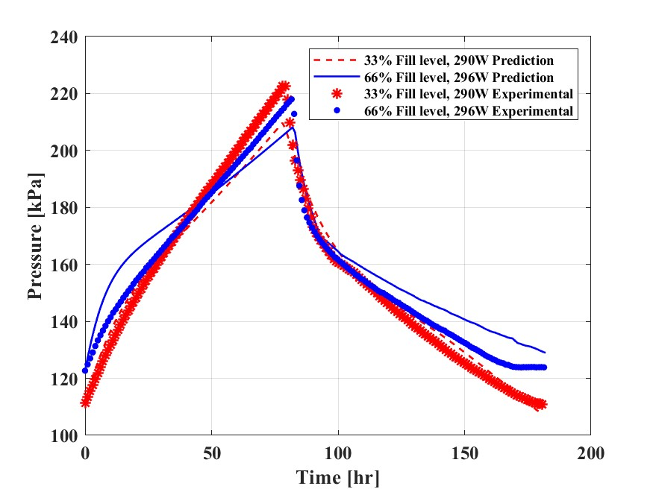









Integrated Refrigeration and Storage System Validation
IRAS test stand experimental data [5] is used for model validation of a horizontal tank.
  Optimized calibration for 2 data sets then an average calibration is found of 0.045.
$${\dot{Q}}_{V}$$
$$Vapor$$
$${\dot{Q}}_{VI}$$
$${\dot{Q}}_{Vext}$$
$${\dot{m}}_{evap}$$
$${\dot{Q}}_{Lext}$$
$$Liquid$$
$${\dot{Q}}_{LI}$$
$${\dot{Q}}_{L}$$
Predictions for IRAS data with average calibration coefficient of 0.045.
Fill Level [-] | Heat Leak Liquid [W] | Heat Leak Gas [W] | Initial Pressure [kPa] | Initial Temperature [K] | Average Calibration Coefficient [-] | MAPE [%]
66% | 196 | 100 | 122.7 | 21.5 | 0.045 | ±3.6
33% | 170 | 120 | 111.4 | 21.5 | 0.045 | ±2.7
[5] Notardonato WU, Swanger AM, Fesmire JE, Jumper KM, Johnson WL, Tomsik TM. Final test results for the ground operations demonstration unit for liquid hydrogen. Cryogenics (Guildf). 2017 Dec 1;88:147–55.
Notes:
Validation is also conducted for a horizontal cylindrical tank using the Integrated Refrigeration and storage system operated by NASA. Two data sets are used to find the optimal calibration coefficient and an average is used to evaluate the expected error in the model for future horizontal tank predictions.

Slide 7
Parametric Analysis
Analysis of boil-off losses with steady state venting due to tank configuration and conditions.

Slide 8
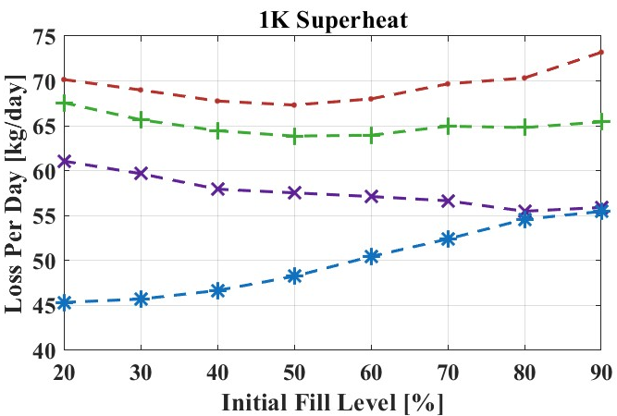
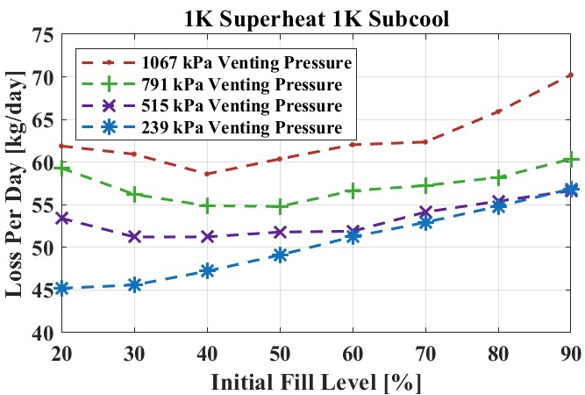
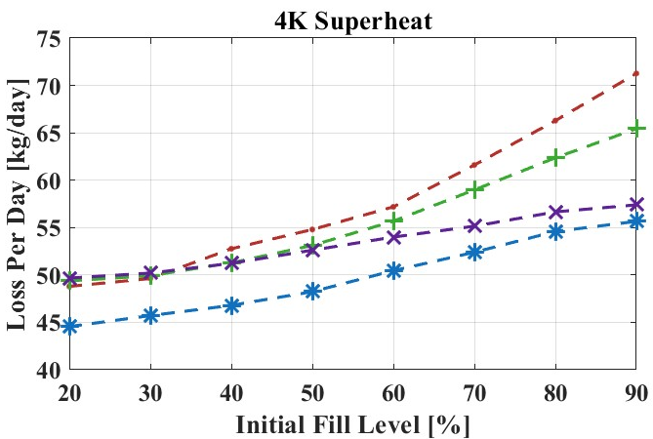
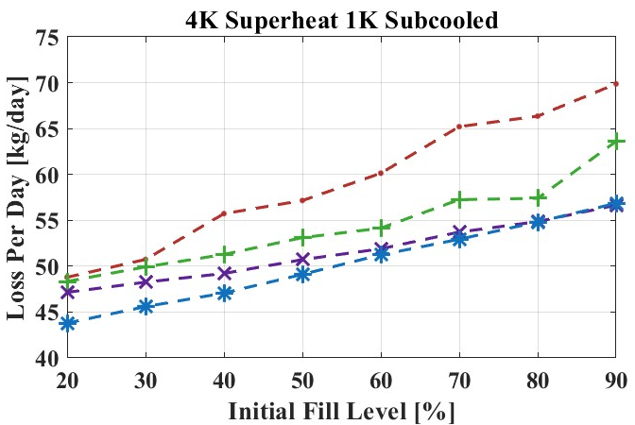
Horizontal Tank Venting Losses
Steady state venting for four venting pressures is investigated with varied tank fill levels and initial hydrogen conditions for a horizontal tank.
After steady state venting is achieved one full venting cycle is used as an average.
Subcooling the liquid effectively reduces the losses for higher pressure tanks.
Superheating of the vapor results in lower losses. The increased temperature results in lower density and higher enthalpy hydrogen venting.
For low fill levels, losses are reduced by subcooling the liquid or increasing the vapor temperature.
Notes:
A parametric study is conducted investigating the steady state average daily losses for horizontal tanks with varied initial pressures and temperatures. Comparing the first two plots shows that subcooling the liquid decreases losses for all pressures except 239 kpa.

Slide 9
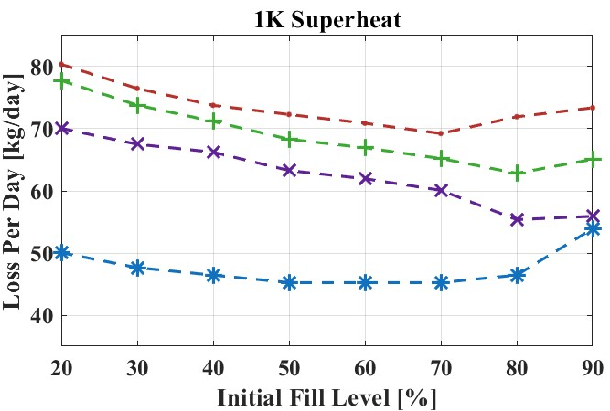
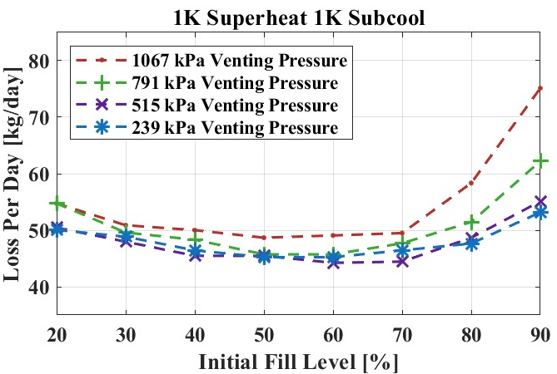
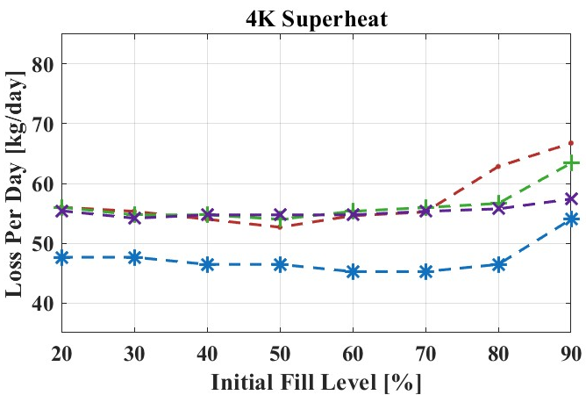
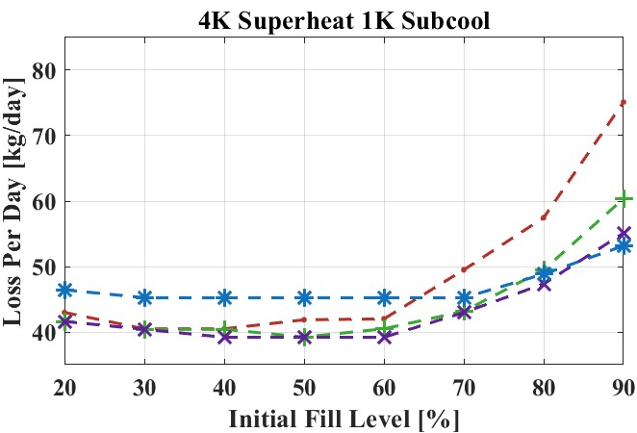
Vertical Tank Venting Losses
Steady state venting for four venting pressures is investigated with varied tank fill levels and initial hydrogen conditions for a vertical tank.
The effects of initial conditions in the tank tend to last into higher fill levels compared to the horizontal tank.
Vertical
Horizontal
The effect of subcooling lasts into higher fill levels than in horizontal tanks due to the smaller interface area.
The rate of change for the venting loss increases at higher fill levels compared to the horizontal tank.
Average daily losses are lower when the liquid is subcooled, higher when the vapor is 1 K superheated, and similar when the vapor is 4 K superheated.

Slide 10
Conclusions
A reduced-order model has been developed to predict boil-off losses from liquid hydrogen storage tanks.
Using the model, parametric studies can predict the expected boil-off losses due to changes to storage systems and conditions.
In this work, the model was used to predict the effect of storage pressure with different initial hydrogen conditions on the steady state boil-off losses.
  Horizontal tanks are less susceptible to the effects of initial conditions based on the fill level due to the large interface area between liquid and vapor.
  Vertical tanks display the effects of initial conditions into higher liquid fill levels because of the small interface area.
  In general, for both tanks increasing storage pressure results in greater steady state losses.
  Increasing the vapor temperature is predicted to reduce losses because of the low-density hydrogen being vented.
  Subcooling the liquid also decreases the losses but can increase the losses with high fill levels as the vapor is densified by cooling.
The developed reduced-order model is a powerful tool to predict how tank design changes will affect boil-off losses, even accounting for operational effects.
Notes:
Importance of hydrogen
Two most commonly used tanks
Steady movement

Slide 11
Thank You!
Thank you, Plug Power, for sponsoring the development of the numerical model!
Kyle Appel
kyle.appel@wsu.edu
+1-509-288-9046

Slide 12















Conceptual Model Schematic
A tank is separated into three nodes for the model with associated thermal heat leaks and mass flows crossing the boundary.
Vapor
  Thermal heat leak from the environment into the vapor.
  Thermal heat leak from the vapor to the interface.
  Thermal heat leak extracted from the vapor.
  Mass venting from the vapor.
  Mass evaporating or condensing in the vapor.
  Mass returning to the vapor during liquid extraction.
  Mass filling the vapor.
Liquid
  Thermal heat leak from the environment into the liquid.
  Thermal heat leak from the liquid to the interface.
  Thermal heat leak extracted from the liquid.
  Mass evaporating or condensing in the liquid.
  Mass extracted from the liquid.
  Mass filling the liquid.
$${\dot{Q}}_{V}$$
$$Vent Tube$$
$${\dot{m}}_{return,fill}$$
$${\dot{Q}}_{Vext}$$
$$Vapor$$
$${\dot{m}}_{vent}$$
$${\dot{Q}}_{VI}$$
$${\dot{m}}_{evap}$$
$$Interface$$
$${\dot{m}}_{fill}$$
$${\dot{Q}}_{Lext}$$
$${\dot{Q}}_{LI}$$
$$Liquid$$
$${\dot{m}}_{extract}$$
$${\dot{Q}}_{L}$$
Notes:
For a reduced order model, the tank is broken up into nodes. The vapor and liquid, and the interface between the two fluids. Multiple heat leaks and mass flows cross the node boundary and need to be accounted for in energy and mass conservation equations. For the vapor node of the model heat leaks include the environment, to and from the interface and any extracted heat leak via cooling. Mass that enters or leaves the node is the hydrogen for venting, the mass condensing or evaporating at the interface, the returning mass during liquid extraction, and the mass entering during filling. Thermal heat leaks in to the liquid include that from the environment, the interface and extracted heat. Mass leaves or returns at the interface, leaves during extraction and enters during filling.
Based on the terms of this schematic the conservation of energy and mass equations will make up the backbone of the model.

Slide 13
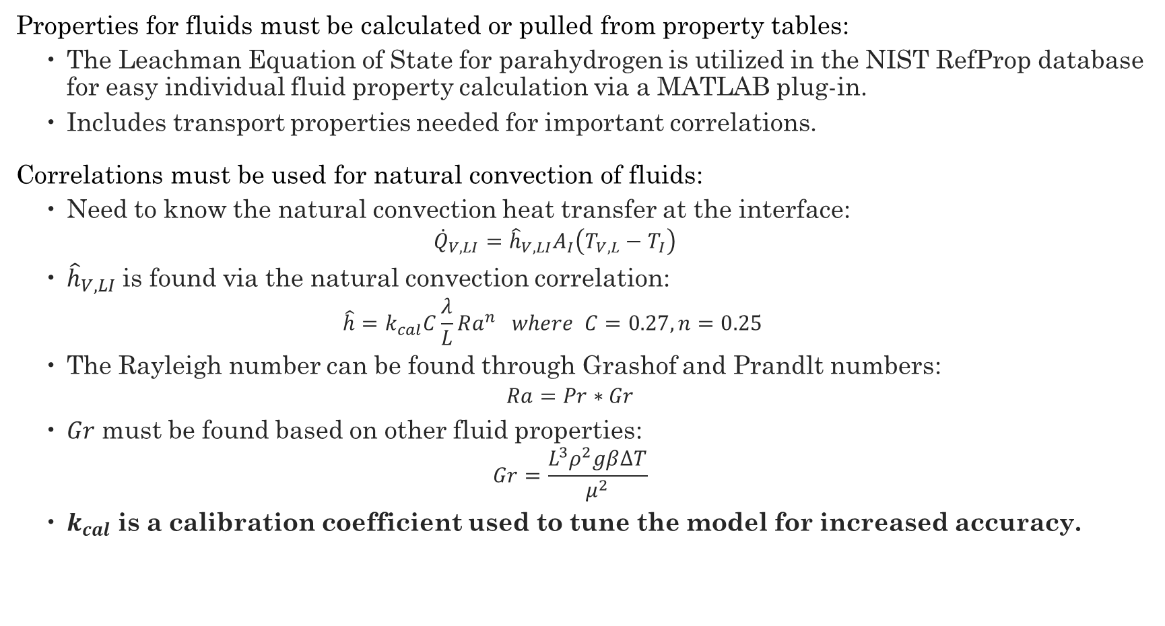
Fluid Properties and Correlations
Properties for fluids must be calculated or pulled from property tables:
  The Leachman Equation of State for parahydrogen is utilized in the NIST RefProp database for easy individual fluid property calculation via a MATLAB plug-in.
  Includes transport properties needed for important correlations.
Correlations must be used for natural convection of fluids:
  Need to know the natural convection heat transfer at the interface:
    $${\dot{Q}}_{V,LI}={\hat{h}}_{V,LI}A_{I}\left(T_{V,L}−T_{I}\right)$$
  ${\hat{h}}_{V,LI}$ is found via the natural convection correlation:
    $$\hat{h}=k_{cal}C\frac{λ}{L}Ra^{n} where C=0.27, n=0.25$$
  The Rayleigh number can be found through Grashof and Prandlt numbers:
  $$Ra=Pr∗Gr$$
  $Gr$ must be found based on other fluid properties:
  $$Gr=\frac{L^{3}ρ^{2}gβ∆T}{μ^{2}}$$
  $k_{cal}$ is a calibration coefficient used to tune the model for increased accuracy.
J. W. Leachman, R. T. Jacobsen, S. G. Penoncello, and E. W. Lemmon, “Fundamental equations of state for parahydrogen, normal hydrogen, and orthohydrogen,” J Phys Chem Ref Data, vol. 38, no. 3, pp. 721–748, 2009, doi: 10.1063/1.3160306.
E. W. Lemmon, I. H. Bell, M. L. Huber, and M. O. McLinden, “NIST Standard Reference Database 23: Reference Fluid Thermodynamic and Transport Properties-REFPROP,” 2018, National Institute of Standards and Technology Standard Reference Data Program, Gaithersburg: 10.0.
M. J. Assael, J.-A. M. Assael, M. L. Huber, R. A. Perkins, and Y. Takata, “Correlation of the Thermal Conductivity of Normal and Parahydrogen from the Triple Point to 1000 K and up to 100 MPa,” 2011.
A. Majumdar, J. Valenzuela, A. Leclair, and J. Moder, “Numerical modeling of self-pressurization and pressure control by a thermodynamic vent system in a cryogenic tank,” Cryogenics (Guildf), vol. 74, pp. 113–122, Mar. 2016, doi: 10.1016/j.cryogenics.2015.12.001.
Notes:
During the model integration properties for both liquid and gas are required so the leachman equation os state is used in the NIST program RefProp which has a convenient plugin in matlab for quick property lookup. Correlations also have to be used for the natural convection in the fluids due to thermal stratification. Using the common equation for convective heat transfer the coefficient must be found using the correlation shown. Where c and n are used ra Is the Rayleigh number and k_cal is a calibration coefficient used to tune the model with experimental data. using these correlations and many lines in matlab the model analyzes the self-pressurization and operations of tanks.
Prandtl measure of momentum diffusivity to thermal diffusivity
Grashoff buoyancy forces vs viscous forces

Slide 14
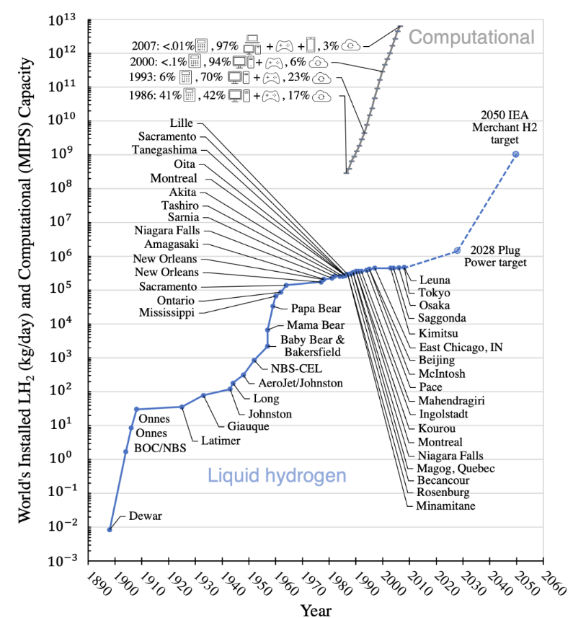
LH2 Storage Losses and Demand
Daily losses are estimated between 0.1%-3% of total mass in an LH2 tank with an average estimate of 1% per day.
Hydrogen production has been increasing and is expected to continue.
With the increase in production, reliably and economically storing large quantities of hydrogen is paramount.
To decrease the overall losses, analysis must be conducted on LH2 tanks and operations.
L. Decker, “Liquid hydrogen distribution technology,” HYPER closing seminar, 2019.
F. Zhang, P. Zhao, M. Niu, and J. Maddy, “The survey of key technologies in hydrogen energy storage,” Sep. 07, 2016, Elsevier Ltd. doi: 10.1016/j.ijhydene.2016.05.293.
C. D. Bunge, “A HIGH-FIDELITY, CONTINUOUS ORTHO-PARAHYDROGEN MEASUREMENT AND CONVERSION SYSTEM,” 2021.
Notes:
Based on the operations of the tanks and heat leak between 7-25% of a load of hydrogen goes unutilized as announced by Plug Power. Around 40 tonnes are distributed and stored by plug power, at 25 % which equates to 10 tonnes unutilized, at 8$ /kg this is around 80000 lost. On the daily loss somewhere between 0.1-3 % of the total mass is lost daily.
With the push for decarbonization of large production sectors the global hydrogen demand is forecast to increase 4-5 $% yearly until 2025 and reach more than 500 million tonnes by 2070.
Due to the large increase in demand effectively storing hydrogen is paramount, and the large loss percent is unacceptable.

