Slide 1


CEC/ICMC 2025
May 21
Experimental research on a highly compact
miniature coaxial pulse tube cryocooler at 80 K
Authors: Zhixiang Yang, Yijing He, Xiaoqin Zhi*, Limin Qiu
Zhejiang University, Hangzhou, P.R. China
Notes:
Dear experts, scholars and professors, I'm a student from Zhejiang University in China. My name is Yang Zhixiang.
The topic I'm going to share today is titled Experimental research on a highly compact
miniature coaxial pulse tube cryocooler at 80 K

Slide 2
CONTENTS
Motivation
1
Experimental setup
2
Results and analysis
3
Summary
4
2
Notes:
There are four parts of content in total.
The first part is Motivation

Slide 3

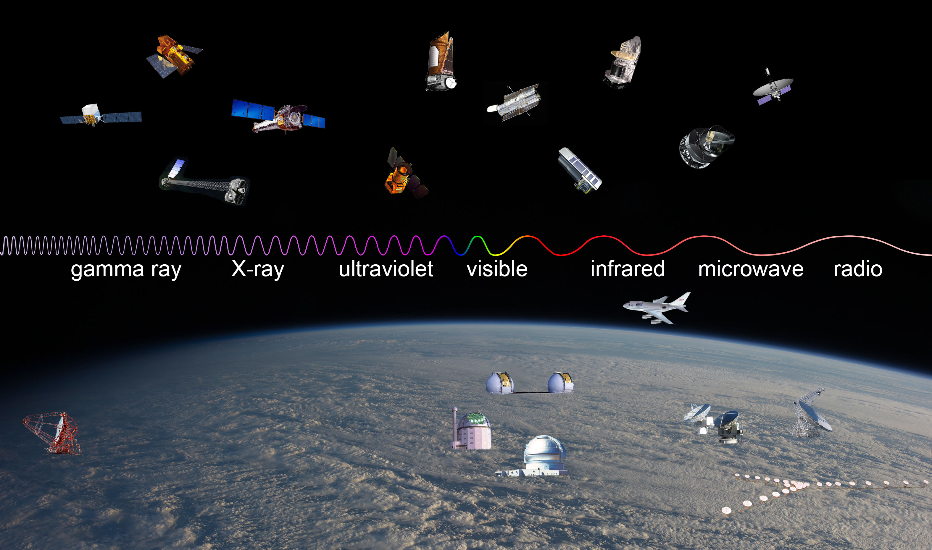
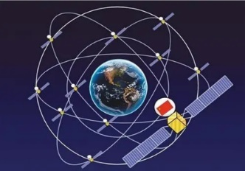


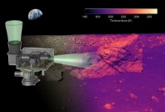
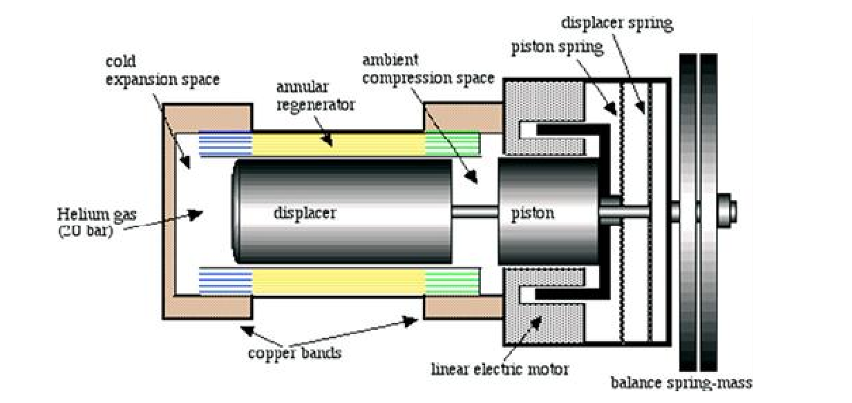
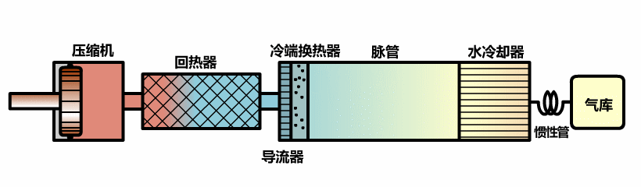


Motivation
Demand for miniature pulse tube cryocoolers
Compact and reliable miniature cryocoolers: l Low temperature superconducting optical, electrical, detection and communication system requires : 77 K~150 K ， ≤ 1 kg
infrared band
infrared detector
HOT MWIR
Small satellite
Individual combat
UAV detection
Weight
Efficiency
Life
Stability
Weight
Efficiency
Life
Stability
Displacer
Stirling cryocooler
Pulse tube cryocooler
Miniature pulse tube cryocoolers: simple in structure, low vibration, long lifespan
3
Notes:
In the field of infrared detection applications, a miniature cryocooler less than 1 kilograms is usually used to improve the sensitivity and resolution of detectors and reduce the thermal noise of the system.
Among them, Stirling cryocoolers and pulse tube cryocoolers are commonly used. The former has mature development and has been widely applied. But due to the displacer in the cold end, it is prone to wear, which affects its performance, resulting in low reliability and a short lifespan. The moving parts also cause relatively large vibrations.
In contrast, since the pulse tube cryocooler has no moving parts at the cold end, it improves these situations. Therefore, it’s a hot refrigeration technology for future military and aerospace applications.
在空间和军事红外探测应用领域中，需要低温工作环境来提高探测器灵敏度和分辨率、以及减小系统本身的热噪声，但由于对可靠性、体积、寿命等方面有严格的要求，特别是在军事应用中为加快设备的反应速度，要求能快速将工作环境降低至低温，因此需要使用到77-150 K 温区的体积小、重量轻（＜1kilograms）、降温快且寿命长的微型低温制冷机来满足移动场景的苛刻冷却需求
其中最常用的就是斯特林制冷机和脉管制冷机，斯特林制冷机发展成熟且已有广泛的应用，但它冷端有排出器，容易磨损，影响性能，使得可靠性和寿命不长，
特别是斯特林制冷机本身振动大，而微型低温制冷机大多应用在移动式场景且被冷却对象也是相应的微小型元件，因此对振动会有着严格的要求。
而脉管制冷机因为冷端无运动部件改善了斯特林制冷机这些情况，并且没有运动部件使得脉管制冷机更易微型化，因此也是未来军事航天应用的热点制冷技术。

Slide 4
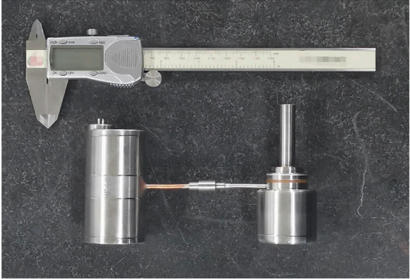
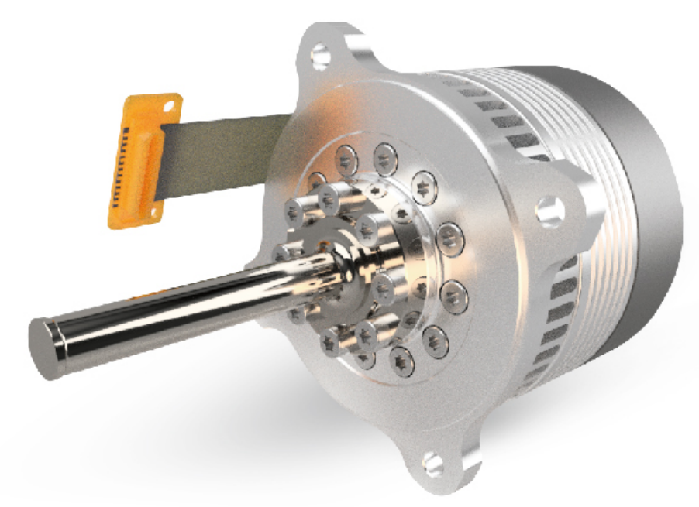
Motivation
Development status of miniature pulse tube cryocoolers
The maximum cooling power is 1.73 W, the highest efficiency is 9.30%, and the maximum cooling capacity per unit mass is 2.22 W/kg It lags behind miniature Stirling cryocooler in efficiency and compactness
Institution | Time | Total weight | Cooling power | Relative Carnot Efficiency | Cooling power per unit mass
NGAS | 2007 | 782 g | 1.1 W at 77 K | 7.89% | 1.41 W/kg
NGAS | 2009 | 857 g | 1.3 W at 77 K | 7.32% | 1.52 W/kg
LM | 2016 | 450 g | 1 W at 80 K | 4.58% | 2.22 W/kg
TIPC,CAS | 2018 | 1 kg | 1.24 W at 80 K | 9.30% | 1.24 W/kg
TIPC,CAS | 2018 | 598 g | 1.2 W at 80 K | 7.33% | 2.01 W/kg
ZJU | 2024 | 0.97 kg | 1.73W at 77K | 7.50% | 1.78 W/kg
NGAS
LM
TIPC
Typical miniature Stirling cryocooler (Lihan-TC3170)
Total weight: 570 g
1.5 W at 77 K
Relative Carnot Efficiency: 11.07%
Cooling power per unit mass: 2.63W/kg
Design a more compact miniature pulse tube cryocooler with higher cooling power.
Carry out experimental research on the influence of operating parameters on performance, which is currently lacking.
4
Notes:
Here, we have listed the parameters of typical miniature pulse tube cryocoolers weighing less than 1 kg in the table. On the left is the miniature Stirling cryocooler of Lihan Cryogenic Technology corporation, and its performance is at a leading level among current miniature Stirling cryocoolers.
Through comparison, we can know about that in the temperature range of 77K to 80K, the maximum cooling power of the miniature pulse tube cryocoolers can reach 1.73W, but the maximum efficiency can only reach 9.30%.
And there is also a lack of compactness, the cooling power per unit mass can only reach 2.22W/kg, that is, less cooling power is provided under the same weight. So, there is still a certain gap in terms of efficiency and compactness compared with the miniature Stirling cryocooler.
Therefore, during the process of developing the miniature pulse tube cryocooler, on the one hand, we need to optimize the refrigeration performance to achieve a larger cooling power, so as to realize higher compactness.
On the other hand, since there is no comprehensive experimental research on the relationship between the operating parameters and its refrigeration characteristics, and in practical applications, the changes of these operating parameters will have a significant impact on the cryocooler, so it’s also important to study this part of the content.
Ultimately, through these studies, we aim to enhance the cooling power and compactness of the miniature pulse tube cryocooler, with the expectation that it can replace the miniature Stirling cryocooler in the future.
表格中列出了小于1kg典型的微型脉管制冷机参数，左边是力函低温科技有限公司的微型斯特林制冷机，它的性能在目前微型斯特林制冷机中处于领先水平。
通过对比可知，在77K到80K这个温区，微型脉管制冷机的最高制冷量可以达到1.73W，但最大效率只能到9.30%。
同时紧凑性也不足，单位质量下的制冷量只能达到2.22W/kg，即在同等重量下的提供的制冷量更少。相比微型斯特林制冷机，在效率和紧凑性方面仍有一定差距。
因此我们在研制微型脉管制冷机的过程中，一方面要通过优化制冷性能来达到更大的制冷量，从而实现更高的紧凑性，另一方面，目前基本还没有针对微型脉管制冷机运行参数与制冷特性关系的综合实验研究，而在实际应用中，这些运行参数的变化又会对制冷机产生明显影响，所以研究这部分的内容也是非常重要的。
最终我们也是想通过这些研究来提高微型脉管制冷机的制冷量和紧凑性，以期在未来能够替代微型斯特林制冷机。

Slide 5
Experimental setup
2
Notes:
The second part is Experimental setup

Slide 6
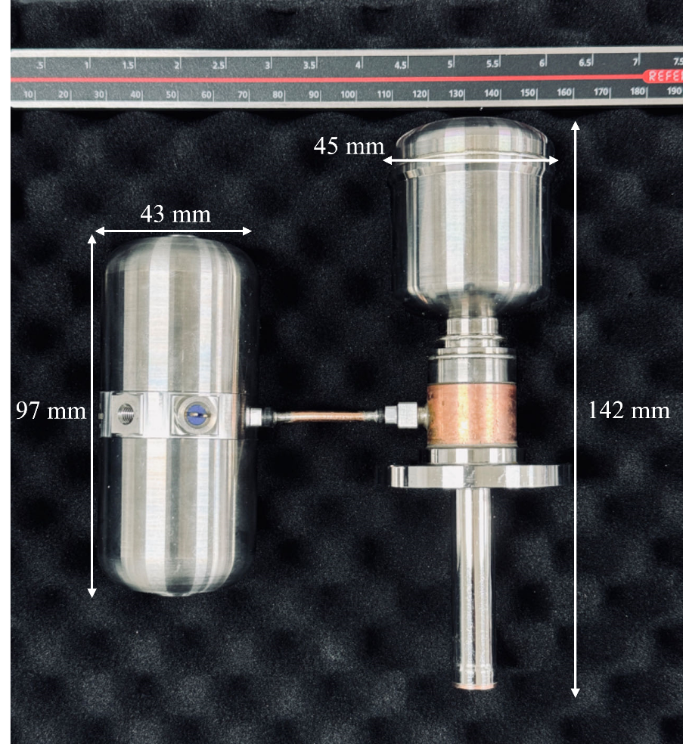
Experimental setup
PTC structure and parameters
Item | Values
Compressor
Piston diameter | 11 mm
Piston Stroke | ±4 mm
Regenerator
Length | 46 mm
Outer diameter | 11.5 mm
Inner diameter | 5.5 mm
Regenerative filler | SS 304, #400
Pulse tube
Length | 56 mm
Inner diameter | 5.5 mm
Inertance tube
Length | 1415 mm
Inner diameter | 2 mm
Reservoir | 50 cm³
Leaf spring compressor + Coaxial cold finger
Fig. 1 Experimental prototype of the cryocooler
Total weight | Compressor | Cold finger
0.91 kg | 625 g | 277 g
6
6
Notes:
The figure shows the experimental prototype of the miniature pulse tube cryocooler. The total weight is 0.91 kg, including 625 g miniature compressor, 8 g connecting tube and 277 g cold finger assembly.
The cold finger assembly has a length of 142 mm and a diameter of 45 mm, and the compressor has a length of 97 mm and a diameter of 43 mm.
The micro compressor is of the moving magnet linear type, featuring a dual-piston opposed configuration with pistons supported by leaf springs, while the cold finger utilizes a coaxial structure. And the inertance tube is coiled and integrated in the gas reservoir for a compact structure.
Through Sage modeling and a series of experimental tests, the design parameters determined by optimization calculation are shown in the table.
左图是微型脉管制冷机的实验样机，总重量为0.91 kg，包括625 g微型压缩机，8 g连接管和277 g冷指组件。冷指组件长度142毫米，直径45毫米，压缩机长度97毫米，直径43毫米。微型压缩机为动磁直线型。采用双活塞对置配置，活塞由板弹簧支撑，而冷指采用同轴结构，惰性管盘绕集成在储气罐中，结构紧凑。通过Sage建模和一系列实验测试，优化计算确定的设计参数如右表所示。

Slide 7
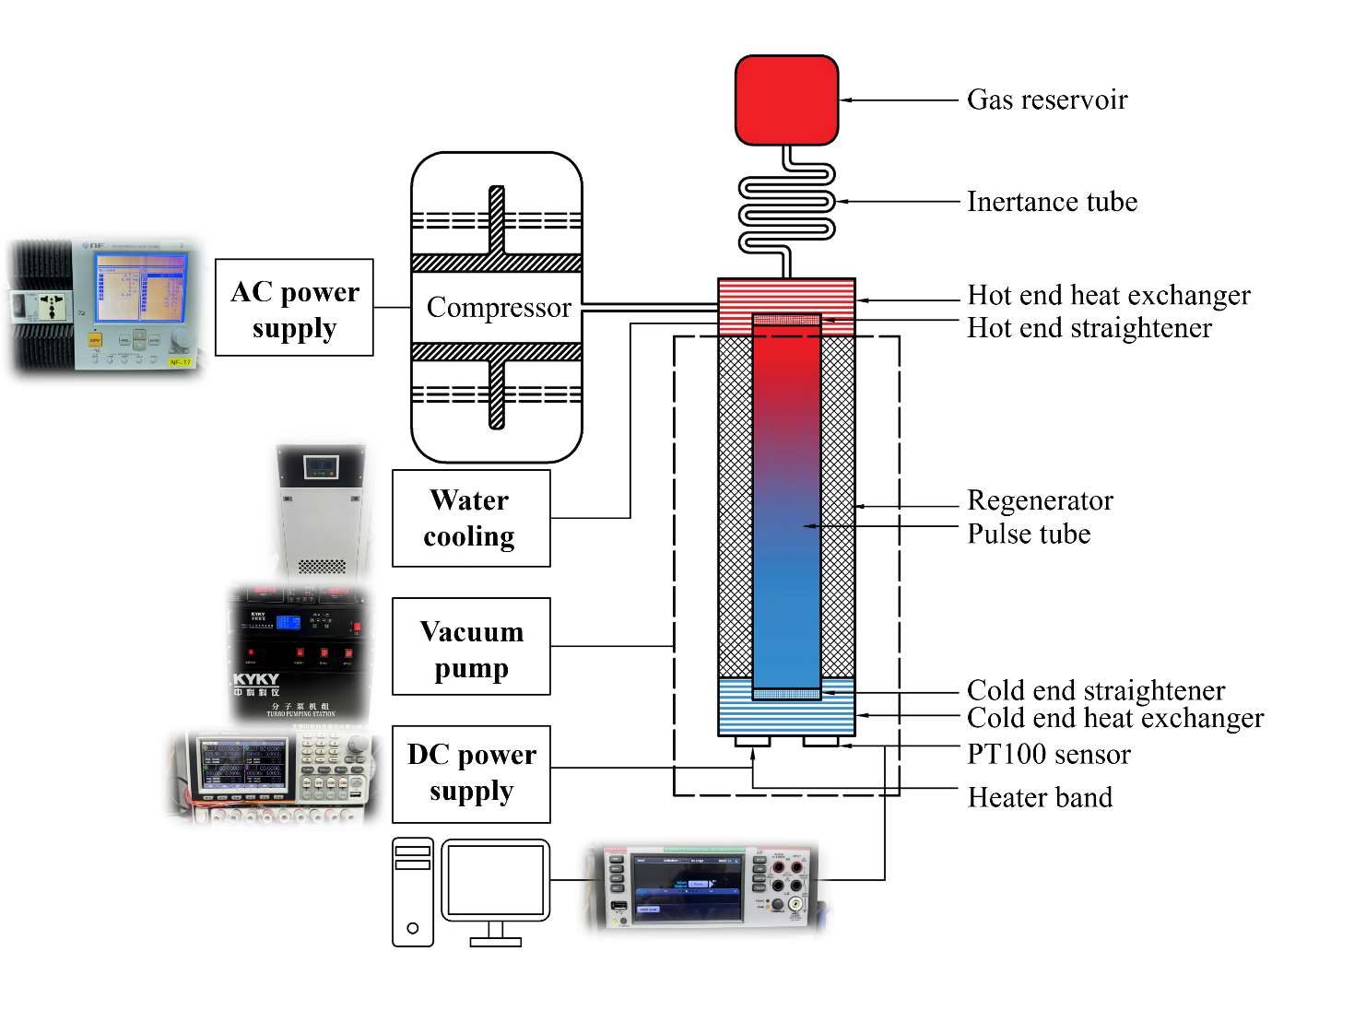
Experimental setup
Experimental system
Operating Condition | Value Range
Charging pressure | 3 ~ 4 MPa
Operating Frequency | 110 ~ 120 Hz
Ambient Temperature | 283 ~ 303 K
Input Power | 0 ~ 74 W
Fig. 2 The schematic diagram of the experimental system
6
7
Notes:
This figure shows the experimental system, which mainly includes the cryocooler, power supply system, temperature acquisition system, vacuum pump system and water-cooling unit.
The power system includes both AC power supply and DC power supply. The compressor is driven by the AC power supply. The cooling power is measured using the thermal equilibrium method, where a heating resistor is tightly attached to the end surface of the cold end. The resistance of the heater is 115 Ω. The heating power is controlled by adjusting the input voltage of the DC power supply.
The system employs Pt100 sensor with an accuracy of 0.1 K to measure the cold end temperature. The vacuum pump system is mainly used to maintain vacuum environment around the cold finger, reducing heat losses between the cold finger and the surrounding environment.
Additionally, during experiments, the cold finger is wrapped with multiple layers of insulation material to further minimize heat losses.
The water-cooling unit can create constant-temperature water bath for the hot end heat exchanger.
The charging pressure of the experiment is within the range of 3 MPa to 4 MPa, the operating frequency is within the range of 110 Hz to 120 Hz, the hot end temperature can vary between 283K and 303K, and the maximum input power of the compressor can reach 74W.
微型脉管制冷机实验系统如图所示，主要包括制冷机、供电系统、温度采集系统、真空泵系统和水冷却装置。
压缩机由交流电源驱动。冷却功率（Qc）使用热平衡法测量，加热器的电阻为115 Ω，加热功率通过调节直流电源的输入电压来控制。采用精度为0.1 K的Pt100铂电阻传感器测量冷端温度（Tc）。真空泵系统主要用于保持冷手指周围的真空环境，减少冷手指与周围环境之间的热损失。此外，在实验过程中，冷手指被多层绝缘材料包裹，以进一步减少热量损失。水冷机组为热端换热器创造恒温水浴。
实验的充气压力在3MPa到4MPa范围内，运行频率在110到120Hz范围内，热端温度可以在283K到303K之间变化，压缩机的最大输入功可达74W.

Slide 8
Results and analysis
3
Notes:
The third part mainly introduces the progress of the experiment.

Slide 9
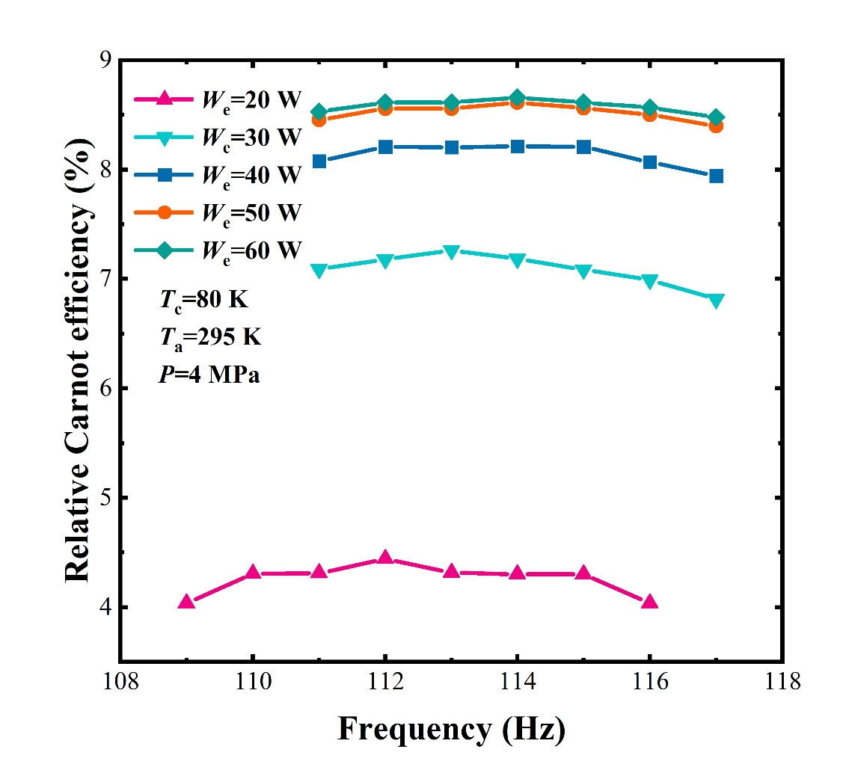
Results and analysis
The influence of the input power
The relationship between the operating frequency and the refrigeration performance
Within 111 Hz to 116 Hz, the efficiency variation is within 5%.
As the input power increases, the amplitude of the efficiency change within this range also further reduces.
when the input power increases from 20 W to 60 W, the optimum frequency only slightly increases from 112 Hz to 114 Hz.
114 Hz, 8.66%
114 Hz, 8.61%
114 Hz, 8.21%
113 Hz, 7.26%
112 Hz, 4.44%
The efficiency remains basically constant at 111–116 Hz across input powers, with smaller fluctuations at higher powers and minimal effect on the optimal frequency.
6
9
Notes:
During the operation of the cryocooler, the cooling power is usually controlled by adjusting the input power. Therefore, the relationship between the relative Carnot efficiency and the frequency under different input powers is studied here first.
The figure shows, under different input powers, the efficiency initially increases with the change of frequency and then decreases.
Within the range of 111 Hz to 116 Hz, the variation of efficiency is within 5%. Moreover, as the input power increases, the variation range of the efficiency further decreases.
All these indicate that within this frequency range, the change of frequency has little effect on the refrigeration performance, and the efficiency remains basically unchanged.
Additionally, when the input power increases from 20 watts to 60 watts, the optimal frequency only increases slightly from 112 Hz to 114 Hz, indicating that the change in input power hardly affects the optimal frequency either.
在制冷机的运行过程中，通常是通过调整输入功来控制制冷量，因此这里首先研究了在不同输入功下，相对卡诺效率与频率之间的关系。
图中表明，在不同的输入功率下，相对卡诺效率起初会随着频率的变化而上升，随后又会下降。然而，在 111赫兹至 116 赫兹的范围内，效率的变化幅度在 5%以内。并且随着输入功率的增加，相对卡诺效率的变化幅度还会进一步减小。这些均表明在111Hz到116Hz范围内，频率的变化对制冷性能几乎没有影响，效率基本不变。
此外，当输入功率从 20 瓦增加到60 瓦时，最佳频率仅从112赫兹略微增加到 114 赫兹，表明输入功的变化也几乎不会影响最佳频率。

Slide 10
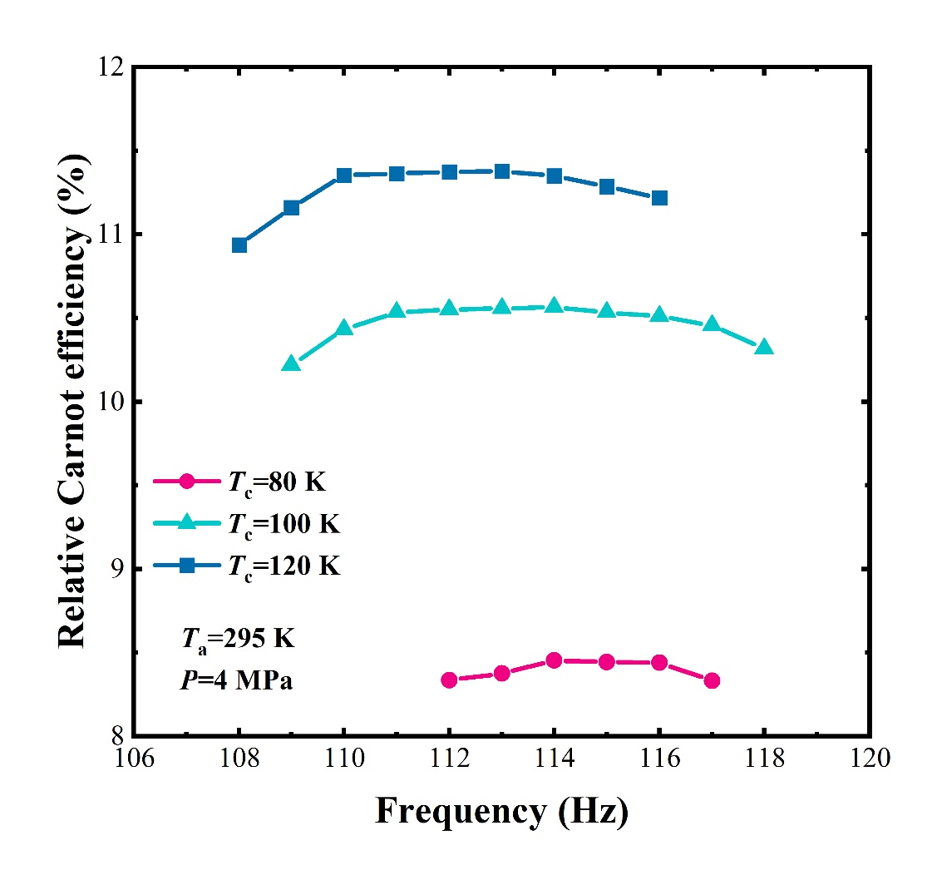
Results and analysis
The influence of the input power
The relationship between efficiency and frequency under different refrigeration temperatures
112 Hz, 11.38%
Under different refrigeration temperatures, a frequency range can also be found where the efficiency remains basically constant. Only when it deviates from this range will the efficiency drop significantly.
113 Hz, 10.56%
114 Hz, 8.45%
If the input power or the refrigeration temperature is slightly adjusted, the optimal frequency usually does not need to be changed.
6
10
Notes:
Since the cryocooler often shows different characteristics at different refrigeration temperatures, the relationship between the efficiency and the frequency under different refrigeration temperatures has also been studied.
As shown in the figure, even when the refrigeration temperature varies between 80K, 100K and 120K, the efficiency of this cryocooler can remain basically constant within a certain frequency range. Only when the frequency deviates from this range will the performance drop significantly, which is consistent with the previous conclusion.
These two figures indicate that within a certain frequency range, the efficiency is not sensitive to frequency changes. In practical applications, If the input power or the refrigeration temperature is slightly adjusted, the optimal frequency usually does not need to be changed.
由于制冷机在不同的制冷温度下往往会表现出不同的特性，因此还研究了在不同制冷温度下效率与频率之间的关系。
如图所示，即使在制冷温度为 80 K、100K和 120K时，该微型脉管制冷机的效率仍能一定频率范围内保持基本不变，只有当频率偏离此范围时，性能才会显著下降，这与之前的结论一致。
这两张图的现象表明，在一定频率范围内，该微型脉管制冷机的效率对频率变化并不敏感，在实际应用中，如果适当调整输入功率以改变冷却负荷，或者略微调整制冷温度，那么最佳频率通常就不需要改变。

Slide 11
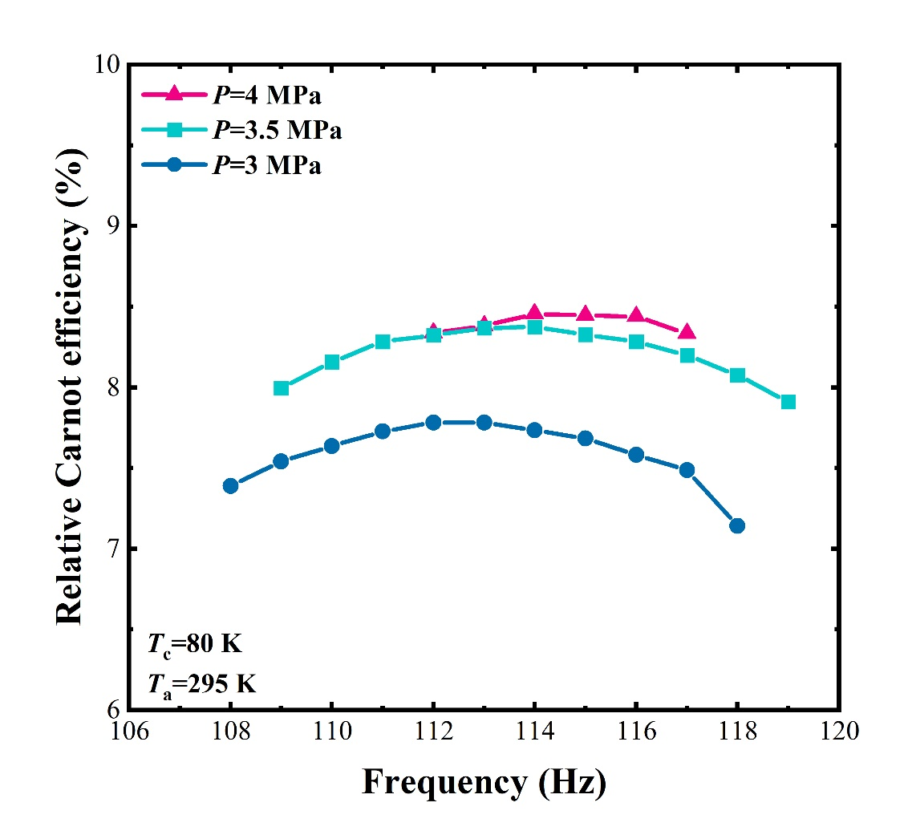
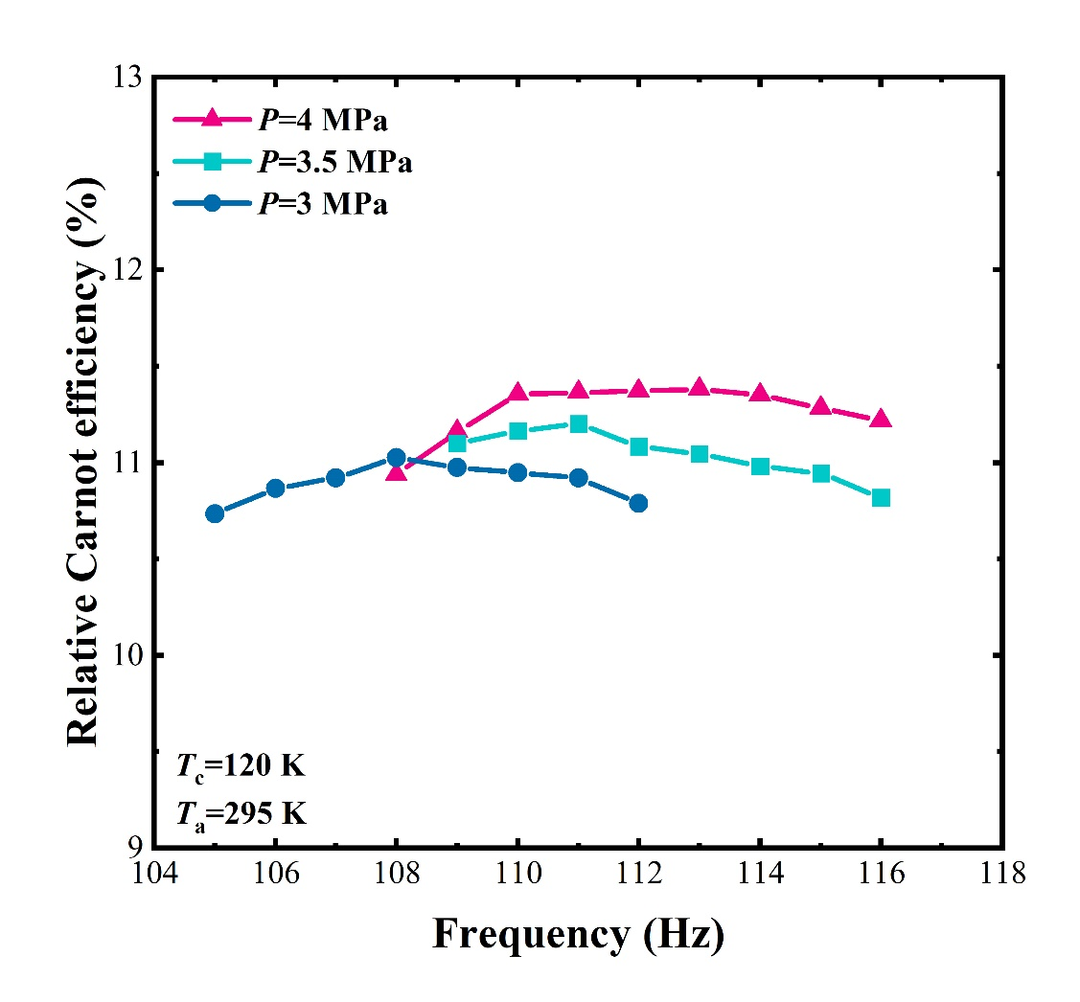
Results and analysis
The influence of the charging pressure
The relationship of relative Carnot efficiency with frequency across charging pressures
114 Hz, 8.45%
113 Hz, 11.38%
0.67%
0.36%
108 Hz, 11.02%
112 Hz, 7.78%
The charging pressure varies between 3 MPa and 4 MPa, the efficiency remains basically constant within a certain frequency range.
Increasing the charging pressure is conducive to improving the efficiency. The lower the cold end temperature, the more remarkable the improvement in efficiency.
6
11
Notes:
Then, we studied the influence of the charging pressure.
The figures show the relationship between the relative Carnot efficiency and the frequency under different charging pressures when the refrigeration temperatures are 80 K and 120 K respectively.
As can be seen, even when the charging pressure varies between 3 MPa and 4 MPa, the efficiency can remain basically constant within a certain frequency range, which is consistent with the previous conclusion.
And the optimal frequency will increase with the increase of the charging pressure. This is because simply increasing the frequency will lead to an increase in the losses of the regenerator. Therefore, while increasing the frequency, it’s necessary to improve the refrigeration efficiency by increasing the charging pressure.
Additionally, the figures also show that increasing the charging pressure from 3 MPa to 4 MPa helps to improve the efficiency. When the cold end temperature is 120 K, the efficiency increases by 0.36%, and when the temperature drops to 80 K, the efficiency increases by 0.67%, resulting in a more significant improvement in performance.
在第二部分，我们研究了充气压力的影响。
图中显示了当制冷温度分别为80 K和120 K时，在不同充气压力下相对卡诺效率与频率的关系。
从图可知，即使充气压力在3 MPa到4 MPa之间变化，该制冷机的效率仍能在一个频率范围内保持基本不变，这与前面的结论保持一致。
而最佳频率会随着充气压力的增加而提高，这是因为单纯提高频率会导致回热器损失增加。因此，在提高频率的同时，有必要通过增加充气压力来提高制冷效率。
此外，图中还表明，将充气压力从3 MPa提高到4 MPa有助于提高制冷机的效率。当冷端温度为120K时，效率提升0.36%，当冷端温度降低到80K时，效率能提升0.67%，性能的提升效果更为显著。

Slide 12
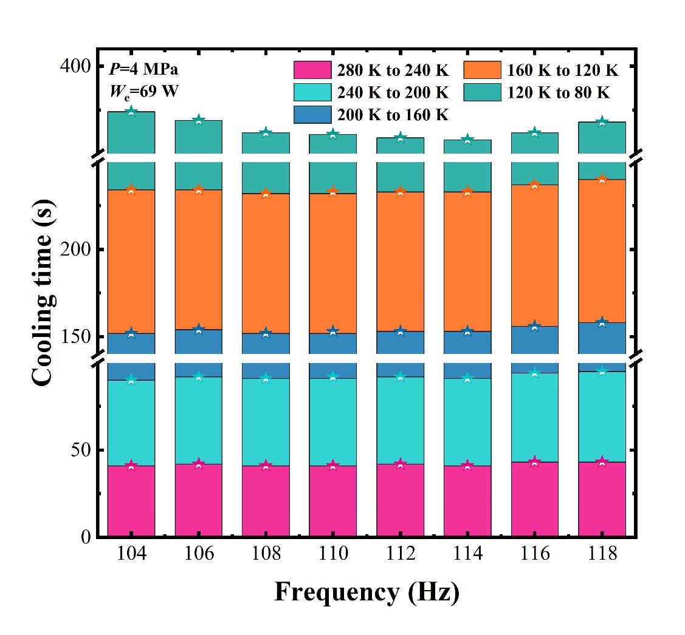
Results and analysis
The influence on the cooling rate
The influence of the operating frequency on the cooling rate
During the process of cooling from 280 K to 120 K, the cooling time remains basically unchanged within 104 - 118 Hz.
During the process of cooling from 120 K to 80 K, when the frequency changes from 104 Hz to 114 Hz, the cooling time will be shortened from 140 s to 125 s.
The cooling rate is related to the refrigeration temperature.
If the refrigeration temperature changes, the decision of whether to adjust the operating frequency can be made according to which stage the refrigeration temperature is in.
6
13
Notes:
For the miniature pulse tube cryocooler, another performance index is the cooling rate.
Therefore, we studied the influence of the change of the operating frequency on the cooling rate. The figure shows the time required for the cold end temperature to drop from 280 K to 80 K with the change of frequency. During the experiment, we manually adjust the input power, and the speed of adjusting the input power each time cannot be guaranteed to be completely consistent. Therefore, to avoid the influence caused by the operation, we do not include the time required to drop from 295 K to 280 K in the analysis.
Here presents the variation relationship between the cooling time and the frequency. We record the time at an interval of 40K.
During the process of cooling from 280 K to 120 K, the cooling time remains basically unchanged within the frequency range of 104 Hz to 118 Hz.
However, during the process of cooling from 120 K to 80 K, when the frequency changes from 104 Hz to 114 Hz, the cooling time will be shortened from 140 s to 125 s. Obviously, the cooling rate of this cryocooler during the cooling process is related to the refrigeration temperature. If the refrigeration temperature changes, the decision of whether to adjust the operating frequency can be made according to which stage the refrigeration temperature is in.
这里给出了制冷机从280 K降至80 K过程中间隔40 K所需时间随频率的变化关系。
从图中可知，降温速度与制冷温度有关。从280 K降至120 K的过程中，降温时间在 104 赫兹至 118 赫兹范围内基本不变。但从120 K降低到80 K的过程中，频率对降温速度影响较大，当频率为104 Hz时，降温时间为140 秒，但当频率变为80 K时的最佳频率 114 Hz 时，降温时间会缩短至125 秒，减少了 15 秒。显然，该制冷机在冷却过程中的降温速率与制冷温度有关。
如果该设备重新启动时制冷温度发生变化，可以根据制冷温度所处的阶段来决定是否调整运行频率。

Slide 13
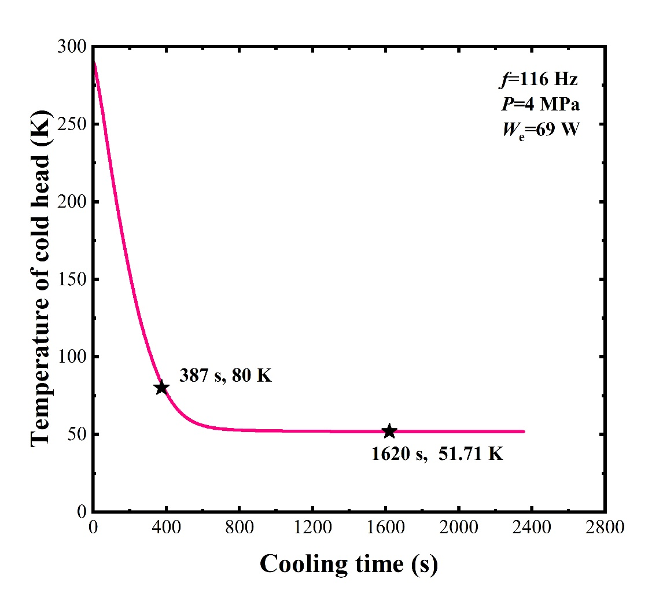
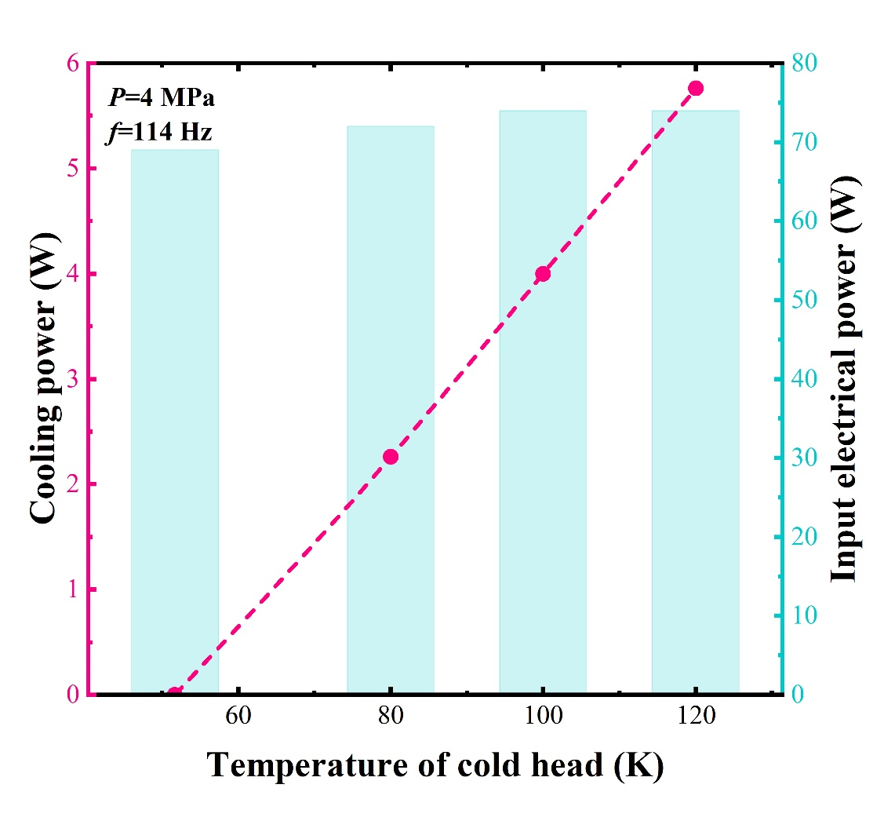
Results and analysis
Refrigeration performance
The no-load refrigeration temperature is 51.71K.
The maximum cooling power reaches 2.26 W at 80 K with the input power of 72 W.
The maximum cooling powers reach 4 W at 100 K and 5.75 W at 120 K respectively.
6
14
Notes:
The left figure shows the cooling curve. It takes 387 seconds for the cryocooler to drop from 295 K to 80 K. After 1620 seconds, the no-load temperature stabilizes at 51.71 Kelvin.
The right figure shows the refrigeration curve when the displacement of the compression piston reaches the full stroke. In the state of the maximum displacement of the compression piston, the condenser reaches its maximum input electric power and cooling power.
The maximum cooling power reaches 2.26 W at 80 K with the input power of 72 W, which is the highest cooling power at 80 Kelvin among the reported miniature pulse tube cryocoolers weighing less than 1 kilogram.
In addition, the figure also shows that the maximum cooling powers reach 4 W at 100 K and 5.75 W at 120 K respectively with the input power of 74 W.
左图为制冷机的降温曲线。该制冷机从 295开始降温至 80 开需要 387秒。在经过 1620秒后，制冷机的空载温度稳定在51.71开尔文。
右图为压缩活塞位移达到满行程时的制冷曲线。在压缩活塞的最大位移状态下，冷凝器达到其最大输入电功率和冷却功率。
在冷端温度为80 K时，输入72 W电功，最大制冷量达到2.26 W。在目前报道的重量小于1千克的微型脉冲管冷凝器中，这实现了在 80 开尔文时最高的冷却功率。此外，该图还显示，在冷端温度分别为 100 K和120 K时，最大输入功能达到74 W，最大制冷量分别可以达到4 W和5.75 W。

Slide 14

Results and analysis
Institution | Time | Total weight | Cooling power | Relative Carnot Efficiency | Cooling power per unit mass
NGAS | 2007 | 782 g | 1.1 W at 77 K | 7.89% | 1.41 W/kg
NGAS | 2009 | 857 g | 1.3 W at 77 K | 7.32% | 1.52 W/kg
LM | 2016 | 450 g | 1 W at 80 K | 4.58% | 2.22 W/kg
TIPC,CAS | 2018 | 1 kg | 1.24 W at 80 K | 9.30% | 1.24 W/kg
TIPC,CAS | 2021 | 598 g | 1.2 W at 80 K | 7.33% | 2.01 W/kg
ZJU | 2024 | 0.97 kg | 1.73 W at 77 K | 7.5% | 1.78 W/kg
This work | 2025 | 0.91 kg | 2.26 W at 80 K | 8.45% | 2.48 W/kg
Miniature Stirling cryocooler (Lihan-TC3170)
Total weight: 570 g
1.5 W at 77 K
Relative Carnot Efficiency: 11.07%
Cooling power per unit mass: 2.63W/kg
A significant breakthrough in the cooling power and cooling power per unit mass at 80 K.
High compactness: the cooling power per unit mass reaches 2.48 W/kg, which is very close to the level of the miniature Stirling cryocooler shown on the right.
14
Notes:
From this table, it can be seen that this miniature pulse tube cryocooler has achieved a significant breakthrough in the cooling power at 80 K, and the maximum cooling power can reach 2.26 W.
Compared with other miniature pulse tube cryocoolers of the same level, it also leads in terms of compactness. The cooling power per unit mass reaches 2.48 W/kg, which is very close to the level of the miniature Stirling cryocooler shown on the right.
通过这张表可知，目前该微型脉管制冷机在80 K的制冷量已经实现了较大突破，最大制冷量可以达到2.26W。同时与其它同类型微型脉管制冷机相比，在紧凑性上也处于领先水平，其单位质量下的制冷量达到了2.48W/kg，十分接近右边所示微型斯特林制冷机的水平。

Slide 15
Summary
4

Slide 16
Summary
Main conclusions
A miniature pulse tube cryocooler weighing approximately 0.91 kg is developed, operating at a pressure of 4 MPa. At a hot end temperature of 295 K, a frequency of 114 Hz, and an input electrical power of 72 W, the cryocooler achieves a cooling power of 2.26 W at 80 K, with a relative Carnot efficiency of 8.45%. The cooling power per unit mass reaches 2.48 W/kg. Both its cooling power and compactness are in a leading position. Some conclusions about the influence of operating parameters are as follows:
When the input power increases from 20 W to 60 W, the optimal frequency only increases slightly from 112 Hz to 114 Hz. This shows that increasing the input power hardly affects the optimal frequency, and this characteristic also exists at different refrigeration temperatures.
Increasing the charging pressure from 3 MPa to 4 MPa helps to improve the efficiency. When the cold end temperature is 120 K, the efficiency increases by 0.36%, and when the temperature drops to 80 K, the efficiency increases by 0.67%. The lower the refrigeration temperature is, the more remarkable the efficiency improvement will be.
During the process of cooling from 120 K to 80 K, when the frequency changes from 104 Hz to 114 Hz, the cooling time will be shortened from 140 s to 125 s. The cooling rate is related to the refrigeration temperature
16
Notes:
Here is a summary of all the work.
We have developed a miniature pulse tube cryocooler weighing approximately 0.91 kg, operating at a pressure of 4 MPa. At a hot end temperature of 295 K, a frequency of 114 Hz, and an input electrical power of 72 W, the cryocooler achieves a cooling power of 2.26 W at 80 K, with a relative Carnot efficiency of 8.45%. The cooling power per unit mass reaches 2.48 W/kg. Both its cooling power and compactness are in a leading position.
The experiment studied the influence of operating parameters on the refrigeration performance and obtained some conclusions that can serve as a reference.
这里对所有工作进行一个总结：
1.目前我们已经研制出了一台重约0.91kg的微型脉管制冷机，其充气压力为4MPa，工作频率为114Hz，在热端温度为295K时，输入72W的电功，该制冷机在80K可以获得2.26W的制冷量，相对卡诺效率为8.45%，单位质量下的制冷量达到了2.48W/kg，其制冷量和紧凑性在同级别的微型脉管制冷机中均处于领先地位。
2.实验研究了运行参数对制冷性能的影响，得到了一些可供参考的结论：
输入功从 20 瓦增加到 60 瓦，最佳频率仅从 112 赫兹略微增加到 114 赫兹，表明增加输入功率几乎不会影响最佳频率，即使在不同的制冷温度下，仍会表现出这个特性；
充气压力从3 MPa提高到4 MPa有助于提高制冷机的效率。当冷端温度为120K时，效率提升0.36%，当冷端温度降低到80K时，效率能提升0.67%，性能的提升效果更为显著；
降温速度与制冷温度有关。从280 K降至120 K的过程中，在 104 赫兹至 118 赫兹范围内降温时间基本不变。但从120 K降低到80 K的过程中，频率对降温速度影响较大，频率从104 Hz变化到114 Hz时，冷却时间将从140 s缩短到125 s。

Slide 17



Scan the following to get our latest news
AI Agent
cryoboat.zju.edu.cn
WeChat Official Account
17
Notes:
If you are interested in learning about us, you can scan the QR code here to get our latest news. The first one is the website of our research group. The second one is our social media platform, where we will share various articles every day. The third one is an AI agent about cryogenics generated. Everyone is welcome to use it.
如果大家有兴趣了解我们，可以扫描这里的二维码来获取我们最新的消息。第一个二维码是我们课题组的网站，第二个是社交媒体平台，我们会每天分享各种低温相关的文献，第三个是我们基于AI大模型生成的一个关于低温知识的智能体，欢迎大家来使用。

Slide 18


THANKS！
Zhejiang University, Hangzhou, P.R. China
Zhejiang University, Hangzhou, P.R. China
Notes:
That‘s all for my sharing. Thanks to everyone.

