Slide 1
Investigation of chill-down process of cryogenic tank
Dr. Seungwhan BaEK
KARI (Korea aerospace Research Institute)
UST (University of Science & Technology)
Dr. Seojeong KIM
IBS (Institute of Basic Science)
May 20th, 2025, 4:15 PM
CEC/ICMC 2025
Notes:
Hello,
I’m pleased to present our work at CEC-ICMC on the topic of “Investigation of the Chill-Down Process of a Cryogenic Tank.”
My name is Seungwhan Baek from KARI, and this research was conducted in collaboration with Dr. Sejeong Kim from IBS, who is a co-author of this study.

Slide 2
Contents
Introduction
Experimental setup
Simulation setup
Comparison
Future work
Notes:
This presentation is structured as follows:
First, I will cover the introduction, the experimental process, and the simulation setup.
Then, I will present the experimental results and compare them with the simulation data.

Slide 3
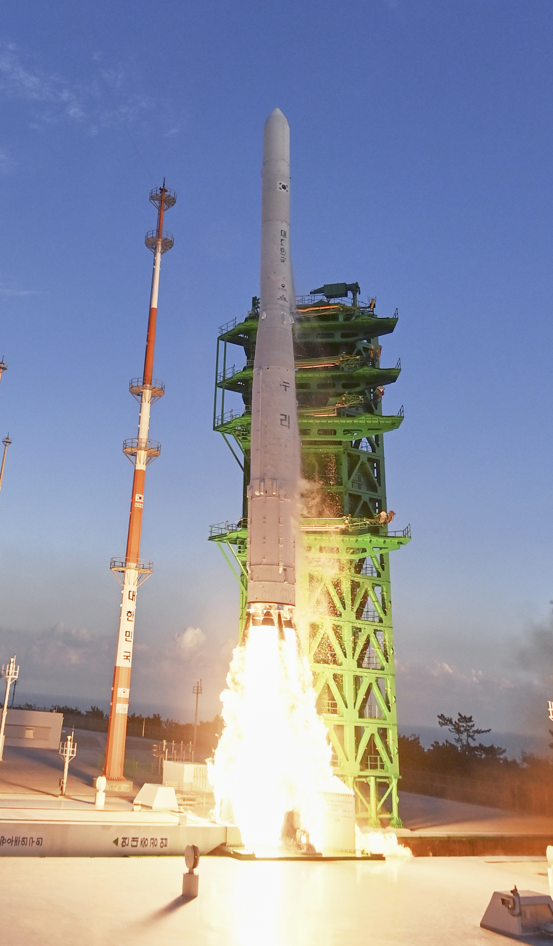
Introduction
Launch vehicles utilize the cryogenic propellants
  Liquid methane ~120 K
  Liquid oxygen ~90 K
  Liquid hydrogen ~ 20 K
Efficient utilization of cryogenic liquids required for the future missions
  Earth (1g), moon, mars
Notes:
Launch vehicles use various cryogenic liquids, such as liquid methane at 120 K, liquid oxygen at 90 K, and liquid hydrogen at 20 K.
Because the use of these cryogenic fluids inevitably involves boil-off due to external heat ingress, it is essential to gain a deeper understanding of both the chill-down process and the evaporation behavior of the tank in order to utilize them efficiently.

Slide 4

Introduction
Cryogenic liquid transfer process @ 1g
  Cooled tank & Cooled liquid → Hot tank walls and cold liquid
Precise estimation of boil off rate according to the wall temperature distribution
Before charge
During charge
300 K
300 K
77 K
77 K
LN2
77 K
77 K
During charge
300 K
77 K
77 K
77 K
Notes:
This slide provides a simplified illustration of the filling process of a cryogenic liquid.
Under 1-g conditions, the cryogenic liquid is transferred from a storage container to the target tank.
Initially, the target tank has walls at 300 K, which creates a significant temperature difference between the cryogenic liquid and the tank wall.
When the valve is opened, the liquid starts to flow into the tank. As the cryogenic liquid comes into contact with the warm tank wall, the wall temperature begins to drop, boil-off occurs, and liquid fill progresses.
Over time, the tank wall cools down in the vertical direction, forming a temperature gradient along the height of the tank.

Slide 5
Experimental setup
Empty tank
Non insulated
Cryogenic liquid transfer process
  Coriolis flow meter: measures total flow input
  Level meter : measures liquid accumulation in the tank
  Total flow input = (liquid accumulation) + (boil off)
P
Level meter
Vent valve
Outer wall surface
Three RTDs
Inside tank for fluids
eight RTDs
5.8 m
T
P
LN2 source
Coriolis
Flow meter
Inner wall surface
eight RTDs
2.8 m
Notes:
In order to better understand this process, the following experimental apparatus was developed and implemented.
To measure the total amount of liquid entering the tank, a mass flow meter was installed.
Inside the tank, a level sensor was used to measure the accumulated volume of liquid.
In addition, temperature sensors were placed on the outer wall, the inner wall, and inside the tank to monitor the liquid temperature.
The tank has a height of 5.8 meters and a width of 2.8 meters.
By comparing the mass entering the tank with the mass accumulated inside the tank,
we can estimate the boil-off that occurs during the filling process as the difference between the two.

Slide 6
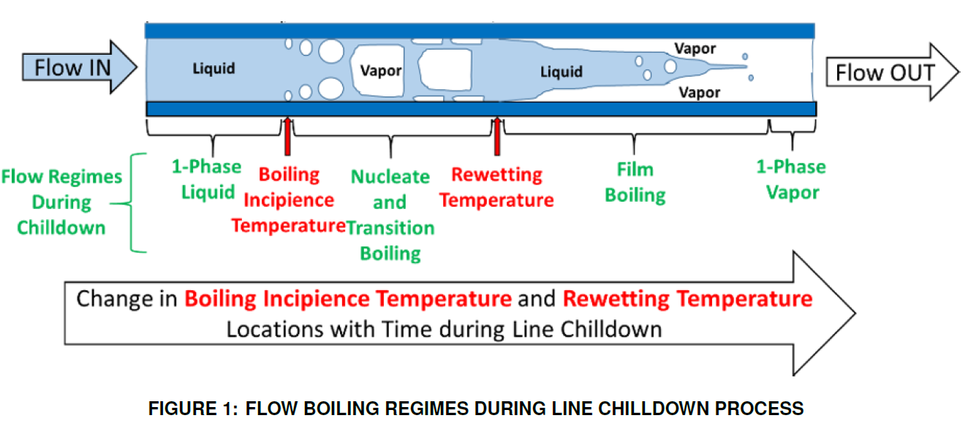
Experimental condition as tank wall chilldown
P
Jayachandran K. Narayanan et al. NUMERICAL PREDICTIONS OF THE FLOW AND HEAT TRANSFER CHARACTERISTICS IN THE FILM BOILING
REGIME DURING TUBE QUENCHING, July 10–12, 2023, Washington DC, SHTC2023-107451
Notes:
During the tank filling process, we measured the inner wall temperature, outer wall temperature, and fluid temperature.
As the filling progresses, we can observe a vertical rise in liquid level within the tank.
Interestingly, if we rotate this process by 90 degrees, it shows strong similarities to a line chill-down process observed in pipelines.
The key difference, however, is that in the tank, the liquid–gas interface forms a flat surface, unlike the typical flow in pipelines.
In this sense, the tank chill-down process can be considered as a line chill-down with a very thin wall and a very slow flow rate.

Slide 7
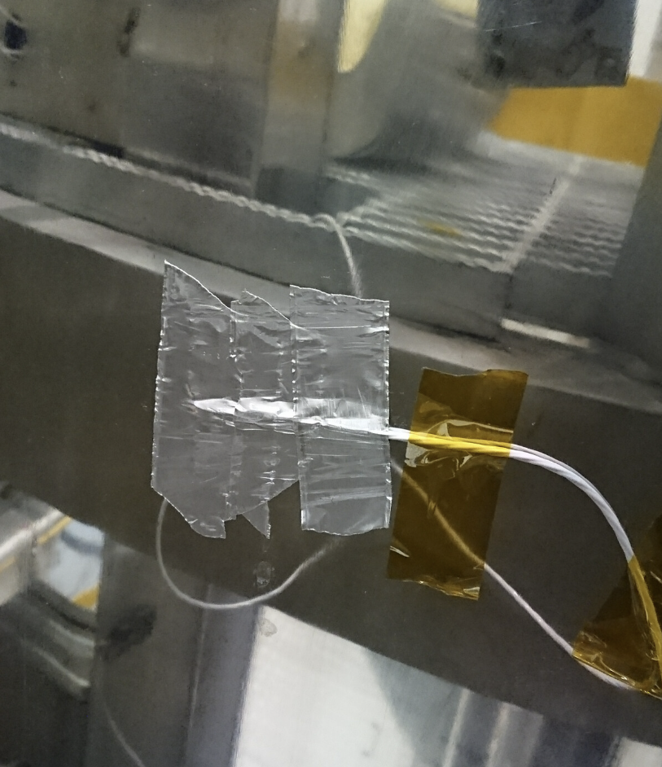
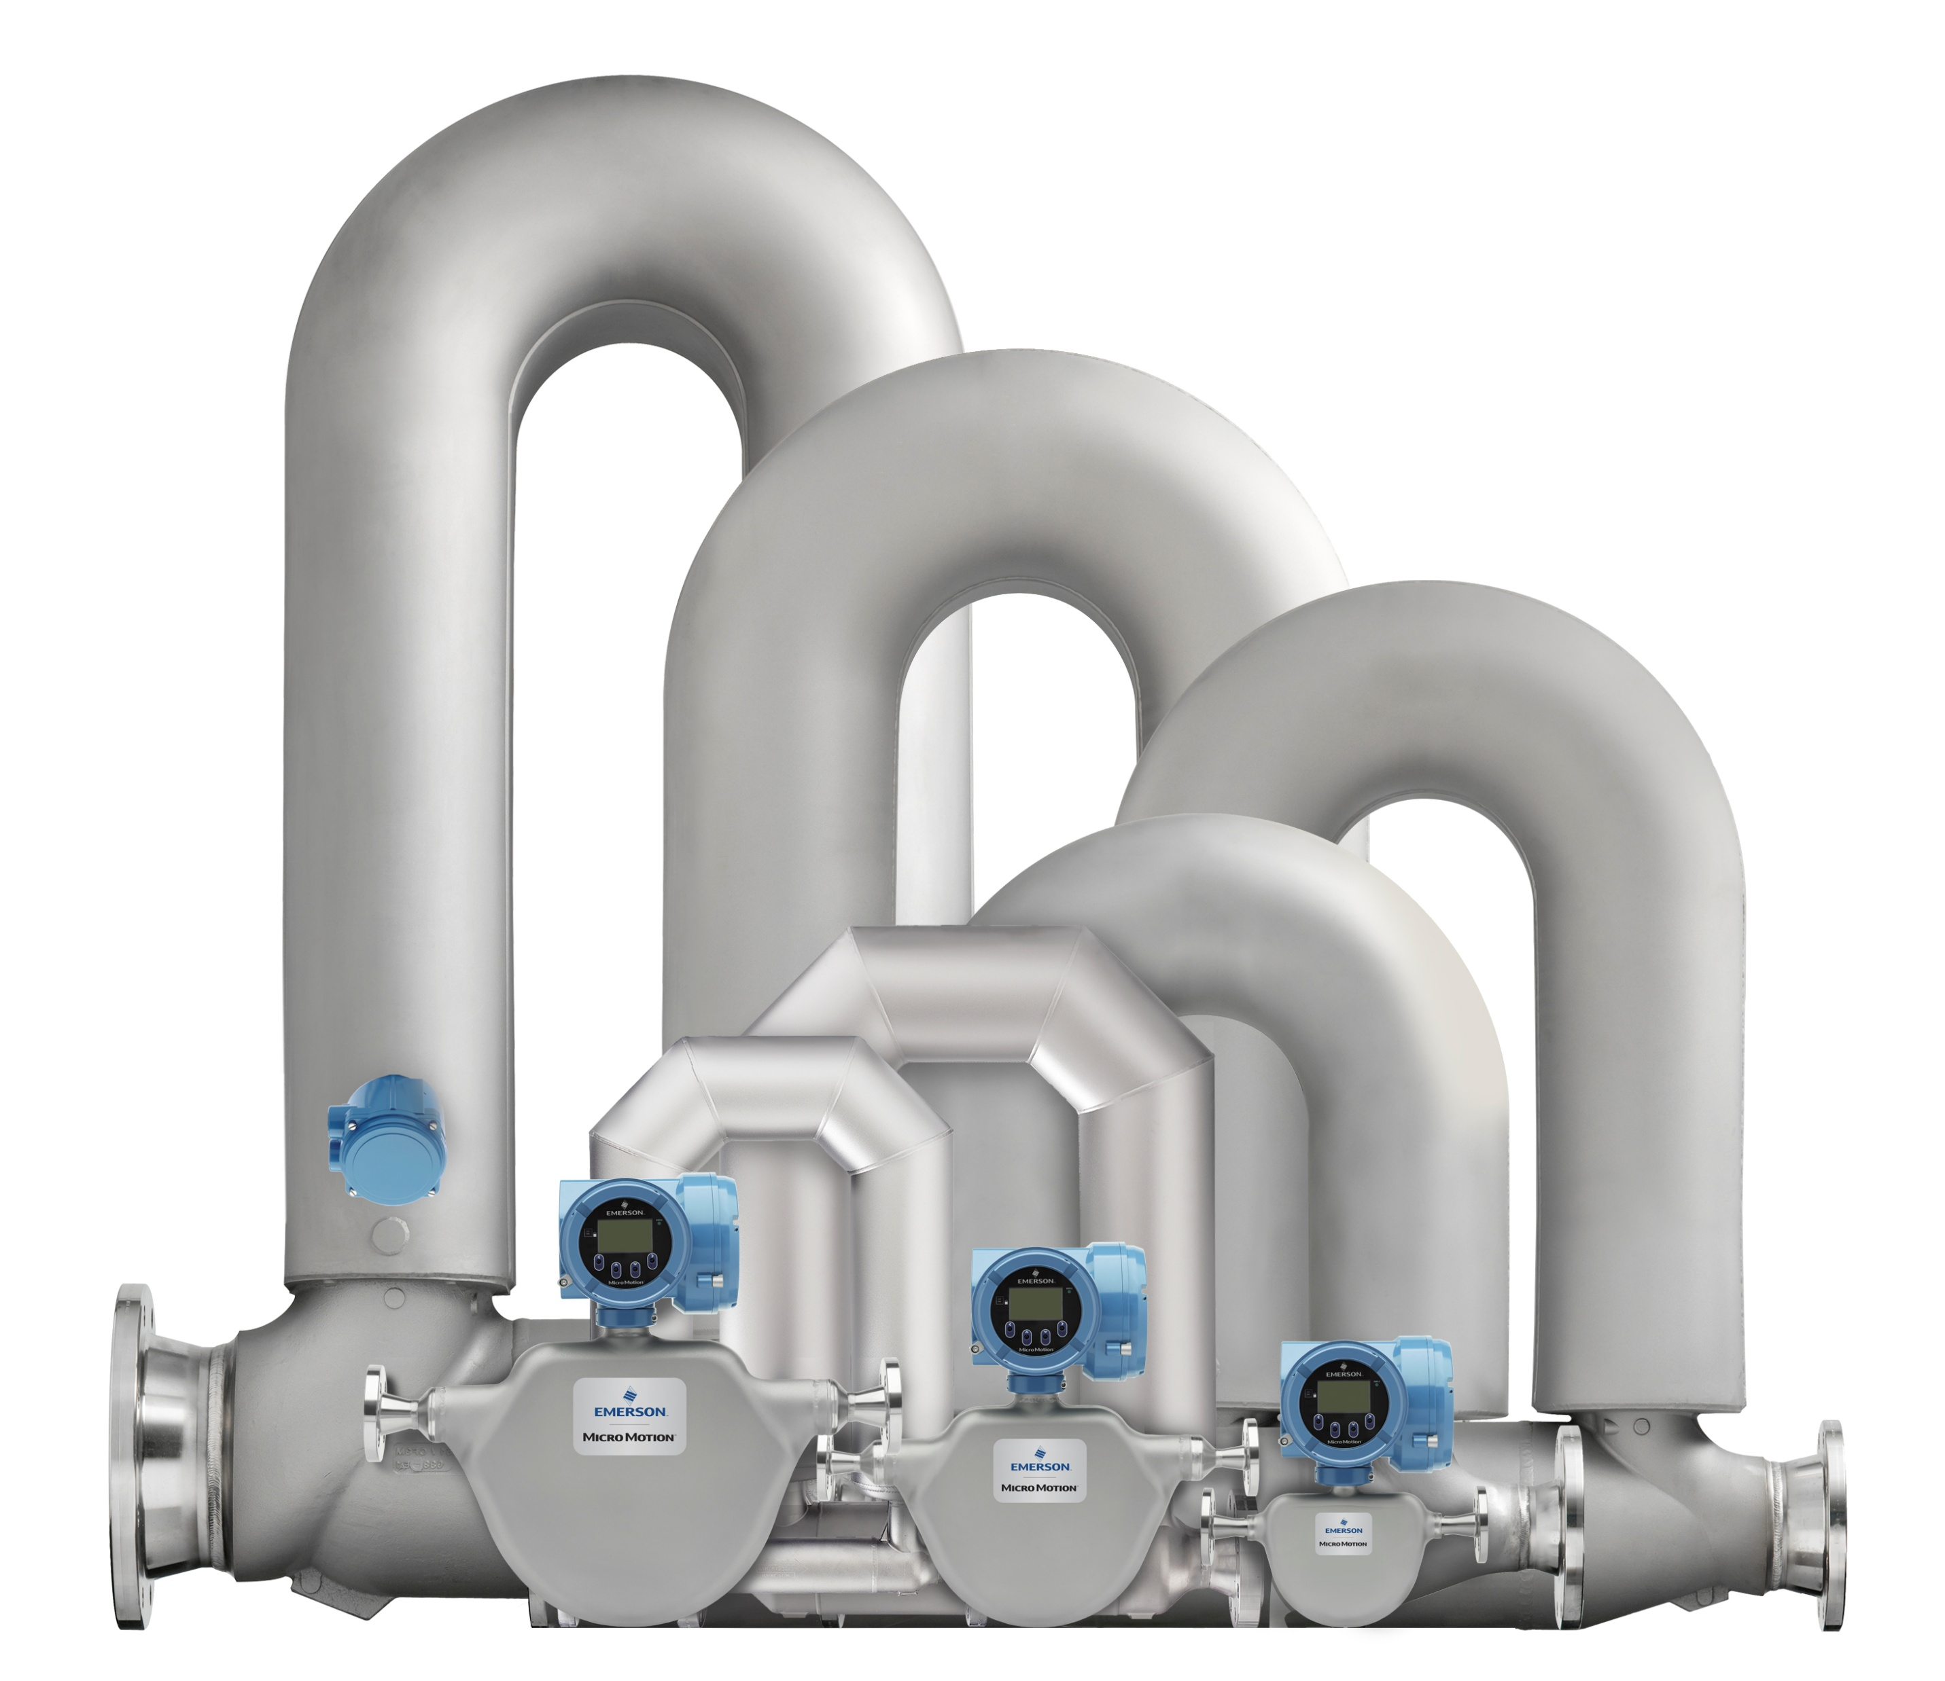
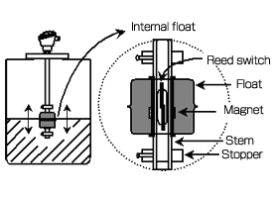
Experimental setup
Measurements
Temperature : RTD installation on the tank, Explosed RTD for the fluid measurement
Mass flow rate : Coriolis mass flow meter
Level meter : Floating magnetic level sensor (discrete)
Notes:
The sensors used in this experiment are as follows:
For temperature measurement, we used PT100 Resistance Temperature Detectors (RTDs) with an exposed sensing element type for faster response.
A Coriolis mass flow meter was employed to measure the mass flow rate.
For liquid level measurement, we used a floating ball level sensor based on a magnetic principle to detect the height of the accumulated liquid.

Slide 8
Experimental results
Inlet condition & Filling results
Notes:
Here, we can see the experimental results.
The data include the temperature and pressure in the inlet pipe, the mass flow rate of the incoming fluid, and the liquid level increase measured by the level sensor inside the tank.
In this experiment, we investigated the results for two different mass flow rates: 2 kg/s and 3.5 kg/s.
We observed the temperature variation of the tank wall under each condition.

Slide 9
Experimental results
Fluid temperature inside the tank Inner wall temperature measurements
Notes:
The following results show the temperature variation of the internal fluid as well as the inner wall temperature of the tank.
If you imagine the process of the fluid transitioning from gas to liquid, you can observe how the temperature at different heights changes over time.
The wall temperature also changes during the process, but it shows a different trend compared to the fluid temperature.

Slide 10
Experimental results
Outer wall temperature measurements
Notes:
Next, we can observe the temperature variation on the outer wall of the tank.
At certain locations, a sudden temperature drop can be clearly seen, indicating rapid cooling during the chill-down process.
By calculating the temperature difference between the inner and outer wall surfaces,
we can estimate the heat flux occurring through the tank wall.

Slide 11
Experimental results
Inner wall vs Outer wall measurements
Notes:
On this slide, we can see a graph showing both the outer wall and inner wall temperatures plotted together.
It clearly shows that at a certain point, both temperatures exhibit a sudden drop, following a similar trend.
This indicates a rapid cooling event occurring simultaneously across the wall.

Slide 12
Experimental results
Fluid temperature vs inner wall measurements
Notes:
In this slide, we present a graph showing the fluid temperature and the inner wall temperature measured at various vertical positions in the tank.
For example, if we focus on the fourth fluid temperature sensor along with its corresponding wall temperature sensor,
we can observe a gradual decrease in fluid temperature, which corresponds to the gas phase region.
Then, at the point where the temperature rapidly drops to around 77 K, we also see a sudden decrease in the inner wall temperature.
This behavior is consistently observed at other positions as well.

Slide 13
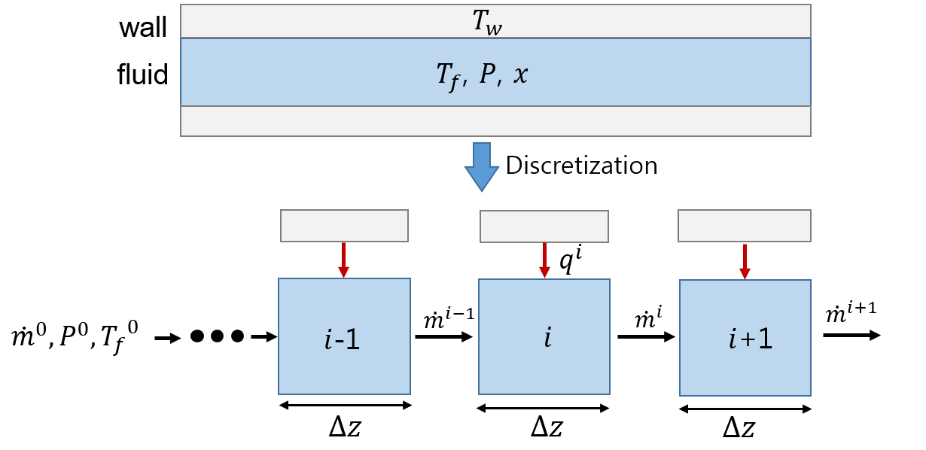


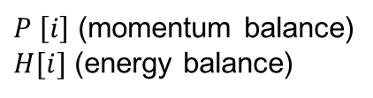

Simulation basis
1-D homogeneous model
Fluid side
$$q^{′′}=h(T_{w}−T_{f})$$
Mass balance:
$$\frac{∂ρ}{∂t}+\frac{∂(ρu)}{∂z}=0$$
Momentum balance:
$$\frac{∂(ρu)}{∂t}+\frac{∂(ρu^{2})}{∂z}+\frac{∂P}{∂z}=ρg+F_{fric}$$
Energy balance:
$$\frac{∂(ρH−P)}{∂t}+\frac{∂(ρuH)}{∂z}=\dot{q}$$
$P \left[i\right]$ (momentum balance)
$H[i]$ (energy balance)
$$x_{eq} \left[i\right]$$
* Fluid and stainless steel properties are from NIST data.
Notes:
Now that we have reviewed the experimental results, I will explain how the simulation was conducted.
To model the chill-down process in the pipeline, we used a one-dimensional homogeneous model.
In this model, the pipe is divided into two regions: the wall section and the fluid section.
For the wall, the state variable is temperature.
For the fluid, the state variables are temperature, pressure, and quality (vapor fraction).
Both the wall and the fluid regions are discretized along the axial (length) direction,
and the time evolution of each state variable is calculated using the given initial and boundary conditions.
The thermophysical properties of the fluid and the stainless steel pipe were taken from NIST data.
On the fluid side, we solved the mass, momentum, and energy balance equations.
The vapor quality of the fluid was calculated using the enthalpy-based equilibrium approach.
The fluid and wall are thermally coupled, meaning that heat transfer between the two domains is a key element of the model.
Therefore, selecting the appropriate heat transfer coefficient based on the heat transfer regime is critical for accurate prediction.
배관 냉각 과정을 모사하기 위해 사용된 1차원 균질 모델 설명
1차원 균질 모델에서는 유체 운송 배관을 벽면 부분과 유체 부분으로 나눕니다.
벽면부분에서의 상태량은 온도
유체부분에서의 상태량은 온도, 압력, 건도 입니다.
벽면부분과 유체부분을 길이 방향으로 차분화하여, 주어진 경계조건과 초기조건을 이용하여
각 노드에서 시간에 따른 상태량을 계산합니다.
유체와 stainless steel pipe의 property는 NIST data 를 사용하였습니다.
유체 측에서는 mass balance, momentum balance, energy balance를 이용하여 계산을 하였습니다.
유체의 건도는 엔탈피를 이용해 equilibrium quality를 사용하였습니다.
유체측과 벽면측은 열전달로 연결이 되어있습니다.
따라서 열전달 량을 정확히 계산하기 위해 열전달 영역에 따라 적절한 열전달 계수를 선택하는것이 가장 중요합니다.

Slide 14
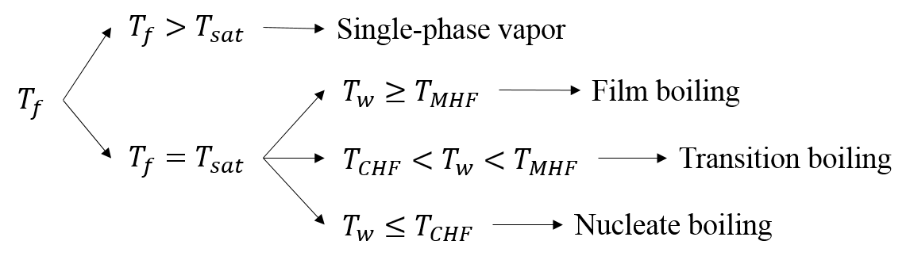
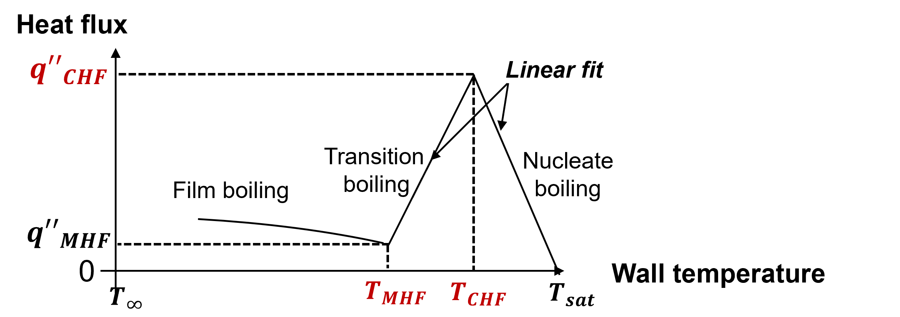




Simulation basis
HTC correlations
$q^{′′}=h(T_{w}−T_{f})$
HTC for single-phase vapor convection
HTC for film boiling
$$T_{MHF}$$
140 K
$$T_{CHF}$$
120 K
$${q′′}_{CHF}$$
~30 kW/m²
* Experimental data of $T_{MHF}$, $T_{CHF}$, and ${q′′}_{CHF}$ are used in the simulation.
Notes:
To determine whether the flow is single-phase or in a boiling regime, we compare the fluid temperature with the saturation temperature.
If the temperature suggests the presence of boiling, we then compare the wall temperature with the Minimum Heat Flux (MHF) temperature and the Critical Heat Flux (CHF) temperature to identify the specific boiling regime.
In the cryogenic chill-down process, four distinct heat transfer regimes are typically observed.
Each of these regimes requires an appropriate heat transfer coefficient for accurate modeling.
However, the transition boiling and nucleate boiling regimes have minimal impact on the overall chill-down behavior.
Therefore, as illustrated in the figure, we assumed that the heat flux varies linearly with wall temperature in these regions.
Instead of using heat transfer coefficients in these two regimes, we calculated the heat flux using the following key parameters:
Minimum Heat Flux Temperature
Critical Heat Flux Temperature
Critical Heat Flux Value
유체온도와 포화온도를 비교하여 단상 또는 이상유동 영역 판단
이상유동 영역에서는 벽면온도를 minimum heat flux 온도와 critical heat flux 온도와 비교 하여 비등 영역을 판단
따라서 극저온배관 냉각과정에서 4개의 열전달 영역이 나타나게 되는데
각열전달 영역에서의 열전달 계수가 필요하게 됩니다.
전이비등과 핵비등 영역은 배관 냉각 과정에 큰 영향을 주지 않기때문에
그림에서 나타낸 바와 같이 전이비등과 핵비등 영역에서 열유속이 벽면온도에 따라 linear하게 변한다고 가정하였습니다.
따라서 이 두 영역에서는 열전달 계수를 사용하지 않고,
minimum heat flux temperature, critical heat flux temperature, critical heat flux 를 이용하여 열유속을 계산하였습니다.

Slide 15
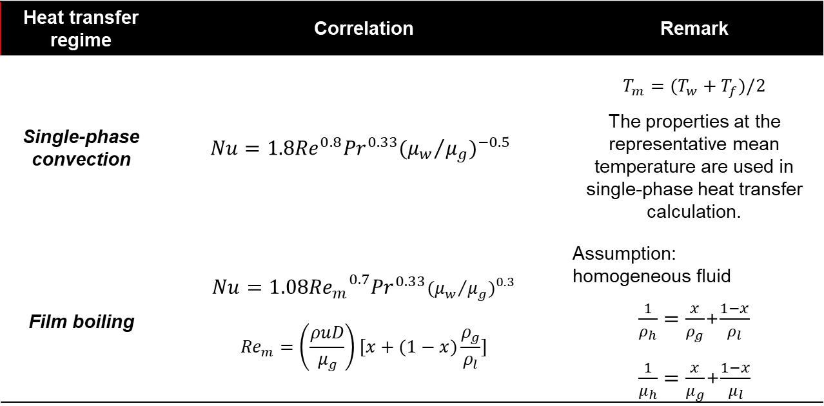
Simulation basis
HTC correlations
Heat transfer regime | Correlation | Remark
Single-phase convection | $$Nu=1.8{Re}^{0.8}{Pr}^{0.33}{({μ_{w}}/{μ_{g}})}^{−0.5}$$ | $$T_{m}=(T_{w}+T_{f})/2$$ The properties at the representative mean temperature are used in single-phase heat transfer calculation.
Film boiling | $$Nu=1.08{{Re}_{m}}^{0.7}{Pr}^{0.33}{({μ_{w}}/{μ_{g}})}^{0.3}$$ $${Re}_{m}=\left(\frac{ρuD}{μ_{g}}\right)[x+(1−x)\frac{ρ_{g}}{ρ_{l}}]$$ | Assumption: homogeneous fluid $\frac{1}{ρ_{h}}=\frac{x}{ρ_{g}}$+$\frac{1−x}{ρ_{l}}$ $\frac{1}{μ_{h}}=\frac{x}{μ_{g}}$+$\frac{1−x}{μ_{l}}$
Notes:
The heat transfer coefficient relationship that best represents the chill-down process in the tank experiment is summarized here.
This empirical correlation was derived directly from our experimental data, and we plan to name it the Seojeong–Baek correlation.
탱크 냉각 실험을 가장 잘 모사하는 열전달 계수 관계식을 다음과 같이 정리하였습니다.

Slide 16

Simulation basis
Evaporated mass flow rate calculation based on the measurements
Evaporation mass flow rate during the filling process of LN2
$$\dot{m}=1.56−0.17×ln⁡(t)$$
Notes:
The mass flow rate function used in the simulation is shown here.
As you can see in the graph, the difference between the total measured mass flow and the accumulated liquid level indicates a significant discrepancy,
which makes it difficult to express the actual inflow rate using a simple analytical function.
Therefore, in the simulation, we applied a smoothed exponential function fitted to the experimental data as a function of time.
계산에서 사용된 질량유량 관계식은 다음과 같습니다.
실제 측정된 액체 레벨이 차는 유량을 제외한 질량유량은 그림에서 보시는 바와 같이 오차가 큽니다.
(특정 함수로 표현하기 어려움)
계산에선 시간에 따라 지수로 smoothing 한 함수를 사용함.

Slide 17
Simulation results
Inner wall temperature estimation by simulation
Notes:
This slide shows a comparison between the calculated inner wall temperatures and the experimental data.
The simulation and experimental results at the same sensor positions are shown using the same color lines.
There are deviations between the two, mainly due to errors in the real-time mass flow estimation used in the simulation.
As future work, we aim to develop a predictive model that can simultaneously estimate both the liquid accumulation rate and the mass flow rate more accurately.
내벽 온도의 계산 결과와 실험 데이터 비교 그래프입니다.
동일 위치의 실험결과와 계산 결과는 같은 색 라인으로 표현했습니다.
실시간 유량 계산 오차에 따른 계산 오차가 존재함.
Future work으로 액체 레벨이 쌓이는 시간과 유량을 함께 예측하는 모델을 개발하는 걸 목표로 함.

Slide 18
Summary
Tank wall inner, outer temperature measured
Inlet flow mass rate, accumulated liquid mass compared to find boil-off rate per time
Chill-down of the tank wall investigated with comparison of simulation
New heat transfer correlation has ben discussed.
Notes:
We believe that this work represents the first attempt to interpret the chill-down process in a cryogenic tank in a manner similar to the line chill-down process—an aspect that has often been overlooked or taken for granted in previous studies.
By carefully analyzing the experimental data, we were able to recognize this correlation, which provided new insights into the tank cooling behavior.
We are grateful for the opportunity to share these findings at this conference, and we hope they will contribute to further discussions in the field.

Slide 19
Thank you
Notes:
We believe that this work represents the first attempt to interpret the chill-down process in a cryogenic tank in a manner similar to the line chill-down process—an aspect that has often been overlooked or taken for granted in previous studies.
By carefully analyzing the experimental data, we were able to recognize this correlation, which provided new insights into the tank cooling behavior.
We are grateful for the opportunity to share these findings at this conference, and we hope they will contribute to further discussions in the field.

Slide 20
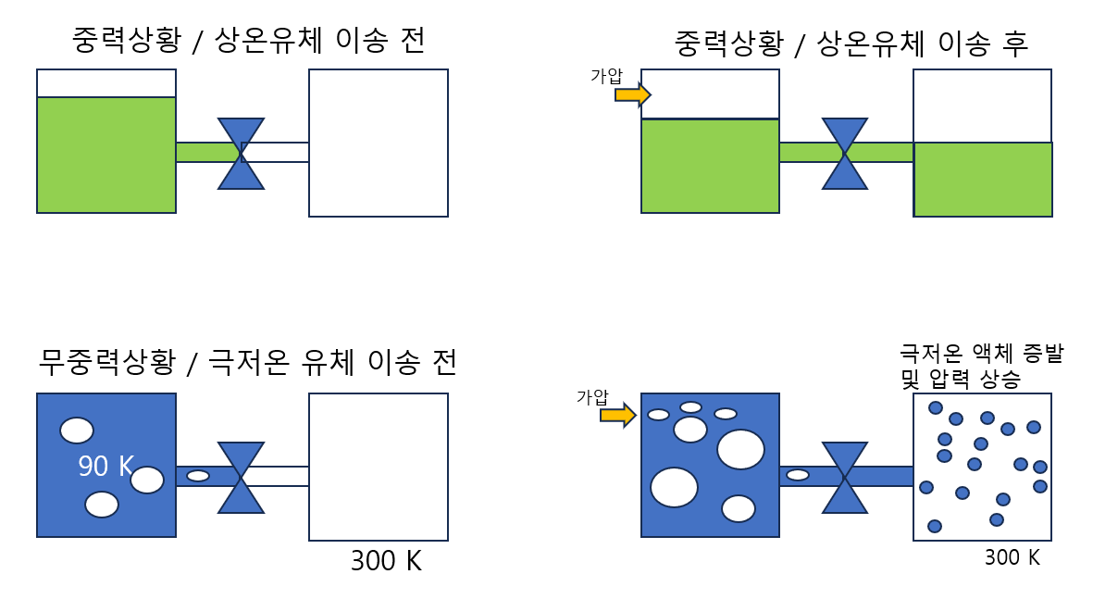
Microgravity fluid transfer
1g vs 0g Fluid transfer
추진제 다량 소모 및
임무실패
열전달 현상 파악→
추진제 관리

Slide 21
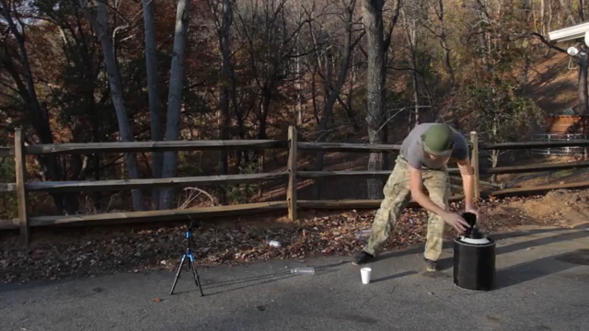
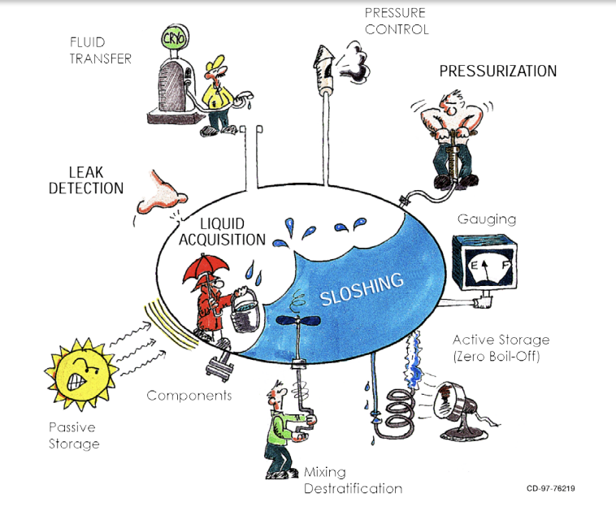
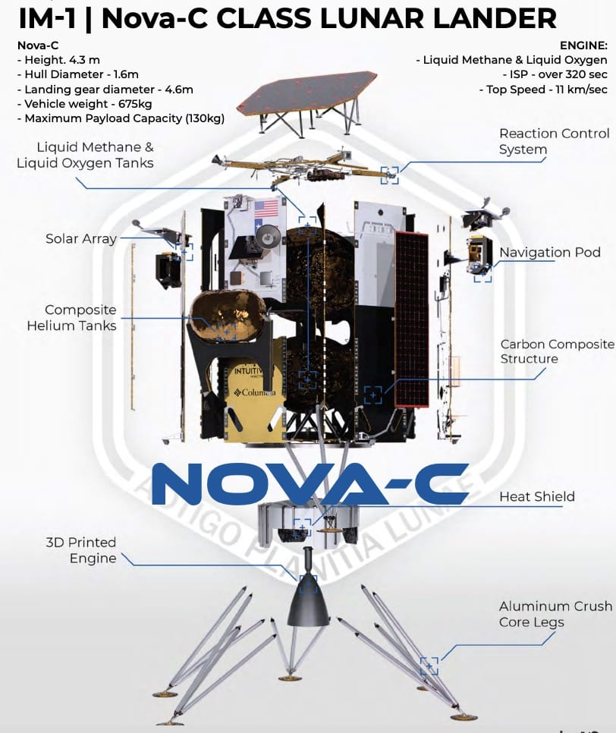
Microgravity propellant management
Cryogenic propellent management in microgravity
  Pressure control, fluid transfer, gauging

