Slide 2

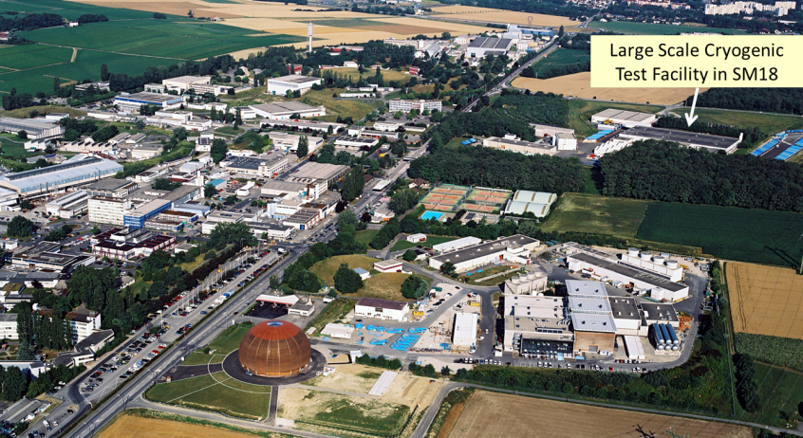
Upgrade of the CERN cryogenic test facility for the HL-LHC superconducting magnets and superconducting links
O. Pirotte, T. Barbe, M. Buzio, L Dassa, V. Gahier, N. Guillotin, A. Lees, F. Mangiarotti, R. Mauny, G. Ninet, A. Perin, H. Prin, S. Russenschuck, F. Savary, A. Vande Craen, G. Willering
CEC – ICMC 2025 Reno, Nevada
May 18-22, 2025

Slide 3
Content
Introduction
Layout of the HL-LHC interaction region & HL-LHC magnets
SM18 Magnet Test Facility reconfiguration
F2 Test Bench for HL-LHC Cold Powering System
Test benches for HL-LHC magnets
Conclusion

Slide 4
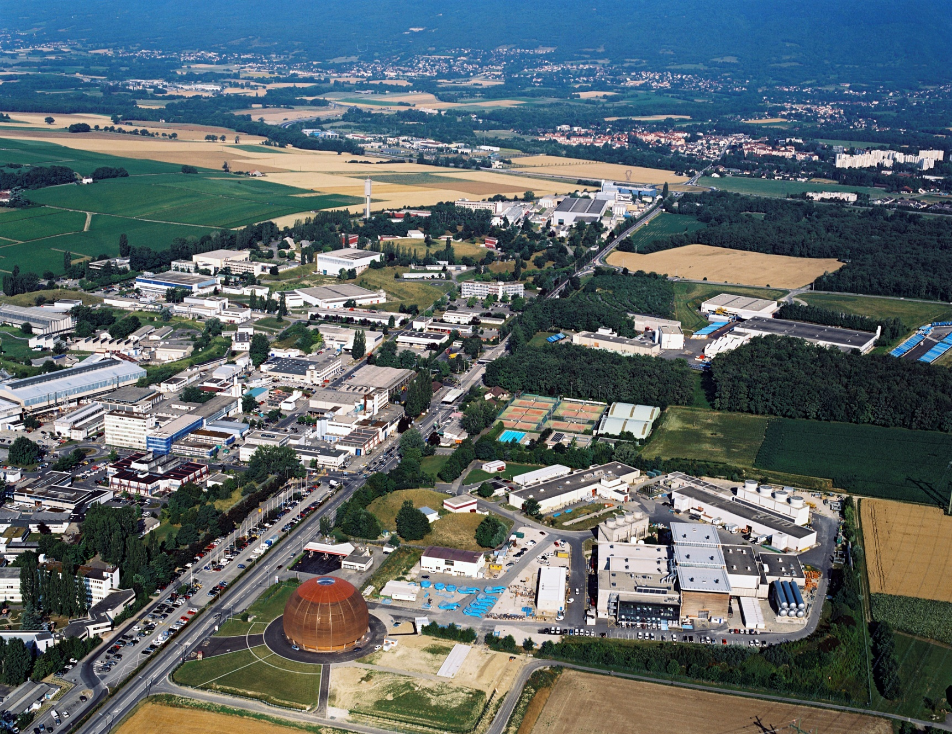
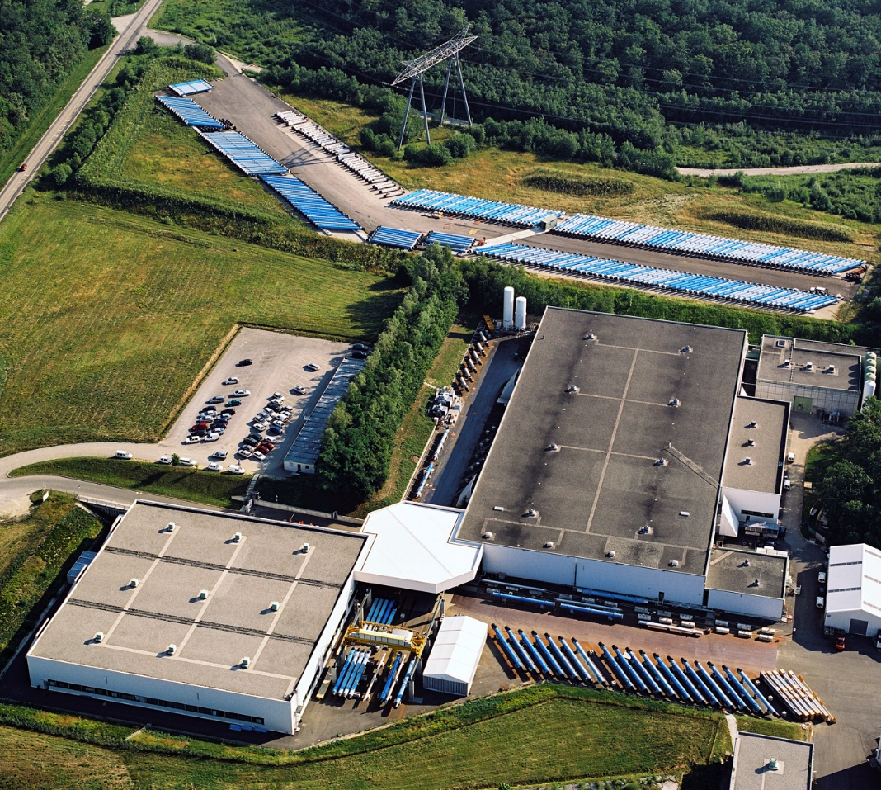
CERN SM18 Magnet Test Facility Location
SM18
120 m

Slide 5
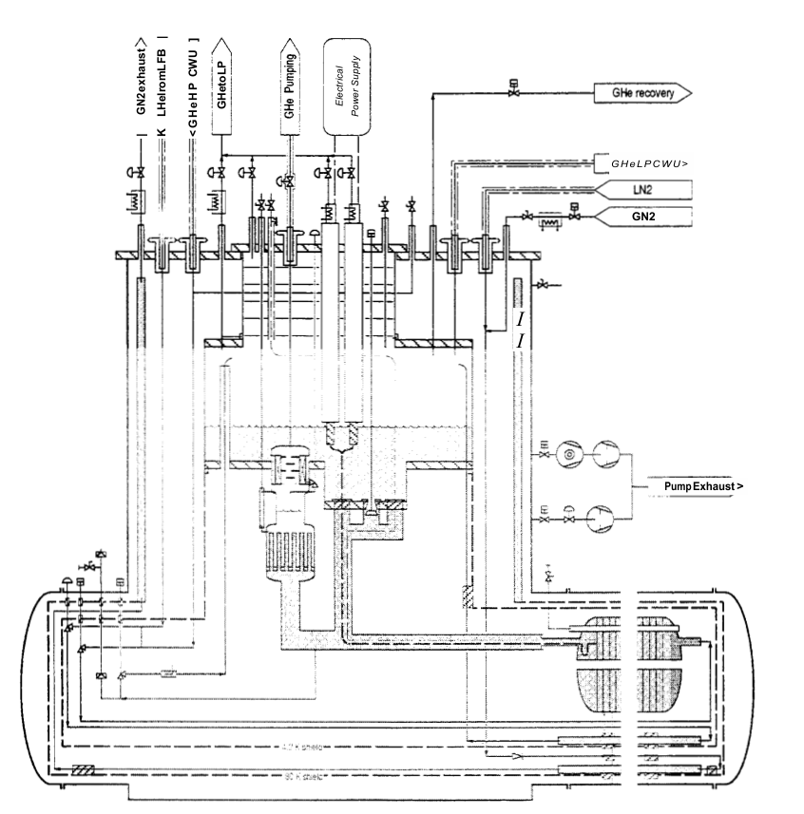
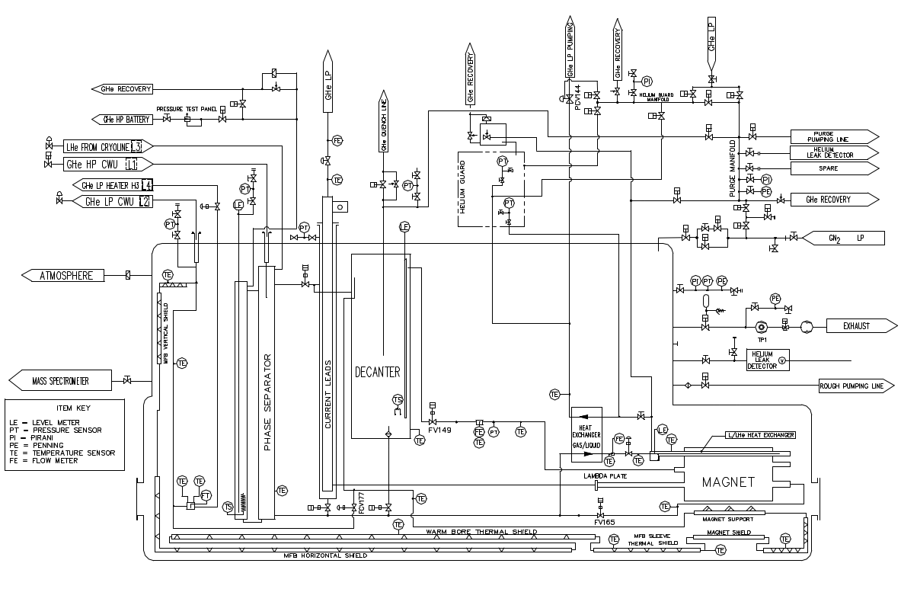
Introduction
For more than 30 years, main superconducting magnets and RF cavities are tested in CERN’s SM18 test facility (7200 m² floor space)
1994: first cryogenic infrastructure, including a Magnet Feed Box, to test and study LHC 10-m-long magnet prototypes
2000: upgrade of the magnet TF with two pre-series Cryogenic Feeder Unit, then 12 Cryogenic Feed Box for serial testing of the ~1700 LHC magnets (2004-2008)
Powering (2 x15 kA + 4 x 0.6 kA) was organized in six clusters, each including two test benches
Magnet Feeb Box
Cryogenic Feeder Unit

Slide 6
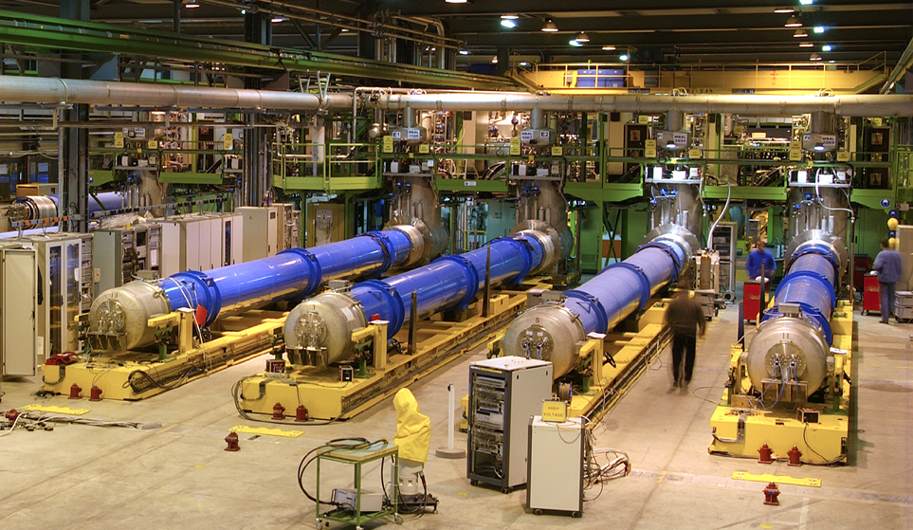
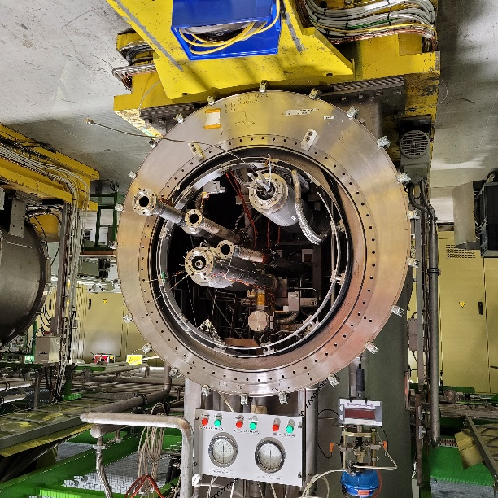
Introduction
Cryogenic Feed Box were designed to allow automatic testing of magnets :
  Leak check
  Cool-down / warm-up of a magnet
  Maintain magnet at 1.9 K or 4.5 K for magnetic measurements and quench training
  Recovery of as much as possible of He after a quench and automatic cool-down again
Cryogenic Feeb Box (CFB)
From 2010, test of new SC components for HL-LHC : magnets and SC-Links
=> SM18 magnet test facility needed to be adapted for HL-LHC magnets

Slide 7
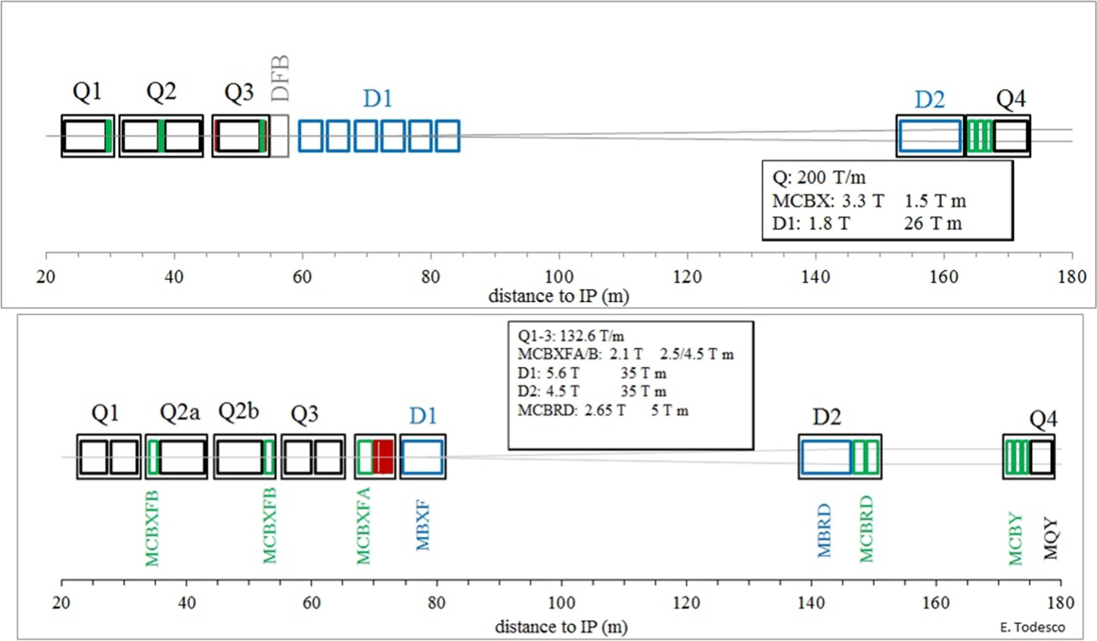
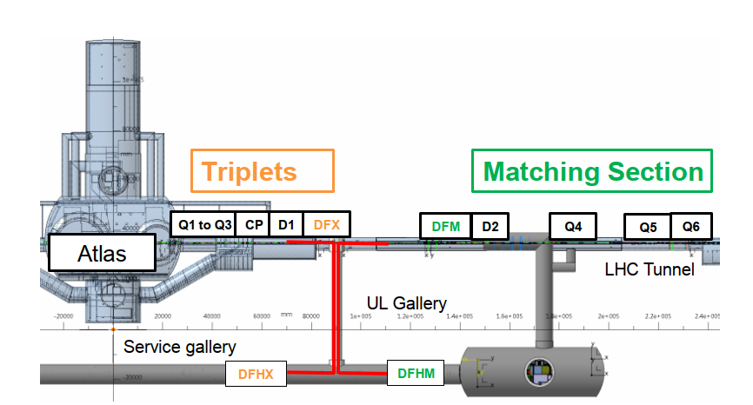
Layout of the HL-LHC interaction region
SC Link
Cold Powering System (CPS) for Inner Tripllets and Matching Section

Slide 8
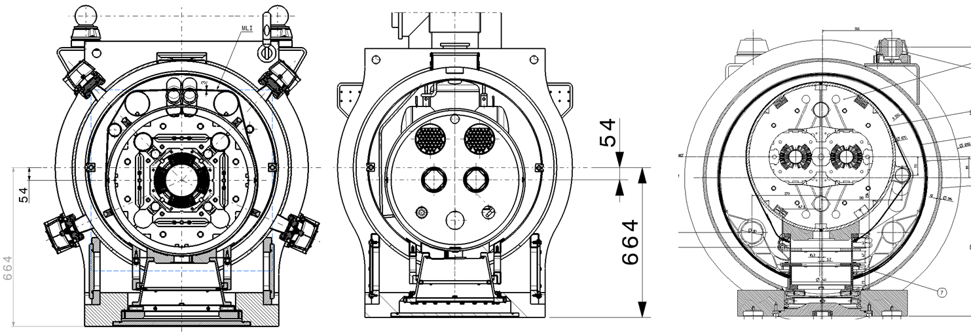
HL-LHC Magnets
HL-LHC
Q1 / Q2 / Q3 / CP
HL-LHC D2
LHC Dipole
HL-LHC magnets vs LHC magnets :
Different superconducting material (Nb₃Sn)
Larger aperture
Higher operating current and higher stored energy
Larger cold mass diameter and different arrangement of busbars and cryogenic headers
Requirement to limit the temperature gradient in the cold mass during cool-down and warm-up phases.
HL-LHC cryomagnet parameters & testing requirements |  |  |  |  |  |  | LHC
Cryo-magnet | MBH 11T | Q2a/b | Q1/Q3 | CP | D1 | D2 | Dipole
SC material (main / correctors) | Nb₃Sn | Nb3Sn / Nb-Ti | Nb₃Sn | - / Nb-Ti | Nb-Ti | Nb-Ti | Nb-Ti
Powering requirement [kA] (main + correctors) | 15 | 20 + 2 x 2 | 20 | 0 + 2 x 2 | 15 | 15 + 2 x 0.6 | 15 + 2 x 0.6
Nominal / maximum test ramp rate [A/s] (main) | 10 / 100 | 20 / 150 | 20 / 150 | - | 10 / 150 | 10 / 100 | 10 / 100
Stored energy at nominal/ultimate current [MJ] | 4.75 / 5.54 | 8.4 / 10 | 9.2 / 11 | 0.28 | 2.13 / 2.48 | 2.26 / 2.62 | 7 / 8.2
Cold mass outer diameter [mm] | 570 | 630 | 630 | 630 | 570 | 630 | 570
Aperture [mm] | 60 | 150 | 150 | 150 | 150 | 105 | 56
Testing temperature [K] | 1.9 / 4.5 | 1.9 / 4.5 | 1.9 / 4.5 | 1.9 | 1.9 | 1.9 / 4.5 | 1.9 / 4.5
Temperature stability [K] | ±0.05 | ±0.05 | ±0.05 | ±0.05 | ±0.05 | ±0.05 | ±0.05
Thermal shield temperature [K] | < 100 | < 100 | < 100 | 60 - 80 | < 100 | < 100 | < 100
Max ΔT during cool-down/warm-up [K] | < 30 | < 30 | < 30 | < 50 | < 50 | < 50 | -

Slide 9
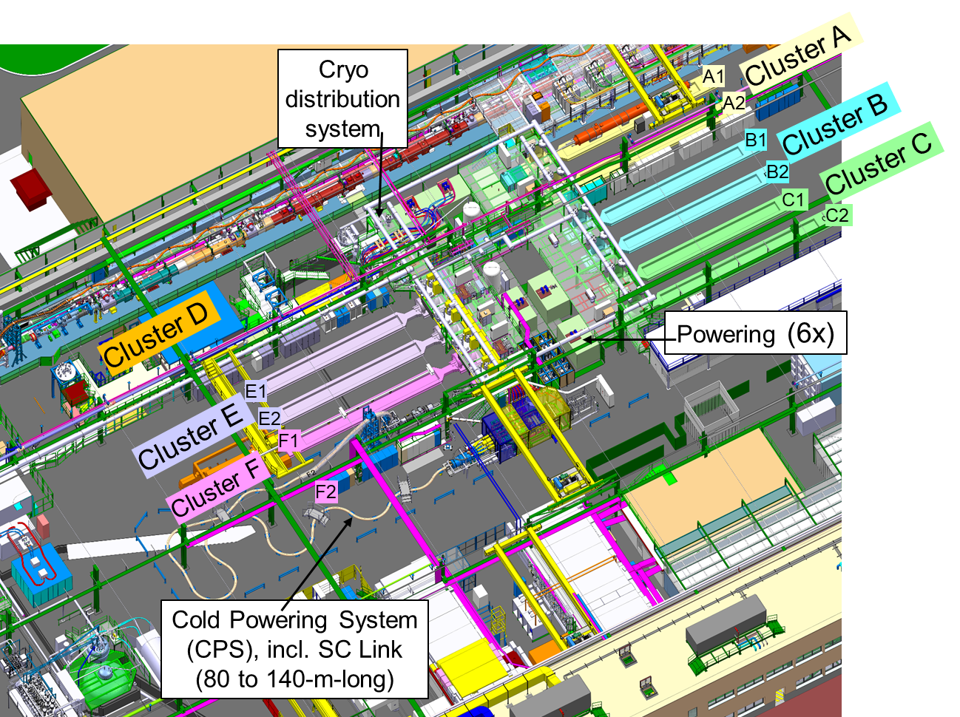
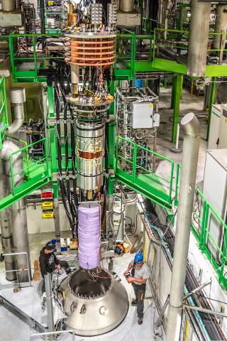
CERN SM18 Magnet Test Bench New Layout
Reconfiguration :
New vertical test benches
Upgrade of powering system
Reassignment of test benches based on dedicated LHC or HL-LHC components, considering space and handling constraints

Slide 10
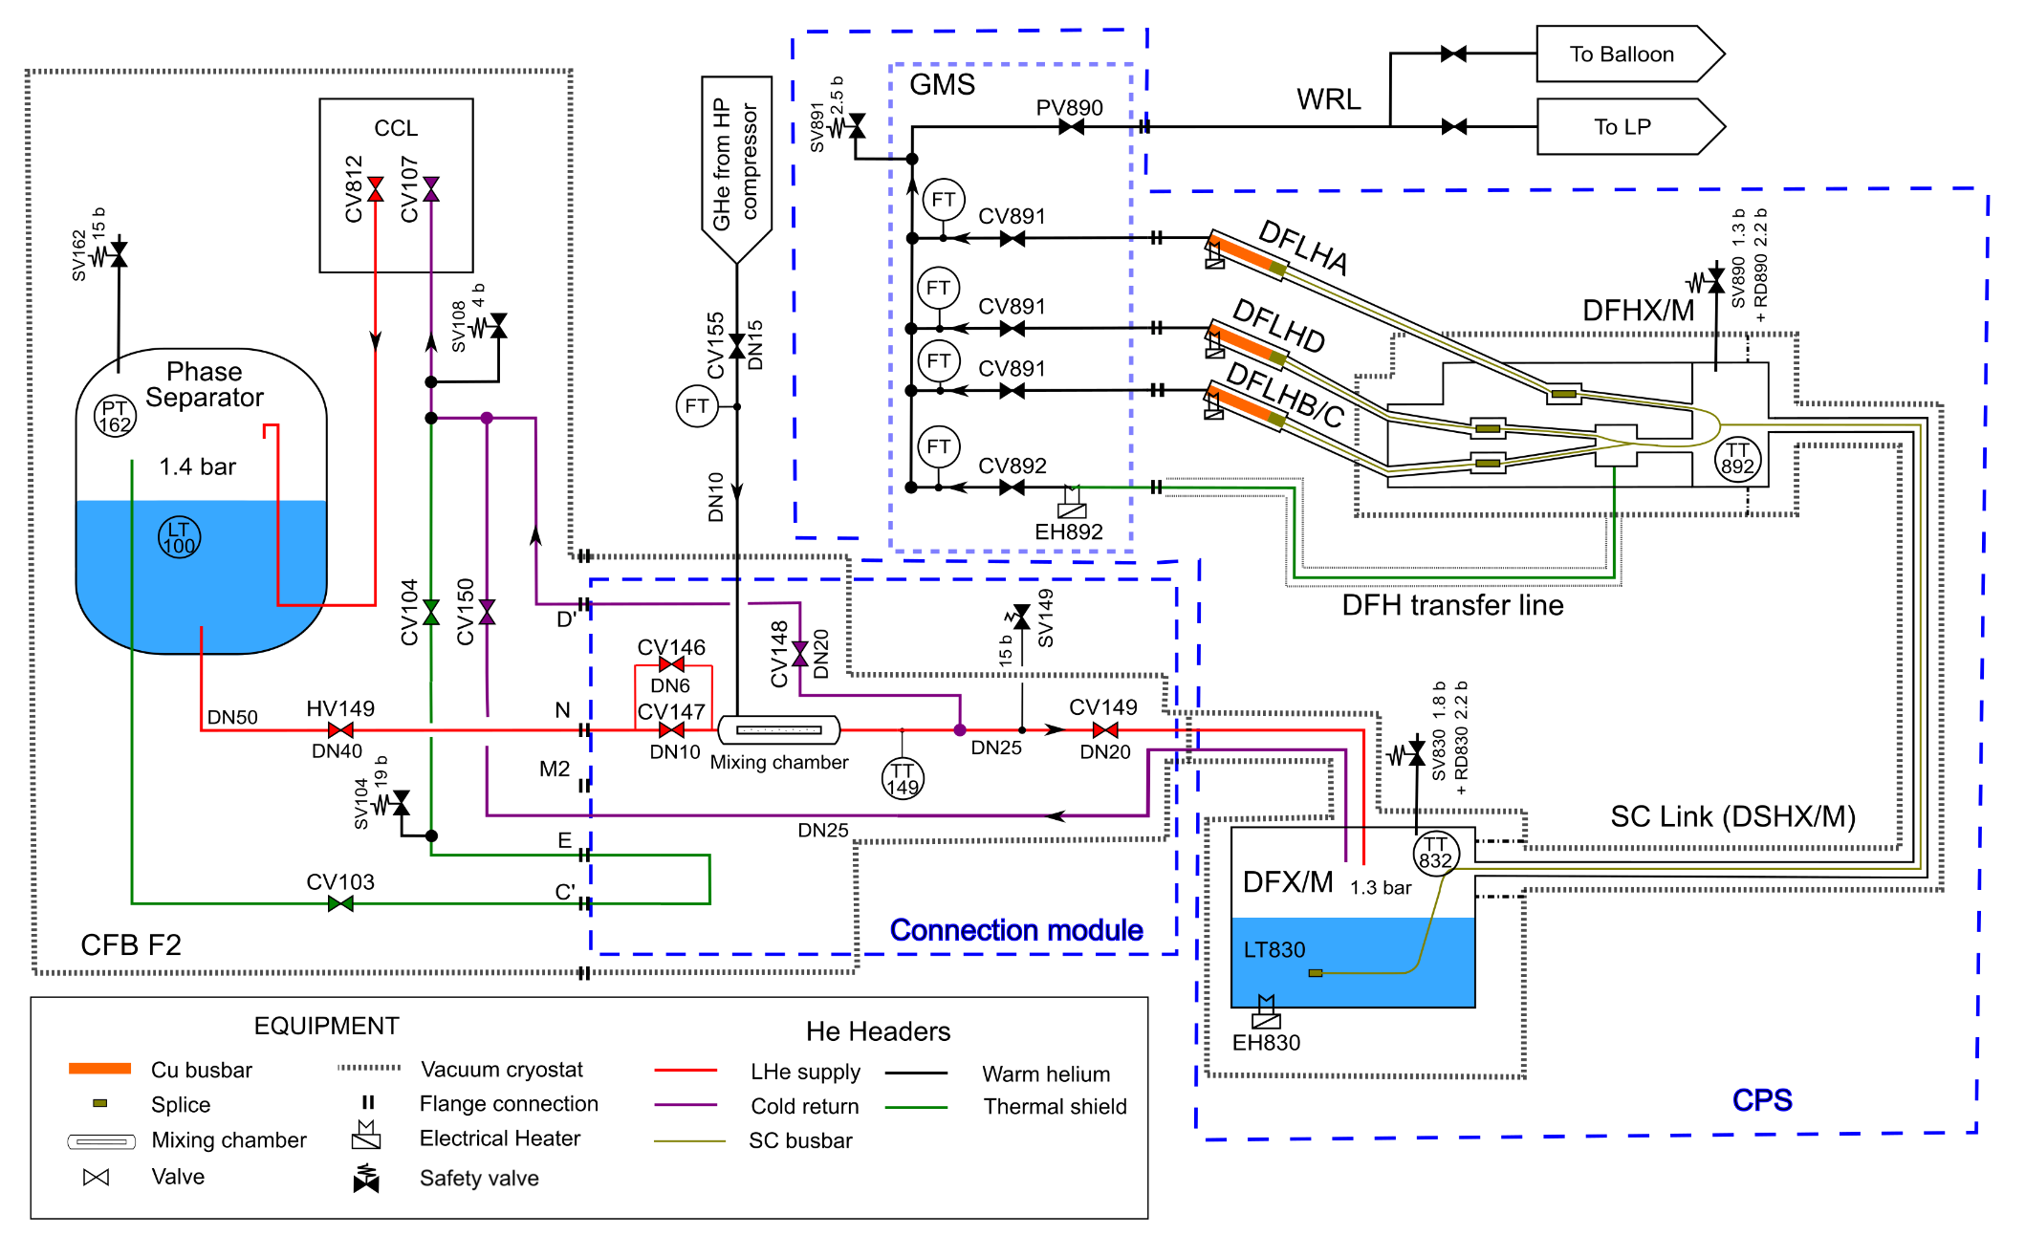
F2 Test Bench for Cold Powering System
Functional requirements for CPS:
Supply of LHe 4.5 K, 1.3 bar (max flow: 10 g/s)
Control of cool-down / warm-up of SC Link: max ΔT < 60 K,
(flow range: 2 - 4 g/s)
F2 upgrade : add a connection module between CFB and DFX/M, including a mixing chamber and control valves
CPS : DFX/M + SC Link + DFHX/M + GMS

Slide 11
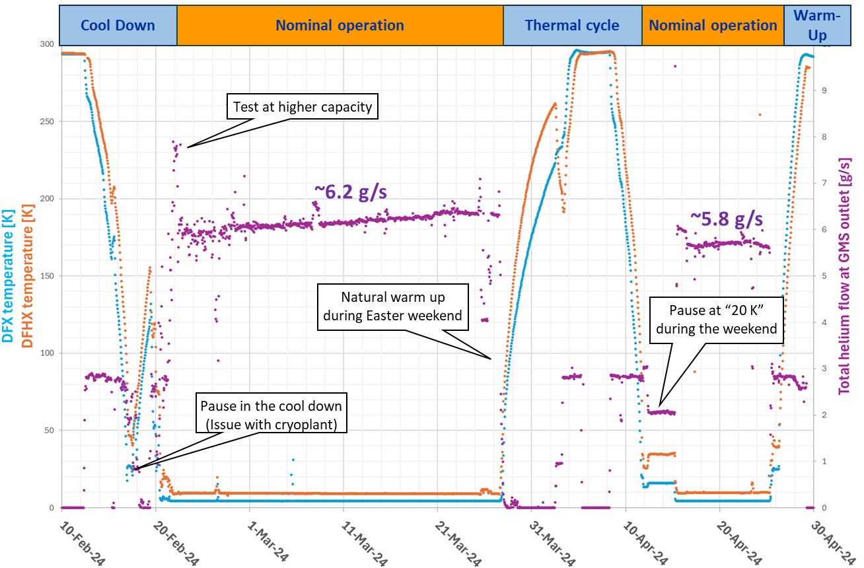
F2 Test Bench – first results
2024, successful commissioning of the Cold Powering System prototype for the HL-LHC Inner Triplets :
Two thermal cycles performed
Smooth control with the mixing chamber of SC Link temperature gradient during cool-down and warm-up (flow ~3 g/s)
~5.8 g/s needed for the nominal operation of the SC Link with 18 current leads (total 94 kA) in DFHX
Smooth operation during current transients

Slide 12
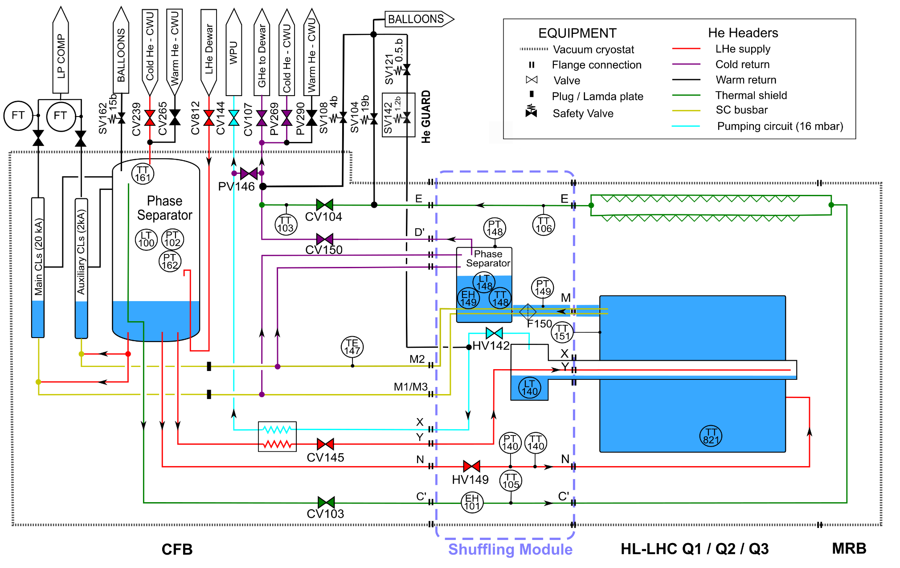
Test benches for HL-LHC magnets
Exchange of the four 0.6 kA current leads of A2 and F1 test benches by 2 kA ones
To accommodate for the geometric differences with LHC magnets and testing at 4.5 K, a Shuffling Module was added to benches A2, B2, F1 and C2.
The Shuffling Module includes :
Rerouting of the cryogenic headers and the SC busbars
A phase separator to enable testing at 4.5 K
Additional TTs to control temperature during cool-down and warm-up
A heater in the shield header to regulate the temperature

Slide 13
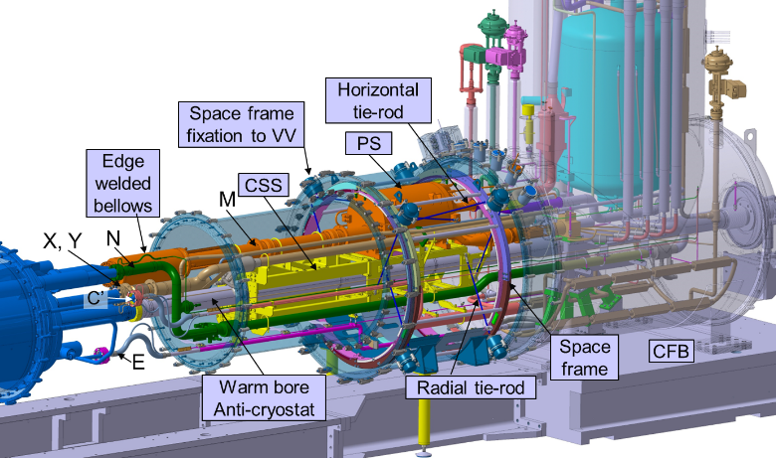
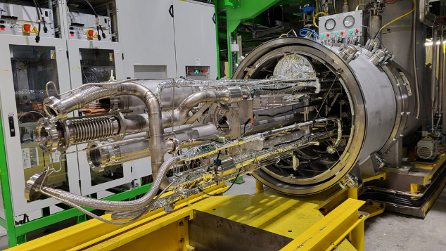
CFB with shuffling module
Complex design considering :
Rerouting the SC busbars into a top-positioned header through the phase separator (PS), where the liquid level is controlled to ensure continuous wetting
Cantilever system -> cantilever support structure (CSS) and a space frame with Ti tie-rods
Geometric constraints (not possible to raise the CFB)
Mechanical stresses, potential vibrations, and thermal shrinkage while ensuring good thermal performance

Slide 14
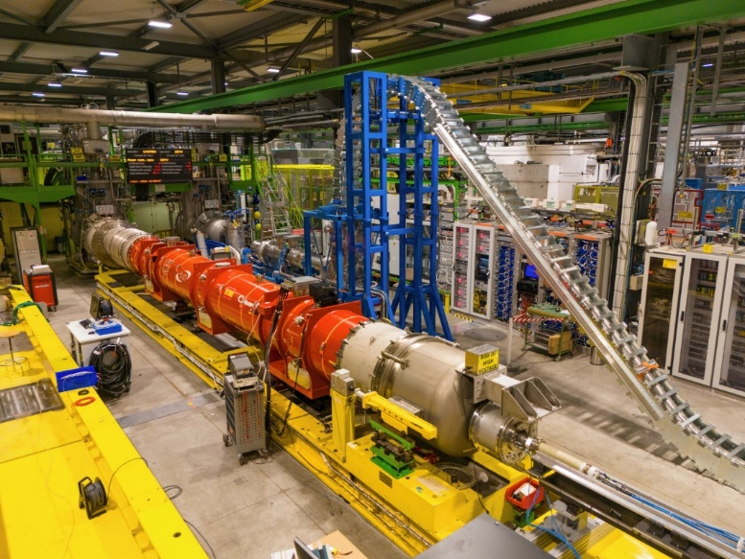
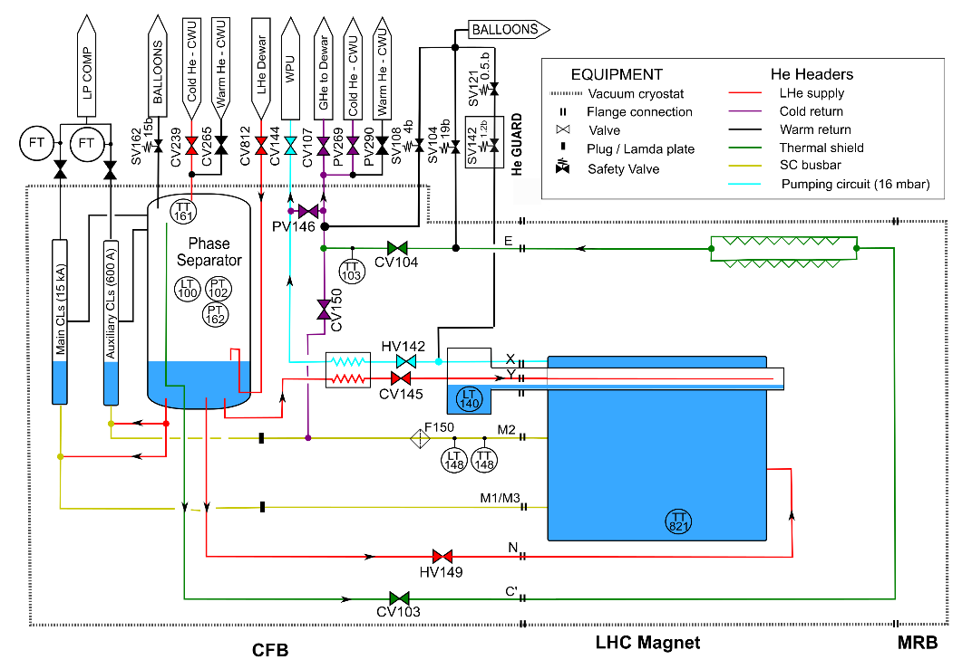

Experience with CFB upgraded with a Shuffling Module
In 2023, F1 was the first test bench upgraded with a SM, followed by A2, B2 and C2 in 2024
End 2023, successful commissioning of F1 test bench with a first Q2 HL-LHC magnet
One concern with cooling time from 4.5 K to 1.9 K because of temperature sensor moved to PS -> use of T sensor in magnet and update of process control logic
Q2 on F1 test bench
3 m long M-header
T sensor

Slide 15
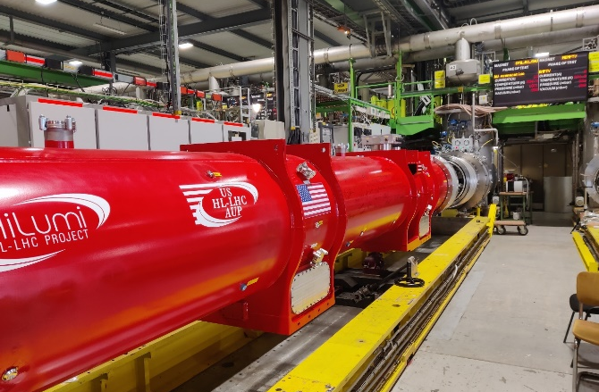
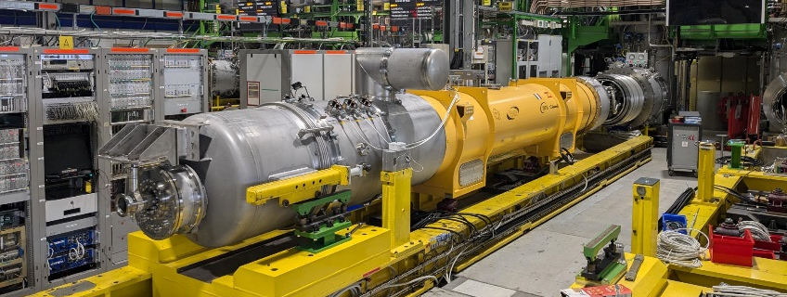
Experience with CFB upgraded with a Shuffling Module
In 2024, successful commissioning of A2 test bench with a first Q3 HL-LHC magnet from the US collaboration, followed by a first CP magnet. F1 test bench housed seven tests of Q2 HL-LHC magnets
In 2025, B2 and C2 test benches will be commissioned with D1 and D2 magnet. Tests with Q1, Q2, Q3 and CP will continue on test benches A2 and F1
CP on A2 test bench
Q3 on A2 test bench

Slide 16
CONCLUSION
CERN’s test facility, designed initially for serial testing of LHC magnets, has been reconfigured and upgraded to accommodate HL-LHC magnet assemblies and their Cold Powering Systems
This involved upgrading the powering capacity and adapting the complex interface of five CFBs
One of the test benches was adapted for testing the new HL-LHC Cold Powering System
A Shuffling Module was added to four CFBs, enabling all the modes required for testing HL-LHC magnet assemblies
In 2024, the Cold Powering System prototype was successfully tested and two upgraded test benches have already housed series testing of HL-LHC magnet assemblies.
Thank you for your attention

Slide 18

Simplified flow diagram for LHC test bench

Slide 19
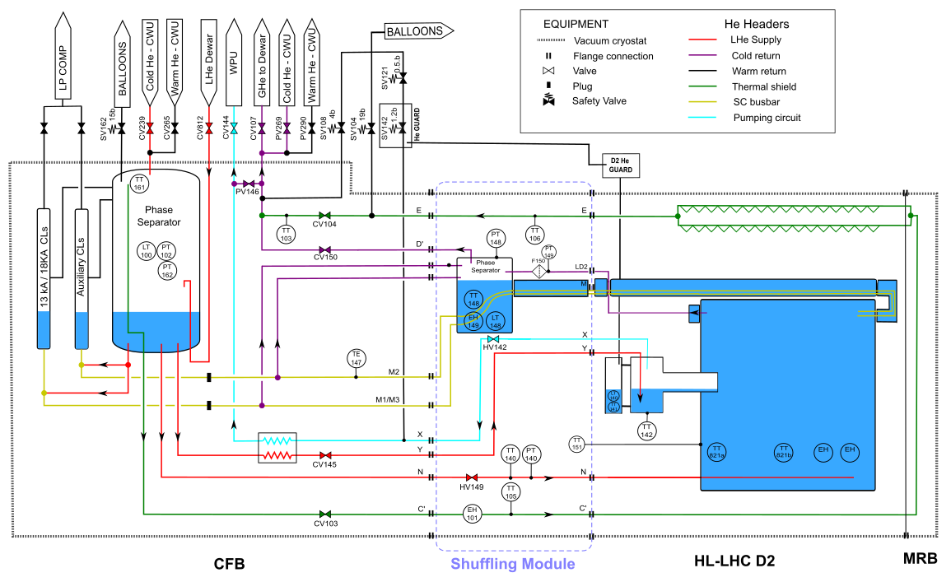
Simplified flow diagram for C2 test bench

Slide 20
Operation of magnet test bench with CFB
Precooling system from 300K down to 80 K and warm up from 5K to 300K
  Pressurized GHe is cool down by LN at 90 g/s
Operating temperature 1.9 K
  G/L heat exchanger in CFB
  L/L heat exchanger in the magnet
Recuperation of helium after quench – quench buffer
  Design pressure of the system is 20 bar
  Volume of LHe in the magnet about 220 l
  Volume of the quench buffer is around 1 m³
  As the quench buffer is small it is integrated directly in the CFB
All LHC magnets were tested on these 12 CFBs
Time schedule of a magnet test
  Purge of He circuits 1d
  Pumping of vacuum insulation & leak test 1d
  Cool down from 300 K down to 80 K 11h
  Cool down from 80 K down to 4.5 K and filling by LHe 5+1h
  Pumping down to 1.9 K 4h
  Magnetic test
  Quench recuperation 4h/quench
  Warm up 14 h

Slide 21
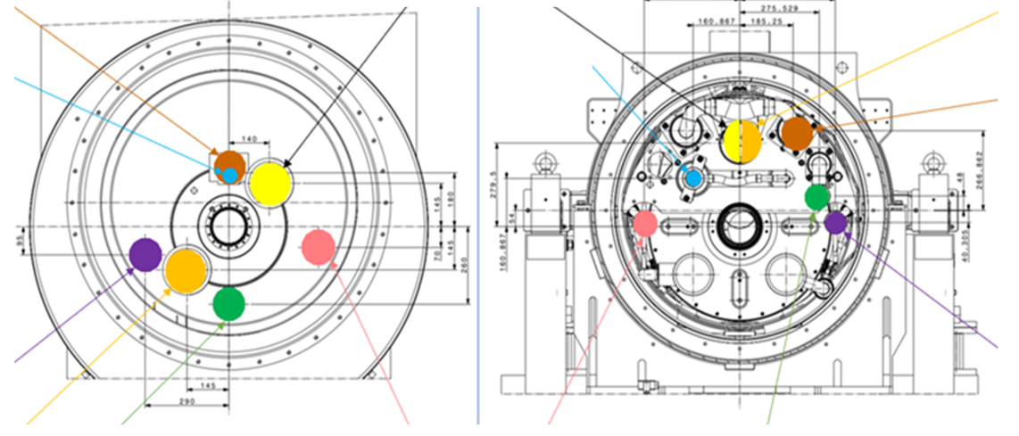
CFB/LHC magnet vs HL-LHC Q1/Q2/Q3 magnet
X
M2
M2
M3
Y
Y
X
E
E
M3
N
C’
C’
N
CFB section (LHC magnet, cold mass Ø 570 mm)
Section of an HL-LHC Q1/Q2/Q3 magnet cold mass Ø 630 mm

Slide 22
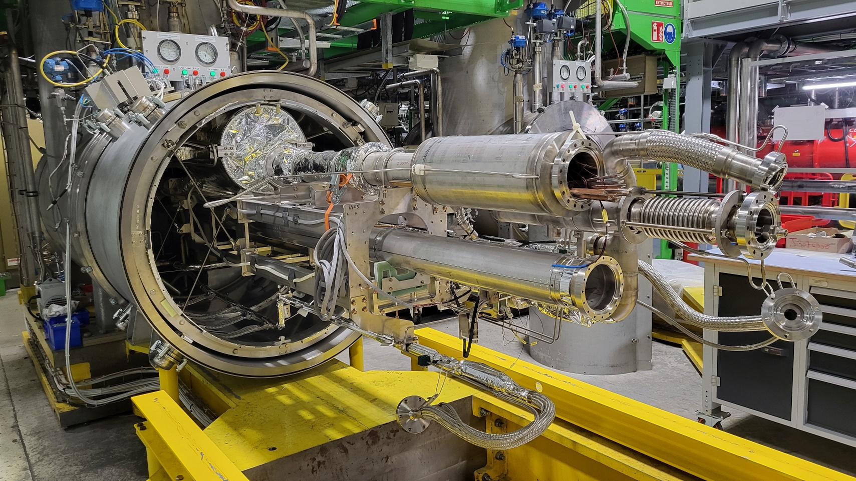
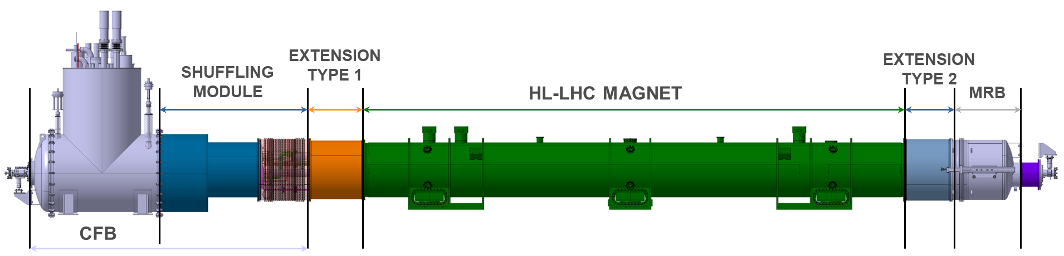
Addition of a shuffling module to CFB

Slide 23
Layout of the HL-LHC interaction region
(upper part)
(lower part)

Slide 24
Layout of the HL-LHC Cold Powering System

