Slide 1

Elimination of Training in Nb₃Sn and NbTi Superconducting Magnets
Emanuela Barzi (Muons Inc), Dan Turrioni (FNAL), Igor Novitski (FNAL), Elena Tamagnini (Politecnico
di Torino), Alexander Zlobin (FNAL), Masaki Takeuchi (RIMTEC) and Akihiro Kikuchi (NIMS)
May 19, 2025
2025 Cryogenic Engineering Conference (CEC) and International Cryogenic Materials Conference (ICMC)
Notes:
Good morning, everyone. My name is Elena Tamagnini, and I’m a master’s student in Nuclear Engineering at Politecnico di Torino (in Italy). I’m pleased to be here at CEC and ICMC to present work titled ‘Elimination of Training in Nb₃Sn and NbTi Superconducting Magnets” ON BEHALF OF MY ADVISOR EMANUELA BARZI. Cosi’ ti metti al riparo se non sai rispondere a tutte le domande.

Slide 2
Outline
Introduction
What was done
New results
Conclusions

Slide 3
Introduction
Superconducting magnets are impregnated with epoxy to improve their insulating and mechanical properties.
CTD-101K is the epoxy used in modern accelerator due to low viscosity and long pot life.
However, epoxy cracking during operation under large Lorentz forces leads to heat release which causes long magnet training.
A new impregnation resin called TELENE® was developed at RIMTEC, Japan, and is being studied within an US-Japan collaboration to reduce magnet training.
Examples of long NbTi and Nb₃Sn undulator magnet training
Notes:
[read text on the left]
Plot: some examples of long NbTi and Nb₃Sn undulator magnet training
Focus on the fact that with NbTi quenches at lower values of current with respect to Nb₃Sn

Slide 4
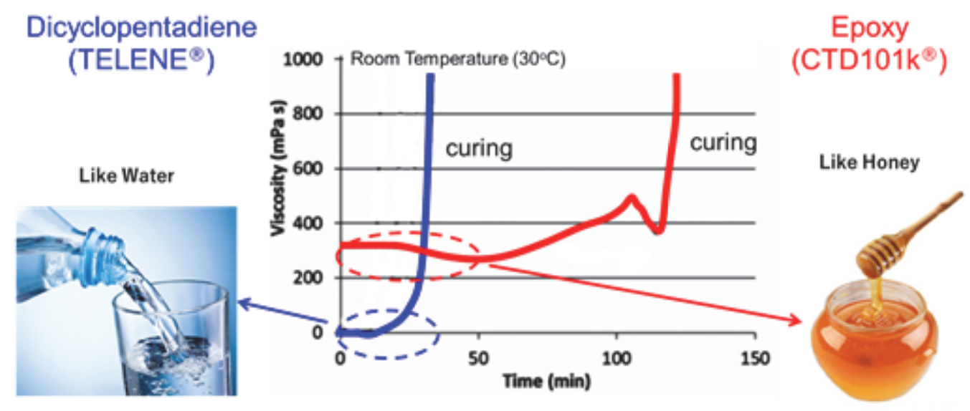
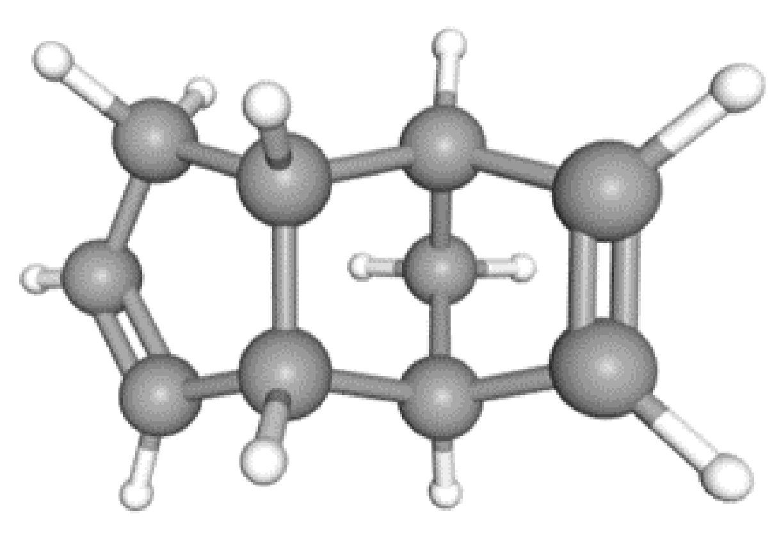
What is TELENE®
A novel organic olefin-based thermosetting dicyclopentadiene (DCP) resin, commercially available as TELENE® at RIMTEC.
Dicyclopentadiene (C₁₀H₁₂)
Notes:
Telene is a novel organic olefin-based thermosetting dicyclopentadiene (DCP) resin, named as TELENE® at RIMTEC.
Here you can see its molecular geometry
Epoxy is like honey, while TELENE is like water. In fact, epoxy has a quite high viscosity (about 300mPa s), while TELENE viscosity is close to zero. The only problem is that the pot life (amount of time the material remains usable before it begins to harden) of TELENE is quite small (at room temperature is about 15 mins).

Slide 5
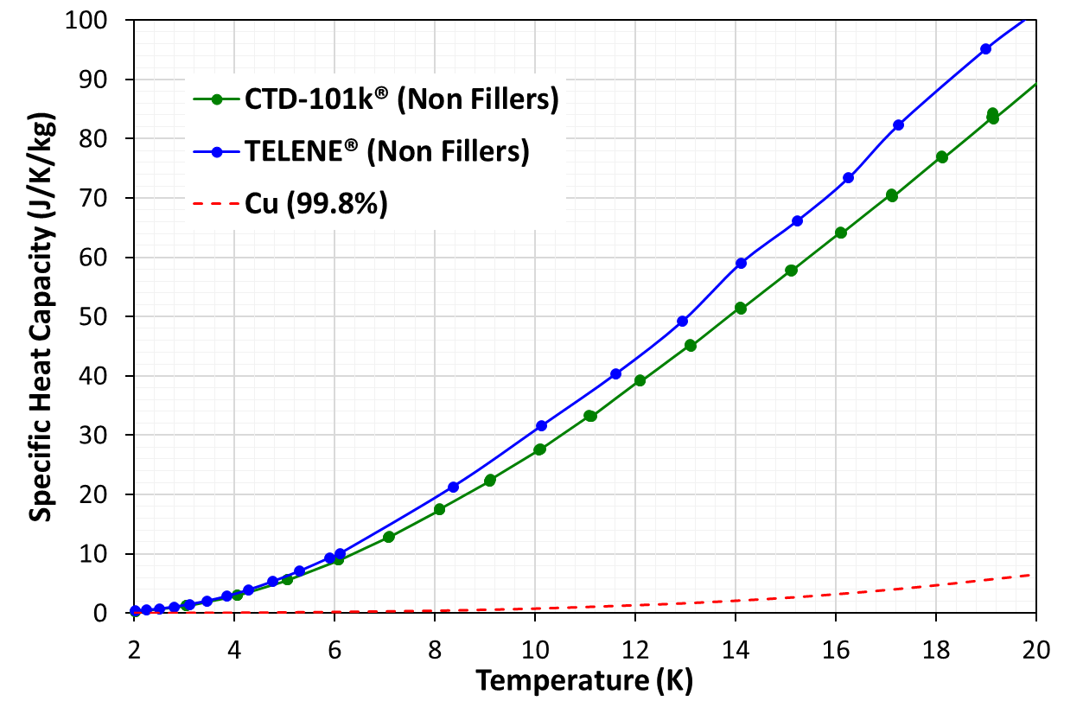
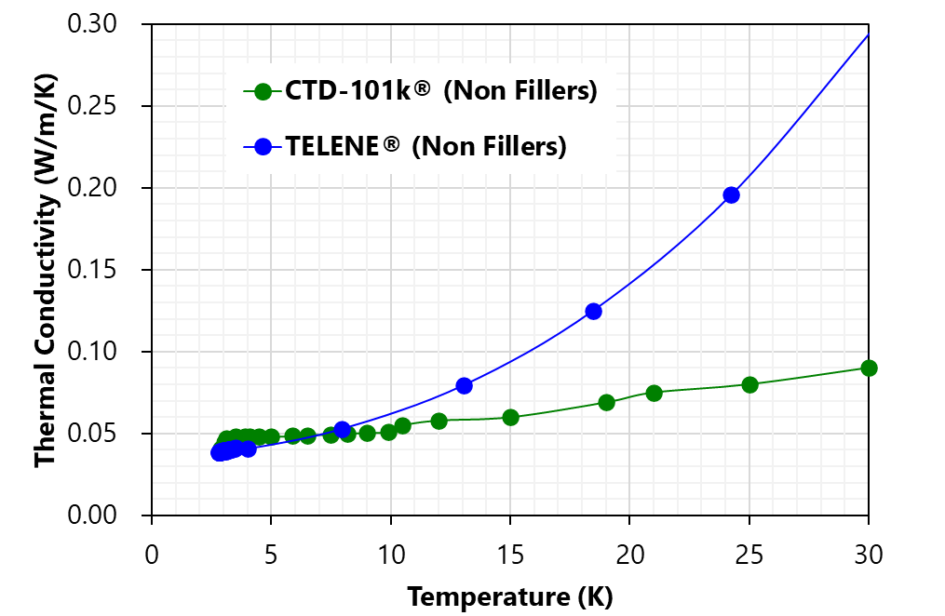
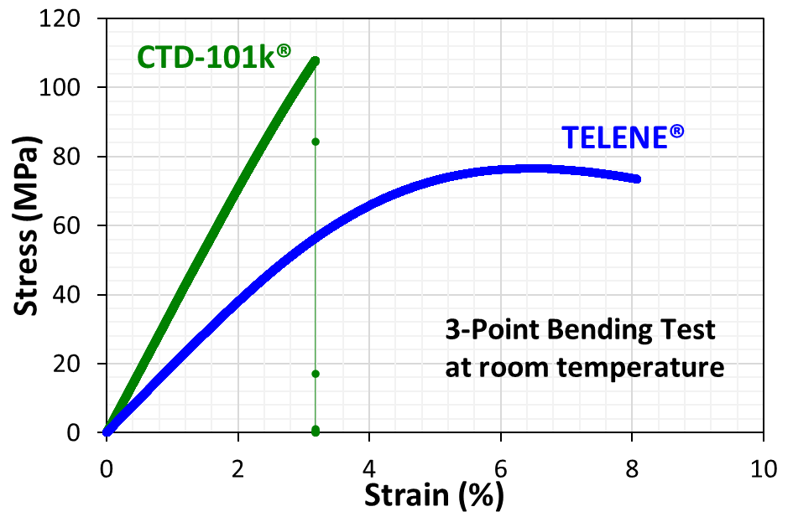
Why TELENE?
Specific heat C_{p} is only somewhat larger than for epoxy
Thermal conductivity is larger than for epoxy
It accepts much larger strains than epoxy, also at cryogenic temperature
Notes:
[read the caption, focusing on the stress-strain plot: epoxy has a fragile behavior, while TELENE is ductile at T cryogenic, so it exhibits higher toughness] – Attenzione: E’ stato verificato alla Rimtec che la duttilita’ (presentata qui a temperatura ambiente) permane alla temperatura dell’azoto liquido.

Slide 6
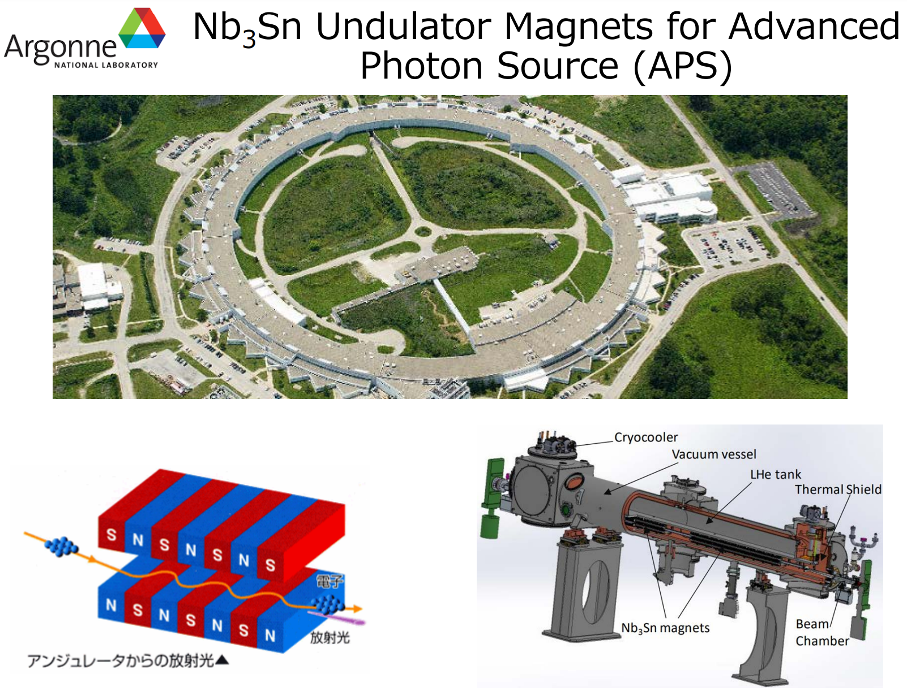
TELENE in Superconducting Undulators
The first studies with TELENE were performed using Nb₃Sn undulator models developed at ANL for the APS.
5 periods undulator short models were fabricated at ANL with an S2-glass braided 0.6 mm Nb₃Sn wire.
After winding, the magnets were heat treated at FNAL in argon using well-established treatment cycles.
Then they were impregnated with TELENE at FNAL.
Finally, they were tested at FNAL in the Superconducting R&D lab, using a new DAQ hardware&software system for quench protection.
Notes:
First tests of TELENE performed on a small Nb₃Sn undulator models :
[read text]

Slide 7
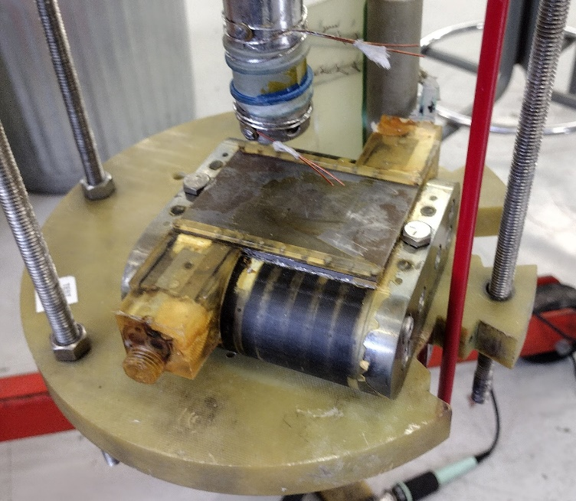
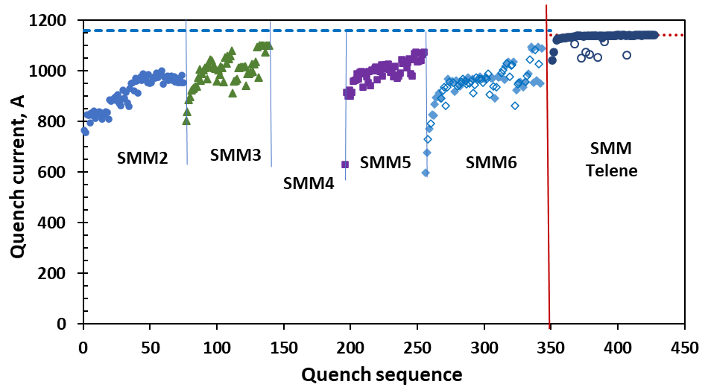
Nb₃Sn Undulator Training
Performance reproducibility but long training on this side
SSL of 1,140 A reached after two quenches
1000 A
820 A
Small undulator magnets SMM3 to SMM6 on this side nearly identical and impregnated with standard CTD-101K epoxy
Training elimination allows reducing the operation margin of these magnets by increasing the operation current from 820 A to at least 1000 A.
Notes:
On this plot, it is possible to see the training of 5 small undulators (SMM2, SMM3, etc…), which are nearly identical (in design) and impregnated with standard CTD-101 epoxy. Nota: SMM4 era danneggiato e per questo non si vedono i dati.
These values can be compared with the ones obtained with the small undulator impregnated with Telene, which needs only 2 quenches before reaching its SSL limit value of 1140A, almost equal to the value of the SSL (short-sample limit), equal to 1143A.
[Figure of this SMM on the right]

Slide 8
Impact
The best Nb₃Sn undulator magnets for the ANL Advanced Photon Source showed performance reproducibility but long training, which did not allow obtaining the expected 50% increase of the on-axis magnetic field with respect to the ~1 T produced in the ANL NbTi undulator.
By replacing the CTD-101K® epoxy with TELENE®, training and magnet retraining after a thermal cycle were nearly eliminated, with only a couple of quenches needed before reaching short sample limit over 1,100 A. This allows increasing the operation current to at least 1000 A, i.e. a 40% increase of the on-axis field.
Because of its superior ductility and toughness, TELENE will thus enable operation of Nb₃Sn undulators much closer to their short sample limit, expanding the energy range and brightness intensity of light sources.
TELENE is Co-60 gamma radiation resistant up to 7-8 MGy, and therefore already applicable to impregnate planar, helical and universal devices operating in lower radiation environments than high energy colliders.
Notes:
Vedi plot in backup slide no. 16.

Slide 9
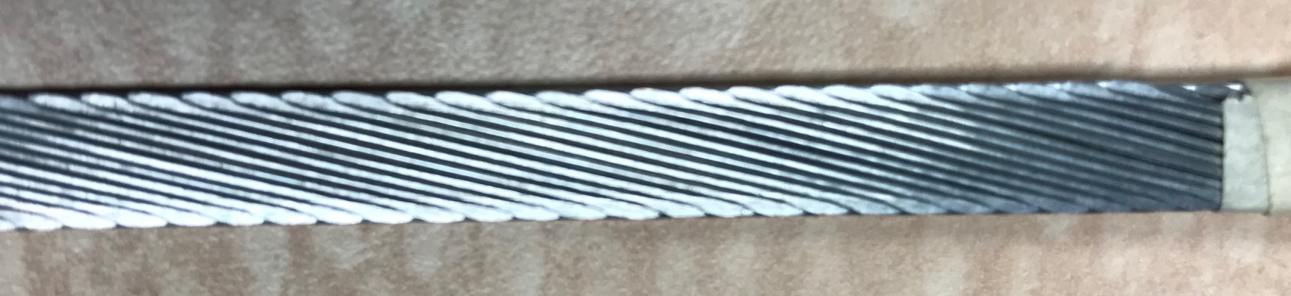
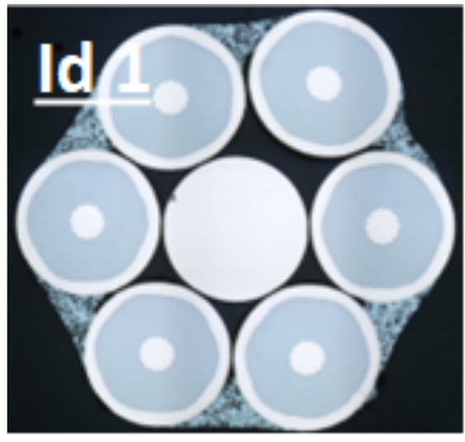
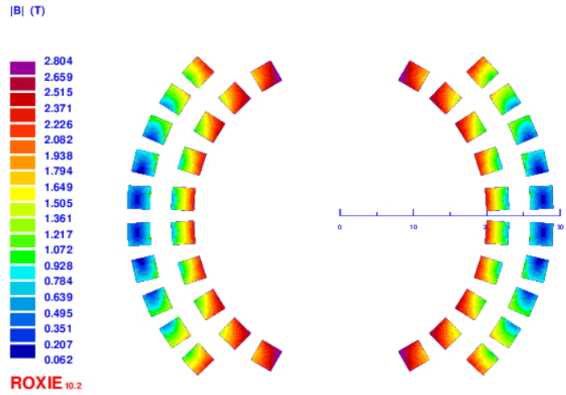
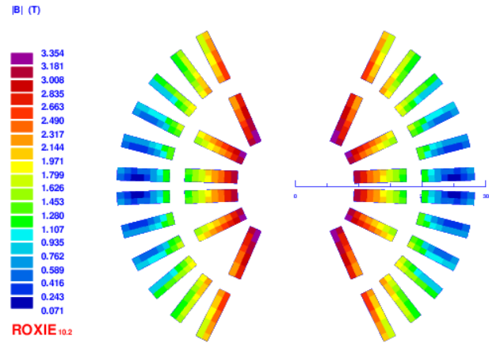
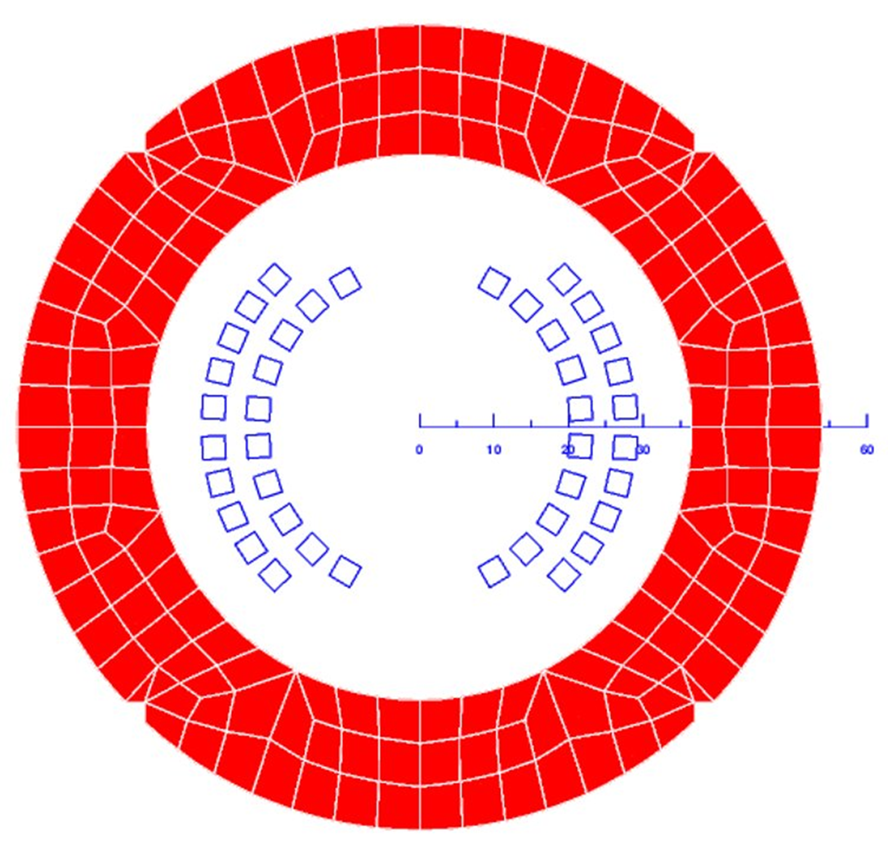
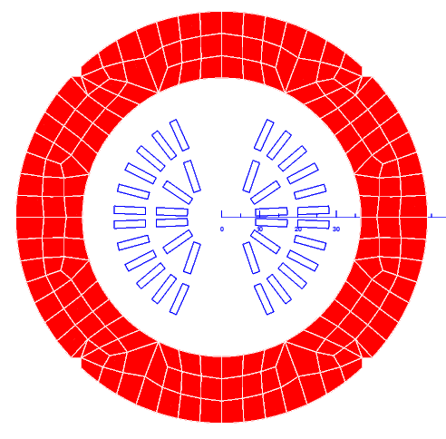
NbTi Small Dipole Coils
34 strands LHC Type 5 cable
8.3 mm wide
6/1 round cable
2.4 mm wide
L_{coil}=35 μH
TELENE tests continue with small dipole coils based on Nb-Ti cables
  6/1 round cable
  Rutherford-type with keystoned cross-section
Two-layer coils
Cold iron yoke
L_{coil} = 60 μH
SSL = 6,300 A
SSL = 9,200 A
Notes:
Another test of TELENE has been done on small dipole coils based on Nb-Ti cables
Coils with the following characteristics: [read points on the slide]
6/1 si dice “6 around 1”
[read table]

Slide 10
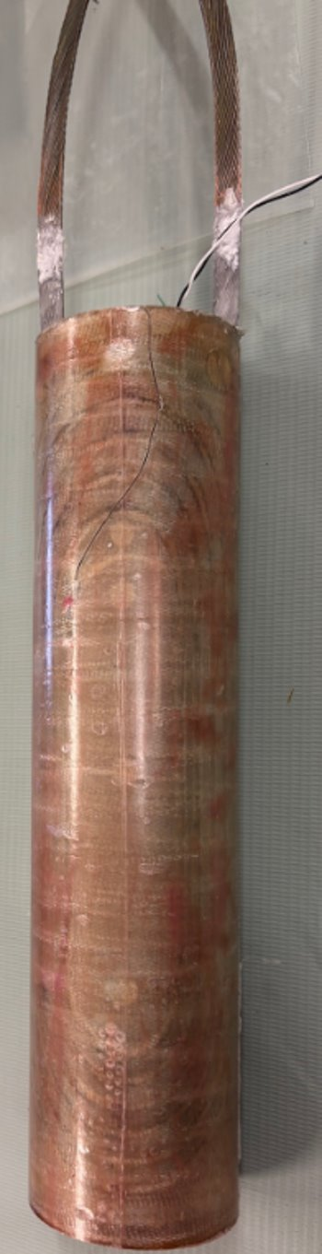
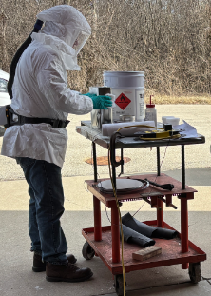
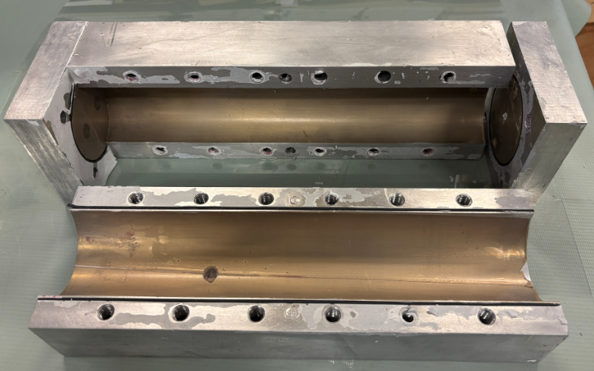
Coil Impregnation with TELENE
Aluminum vacuum impregnation fixture
RECIPE
Mix 100 parts of DCP monomers with 2 parts of hardener at 5° to 30°C.
Cure Cycle is 1.5 hours at 25ºC for followed by 1 hour at 120ºC.
Impregnated dipole
Notes:
Here you can see the process of impregnation of the coil with TELENE

Slide 11
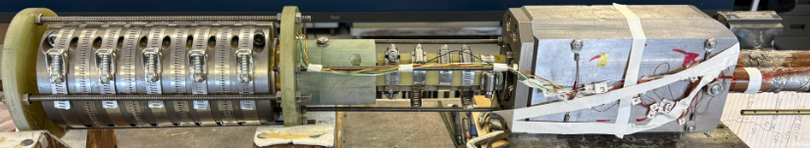
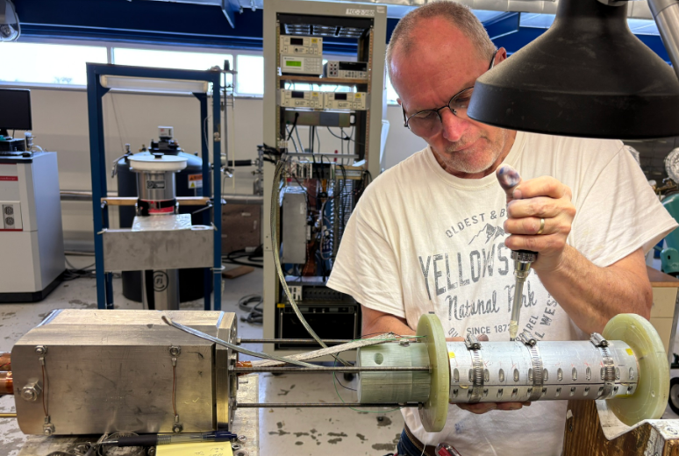
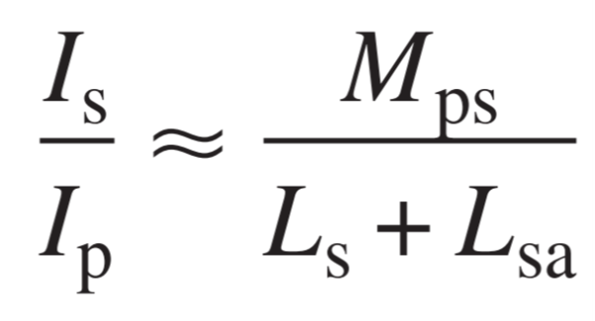
Small Coil Test System
Transformer primary and secondary coils
Lead splice area
Instrumentation wires
Test coil with iron yoke
ORIGINAL TRANSFORMER FOR RUTHERFORD CABLE TESTS UP TO 25 kA and 15 T
MAXIMUM SECONDARY CURRENT IN TRANSFORMER DEPENDS ON:
MAX. COIL LENGTH = 35 cm
2400 A – 8 V PS
NI compact RIO DAQ
Notes:
Qui Ip e’ la corrente che si manda nel primario col power supply; Is e’ la corrente che si induce nel secondario; Mps e’ l’induttanza mutua tra primario e secondario; Ls e’ l’induttanza del secondario; Lsa e’ l’induttanza del campione collegato al secondario: quando il nostro campione era un cavo Rutherford (bifilar sample) Lsa era trasurabile, ma ora che testiamo dei dipoli Lsa e’ di varie decine di microhenry (vedi due slide successive).
Here there is the small coil test system represented (with Test coil with iron yoke, lead splice area, transformer primary and secondary coils and instrumentation wires).
[read bullet points]
Focus on the equation, where Mps is the mutual inductance between the primary and secondary, Ls is the inductance in the secondary, Lsa is the inductance of what is connected to the secondary (in this case the dipole, so this value is not negligible anymore, about dozens of uH)

Slide 12
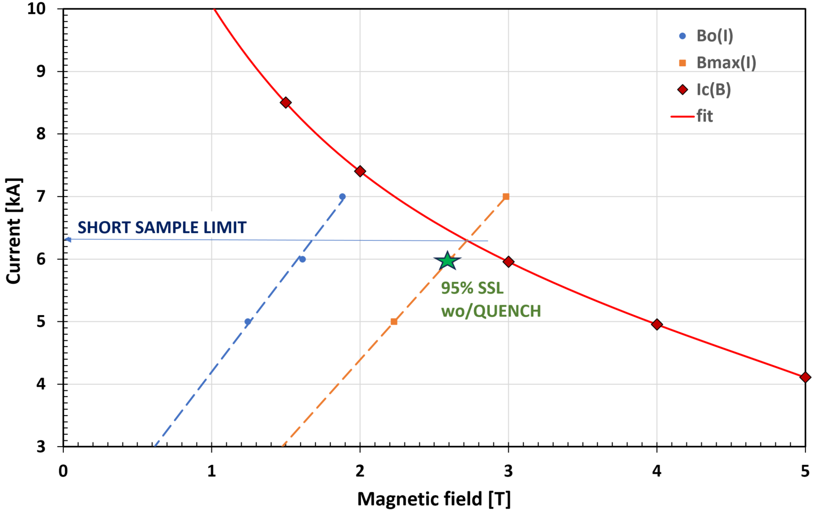
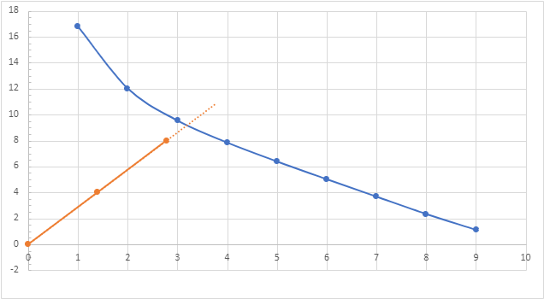
Test Results
SSL
Current [kA]
9200 A
6300 A
87% SSL wo/QUEMCH
Magnetic field [T]
NbTi insert dipole reached ~6000 A, i.e. 95% of its short sample limit without quenching
I_{max} = 6 kA was limited by the transformer primary coil => primary coil was then upgraded to one with 2+ times the inductance
NbTi larger insert dipole reached ~8000 A, i.e. 87% of its short sample limit without quenching
I_{max} = 8 kA => Upgraded primary coil still under training, test continues
Notes:
2 test have been made:
Figure on the left (1 test): [read bullet points]
After the upgrade of the primary coil of the transformer it was possible to do a second test, and the results are shown in the figure on the right: [read bullet points]
Metto una slide in backup (slide 23) per mostrare che upgrade sono stati fatti sul primario.
“2+ times the inductance” vuol dire “piu’ del doppio dell’induttanza precedente”
Qui bisogna far presente che in entrambi i casi i coil di NbTi non hanno quenchato a correnti molto vicine a quella critica, contrariamente a quello che accade coll’epoxy, per cui iniziano a quenchare sotto il 50% della Corrente critica!!!!

Slide 13
Conclusions
a). TELENE® was successful in preventing training in the Nb₃Sn ANL undulator.
When replacing CTD-101K with TELENE as impregnation material, training and magnet retraining were nearly eliminated before reaching short sample limit at over 1,100 A.
By operating at 1000 A, an on-axis maximum magnetic field of ~1.4 T is produced, which is a 40% increase with respect to the NbTi undulator.
TELENE will therefore enable operation of Nb₃Sn undulators much closer to their short sample limit, expanding the energy range and brightness intensity of light sources.
b). TELENE was successful in preventing quenching
Up to 95% of its short sample limit (because of the test system current limits) in a NbTi dipole made of 6/1 round cable.
Up to 87% of its short sample limit (because of the test system is still under commissioning) for a larger NbTi dipole made with Rutherford cable.
These results are readily applicable in the NbTi solenoids used in the Magnetic Resonance Imaging (MRI) industry to solve the solenoid training problem.
The transfer of TELENE technology to the MRI industry will have transformative societal impact on global health.
Funded through a U.S.-Japan Science and Technology Cooperation Program in HEP, DOE

Slide 14

Thank you for the attention!
Notes:
Thank you all for the attention and thank the organizers for this opportunity.

Slide 15
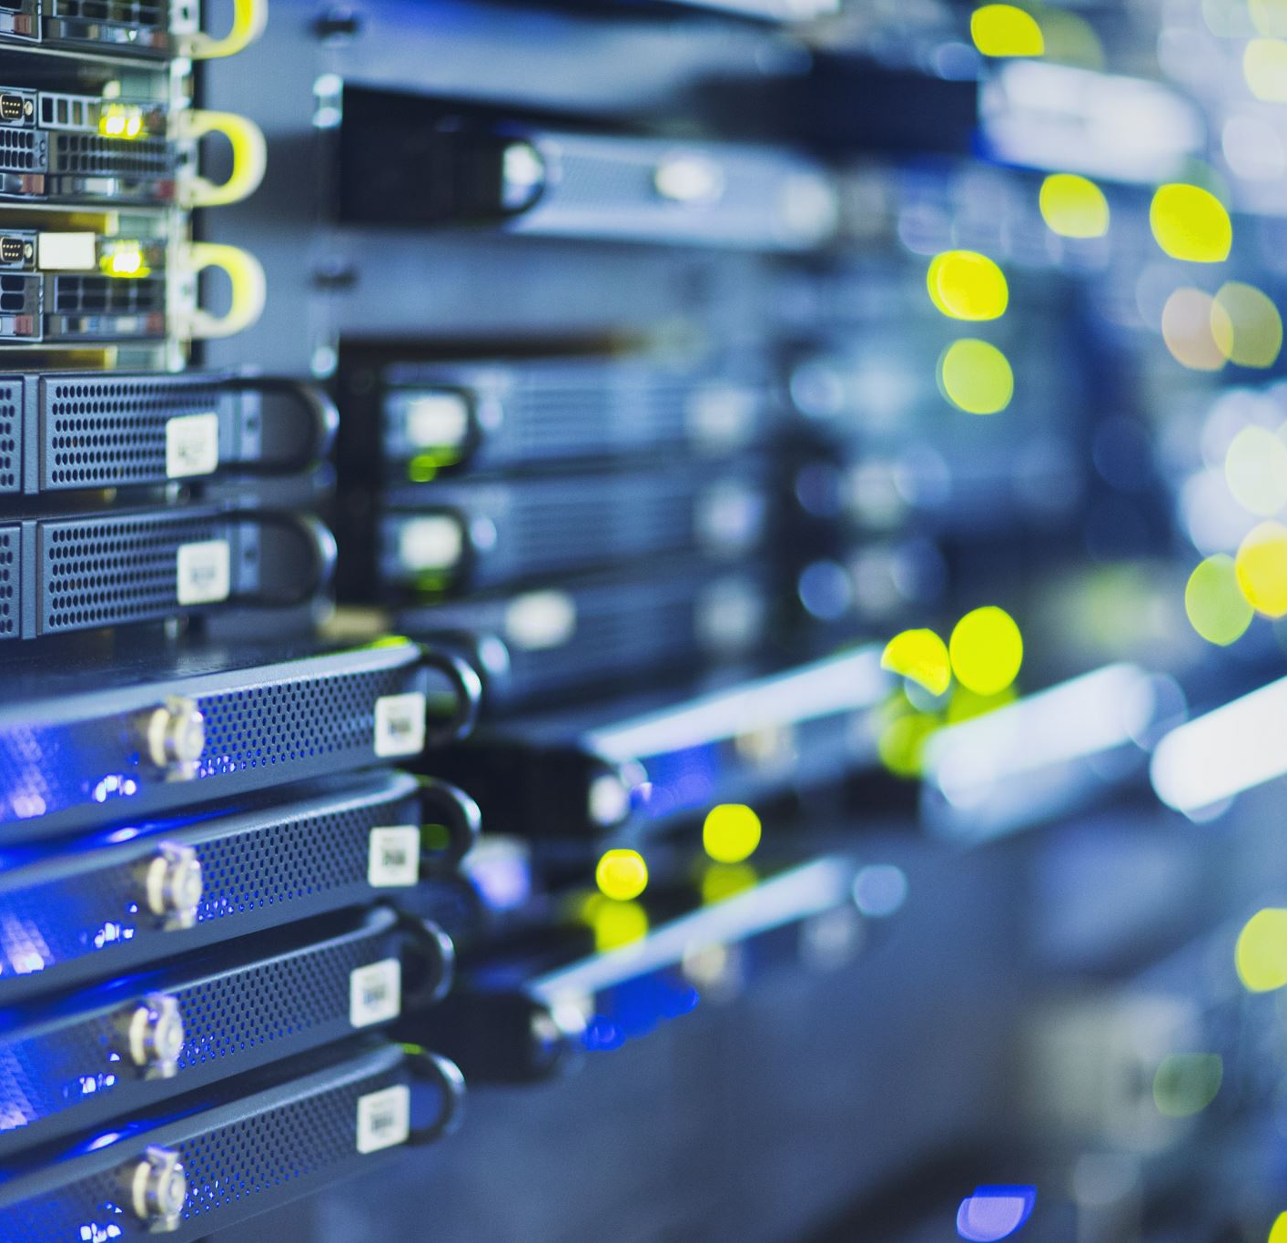
Backup

Slide 16
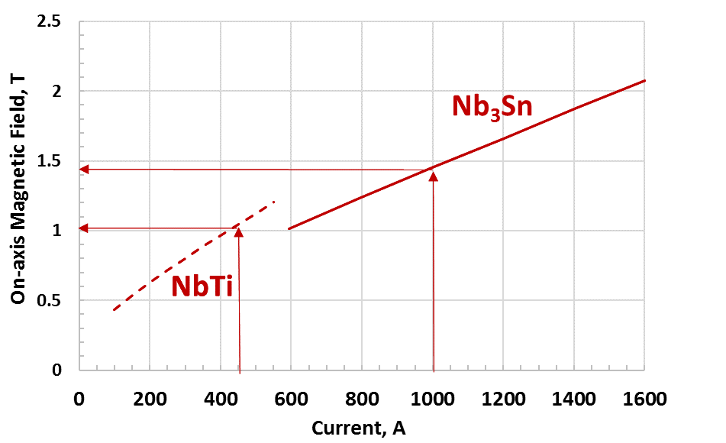
NbTi vs. Nb₃Sn APS (ANL) Undulator Performance
On-axis Magnetic Field (18 mm period length)

Slide 17
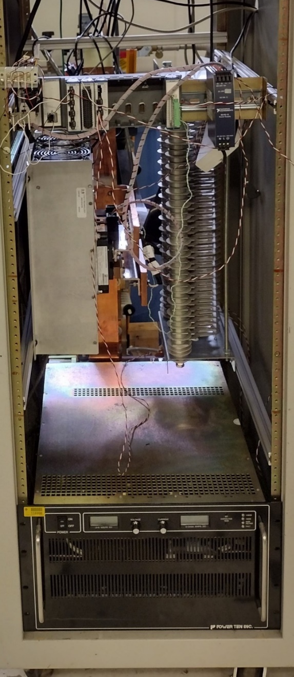
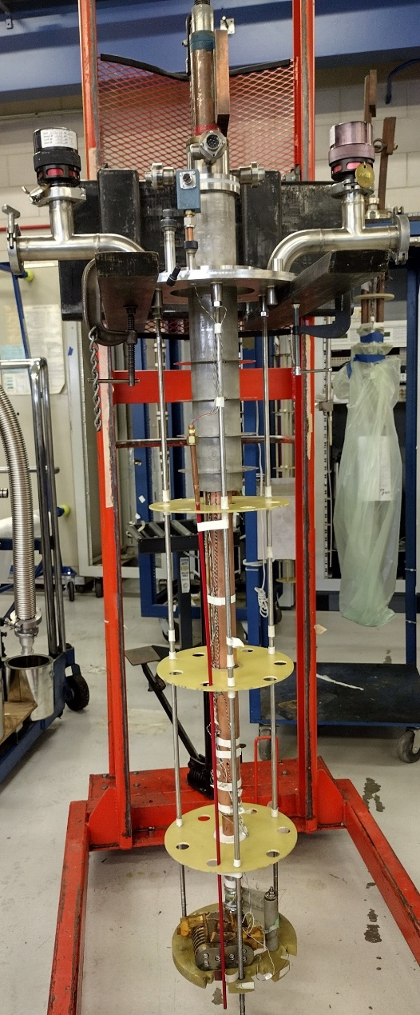
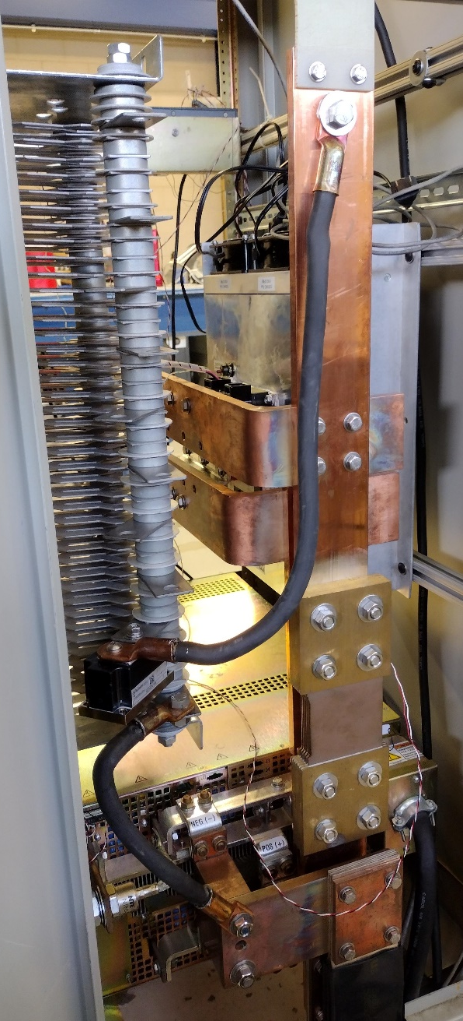
New FNAL DAQ/Quench Protection System
PROBE
NI cRIO-9073 DAQ
A quench protection system with a fast IGBT (insulated gate bipolar transistor) switch, dump resistor and a NI compact RIO DAQ system was used.
IGBT switch
Dump resistor
2400 A, 0-8 V Power Supply
REAR

Slide 18
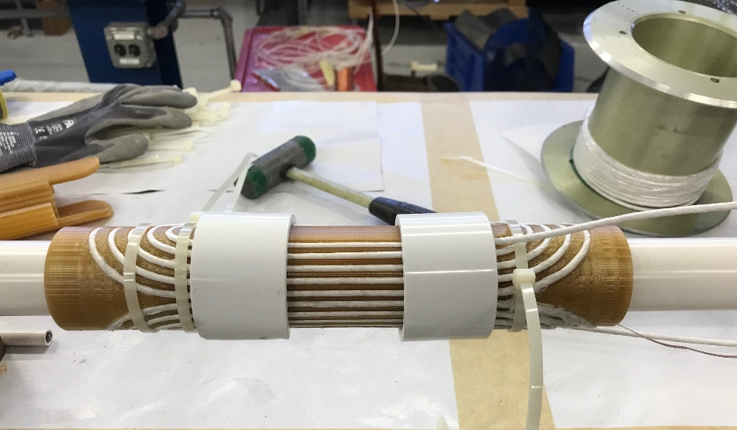
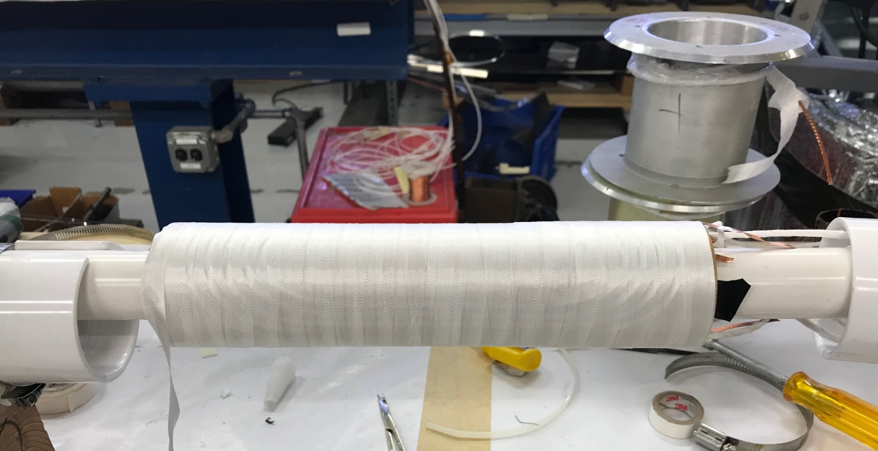
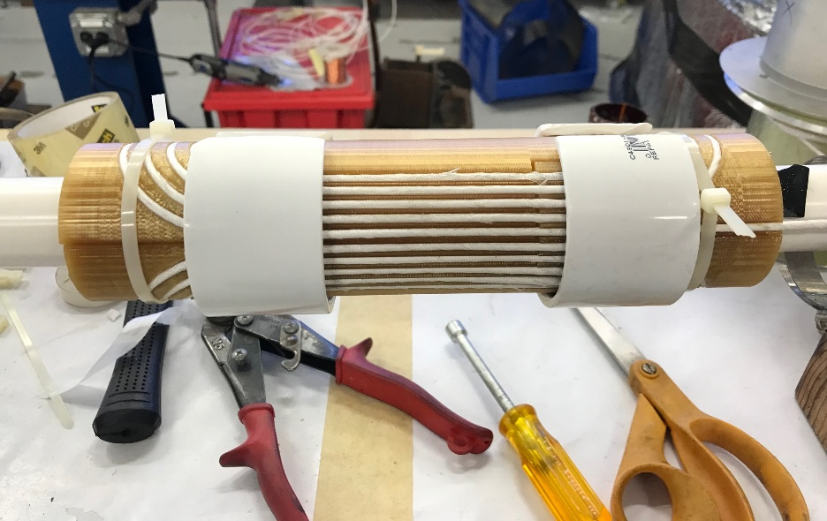
Coil Winding and Insulation
Two-layer coils are wound using single piece of cable in 3D printed Ultem mandrel
Coil inter-layer and outer layer insulation with E-glass tape
Notes:
Here you can see the process of winding and insulation:
Inter-layer winding
outer-layer winding
Coil inter-layer and outer layer insulation with E-glass tape (Two-layer coils are wound using single piece of cable in Ultem mandrel)

Slide 19
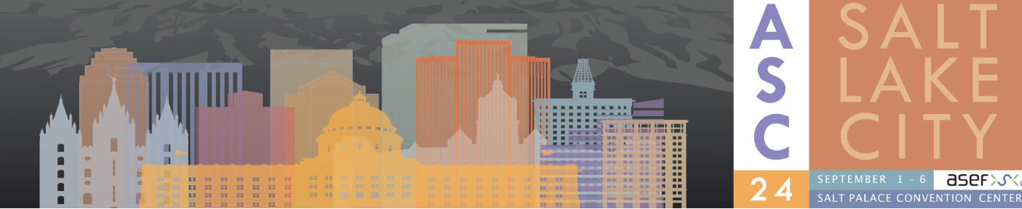
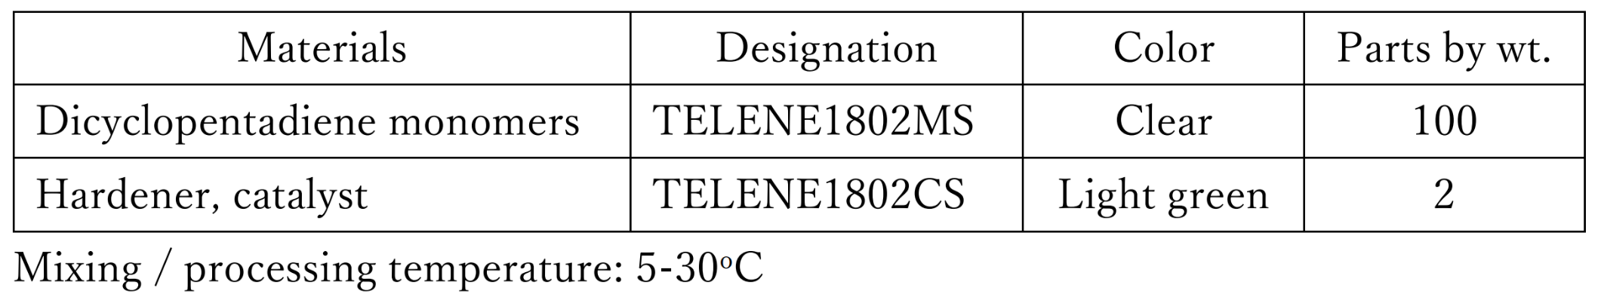
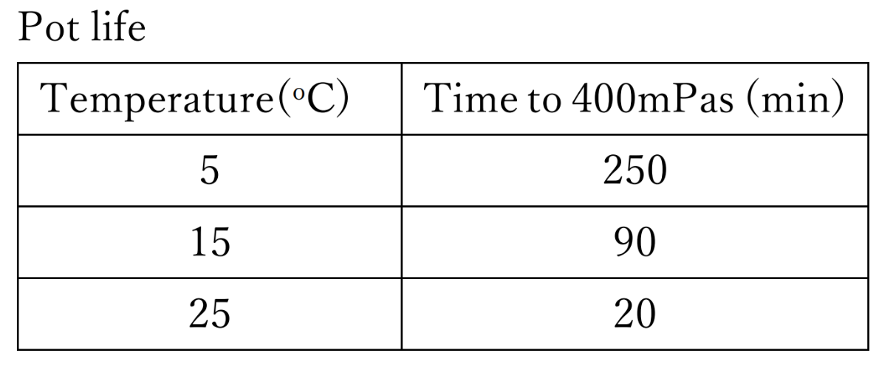
Properties (1)
Cure Cycle
1.5 hours at 25ºC for followed by 1 hour at 120ºC.

Slide 20
Properties (2)

Slide 21
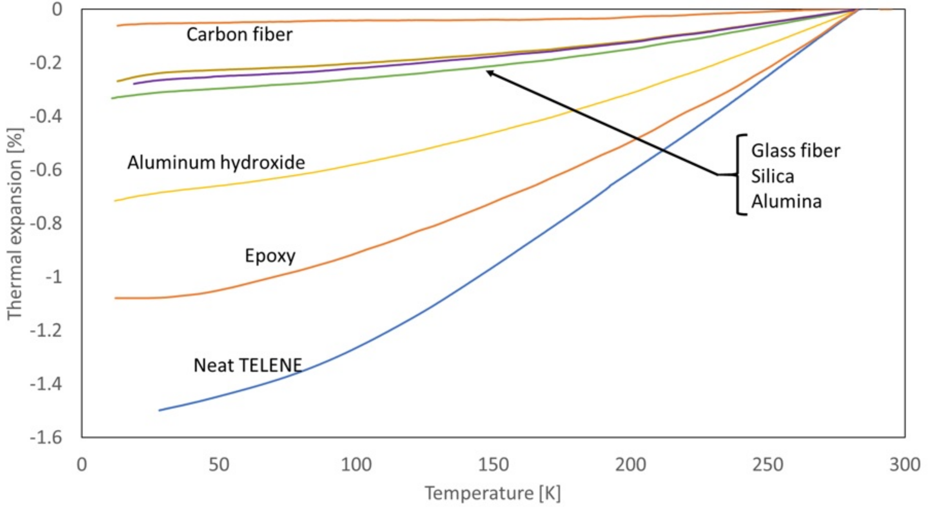
Properties (3)

Slide 22
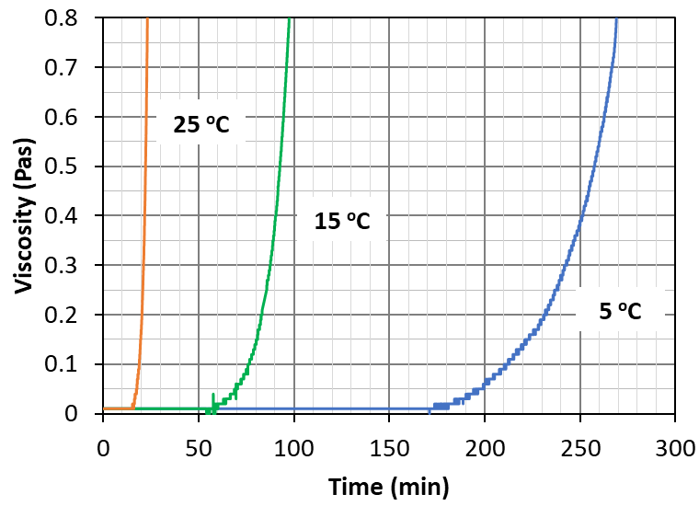
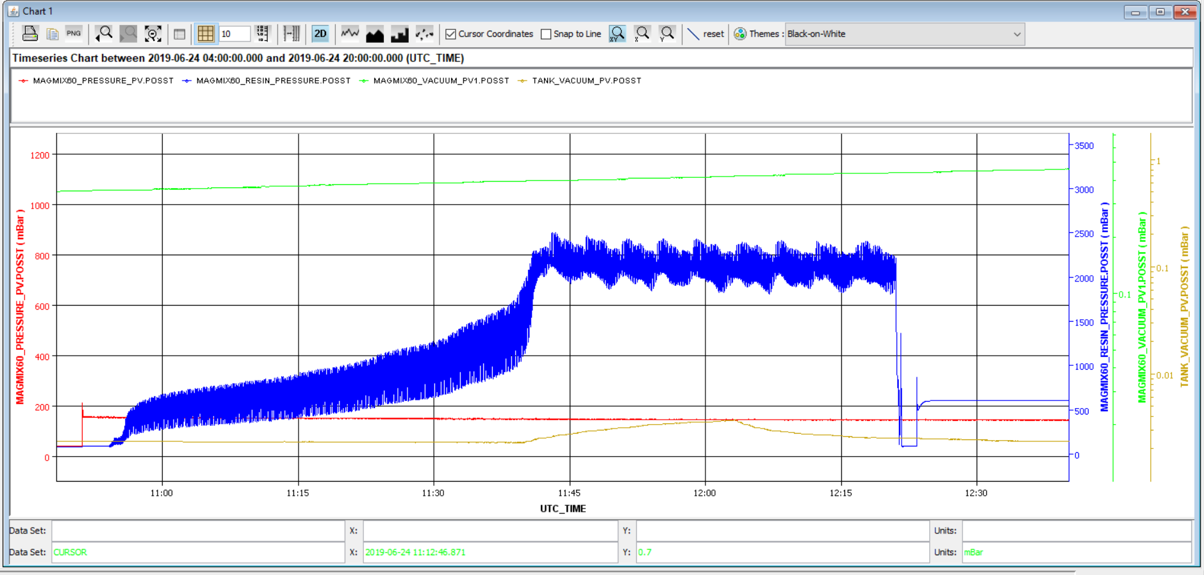
Impregnation Scalability Solved
POT LIFE, min | TEMPERATURE, ºC
20 | 25
90 | 15
240 | 5
Max. time limit for impregnation process with TELENE
Outflow tank filling
Resin Injection, mold filling
By using one epoxy inlet into the tooling with multiple vents and an inlet pressure of 2 Bar, fill times vary from 45 min to 1.5 hrs for CERN accelerator quadrupoles 7.3 m long.
Courtesy of J. Axensalva, F. Nobrega et al.

Slide 23
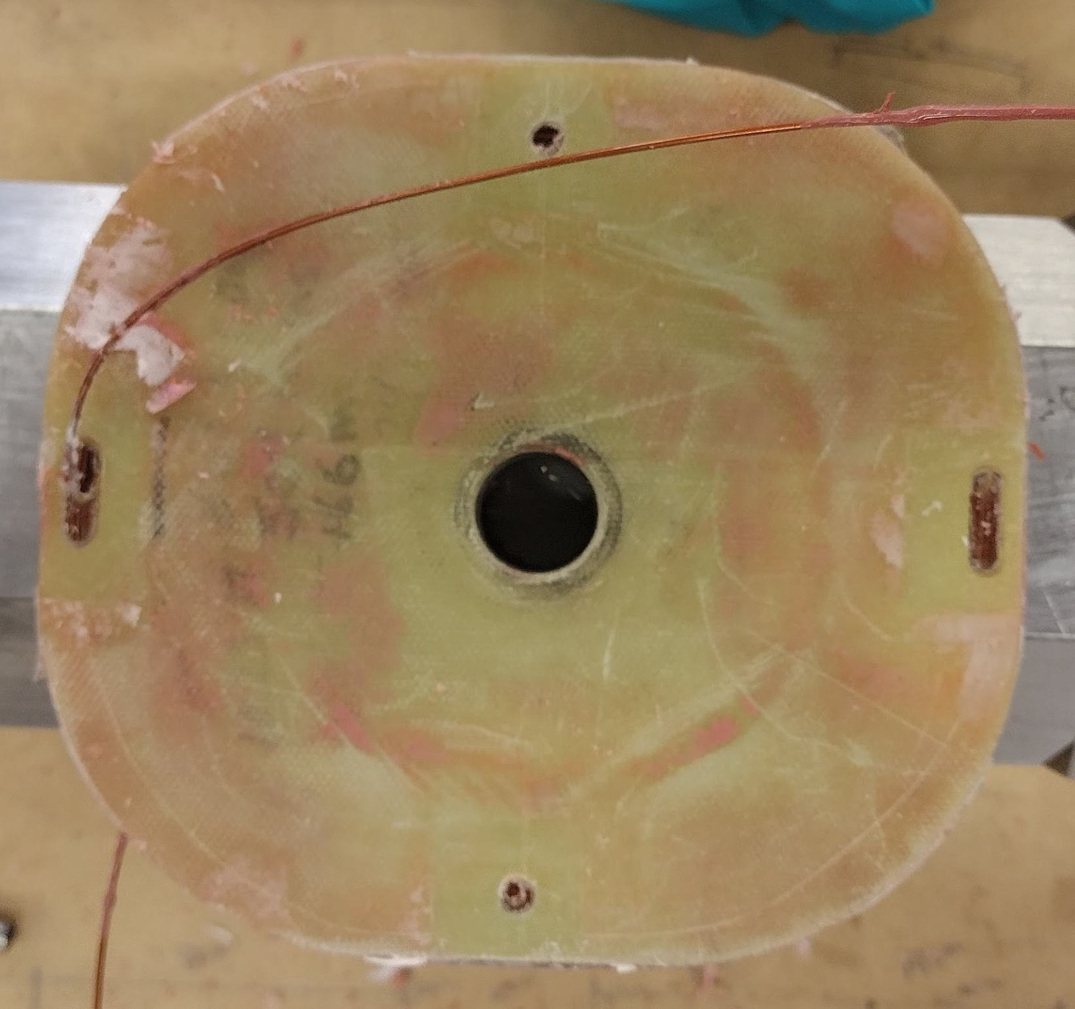
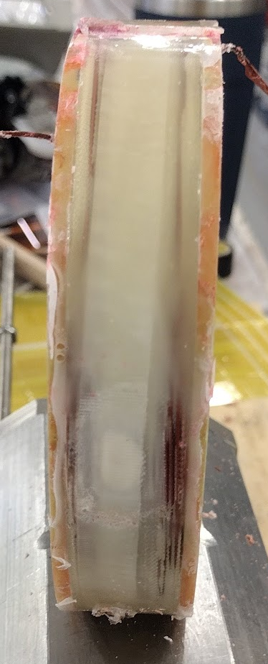
Primary Coil Upgrade
Former primary coil
New primary coil
Rogowski
2 x 105 Ω heaters
Formvar coated 0.8 mm NbTi
Impregnated
No. turns = 271
Inductance = 11.87 mH
Formvar coated 1.0 mm NbTi
Impregnated
No. turns = 504
Inductance = 25.46 mH
Notes:
Se ti chiedono, il Vecchio primario era impregnato con CTD-101K e il nuovo con TELENE. Ci potrebbe essere il solito furbo che ti chiede come mai sta trainando se e’ impregnato con TELENE. La risposta e’ che non e’ stato progettato con la struttura meccanica che si usa per i dipoli per acceleratori, che hanno tutta quella struttura meccanica intorno (come si vede nelle foto dei dipoli attaccati al trasformatore che intorno hanno tutti quei clamp che li tengono compressi).

