Slide 1


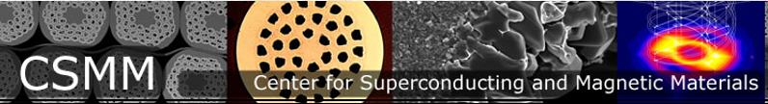

FEM Modeling of Current Sharing in Tape Stack Cables; Influence of ICR, ITR, Defect Number, Defect Patterns, and Thermal Boundary Conditions
Minzheng Jiang, Milan Majoros, Edward W. Collings, and Mike D. Sumption
This work was supported by the U.S. Department of Energy, Office of Science, Division of High Energy Physics, under Grant DE SC0011721.

Slide 2
OUTLINE
Background
Methods
Results
Conclusion
Future Work
Questions
Introduction

Slide 3
INTRODUCTION
What– FEM simulations of quench in HTS cables with defects-- and how it is delayed to higher currents with current sharing
WHY – Real conductors will have defects, we need to know how much current sharing is needed to ensure “margin”, so that cable does not quench
Relevant Applications
  Particle Accelerator Magnet
  Nuclear Fusion, Tokamak
  Proton therapy magnets
  Now – what has been done to date? Some initial work and context…..

Slide 4
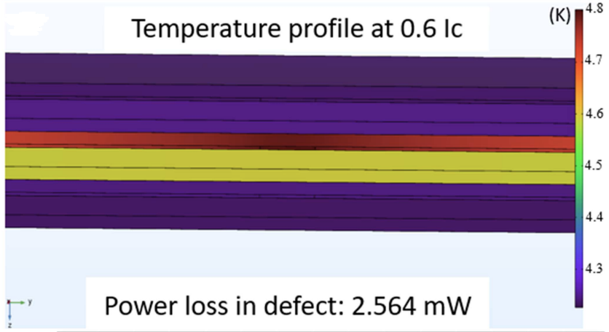
BACKGROUND – First, the effect of one defect on current sharing, with various Intertape ICR, ITR
Shengchen Xue (previous OSU student) ---- One defect on three-tape simulation, 3D
ITR – Interfacial Thermal Resistance
Thermal resistance at the interface between two materials
ICR — Interfacial Contact Resistance
Electrical resistance at the contact between layers
Notes:
Found the current sharing do exit in superconductor tapes

Slide 5
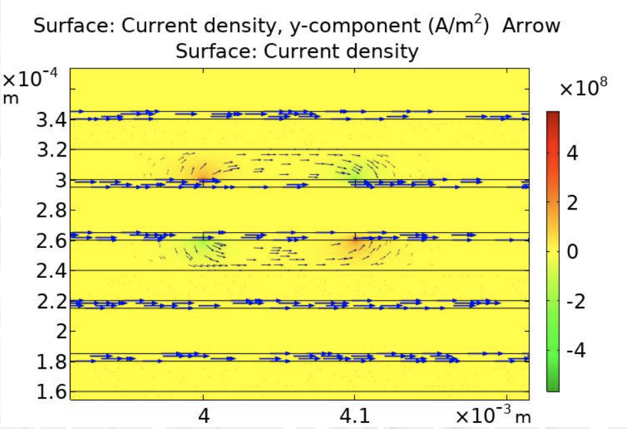
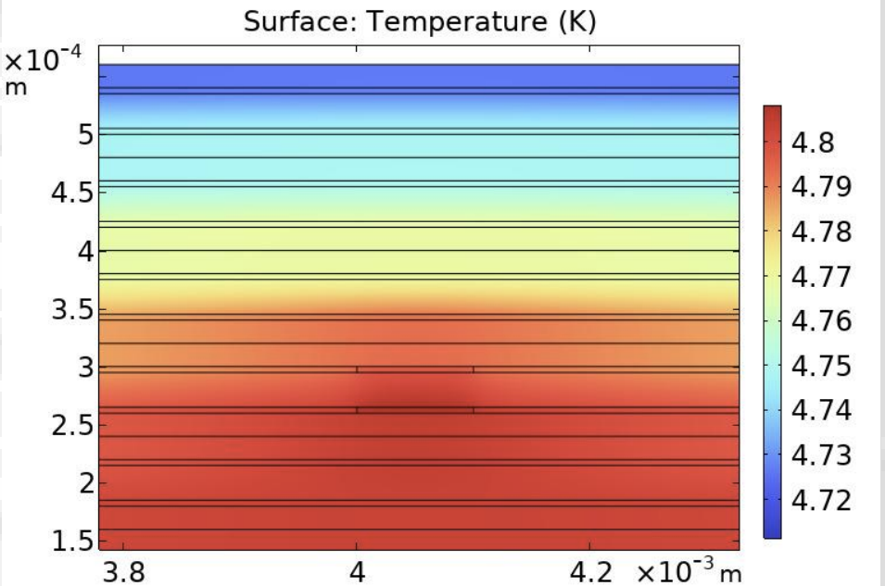
BACKGROUND
Milan Majoros ---- Defects of Tape Stack/REBCO tape simulation, 2D
Notes:
Validate the previous 3D simulation result

Slide 6
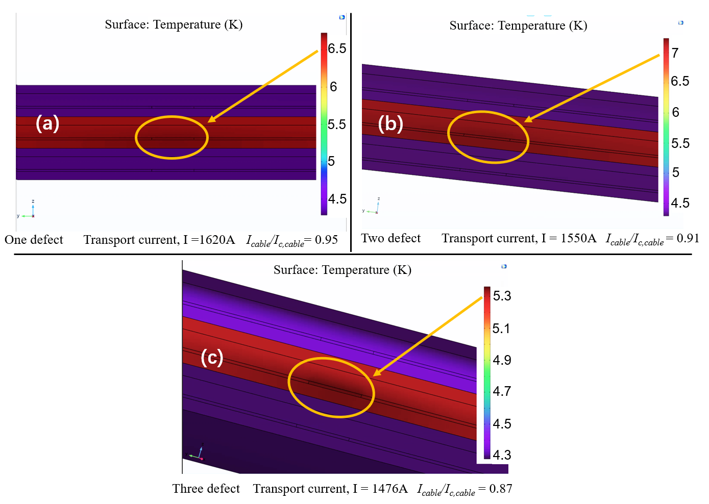
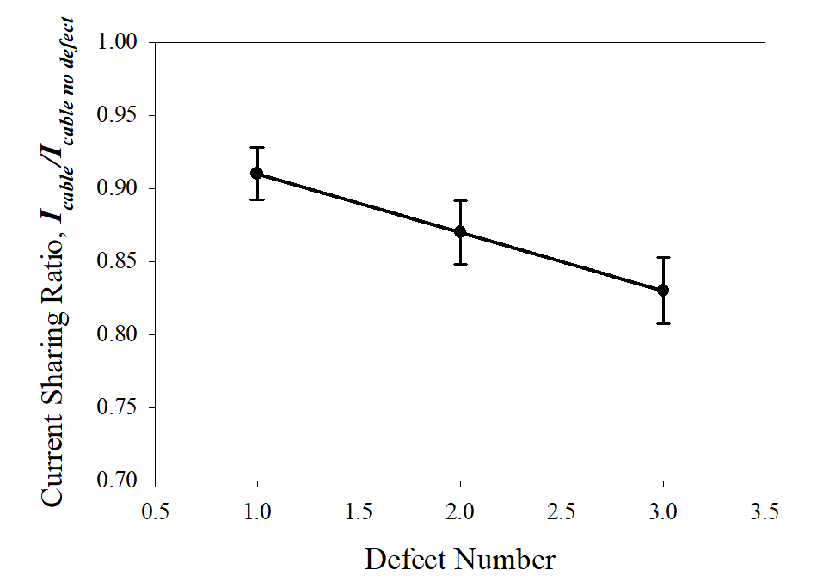
BACKGROUND
Minzheng Jiang ---- Multiple defects on three-tape simulation, 3D

Slide 7
Current Work
Increased the tape layers to four, and applied multiple defects on two center tapes
Want to see how the defect patterns affect the maximum current before quench

Slide 8
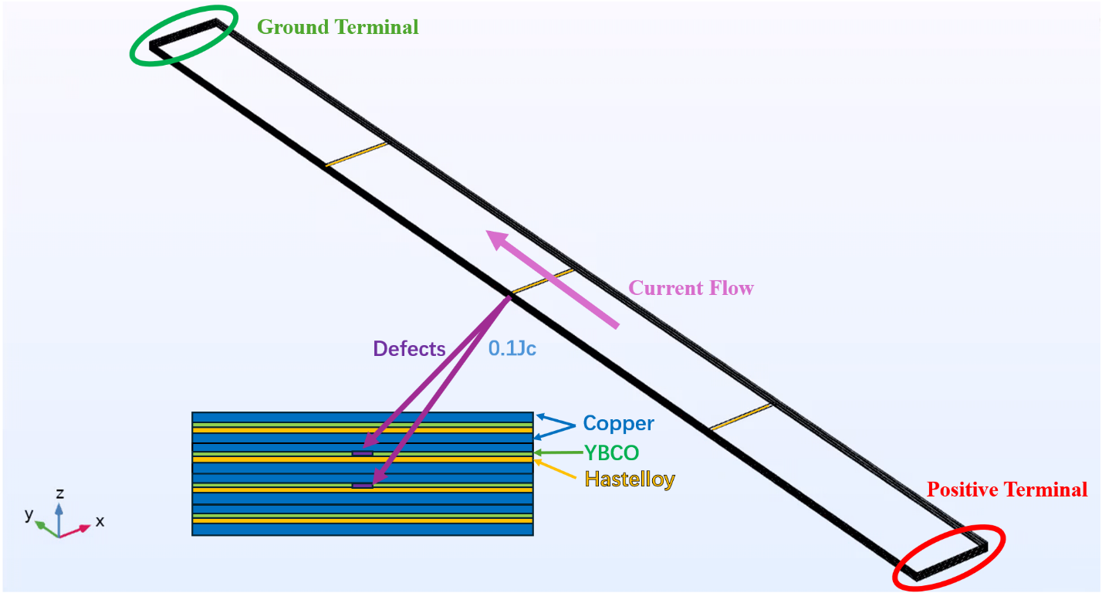
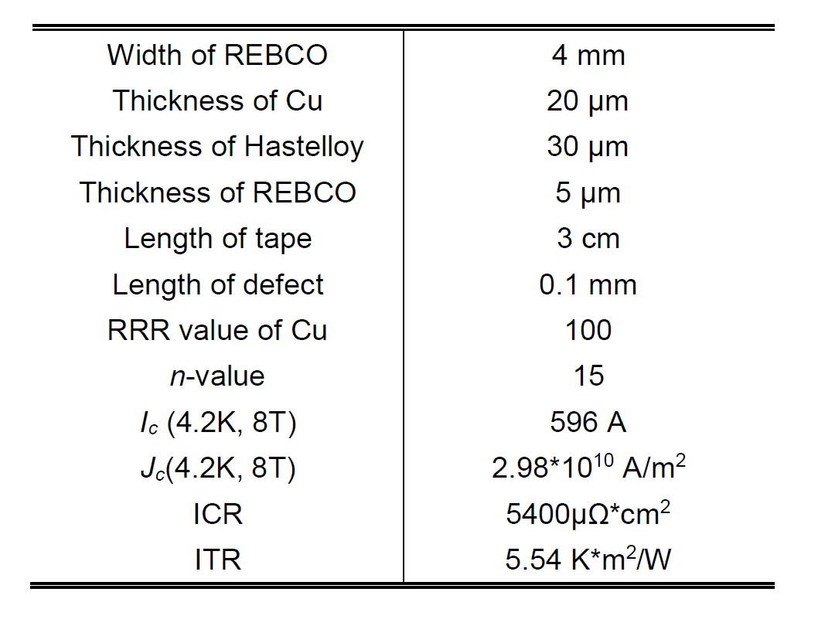
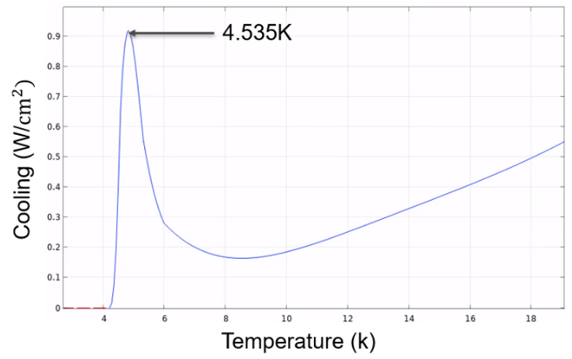
Methods
Fine mesh
Stationary error tolerance 1e-3

Slide 9
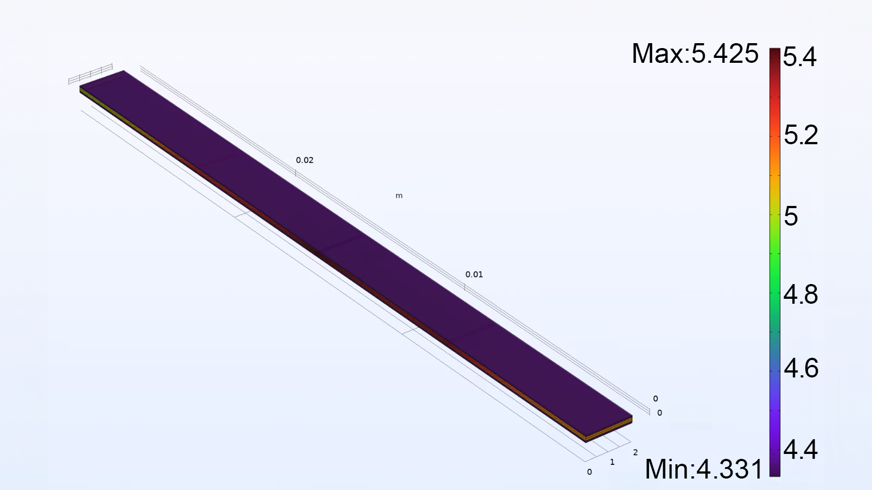
Temperature Graph for Column pattern
1
2
Defects are placed uniformly in the middle two tapes
All 3 defects of 2 tapes are on the same line
3

Slide 10
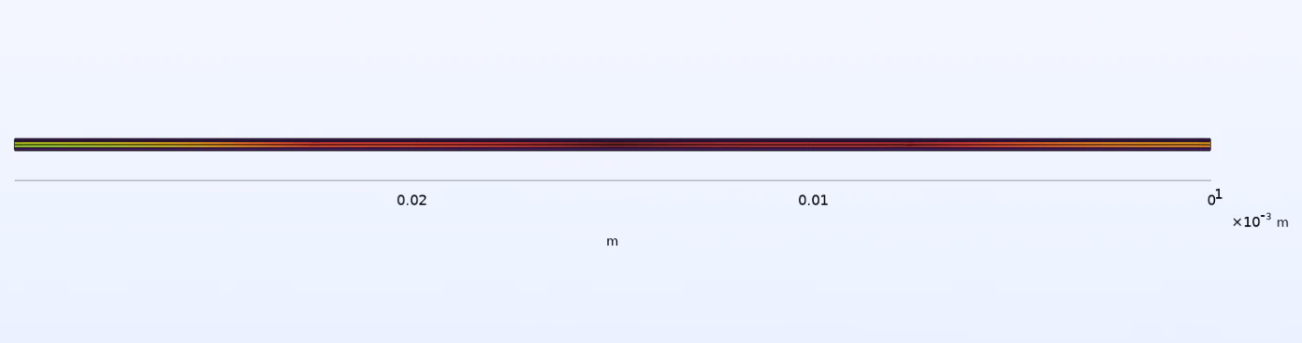
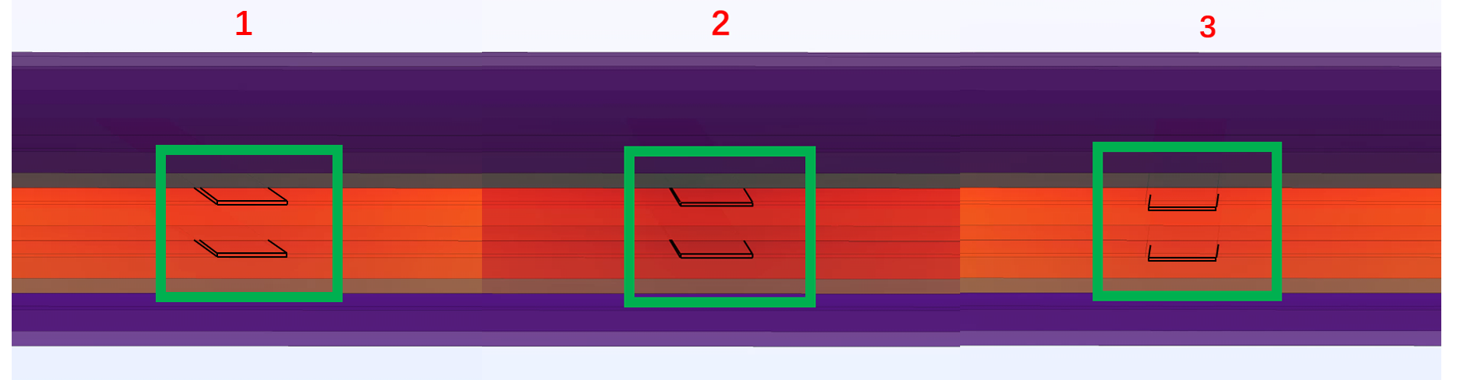
Temperature Graph for Column pattern
1
2
3

Slide 11
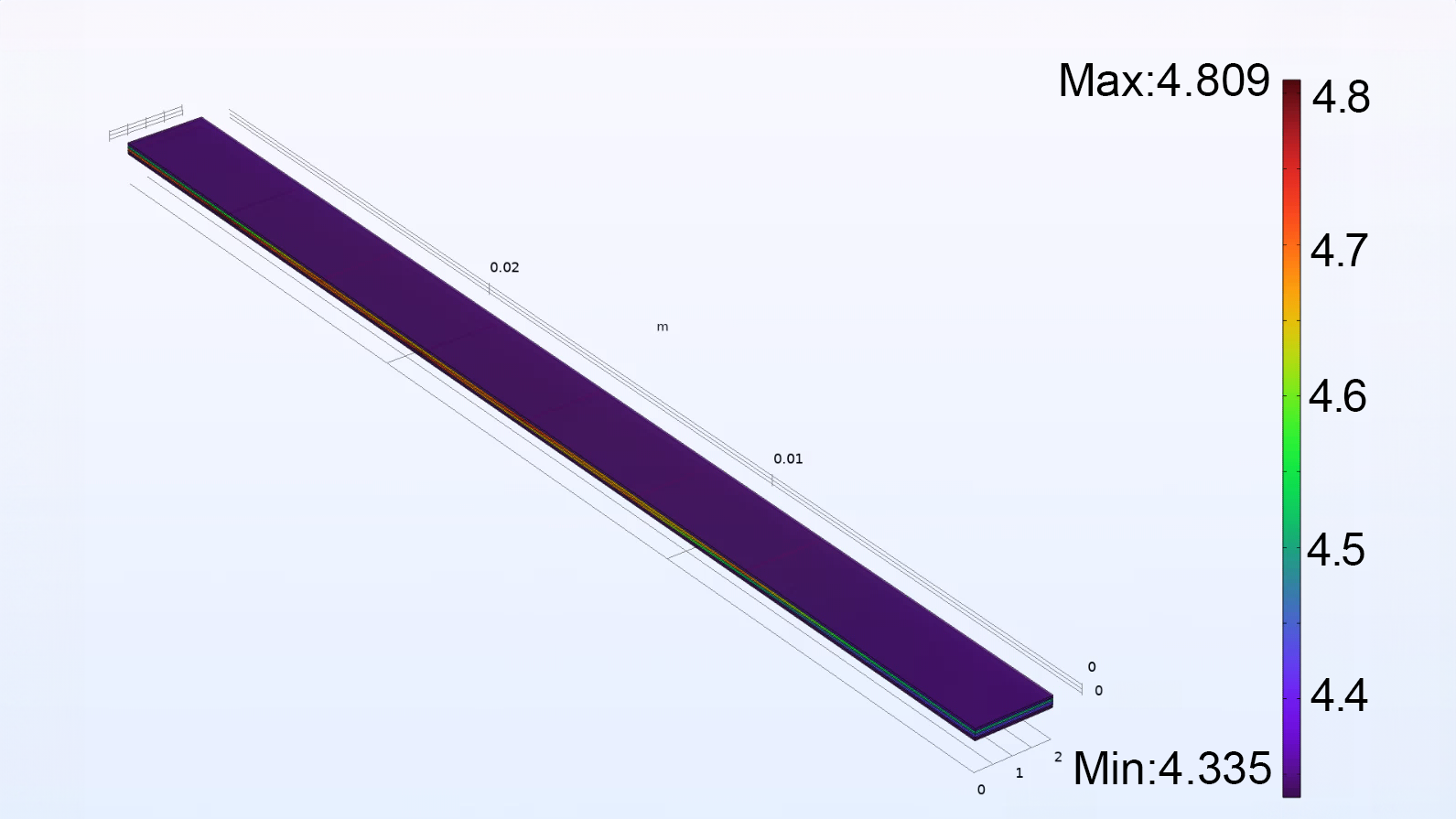
Temperature Graph for off-center pattern
1
2
3
4
5
6
Defects are placed uniformly in the middle two tapes
All 6 defects do not overlap with each other

Slide 12
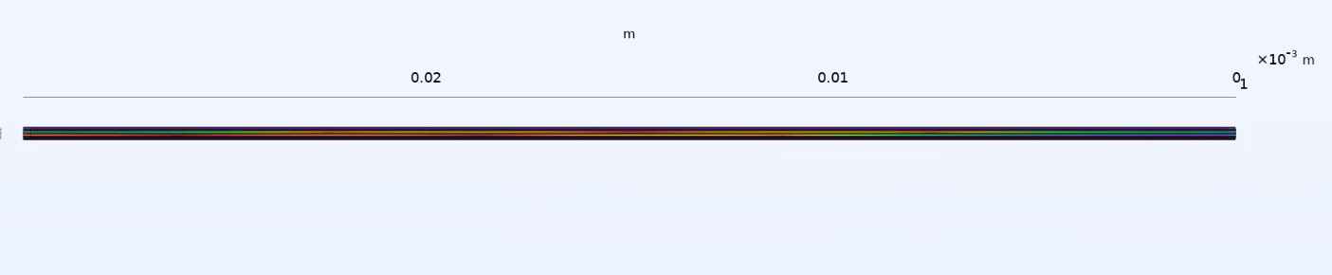
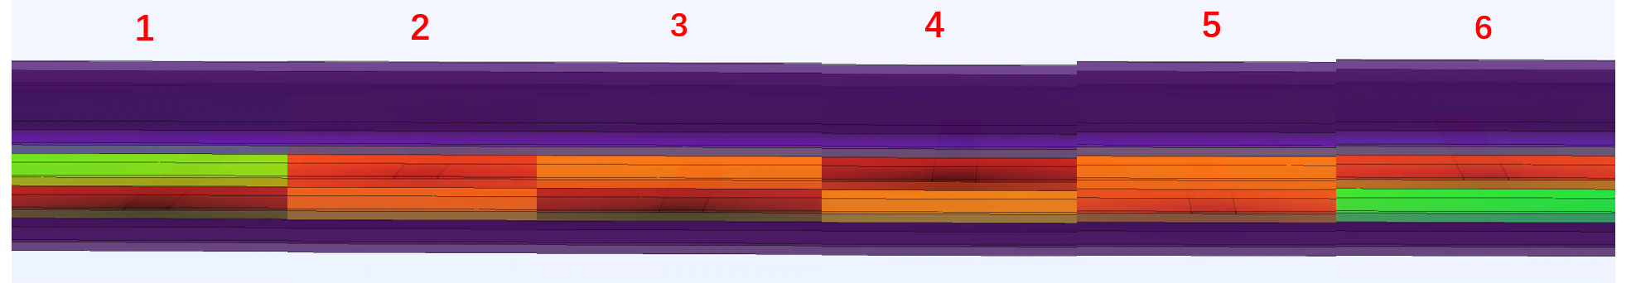
Temperature Graph for off-center pattern
1
2
3
4
5
6

Slide 13
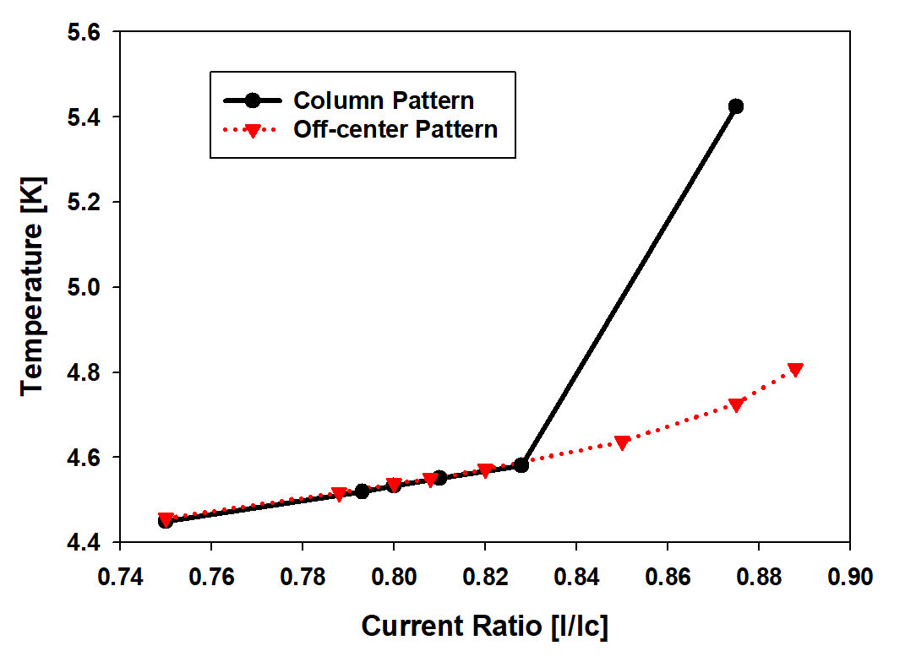
RESULTS
Column current ratio (I/Ic） | Tape Temperature(K) | Off-center current ratio (I/Ic) | Tape Temperature(K)
0.75 | 4.45 | 0.75 | 4.457
0.793 | 4.52 | 0.788 | 4.517
0.8 | 4.533 | 0.8 | 4.538
0.81 | 4.551 | 0.808 | 4.55
0.828 | 4.581 | 0.82 | 4.572
0.875 | 5.425 | 0.85 | 4.637
 |  | 0.875 | 4.726
 |  | 0.888 | 4.809

Slide 14
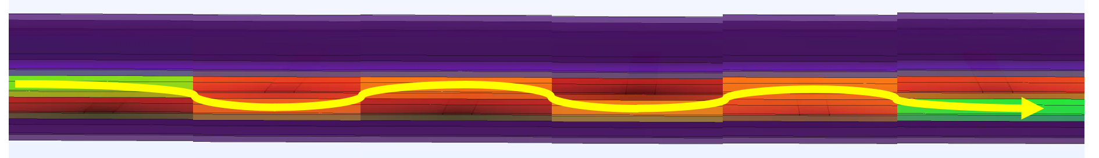
CONCLUSION
In the previous work, we found the low current sharing for low ICR and ITR
The patterns of defects will affect the maximum current go through cable
The off-center pattern of defects can load more current than column pattern

Slide 15
FUTURE WORK
Apply defects on all layers of tapes to mimic real tape results
Do the real-world experiments to validate the simulation results

Slide 16
REFERENCE
M. Bonura, C. Barth, A. Joudrier, J. F. Troitino, A. Fête, and C. Senatore, “Systematic Study of the Contact Resistance Between REBCO Tapes: Pressure Dependence in the Case of No-Insulation, Metal Co-Winding and Metal-Insulation,” IEEE Trans. on Appl. Supercond., vol. 29, no. 5, pp. 1–5, Aug. 2019, doi:10.1109/TASC.2019.2893564.
C. J. Kovacs, M. D. Sumption, M. Majoros, and E. W. Collings, “Modified Inter conductor Contact Resistivity in Coated Conductor Stacks and Roebel Cables,” IEEE Trans. Appl. Supercond, vol. 30, no.4, pp. 1–5, Jun. 2020, doi: 10.1109/TASC.2020.2966461.
S. Xue, M. Majoros, M. D. Sumption, T. Garg, and E. W. Collings, “FEM Analysis of Current Sharing in REBCO Coated Conductor Cables for Particle Accelerator Applications,” IEEE Trans. Appl. Supercond., vol. 33, no. 5, pp. 1–7, Aug. 2023, doi:10.1109/TASC.2023.3253666.
M. Majoros, M. D. Sumption, S. Xue, and E. W. Collings, “Stability and Current Sharing in YBCO Cables – Impact of Broken Elements –FEM Modeling,” IEEE Trans. Appl. Supercond., vol. 32, no. 6, pp. 1–5,Sep. 2022, doi: 10.1109/TASC.2022.3154335.
J. Lu, R. Goddard, K. Han, and S. Hahn, “Contact resistance betweentwo REBCO tapes under load and load cycles,” Supercond. Sci.Technol., vol. 30, no. 4, p. 045005, Apr. 2017, doi: 10.1088/1361-6668/aa5b05.
M. Paidpilli, Rudra Pratap, Mehdi Kochat, Eduard Galstyan, Chirag Goel, Goran Majkic et al., “Growth of High-Performance 4-5μm Thick Film REBCO Tapes Doped With Hafnium Using Advanced MOCVD,”IEEE Trans. Appl. Supercond., vol. 31, no. 5, pp. 1–5, Aug. 2021, doi:10.1109/TASC.2021.3060366.
M. Marchevsky and S. Prestemon, “Thermal runaway criterion as a basis for the protection of high-temperature superconductor magnets,” Superconductor Science and Technology, vol. 37, no. 3, p. 035012, Feb. 2024. doi:10.1088/1361-6668/ad20fe
L. Bromberg, M. Takayasu, P. Michael, J. V. Minervini, and A. Dietz, “Current distribution and re-distribution in HTS cables made from 2nd generation tapes,” presented at the Adv. Cryog. Eng., vol. 57, 2012, pp.1001–1008. doi: 10.1063/1.4707018.
M. Majoros, M. D. Sumption, S. Xue, and E. W. Collings, “CurrentSharing in Superconducting REBCO Cables-FEM Modeling,” IEEETrans. Appl. Supercond., vol. 34, no. 3, pp. 1–5, May 2024, doi:10.1109/TASC.2024.3366160.
J. W. Ekin, Experimental Techniques for Low-Temperature Measurements Cryostat Design, Material Properties, and Superconductor Critical-Current Testing. Oxford: Oxford University Press, 2006.

Slide 17
Questions?

