Slide 1
Composite Cryogenic Hydrogen Insulated Lightweight Lined Storage (C-CHILL)
M1Or4A-02
M1Or4A-02
Presented By: Sascha Stevens
CEC-ICMC 2025
5/19/2025 4:45PM Naples 4/5
Robert Kolozs - robert.kolozs@dynovas.com – (858) 229-6966
Luke Bockman – luke.bockman@dynovas.com – (760) 712-6665
Sascha Stevens – sascha.stevens@dynovas.com – (818) 414-7795
Notes:
AL Intro

Slide 2
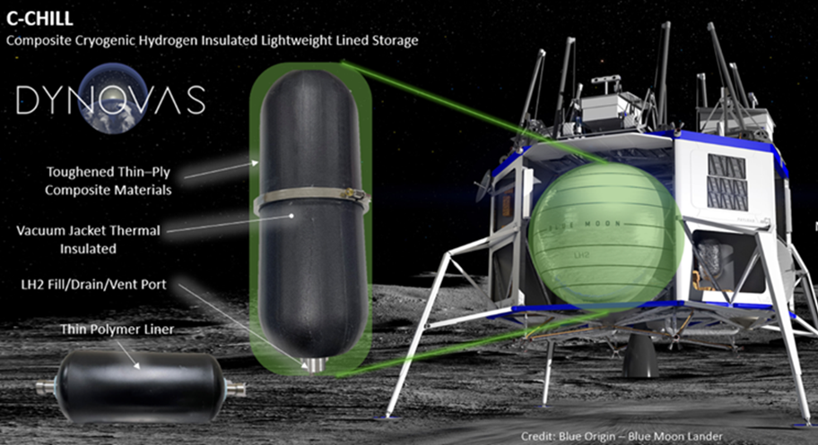
C-CHILL System Overview
Composite Cryogenic Hydrogen Insulated Lightweight Lined-Storage (C-CHILL)
C-CHILL is a reusable carbon composite liquid hydrogen storage system
Enables a higher weight percent of liquid hydrogen compared to more traditional cryogenic dewars
System is engineered to meet the growing demands for liquid hydrogen storage in space and terrestrial applications
Leveraging a type IV COPV C-CHILL will provide a tank weight reduction of 20-60% compared to traditional metallic tanks
Notes:
AL

Slide 3
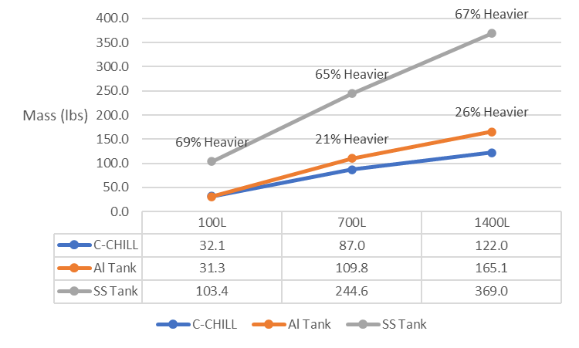
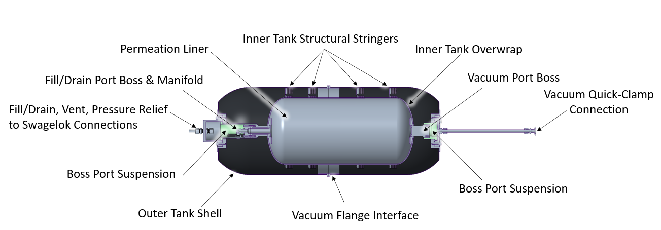
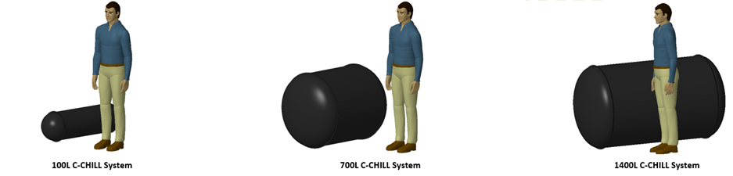
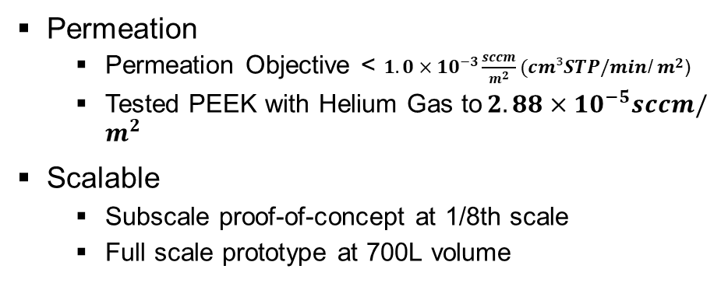
C-CHILL System Advantages
Weight / mass reductions
  67% reduction over stainless-steel tanks
  26% reduction over aluminum tanks
Life-cycle capability at cryogenic temps
  >5k pressure cycles
  >10k thermal cycles
C-CHILL
64.2wt%
Permeation
  Permeation Objective < $1.0×{10}^{−3}\frac{sccm}{m^{2}}(cm³STP/min$/ $m^{2}$)
  Tested PEEK with Helium Gas to${ 2.88×10}^{−5}sccm/m^{2}$
Scalable
  Subscale proof-of-concept at 1/8th scale
  Full scale prototype at 700L volume

Slide 4
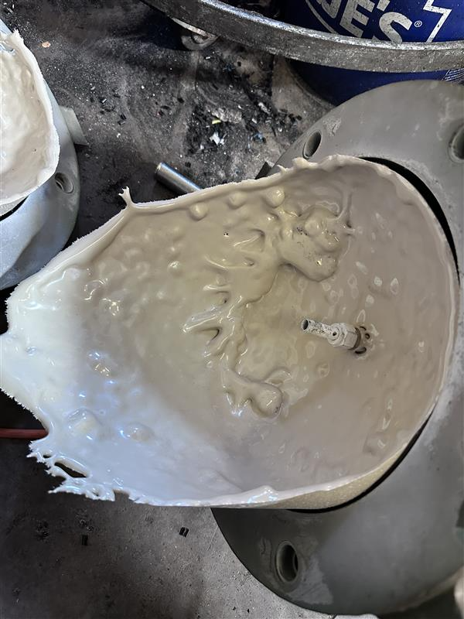
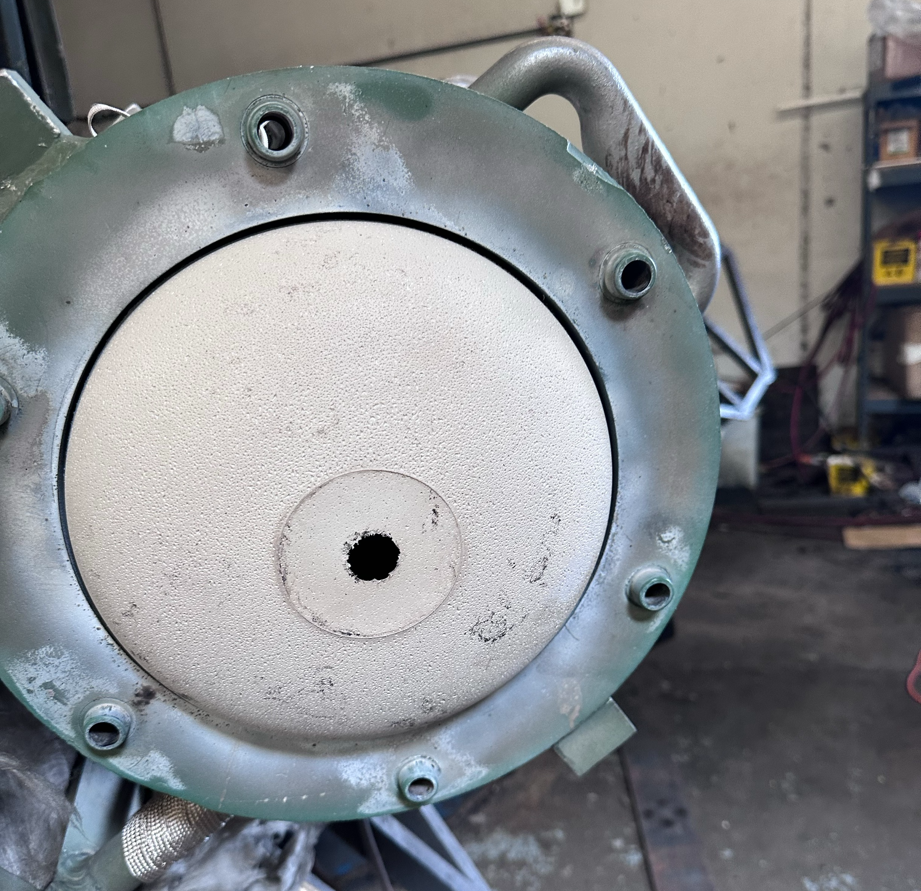
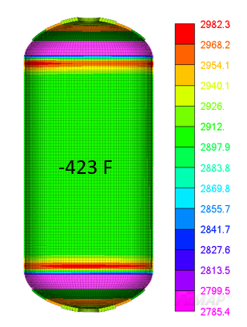
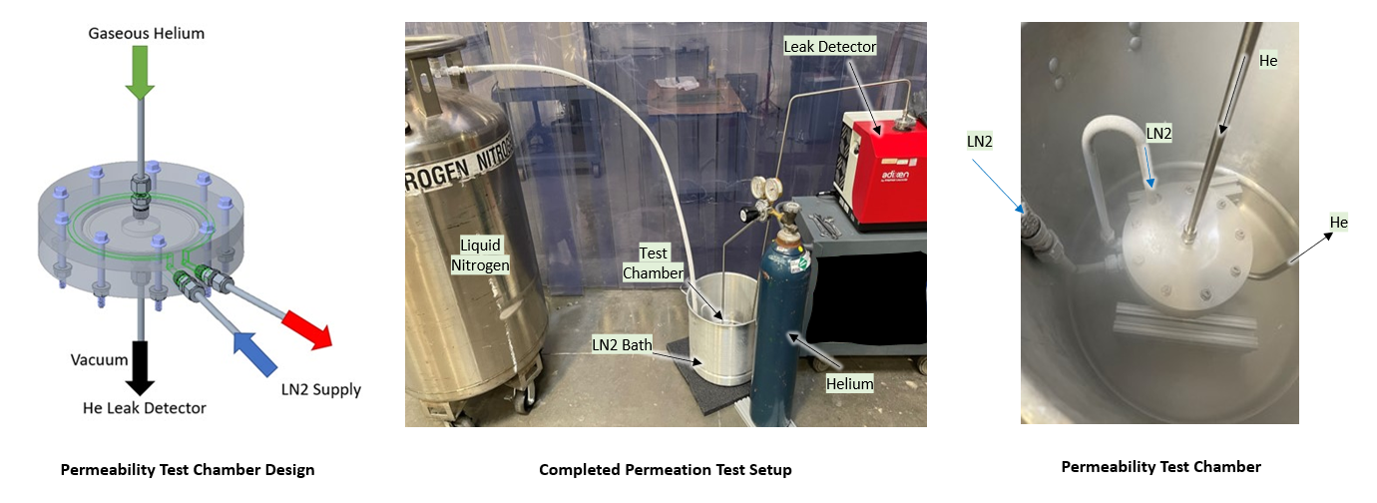
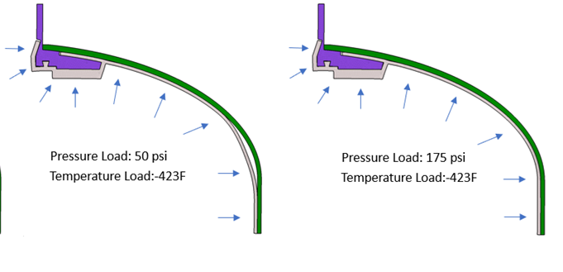
C-CHILL Innovations
C-CHILL is an advanced liquid hydrogen storage solution:
Matched CTE between boss, liner, and composite overwrap
Low permeability liner
High cryogenic capability rotomolded PEEK liner
Liner Manufacturability
CTE Differential Between Materials
Permeation Testing

Slide 5
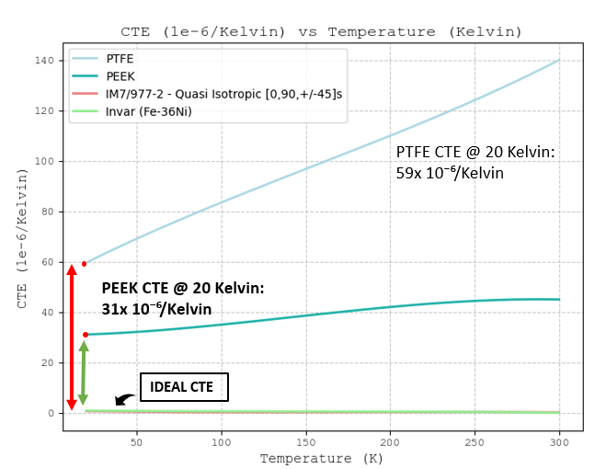
C-CHILL Materials Breakdown
COPV liner material selection is critical in this type IV COPV configuration
  The liner requirements are:
    High Bonding Strength
    Low Cryogenic Hydrogen Permeability
    Low Percent Strain from Nominal to 20 Kelvin
    Liner Material Needs be able to be Rotomolded
    Maintain Mechanical Properties at Cryogenic Temperatures
  PEEK (Polyether ether ketone) has show the best performance for liner material
Boss material is the second critical material choice
  The boss requirements are:
    CTE Match with the Carbon Composite Overwrap
    Low Hydrogen Embrittlement
  Invar-36 (Fe-36Ni) has shown to be the optimal material to match the CTE between the boss and composite overwrap
PEEK, Invar, and IM7/EX-1510 is the Optimal Material Combination for the Cryogenic Type IV COPV

Slide 6
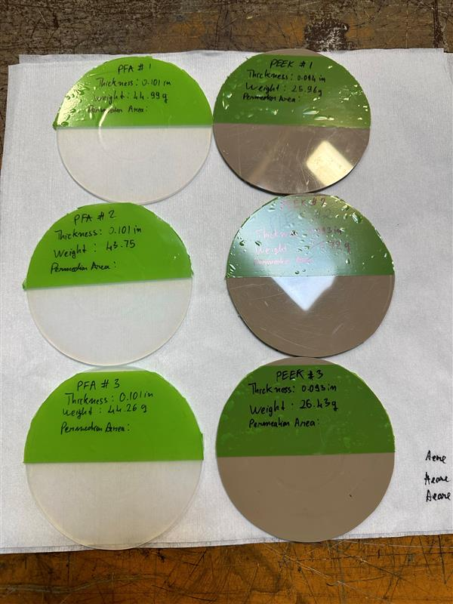
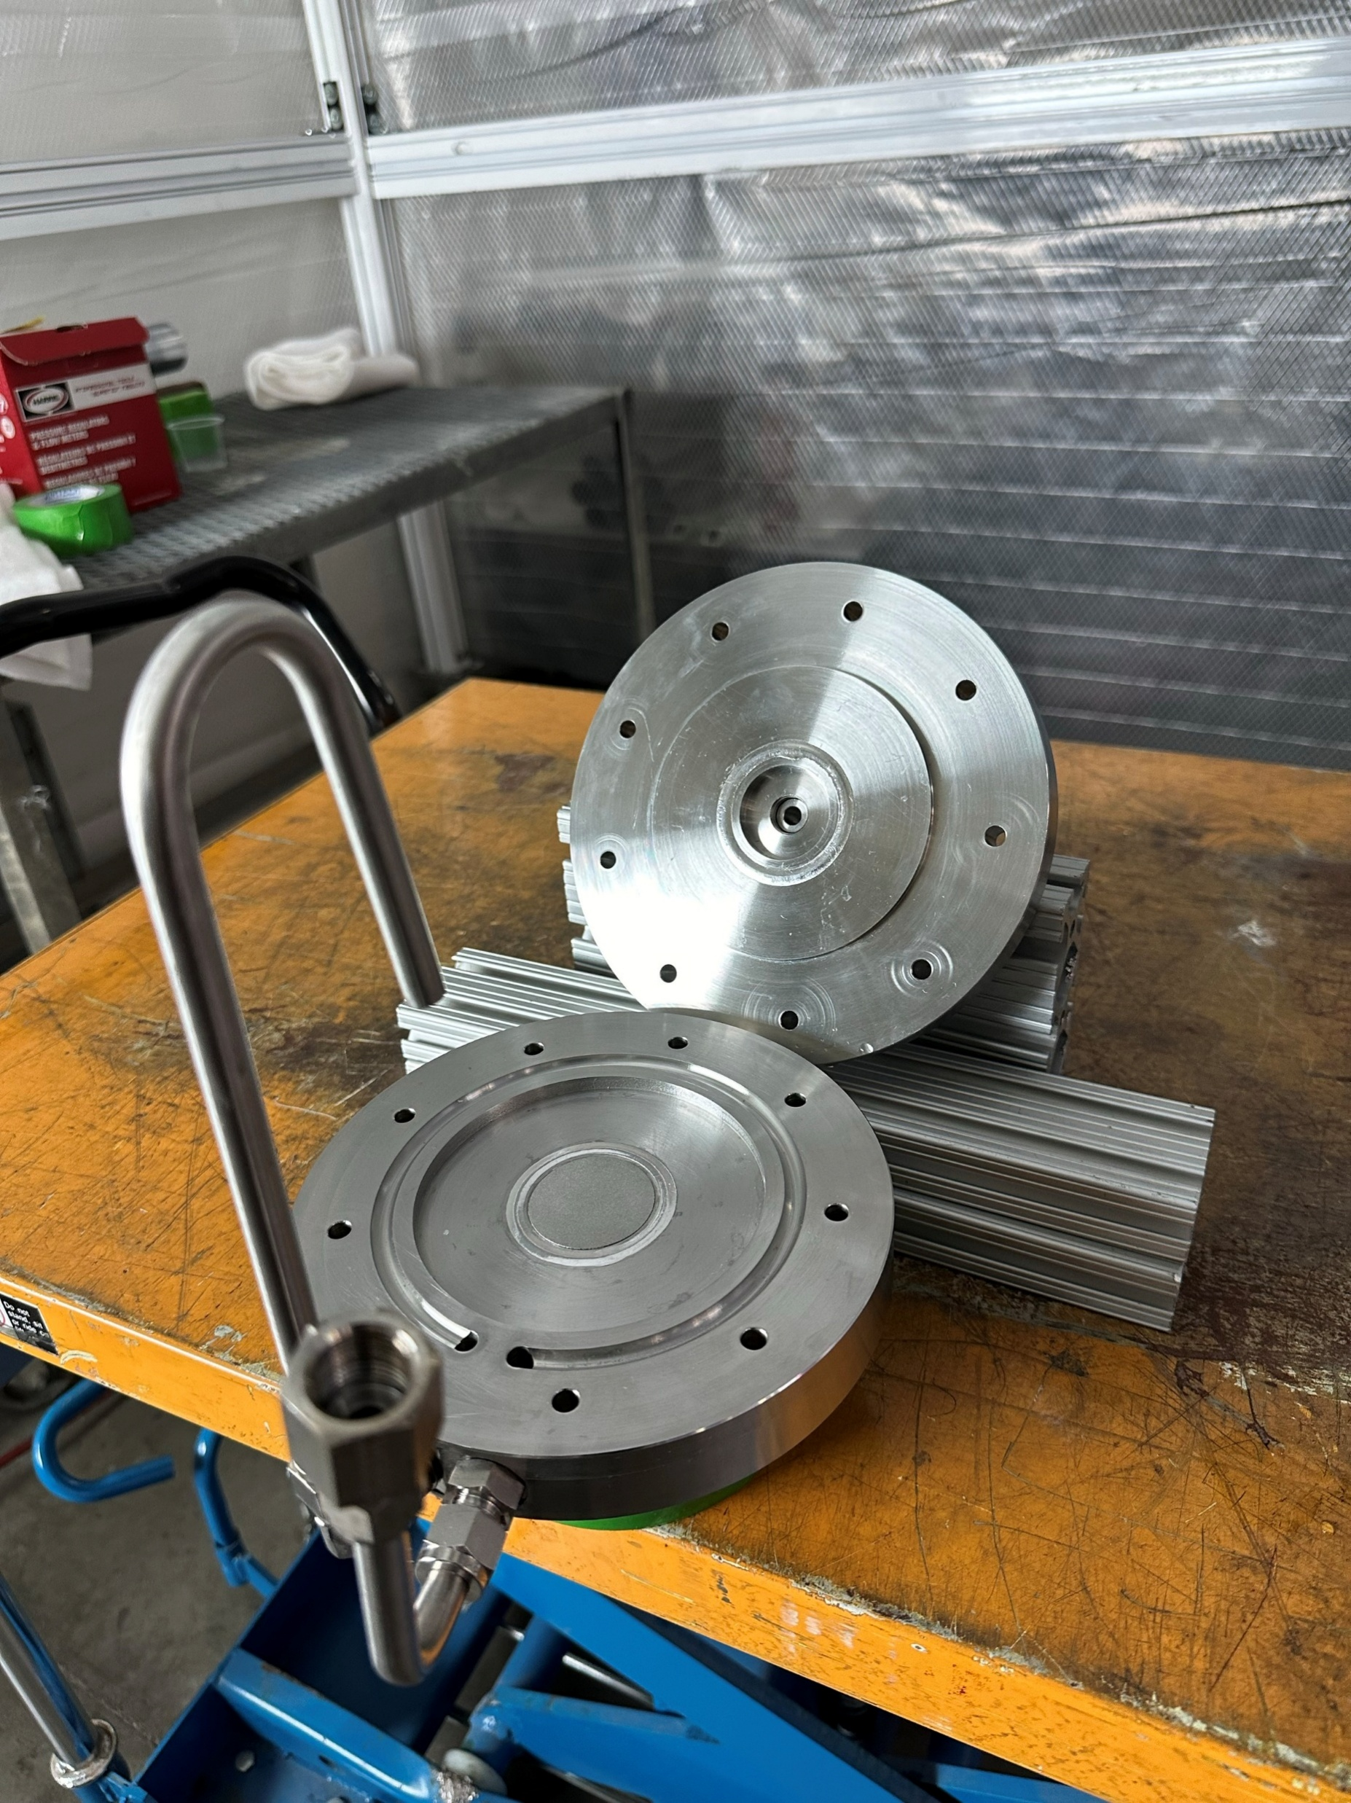
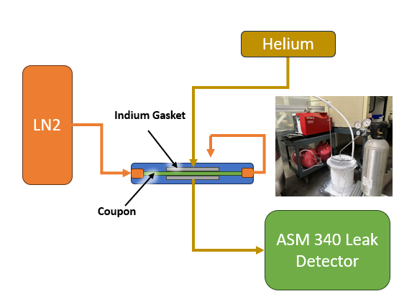
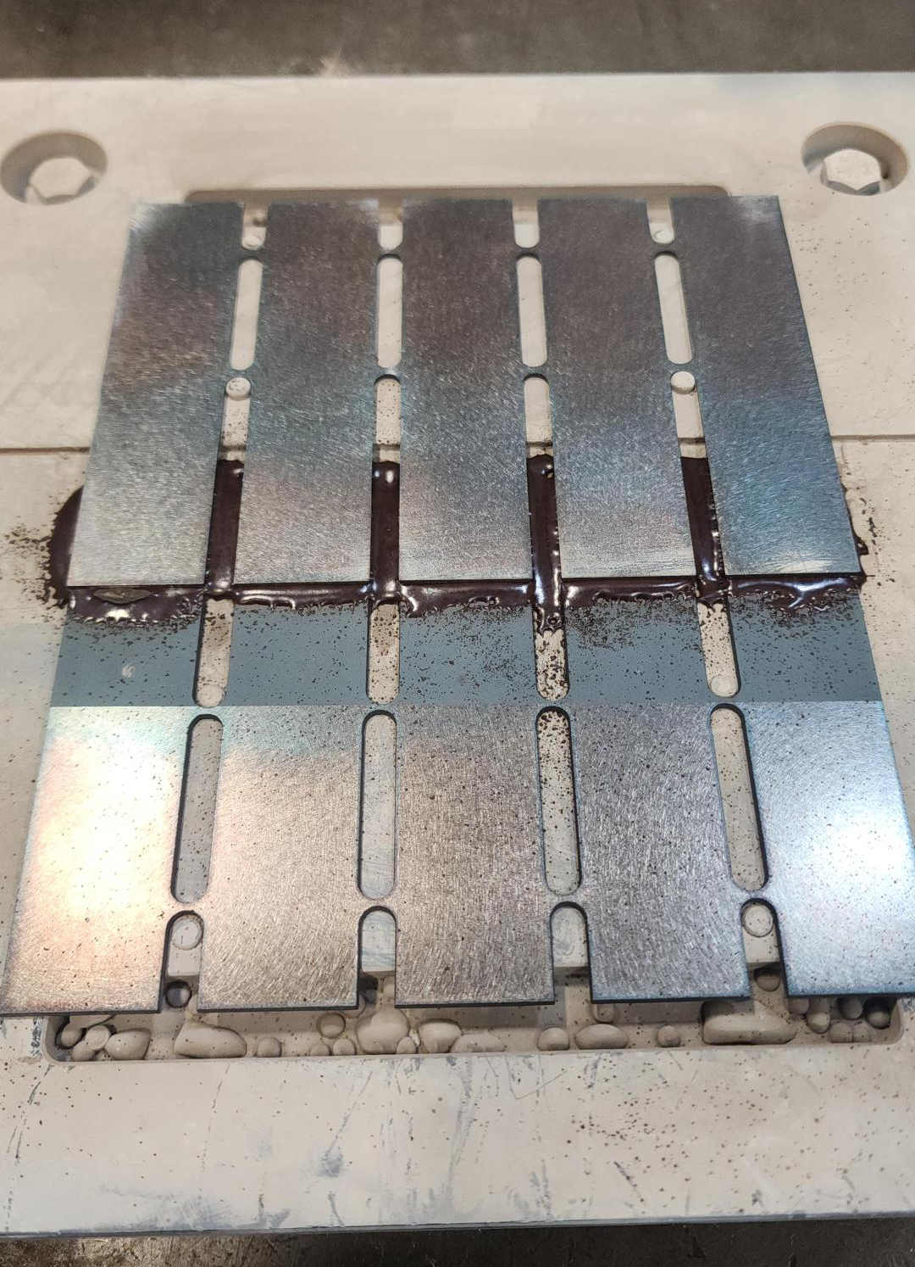
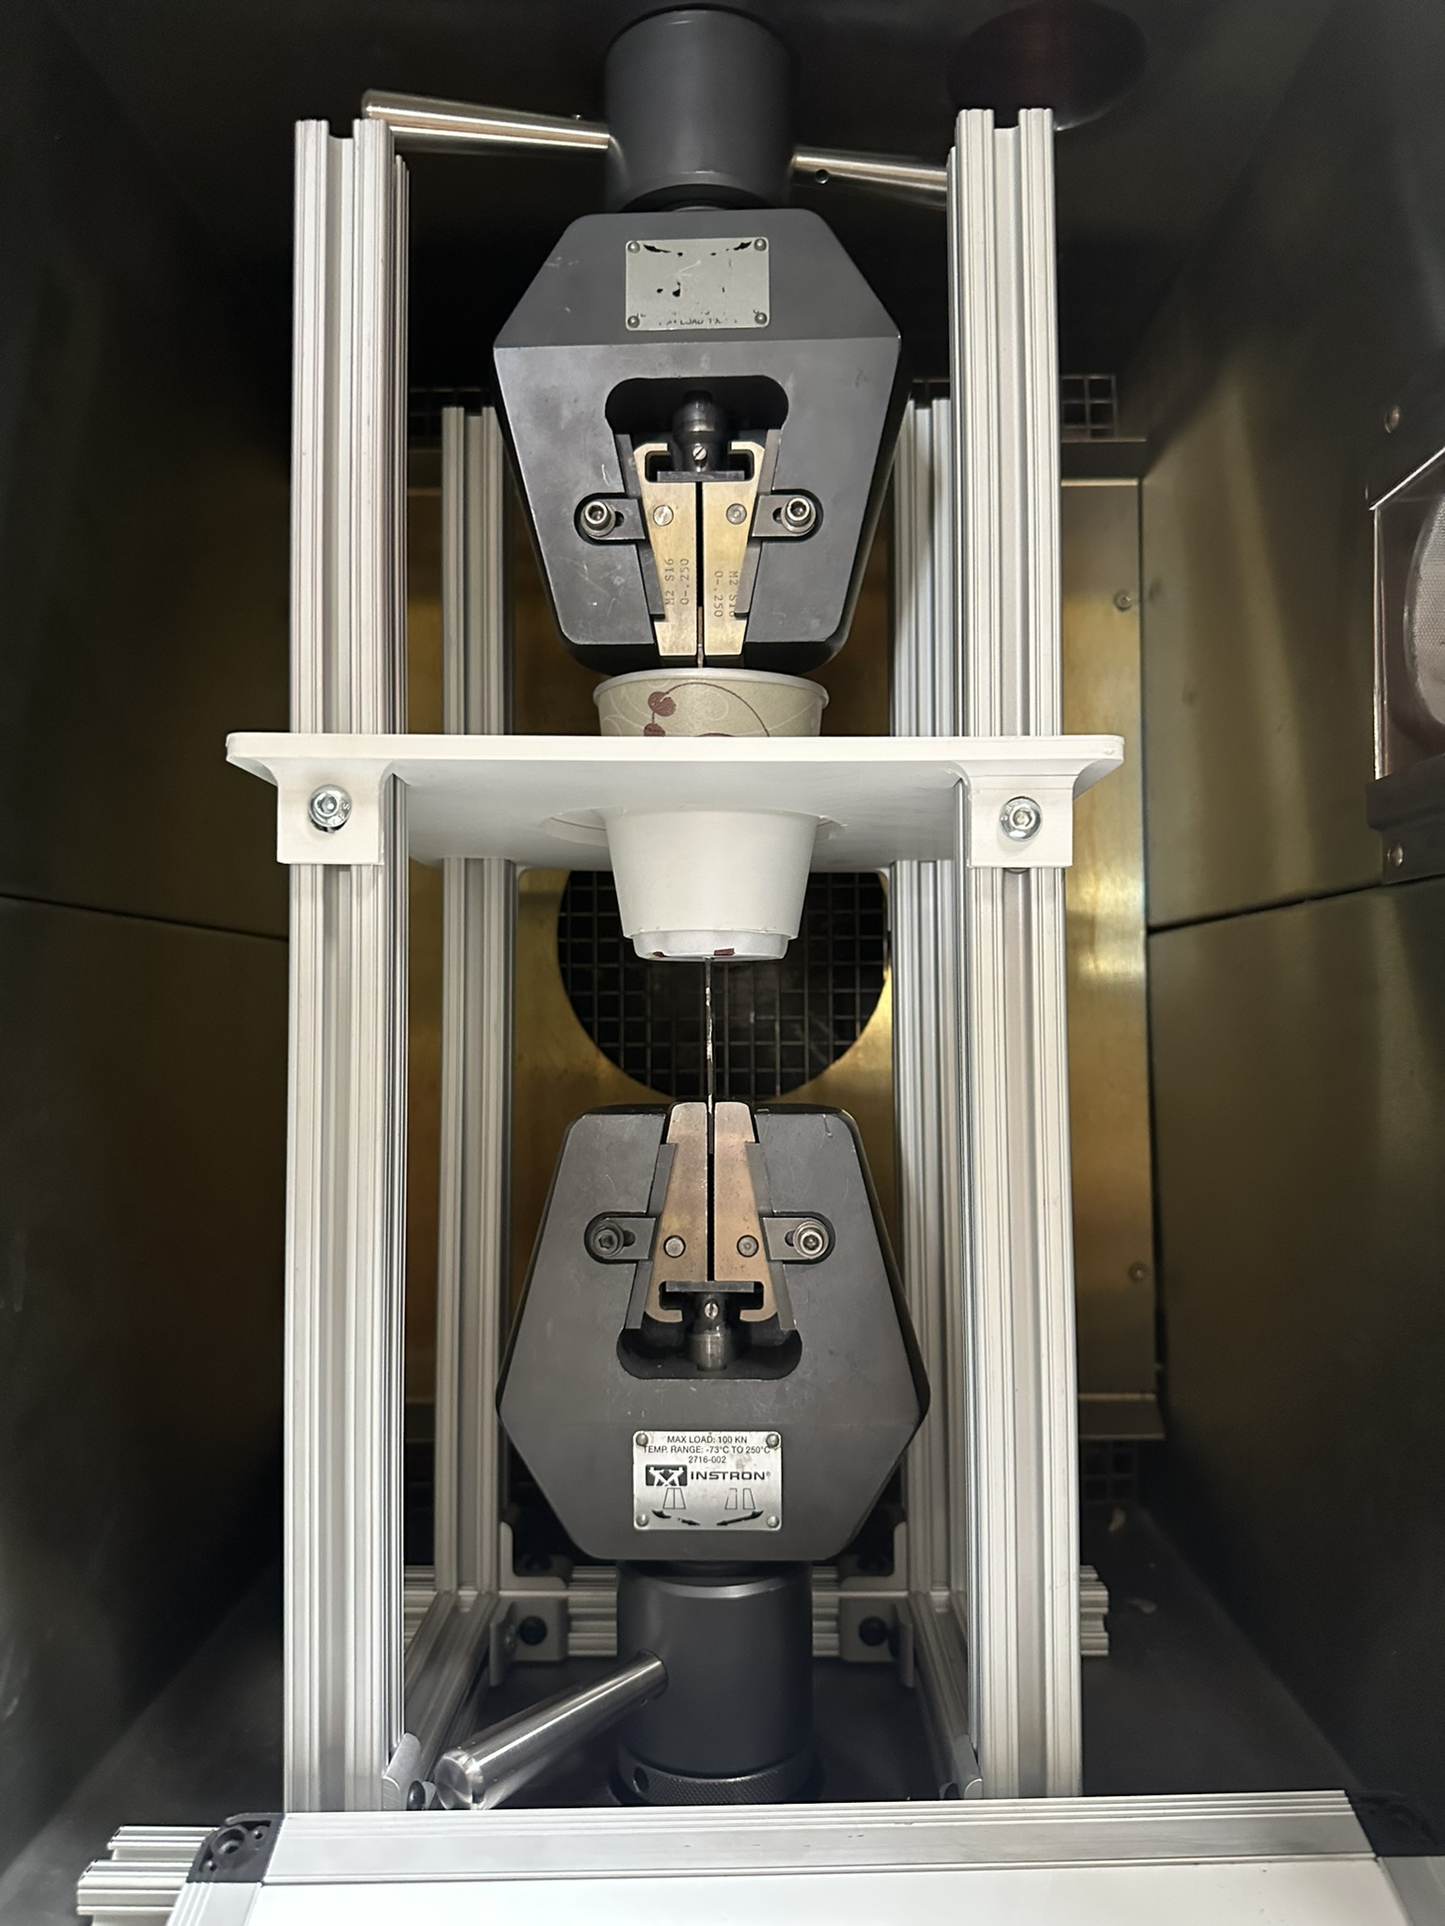
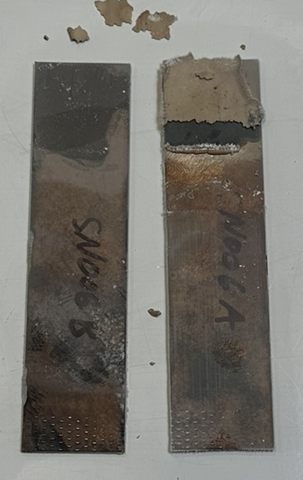
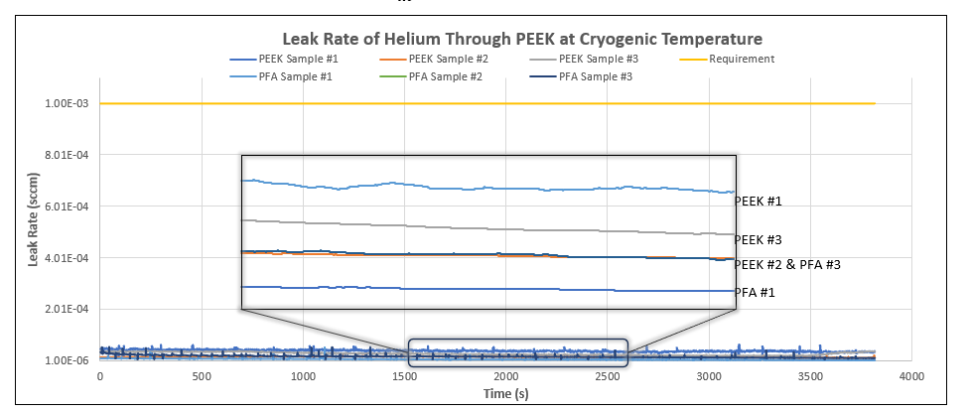
Material Testing and Validation
Helium Permeation Testing Workflow
PEEK-Invar Lap Shear Testing Workflow
PEEK Permeability Orders of Magnitude within Requirement
BR-127 Treatment Verified with High Bondability
Helium Permeation Testing at Cryogenic Temperatures
PEEK-Invar Lap Shear Testing Cryogenic and Room Temperature
Testing Has Validated PEEK as an Optimal Material for the C-CHILL Liner

Slide 7
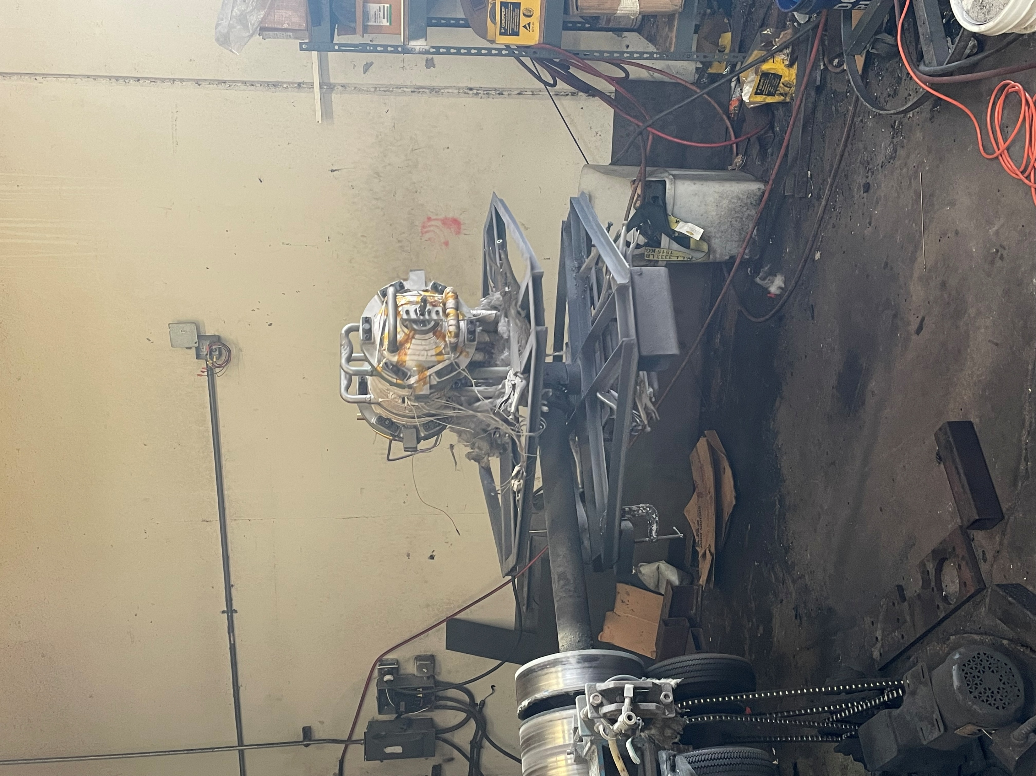
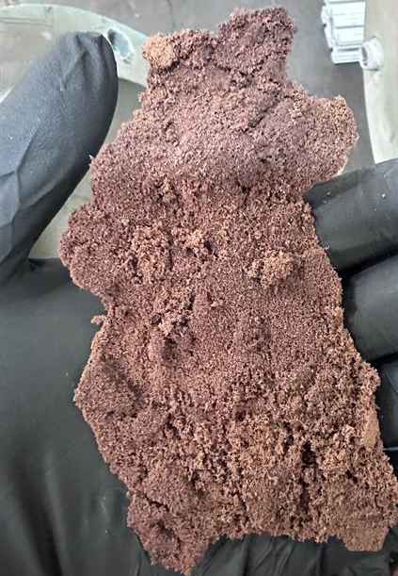
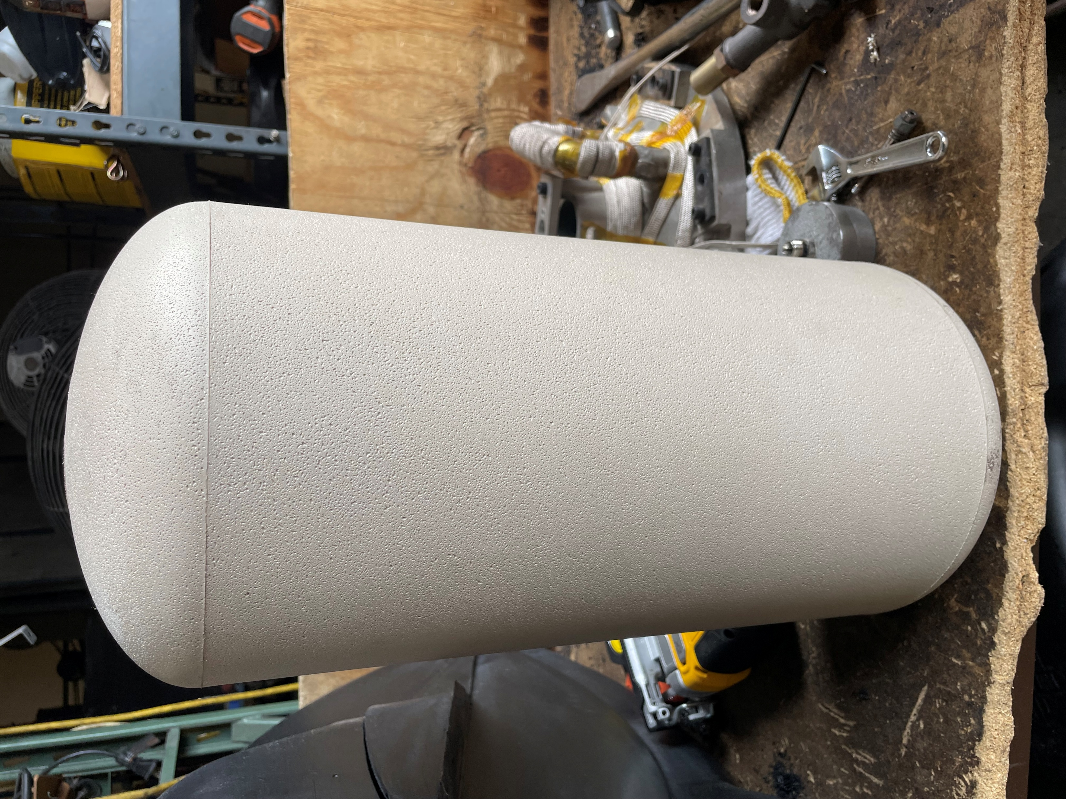
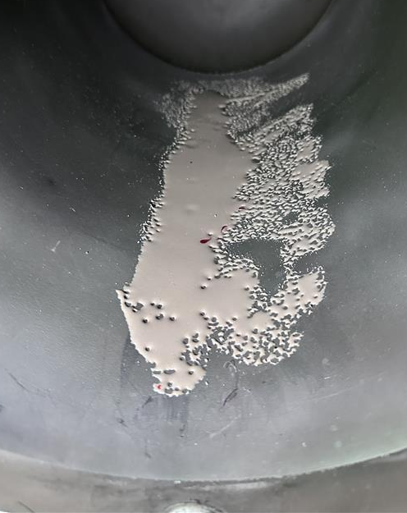
PEEK Process Development
Rotomolding (Rotational Molding) uses a heated mold on a rotating carousel with a ground plastic charge inside to form a thin-walled plastic article
PEEK has required more development than expected to achieve complete liner results compared to previously used materials
PEEK requires:
  Nitrogen Purging During the Whole Rotomolding Process
  Elevated Molding Temperatures of 700°F - 800°F
Facilities have required modification to meet these requirements
Liner molding has progressed greatly – Full liner molding has been successfully completed
Liner porosity is the final issue before molding liners with bosses
Rotomolding Assembly
Burnt PEEK
Successful Liner
Successful PEEK Melting
Surface Porosity

Slide 8
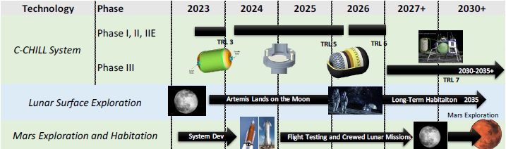
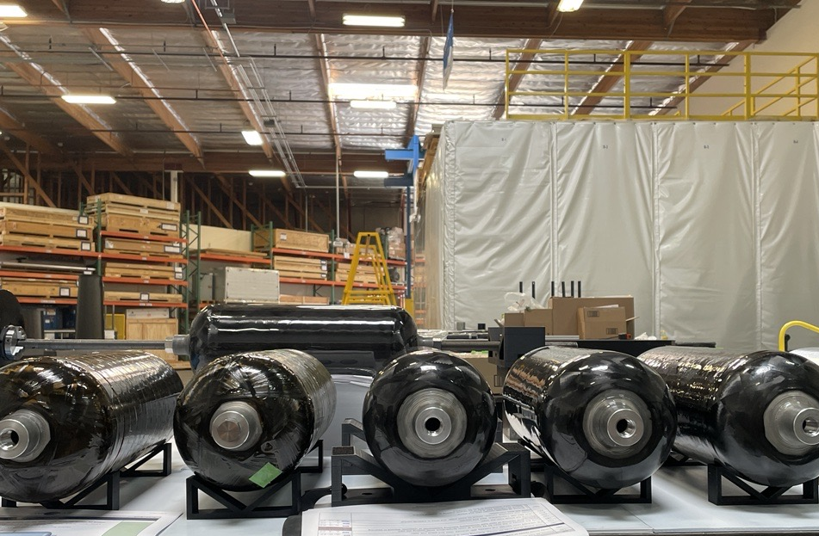
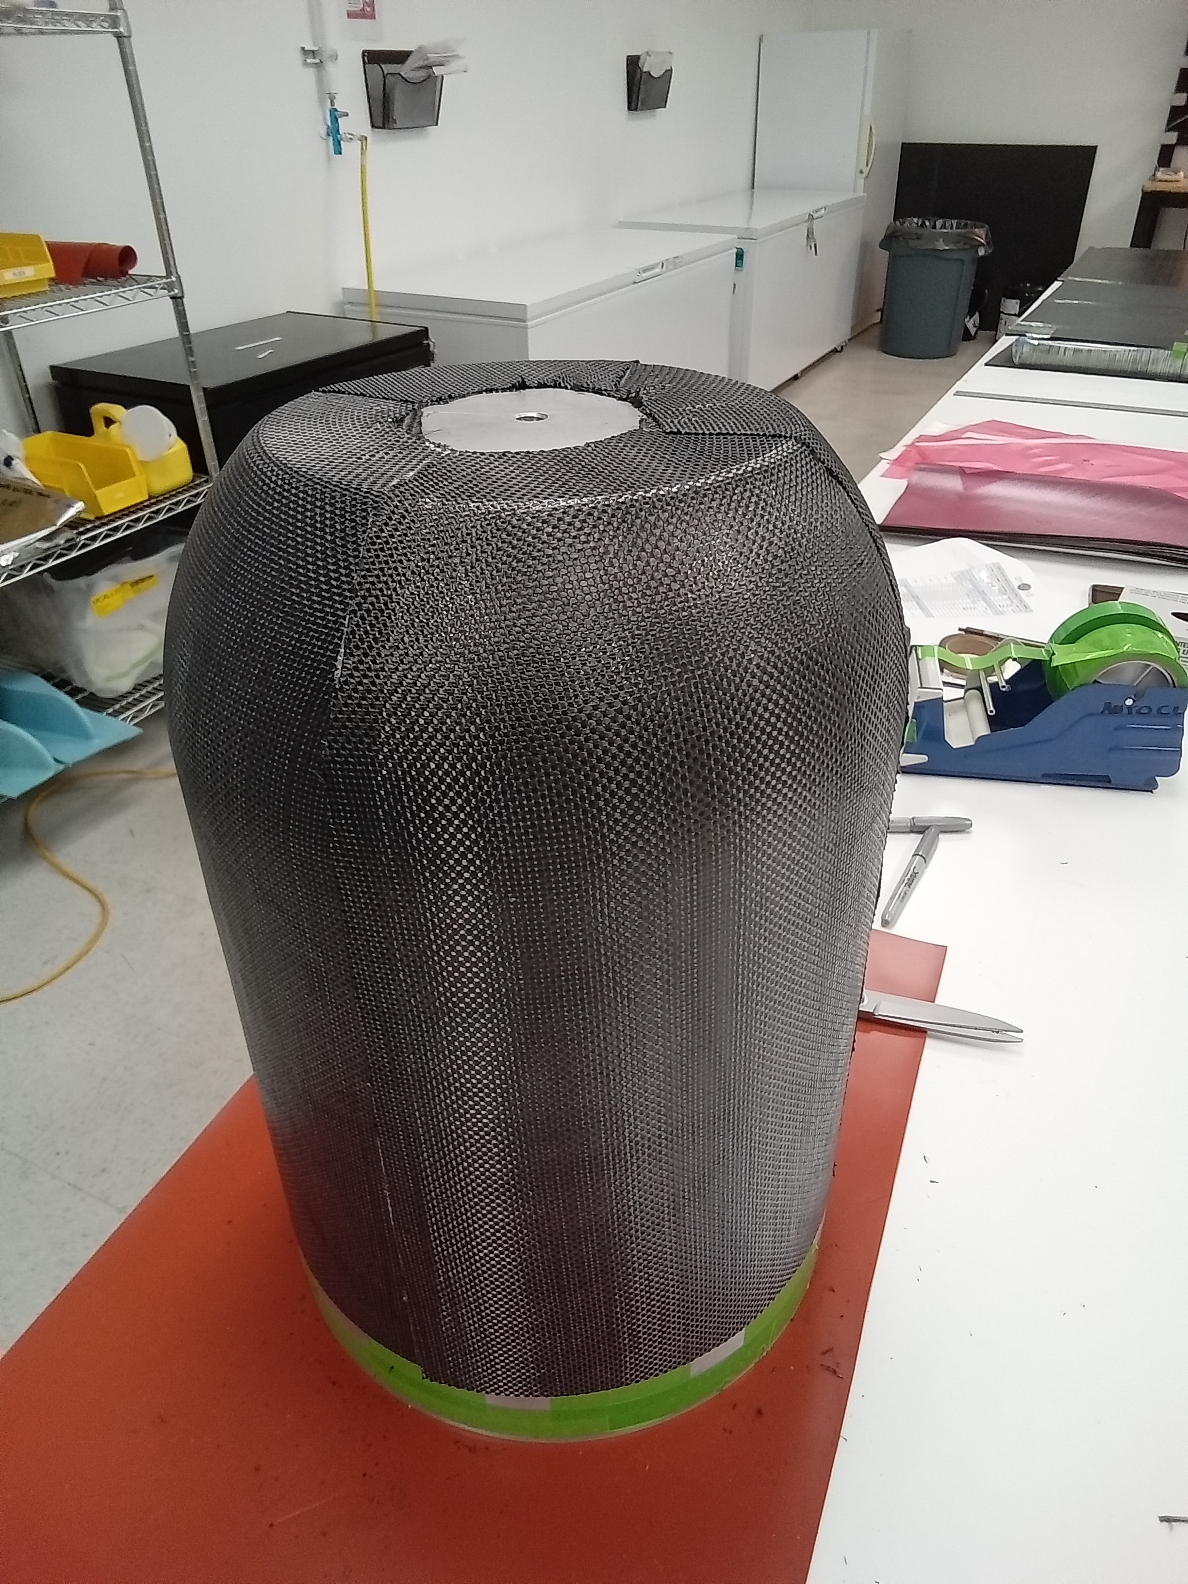
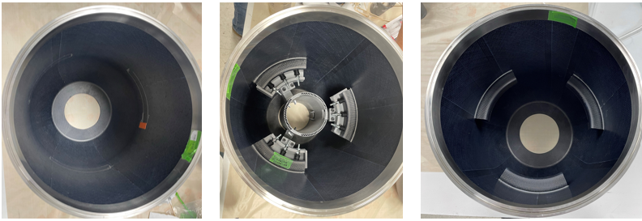
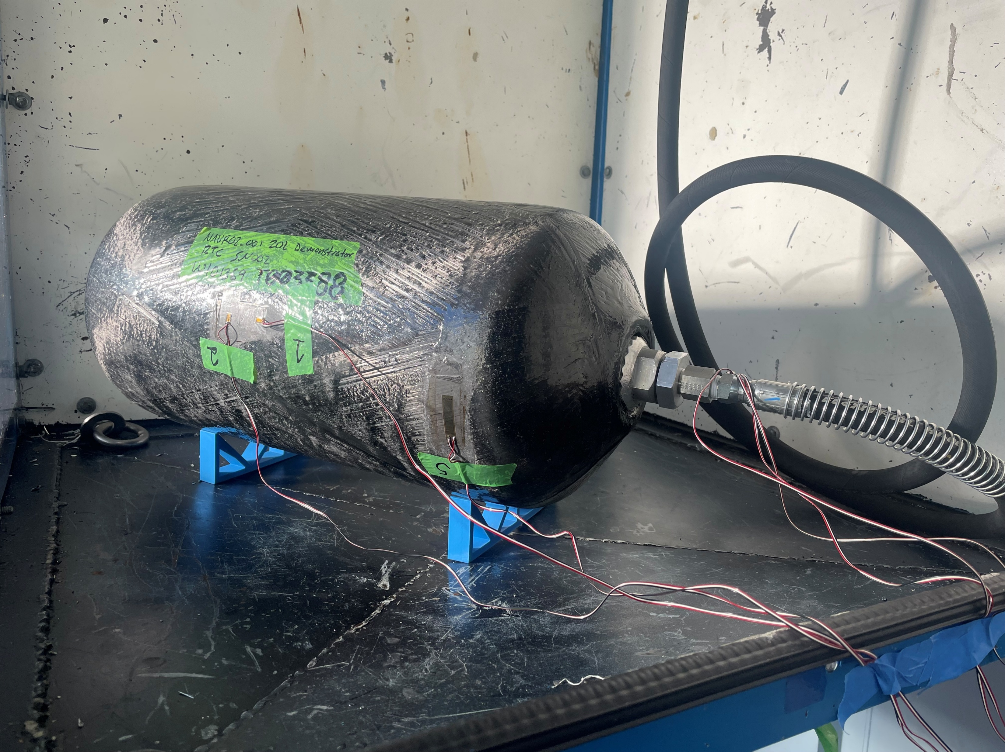
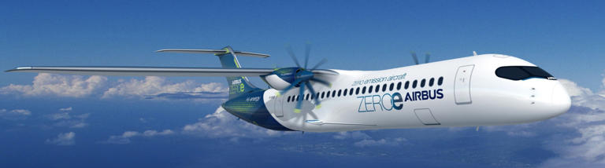
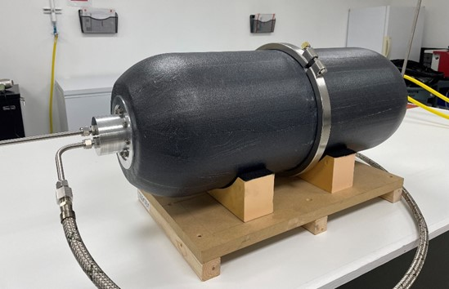
Next Step for C-CHILL
Volume Production
Component Qualification
Flight Test
Airbus

Slide 9
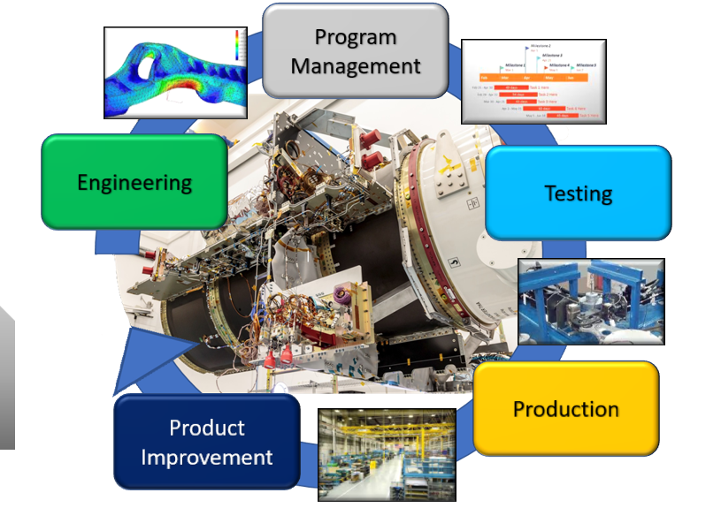
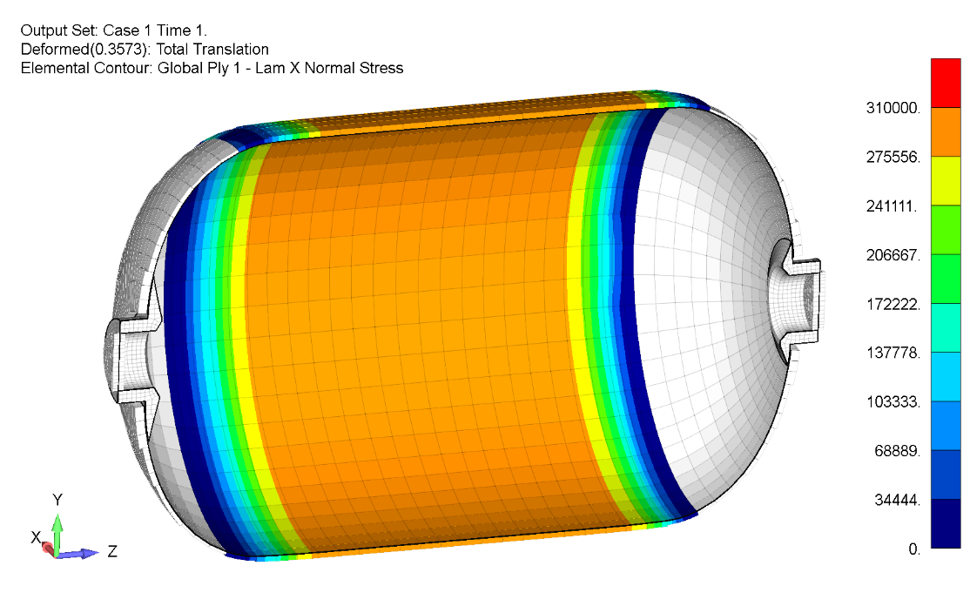
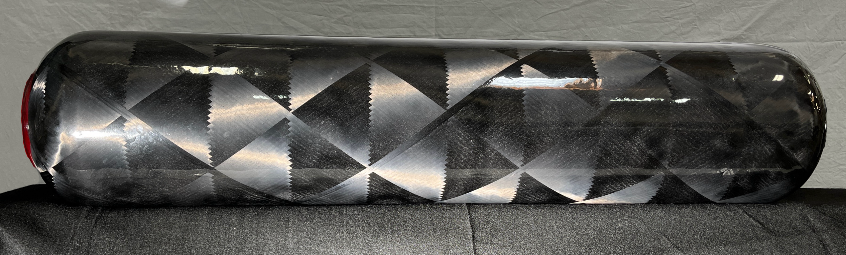
Dynovas Overview
Dynovas Provides Full-Service Engineering and Manufacturing to the Aerospace and Defense Industry
  Specializing in Composites
    Flat panels to aerostructures
  Advanced Testing
  Production of Tanks and Integrated Structures
Contact Dynovas For Your Aerospace Composites Needs

Slide 10
Thank You

