Slide 1
BAE/Ball Cryogenic Margins
CEC/ICMC
May 18-22, 2025
Carlita Gorham & Dave Glaister

Slide 2
Thermal/Cryogenic Margin Covers Uncertainty
Covers inherent uncertainty due to both design and analysis limitations
  To predicting flight performance
  Not equivalent to sensitivity analysis
    Focuses on impact of individual design and analysis parameters and assumptions
Envelopes all areas of uncertainty in design and examples include:
  Unidentified heat flow paths
  Thermal contact resistance at interface joints
  Transient orbit environments
  Surface optical properties
  Variation in thermophysical properties by material lot
  MLI (Multilayer Insulation) performance
  Workmanship employed at the various assembly levels

Slide 3
Thermal Margin Appropriate to Risk is Optimum
Typical:
  Thermal Engineer: “the more margin the better”
  Program Manager: “we don’t need any thermal margin as Thermal Engineers are always too conservative”
Need to balance and establish margin commensurate with risk
Too little margin
  Real risk of late program or on orbit failure to meet temperature/performance/requirements
Too much margin
  At a minimum, increases system mass and power
  Worst case, can prevent a system from even being proposed as not feasible

Slide 4
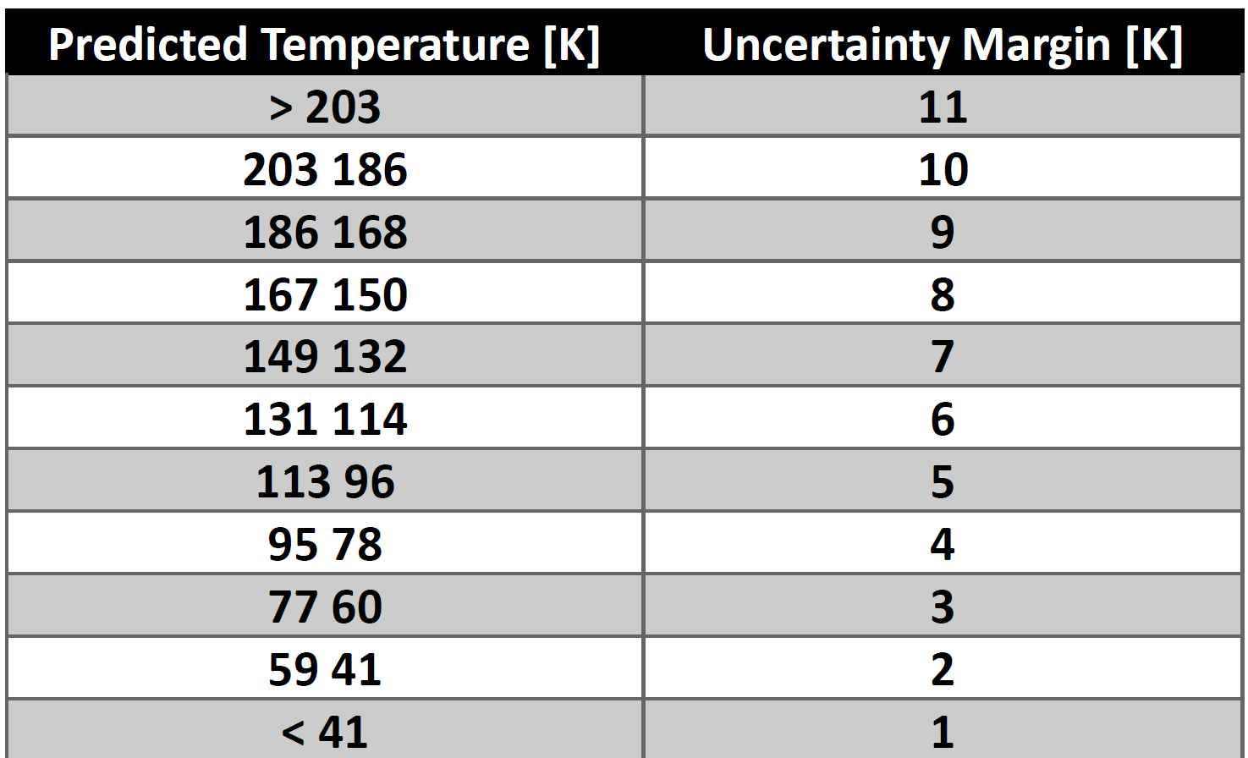
Margin Foundation is Key to Understanding How to Apply
Foundational Databases
  MIL-HDBK-340 and MIL-STD-1540D (now SMC-S-016)
  Donabedian led the addition of Cryogenic Margins using a database of about 12 programs (that young Glaister compiled)
Aligned with ambient temperature margins as follows:
Heat Load margin preferred over temperature margin for cryogenic systems

Slide 5
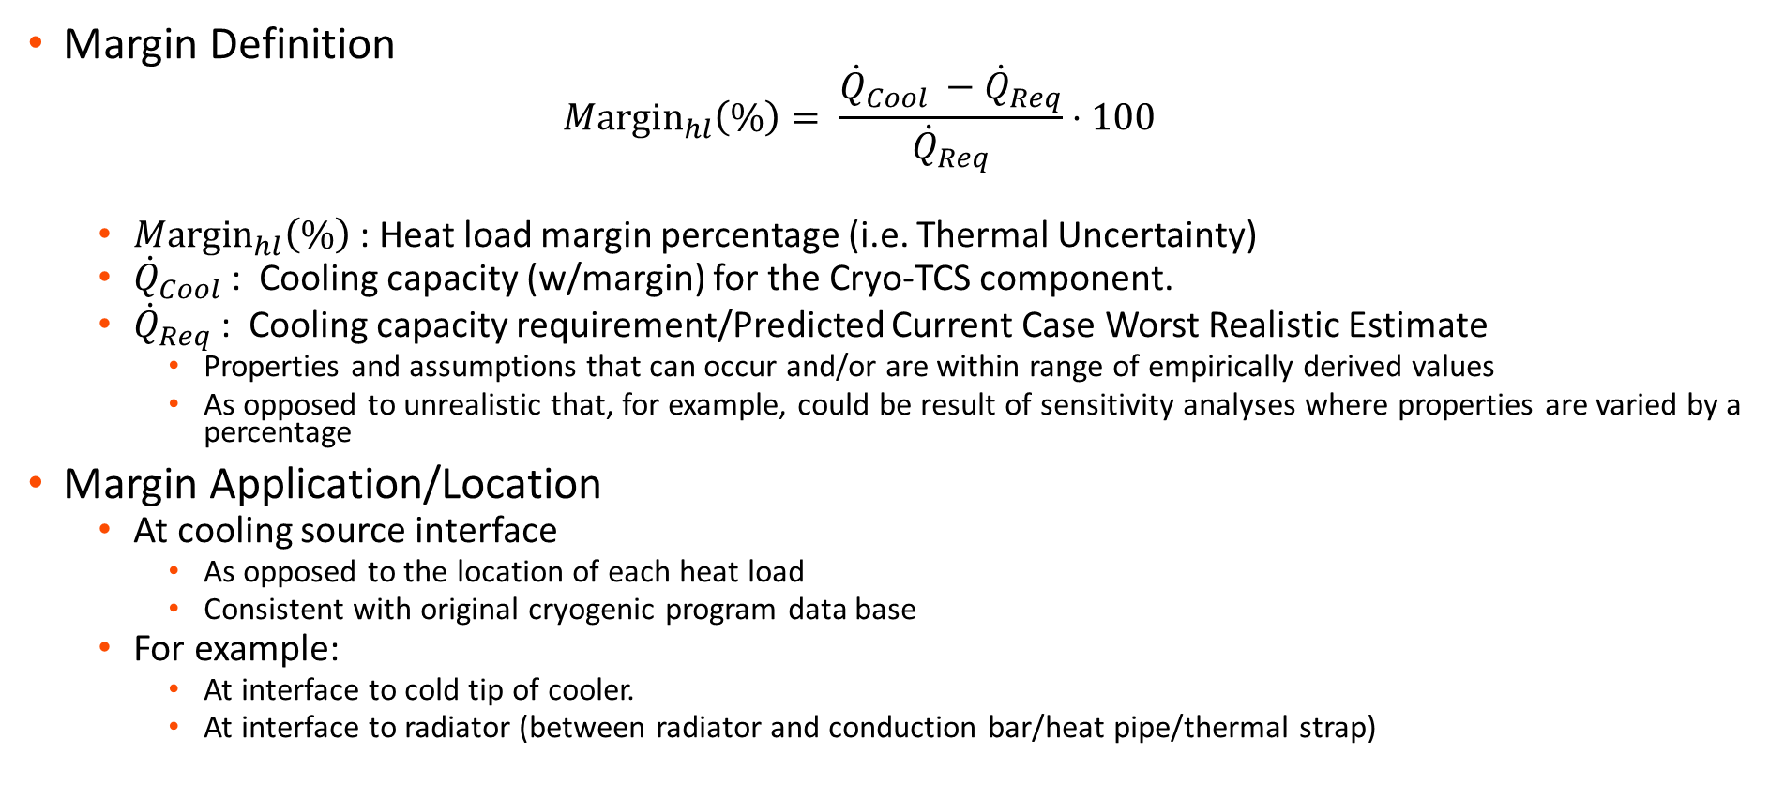
Margin Definition and Application Aligned with Foundation
Margin Definition
  $$Μ\text{argi}{\text{n}}_{hl}\left(\%\right)= \frac{{\dot{Q}}_{Cool} −{\dot{Q}}_{Req}}{{\dot{Q}}_{Req}}⋅100$$
  $Μ\text{argi}{\text{n}}_{hl}\left(\%\right)$: Heat load margin percentage (i.e. Thermal Uncertainty)
  ${\dot{Q}}_{Cool}$: Cooling capacity (w/margin) for the Cryo-TCS component.
  ${\dot{Q}}_{Req}$ : Cooling capacity requirement/Predicted Current Case Worst Realistic Estimate
    Properties and assumptions that can occur and/or are within range of empirically derived values
    As opposed to unrealistic that, for example, could be result of sensitivity analyses where properties are varied by a percentage
Margin Application/Location
  At cooling source interface
    As opposed to the location of each heat load
    Consistent with original cryogenic program data base
  For example:
    At interface to cold tip of cooler.
    At interface to radiator (between radiator and conduction bar/heat pipe/thermal strap)

Slide 6
Standard Program Cryogenic Margin Recommendations
Risk is reduced just by act of establishing and tracking cryogenic margins
Standard Program Cryogenic Margin Recommendations
  BAE standard based on MIL-STD
    Corresponds to 98% probability or 2 sigma standard deviation range
    98% of on orbit performance should be within worst case prediction plus this margin
  Applied as function of design maturity and performance/verification testing
    Important note: margin cannot be reduced until milestone is completed
Life Cycle Phase: NASA/MIL | Heat Load Margin (%)
 | MIL-STD and British Aerospace | NASA GSFC
Pre-Phase A/ATP | 50 | 100
Phase A/SDR Phase B/PDR Phase C/CDR Phase D/Qualification Phase E/TVAC Correlation | 50 45 35 30 25 | 100 80 50 40 33

Slide 7
Margin Tailoring is Important
As margin covers uncertainty, it can and should be updated/modified when uncertainty changes
Tailoring for individual heat loads
  Some heat loads can have larger or smaller uncertainties than average
  For cryogenic systems, detector electrical heat loads can be measured with good accuracy
    Thus, common practice is to reduce margin at ATP to 20% against prior, similar measured detector dissipations
    For NTE (Not To Exceed) dissipation or quantity (e.g., thermal strap conductance), margin can be reduced or eliminated
Best method for reducing uncertainty and margin is through test and model correlation
  Tests at lower levels can reduce specific uncertainty and margin
  For example, thermal strap/conductor test or a thermal brassboard tested earlier (e.g., prior to PDR)
  Important to update margin based on lower level test results
    Not only as uncertainty has been reduced
    Also to justify value of performing early risk reduction tests
On reverse side, for resource/schedule/cost constrained programs, the margin can be higher due to increased risk
  At BAE, typically double cryogenic margin requirements for low resource programs (for example: 100% at ATP).

Slide 8
BAE Margin Examples Summary
Six BAE programs with seven instruments, within last 8 years
Some key takeaways:
  Demonstrates adequacy of MIL-STD based BAE margin philosophy of 50% at ATP and 25% margin at delivery
  Delivery (post TVAC test and model correlation) to on-orbit margin either stayed same or increased
    For two programs with on-orbit flight data
    On-orbit conditions did not cause additional margin loss
  Margin that significantly exceeds the requirement can be a sign of overdesign
    However, BAE programs with excess margin is a byproduct of leveraging heritage design features and maturing technologies rather than overdesign
  Generally, margin becomes more stable towards end of program as design and requirements mature

Slide 9
Program A: Successful and Margin Increased On Orbit
Challenging to provide tracking information across entire life cycle of the program
However, TVAC Correlated Model/delivery cryogenic margin of 37% and, on orbit, never seen less than 53% margin

Slide 10
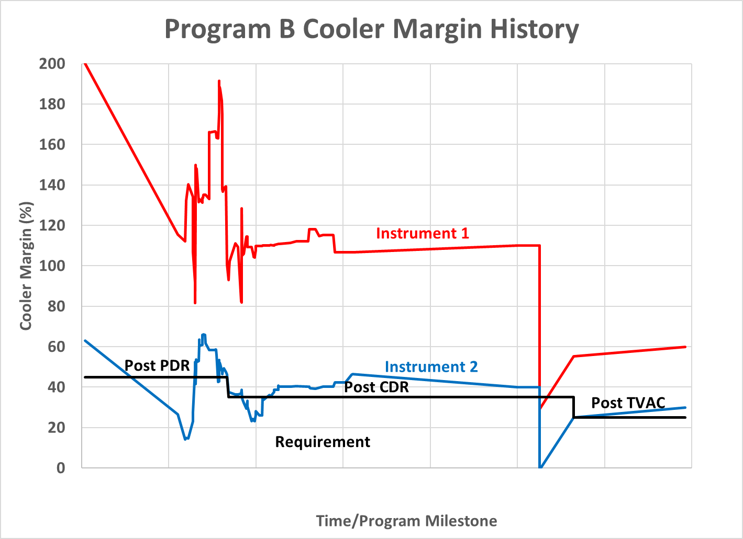
Program B: Challenging Assembly and Integration Margin Loss, but Recovered and Didn’t Lose Margin On-Orbit
Two independent cryogenic instruments
Significant assembly and integration anomaly that affected both instruments in final TVAC, with corresponding loss in margin
Mitigations enacted that compensated for margin loss, resulting in meeting requirements at delivery and on-orbit

Slide 11
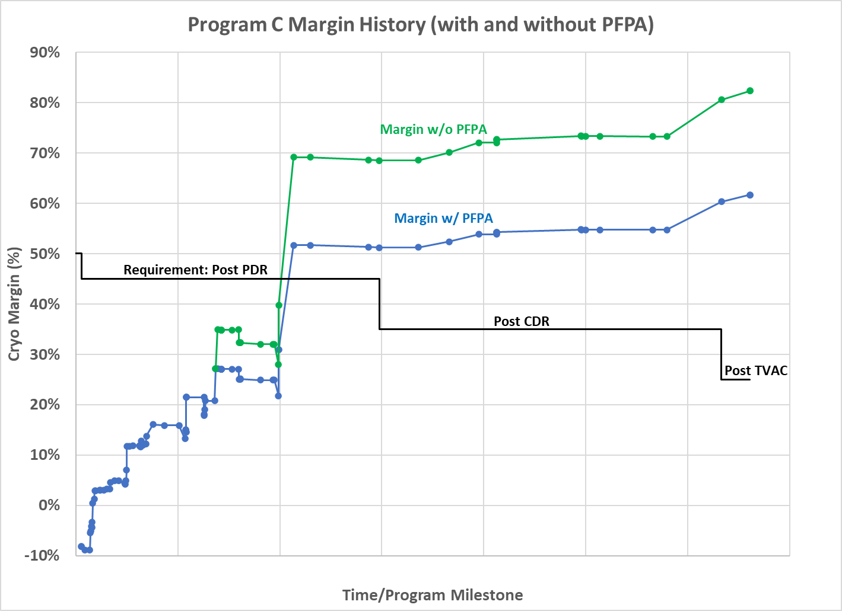
Program C: Recovered Pre-PDR Challenges to Meet CDR Through Delivery Requirements
NTE FPA dissipation not included in margin requirement
Early significant margin impact due challenges inherited from previous program
Design mitigations developed enabled margin recovery by CDR
Completed final TVAC and model correlation and delivery and met all margin requirements

Slide 12
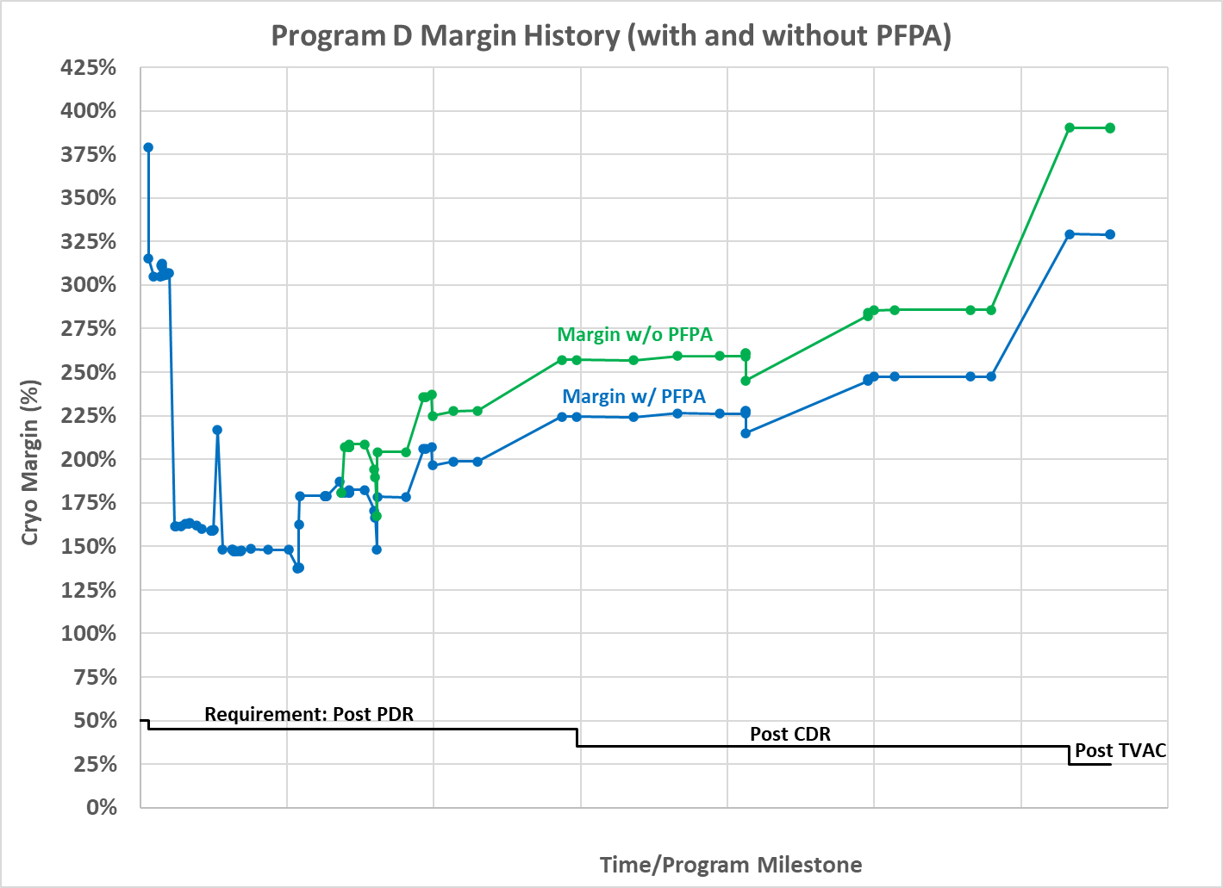
Program D: Met Margin Requirements from ATP to Delivery
NTE FPA dissipation not included in margin requirement
Early significant margin impact due challenges inherited from previous program
Design mitigations developed to recover margin
Completed final TVAC and model correlation and delivery and met all margin requirements

Slide 13
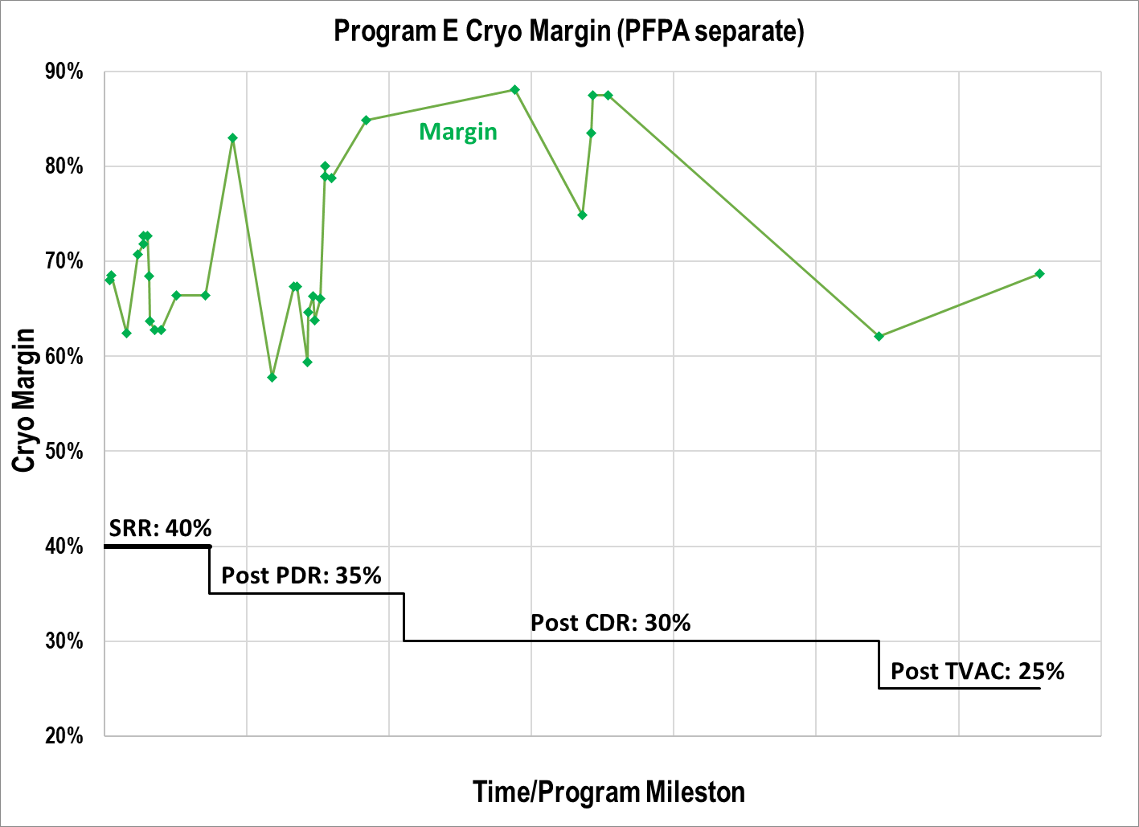
Program E: Tailored Reduced Margin Requirements Met Through Delivery
NTE FPA dissipation not included in margin requirement
Leveraged off previous program
  Started with lower thermal uncertainty
  Margin requirements tailored for lower levels
Completed final TVAC and model correlation and delivery and met all margin requirements

Slide 14
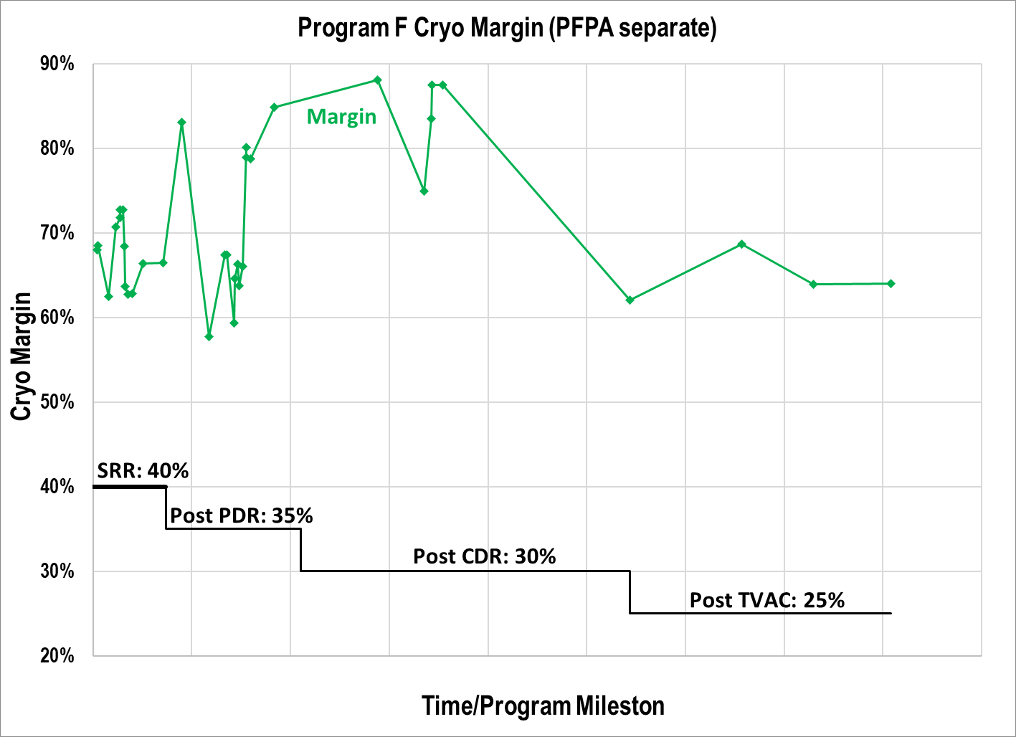
Program F: Tailored Reduced Margin Requirements Met Through Delivery
NTE FPA dissipation not included in margin requirement
Second unit of Program E
  Started with lower thermal uncertainty
  Margin requirements tailored for lower levels
Identical thermal model, therefore margin, to Program E prior to TVAC
Completed final TVAC and model correlation and delivery and met all margin requirements

Slide 15
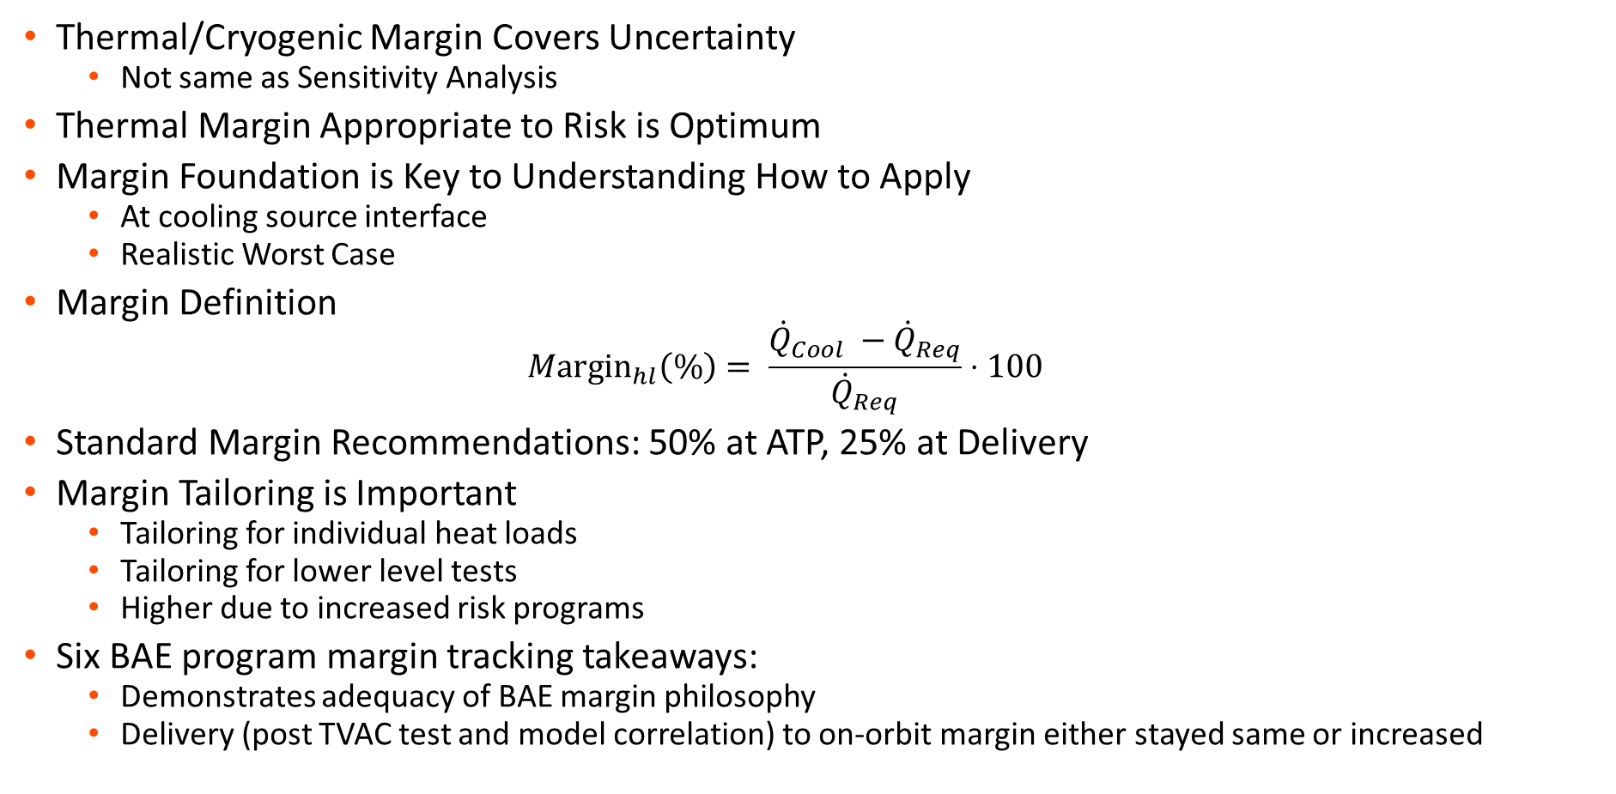
Executive Summary
Thermal/Cryogenic Margin Covers Uncertainty
  Not same as Sensitivity Analysis
Thermal Margin Appropriate to Risk is Optimum
Margin Foundation is Key to Understanding How to Apply
  At cooling source interface
  Realistic Worst Case
Margin Definition
  $$Μ\text{argi}{\text{n}}_{hl}\left(\%\right)= \frac{{\dot{Q}}_{Cool} −{\dot{Q}}_{Req}}{{\dot{Q}}_{Req}}⋅100$$
Standard Margin Recommendations: 50% at ATP, 25% at Delivery
Margin Tailoring is Important
  Tailoring for individual heat loads
  Tailoring for lower level tests
  Higher due to increased risk programs
Six BAE program margin tracking takeaways:
  Demonstrates adequacy of BAE margin philosophy
  Delivery (post TVAC test and model correlation) to on-orbit margin either stayed same or increased

