Slide 1

C3Or3D-03
Analysis of a cryogenic refrigerator solution for the ITER Isotope Separation System
Matthias Dremel, F4E
Grigory Kouzmenko, Fabien Seyvet, Marc Simon: F4E
Robert Michling, Ian Bonnett: ITER Organization
May 2025

Slide 2
Content
Context: Fusion for Energy’s role in the procurement of the ITER Isotope Separation System (ISS)
Introduction to the Isotope Separation System of ITER
Needs: Cryogenic and Nuclear Safety aspects
Solutions: Pro’s and Con’s of refrigerator solutions

Slide 3
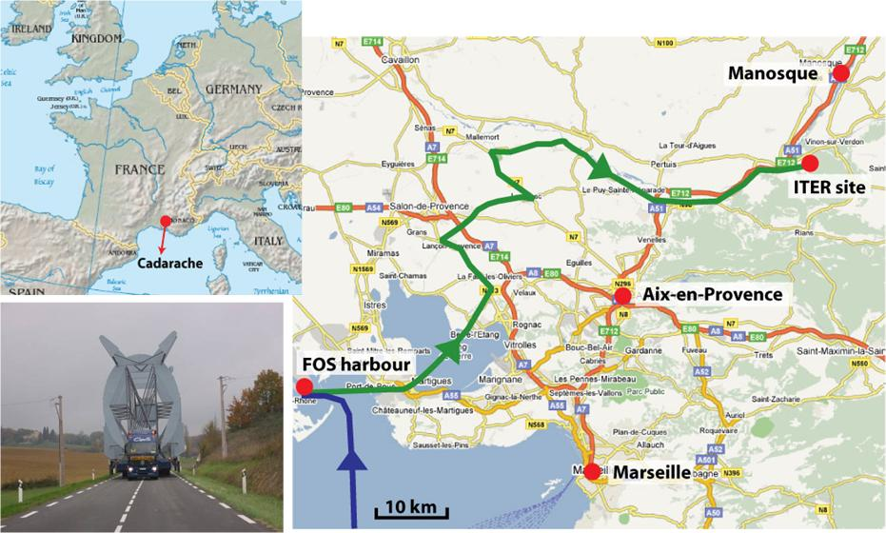
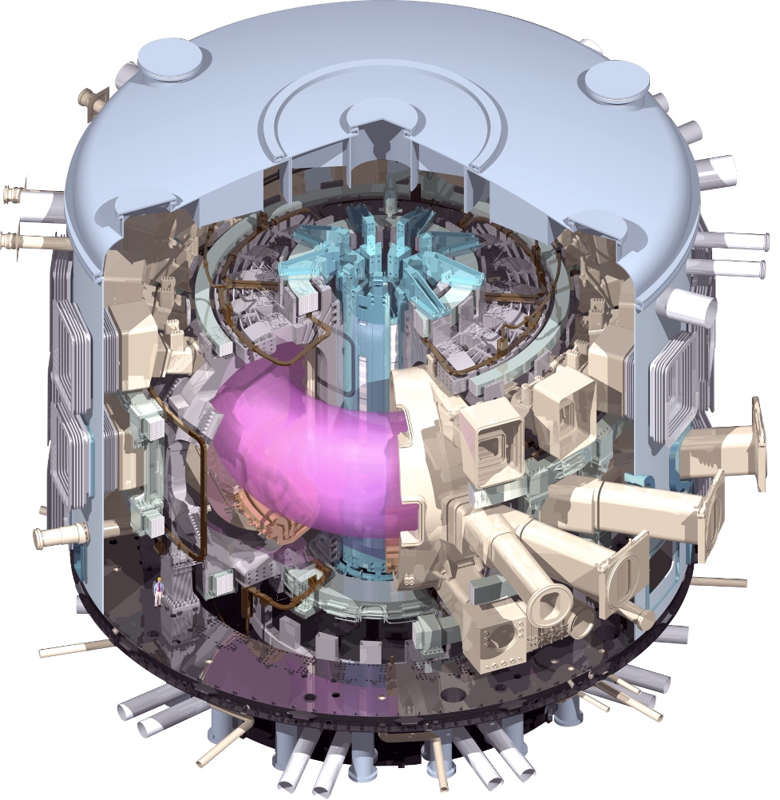
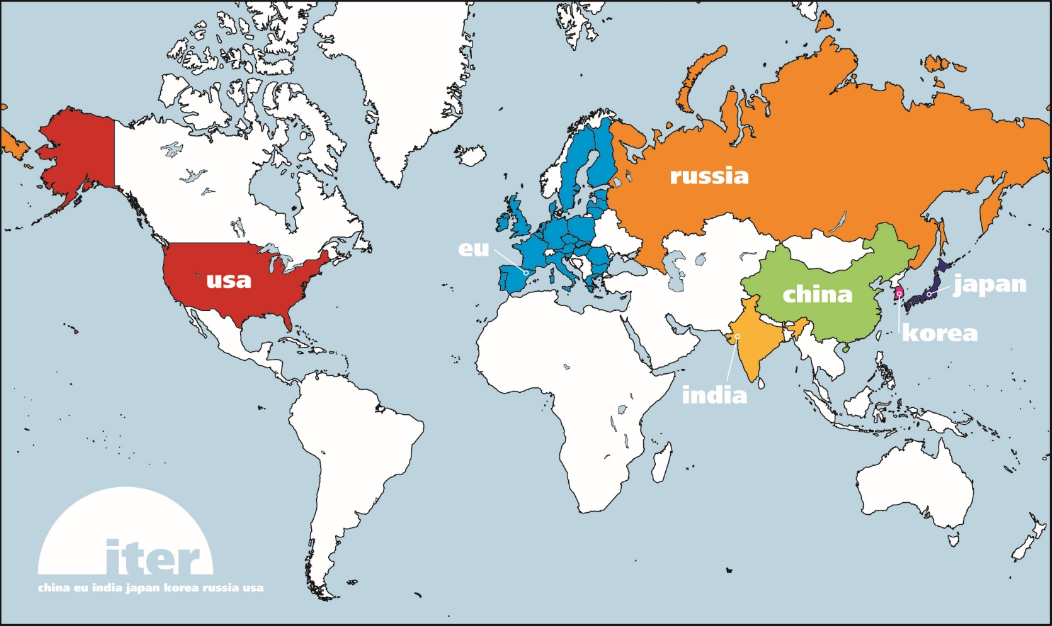







ITER - an international cooperation…
ITER is supported by 7 Parties (China, EU, IN, KO, JA, RF and US)
Project execution: 90% in kind procurements

Slide 4
Context: Fusion Power Plant Fuel Cycle
For research we needs a controlled fuelling of D2 and T2 rates
Fuelling
Systems
Tritium is radioactive and cannot be released to the environment. Tritium is also expensive.
Plasma Chamber
Tritium Plant
D⁺+T⁺
He⁺⁺(3.5MeV)
n(14MeV)
Vacuum Systems
The plasma creates a mixture of many different gases: H2, D2, T2, HD, HT, DT, He
but also: NH3, NT3, NTD2, Ar, Ne…

Slide 5
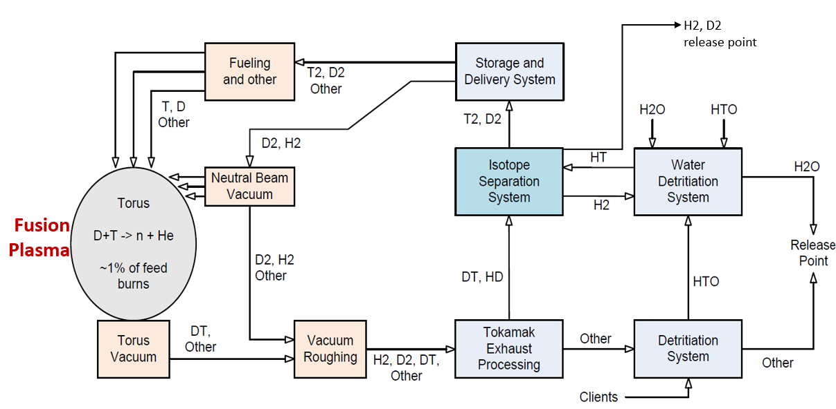

The ITER tritium plant

Slide 6
Duties of the ISS
  Separate Q2 (H2, D2, T2, HT, HD, DT) that are coming to ISS in different mixtures into the products D2, T2, H2 with different purity levels for re-use or release.
Delivery of T2 and D2 for plasma fueling (99%)
Delivery of D2, H2 for Plasma Heating Systems (99.5% and 99,7%)
Purification of H2 and D2 for release (2ppb)

Slide 7
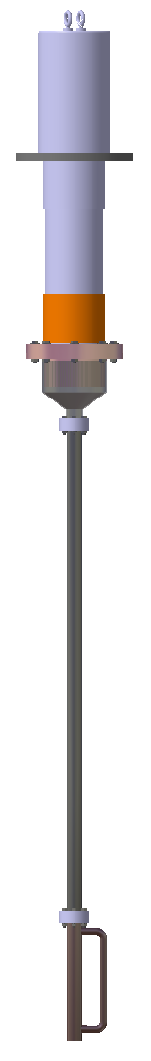
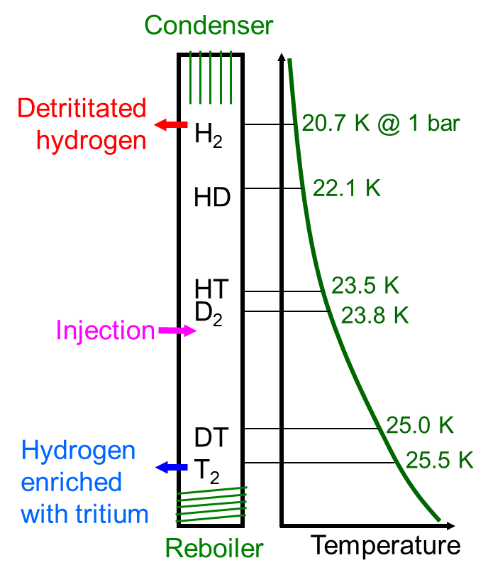
How is it done?
Distillation
Condenser
Cooled Part of the column:
Vapor is condensed at the condenser (e.g. 18 K) and trickles down through the column into the reboiler
Column
4-7.2m
Boiling points
Gas feed
The liquid is collected in the reboiler and boiled off again (25 K) to pass up through the column to the condenser.
Reboiler

Slide 8
The complete ITER ISS
Column 1: Protium (H₂) column (diagnostics)
Column 2: First Deuterium (D₂) column (purity for plasma fuel)
Column 3: Second Deuterium column (purity for Heating System)
Column 4: Tritium column (purity for plasma fuel)
Column 5: H2 purification for release (2 ppb of T2)
Column 6: D2 purification for release (2 ppb of T2)
Storage Delivery System: SDS
Water Detritiation System: WDS
Tritium Exhaust Processing: TEP
5
6

Slide 9
Cryogenic Needs
COLD BOX 1
CD1: 7.2 m, 300 W
CD2: 3.6 m, 140 W
CD3: 7.0 m, 165 W
CD4: 5.4 m, 215 W
CD1 Feed Cooler#1: 40 W 24hrs (WDS-H2)
CD1 Feed Cooler#2: (115 W) during the night only (NB-H2)
CD4 Feed Cooler: 115 W during the day (TEP-D2)
Inlet supply temperature 18 K and 20 K
Summary:
1500 W overall cooling power
~600 W @ 18 K
~900 W @ 20 K
dT ~ 2-2,5K
COLD BOX 2
CD5: 2.2 m, 40 W
CD6: 3.8 m, 70 W
CD5 Feed Cooler: 50 W
CD6 Feed Cooler: 50 W
Heat loads from control valves; transfer lines or couplings are not covered.

Slide 10
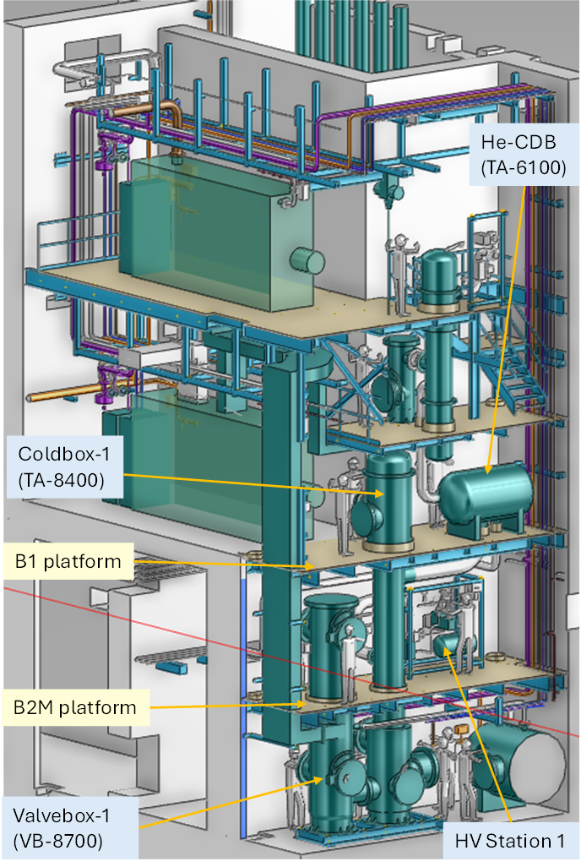
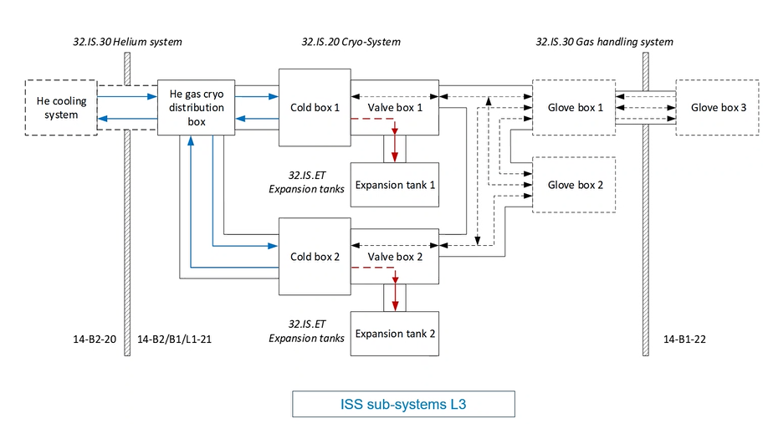
Plant Layout overview
25m
10m

Slide 11
Environmental/Boundary conditions
    Building internal conditions
Temperature: 18°C < T° < 35°C
Humidity: 20% < RH < 60%
Static Magnetic Field: 5-15 mT (earth field: 25-65 microT)
Ionizing radiation not relevant
    Liquid nitrogen
Liquid nitrogen for precooling is NOT available.
    Cooling fluid pressure
    > 4 bar

Slide 12
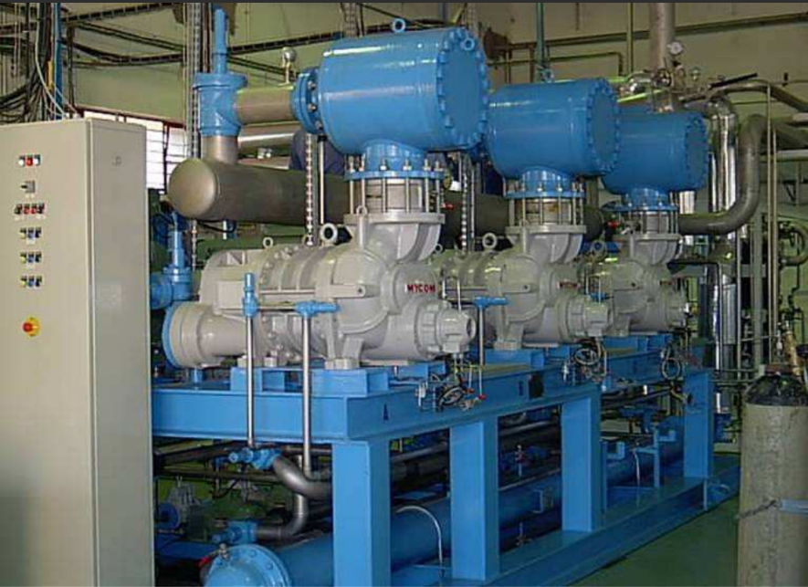
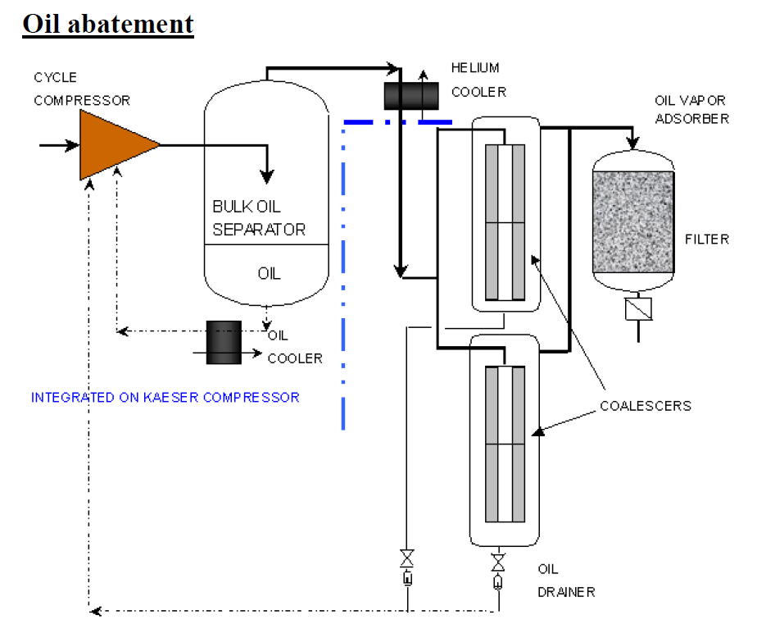
The classical refrigerator solution
Based on:
Screw Helium Compressors with their required oil and heat removal systems.
Followed by the expansion turbines with the counterflow heat exchangers.
These refrigerators are optimized for achieving high efficiency at 4 K and are therefore not ideal for the ISS
They are very elaborate and require complex maintenance efforts.
In the case of ITER difficult to integrate in the existing building
Magnetic field compatibility under investigation

Slide 13
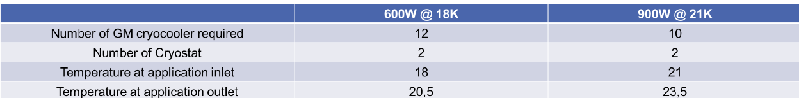

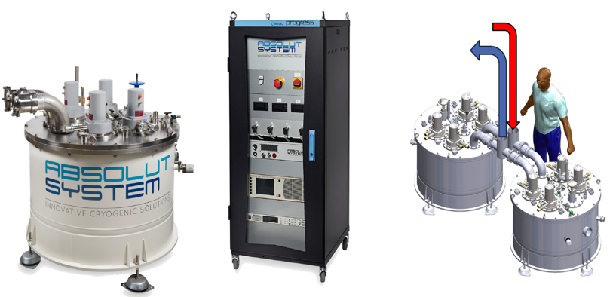
Coldhead solution
4 cold heads Remote Helium Cooling Loop can provide up to 300 W@20 K in a single cryostat through GHe flow
Possibility to parallelize the cryostats
Magnetic Field compatibility up to 50 mT

Slide 14
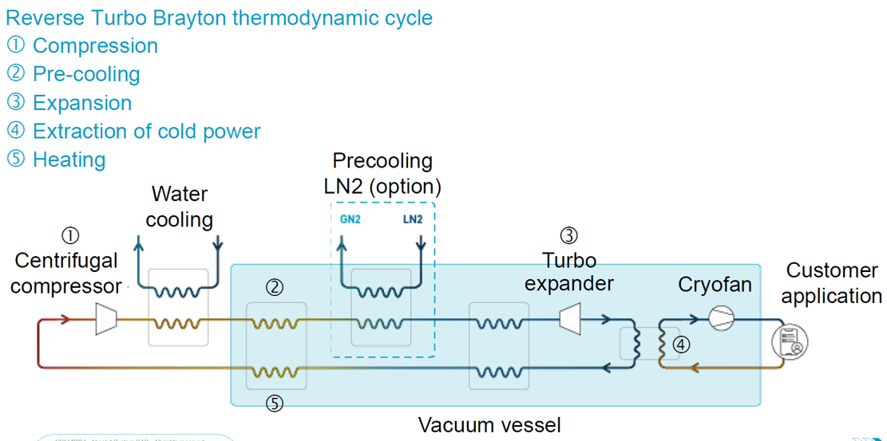
Turbo Brayton Cycle
100 000 rpm
Application from 18 K to 110 K, or more …
Can be optimized to the supply cooling power at ISS temperature needs
Is an oil free system
High frequency sealed compressors and expansion turbines are fully developed
Modular solution with electrical and mechanical couplings
Limited on-site activities ➔ only utilities and feed/customer application connections
Magnetic field compatibility under investigation

Slide 15
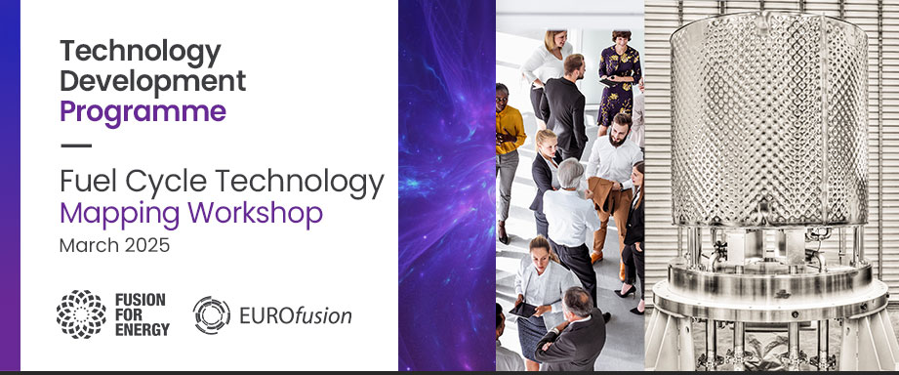
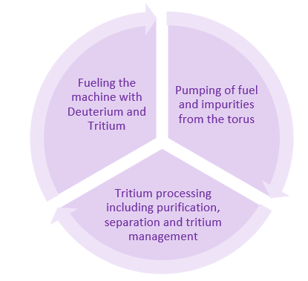































































Slide 16





Thank you for your attention
Follow us on:
www.f4e.europa.eu
www.twitter.com/fusionforenergy
www.youtube.com/fusionforenergy
www.linkedin.com/company/fusion-for-energy www.flickr.com/photos/fusionforenergy

