Slide 1

Lumped-Element Modeling of Density Wave Oscillations in Two-Phase Hydrogen Flows
C1Or4A-05
Trinity Templeton, Professor Konstantin Matveev, and Professor Jacob Leachman
Cryogenic Engineering Conference
Reno, Nevada
May 19th, 2025
Flow Boiling and Instabilities in Cryogenic Systems
Density Wave Oscillations
Modeling
Validation of the Stability Boundary for Freon-113 and Liquid Nitrogen
Liquid Hydrogen Results
Future Work and Conclusions

Slide 2
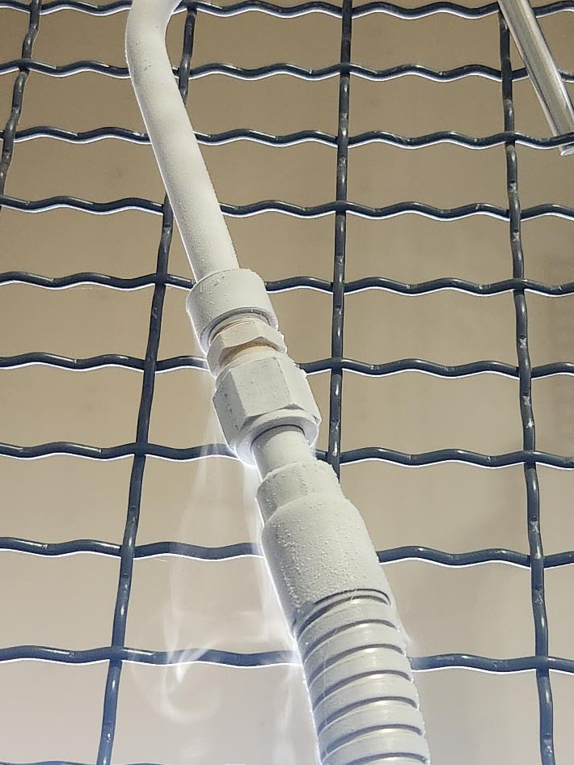
Flow Boiling in Cryogenic Systems
Two-phase flow instabilities occur in cryogenic flow boiling systems.
Vapor generation causes instabilities due to density differences between liquid and vapor states
Can damage equipment
High heat input to a cryogenic system causes flow boiling.
Transfer line chill in
Cryogenic flow evaporators
Rocket engines
To scale up cryogenic systems two-phase flow instabilities must be prevented and understood.
Component design
Fueling stations
Flow evaporators

Slide 3



Two-Phase Flow Instabilities
$$k_{ex}$$
Density wave oscillations.
Dynamic instability
Studied heavily for boiling water reactors
Limited data for cryogenic applications
Typical system for density wave oscillation analysis found in literature.
Inlet mass flux, boiling boundary, and exit quality fluctuate in time.
d
Two-phase flow
Z
Heat
Boiling boundary
$$Z_{bb}$$
0
Liquid
flow
Inlet flow
$$k_{in}$$

Slide 4
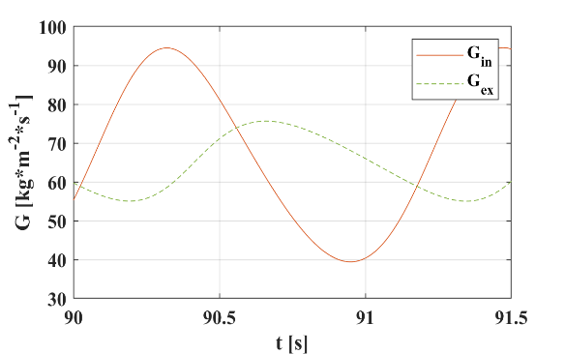
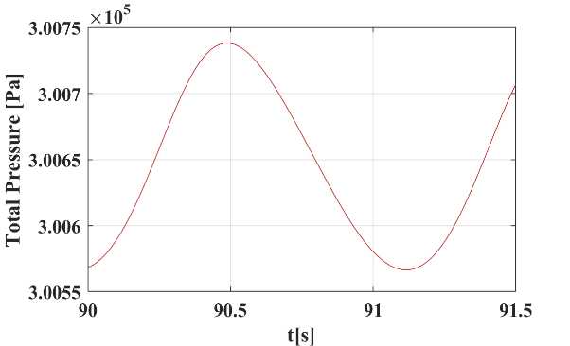
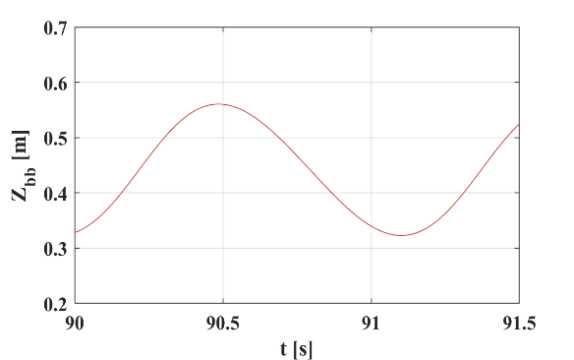
Density Wave Oscillation Mechanism
State 1:
Minimum boiling boundary
Minimum pressure
Inlet mass flux is increasing
1 → 2
Increase in mass flux causes boiling boundary to move upwards
Shift in boiling boundary increases pressure by compressing two-phase flow
State 2:
Inlet mass flux, boiling boundary, and pressure increasing coming closer to the maximum value
3
2 → 3
Inlet mass flux passes maximum and begins decreasing
Boiling boundary and pressure continue increasing
Inertia of single-phase causes continued rise in inlet mass flux and pressure
2
1
State 3:
Maximum boiling boundary
Maximum pressure
Inlet mass flux is decreasing
1
2
3

Slide 5


Partial Differential Equations
Z
$$ΔP_{tot}=Constant$$
Assumptions:
One-dimensional homogeneous flow
Overall system pressure drop is constant
Fixed fluid properties at the inlet
Sub-cooled boiling neglected
Constant wall heat input
Q
$$G= ρu$$
$$ρ=f(P,h)$$
$$\begin{aligned}\frac{∂ρ}{∂t}+\frac{∂G}{∂z}=0\end{aligned}$$
$$\begin{aligned}\frac{∂\left(ρh\right)}{∂t}+\frac{∂\left(Gh\right)}{∂z}=\frac{Q}{V} \end{aligned}$$
$$\begin{aligned}\int_{0}^{L}{\frac{∂G\left(z,t\right)}{∂t}}dz=ΔP\left(t\right)−ΔP_{acc}−{ΔP}_{grav}−{ΔP}_{frict}\end{aligned}$$
Mass Flux
0
G
Mass
Energy
Momentum
[1] Papini D, Cammi A, Colombo M, and Ricotti M E 2012 Chemical engineering science 81 118-39

Slide 6

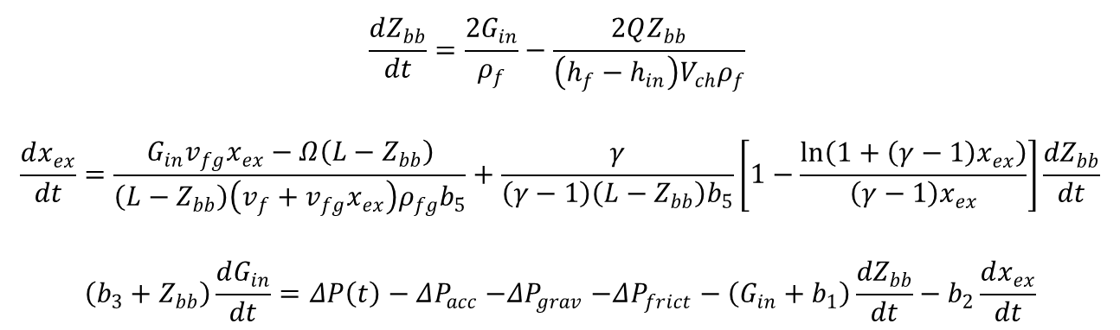
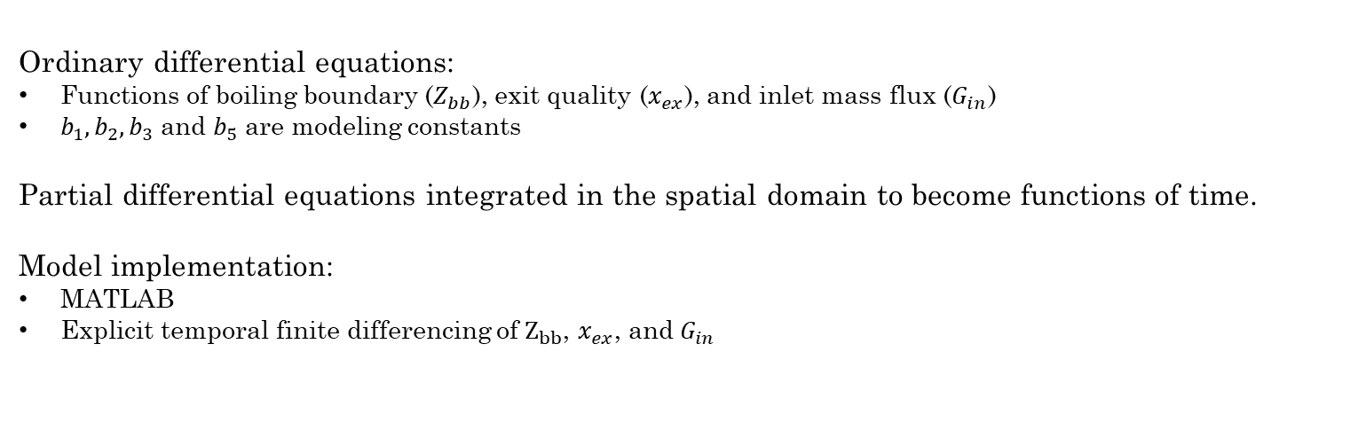


Reduced Order Model
Z
$$x_{ex}$$
$ΔP_{tot}$ = Constant
$$\begin{aligned}\frac{dZ_{bb}}{dt}=\frac{2G_{in}}{ρ_{f}}−\frac{2QZ_{bb}}{\left(h_{f}−h_{in}\right)V_{ch}ρ_{f}} \end{aligned}$$
$$\begin{aligned}\frac{dx_{ex}}{dt}=\frac{G_{in}v_{fg}x_{ex}−Ω\left(L−Z_{bb}\right)}{\left(L−Z_{bb}\right)\left(v_{f}+v_{fg}x_{ex}\right)ρ_{fg}b_{5}}+\frac{γ}{\left(γ−1\right)\left(L−Z_{bb}\right)b_{5}}\left[1−\frac{\ln\left(1+\left(γ−1\right)x_{ex}\right)}{\left(γ−1\right)x_{ex}}\right]\frac{{dZ}_{bb}}{dt}\end{aligned}$$
$$\begin{aligned}\left(b_{3}+Z_{bb}\right)\frac{dG_{in}}{dt}=ΔP\left(t\right)−ΔP_{acc}{−ΔP}_{grav}−ΔP_{frict}−\left(G_{in}+b_{1}\right)\frac{{dZ}_{bb}}{dt}−b_{2}\frac{dx_{ex}}{dt}\end{aligned}$$
Q
$$Z_{bb}$$
0
Ordinary differential equations:
Functions of boiling boundary ($Z_{bb}$), exit quality ($x_{ex}$), and inlet mass flux ($G_{in}$)
$b_{1}, b_{2}, b_{3}$ and $b_{5}$ are modeling constants
Partial differential equations integrated in the spatial domain to become functions of time.
Model implementation:
MATLAB
Explicit temporal finite differencing of $Z_{bb}$, $x_{ex}$, and $G_{in}$
$$G_{in}$$
[1] Papini D, Cammi A, Colombo M, and Ricotti M E 2012 Chemical engineering science 81 118-39

Slide 7

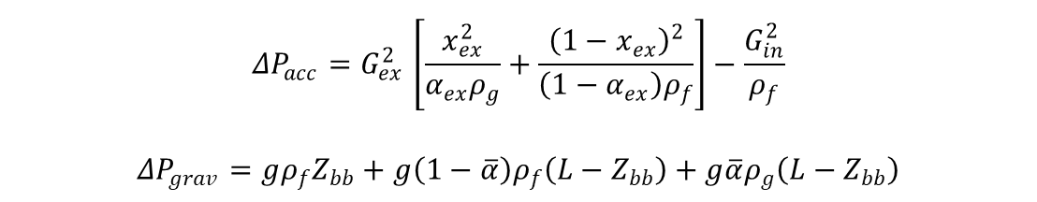




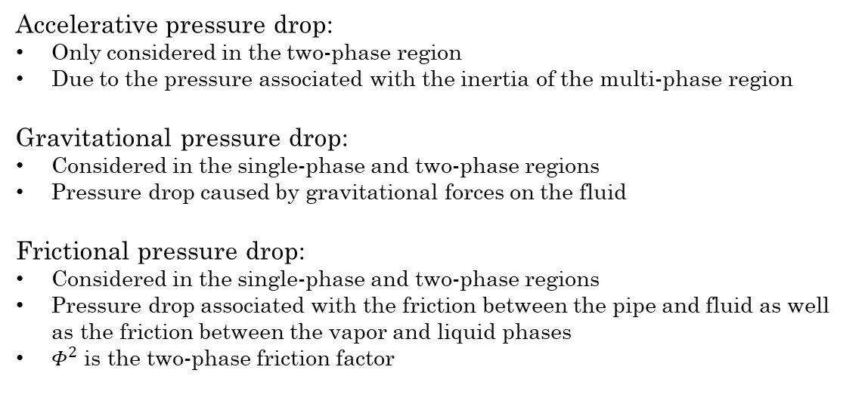

Pressure Drop Terms
$$\begin{aligned}{ΔP}_{acc}{=G}_{ex}^{2}\left[\frac{x_{ex}^{2}}{α_{ex}ρ_{g}}+\frac{{\left(1−x_{ex}\right)}^{2}}{\left(1−α_{ex}\right)ρ_{f}}\right]−\frac{G_{in}^{2}}{ρ_{f}}\end{aligned}$$
$$\begin{aligned}ΔP_{grav}=gρ_{f}Z_{bb}+g\left(1−\overline{α}\right)ρ_{f}\left(L−Z_{bb}\right)+g\overline{α}ρ_{g}\left(L−Z_{bb}\right)\end{aligned}$$
$$k_{ex}$$
$$x_{ex}$$
Z
$$ΔP_{frict}=\left(k_{in}+f\frac{Z_{bb}}{d}\right)\frac{G_{in}^{2}}{2ρ_{f}}+f\frac{L−Z_{bb}}{d}〈Φ^{2}〉\frac{{〈G_{2Φ}〉}^{2}}{2ρ_{f}}+k_{ex}Φ_{ex}^{2}$$
$ΔP_{tot}$ = Constant
Q
Accelerative pressure drop:
Only considered in the two-phase region
Due to the pressure associated with the inertia of the multi-phase region
Gravitational pressure drop:
Considered in the single-phase and two-phase regions
Pressure drop caused by gravitational forces on the fluid
Frictional pressure drop:
Considered in the single-phase and two-phase regions
Pressure drop associated with the friction between the pipe and fluid as well as the friction between the vapor and liquid phases
$Φ^{2}$ is the two-phase friction factor
$$Z_{bb}$$
0
$$G_{in}$$
$$k_{in}$$
[1] Papini D, Cammi A, Colombo M, and Ricotti M E 2012 Chemical engineering science 81 118-39

Slide 8
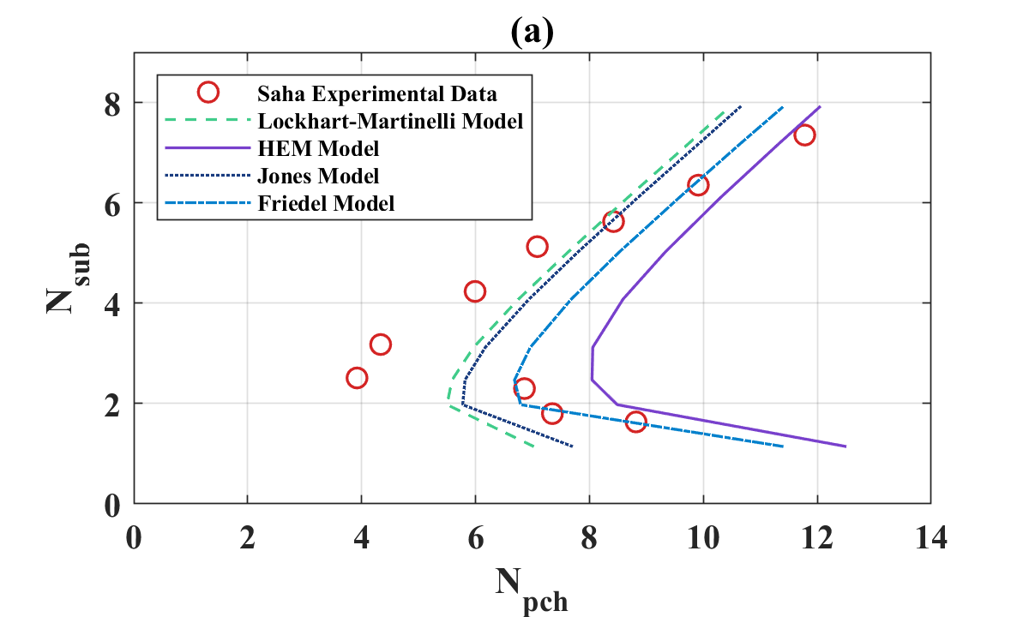


Validation of Stability Boundary for Freon-113
Experimental and modeling data for Freon-113.
Investigates multiple two-phase friction factors.
Characteristic L shape is present.
Lockhart-Martinell friction factor was selected due to lowest margin of error (~25%)
$N_{sub}$ is influenced by inlet enthalpy which is dictated by inlet temperature.
$N_{pch}$ is influenced by the ratio between heat input and inlet mass flux.
$$\begin{aligned}N_{sub}=\frac{h_{in}−h_{sat}}{h_{fg}}\frac{ρ_{fg}}{ρ_{g}} \end{aligned}$$
$$\begin{aligned}N_{pch}=\frac{Qv_{fg}}{G_{in}Ah_{fg}v_{f}} \end{aligned}$$
* sub = subcooling
* pch = phase change
Approximate agreement between experimental and modeling data.
[2] Saha P 1974 Thermally induced two-phase flow instabilities, including the effect of thermal non-equilibrium between the phases
PhD Thesis Georgia Institute of Technology
[3] Friedel L 1979 European Two-Phase Flow Group Meeting
[4] Lockhart W R 1949 Chemical engineering progress 45(1) 39-48
[5] Martinelli R T and Nelson D B 1948 Transactions of the American Society of Mechanical Engineers 70(6) 695-702
[6] Todreas N E and Kazimi M S 2011 Nuclear Systems I: Thermal Hydraulic Fundamentals (Boca Raton: Taylor & Francis)

Slide 9
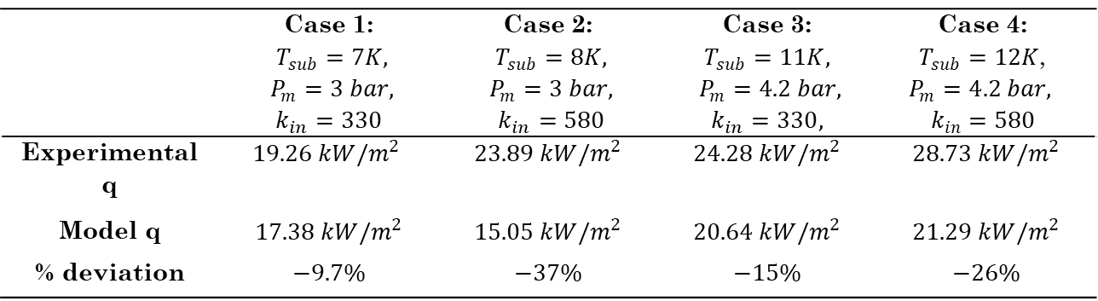






Validation of Stability Boundary for Liquid Nitrogen
 | Case 1: $T_{sub}=7K,$ $P_{m}=3 bar,$ $$k_{in}=330$$ | Case 2: $T_{sub}=8K,$ $P_{m}=3 bar,$ $k_{in}=580$ | Case 3: $$T_{sub}=11K,$$ $P_{m}=4.2 bar,$ $$k_{in}=330,$$ | Case 4: $T_{sub}=12K$, $$P_{m}=4.2 bar,$$ $$k_{in}=580$$
Experimental q | $$19.26 kW/m^{2}$$ | $$23.89 kW/m^{2}$$ | $$24.28 kW/m^{2}$$ | $$28.73 kW/m^{2}$$
Model q | $$17.38 kW/m^{2}$$ | $$15.05 kW/m^{2}$$ | $$20.64 kW/m^{2}$$ | $$21.29 kW/m^{2}$$
% deviation | $$−9.7\%$$ | $$−37\%$$ | $$−15\%$$ | $$−26\%$$
$$k_{ex}$$
$$x_{ex}$$
Z
$ΔP_{tot}$ = Constant
Q
$$Z_{bb}$$
Experimental and modeling data using the Lockhart-Martinelli friction factor for liquid nitrogen.
Model underpredicts experimental results by ~25%.
Cases with larger inlet resistance coefficient have a larger % deviation.
Approximate agreement between the experimental and modeling data.
0
$$G_{in}$$
$$k_{in}$$
[7] Ozawa M, Asao Y, and Takenaka N 1993 Instabilities in Multiphase Flows (Boston: Springer)

Slide 10
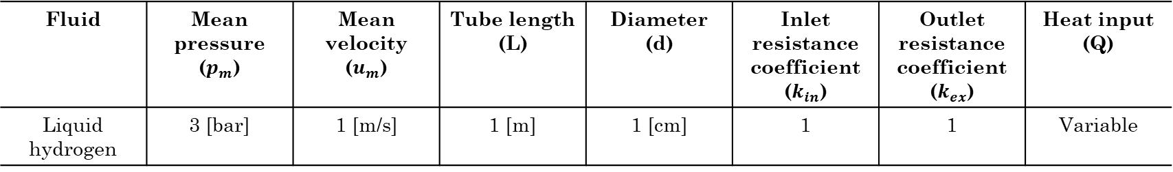
Transient Response: Limit Cycle Oscillations
Fluid | Mean pressure ($p_{m}$) | Mean velocity ($u_{m}$) | Tube length (L) | Diameter (d) | Inlet resistance coefficient ($k_{in}$) | Outlet resistance coefficient ($k_{ex}$) | Heat input (Q)
Liquid hydrogen | 3 [bar] | 1 [m/s] | 1 [m] | 1 [cm] | 1 | 1 | Variable
$$k_{ex}$$
$$x_{ex}$$
Z
$ΔP_{tot}$ = Constant
Q
$$Z_{bb}$$
0
$$G_{in}$$
$$k_{in}$$

Slide 11
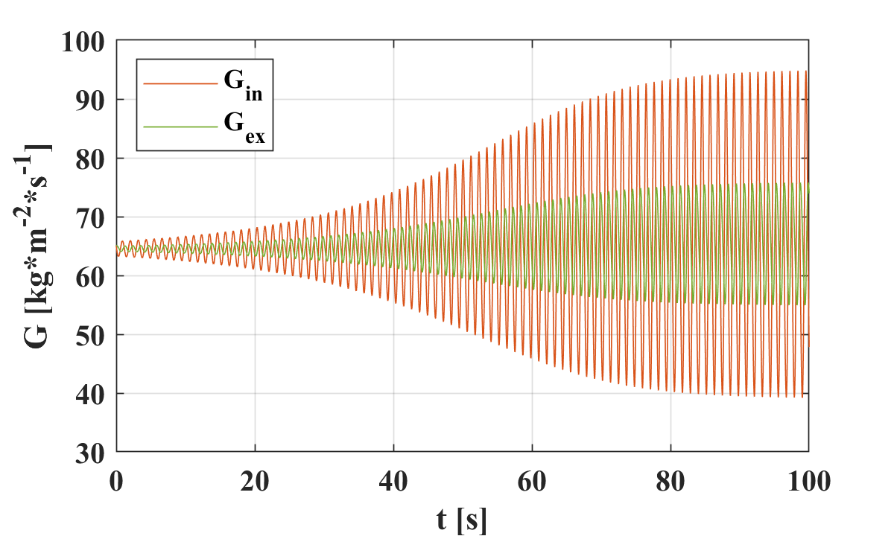
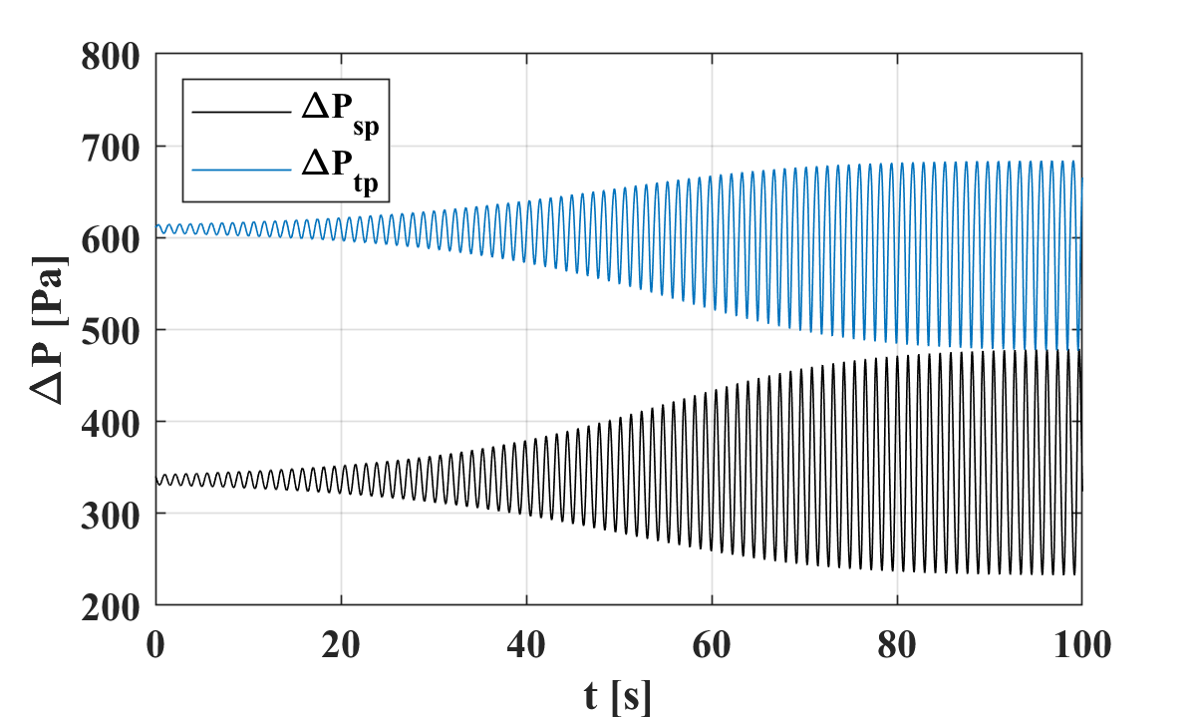
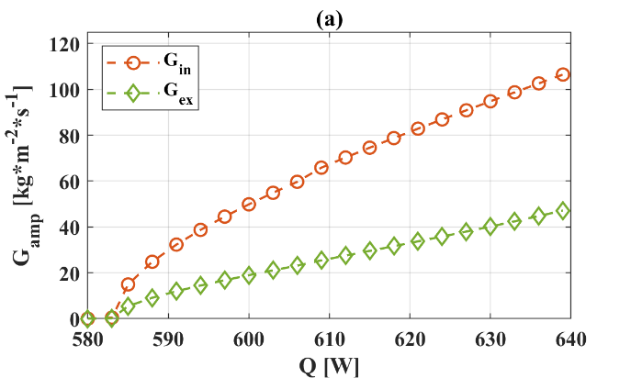
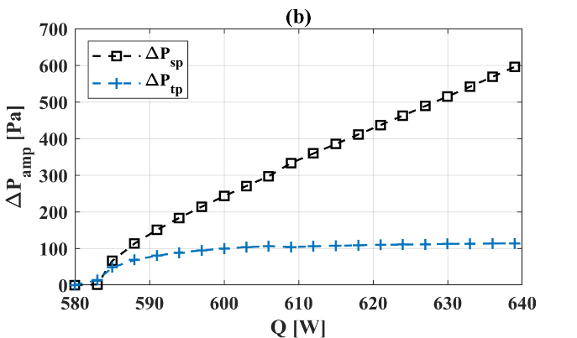
Transient Response: Limit Cycle Oscillations
Provide a small perturbation of the system pressure to induce fluctuations.
Limit cycle oscillations neither grow nor decay in time.
Single-phase and two-phase pressure drop are out of phase.
Q = 590 W
Q = 590 W
Limit cycle oscillations are present from 585 W – 639 W.
Amplitude of the limit cycle oscillations for several parameters increases with heat input.

Slide 12
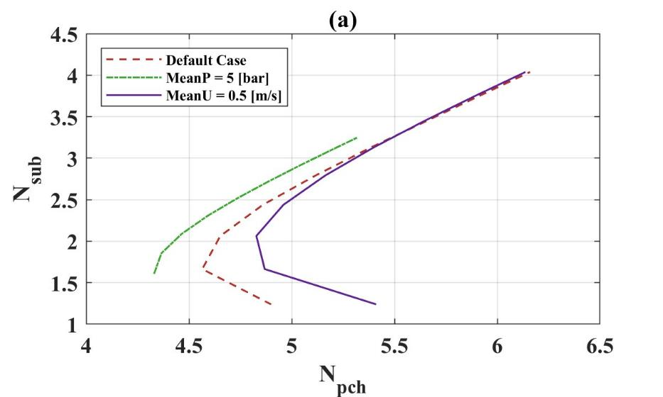
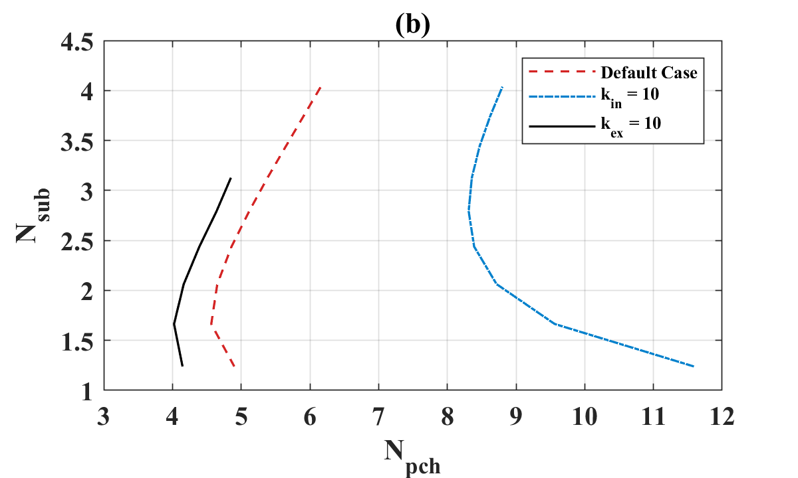
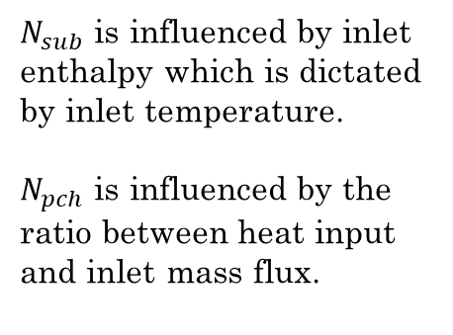

Liquid Hydrogen Stability Boundary Study
Stable
Stable
Unstable
Unstable
$$\begin{aligned}N_{sub}=\frac{h_{in}−h_{sat}}{h_{fg}}\frac{ρ_{fg}}{ρ_{g}} \end{aligned}$$
$$\begin{aligned}N_{pch}=\frac{Qv_{fg}}{G_{in}Ah_{fg}v_{f}} \end{aligned}$$
$N_{sub}$ is influenced by inlet enthalpy which is dictated by inlet temperature.
$N_{pch}$ is influenced by the ratio between heat input and inlet mass flux.
* sub = subcooling
* pch = phase change

Slide 13
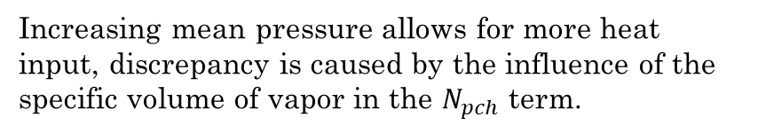
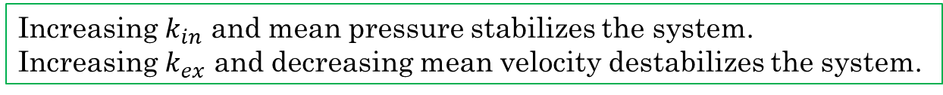
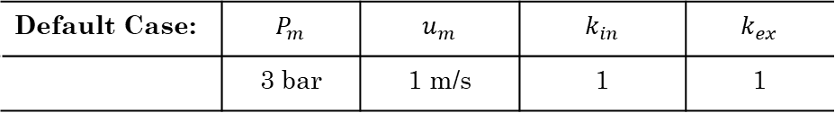
Liquid Hydrogen Stability Boundary Study
Stable
Stable
Unstable
Unstable
Increasing mean pressure allows for more heat input, discrepancy is caused by the influence of the specific volume of vapor in the $N_{pch}$ term.
Default Case: | $$P_{m}$$ | $$u_{m}$$ | $$k_{in}$$ | $$k_{ex}$$
 | 3 bar | 1 m/s | 1 | 1
Increasing $k_{in}$ and mean pressure stabilizes the system.
Increasing $k_{ex}$ and decreasing mean velocity destabilizes the system.

Slide 14
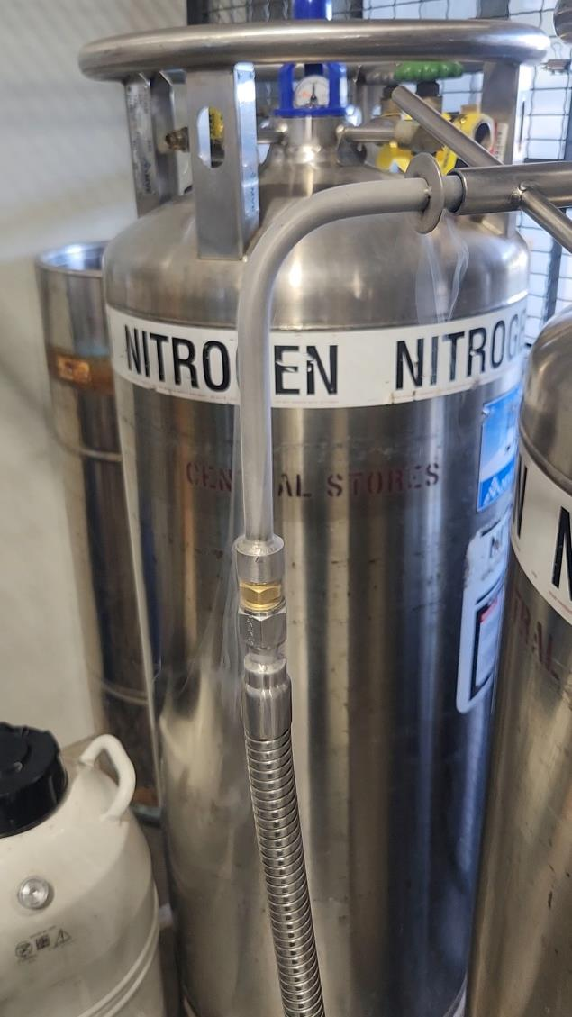
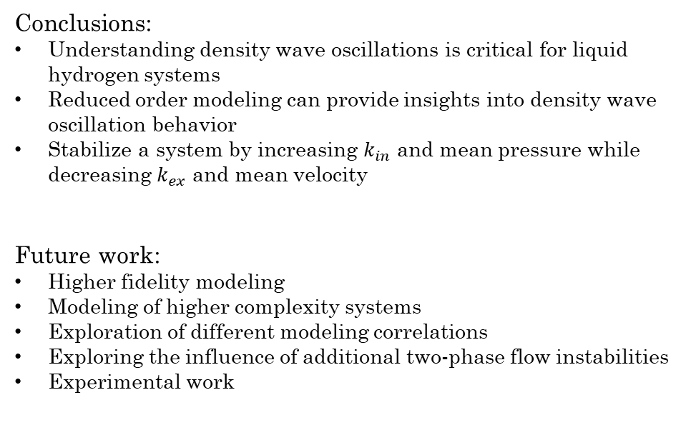
Conclusions and Future Work
Conclusions:
Understanding density wave oscillations is critical for liquid hydrogen systems
Reduced order modeling can provide insights into density wave oscillation behavior
Stabilize a system by increasing $k_{in}$ and mean pressure while decreasing $k_{ex}$ and mean velocity
Future work:
Higher fidelity modeling
Modeling of higher complexity systems
Exploration of different modeling correlations
Exploring the influence of additional two-phase flow instabilities
Experimental work

Slide 15
Thank You!
Trinity Templeton
trinity.templeton@wsu.edu
+1 541 480 3679

