Slide 1

Energy efficiency and flexible performance by independent speed adjustment of the cryocooler and the compressor
Lucjan Pajdzik, Thomas Rich, Ionela Bicean, Jonathan Shaxted,
Adriana L. Klyszejko, Alex Renshaw
Presented by Amy Kennedy
Notes:
Good morning. My name is Amy Kennedy, and I am representing Oxford Cryosystems, and we specialize in designing and manufacturing cryogenic solutions for scientific and industrial applications.
We use Gifford-McMahon cryocoolers in many of our products, and today, it is my pleasure to present the latest OxCryo solution to improve energy efficiency and flexible performance through independent speed adjustment of the cryocooler and the compressor.
This innovative approach allows us to optimise the performance of our cryogenic systems while minimising energy consumption.
In this presentation, I will discuss the technical aspects of our approach, the benefits it offers, and some real-world examples of its application.

Slide 2
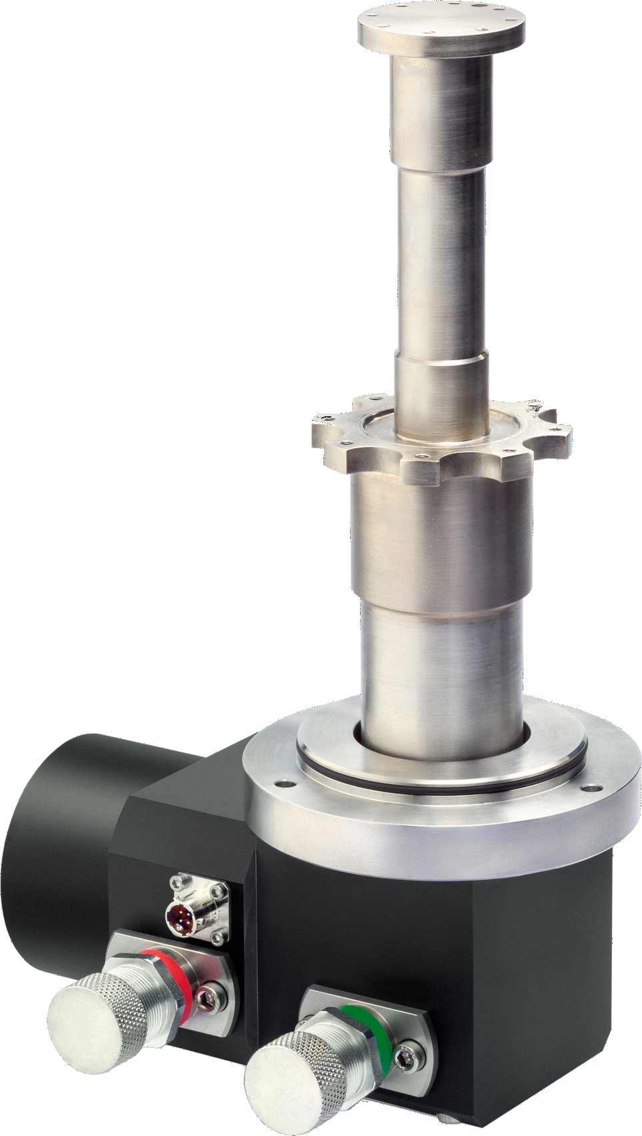

GIFFORD-MCMAHON (GM) CRYOCOOLERS
Cost-effective & cryogen-free
Operate across a broad temperature range
Simple design ensures reliable,
long-term performance
Relatively efficient cooling performance while minimising space requirements
Two-Stage 6/30 OxCryo GM Cryocooler
2
Notes:
As we know, Gifford-McMahon cryocoolers offer a cost-effective, cryogen-free solution across a broad range of temperatures.
Their simple design ensures long-term reliability with minimal maintenance and space requirements.
_____________________
This picture shows our two-stage 6/30 GM cryocooler, which provides a 6 W heat lift at 20 K on the second stage and a 30 W heat lift at 77 K on the first stage under nominal conditions.

Slide 3
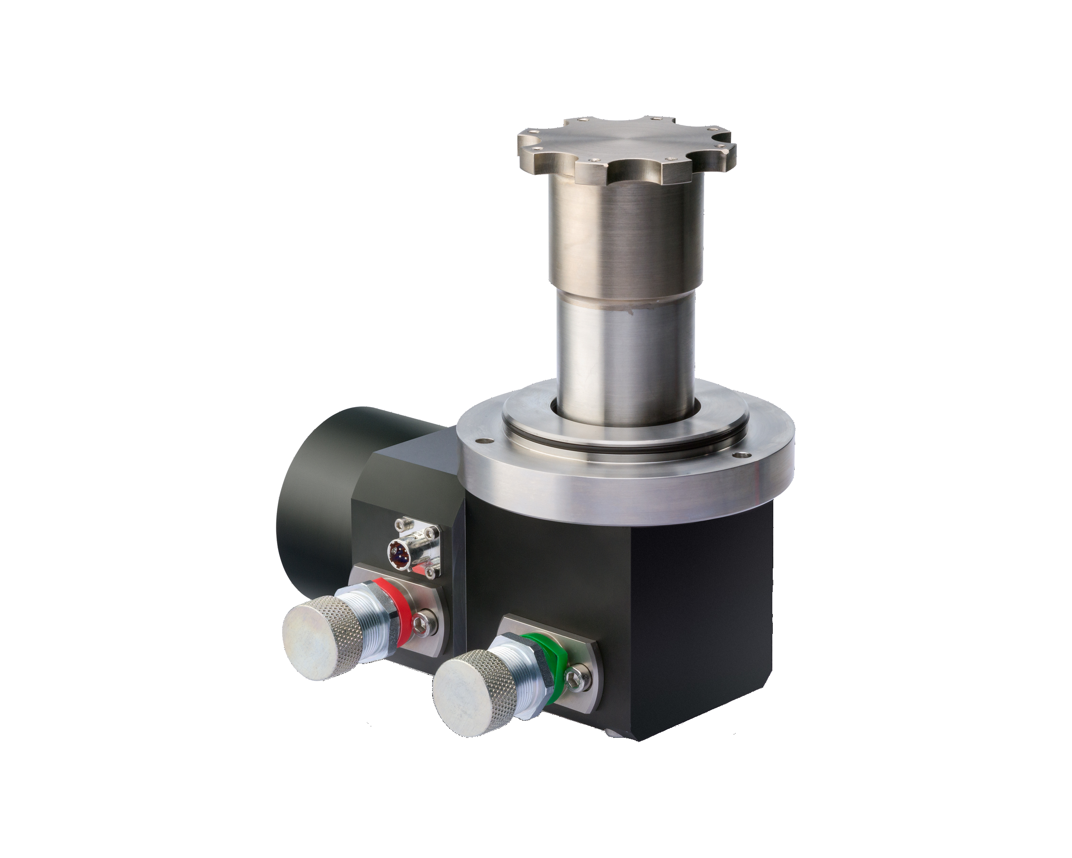
OxCryo VARIABLE CRYOCOOLER SPEED SOLUTION
High-speed operation is beneficial for
rapid cooldown and high thermal loads
Increasing speed from 60 to 90 rpm
reduces cooldown time by up to 50%
Dynamic speed adjustment optimises thermal performance & lengthens maintenance intervals
Single-Stage 0/40 OxCryo GM Cryocooler
3
Notes:
OxCryo GM cryocoolers offer adjustable speeds that cover a wide operational range.
Operating a cryocooler at high speeds is beneficial for rapid cooldown and managing high thermal loads. For example, increasing cryocooler speed from 60 to 90 rpm can reduce cooldown time by up to 50%, which I’ll show in the next slide.
When the cryocooler stabilises at its base temperature and manages relatively low thermal loads, its speed can be decreased, significantly extending maintenance intervals.
Dynamic cryocooler speed adjustment can effectively optimise thermal performance. Our variable speed cryocoolers have been operating at the Square Kilometre Array Radio Astronomy project in South Africa. These cryocoolers utilise a speed control algorithm developed by Oxford Cryosystems, designed to optimise service intervals and prevent unexpected failures.
_____________________________________
This picture shows our single-stage 0/40 GM cryocooler, which provides a 57 W heat lift at 77 K under nominal conditions.

Slide 4
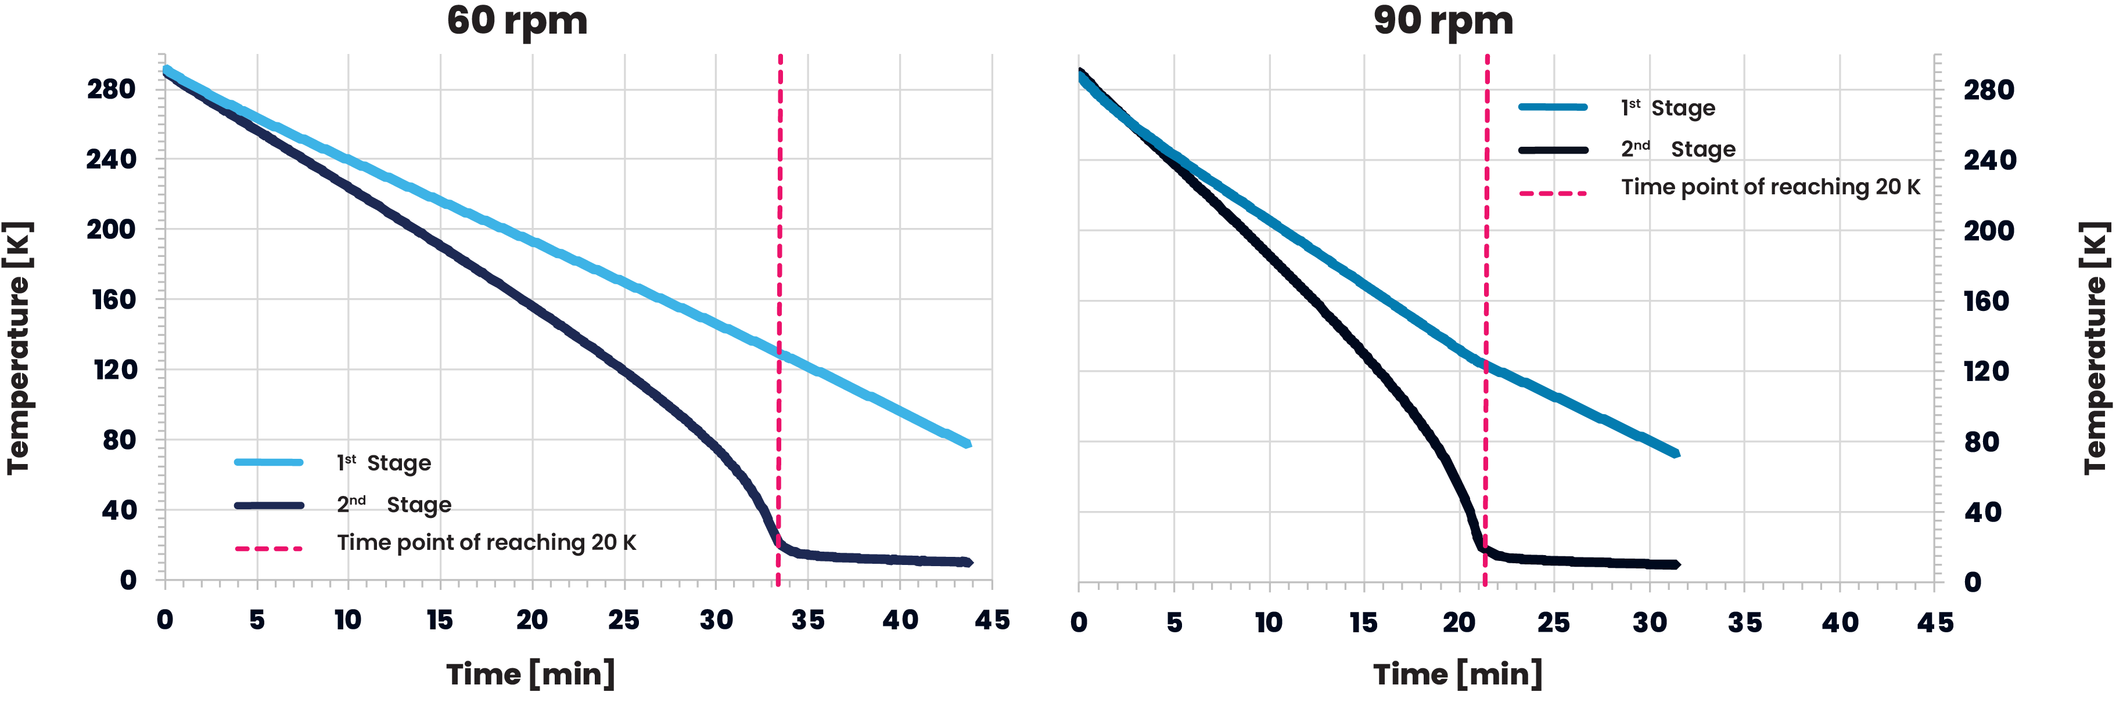
REDUCING COOLDOWN TIMES
Two-Stage 6/30 OxCryo GM Cryocooler
4
Notes:
These two figures demonstrate that increasing the cryocooler speed from 60 to 90 rpm results in a reduction of cooldown time from 33.5 minutes to 21.25 minutes for our two-stage 6/30 GM cryocooler.
Magenta dotted lines show when the 2nd stage reaches 20 K. The 1st stage temperature is indicated by a solid light blue line, and the 2nd stage by a dark blue line.

Slide 5

INCREASING COOLDOWN RATES
Two-Stage 6/30 OxCryo GM Cryocooler
5
Notes:
Increasing the cryocooler speed from 60 to 90 rpm improves the cooldown rate from 8.15 K/min to 12.85 K/min.
Since cooldown rates are non-linear and affected by cryogenic temperatures and heat loads, the dynamic speed adjustment improves efficiency and ensures stable and optimal system performance.
The OxCryo GMi controller dynamically regulates cryocooler speed based on the real time system thermal load.
_______________________________________________________________________
The same as previously, the magenta dotted lines indicate when the 2nd stage reaches 20 K. The 1st stage temperature is shown by a solid light blue line, and the 2nd stage by a dark blue line. Experimental data are represented by thicker solid lines, with running averages in thinner lines.

Slide 6
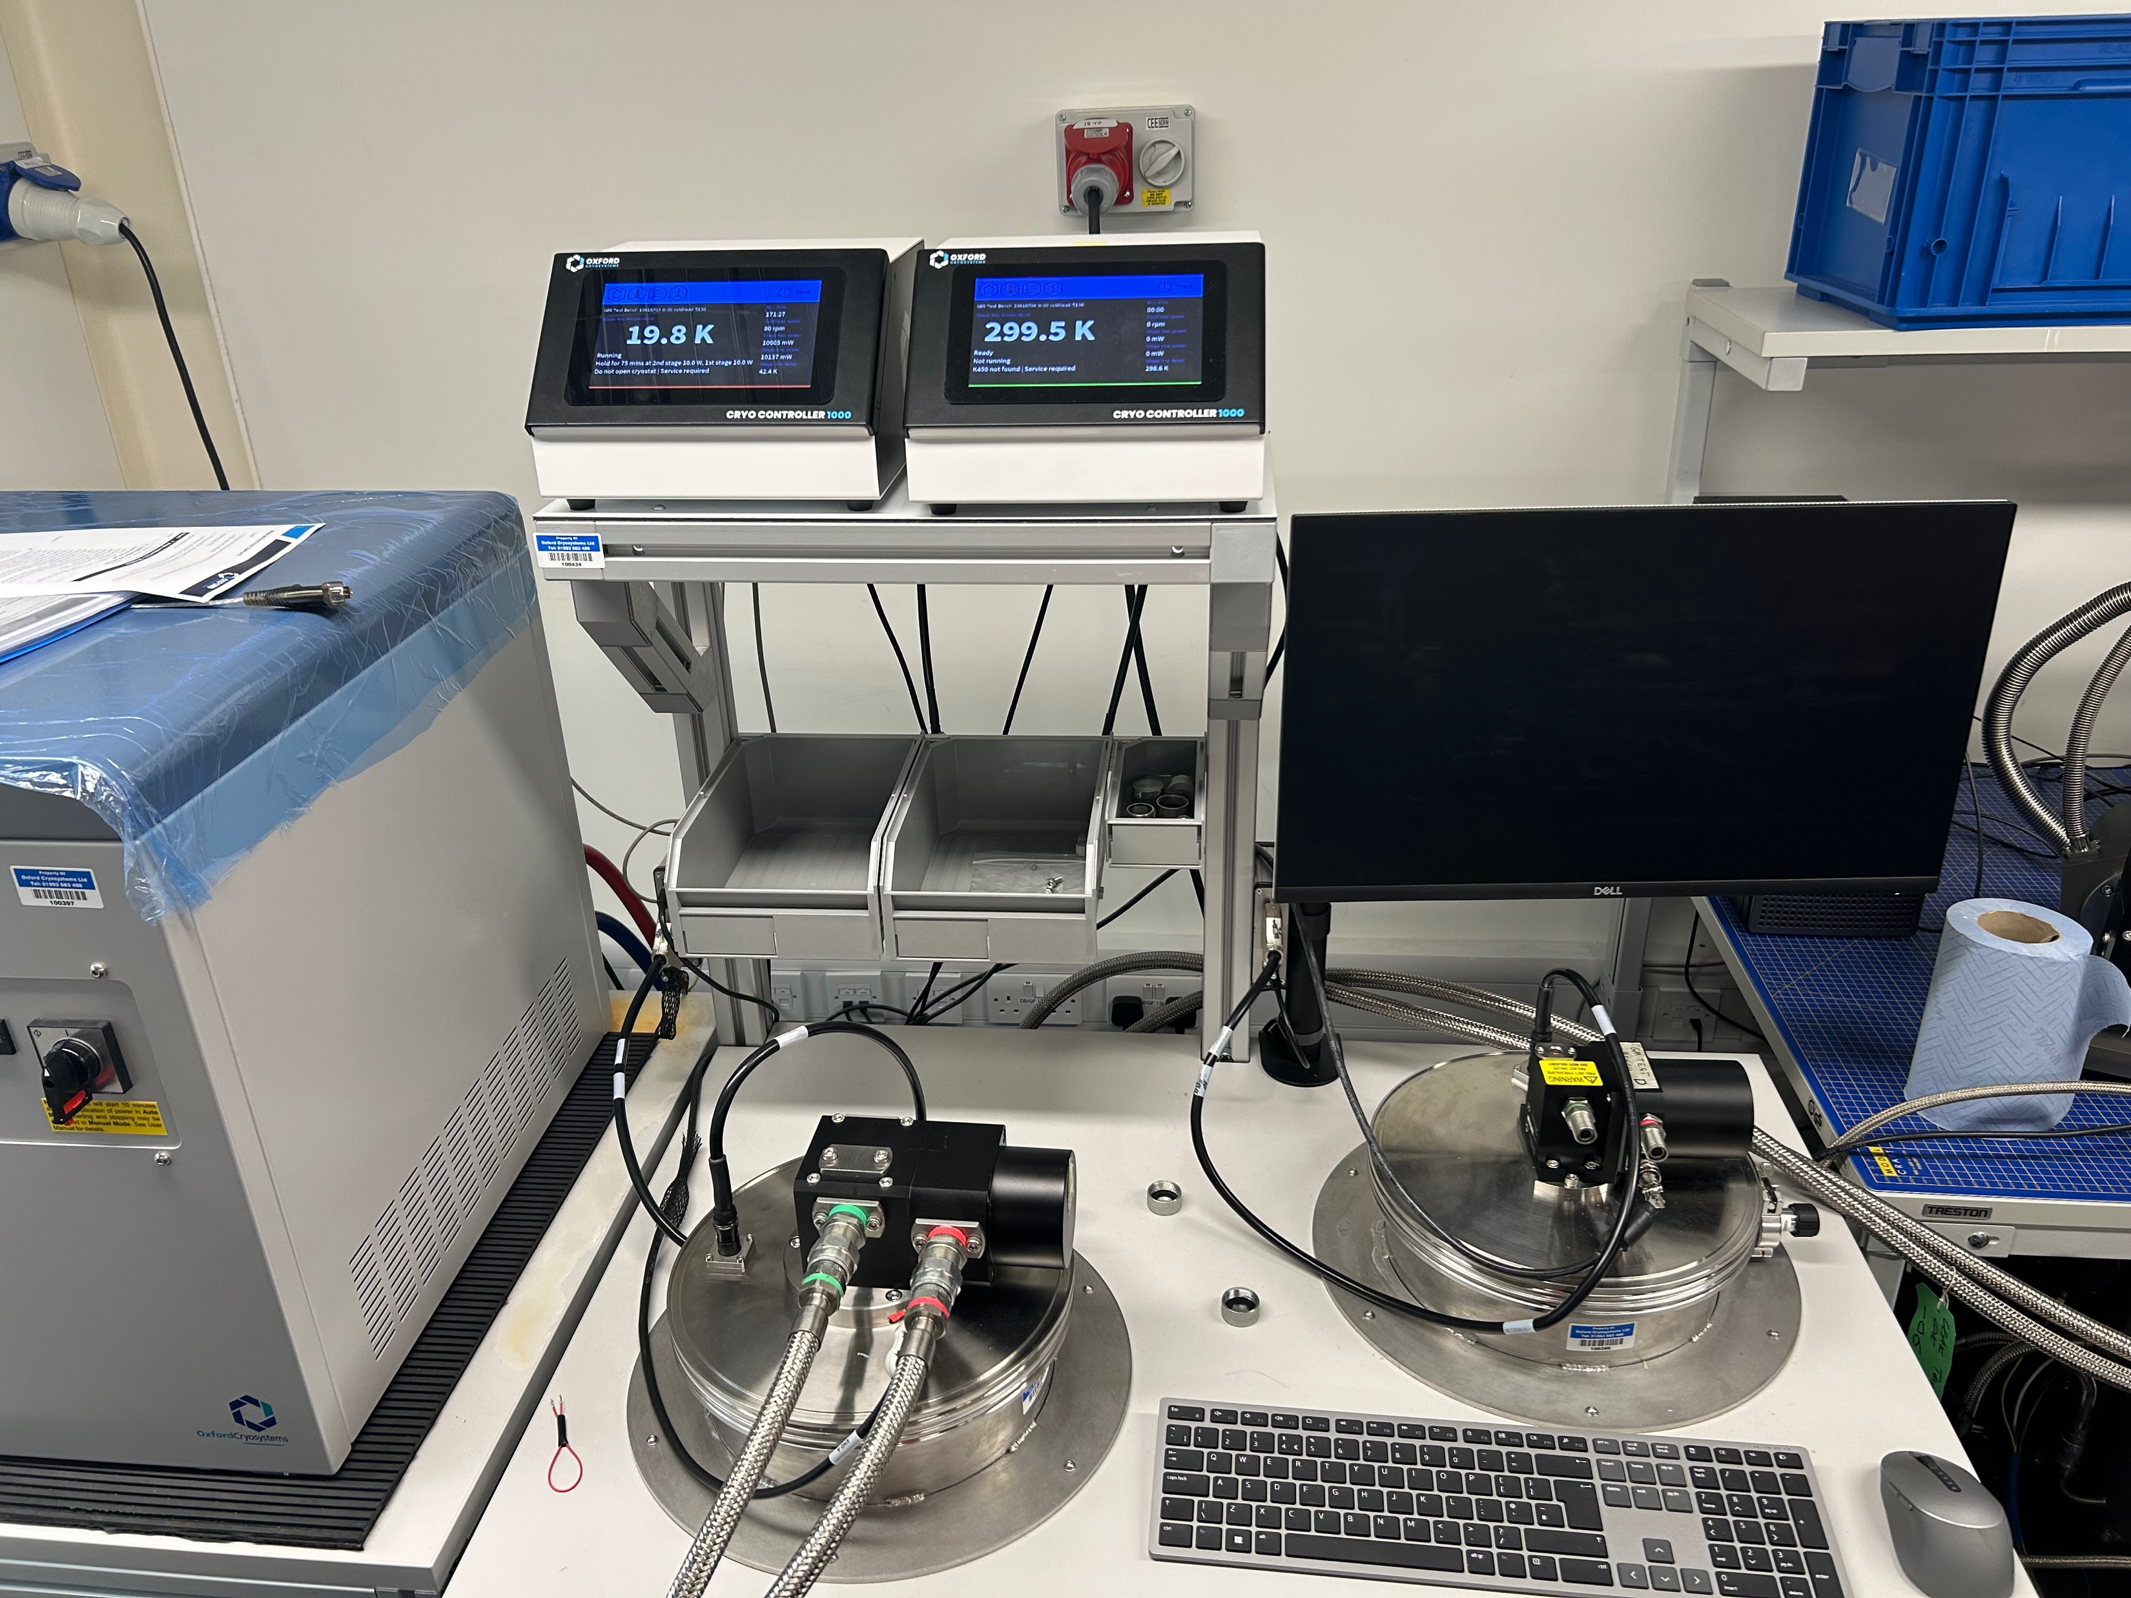
DYNAMIC CONTROL SYSTEM TO FURTHER ENHANCE CRYOCOOLER PERFORMANCE
Variable speed GM
cryocoolers
Dynamic compressor
adjustment
OxCryo GMi controller
GMi Test Bench
6
Notes:
The conventional methods of matching cryocooler’s heat lift to application requirements often compromise efficiency.
Our strategy to optimise GM cryocooler performance involves adjusting its variable speed and synchronising it with the helium compressor adjustable frequency.
This approach aims to minimise excess cooling, ensuring efficient operation and reducing environmental impact, especially for long-term applications.
The OxCryo GMi controller effectively regulates cryocooler speed and differential pressure in response to the real-time system load.

Slide 7
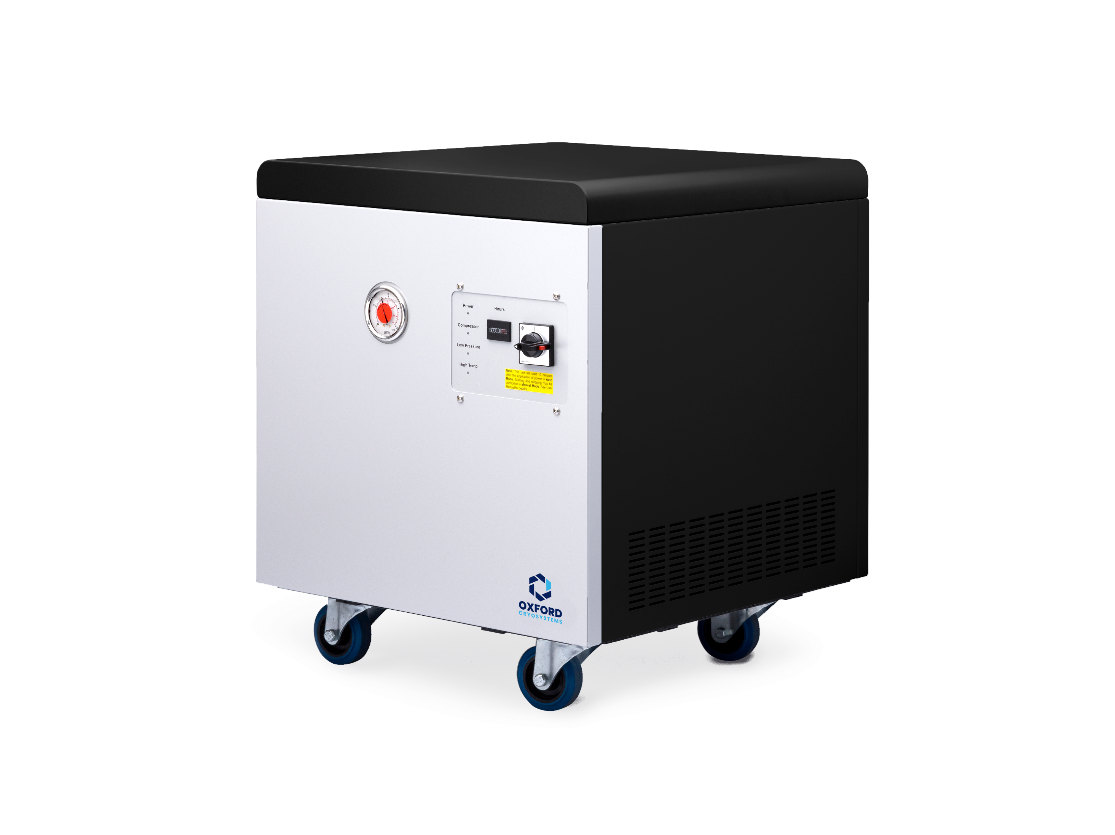
OPTIMISING COMPRESSOR PERFORMANCE
OxCryo helium compressor adapts its operational frequency to match gas demand
Reducing speed decreases power consumption when demand is low
Increased speed maintains cooling performance when demand is high
New OxCryo Variable-Speed Helium Compressor
7
Notes:
The new OxCryo helium compressor adjusts its operational frequency to align with gas demand, thereby enhancing energy efficiency.
When demand is low, the compressor speed is reduced, leading to lower power consumption. Conversely, higher demand requires an increase in speed to maintain cooling performance.
The dynamic system is being tested to be implemented into the proposed new generation Very Large Array (ngVLA) project led by National Radio Astronomy Observatory (NRAO) in New Mexico, USA.

Slide 8
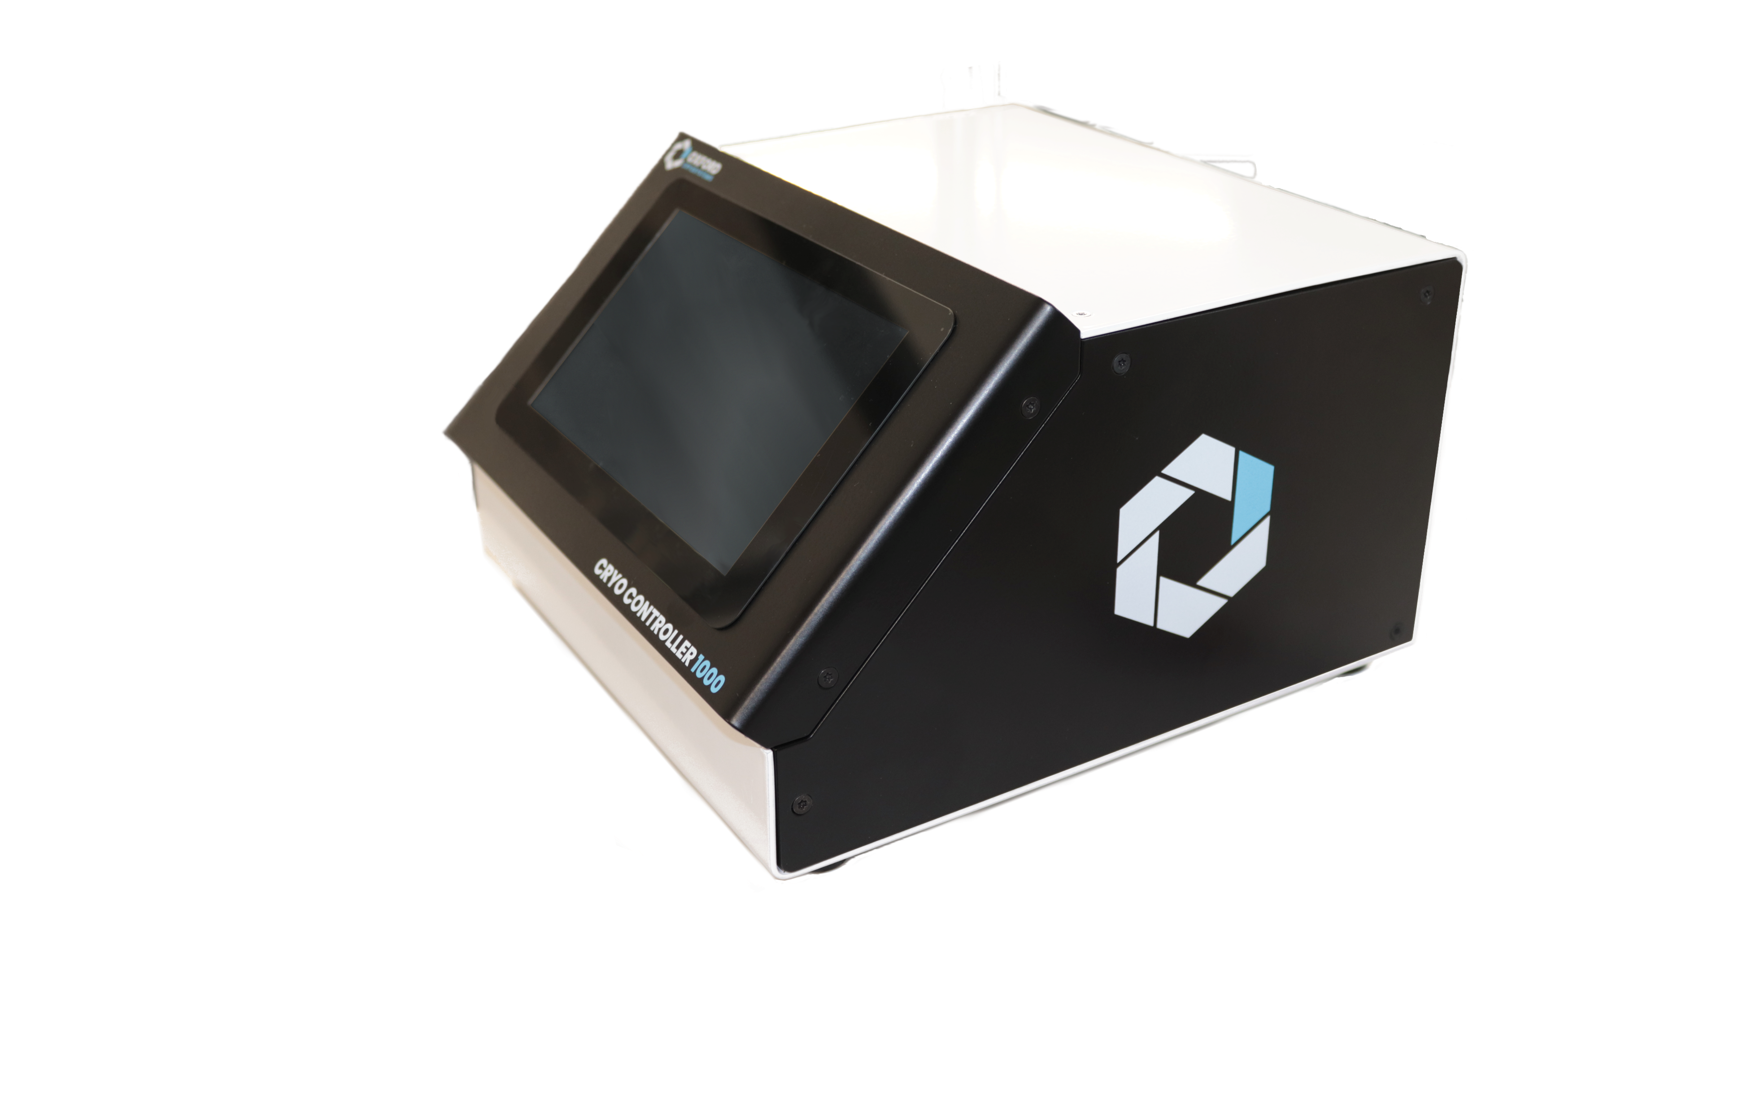
MULTIPLE CRYOCOOLER OPERATION
GMi system allows a single helium compressor to support multiple cryocoolers
Independent control over cryocooler performance
Beneficial for applications requiring variable cooling capacities for multiple cryocoolers
OxCryo GMi Controller
8
Notes:
Our GMi system allows a single helium compressor to support multiple cryocoolers, each with independent performance control.
This flexibility is ideal for applications that require custom levels of cooling capabilities. For example, in optical systems it is often beneficial when two different cryocoolers are used to cool different elements of the system.

Slide 9
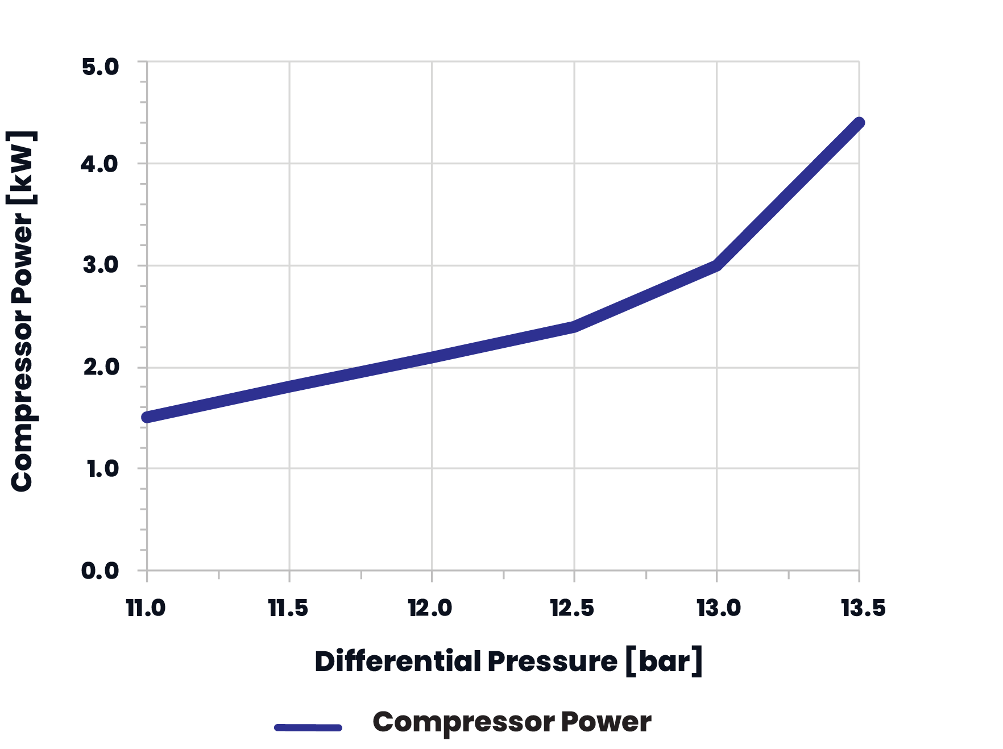
OPTIMISING COMPRESSOR PERFORMANCE
OxCryo GMi Test Bench
9
Notes:
The left figure illustrates compressor power consumption against differential pressure for OxCryo two-stage 6/30 cryocooler operated at 60 rpm. The preset temperature was 15 K on the 2nd stage with a 20 W load on the 1st stage.
At 11 bar of differential pressure, the power consumption was reduced to as low as 1.5 kW while maintaining 15 K on the 2nd stage.
Data was collected using our dynamic GMi system, shown on the right, which is similar to the system we proposed for the ngVLA radio astronomy project.

Slide 10
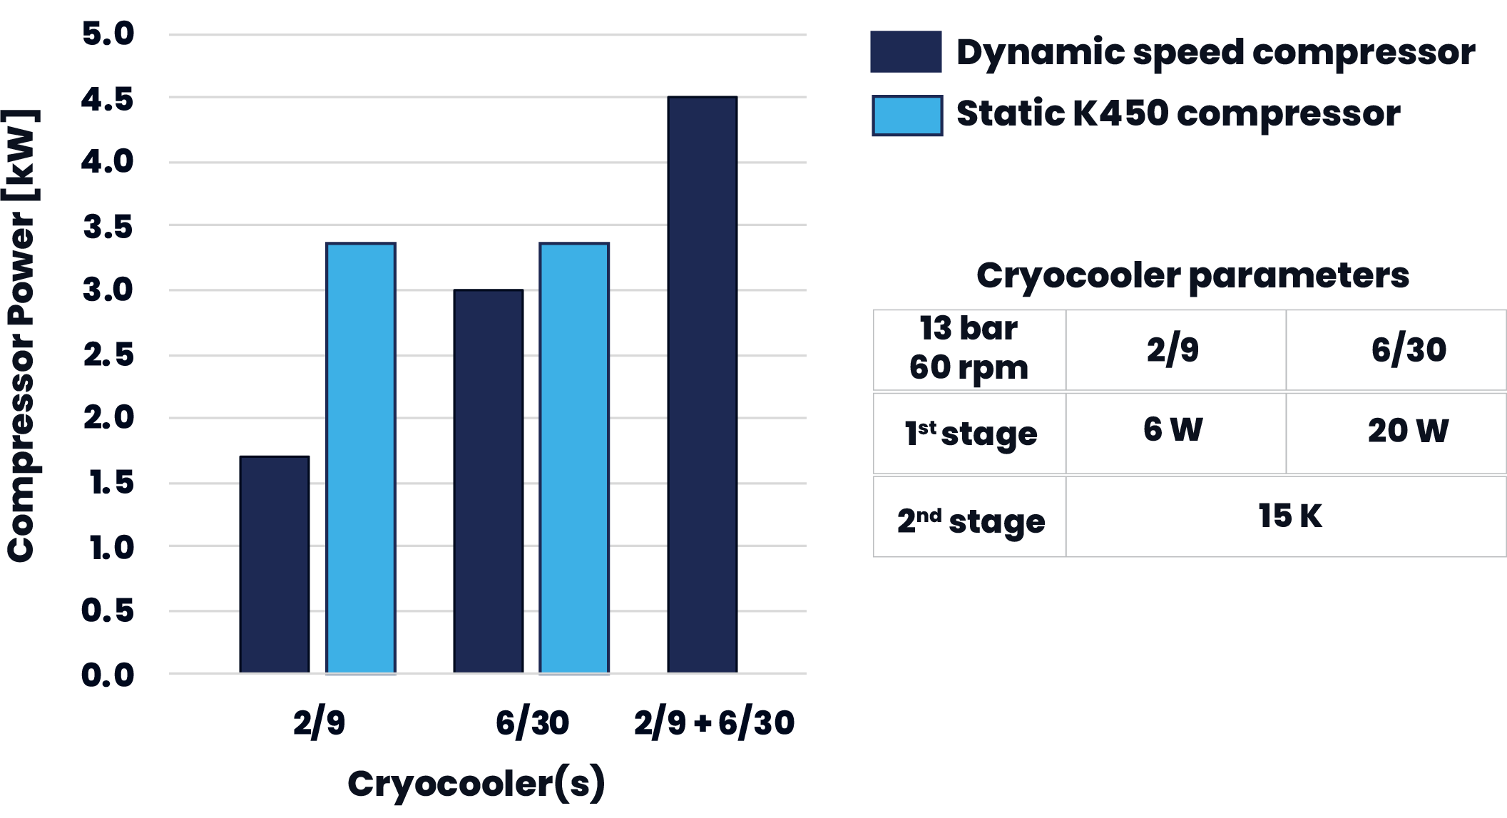
ENERGY SAVINGS BY DYNAMIC SPEED COMPRESSOR
Up to 1.7 kW
power consumption
savings
10
Notes:
This graph compares compressor power consumption for our smaller two-stage 2/9 cryocooler, larger two-stage 6/30 cryocooler, and both in parallel operated at constant 13 bar differential pressure.
The compressor varied its speed to match cooling needs, and the cryocoolers ran at fixed 60 rpm with set temperatures of 15 K on the 2nd stage and fixed heat loads of 20 W (in the case of the 6/30 cryocooler) or 6 W (in the case of the 2/9 cryocooler) on the 1st stage.
As we can see from the graph, the implementation of the dynamic GMi system has the potential to lower the total power consumption by up to 1.7 kW compared to the conventional static solution represented by the light blue bars.

Slide 11
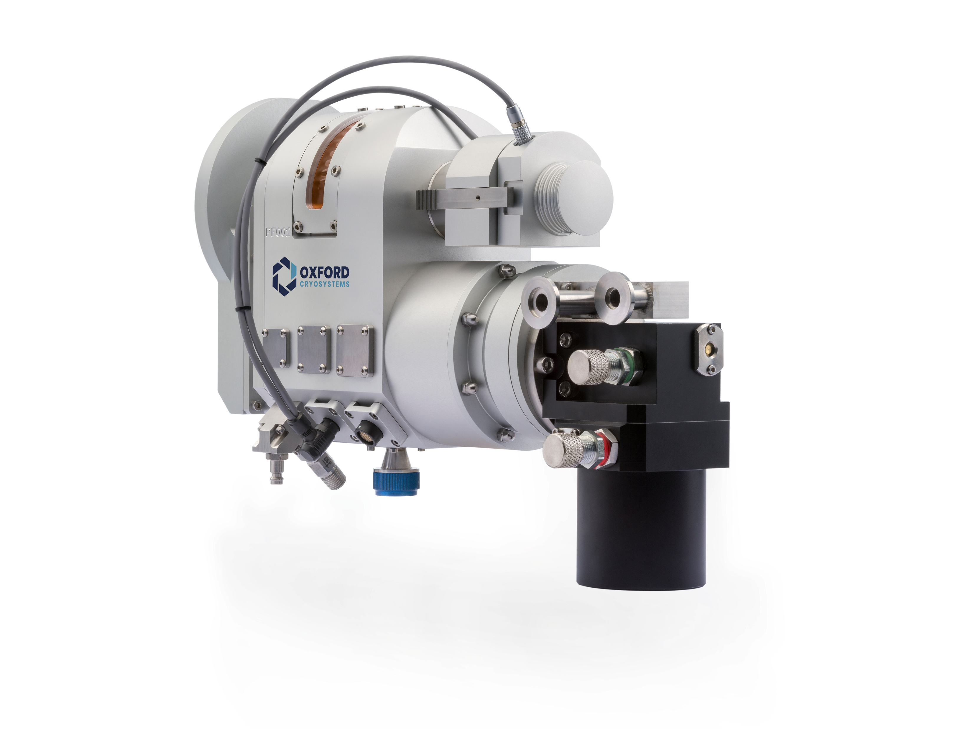
DYNAMIC ADJUSTMENT OF PERFORMANCE
OxCryo GMi controller optimises cryocooler speed and compressor frequency in real time based on system load, enhancing efficiency
and stabilising performance
Energy-efficient approach minimizes excess cooling and reduces environmental impact
for long-term applications
Significantly lengthens maintenance intervals
OxCryo Phenix Front Loader with 2/9 GM Cryocooler
11
Notes:
To summarize this section, our GMi controller adjusts cryocooler speed and compressor frequency in real-time based on the system load, aiming to improve efficiency and stability.
This approach aims to minimise excess cooling, lessen environmental impact for long-term applications, and it significantly extends maintenance intervals.
For instance, our PheniX Front Loader cryostat, shown in the picture, is equipped with a small single-stage 12 W GM cryocooler. This cryostat would greatly benefit from using the new GMi system by reducing both cryocooler and compressor speeds to decrease power consumption, extend maintenance intervals and improve overall efficiency.

Slide 12
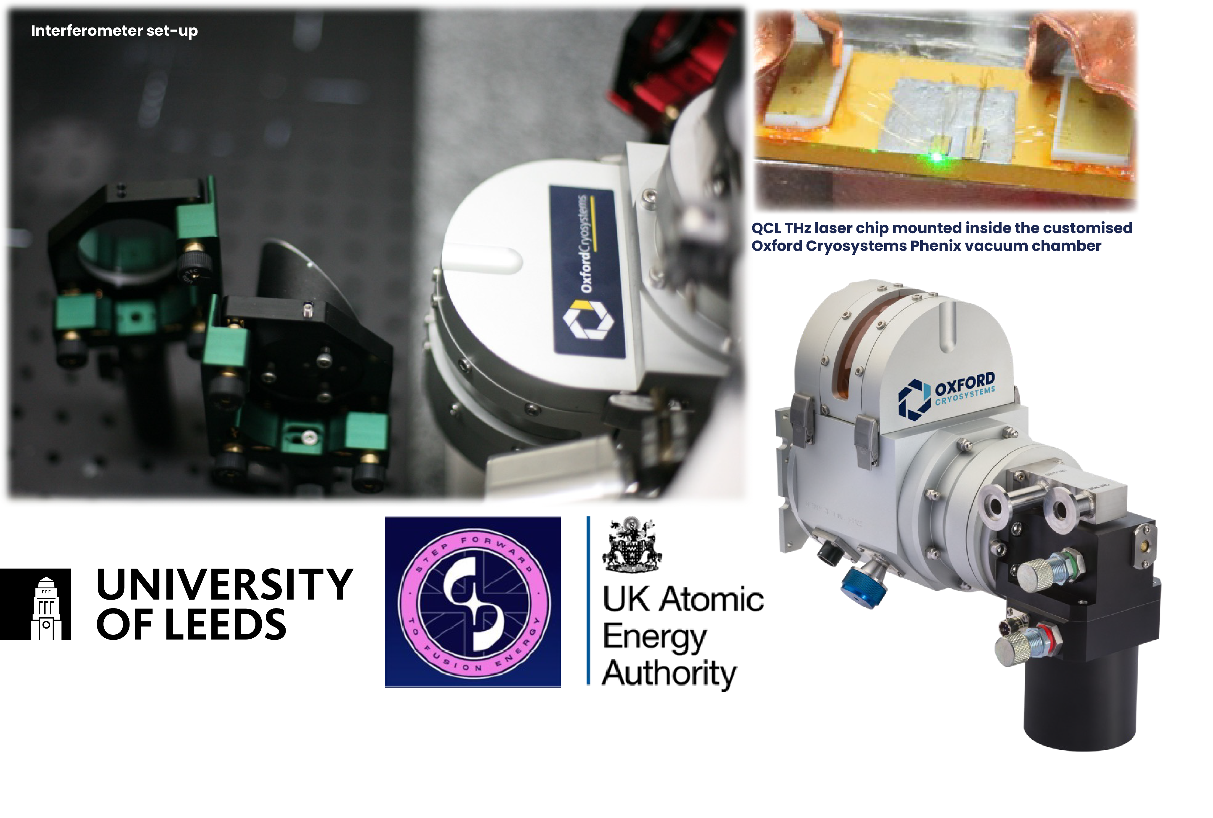
DYNAMIC ADJUSTMENT FOR FUSION ENERGY RESEARCH
OxCryo Phenix with 2/9 GM
Cryocooler adapted to monitor plasma for future fusion reactor design.
Collaboration with
Dr Joshua Freeman
University of Leeds
Dr Alexandru Boboc
UK Atomic Energy Authority
12
Notes:
The GMi system has also been used in Fusion Research.
OxCryo provided a custom cryogenic system for the UK Atomic Energy Authority equipped with a single-stage 12W cryocooler, which had the ability to adjust its performance for variable heat loads. Our cryostat supported tests on laser beam shape, beam stability, and long-duration operation, aiming to advance plasma diagnostics for future fusion reactors.

Slide 13
DYNAMIC ADJUSTMENT OF PERFORMANCE
Dynamic adjustment of performance balances energy efficiency,
increases cryocooler longevity and cooling capacity,
and allows for customizable cooling strategies
REAL LIFE SCENARIOS FROM OUR CUSTOMERS
13
Notes:
So, to summarize, dynamically adjusting performance enhances energy efficiency, prolongs the lifespan of cryocoolers, and allows for tailored cooling strategies.
[CLICK]
Now let me discuss some real-life scenarios from our customers.

Slide 14
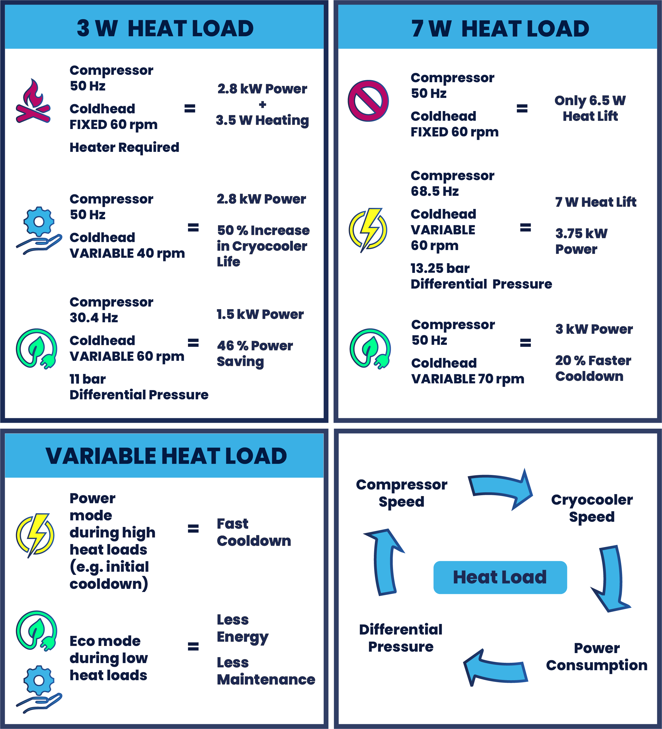
SCENARIO #1:
LOW HEAT
LOAD DEMAND
current
approach
lengthen maintenance intervals
reduce
power consumption
14
Notes:
[CLICK]
In this comparison, we use the conventional approach as a reference point, where the compressor speed is fixed at 50 Hz and the cryocooler speed is fixed at 60 rpm.
[CLICK]
At the 3 W/15 K heat load, lowering cryocooler speed to 40 rpm can extend its lifetime by 50%,
[CLICK]
while reducing compressor speed to 30.4 Hz and differential pressure to 11 bar cuts energy consumption by 46 %. This clearly outperforms conventional fixed speed cryocooler systems.

Slide 15
SCENARIO #2:
HIGH HEAT
LOAD DEMAND
current
approach
fast
cool
down
faster cooldown
& reduced
power
consumption
15
Notes:
[CLICK]
The high heat load requirement of 7 W/15 K is beyond the capability of the fixed speed cryocooler and compressor.
[CLICK]
Using dynamic speed adjustments, we can increase the compressor speed to meet the heat load requirement, however, from the energy savings point of view, it might not be an optimal solution. It might be more economical to increase the cryocooler speed to 70 rpm to provide required cooling with up to 20% energy savings and shorter cooldown times.
[CLICK]

Slide 16

SCENARIO #3:
HEAT LOAD
DEMAND
CHANGES
DURING
OPERATION
16
Notes:
When the heat load demand changes during operation, which is usually the case, the helium compressor adjusts its operational frequency to match the gas demand, enhancing energy efficiency.
[CLICK]
The higher demand requires an increase in speed to maintain cooling performance
[CLICK]
while the low demand allows slowing down the compressor to reduce power consumption. Adjusting the cryocooler speed at the same time optimises thermal performance and extends maintenance intervals.
[CLICK]

Slide 17
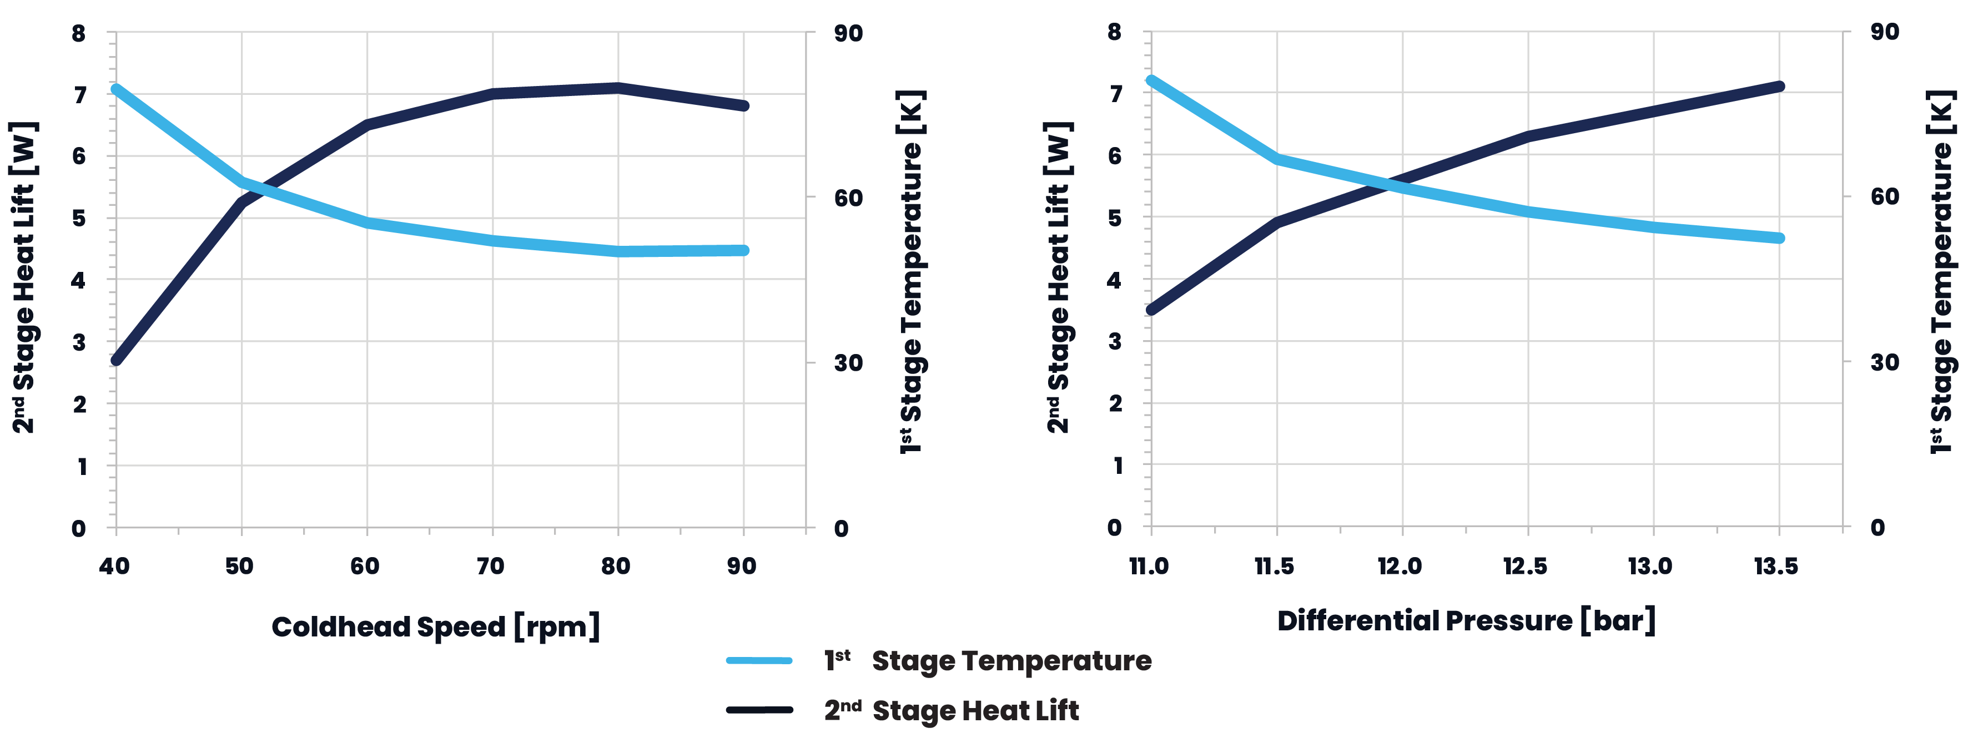
OPTIMISING SYSTEM PERFORMANCE
2nd stage heat lift and 1st stage temperature as a function of the cryocooler speed and differential pressure.
6/30 OxCryo Cryocooler with temperature of 15 K at the 2nd stage and 20 W load on the 1st stage
17
17
Notes:
These two figures illustrate the dynamics behind the performance adjustment for a 6/30 cryocooler with a preset temperature of 15 K on the 2nd stage and a 20 W load on the 1st stage.
The left graph shows the 2nd stage heat lift and the 1st stage temperature as a function of the cryocooler speed at a fixed compressor frequency of 50 Hz. The right graph shows the 2nd stage heat lift and the 1st stage temperature as a function of the differential pressure with the coldhead speed set to 60 rpm.
This provides various dynamic adjustments for a cryogenic system that can significantly improve its longevity, cost savings, stability, and performance.
Reduced speeds are especially beneficial in radio astronomy, analytical instrumentation, and various laboratory settings, lowering maintenance needs and operational costs.

Slide 18
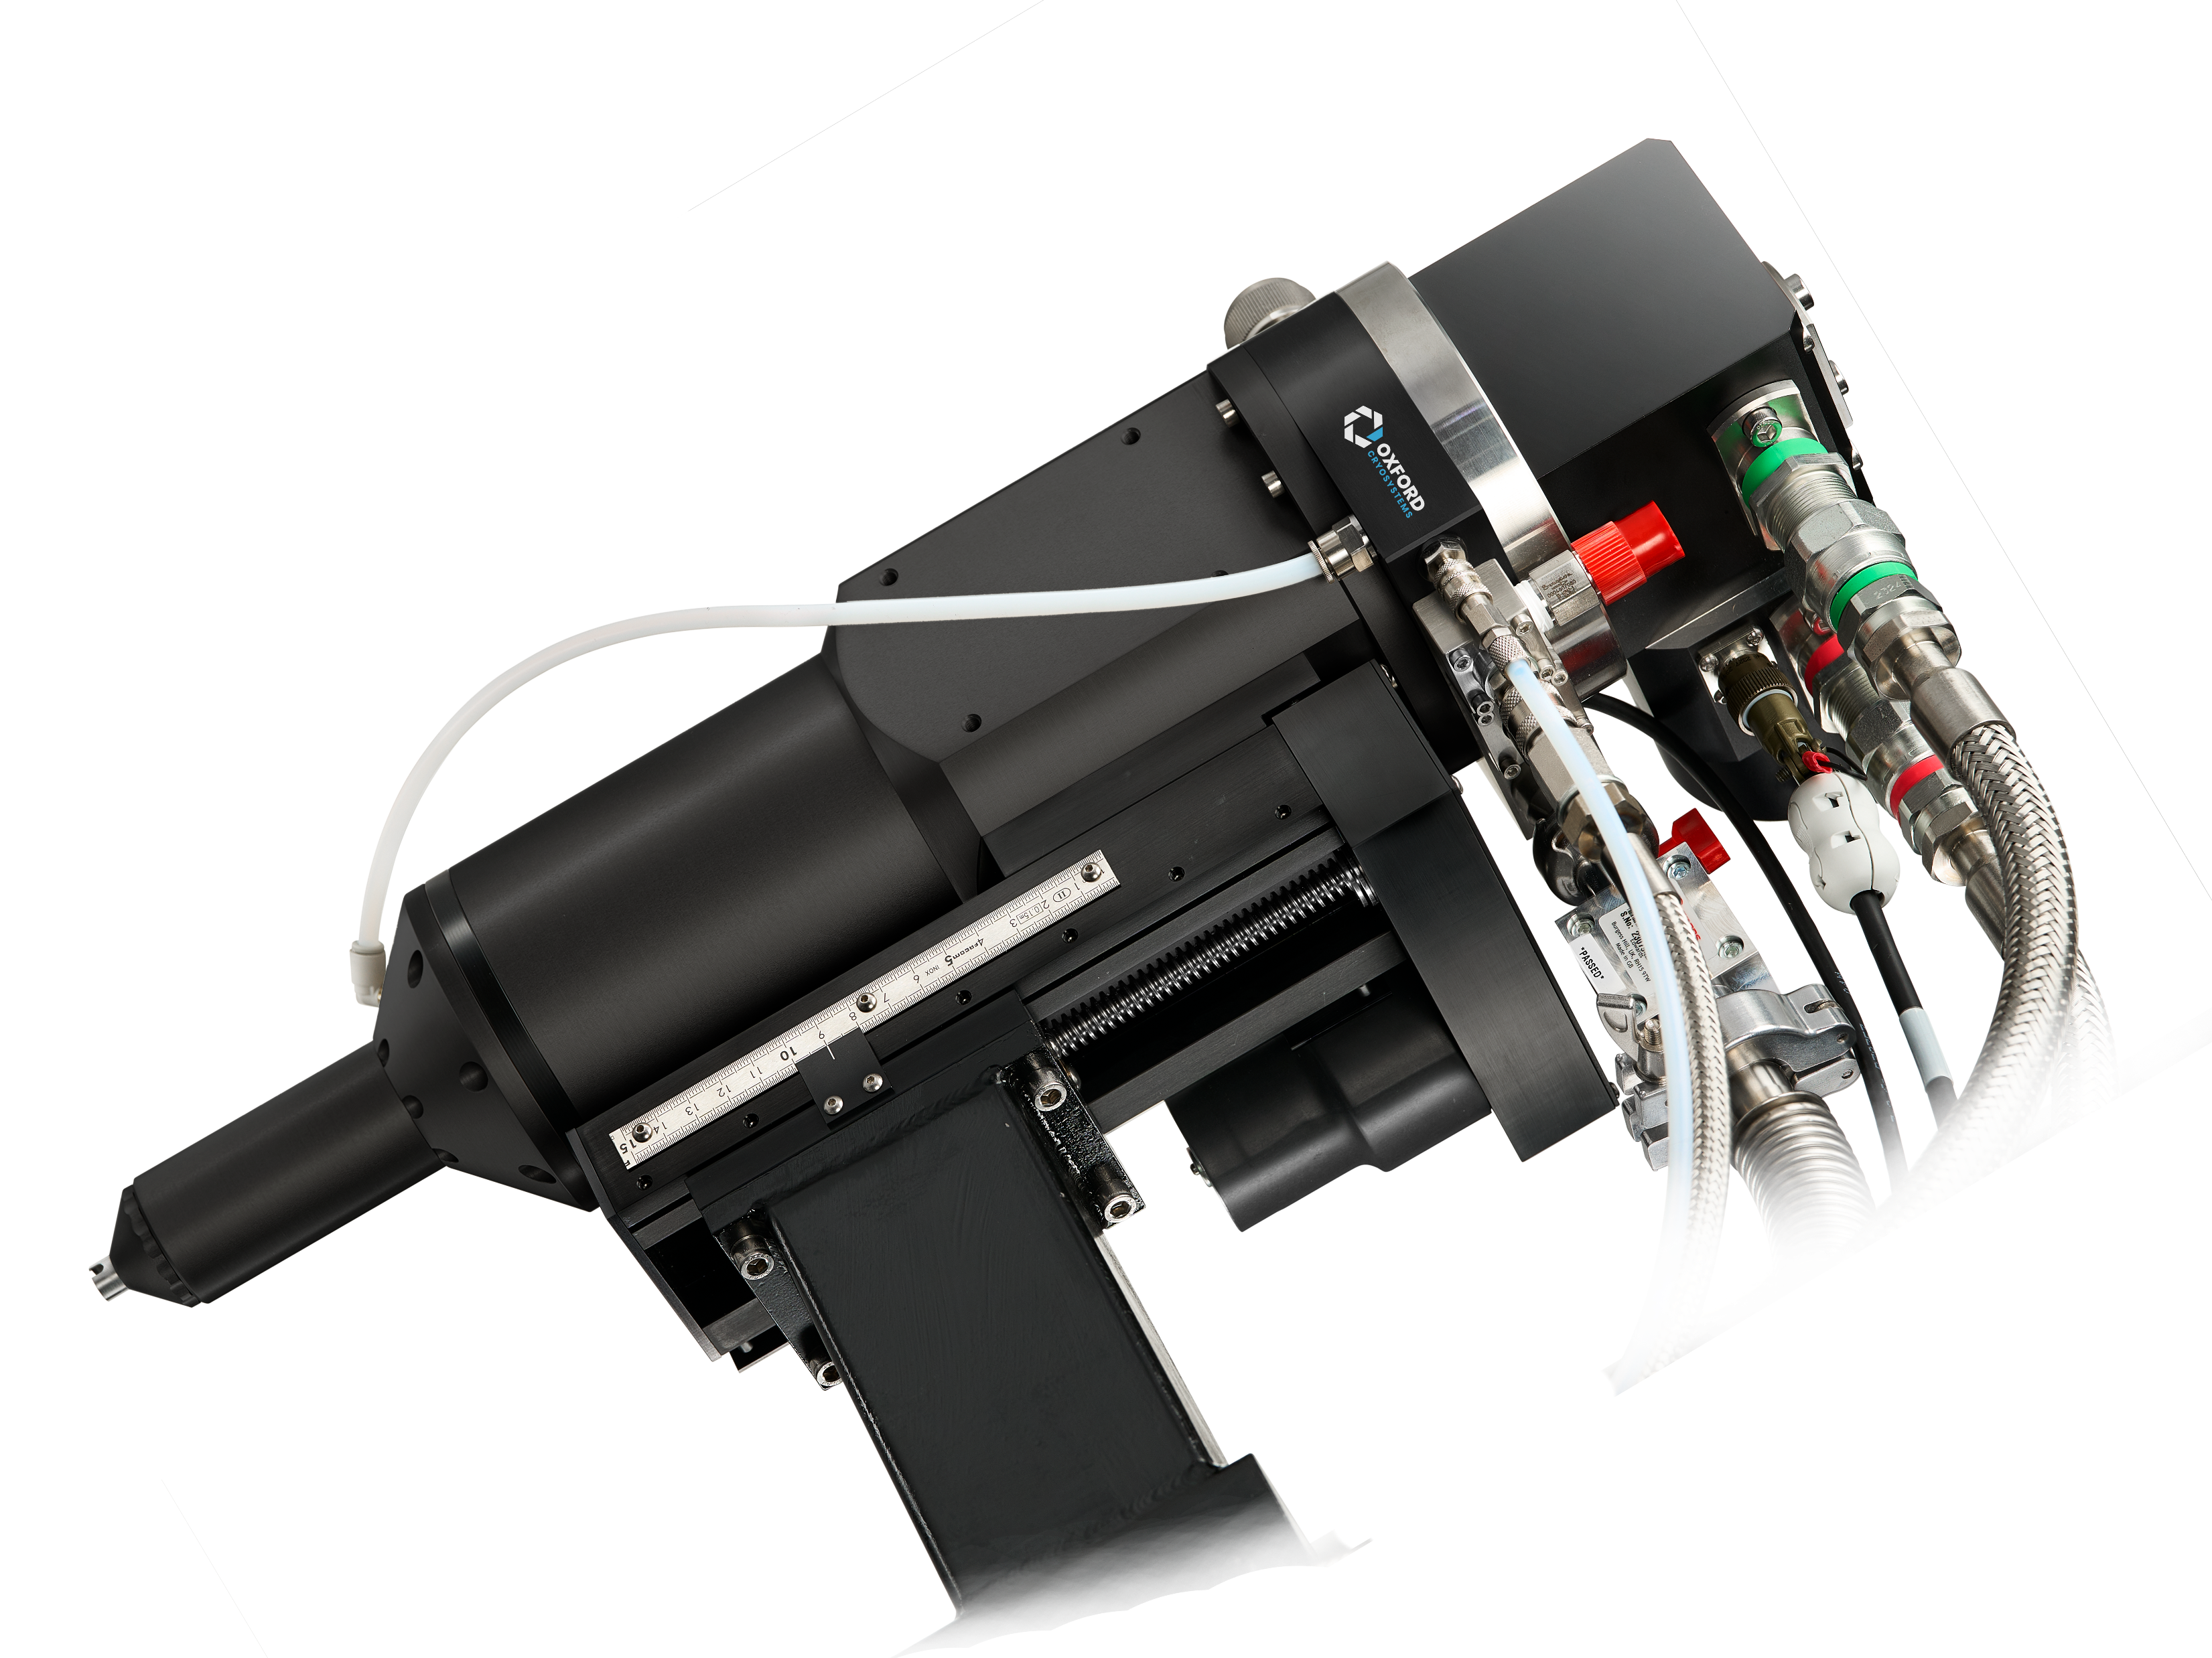
ENERGY EFFICIENCY AND FLEXIBLE PERFORMANCE
Relationship between cryocooler speed, differential pressure, and compressor speed improves system lifetime and lengthens maintenance intervals and ensures efficient operation and energy savings
Prioritises energy efficiency and minimizes environmental impact
OxCryo N-Helix with 6/30 GM Cryocooler
18
Notes:
So, as we’ve seen so far, optimising cryocooler and compressor speeds boosts energy efficiency and allows flexible performance.
For example, our n-HeliX cryostat, shown in the image, is equipped with a large two-stage 6/30 GM cryocooler. This cryostat can utilise the GMi system to adjust cryocooler and compressor speeds depending on the operating temperatures, reducing speeds at relatively high temperatures and increasing speeds at very low temperatures.

Slide 19
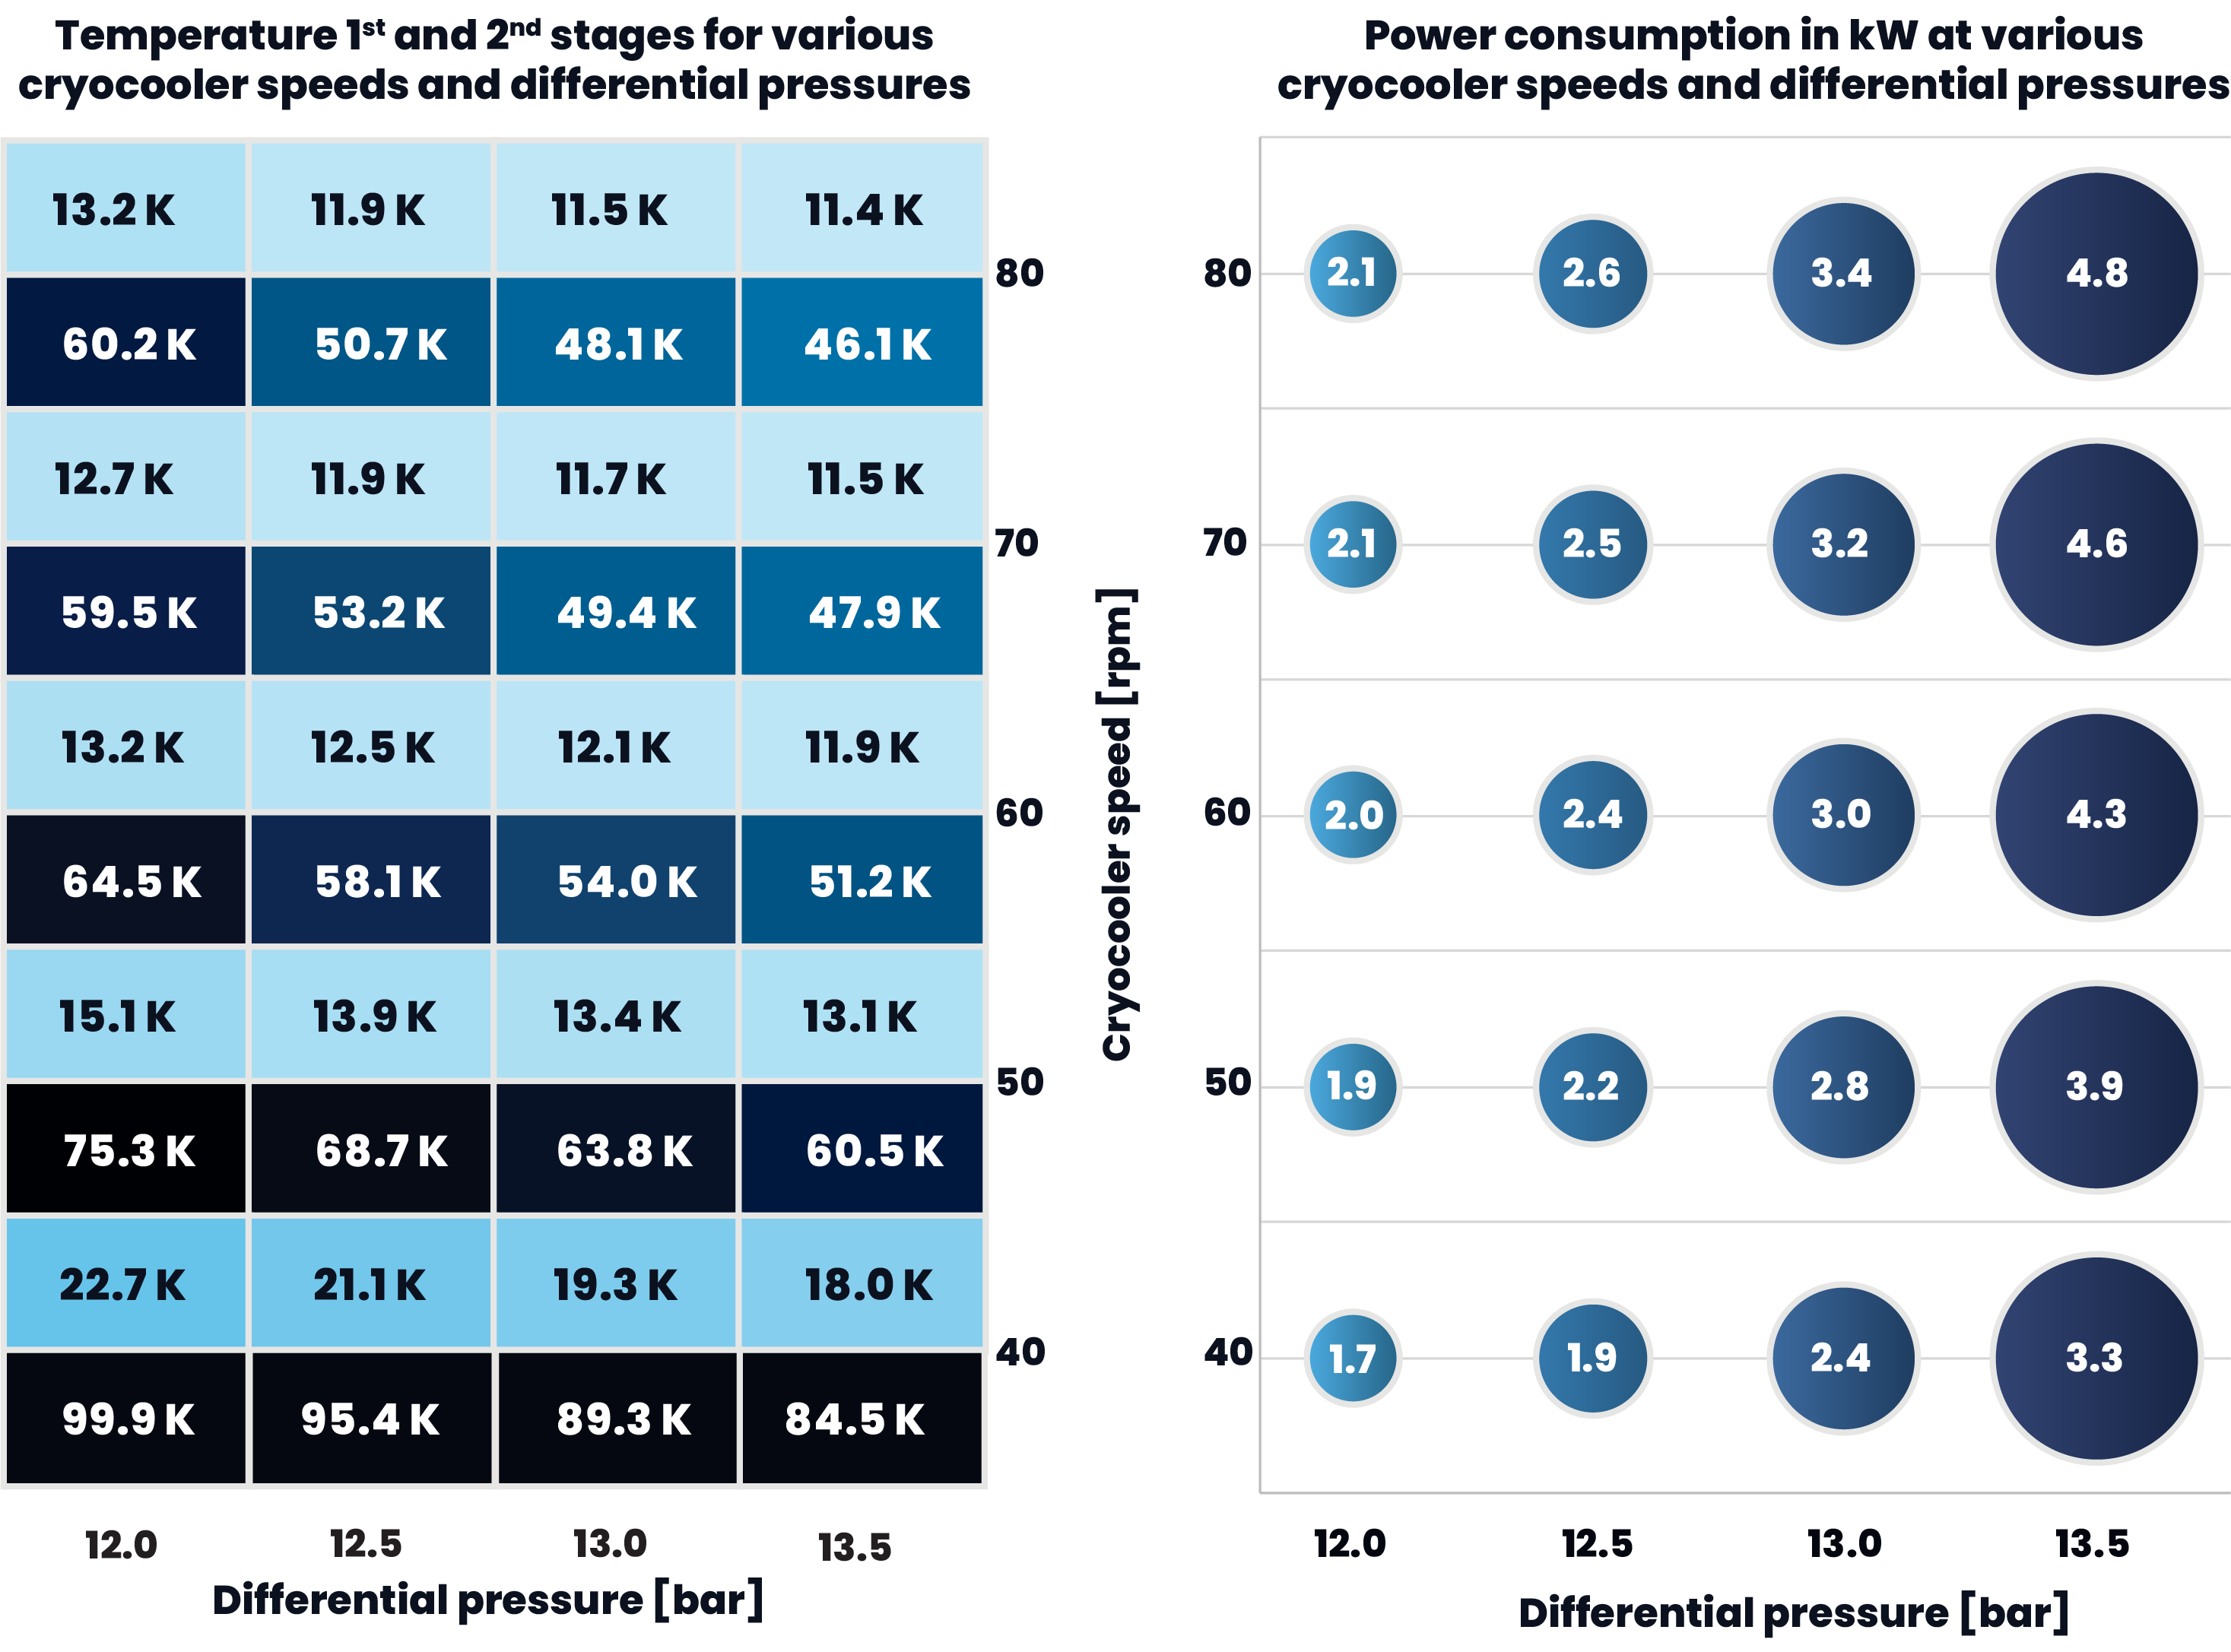
ENERGY
EFFICIENCY
&
DYNAMIC
PERFORMANCE
Static System
3.4 kW
average power
consumption
19
Notes:
Optimising the system requires balancing its performance with cost savings while meeting application requirements.
Cryocooler temperatures (the image on the left) and compressor power consumption (the image on the right) vary with cryocooler speed and differential pressure. For instance, a 6/30 GM cryocooler with 20 W on the 1st stage and 4 W on the 2nd stage uses 1.7 kW at 40 rpm and 12 bar differential pressure, and 4.8 kW at 80 rpm and 13.5 bar differential pressure.
Possible scenarios show similar 2nd stage temperatures of 11.7 - 11.9 K at 70-80 rpm and 12.5 bar,
[CLICK]
or 70 rpm and 13.0 bar, with energy consumption from 2.5 kW to 3.2 kW.
[CLICK]
If our goal is to reduce power consumption and extend maintenance intervals, then the optimal parameters are 70 rpm and 12.5 bar.
Light blue indicates low energy use; navy to black indicates high energy use.

Slide 20
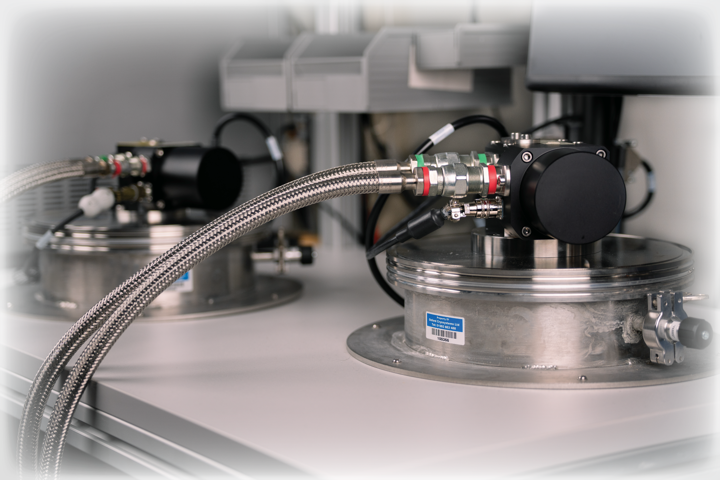
CONCLUSIONS
By dynamically adjusting the cryocooler and compressor speeds to changing cooling requirements, it is possible to significantly shorten cooldown times, reduce operational costs, and improve maintenance intervals, all without any compromise to performance
OxCryo Gmi Test Bench
20
Notes:
In conclusion, I’ve shown that by dynamically adjusting the cryocooler and compressor speeds to changing cooling requirements, it is possible to significantly shorten cooldown times, reduce operational costs, and improve maintenance intervals, all without any compromise to performance.

Slide 21




ACKNOWLEDGEMENTS
Dr. Adriana L. Klyszejko and Dr. Alex Renshaw for their contribution to data collection and analysis, writing and reviewing the scientific paper
Dr. Lucjan Pajdzik and Dr. Maria C. Kokkinidou for their valuable technical input
OxCryo Development Team for support of the project
Denis Urbain, National Radio Astronomy Observatory
Johan van Staden, EMSS Antennas
Dr. Alexandru Boboc, UK Atomic Energy Authority
Dr. Joshua Freeman, University of Leeds
21
Notes:
I would like to thank Dr. Adriana L. Klyszejko and Dr. Alex Renshaw for their work on data collection, analysis, writing, and reviewing the scientific paper. Special thanks to Dr. Amy Kennedy, Dr. Maria C. Kokkinidou, and the Oxford Cryosystems Development Team for their technical support.
Our collaborators include:
Denis Urbain, National Radio Astronomy Observatory (New Generation Very Large Array project)
Johan van Staden, EMSS Antennas (Square Kilometre Array Observatory project)
Dr. Alexandru Boboc, UK Atomic Energy Authority, and Dr. Joshua Freeman, University of Leeds (Reactor Grade Plasma Diagnostics project)

Slide 22
THANK YOU FOR LISTENING
Any Questions?
22
Notes:
Thank you for listening.
Any questions?

