Slide 1

AC Loss in Round Superconductor wires and Flat Helical Wrap Conductors in a range of frequencies
T. Haugan, AFRL
Mike Sumption, M. Majoros, E.W. Collings
Center for Superconducting and Magnetic Materials, MSE, The Ohio State University
This work was supported by NASA (Cheeta), Raytheon, and the Air Force Summer Faculty Program
3Or-3B02

Slide 2




What are the components of loss of a ROUND SC
Let’s keep to round ones for now (YBCO later!)
Because of large L_{p}/d ratio, and also f² like dependence, coupling loss dominates at high frequency
Total loss
Hysteretic Loss
But this is just at LOW FREQUENCIES
What if we wanted to know loss at high f, for example for harmonics analysis?
What is the effect of skin depth?
$$P_{h}=\left(\frac{8}{3π}\right)B_{0}fλJ_{c}d_{f}$$
Coupling loss
$$P_{coup}= \frac{B_{0}^{2}f^{2}L_{p}^{2}}{2ρ_{m,eff}}\frac{1}{\left(1+ω^{2}τ^{2}\right)}$$
Eddy Current loss
Transport Current loss

Slide 3
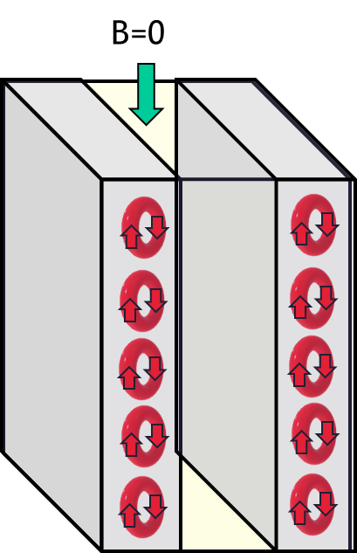
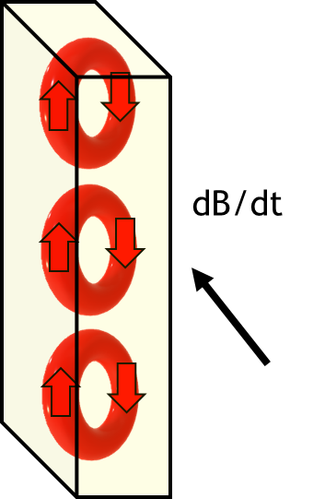
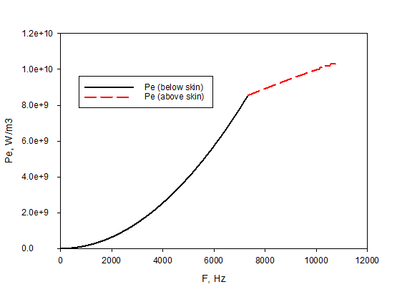
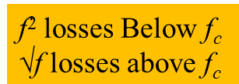

Skin Depth Effect in Ordinary Conductors
At low frequencies we have the standard eddy current expression
But, at high frequency, the currents are constrained to a surface region, depth (smaller area, higher R)
The skin depth begins to appear when δ = √2X, where X is the wire depth. The critical frequency is
Room T
Here d is the wire diameter
Here losses are normalized to total conductor,
w = d, and the losses go as f^{1/2}

Slide 4



Superconducting Composites have several critical frequencies
There are three critical frequencies, f_{c1}, f_{c2}, and f_{c3}
f_{c3} corresponds to the f_{c} of metal wires, when the skin depth is less that the thickness of the outer sheath, here X. Here the loss is the same as that of a metal wire
At frequencies below f_{c3}, but above an f_{c2}, the skin depth is greater than X, but less than the wire radius
Between f_{c2} and f_{c1}, some screening still modifies the loss, until below f_{c1}, the “low freq loss expressions” apply
Partial screening

Slide 5
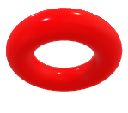
If f > f_{c3,} we have results same as metallic conductor
Self-field B sizeable compared to external B
z
Eddy current flowing within skin depth of outer stabilizer only
y
δ
B only penetrates into outer Stabilizer shell
B does not penetrate into filamentary array
δ < t_{os}
B, dB/dt
x
X = t_{os}
Filamentary array
Outer Stabilizer

Slide 6
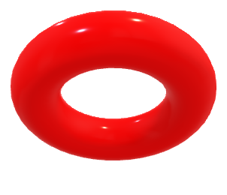

If f_{c2} < f < f_{c3,} in some ways similar*, except B penetrates partially into array, ρ = ρ_{m}
z
Eddy current flowing within outer stabilizer AND in filamentary region
y
δ
Self-field B sizeable compared to external B
X = t_{os}
B, dB/dt
B penetrates partially into filamentary array as well as Stabilizer shell
Currents flow in eddy current pattern, treat filamentary array as region of very low resistivity only
t_{os} < δ < R_{o}
x
Filamentary array
Outer Stabilizer
* Does interact with hysteretic contributions, with added complications

Slide 7
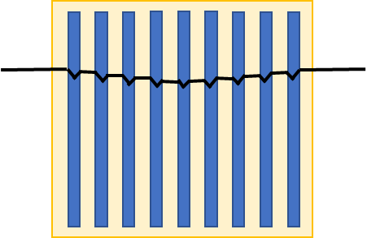
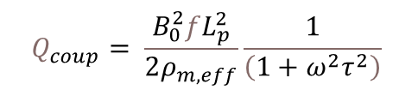
But what about between f_{c1} and f_{c2}?
It’s also the place where filaments re-couple
Quasistatic ramp, no eddy currents, filament hysteresis only
Let’s reminder ourselves what fc1 is
For one thing, its where Q_{coup} peaks…
$$Q_{coup}= \frac{B_{0}^{2}fL_{p}^{2}}{2ρ_{m,eff}}\frac{1}{\left(1+ω^{2}τ^{2}\right)}$$
Low/modest ramp rate, eddy currents, adds weak background slope and gradient across whole composite
Very fast ramp, complete coupling, loss is “hysteretic-like” one fat filament
But, we really need to look in much greater detail here

Slide 8
Coupling currents, shielding, and saturated regions I
An applied dB/dt creates coupling currents which flow “up one side of strand and down the other”
But twist drives currents to centerline at front (or back) of conductor
Charge accumulation drives currents to back (front) of conductor, completing circuit and creating an opposing B
Currents in filaments are superconducting
Filaments crossing matrix create coupling loss

Slide 9
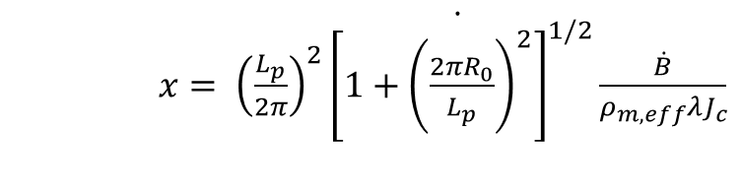
Coupling currents, shielding, and saturated regions II
Currents in the filaments tends to flow at the critical current in in thin shell region
This region is called the saturated region
The currents completing the path through the matrix flow in the inner region
The thickness of this saturated region at the conductor edges is
Once the total coupling current exceeds a critical value (λJ_{c} times the area of the first filamentary layer in from the periphery) this layer of filaments will be “saturated” with current.
$x\dot{= {\left(\frac{L_{p}}{2π}\right)}^{2}{\left[1+{\left(\frac{2πR_{0}}{L_{p}}\right)}^{2}\right]}^{1/2}\frac{\dot{B}}{ρ_{m,eff}λJ_{c}}}$
Here x is limited to x < B_{a}/(λJ_{c})
(see left)

Slide 10

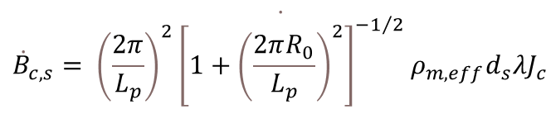

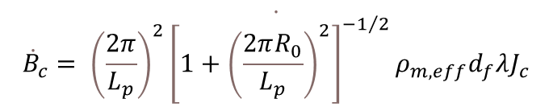
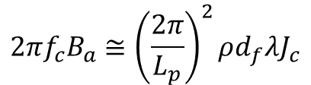


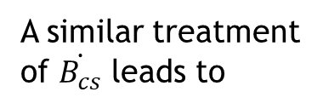
Coupling currents, and saturated regions III
If we take x to be d_{f}, then we can define a critical ramp rate
$$\dot{{\dot{B}}_{c}= {\left(\frac{2π}{L_{p}}\right)}^{2}{\left[1+{\left(\frac{2πR_{0}}{L_{p}}\right)}^{2}\right]}^{−1/2}ρ_{m,eff}d_{f}λJ_{c}}$$
If we take x to be d_{s}, then we can define a saturation critical ramp rate
$$\dot{{\dot{B}}_{c,s}= {\left(\frac{2π}{L_{p}}\right)}^{2}{\left[1+{\left(\frac{2πR_{0}}{L_{p}}\right)}^{2}\right]}^{−1/2}ρ_{m,eff}d_{s}λJ_{c}}$$
$$f_{c1}=\frac{4πρ}{μ_{0}L_{p}^{2}}$$
$$f_{c}=\frac{4πρ}{L_{p}^{2}}=f_{c1}$$
Remembering our definition of f_{c1}
Which leads to
And since B(t) = B_{a}sin(ωt), dB/dt = 2πfB_{a}
A similar treatment of $\dot{B_{cs}}$ leads to
$$f_{cs}=\frac{4πρ}{L_{p}^{2}}=f_{c1}$$
Then
$${\dot{B}}_{c}=2πf_{c}B_{a}$$
$$2πf_{c}B_{a}≅{\left(\frac{2π}{L_{p}}\right)}^{2}ρd_{f}λJ_{c}$$
Thus, f_{c1} is the frequency at which the maximum filamentary saturation happens for a given B_{a}
(or)
f_{c1} is where all the filaments that can re-couple do so
(although, for large B_{a}, we can saturate before fc1)
and
But the B_{p} of a layer of filaments d_{f} thick is d_{f}λJ_{c}/2

Slide 11
Coupling currents, and saturated regions IV
Note filament recouple at f_{c1}/2 for B_{a}=2B_{ps}
B_{a} = 2B_{ps}
f_{c1}
B_{ps}
2nB_{pf}
2B_{pf}
Q* = Q/B_{a}²
f/f_{c}

Slide 12
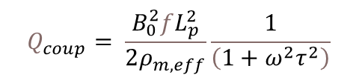
Additional screening above f_{c1}
We might ask, why can we have reduced loss at high frequency? Note that the equation below is coupling loss only
How can increased M lead to lower loss?
Q* = Q/B_{a}²
$$Q_{coup}= \frac{B_{0}^{2}fL_{p}^{2}}{2ρ_{m,eff}}\frac{1}{\left(1+ω^{2}τ^{2}\right)}$$
Low loss, low M
High loss, high M
Low loss, high M
Zero loss, max M
However, the graph at right includes both coupling and Saturated region loss
f/f_{c}
Our Bean-like profiles are 2-D, and our filament layers are porous to flux
This flux is further shielded as we increase f above f_{c1}
Since coupling currents are driven by dB/dt, this shielding reduces loss

Slide 13

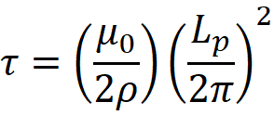
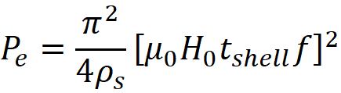
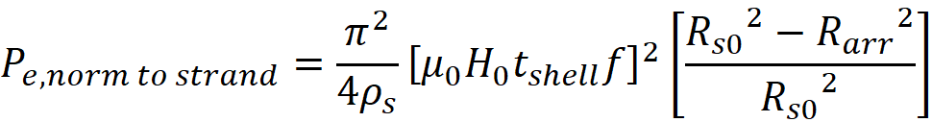


Coupling & Eddy loss ignoring saturated filament regions
Coupling Currents
Shell eddy currents*
From f = 0 to f_{c2}
For f < f_{c3}
$P_{coup}= \frac{B_{0}^{2}fL_{p}^{2}}{2ρ}\frac{f}{\left(1+ω^{2}τ^{2}\right)}$
For f_{c2} < f < f_{c3}
Normalized to strand volume…
For f > f_{c3}
* The shell also contributes to coupling, accounted for by an effective matrix ρ (conductance contribution)

Slide 14
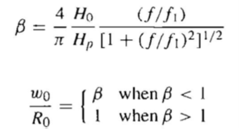
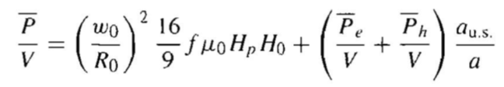

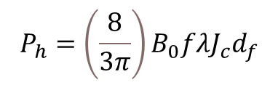
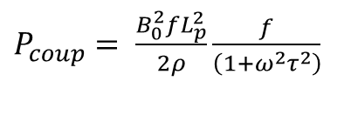
AC loss calculations at high frequency including filamentary saturation effects
Fraction of strand saturated
Fraction of strand unsaturated
Loss in Saturation layer
The Eddy or coupling loss
Filament hysteretic loss, here set to zero
Using the appropriate expression for Coupling loss (Here P_{e})
$$P_{h}=\left(\frac{8}{3π}\right)B_{0}fλJ_{c}d_{f}$$
B_{a} > B_{pf}
$P_{coup}= \frac{B_{0}^{2}fL_{p}^{2}}{2ρ}\frac{f}{\left(1+ω^{2}τ^{2}\right)}$
$P_{h}=\left(\frac{128}{9π}\right)\frac{{2μ}_{0}H_{0}^{3}fλ}{d_{f}J_{c}}$
B_{a} < B_{pf}
(or)
Below f_{c2}
Above f_{c2}

Slide 15
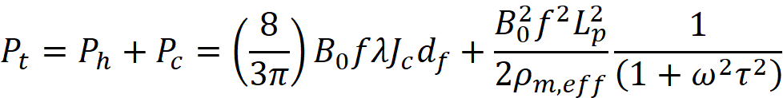

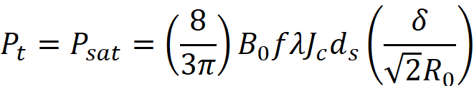
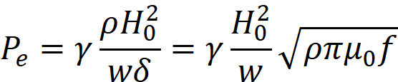
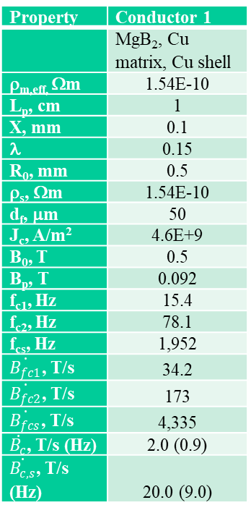
Loss of Selected MgB₂ strand over wide frequency range with various B_{a} (I)
Property | Conductor 1
 | MgB₂, Cu matrix, Cu shell
ρ_{m,eff,} Ωm | 1.54E-10
L_{p}, cm | 1
X, mm | 0.1
λ | 0.15
R₀, mm | 0.5
ρ_{s}, Ωm | 1.54E-10
d_{f}, μm | 50
J_{c}, A/m² | 4.6E+9
B₀, T | 0.5
B_{p}, T | 0.092
f_{c1}, Hz | 15.4
f_{c2}, Hz | 78.1
f_{cs}, Hz | 1,952
$\dot{B_{fc1}}$, T/s | 34.2
$\dot{B_{fc2}}$, T/s | 173
$\dot{B_{fcs}}$, T/s | 4,335
$\dot{B_{c}}$, T/s (Hz) | 2.0 (0.9)
$\dot{B_{c,s}}$, T/s (Hz) | 20.0 (9.0)
(1 – Below f_{c1}, below dB/dt_{c})
Here individual filament hysteresis = 0
(2 - Below dB/dt_{cs})
(3 - Above dB/dt_{cs})
(4 - Above dB/dt_{cs})
(5 - Above f_{c3})

Slide 16

Loss of Selected MgB₂ strand over wide frequency range with various B_{a} (II)
Here individual filament hysteresis = 0
Possible errors in loss

Slide 17

Loss of Selected MgB₂ strand over wide frequency range with various B_{a} (II)
Property | Conductor 1
 | MgB₂, Cu matrix, Cu shell
ρ_{m,eff,} Ωm | 1.54E-10
L_{p}, cm | 1
X, mm | 0.1
λ | 0.15
R₀, mm | 0.5
ρ_{s}, Ωm | 1.54E-10
d_{f}, μm | 50
J_{c}, A/m² | 4.6E+9
B₀, T | 0.5
B_{p}, T | 0.092
f_{c1}, Hz | 15.4
f_{c2}, Hz | 78.1
f_{cs}, Hz | 1,952
$\dot{B_{fc1}}$, T/s | 34.2
$\dot{B_{fc2}}$, T/s | 173
$\dot{B_{fcs}}$, T/s | 4,335
$\dot{B_{c}}$, T/s (Hz) | 2.0 (0.9)
$\dot{B_{c,s}}$, T/s (Hz) | 20.0 (9.0)
Here individual filament hysteresis = 0

Slide 18
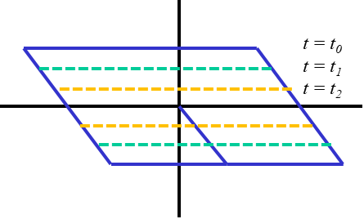
Including the effects of Flux Creep
(or Power Law)
To a first approx
t = t₂
t = t₁
t = t₀
P_{t} ≅ P_{h}+P_{c}
But, in using this formulation, we have merely applied the LTSC formulation to HTS without thinking about thermal activation – but we should!
In reality, with time, flux creep drives us away from the critical state, if f < fc
Hysteretic
P_{c}
Eddy and coupling
However, at high frequencies (above fc) creep effects can be seen as adding to loss. Essentially we are probing losses for Jc values higher than those we “measured” at some fixed electric field criterion
P_{h}
LTSC Cables

Slide 19
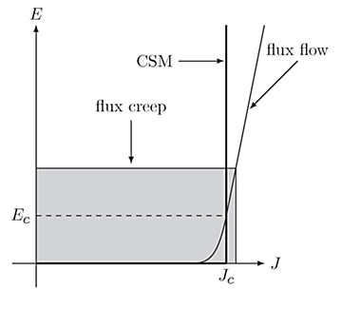
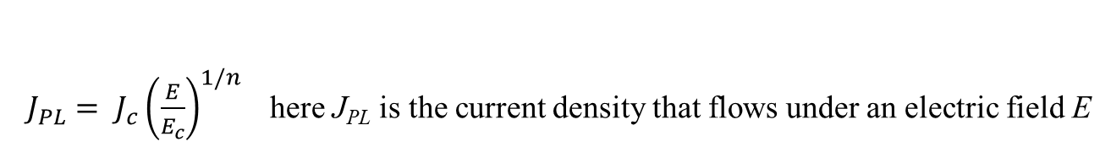
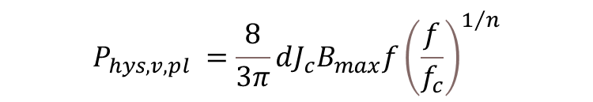
Including the effects of Flux Creep (or Power Law)
We note that n ≅ U₀/k_{b}T
If we account for the fact that the SC transition has an n-value
$E= E_{c}{\left(\frac{I}{I_{c}}\right)}^{n}$ thus ${\left(\frac{E}{E_{c}}\right)}^{1/n}=J/J_{c}$ and then $J= J_{c}{\left(\frac{E}{E_{c}}\right)}^{1/n}$
$J_{PL}= J_{c}{\left(\frac{E}{E_{c}}\right)}^{1/n}$here J_{PL} is the current density that flows under an electric field E
$$P_{hys,v,pl}=\frac{8}{3π}dJB_{max}f=\frac{8}{3π}dB_{max}fJ_{c}{\left(\frac{E}{E_{c}}\right)}^{1/n}=\frac{8}{3π}dB_{max}fJ_{c}{\left[\frac{\left(dB/dt\right)}{{\left(dB/dt\right)}_{c}}\right]}^{1/n}$$
If we use an average dB/dt defined as dB/dt = 2πB_{m}f, then
(Since E = xdB/dt)
$$P_{hys,v,pl} =\frac{8}{3π}dJ_{c}B_{max}f{\left(\frac{f}{f_{c}}\right)}^{1/n}$$
This is a simple and approximate approach, but agrees with the result from Thakur in the limit of B_{m} >> B_{p}

Slide 20
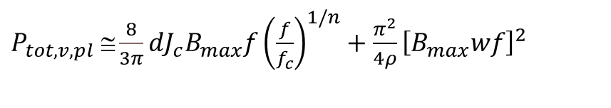
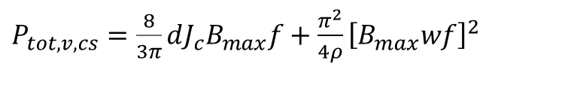
Including the effects of Flux Creep
(or Power Law) II
$P_{tot,v,cs}=\frac{8}{3π}dJ_{c}B_{max}f+\frac{π^{2}}{4ρ}{\left[B_{max}wf\right]}^{2}$
CSM, hysteretic + eddy current
$P_{tot,v,pl} ≅\frac{8}{3π}{dJ}_{c}B_{max}f{\left(\frac{f}{f_{c}}\right)}^{1/n}+\frac{π^{2}}{4ρ}{\left[B_{max}wf\right]}^{2}$
PLM, hysteretic-creep + eddy current
$P_{tot,v,pl} ≅\frac{8}{3π}dJ_{c}B_{max}f+\frac{8}{3π}dJ_{c}B_{max}f\left[{\left(\frac{f}{f_{c}}\right)}^{1/n}−1\right]+\frac{π^{2}}{4ρ}{\left[B_{max}wf\right]}^{2}$
f/f_{c} < 1 (f/f₀)^{1/2}-1 < 1
f/f_{c} > 1 (f/f₀)^{1/2}-1 > 1
Middle term negative
Middle term positive
At f = f_{c} JPL (PLM)→J_{c} (CSM)
If we take a B_{max} field of, say 0.5 T, assuming we use an I_{c} defined by E_{c} = 1 μV/cm, and for a 0.1 mm wide filament, f_{c} = (E_{c})/πwB_{max} = 10⁻⁴ V/m/(π*0.0001 m*0.5 T) ≅ 0.6 Hz

Slide 21
Alternatively, Losses in coated conductor TAPES below the skin depth, ignoring flux creep
Hysteretic Loss
$N= \left(\frac{H_{0}}{H_{d}}\right)g\left\{\frac{H_{0}}{H_{d}}\right\}$
$$P_{hys,v}=N\left(B_{max}\right)wJ_{c}B_{max}f$$
Eddy Current loss
$g\left\{\frac{H_{0}}{H_{d}}\right\}=\frac{H_{d}}{H_{0}}\left[\frac{{2H}_{d}}{H_{0}}\ln\left(cosh⁡(\frac{H_{0}}{H_{d}})\right)−tanh⁡(\frac{H_{0}}{H_{d}})\right]$
$P_{ed,v}=\frac{π^{2}}{6ρ}{\left[B_{max}wf\right]}^{2}$
But for B_{max} > B_{p}, N →1
Transport Current Loss
But, flux creep influences on loss can be important
F. Grilli, E. Pardo, A. Stenvall, D. N. Nguyen, W. Yuan, and F. Gömöry, IEEE Trans. Appl. Supercond. 24 (2014) 8200433.
M. Kapolka, V. M. R. Zermeno, S. Zou, A. Morandi, P. L. Ribani, Member, E. Pardo, and F. Grilli, IEEE Trans. Appl. Supercond. 28 (2018) 8201206
L. Pust, Supercond. Sci. Technol. 3 (1990) 598-601.
K. P. Thakur, A. Raj, E. H. Brandt, and P. Sastry, Supercond. Sci. Technol. 24 (2011) 045006, doi:10.1088/0953-2048/24/4/045006.
E.H. Brandt, Phys. Rev B 55 (1997) 14514.
Ignoring transport current and for B_{m} > B_{p}
$$P_{tot,L}=wI_{c}B_{max}f+\frac{π^{2}}{6ρ}{\left[B_{max}wf\right]}^{2}wt$$

Slide 22
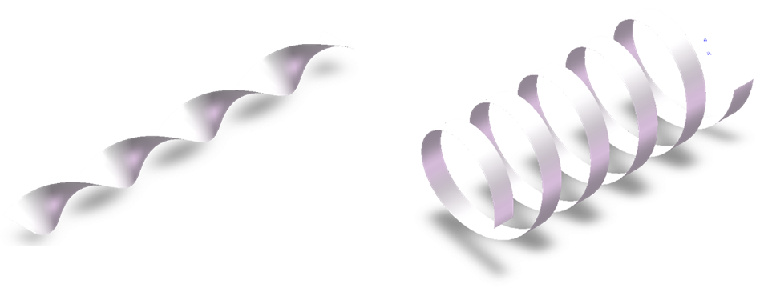
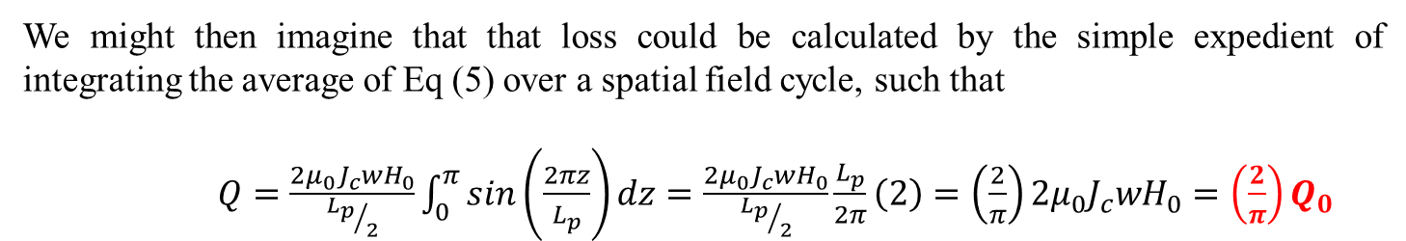
Losses for coated conductor TAPES with helical wrap (e.g. CORC) WITH flux creep
Hysteretic loss correction
Eddy loss correction goes as square, since Q_{e} ∝ (dB/dt)²
B
B
$P_{tot,L}=wI_{c0}B_{max}f+wI_{c0}B_{max}f\left[{\left(\frac{f}{f_{0}}\right)}^{1/n}−1\right]+\frac{π^{2}}{6ρ}{\left[B_{max}wf\right]}^{2}wt$
π/2
(π/2)²
$$P_{tot,L}=\left(\frac{2}{π}\right)wI_{c0}B_{max}f+\left(\frac{2}{π}\right)wI_{c0}B_{max}f\left[{\left(\frac{f}{f_{0}}\right)}^{1/n}−1\right]+\frac{4}{6ρ}{\left[B_{max}wf\right]}^{2}wt$$

Slide 23
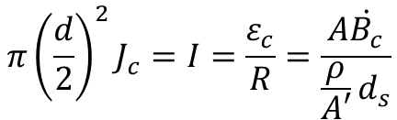

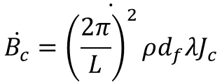

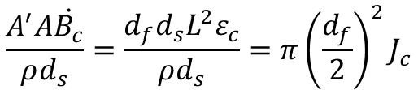
Coupling currents in typical multifilamentary strands
$$ε=−\frac{dφ}{dt}$$
$$π{\left(\frac{d}{2}\right)}^{2}J_{c}=I=\frac{ε_{c}}{R}=\frac{A\dot{B_{c}}}{\frac{ρ}{A′}d_{s}}$$
filament
filament
filament
filament
matrix
matrix
$$\frac{A^{′}A\dot{B_{c}}}{ρd_{s}}=\frac{d_{f}d_{s}L^{2}ε_{c}}{ρd_{s}}=π{\left(\frac{d_{f}}{2}\right)}^{2}J_{c}$$
$$ε_{c}=\frac{π}{L^{2}}d_{f}J_{c}ρ$$
B, dB/dt
B, dB/dt
$$\dot{\dot{B_{c}}={\left(\frac{2π}{L}\right)}^{2}ρd_{f}λJ_{c}}$$
Slow ramping, hysteresis only
fast ramping, Hyst+coupling
The critical ramp rate needed to fully re-couple

Slide 24




Coupling currents in conductors with tapes
$$ε=−\frac{dφ}{dt}$$
$$\frac{ε_{c}}{R}=I_{c}$$
filament
filament
filament
filament
$$A\frac{\dot{B_{c}}}{R}=I_{c}$$
matrix
matrix
$$\dot{\dot{B_{c}}=\frac{I_{c}R}{2Lw}}$$
The critical ramp rate needed to fully re-couple
B, dB/dt
B, dB/dt
This is a very fast ramp!
i.e., coupling of coated conductor structures requires a very fast ramp, because the currents to be coupled are large!!
Slow ramping, hysteresis only
Slow ramping, hysteresis only

Slide 25
Summary
We showed loss expressions for superconductors below the skin depth regimes
We then showed the loss expressions for superconductor in high frequencies in various skin depth regimes
Some particular cases were explored, over a wide range of f
We gave the corrections due to power law (flux creep) effects
We discussed (shortly) coated conductor loss and creep modifications
Ramp rates needed to fully couple coated conductor tapes in cable configurations quite large, because currents to be coupled large

