Slide 1

M2Or4B-03, 20.05.2025, 17.00-17.15 (Naples 4/5)
Growth & Characterization of REBCO and Iron-based Superconductors
Charge carrier density and critical current density variations of superconducting layers of GdBCO and EuBCO coated conductors as a result of high pressure oxygenation
T. Prikhna^{1,2,4}, A. Kethamkuzhi², R. Vlad², M. Karpets^{1,3}, R. Kluge⁴, S. Ponomarov⁵,, V. Moshchil¹, X. Obradors^{2,}, B. Büchner⁴ , J. Gutierrez² , Sabine Wurmehl⁴,, and T. Puig²
¹ V. Bakul Institute for Superhard Materials of the National Academy of Sciences of Ukraine,
2, Avtozavodska Str., Kyiv 07074, Ukraine
² Institut de Ciencia de Materials de Barcelona, CSIC, Campus UAB, 08193 Bellaterra, Spain
³ National Technical University of Ukraine «Igor Sikorsky Kyiv Polytechnic Institute”,
Peremogy Avenue 37, 03056 Kyiv, Ukraine
⁴ Leibniz-Institut für Festkörper- und Werkstoffforschung Dresden e. V.,
Helmholtzstrasse 20 01069 Dresden, Germany.
⁵ V.E. Lashkaryov Institute of Semiconductor Physics of the National Academy of Sciences of Ukraine,
41, Nauky Ave., Kyiv 03028, Ukraine
We acknowledge funds from MICIU/AEI/FEDER for SUPERENERTECH (PID2021–127297OB-C21), FUNFUTURE “Severo Ochoa” (CEX2019–000917-S); MUGSUP (UCRAN20088) project from CSIC scientific cooperation with Ukraine; Catalan Government 2021 SGR 00440; NAS of Ukraine Project III-7-24 (0788)

Slide 2
M2Or4B-03, 20.05.2025, 17.00 (Naples 4/5)
Growth & Characterization of REBCO and Iron-based Superconductors
Content
Motivation
Experimental ( 1-160 bar oxygen pressure, 300-800 ºC temperature, 3, 6 or 12 h holding time)
Characteristics before and after treatment (T_{c}, J_{c}, carrier density, n_{H}, c-lattice parameter of RE123 (RE=Gd, Eu)
Study of the materials structures (SEM EDS and Auger spectroscopy).
Conclusions

Slide 3
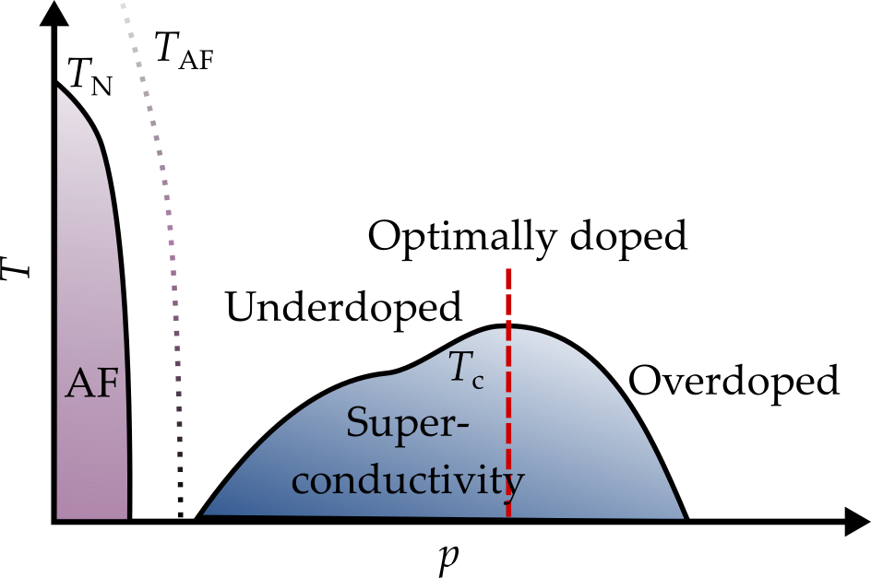
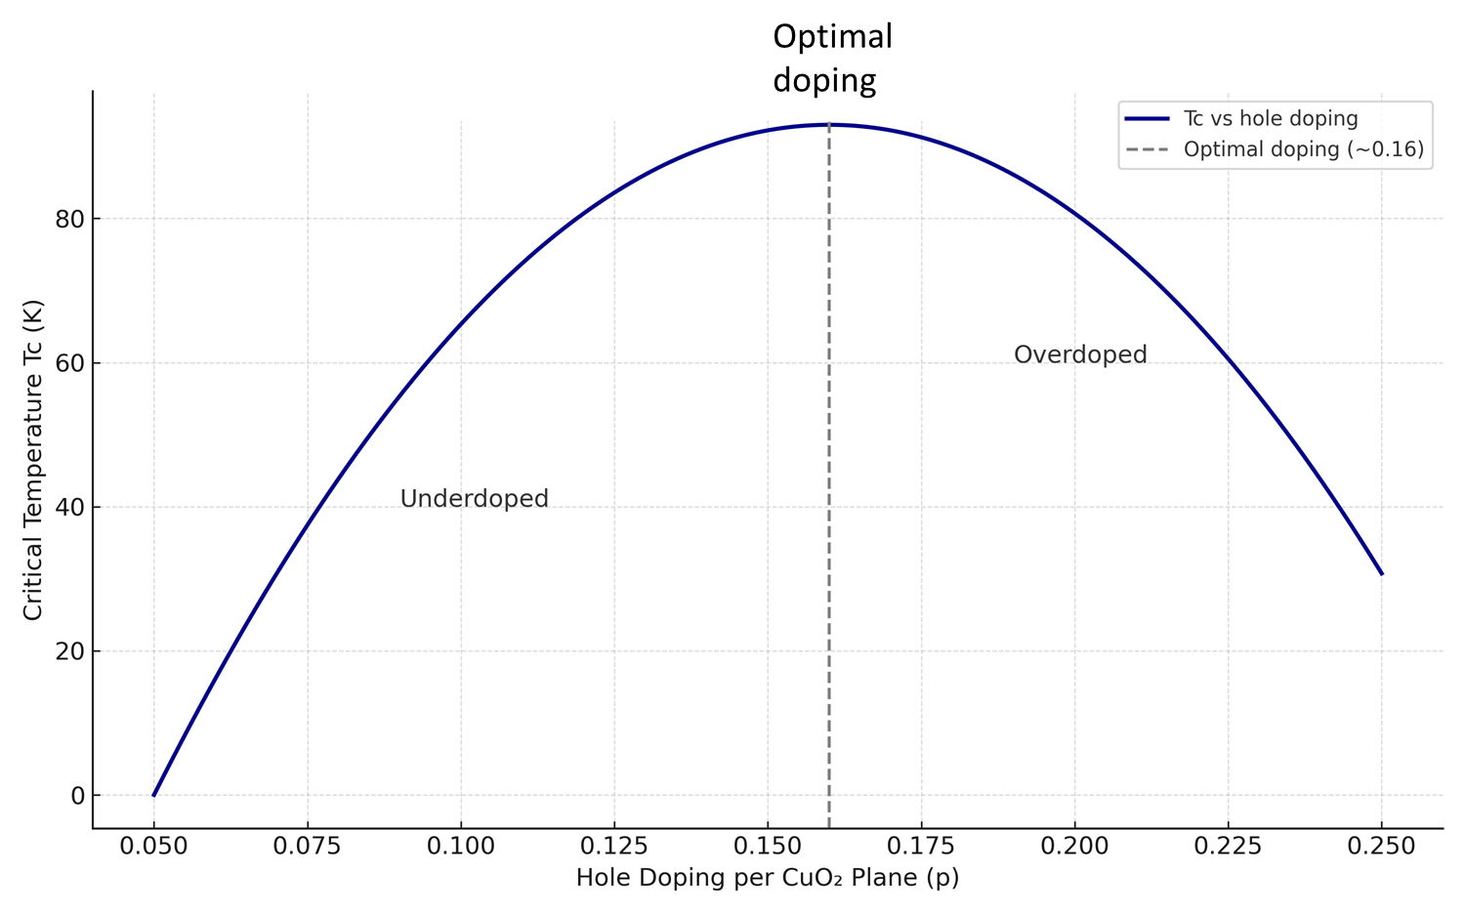
What is overdoping?
p- hole doping per CuO₂ planes of RE123
(the structure of the CuO chains remains unaffected)
- Increase of n_{H}(100 K);
- Reduction of c-lattice
parameters of RE123
(RE=Y, Eu, Gd)
J_{c} of REBCO films is expected to increase in the overdoped state
p_{opt}
I_{c}
Nancomposite
It should be a robust and homogeneous process to increase J_{c} in Coated Conductors.
Optimal Doping (~p = 0.16): maximum T_{c} (~93 K)
Overdoped Regime (p > 0.16): T_{c} decreases despite increasing hole concentration
Underdoped Regime (p < 0.16): T_{c} also decreases; pseudogap opens
REBCO
Overdoped
T_{irr}
H_{irr}

Slide 4
1. Motivation
The overdoping for YBa₂Cu₃O_{7-δ} (Y123) thin films (as a result of treatment via Ag layer when heated under oxygen partial pressure below 1 bar at low temperatures) was confirmed by a sudden increase of charge carrier density, n_{H}, associated to the reconstruction of the Fermi-surface at the Quantum Critical Point (QCP). The authors (Stangl, A., Palau, A., Deutscher, G., Obradors, X., 2021, . Sci Rep., 11, 8176.) achieved the highest ever reported in YBCO films critical current density J_{c}, equal to 90 MA·cm⁻² at 5 K which corresponds to about a fifths of the depairing current.
The Miura, M. et al. ( 2022, NPG Asia Materials , 14, 85) demonstrated that thermodynamic improvements of superconductors can work in parallel with already successful artificial pinning centers and that a maximum critical current density J_{c} ~ 0.3 J_{d} (despairing current ) appears to be the current upper limit for the enhancement in J_{c}. They concluded that variation in λ and ξ leads to an intrinsic improvement in J_{c} via J_{d}, allowing extremely high values of J_{c} of 130 MA/cm² at 4.2 K, consistent with an enhancement in J_{d} of a factor of 2 for nanoparticle-doped (Y,Gd)123 coated conductors (CCs). The combination of thermodynamic and pinning optimization route for the (Y,Gd)123 CCs resulted in high vortex-pinning force ~3.17 TN/m³ at 4.2 K and 18 T (H||c) .
The idea to apply such high oxygen pressure (100-160 bar) and annealing temperature (600-800 ºC) was caused by our experience with melt-texturing YBCO for which such conditions allowed essentially decrease the time, τ, of oxygenation, increase J_{C} (especially in high magnetic fields) due to increase of twin density, reduce anisotropy of J_{C}, decrease mico- and macrocracking (and thus improve mechanical properties). [3-5]

Slide 5
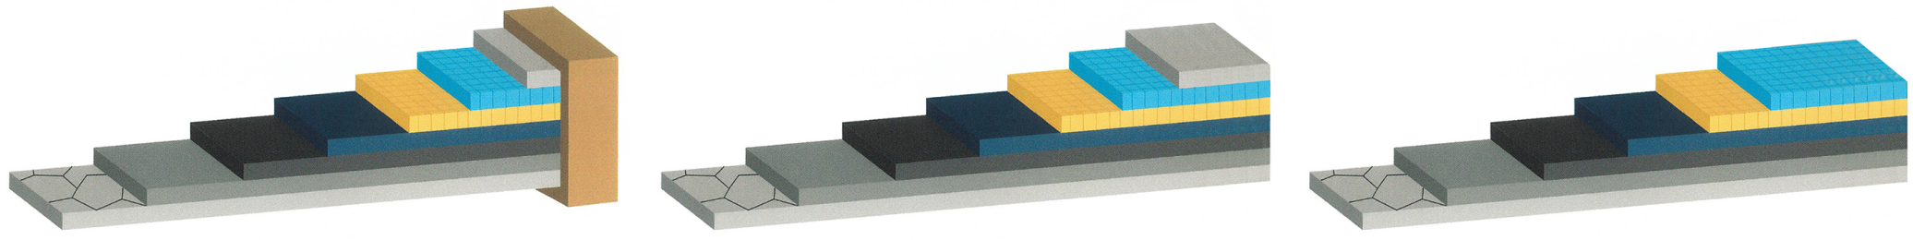
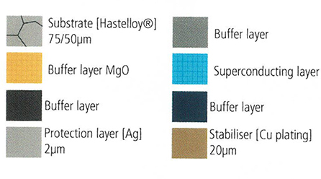
Experimental
Architecture of the studied types of commercial Fujikura coated conductors,
model numbers FYSC-S12 and FESC-SCH12:
FYSC : Ag (2μm)/ GdBCO (1.8μm)// CeO₂ (700 nm)/ MgO/Y₂O₃/Al₂O₃/ Hastelloy (75 μm);
FESC : EuBCO (2.5μm)+BaHfO₃ nanorods (BHO)/ CeO₂ (700 nm)/ /MgO/Y₂O₃//Al₂O₃/ Hastelloy (50 μm);
FESC : Ag (2μm)/ EuBCO (2.5μm)+BaHfO₃ nanorods / CeO₂ (700 nm)//MgO/Y₂O₃/Al₂O₃/ Hastelloy 50 μm).
Ag
REBCO
Ag
REBCO
REBCO
Cu
Type 1
Type 2
Cu layer etched in HCl: H₂O₂=1:1
Ag layer etched in NH₃: H₂O₂:MeOH 1:1:5
Commercial tape (Fujikura)
Cu layer etched in HCl: H₂O₂=1:1
The transition temperature, T_{C}, and critical current density, J_{c}, were estimated by SQUID magnetometer.
T_{c} was estimated as well using transport measurements.
Charge carrier density, n_{H}, were found from the Hall effect at 100 K by Quatum Design PPMS (before the n_{H} study Ag layer was removed by etching from CC re-oxygenated via Ag layer)

Slide 6
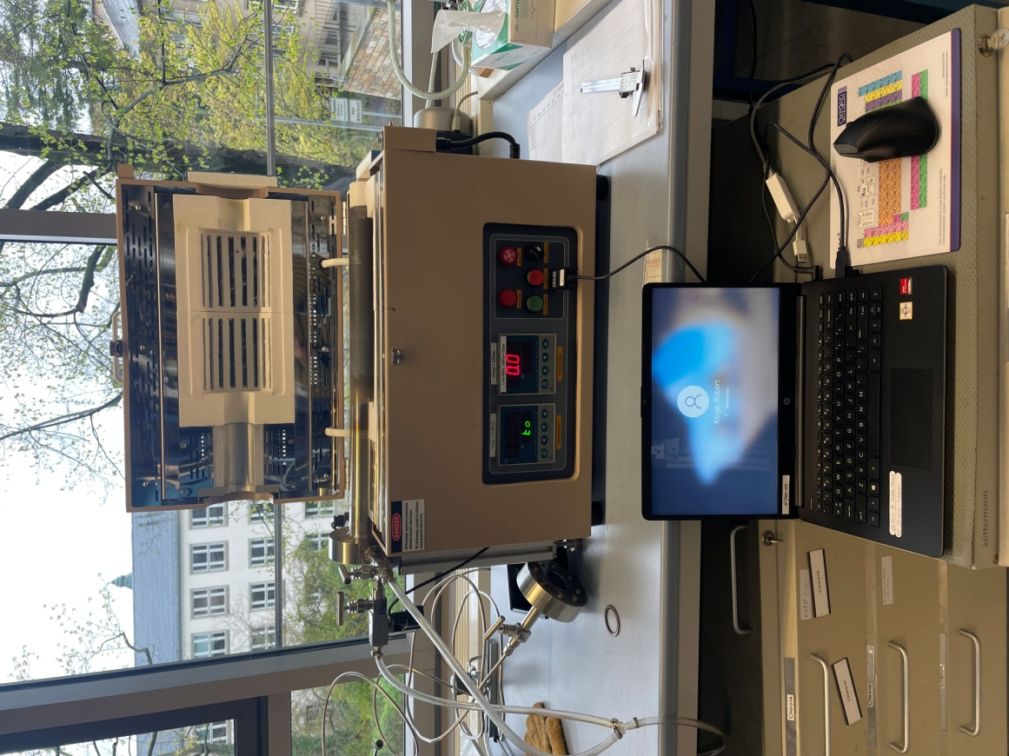
Experimental
Oxygenations conditions
1-160 bar O₂
T_{S}=300-800 ºC
Ramp =
5 ºC/min
τ= 3,, 6 or
12 h
Mode 1
Mode1
O₂ pressure decreased
when cooling
Mode 1
P_{O2}
T
T
Mode 2
O₂ pressure was kept constant up to cooling down to room temperature
P_{O2}
Mode 2
Mode 2
Leibniz-Institut für Festkörper- und Werkstoffforschung Dresden e. V.,
Helmholtzstrasse 20 01069 Dresden, Germany.

Slide 7
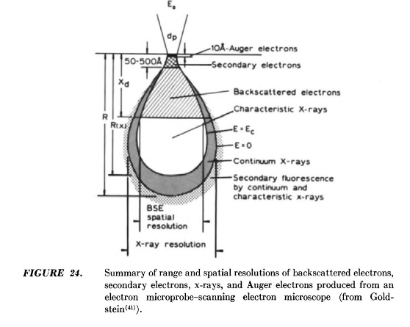
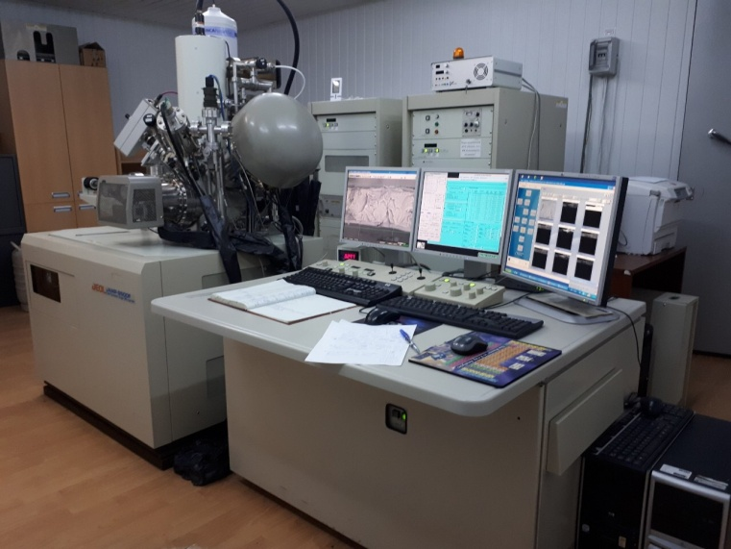
Study of materials structures
The c-lattice parameters of RE123 superconducting phases (RE=Gd, Eu) of GdBCO_CC and EuBCO_CC were estimated from X-ray diffraction patterns obtained using Ultima IV (Japan, Rigaku) in CuKα radiation λ = 1.54184 Å, in 2θ = 8–88° range, with scanning step 0.05°, and the acquisition time at one point 2–4 s. The obtained diffractograms were refined by the Rietveld method.
The materials microstructures were examined by SEM EDS and Auger spectroscopy using JAMP−9500F, JEOL, Japan.
10 Å- Auer electrons
JAMP−9500F, JEOL, Japan – Scanning Auger Microscopy which is combination of HRSEM (secondary electron mode, resolution 3 nm) and Local Auger-electron Spectroscopy (resolution 5 - 8 nm)

Slide 8
Characterization
No | p(O₂), bar |  |  |  | T_{s}, ºC | τ, h |  | Mode 1 or 2 |  |  |  | J_{c} (0 T, 77K), MA/cm² | c-parameter, nm |  |  | n_{H}(100 K), ×10²¹ cm⁻³ |  |  |  |  | T_{c}, K
(1) Ag (2μm)/ GdBCO (1.8μm)/ CeO₂ (700 nm)/ MgO/Y₂O₃/Al₂O₃/Hastelloy (75 μm)
1 | Starting |  |  |  |  |  |  |  |  |  | 2.57 |  |  | 1.17351 |  |  |  |  | 6.55 | 92.75
2 | 10 |  |  | 300 |  |  | 3 |  | 1 |  | 2.23 |  |  | 1.17318 |  |  |  |  | 5.09 | 92.71
3 | 5 |  |  | 300 |  |  | 3 |  | 1 |  | 2.49 |  |  | 1.17343 |  |  |  |  | 6.18 | 92.60
4 | 100 |  |  | 600 |  |  | 3 |  | 1 |  | 2.67 |  |  | 1.17310 |  |  |  |  | 6.91 | 92.77
5 | 160 |  |  | 800 |  |  | 3 |  | 1 |  | 2.49 |  |  | 1.1,7300 |  |  |  |  | - | 92.74
6 | 2 |  |  | 300 |  |  | 3 |  | 1 |  | 2.47 |  |  | 1.17289 |  |  |  |  | 6.22 | 93.26
7 | 1 |  |  | 300 |  |  | 3 |  | 1 |  | 2.19 |  |  | 1.17320 |  |  |  |  | 5.27 | 92.76
8 | 100 |  |  | 600 |  |  | 6 |  | 1 |  | 2.36 |  |  | - |  |  |  |  | 7.05 | -
9 | 100 |  |  | 600 |  |  | 12 |  | 1 |  | 2.65 |  |  | - |  |  |  |  | 8.21 | -
(2) EuBCO (2.5μm)+BHO Nanorods/ CeO₂ (700 nm)/MgO/Y₂O₃/Al₂O₃)/ Hastelloy (50 μm)
10 | Starting |  |  |  |  |  |  |  |  | 1.38-1.21 |  |  |  |  | 1.17419 |  | 6.05 |  |  |  |  | 92.35
11 | 10 |  |  | 300 |  |  | 3 |  | 1 | 0.87 |  |  |  |  | 1.174631 |  | 3.77 |  |  |  |  | 91.65
12 | 5 |  |  | 300 |  |  | 3 |  | 1 | 0.99 |  |  |  |  | 1.17384 |  | 3.85 |  |  |  |  | -
13 | 100 |  |  | 600 |  |  | 3 |  | 1 | 0.77 |  |  |  |  | 1.17425 |  | 4.02 |  |  |  |  | -
14 | 160 |  |  | 800 |  |  | 3 |  | 1 | 1.31 |  |  |  |  | 1.17341 |  | - |  |  |  |  | -
15 | 2 |  |  | 300 |  |  | 3 |  | 1 | 1.09 |  |  |  |  | 1.17341 |  | 4.43 |  |  |  |  | -
16 | 1 |  |  | 300 |  |  | 3 |  | 1 | 1.09 |  |  |  |  | 1.17341 |  | 4.33 |  |  |  |  | 91.65
17 | 100 |  |  | 600 |  |  | 3 |  | 1 | 0.97 |  |  |  |  | 1.17433 |  | 4.92 |  |  |  |  | 92.22
(3) Ag (2μm)/ EuBCO (2.5μm)+BHO Nanorods/ CeO₂ (700 nm)/MgO/Y₂O₃/Al₂O₃)/ Hastelloy (50 μm)
18 |  | 160 | 600 |  |  |  | 3 |  | 2 |  | 1.32 |  |  |  | 1.17488 |  |  | 6.25 |  |  | 93.04
19 |  | 160 | 800 |  |  |  | 3 |  | 2 |  | 0.69 |  |  |  | 1.17471 |  |  | 6.69 |  |  | 92.09

Slide 9
Gd_CC00
Gd_CC01
Gd_CC03
No 4 GdBCO
100 bar 600 ºC
No 1 Starting GdBCO
No 2 GdBCO
10 bar 300 ºC
No 1 Starting GdBCO
No 2 GdBCO
10 bar 300 ºC
No 4 GdBCO
100 bar 600 ºC

Slide 10
Comparison of normalized resistivity of GdBCO_CC
Signatures of overdoping are observed
O₂ pressure decreased
as furnace
cooled
O₂ pressure was kept constant up to cooling down to room temperature
Mode 1
Mode 2

Slide 11
Regime of Oxygenation (p, T_{s}, , τ, Oxygenation Mode): and Results of Study of J_{c}(0 T) at 77 K and 5 K, T_{c}, n_{H}(100 K), c- parameter of Gd 123
No | Regime P_{O2}/T_{S}/τ/mode |  | c, nm of RE123 | J_{c} (0 T), MA/cm² |  | T_{c,} K | n_{H} ×10²¹, cm⁻³
 |  |  |  | 77 K | 5 K | SQUID DС | (at 100 K)
Ag (2μm)/GdBCO (1.8μm)/CeO₂ (700 nm)/ MgO/Y₂O₃/Al₂O₃/Hastelloy (75 μm)
1 | Initial I (Gd123+Ag) | 1.17351 |  | 2.57 | - | 92.75 92.58 | 6.55
2 | 100 bar/250 ºC/3 h/2 | 1.1.7213 |  | 2.20 | 26.63 | 93.02 91.15 | -
3 | 160 bar/250 ºC/3 h/2 | 1.17284 |  | 1.92 | 23.37 | 92.79 91.15 | 5.37
4 | 1 bar/300 ºC/3 h/1 | 1.17320 |  | 2.19 | - | 92.76 92.18 | 5.27
5 | 2 bar/300 ºC/3 h/1 | 1.7289 |  | 2.47 | - | 93.26 91.63 | 6.22
6 | 5 bar/ 300 ºC/3 h/1 | 1.17343 |  | 2.49 | - | 92.60 92.17 | 6.18
7 | 10 bar,/300 ºC/3 h/1 | 1.17318 |  | 2.23 | - | 92.71 92.25 | 5.09
8 | 100 bar/300 ºC/3 h/2 | 1.17374 |  | 2.12 | 26.12 | 92.55 92.23 | 5.34
9 | 160 bar/450 ºC/3 h/2 | 1.17334 |  | 2.02 | 24.56 | 93.06 92.23 | 5.49
10 | 100 bar/600 ºC/3 h/1 | 1.17310 |  | 2.67 | - | 92.77 92.23 | 6.91
11 | 100 bar/600 ºC/3 h/ 2 | 1.17141 |  | 2.22 | 25.16 | __-__ - | -
12 | 100 bar/600 ºC/ 12 h/1 | 1.17310 |  | 2.65 | - | __-_ 92.22 | 8.21
13 | 160 bar/600 ºC/3 h/2 | 1.17312 |  | 1.98 | 23.67 | 92.65 92.22 | 6.84
14 | 160 bar/800 ºC/3 h/1 | 1,17300 |  | 2.49 | - | 92.74 92.17 | -
15 | 160 bar/800 ºC/3 h/2 | 1.17246 |  | 2.62 | 28.94 | 92.76 92.75 | 6.27

Slide 12
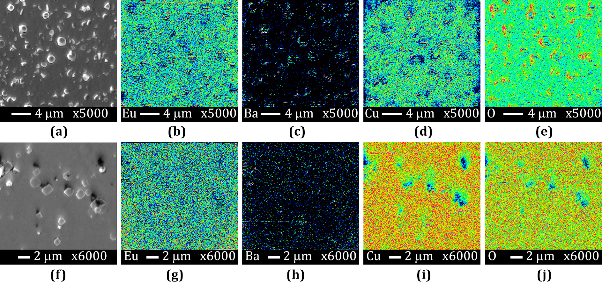
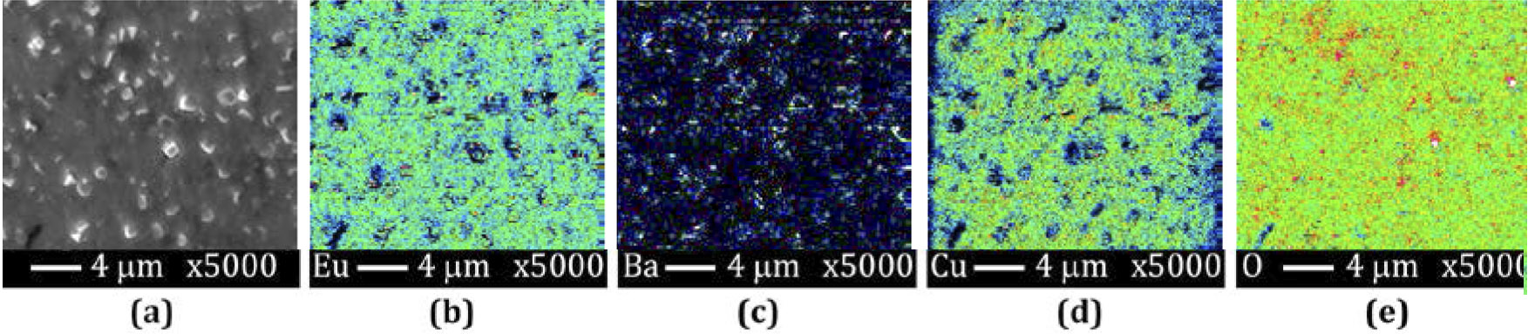
GdBCO_CC starting ( Ag layer etched)
Figure (a, f) – Images in SEI (secondary electrons) mode of GdBCO_CC and EuBCO+BHO_CC (materials without Cu and Ag layers, which were removed by etching in acids), respectively, and Auger maps of elements distributionover these images: (b-e) – Eu, Ba, Cu, O; (g-j) – Gd, Ba, Cu, O.
Gd
EuBCO+BHO_CC – starting (Ag layer etched)
Figure (a) – SEM of EuBCO+BHO_CC after re-oxygenation at 800 C, under 160 bar oxygen pressure for 3 h, and (b-e) - Auger maps of elements Eu, Ba, Cu, O distribution over this image. Before repeated oxygenation the Cu and Ag layers was removed by etching in acids after re-oxygenation.
EuBCO+BHO_CC after re- oxygenation at 800 C, 160 bar , 3 h)

Slide 13
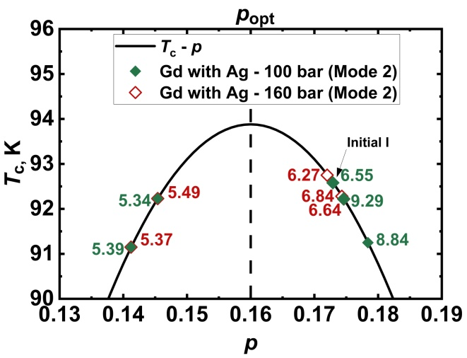
a)
b)
c)
d)
Figure. Dependences of critical current density J_{c} at 77 K in 0 T field vs. c-lattice parameter (on the left y-axis) and carrier densities n_{H} (on the right y-axis) at 100 K in comparison between initial samples and the treaded ones for GdBCO_CC (with Ag protected layer) oxygenated at 300 ºC, under 1-100 bar O₂ (a) and at 600 ºC under 100 bar O₂ (b), for EuBCO_CC (without Ag) treated at 300 ºC under 1-10 bar O₂ (c). J_{c} vs. O₂ pressure for EuBCO_CC (without Ag) treated at 300-800 ºC (d).
Transition temperature, T_{c} (K), charge carrier density at 100 K, n_{H} /10²¹ (cm⁻³) (values next to the data points), and estimated doping, p, for GdBCO_CC (with Ag layer) after treatment using Mode 2
(100 and 160 bar O₂).

Slide 14
Regimes of oxygenation (oxygen pressure, p, maximal heating temperature, T_{s}, holding time at maximal temperature, τ) and J_{c} in 0 T before (at 77 K) and after (at 77 and 5 K) re-oxygenation; transport T_{c}, n_{H}(100 K), and c-parameter after re-oxygenation
No | p(O₂), bar | T_{s}, ºC | τ, h | Rate of T_{s}, and p(O₂) decrease (Mode 1 or 2) | J_{c} (0 T), MA/cm² |  |  | c-para-meter, nm | n_{H} (100 K), ×10²¹ cm⁻³ | T_{c}, K
 |  |  |  |  | Before at 77 K | After at 77K | After at 5K
Ag (2μm)/ GdBCO (1.8μm)/CeO₂ (700 nm)/MgO/Y₂O₃/Al₂O₃ /Hastelloy (75 μm)
A | Reference GdBCO_CC sample for c, T_{c} and n_{H} |  |  |  | 2.57 1.95 | - | - 23.69 | 1.1735(1) - | 6.55 6.93 | 92.58 91.45
1 | 100 | 600 | 3 | with furnace (1) | 2.04 | 2.22 | 24.79 | 1.1715(5) | 6.5 | 92.72
2 | 100 | 600 | 6 | with furnace (2) | 2.14 | 2.49 | 24.98 | 1.1718(8) | 7.86 | 92.79
3 | 100 | 600 | 12 | with furnace (1) | 2.10 | 2.42 | satu-rated | 1.1720(6) | 7.73 | 93.25
4 | 160 | 800 | 3 | with furnace (1) | 2.12 | 2.70 | satu-rated | 1.1,727(1) | 7.3 | 92.63
5 | 160 | 800 | 6 | with furnace (1) | 1.87 | 2.29 | 23.14 | 1.1725(3) | 6.74 | 92.35
6 | 160 | 800 | 12 | with furnace (1) | 1.79 | 1.11 | 22.73 | 1.1724(8) | 3.25 | 92.63

Slide 15
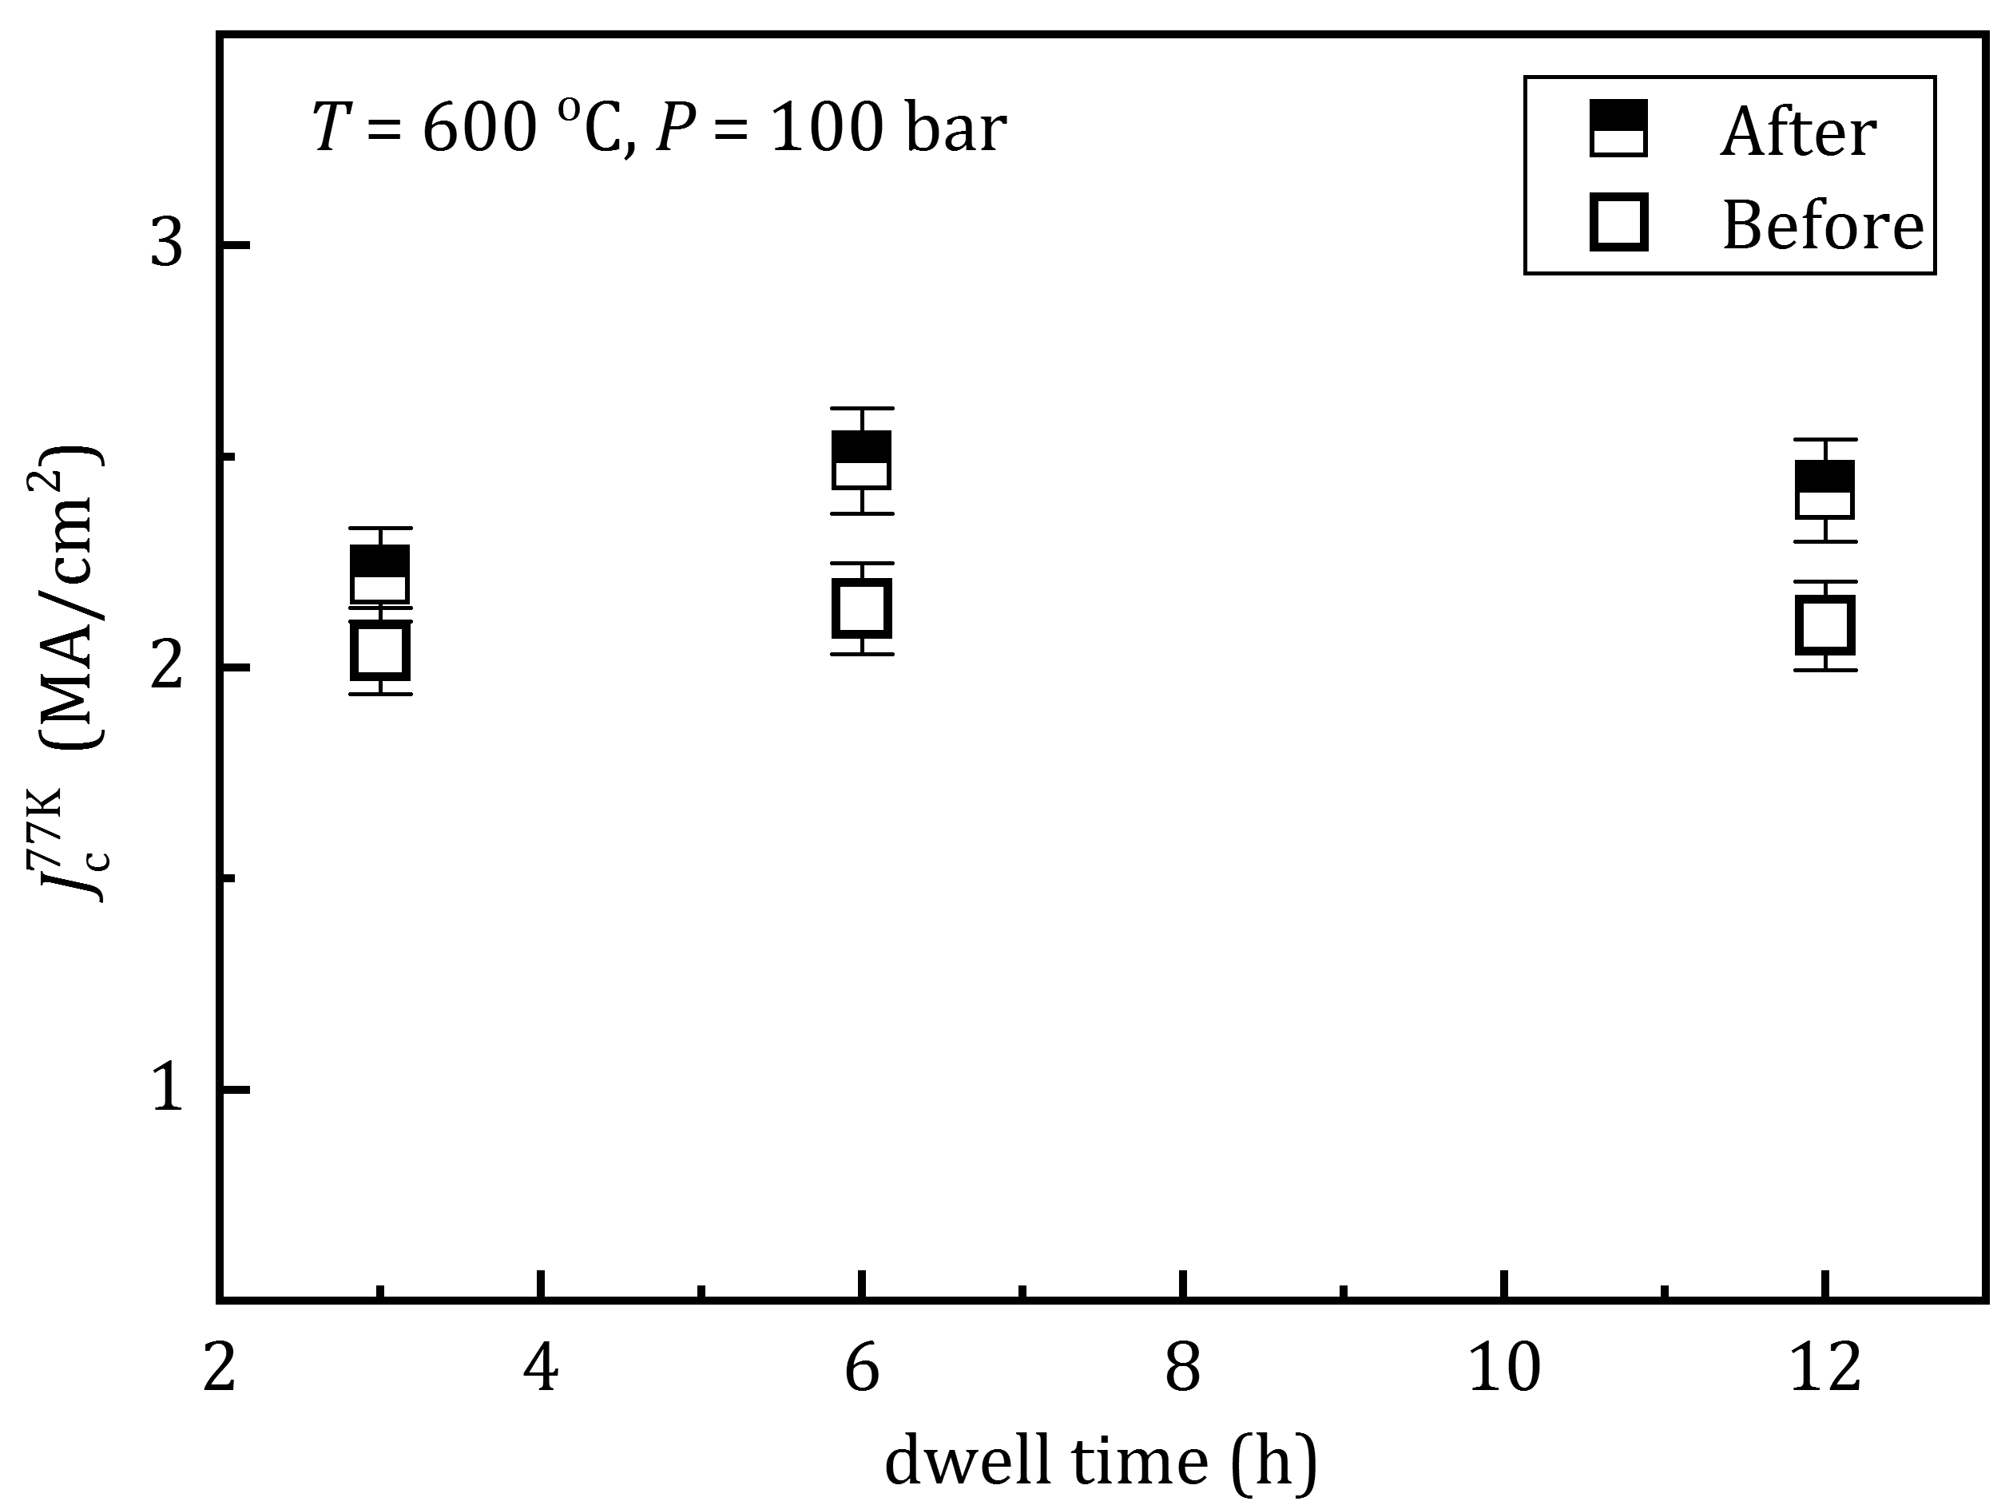
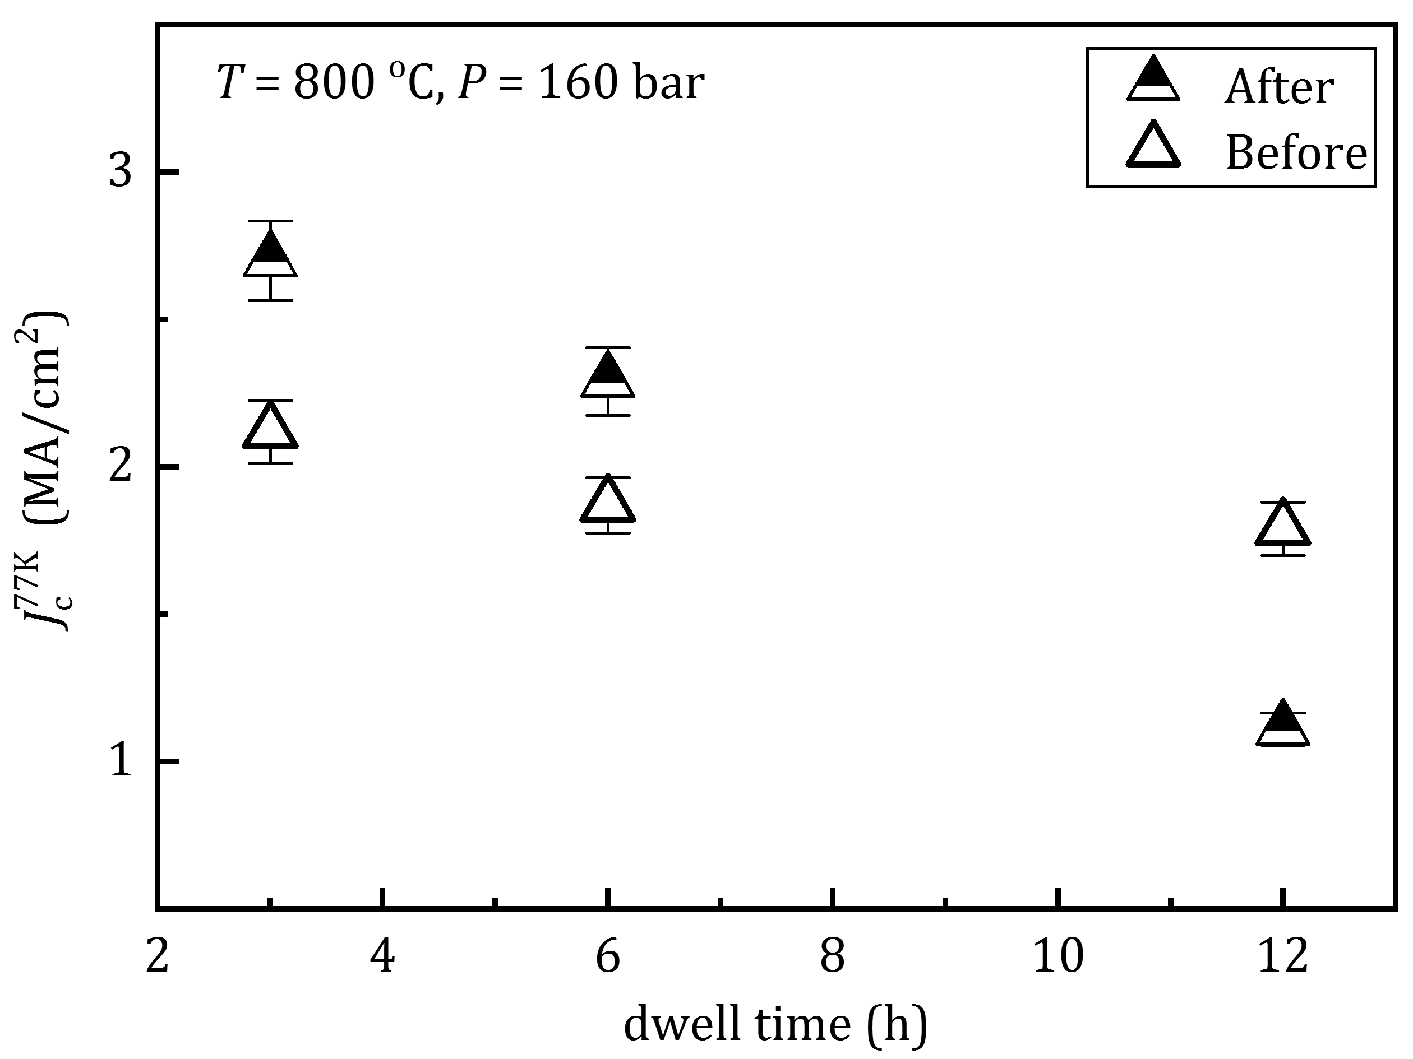
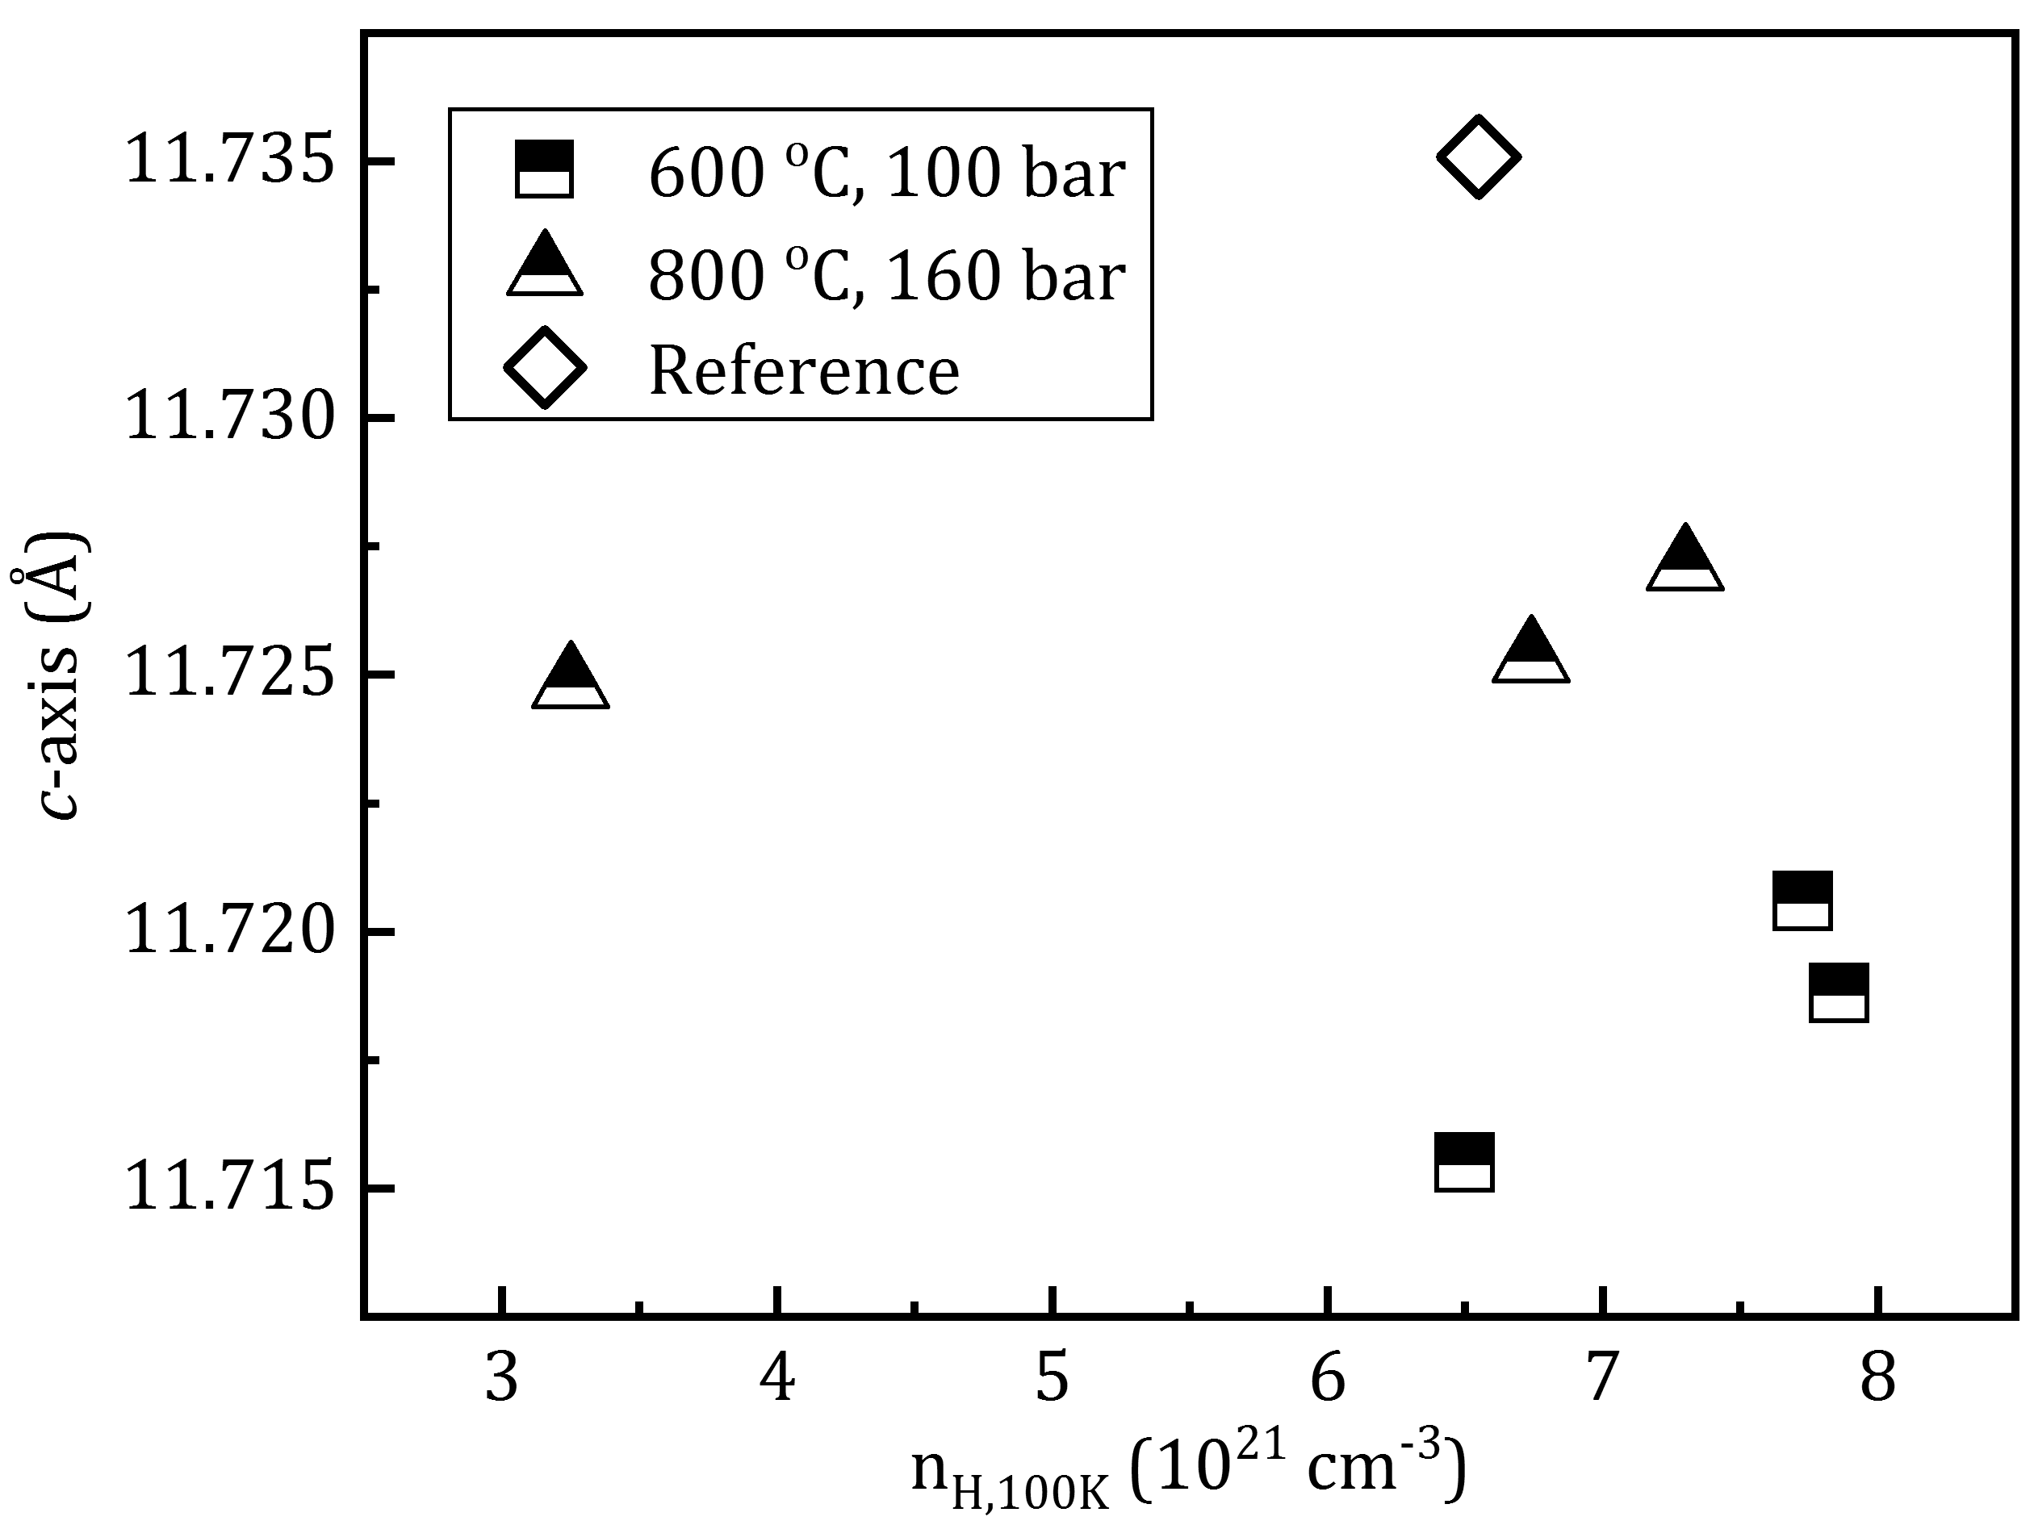
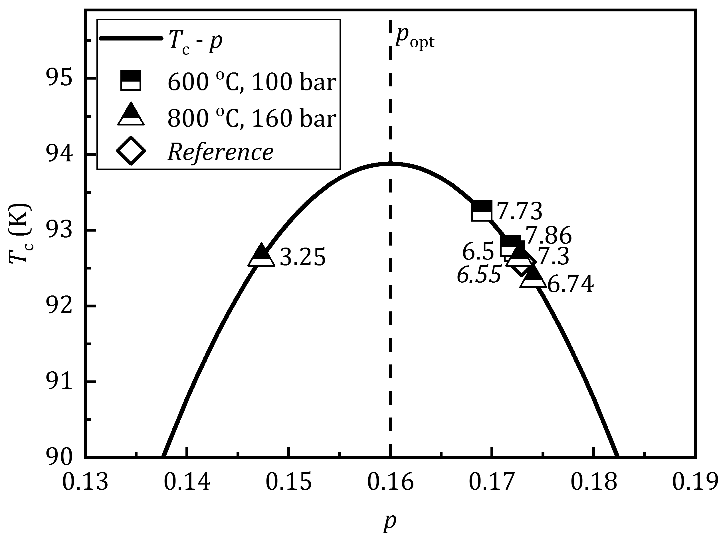
GdBCO_CC with Ag: critical current density J_{C} at 77 K in 0 T field vs. dwell time before and after re-oxygenation under 100 bar at 600 ºC (a) and under 160 bar at 800 ºC (b) depending on on dwell time
After treatment at 160 bar O₂ at 800 ºC for 3 h J_{C}(77K,0T) of GdBCO_CC was increased for 21.5 % (from 2.12 to 2.70 MA/cm²) while heating for 6 h resulted in J_{C}(77K,0T) increase to less extend - for 18 %, and after 12 h dwell the Gd123 structure partly decomposed and critical current density decreased from 1.79 to 1.11 MA/cm². Treatment of samples at 600 ºC under 100 bar O₂ for 3, 6, and 12 h resulted in J_{C}(77K,0T) increase for 8, 14 and 13 %, respectively.
(a) (b)
c-lattice parameters of GdBa₂Cu₃O_{7-δ} after re-oxygenation vs. charge carrier density n_{H} estimated at 100 K.; (b) - Transition temperature, T_{c} (K), charge carrier density at 100 K, n_{H} /10²¹ (cm⁻³) (values next to the data points), and estimated doping, p, for GdBCO_CC after re-oxygenation under 100 bar at 600 ºC and under 160 bar O₂ at 800 ºC). The c-parameter, T_{c} , n_{H} and p of the reference sample A is as well presented.
The re-oxygenation under 160 bar at 800 ºC for 3 h result in n_{H} = 7.3×10²¹ cm⁻³ and p=0.174; c-parameter decreased to 1.1727(1) nm.
The analysis of obtained results allowed us to conclude that optimal doping of CuO planes of Gd123 is around p=0.1740- 0.1745.
(a) (b)

Slide 16
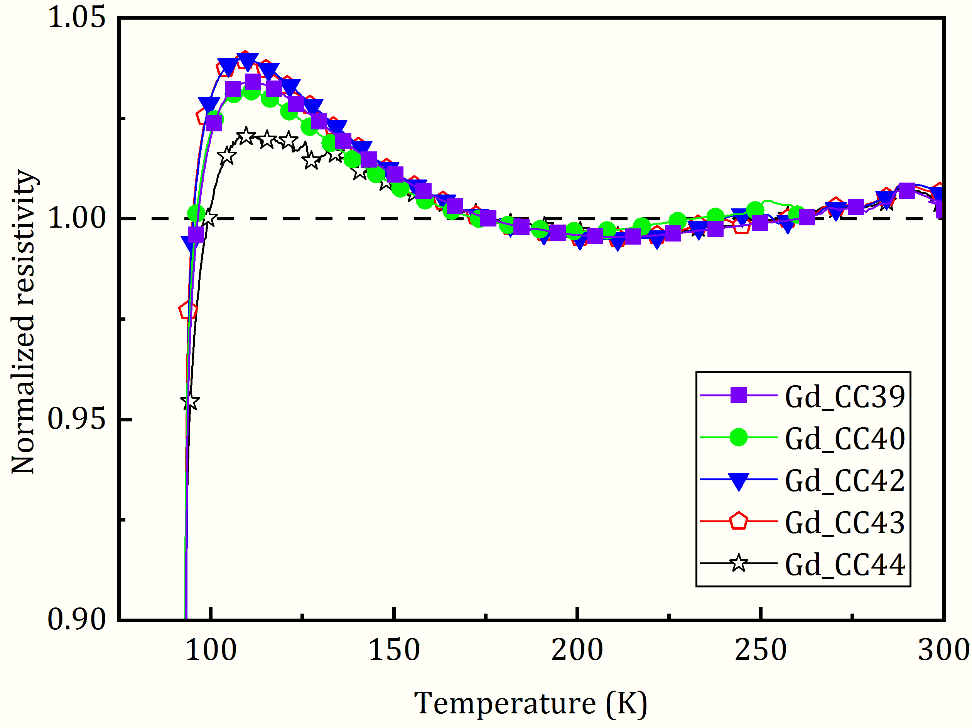
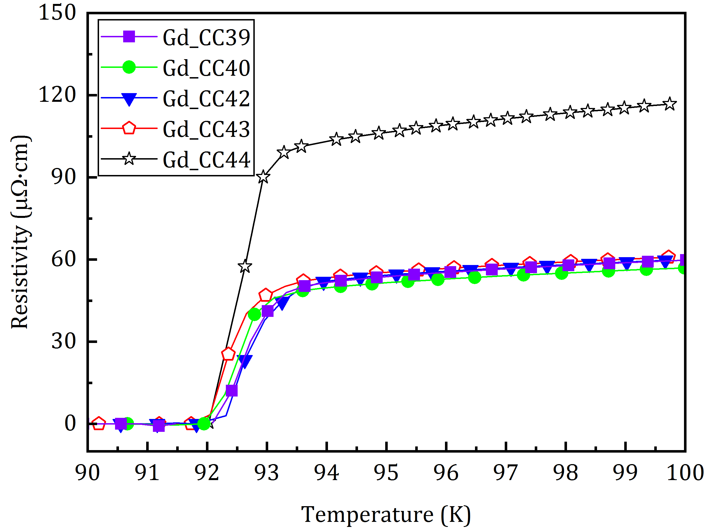
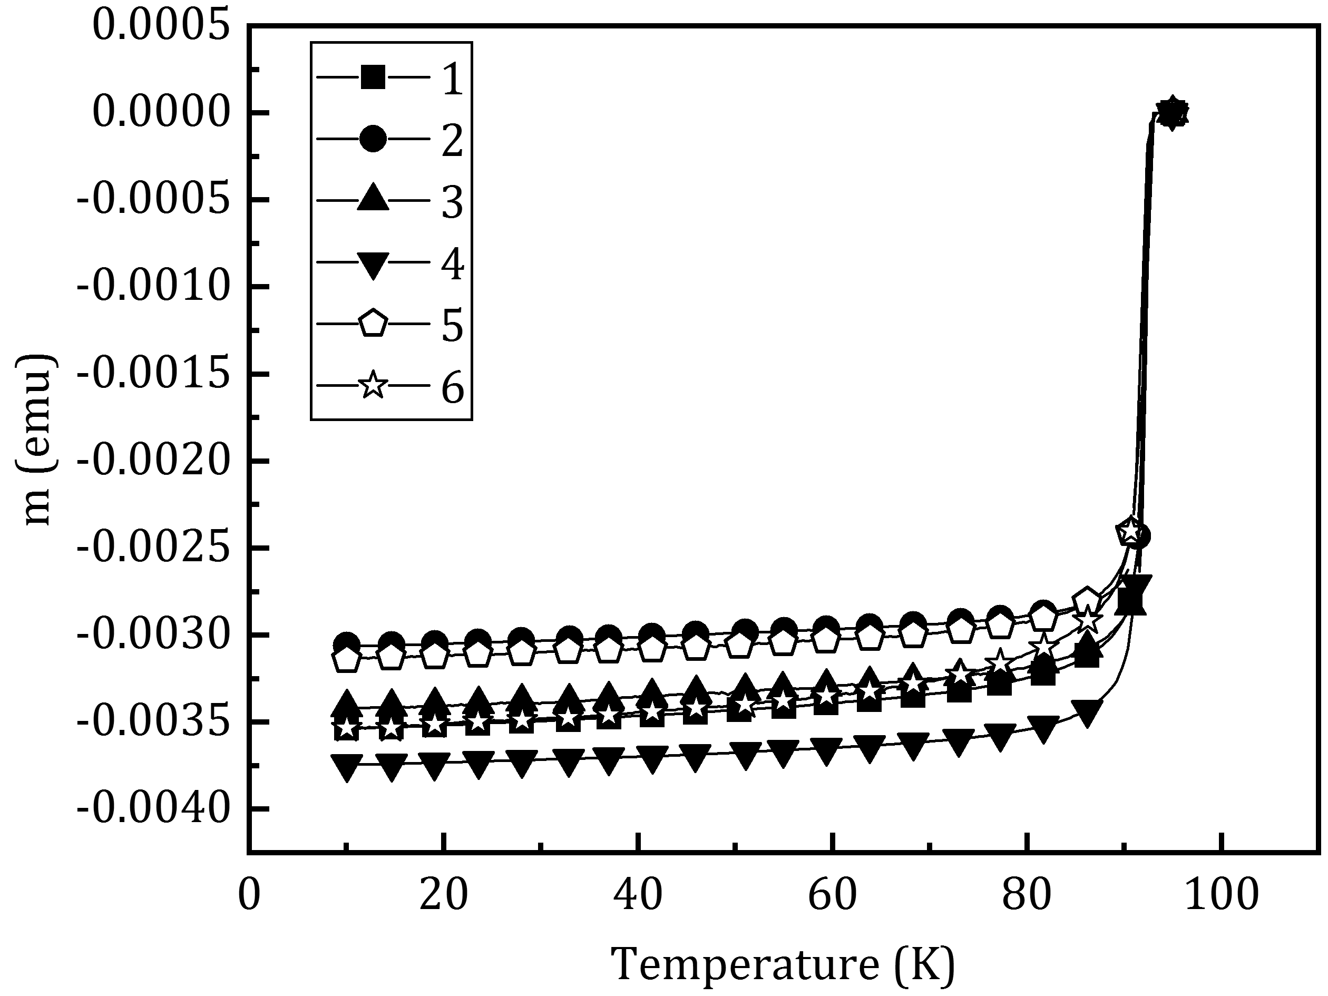
Behaviour of normalized resistivity before superconducting transition evidenced about overdoping
(a) (b) (c)
(a) - Normalized resistivity and (b) - resistivity, ρ, and (c) - T_{c} estimated magnetically vs. temperature of the GdBCO_CC samples after re-oxygenation 1 (a) and 2 (b).

Slide 17
5th batch – YBCO on STO (initial samples are not oxygenated)
YBCO/STO
Sample No | Conditions |  |  |  |  | Architecture | Jc After
 | Pressure O₂, bar | Rate of heating, ºC/min | Temperature, ºC | Holding time, h | Mode of oxygenation |  | Jc ( 77K) MA/cm² After | Jc ( 5K) MA/cm² After | c axis parameter Measured at ICMAB, calculated by Kyiv | Charge carrier density n_{H} (100K) X 10²¹ cm⁻³ | Tc (K) by SQUID | Tc (K) by Transport
Y13284 | 100 | 5 | 600 | 3 | 1 | YBCO/STO | 0.13 | 15.1 |  |  | 89.8
Y13291 | 100 | 5 | 600 | 6 | 2 | YBCO/STO | 3.82 | 35.3 |  |  | 91.6
Y13283 | 160 | 5 | 800 | 3 | 1 | YBCO/STO | 1.19 | 11.7 |  |  | 92.2
Y13282 | 160 | 5 | 800 | 6 | 1 | YBCO/STO | 4.09 | 38.2 |  |  | 91.8
On going!
Best values of Jc (3.8-4 MA/cm2) obtained ever for YBCO/STO using high pressure oxygenations at 100, 160 bar.

Slide 18
Conclusions
The evidences of overdoping were observed about what were witnessed an increase of n_{H}(100 K), reduction of c-lattice parameters of RE123 (RE=Eu, Gd) of superconducting layers, behavior of normalized resistivity before superconducting transition, and J_{c} variation.
2. After treatment at 160 bar O₂ at 800 ºC for 3 h J_{C}(77K,0T) of GdBCO_CC was increased for 21.5 % from 2.12 to 2.70 MA/cm², (n_{H} = 7.3×10²¹ cm⁻³ , p=0.174; c-parameter decreased to 1.1727(1) nm), while heating for 6 h under same pressure-temperature conditions leaded to J_{C}(77K,0T) increase for 18 % only. After 12 h heating J_{C}(77K,0T) decrease from 1.79 to 1.11 MA/cm² because of superconducting structure decomposition. Treatment of the samples at 600 ºC under 100 bar O₂ for 3, 6, and 12 h resulted in increase in J_{C}(77K,0T) for 8, 14 and 13 %, respectively.
4. The c-parameter of Gd123 as a result high pressure – high temperature treatment under 100 bar oxygen pressure can be decrease from 1.1735(1) down to 1.1715(5) nm, but the increase in critical current density was for 8% only. Decrease of c-parameter down to 1.1718(8) nm and attaining n_{H} = 7.86×10²¹ cm⁻³ (which was the highest for the last batch of GdBCO_CC) resulted in 14 % increase of J_{C}(77K,0T). Seems optimal doping of CuO planes of Gd123 is around p=0.1740- 0.1745.
5. For EuBCO_СС with HBO nanorods after treatment a decrease in c-parameters of Eu123 was observed: from 1.1738(8) to 1.1734(5) nm (for the Ag-coated sample under 100 bar O₂ at 300 °C) and from 1.1740(2) to 1.1736(3) nm (for the sample without Ag under 160 bar O₂ at 800 ºC), but we failed to increase n_{H}(100 K) and J_{c} of the studied samples. J_{C}(77K,0T) remained on the same level or slightly decreased.

