Slide 1



Transient system-level cryogenic thermal management models of liquid hydrogen-fueled electric aircraft
CEC/ICMC 2025
(C3Or4A-03, May 21, 2025 Wednesday 4:45 pm)
Youngjun Choi, Chul H. Kim, Peter Cheetham, Sastry Pamidi
Center for Advanced Power Systems, Florida State University, Florida, USA
FAMU-FSU College of Engineering, Department of Electrical & Computer Engineering, Florida, USA

Slide 2
Cryogenics and cryocoolers for superconducting power devices
High Temperature Superconducting (HTS) devices are being developed for large electric transportation systems
  Electric Aircraft (NASA, Airbus, Boing, Rolls-Royce, and others)
  Electric Ships (US Navy and others)
High power density (gravimetric and volumetric) is primary attraction for HTS devices
To achieve high power density at system-level, the cryogenic systems need to support the power density targets
  Without compromising resiliency and safety of the transportation platforms
  Without lowering the efficiency
  With little routine maintenance
Cryocooler technology and the system designs of cryogen circulation systems in the integrated electrical and cryogenic systems are critical for electric transportation systems

Slide 3
Thermal management of electric transportation system
Electric vehicles have thermal loads at various temperature regimes
  Cryogenic regime (20-80 K): HTS generator, HTS motor, HTS power cable
  Sub-freezing regime (80 – 270 K): Power electronics, convertor, inverter, motor, etc.
  Normal regime (270 – 300 K): Fuel cells, etc.
Integrated cooling system offers better efficiency in system level thermal management
  Subsequent cooling in order of operating temperature can reduce the number of cooling loops
  Integrated cooling system can have less components than individual cooling
Efficient heat exchanger that can provide cooling agent at multiple temperature regimes needed for integrated cooling system
  To promote resiliency and safety of the transportation platforms
  To maximize efficiency of cooling

Slide 4
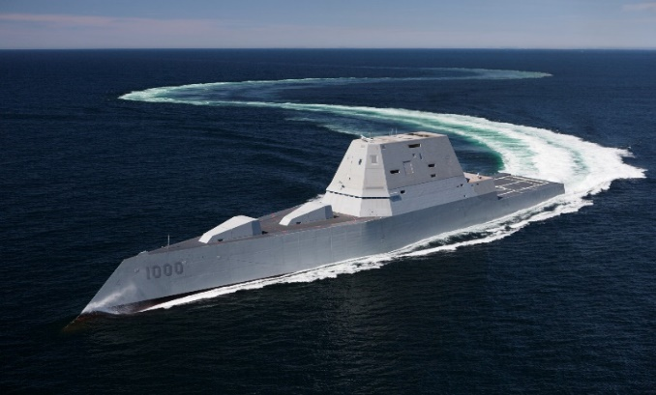

Focus of our research group
Development of high power dense HTS cables and cryogenic system topologies for all-electric ships and electric aircraft
Majority of our work is on gaseous helium cooled HTS power cables but is equally applicable for liquid hydrogen, liquid nitrogen, liquified natural gas and gaseous hydrogen
Interested in high energy dense, low carbon alternative fuel source for reduced emission and improved efficiencies at all speeds
All-electric ship commissioned by U.S. Navy
Advantages of all electric vehicles :
  Increased
    Fuel efficiency
    Power density
    Flexibility
  Reduced
    Emission
    Noise
    Magnetic signature
    Voltage drop
Blended wing body electric aircraft

Slide 5
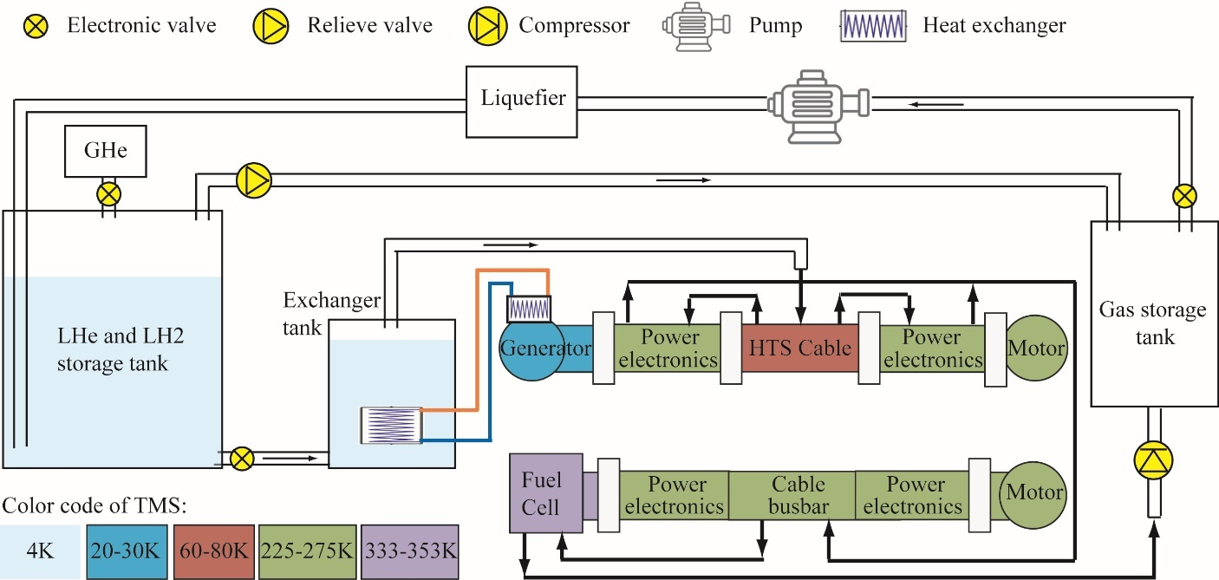
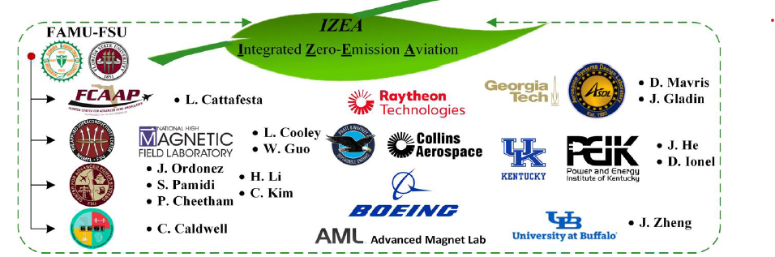
IZEA (Integrated Zero-Emission Aviation) using a robust hybrid architecture
NASA 5yr ULI Develop HTS cable network as part of a hydrogen aircraft
Design must use finite amount of hydrogen as both fuel source and coolant
Thermal management of HTS power devices and conventional devices at variable power rating based on stage of flight is needed
Optimally integrated cryogenic systems to allow fast response and risk mitigation

Slide 6
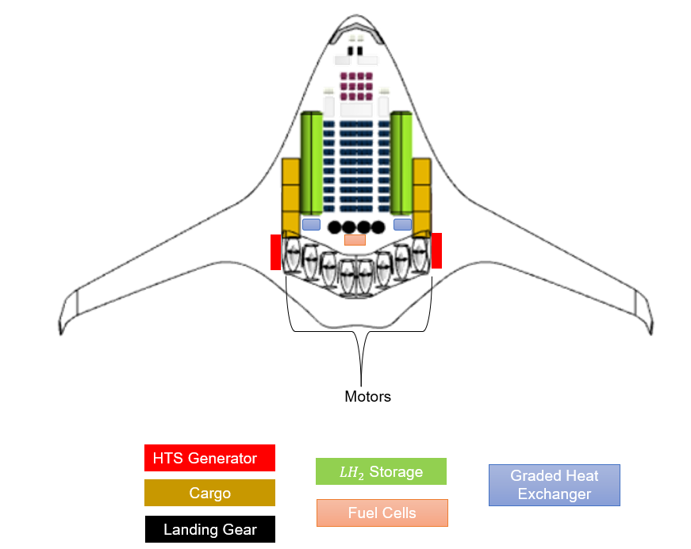
Integrated cooling system
LH2/GH2
Individual
  GHe
  GHe
  GHe
Air
Water
Generator
HTS cable
Motor
Power Electronics
Fuel Cell
Thermal management for multiple temperature ranges is required
Efficient use of cooling budget from cryogen is essential
Advantages of integrated cooling system using graded heat exchanger
  Minimize heat leaks in HXs
  Simpler plumbing for LH2
  Versatile cooling on each component by secondary
  Independent flow controls for resilient cooling
LH2/GH2
Integrated
Graded HX
  GHe
Air
Water
Generator
HTS cable
Motor
Power Electronics
Fuel Cell
Flow control is essential to design thermal management system at system level - Tool needed

Slide 7

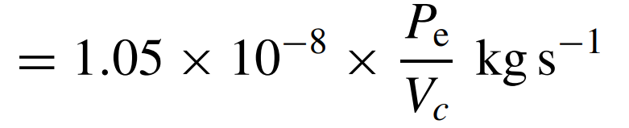
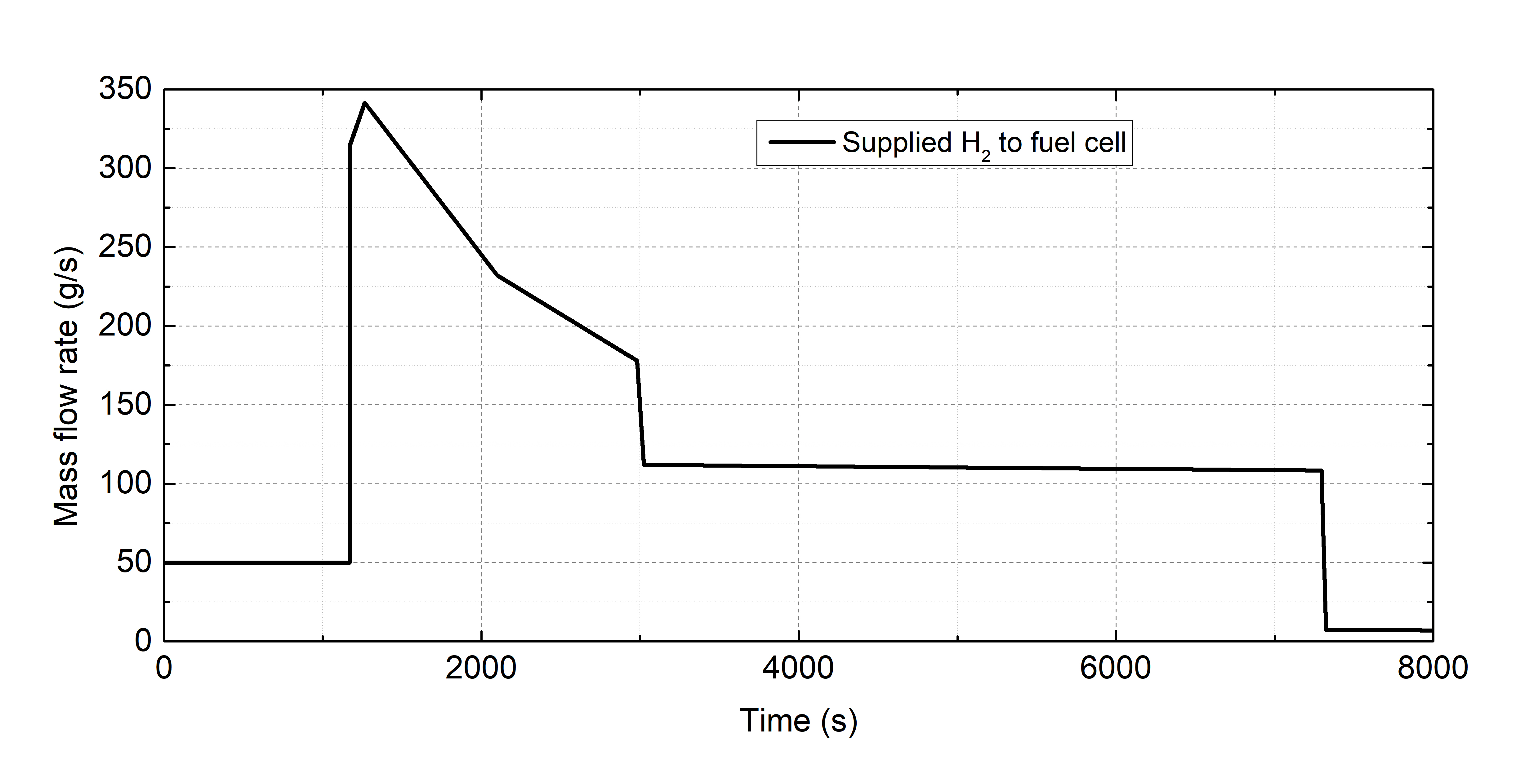
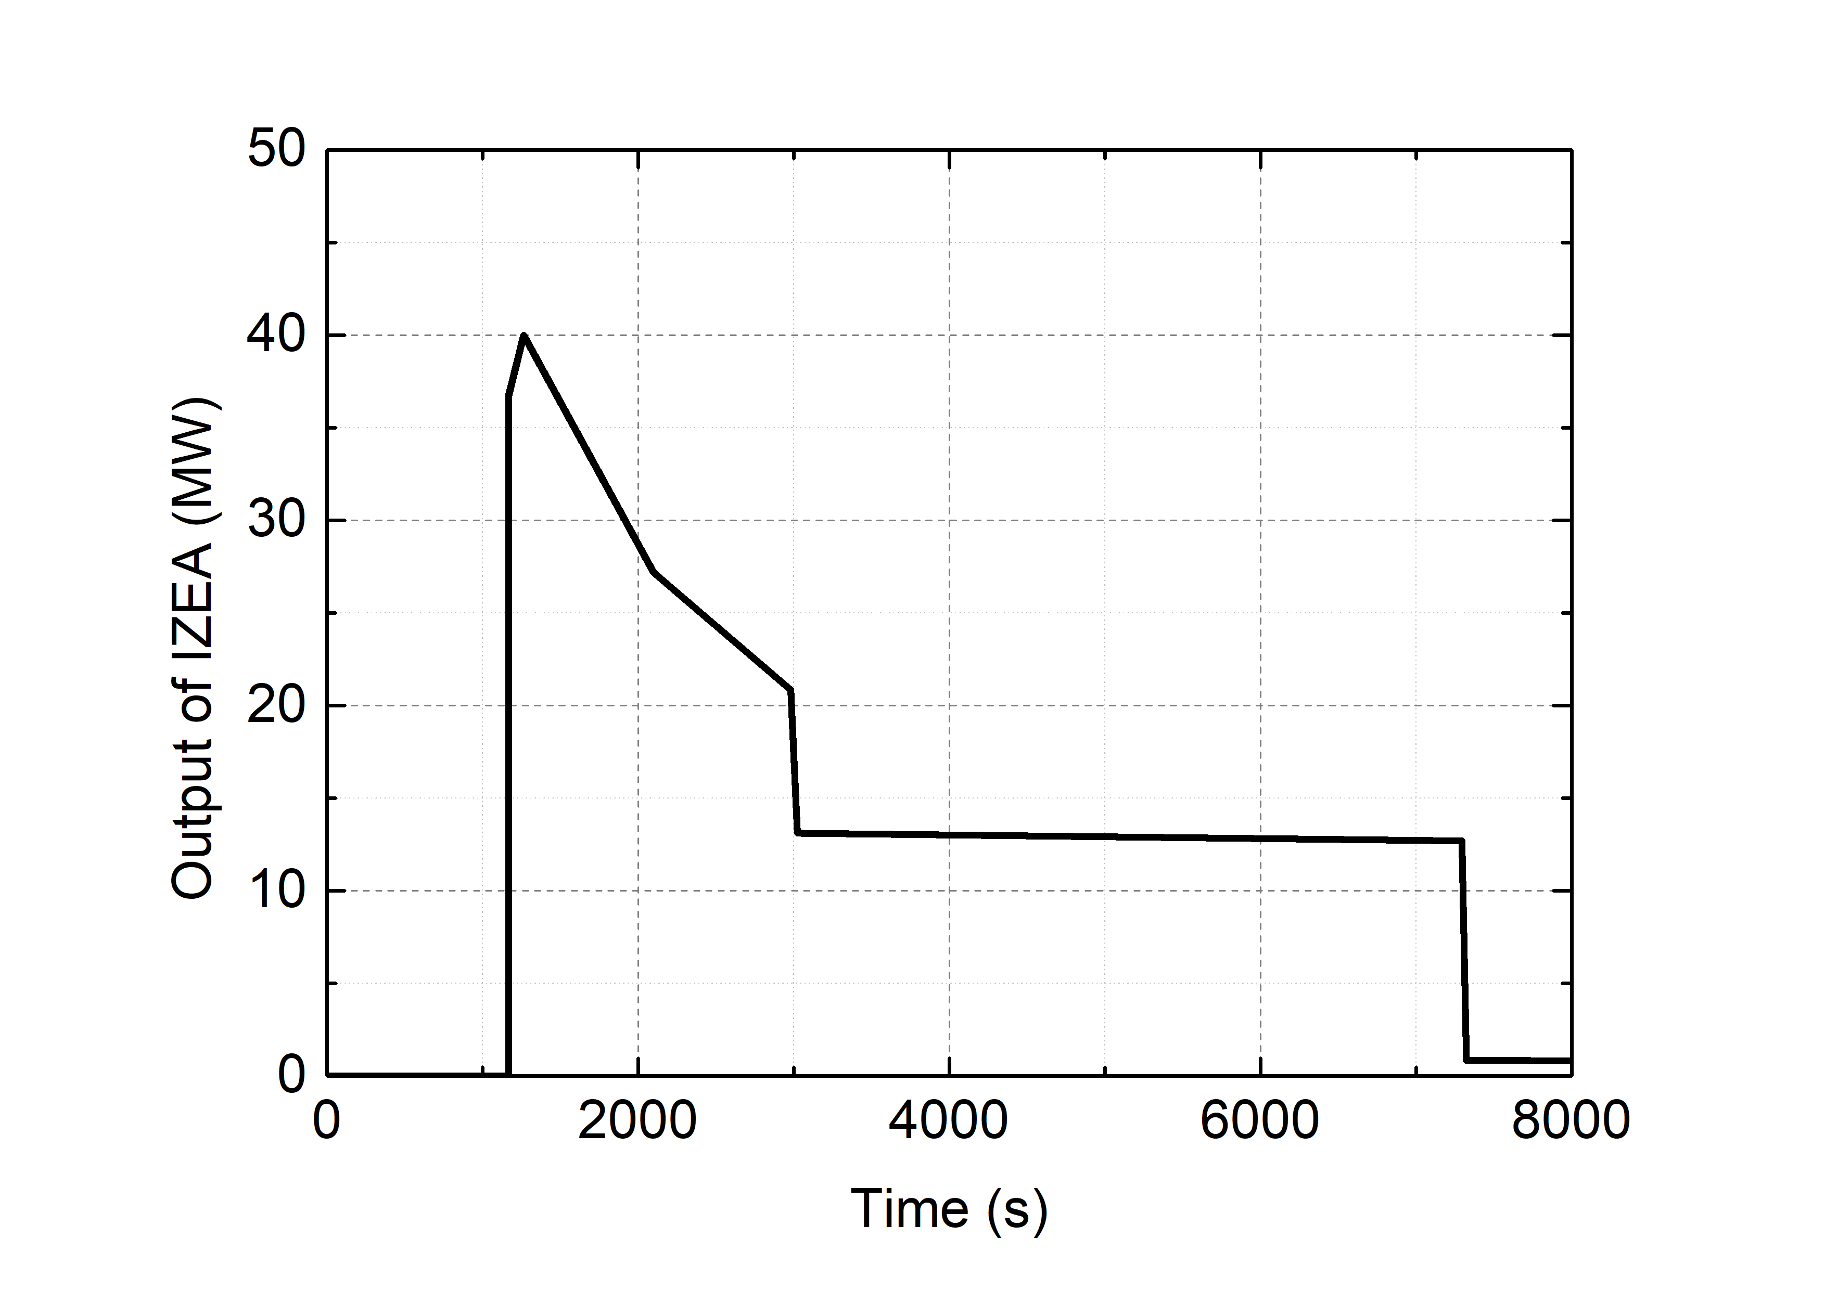
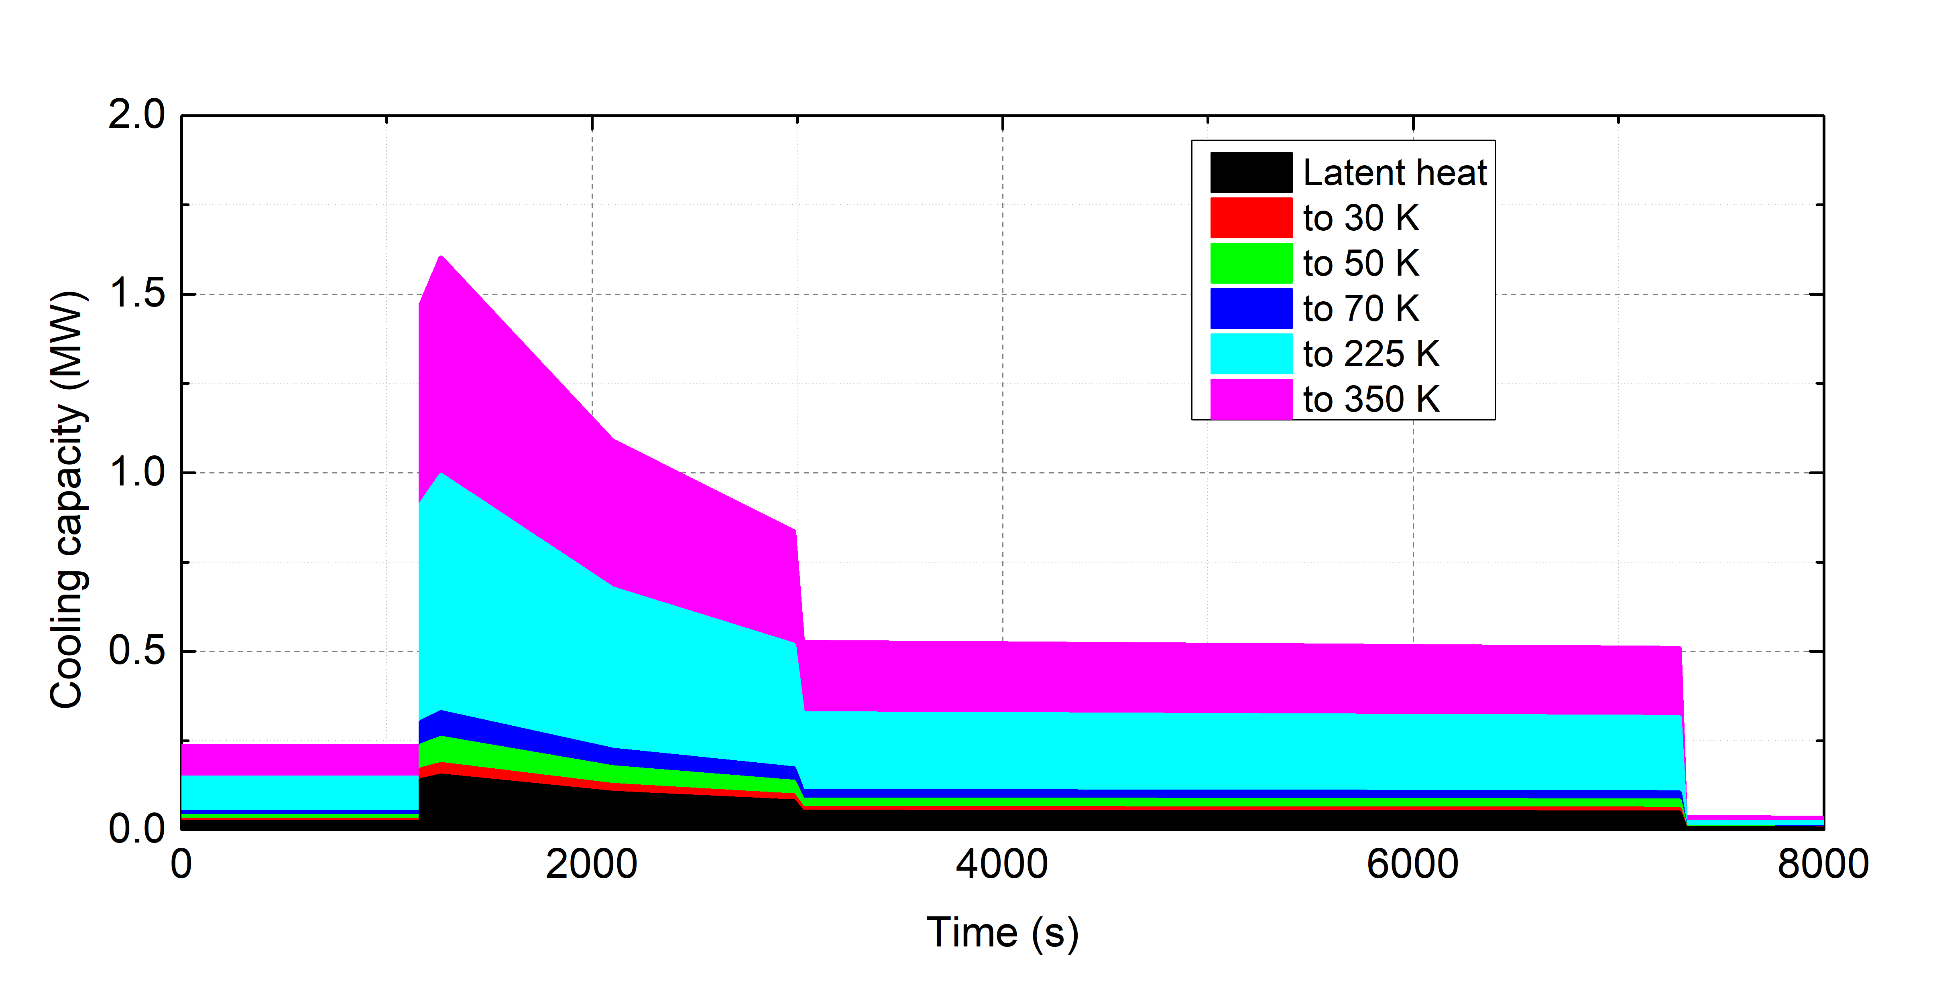
Cooling budget for given mission profile
(Voltage : 1.23 V)
Initial cooling completed before mission
H₂ supplied to the fuel cell by mission profile
Utilizing cooling capacity of H₂ to maintain operating temperatures for cryogenic devices
Initial cooling
Mission
Mission profile of IZEA
Supplied H₂ and cooling capacity

Slide 8
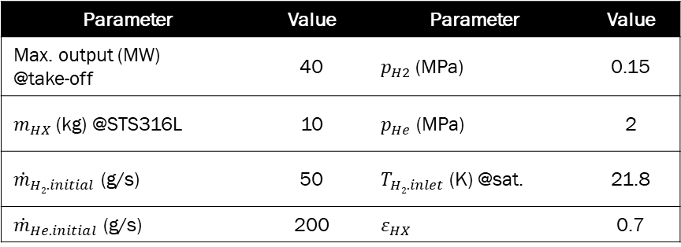
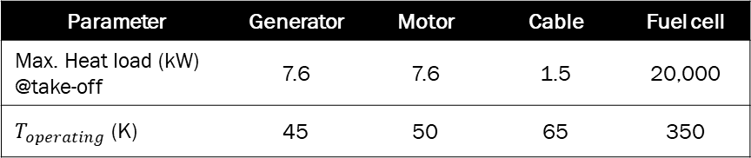
Scenario of Thermal Management System
Operating temperatures and heat loads of cryogenic components are based on a maximum output of 40 MW
Parameter | Value | Parameter | Value
Max. output (MW) @take-off | 40 | $p_{H2}$(MPa) | 0.15
$m_{HX}$(kg) @STS316L | 10 | $p_{He}$ (MPa) | 2
${\dot{m}}_{H2.initial}$ (g/s) | 50 | $T_{H2.inlet}$(K) @sat. | 21.8
${\dot{m}}_{He.initial}$ (g/s) | 200 | $ε_{HX}$ | 0.7
Initial cooling
Mission
Parameter | Generator | Motor | Cable | Fuel cell
Max. Heat load (kW) @take-off | 7.6 | 7.6 | 1.5 | 20,000
$T_{operating}$ (K) | 45 | 50 | 65 | 350
Mission profile of IZEA
Condition of thermal management system

Slide 9
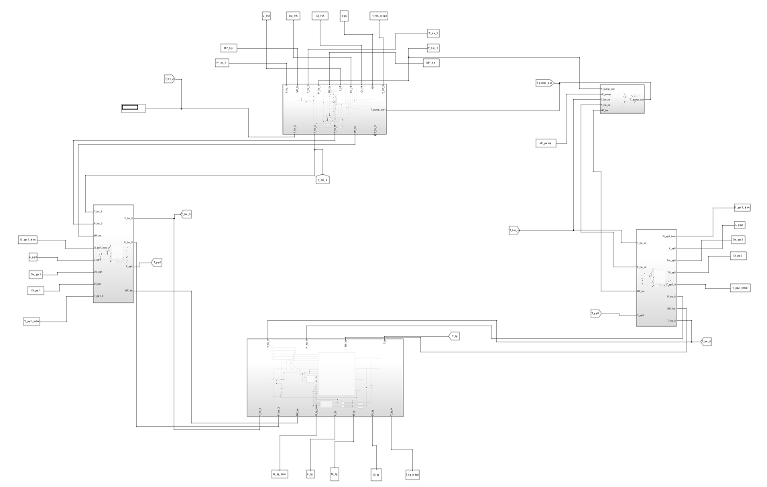
Unit module modeling
Graded HX
LH₂
HX_{H2}
HX_{H2}
HX_{H2}
Fuel cell
Heat exchanger
HX_{He}
HX_{He}
HX_{He}
Fan
Com
Com
Com
H₂
Gen
Cab
etc.
He
Schematic of thermal management system
Supply Line
Supply Line
Cooling target
Matlab Simulink based model
The unit module consists of a heat exchanger, supply line, cooling target, and fan
The cooling target is cooled by helium
Matlab model of unit module

Slide 10





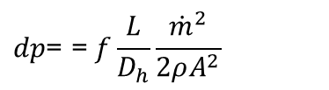




Heat Exchanger Design Equations
He and H₂ properties are referenced from NIST
Heat exchanger performance is calculated based on efficiency, while efficiency varies with initial cooling
The fan compensates for the pressure difference, with losses considered based on efficiency
ε
$${\dot{Q}}_{max}={\dot{m}}_{He}{ c}_{p.He} (T_{He.in}−T_{H2.in})$$
Pressure drop (smooth surface)
ε_{HX}
$$f=0.3164 × {Re}^{−0.25}$$
$${\dot{Q}}_{act}=ε×{\dot{Q}}_{max}$$
$$dp\text{=} \text{= }f\frac{L}{D_{h}}\frac{{\dot{m}}^{2}}{2ρA^{2}}$$
$$T_{He.out.max}=T_{He.in}−{\dot{Q}}_{act}/({\dot{m}}_{He}{ c}_{p.He})$$
Performance of fan
$$dp=p_{HX.in}−p_{fan.in}$$
$$p_{fan}=dp∗({\dot{m}}_{He}/ρ)$$
ε_{min}
$$p_{total}=p_{fan}/η_{fan}$$
T_{He_out}
T_{HX}
T_{initial}
$${\dot{Q}}_{fan}=p_{total}∗(1−η_{fan})$$
Performance of Heat exchanger
$$T_{fan.out}=T_{fan.in}+{\dot{Q}}_{fan}/({\dot{m}}_{He}∗c_{p, He})$$

Slide 11





He Control Algorithm for Thermal Management System
He control algorithm is developed to determine helium flowrate to keep devices at operating temperature
For given power profile and heat exchanger efficiency, H2 and He flowrates are determined.
Start
Initial cooling completed?
NO
YES
Apply mission profile
NO
Abs(Err) < Tolerance
YES
$$Err=T_{operating} −T_{tg_out}$$
NO
Err <0
YES
$$Tolerance=0.1$$
${\dot{m}}_{He}$ - ${\dot{m}}_{step}$
${\dot{m}}_{He}$ + ${\dot{m}}_{step}$
$${\dot{m}}_{step}=0.001 g/s$$
Next time step

Slide 12
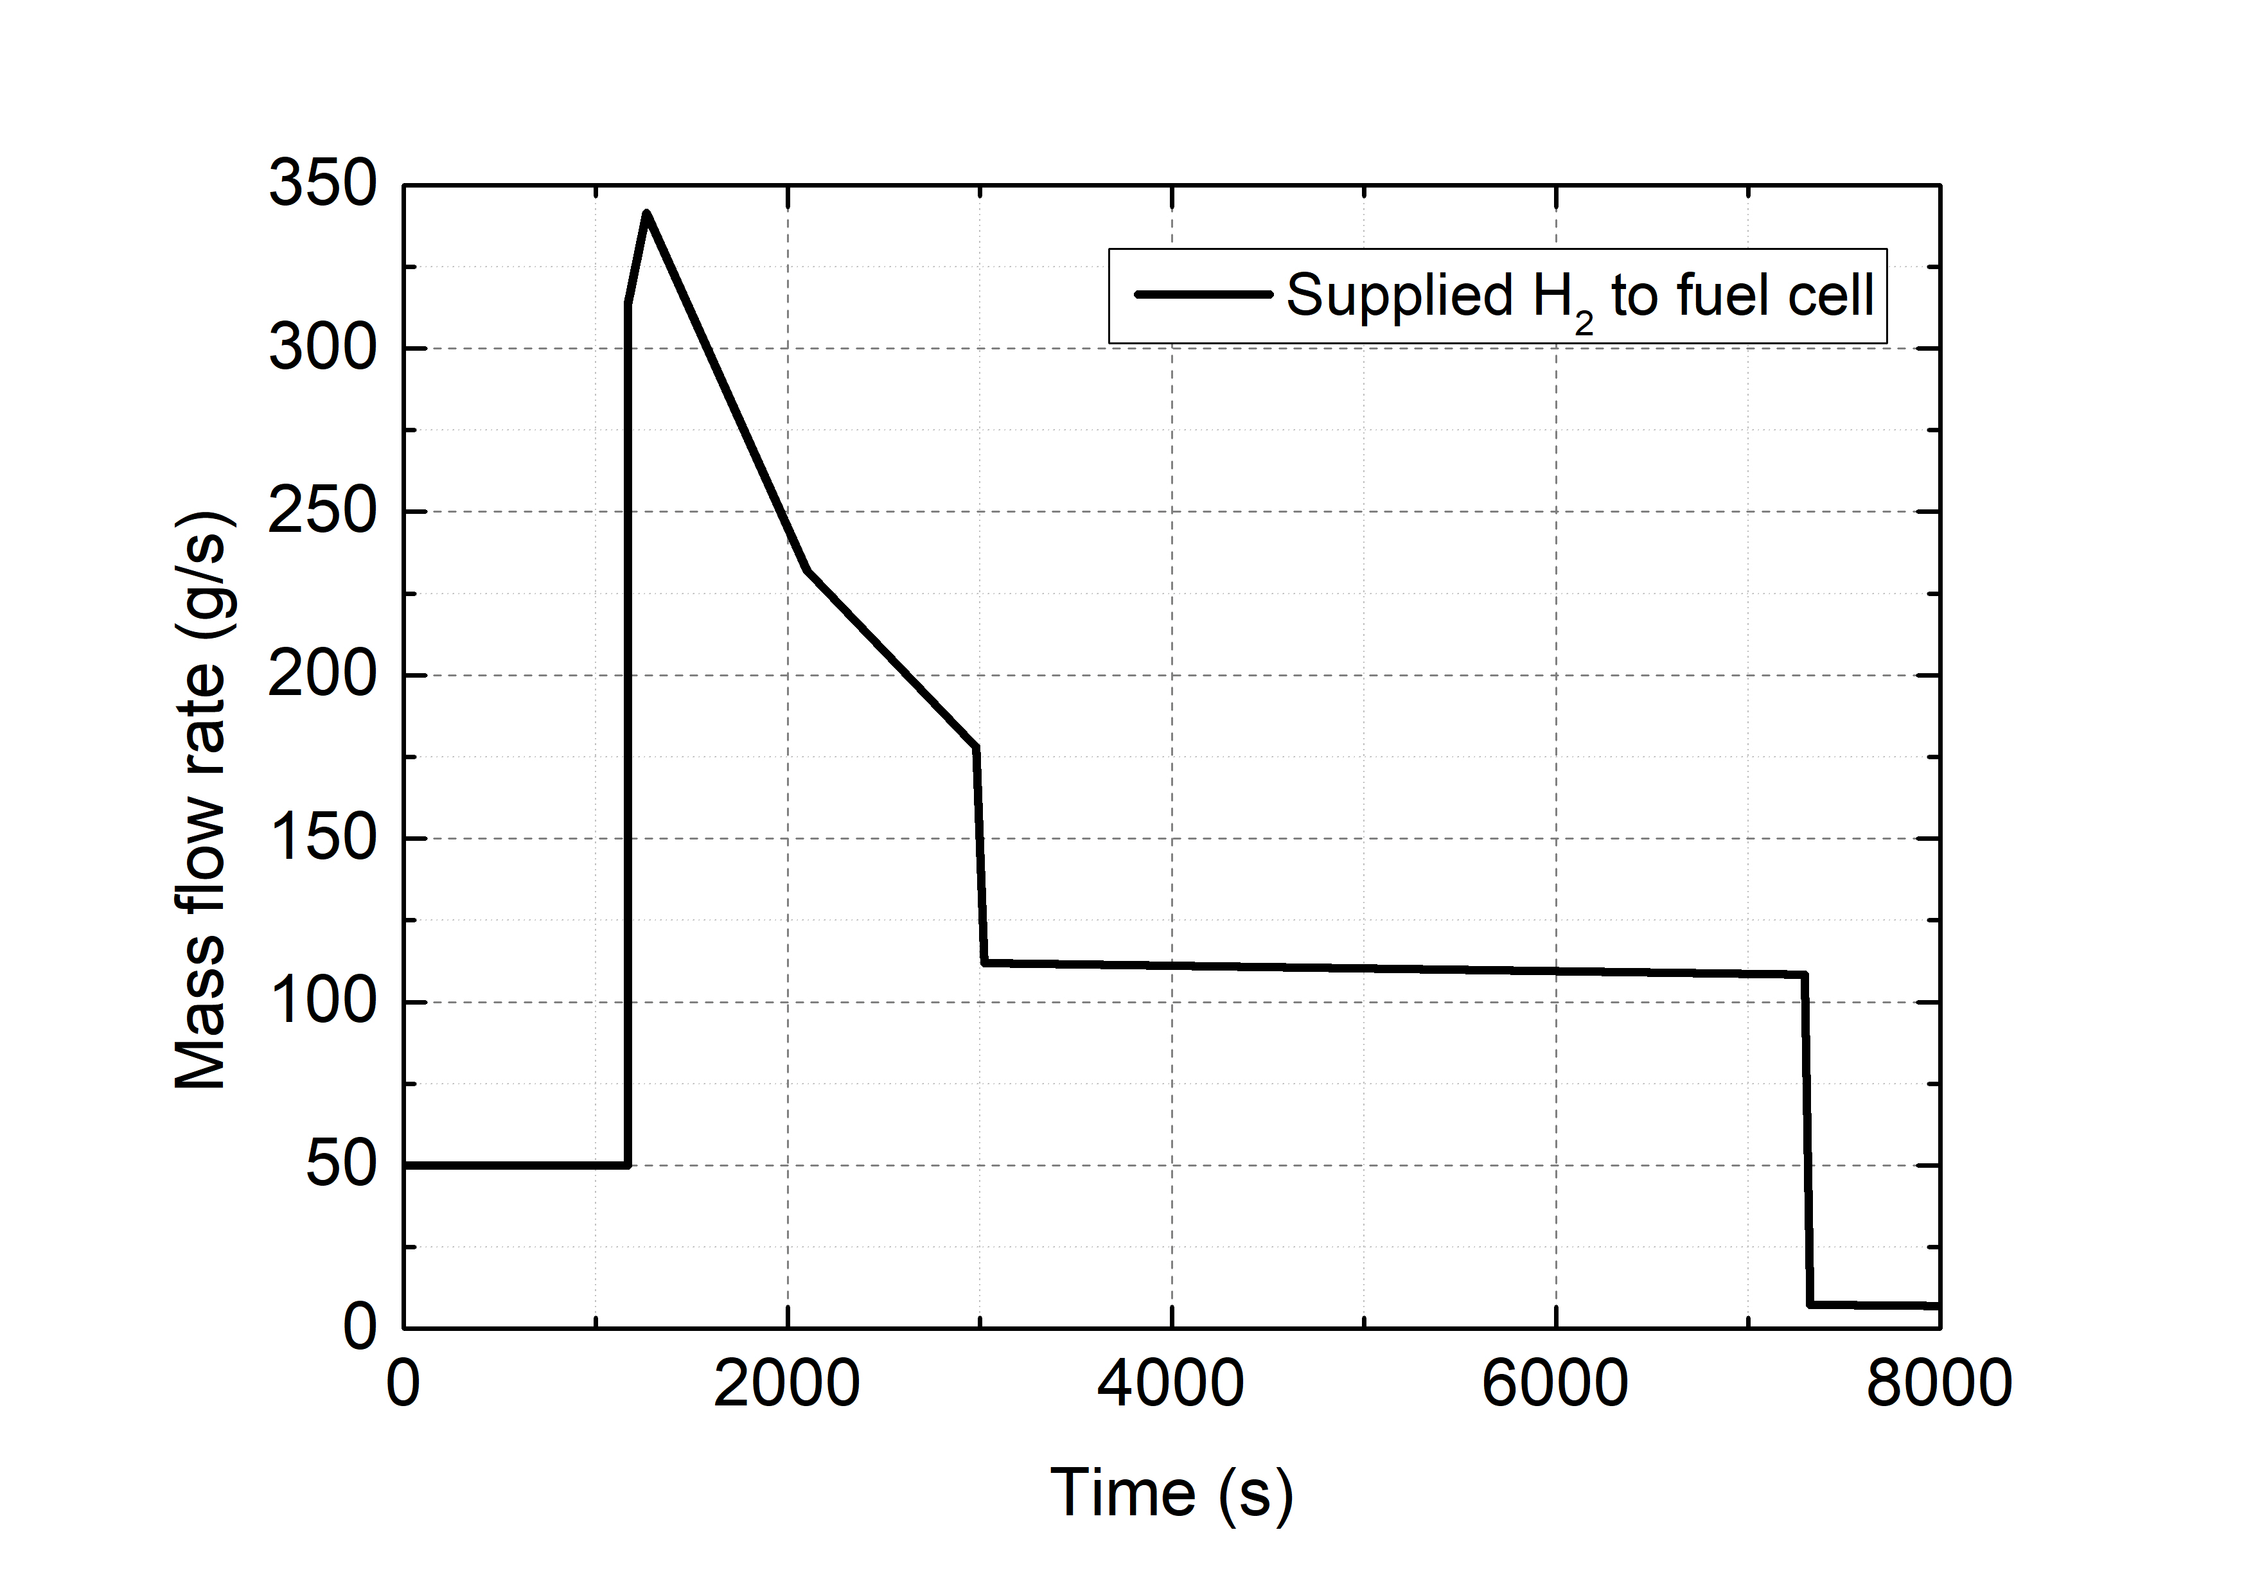
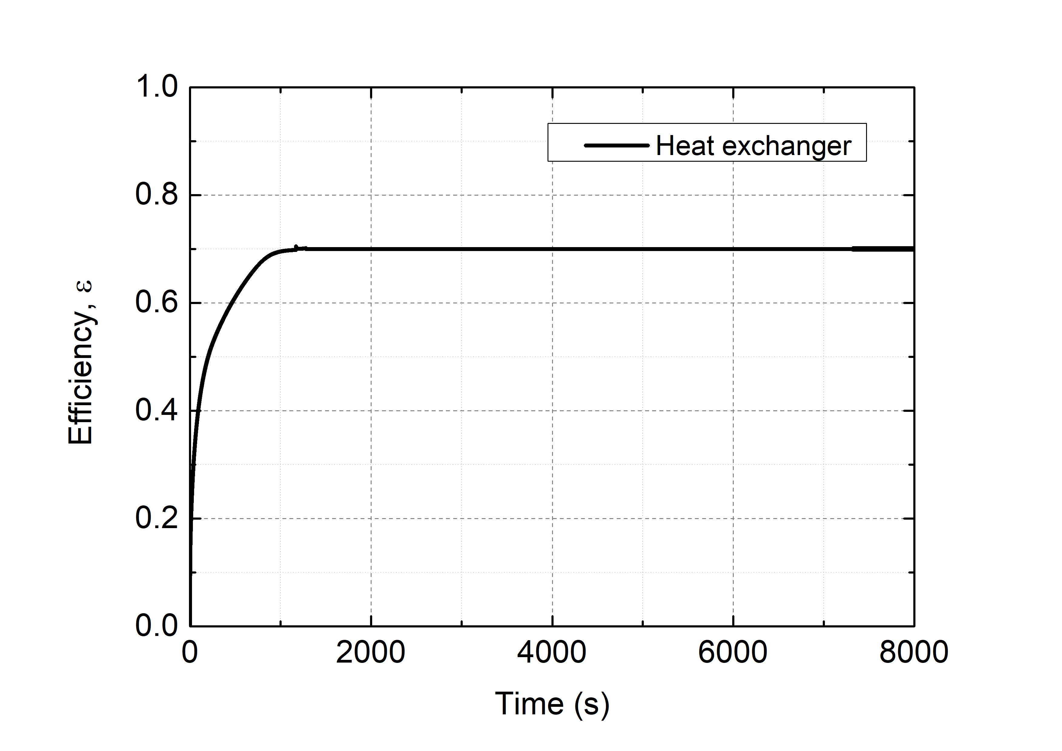
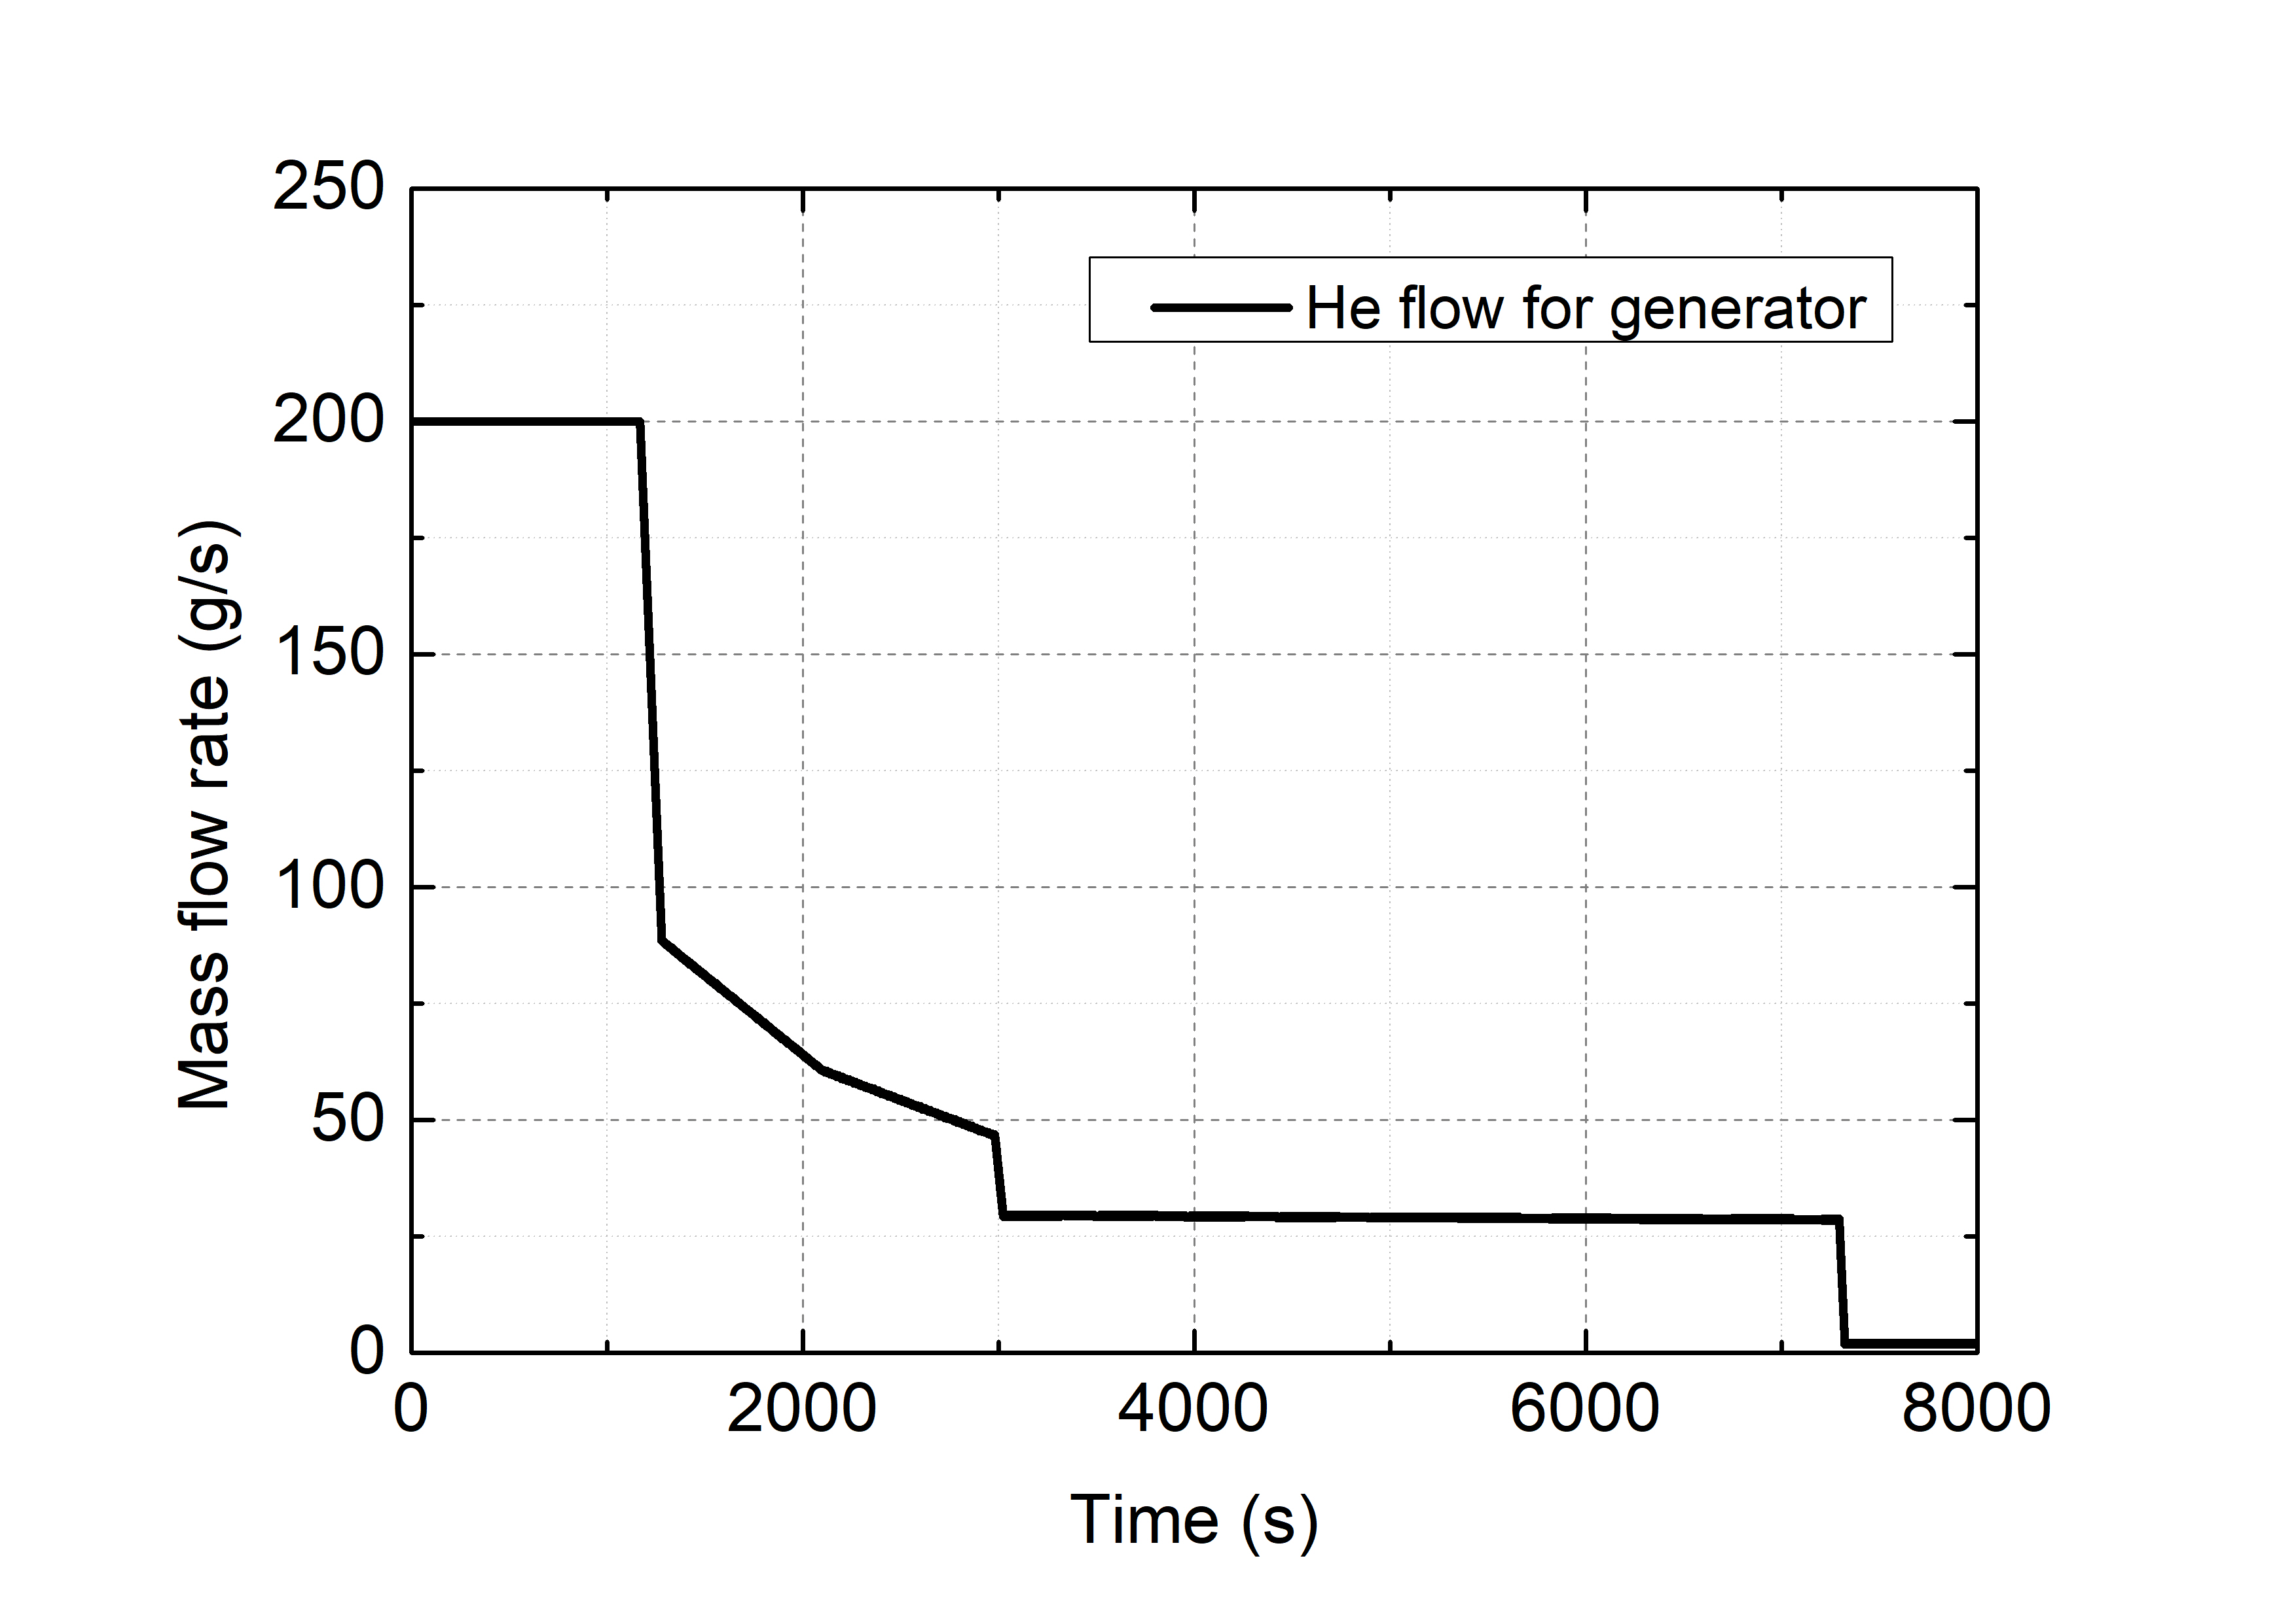
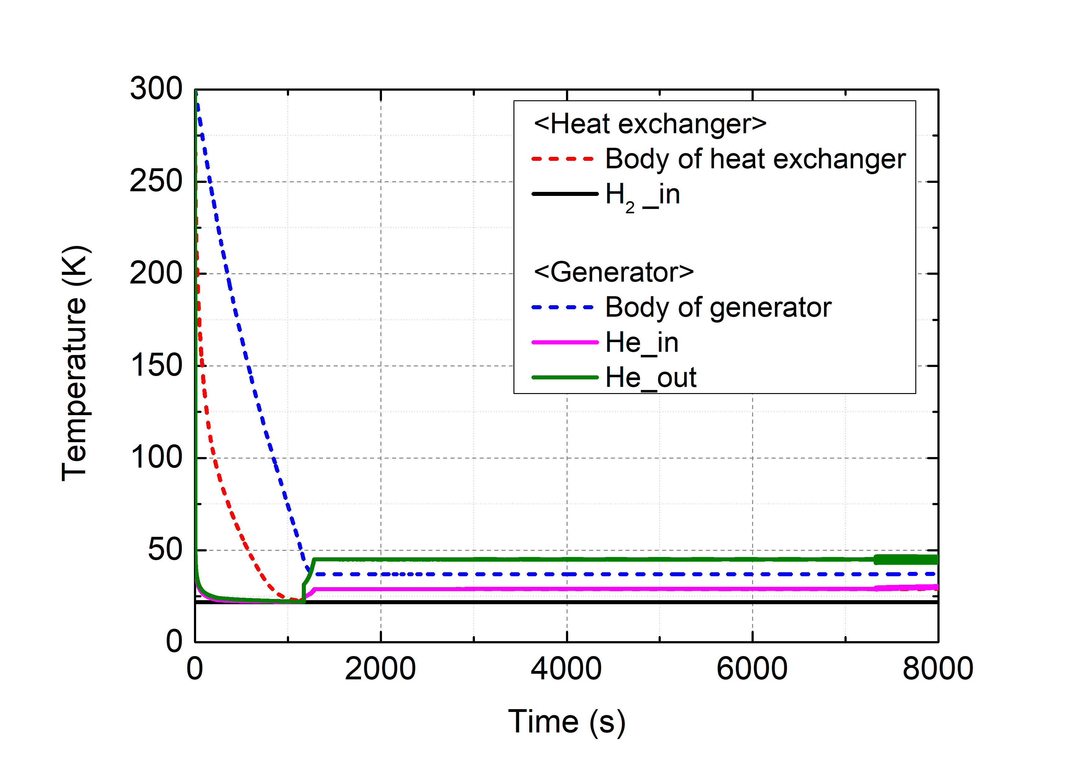
Result of heat exchanger simulation for generator
Initial cooling
Mission
During initial cooling, the temperatures of the heat exchanger decrease, while its efficiency gradually recovers
The mission starts after completing the initial cooling
He flow is controlled to maintain operating temperature
Simulation result of unit module for generator

Slide 13
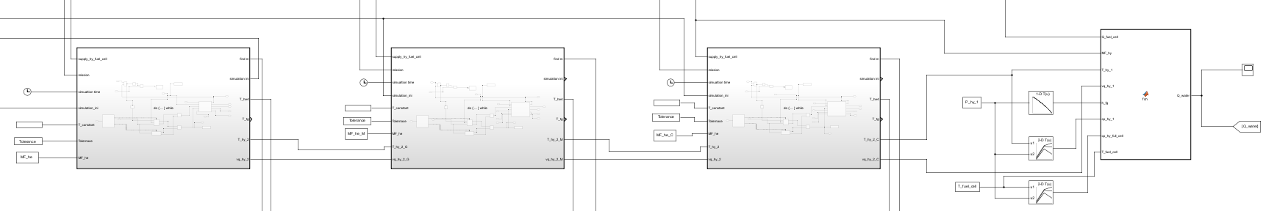
Model of Thermal Management System
Thermal management system model is extended from a unit module to a multi-stage configuration
Graded heat exchangers are used to provide cooling power of He flow for each component
H₂ can be used as a heat sink for cryogenic cooling and other power devices including fuel cell
Graded HX
LH₂
HX_{H2}
HX_{H2}
HX_{H2}
Fuel cell
HX_{He}
HX_{He}
HX_{He}
Com
Com
Com
Gen
Cab
Oth
Schematic of thermal management system
Generator
Motor
Cable
Fuel cell
Matlab model of Thermal management system

Slide 14
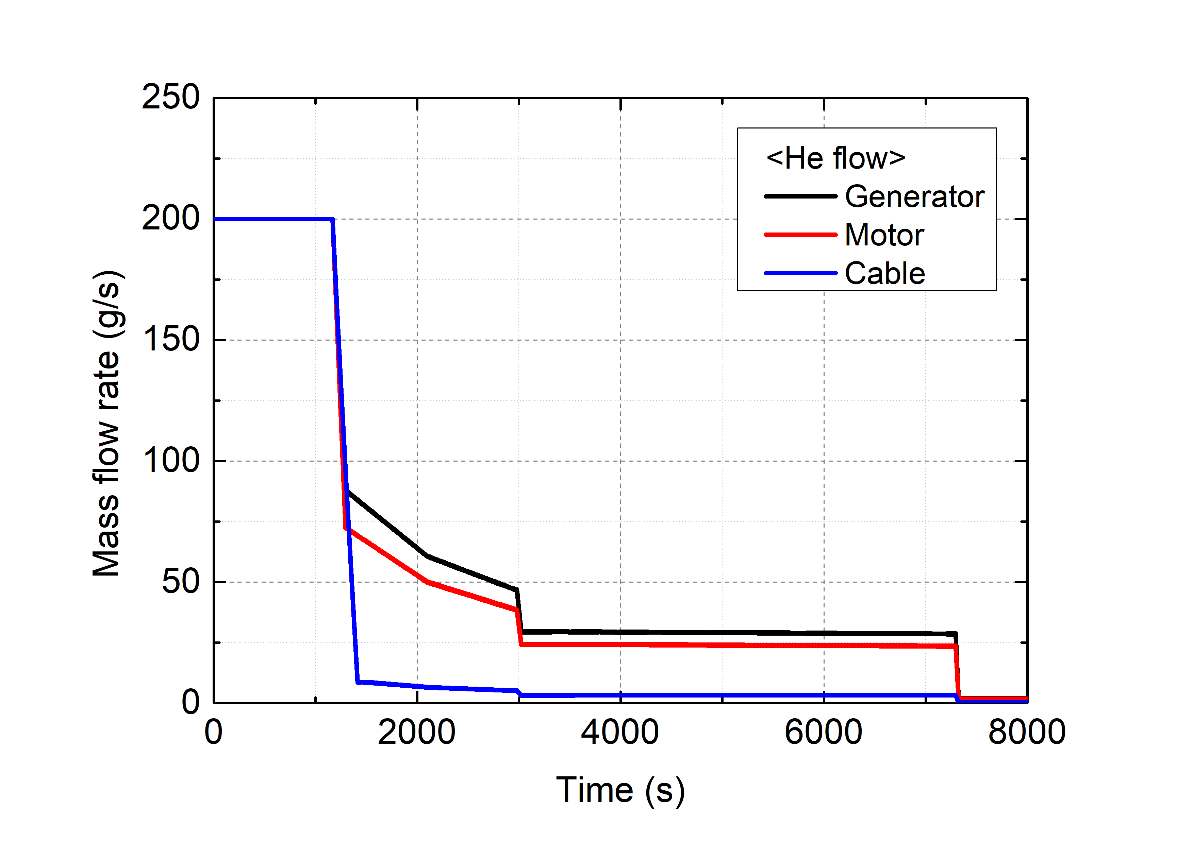
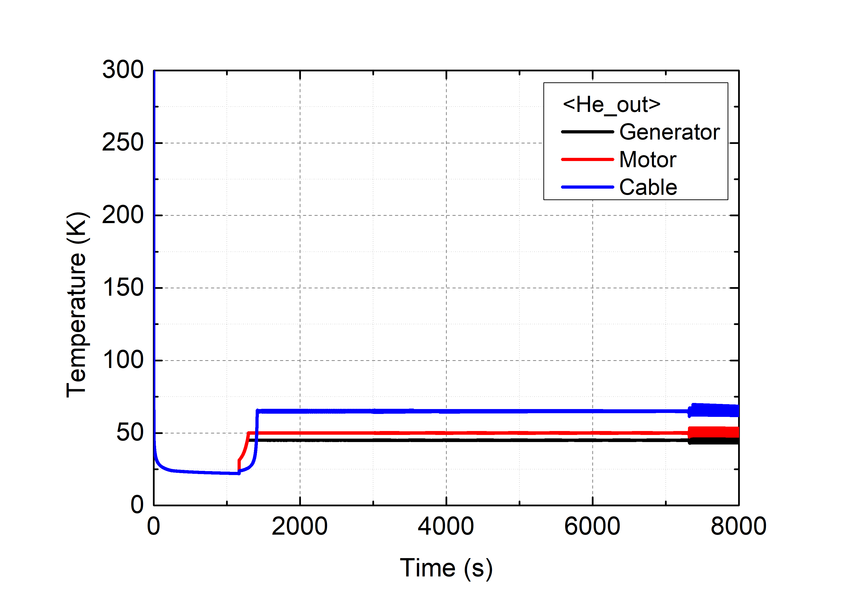
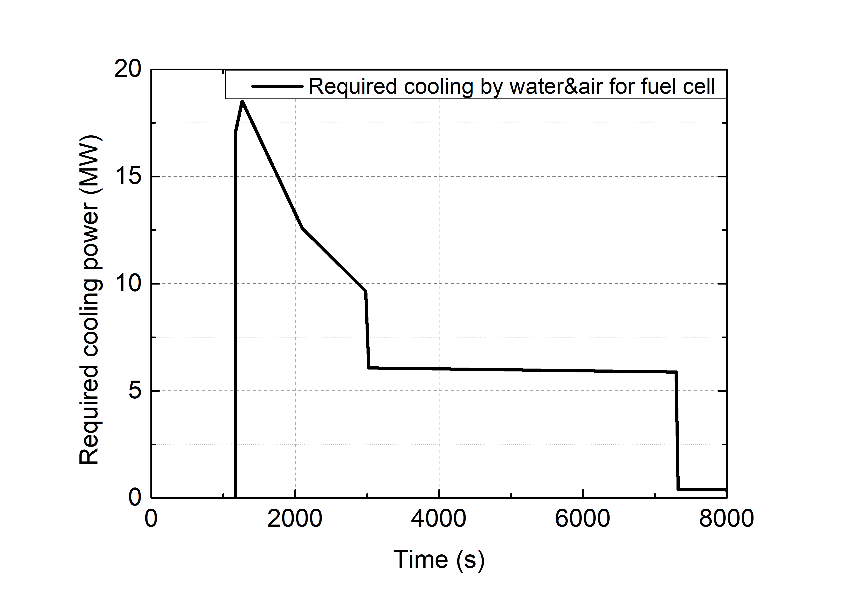
Result of Thermal Management System simulation
Graded heat exchanger works efficiently, maintaining the operating temperatures for all cryogenic components
He flow for the generator, motor, and cable are individually controlled based on their heat loads and operating temperatures
Significant amount of heat loads still required to be removed by other cooling sources (such as skin cooling)
Initial cooling
Mission
Simulation result of thermal management system

Slide 15
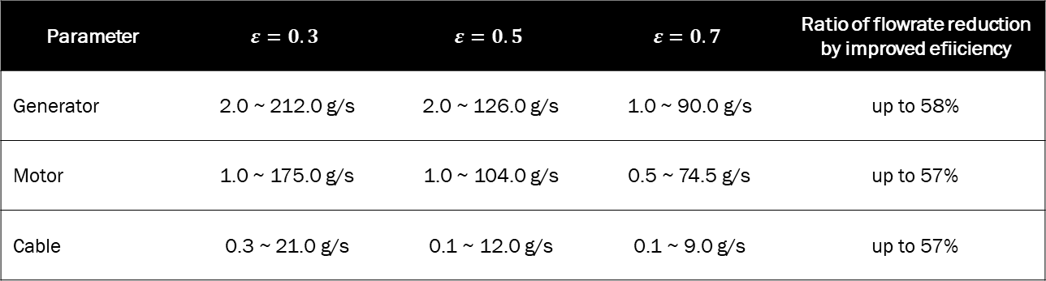
Result of Thermal Management System simulation
Higher heat exchanger efficiency requires less helium flowrate to maintain operating temperatures
Required helium flow can be reduced by up to 58% by improving ε from 0.3 to 0.7
High-efficiency heat exchanger allows reduction in size and weight of fan, improving the overall system efficiency
Parameter | $$ε=0.3$$ | $$ε=0.5$$ | $$ε=0.7$$ | Ratio of flowrate reduction by improved efiiciency
Generator | 2.0 ~ 212.0 g/s | 2.0 ~ 126.0 g/s | 1.0 ~ 90.0 g/s | up to 58%
Motor | 1.0 ~ 175.0 g/s | 1.0 ~ 104.0 g/s | 0.5 ~ 74.5 g/s | up to 57%
Cable | 0.3 ~ 21.0 g/s | 0.1 ~ 12.0 g/s | 0.1 ~ 9.0 g/s | up to 57%

Slide 16
Conclusion
Developed transient simulation model using a graded heat exchanger for thermal management system
Helium flow is controlled by an algorithm to maintain key components' operating temperatures
during the mission
Heat exchanger efficiency is crucial in determining helium flowrate to maintain operating temperatures
Future work
Analyze the effects of heat exchanger design and efficiency variations
More simulations using updated mission profiles and specifications of IZEA
Develop additional thermal management design to improve resiliency including fault conditions
Optimize the helium flow control algorithm for simulation stability

