Slide 1


Comparison study on a large-scale free-piston Stirling cryocooler
CEC/ICMC 2025
Hangyu Ma, Guoyao Yu, Haojie Sun, Ying Ma, Wei Dai, Ercang Luo
Technical Institute of Physics and Chemistry, CAS
May 21, 2025

Slide 2
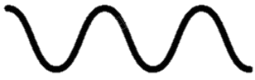
CONTENTS
1
2
3
4
Motivation
Method and design
Experiments
Summary

Slide 3
Motivation
1
Demand for compact large-scale cryocoolers
Development of large-scale Stirling-type cryocoolers

Slide 4
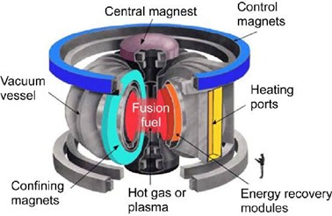
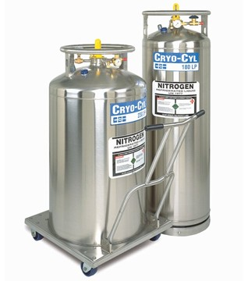
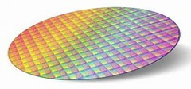
Motivation
Demand for compact large-scale cryocoolers
Demand within the industry and research is still booming around 80 K
Nitrogen liquefaction and re-liquefaction (BOG)
Manufacturing processes
Precooling of low-T cryocooler for Superconducting
Regenerative cryocooler demonstrates comprehensive advantages in the cooling power range of 100 W~ 1000 W
Most of the applications demand compact and large-scale cryocoolers with low maintenance

Slide 5

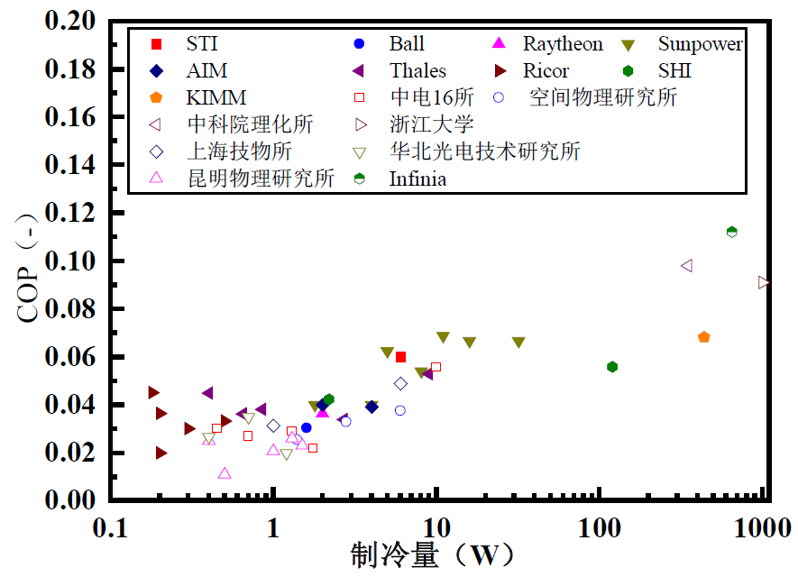
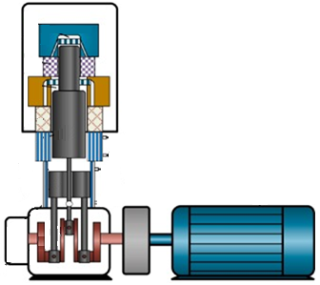
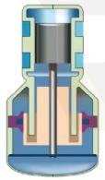
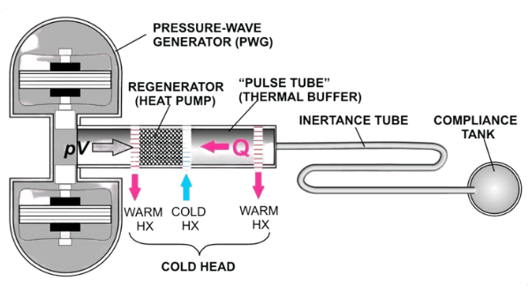
Motivation
Development of large-scale Stirling-type cryocoolers
CETC16
LIPCAST
TIPC
ZJU
SITP
NCRIEO
KPI
Rotary Stirling
Stirling-type PTC
Linear Stirling
Cooling power
Developing compact and large-scale linear Stirling cryocoolers with comprehensive performance

Slide 6
Method and design
2
Free piston Stirling structure
Issue and method
Parameters
Design features
Calculations

Slide 7
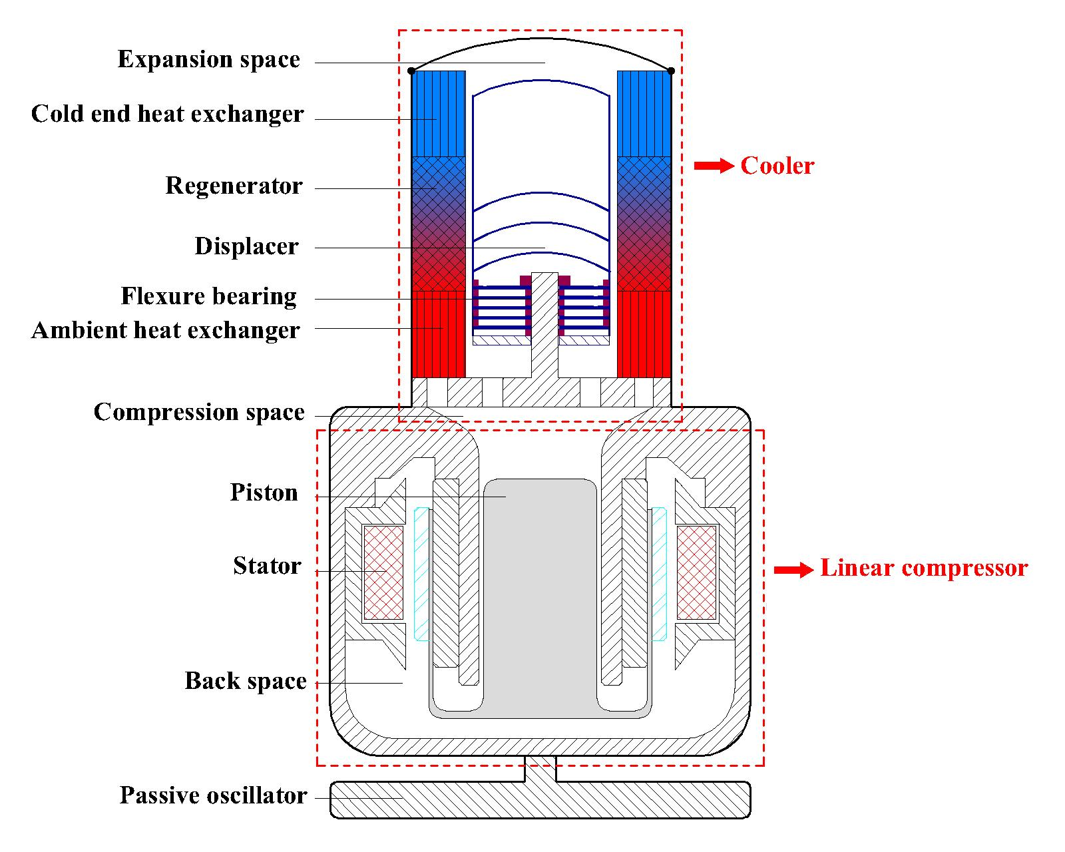
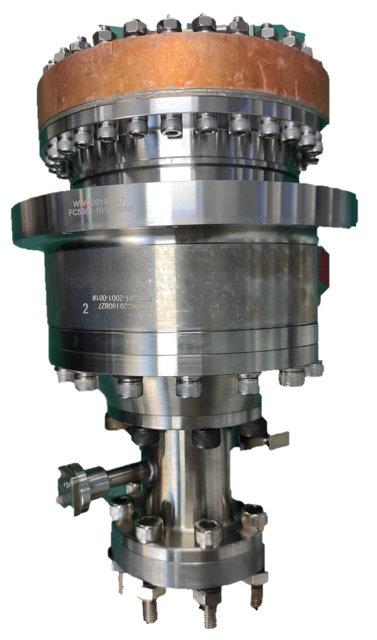
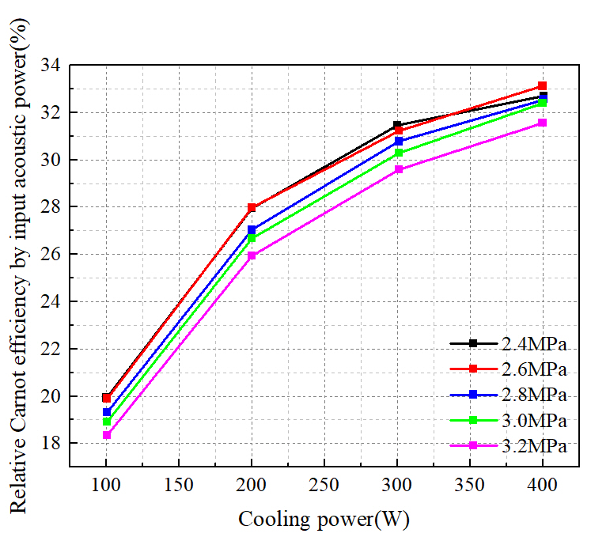
Method and design
Free-piston Stirling structure
Traditional structure
Item | Value
Frequency | 52 Hz
Mean pressure | 2.8 MPa
Working fluid | Helium
 | Cooler only | System
Acoustic power input | 3265 W | 3358 W
Cooling power @80K | 402 W | 406 W
rCarnot by Ea | 33.6% | 32.9%
rCarnot by We | 27.1% | 27.8%
Through delicate tuning, a high relative Carnot efficiency of 27.8% has been achieved.
Large deviation between experiment and calculation still exists.

Slide 8

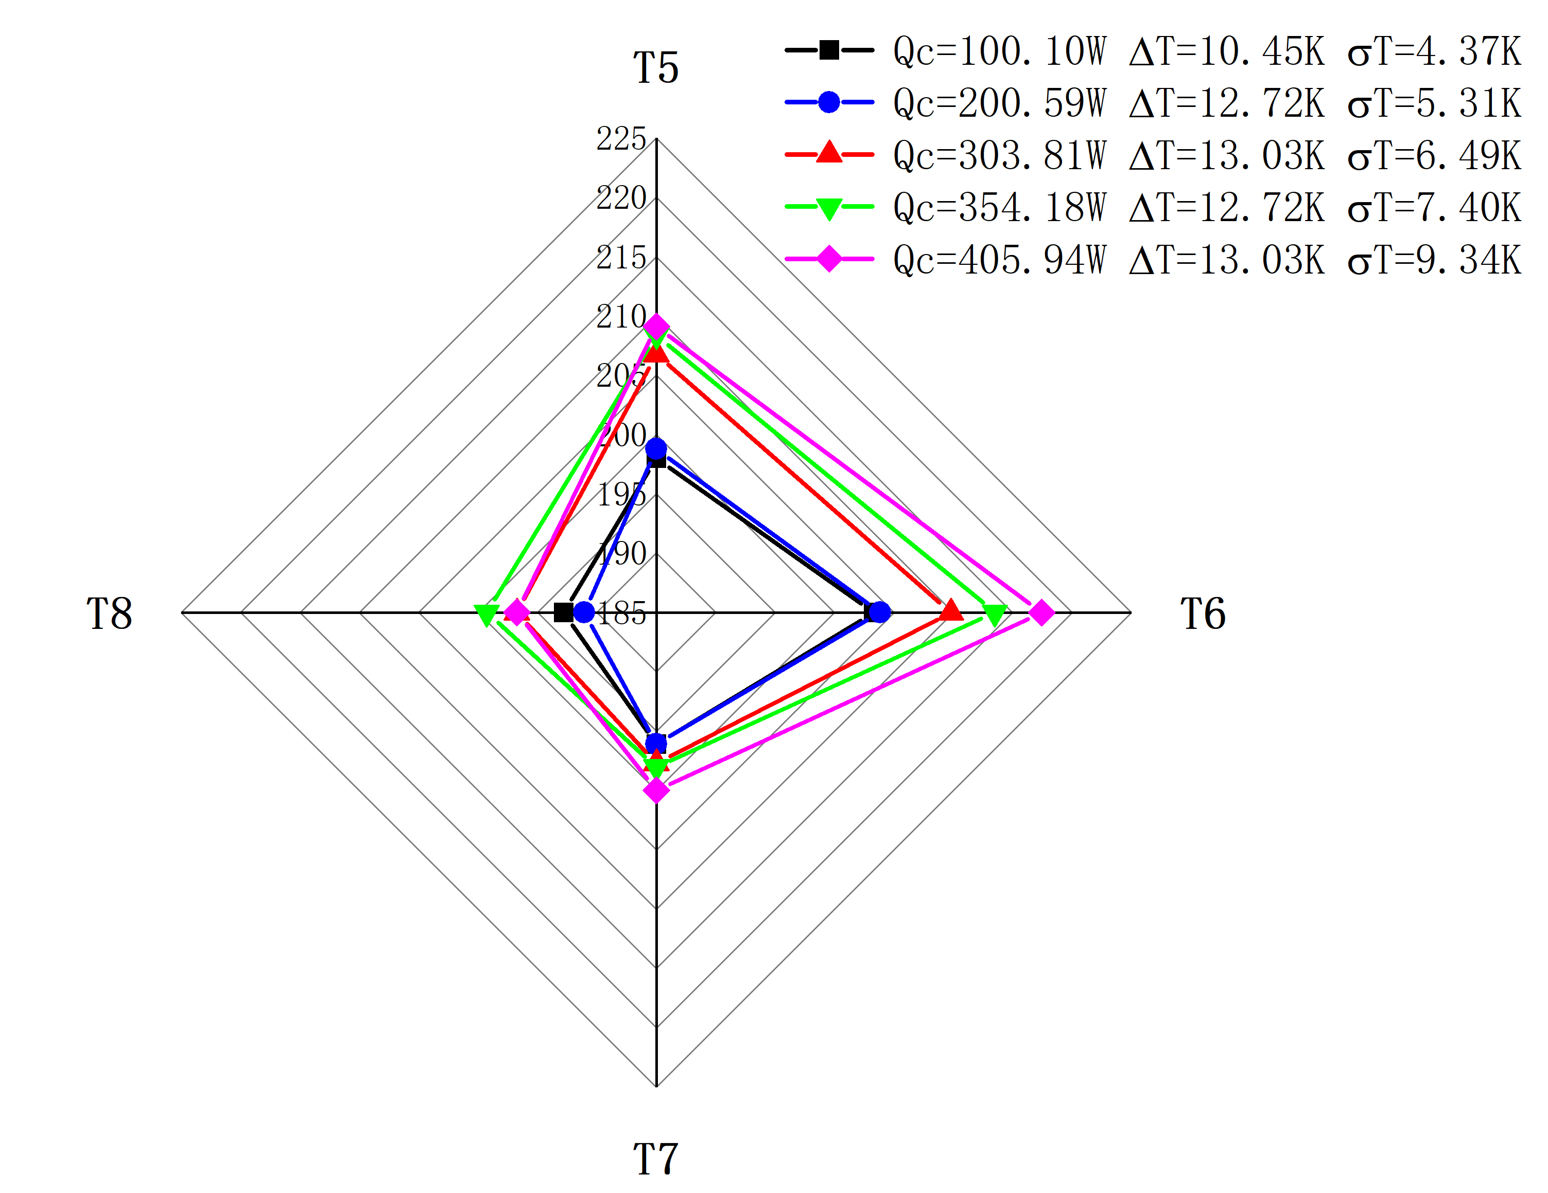
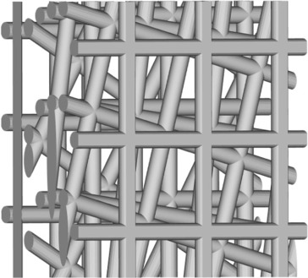

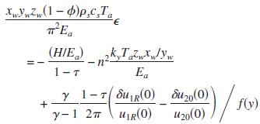
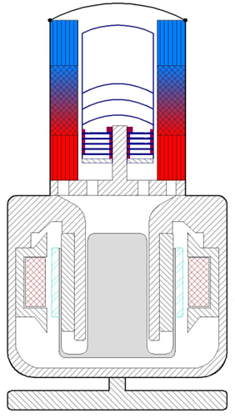
Method and design
Issue and method
Non-uniformity in the regenerator
T5
T8
T6
Local acoustic streaming
T7
L
D
Local acoustic streaming might account for a significant part of the deviation.
Experiments show non-uniform temperature distribution in the middle of the regenerator.

Slide 9
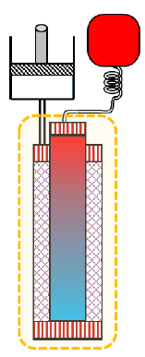
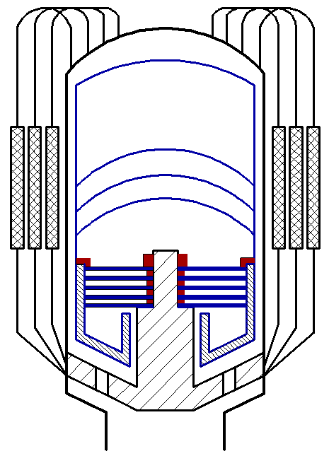
Method and design
Issue and method
Parallel regenerators
59
46
5.8
84
11.5
124
L/D=8.1
L/D=0.64
L/D=2.35
Aspect ratio increases by virtue of the parallel-regenerator design.

Slide 10
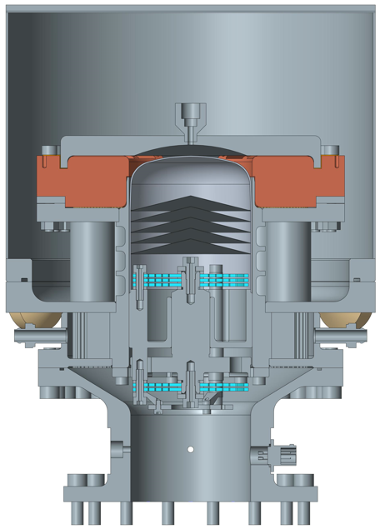
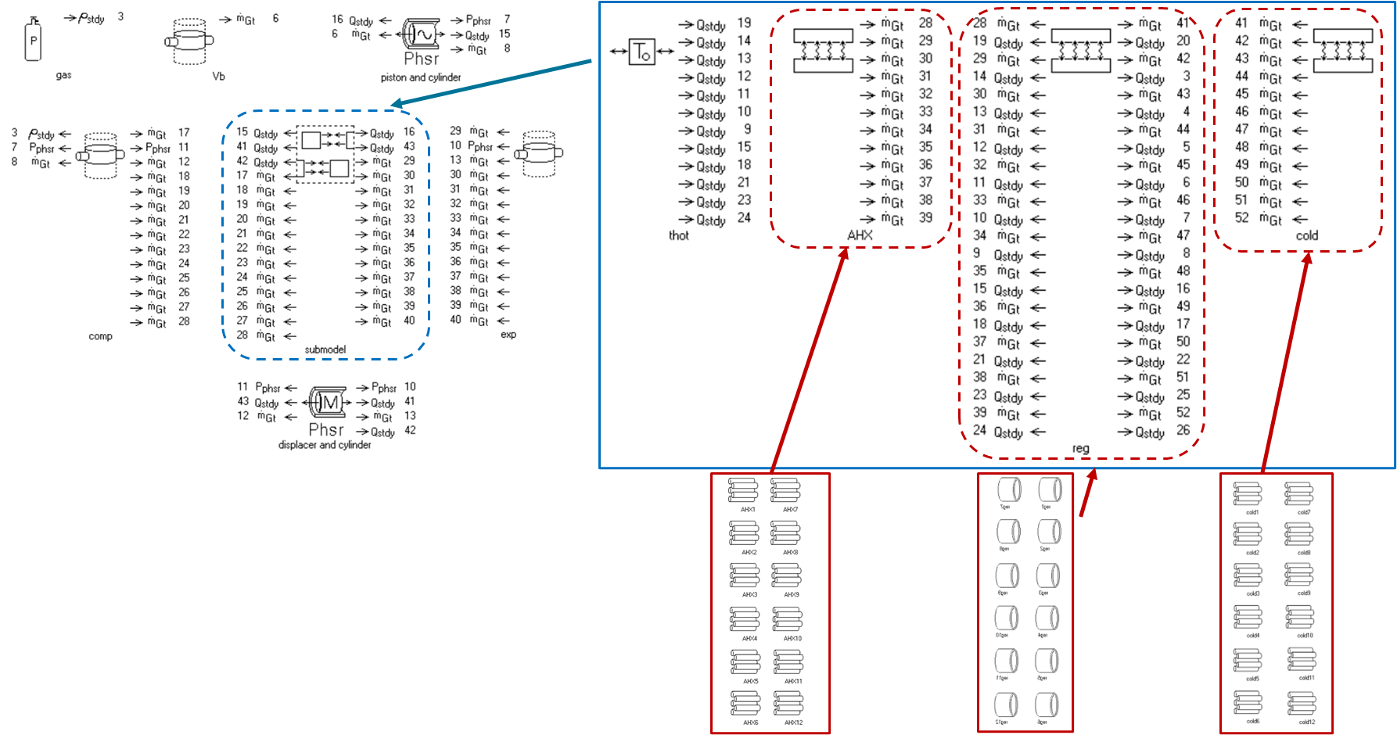
Method and design
Parameters
12-independent thermoacoustic cores
Regenerator
Number | 12
Length, mm | 61
Diameter, mm | 26
Matrix | SS316L, #300
Displacer
Moving mass, kg | 0.97
Spring stiffness, kN/m | 113.3
Area facing expansion, m2 | 5.00E-03
Area facing compression, m2 | 4.56E-03
Damping coefficient, Ns/m | 30
Expansion space
Volume, m3 | 6.32E-05

Slide 11
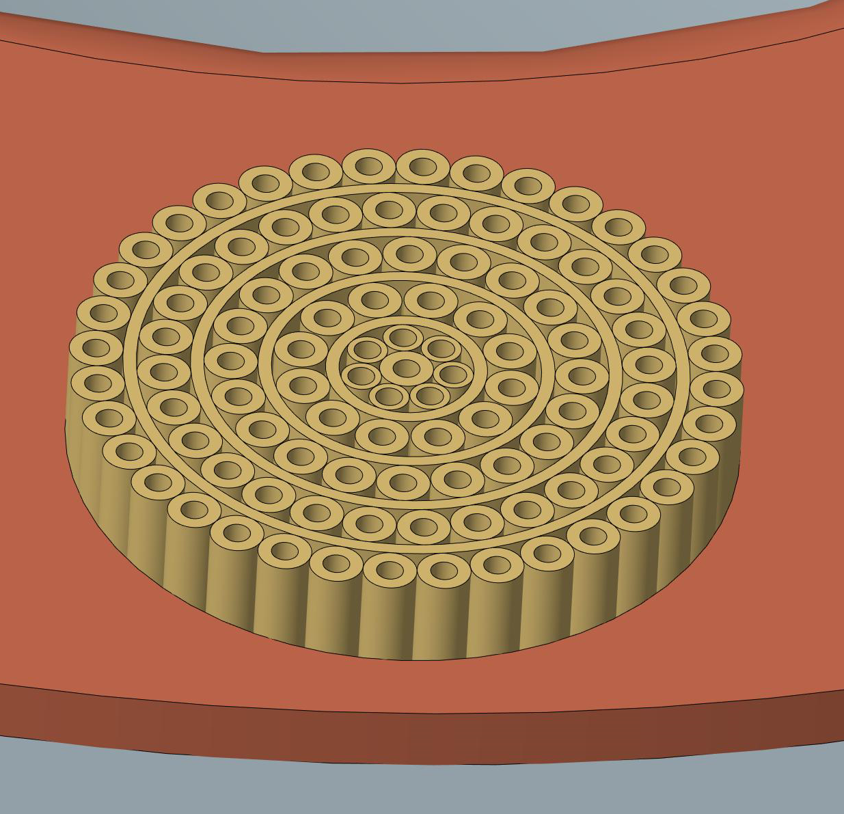
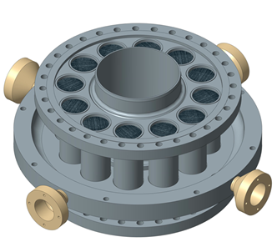
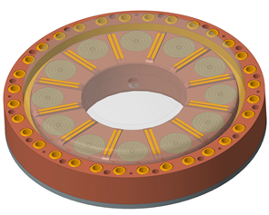

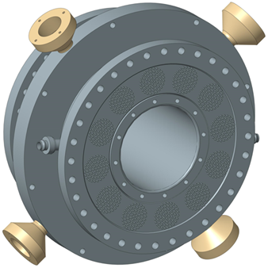
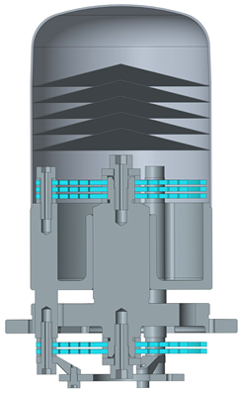
Method and design
Design features
Parallel-regenerator assembly
Multi-tube-bundle
cold head
Split Displacer assembly
Multi-tube-bundle aftercooler

Slide 12
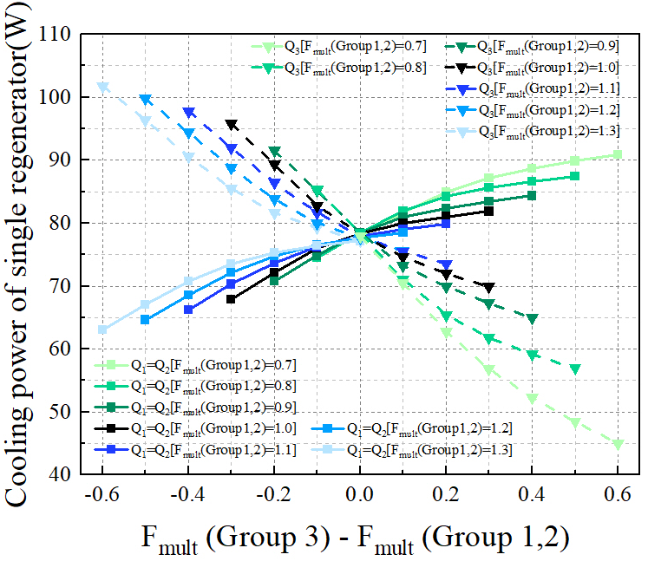
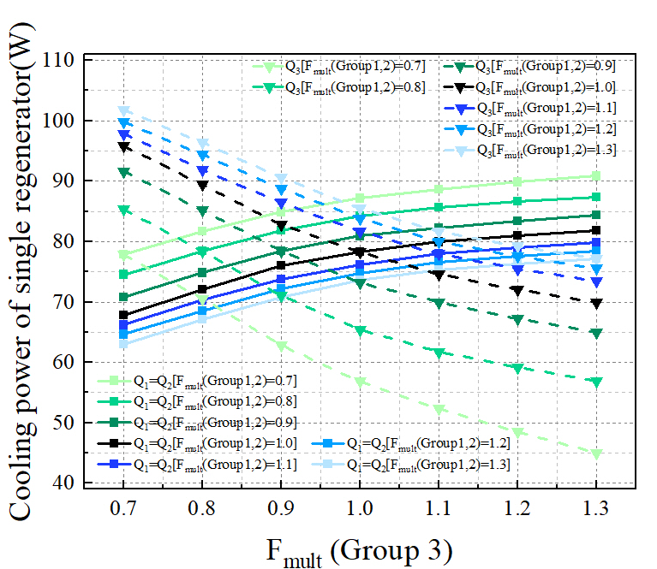
Method and design
Calculations
Variation of relative flow resistance
Variation of flow resistance
 | Qc（W） | Ea-in（W） | Ea-out（W）
Traditional design by Sage | 400 | 3257 | 371
Current design by Sage | 604 | 3500 | 980
Current design by CFD | 448 | 4262 | 744
Acoustic characteristics remains the same in Sage calculations.
CFD simulations reveals complicated flow and heat transfer, indicating underlying loss.

Slide 13
Experiments
3
Experimental setup
Fundamental performance
Parametric test

Slide 14
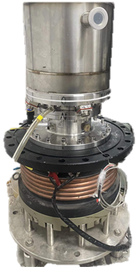
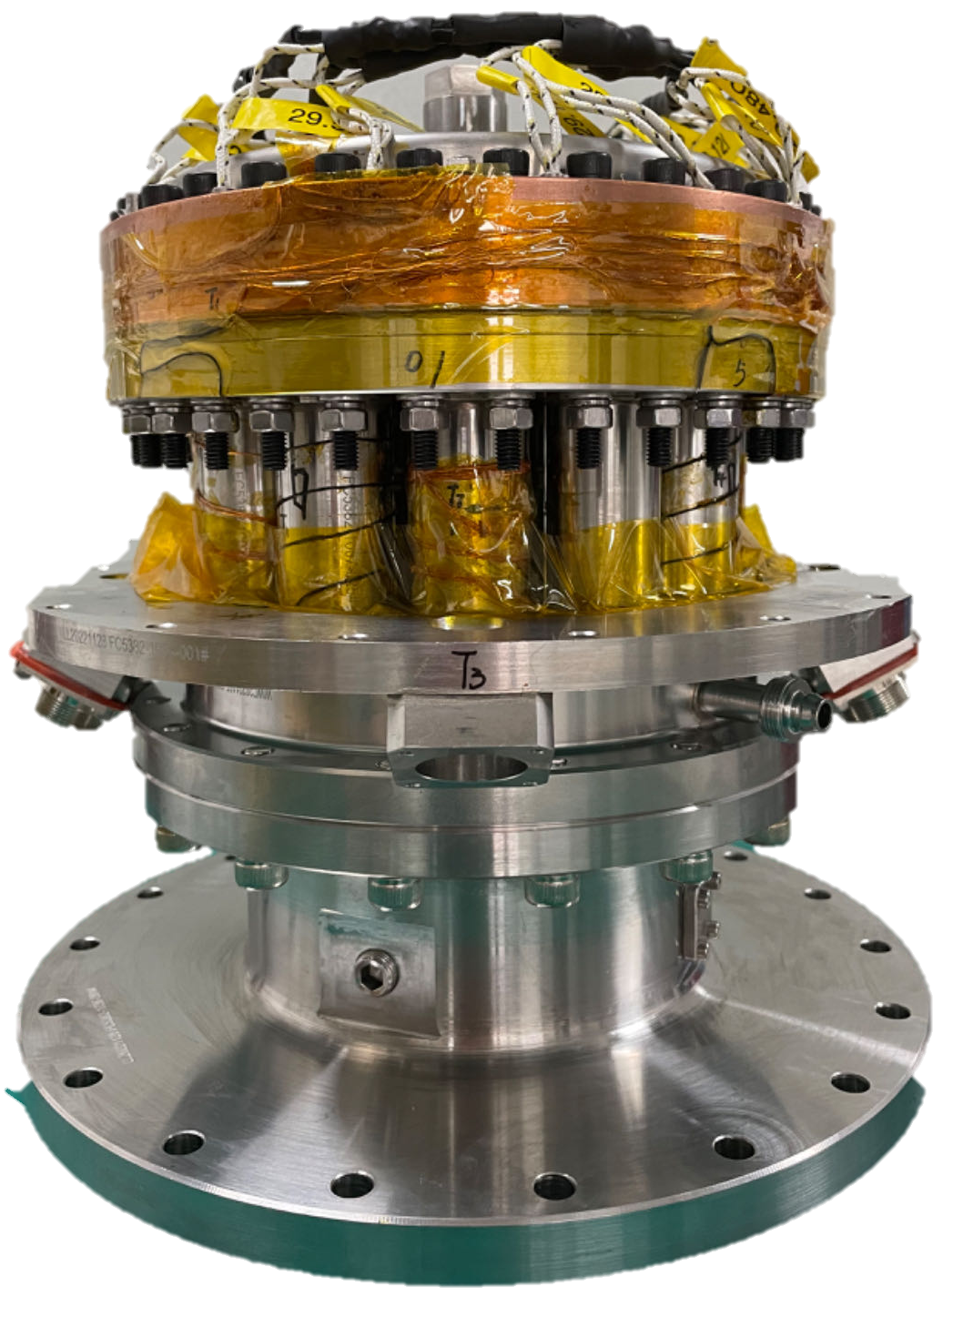
Experiments
Experimental setup
Experimental prototype
Cold head and measurement assembly
Operating condition | Mean pressure | Frequency | Acoustic power input | Ambient temperature
Range | 2.6-3 MPa | 48~54 Hz | 1000~3000 W | 293 K

Slide 15
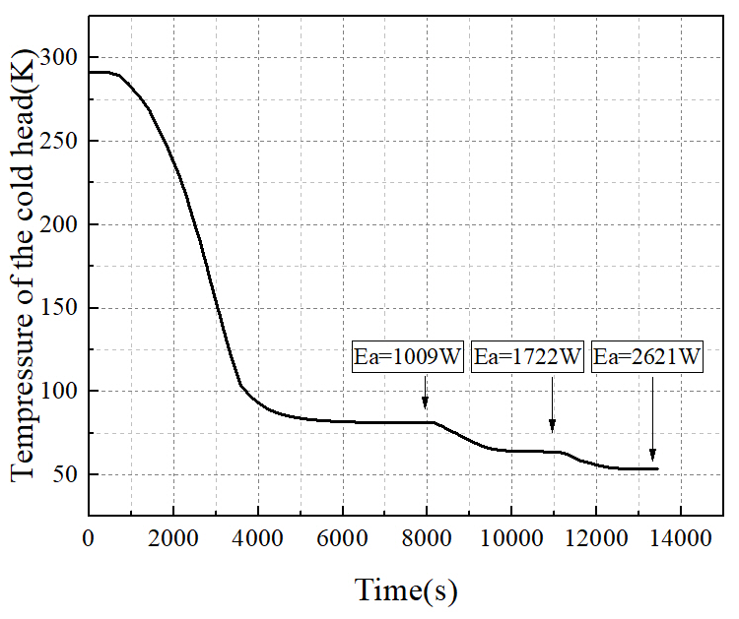
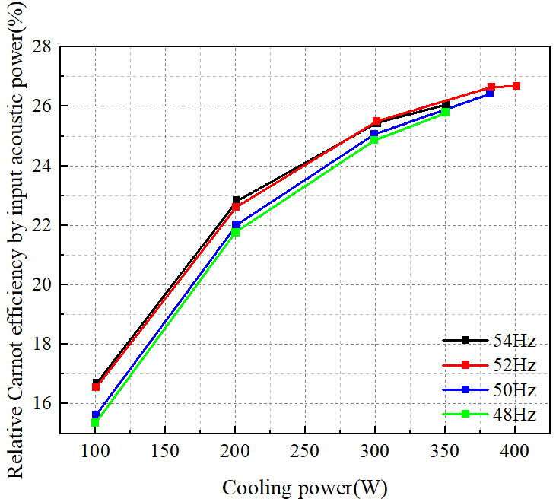
Experiments
Cooling down process
Cooling performance
f=52 Hz
Th=293 K
Ea=1009 W
Pm=3.0 MPa
80 K, 1 hour
Cooling down curve
Relative Carnot efficiency @80 K
1009 W acoustic power to cool down the cryocooler to 80 K with 1 hour.
The peak relative Carnot efficiency reaches about 27% at 400 W @ 80 K, 6 points more below previous work.

Slide 16
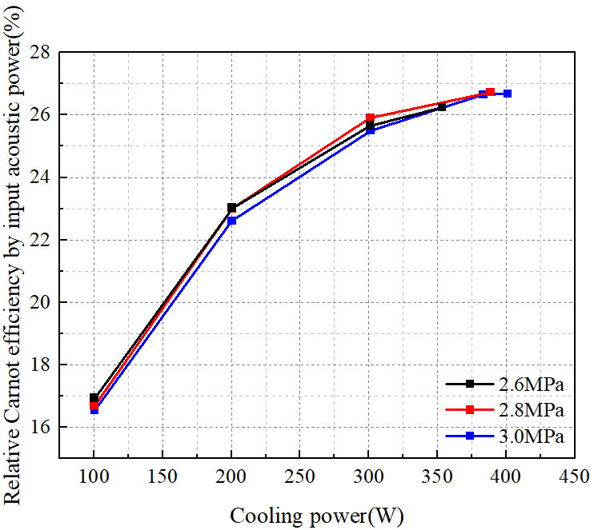
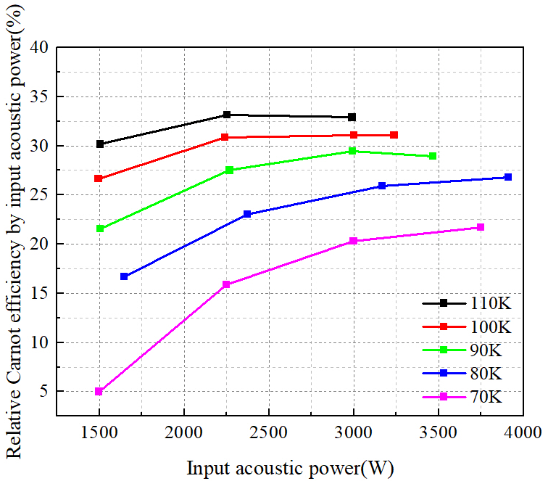
Experiments
Parametric test
Impact of refrigeration temperature and mean pressure on rCarnot
Mean pressure vs. rCarnot
Refrigeration temperature vs. rCarnot
Mean pressure has limited influence on the relative Carnot efficiency under different cooling power.
Gains in rCarnot upon higher refrigeration temperature falter.

Slide 17
Summary
4
Conclusions and future work

Slide 18
Summary
Conclusion and future work
A parallel thermoacoustic-core design was proposed for a free-piston Stirling cryocooler capable of providing several hundred Watt cooling power at 80 K.
Several novel design features were incorporated into the prototype.
A cooling power of over 400 watt, and a peak efficiency of 27% rCarnot were obtained, whereas far below expectation.
Inconsistency among the thermoacoustic cores, matching between compressor and cryocooler require further investigation.

Slide 19
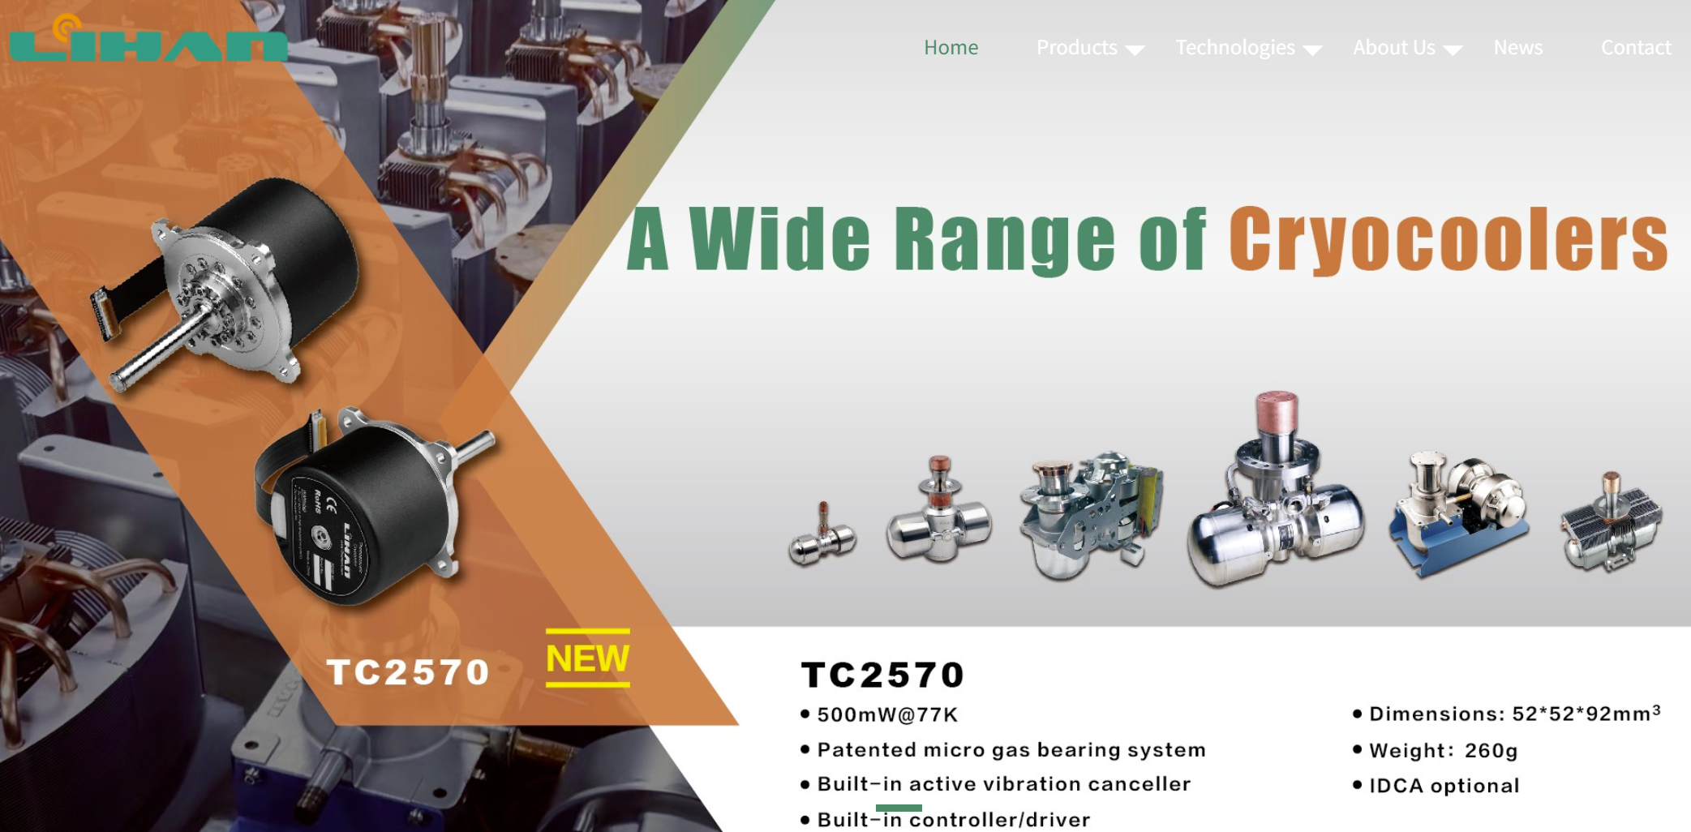
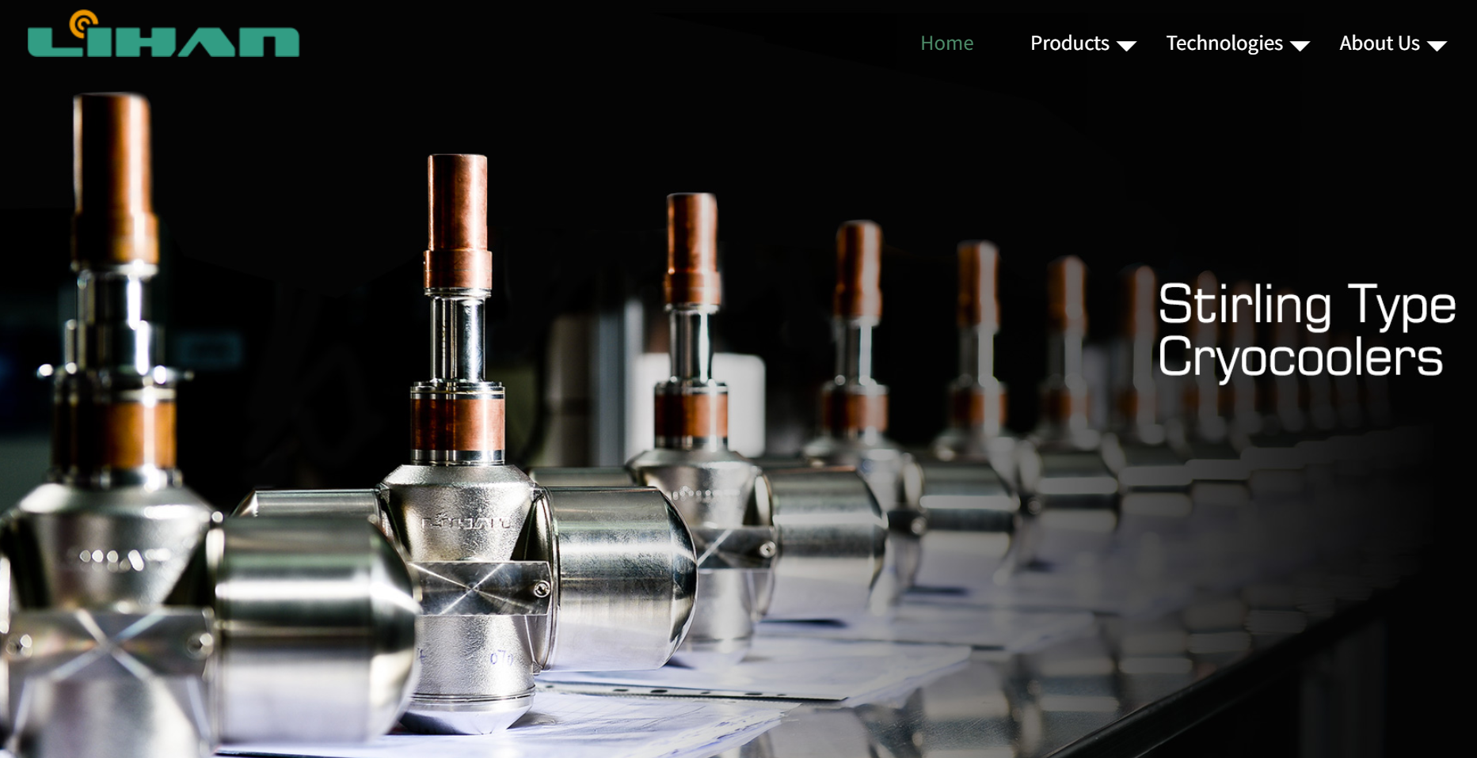
Thank You!
CEC/ICMC 2025
Special thanks to Haibing Li of Lihan for financial and technical support!
Technical Institute of Physics and Chemistry, CAS
May 21, 2025

