Slide 1
Inconel 625 flange development for Cu-based superconducting radio frequency cavities
Shreyas Balachandran¹, Oleksandr Hryhorenko²
Adam O’Brien², Gregory Grose², Aniket Ingrole³, Jun Lu³, Anne-Marie Valente-Feliciano²
Department of Mechanical Engineering, FAMU- FSU College of Engineering, Tallahassee, FL.
Thomas Jefferson National Lab Facility, Newport News, VA.
Magnet Science and Technology, National High Magnetic Field Lab, Tallahassee, FL.
Acknowledgement: The work was performed under the DOE- ACCELERATE program. Additional support for the National High Magnetic Field Laboratory facilities is from the NSF: NSF-DMR-2128556, and the State of Florida. This work is authored by Jefferson Science Associates, LLC, under U.S. DOE Contract No. DE-AC05-06OR23177.

Slide 2
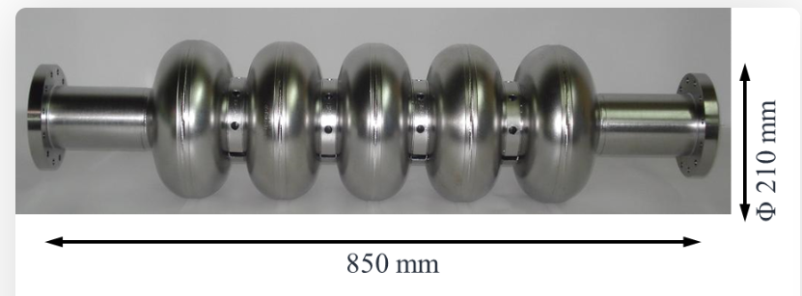
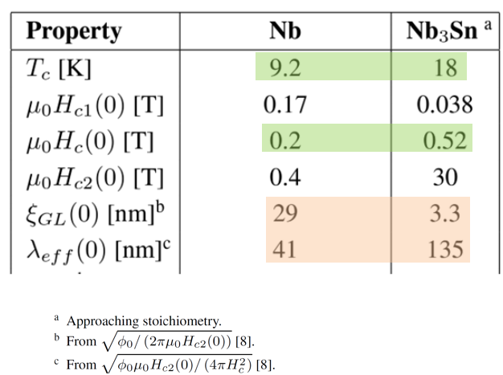
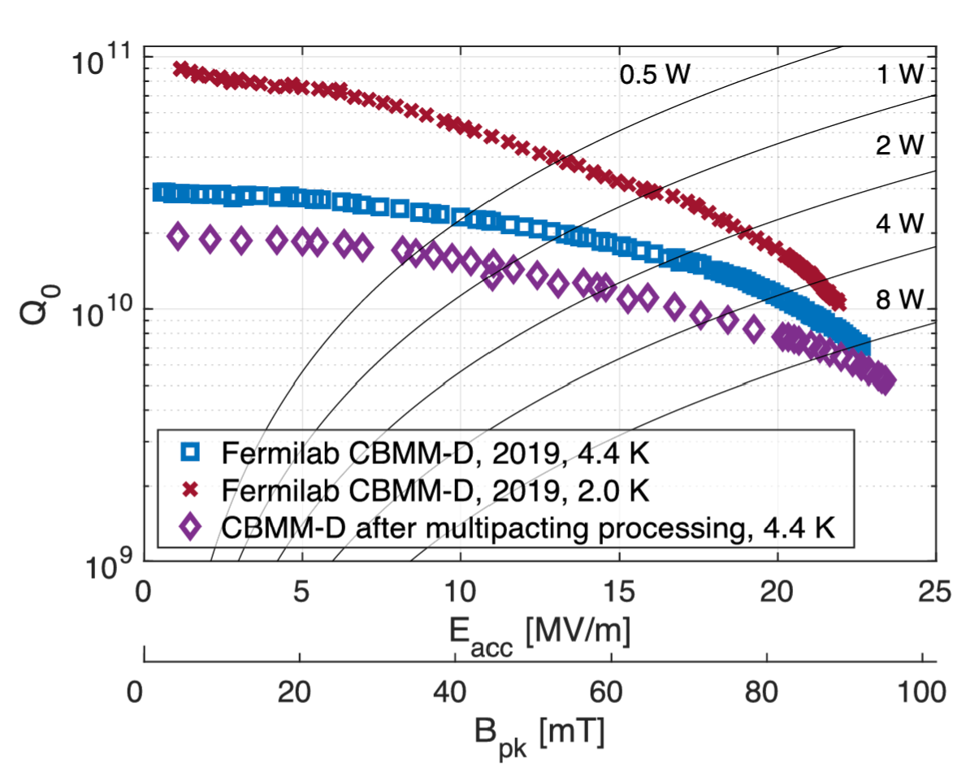
Beyond SRF Nb- Alternative materials: Focus on Nb₃Sn
4W
at ~4 K
Posen, S., Lee, J., Seidman, D. N., Romanenko, A., Tennis, B., Melnychuk, O. S., & Sergatskov, D. A. (2021). Advances in Nb₃Sn superconducting radiofrequency cavities towards first practical accelerator applications. Superconductor Science and Technology, 34(2), 025007.

Slide 3
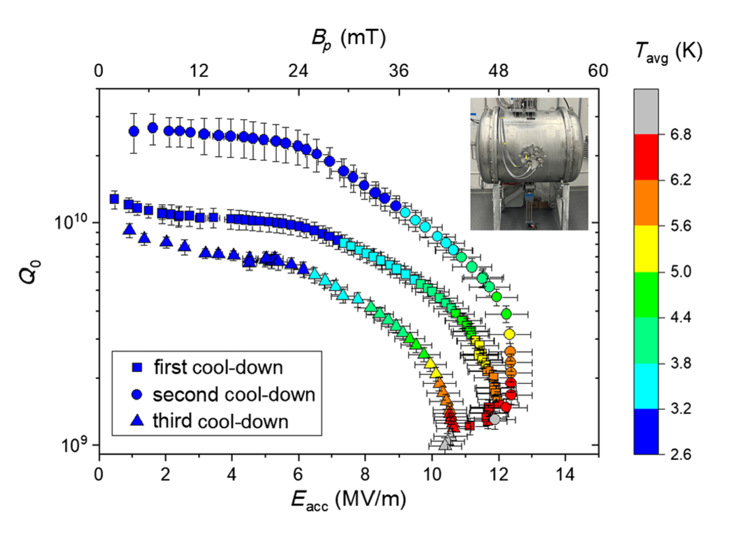
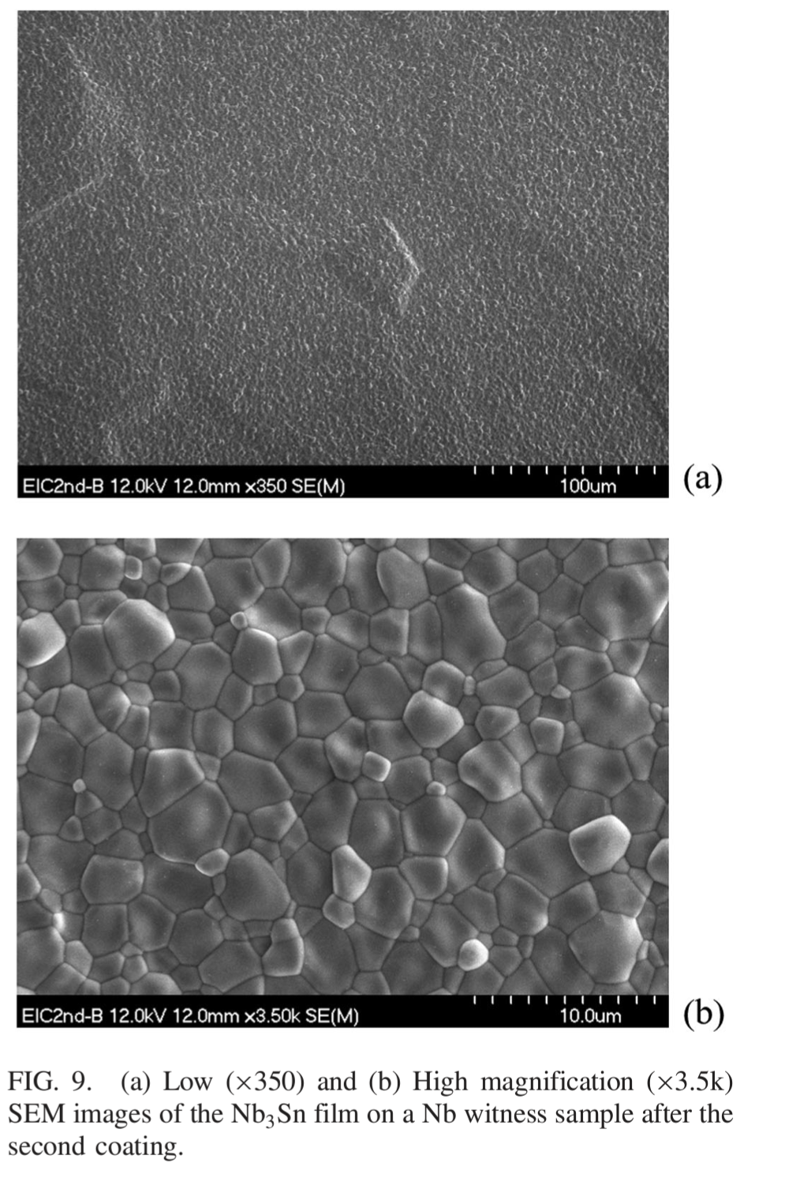
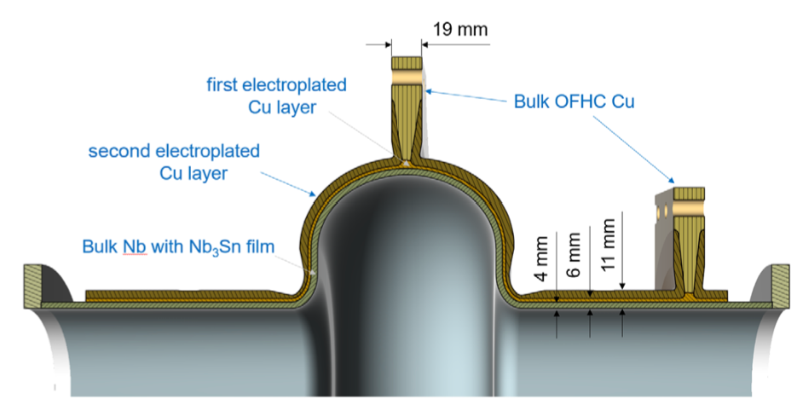
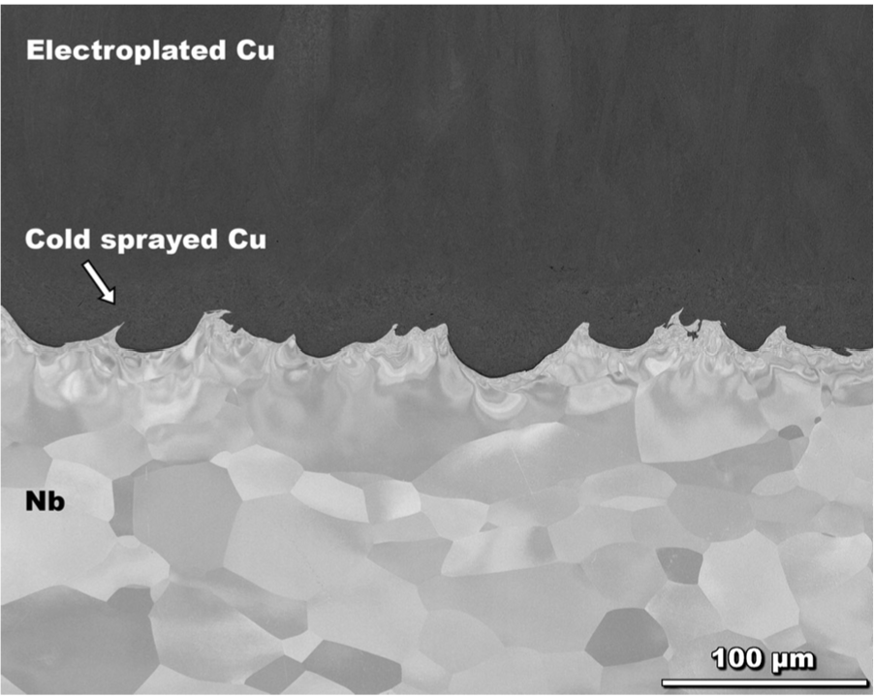
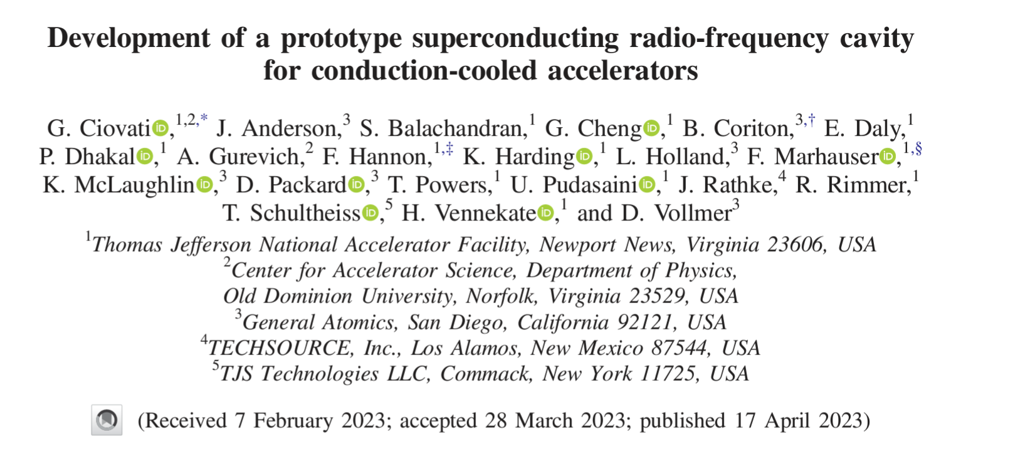
Cryocooled Nb₃Sn on Nb successfully tested in Jefferson Lab- 1MW, 1MeV compact electron accelerator possible.
10 MeV, 1 MW system in the works!

Slide 4
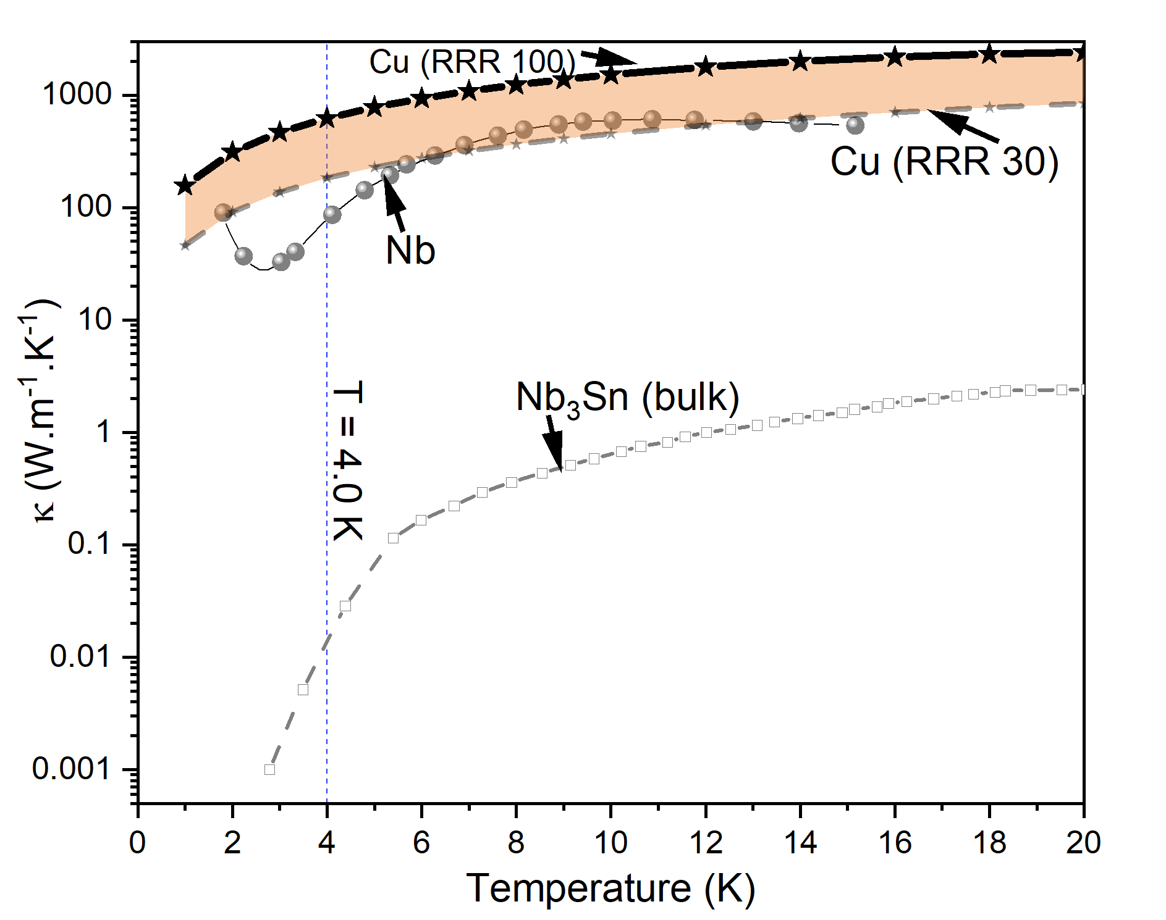
Nb₃Sn on Cu for SRF applications
Current
Nb₃Sn
Cu melts at ~1100°C.
Nb
Cu
Cu-based Nb₃Sn is a widely studied system.
Proposed
Nb₃Sn
Cost of RRR 100 Cu ~ 1/20 of RRR 300 Nb
Cu
~ 5 times improvement in thermal conductivity at 4K with Cu

Slide 5
Techniques available to deposit Nb₃Sn on Cu
Process | Hold Temperature (°C) | Hold Time (h) | References
CVD | 850-950 | 1-2 | Personal communication with Ultramet.
Magnetron sputtering- Subsequent heat treatments to obtain higher T_{c} | 850 | 5 | L. Xiao et al., “The Study of Deposition Method of Nb3Sn Film on Cu Substrate,” presented at the 18th Int. Conf. on RF Superconductivity (SRF’17), Lanzhou, China, July 17-21, 2017, JACOW, Geneva, Switzerland, Jan. 2018, pp. 131–133. doi: 10.18429/JACoW-SRF2017-MOPB036.
 | > 750 | 24 | E. A. Ilyina et al., “Development of sputtered Nb3Sn films on copper substrates for superconducting radiofrequency applications,” Supercond. Sci. Technol., vol. 32, no. 3, p. 035002, Jan. 2019, doi: 10.1088/1361-6668/aaf61f.

Slide 6
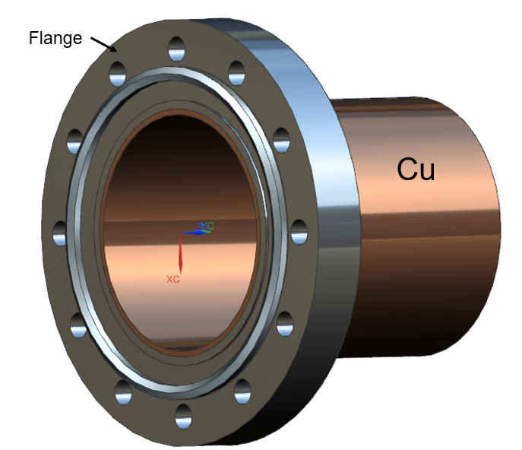
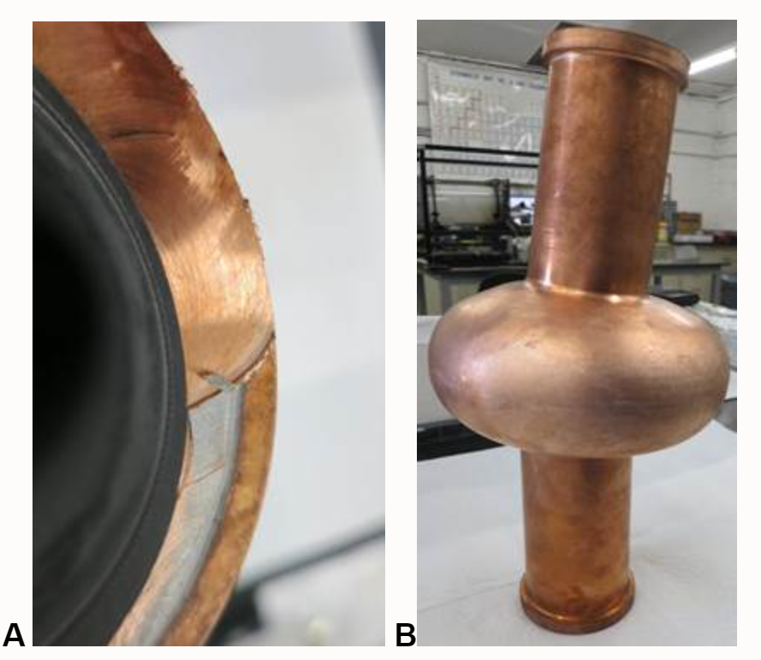
Problem: Cu structure after heat treatment

Slide 7
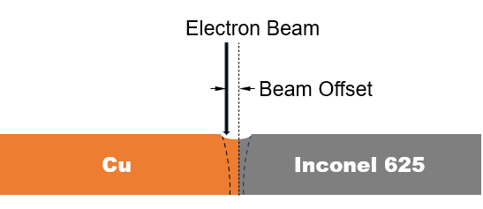
Materials and Methods
Inconel 625- 3.1mm sheet and 1 in. plate
Cu- C10100, off the shelf- 3.1 mm sheet
Element | Weight percent
Chromium | 22.0
Molybdenum | 9
Niobium + Tantalum | 1.2
Iron | 1.8
Aluminum | 0.3
Titanium | 0.26
Silicon | 0.16
Manganese | 0.3
Carbon | 0.04
Sulphur + Phosphorus | <0.005
Nickel | Bal.
Welding parameters for 3mm thick sheets of Cu and Inconel 625. Beam current = 50 mA, beam Voltage = 50 kV, and oscillation diameter of 2mm, 10 kHz.
Sample ID | Weld speed (mm/s) | Beam Offset (mm) | Energy per unit length (W/mm)
O1-C | 6.8 | 0.4 | 328
O2-C | 6.8 | 0.6 | 328
O3-C | 6.8 | 0.9 | 328
O4-C | 6.8 | 1.1 | 328
V1-C | 7.6 | 1.0 | 328
V2-C | 6.8 | 1.0 | 369
V3-C | 5.9 | 1.0 | 422
V4-C | 5.1 | 1.0 | 492
O7-I | 7.2 | 0.4 | 328
O8-I | 7.2 | 1.0 | 328
Beam
Offset
In Cu
In A-625

Slide 8
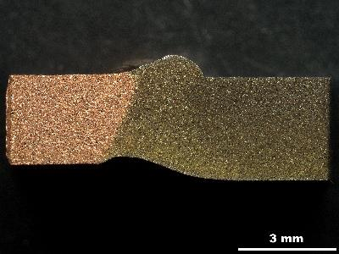
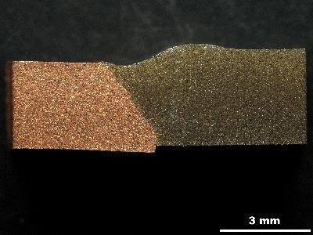
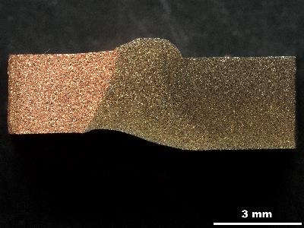
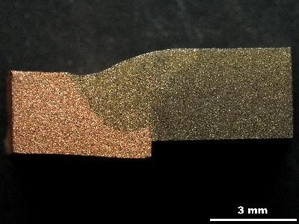
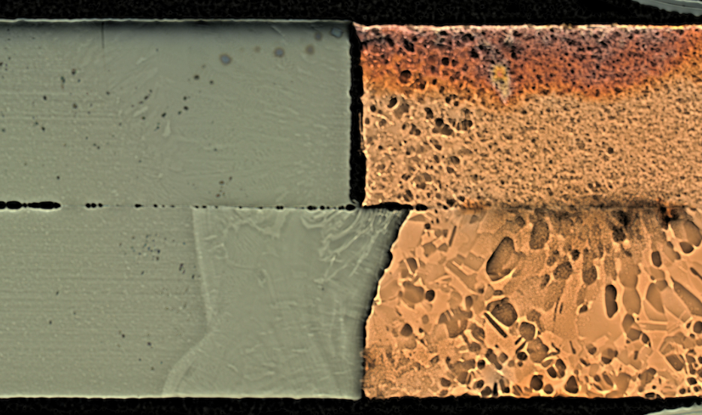
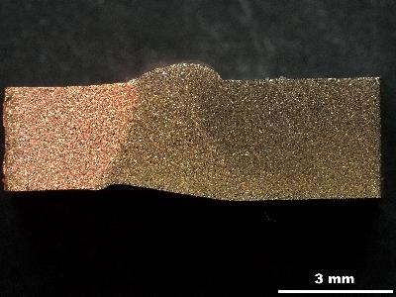
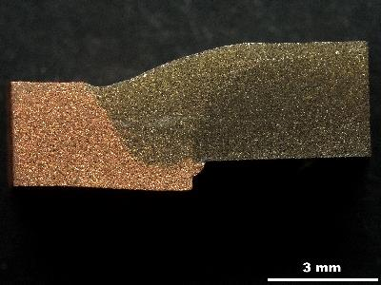
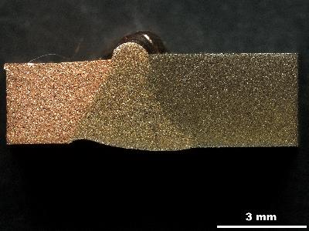
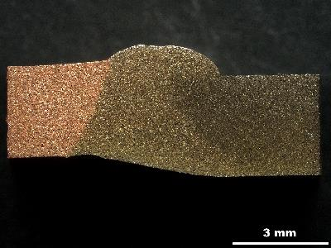
Result- Beam offset in Cu leads to better welds.
Offset in Cu, v = 6.8 mm/s
Varying speed, Offset in Cu = 1mm
V= 7.6 mm/s
Cu
Alloy 625
Cu
Alloy 625
0.4 mm
V= 6.8 mm/s
Offset in Inconel 625, v = 6.8 mm/s
0.6 mm
1.0 mm
V= 5.9 mm/s
0.9 mm
0.4 mm
V= 5.1 mm/s
3 mm
1.1 mm
O = 1 mm

Slide 9
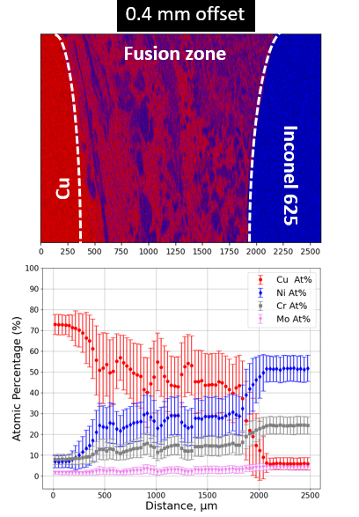
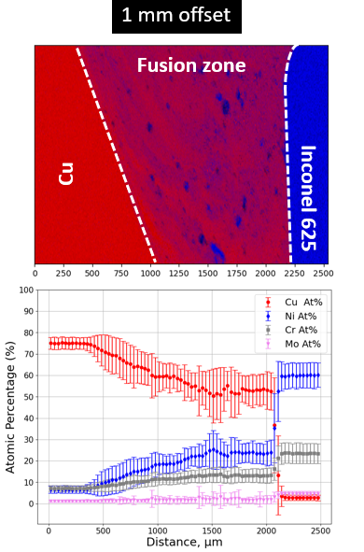
Result- Quantification of the fusion zone -Ni, Cr, Mo distribution
There is diffusion of Ni and Cr in Cu. There is a slight Cu diffusion on the Inconel edge in the 0.4mm offset sample.
The Inconel particle density in the fusion zone depends on the Cu offset.

Slide 10
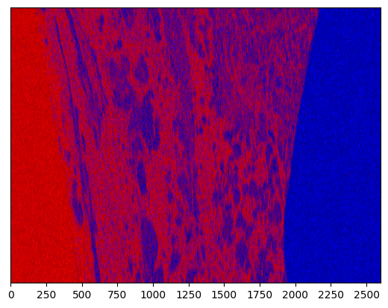
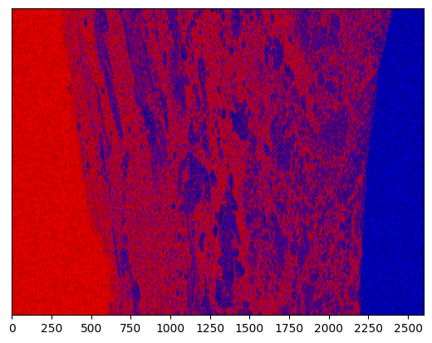
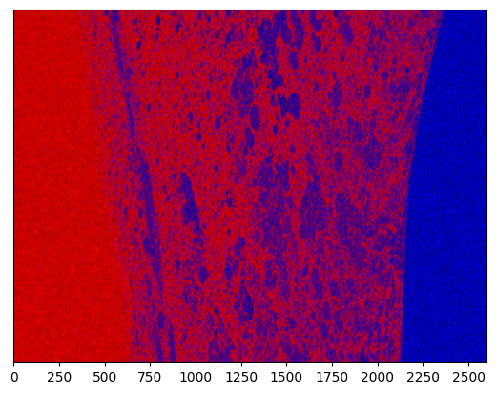
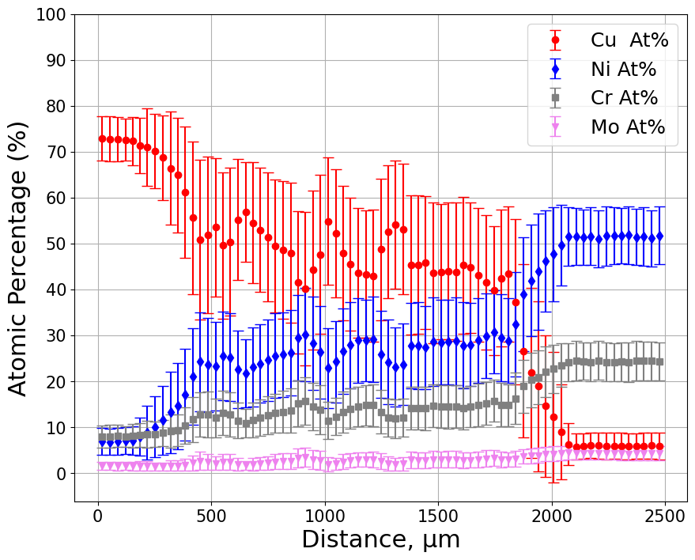
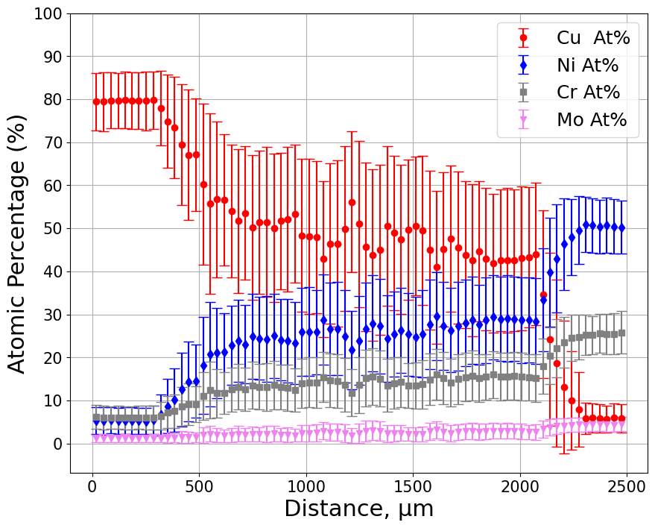
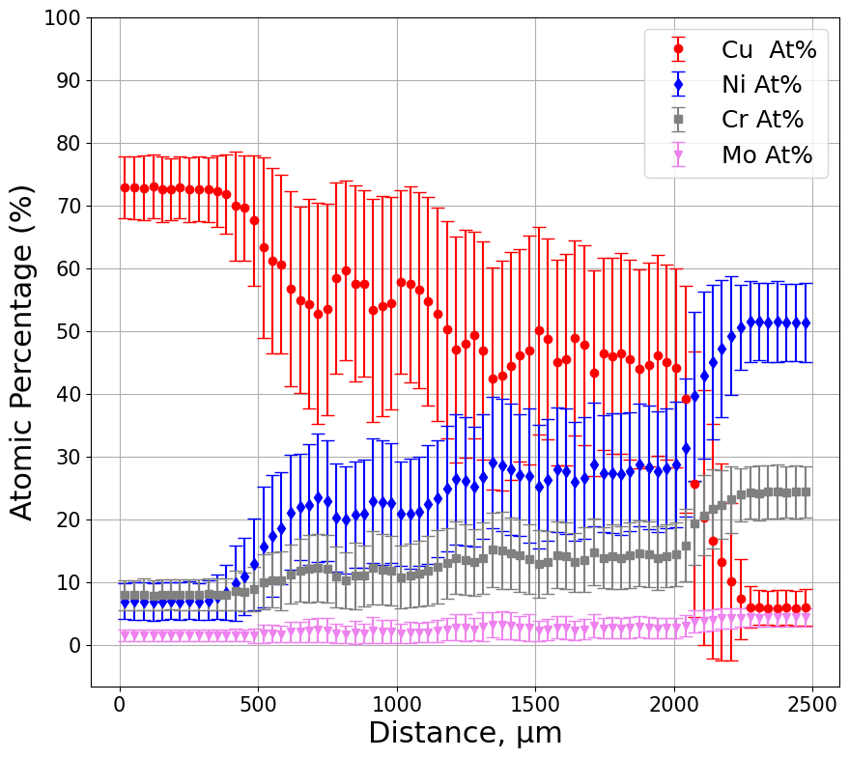
Result- Quantifying the fusion zone after heat treatments- Offset 1mm in Cu.
As welded
750℃ / 50h
950℃ / 2h

Slide 11
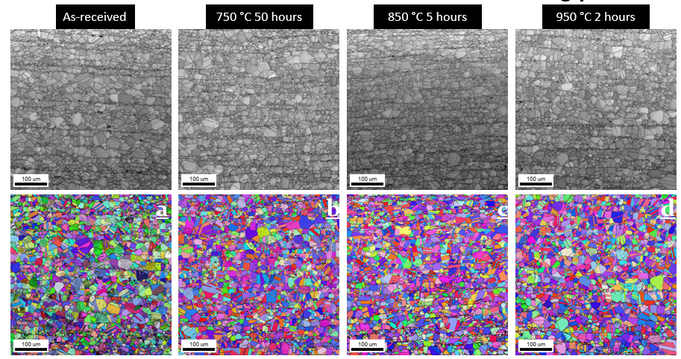
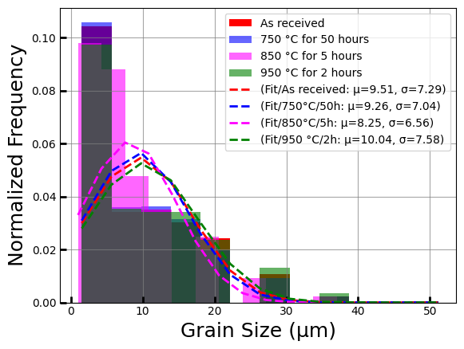
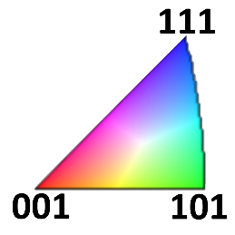
Result: Alloy 625 microstructure does not change with heat treatment

Slide 12
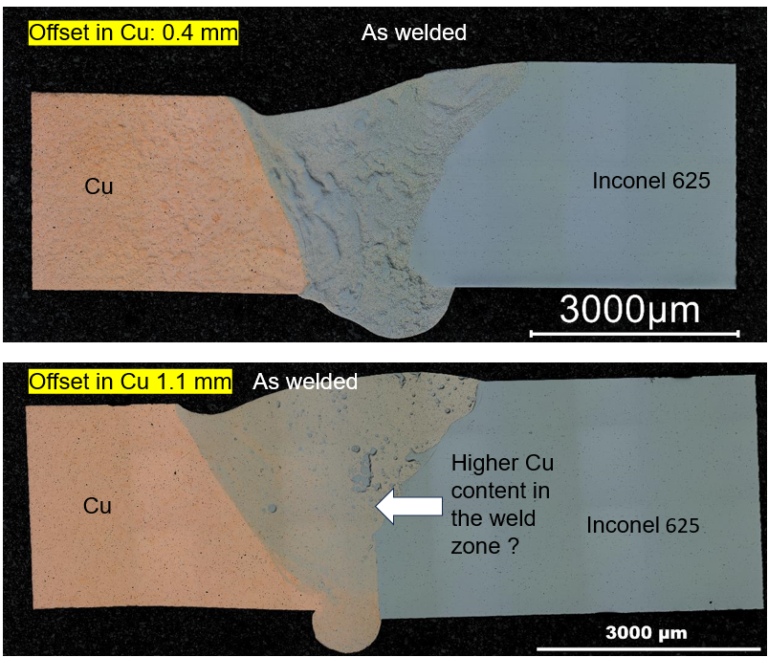
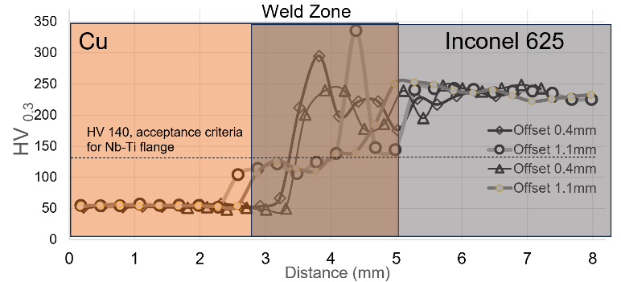
Result: Hardness values of regions around the fusion zone.

Slide 13
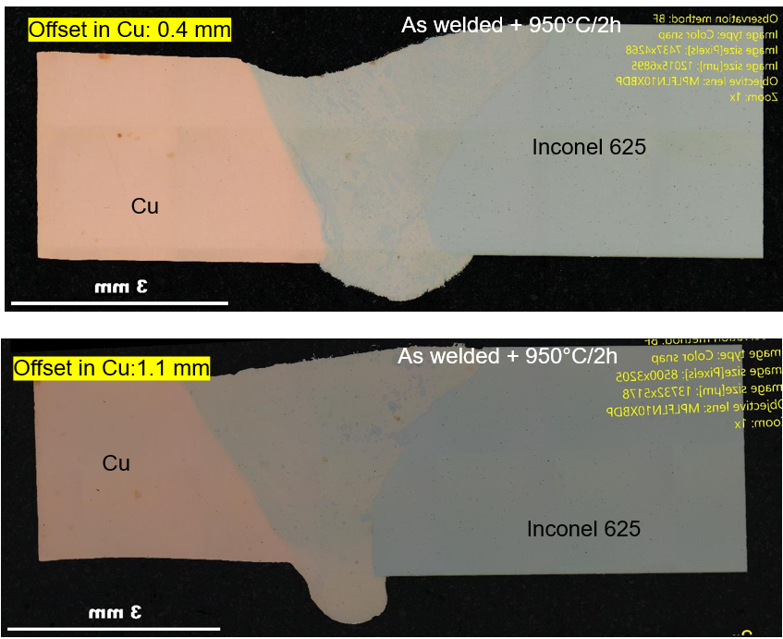
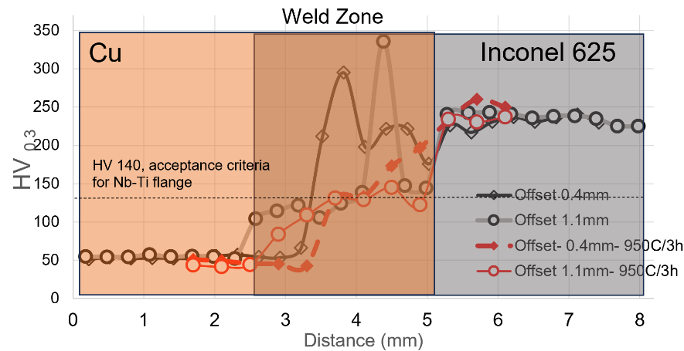
Result: Hardness values of regions around the fusion zone after 950℃/2h.

Slide 14
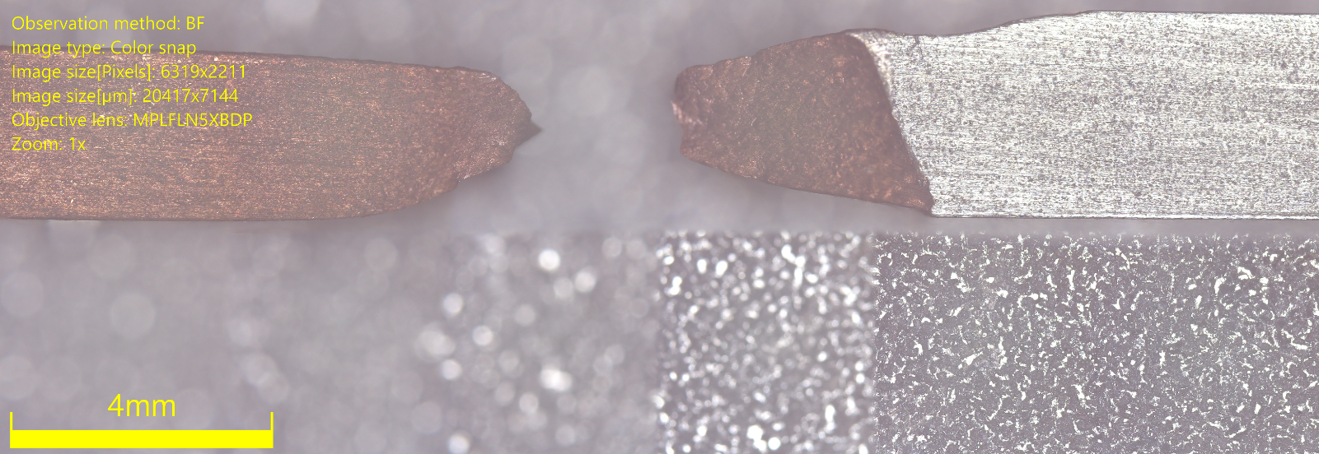
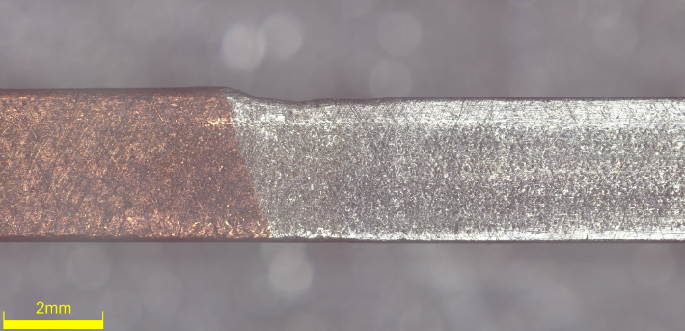
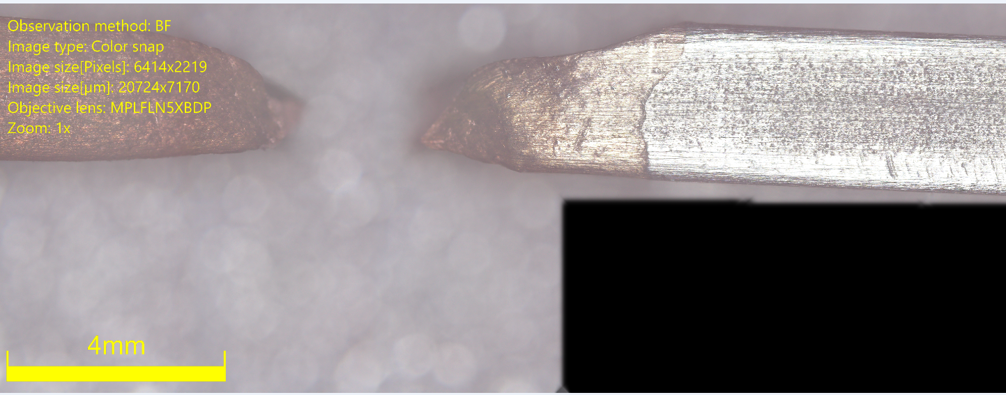
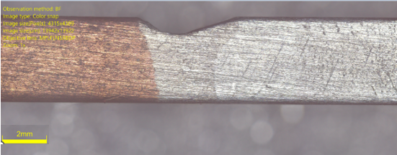
Mechanical testing in progress (77K) - Fracture in Cu
Offset in Cu 1mm
Offset in Cu 0.4 mm

Slide 15
Conclusions
Cu welds well with Inconel 625.
  Offsets in Cu were easier to weld than offsets in Inconel 625.
The welds last heat treatments in the range of 750℃ - 950℃.
  Preliminary testing indicates Cu is the weak spot but…
  Fatigue properties need exploration.
Inconel 625 maintains its microstructure in the temperature range explored.
  Precipitation is expected.

Slide 16
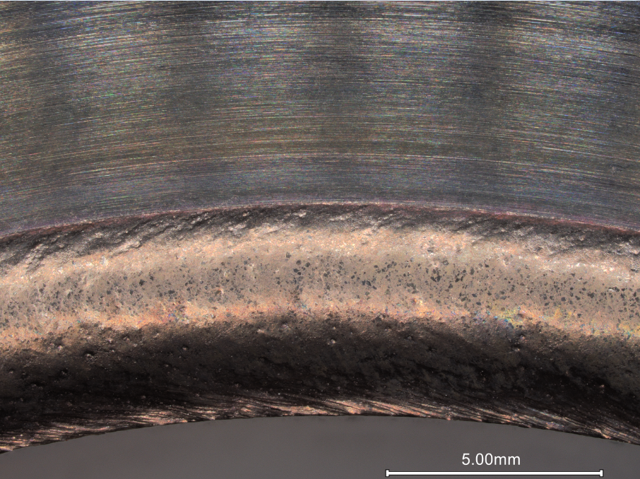
Inconel Flange welded to Cu tube

