Slide 1

Validating effective thermal conductivity of glass microspheres in cryogenic storage insulation via finite element analysis
Marc Dunham, Ph.D. (presenter)
Rob Hunter
Clara Mata, Ph.D.
Matt Mortensen, Ph.D.

Slide 2
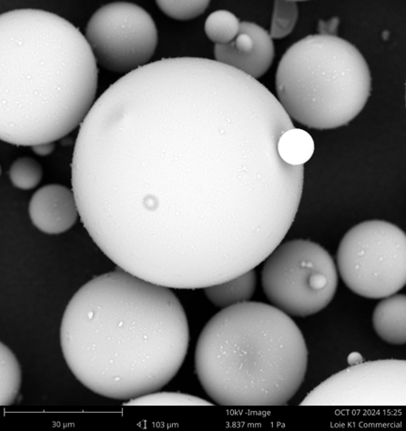
Background
Long history of 3M™ Glass Bubbles¹ use in a wide range of applications and industries:
Transportation & automotive
Construction & manufacturing
Energy
  Mining
  Oil & Gas
  Cryogenic storage application^{2,3}
https://www.3m.com/glassbubbles
Fesmire, J., Research and Development History of Glass Bubbles Bulk-Fill Thermal Insulation Systems for Large-Scale Cryogenic Liquid Hydrogen Storage Tanks, Cryogenics Test Laboratory, NASA Kenedy Space Center (2017).
Swanger, A., NASA-KSC & Liquid hydrogen: Past, Present & Future (2021).

Slide 3
Recent modeling work
Experimental and computational study of thermal properties of HGM (Wang et al, 2024)
Analytical models of heat transfer and buoyancy effects in tank (Taghavi et al, 2024)
Analytical model of conductivity in HGM insulation (Kim et al, 2024)

Slide 4

Model construct
mesoscale
microscale
$$Q′′→f\left(k\left(T,P\right)\right)$$
T=300K
T=20K
T+dT
T-dT
Sweep T from 20K->300K and gas pressure from 0.1 mTorr to ambient to generate effective material model

Slide 5
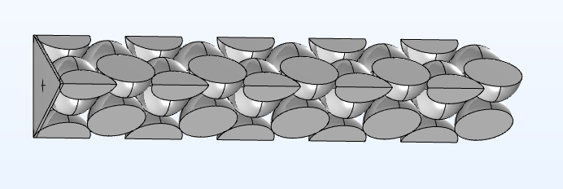
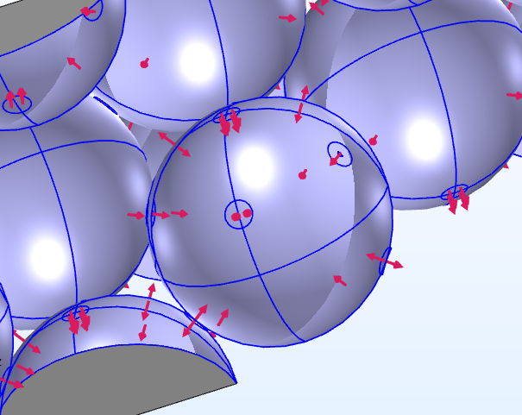
Model construct – Symmetry and radiation
COMSOLTM model: Hexagonal close-packed configuration with three-plane symmetry
Surface-to-surface radiation defined for both interior and exterior of spheres

Slide 6
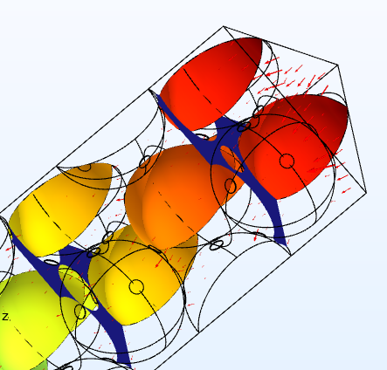
Gas conduction
All materials exhibit some combination of pressure and temperature effects.
Temperature-dependence:
Glass shell thermal conductivity
Bubble interior gas conductivity (SO2: decreasing with temperature until triple point, then effectively zero)
Interstitial gas conductivity
Pressure-dependence
Interstitial gas conductivity

Slide 7
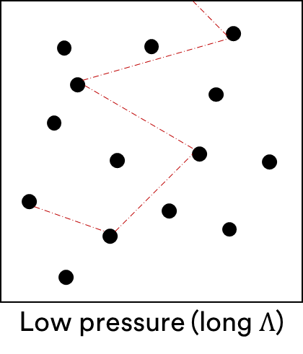
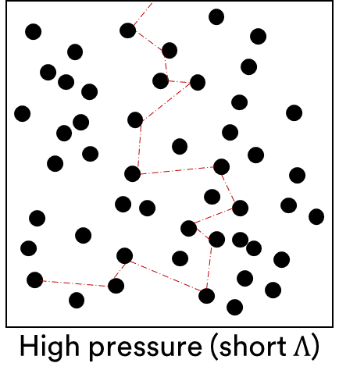


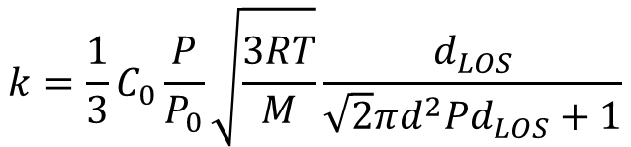


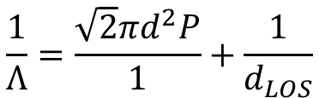

Quasi-ballistic gas conduction
With size effect
$$\frac{1}{Λ}=\frac{\sqrt{2}πd^{2}P}{1}+\frac{1}{d_{LOS}}$$
$$k=\frac{1}{3}CvΛ$$
$$k=\frac{1}{3}CvΛ$$
$$Λ=\frac{1}{\sqrt{2}πd^{2}P}$$
$$k=\frac{1}{3}C_{0}\frac{P}{P_{0}}\sqrt{\frac{3RT}{M}}\frac{d_{LOS}}{\sqrt{2}πd^{2}Pd_{LOS}+1}$$
$$v=\sqrt{\frac{3RT}{M}}$$
$$C=C_{0}\frac{P}{P_{0}}$$

Slide 8
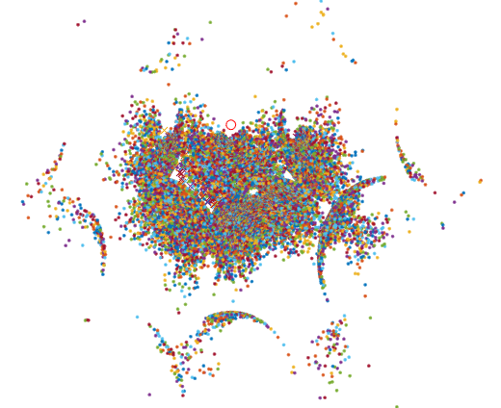
Monte Carlo line-of-sight analysis
(Values calculated using Matlab for Monte Carlo ray tracing)

Slide 9
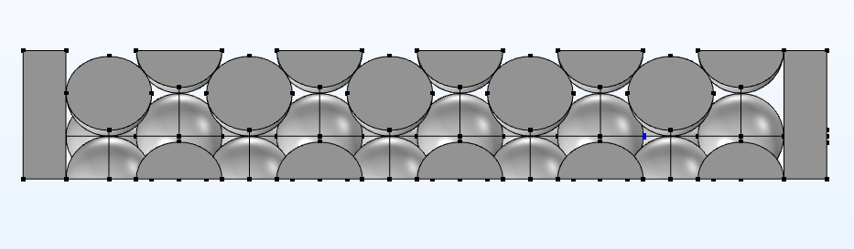



Interpretation of thermal conductivity
Ensure mesh and tolerance settings result in heat in/out within ~2%
Calculate an envelope for effective thermal conductivity
Sweep temperature and pressure
dT₁
dx₁
$${\dot{Q}}_{out}$$
$${\dot{Q}}_{in}$$
dT₂
dx₂
$$k=−\frac{{\dot{Q}}_{in}}{A\frac{dT}{dx}}$$

Slide 10
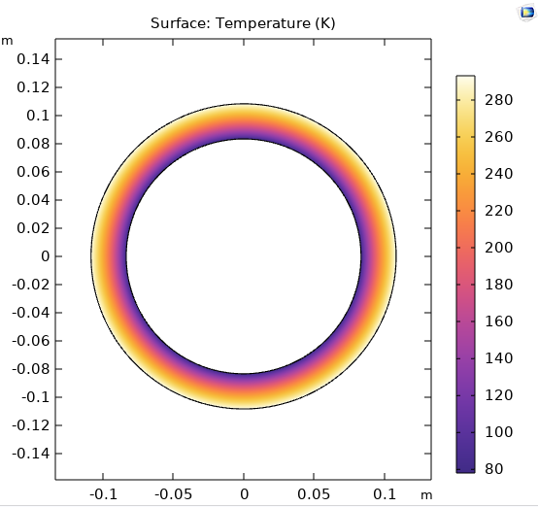


Mesoscale – Cryostat effective conductivity validation
Ambient
$$k(T,P)$$
Cryo liquid
Insulation (bubbles)
$$k=\frac{{\dot{Q}}_{out}}{\frac{2π\left(T_{1}−T_{2}\right)}{ln\left({r_{2}}/{r_{1}}\right)}}$$
(Simulated results are specific to model parameters including geometry, material properties, and boundary conditions)

Slide 11
Results
10 mTorr, 160K
31% (this work)
38% (Kim et al)
10 mTorr, 300K
67% (this work)
54% (Kim et al)

Slide 12
Model limitations
Lack of spectral radiation data at cryogenic temperatures
Continuum approximation in quasi-ballistic regime
Limited data on microsphere-microsphere contact resistance
Currently a monodisperse, close packed hexagonal distribution (but model provides ability to examine polydisperse and irregular packing)
Not explicitly accounting for gas phase change/condensation

Slide 13
Questions?
Validating effective thermal conductivity of glass microspheres in cryogenic storage insulation via finite element analysis
References
Fesmire, J.E., 2017, “Research and Development History of Glass Bubbles Bulk-Fill Thermal Insulation Systems for Large-Scale Cryogenic Liquid Hydrogen Storage Tanks,” NASA Technical Reports Server, Report Number KSC-E-DAA-TN57204.
Swanger, A., 2021, “NASA-KSC & Liquid Hydrogen: Past, Present & Future,” SPE International, SPE Review London, May-Jun 2021.
Wang, Y, Chen, S, Dang, Z, Jiao, J, Pang, C., 2024, “Research on effective thermal conductivity of hollow glass microspheres under vacuum at low temperature,” Applied Thermal Engineering 252, pp. 123675.
Taghavi, M., Sharma, S., Balakotaiah, V., 2024, “Natural convection effects in insulation layers of spherical cryogenic storage tanks,” International Journal of Heat and Mass Transfer 220, pp. 124918.
Kim, J., Kim, K., Bae, K., Juhn, K.J., Kang, J.S., 2024, “Exploring the ultralow effective thermal conductivity of hollow glass microsphere at various pressures and temperatures,” International Journal of Heat and Mass Transfer 230, pp. 125784.
Marc Dunham, Ph.D. (presenter)
Rob Hunter
Clara Mata, Ph.D.
Matt Mortensen, Ph.D.

