Slide 1


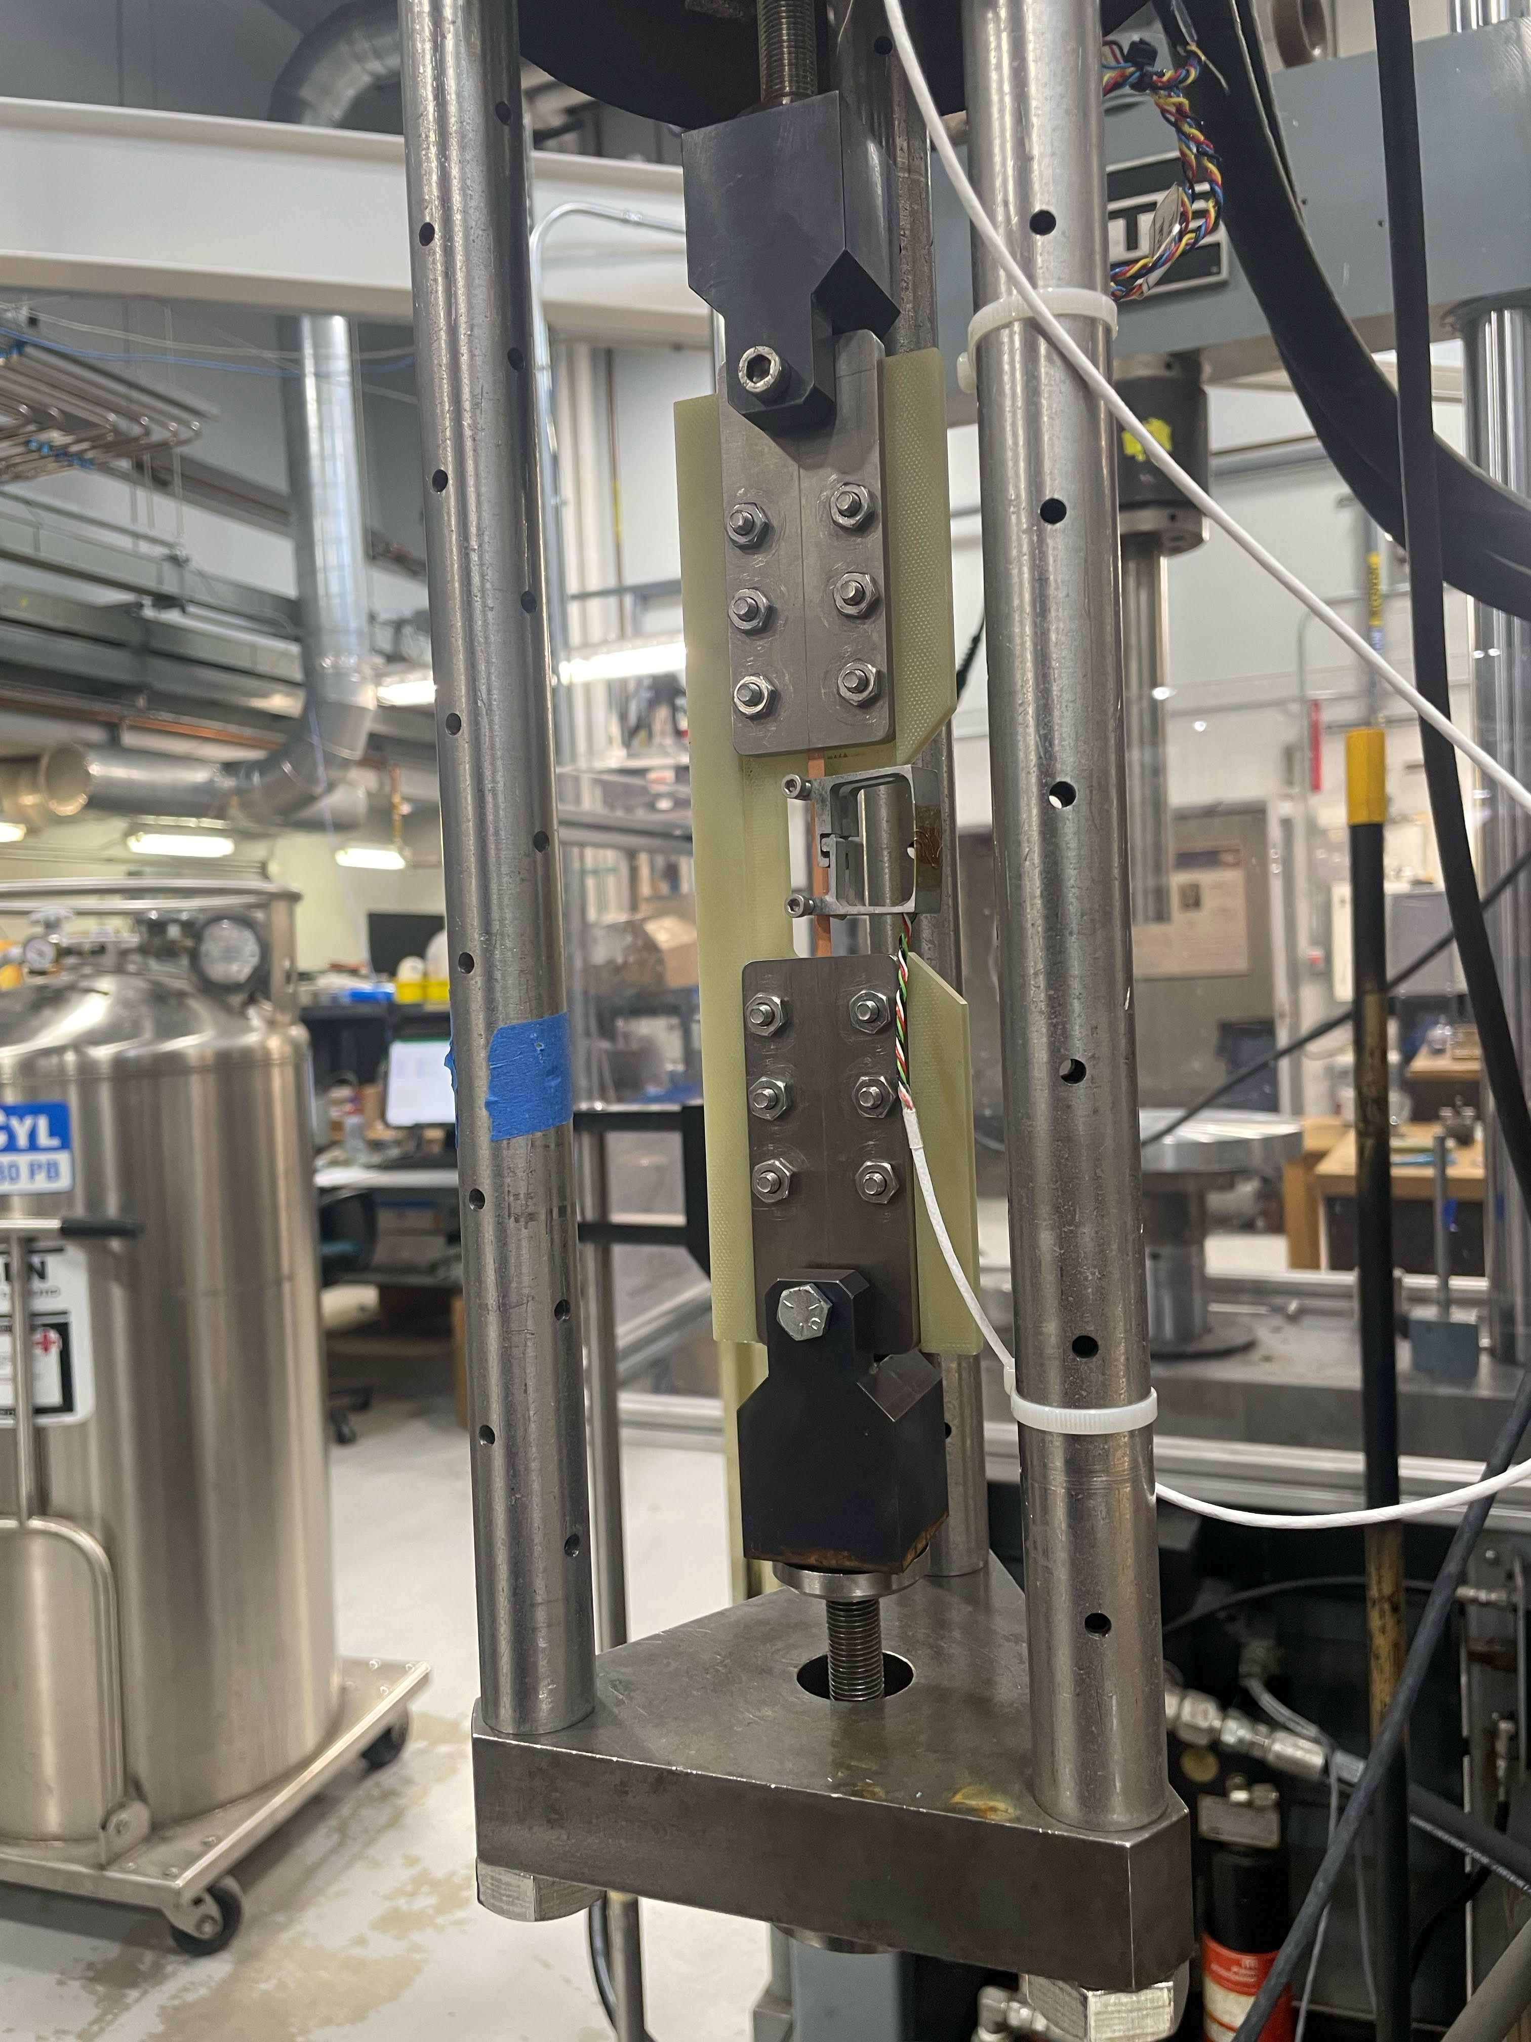
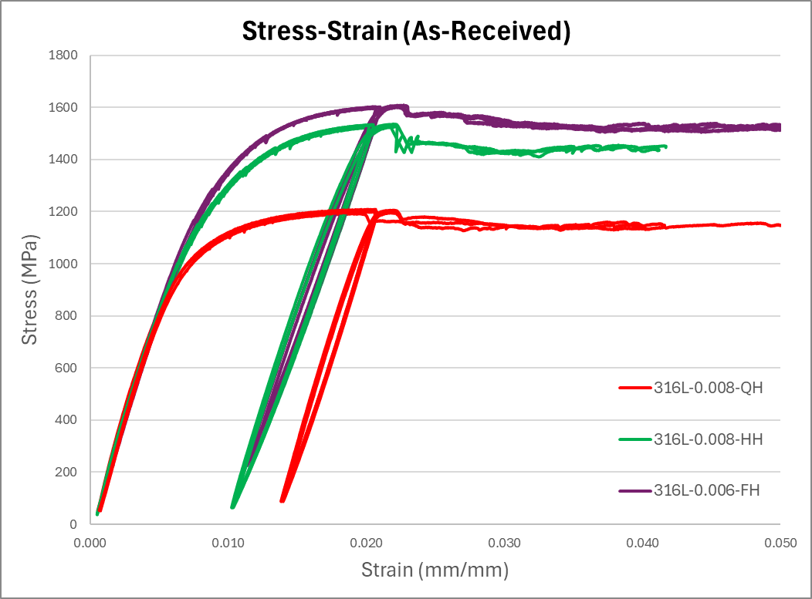
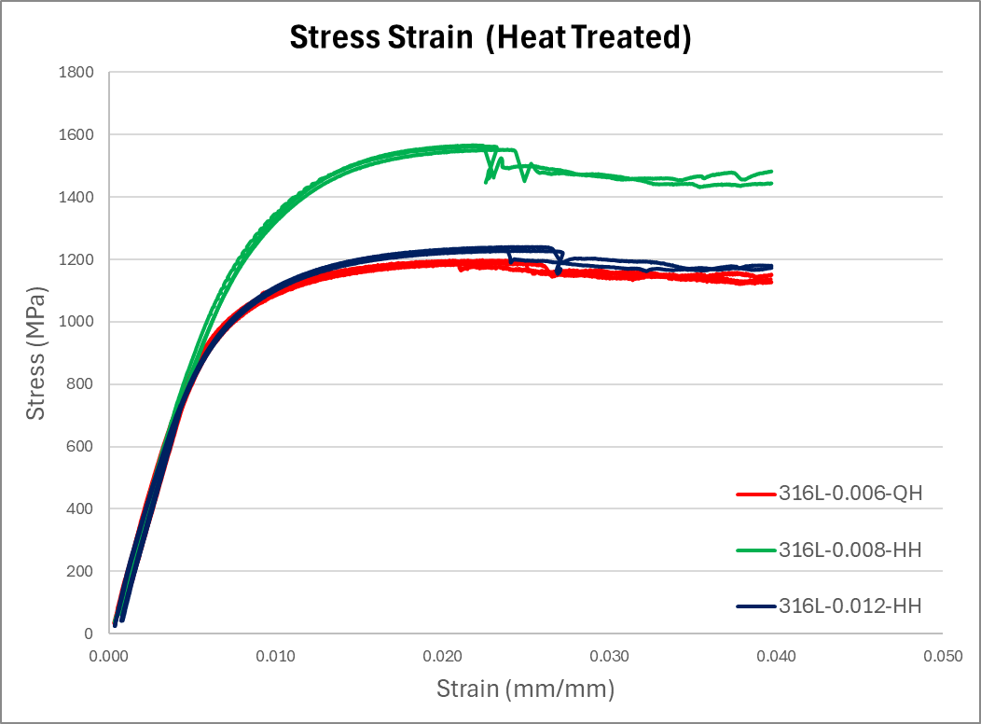

Mechanical Properties of Stainless-Steel co-wind Tapes for REBCO magnets
A. Ingrole and J. Lu – National High Magnetic Field Laboratory, Tallahassee, Florida USA.
Introduction
Results
REBCO HTS tapes offer high critical current density in strong magnetic fields and are used in ultra-high field superconducting magnets.
Co-winding REBCO with insulated 316L stainless-steel tapes is a promising method to improve mechanical performance under high stress.
This study focuses on the mechanical properties of 316L stainless-steel tapes of different tempers (quarter-hard and half-hard).
The impact of heat treatment—simulating sol-gel insulation curing—was investigated to understand its effect on material behavior.
Understanding these effects is essential for optimizing magnet design and co-winding performance in next-generation superconducting systems.
Temper | Thickness (inch) | HT | Modulus (0-0.4% Strain) | Yield strength
Full hard | 0.006 | No | 172±5 | 1354±12
Half hard | 0.008 | No | 175±4 | 1254±7
Quarter hard | 0.008 | No | 180±2 | 1046±8
Quarter hard | 0.006 | Yes | 192±6 | 1022±2
Half hard | 0.008 | Yes | 186±4 | 1288±21
Half hard | 0.012 | Yes | 192±2 | 1020±5
Figure 1: Tensile Test Setup
Material Information
Temper | Thickness (mm) | Serial Number | Heat treatment
Quarter hard | 0.152 (0.006”) | Ulbrich S316L-006-QH-#2-.15555 | 550C, 1 min
Half hard | 0.203 (0.008”) | Ulbrich S316L-008-HH-#2-.15551 | 550C, 1 min
Half hard | 0.305 (0.012”) | Ulbrich S316L-012-HH-#2-.15551 | 550C, 1 min
Test Method
Figure 2: Stress-Strain Curves for As-Received Samples
Figure 3: Stress-Strain Curves for Heat Treated Samples
Discussion
Acknowledgement
A 100 kN Landmark MTS servo-hydraulic tensile machine with a 5 kN load cell and a 25 mm wire extensometer was used for strain measurement.
Tests were conducted in a liquid nitrogen bath (77 K) at a displacement rate of 0.5 mm/min. Grips used are shown in Figure 4.
An unload/reload cycle was applied at 0.4% strain, matching the maximum expected strain in the 40 T magnet design, to determine Young’s modulus.
Samples were loaded up to ~4% strain, without breaking, to simulate operational stress conditions. Three tests were performed per tape length for consistency.
Measured Parameters:
  2% offset yield strength
  Young’s modulus from unload/reload at 0.4% strain
As 316L stainless steel moves from annealed to quarter-hard to half-hard temper, cold working introduces more dislocations and residual stresses into the material.
While cold work increases strength and hardness, the elastic modulus (stiffness) is relatively insensitive and may slightly decrease (typically ~5–10%) because internal stresses and defects disrupt the purely elastic response.
Heat treatment or annealing reduces dislocation density and residual stresses, partially restoring the elastic modulus and improving ductility.
For metals like stainless steels, modulus changes are small across temper levels, unlike strength and hardness, which increase significantly.
Stainless steel tapes were tested in two conditions: quarter-hard (0.006") and half-hard (0.008") as-received.
An increase of approximately 6.5% after heat treatment as expected, ~5–10% modulus variation.
Yield strength showed minimal reduction, around 2%.
This work was performed at the National High Magnetic Field Laboratory, which is supported by National Science Foundation Cooperative Agreement No. DMR-1644779, DMR-1839796, DMR- 2131790, and the State of Florida.
Reference:
Callister Jr, William D., and David G. Rethwisch. Materials science and engineering: an introduction. John wiley & sons, 2020.
Davis, Joseph R., ed. Stainless steels. ASM international, 1994.
A01 Committee. "Specification for Annealed or Cold-Worked Austenitic Stainless Steel Sheet, Strip, Plate, and Flat Bar." ASTM International. doi 10 (2015).

