Slide 1

Design, fabrication, and testing of the quadrupole triplet magnet for the HRS project
Xiaoji Du, Yamen Al-Mahmoud, Yoonhyuck Choi, David Greene, Junseong Kim, Ryan Koschay, Hai Nguyen, John Wenstrom, Ting Xu, Danlu Zhang, Hengkang Zheng
Facility for Rare Isotope Beams, Michigan State University, East Lansing, MI 48824, USA

Slide 2
Outline
Introduction of HRS project in FRIB
Quadrupole triplet magnet for HRS project
Magnet design
Magnet fabrication
Magnet cold test
Summary

Slide 3
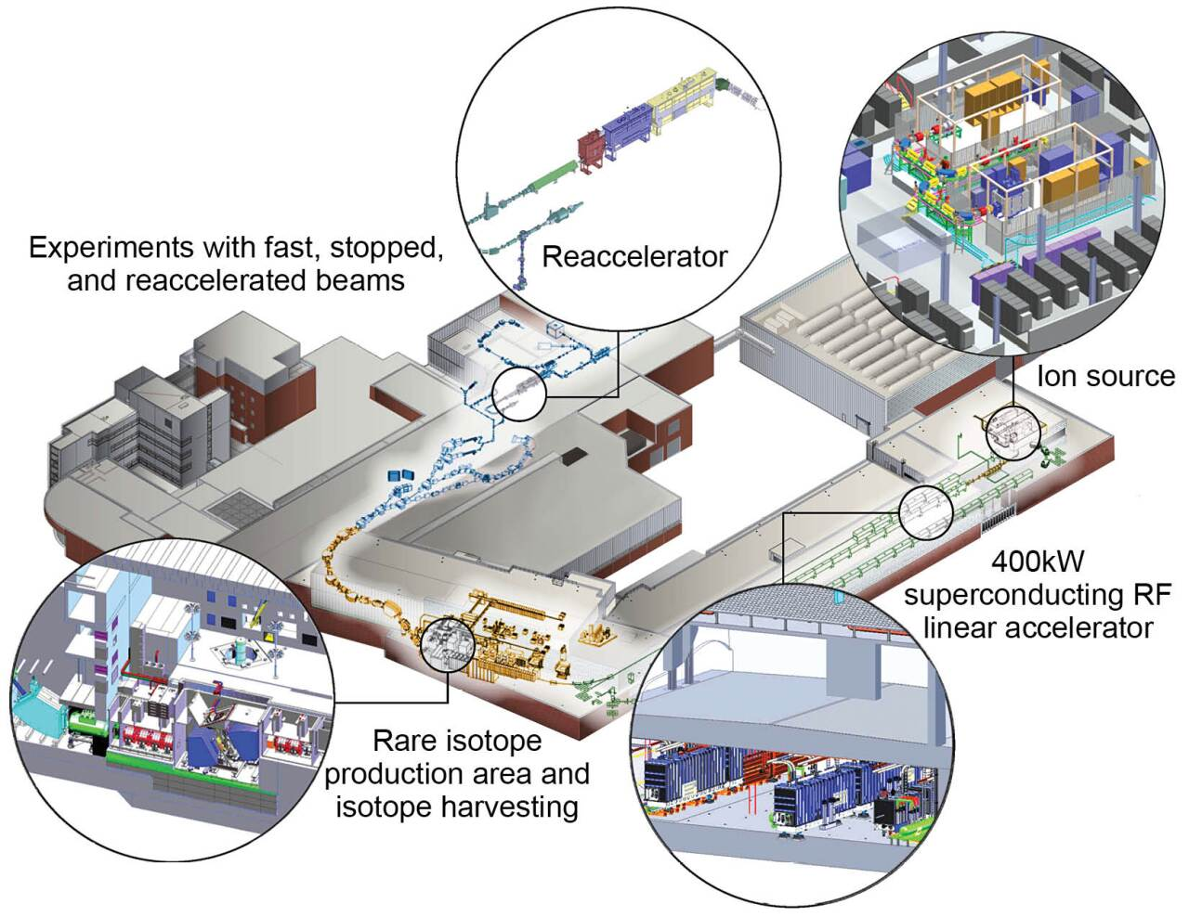
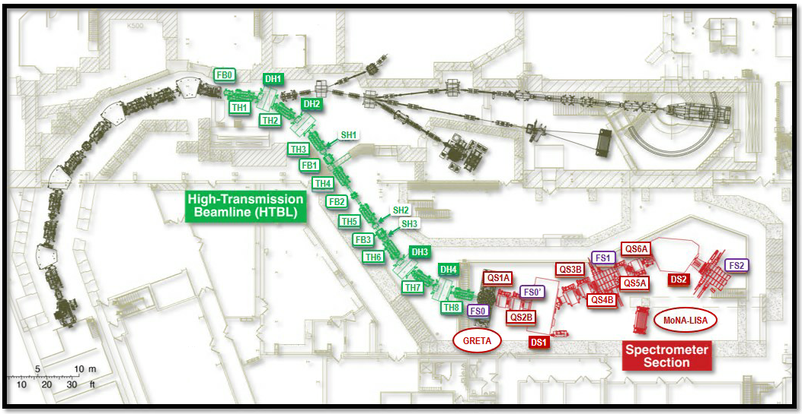
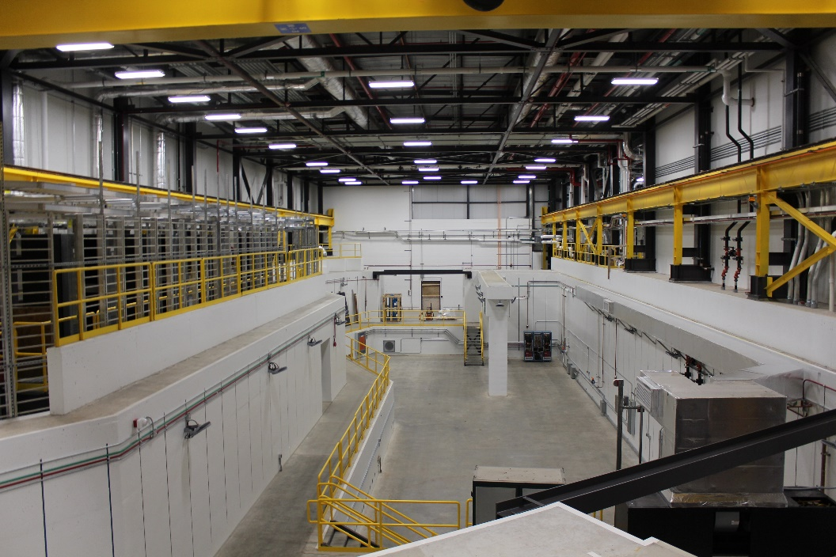
Introduction of HRS project in FRIB
High Rigidity Spectrometer (HRS) is a key expansion of FRIB user facility and will improve beam efficiency and provide high rigidity (8 Tm) rare isotope beams
HRS project divided into two sub-projects: High Transmission Beamline (HTBL) and Spectrometer Section (SPS)
HRS

Slide 4
Quadrupole triplet magnet for HRS project
Functional Requirements for the Quadrupole Magnets of the HTBL
Parameter | QHA | QHB
Quantity (in 8 quadrupole triplets) | 16 | 8
Effective field length (nominal) (m) | 0.40 | 0.79
Pole-tip radius (m) | 0.15 | 0.15
Warm-bore radius (m) | 0.10 | 0.10
Quadrupole maximum field strength (T@poletip, base requirement) | 2.34 | 2.48
Quadrupole maximum field strength (T@poletip, with 10% tuning margin) | 2.57 | 2.73
Quadrupole gradient integral (T, base requirement) | 6.24 | 13.06
Quadrupole gradient integral (T, with 10% tuning margin) | 6.86 | 14.37
Quadrupole good-field region radius (m) | 0.10 | 0.10
Maximum higher-order-field contamination (%) | 1 | 1
Sextupole maximum field strength (T/m², base requirement) | 10 | 10
Sextupole maximum field strength (T/m², with 10% tuning margin) | 11 | 11
Octupole maximum field strength (T/m³, base requirement) | 50 | 50
Octupole maximum field strength (T/m³, with 10% tuning margin) | 55 | 55

Slide 5
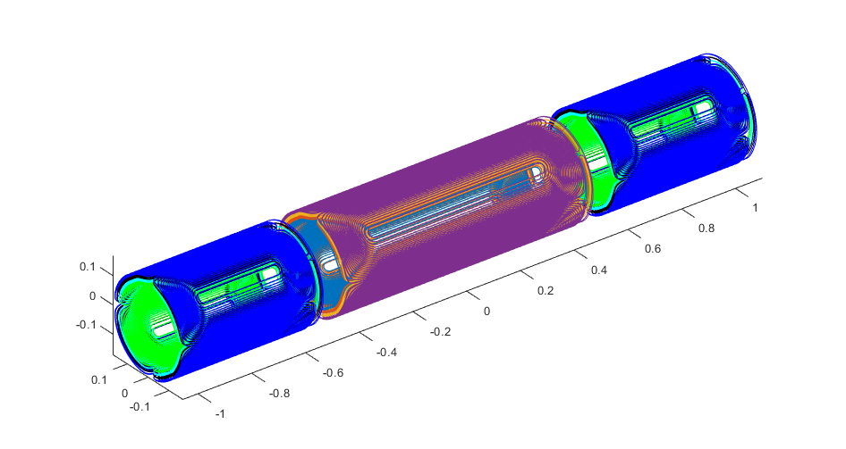
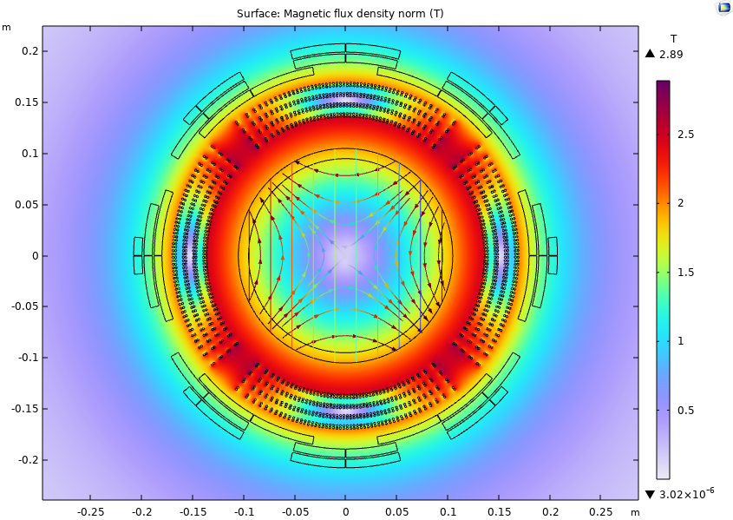
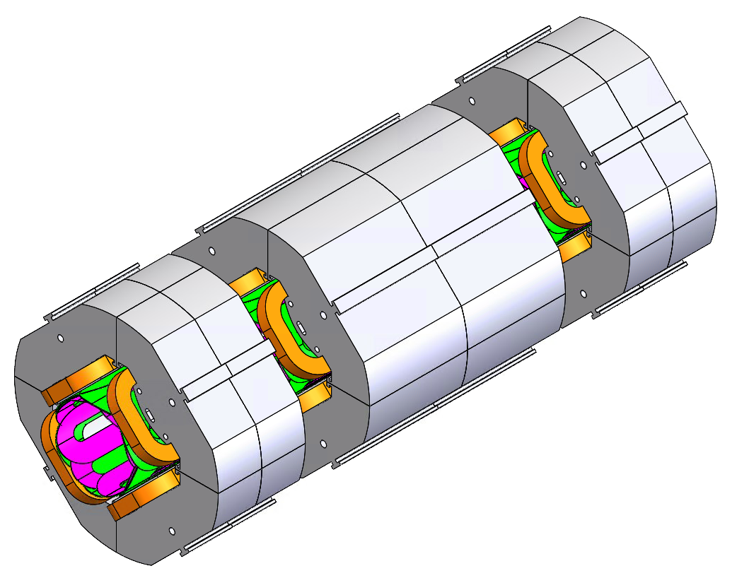
Magnet design
Coil-dominated quadrupole triplet (CDQT)
Lower weight
Decreased helium consumption
Reduced cool-down time
Improved mechanical performance
Shortened secondary beam tuning time
Iron-dominated quadrupole triplet (IDQT)

Slide 6
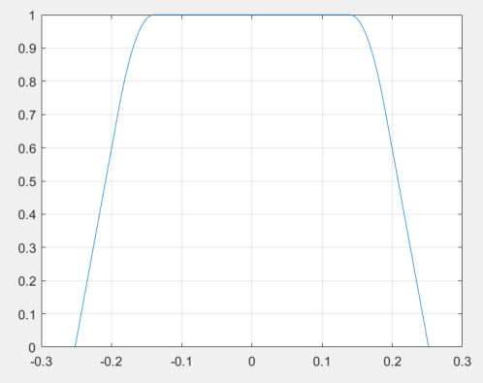
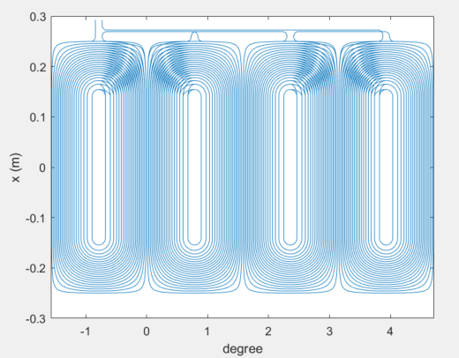
Magnet design
Quadrupole design (discrete cosine theta coil)
Property | Value
Multipole Order | 2
Number of super-layers | 4
Number of Layers per super-layers | 2
Number of Turns | 20, 21, 23, 24
Length of cable [m] | 731.47
Min wire spacing in arcs [mm] | 3.4
Min wire spacing in straights [mm] | 3.8
Tip-to-Tip length [m] | 0.5
Effective Length, L₀ (m) | 0.40
Radius of Aperture, R₀ (m) | 0.10
Quad. MAX gradient, G₂ (T/m) | 17.4
Quad. MAX grad. integral, Gi₂ (T) | 6.98
Maximum non-quadrupole content | 0.12%
Bmax in coil [T] | 2.9
Total magnetic stored energy [kJ] | 70
Total Inductance [H] | 0.69
Shape function
2D plot of coil geometry
Quadrupole gradient along beam axis
Harmonic decomposition analysis

Slide 7
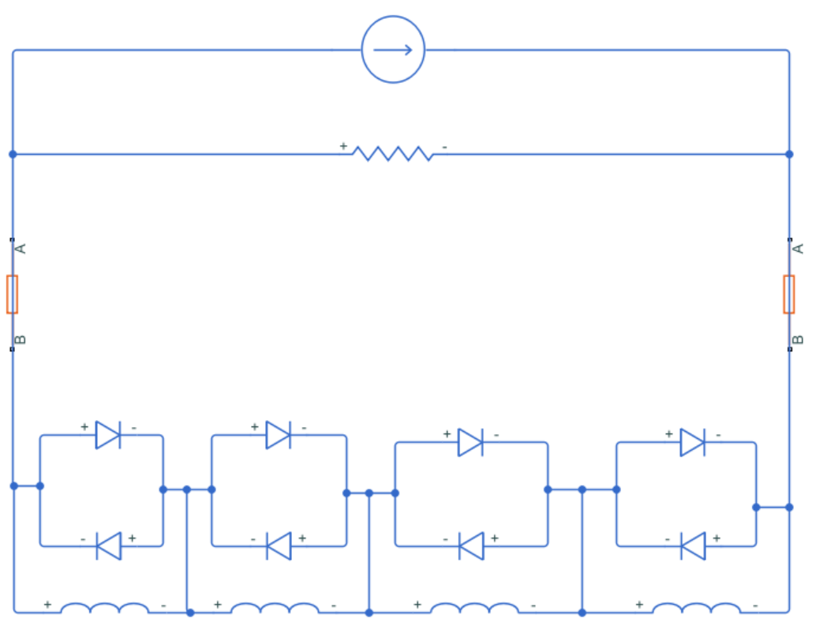
Magnet design
Quench protection circuit for quadrupole
PS (500A)
Room Temperature
Slow Dump Resistor (0.16 Ohm)
HTS Leads
HTS Leads
Cold Diodes (4V)
SC Coil
SC Coil
SC Coil
SC Coil
In Cryo Vessel

Slide 8
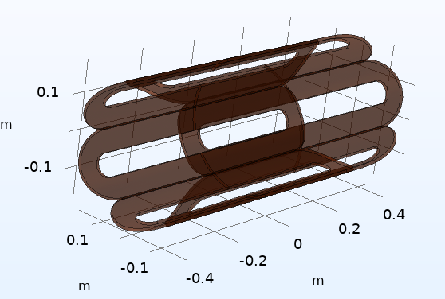
Magnet design
Sextupole coil (QHA)
Operating Current [A] | 36
Diameter of wire [mm] | 0.6
Inner Radius [m] | 0.1798
Outer Radius [m] | 0.1874
Number of Turns | 969
Racial Thickness [mm] | 7.6
Packing factor | 0.562
straight section length [mm] | 302.714
Total length [mm] | 490
Start angle [degree] | 0.0797
End angle [degree] | 20.1077
Coil angle [degree] | 20.028
Max field on wire [T] | 0.658
Reference radius [m] | 0.1
Field Gradient [T/m^2] | 11.2566
Effective length [mm] | 409.2489
Integrated Strength [T/m] | 4.6068
Non_uniform | 0.3322%

Slide 9
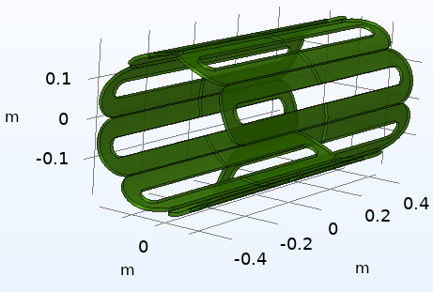
Magnet design
Octupole coil (QHA)
Operating Current [A] | 36
Diameter of wire [mm] | 0.6
Inner Radius [m] | 0.1892
Outer Radius [m] | 0.1975
Number of Turns | 819
Racial Thickness [mm] | 8.3
straight section length [mm] | 341.90
Packing factor | 0.554
Total length [mm] | 490
Start angle [degree] | 0.0755
End angle [degree] | 14.9935
Coil angle [degree] | 14.918
Max field on wire [T] | 0.664
Reference radius [m] | 0.1
Field Gradient [T/m^3] | 56.0406
Effective length [mm] | 427.93
Integrated Strength [T/m^2] | 23.98
Non_uniform | 0.0878%

Slide 10
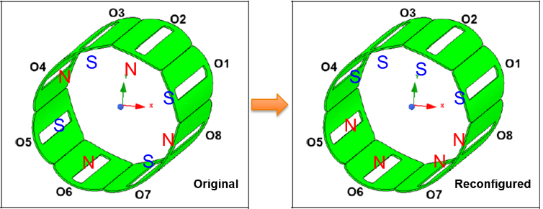
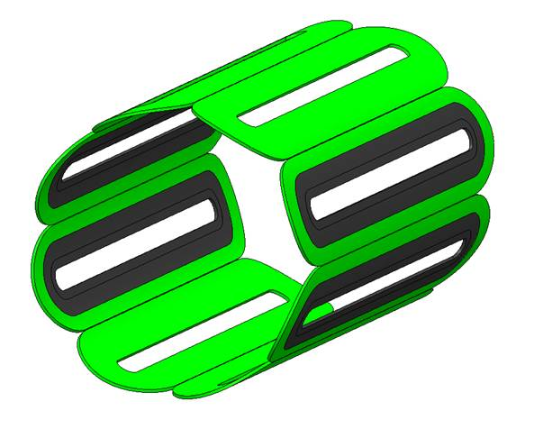
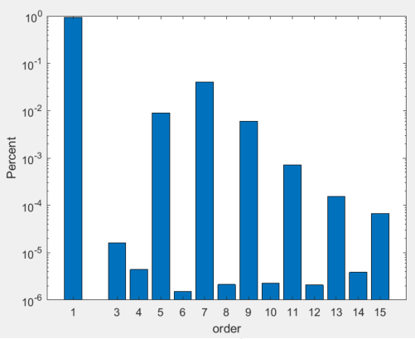
Magnet design
Dipole
Operating Current [A] | 36
Diameter of wire [mm] | 0.6
Inner Radius [m] | 0.1993
Outer Radius [m] | 0.2076
Number of Turns | 866
Racial Thickness [mm] | 8.3
straight section length [mm] | 341.90
Packing factor | 0.554
Total length [mm] | 490
Start angle [degree] | 0.075
End angle [degree] | 15.075
Coil angle [degree] | 15
Ratio of co-winding | 0.33
Max field on wire [T] | 0.686
Reference radius [m] | 0.1
Field Strength [T] | 0.06488
Effective length [mm] | ~428
Integrated Strength [Tm] | ~0.0278
Non_uniform [%] | 5.669

Slide 11
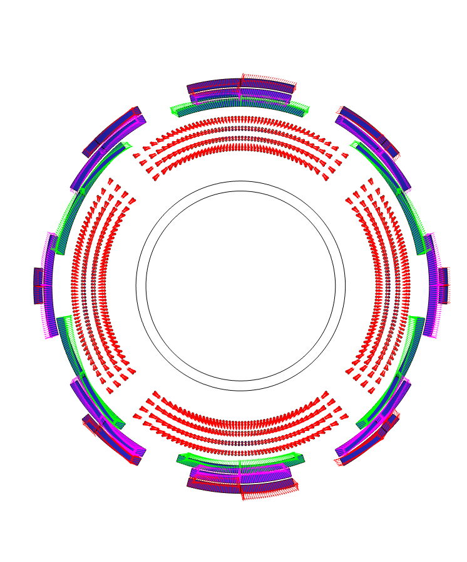
Magnet design
Force calculation
Polarity (1 for +36 A; -1 for -36 A)
8 different cases totally (Setting quadrupole to 450 A)
Dipole | Sext | Octu
1 | 1 | 1
1 | 1 | -1
1 | -1 | 1
1 | -1 | -1
-1 | 1 | 1
-1 | 1 | -1
-1 | -1 | 1
-1 | -1 | -1

Slide 12
Magnet design
Polarity |  |  |  | Dipole |  | Quadrupole |  |  |  |  |  |  |  | Sextupole |  | Octupole
 |  |  |  |  |  | Layer_1 |  | Layer_2 |  | Layer_3 |  | Layer_4
Dipole | Sext | Octu |  | F_x (N/m) | F_y (N/m) | F_x (N/m) | F_y (N/m) | F_x (N/m) | F_y (N/m) | F_x (N/m) | F_y (N/m) | F_x (N/m) | F_y (N/m) | F_x (N/m) | F_y (N/m) | F_x (N/m) | F_y (N/m)
1 | 1 | 1 | maximum net force of segment | 45164 | 20379 | 167670 | 143560 | 106640 | 110040 | 108290 | 129400 | 119810 | 145030 | -29698 | 39337 | 34499 | 45521
1 | 1 | -1 |  | 31209 | 14702 | 154510 | 156720 | 111510 | 93830 | 132320 | 105370 | 149850 | 114990 | -49599 | 27608 | 51732 | 41570
1 | -1 | 1 |  | 44422 | 23369 | 141190 | 142860 | 74790 | 110030 | 70438 | 129400 | 75246 | 145050 | 43944 | 39337 | 49671 | 45521
1 | -1 | -1 |  | 18929 | 14702 | 128030 | 155890 | 79675 | 93484 | 94468 | 105370 | 105290 | 115010 | 63845 | 27608 | 36560 | 41570
-1 | 1 | 1 |  | 45164 | 34366 | 166720 | 153740 | 106150 | 99413 | 108160 | 118290 | 119660 | 133400 | -29698 | 38234 | 34499 | 50231
-1 | 1 | -1 |  | 31209 | 36802 | 153680 | 166900 | 111400 | 104480 | 132190 | 94259 | 149700 | 103360 | -49599 | 26505 | 51732 | 43460
-1 | -1 | 1 |  | 44422 | 34366 | 140420 | 152970 | 74515 | 99422 | 70567 | 118290 | 75390 | 133370 | 43944 | 38234 | 49671 | 50231
-1 | -1 | -1 |  | 30467 | 36802 | 127380 | 166000 | 79785 | 104060 | 94597 | 94257 | 105430 | 103330 | 63845 | 26505 | 36560 | 43460
1 | 1 | 1 | minimum net force of segment | -44422 | -34366 | -140420 | -152970 | -74515 | -99422 | -70567 | -118290 | -75390 | -133370 | -43944 | -38234 | -49671 | -50231
1 | 1 | -1 |  | -30467 | -36802 | -127380 | -166000 | -79785 | -104060 | -94597 | -94257 | -105430 | -103330 | -63845 | -26505 | -36560 | -43460
1 | -1 | 1 |  | -45164 | -34366 | -166720 | -153740 | -106150 | -99413 | -108160 | -118290 | -119660 | -133400 | 29698 | -38234 | -34499 | -50231
1 | -1 | -1 |  | -31209 | -36802 | -153680 | -166900 | -111400 | -104480 | -132190 | -94259 | -149700 | -103360 | 49599 | -26505 | -51732 | -43460
-1 | 1 | 1 |  | -44422 | -23369 | -141190 | -142860 | -74791 | -110030 | -70438 | -129400 | -75246 | -145050 | -43944 | -39337 | -49671 | -45521
-1 | 1 | -1 |  | -30467 | -14702 | -128030 | -155890 | -79675 | -93484 | -94468 | -105370 | -105290 | -115010 | -63845 | -27608 | -36560 | -41570
-1 | -1 | 1 |  | -45164 | -23369 | -167670 | -143560 | -106640 | -110040 | -108290 | -129400 | -119810 | -145030 | 29698 | -39337 | -34499 | -45521
-1 | -1 | -1 |  | -31209 | -14702 | -154510 | -156720 | -111510 | -93830 | -132320 | -105370 | -149850 | -114990 | 49599 | -27608 | -51732 | -41570
The maximum segment net force always appears on quadrupole. The order of magnitude of max/min force remains roughly unchanged when changing polarities.

Slide 13
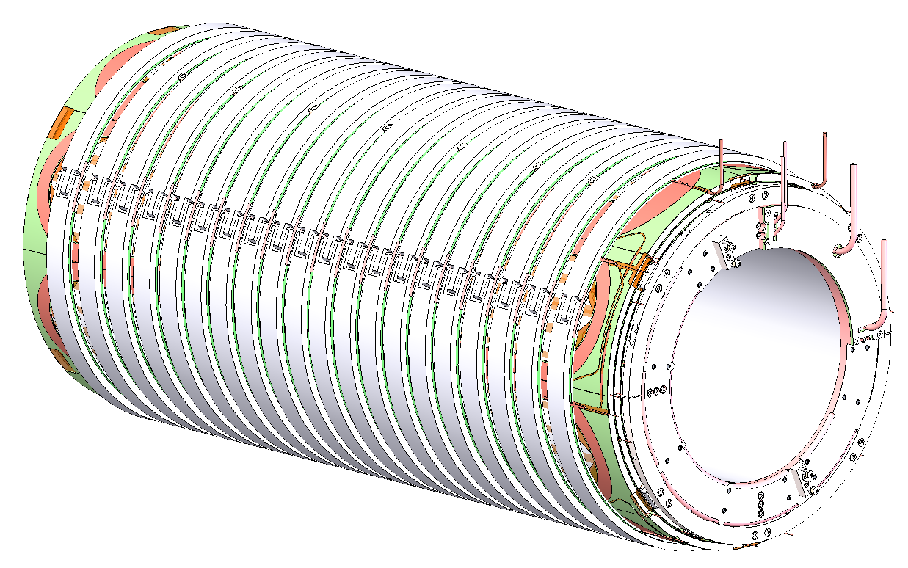
Magnet design
Overbending structure
M1Po3C-02: Structural analysis and field mapping test setup of the quadrupole triplet magnet for HRS project
Hengkang Zheng, Xiaoji Du, Yamen Al-Mahmoud, Yoonhyuck Choi, David Greene, Junseong Kim, Ryan Koschay, Hai Nguyen, John Wenstrom, Danlu Zhang, Ting Xu

Slide 14
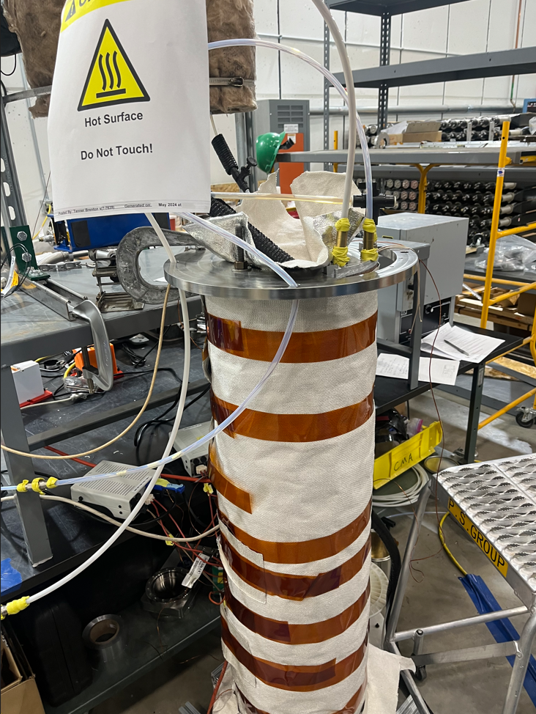
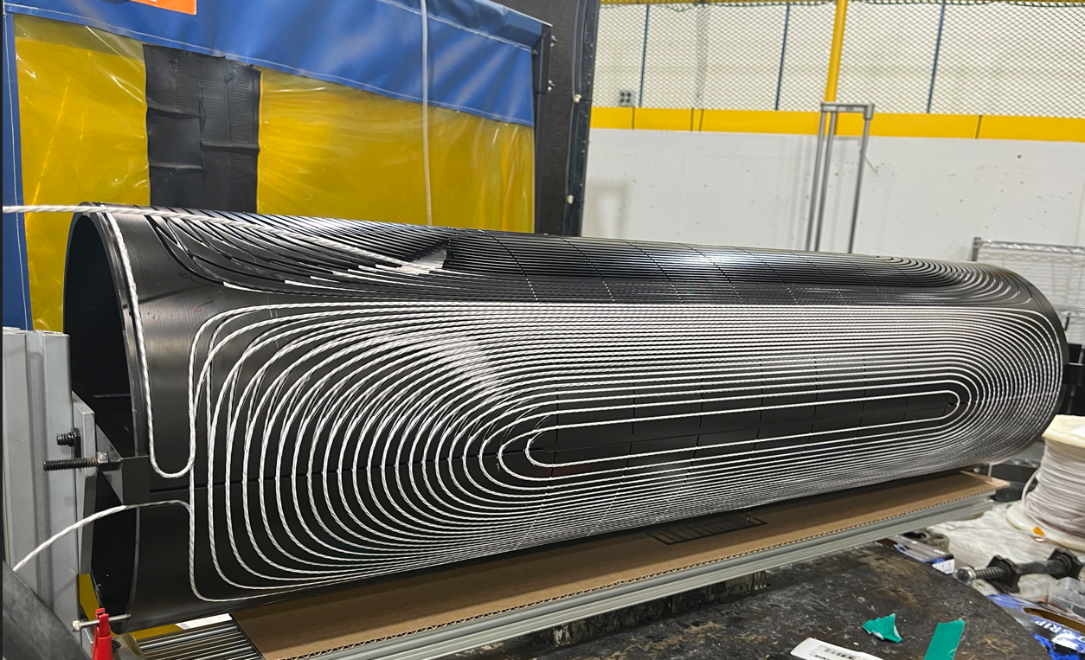
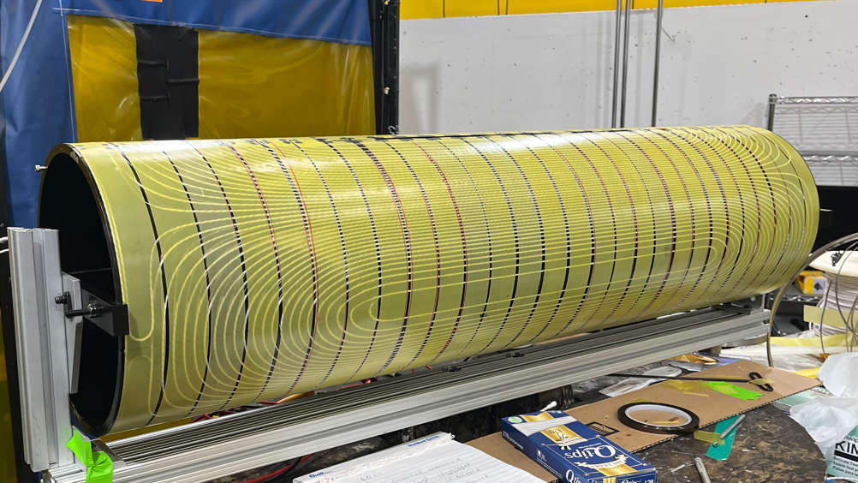
Magnet Fabrication
Quadrupole coil fabrication
The quadrupole is discrete cosine-theta NbTi coil wound on anodized Aluminum bobbin, There are 4 layers with G-10 inter-layer separators and aluminum outer cylinder.
Coil winding
G-10 pieces overbending
Vacuum Pressure Impregnation

Slide 15
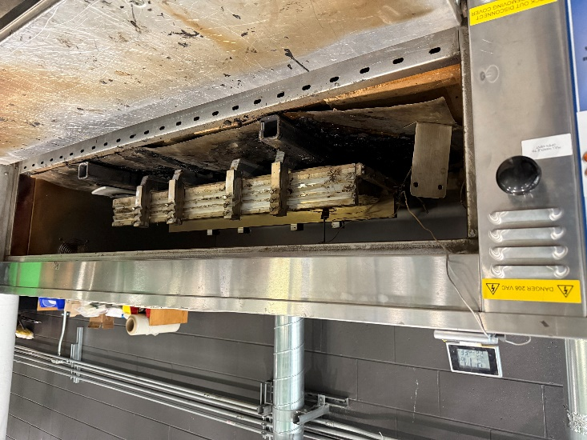
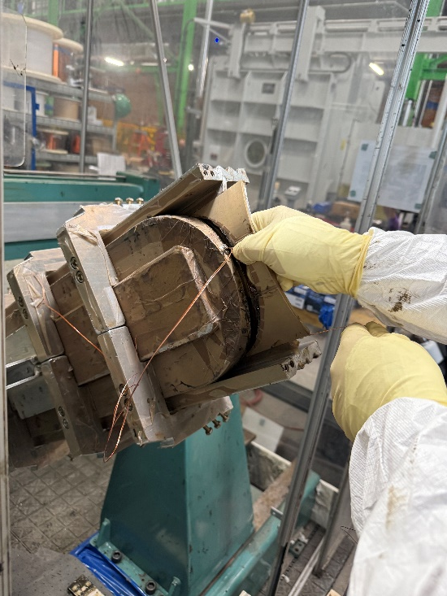
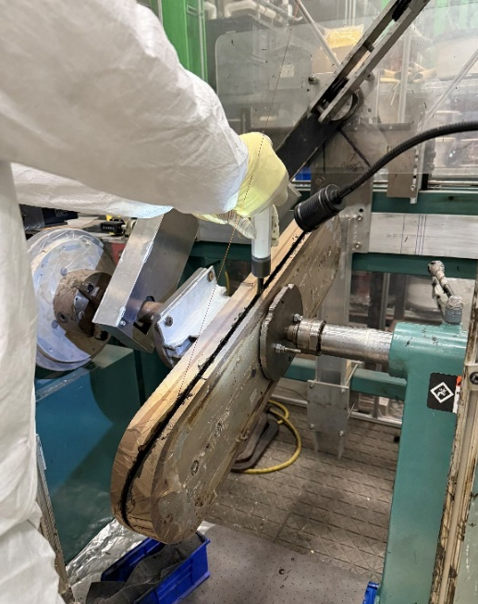
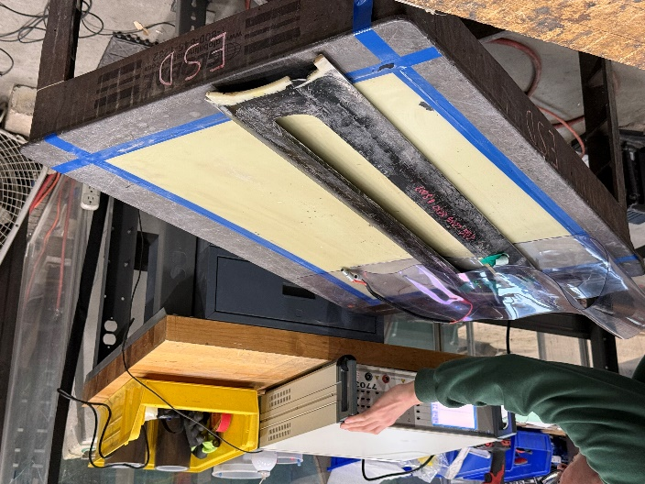
Magnet Fabrication
Multipole coil fabrication
Curing
Inspection
Coil winding
Side clamp bars and end pieces assembly

Slide 16
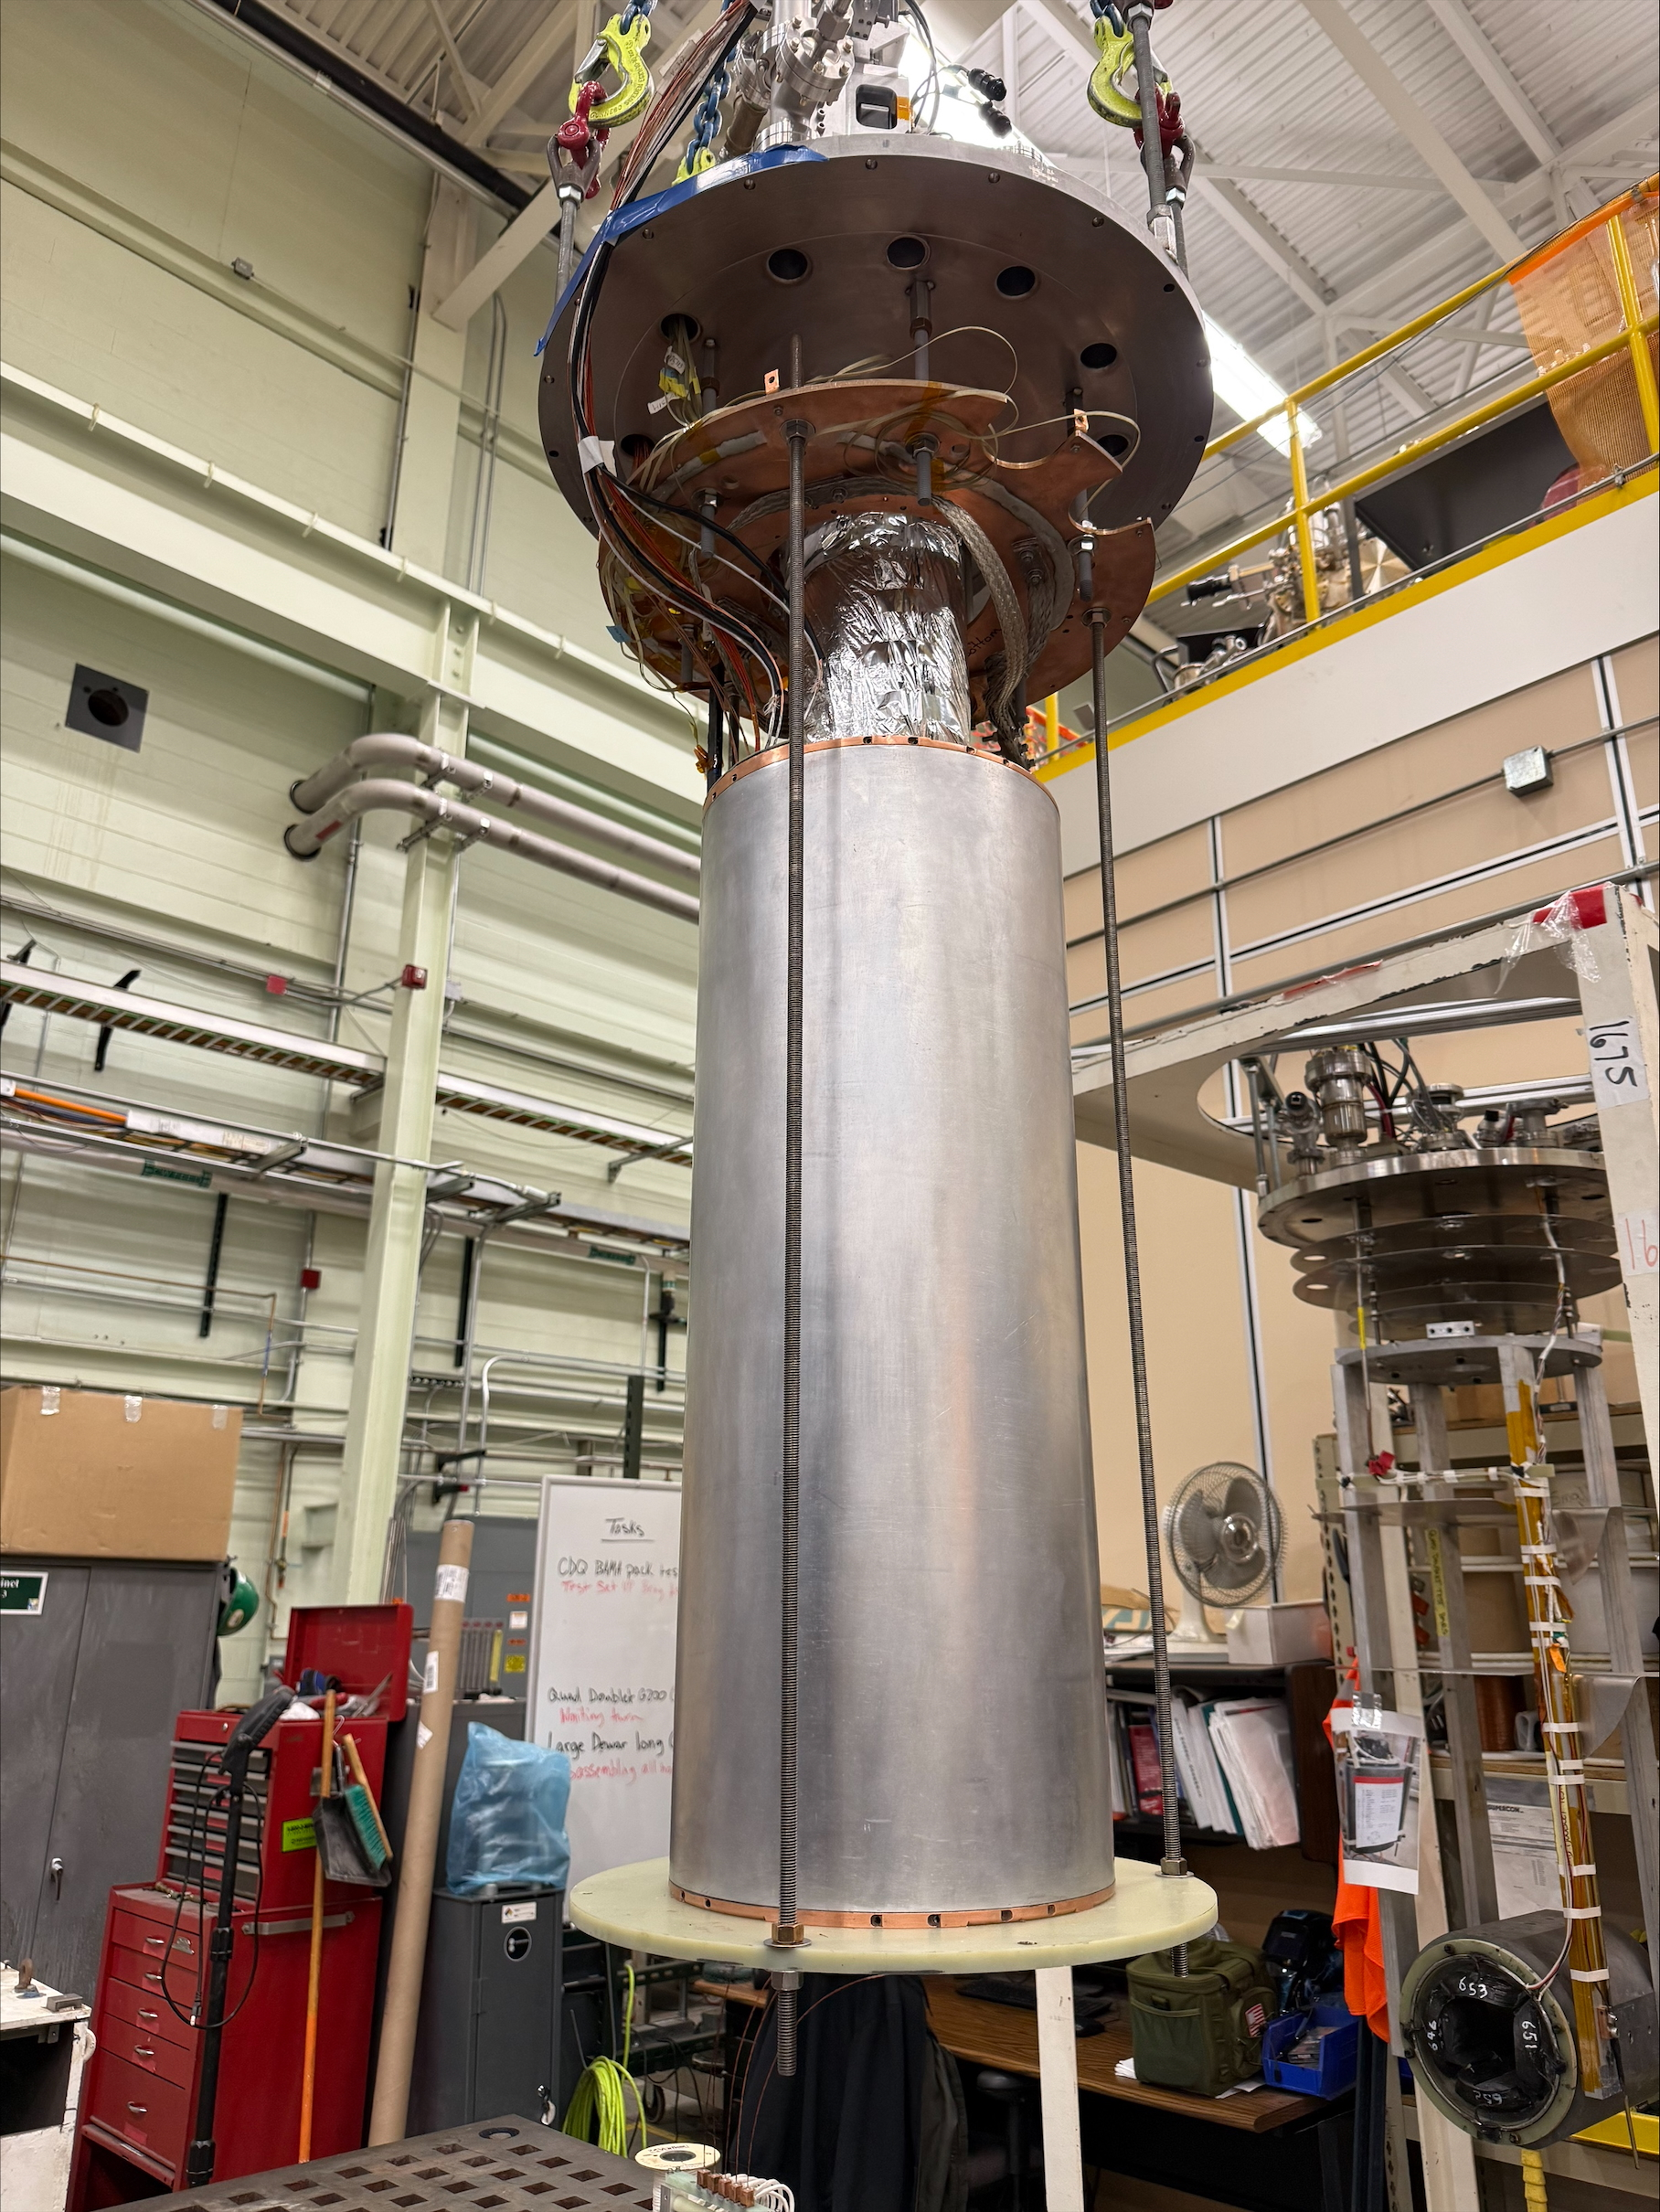
Quadrupole coil testing
The single-layer prototype
  In-house fabrication, and cold testing have been completed.
The full-scale quadrupole coils
  Fabricated by vendors.
  2 long and 6 short coils have been fabricated.
  1 long and 1 short coil have passed cold testing，with no quench occurrences.
  The remaining coils are currently waiting for testing.
Quadrupole coil LHe test set up

Slide 17
Summary
A discrete cosine theta quadrupole triplet was designed for HRS project.
Quench protection circuit was designed to ensure the safe operation of superconducting magnets.
The quadrupole coils have been fabricated and has passed individual cold testing.
The multipole coils, which is paired with the long quadrupole coil, have also been fabricated.
Next step: assemble the multipole and quadrupole coils together and carry out cold testing.
References:
  [1] Yoonhyuck Choi, et al., “The High Transmission Beamline Superconducting Magnets for High Rigidity Spectrometer Project at FRIB: Design Status”, IEEE Transactions on Applied Superconductivity, vol. 35, no. 5, August 2025.
  [2] D. Greene, et al., "Design of Coil-Dominated Quadrupole Triplet for High Rigidity Isotope Beams," IEEE Transactions on Applied Superconductivity, vol. 33, no. 5, pp. 1-5, 2023.
  [3] D. Greene, et al., “Status of coil-dominated discrete-cosine-theta quadrupole prototype for High Rigidity isotope beams”, 15th IPAC, 2024, doi: 10.18429/JACoW-IPAC2024-WEPS67

