Slide 1


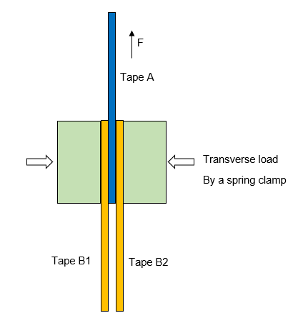
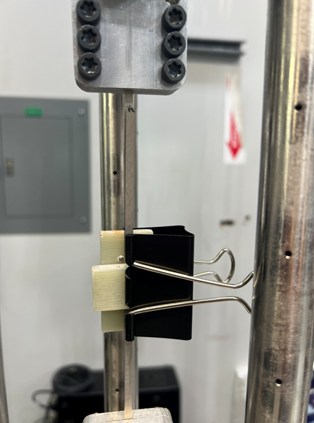
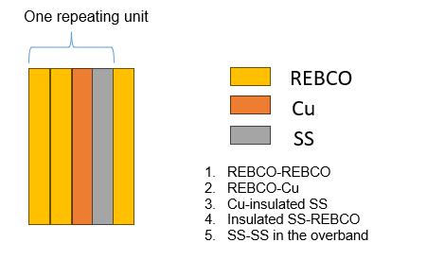
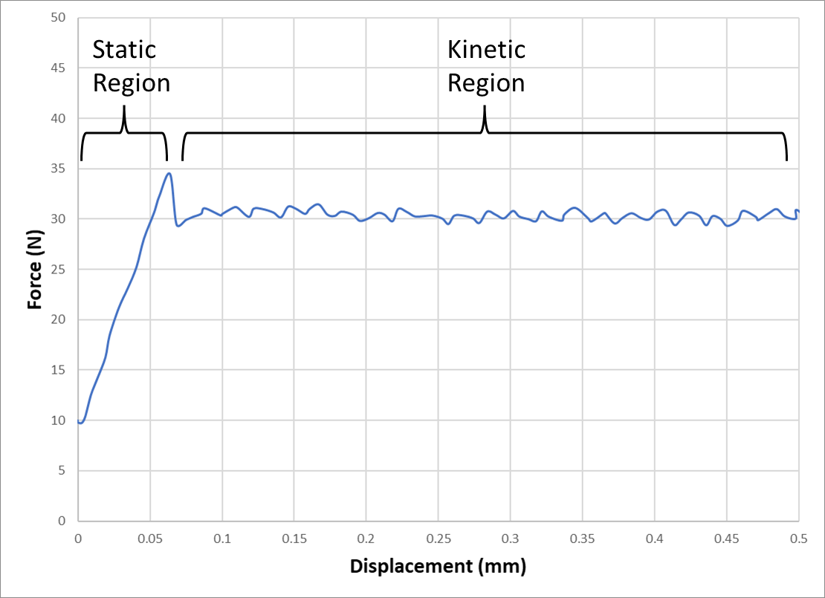
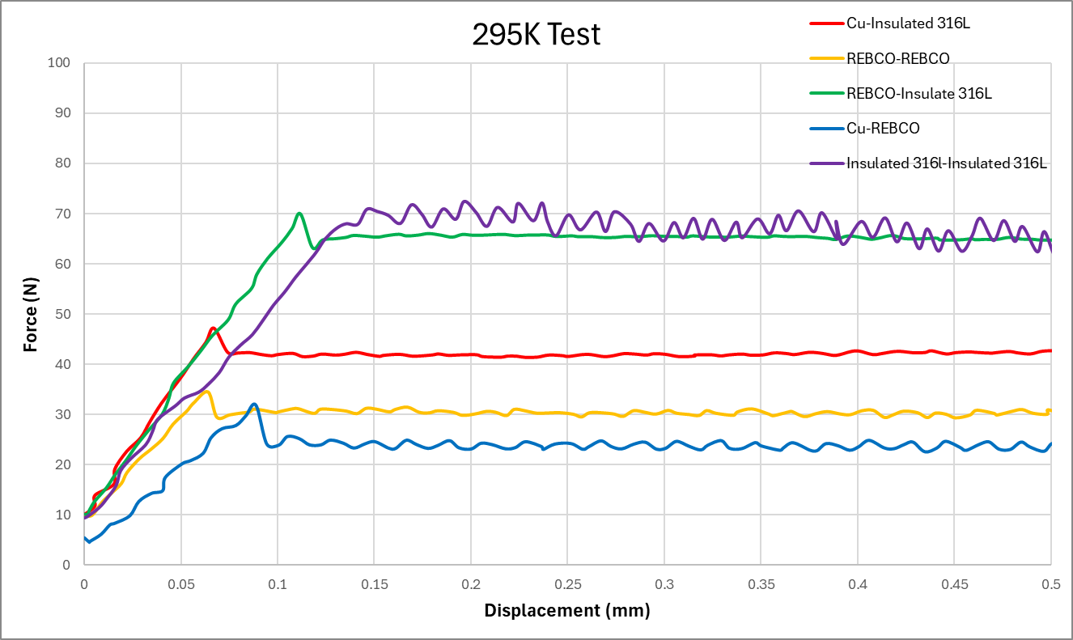
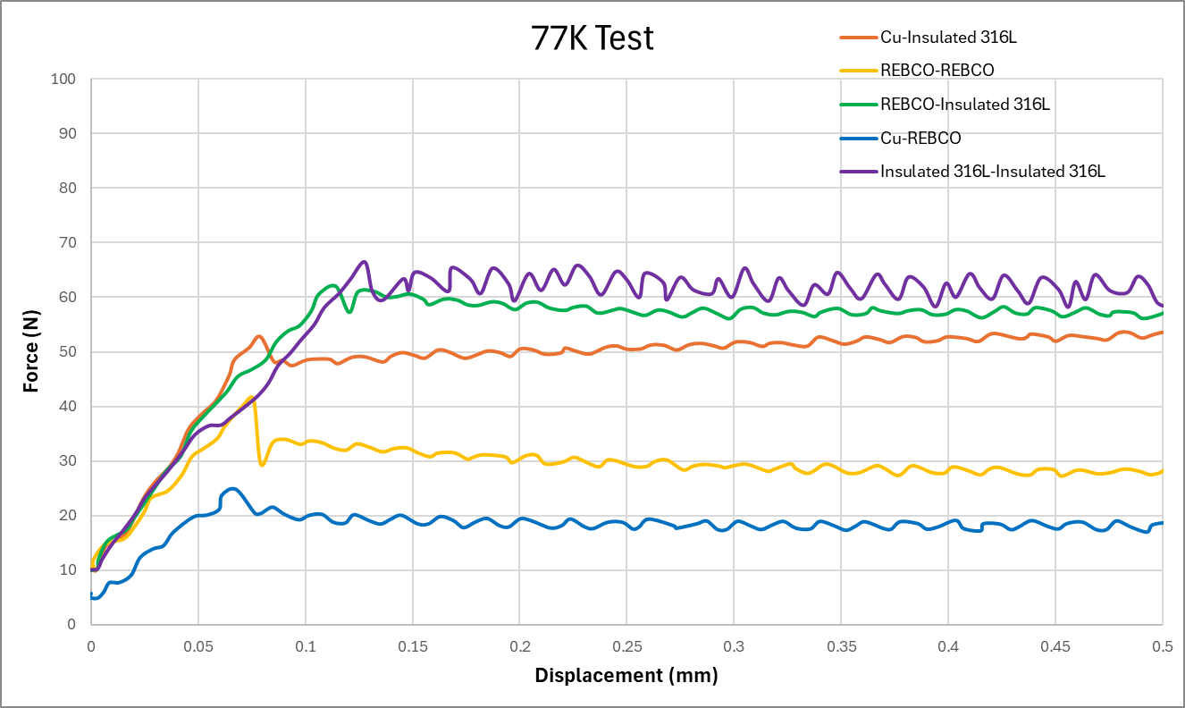

Friction Coefficient Measurements for High-Temperature Superconducting Magnet Design
A. Ingrole and J. Lu – National High Magnetic Field Laboratory, Tallahassee, Florida USA.
Introduction
Test Setup
Results
In dry-wound 40 T superconducting magnets, friction between tape turns is crucial for load transfer and stress distribution across multiple tape interfaces.
The friction coefficient (μ) varies with surface conditions, pressure, and temperature; static friction (μs) is typically greater than kinetic friction (μk).
Existing data are limited to room temperature and often inconsistent; no prior measurements exist at cryogenic temperatures.
A custom experimental setup was developed to measure friction between REBCO and co-winding tapes at 295 K and 77 K under controlled transverse loading.
Results showed temperature-dependent friction behavior, enabling improved stress modeling and magnet design optimization.
Contacting surface | Temp | Number of tests | Static friction coef. | Kinetic friction coef.
Copper - Insulated 316L | 295 K | 5 | 0.71 ± 0.06 | 0.67 ± 0.07
 | 77 K | 2 | 0.76 ± 0.02 | 0.68 ± 0.07
REBCO - REBCO | 295 K | 5 | 0.50 ± 0.07 | 0.42± 0.07
 | 77 K | 2 | 0.54 ± 0.07 | 0.43± 0.00
REBCO - Insulated 316L | 295 K | 5 | 0.97 ± 0.05 | 0.88 ± 0.06
 | 77 K | 2 | 0.91 ± 0.03 | 0.84 ± 0.04
Copper - REBCO | 295 K | 5 | 0.37 ± 0.06 | 0.30 ± 0.04
 | 77 K | 2 | 0.37 ± 0.02 | 0.27 ± 0.02
Insulated 316L - Insulated 316L | 295 K | 5 | 0.97 ± 0.08 | 0.90 ± 0.07
 | 77 K | 2 | 0.88 ± 0.09 | 0.85 ± 0.05
Stdev?
Figure 2: Schematic of the test method and actual setup
Discussion
The lower friction coefficient (0.31) measured for uncoated 316 SS tapes compared to literature values (~0.41–0.52) is likely due to ethanol cleaning, smoother surface conditions, the specific transverse pressure used (350 kPa), and differences in test setup compared to standard tribology methods.
Standard deviations (±0.02–0.09) indicate good overall repeatability, but slight variability is likely due to stick-slip behavior and instrument noise.
The spring clamp was calibrated at room temperature; thermal contraction at 77 K may slightly alter the actual clamping force, introducing minor systematic error.
Misalignment between samples and added friction at roll pins may slightly inflate measured friction values.
Variability in surface roughness, oxide layers, or residual contamination—even after ethanol cleaning—can impact friction measurements between material pairs.
Future work will focus on improving load control, re-benchmarking with known materials, collaborating with tribology experts, and validating results using commercial friction test systems.
Figure 1: Schematic (not to scale) of the 40 T conductor and cowind.
Figure 3: Static and Kinetic region in force-displacement curve
Material Information
Force-Displacement Curves
Name | Details
REBCO | SuperPower SCS4050, 4 mm wide
Stainless Steel | Ulbrich 0.006” thick 316 L Half-Hard, with sol-gel insulation, 4 mm wide
Copper | US foil 0.005” thick C101, Half-Hard, RRR=100, 4 mm wide
Test Method
A 35 N transverse load was applied using a calibrated spring clamp, effective at both 295 K and 77 K, assuming negligible temperature effect on clamp stiffness (Figure 2).
Tape A was placed between two Tape B strips with 25 mm overlap, aligned using G10 blocks and roll pins. The contact pressure was ~350 kPa.
Tests were conducted on a 100 kN MTS machine with a 5 kN load cell and 10 mm/min stroke rate.
Static friction coefficient was calculated using the peak load in the static region of Figure 3, divided by two for dual interfaces.
Kinetic friction was obtained by averaging the force after the peak in Figure 3, minimizing stick-slip effects.
Figure 4: Force-displacement curve at 295K
Acknowledgement
This work was performed at the National High Magnetic Field Laboratory, which is supported by National Science Foundation Cooperative Agreement No. DMR-1644779, DMR-1839796, DMR- 2131790, and the State of Florida.
References:
Dudley Fuller, Coefficients of friction, section 2d, American Institute of physics handbook, 3rd ed.
Huang, M., Fu, Y., Qiao, X., & Chen, P. (2022). Investigation into Friction and Wear Characteristics of 316L Stainless-Steel Wire at High Temperature. Materials, 16(1), 213.
Qin, W., Kang, J., Li, J., Yue, W., Liu, Y., She, D., ... & Li, Y. (2018). Tribological behavior of the 316L stainless steel with heterogeneous lamella structure. Materials, 11(10), 1839.
Figure 5: Force-displacement curve at 77K

