Slide 1
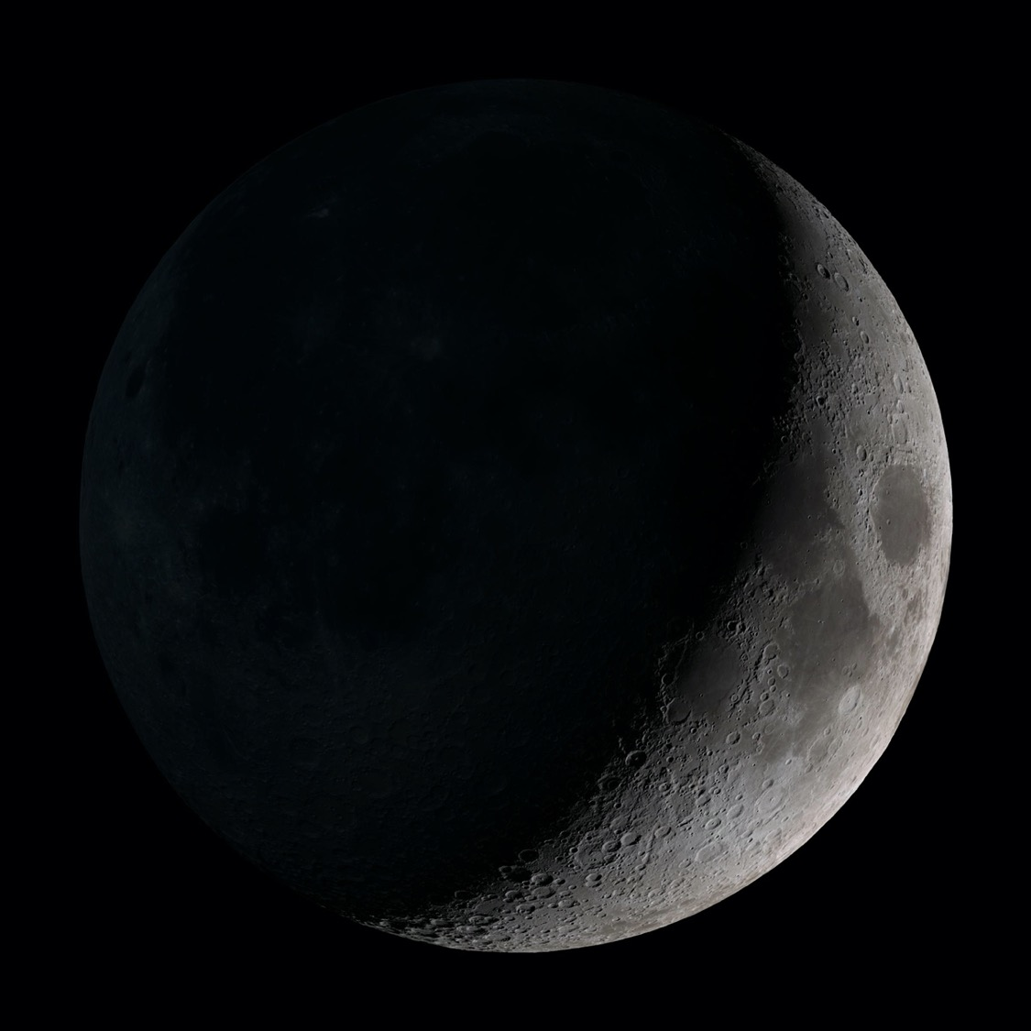



Intro to HLS Propulsion Team
Reid Ruggles¹, Juan Valenzuela², and Wesley Johnson³
¹HLS Propulsion Discipline Lead Engineer, Marshall Space Flight Center
²HLS CFM / MPS Lead, Marshall Space Flight Center
³HLS CFM SME, Glenn Research Center
2025 Cryogenic Engineering Conference, Reno, NV, May 19 – 22, 2025

Slide 2
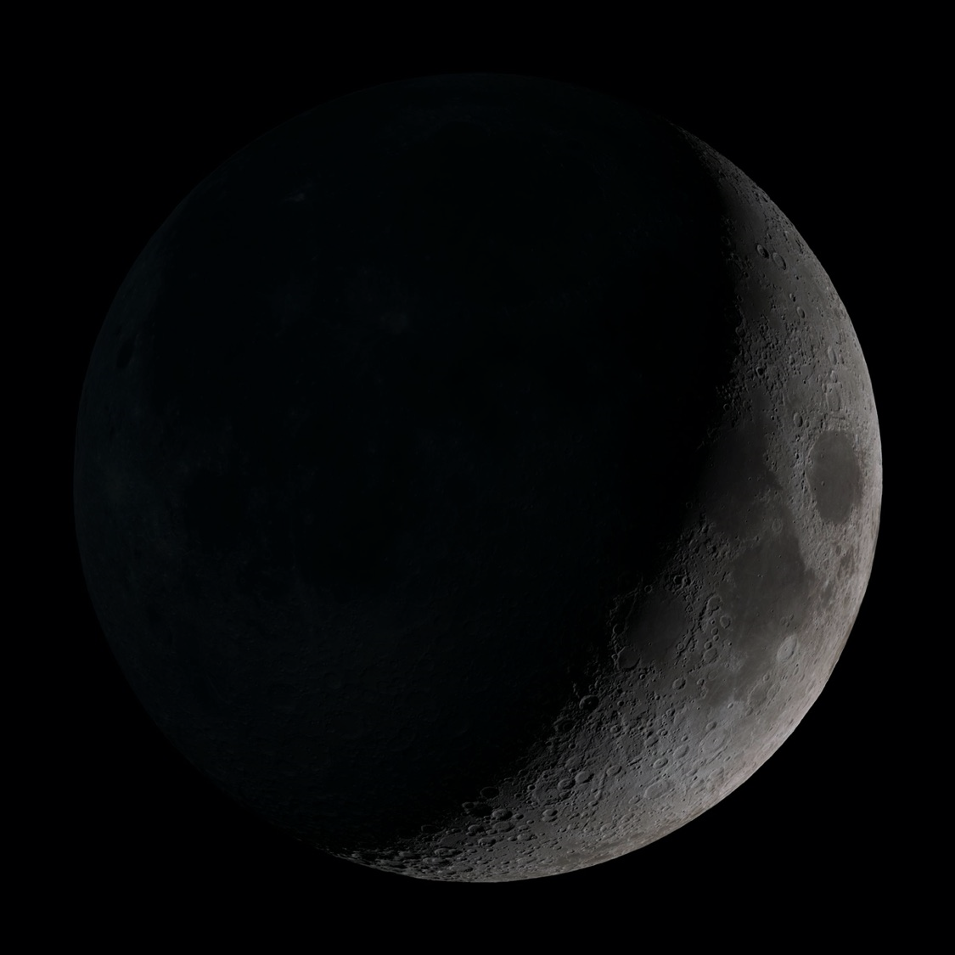
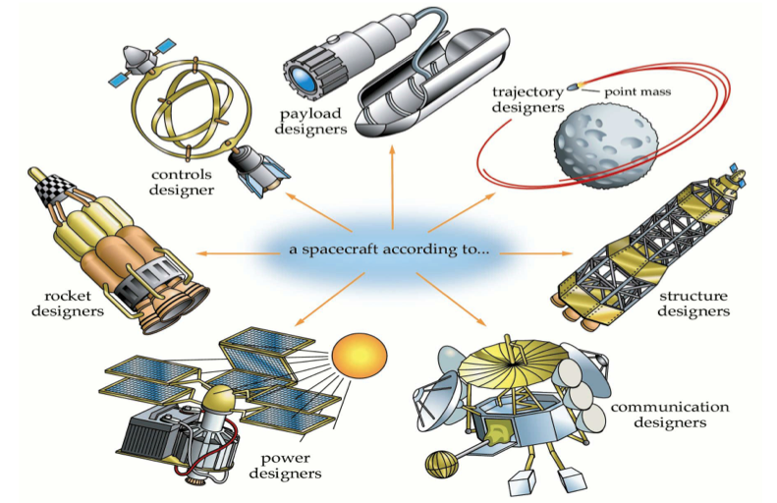
WARNING: Propulsion Biased Presentation
NASA HLS Propulsion Team Engineers
2
Image: Understanding Space Figure 11-25 (Sellers J. et al. 2005)

Slide 3
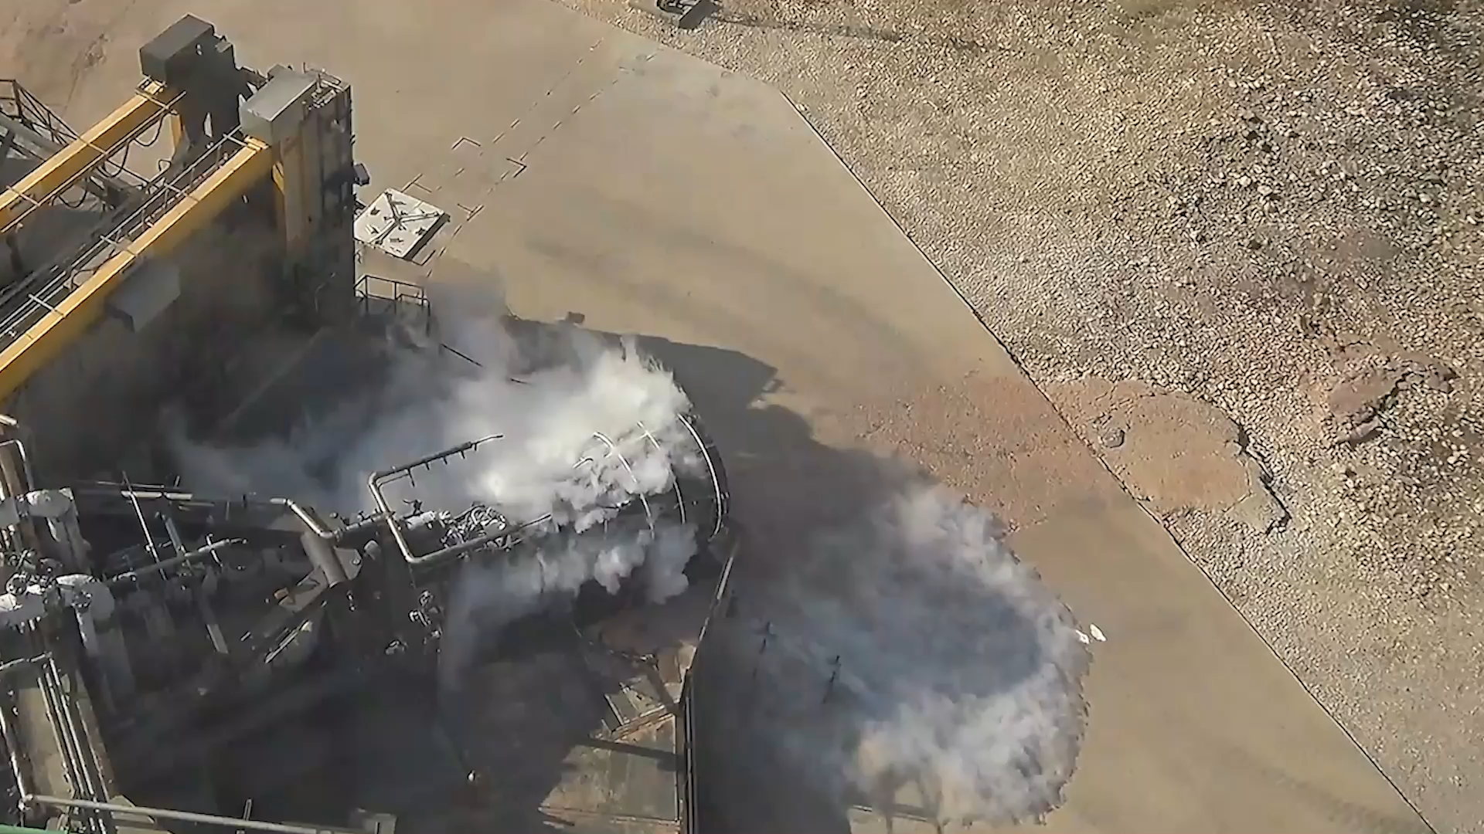
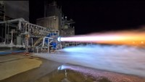
WARNING: Propulsion Biased Presentation
Vacuum Raptor Cold Start Test – August 2023
BE-7 TCA Hotfire Test – March 2023
Video Credit: SpaceX
Video Credit: Blue Origin
Needless to say… we have the best job in the world
3

Slide 4
WARNING: Propulsion Biased Presentation
However, best ≠ easiest — Propulsion includes…
Main engines (see previous slide)
  And all the fun that goes with them (turbomachinery, combustion devices)
Main Propulsion Systems / Cryogenic Fluid Management (CFM)
  Including conditioning, storing, transferring, and gauging cryogenic propellants
Reaction / Attitude Control Systems
Gas Storage and Generation Systems
+all the supporting lines, valves, tanks, small structures, analysis, etc.
If it’s really hot, really cold, really high pressure, spins really fast, or shoots flames out the back… it’s probably Propulsion ™
4
*not actually trademarked

Slide 5
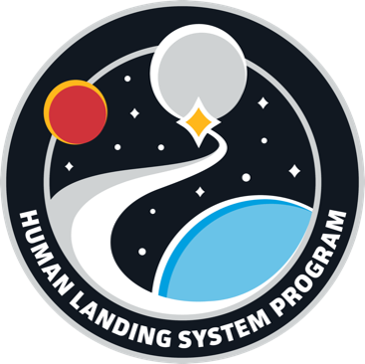
Human Landing System (HLS)
Objective – Return U.S. astronauts to the lunar surface for a sustained campaign of exploration and utilization
Goals (HLS-PLAN-001)
Create a sustainable path to rapidly and safely get humans back to the moon
U.S. Industry-led design, development, manufacture, and operation of lunar human landing systems
Strengthen and utilize subject matter expertise of the NASA workforce critical to developing human-rated lander capabilities
Bottom Line: Get the moon and stay there with U.S. Industry
5

Slide 6
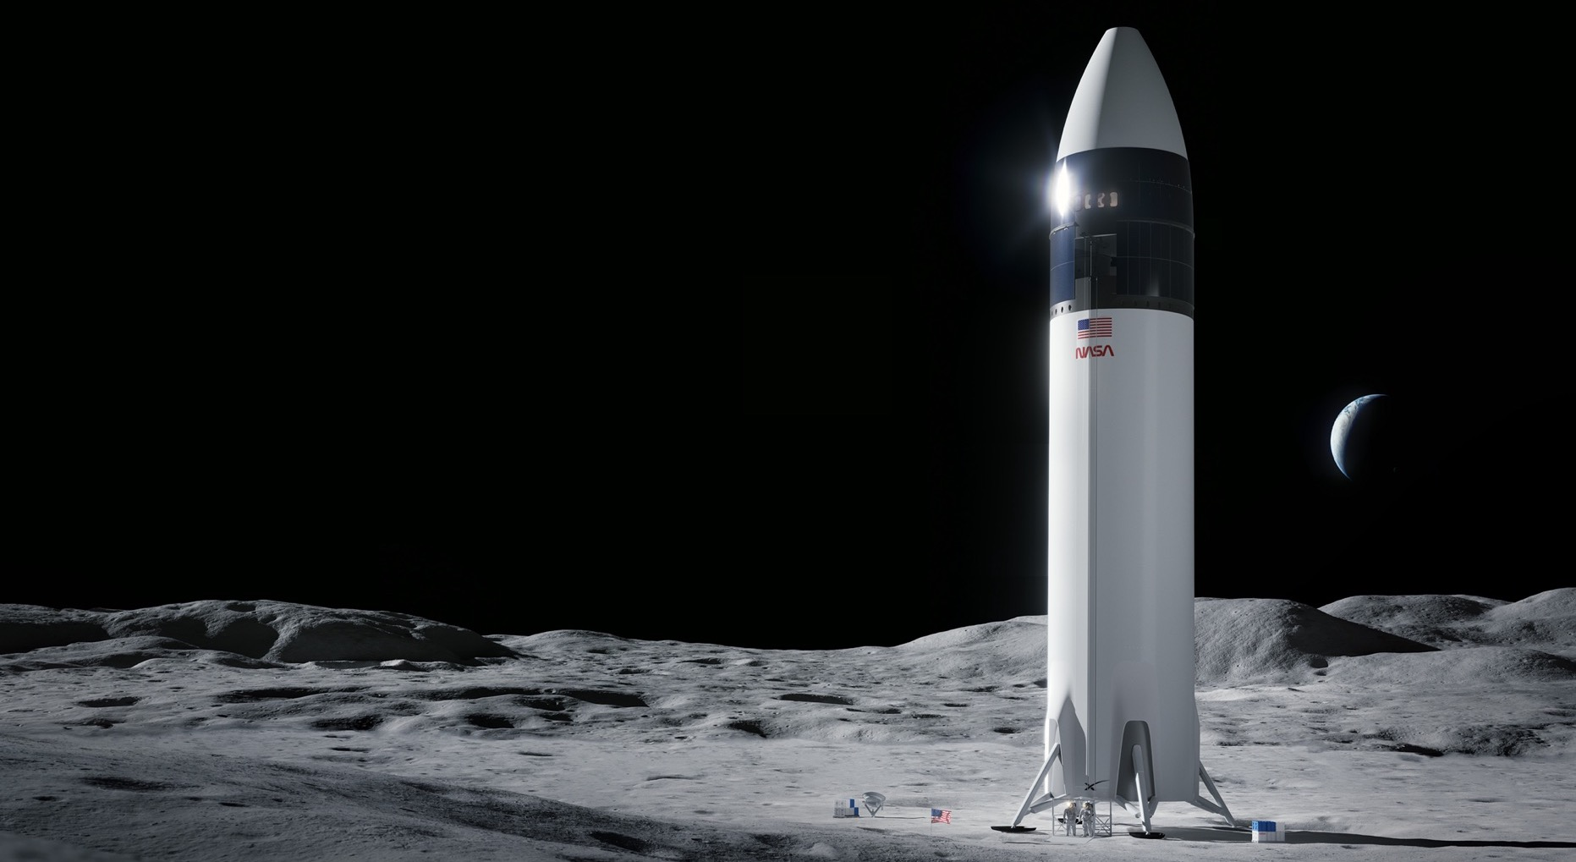
Human Landing System (HLS)
NASA is working with SpaceX to develop its Starship Human Landing System for use on:
Artemis III - the mission that will put the next two Americans on the surface of the Moon
Artemis IV - which meets an extended set of requirements such as docking with Gateway for crew transfer, more mass to the surface, and longer mission durations
SpaceX will perform an uncrewed demonstration mission prior to the crewed Artemis III mission.
6
Image Credit: SpaceX

Slide 7
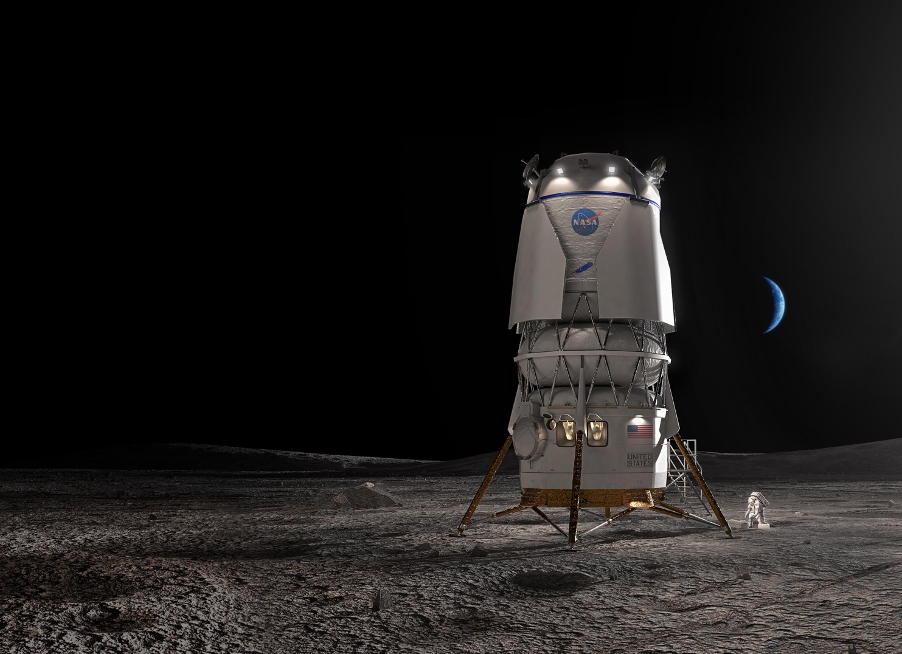

Human Landing System (HLS)
NASA is working with Blue Origin to develop a human landing system
for use on:
Artemis V – meets NASA’s extended set of requirements such as docking with Gateway for crew transfer, more mass to the surface,
and longer mission durations
Blue Origin will perform an uncrewed demonstration mission prior to
the crewed Artemis V mission.
The team’s approach consists of: Blue Origin’s Blue Moon lander
and Lockheed Martin’s Cislunar Transporter along with partners:
Astrobotic
Honeybee Robotics
Draper
Boeing
Image Credit: Blue Origin
7

Slide 8
How do we get from today…
… to here?
8

Slide 9
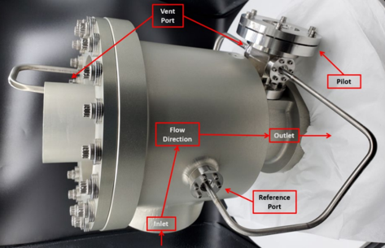
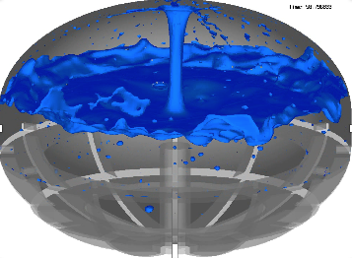
Propulsion Industry Collaboration
Working together to develop key technologies and analyze difficult technical challenges to ensure successful lunar exploration missions
Engine Systems and RCS
  Turbomachinery and Combustion Devices expertise sharing
  Transient and steady state engine performance modeling
  Plume Surface Interaction (PSI) lessons learned and modeling assistance
  Thrust Vector Control (TVC) verification and certification lessons learned
  Reaction Control Systems (RCS) design, development, and test lessons learned
Cryogenic Fluid Management and Prop Transfer
  Cryogenic valve leakage analysis and testing, and low leakage valve design
  Thermal analysis of cryogenic propulsion systems
  Lessons learned from previous CFM projects at MSFC, GRC, and KSC
  CFM modeling leveraging extensive NASA experience and expertise
  Models of propellant transfer operations
  STMD CFM Portfolio Projects – Tipping Point flight tests & cryocooler development
NASA Internal Low Leakage Relief Valve (LLRV) Development Article
NASA MSFC ER42 CFD Simulation
of Tank Slosh
9

Slide 10
HLS Propulsion Insight
HLS Prop Insight Team
PM Decisions
Supports
TA & Risk Assess.
Informs
Design Cert. and COFR Signatures
Recommends
Provider Designs and Procedures
Leveraging the best of NASA’s propulsion and fluids technical community to understand Commercial Provider designs and processes and inform Program stakeholders
Starts with a great team—led by MSFC with support across NASA centers
Deeply technical and disciplined team of engineers committed to the lunar mission
Focused insight justified by risk to understand provider designs
Use risk-based analysis to justify deeper insight in targeted areas
e.g., Engines, CFM
Use the understanding to inform the Program by:
Providing expert propulsion insight and analysis to support Program Management (PM) and Technical Authority (TA) risk assessments and real-time mission support
Providing expert propulsion design, certification, and flight hardware reviews to support Design Certification and Certification of Flight Readiness (COFR)
Understands
10

Slide 11
To summarize, NASA has:
Goals – land on the Moon and stay
Partners – U.S. industry designing and building vehicles
Methods – insight and collaboration with partner operation
People – deep technical bench committed to the lunar mission
Capabilities – extensive manufacturing, test, and analysis
What’s next?
11

Slide 12
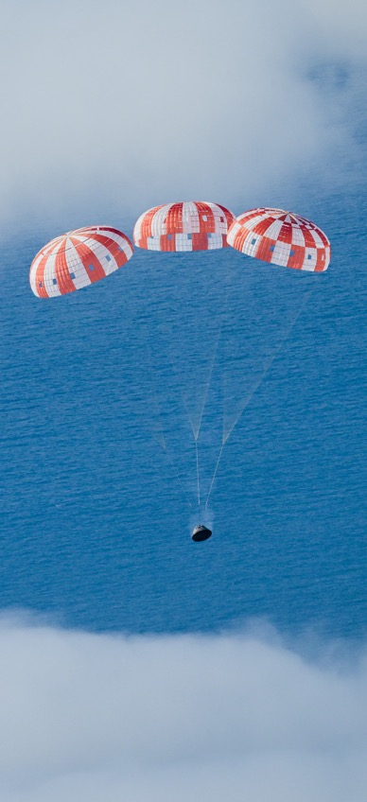
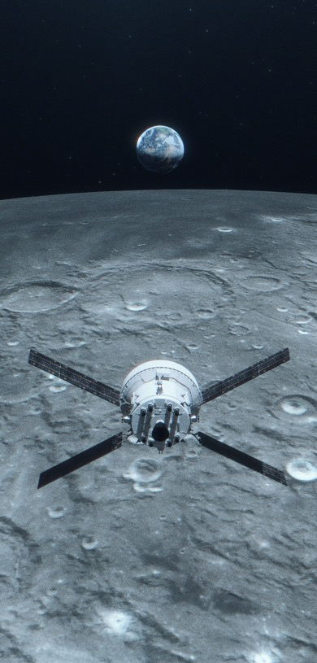
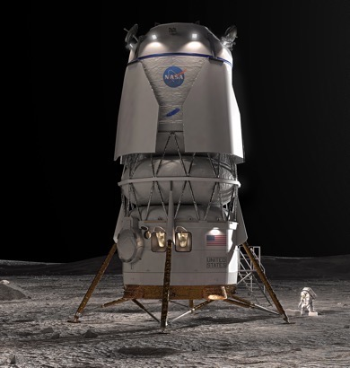
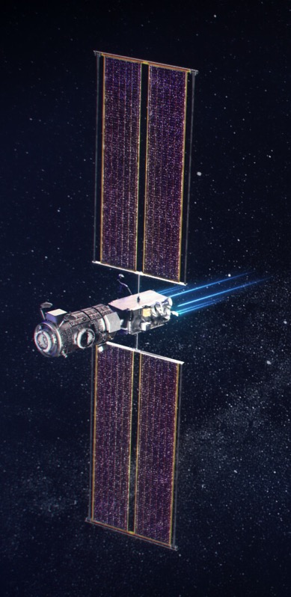
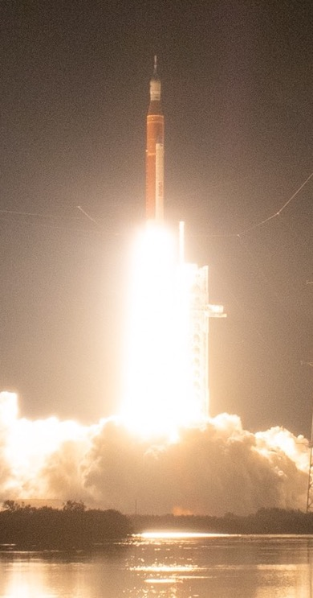
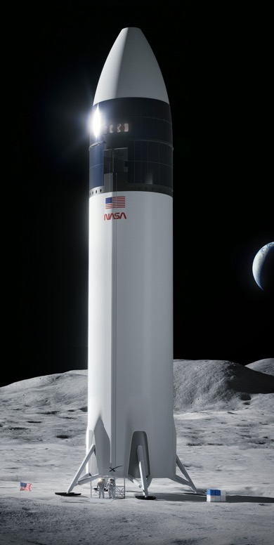
Artemis I
Uncrewed flight test
COMPLETE
Artemis II
Crewed flight test
Artemis III
Crewed surface expedition
Artemis IV
Gateway assembly, crewed sustaining lander expedition
Artemis V
Crewed mobile
surface exploration, Gateway expansion
Illustration
Illustration
Illustration
Illustration
SLS, Orion, EGS
SLS, Orion, EGS
SLS, Orion, EGS, HLS, EHP
SLS, Orion, EGS,
HLS, EHP, Gateway (PPE/HALO, I-HAB)
SLS, Orion, EGS,
HLS, EHP, LTV, Gateway (ESPRIT, Canadarm3)

Slide 13
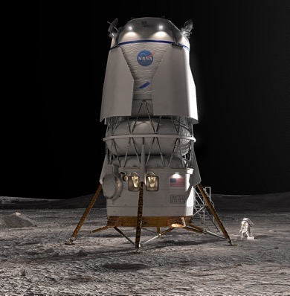
HLS Uncrewed Demo
SpaceX Starship
Artemis III
SpaceX Starship
Artemis IV
SpaceX Starship
HLS Uncrewed Demo
Blue Origin
Blue Moon
Artemis V
Blue Origin
Blue Moon
Illustration
Illustration
Illustration
Illustration
Illustration
13

Slide 14


Follow the missions
Questions?
reid.m.ruggles@nasa.gov
14

