Slide 1
[C4Or1B] NASA’s Cryogenic Fluids for Aerospace Propulsion Applications
Overview and 2024-2025 Highlights
Jeremy Kenny
Technology Demonstration Missions Program Manager
NASA Marshall Space Flight Center
May 22, 2025

Slide 2
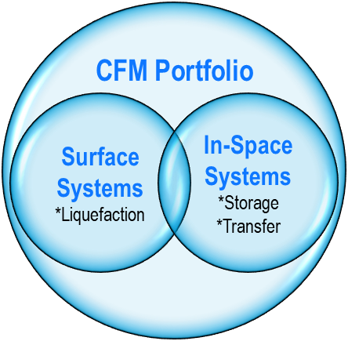
CFM Portfolio Project (CFMPP)
CFMPP is a NASA Space Technology Mission Directorate (STMD) Portfolio Project initiated in 2021
  ~20 individual CFM technology development activities
  Includes flight and ground activities related to Lunar/Mars exploration
  Strong combination of In-house and contracted developments; large and small businesses
CFMPP closes technology gaps, with focus on integrated CFM systems development and demonstration, to advance the national goals of landing and exploring the Moon and Mars
  Technology enters project ~ TRL 4, completes with end state of TRL 6 / 7
Partnered leadership and execution by MSFC and GRC
  Other NASA participating Centers include KSC, LaRC, ARC, AFRC, and JSC
Portfolio Project Charter
Mature CFM technologies essential to NASA’s future missions in science and exploration which utilize both chemical and nuclear in-space propulsion, landers, and in-situ resource utilization
*Modeling

Slide 3
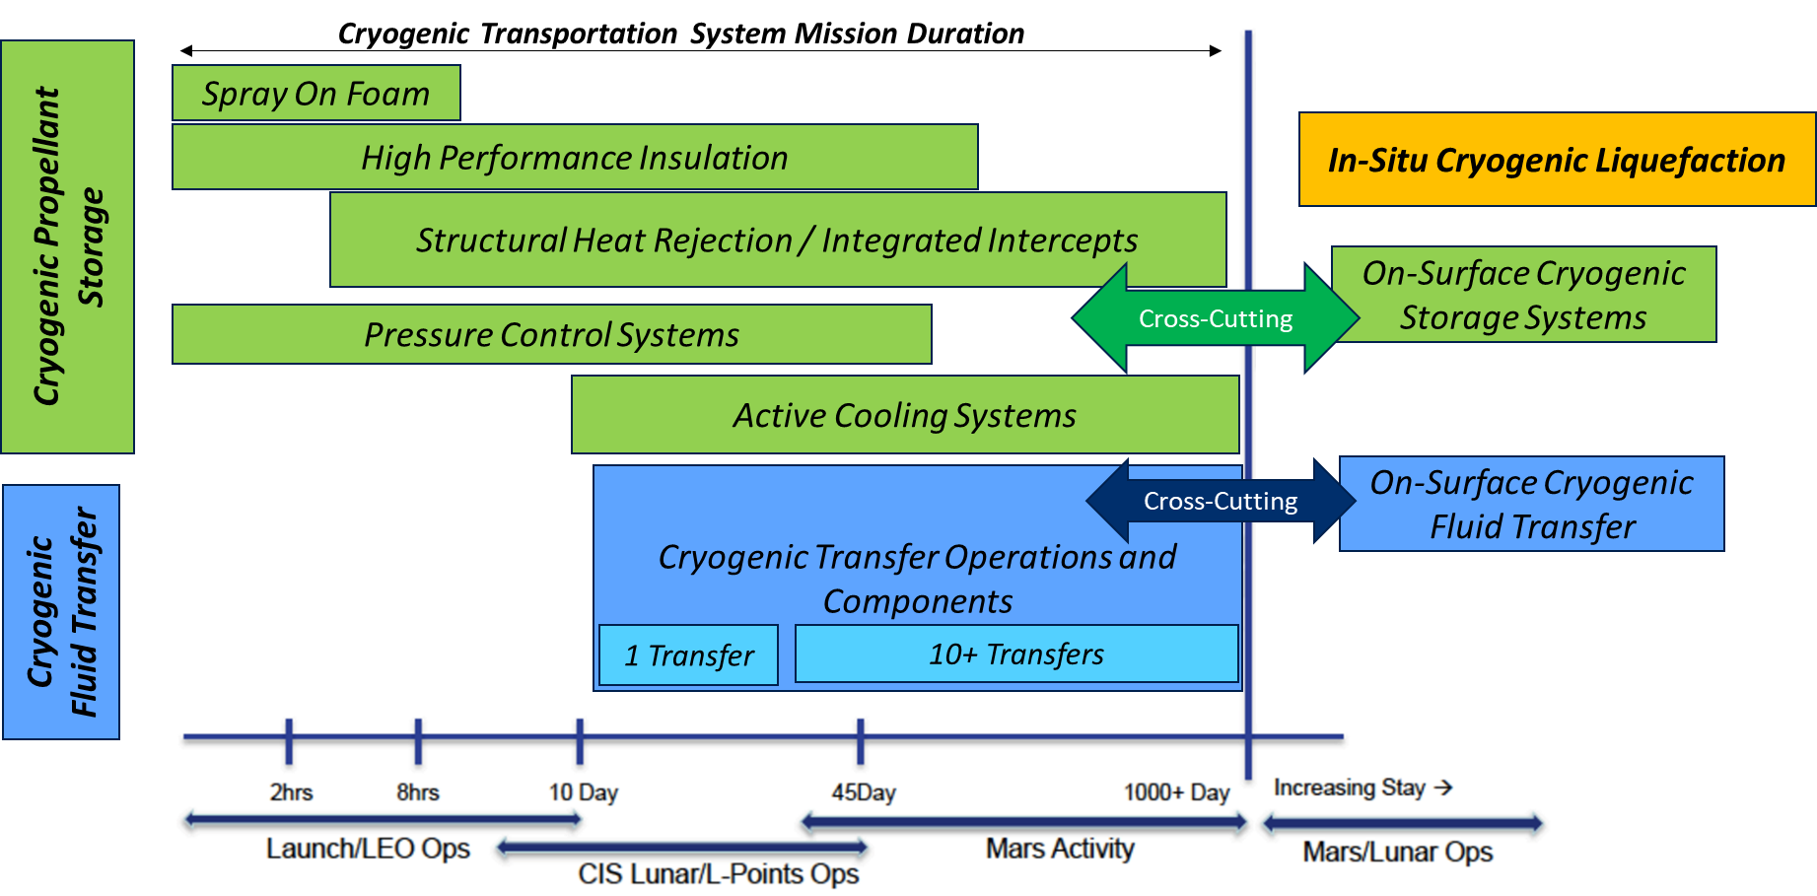





CFM – State of the Art vs Where We Need to Go
Current State
of the Art
Depots

Slide 4



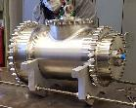

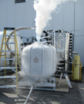

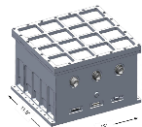
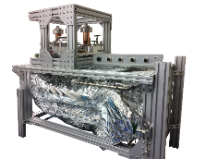
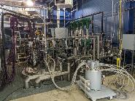
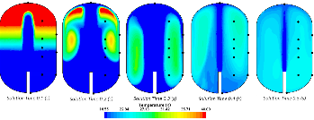

Cryogenic Fluid Management Portfolio Project (CFMPP)
System Demonstration Complexity
Technologies Portfolio
Subsystems Portfolio
Demonstrations Portfolio
Modeling
Portfolio
Scope: Design, development, testing, and evaluation of critical-need cryogenic components enabling long-duration CFM storage and propellant transfer
Major Activities:
Scope: Design, development, and testing of complex systems of technologies to address technical challenges for specific CFM mission needs
Major Activities:
Scope: Design, build, and test integrated flight and ground systems comprised of multiple CFM subsystems, enabling TRL 5+ maturation for many technologies
Major Activities:
Ground System Demonstrations
Scope: Develop, enhance, validate, and demonstrate Computational Fluid Dynamics (CFD) and Nodal tools to address capability gaps for predicting cryogenic fluid behavior in 1-G and microgravity environments for use as design tools for future NASA missions
Testing and demo activities across the CFMP project used within modeling tools to predict CFM behavior at a flight vehicle scale in a relevant microgravity environment
Hydrogen low-leakage valves and cryo-couplers
20W/20K Cryocooler
Tipping Point Demo Contracts
150W/90K Cryocooler
Radio Frequency Mass Gauge (RFMG)
Cryocooler Electronics
Alternate Cryocooler Studies
Two-Stage Cooling Demonstration
Next-generation FOSS (fiber optics sensing system)
Reduced Gravity Cryogenic Transfer (RGCT)
CryoFILL Liquefaction Demonstration
Images by Creare LLC
System Validation

Slide 5
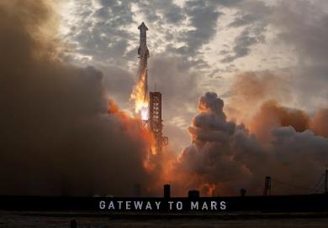
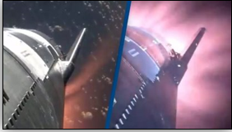
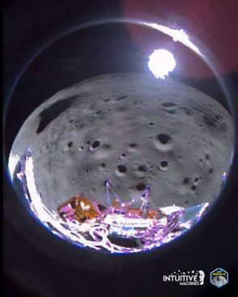
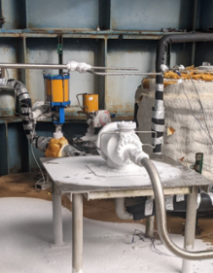
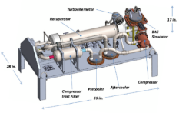
FY2024 CFMPP Highlights
SpaceX Flight Demonstration Completed in March 2024
  Conducted large-scale propellant transfer, moving several metric tons of propellant from one tank to another within Starship, while in space; completed with NASA Tipping Point contract
RFMG technology flight demonstrated on IM-1 mission
  Conducted large-scale propellant transfer, moving several metric tons of propellant from one tank to another, while in space; joint Intuitive Machines / NASA demonstration
NASA Low Leakage Valve Technology Contract awarded to Sierra Space
  Executed technology development contract for advancing cryogenic low leakage valve technology; contract awarded in parallel for continued MSFC in-house valve development efforts
NASA flight cryocooler development system reaches TRL 5
  90K cryocooler system reached development milestones through successful performance and environmental testing;
  System delivered to GRC for additional testing in integrated system
SpaceX Starship #3 Flight Test
Credit: Intuitive Machines
150W/ 90K Cryocooler
Design
Low-leakage relief valve during LH2 testing

Slide 6
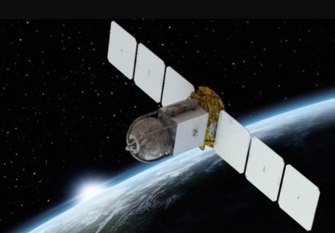
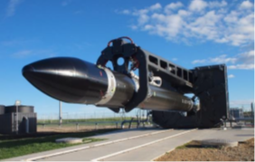
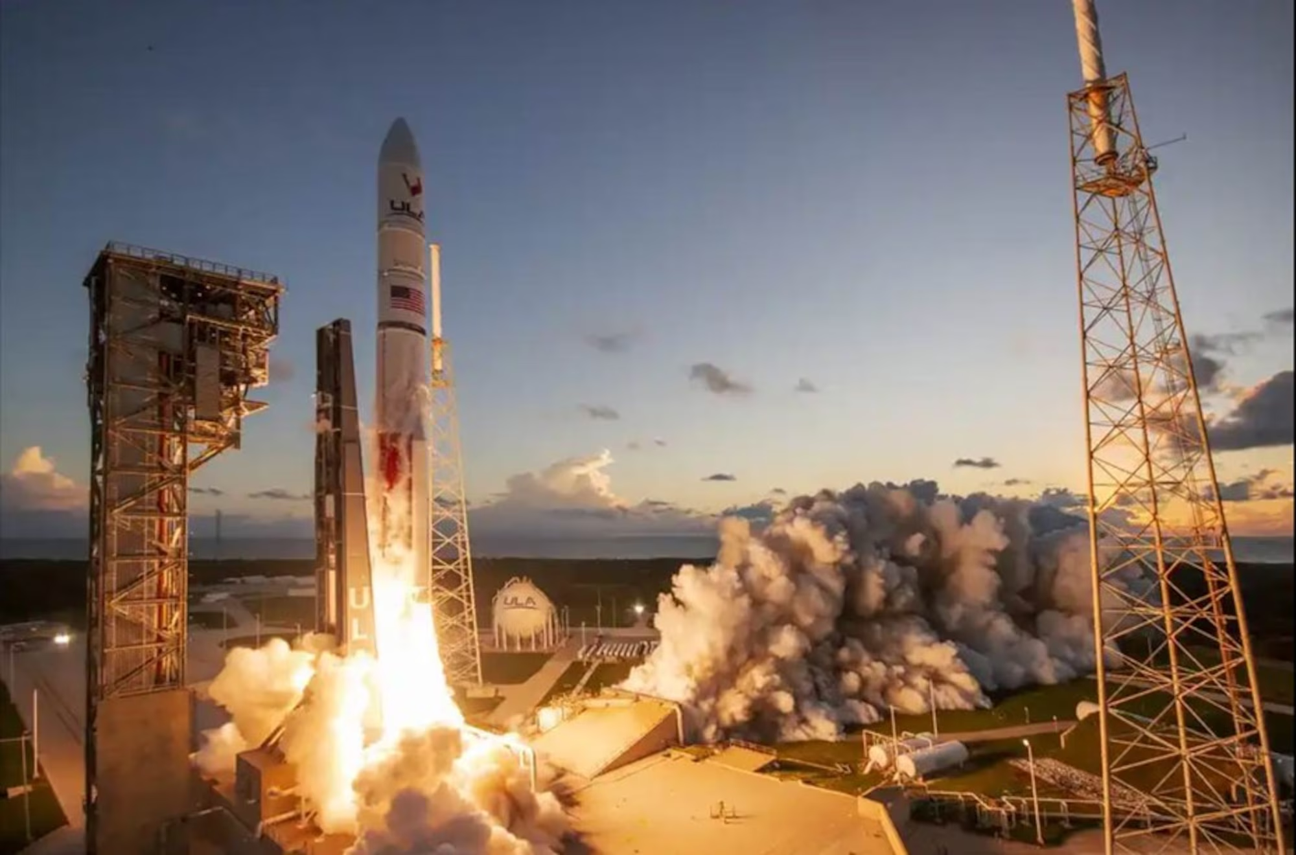
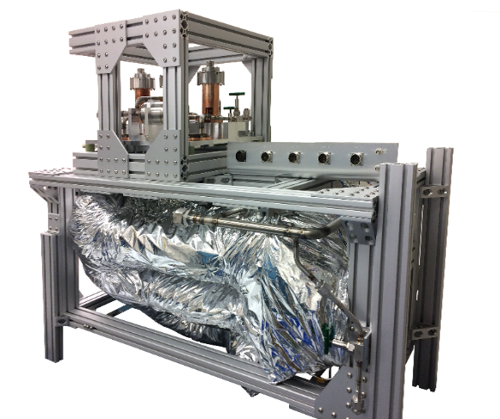
CFMPP 2025 Look Ahead (1/3)
Complete Tipping Point contracts and Ground Demos
  Conduct remaining 2020 Tipping Point flight demonstrations
  Conduct Two-Stage Cooling hydrogen storage testing
  Conduct oxygen liquefaction demonstration with 90K cryocooler
Continue cryocooler development activities
  Test 90K cryocooler at GRC; conduct 20K cryocooler testing for TRL 5
  Grow NASA in-house cryocooler expertise to support Lunar and Mars mission needs
  Expand cryocooler industry base and foster alternative cryocooling technologies
Continue technology and modeling work
  Complete Low-leakage valve Critical Design Reviews and progress to manufacturing
  Complete RFMG Next-Gen advanced reviews and unit testing
  Further design tool validation within Modeling portfolio
Eta Space Cryogenic Spacecraft and
Rocket Lab Electron Launch Vehicle
ULA Vulcan
20K Engineering Model Cryocooler System

Slide 7
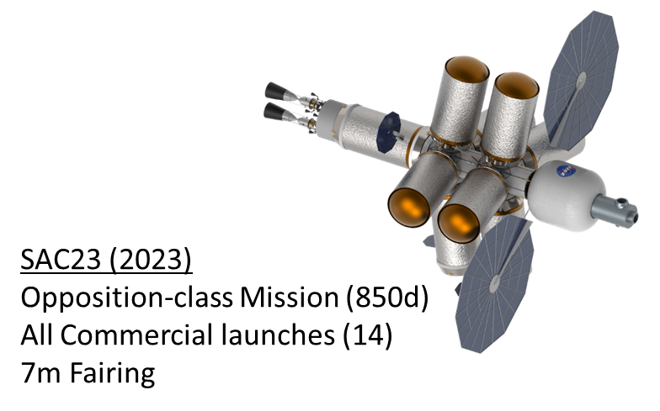
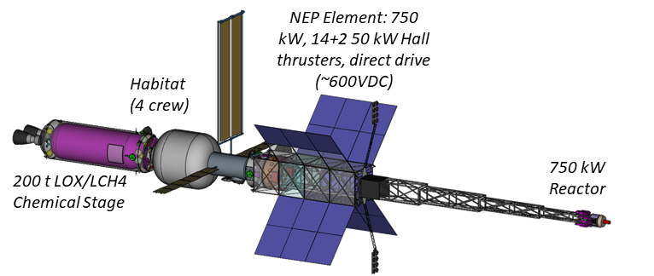
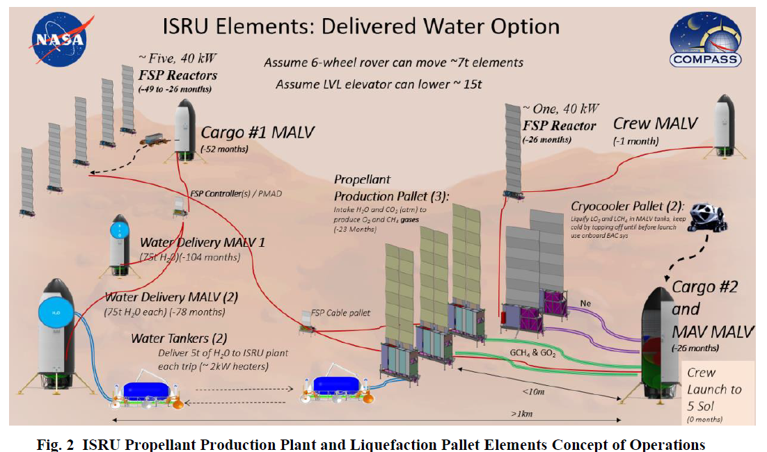
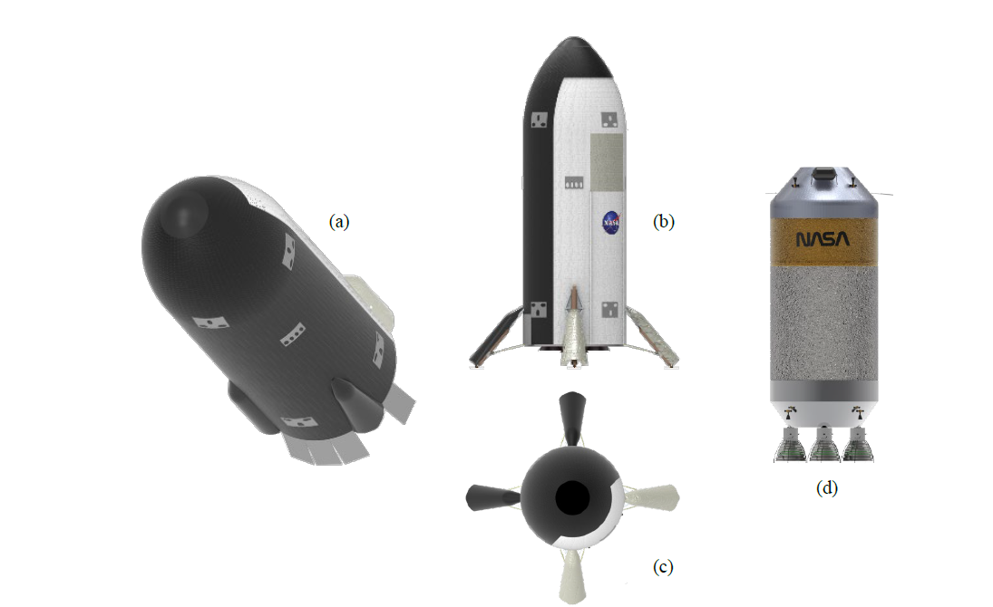
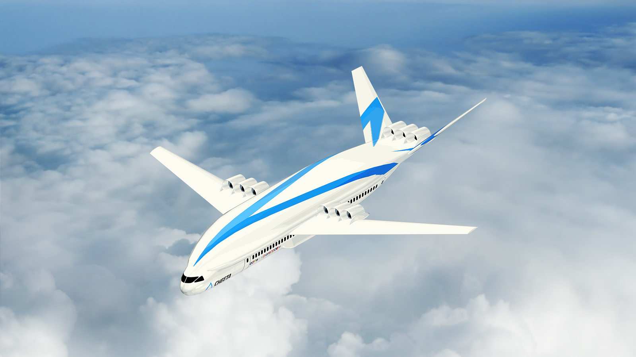
CFMPP 2025 Look Ahead (2/3)
Identify and foster CFMPP partnerships
  Document collaborations and cross-dependency with other projects / programs
    Human Landing System Program, Mars Campaign Office
    Advanced H2 Aviation Applications
    Science Missions
  Leverage partnerships to identify CFMPP office prioritization

Slide 8
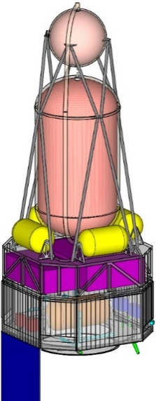
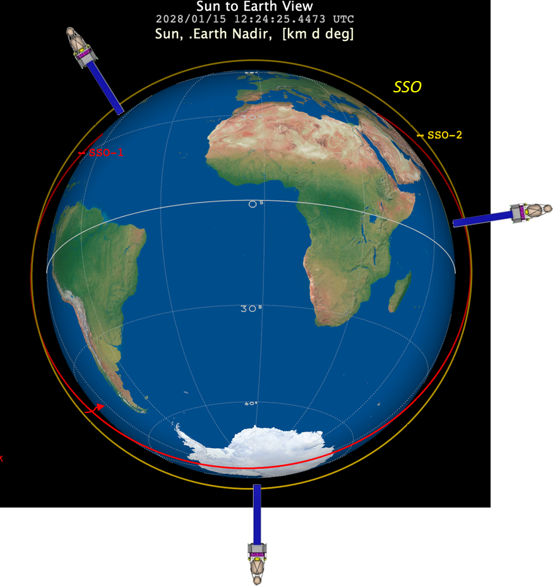
CFMPP 2025 Look Ahead (3/3)
Refine CFM flight mission requirements to achieve CFM capability goals
  CFM Capability Goals: ‘Demonstrations of cryogenic storage and transfer systems in microgravity’
    Flight demonstration(s), beyond current Tipping Point and HLS Missions, are required to meet goals
  CFMPP continuing pre-formulation work to refine Government Reference mission concept requirements
    LH2 Loading concept (KSC) and spacecraft definition refinement
    Supports CFM STMD roadmap development and provides basis of ‘demonstrative value’ for alternative cryogenic mission approaches

Slide 9
Questions?
And Thanks!

Slide 10
Backup

Slide 11
FY24 Highlight: 2020 Tipping Points - SpaceX
On-Orbit Large-Scale Cryogenic Propellant Management and Transfer Demonstration
Overview: Demonstration of large-scale on-orbit cryogenic fluid transfer of liquid oxygen (up to 3 metric tons) between tanks on a Starship in orbit and management to provide a basis for operational use of in-space refueling technology.
Mission Overview:
Demonstration conducted as part of a Starship flight
Active settling maneuver with settled transfer between propellant tanks located within Starship (not ship-to-ship)
  Flight-3 included special demonstration hardware specific to Tipping Point
≤ 1 day mission duration
Flight Demonstration Completed on Starship Flight-3 on March 14, 2024!
Conducted the large-scale propellant transfer, moving several metric tons of propellant from one tank to another, while in space
Storing and transferring cryogenic propellant in orbit has never been attempted on this scale before. This is a huge milestone toward providing NASA with the technologies it will need for both a long-term presence on the moon and its boldest missions to deep space destinations such as Mars and beyond.

Slide 12
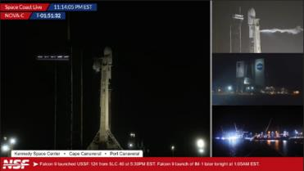
FY24 Highlight: RFMG Demo on CLPS IM-1
Radio Frequency Mass Gauge (RFMG) Technology
Measures tank RF spectrum to provide tank fill level; the spectrum changes with fill level, since the dielectric fluid (e) slows the speed of light
Tech has been in development for over 15 years at Glenn Research Center
RFMG successfully flew and operated onboard the Intuitive Machines IM-1 Nova-C (Odysseus) lunar lander as part of Commercial Lunar Payload Services Program!
Mission Objectives:
  Support pre-flight and flight operations during CLPS Program with Intuitive Machines (IM-1) Nova C lander.
  Demonstrate RFMG system operations at multiple fluid levels for both liquid oxygen (LOX) and liquid methane (LCH4) propulsion tanks throughout IM-1 mission.
NASA team participated multiple in pre-launch activities, including RF fluid simulations and propellant tanking during wet-dress rehearsals
This technology was actively used on throughout IM-1 mission, where it not only provided critical data to advance the RFMG technology but also assisted the IM-1 team during maneuvers and the lunar landing.
Propellant loading of IM-1 tank at LC 39A
Credit: Intuitive Machines

Slide 13
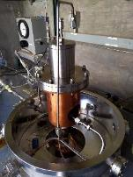
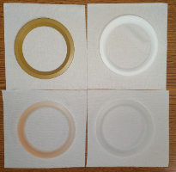
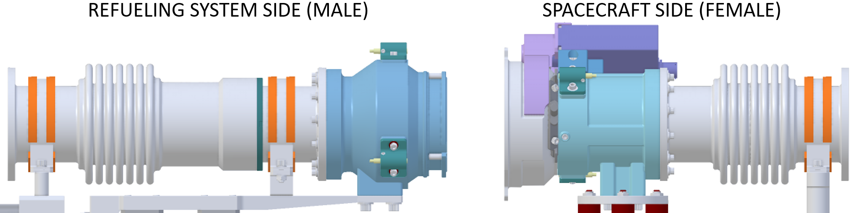
FY24 Highlight: Low-Leakage Hydrogen Valves
NASA in-house team at Marshall Space Flight Center has developed a patented valve technology that utilizes a seat and poppet concept enabling self-alignment, greatly reducing leakage rates.
Activity Goal:
  Develop valves that are more tolerant of imperfections and reduce internal leakage rates by an order of. Traditional internal leakage rates up to 2000 Standard Cubic Inches per Minute (SCIM)
  Low-leakage rates are required for future long-duration cryogenic missions
In 2023, CFMPP successfully developed and tested a relief valve design on small scale at MSFC
  Test results indicated leakage rates under 10 SCIM
  Achieved TRL 4 criteria; extensible to cryo-coupler designs
CFMPP started new activity in 2024 to continue valve technology development and begin tech transfer and infusion with industry
  Procure a high-fidelity prototype valve from a commercial partner which will enable a future test campaign to bring the low-leakage valve design to TRL 6 except for the electromechanical actuator
  Sierra Space contract and continued in-house developments started in October 2024
Seat Seal Test Fixture
Valve Seat Materials
Low-leakage relief valve during LH2 testing

