Slide 1

CFMPP Office Cryocooler Technology Strategy
Sean M. Kenny
CFMPP Sub-Systems Portfolio Lead
NASA/MSFC/ST23
May 22, 2025

Slide 2
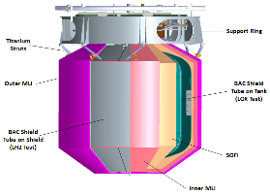
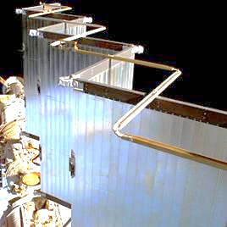
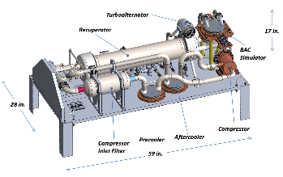
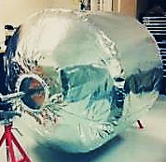
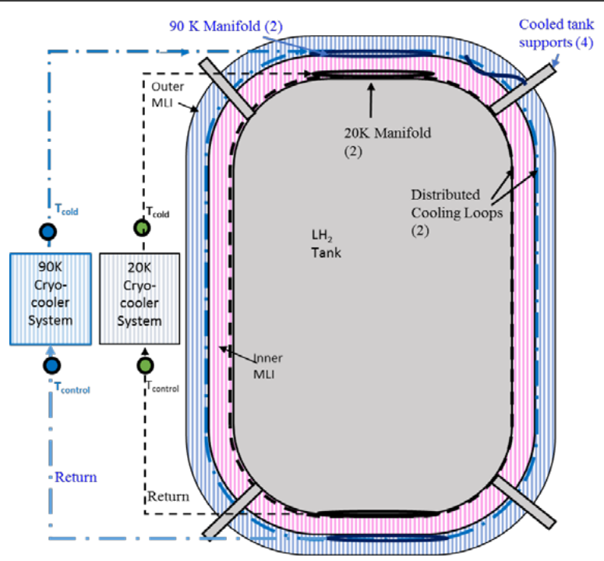
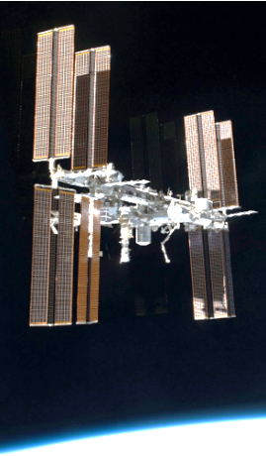
NASA Cryocooler Technology Need
Insulation
Long duration cryogenic missions (Months to Years):
  Propellant Storage: LOX & LH₂ or LCH₄ (Methane)
    Space Nuclear Propulsion (SNP)
      Nuclear Thermal Propulsion (NTP)
      Nuclear Electric Propulsion (NEP)
    Traditional Chemical Propulsion
  On-Orbit Operations (Types of vehicles & missions)
    Tanker / Receiver
    Cryogenic Depot
    Aggregation Missions
  ISRU (In Space Resource Utilization on Moon & Mars)
    Liquefaction, Storage, & Transfer
    LH₂, LOX, LCH₄
Active Cooling is required: Cryocooler is the powered component
  Uses thermodynamic refrigeration cycles to transport heat from a cold zone to a warm zone
Active cooling systems also require:
  Passive thermal management: Insulation & Low conductivity structure
  Coolant Distribution: Broad Area Cooling (BAC) Tube-on-Tank & Tube-on-Shield
    NTP baseline BAC uses ‘Nested’ BAC with 20K on tank and 90K on shield within MLI
  Power: Solar Panels, etc.
  Heat Rejection: Radiators
Cryocooler
Image by Creare LLC
Heat Rejection
(Radiators)
BAC
Power

Slide 3
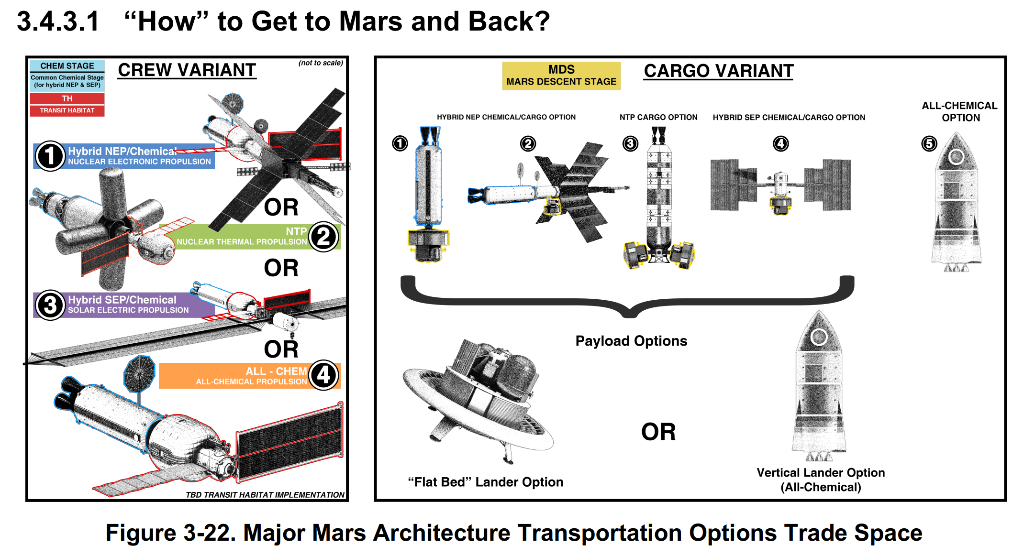
NASA Cryocooler Technology Reference Architectures
Propellant Summary
Space Nuclear Propulsion
Nuclear Electric (NEP) Hybrid:
See below
Nuclear Thermal (NTP):
Liquid Hydrogen
NEP or SEP/Chemical Hybrids
Solar Electric (SEP)
Chemicals:
Methane and LOX
EP:
Xenon or Krypton
All-Chemical
Methane and LOX

Slide 4
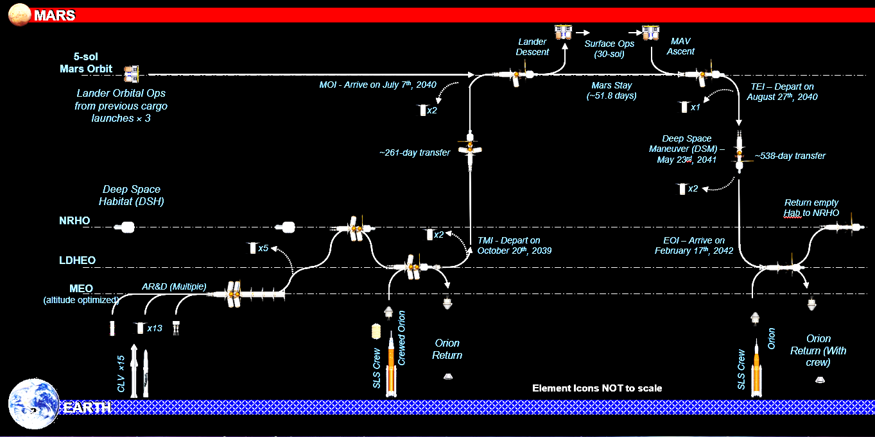
NASA Cryocooler Technology Reference Mission
Mission Duration Drives Cryocooler Design Life
~ 5 years of operation
(Includes aggregation)
~ 120 Start/stop cycles defined by mission CONOPS
(Assumes shutdown for each propulsive maneuver)

Slide 5
Desirable Characteristics needed for spaceflight Cryocooler
  Performance
    Refrigeration Power, “Lift”
      NTP Mission: 50W each for 90K and 20K
  Efficiency
    Key Performance Parameters (KPP)
      Power & Thermodynamic Efficiency
        ~20% COP relative to Carnot
        (at 300K Heat Rejection Interface Temp.)
      Mass Efficiency (Mass/Watts_{lift})
  System Integration
    Flexible Packaging for improved thermal management
    Broad Area Cooling interface
      Coolant circulation for Tube-on-Tank or Tube-on-Shield
    Thermal Management
      Minimize parasitic heat
      Heat Rejection
  Reliability
    Operational life ~5 years
    Duty Cycle >120 start/stop
    Closed cycle cryocoolers are more reliable
      (Working fluid is closed cycle, ‘not prop’)
      Sealed from contamination
      More predictable and controllable operating conditions
  Applicability to Hard & Soft Cryogens
    Cycle + Working Fluid must be efficient at Target Temps
    Investment in Technologies applicable to all Reference missions and vehicles
      Technology commonality between applications:
        (Design Processes, Manufacturing Processes, Cycles, Configurations, Components, Interfaces, etc.)
        Delivers the Best Value and Return on technology investment
      “Hard Cryogens” = Hydrogen
      “Soft Cryogens” = Oxygen, Methane

Slide 6
Key Performance Parameters
  Design target temperature, Kelvin
  Heat Removal, Refrigeration Power, or “Lift”, Watts
  Power Efficiency stated in two ways:
    (Coefficient of Performance, COP) or % of Carnot
    (Watts needed to power the cooler / Watts of heat removed) [Lower is Better]
  Mass Efficiency (Cryocooler Mass, KG / Watts of heat removed) [Lower is Better]
  CURRENT TECHNOLOGY DEVELOPMENTS
  FUTURE TECHNOLOGY INVESTMENTS (CACHE)
20 Kelvin Cryocooler | Threshold | Goal
Lift (W) | 17 | 20
W_{in}/W_{L} (TMU) | 80 | 60
kg/W (TMU) | 5.5 | 4.4
Assumption: 285K Heat Rejection Temp
90 Kelvin Cryocooler | Threshold | Goal
Lift (W) | 120 | 150
W_{in}/W_{L} (TMU) | 15 | 8
kg/W (TMU) | 0.8 | 0.5
Assumption: 300K Heat Rejection Temp
20 Kelvin Cryocooler | Threshold | Goal
Lift (W) | 45 | 50
COP | 15 | 20
kg/W (TMU) | 5.5 | 4.4
Assumption: 285K Heat Rejection Temp

Slide 7
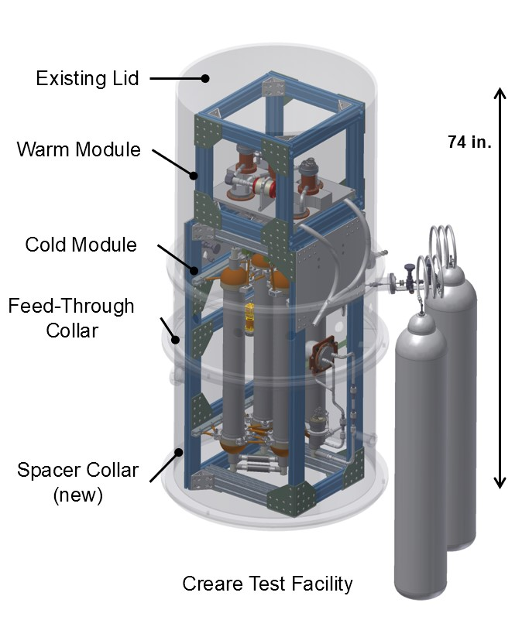
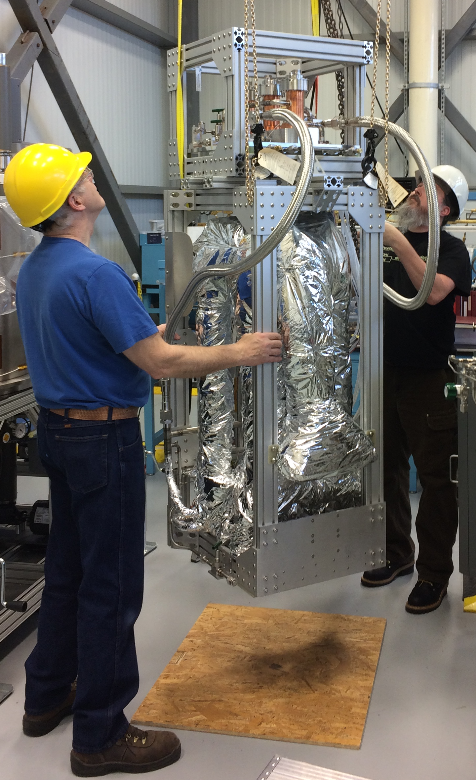
20 Kelvin 20 Watt Cryocooler Status
Technology Description:
The 20W 20K Cryocooler addresses the need for zero boil off storage of Liquid Hydrogen (LH₂), critical for Nuclear Thermal Propulsion as well as LH₂-based architectures for exploration and enable ISRU liquefaction.
Thermodynamic Cycle: Reverse Turbo-Brayton (RTB)
Objectives:
Design, build, and demonstrate a 20W 20K RTB cryocooler with a specific mass of 4.4 kg/W and a specific power of 60 W/W.
Scope / Status:
Development under SBIR with CREARE LLC (Contact: Mark Zagarola)
All Components developed and integrated with initial performance verification completed
Current Work and Next steps:
  Full operating range characterization in flight-like configuration through August, 2025
  Vibration & Thermal Vacuum Testing (with post test functional verification)
    TRL 6 Achievement in 2026
Mission Pull:
Nuclear Thermal Propulsion as well as LH₂-based architectures for exploration
ISRU (LH₂)
20W 20K Cryocooler Vacuum Chamber Model
Images by Creare LLC
20W 20K Cryocooler Configured for Test

Slide 8
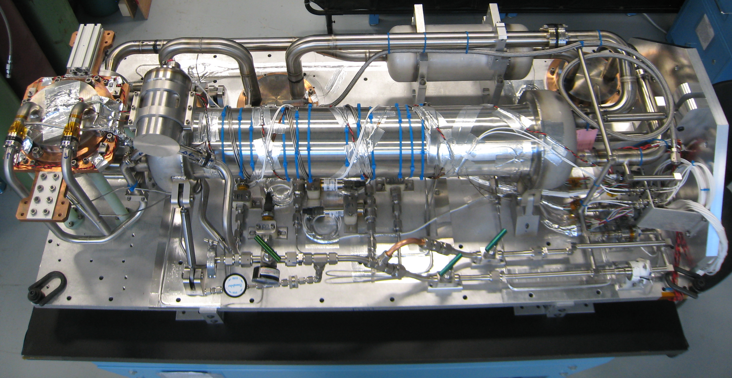
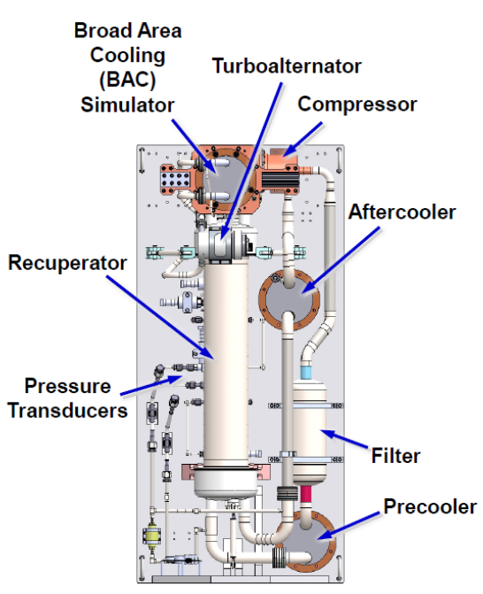
90 Kelvin 150 Watt Cryocooler TMU Status
(Thermo-Mechanical Unit)
Technology Description:
90K High Capacity Cryocoolers are an enabling technology for the long duration storage of cryogens as well as ISRU liquefaction of LOX & LCH₄
The Reverse Turbo-Brayton (RTB)
Objectives:
Design, build, demonstrate a 150W / 90K RTB cryocooler having a specific mass of 0.4 kg/W and a specific power requirement of 8.0 W/W.
Scope / Status [Complete!]:
Development was performed under SBIR contracts with CREARE LLC
  Contact Mark Zagarola @ Creare
All Components developed and integrated with initial performance verification completed (Brassboard)
Flight-like integration into Engineering Model (EM)
Full operating range characterization in flight prototype configuration
Performed vibration testing on EM and repeat functional testing
Delivered to NASA for “CryoFILL” integrated liquefaction system demonstration
Mission Pull:
Nuclear Thermal Propulsion (Staged BAC cooling application), ISRU (LOX)
Mars architecture studies (NEP, SEP, Hybrid, All-Chemical)
150W/ 90K Cryocooler
Images by Creare LLC
150W/ 90K Cryocooler in Vacuum Test Chamber

Slide 9
90 Kelvin 150 Watt Cryocooler CCE Status
(Cryocooler Control Electronics)
Technology Description:
Prototype Cryocooler Control Electronics Unit (CCE)
Designed to operate the Creare 90K 150W RTB TMU
Operate in defined environments (Mars Transit Missions)
Achieve power and weight efficiency requirements (KPPs)
Objectives:
Design, build, demonstrate a 150W / 90K RTB CCE (~1600 Watts input power) enabling its required performance (specific mass of 0.4 kg/W and a specific power requirement of 8.0 W/W)
Scope / Status:
(Development under SBIR Ph III, CREARE LLC, Contact: Mark Zagarola)
Completed Detailed Engineering Model Design (“EMCCE”)
Completed Test Planning, Simulators, Facilities, etc. (PDR Level)
  Include Assessment of applicability to 20K / 20W TMU
Perform Developmental Testing (component, breadboard)
Current and Next Steps: (Contract awarded November 2024)
Fabricate EMCCE – Feb 2026
Perform Demonstration Phase Testing (TRL 5) – May 2026
  Test using simulated TMU
Perform Environmental Testing (TRL 6) – July 2026: Vibration, EMI, TVAC testing
Images by Creare LLC
Key functions
Power conversion and conditioning
Turbomachine speed control
System level controls
Telemetry processing
Total mass: 21 kg
Total volume: 18 liters
Conductively cooled through baseplate
Low EMI

Slide 10
Future Cryocooler Technology Investment:
CACHE (Cryogenic Active Cooling for Human Exploration)
Approach:
Utilize NextSTEP-3 BAA to solicit proposals to develop cryocooler and control electronics for Mars missions
Objectives:
Develop active cooling technologies to enable future missions
  Requirements derived from Mars Architecture Studies
  Mature Prototype Cryocooler Technology to TRL-6
  Mitigate risk factors for TRL 7+ flight Demo
  Address human rated flight certification
    Predictable and flight certifiable performance and reliability
  Enhance NASA institutional knowledge
    Smart Buyer / Operator
Assure availability of high capacity cryocoolers for future NASA missions
Scope of CACHE:
Prior or Current NASA funded technologies are not eligible
Two contracts with Options (multiple awards possible): (Firm Fixed Price, FFP)
  First Contract: “Concept Development & Detailed Design”
    Base Scope includes Concept Development & Preliminary Design
    Option CLIN includes Detailed Design
    A Special Studies CLIN will allow for Risk Reduction, Developmental Testing, Etc
      FFP RFP’s to be requested during contract execution as needed
  Second Contract: “Build, Verification, & Demonstration with Environmental Testing” (Only awardees from first contract are eligible to propose)
    Base Scope: Fabrication, Assembly & Acceptance Test
      Parts, Components, Assemblies & Integrated System
    Option CLIN: Performance Testing (TRL-5)
    Option CLIN: Environmental Testing (TRL-6)
Schedule:
  Anticipated RFP Release 4Q FY25 (July)
  Anticipate completion of both contracts by 2030
NextSTEP https://www.nasa.gov/humans-in-space/nextstep/

Slide 11

NASA Cryogenic Propellant Active Cooling Summary
The NASA CFM Portfolio Project is enabling long duration cryogenic missions through maturation of critical technologies
Technology KPP’s and requirements derived from current Mars Architecture Studies
Current Cryocooler investments are progressing primarily via SBIR contracts with Creare LLC
CFMPP will continue to mitigate risks for infusion for a TRL 7 demonstration opportunity
  Will target risks that impact performance, reliability & life
Stakeholders include
  Earth/Moon missions, Transit and Surface
    Depots, Aggregation Architectures, ISRU
    HLS Sustaining Missions
  Mars Mission Architecture Studies
    Nuclear Thermal, Nuclear Electric/Chemical
    Solar Electric/Chemical
    All-Chemical
CFMPP will be soliciting proposals for alternative cryocooler
technical solutions under CACHE RFP
NextSTEP https://www.nasa.gov/humans-in-space/nextstep/

Slide 12
Backup

Slide 13
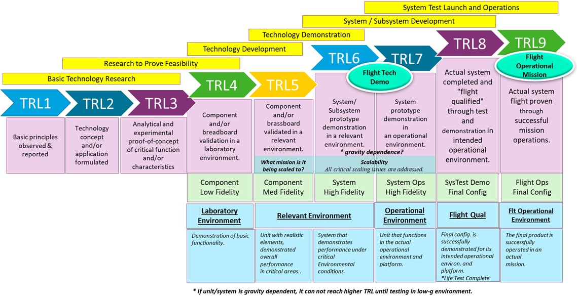
TRL Maturity Chart

Slide 14
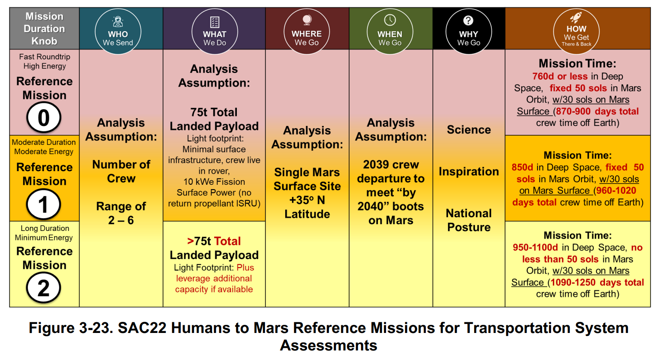
NASA Cryocooler Technology Reference Missions
Mission Duration Drives Cryocooler Design Life
(Longest Selected)
~ 5 years of operation
(Includes aggregation)
~ 120 Start/stop cycles defined by mission CONOPS

