Slide 1
The Need for the Development of Liquid Hydrogen Test Capability for Aviation and Beyond
Johnson, W.L.¹, Vivod, S.L. ¹, Lvovich, V.F. ¹, Hunter, G.W. ¹, Martinovic, Z.², Koci, F.D. ¹, Mazhari, A. ³, Rinehart, D.¹, Malakooti, S. ¹, Jakupca, I.J. ¹, Hewston, A.W.¹, Tomlinson, B.H.⁴, and Chin, J. ¹
¹NASA Glenn Research Center, Cleveland OH
²NASA Langley Research Center, Hampton, VA
³NASA Ames Research Center, Moffit Field, CA
⁴NASA Armstrong Flight Research Center, Edwards Air Force Base, CA
Presented at the 2025 Cryogenic Engineering Conference, Reno NV, May 21, 2025

Slide 2
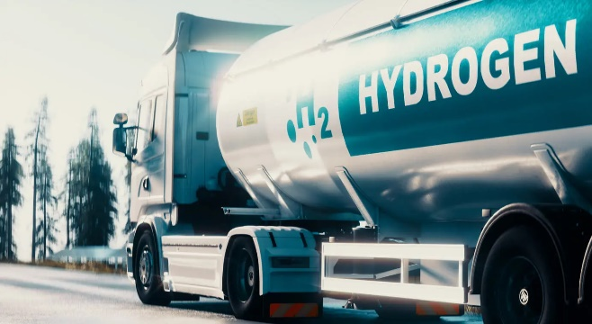
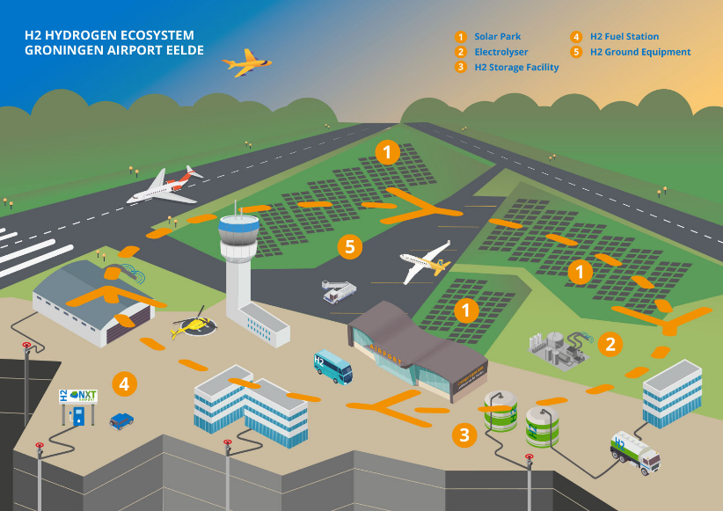

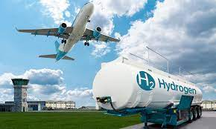
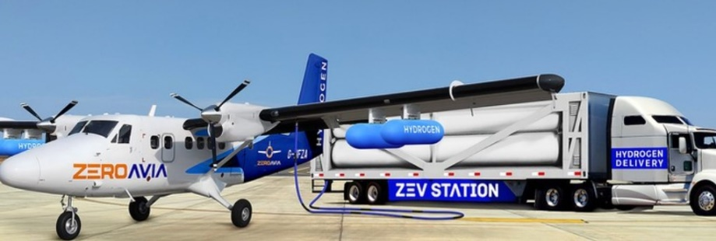

Collaborative Hydrogen Aero Testing Area
Opportunity:
There is a large and increasing need for hydrogen test capabilities for the development of components, subsystems, and systems for aircraft and other transportation systems. Industry is showing a desire to develop systems for clean energy solutions, but testing with hydrogen, and especially liquid hydrogen is challenging and costly. Furthermore, there is a need to explore the trade-space around operational aircraft refueling. There may be synergistic ways to combine the two problems.
Credit:DHL
Credit: Airbus
Credit: Zero Avia
https://www.iec.ch/blog/how-can-hydrogen-help-decarbonize-aviation via Canva Pro.
https://www.nxtairport.nl/en/groningen-airport-eelde-first-hydrogen-valley-airport-in-europe/
"Wicked-Wild" Idea:
Development of an airport-like liquid hydrogen test and development center of excellence that can support US Industry and US Government development needs utilizing NASA’s facilities and experience that provides capabilities within practical timelines.
University of Birmingham | Porterbrook

Slide 3
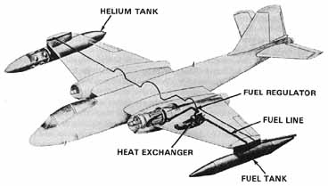
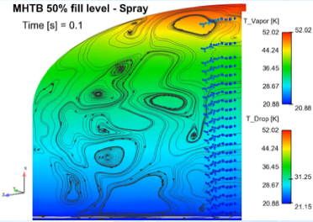
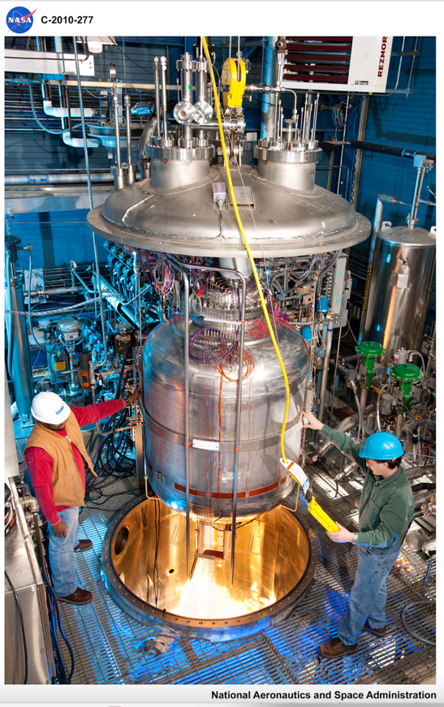
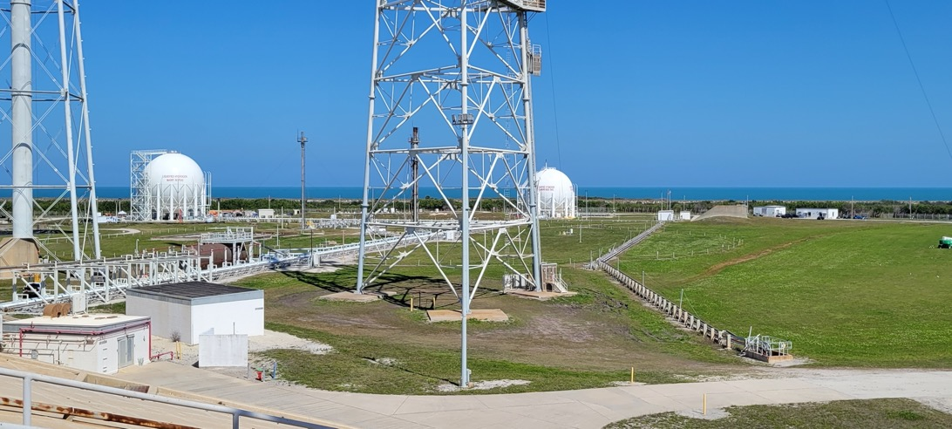
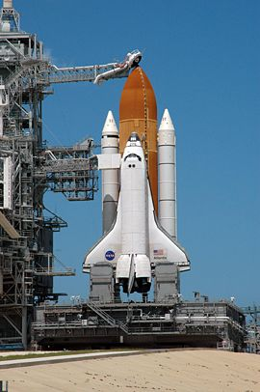
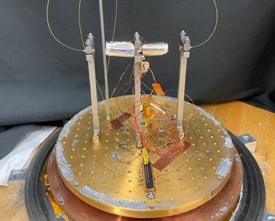
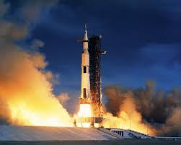
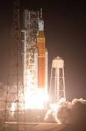
NASA’s Experience With LH₂
NASA has been a major user of Liquid Hydrogen for the past 80 years.
How can this be leveraged to help US Industry move forward in it’s interest in hydrogen aviation?
Liquid-hydrogen fuel system for one engine of a B-57 flew successfully in 1957. Image from NASA SP-4404, “Liquid Hydrogen as a Propulsion Fuel, 1945-1959”
Liquid Hydrogen System Modeling
Liquid Hydrogen Operations on Launch Pads
Liquid Hydrogen Technology Development and Testing
Low Temperature Materials Development and Characterization
Transportation Systems Vehicles

Slide 4
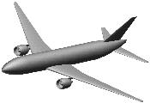

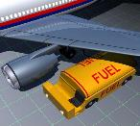

NASA Technology Development Focus
Overall Environmental Impact
Primary focus will be the aircraft
Single-aisle and larger is the ultimate long-term interest
Experience with smaller applications should be leveraged
Any propulsion systems using cryogenic fuels were within scope (gas-turbine, fuel cells, hybrid)
Aircraft
Multiple Fuel Types?
Fuel Production
Less focus will be devoted to non-aircraft considerations
Airport Infrastructure
- Ground Handling
- Refueling
Fuel Transportation
Initial investment
Fuel cost/availability
Carbon Tax?, etc.
Nation, global energy policies
Not a direct part of NASA Scope

Slide 5
External Perspective on NASA Research Investment Opportunities
Results from September 2022 Workshop at GRC
Materials
  Additive manufacturing and composites for cryo temperatures, cycle fatigue, and hydrogen permeation
  Seals, insulation, embrittlement, thermal expansion
Structures
  Fuel tank, pressurized structure, conformal pressure vessels, impact absorbing structures
Testing Capabilities and Techniques
  Hydrogen enabled facilities, crashworthiness, impact testing, icing
Operations
  ConOps development, fuel system purging, fueling/defueling operations, tarmac hold, failure analysis, contingency scenarios unique to cryogenics
Systems Studies
  Concept studies, fuel cell vs hydrogen combustion vs combination, fuel cell as secondary power (APU replacement), impact of current vs future grid, exploration of acceptable boil-off, tank design trades
Propulsion and Powertrain
  Combustor design research (fundamental computational and experimental capability development), superconducting electrical components, fuel cell technology development, engine controls with phase changes, thermal management (especially heat exchangers), exploration of innovative turbine cycles
Fuel Pumps and Valves
Standards Development Support
Cryo Technology Roadmap Development
Sensor Technology
  Tank level gauging, hydrogen fire detection, hydrogen leak detection
Climate Research
  Contrails modeling, simulation, and mitigation, cryo fuel leakage impacts at ground/altitude, low particulate impacts on contrail characteristics
Strong desire for NASA leadership role in pulling community together on cryogenic fuels for aircraft.

Slide 6
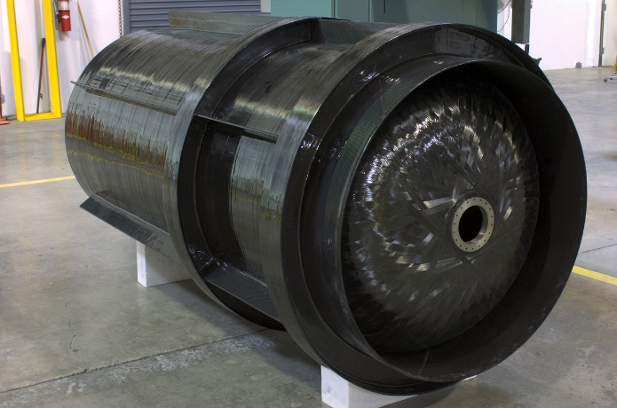
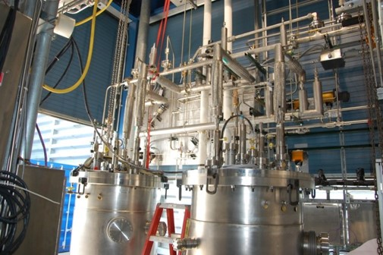
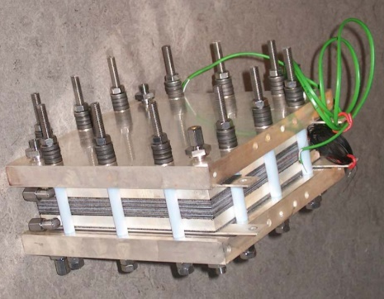
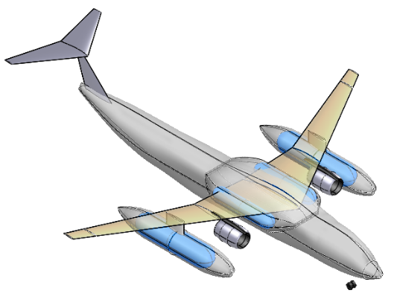

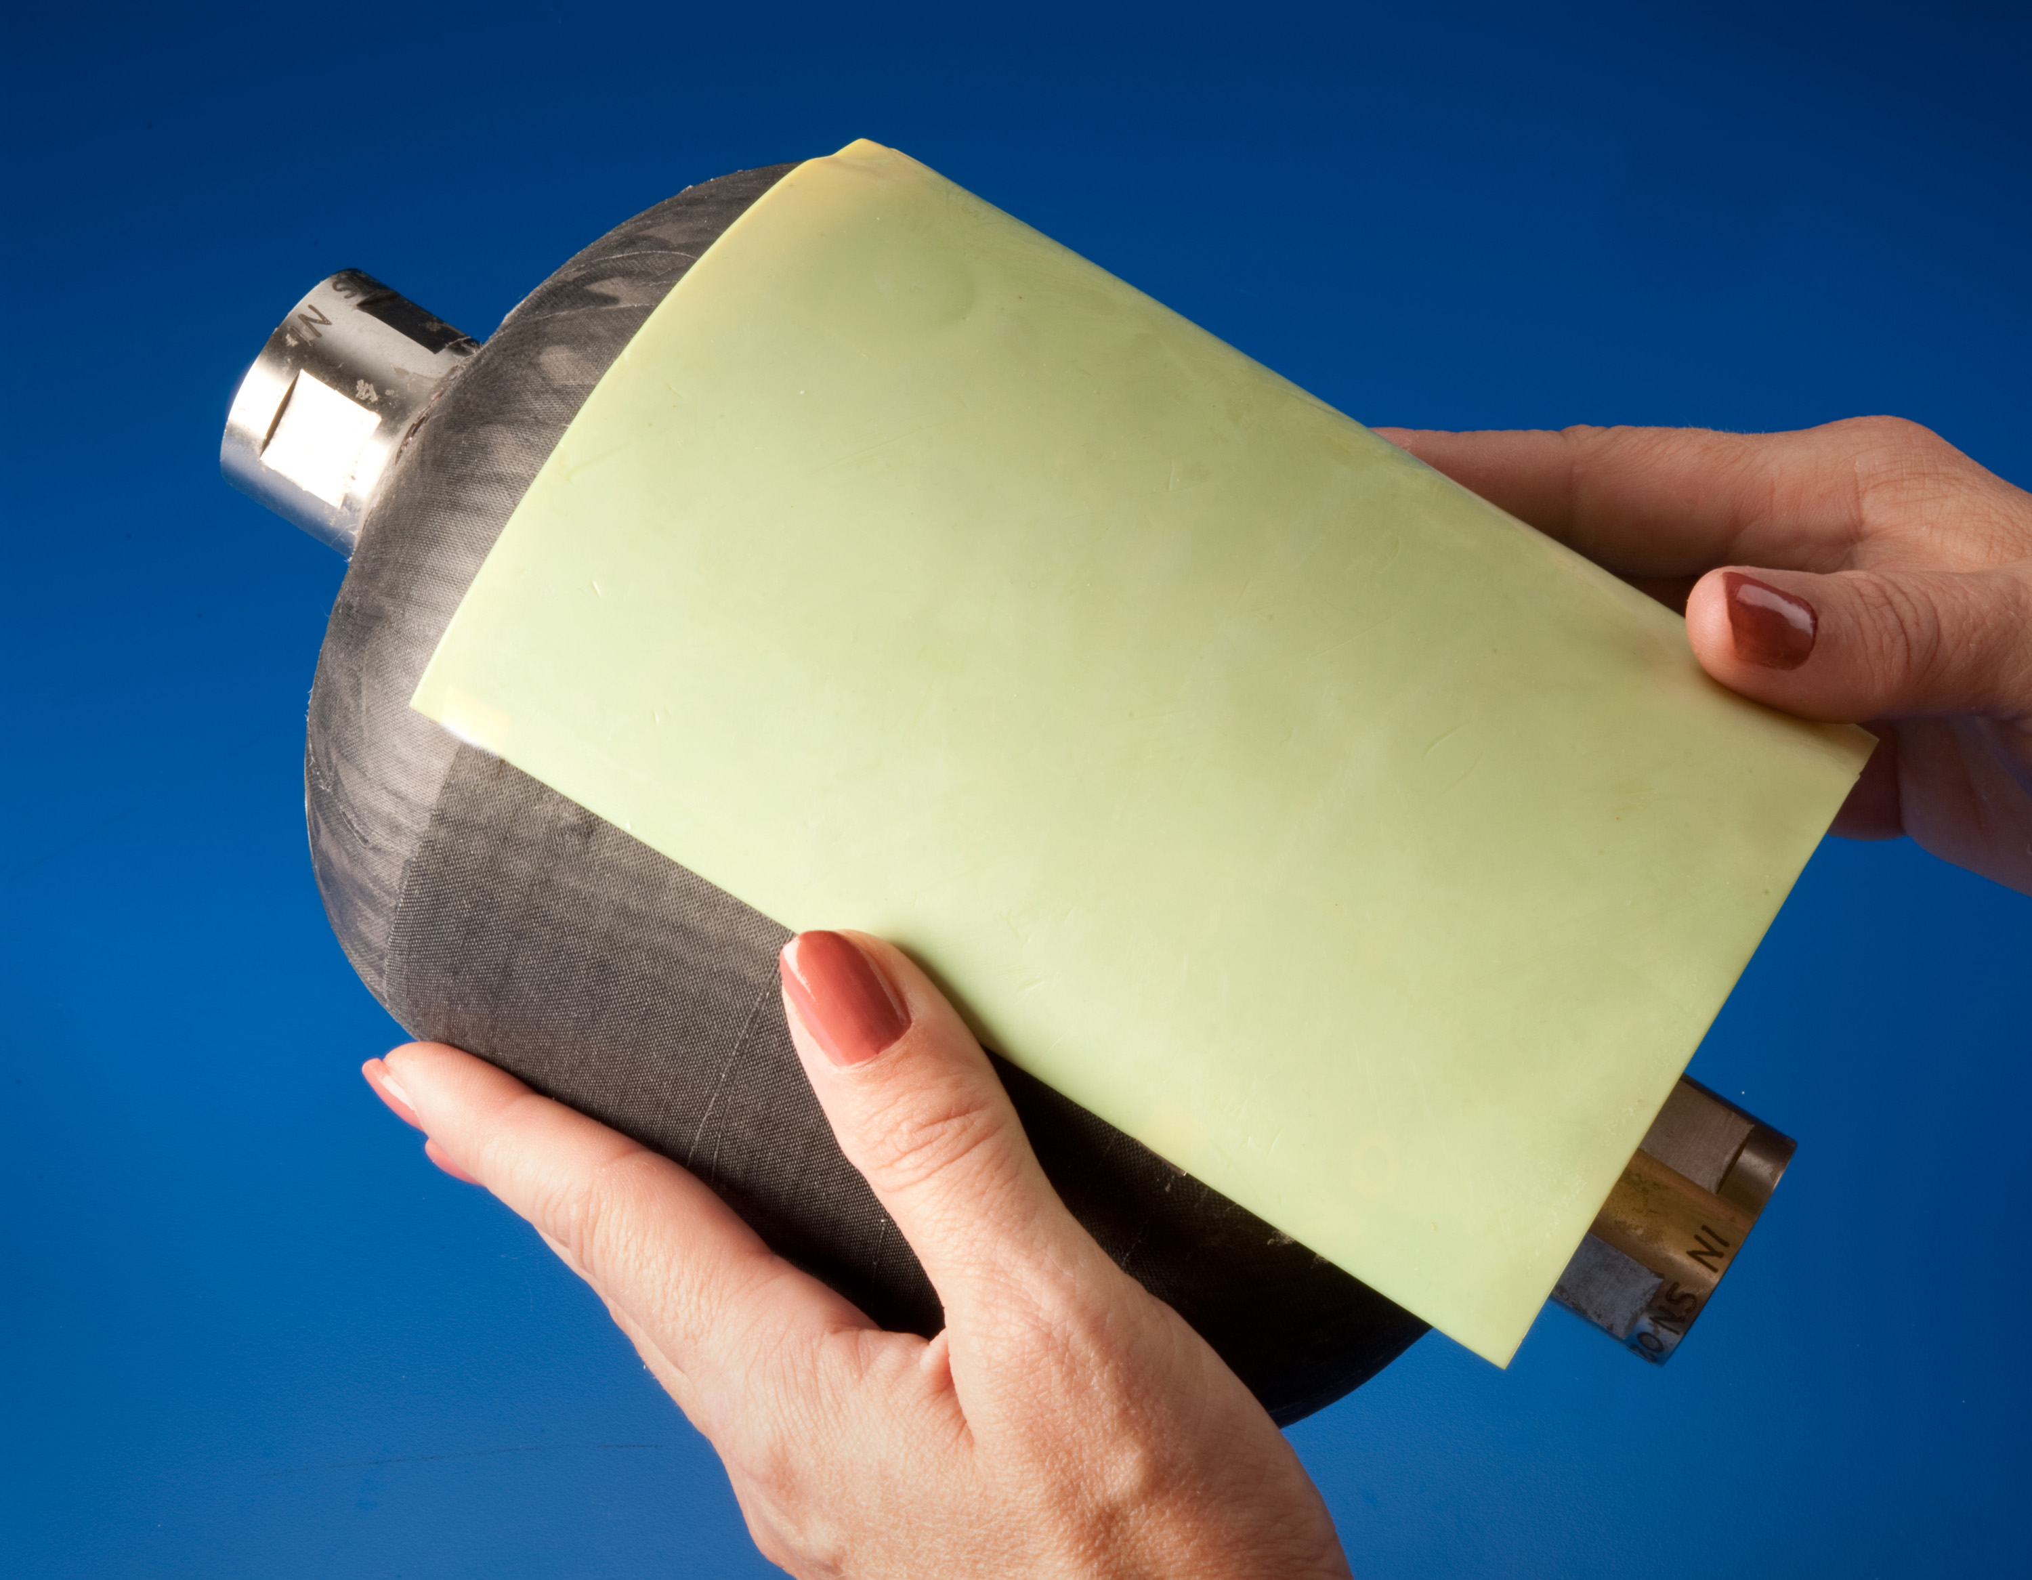
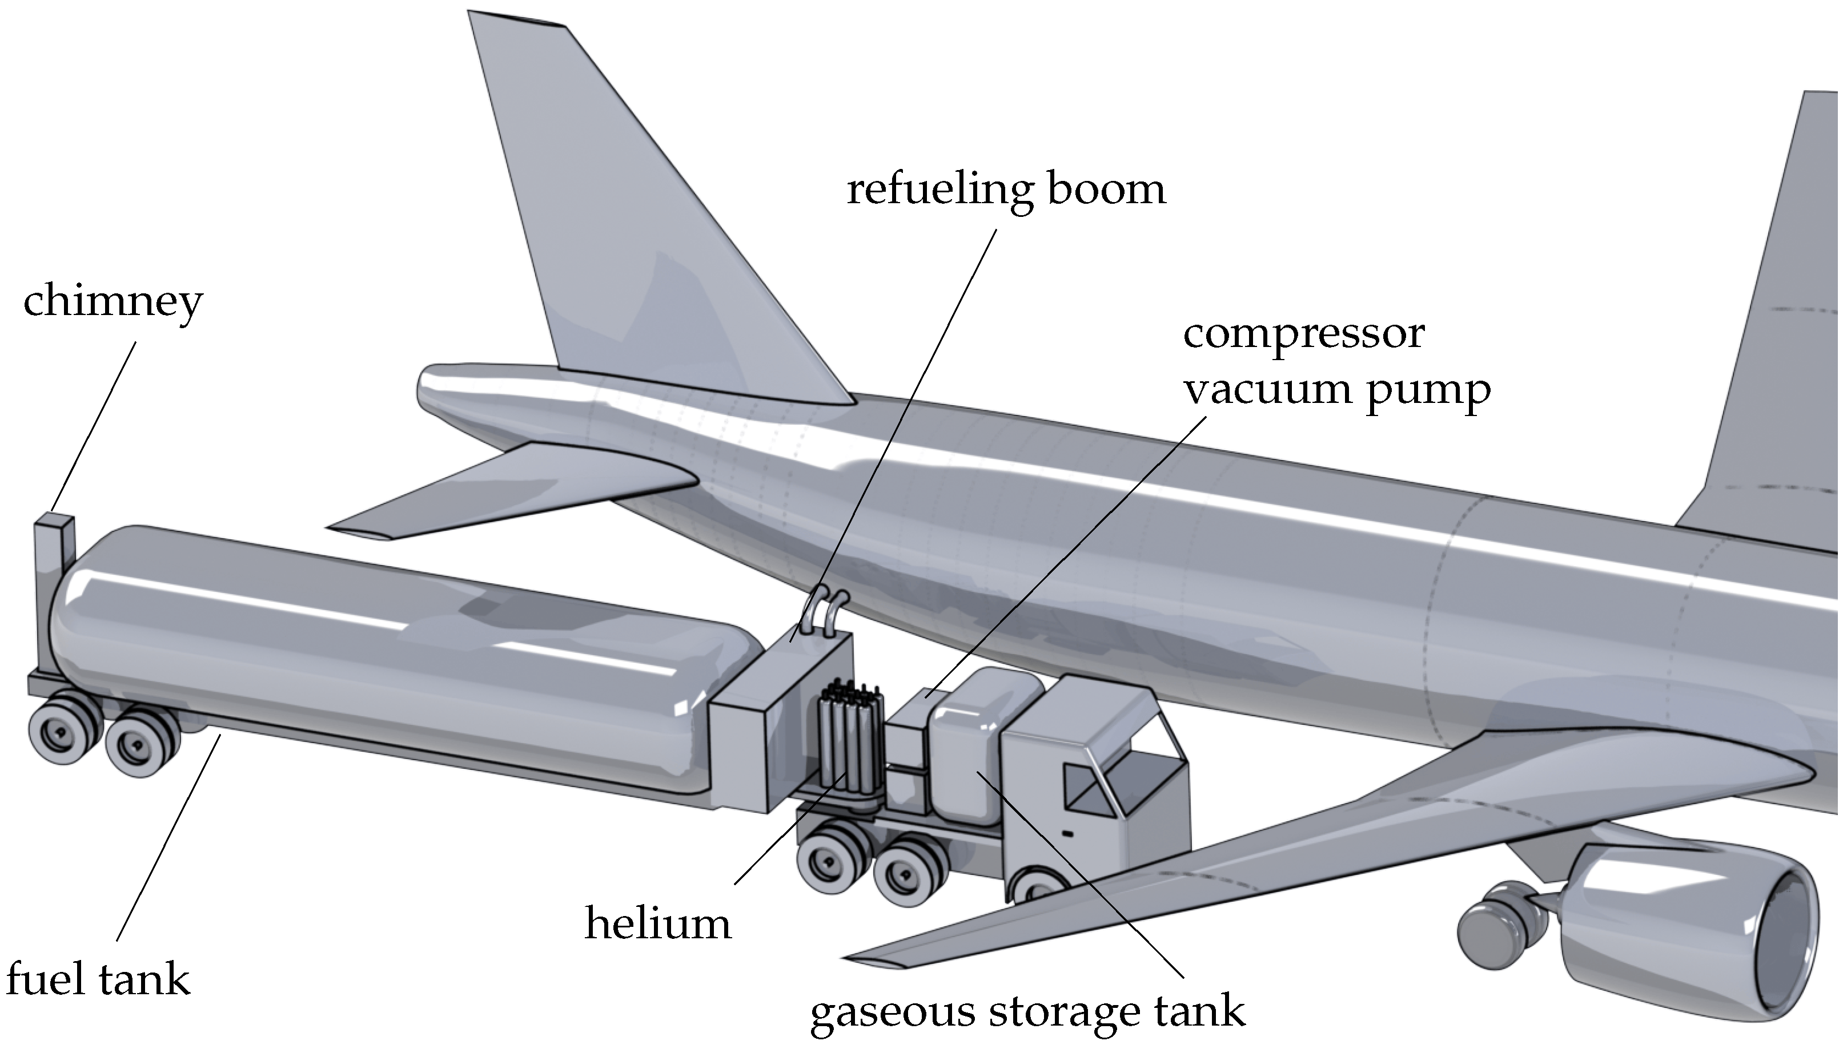
Possible Test Considerations
Pumps, Valves, and High Efficiency Transfer Lines
Composite Tanks
High Temperature PEM Fuel Cells
Leak Detection
NASA
NASA
Integrated Aircraft
Airport Energy Hub
NASA
Polymer Aerogel Infused Tanks
Aircraft Refueling Ops
NASA
https://www.nxtairport.nl/en/groningen-airport-eelde-first-hydrogen-valley-airport-in-europe/
NASA
https://www.mdpi.com/1996-1073/15/7/2475

Slide 7
Scope
What this is:
What this is not:
An exploratory activity to understand:
What a test facility might look like / need.
What the needs are for testing with various forms of hydrogen.
What industry groups and government agencies are interested in participating in this conversation.
A commitment on behalf of NASA to fund anything.
Looking for proposals for technology development or testing.

Slide 8
Areas of Interest
Testing –
  What are the testing needs/objectives that might drive the requirements for this capability?
  What gaps are there in testing standards or protocols are there in testing?
Facilities –
  What are the essential characteristics/functions of the facility?
  How can that be developed over time?
Materials –
  What are the general materials gaps in hydrogen systems?
Collaboration –
  How can NASA participate in external collaborations?
  How do others want to participate with us?

Slide 9
How will the Information be Used
The goal of this activity is to get a better understanding of the needs, challenges, and requirements for a testing facility from as many different perspectives as possible.
Data will be used for advocacy in a manner that is not tracable to the submitter.
Plan to use data in a manner that is sharable without identification of individual respondents.

Slide 10
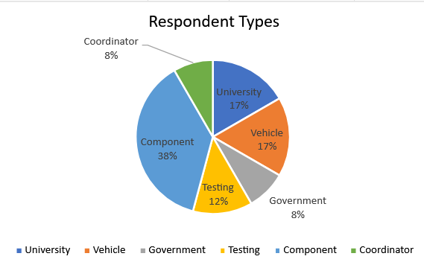
Responses
A variety of highly diverse Respondents that cover the range from:
Aspiring component developers to existing test facilities to full aircraft manufacturers;
From small business to large international corporations to companies running Federally Funded Research and Development Centers (i.e. National Labs)
Companies with existing test capabilities to those looking to use a developed capability

Slide 11
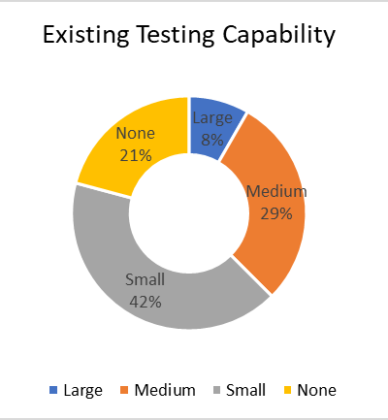
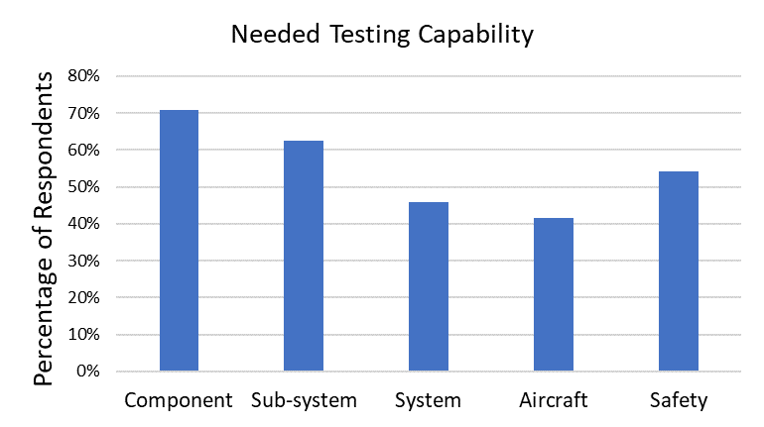
Existing Testing Capabilities
Most of the respondents have some level of hydrogen testing capability
A majority of respondents indicated that they saw a need for further test capability at a range of different sizes.

Slide 12
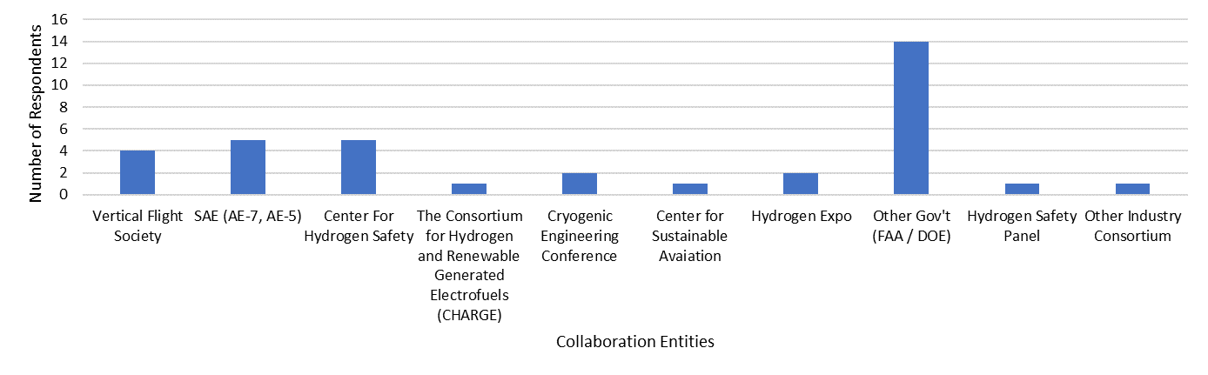
Existing Collaboration Groups
The existing industry collaboration groups are spread out and not widely supported by respondents.
  The average respondent participates in more than one (1.5) of these groups with some participating in up to 6 different groups.
Other government agencies have large portions of the respondents already working with them.
  Continue to focus on working with other government agencies collaboratively instead of trying to start other groups.

Slide 13
Conclusions
Our team is investigating the observed need for liquid hydrogen testing capability within the US to meet the need for development of hydrogen aircraft and transportation systems.
We have conducted a Request For Information (RFI) regarding the need and uses for testing for cryogenic hydrogen.
The data from the responses to the RFI is currently being analyzed internally.

