Slide 1
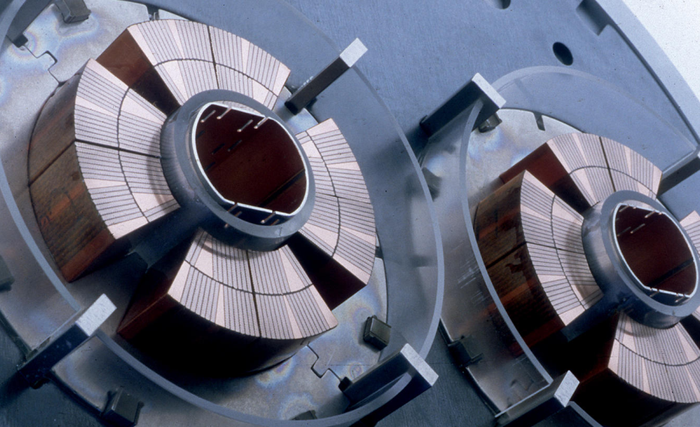
ICMC Reno 2025
Primary Author
May 21, 2025
Markus Kind
Co-Authors
Ignacio Aviles Santillana
Enrique Rodriguez Castro
Berta Ruiz Palenzuela
Stefano Sgobba
Cryogenic Mechanical Properties of
Large Forgings for High Field Fusion Magnets
Why structural materials deserve more spotlight in fusion magnet design.

Slide 2
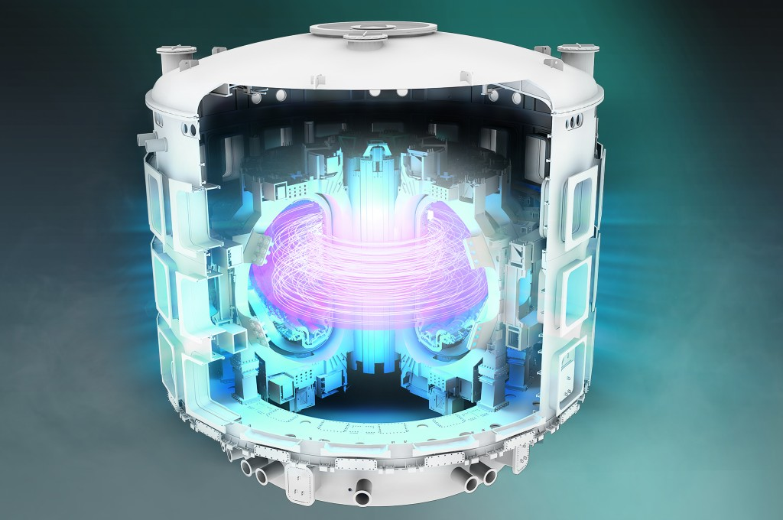
Magnets are the Heart of Magnetic Confinement Fusion.
Why High-Field Superconducting Magnets Matter.
Why High-Field Superconducting Magnets Matter
Fusion requires magnetic fields to confine plasma at >100 million °C
Magnetic field strength ∝ fusion performance ∝ energy gain
Tokamaks and stellarators rely on precise, powerful, continuous fields

Slide 3
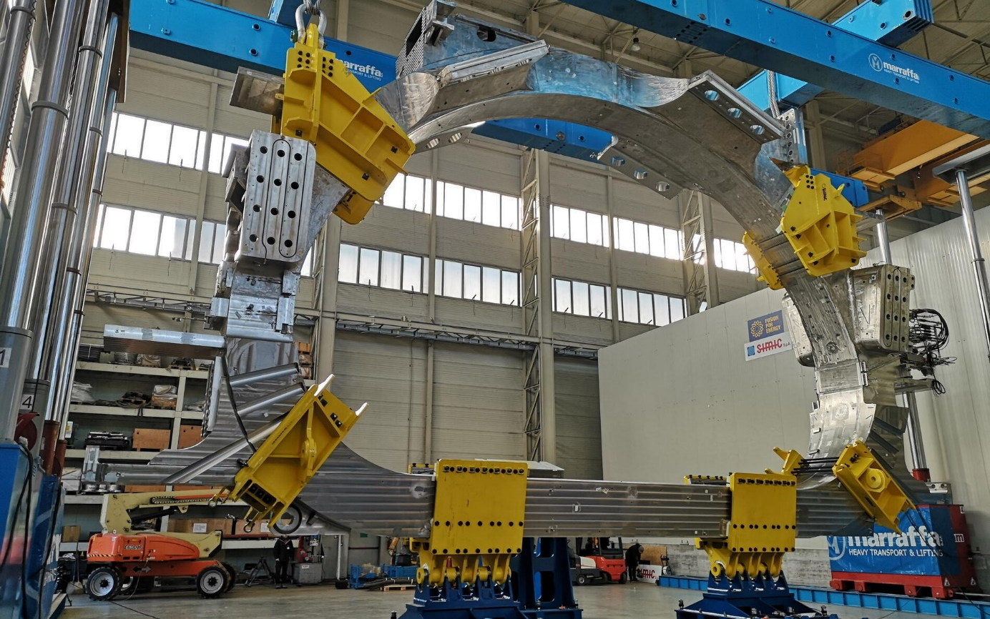
Magnets are the Heart of Magnetic Confinement Fusion.
Why High-Field Superconducting Magnets Matter.
Superconducting Magnets –
The Enabler
Carry enormous currents with zero resistance
Allow compact high-field designs
(SPARC, ITER, DEMO)
Operate at cryogenic temperatures,
inside high-radiation environments

Slide 4
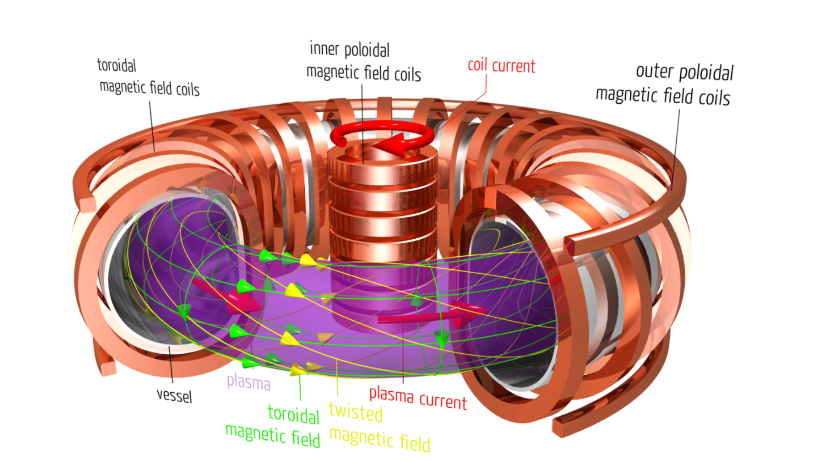
Magnets are the Heart of Magnetic Confinement Fusion.
But Magnets Don’t Float in Space.
Superconductors carry current – but structure carries the system
Structural materials must withstand: Lorentz forces, thermal shrinkage, fatigue, neutron flux
Operate under harsh conditions: 4 K, radiation, stress cycling
Determine magnet lifetime, stability, safety
Often overlooked – until structural failure becomes real → brittle fracture, creep, delamination

Slide 5
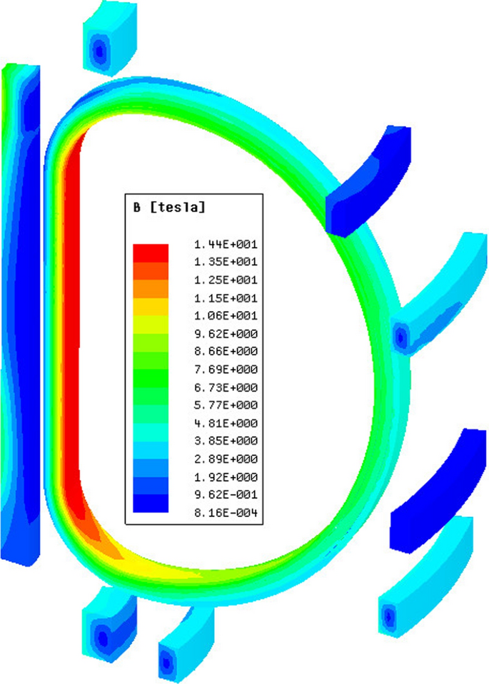
Magnets are the Heart of Magnetic Confinement Fusion.
But Magnets Don’t Float in Space.
Structural materials must combine:
Strength + Toughness + Fatigue Resistance – all at 4 K
Superconductors get the spotlight – but structure makes it work.
DANGER: If structure fails, the magnet fails – instantly and irreversibly.

Slide 6
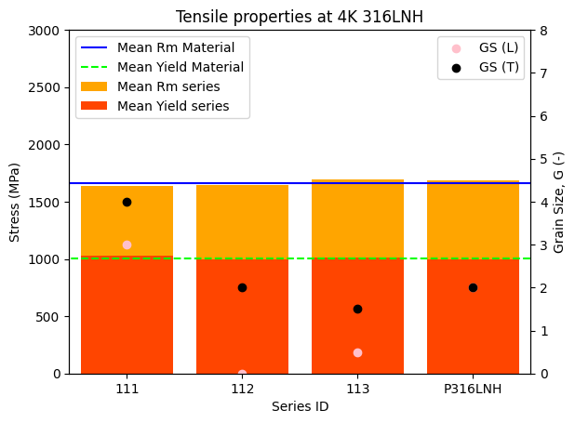
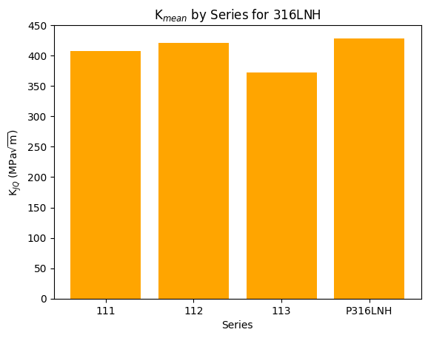
316LNH & XM-19 – When 'standard' stainless steel isn’t enough.
Materials built for the extremes of fusion magnets - 4K cryogenic conditions!
Why 316LNH?
Austenitic CrNiMo steel with low carbon and enhanced nitrogen → stable, non-magnetic microstructure
Designed for high strength & ductility (>40%) at 4 K >900 MPa tensile
Excellent weldability, corrosion resistance, and radiation tolerance
Industrially available as large forgings → ideal for fusion magnets

Slide 7
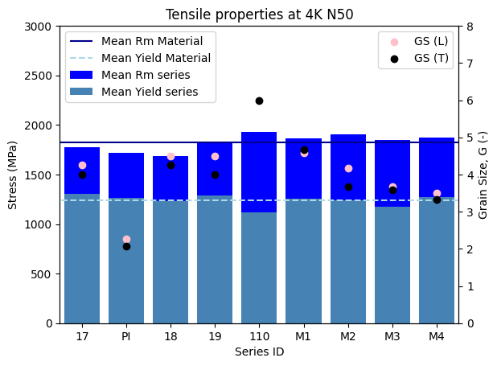
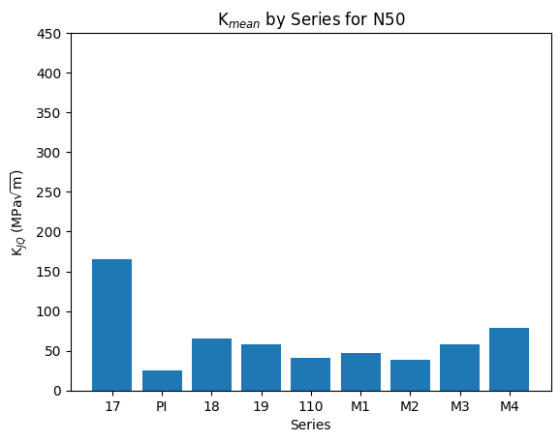
316LNH & XM-19 – When 'standard' stainless steel isn’t enough.
Materials built for the extremes of fusion magnets - 4K cryogenic conditions!
XM-19 (Nitronic 50) offers higher strength, but reduced weldability and limited availability in large forgings → suitable as complementary material for secondary components. Furthermore, unstable crack propagation will limit its use in safety-critical environments.

Slide 8
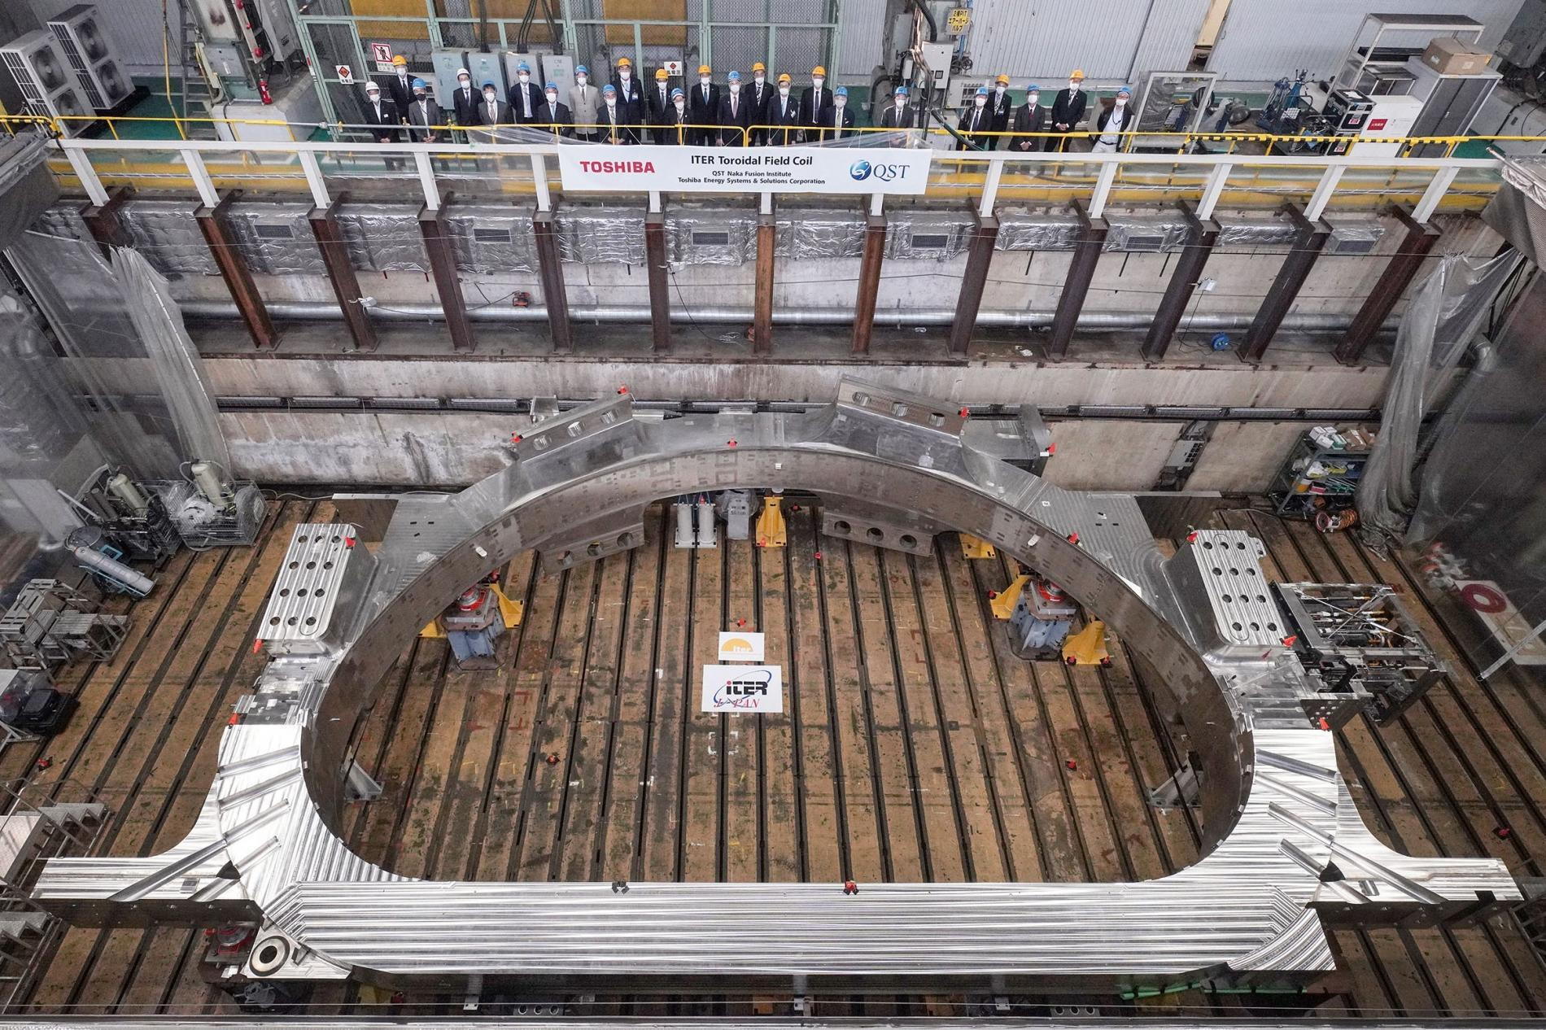
From sample to structure.
When size becomes the challenge.
Key Challenges
316LNH
N depletion → reduced core toughness
Grain coarsening, segregation
Residual stresses from thermal gradients
XM-19
Nitrides / chi-phase formation
Segregation in thick sections
Limited weldability

Slide 9
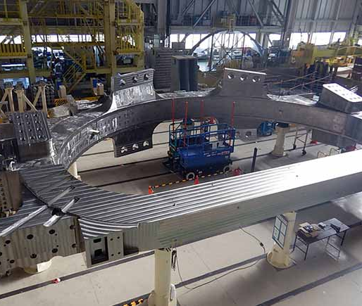
From sample to structure.
When size becomes the challenge.
Key Challenges
Systemic Issues
Uneven element distribution
Directional grain growth
Surface samples miss core defects
Takeaway
Process control is key to achieving reliable, isotropic properties at scale.
!
PAY ATTENTION:
material properties from small material samples and large size forgings even of the same grade can often not be compared!

Slide 10
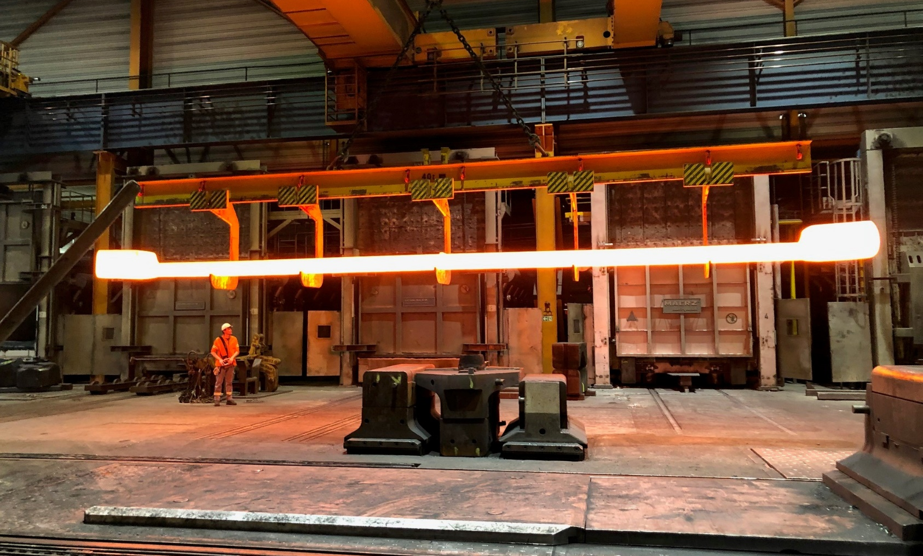
Case Study
ITER Tie Plates made from XM 19 material.
Lessons from production.
Application
Structural components for the Central Solenoid – the most powerful magnet in ITER.
Key Challenges
Resist high vertical tensile loads and maintain contact between solenoid coils under cryogenic operation. Mechanical properties must meet strict criteria at 295 K and 4 K (strength, fatigue, toughness).

Slide 11
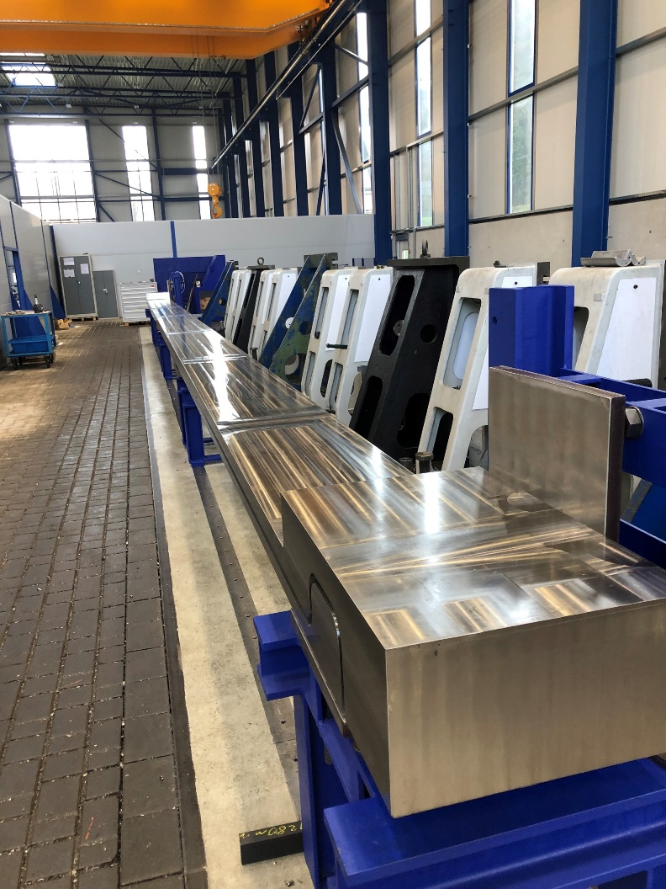
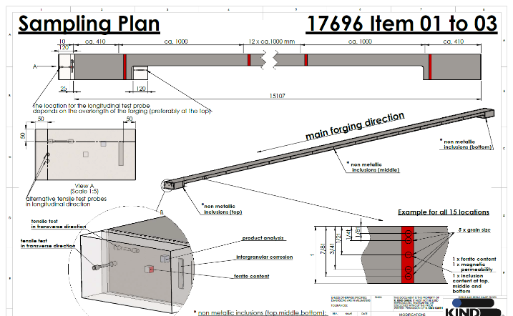
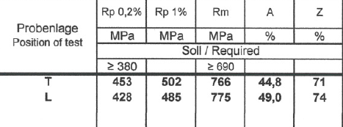
Case Study
ITER Tie Plates made from XM 19 material.
Lessons from production.
Manufacturing
26 parts, each ~ 17 m long, forged from
17 t ESR ingots. Three forging machines used per part to achieve final length
Microstructure
Fully austenitic, homogeneous along full length. 20 microstructural checks per part (every 80 cm).
Takeaway
Industrial forging of ultra-long cryogenic parts is possible – with full-process control.

Slide 12
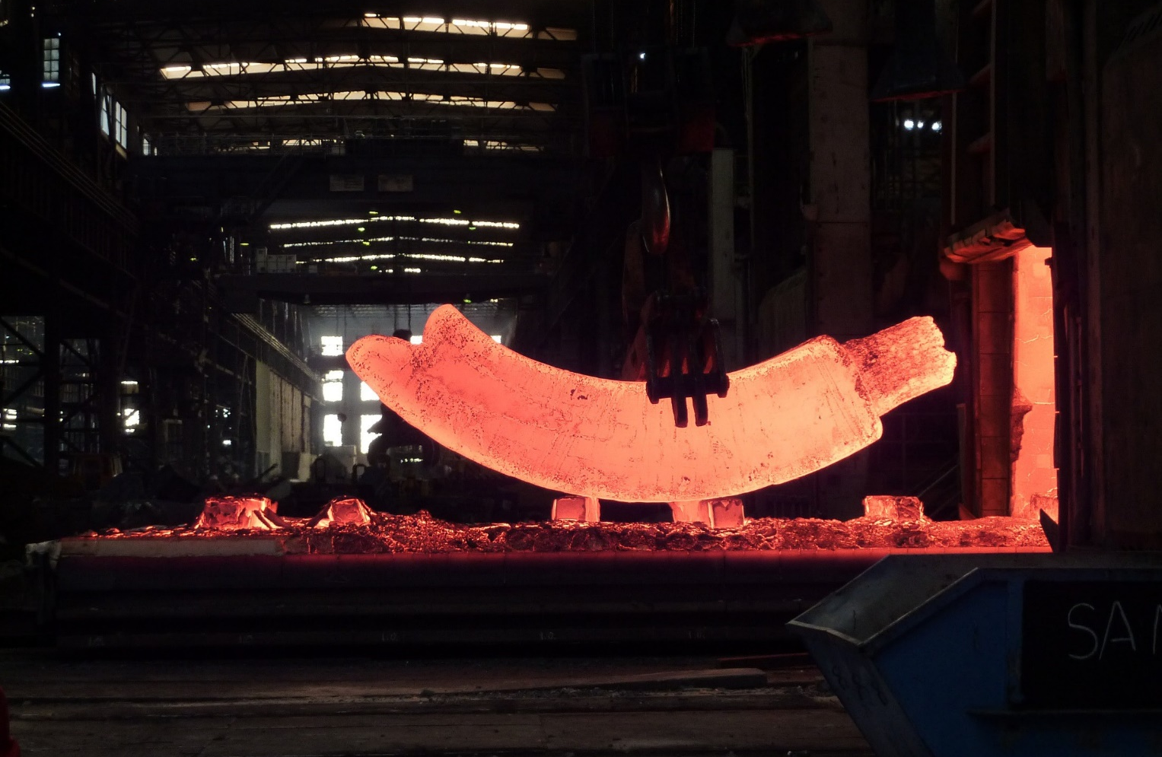
Case Study
ITER TF Coil Magnet forgings from F316 LNH Material.
Forging cryogenic reliability.
Application
Casing structure for ITER’s superconducting TF coils. Supports and aligns coils under extreme electromagnetic loads; ensures plasma confinement integrity.
Manufacturing
Fabricated in segments, welded to final shape. Forged from up to 40 t ESR ingots, segment lengths up to 12 m. High-precision welding & post-processing for dimensional stability.

Slide 13
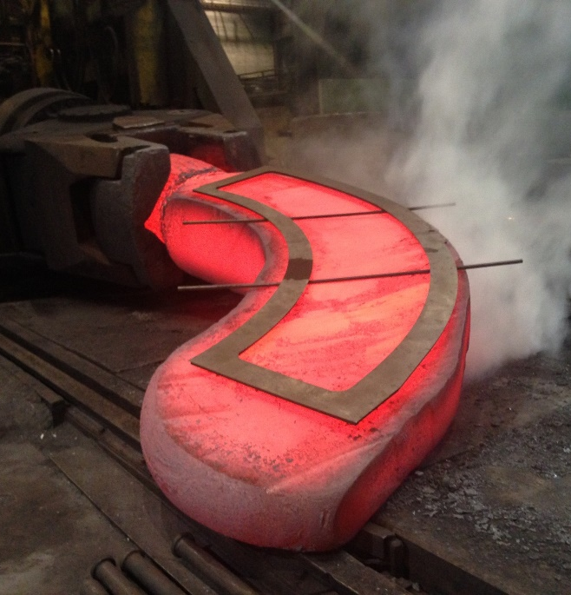
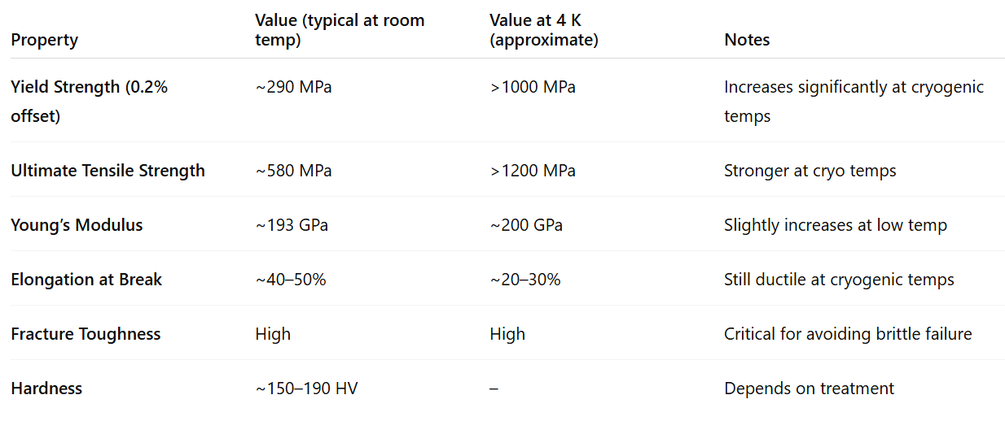
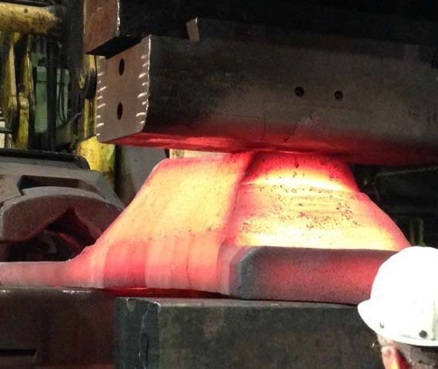
Case Study
ITER TF Coil Magnet forgings from F316 LNH Material.
Forging cryogenic reliability.
Mechanical
Properties
Austenitic Structure
Face-centered cubic (γ-phase) Excellent toughness and fracture resistance down to 4 K
Takeaway
The TF casing is more than protection – it’s structural steel for magnetic precision at cryogenic extremes.

Slide 14
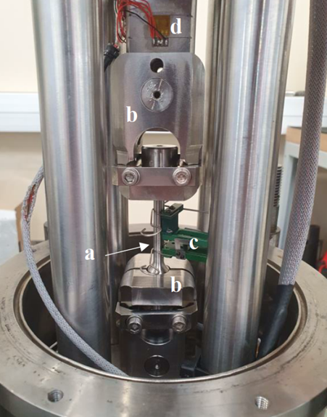
Pulling steel in the cold.
Tensile properties at 4K.
Influencing Factors
Grain size: Finer grains → higher yield & tensile strength (Hall–Petch)
Nitrogen content: Solid-solution strengthening → improves both strength & toughness
Tensile Behaviour
High strength (>900 MPa) and elongation (>40%) at 4 K
Stable stress–strain response under cryogenic conditions
Dewar
Thermal screens
Top flange
Bottom plate
Takeaway:
Strength keeps structure in shape – even when the temperature drops to 4 K.

Slide 15
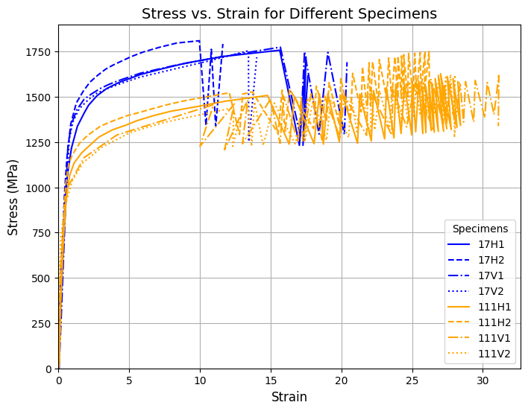
Pulling steel in the cold.
Tensile properties at 4K.

Slide 16
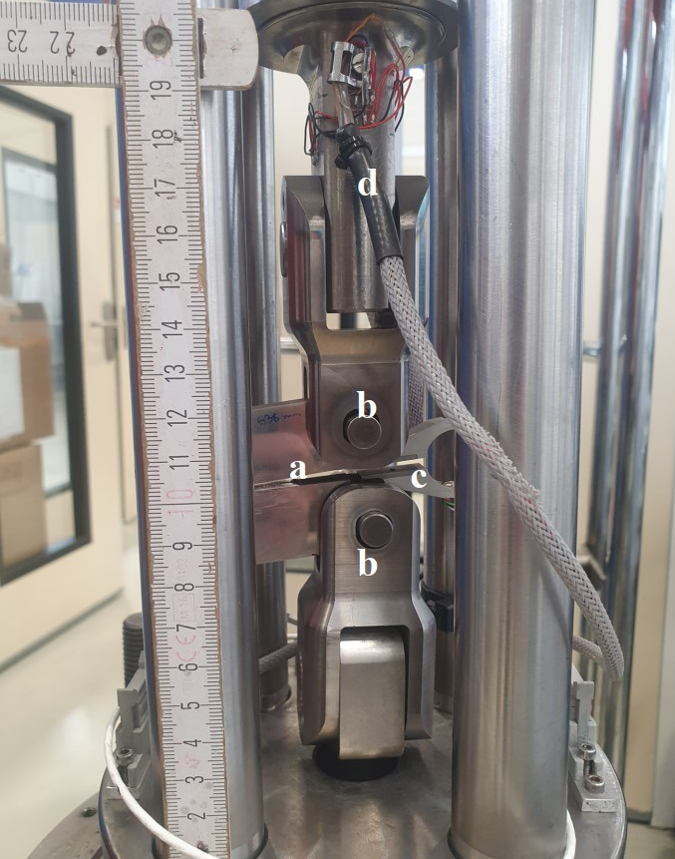
When failure must be avoided.
Fracure Toughness at cryo conditions.
Influencing Factors
Temperature: Lower T → lower crack-tip plasticity
Loading rate: Fast transients increase fracture risk
Microstructure: Fine grain size, low δ-ferrite, high N = higher toughness
Tensile Behaviour
High fracture toughness (K<sub>IC</sub> 150–250 MPa√m) at 4 K
Stable crack resistance in ductile regime
Dewar
Thermal screens
Top flange
Bottom plate
Takeaway:
Strength prevents deformation – toughness prevents disaster.

Slide 17
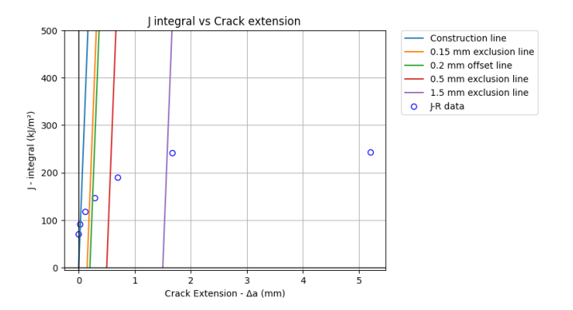

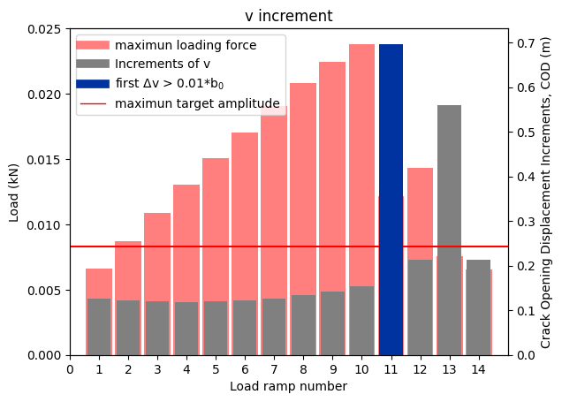
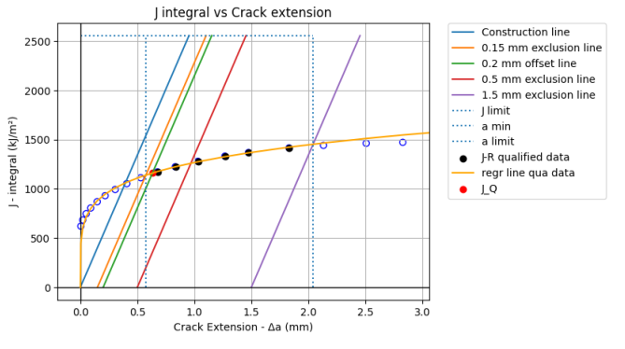
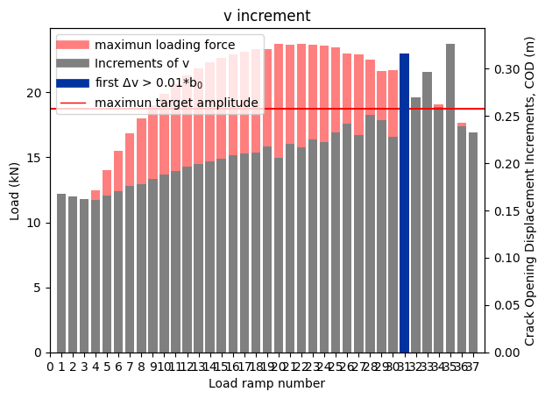
When failure must be avoided.
Fracture Toughness at cryo conditions.

Slide 18
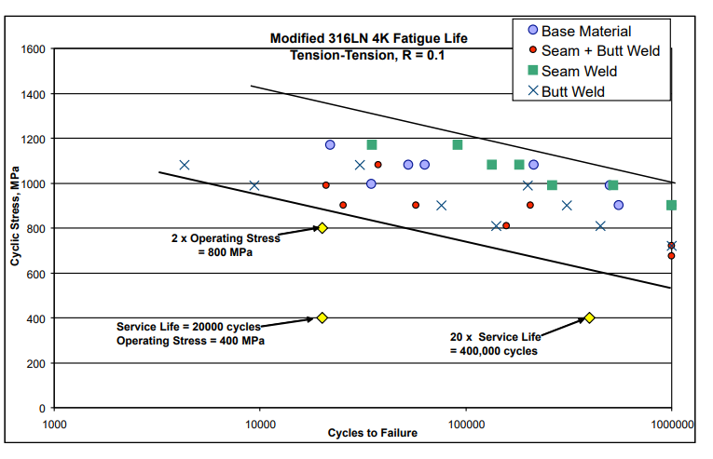
Fatigue Behaviour at 4 K
Improved vs. room temperature due to:
Higher yield strength
Increased strain hardening
Reduced dislocation mobility
Fatigue limit:
Room temperature: ~ 220 - 250 MPa
At 4 K: Up to 400 MPa at 10⁷ cycles
Counting cracks.
Fatigue life of 316LNH.
Influencing Factors
Stress amplitude: Higher amplitude → shorter fatigue life
Frequency: Affects crack initiation and propagation kinetics
Environment: Cryogenic vacuum = better performance; humidity or surface defects = earlier failure
Takeaway:
At 4 K, 316LNH offers excellent fatigue resistance – but weld quality and surface integrity are key to achieving long life.

Slide 19
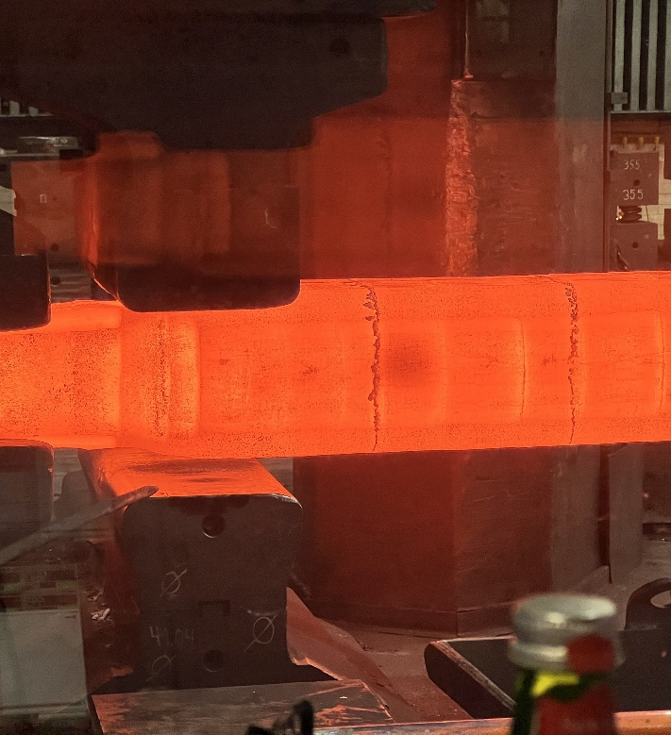
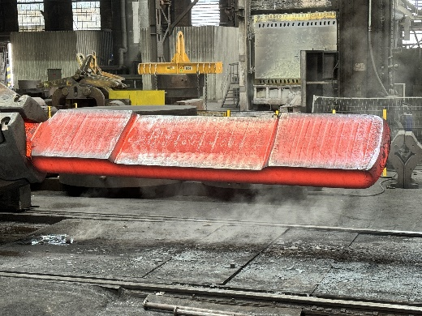
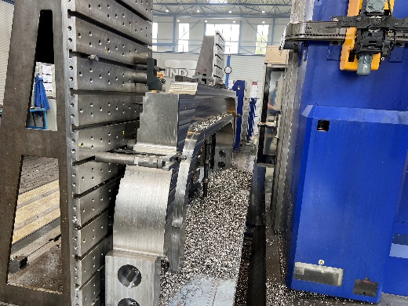
From plant to part.
Manufacturing TF coil forgings for CFS SPARC.
Process Overview
Material Selcetion F 316 LNH due to excellent mechanical properties at 4K
Large-scale ESR-ingot production and open-die forging
Precision forging for dimensional stability & isotropy
Great importance on homogeneity
Heat treatment: solution annealing + quenching
Machining to tight tolerances before integration
3-D measurement to ensure Geometric Dimensioning and Tolerancing

Slide 20
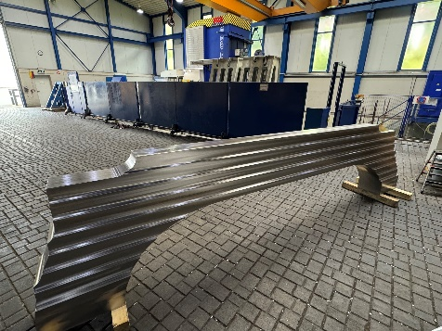
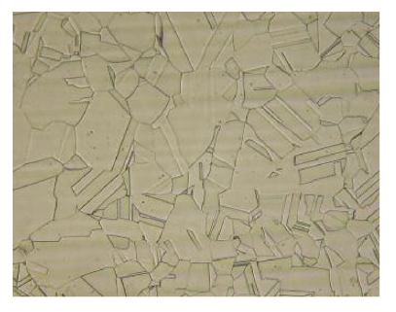
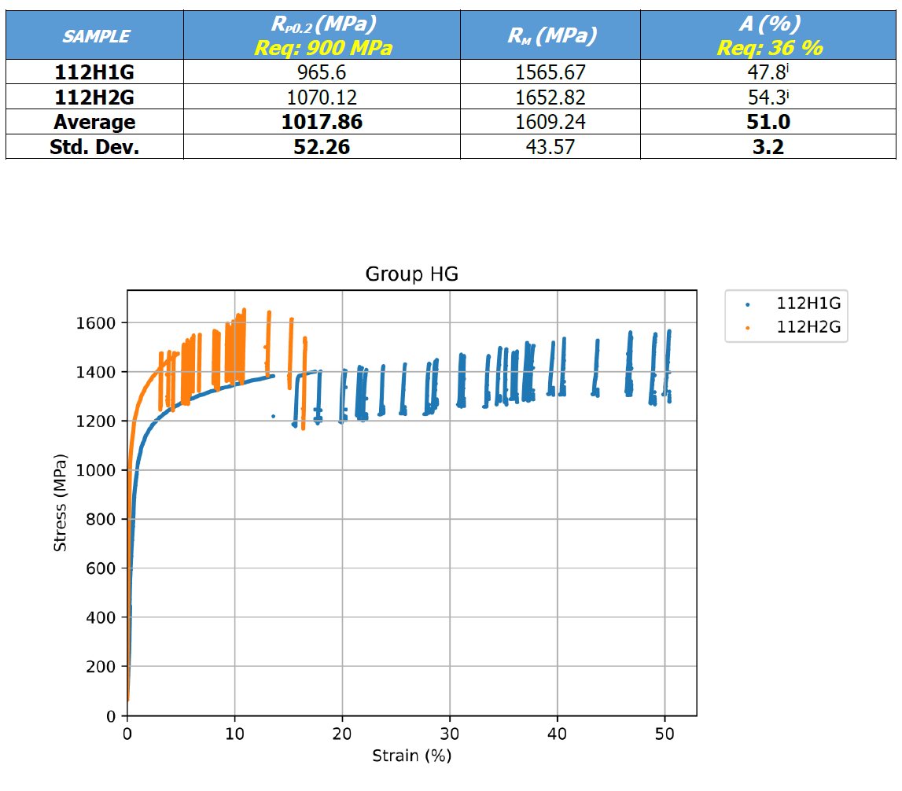
From plant to part.
Manufacturing TF coil forgings for CFS SPARC.
Material Characterisation
Mechanical properties:
High strength and ductility confirmed at 4 K
Consistent values across forging cross-section
Microstructure:
Fully austenitic, fine-grained
No δ-ferrite, no coarse segregations → isotropic behaviour
Takeaway
SPARC proves: industrial-scale forging of cryogenic steel is possible – if process control is mastered

Slide 21
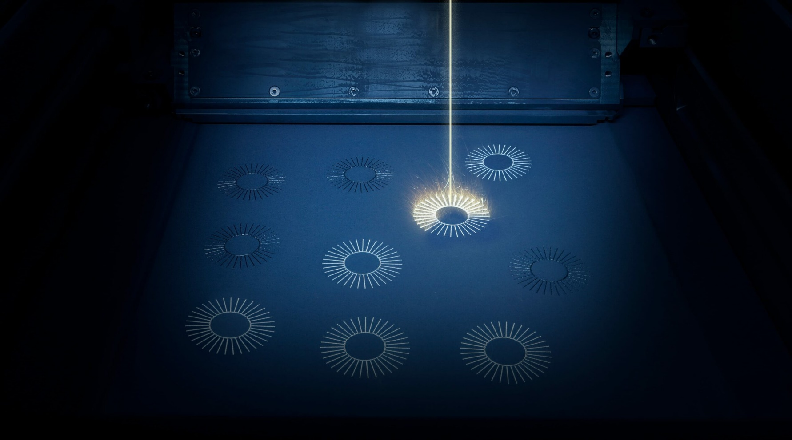
Printing the Future.
Additive Manufacturing of 316LNH – Laser Powder Based Fusion Route (Selective Laser Melting).
Process Overview
Powder Production: Gas-atomized 316LNH, N-stabilised
Selective Laser Melting (SLM®): Layer-wise melting under inert gas
Advantages of LPBF
Complex geometry with internal channels, lattices, and overhangs
High mechanical strength and material density
Minimal material waste

Slide 22
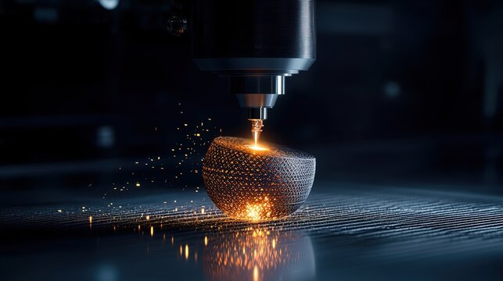
Printing the Future.
Additive Manufacturing of 316LNH – Laser Powder Based Fusion Route (Selective Laser Melting).
Material Characterisation
Mechanical properties:
High strength & fine detail resolution expected
Influence of build orientation and heat treatment under study
Microstructure:
Fine, columnar grains; needs
post-processing
Risk of δ-ferrite & residual stress without HIP or annealing
Takeaway:
LPBF offers design freedom – but needs tailored process control for 316LNH.

Slide 23
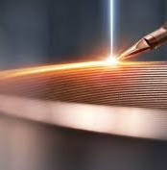
Wire by Wire.
Additive Manufacturing of 316LNH – Direc Energy Deposition (Wire Electron Beam Additive Manufacturing).
Process Overview
Wire feedstock: 316LNH custom wire, N-stabilised
WEBAM (Wire Electron Beam Additive Manufacturing):
  Performed in vacuum → oxidation-free process
  Electron beam fuses wire layer-by-layer
  Enables large components, fast and flexible production
  Precise wire feed control via integrated system

Slide 24
Wire by Wire.
Additive Manufacturing of 316LNH – Direc Energy Deposition (Wire Electron Beam Additive Manufacturing).
Material Characterisation
Mechanical properties:
Promising strength; needs validation at 4 K
Process stability and reproducibility under investigation
Microstructure:
Directional solidification → anisotropy possible
Requires grain refinement and N-retention strategies
Takeaway:
WEBAM enables fast, large-scale production of 316LNH – but cryogenic performance depends on mastering the microstructure.

Slide 25
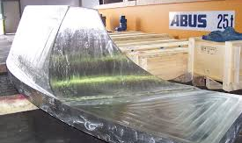
Why 316LNH for Fusion Magnets?
Non-magnetic, weldable, cryo-tough
Proven in large-scale forgings (ITER, SPARC)
Isotropic properties achievable with proper processing
Conclusions
Where are we now:
316 LNH is proven as THE Reliable Steel for Unforgiving Conditions – the ideal choice for Fusion Magnet Structures
Mechanical Properties @ 4 K
High strength: >900 MPa tensile strength
Excellent ductility: >40% elongation
Fracture toughness: K<sub>IC</sub> up to 250 MPa√m
Fatigue resistance: >10⁶ cycles at moderate stress

Slide 26
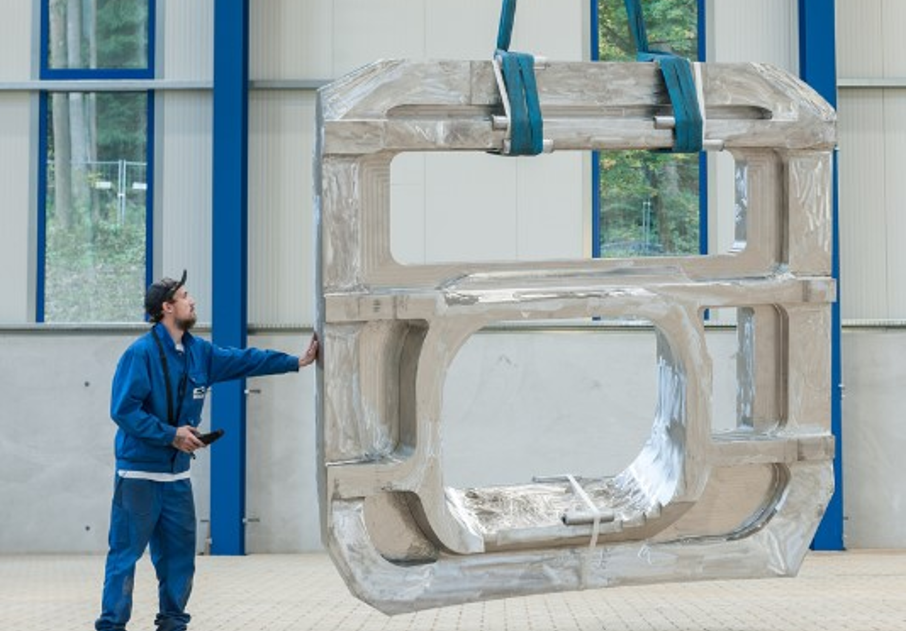
Conclusions
Looking Ahead –
What will be the future
new super austenitic stainless steel grades with higher mechanical properties at 4K
Optimisation for additive manufacturing (powder & wire); IF large scale production and 4 K mechanical properties are confirmed:
Advanced QA strategies for large forgings

Slide 27
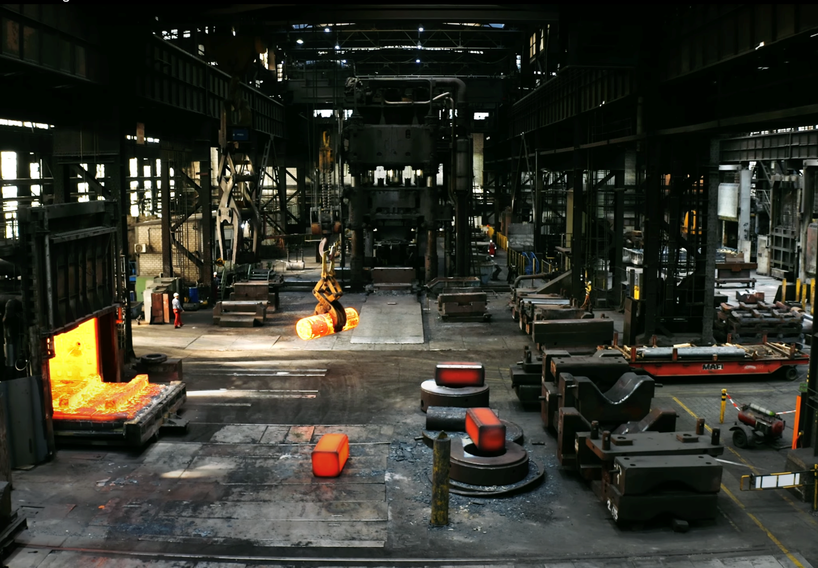
What's next?
Future developments of new super austenitic stainless steel grades – for Forgings beyond the limits of existing boundaries!
Why New Alloys?
316LN is the benchmark for cryogenic forging – but approaching its limits
Next-gen fusion requires: → Higher strength (Rp₀.₂ > 1200 MPa) → High fracture toughness (K<sub>IC</sub> > 200 MPa√m @ 4 K) → Compliance with JAERI Box criteria
Fusion magnets demand perfection.
316LNH is one of the few materials that can come close - and future developments are ongoing.

Slide 28
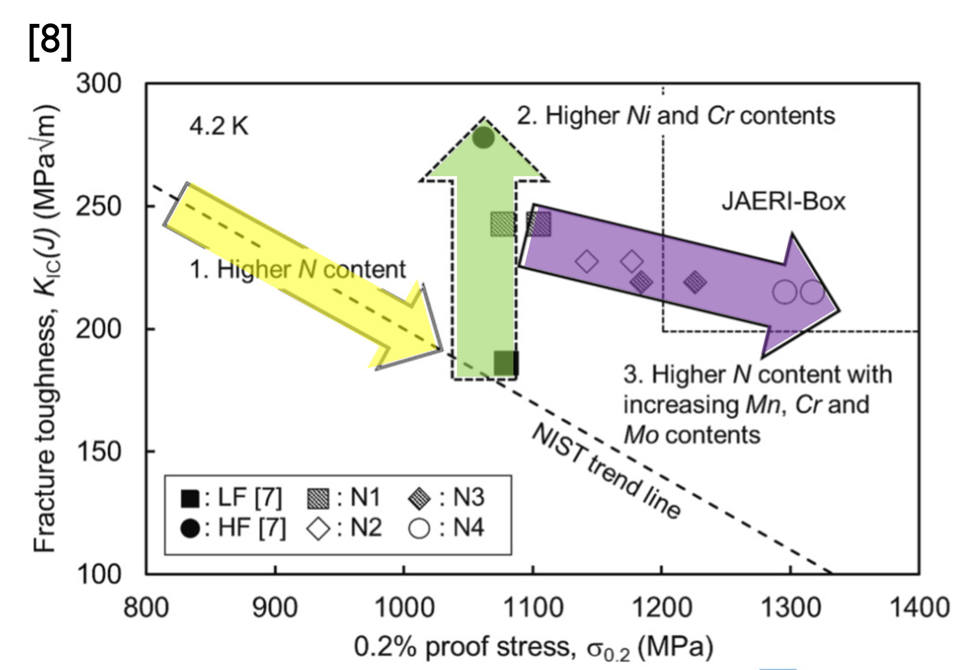
What's next?
Future developments of new super austenitic stainless steel grades – for Forgings beyond te limits of existing boundaries!
Development Goals
Design high-nitrogen austenitic steels with optimised Mn, Cr, Mo
Improve synergy of alloying elements → control dislocation behavior
Ensure forgeability at large scale beyond conventional alloys
Candidate Grades (Examples)
X2CrNiMn22-16-6N
X1CrNiMn19-11-12N
X2CrNiMoN22-5-3 with ↓Nb, ↓V

Slide 29
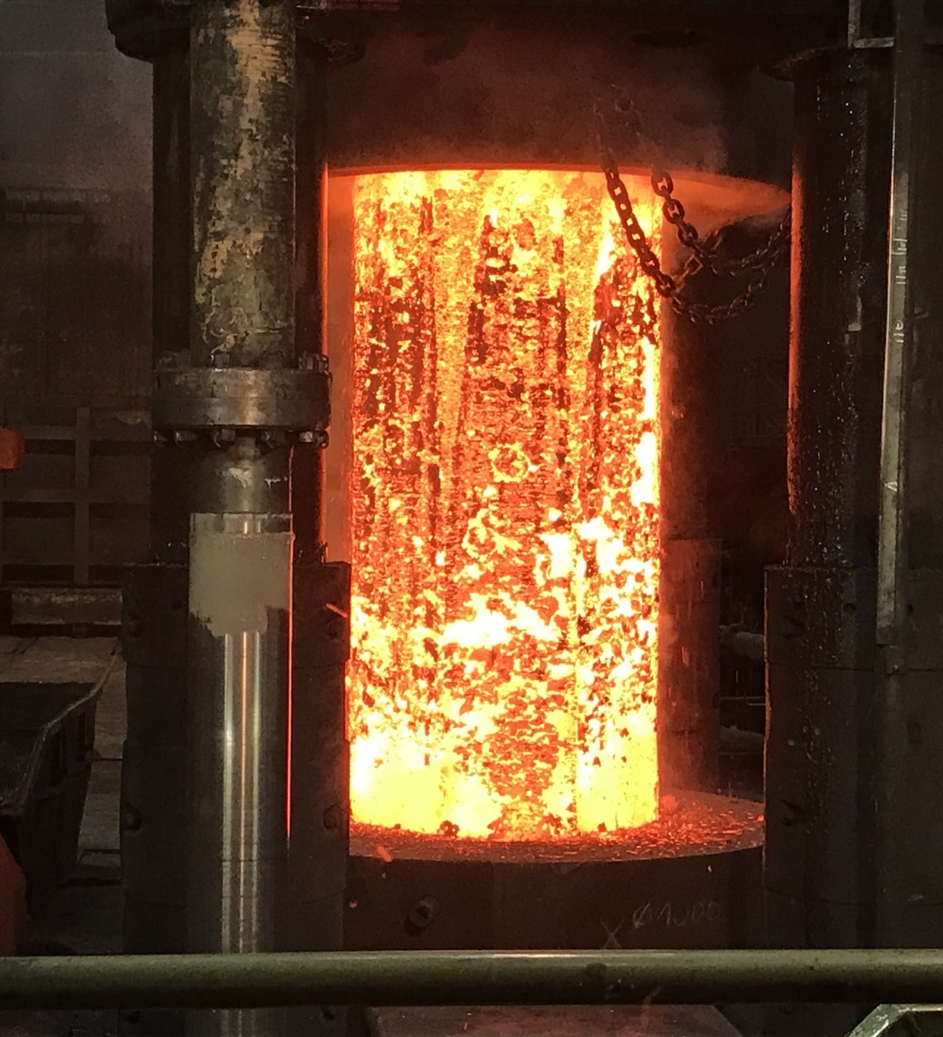

Engineering
Contact Information
Email
markus.kind@r-kind.de
Website
www.r-kind.de

Slide 30
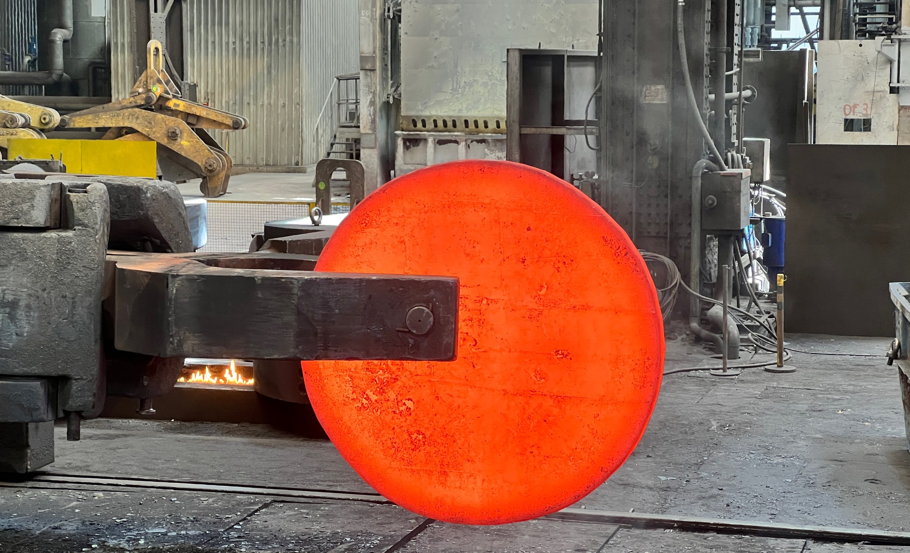
THANK YOU

