Slide 1
Quality assurance testing of REBCO tapes for the 40 T all-superconducting magnet project
J. Lu, D.V. Abraimov, J.W. Levitan, J. Kvitkovic, A. Ingrole, J.J. Jaroszynski, W.S. Marshall,
N. Gavin, A. Hutley, A. Garrett, H. Pimentel, and H. Bai
National High Magnetic Field Laboratory, Tallahassee, Florida USA

Slide 2
Outline
Introduction
Test method and results
      Ic (B, θ) at 4.2 K by transport
      Ic (B, θ, T) by magnetometry
      RRR of Cu stabilizer
      Lap joint resistance at 77 K
      Ic-strain at 77 K
      ab plane tilt angle
      Delamination strength
      Cu thickness profile
Summary and outlook
Low temperature
Room temperature

Slide 3
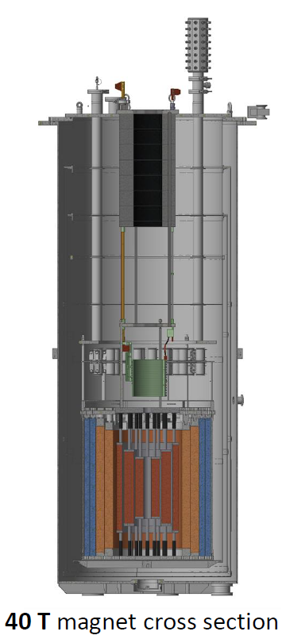
40 T all-superconducting magnet project
NHMFL is funded by NSF for conceptual design of a 40 T all superconducting magnet (2021-2026) based on the technology developed in the 32 T all- superconducting magnet which was commissioned in 2017 at the NHMFL.
REBCO coated conductor will be used for HTS insert coils.
155 spools of about 25 km SuperPower REBCO tapes (SCS-4050-AP) has been purchased and used in various test coils.
These tapes have been fully characterized according to our incoming quality assurance plan.
(Preliminary design)

Slide 4
Full range of testing of incoming REBCO tapes
REBCO characterization is a critical precondition for the prototype test coils and the final design
  The magnet will be operated at 4.2 K. But vendor Ic data are at 77 K only.
  The concern of stress induced by screening current limited the maximum Ic. REBCO are Ic graded based on their location in the magnet. Therefore, reliable accurate Ic measurement becomes extremely important.
  To verify vendor production stability.
  To provide feedback to the vendor who can improve the quality for the 40 T project.

Slide 5
40 T REBCO testing at glance
 | Tests | Significance | Test method | Frequency
1 | I_{c} at 8°, 90° and 18° | No vendor data | 0-15 T, 4.2 K transport | 1-2 /spool
2 | I_{c} vs θ, 30-150° CW | Ic at ab peak. Need correction by transport Ic. | 0-15 (31)T, 4.2- 50 K magnetometry | 1 /spool
3 | RRR of Cu layer | For quench analysis | R_295K/R_4.2K | 1 /spool
4 | ab plane tilt angle | To determine the desirable orientation | By XRD at RT | 1 /spool
5 | Peel strength | Delamination property | 90 deg. Peel | 1/spool
6 | Joint resistivity | Crossover and terminal resistance | 25 (120) mm lap joint 77 K | 2/spool
7 | Ic-strain at 77 K | Irreversible strain limit, fatigue | I_{c} vs. strain, cycling, 77 K | 1/10 spools
8 | X-section | Cu/non-Cu ratio for quench analysis | Microscopy of x-section | 1 /order
So far 155 spools of SuperPower SCS4050-AP tapes were tested (average 160 m per spool)

Slide 6
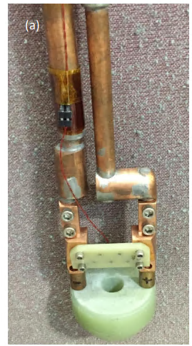
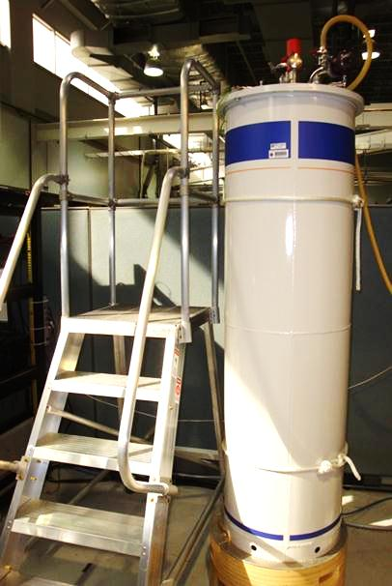
Critical current by transport at 4.2 K
To minimize the stress by screening current, REBCO tapes are graded for different locations of the coils
(b)
Oxford 15/17 T
SuperPower provided graded conductors. There is significant scatter within one grade.

Slide 7
Critical current vs. B

Slide 8
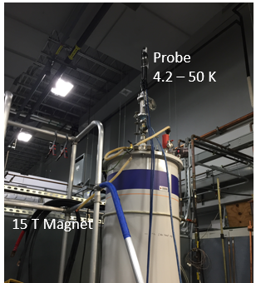
Torque magnetometry
It is difficult to measure REBCO Ic by transport method at low field angles and in gaseous helium (4.2 K < T < 40 K).
Developed at NHMFL*, torque magnetometry is a powerful tool to measure REBCO Ic (θ, B, T). Especially useful for characterizing Ic at low field angles.
In a 15 T SC magnet. Most samples were tested in 3 fields at 4.2 K. Several selected samples were tested at T = 10 – 50 K.
Use Bean’s model to calculated I_{c} from torque vs angle data.
Ic(θ, B, T) functions obtained are used in 40 T stress and quench calculations.
Actuator
Load cell
Tension Spring
Fish line
Sample
Sample stage
Torque is measured by a loadcell, while sample is rotated by the actuator via the fish line.
* J. Jaroszynski, et al., Supercond. Sci. Technol. 35 (2022) 095009
Notes:
Most REBCO in 40 T at <8 deg

Slide 9
Field and temperature dependence

Slide 10
Ic (θ) at 4.2 K 14/15 T
Mean = 8.1
Stdev = 1.1
Obtained Ic at ab-plane (Ic_max) where transport Ic measurement is very difficult.
Ic peak width varies from 5.4° to 10.3°.

Slide 11
Residual resistance ratio (RRR)
RRR ≡ R_295K/R_4.2K is a measure of low temperature electrical conductivity.
High RRR lowers hot-spot temperature after quench, provides better stability against spontaneous quench.
Specification RRR > 50
Test method
Trim the edges of 100 mm sample, peel off the Cu/Ag layer.
Chemically etch the residual REBCO (1.5 um Ag layer remains)
Measure resistance at 295 K and 4.2 K.
For details, J. Lu, et al, Cryogenics 141 (2024) 103901

Slide 12
RRR results
Vendor plating process adjustment
Total 95 tests.

Slide 13
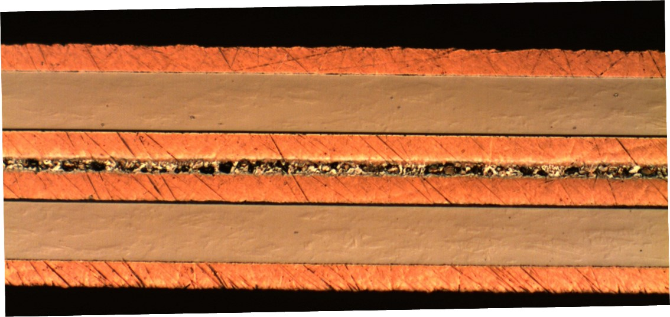
Lap joint resistance at 77 K
Lap joint is needed at crossovers which are critical to the magnet design.
Joints are made by soldering with eutectic PbSn solder.
Joint resistance is usually dominated by the interfacial resistance at REBCO/Ag interface which is a property of the as-received REBCO conductor.
REBO
Solder
REBO
W.S. Marshall, et al., IEEE Trans. Appl. Supercond. 35(5), (2025) 6600304

Slide 14
Lap joint resistivity at 77 K
Identified 3 samples have high joint resistivity of > 500 nΩ-cm².
Average resistivity = 48 +/- 20 nΩ-cm² (Excluding the 3 outliers).

Slide 15
Electromechanical tests at 77 K
The magnet design is often stress limited. So it is important to measure Ic under longitudinal mechanical stress.
Sample thickness and width measurements.
Load-strain curve measurement at 77 K (w/ extensometer).
Ic vs. load/unload measurement at 77 K (w/o extensometer to avoid premature failure at the extensometer clip-on spots)
Ic vs. fatigue cycle up to 100 k cycles with R = 0.1 at a load corresponding to 0.4% strain.
Data analysis to obtain modulus, yield strength, irreversible strain limits.
A. Ingrole, et al., Thu-Po-3.6, ICEC/ICMC, Geneva, Switzerland, 2024

Slide 16
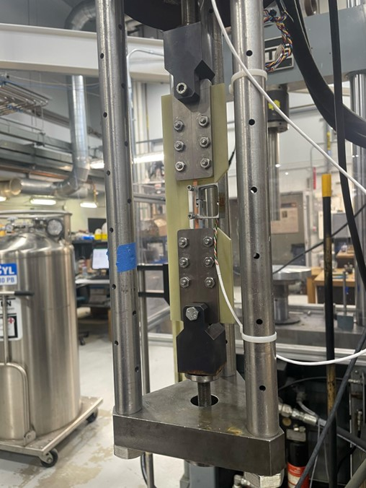
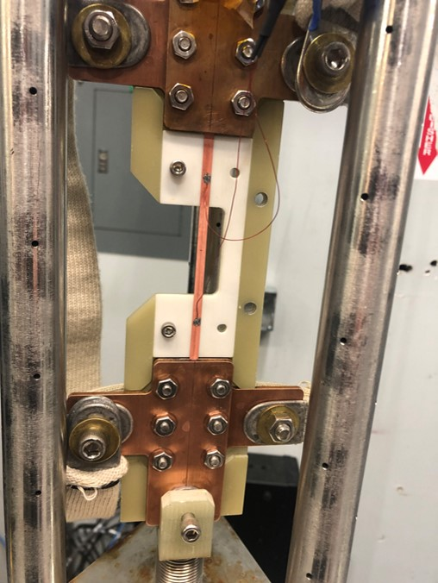
Ic-strain test method
(developed by R. P. Walsh)
Load-strain at 77 K
Ic vs load at 77 K
Notes:
Add another line with .3% strain

Slide 17
77 K Ic vs Strain
Irreversible Strain 0.0069
Reversible Strain 0.0040

Slide 18
77 K Ic vs Strain Test Results
0.45 % strain

Slide 19
ab-plane tilt angle by XRD
ab-plane of REBCO grown on IBAD buffer is tilted from the tape plane by ~3°.
Ic is different depending on how the tape is orientated in the magnet.
The difference between
Ic (θ+δ) and Ic (θ−δ)
can be as much as 20%
The measured tilt angles are used in the Ic(B,θ) function in the magnet design.
Critical to verify the tilt orientations in a wound coil.
Details in J. Lu, et al., IEEE Trans. Appl. Supercond. 33 (5) (2023) 6600504

Slide 20
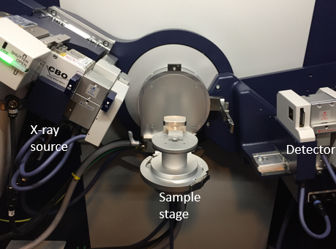
XRD measurement of ab-plane tilt
Chemically remove copper stabilizer
Glue the sample to a microscope glass slide.
Peak shifted by ~2°
Measurement uncertainty: +/- 0.2°. The main source of error is the uneven glue.

Slide 21
ab plane tilt results
Spool end-end variation is not significant.
Tested 119 samples. tilt angle average = 2.2 °, stdev = 0.6°

Slide 22
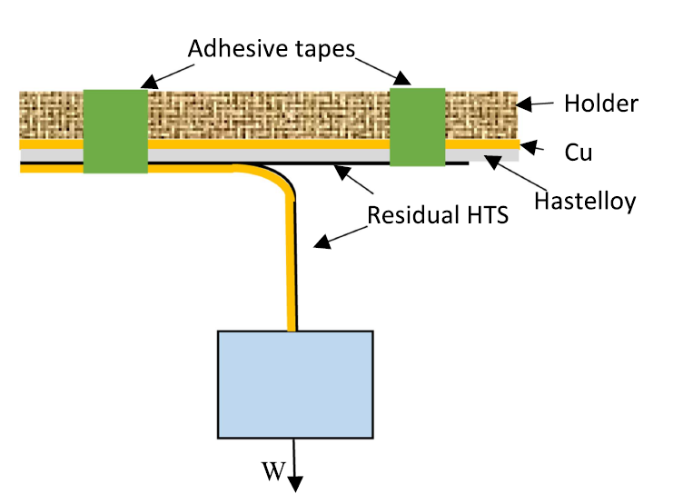
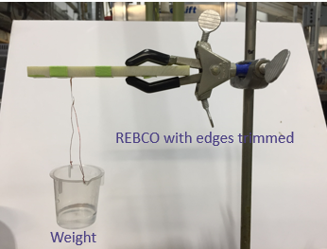
Room temperature 90° peel strength test
90° peel test is one way to measure adhesion strength of thin tapes.
Increase the weight on the pre-peeled layer until peeling motion starts.
Peel strength = critical weight/layer width

Slide 23
Peel strength results

Slide 24
Correlation between RRR and peel strength
There is a correlation between peel strength and RRR
J. Lu, et al., IEEE Trans. Appl. Supercond., 35(5), (2025) 8400105

Slide 25
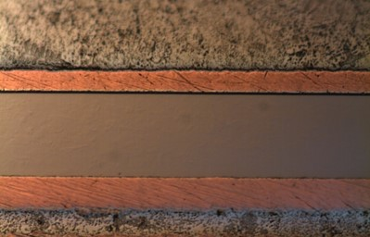
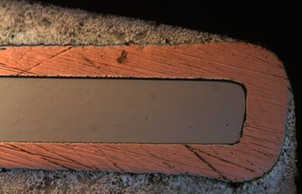
Cu thickness characterization
Important for quench calculation and coil transverse modulus estimation

Slide 26
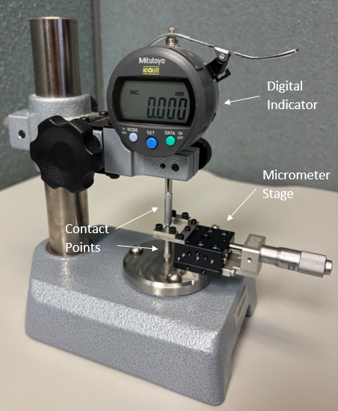
Newly developed thickness gauge
Top and bottom both by spherical contacts of 1.5 mm radius.

Slide 27
Summary and outlook
Full range of characterization of SuperPower REBCO tapes for conceptual design of the 40 T project
      Ic (B, θ) at 4.2 K by transport
      Ic (B, θ, T) by magnetometry
      RRR of Cu stabilizer
      Lap joint resistance at 77 K
      Ic-strain at 77 K
      ab plane tilt angle
      Delamination strength
      Cu thickness profile
In the 40 T construction phase, the total amount of REBCO testing would be more than doubled.

Slide 28
Thank you
for your attention!

