Slide 1
[C4Or1B] NASA’s Cryogenic Fluids for Aerospace Propulsion Applications
CFM Modeling and Technologies Portfolio Progress
Erin Pisciotta
Deputy Project Manager/CFM Modeling Portfolio Lead/CFM Technologies Portfolio Lead
NASA Glenn Research Center
May 22, 2025

Slide 2



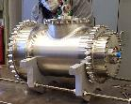

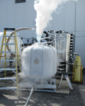

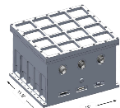
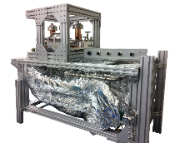
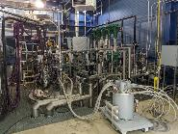
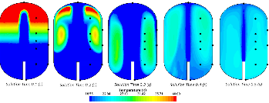

Cryogenic Fluid Management Portfolio Project (CFMPP)
System Demonstration Complexity
Technologies Portfolio
Subsystems Portfolio
Demonstrations Portfolio
Modeling
Portfolio
Scope: Design, development, testing, and evaluation of critical-need cryogenic components enabling long-duration CFM storage and propellant transfer
Major Activities:
Scope: Design, development, and testing of complex systems of technologies to address technical challenges for specific CFM mission needs
Major Activities:
Scope: Design, build, and test integrated flight and ground systems comprised of multiple CFM subsystems, enabling TRL 5+ maturation for many technologies
Major Activities:
Ground System Demonstrations
Scope: Develop, enhance, validate, and demonstrate Computational Fluid Dynamics (CFD) and Nodal tools to address capability gaps for predicting cryogenic fluid behavior in 1-G and microgravity environments for use as design tools for future NASA missions
Testing and demo activities across the CFMP project used within modeling tools to predict CFM behavior at a flight vehicle scale in a relevant microgravity environment
Hydrogen low-leakage valves and cryo-couplers
20W/20K Cryocooler
Tipping Point Demo Contracts
150W/90K Cryocooler
Radio Frequency Mass Gauge (RFMG)
Cryocooler Electronics
Alternate Cryocooler Studies
Two-Stage Cooling Demonstration
Next-generation FOSS (fiber optics sensing system)
Reduced Gravity Cryogenic Transfer (RGCT)
CryoFILL Liquefaction Demonstration
Images by Creare LLC
System Validation

Slide 3
CFM Technologies Portfolio Overview
Technologies Portfolio focuses on cryogenic components supporting long-term storage and transfer operations:
  Sensors
  Valves
  Insulation/Passive Cooling Technologies
  Cryocouplers
Technologies are typically accepted into the CFM Portfolio Project as low as TRL-3 and matured up to TRL-6 (TRL-7 in some instances where a flight demonstration is needed to reduce risk)
New technologies initiated through a number of avenues:
  Internal NASA calls for new technology development
  Announcement for Collaborative Opportunities (ACO) ​
    NASA partners with companies for common interest technology development​
    NASA provides personnel and services complementary to company’s contributions
  NASA contracts to companies for specific technology development (contracts, Small Business Innovation Research (SBIR))
    NASA contracts company through a NASA-defined Statement of Work and model contract structure​
    NASA can provide the technology to be further matured (e.g., Low Leakage Valve Seat Technology)​

Slide 4
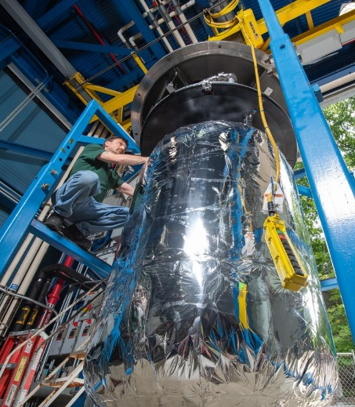
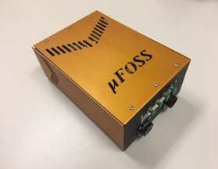
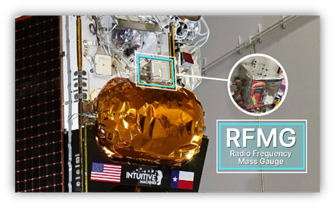
Sensors
Fiber Optic Sensing System (FOSS)
  High spatial density cryogenic temperature measurement system for cryogenic liquefaction applications such as ISRU (In-situ Resources Utilization) monitoring
  NASA Armstrong Flight Research Facility (AFRC) collaborated with Sensuron via ACO to co-develop a FOSS prototype suited to CFM needs
  Successfully monitored cryogenic temperatures on micro-FOSS platform during liquid oxygen (LOX) liquefaction on a 6-foot prototype tank at NASA Glenn Research Center (GRC). Co-locating silicon diodes validated accuracy (+/- 0.5K)* of data. Successful vibration testing completed for the laser in the FOSS integrated system.
MicroFOSS
Image Credit: Sensuron
* WL Johnson et al, AIAA 2023-4748
Liquefaction testing at NASA GRC
Image Credit: NASA
Radio Frequency Mass Gauge (RFMG)
  Measures tank RF spectrum; the spectrum changes with fill level, since the dielectric fluid (e) slows the speed of light
  RFMG analysis software finds the peaks, compares the frequencies to a database of simulations, and returns the best match %fill-level information
  RFMG system built at NASA GRC flew onboard IM-1 Nova-C lunar lander in February 2024
    RFMG gauged results within 1-2% of full-scale mass for 1g tests and 2-5% of low-g gauging measurements**
  RFMG NextGen currently under development to include faster measurements for dynamic fluid environments and on-board gauging
RFMG installed on IM-1 lunar lander
Image Credit: Intuitive Machines
**AIAA 2025-0959 – Dr. Greg Zimmerli et al

Slide 5
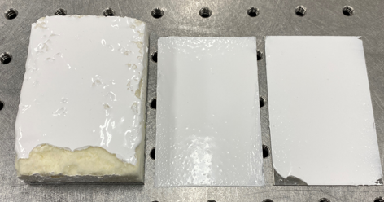
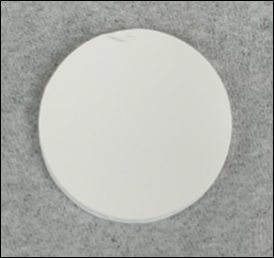
Insulation/Passive Cooling Technologies
Solar White
  Passive thermal coating that reflects and scatters most of the Sun’s energy allowing cryogenic fluids such as propellants to remain cold in a space environment
  Studied effectiveness of Yttrium Oxide (Y₂O₃) and Barium Fluoride (BaF₂) tiles in addition to Y₂O₃ spray on coating
    Best Tile performance in lab: 1.2% solar absorptivity
    Best Spray-on sample performance in lab: 3.5% solar absorptivity
  Sample coupons with spray on coating and tiles tested in a deep space solar simulator
  Successfully tested in accelerated weathering environment lab chamber
  Long-term environmental exposure testing at NASA Kennedy Space Center (KSC) beach side test site
Potential Future Insulation/Passive Cooling Technology Activities:
  Load Bearing MLI (Multi-Layer Insulation)
  MMOD (Micrometeoroid/Orbital Debris)-MLI
Y₂O₃/silicon epoxy spray-on “stucco” samples on SOFI and aluminum plates
Image Credit: NASA
Y₂O₃ Tile
Image Credit: NASA

Slide 6
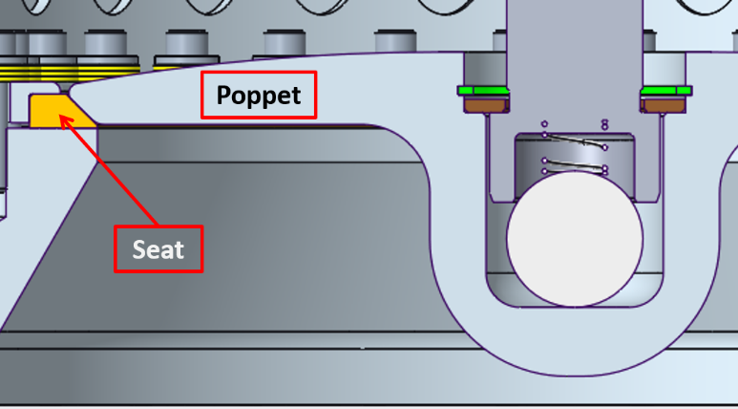
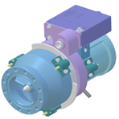
Valves and Cryocouplers
Low Leakage Valves
  NASA team at Marshall Space Flight Center (MSFC) developed a patented valve technology that utilizes a seat and poppet concept enabling self alignment while maintaining the necessary contact stresses for a reliable and tight shutoff
  Previous internal leakage testing yielded results of less than 10 SCIM (Standard Cubic Inches per Minute) with LH₂*
  High-fidelity prototype valve will enable a future test campaign to bring the low-leakage valve design to TRL 6 with the exception of the electromechanical actuator
  Two current design efforts underway at NASA Marshall Space Flight Center (MSFC) and Sierra Space. Critical Design Reviews (CDRs) expected in August 2025.
Valve Seat and Poppet Design
Image Credit: NASA
*RJ Walker and AN Smith, AIAA 2024-0356
Cryocouplers
  NASA MSFC collaborating with Aerojet Rocketdyne (AR) through ACO to develop and test Electrically Actuated Propellant Quick-Disconnect (QD) Coupling
  Broad application for in-space and Lunar surface refueling and enables the development of a vehicle On-Orbit
  When mated, AR’s QDs support axial pressure loads through the Coupling Housings.
  Cryogenic characterization and mate/de-mate testing will occur at NASA MSFC in 2025
Cryocoupler
Image Credit: Aerojet Rocketdyne

Slide 7
Cryogenic Fluid Management Portfolio Project (CFMPP)
System Demonstration Complexity
Technologies Portfolio
Subsystems Portfolio
Demonstrations Portfolio
Modeling
Portfolio
Scope: Design, development, testing, and evaluation of critical-need cryogenic components enabling long-duration CFM storage and propellant transfer
Major Activities:
Scope: Design, development, and testing of complex systems of technologies to address technical challenges for specific CFM mission needs
Major Activities:
Scope: Design, build, and test integrated flight and ground systems comprised of multiple CFM subsystems, enabling TRL 5+ maturation for many technologies
Major Activities:
Ground System Demonstrations
Scope: Develop, enhance, validate, and demonstrate Computational Fluid Dynamics (CFD) and Nodal tools to address capability gaps for predicting cryogenic fluid behavior in 1-G and microgravity environments for use as design tools for future NASA missions
Testing and demo activities across the CFMP project used within modeling tools to predict CFM behavior at a flight vehicle scale in a relevant microgravity environment
Hydrogen low-leakage valves and cryo-couplers
20W/20K Cryocooler
Tipping Point Demo Contracts
150W/90K Cryocooler
Radio Frequency Mass Gauge (RFMG)
Cryocooler Electronics
Alternate Cryocooler Studies
Two-Stage Cooling Demonstration
Next-generation FOSS (fiber optics sensing system)
Reduced Gravity Cryogenic Transfer (RGCT)
CryoFILL Liquefaction Demonstration
Images by Creare LLC
System Validation

Slide 8
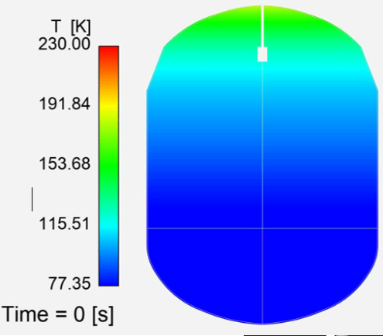
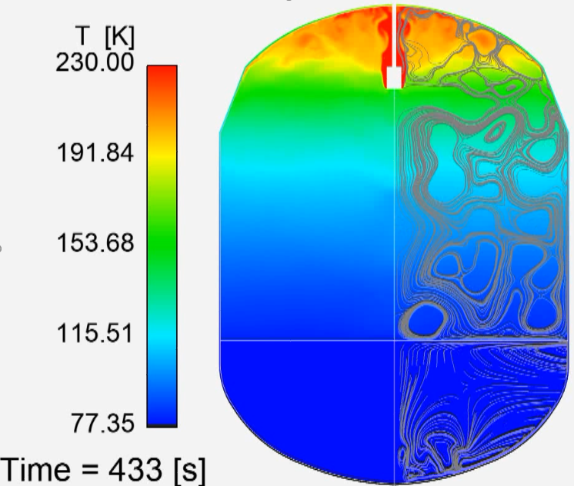
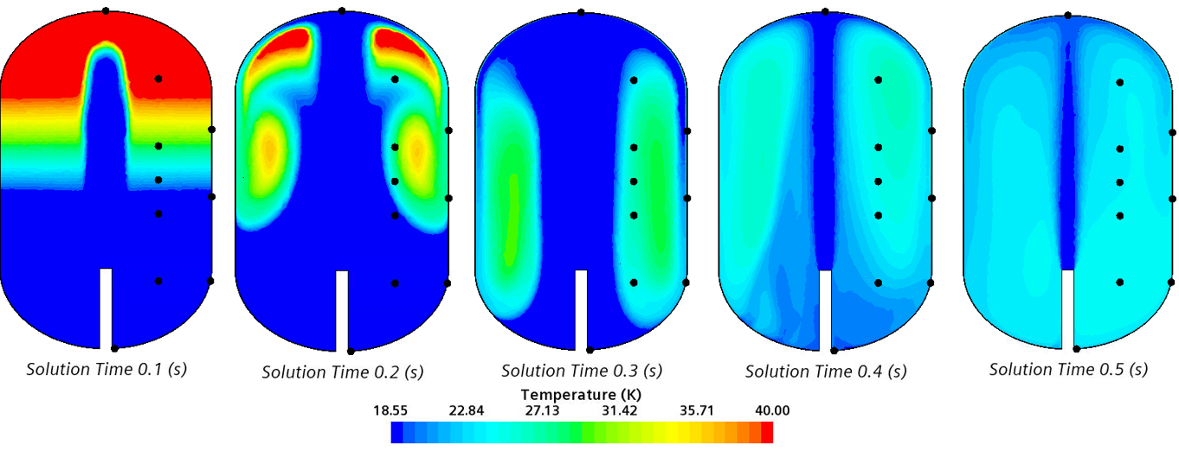
CFM Modeling Overview
Several missions require the use of CFD (Computational Fluid Dynamics) models to better predict the performance of the hardware and operations.
  CFM Modeling reduces risk to future missions and reduces costs by modeling phenomena in the lab. This allows changes in design prior to testing in flight
The CFM Modeling Team uses experimental and flight data to model cryogenic fluid phenomena
  Best data to anchor models comes from flight demonstrations which are expensive and rare
  Quality of modeling is dependent on the quality of the experimental data
  With more confident models, systems can be designed with reduced margin and greater performance.
CFM Modeling Team working to coordinate earlier in mission design lifecycle to optimize flight data to anchor models for future large-scale, long duration missions
Modeling will be complete when the CFM risks are acceptable to the project/stakeholders.
Predicted Temperature Contours During EDU Pressurization Test
Effects of Geometric Configuration on Fluid Temperatures

Slide 9
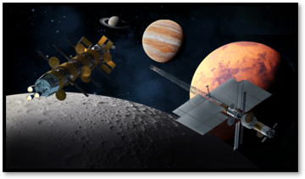
CFM Modeling Benefits
In past and current public and private studies that utilize the long term on-orbit storage and transfer of cryogenic propellant, several mission events required the use of CFD models to better predict the performance of the hardware and operations within the architecture.
One of our goals is to adopt the lessons learned and apply them to NASA missions.
  CFD tools and skills developed at MSFC and GRC are being used outside of the STMD CFM portfolio to support tipping points and HLS mission applications.
Mission Events that members of the NASA modeling community are providing direct inline design support and independent V&V to reduce mission risk include:
Image Credit: NASA
  Pressurization-Important for sizing equipment and operations for Autogenous and GHe pressurization systems (Impact: 10 mTon’s of Propellant)
  Self-Pressurization- Important for predicting the boil-off in propellant tanks in various mission locations (Lunar surface, Gateway, LEO for Depot applications). (Impact: mTons of Propellant)
  Sloshing- Important for predicting how much residual pressurant is available during and after sloshing operations. (Impact: mTons of Propellant)
  Propellant Transfer (Receiver tank chill-down and fill operations, donor Tank Pressurization and vapor pull-through) - Important for predicting the operations and hardware used in the transfer. (Impact: 10’s mTons of Propellant)
With more confident models these CFM systems could be designed with reduced margin and greater performance.

Slide 10
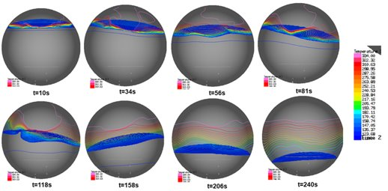
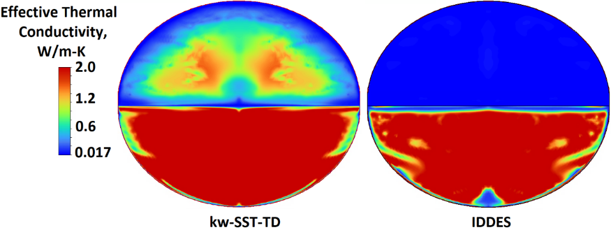
CFM Modeling Team Overview
Modeling Team distributed across three NASA centers
  Glenn Research Center (GRC) – Portfolio Lead, Technical Lead, CFD and Nodal Modeling Analysts
  Marshall Spaceflight Center (MSFC) – CFD and Nodal Modeling Analysts
  Ames Research Center (ARC) – Molecular Modeling Analysts
Portfolio Goals
  Develop, enhance, validate, and demonstrate CFD and Nodal tools to address capability gaps for predicting cryogenic fluid behavior in 1-G and microgravity environments
    Nine (9) CFM Operations: Autogenous Pressurization, Helium Pressurization, Line and Component Chilldown, Liquefaction, Mixing, Self-Pressurization, Tank Chilldown, Tank Fill/Drain, Tank Venting
  Perform technology and knowledge infusion of CFM Modeling capabilities into analyses supporting NASA mission applications
Key progress in the past year focused on Self-Pressurization, Autogenous Pressurization, and Slosh CFM Operations
  Improved ability to predict ullage collapse during propellant sloshing operations. Models predicted ullage collapse within 10% of experimental values
  Enhanced capability to predict self-pressurization in cryogenic tanks by incorporating efficient, advanced turbulence models
Pressurized Draining with Sustained Slosh (CFD – VoF)
Ksite LH2 Self-Pressurization (Ansys Fluent)
Effect of incorporating turbulence model

Slide 11
CFM Modeling Capability Assessment Process
Currently developing process to assess maturity of models based on NASA-STD-7009, NASA Standards for Models and Simulations
  Evaluates experimental data relevance to future missions in addition to level of validation/accuracy for modeling activities
Capability Assessment Level criteria established for experimental/flight data relevance, data pedigree, and validation level
New Capability Assessment process will enable conversations with stakeholders for future flight missions to communicate maturity of models across CFM Operations
  Experimental Data (1-3): Defined set of CFM data types considered most applicable for models and simulations to represent need for future large-scale CFM demonstrations and missions
  Data Pedigree (1-4): Record of traceability from the data’s source through all aspects of its transmission, storage, and processing to its final form
  Validation (1-4): Degree to which a model or a simulation is an accurate representation of the real world form the perspective of the intended uses
Level | Tank Diameter | Acceleration Level | Fluid | Slosh | Heat Flux
1 | ≤ 1 m (Small) | High-G | Simulant | Static (Low) | ≥ 50 W/m² (High)
2 | > 1 m, < 4 m (Medium) | Milli-G | N/A | Unrestrained (Medium) | > 10 W/m², < 50 W/m² (Medium)
3 | ≥ 4 m (Large) | Micro-G | Cryogen | Dynamic (High) | ≤ 10 W/m² (Low)

Slide 12
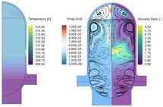
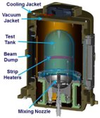
Summary and Forward Work
LOCI-Stream Model of ZBOT Self-Pressurization Test (Temperature, Velocity Magnitude, and Viscosity Ratio Contours)
CFM Modeling team uses experimental and flight demonstration data to validate and mature models in nine CFM Operations
  Access to flight demonstration data will enable further maturation of models to support future missions
CFM Modeling is critical to support future large-scale long duration flight missions to aid in design decisions
Future work includes:
  Continue support of 2020 Tipping Points and perform validation efforts on incoming data from experiments and flight demonstrations
  Continue Capability Assessment process and incorporate into a Model Readiness Level process to communicate progress of modeling for each CFM operation
  Assess new modeling efforts against Capability Assessment Level criteria
  Assess each CFM operation against Model Readiness Level criteria

Slide 13
Backup

Slide 14
Model Experimental Data
The CFM data captured during experimental operations greatly influences the ability of using the data to develop CFM models and conduct simulations that accurately and functionally represent the need of future NASA large-scale CFM demonstrations and missions.
The CFM modeling team has independently identified and defined a set of CFM data types which it considers most applicable for models & simulation to represent the need of future NASA large-scale CFM demonstrations and missions.
Tank Diameter - diameter of the tank used during experimental or mission operations
Acceleration Level – potential or actual rate of change of speed of a body due either to the body’s motion, gravity, or a combination of both
Fluid - substance (such as a liquid or gas) tending to flow or conform to the outline of its container used during experimental or mission operations
Slosh - fluid in a tank is non-quiescent, splashing, and/or rocking
Heat Flux – rate of thermal energy transferred per unit area
REFERENCE: CFM-MODEL-DOC-048, CFM Experimental Data Types

Slide 15
Model Capability Assessment Level
Capability Assessment Level (CAL) is a value assigned to a model/simulation assessment factor that has been determined to have the potential or ability to represent a CFM real world system characteristic, operation, and/or process
Model/Simulation Assessment Factor is associated with properties or processes exhibited during the development phase of the M&S life cycle
  Data Pedigree: A record of traceability from the data's source through all aspects of its transmission, storage, and processing to its final form used in the development of an M&S
    Data Pedigree = Known & Traceable + Accuracy, Precision, & Uncertainty
  Validation: The process of determining the degree to which a model or a simulation is an accurate representation of the real world from the perspective of the intended uses of the M&S
    Validation = Data Representation + Output Agreement
REFERENCE: NASA-STD-7009, Standard for Models and Simulations

