Slide 1


Conceptual Design and Initial Operation of a Single-Shot Dilution Refrigerator with a Small Helium-3 Inventory
Monday, May 19, 2025
Byeungcheol An , Dohoon Kwon, Minseung Ku, and Sangkwon Jeong
Korea Advanced Institute of Science and Technology
Notes:
I would like to emphasize these words, “Small Helium-3 Inventory” at the circumstance of extremely expensive price of Helium-3.

Slide 2
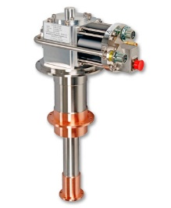
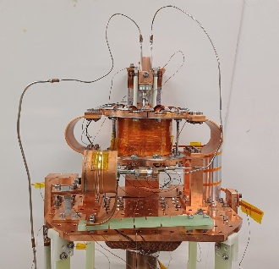
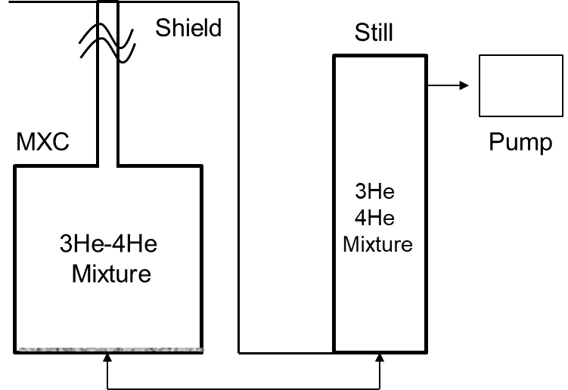
1. Introduction
4 K : Liquid 4He
He Liquefaction ~ 4 K,
Heat sink
Evaporator
Charcoal sorption
Adiabatic Demagnetization
Refrigerator
(~0.7 K)
Sorption
cooler
Intergrated Cooler
He liquefaction
(Heat sink)
300 K~ 4 K
Commercial
Evaporative
Cooler
4.0 K~ 1.5 K
Developed
↓0.7 ~ 0.1 K : Dilution Refrigerator
ADR
1.5 K~ 0.7 K
Developed
DR
0.7 K~ 0.1 K
NEW
Notes:
As you know, reaching sub-Kelvin temperature is not trivial. Usually we use a mechanical cryocooler such as GM or PT to go down about 4 K and liquefy helium 4. From there, sorption cooler or ADR (~) or DR can be used to reach lower temperature. So, there can be several combination or hybridization methods for specific purposes; whether you need a commercially available system without minding an expensive price, whether you want to have a compact system by sacrificing some thermodynamic efficiency, whether you really want to pursue an energy-efficient refrigeration. For this specific presentation today is the task that simplifies a refrigeration architecture with reasonable efficiency and Small Helium-3 Inventory. ~~

Slide 3
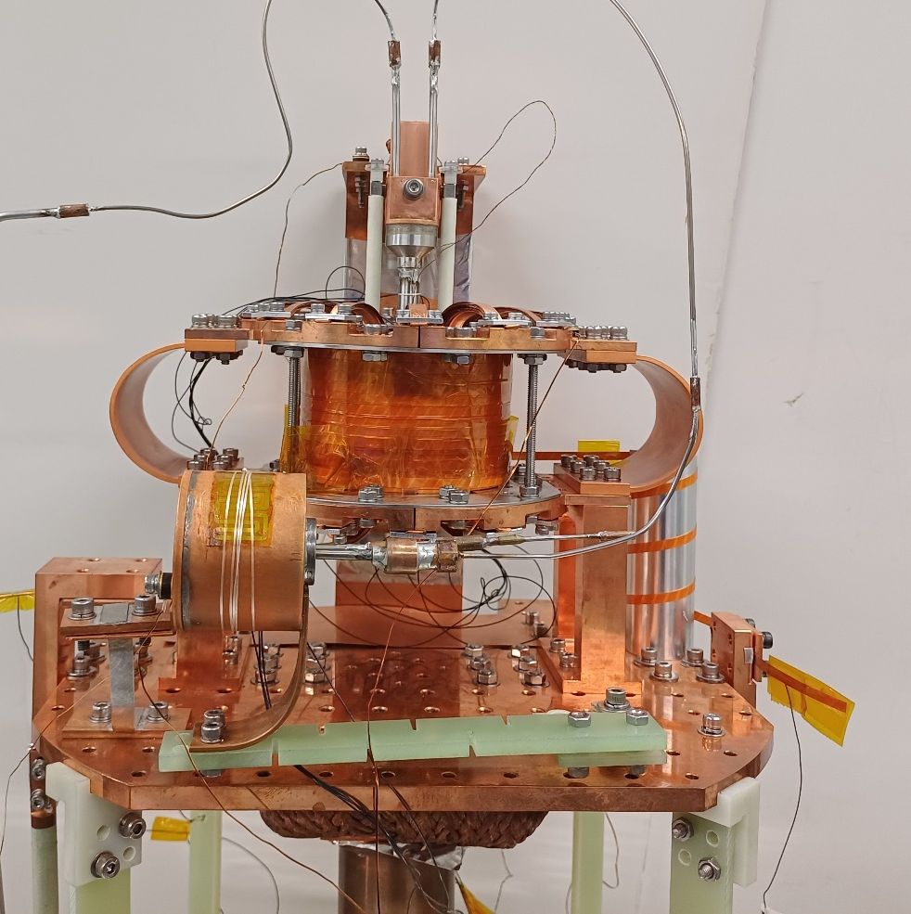
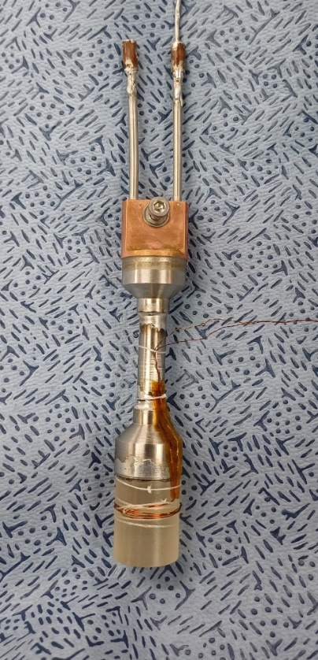
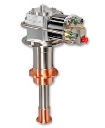
1. Introduction
300 K ~ 0.5 K by integrated sorption ADR
heat sink
tin
gravity-assisted
thermosiphon
HTS magnet
sorption
pump
Sorption
Cooler
GGG,
magnetic
material
GGG
Sorption pump
Heat sink
(4 K G-M)
magnet
300 K~ 4 K : Commercial GM cooler
4 K ~ 1.5 K : Sorption cooling by evaporation
1.5 K ~ 0.7 K : Adiabatic Demagnetization
Notes:
Both sorption cooler and ADR after 4 K GM cooler are actually integrated as shown in this diagram. GGG ~ is magnetized and demagnetized by an HTS magnet while the thermosiphon is directly coupled between GGG and the heat sink which is about 4 or 5 K. The sorption cooler controls the pressure of the thermosiphon so that the ADR can produce cooling effect below 0.7 K.

Slide 4
2. Overview
Develop an integrated cryocooler operating from 300 K to 0.1 K with small He3 inventory
Sorption-integrated ADR is linked to DR for cooling at 0.1 K.
ADR is an efficient precooler for DR.
Single-shot DR necessary to cover temperature from 0.8 K to 0.1 K
Investigate critical issues at hybridizing ADR with DR components for cold cycle
Performance check of heat switch in ADR
Performance check of initial thermal conditioning of the Still by ADR and sorption pump
Notes:
The objective of this work is to Develop an integrated cryocooler operating from 300 K to 0.1 K with small He3 inventory. In detail, Sorption-integrated ADR is linked to DR for cooling at 0.1 K. ADR is an efficient precooler for DR. Single-shot DR operates to cover T from 0.8 K to 0.1 K. As an immediate goal for today’s presentation, we Investigated the critical issues at hybridizing ADR with DR components for cold cycle. Performance check of heat switch in ADR. Performance check of initial thermal conditioning of the Still by ADR and sorption pump.
.

Slide 5
2. Overview
Develop an integrated cryocooler operating from 300 K to 0.1 K with small He3 inventory
Sorption-integrated ADR is linked to DR for cooling at 0.1 K.
ADR is an efficient precooler for DR.
Single-shot DR necessary to cover from 0.8 K to 0.1 K
Investigate critical issues at hybridizing ADR with DR components for cold cycle
Performance check of heat switch in ADR
Performance check of initial thermal conditioning of the Still in DR by ADR (sorption pump)
Notes:
Let me explain the Sorption-integrated ADR in more detail.

Slide 6
Process : Sorption-integrated ADR
Helium condensation by GM with warm sorption pump during magnetization up to 4 T
Evaporation cooling due to helium adsorption by sorption pump
Cooling up to 0.5 K (below 0.8 K) by demagnetization
2nd stage of G-M
4 K
2nd stage of G-M
4 K
2nd stage of G-M
4 K
LHe
GGG
4 K
GGG
1.5 K
GGG
0.5 K
4 T
4 T
0 T
Magnetization
(2) Evaporative cooling
(3) Demagnetization
Notes:
#1, during the magnetization process, the sorption pump which is indicated as red is warm so that the desorbed helium 4 is condensed by the heat sink, GM cooler and the magnetized GGG is cooled to the heat sink temperature. #2, during the evaporation cooling process, the cold sorption pump adsorbs helium causing evaporation cooling effect to cool down GGG up to approximately 1.5 K. #3, during the demagnetization process, GGG is obviously cooled down to 0.5 K almost adiabatically.

Slide 7
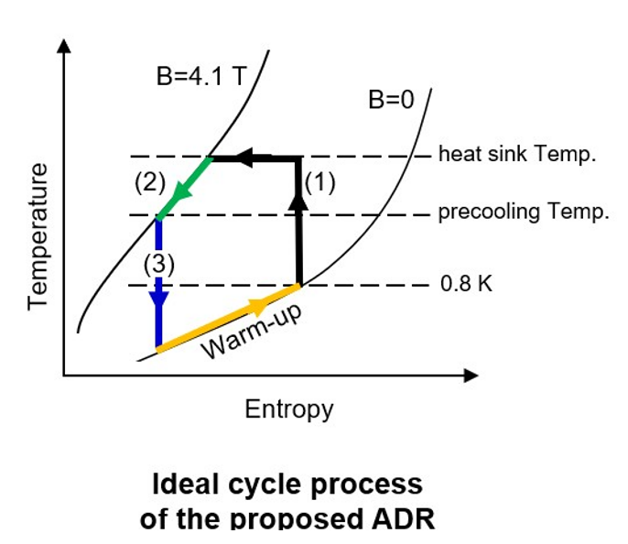
Continuous Adiabatic Demagnetization Refrigerator (CADR)
Notes:
This slide shows the approximate magnetic cycle of GGG in T-s diagram; magnetization, evaporation cooling, and demagnetization. This cycle is repeated as a CADR (~).

Slide 8
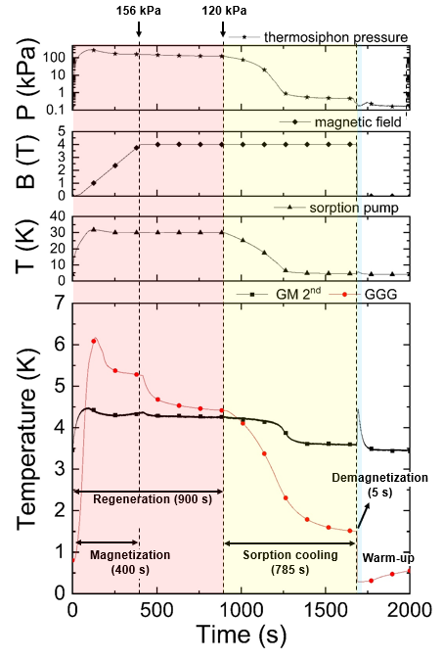
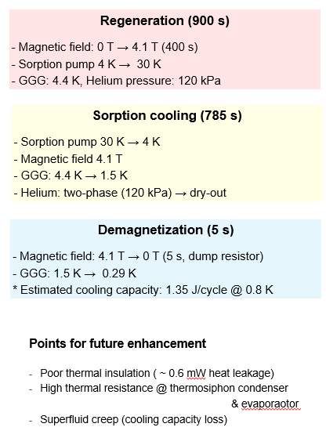
Notes:
The experimental data clearly shows that this proposed cycle operates as we designed. This is a busy slide, but let me go over one by one. During the regeneration process or the magnetization and hold before sorption cooling, ~~~. This process typically lasts about 900 s. Next, in the sorption cooling process, ~~~. The demagnetization process can be relatively short, from 4.1 T to 0 T, ~~~. We have identified several issues for future enhancement such as ~~~.

Slide 9
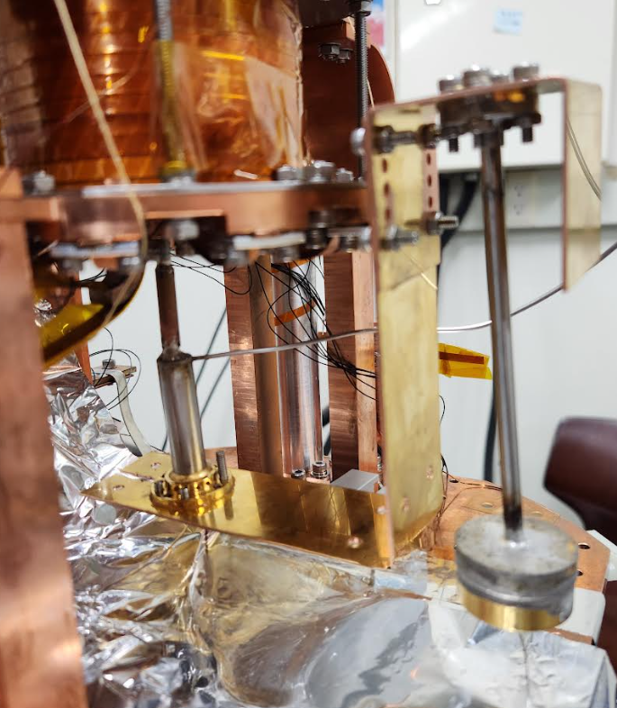

Process : ADR + DR components
2nd stage of G-M
4 K
30 K
LHe
GGG
4 K
ADR
4 T
4 T
Chimney
Q
Still
MXC
4 K
Still
4 K
MXC
capillary tube
Notes:
After we fully recognize the capability of our CADR, the DR components are attached. First, both Still and MXC are supposed to be cooled by the condensed helium similar to the magnetized GGG. This photograph shows the Still and MXC before the radiation shield is installed.

Slide 10
Process : ADR + DR components
2nd stage of G-M
4 K
Evaporation cooling due to helium adsorption by sorption pump
4 K
GGG
1.5 K
4 T
Chimney
Condensation of He by GGG to cool
Still and MXC up to 1.5 K
Q
MXC
1.5 K
Still
1.5 K
capillary tube
Notes:
Now, according to our scenario, DR components will be continuously cooled down with GGG up to 1.5 K.

Slide 11
Process : ADR + DR components
2nd stage of G-M
4 K
4 K
GGG
0.5 K
Cooling up to 0.5 K (below 0.8 K) by demagnetization
0 T
Chimney
Q
MXC
0.7 K
Still
0.7 K
capillary tube
Notes:
AND up to 0.7 K.

Slide 12
Process : ADR + DR components
2nd stage of G-M
4 K
LHe
GGG
4 K
Recycling ADR.
Several ADR cycles are necessary to cool down Still and MXC from 4 K and 1.5 K and ultimately to 0.7 K.
4 T
Chimney
Q
MXC
2 K
Still
2 K
capilary tube
Notes:
Obviously, one cycle of ADR is not sufficient so we need to recycle ADR and carry out several ADR cycles to pump heat from DR components until they reach about 0.7 K.

Slide 13
Process : ADR + DR components
2nd stage of G-M
4 K
LHe
GGG
4 K
Recycling ADR.
Several ADR cycles are necessary to cool down Still and MXC from 4 K and 1.5 K and ultimately to 0.7 K.
4 T
Chimney
Q
MXC
1.5 K
Still
1.5 K
capilary tube

Slide 14
Process : ADR + DR components
2nd stage of G-M
4 K
LHe
GGG
4 K
Recycling ADR.
Several ADR cycles are necessary to cool down Still and MXC from 4 K and 1.5 K and ultimately to 0.7 K.
4 T
Chimney
Q
MXC
0.7 K
Still
0.7 K
capilary tube

Slide 15
Process : Single-shot DR assisted by an ADR
Sorption pump (5 ~ 30 K)
(3He pumping)
ADR
(Liquefying 3He-4He mixture)
4 K cooler
1. Initial 3He-4He condensation by ADR
2. 3He transfer by the sorption pump
30 K → 5 K
3He
3He
Still
0.7-0.8 K
MXC
0.7 K → 0.1 K
Notes:
Once the helium mixture reaches about 0.7 K and it is below the phase separation boundary, the other sorption pump is kicked in being cooled from 30 K to 5 K, so that He3 in the Still is selectively evaporated due to the vapor-pressure difference between He4 and He3. Then, He3 at the concentrated phase is diffused into the dilute phase, crossing the phase boundary and lowering the MXC temperature as long as the phase boundary stays properly at the MXC.

Slide 16
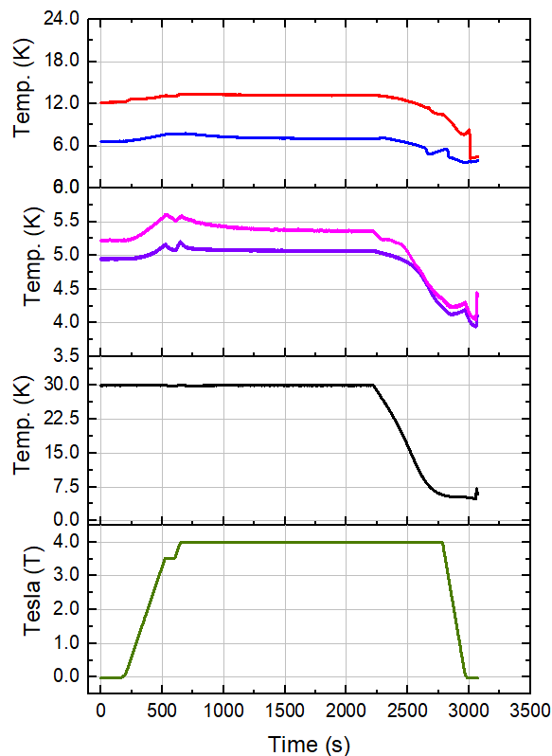
Sorption Pump 30 K → 5 K, t_demag = 200 s
Insufficient cooling power of GM cryocooler
Too slow cooling of MXC
Lowest Still temperature = 3.64 K
Faster demagnetization is possible with magnetic shielding.
Too high heat ingress obsoletes CADR operation,
MXC
Still
Condenser
GM 2nd
S.P.
Magnet
Notes:
Well, that was our prediction. In reality, the experiment didn’t go well and we realized that the cooling power of GM cryocooler is insufficient. Ths MXC cooled down too slowly. The lowest Still temperature was only 3.64 K so far. Even though the faster demagnetization was possible with magnetic shielding, we had too high heat ingress. So the CADR operation was virtually ineffective.

Slide 17
Summary
CADR operation is successful.
Cooling power of GM cooler is insufficient due to too much thermal mass.
Tin heat switch performance needs improvement.
Radiation (or molecular conduction) heat ingress is excessive.
Eddy current heating needs to be reduced.
Notes:
We learned many lessons through this campaign. The valuable lesson #1 is CADR operation is successful. Cooling power of GM cooler is insufficient due to too much thermal mass. The tin heat switch performance needs improvement even though it was perfectly o.k during the CADR. It might be somewhat degraded over the repeated thermal cycling. We also realize the radiation (or molecular conduction) heat ingress is still excessive. Eddy current heating can be definitely reduced by mu metal shield. That’s all for today’s presentation.

Slide 18
Cold Cycle Dilution Refrigerator (CCDR) with tandem CADR
Condensation pump @ 0.7 K
CADR
: Tungsten passive heat switch
4 K
4 K
3He
Still
LHe
~ 0.8 K
MR
MR
HX
- Two superconducting magnet operation in tandem mode : complex
- Continuous heat exchanger in DR : more 3He inventory
- No hydraulic valve
Q
~ 0.7 K
MXC
~ 0.1 K
Notes:
If everything worked as we expected, I was going to propose a continuous cold cycle DR in this configuration or the next, which absolutely minimizes He3 inventory.

Slide 19
CADR with tandem Single-shot Dilution Refrigerator (SDR)
4He sorption cooler
4 K G-M
Sorption
pump
Thermosiphon
GGG
: superconducting heat switch
CADR
MXC
3He-rich
3He-rich
MXC
- Single superconducting magnet operation : simple
- No continuous heat exchanger in DR : less 3He inventory
3He-dilute
3He-dilute
Still
~ 0.1 K
Notes:
If everything worked as we expected, I was going to propose a continuous cold cycle DR in this configuration or the next, which absolutely minimized He3 inventory.

Slide 20
<Back-up>

Slide 21
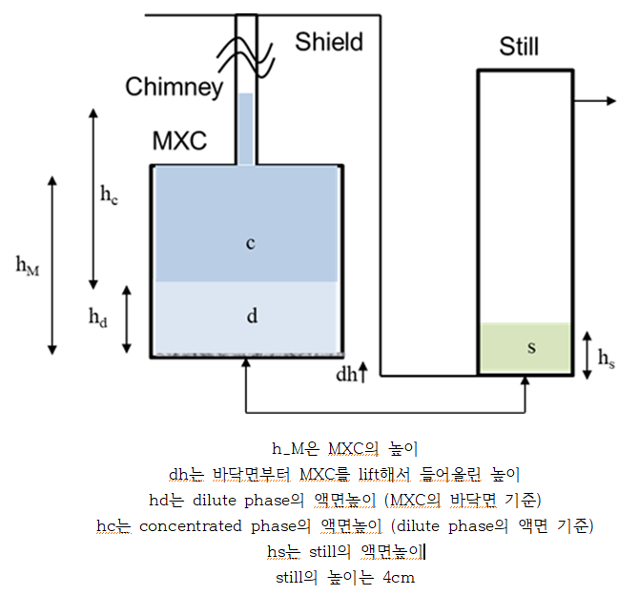
0.223 mol, 50%

Slide 22
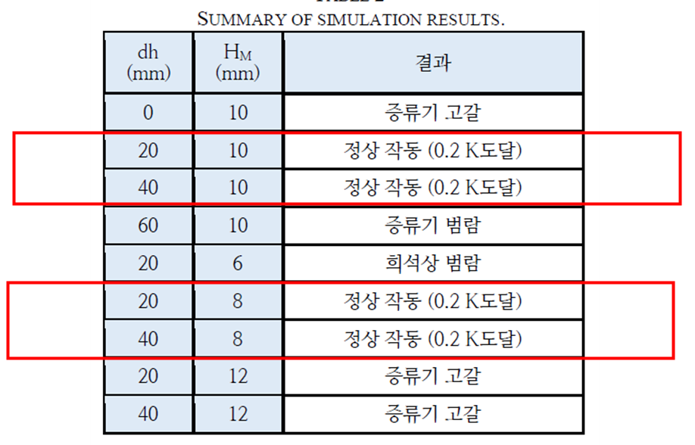

Slide 23
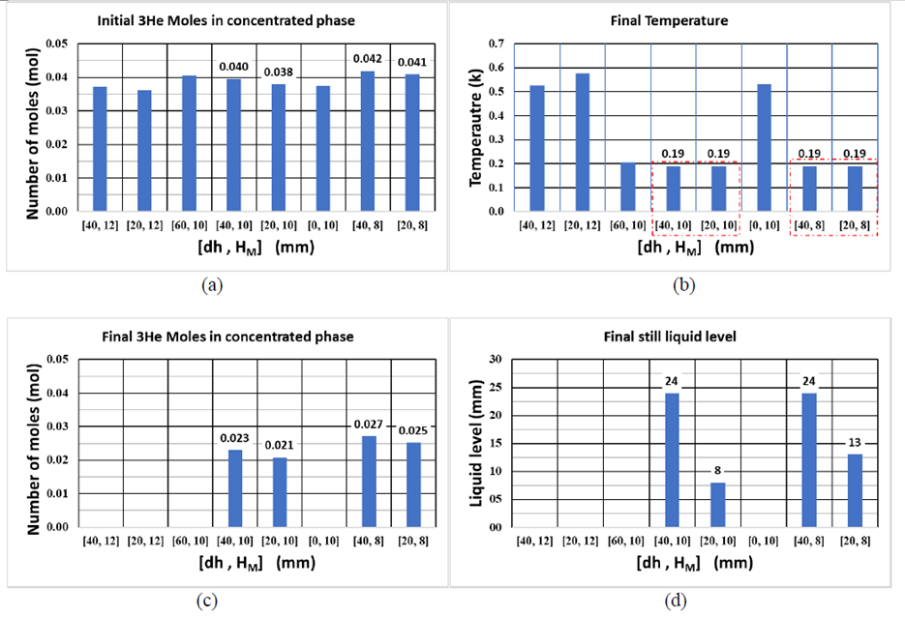

Slide 24
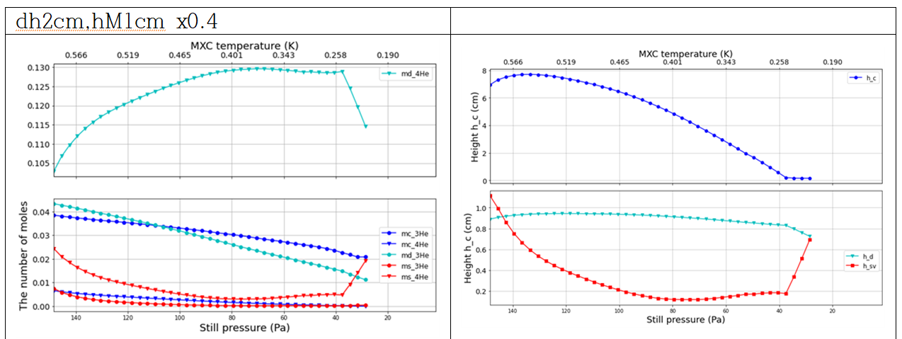

Slide 25
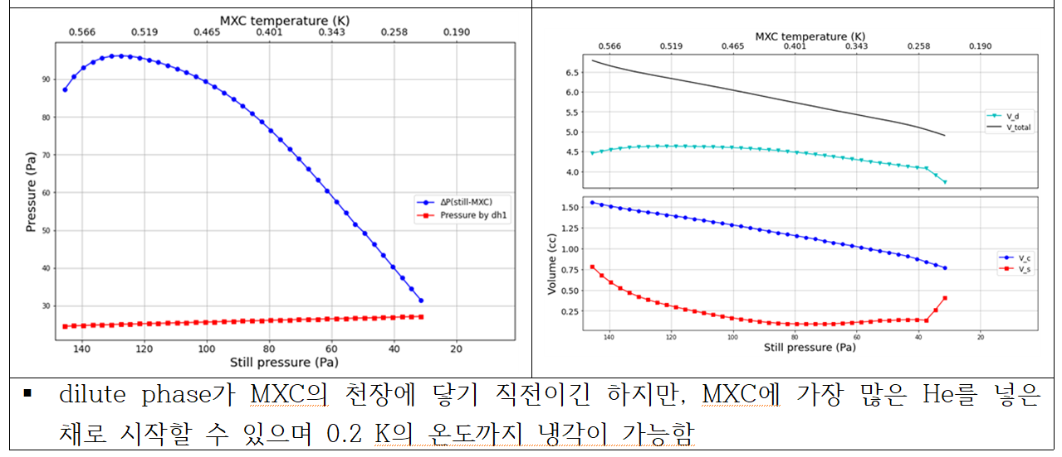

Slide 26
CADR with tandem Single-shot Dilution Refrigerator (SDR)
4He sorption cooler
4 K G-M
Sorption
pump
Thermosiphon
Magnetic material
CADR
: on/off valve for 3He
: superconducting heat switch
MXC
3He-rich
3He-rich
MXC
- Single superconducting magnet operation : simple
- No continuous heat exchanger in DR : less 3He inventory
- Two hydraulic valves
3He-dilute
3He-dilute
Still
~ 0.1 K

Slide 27
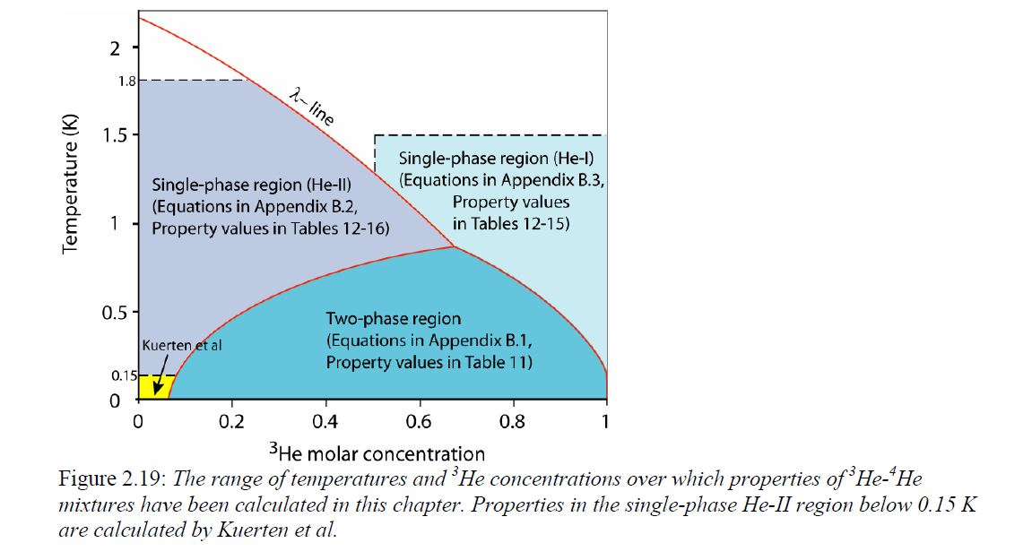
[MIT Thesis] Thermodynamic properties of liquid 3He-4He mixtures between 0.15 K and 1.8 K
x=0.5, n=0.223 mol
Lambda line : Eq. (A.3) → Lambda Temp. 1.3 K
Phase separation curve: Eq. (A.2)
x_{d} 0.5 일 때 T_{d} 0.8 K
따라서, 1.8 K ~ 1.3 K 일 때는 Single-phase He-I (A.16)
1.3 K ~ 0.8 K 일 때는 Single-phase He-II (A.18)

Slide 28
Single-shot DR configuration
300 K (Vacuum chamber)
55 K (Aluminium shield)
4 K shield
0.8 K
(Still shield)
* Kevlar suspension
HTS magnet
4 K
copper connector
⁴He
높이 조절 가능
GGG
SP2
SP1
MXC
Still
D. 10 mm,
H. 40 mm,
MXC
D. 25 mm,
H. 9 mm,
S.
Tin
4 K (Copper plate)
* Internal dimension
Gas-gap
HSW
4 K (G-M 2nd stage)
45 K (G-M 1st stage)

Slide 29
Dimensions
10 mm
Flange) 140 mm
35 mm
⁴He
GGG
64 mm
100 mm
SS tube)
O.D. 4.5 mm, 0.15 t
SS tube)
O.D. 4.5 mm, 0.15 t
112 mm
SS tube)
O.D. 1/16 inch
MXC
S.
H. 125 mm
Still)
I.D. 10 mm, H. 40 mm
( ~ 3.1 cc)
MXC)
I.D. 25 mm
H. 9 mm (~ 4.4 cc)
Sintered silver powder: H. 1 mm
35 mm
150 mm
Cu-Ni tube)
O.D. 0.5 mm, t. 0.05 mm, L. 500 mm

Slide 30
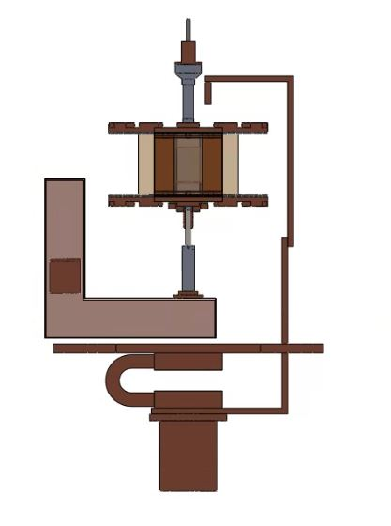
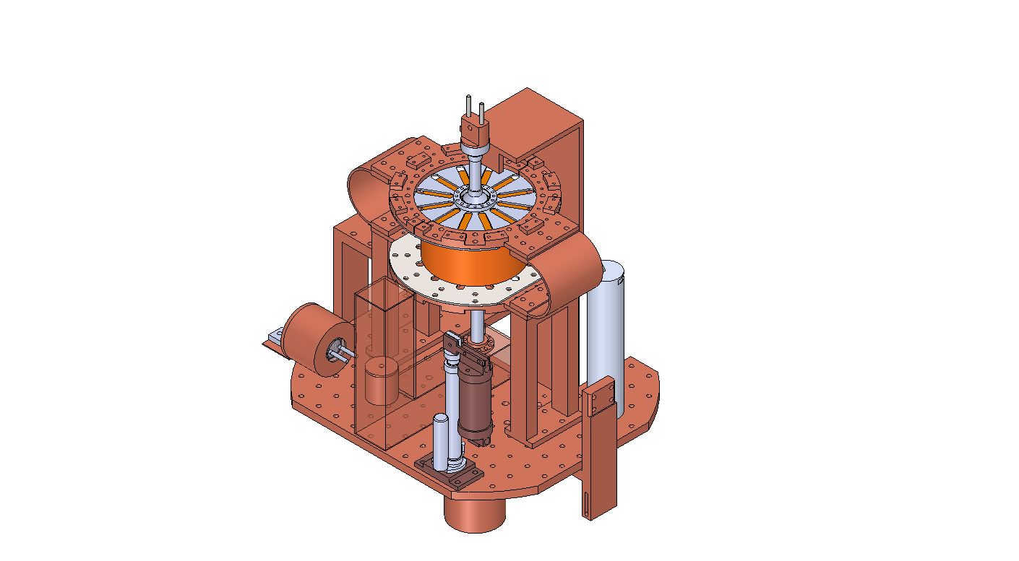
3D CAD
GGG
Still shield
Magnet
Sorption pump 1
(SP1, for ADR)
Still
MXC
Copper plate
GGHS
(for SP2)
Sorption pump 2
(SP2, for DR)
G-M coldhead

Slide 31
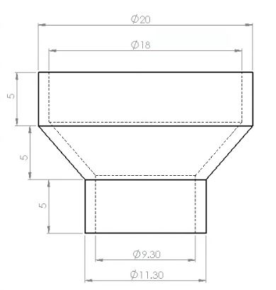
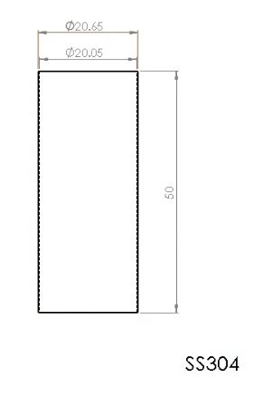
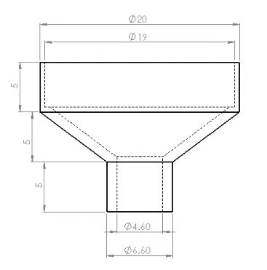
to ADR
thermosiphon
15 mm
GLF
GGG
30 mm
Dia. 20 mm
H. 30 mm
GLF
5 mm
GLF 디스크 추가 설치 가능
Dia. 18 mm
H. 1.8 mm
to still

Slide 32
GGG
GGG
(1) SS pipe와 Still reducer soldering 접합
(2) GGG와 SS pipe STYCAST 접합 및 밀봉
(3) Thermosiphon reducer soldering 접합

Slide 33
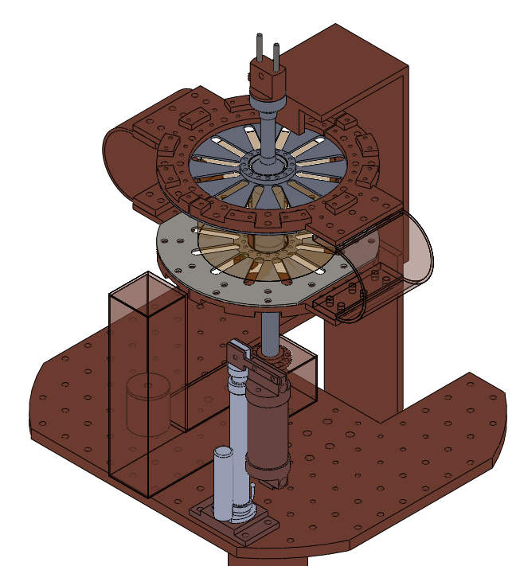
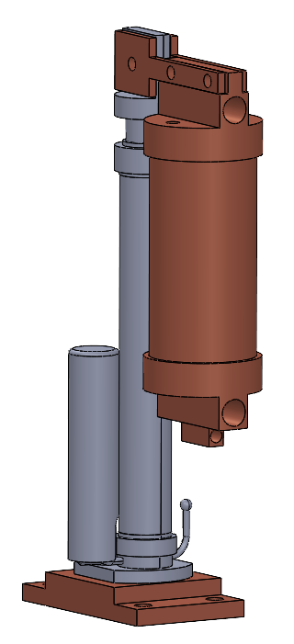
Introduction
Sorption pump assembly
  Active gas-gap heat switch from Chase Research Cryogenics
  The sorption pump is designed in a cylindrical shape.
4 K ~ 30 K
ADR
Heat switch
Sorption
pump
Still
MXC
Sorption
pump
4 K

Slide 34
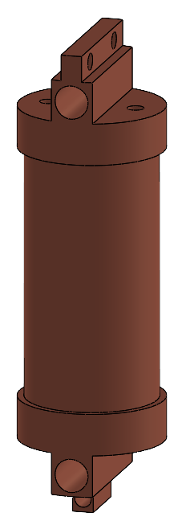
Sorption pump design
Sorption pump
  Copper tube: H = 60 mm, D = 25.4 mm, Wall thickness = 1 mm
  Mass of copper case: 100 g, mass of activated charcoal: 20 g
  Temperature range: 4 K (adsorbing) ~ 30 K (desorbing)
Pumping
Cartridge heaters
Temp.
sensor

Slide 35
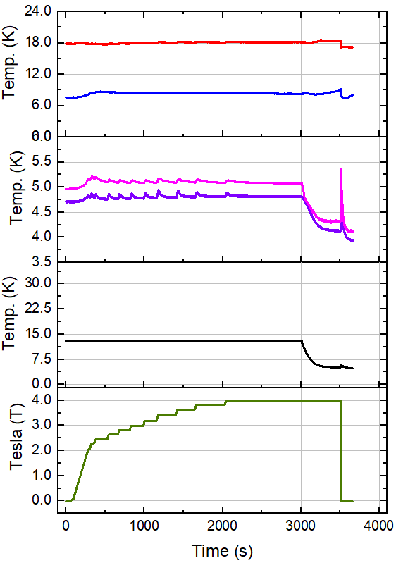
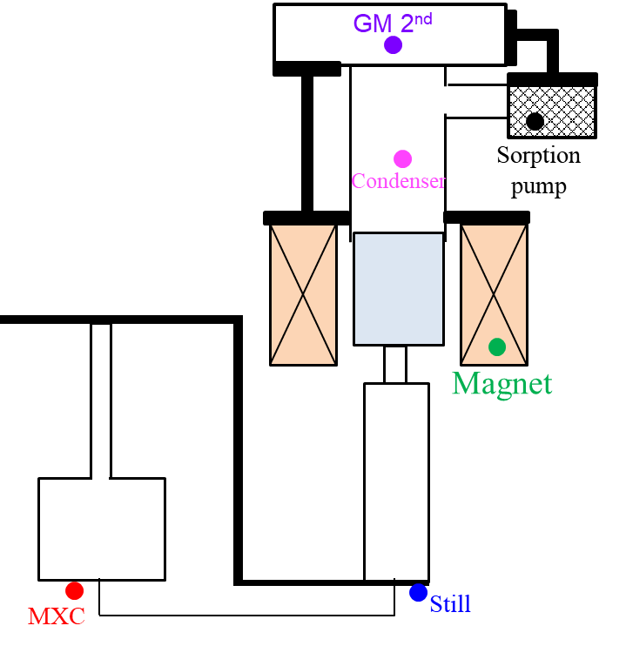
S.P. 13 K → 4 K, dt = 3 s
재생
evaporative cooling
자화
탈자

Slide 36
S.P. 13 K → 4 K, dt = 3 s
S.P.를 13 K에 고정해두면 GGG 위 condenser에 액체 헬륨이 쌓임
자화 시 온도가 상승하지만, 액체 헬륨이 기화되기에 온도가 쉽게 상승하지 않고, 재생 시간동안 다시 액체가 쌓임
솝션 펌프를 4 K으로 냉각하면 흡착량이 늘어나면서 evaporative cooling이 발생하나, 본 경우 흡착량이 매우 적어 온도변화가 적고, 액화가 해제되어 오히려 온도 상승
이후 탈자화시 미미한 온도하강
ECH 영향이 보임
최저 Still 온도 = 5.32 K
재생
evaporative cooling
자화
탈자

Slide 37
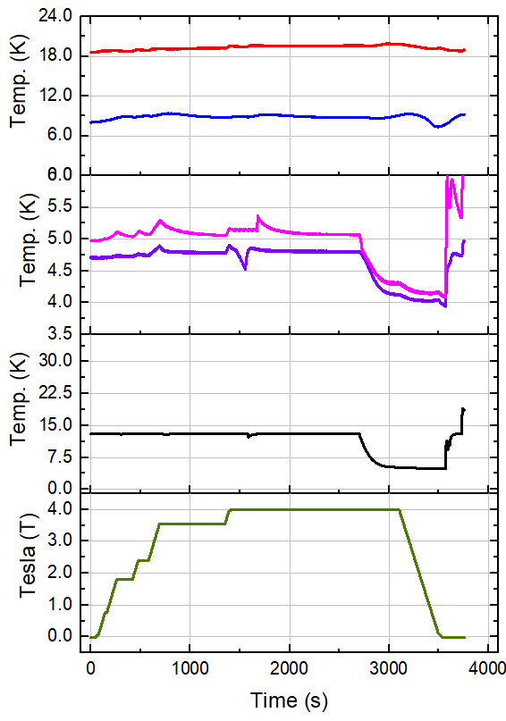
S.P. 13 K → 4 K, dt = 400 s
느린 탈자화로 ECH∝(dB/dt)²에 의해 ECH가 크게 감소한 것을 확인
지금 Still과 MXC는 radiation에 의한 가열이 예상되는데, dt를 너무 크게 상승시키니 오히려 radiation을 받는 시간이 늘어서 온도 하강이 거의 없음
최저 Still 온도 = 6.56 K
응축 잠열을 해결하기 위해 SP를 13 K로 두어 condenser 부분을 미리 응축하는 방법은 사실상 냉각 효과를 기대하기 어려움
MXC
Still
Condenser
GM 2nd
S.P.
Magnet

Slide 38
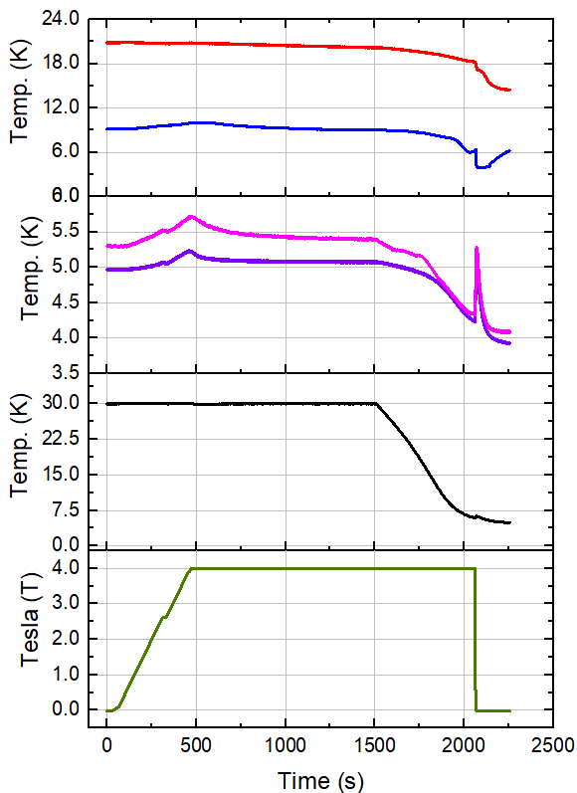
S.P. 30 K → 4 K, dt = 3 s
S.P.를 30 K에서 시작하여 4 K까지 한 번에 냉각하며, condenser 측은 약 3,000 Torr로 초임계 상태에서 시작 (종료시 약 300 Torr)
응축에 의한 잠열이 있어 냉각 용량이 부족할 수 있지만, case 1,2보단 좋음
최저 Still 온도 = 3.85 K
시스템의 냉각을 확인할 수 있으나, dt가 짧아 ECH의 영향이 보임
MXC
Still
Condenser
GM 2nd
S.P.
Magnet

Slide 39
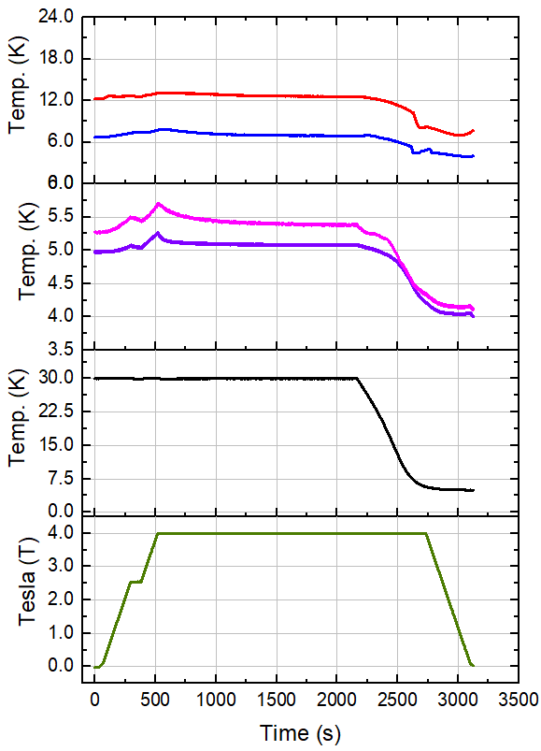
S.P. 30 K → 4 K, dt = 400 s
같은 조건이나, 앞서 사이클을 한 번 돌린 상태라 MXC와 Still이 조금 낮은 온도에서 시작함
dt를 400초로 늘리니 ECH에 의한 효과는 거의 사라짐
최저 Still 온도 = 3.93 K
낮은 온도에서 시작하고, ECH의 영향도 줄였지만 최종 온도는 더 높음. 이는 dt가 너무 길어서 still이 radiation을 받는 시간이 늘었기 때문
MXC
Still
Condenser
GM 2nd
S.P.
Magnet

Slide 40
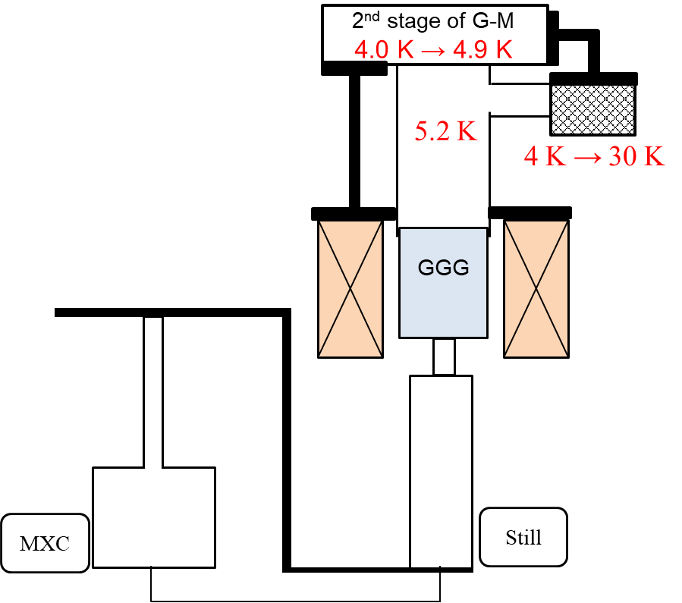
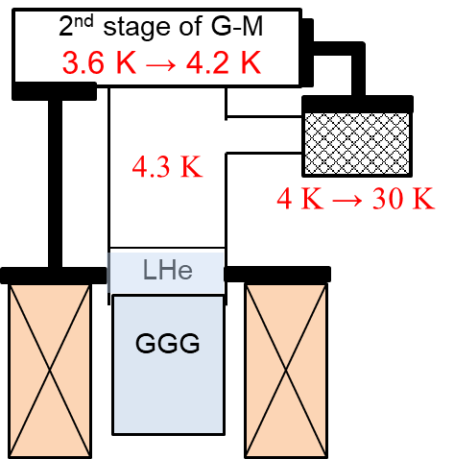
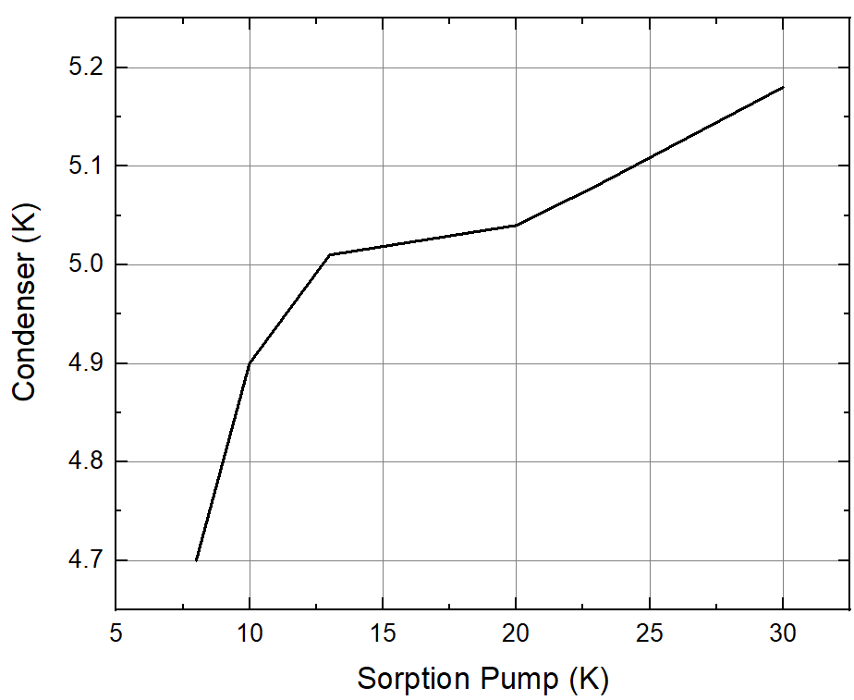
문제점 1 응축 잠열
  GM이 예냉으로 액체를 만들어야 응축 잠열을 이겨낼 수 있으나, 현재 불가능
  기존의 ADR에서 GM 2nd plate의 온도는 3.6 K로 수렴하고, sorption pump를 30K로 가열하면 4.2 K가 되고, 응축을 일으키는 condenser는 4.3 K. LHe가 만들어짐
  반면 DR components가 추가된 ADR의 GM 2nd plate의 온도는 4.0 K로 수렴하고, sorption pump를 30 K로 가열하면 4.9 K가 되고, condenser는 5.2 K. 초임계라 LHe 안됨
[기존 ADR 실험]
[현 ADR 실험]
[S.P. vs Conndenser 온도]

Slide 41
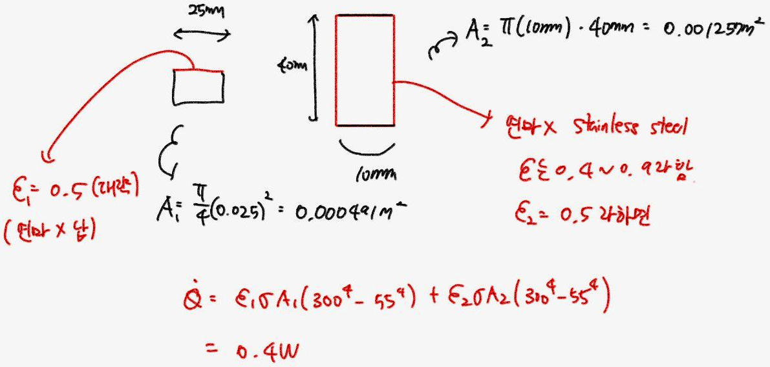
문제점 2 Radiation
Still-MXC가 추가되면서 Radiation에 의한 가열이 매우 심함
계산 radiation = 0.4 W, no load의 GM 냉동기의 온도는 각각 기존 ADR 3.6 K, 현재 ADR 4.0 K임
RDK-415D의 매뉴얼에 따르면 수렴온도 3.6 K → 4.0 K는 약 0.5 W의 열유입이 증가한 것
Still-MXC의 대략적 radiation에 의한 열량은 0.4 W
그래서 Thermosiphon에 의한 열차단도 안되고, GGG 위 condenser에 액체가 쌓여도 still의 온도는 6 K보다 높음
0.74 W @ 3.6 K
1.23 W @ 4.0 K

Slide 42
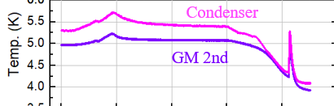
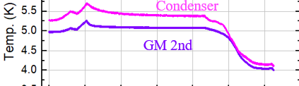
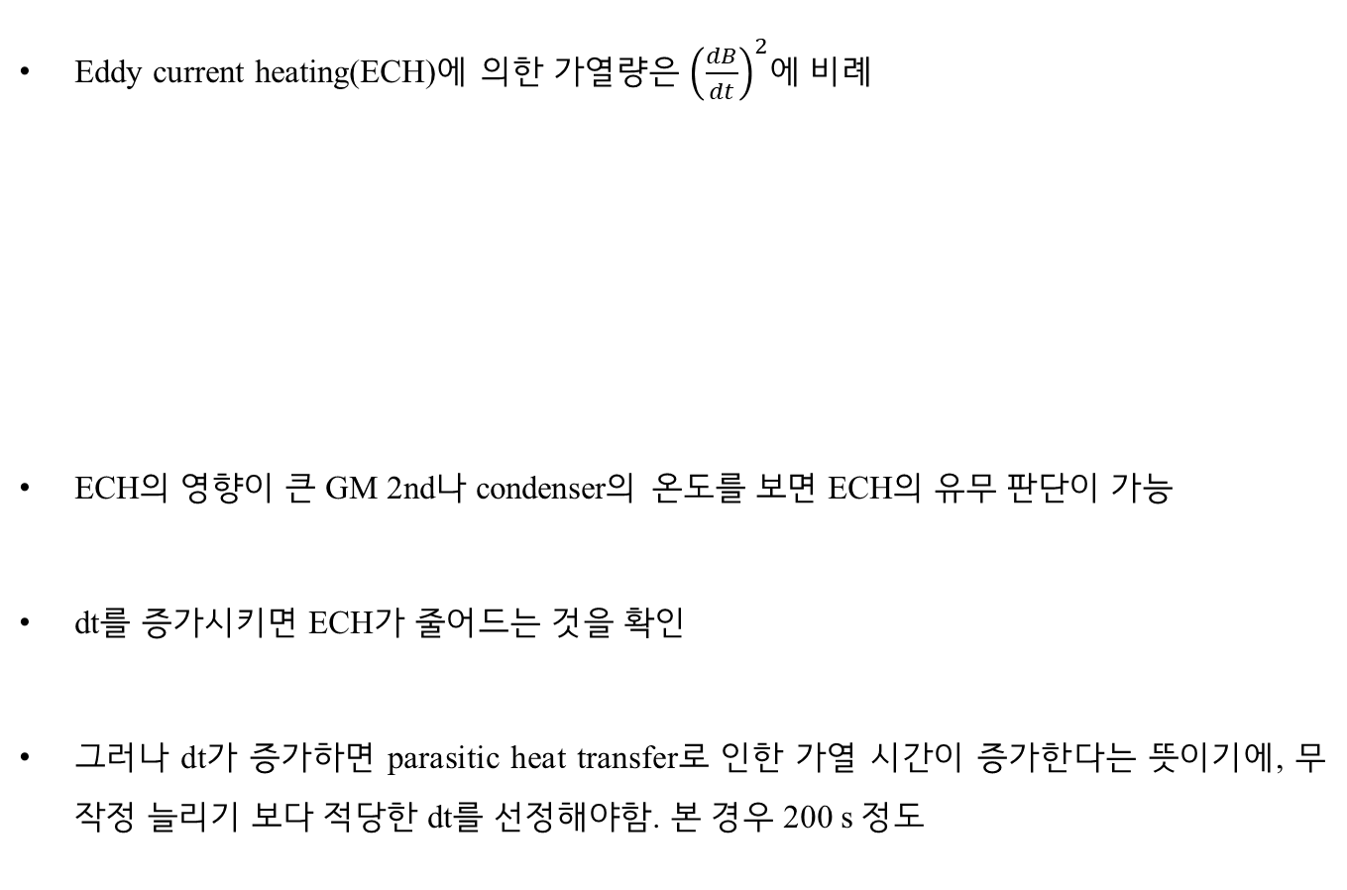
문제점 3 Eddy current heating
Eddy current heating(ECH)에 의한 가열량은 ${\left(\frac{dB}{dt}\right)}^{2}$에 비례
ECH의 영향이 큰 GM 2nd나 condenser의 온도를 보면 ECH의 유무 판단이 가능
dt를 증가시키면 ECH가 줄어드는 것을 확인
그러나 dt가 증가하면 parasitic heat transfer로 인한 가열 시간이 증가한다는 뜻이기에, 무작정 늘리기 보다 적당한 dt를 선정해야함. 본 경우 200 s 정도

Slide 43
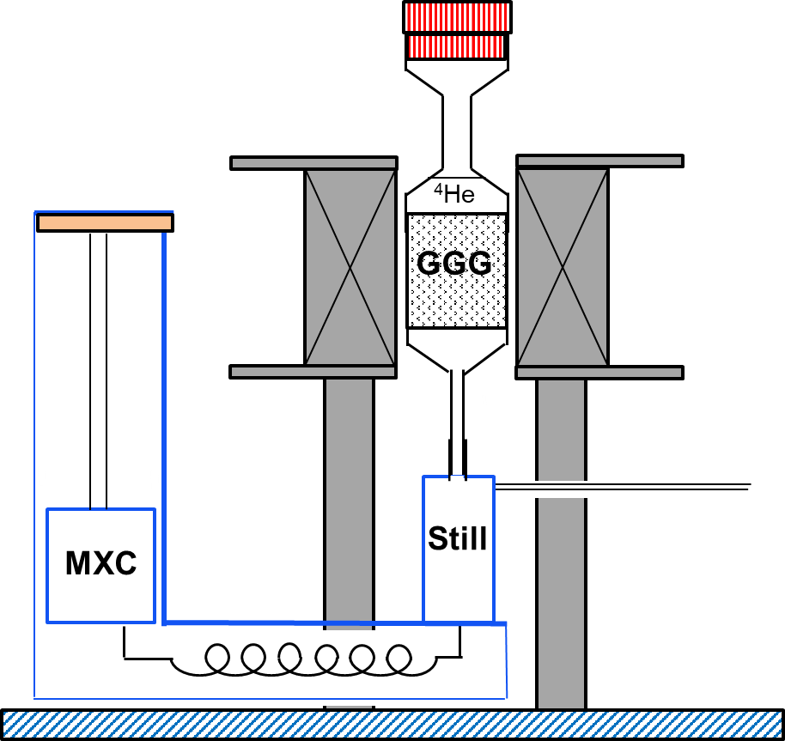

1. Introduction
MXC and Still: Different liquid levels due to vapor pressure
Different cross-sectional areas: 3He in MXC determines cooling capacity
Small Still cross-sectional area: Risk of rapid exhaust
Goal: Optimize Still 3He content for operation without exhaust
Shield
Still
Chimney
MXC
Pump
3He
4He
Mixture
3He-4He
Mixture
[ADR cools the still, still cools the MXC]
[Schematic diagram of DR]
Notes:
Here, the ADR cools the DR's still, and the still cools the MXC through a thermosiphon. The DR structure looks like this.
Now, during DR operation, the MXC and Still have different temperatures. This means they have different vapor pressures, which creates a difference in liquid levels.
The amount of helium-3 in the MXC determines the cooling capacity, so the two chambers have different cross-sections. But this difference in cross-sections could cause the Still to run dry. So, our research goal is to find conditions where the Still doesn't run dry and has just the right amount of helium-3.

Slide 44
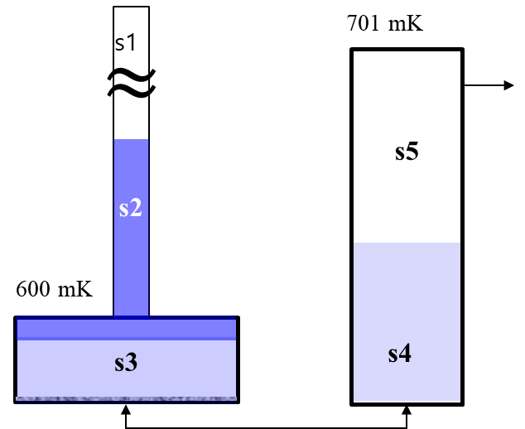
2. Numerical analysis
symbol | meaning | note
T_{t} | Temp. of tricritical point | 0.867 K
x_{t} | concentration of tricritical point | 0.674
g | gravitational acceleration | 9.81 m/s²
rho_{l} | liquid density | g/cm³
x_{initial} | initial concentration | 0.4
h | height | cm
dh₁ | lift of MXC | 0 cm
m | the number of moles | mol
chem | chemical potential | J/mol-4He
x | concentration
Cp | specific heat at constant pressure | J/mol-K
Δh | height difference | cm
h_{sp} | liquid level of still by pressure | cm
h_{sv} | liquid level of still by volume | cm
Q_{M} | cooling cap. of MXC | J
u | internal energy | J/mol-K
h₂
h₄
h₃
subscript
t | at tricritical point
M | Mixing chamber
cn | chimney
s | still
3He | helium-3
4He | helium-4
d | dilute phase
c | concentrated phase
12345 | in 1,2,3,4,5
i | step
e.g. m_{23,3He}=moved 3He from s2 to s3
Notes:
This is our notation. We'll get into details later, but for now, just note the numbers and heights for each position.

Slide 45
2. Numerical analysis
Assumptions:
Always reaches thermodynamic equilibrium (especially chemical potential quickly reaches equilibrium)
Still temperature controllable above MXC temperature; Still temperature set just before phase separation
The number of vapor moles is negligible
MXC vapor pressure determined by the vapor pressure of the concentrated phase (located above the dilute phase) in MXC
Notes:
Here are our assumptions for the analysis. The most important one is that we quickly reach thermodynamic equilibrium. We also assume we can control the Still temperature, ignore the moles of vapor, and consider the MXC vapor pressure.

Slide 46
2. Numerical analysis
For Initial value
Input constant*
Compute
m_{4,3He}, m_{5,3H3}, m_{3,3He}, m_{3,4He}, m_{2,4He}, m_{2,3He}, m_{1,3He}, rho, h₂, h₃, h₄
Set Initial independent variable*
(T, m_{total}, x_{initial}, dimension)
Compute P_{M,bot} , P_{s,bot}
Initial dependent variable calculation*
(P_{M,bot} = P_{s,bot})
Assume m_{4,4He}
No
yes
Print results
Notes:
This is the algorithm for finding initial values. It's really important to set the right initial conditions for DR operation. The MXC temperature will be 0.6K, and the Still temperature will be 0.7K. We're looking for conditions where the pressure at the bottom of the MXC equals the pressure at the bottom of the Still. First, we input constants, independent variables, and dependent variables. Then, we guess the amount of helium-4 in the Still. Since we know the temperature and concentration, we can calculate the amount of helium-3. Then, using the total number of moles, we solve some equations to find out how much helium is in the MXC. We convert this to specific volume and compare the pressures at each bottom to do our calculations.

Slide 47
2. Numerical analysis
Constant input: tricritical point, gravitational acceleration, specific heat coefficients
Initial independent variables: Initial values or constants we can control
  Still temperature, mixing chamber temperature, total mols, concentration, chamber size
Initial dependent variables: Initial values calculated from other independent variables
  Concentration, specific heat, vapor pressure, etc.
Initial mol calculation :
  m4_4He = i*1e-8 가정
  m4_3He = (m4_4He*x_s)/(1-x_s) 계산
  m3_3He = x_d*(m_3He-(m4_3He+m5_3He)-x_c*(m_total-m_still))/(x_d-x_c)
  m3_4He = (1-x_d)*(m_3He-(m4_3He+m5_3He)-x_c*mM)/(x_d-x_c)
  m2_4He = m_4He - m4_4He - m3_4He
  m2_3He = (m2_4He/(1-x_c))*x_c
  Calculate height using specific volume, then compare Still bottom pressure and MXC bottom pressure
Notes:
This is a more detailed explanation of what we talked about in the initial value calculation. For now, let's move on, but we can come back to this if needed.

Slide 48
2. Numerical analysis
Input Initial values
Assume m_{23,3He} (i)
Calculate Q_{M} (eq5)
m₃₄h₃, m₄₃h₄ (eq19, f5)
Reduce P_{s}
m_{2,3He}, m_{2,4He}, h_{c} (eq6~8)
(m_{I}u_{I})₃, (m_{I}u_{I})₄
(m_{II}u_{II})₃, (m_{II}u_{II})₄
(eq19, f5)
x_{s} calculation (f1)
μ_{s} calculation (f2)
Assume m_{34,3He} (j)
No
energy balance (eq.19)
Input T_{M}, calculation μ_{M}(f3)
m_{3,3He}, m_{3,4He}, h_{d},
m_{43,4He}, m_{4,4He},
m_{4,3He}, h_{4p}, h_{4v}
m_{56,3He}
(eq9~18)
yes
yes
(μ_{m}=μ_{s})
Reduce P_{s} & repeat (k)
No
yes
T_{M}-dT
x_{d}, x_{c}, Cp_{2,3,4}, P_{M}
(eq 1~4, f4)
h_{4p}-h_{4v}<ε
f : Property function
Eq : Calculation equation
yes
No
Notes:
Now, this is the algorithm for calculating liquid levels in detail. We start with the Still pressure decreasing because the sorption pump keeps sucking out helium-3 from the Still. So, the Still pressure has to keep going down. The key here is using the law of mass conservation to calculate the amount of helium at each position. Then we use specific volume to figure out the liquid height, and calculate the levels using the pressure at the bottom of each chamber. After that, we check if the energy balance equation works. If it doesn't, we adjust how much helium moves around and repeat the calculations until the energy equation balances out. This is too much to put on a PowerPoint slide, so if we need to, we can look at the extra materials for more details.

