Slide 1
X-Box Summary
2.10.2024

Slide 2
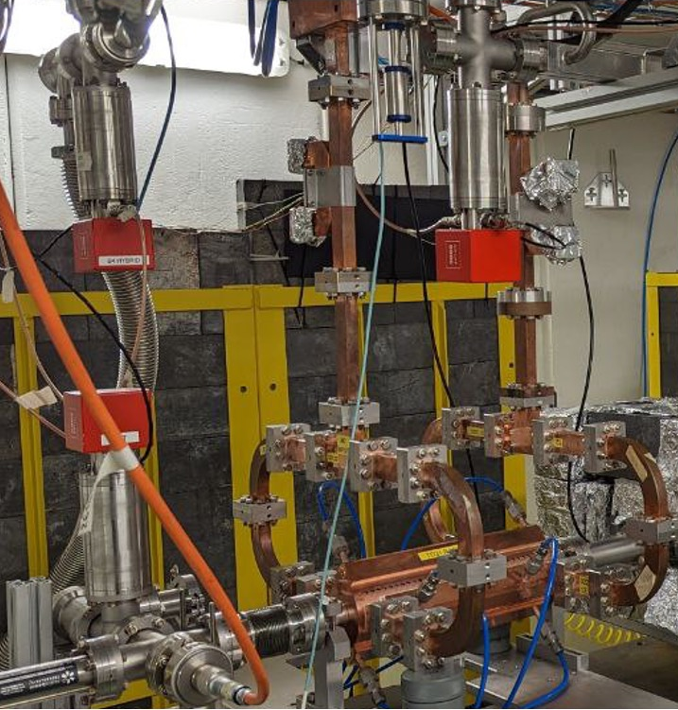
X-Box 2: TD31 N3 N4
X-Box 2 TD31 N3 N4: Structure B
Many problems during summer
  Visit Scandinova 6-9th August
  Several problems with IGBT in HVPS
  Decided to reduce voltage and wait for next fault
Restarted 28.09.2024
100:1 ratio, all power to Structure B
Pulse width 100ns
Setpoint DUT 42MW
BDR=6E-6 (Tuesday 1st)

Slide 3
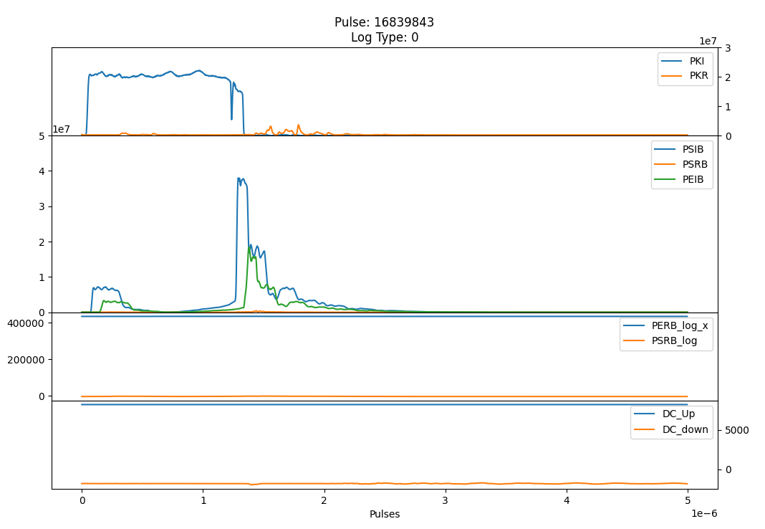
X-Box 2 TD31 N3 N4 Structure B- Pulse

Slide 4
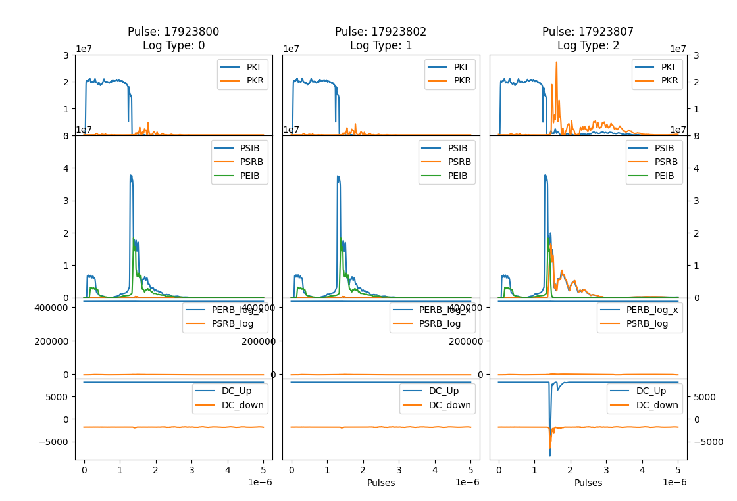
TD31 N3 N4 Structure B- Pulses 30 August

Slide 5
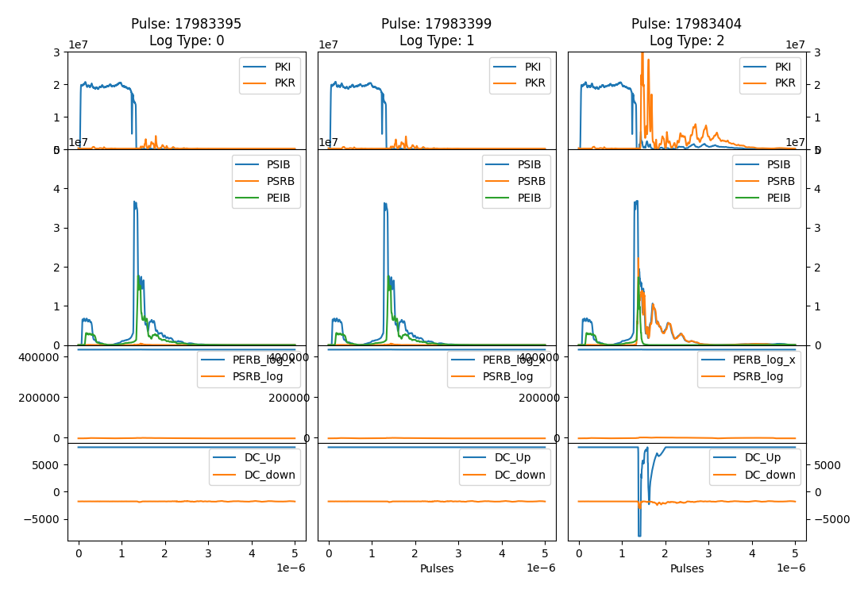
TD31 N3 N4 Structure B- Pulses 30 August

Slide 6
TD31 N3 N4 Structure B- Pulses 30 August

Slide 7
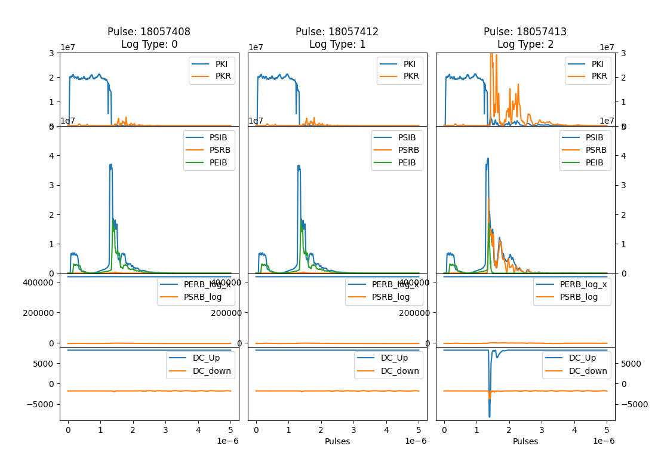
TD31 N3 N4 Structure B- Pulses 30 August

Slide 8
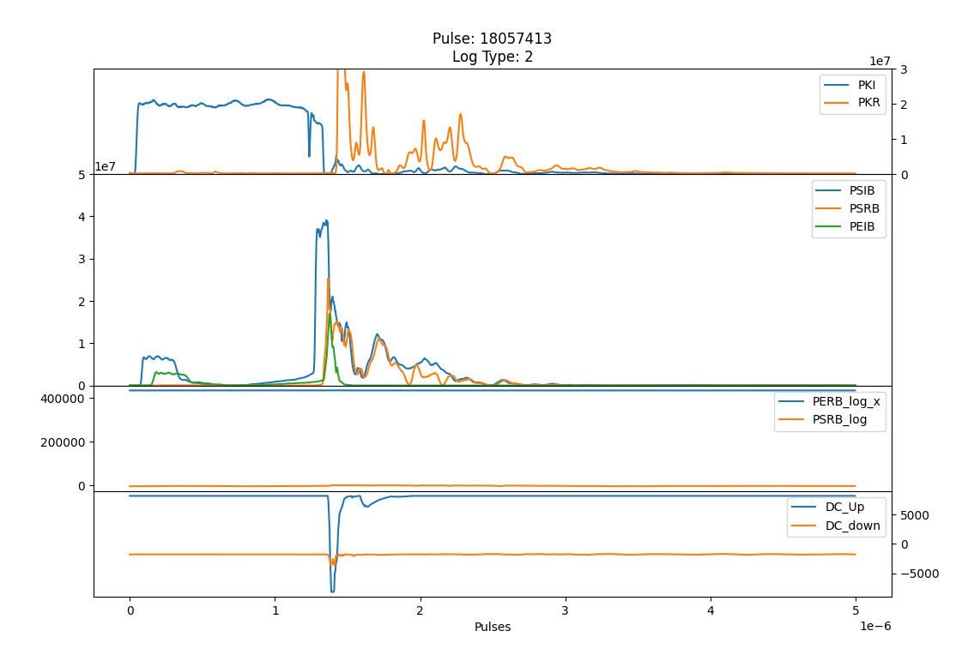
TD31 N3 N4 Structure B- Pulses 30 August

Slide 9
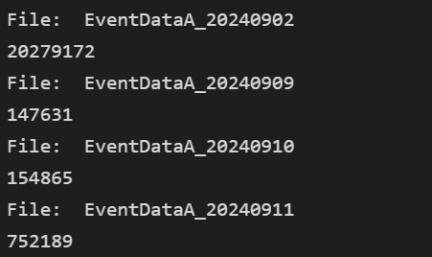
XBox2 – Pulse count
2nd September
  Electrical cut – PXI off
  Pulse count was reset
Need to readjust pulse count manually
Has this ever happened before?

Slide 10
X-Box 3: HEK measurements
Not operative at present
Changed HE klystron position
  From modulator B to modulator A
  Vacuum levels 6e-10mbar approx.
Changed also the solenoid power supply
  Not working at the moment
  Spares have been ordered
Faulty SSA has been shipped for repair
In the meantime…
  Waiting Scandinova answer to fix SPS issue
  Plan to calibrate all the lines for the test (Drive, KLYFWD and KLYRFL)
  Plan to calibrate temperature sensors
  Installation of bigger flowmeter for collector (in range)
  Installation of klystron E37123 in modulator B
Visit from Scandinova (?)
  Offer to come and do calorimetry (Kevin)
  Calibrated calorimeter

Slide 12
X-Box 2: Reminder on BD classification
BD_Flag_PER_log
BD Load
TRUE
BD_Flag_DC_DOWN
DC Up >=140
DC Down>=100
BD DUT w. BDC
BD_Flag_DC_UP
FALSE
BD_Flag_PSR_log
BD DUT wo. BDC
BD_Flag_PKR_log
BD HyPC
No BD

