Slide 1
X-Box Summary
9.10.2024

Slide 2
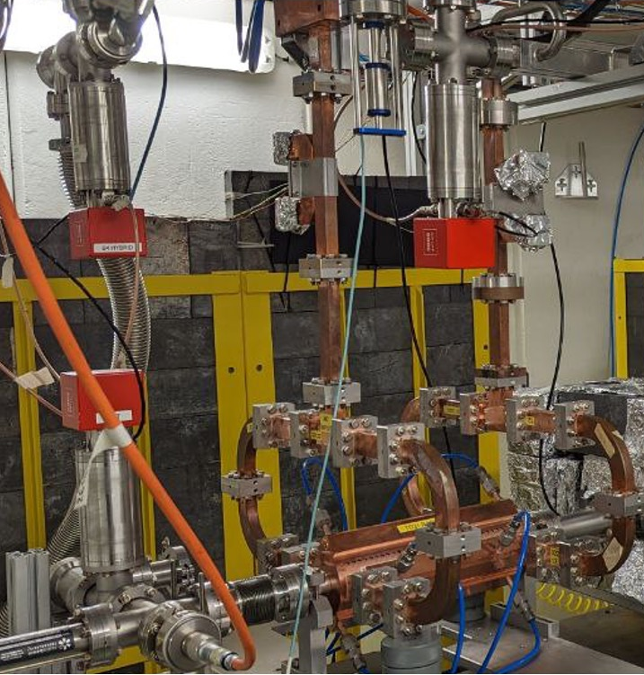
X-Box 2: TD31 N3 N4
X-Box 2 TD31 N3 N4: Structure B
Many problems during summer
  Visit Scandinova 6-9th August
  Several problems with IGBT in HVPS
  Decided to reduce voltage and wait for next fault
Restarted 28.09.2024
100:1 ratio, all power to Structure B
Pulse width 100ns
Setpoint DUT 51MW
BDR=2E-5 (Monday 7th)
IGBT Interlock in modulator HVPS2
  Scandinova visit 14th October

Slide 3
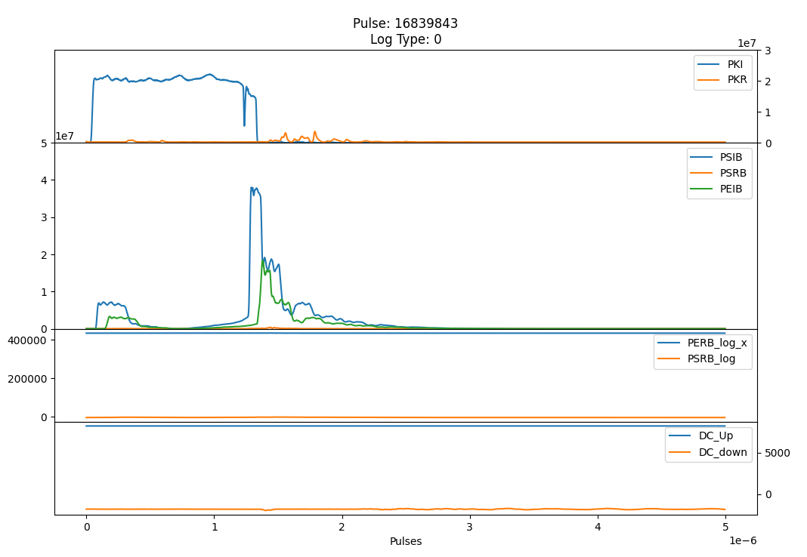
X-Box 2 TD31 N3 N4 Structure B- Pulse

Slide 4
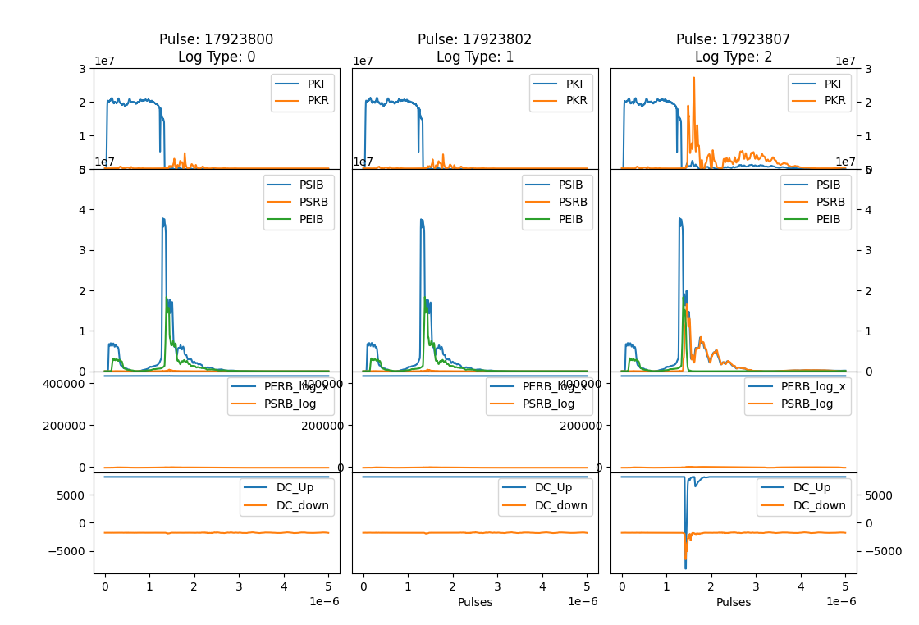
TD31 N3 N4 Structure B- Pulses 30 August

Slide 5
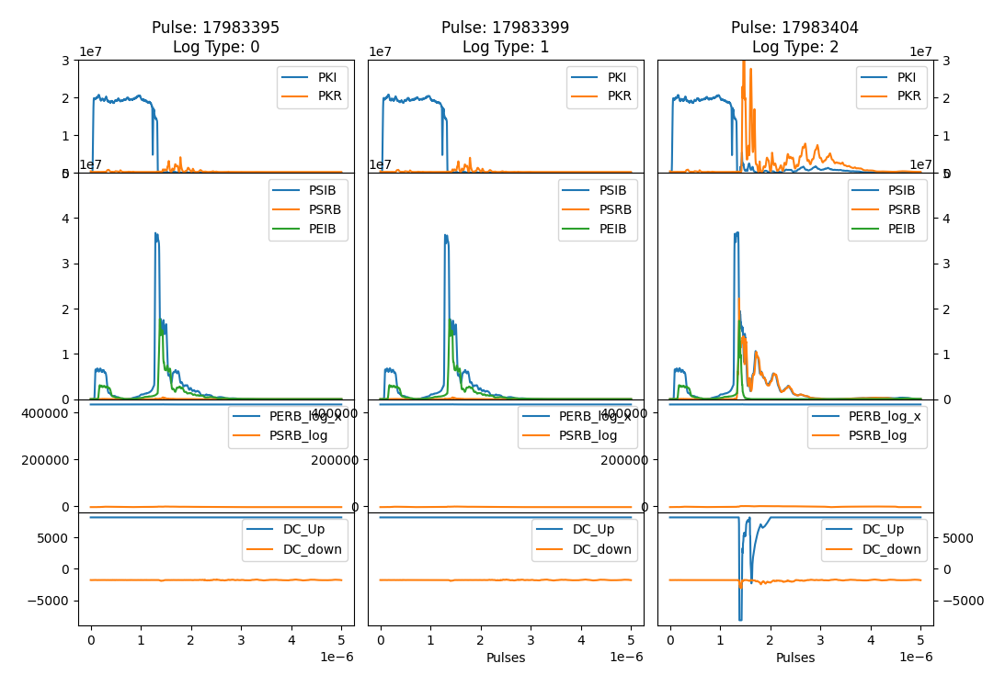
TD31 N3 N4 Structure B- Pulses 30 August

Slide 6
TD31 N3 N4 Structure B- Pulses 30 August

Slide 7
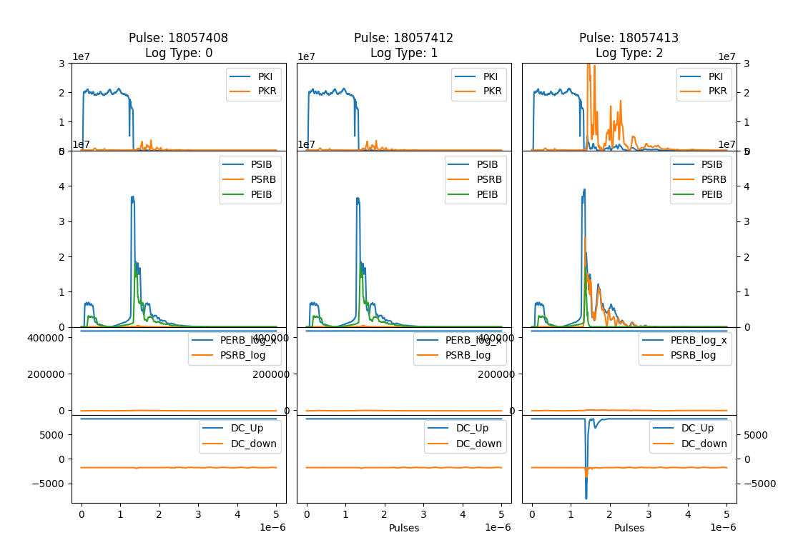
TD31 N3 N4 Structure B- Pulses 30 August

Slide 8
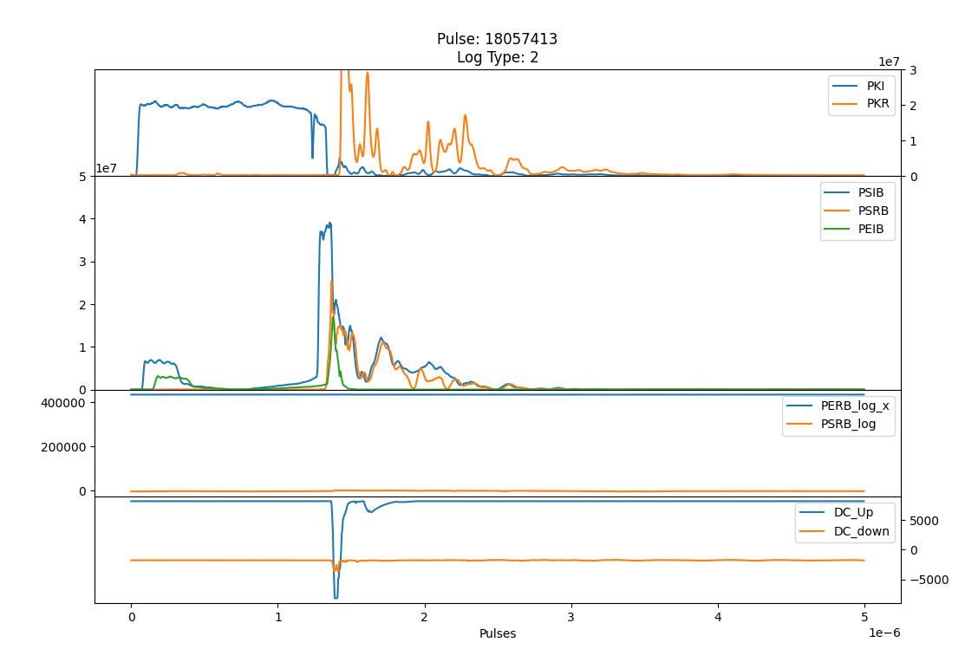
TD31 N3 N4 Structure B- Pulses 30 August

Slide 9
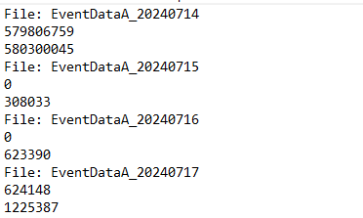
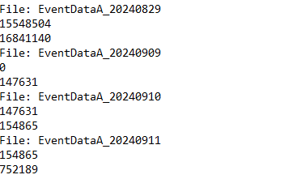
XBox2 – Pulse count
Problems with PXI and Pulse Count reset
  Has this ever happened before?
15th July
  Emergency stop – PXI off
2nd September
  Electrical cut – PXI off
Need to readjust pulse count manually
  Not possible via Python (not allowed)
  Maybe possible with LabView code

Slide 10
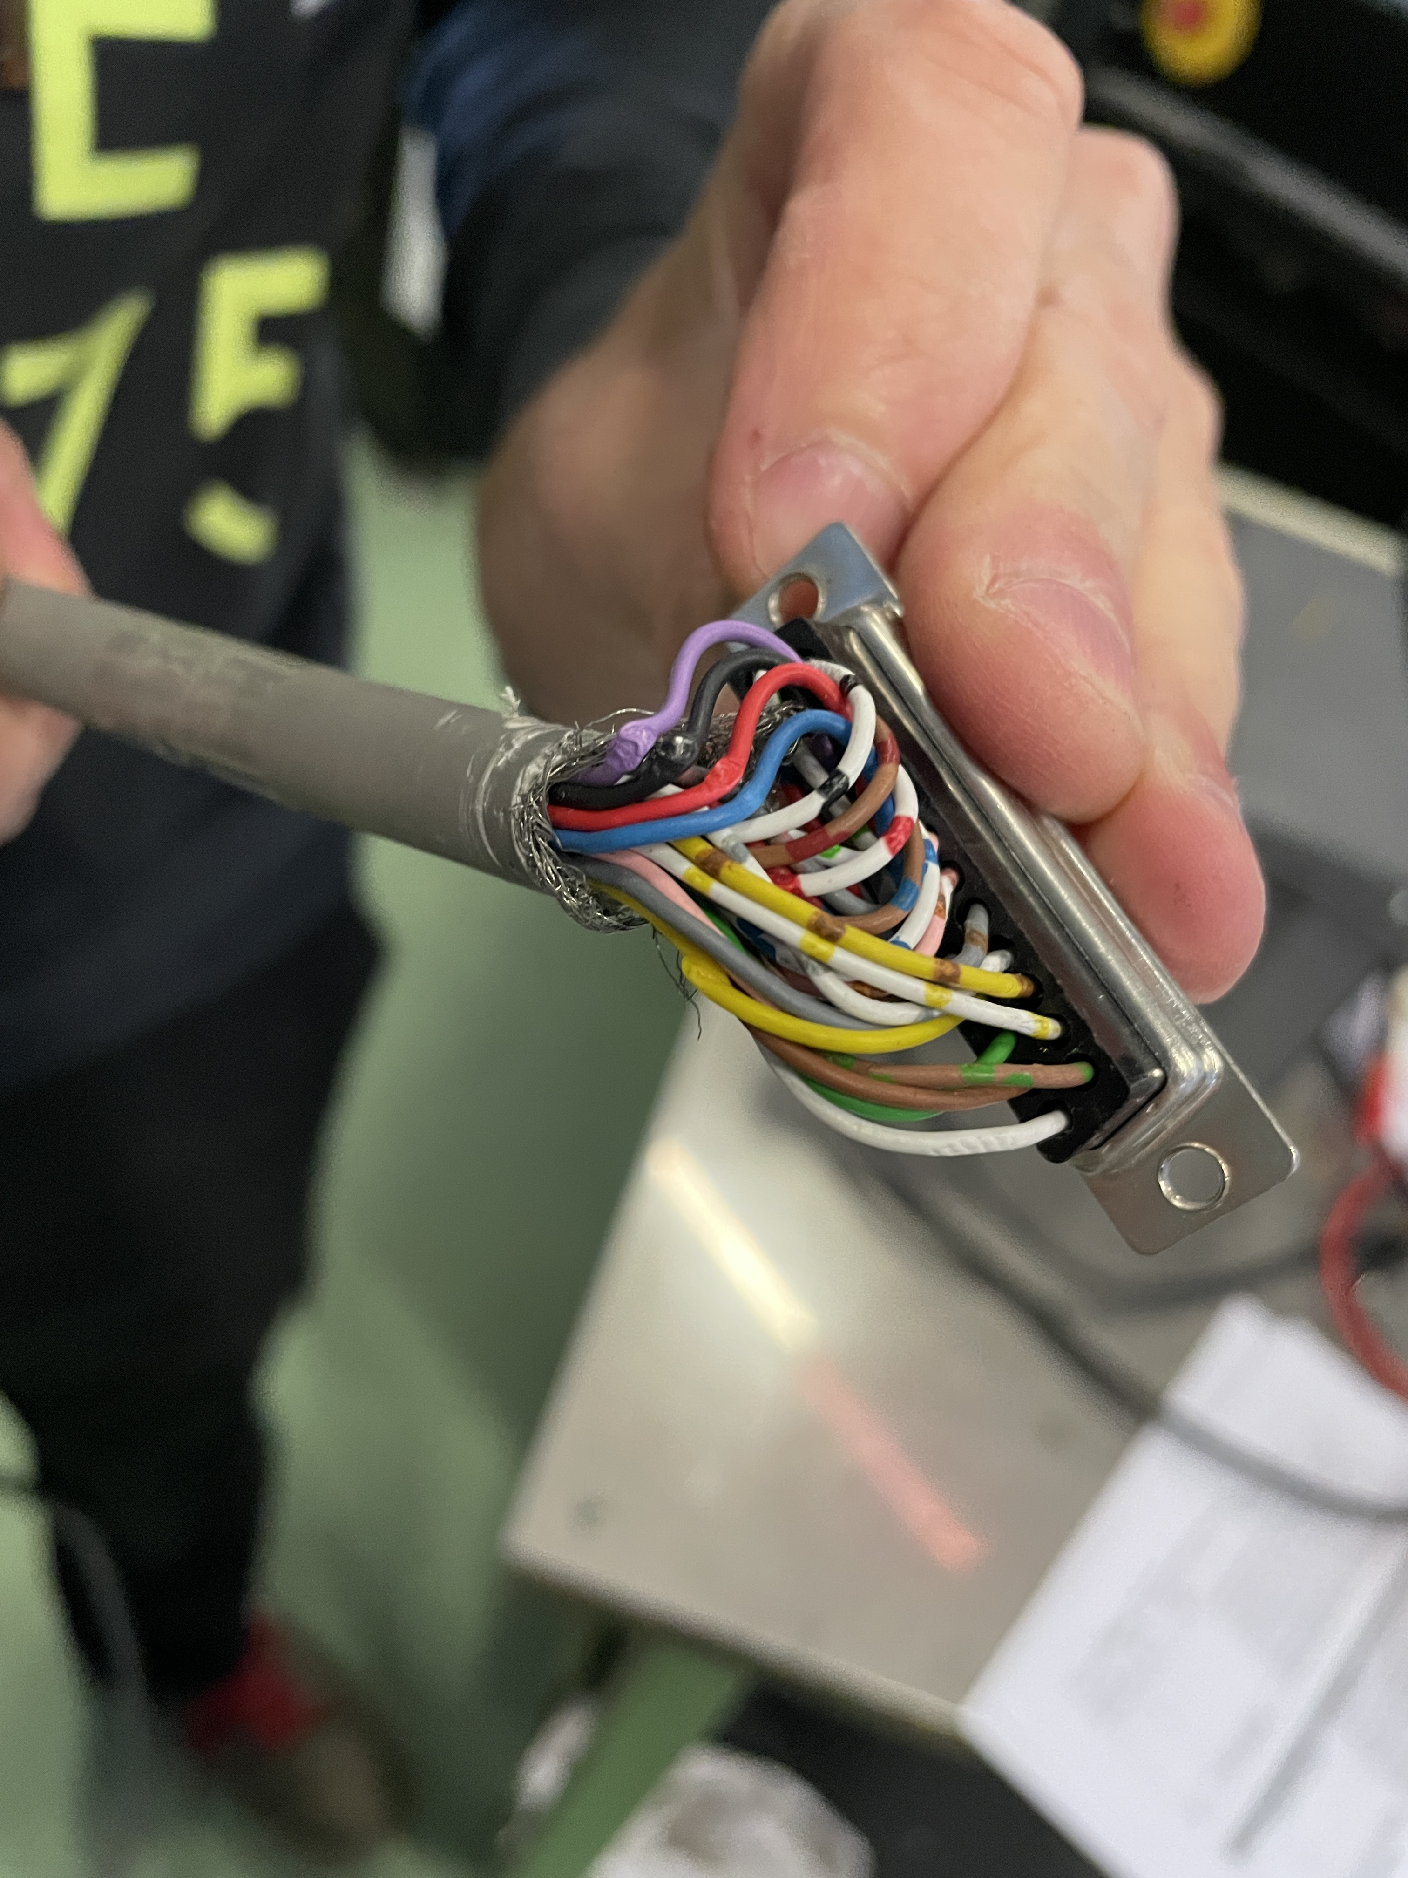
X-Box 3: HEK measurements
Operative now! More or less…
Changed also the solenoid power supply
  „Fixed problem“
  The installed SPS may be faulty
Vacuum is 1.7E-7mbar
  Leak test
In the meantime…
  Plan to calibrate all the lines for the test (Drive, KLYFWD and KLYRFL)
  Plan to calibrate temperature sensors
  Installation of bigger flowmeter for collector (in range)
  Installation of klystron E37123 in modulator B
Visit from Scandinova 14th October
  Offer to come and do calorimetry (Kevin)
  Calibrated calorimeter (custom made). Accuracy:
    flow meter is +-0.8% of reading, +-0.1% full scale
    temperature sensor is +-(0.1C + 0.17% * T)

Slide 12
X-Box 2: Reminder on BD classification
BD_Flag_PER_log
BD Load
TRUE
BD_Flag_DC_DOWN
DC Up >=140
DC Down>=100
BD DUT w. BDC
BD_Flag_DC_UP
FALSE
BD_Flag_PSR_log
BD DUT wo. BDC
BD_Flag_PKR_log
BD HyPC
No BD

