Slide 1
X-Box Summary
06.11.2024

Slide 2
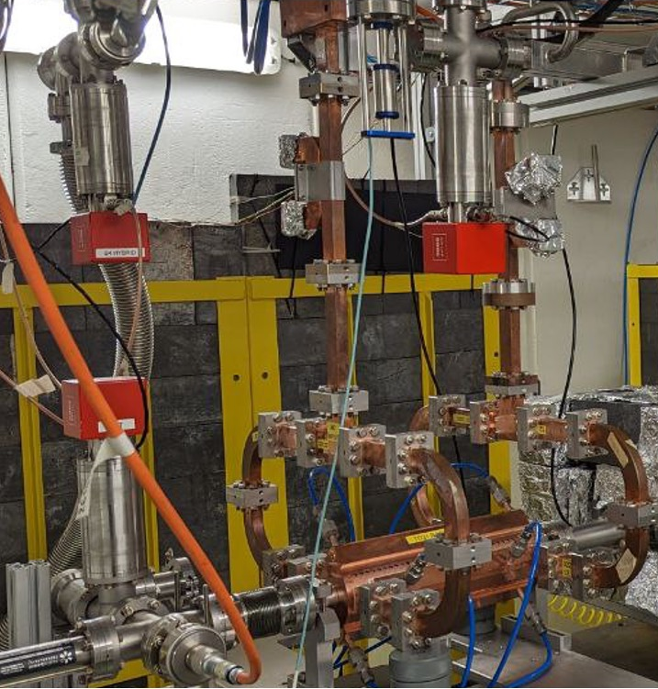
X-Box 2: TD31 N3 N4
X-Box 2 TD31 N3 N4: Structure B
Restarted after visit 18.10.2024
100:1 ratio, all power to Structure B
Pulse width 100ns
Changed pulse shape (Igor‘s request)
Fixed problem with pulse counter
  Saved old and corrected TDMS files
  Corrected PXI Pulse count.txt too
Running flat 50MW
  BDR 1e-5

Slide 3
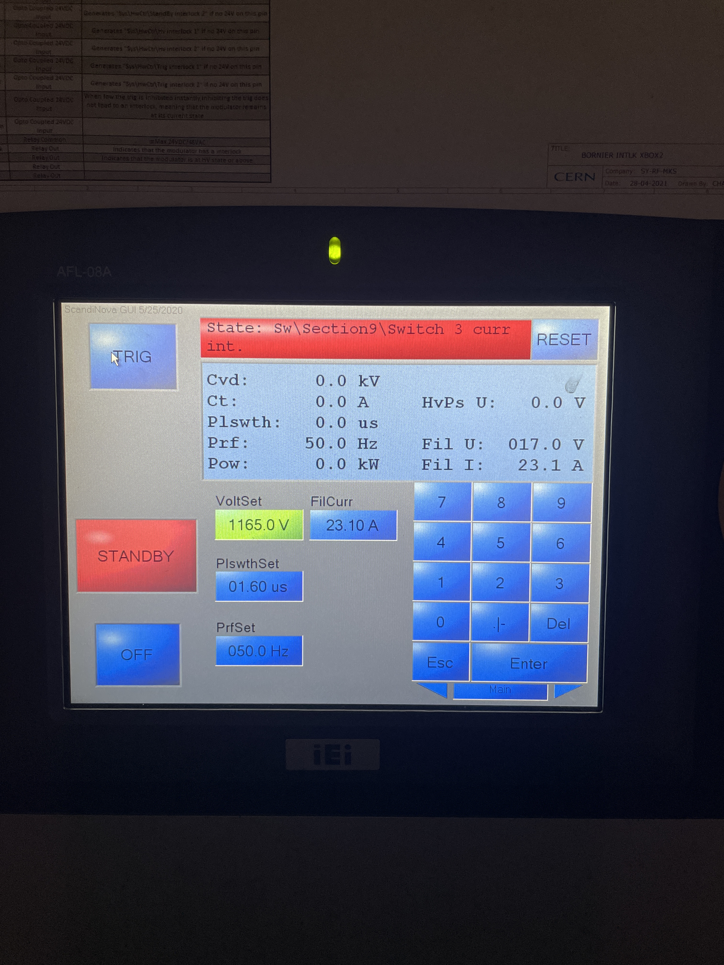
X-Box 2 Modulator – IGBT broken (05Nov)

Slide 4
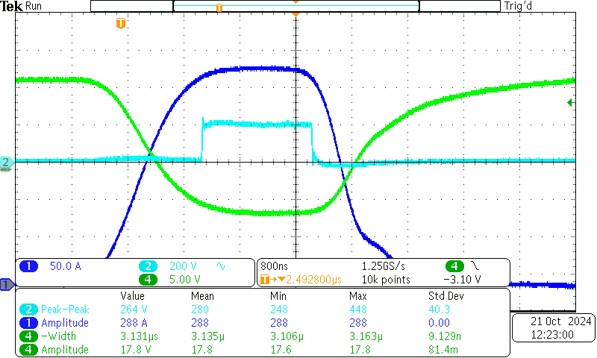
X-Box 2 Modulator – HV pulse shape

Slide 5
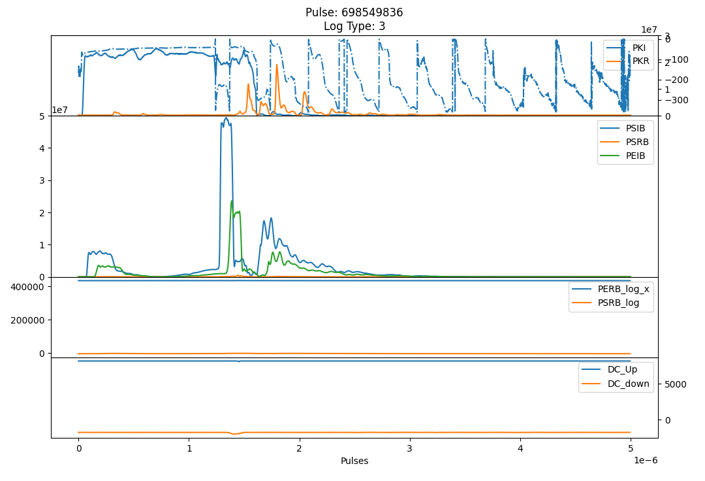
X-Box 2- RF Pulse shape

Slide 6
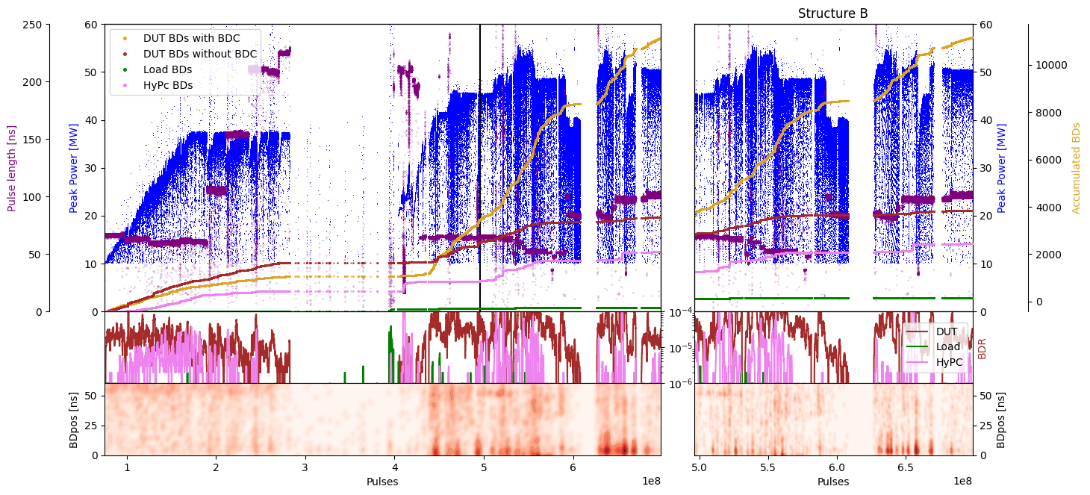
TD31 N3 N4 Structure B- Peak Power

Slide 7
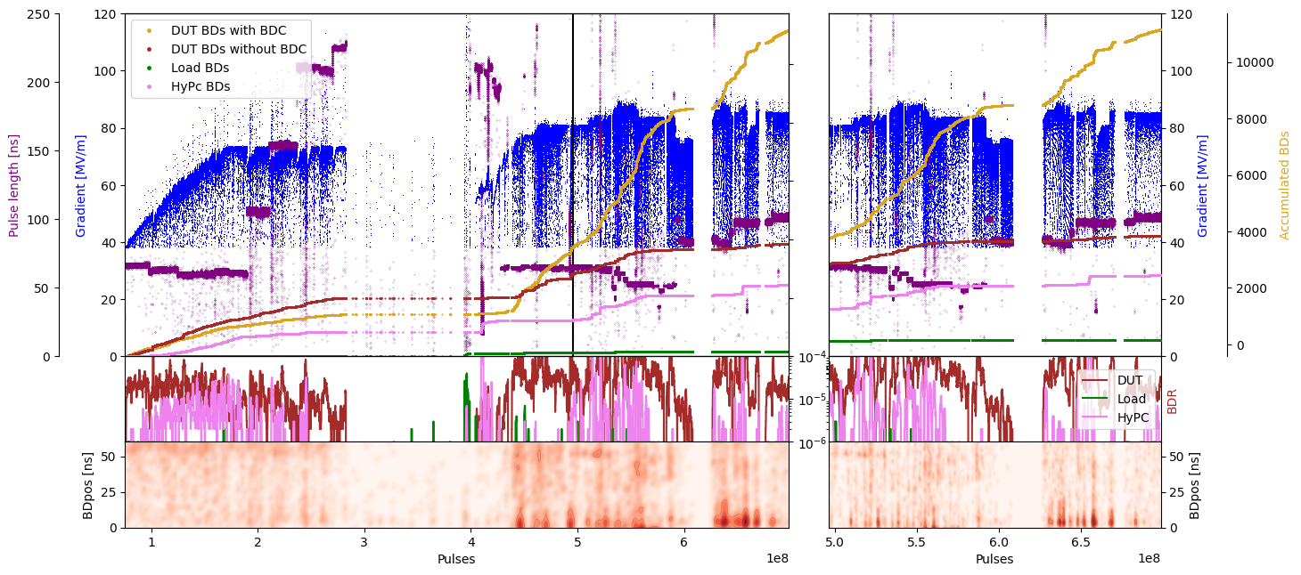
TD31 N3 N4 Structure B- Gradient

Slide 8
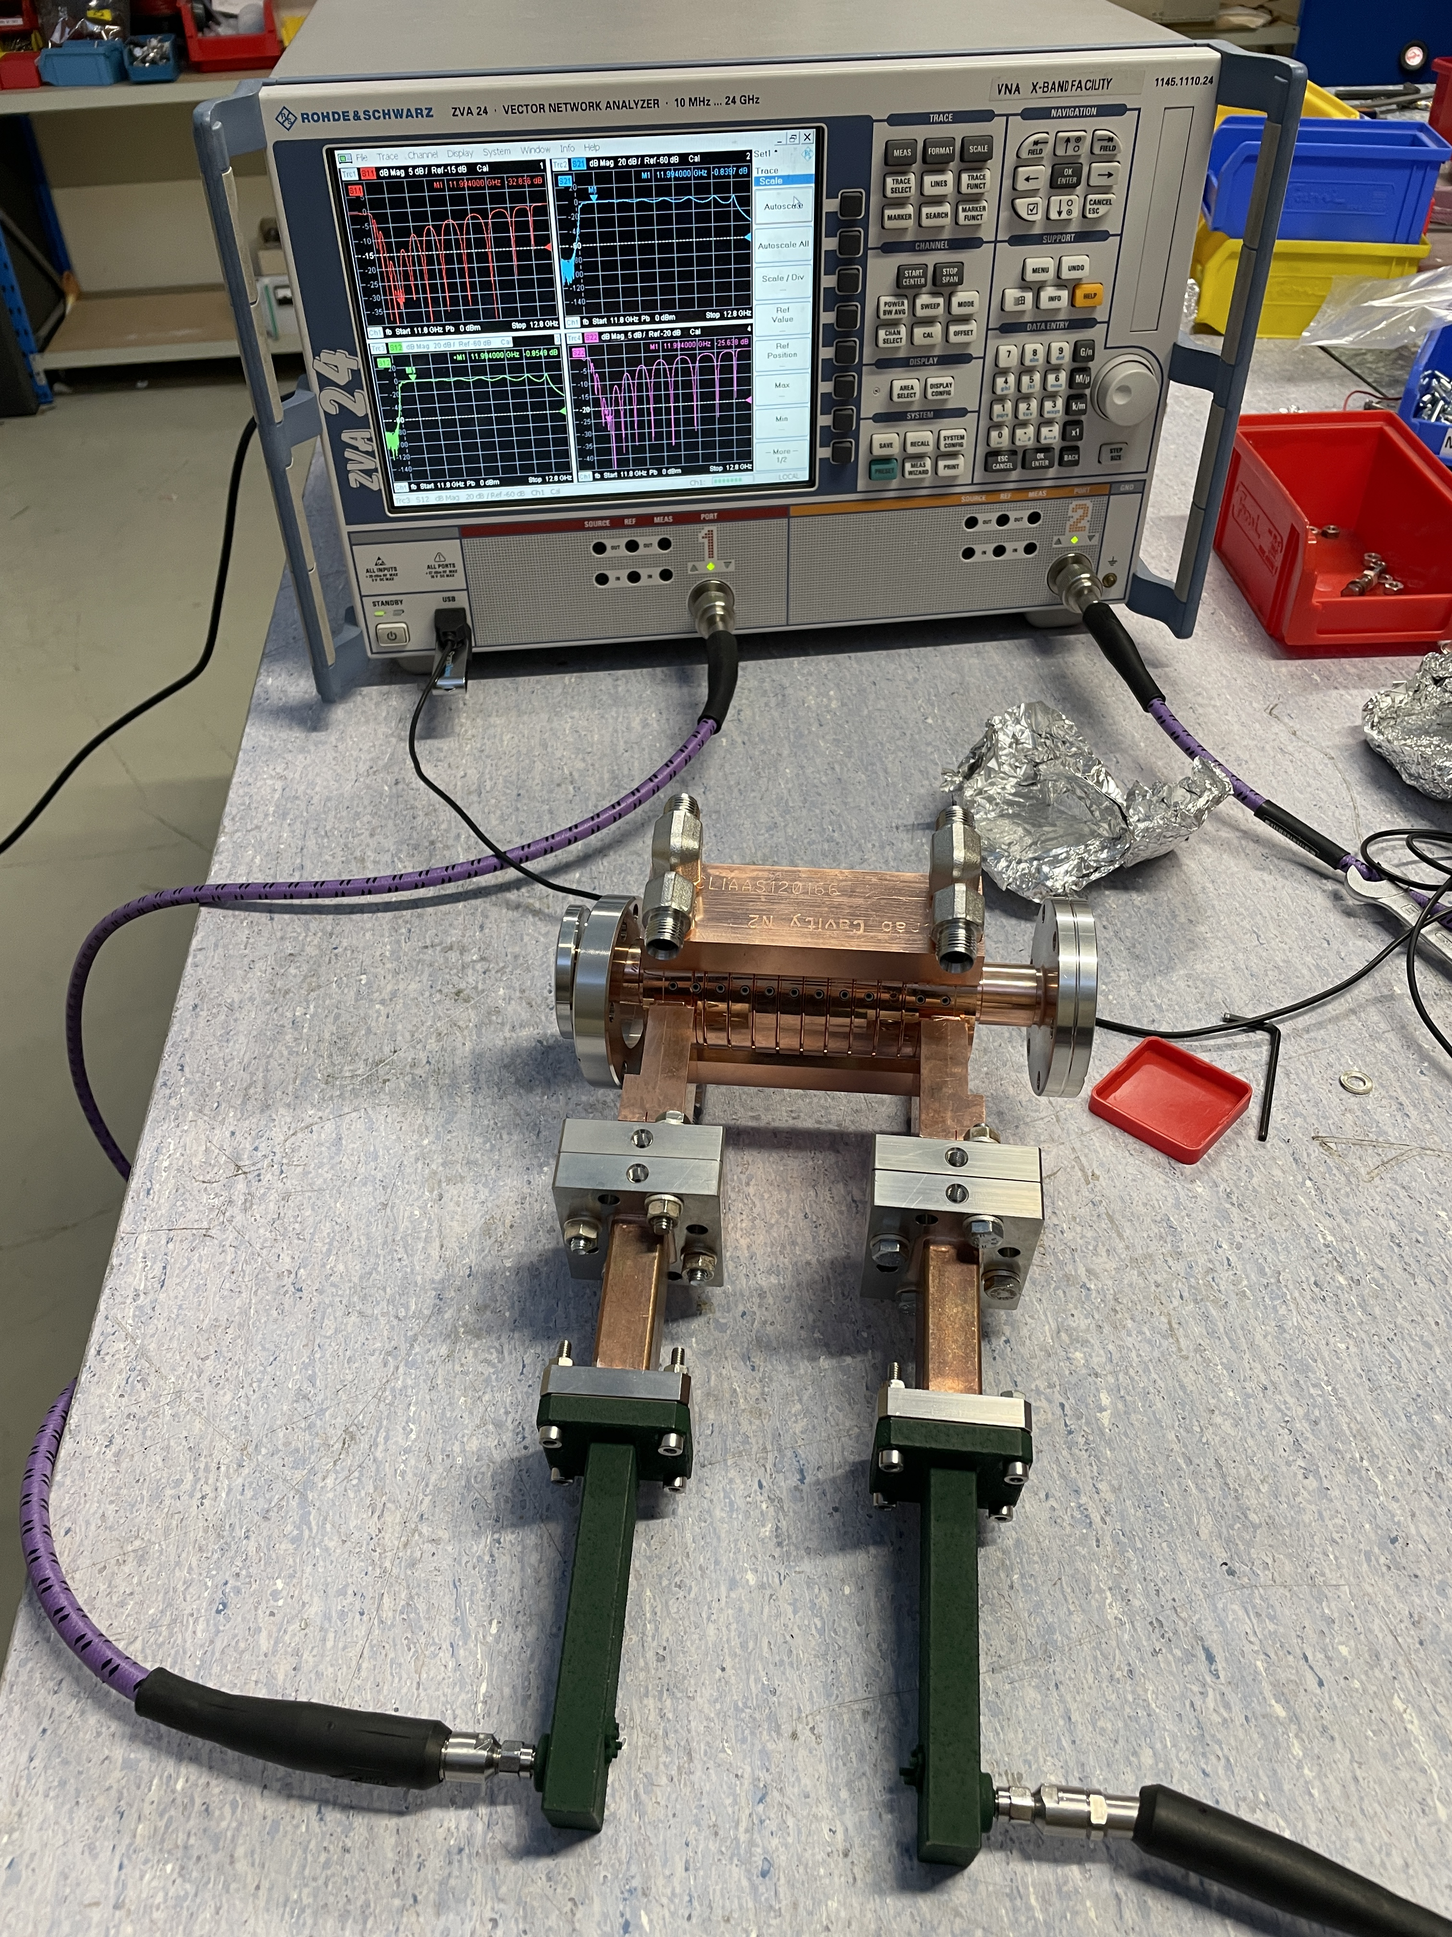
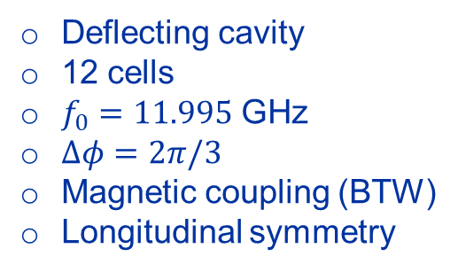
Crab cavity – S parameters measurement
Deflecting cavity
12 cells
$f_{0}=11.995$ GHz
$Δφ=2π/3$
Magnetic coupling (BTW)
Longitudinal symmetry

Slide 9
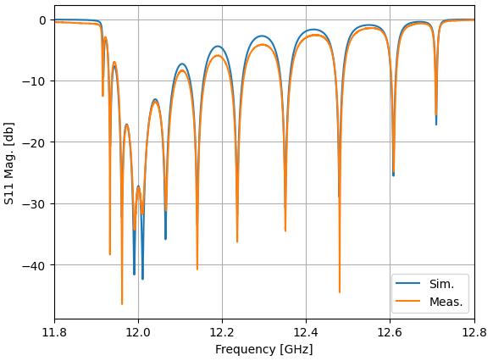
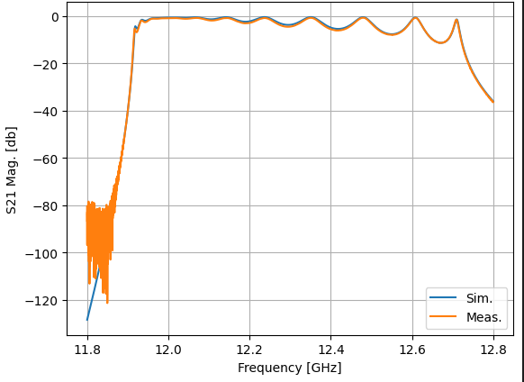
Crab cavity – S parameters measurement

Slide 11
X-Box 2: Reminder on BD classification
BD_Flag_PER_log
BD Load
TRUE
BD_Flag_DC_DOWN
DC Up >=140
DC Down>=100
BD DUT w. BDC
BD_Flag_DC_UP
FALSE
BD_Flag_PSR_log
BD DUT wo. BDC
BD_Flag_PKR_log
BD HyPC
No BD

