Slide 1


TD31 N3N4
October 2024
MARTINEZ REVIRIEGO, Pablo; ALONSO ARIAS, Paz
pablo.martinez.reviriego@cern.ch, paz.alonso.arias@cern.ch

Slide 2
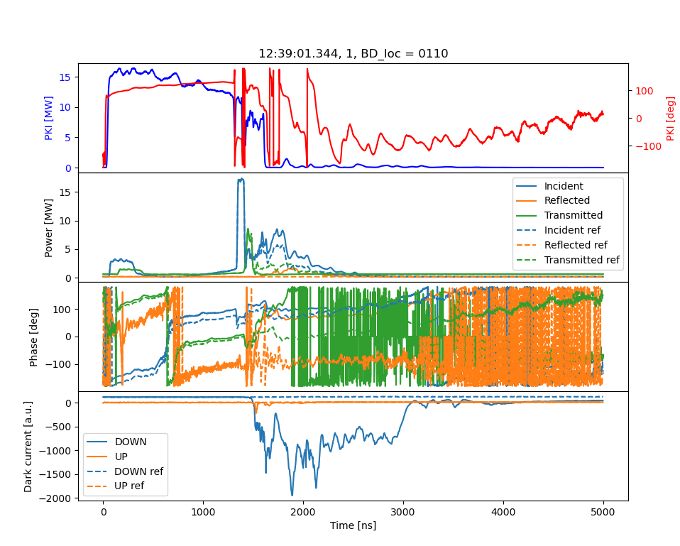
Some pulses

Slide 3
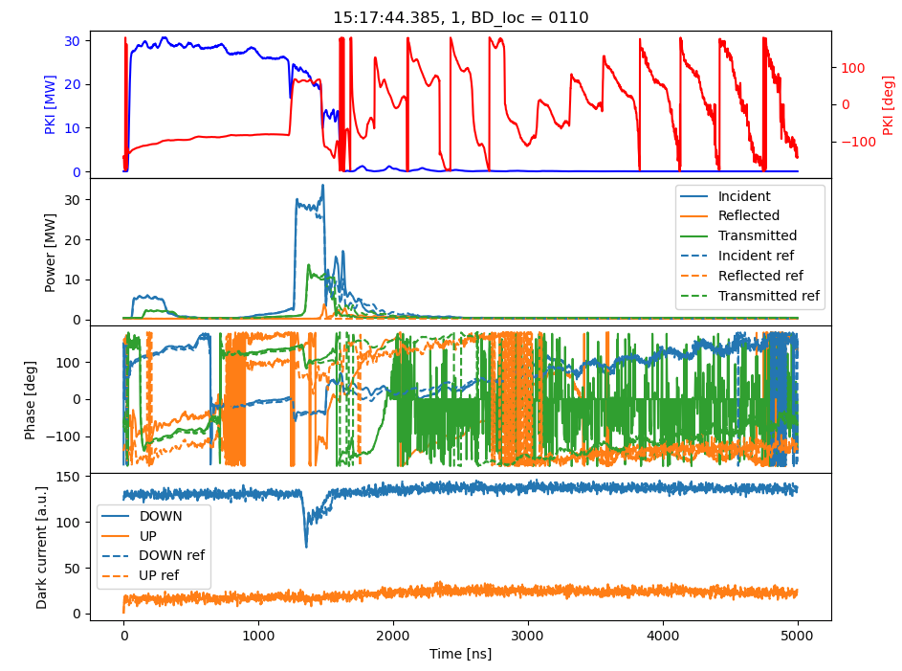
Some pulses

Slide 4
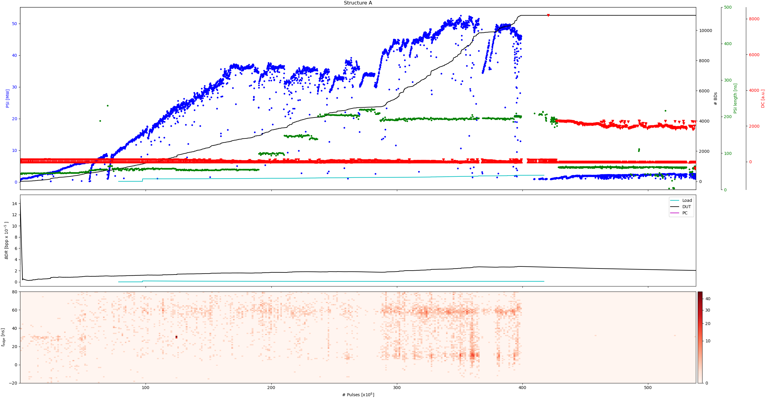
History plot A

Slide 5
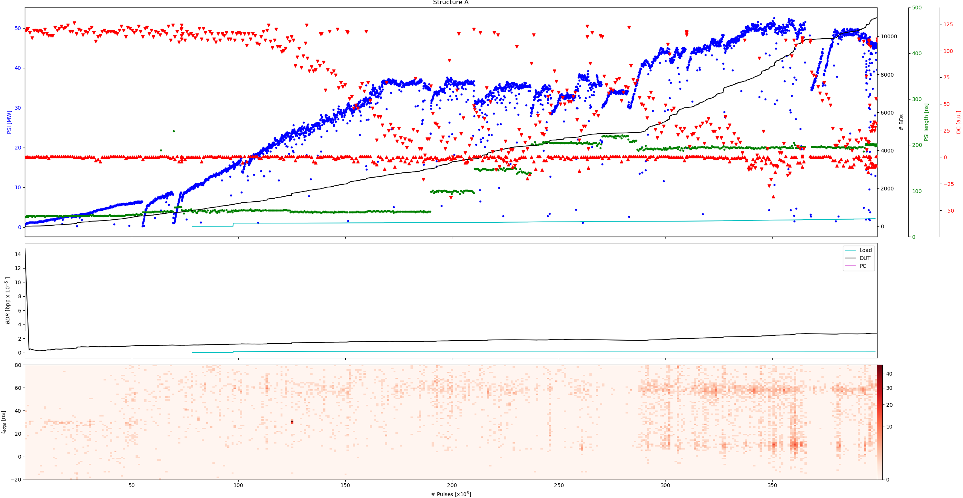
History plot A

Slide 6
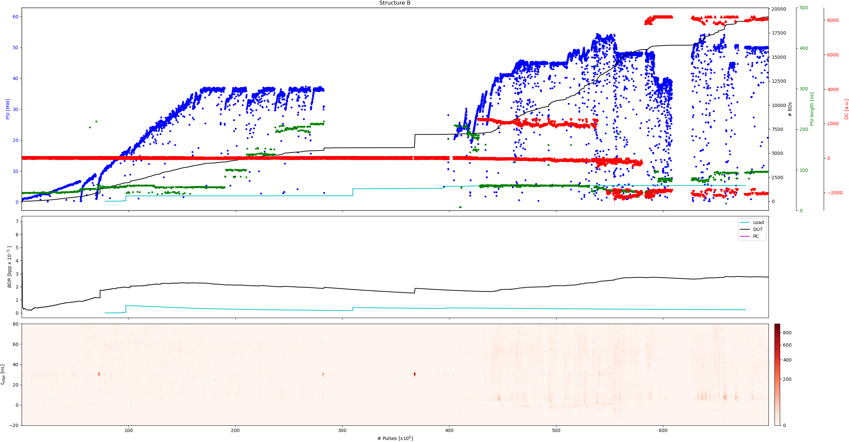
History plot B

Slide 7
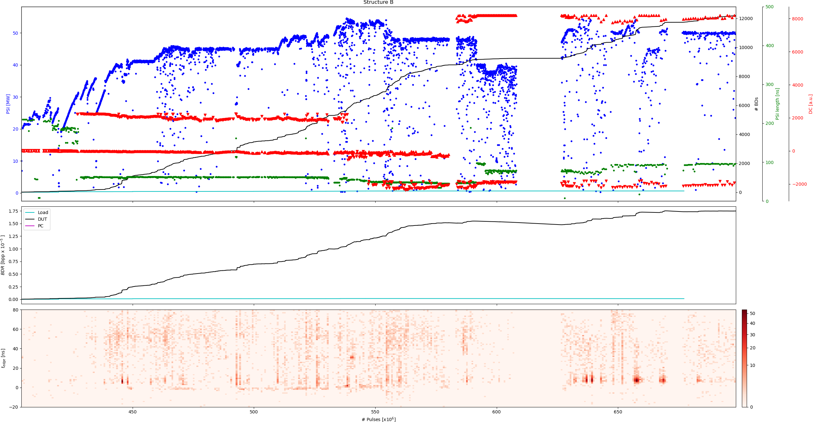
History plot B

Slide 8
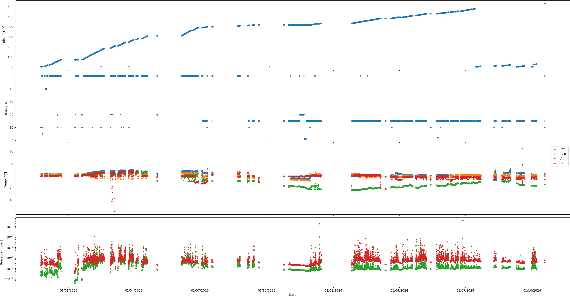
History settings

Slide 9
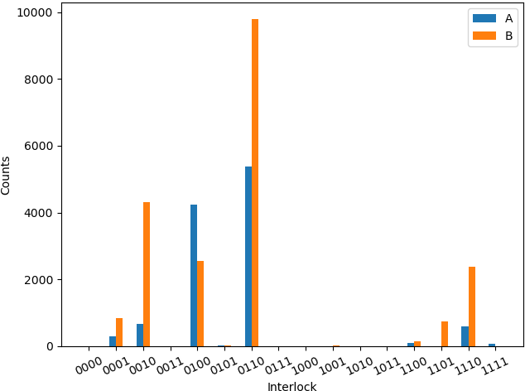
Interlocks
Bit | Interlock
0 | PER
1 | DC
2 | PSR
3 | PKR

Slide 10
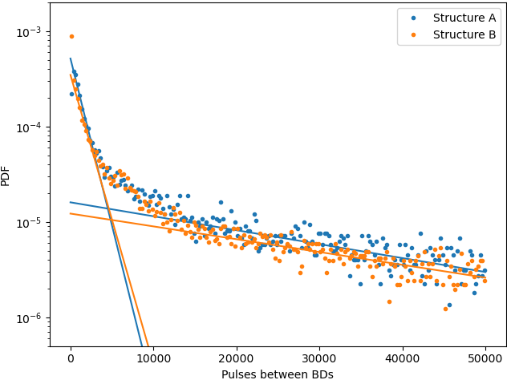
Pulses between BDs

Slide 11
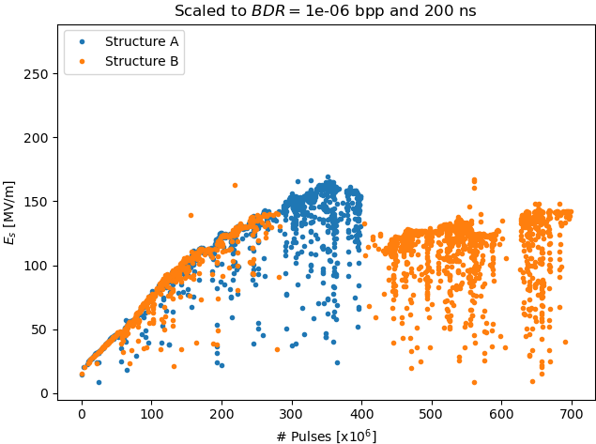
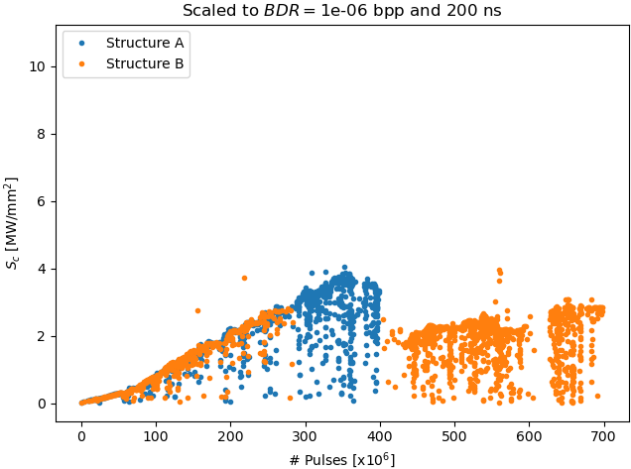
Conditioning history

Slide 12
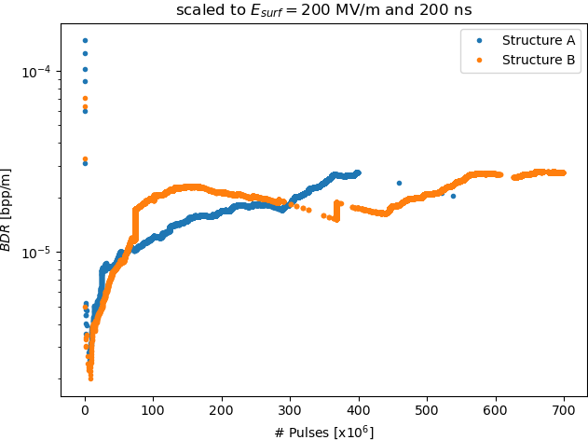
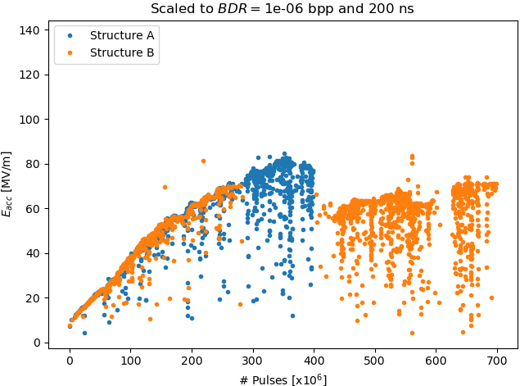
BDR evolution

Slide 13
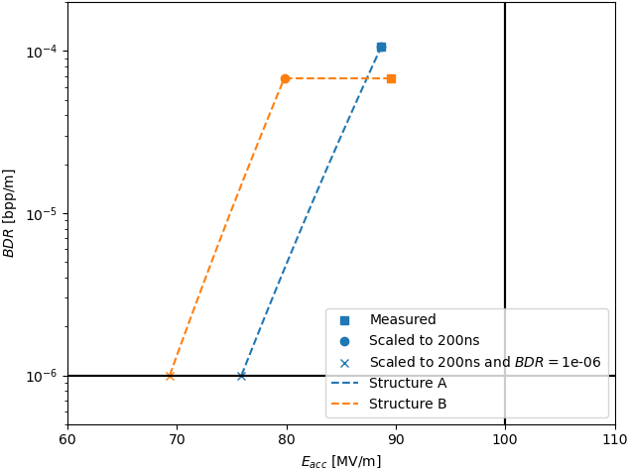
Final performance

