Slide 1
X-Box Summary
27.11.2024

Slide 2
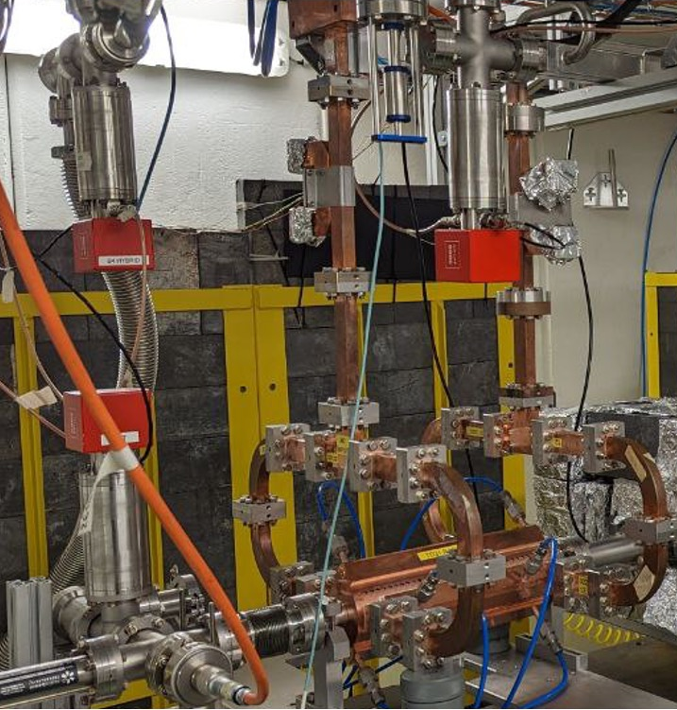
X-Box 2: TD31 N3 N4
X-Box 2 TD31 N3 N4: Structure B
Restarted after visit 18.10.2024
100:1 ratio, all power to Structure B
Pulse width 100ns
Changed pulse shape (Igor‘s request)
Fixed problem with pulse counter
  Saved old and corrected TDMS files
  Corrected PXI Pulse count.txt too
Running flat 50MW
  BDR 1e-5
Stopped – SU6 broken

Slide 3
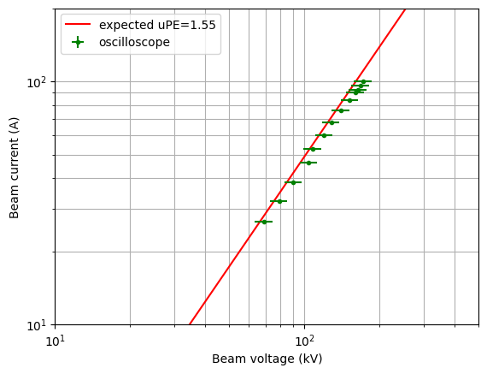
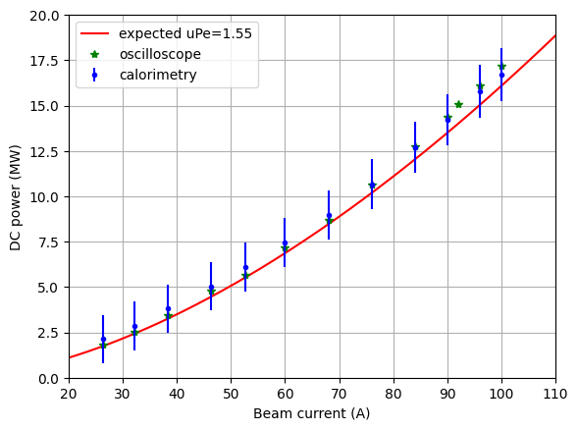
X-Box 3: HEK Measurements

Slide 4
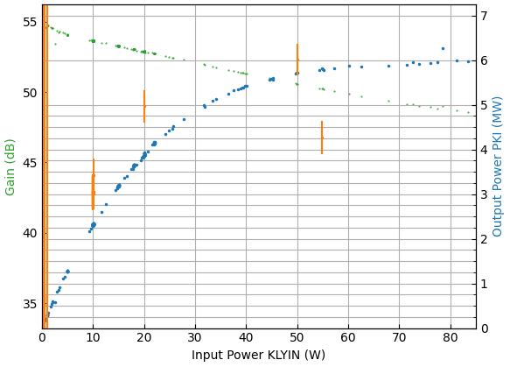
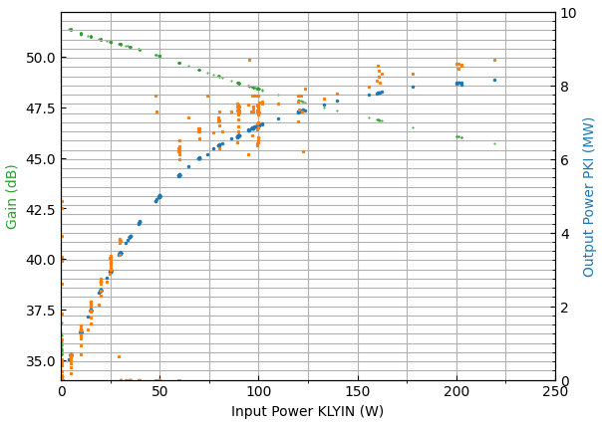
X-Box 3: HEK Measurements
Freq. shift 0MHz
Freq. shift -20MHz

Slide 5
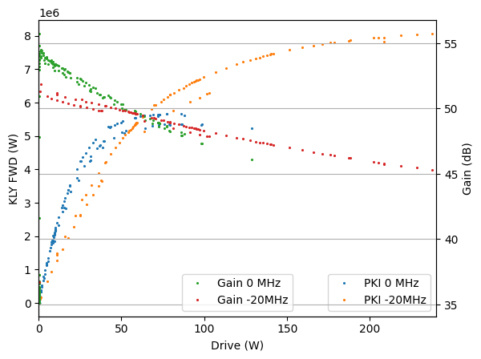
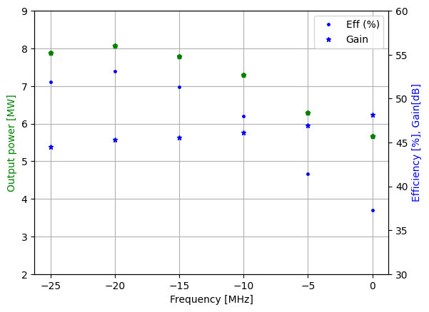
X-Box 3: HEK Measurements

Slide 7
X-Box 2: Reminder on BD classification
BD_Flag_PER_log
BD Load
TRUE
BD_Flag_DC_DOWN
DC Up >=140
DC Down>=100
BD DUT w. BDC
BD_Flag_DC_UP
FALSE
BD_Flag_PSR_log
BD DUT wo. BDC
BD_Flag_PKR_log
BD HyPC
No BD

