Slide 1


Simulations of Beam Wire Scanners’ thermal evolution and Investigating Carbon NanoTubes
Abdelrahman Abouelenain – Master Student at University Franche-Comte, France. 4 months internship in CERN SY-BI-PM
03/07/2024

Slide 2
Introduction
- BWS
- energy deposition
- thermal analysis SW tools
- SPS scan limits
- LHC beam halo
- CNT vs CF wire

Slide 3
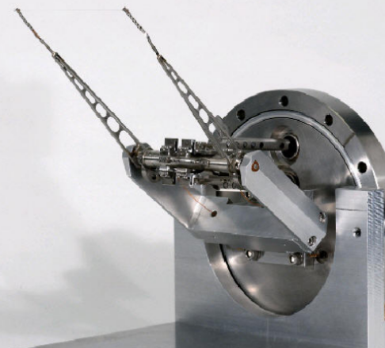
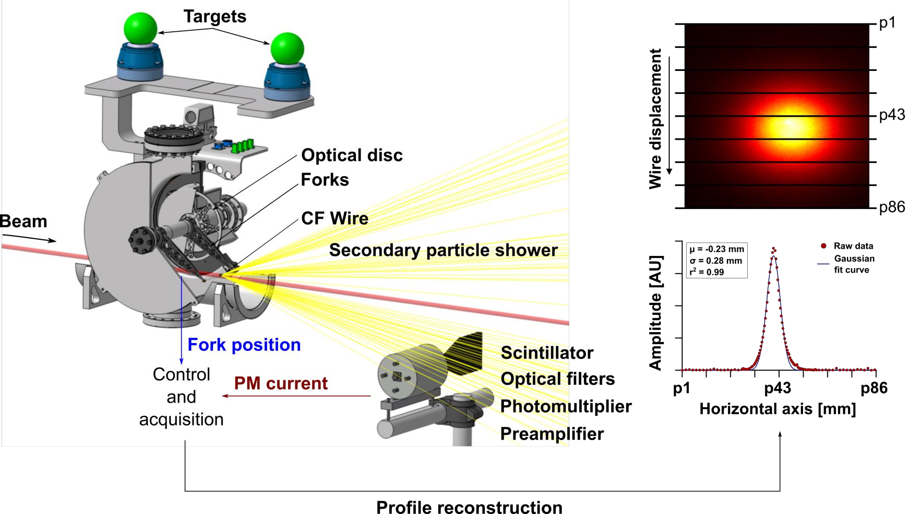
Beam Wire Scanners
Beam Wire Scanners (BWS) is a device used for beam transverse profile​ measurements.
Wires of diameter of few tens micrometers traverse the beam at high speed (typically 1 to 20 m/s).
Secondary particles generated by the beam-wire interaction traverse the beam pipe and are 'counted' (often by scintillator-PMT detectors).​
The transverse profile is reconstructed by combining the measurements of the wire position and the amount of secondary particles. These measurements are taken at synchronized time intervals during the scan.​
In many cases predicting the thermal response of the wires is essential to define operational limits and ensure wire survivability + measurements accuracy.

Slide 4
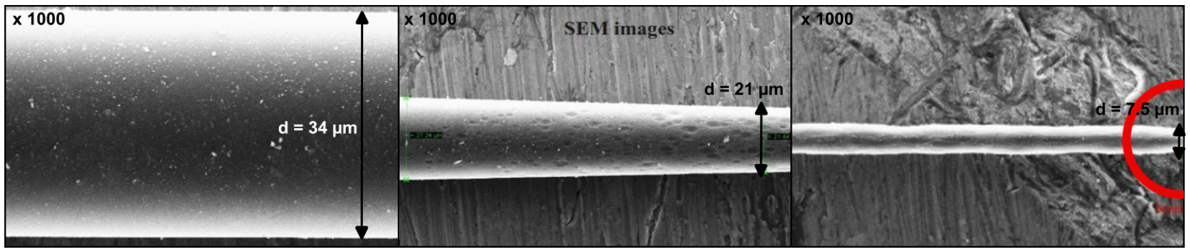
BWS Damage
Present ‘fast’ BWS are based on 34um diameter Carbon Fibers Wire (LINAC scanners also use 40um Tungsten) that might be damaged, sublimate, break.
A way has to be found to balance between having enough signal + scan resolution and minimize energy deposition and wire damage
For given beam conditions, the relevant BWS parameters to optimize are the wire material, geometry (diameter) and scan velocity.
Experiments have been done in 2010 on CF BWS damage showing the sublimation.
Scan speed [m.s⁻¹] | Momentum [GeV.c⁻¹ ] | Intensity [N_{p}] | σ_{l/t} [mm]
0.5 | 400 | 2.41 x 10¹³ | 0.57 / 0.73
0.5 mm away from impact
M. Sapinski, B. Dehning, A. Guerrero, J. Koopman, E. Metral, Carbon fiber breakage experiment on SPS, 2010
At the wire center

Slide 5
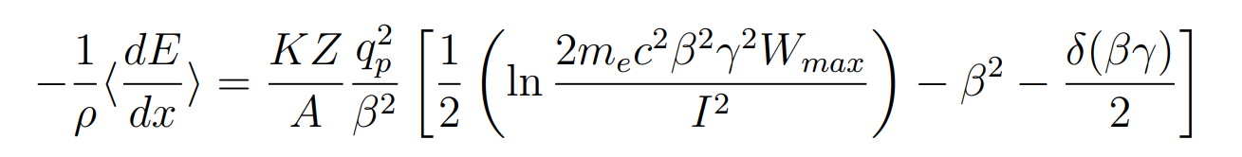
Energy deposition
Particle passage through matter energy loss in the material
Energy loss described by Bethe-Bloch formula
The loss depends on the type of the particle, target, particle’s energy
Stopping power for protons could be found on pstar database up to proton energy 10 GeV
For larger particle energy, Simulation codes like FLUKA has to be used
Stopping-Power & Range Tables for Electrons, Protons, and Helium Ions | NIST

Slide 6
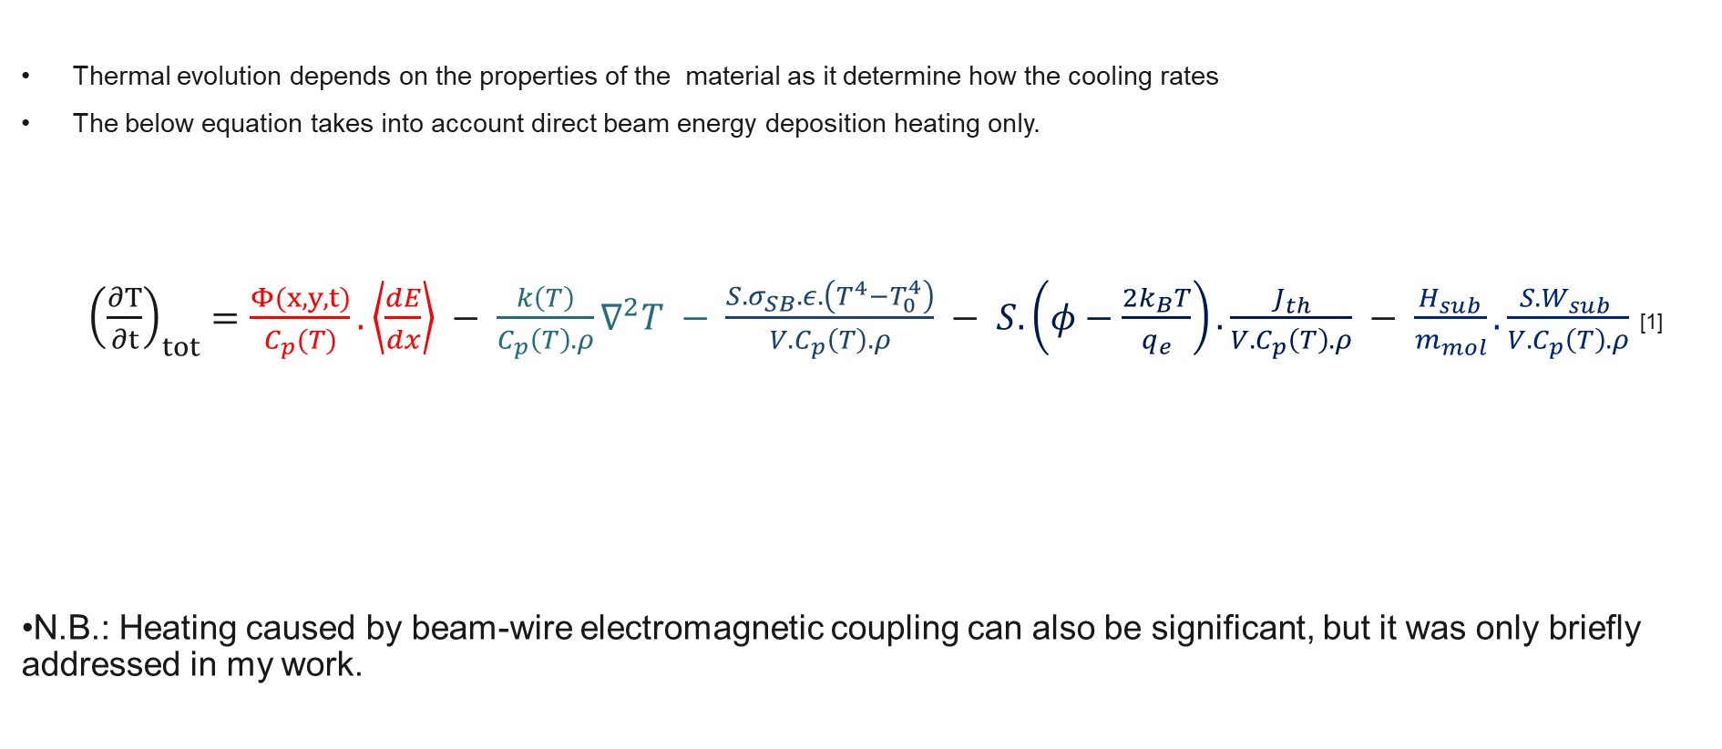
Heating equation
Thermal evolution depends on the properties of the material as it determine how the cooling rates
The below equation takes into account direct beam energy deposition heating only.
${\left(\frac{∂T}{∂t}\right)}_{tot}=\frac{Φ(x,y,t)}{C_{p}(T)}.\left\langle \frac{dE}{dx}\right\rangle − \frac{k\left(T\right)}{C_{p}\left(T\right).ρ}∇^{2}T − \frac{S.σ_{SB}.ε.\left(T^{4}−T_{0}^{4}\right)}{{V.C}_{p}\left(T\right).ρ} − S.\left(φ−\frac{2k_{B}T}{q_{e}}\right).\frac{J_{th}}{{V.C}_{p}\left(T\right).ρ} − \frac{H_{sub}}{m_{mol}}.\frac{S.W_{sub} }{{V.C}_{p}\left(T\right).ρ}$ [1]
N.B.: Heating caused by beam-wire electromagnetic coupling can also be significant, but it was only briefly addressed in my work.
Total temperature change rate
Beam heating:
Direct heating due to beam energy deposition
Conductive cooling:
Temperature gradient, has small effect due to BWS small diameter
Radiative cooling:
Thermal radiation. The dominant cooling process up to 2400 K.
Thermionic cooling:
Electron emitted when they acquire energy exceeding the works function. Dominant at high temperature.
Sublimation cooling:
Amount of the material get enough energy to sublimate. It is dominant if BWS is being sublimated
[1] A.Navarro Fernandez. Understanding Secondary Emission Processes and Beam Matter interactions for Optimization of Diagnostic Wire Grid System in Particle Accelerators. PhD thesis, Universitat Politecnica de Catalunya, September 2022.

Slide 7
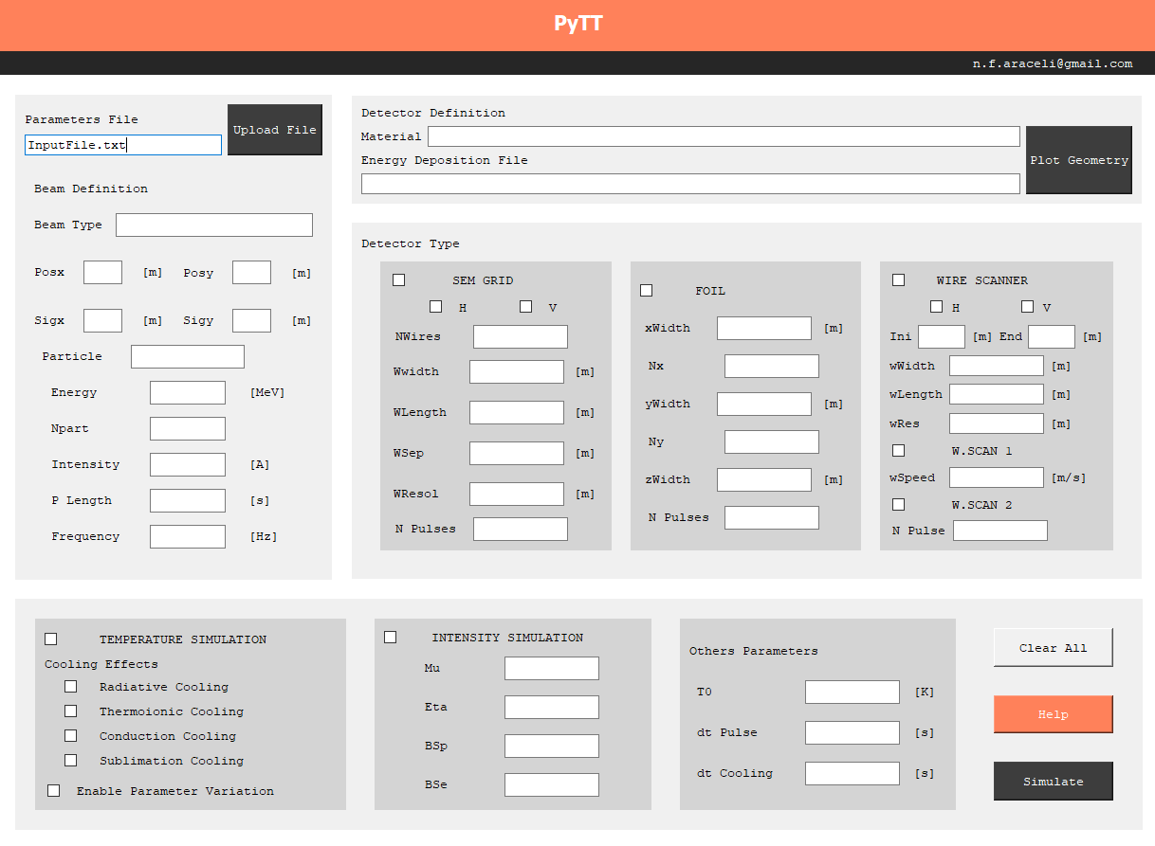
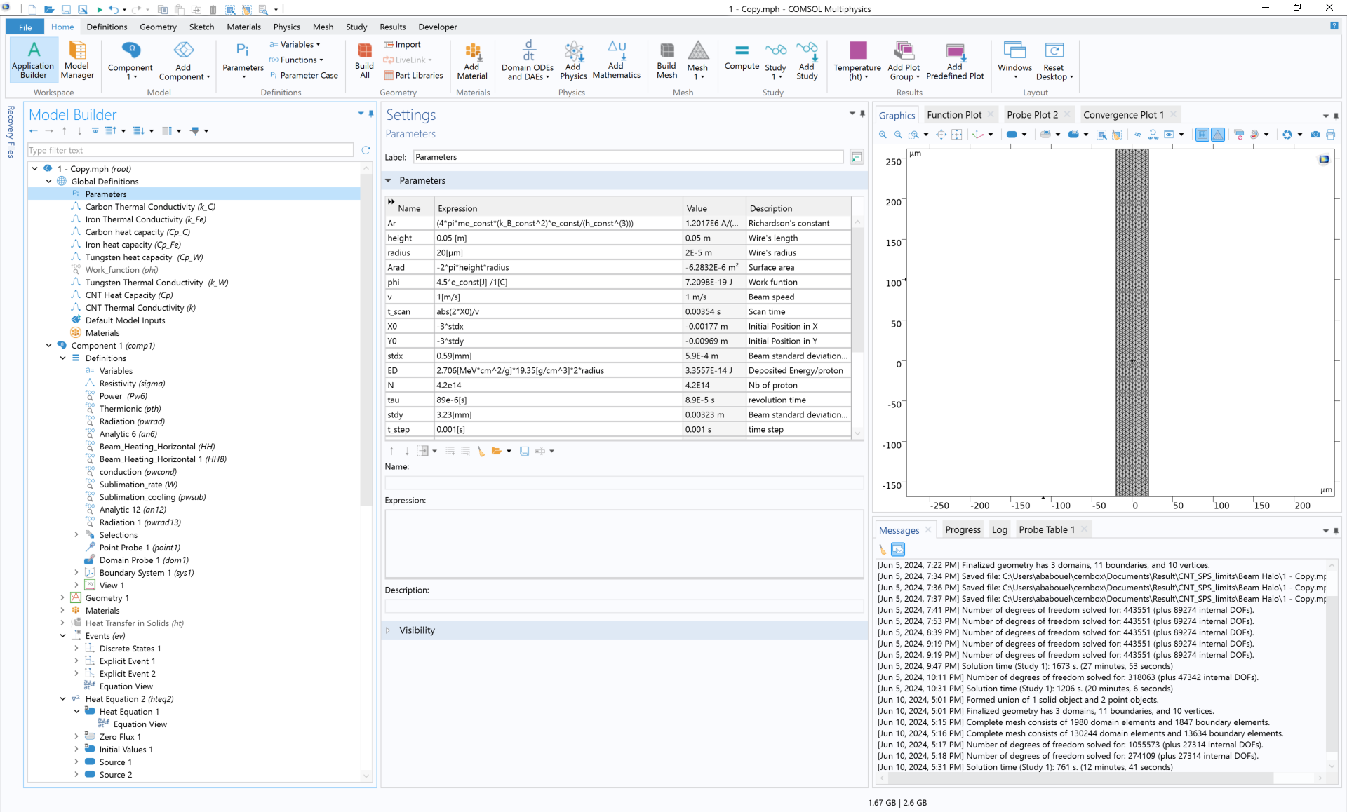
PyTT and COMSOL
FLUKA output (energy deposition) is used as input for thermal analysis.
In my master project work I used and compared two different thermal simulation tools, pyTT and COMSOL.
PyTT (Python Thin Target) is a custom-made python software made by M .Spaniski and A. Navarro Fernandez based on the finite difference method.
COMSOL Multiphysics is a commercial software based in finite element method.
Benchmark between the two SW.

Slide 8
‘Standard’ wires Simulation Results (selected examples)
Tungsten and Carbon fiber.

Slide 9
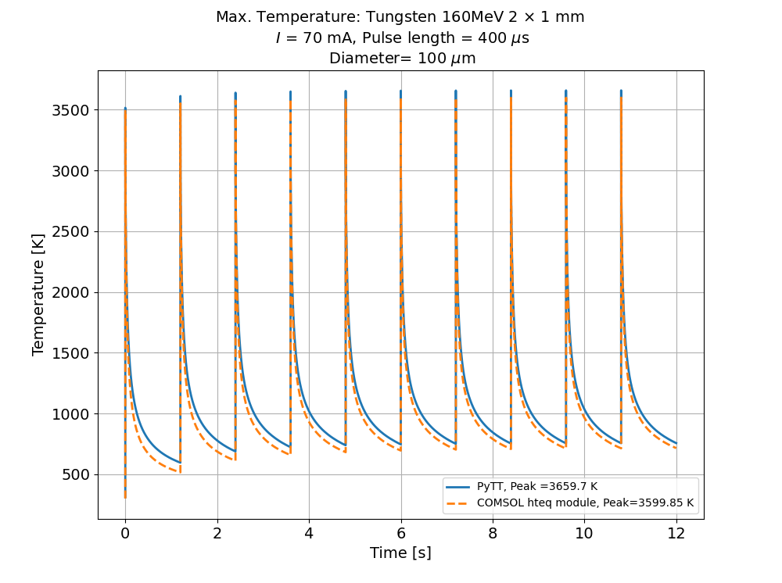
Tungsten wire heating in Linac 4
Some parameters are taken from Benjamin Cheymol’s thesis[1] which has a max temp of 5337 K!
The differences are
Cheymol hasn’t used the conductive cooling (still alone doesn’t make that difference )
The Energy deposited he used is unknown and the energy deposited here are taken from the Proton_Tungsten.txt in PyTT file
Parameters | Values
Beam energy | 160 MeV
Energy deposited by a proton | 2.706 MeV cm² /g
Wire's density | 19.35 g/cm³
Wire diameter | 100 um
Beam 𝜎_{x} | 2 mm
Beam 𝜎_{y} | 1 mm
Pulse length | 400 us
Beam current | 70 mA
Period between pulses | 1.2 sec
Scan direction | Horizontal
[1] Benjamin Cheymol. Development of beam transverse profile and emittance monitors or the CERN LINAC4. Thesis, UNIVERSITE CLERMONT-FERRAND II -BLAISE PASCAL, December 2011

Slide 10
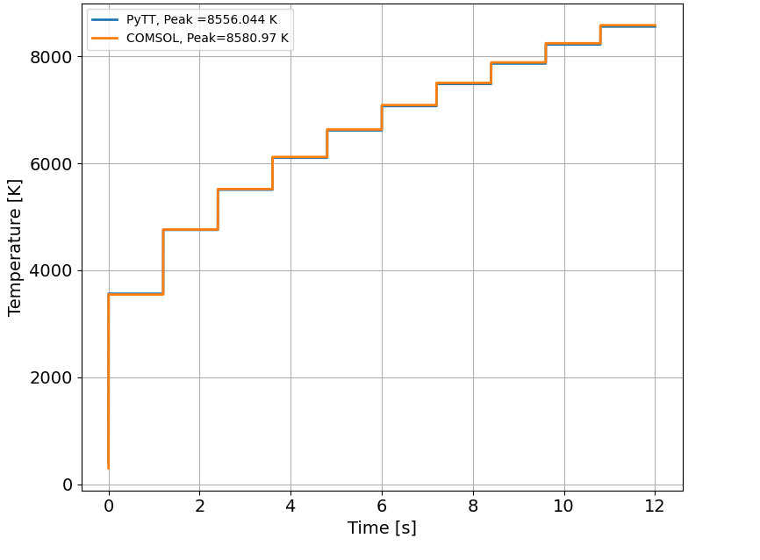
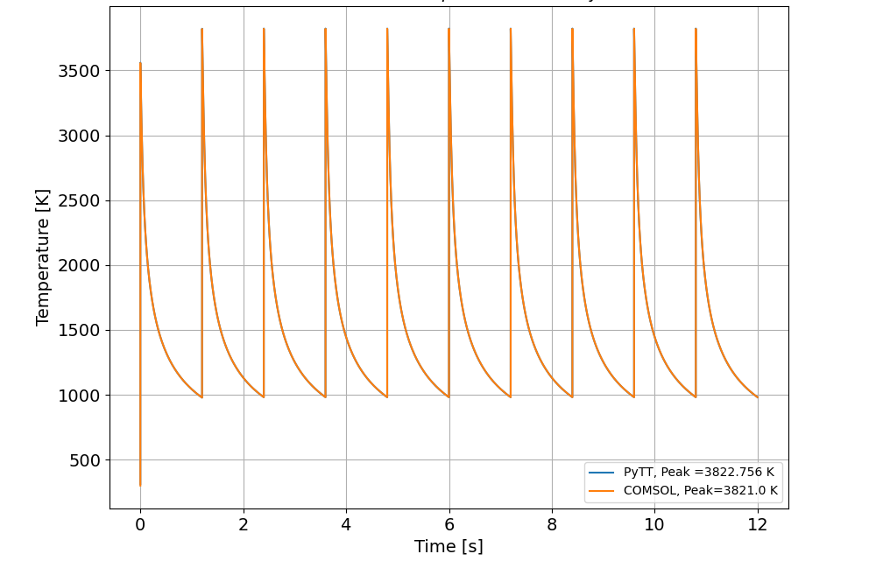
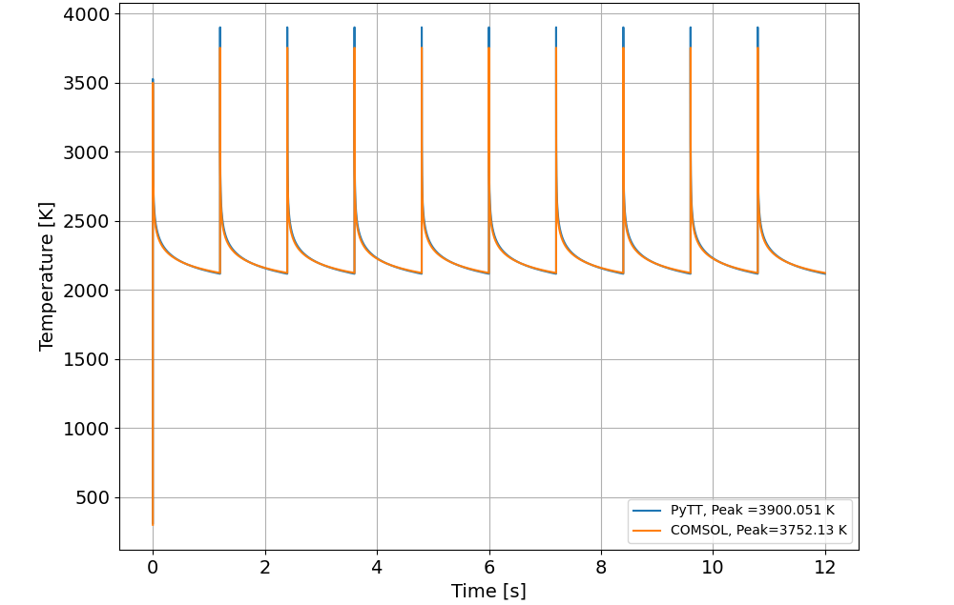
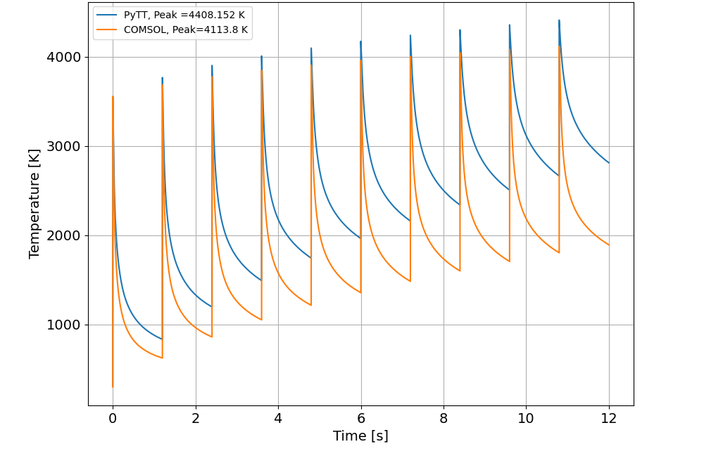
Cooling process in the Tungsten wire
Beam heating
Radiative cooling
Compared comsol and pytt by looking at heating and cooling separately.
    Here each one of the cooling processes is examined alone for the case in the previous slide
    The heating without cooling showed the same behavior in the two simulation.
    The same for the radiative cooling.
    The Thermionic cooling process show the same behavior as PyTT.
    The conductive cooling in COMSOL is stronger than PyTT .
Thermionic cooling
Conductive cooling

Slide 11
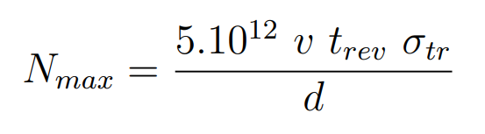
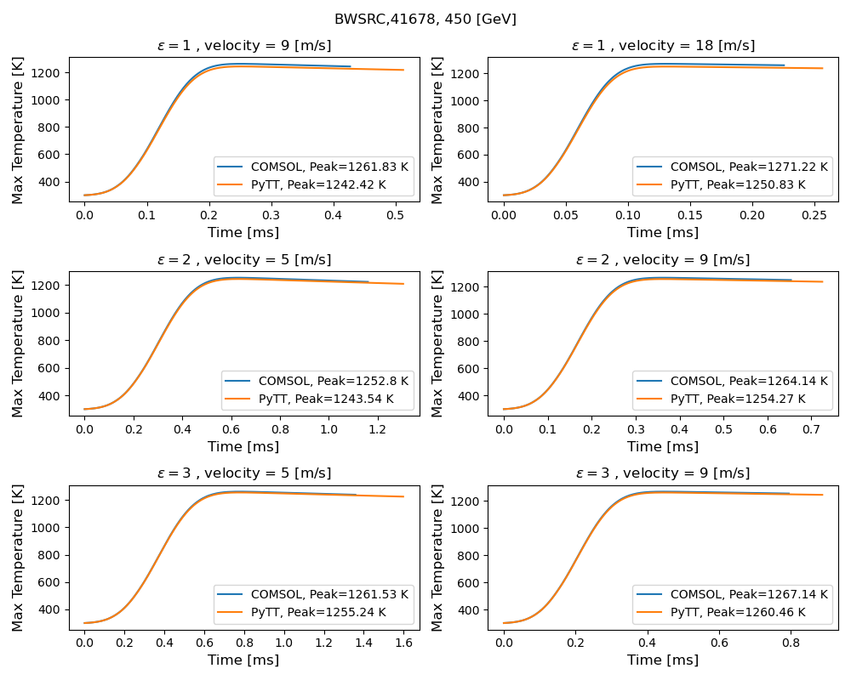
SPS safe scan limits
Four CF BWS in SPS are being tested for new suggested for safe scan limits at energy 450 GeV.
BWSRC 41677, 41678, 51637 and 51638.
BWSRC 41678 is shown in this slide.
All of the four BWS reached a maximum temperature in range between 1250 K to 1272 K
These temperatures should be safe for scanning, but do not count for ‘indirect’ EM coupling between the wire and the beam.
COMSOL and PyTT showed the same results.
σ_{x} [mm] | σ_{y} [mm] | Speed [m/s] | N_{max} [E+13]
0.318381598 | 0.384452997 | 9 | 1.1
0.318381598 | 0.384452997 | 18 | 2.2
0.450259574 | 0.543698642 | 5 | 0.86
0.450259574 | 0.543698642 | 9 | 1.55
0.551453104 | 0.665892124 | 5 | 1.06
0.551453104 | 0.665892124 | 9 | 1.90

Slide 12
Temperature behavior at Beam Halo
  Can a wire be used for beam halo measurments at LHC ? Ideas is to put it at a certain fixed distance from the beam center (expressed in 'sigmas') and what is the equilibrium temperature for certain beam size and beam intensity
  I simulated wire thermal response when placed at different sigmasσ(beam size ) from the beam center
  BWS is fixed and intercepting Beams of energy 7 TeV, but different sizes :
  200 um
  300 um
  400 um
  The relation between the temperature at thermal equilibrium and the beam size

Slide 13
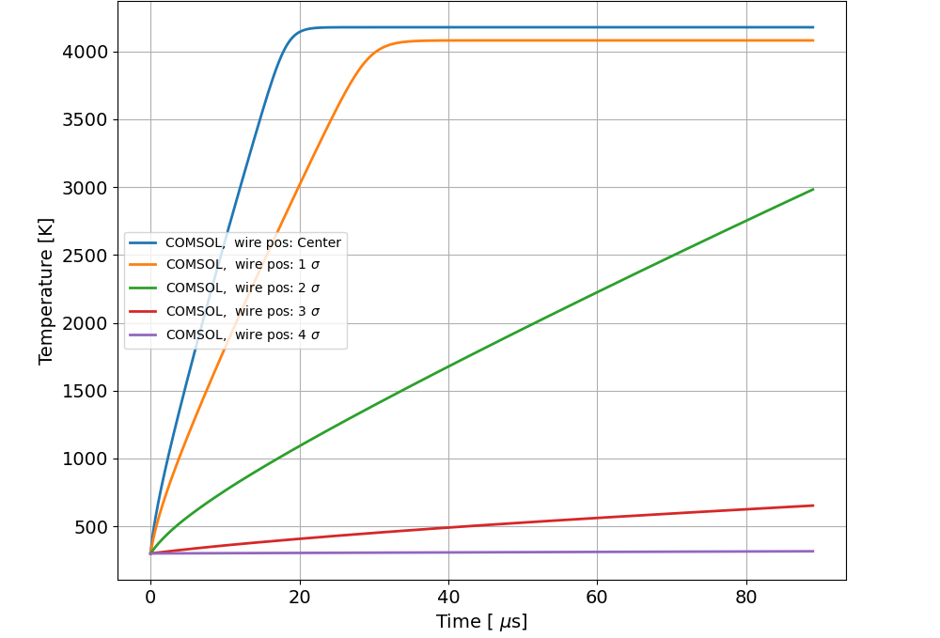
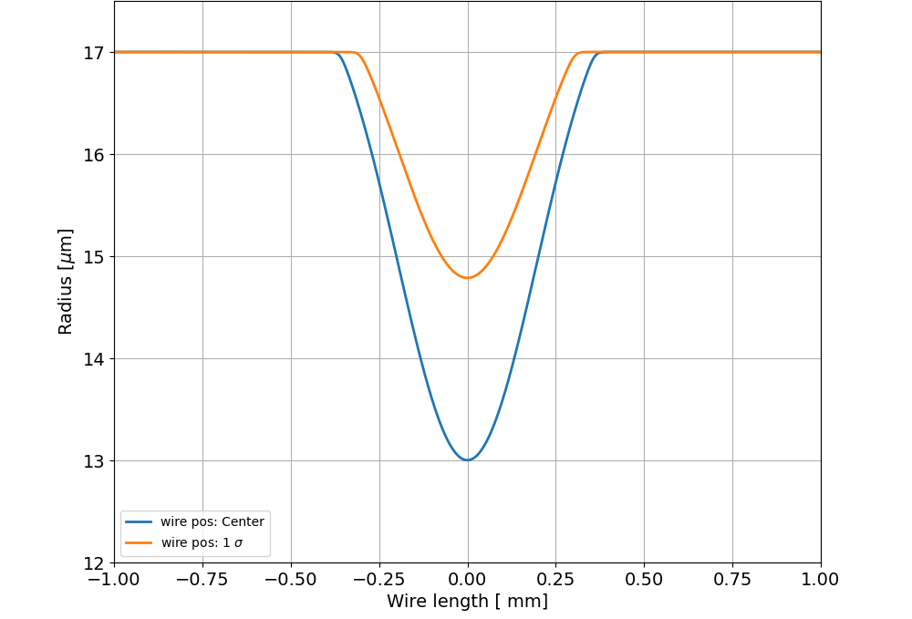
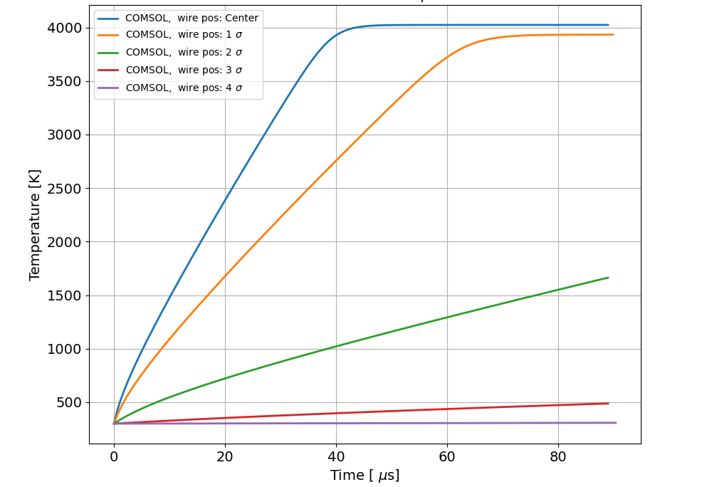
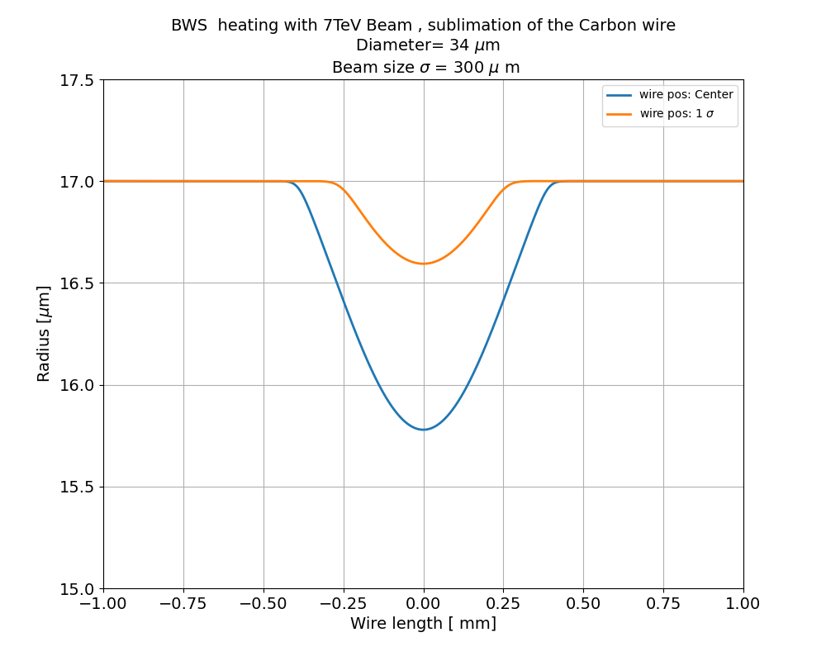
Wire for Beam Halo: Wire @ different positions
Beam size 200 um
BWS is put for different positions for one revolution time interacting with LHC beam.
BWS sublimates at wire center and a distance sigma for two beam sizes (200,300) um.
BWS shouldn’t be put the beam center.
Parameters | Values
Beam energy | 7 TeV
Wire's density | 1.8 g/cm³
Wire diameter | 34 um
Revolution time 𝜏 | 89 us
Protons in the beam | 4.2 × 10¹⁴
Beam size 300 um

Slide 14
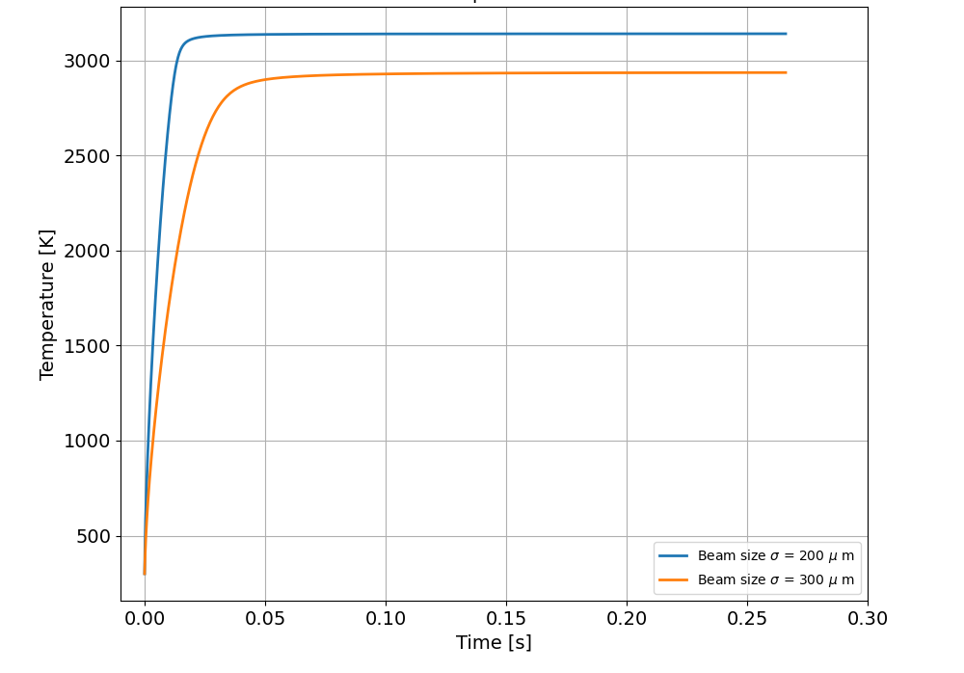
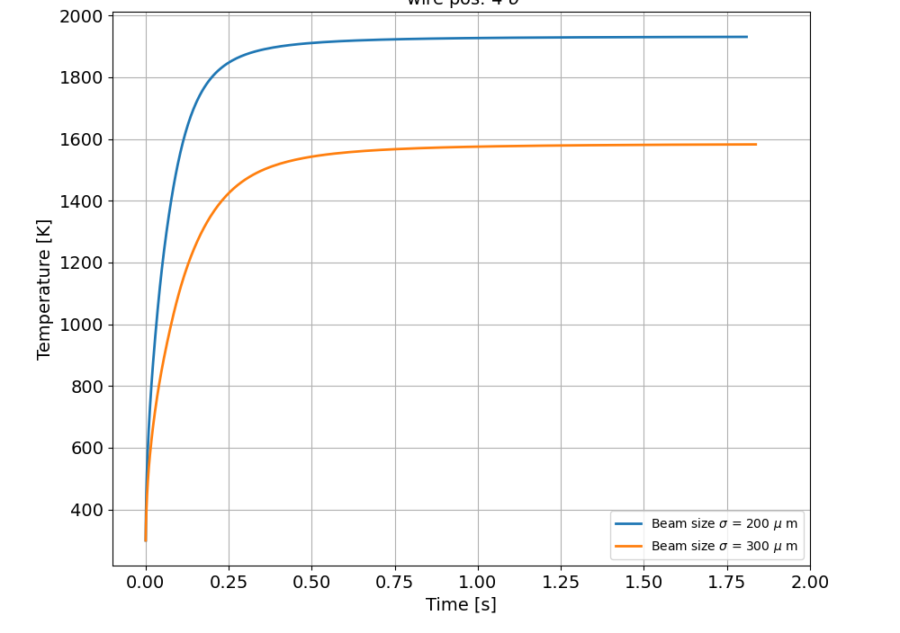
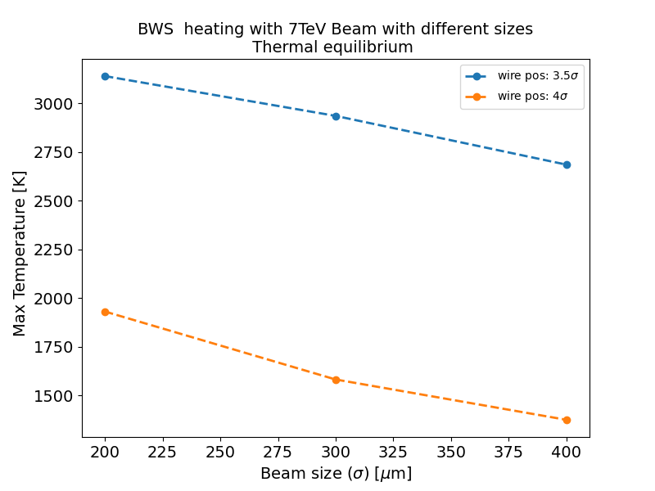
Wire for Beam Halo: Equilibrium temperatures:
The interest are in positions 3.5 and 4 sigmas from the beam center.
The thermal equilibrium reached at position 4 sigma is much lower than that of 3.5 sigma and at much later time.
The results suggested that BWS at 4 sigma could be safe

Slide 15
Simulation with Carbon Nano Tubes (CNT)

Slide 16
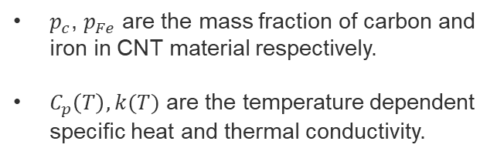
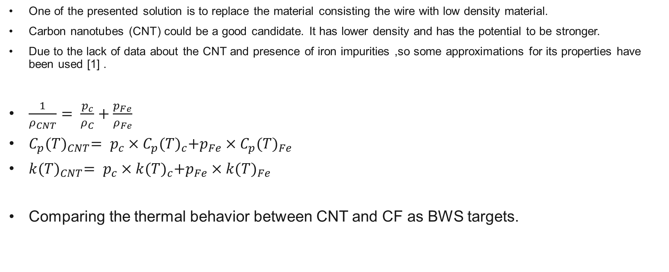
Carbon nanotubes
One of the presented solution is to replace the material consisting the wire with low density material.
Carbon nanotubes (CNT) could be a good candidate. It has lower density and has the potential to be stronger.
Due to the lack of data about the CNT and presence of iron impurities ,so some approximations for its properties have been used [1] .
$\frac{1}{ρ_{CNT}}= \frac{p_{c}}{ρ_{C}}+\frac{p_{Fe}}{ρ_{Fe}}$
$C_{p}{(T)}_{CNT}= p_{c}×C_{p}{(T)}_{c}+p_{Fe}×C_{p}{(T)}_{Fe}$
$k{(T)}_{CNT}= p_{c}×k{(T)}_{c}+p_{Fe}×k{(T)}_{Fe}$
Comparing the thermal behavior between CNT and CF as BWS targets.
$p_{c}$, $p_{Fe}$ are the mass fraction of carbon and iron in CNT material respectively.
$C_{p}\left(T\right), k(T)$ are the temperature dependent specific heat and thermal conductivity.
[1] Alexandre MARIET. Study of the effects of copper-coating and proton irradiation at 440 GeV on the mechanical properties of carbon nanotube wires for particle beam. PhD thesis, University of Bourgogne Franche-Comté, May 2023.

Slide 17
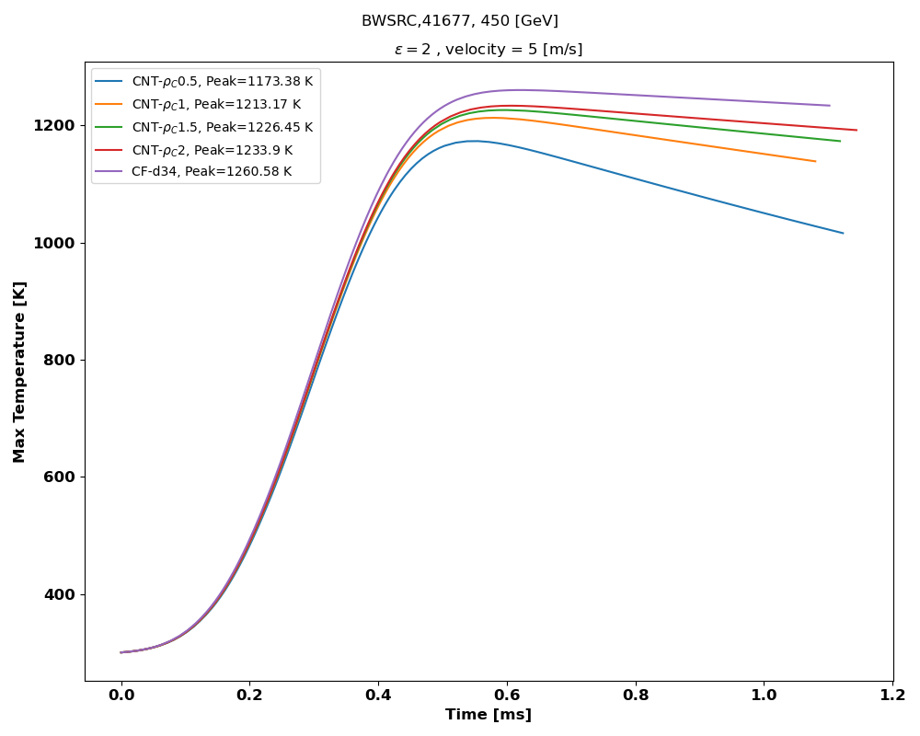
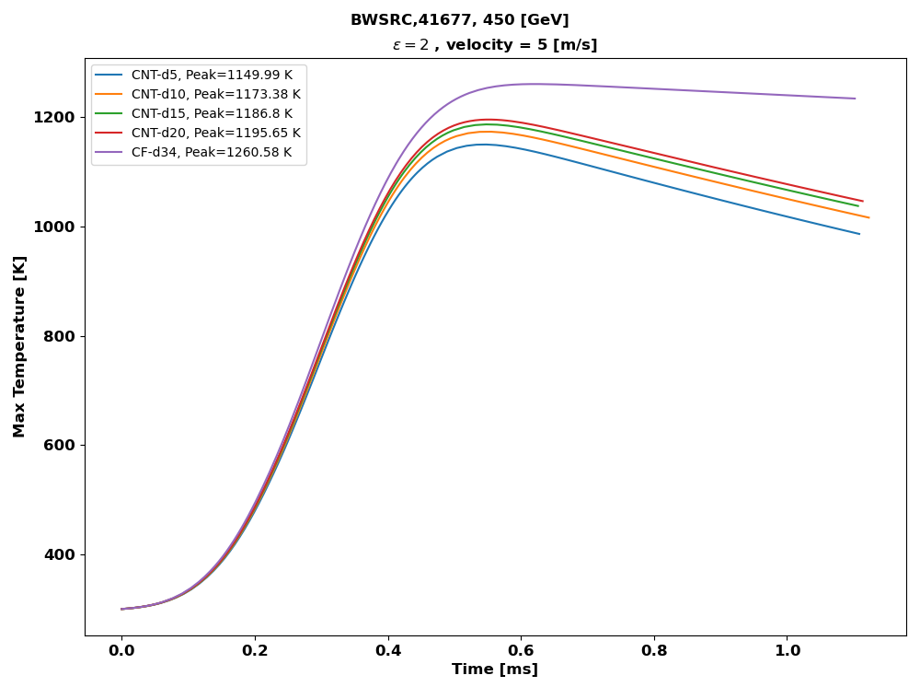

SPS safe scan limits
Diameter = 10μm
Different CNT wires are simulated for BWSRC, 41677 SPS safe scan operation.
The cooling processes are more effective in CNT wires due to the decrease of the density and the diameter.
The CNT wires’ maximum temperature reached also is lower.
$$ρ_{C}=0.5 g/{cm}^{3}$$
σ_{x} [mm] | σ_{y} [mm] | Speed [m/s] | N_{max} [E+13]
0.456595916 | 0.536565283 | 5 | 0.88

Slide 18
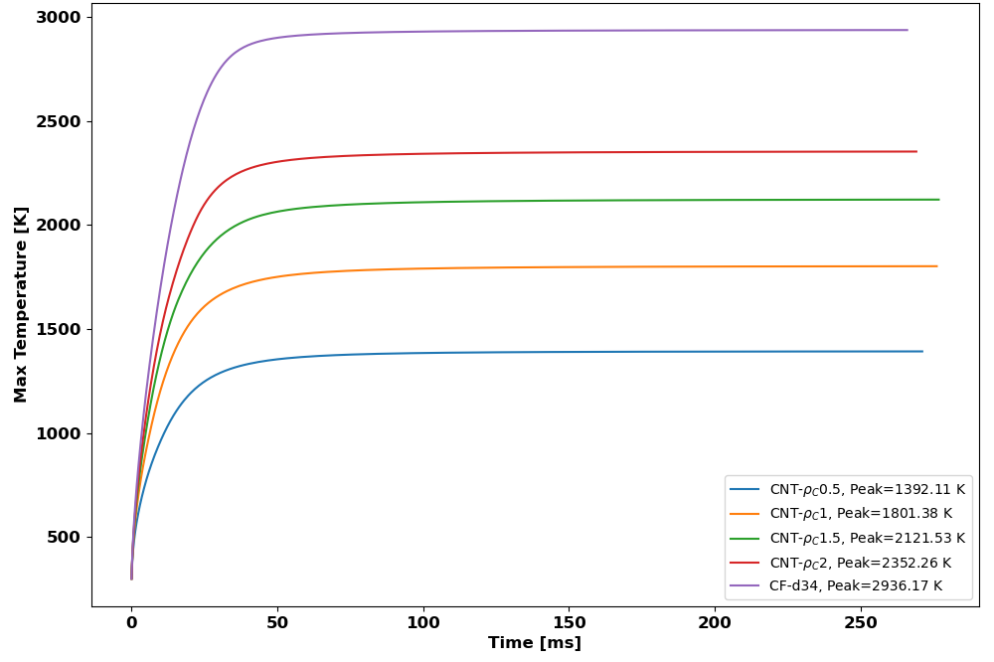
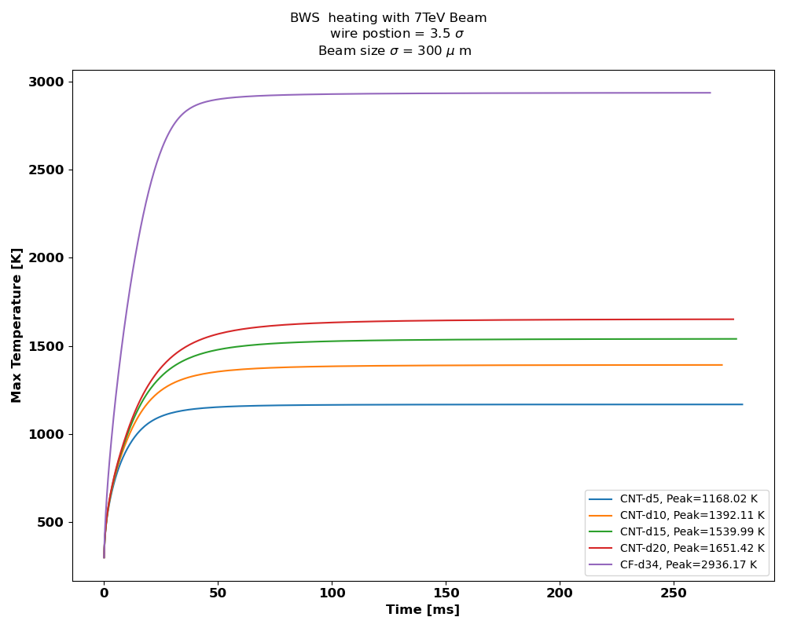

CNT wire at the beam Halo
Diameter = 10μm
  The simulations showed the advantage of CNT wires over CF in the Beam Halo application.
  The simulation are done for position 3.5 sigma for a beam size of 300 μm
  The maximum temperature reached for CNT is much lower than the temperature reached for CF wire.
  CNT could provide a safe operation at distance 3.5 sigma .
$$ρ_{C}=0.5 g/{cm}^{3}$$

Slide 19
Conclusion
A 2D COMSOL model has been built for the thermal evolution for BWS.
Benchmarking with the custom-made PyTT showed similar results.
Simulations showed that a new suggested operational scan limits in SPS are successful for BWS safety.
A preliminary study for BWS for LHC beam halo monitoring applications with different beam sizes and BWS positions suggesting a safe position of 4σ.
Various CNT wires have been tested with different densities and diameters for previous applications.
They showed encouraging advantages of low-density materials over the currently used CF.
All the result excluding the indirect heating effect of electromagnetic coupling between the beam and BWS.

Slide 20
Prospectives
Simulate the RF coupling between the beam and BWS, and examine its thermal
effects to fully understand BWS wire thermal evolution during operation.
Conduct a more detailed study of the beam halo and beam profile, including the
beam halo shape, for a more accurate thermal behavior of BWS.
Carry out experimental studies on the work function and emissivity of carbon fiber
and CNT, along with other CNT properties.
Develop a 3D COMSOL model where cooling processes other than conductive cool-
ing are treated as surface boundary cooling processes, rather than as a heat sink
in less dimensional models.

Slide 21
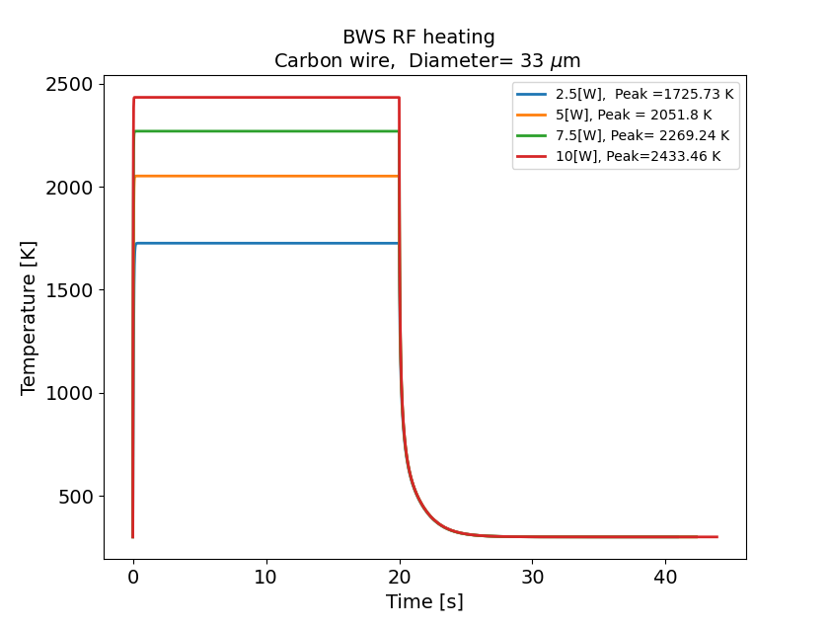
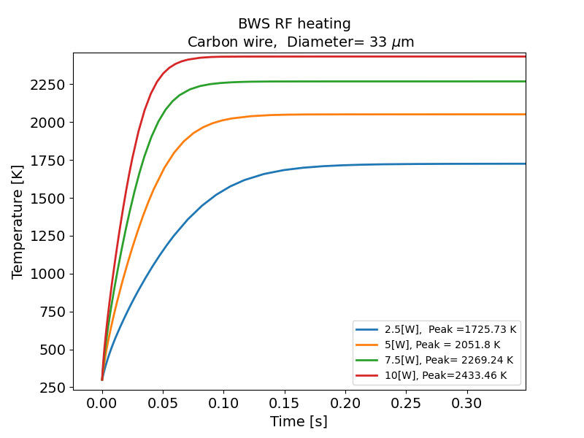
RF heating in SPS
Here are some of values of the heating power due to RF coupling are given.
The temperatures due to those powers are overestimated compared to the temperature obtained from observed data
Zooming in

