Slide 1

Muon Performance Study
Yongwen Zheng
Kevin Nelson
6/27/24

Slide 2
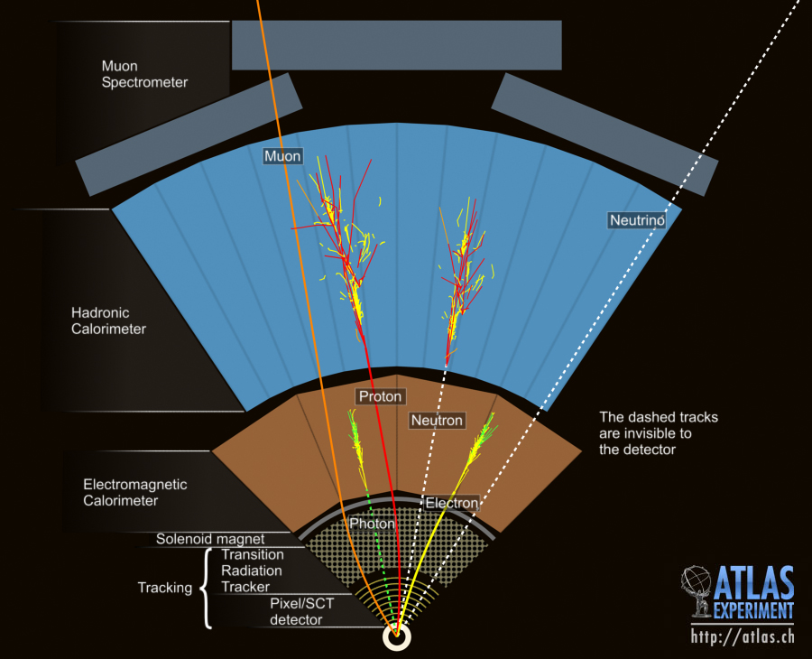
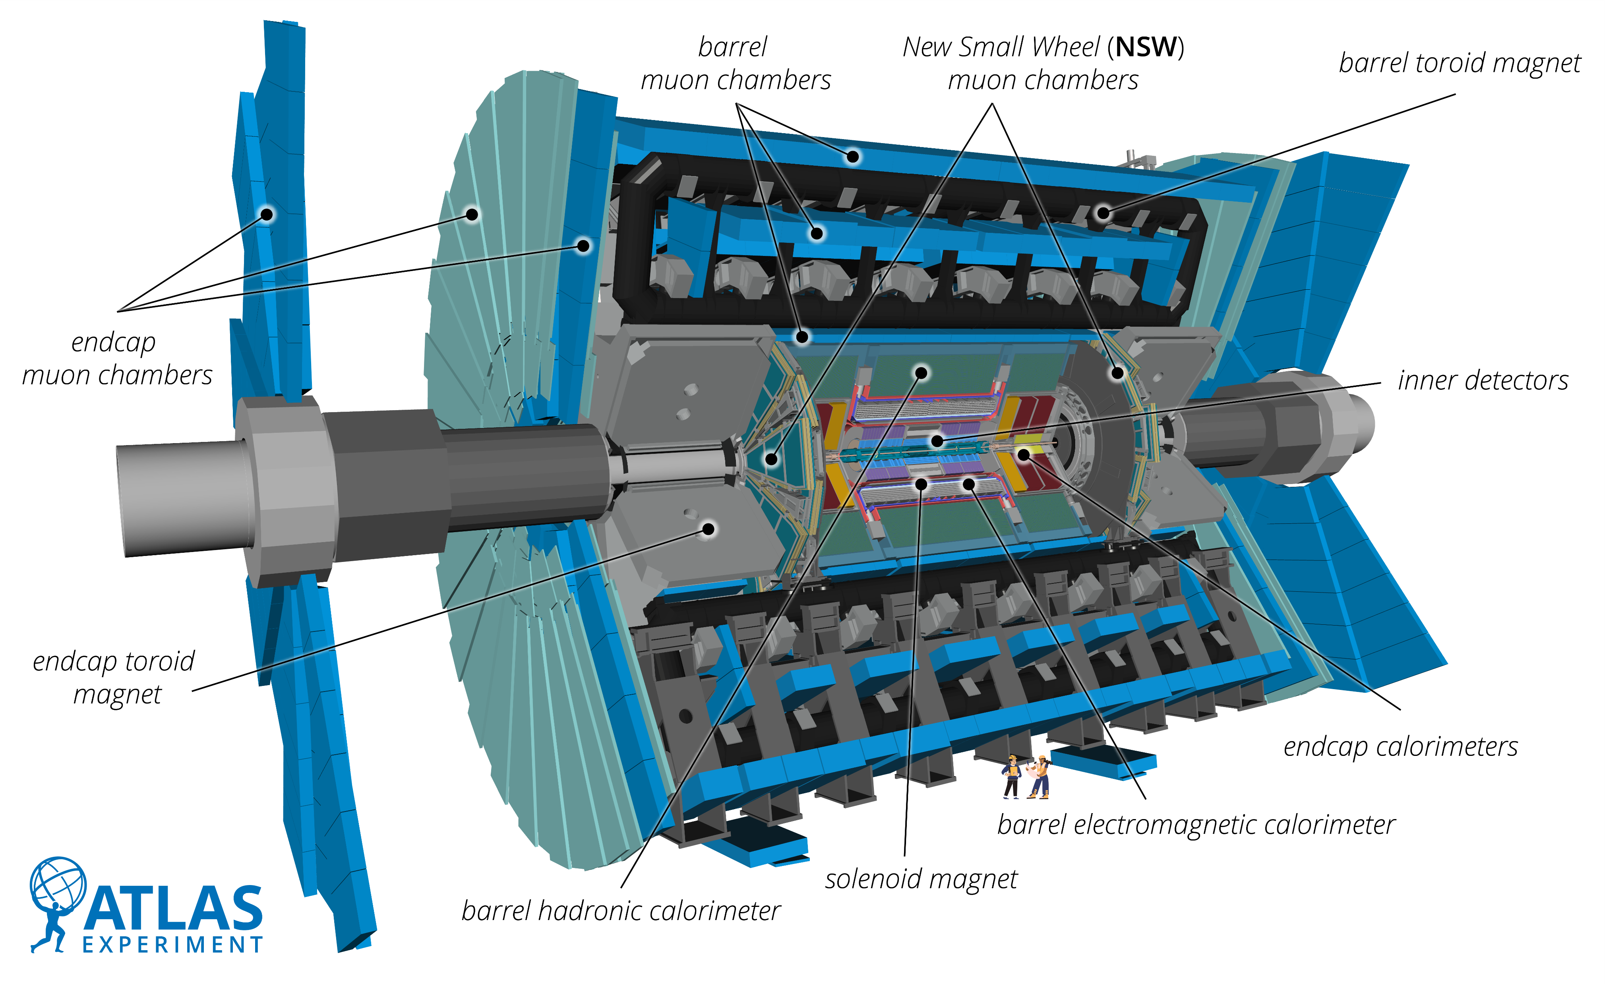
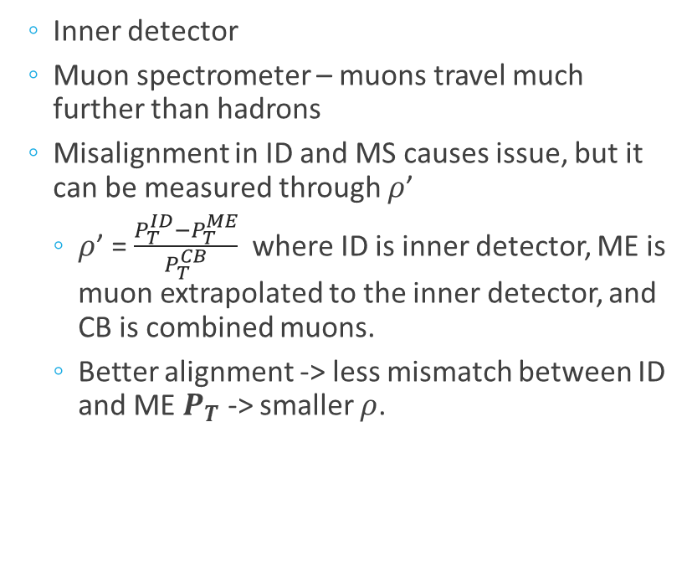
The Detector and Alignment
  Inner detector
  Muon spectrometer – muons travel much further than hadrons
  Misalignment in ID and MS causes issue, but it can be measured through $ρ$’
    $ρ$’ = $\frac{P_{T}^{ID}−P_{T}^{ME}}{P_{T}^{CB}}$ where ID is inner detector, ME is muon extrapolated to the inner detector, and CB is combined muons.
    Better alignment -> less mismatch between ID and ME $P_{T}$ -> smaller $ρ$.
Notes:
The atlas detector is composed of the inner detector and muon spectrometer. When a muon is produced, it travels a greater distance than some other particles such as hadrons. This is why we need the muon spectrometer on the outside to calculate muon momentum more accurately. Both the ID and the MS can measure pt, but when there is a misalignment, this can cause an issue.

Slide 3
Part 1 – 2024 Alignment

Slide 4
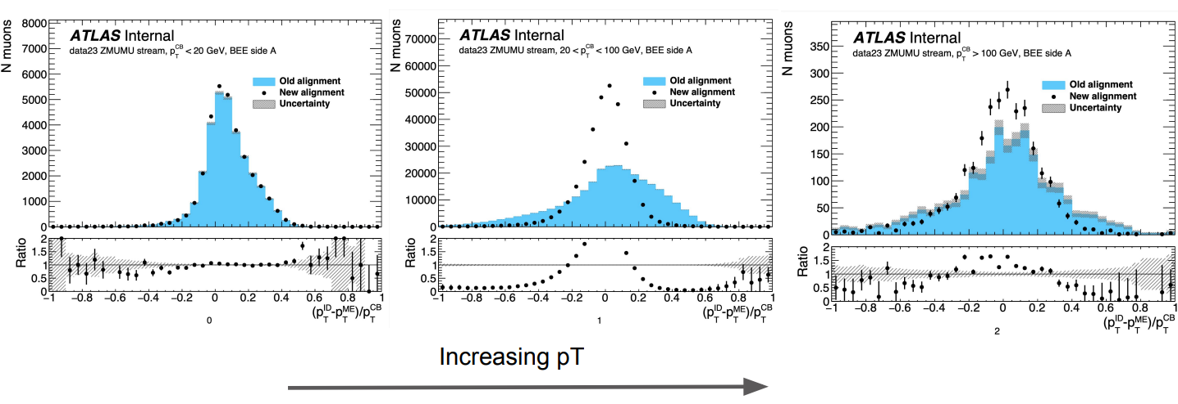
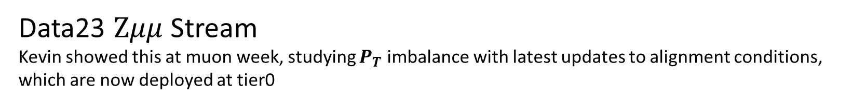
BEE Side A
Data23 $Zμμ$ Stream
Kevin showed this at muon week, studying $P_{T}$ imbalance with latest updates to alignment conditions, which are now deployed at tier0
Credit: Kevin Nelson

Slide 5
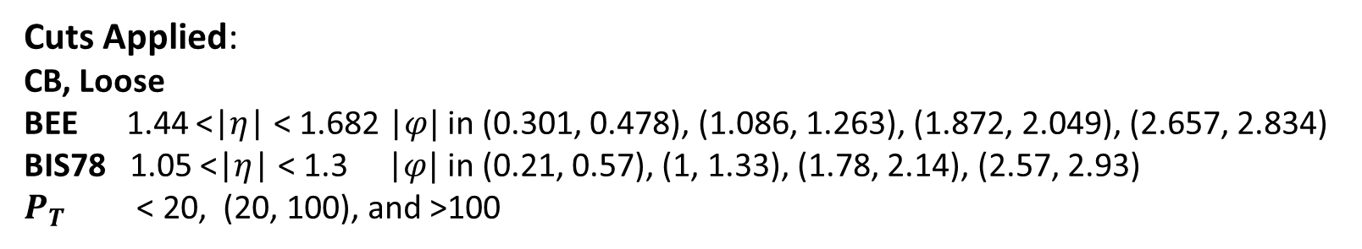
Data 24 Study (Main Stream)
 | Old Alignment | New Alignment
Tag | <= f1456 | >= f1462
Run No. | <= 00474271 | >= 00474441
Condition tag | CONDBR2-BLKPA-2024-02 | CONDBR2_BLKPA_2024_03
Run Selected | data24_13p6TeV.00473968.physics_Main.deriv.DAOD_PHYS.f1450_m2248_p6142_tid38351515_00 | data24_13p6TeV.00474572.physics_Main.deriv.DAOD_PHYS.f1462_m2248_p6142
Cuts Applied:
CB, Loose
BEE 1.44 <|$η$| < 1.682 |$φ|$ in (0.301, 0.478), (1.086, 1.263), (1.872, 2.049), (2.657, 2.834)
BIS78 1.05 <|$η$| < 1.3 |$φ|$ in (0.21, 0.57), (1, 1.33), (1.78, 2.14), (2.57, 2.93)
$P_{T}$ < 20, (20, 100), and >100
Notes:
For the 2024 study, these are the run specifics for the old and new alignments. This is a static change where it applied a different geometry description to the data collected.
I selected the relevant run and applied the same cuts as in the previous study. These are …
After data collection, the processing uses

Slide 6
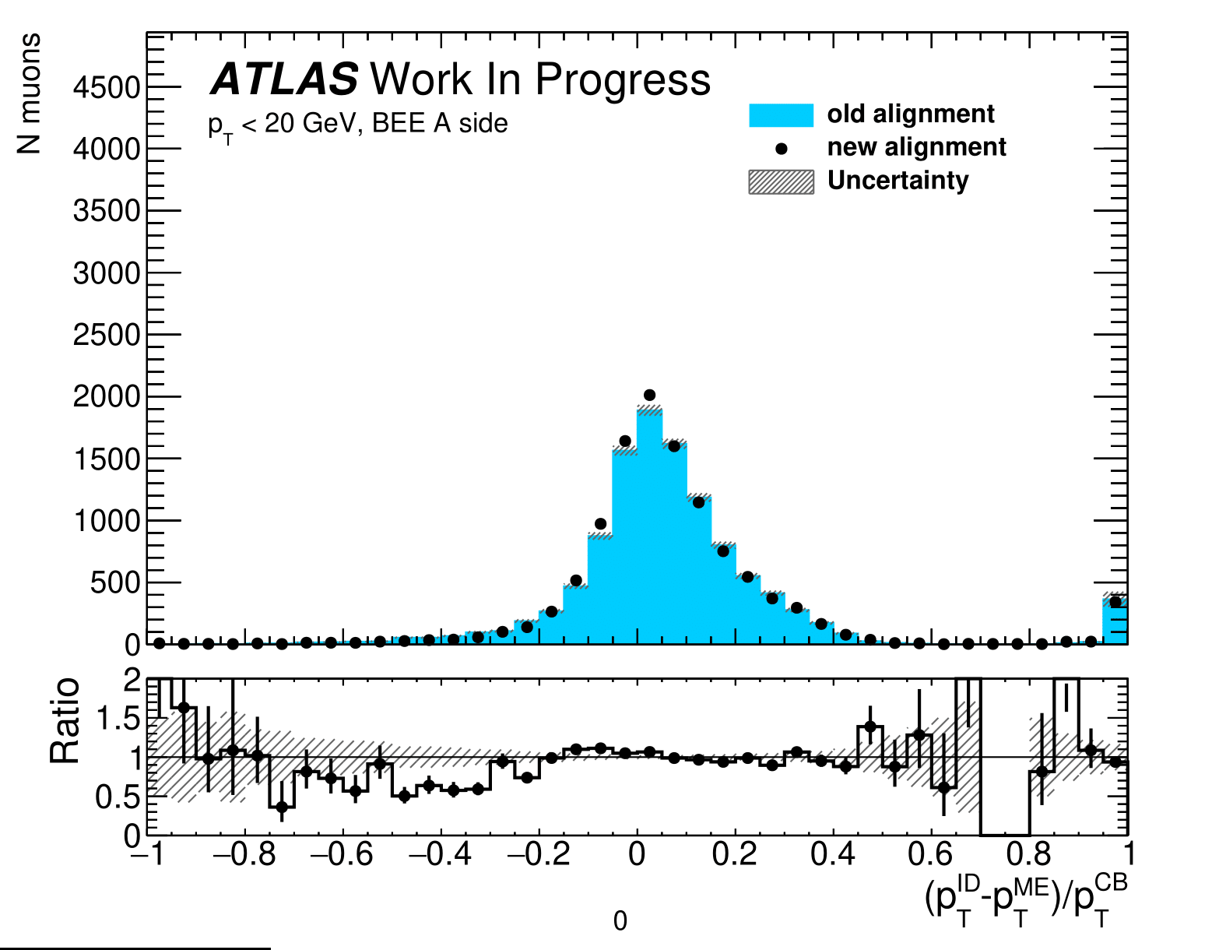
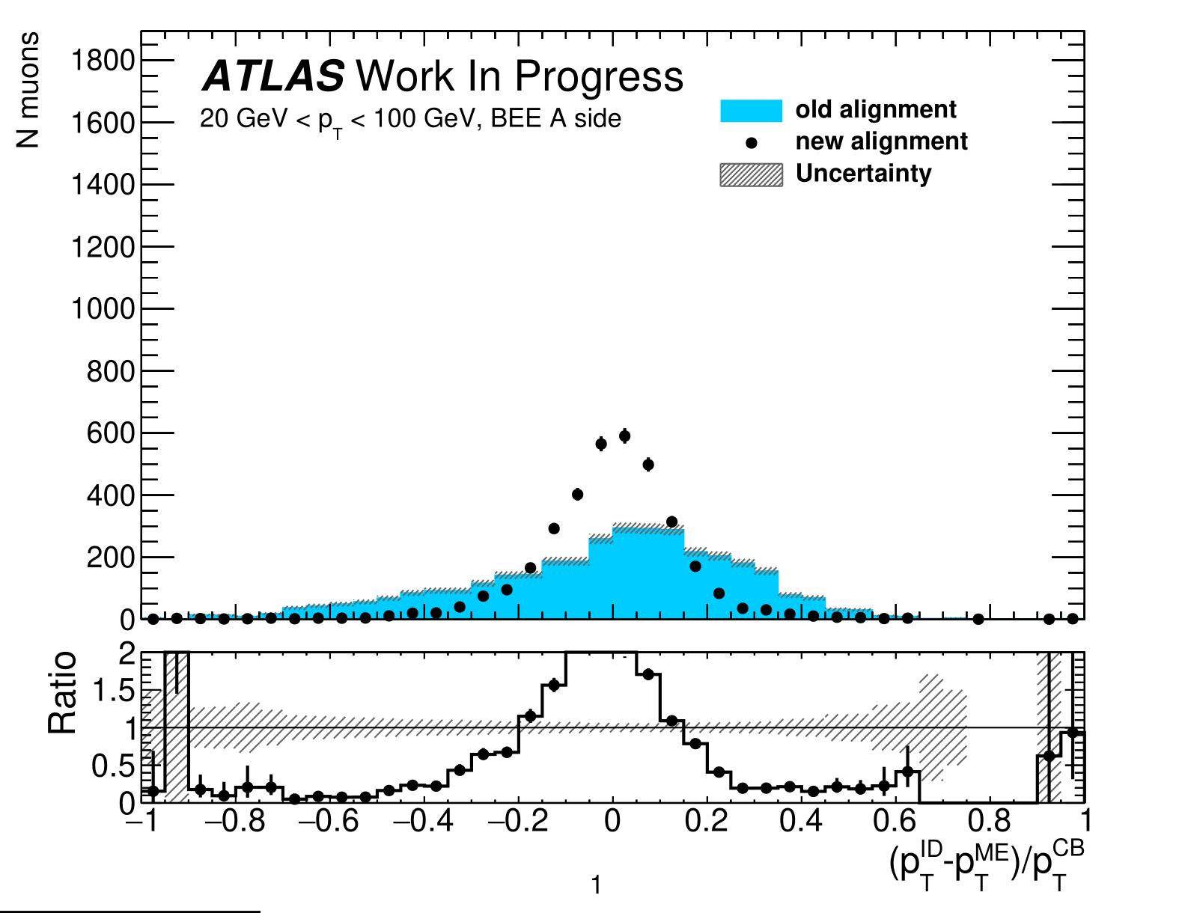
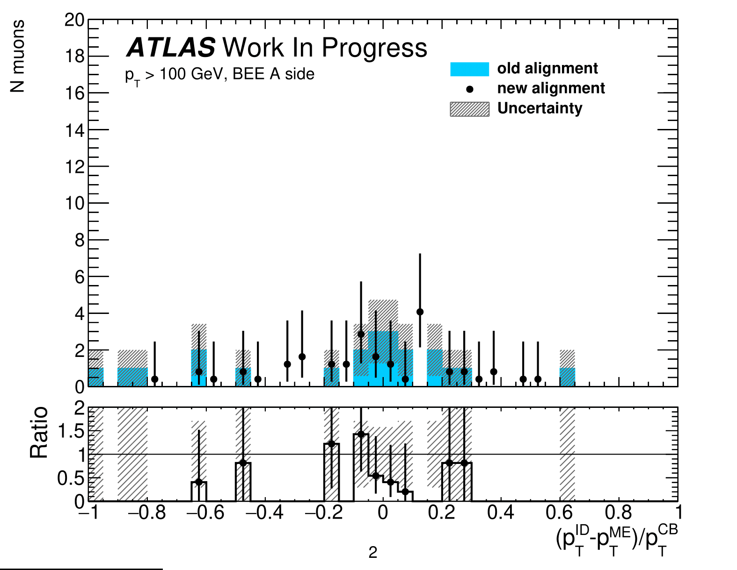
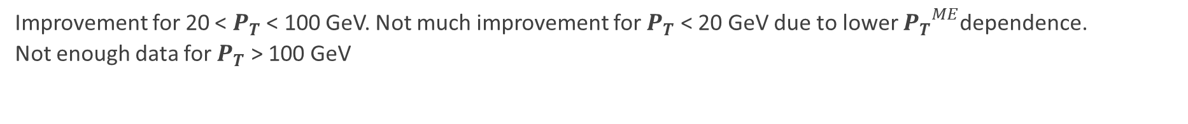
BEE Side A
Improvement for 20 < $P_{T}$ < 100 GeV. Not much improvement for $P_{T}$ < 20 GeV due to lower ${P_{T}}^{ME}$dependence.
Not enough data for $P_{T}$ > 100 GeV

Slide 7
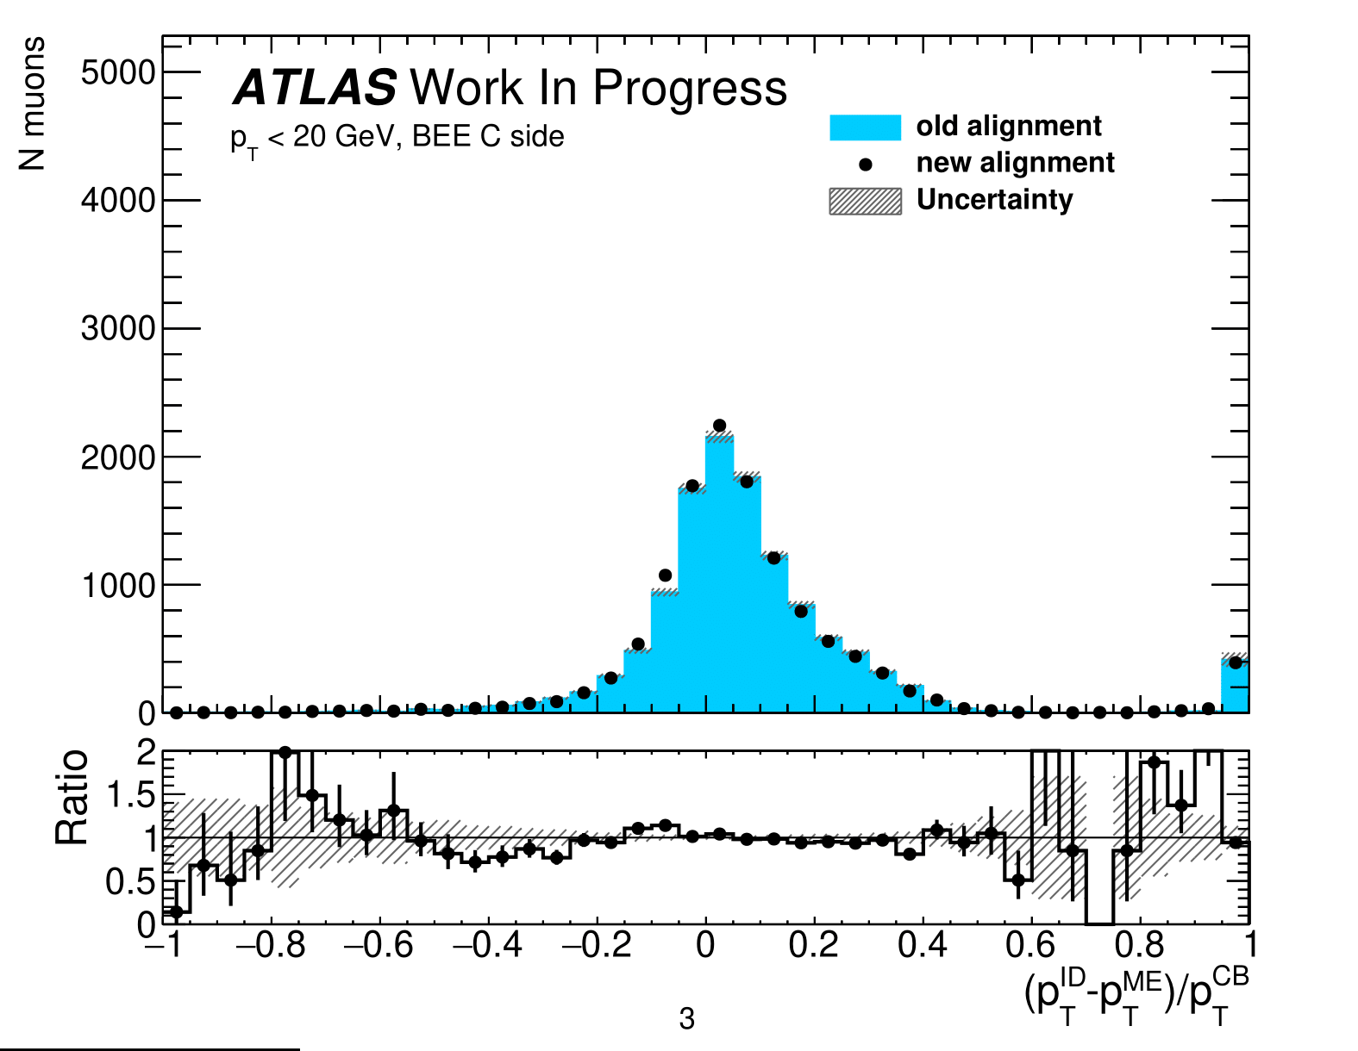
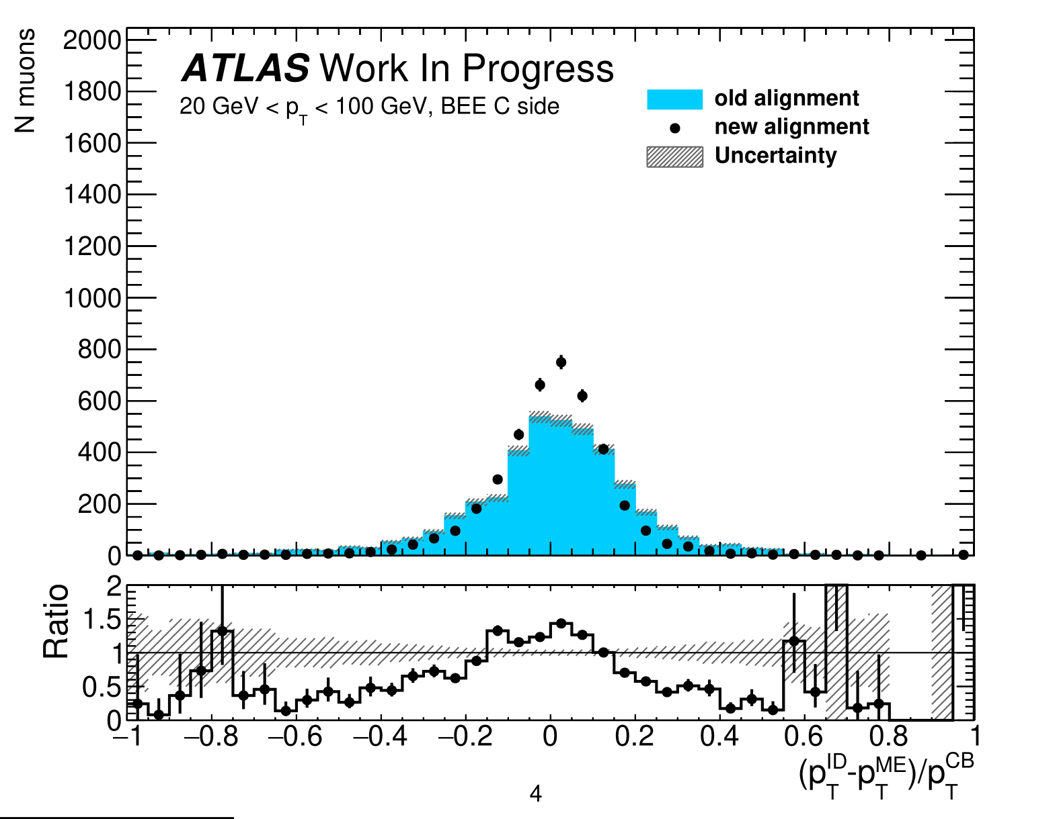
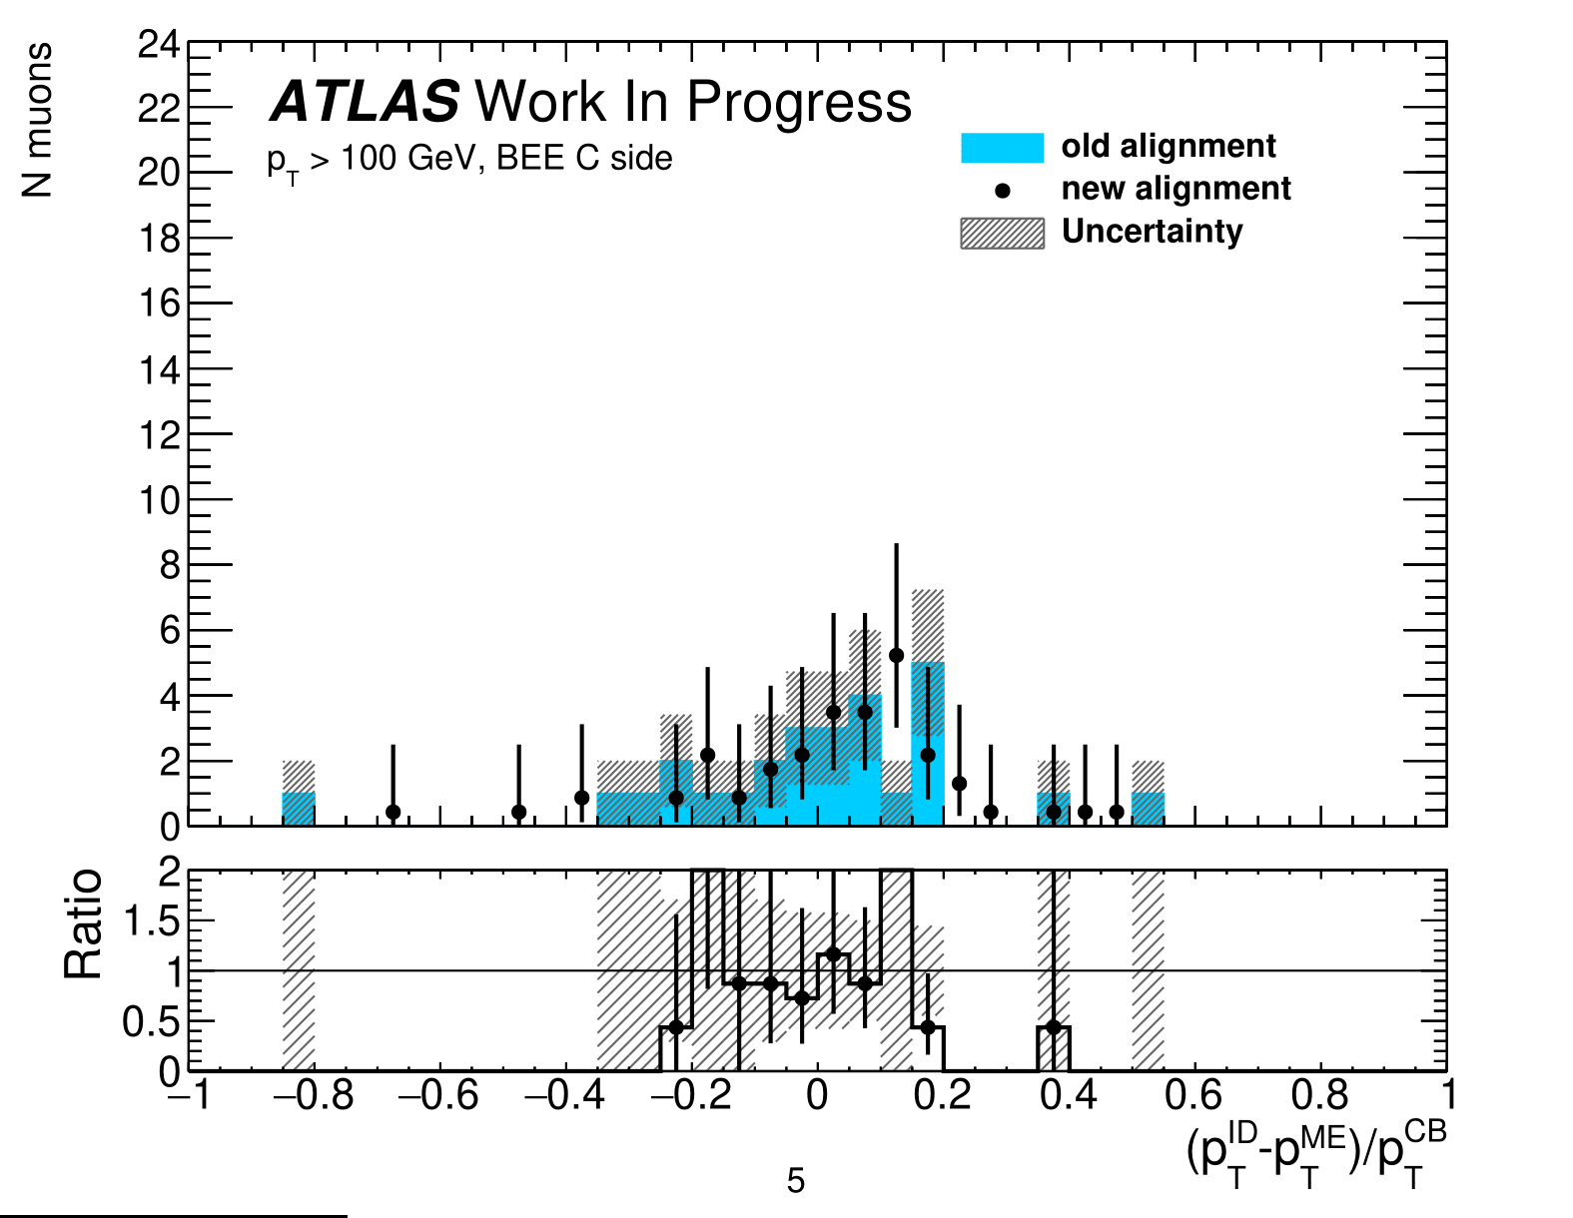
BEE Side C
Similar changes as BEE side A

Slide 8
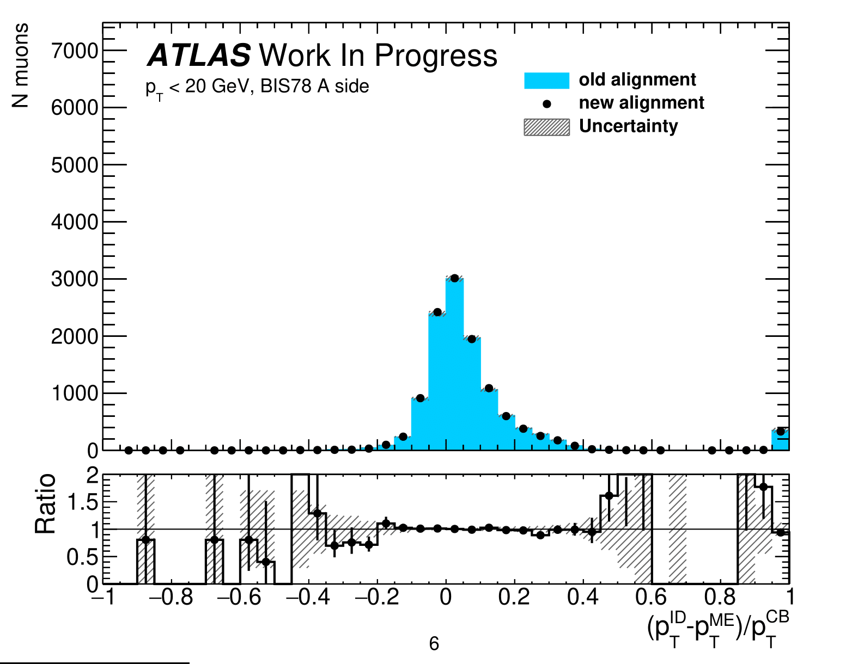
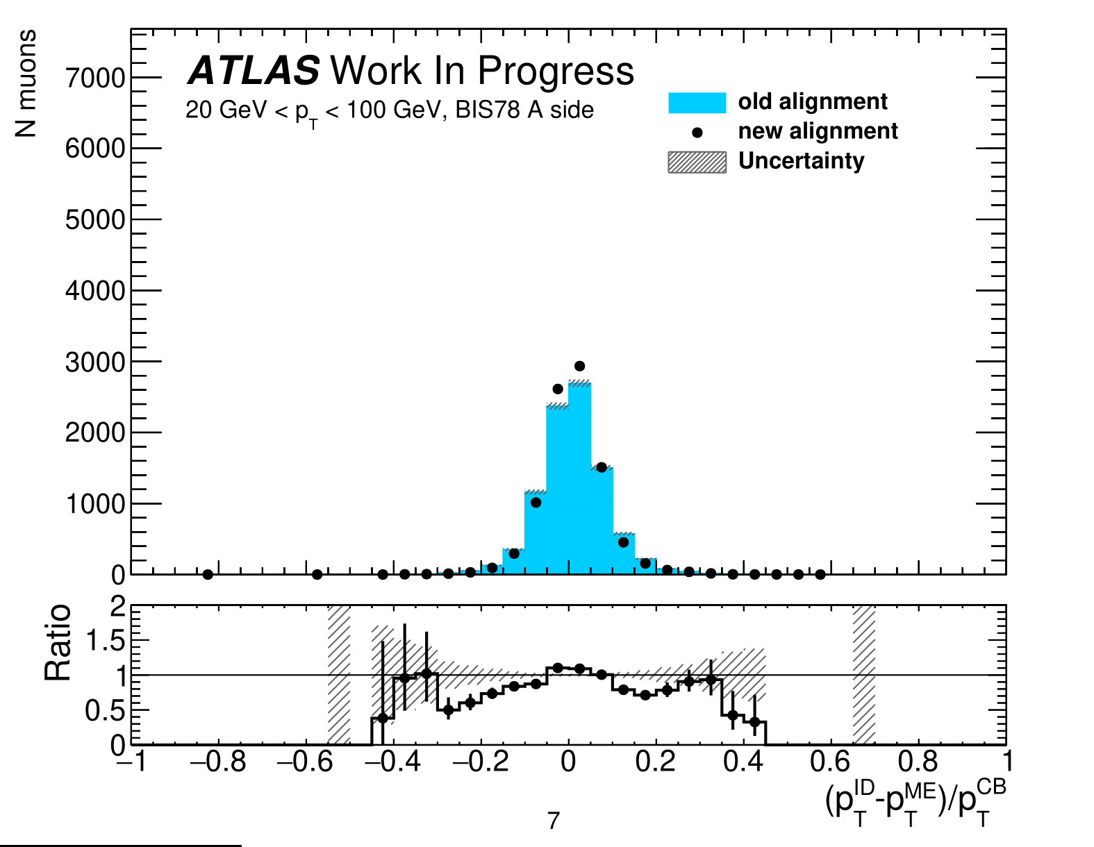
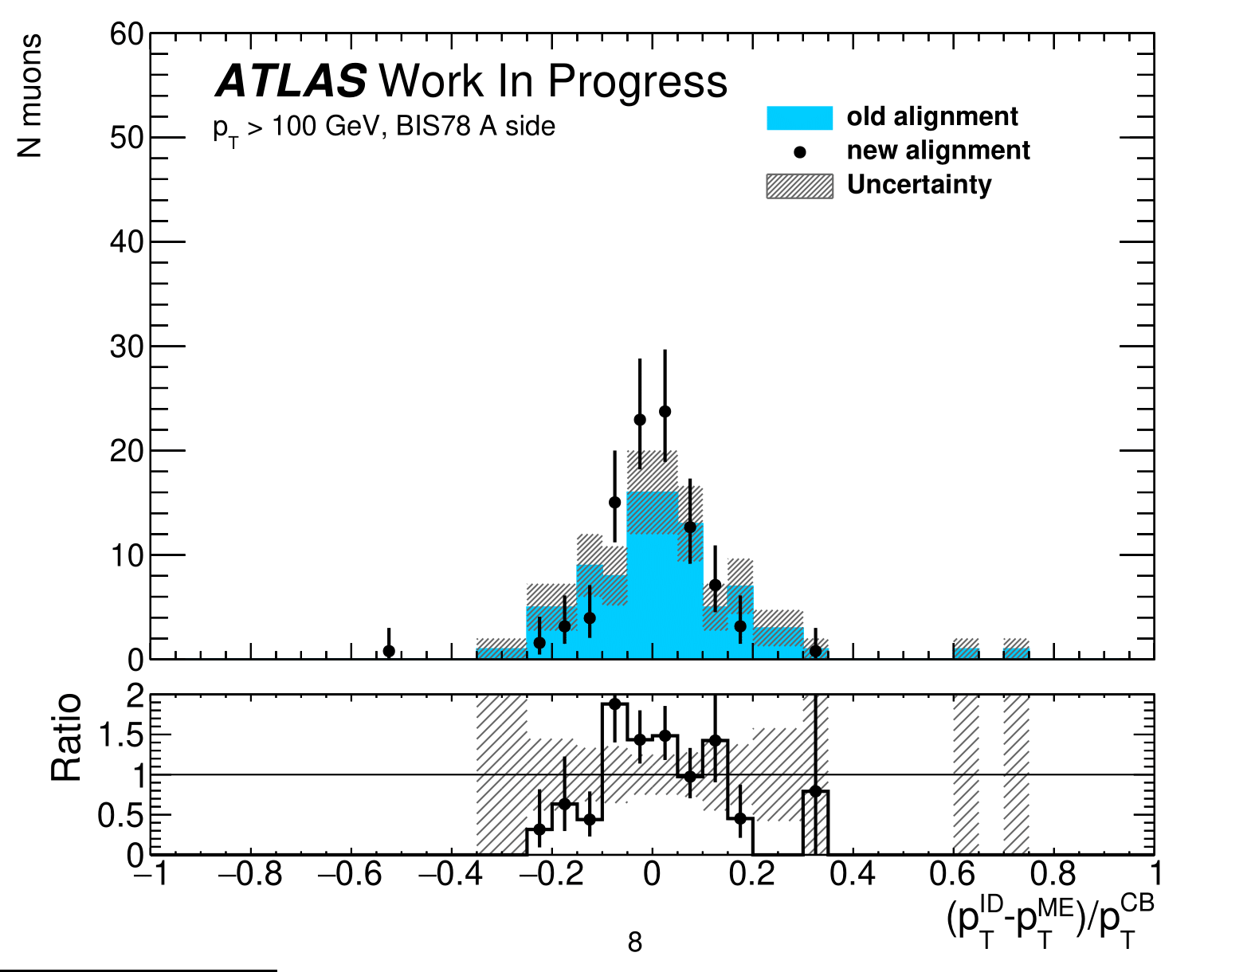
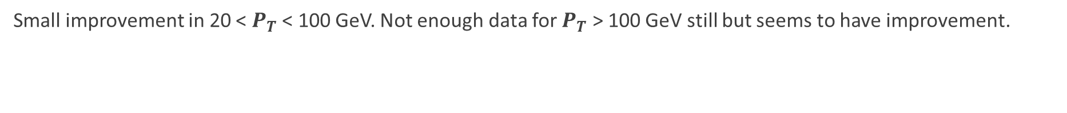
BIS78 Side A
Small improvement in 20 < $P_{T}$ < 100 GeV. Not enough data for $P_{T}$ > 100 GeV still but seems to have improvement.

Slide 9
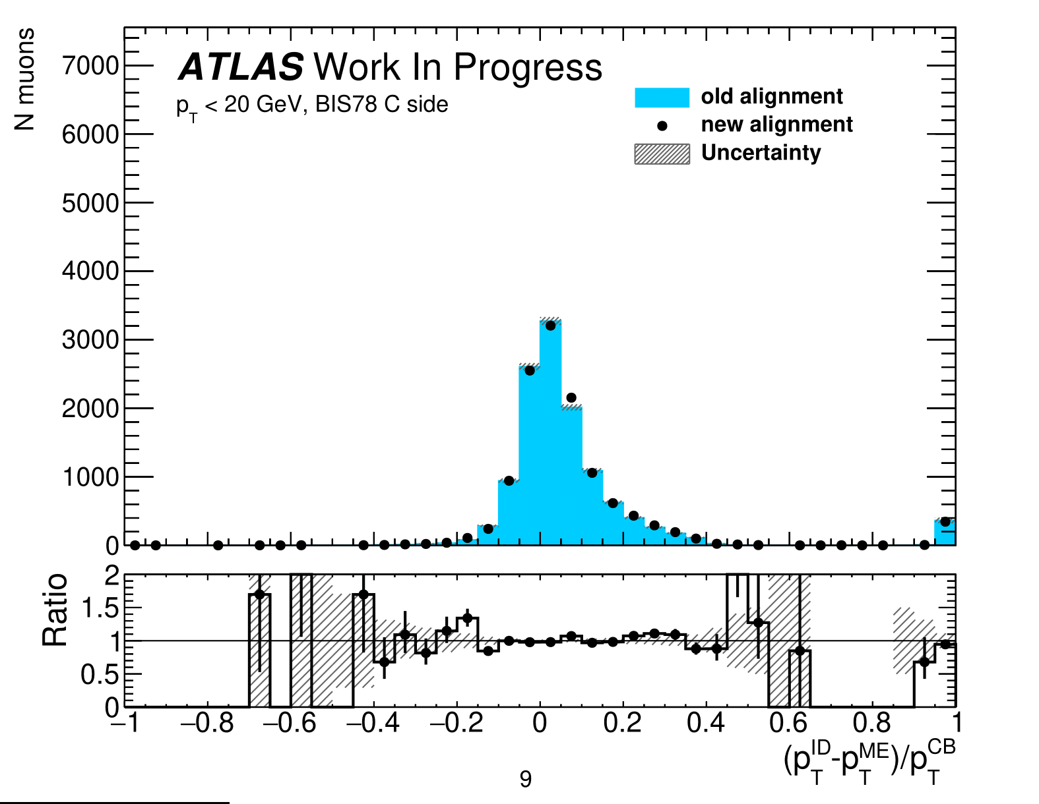
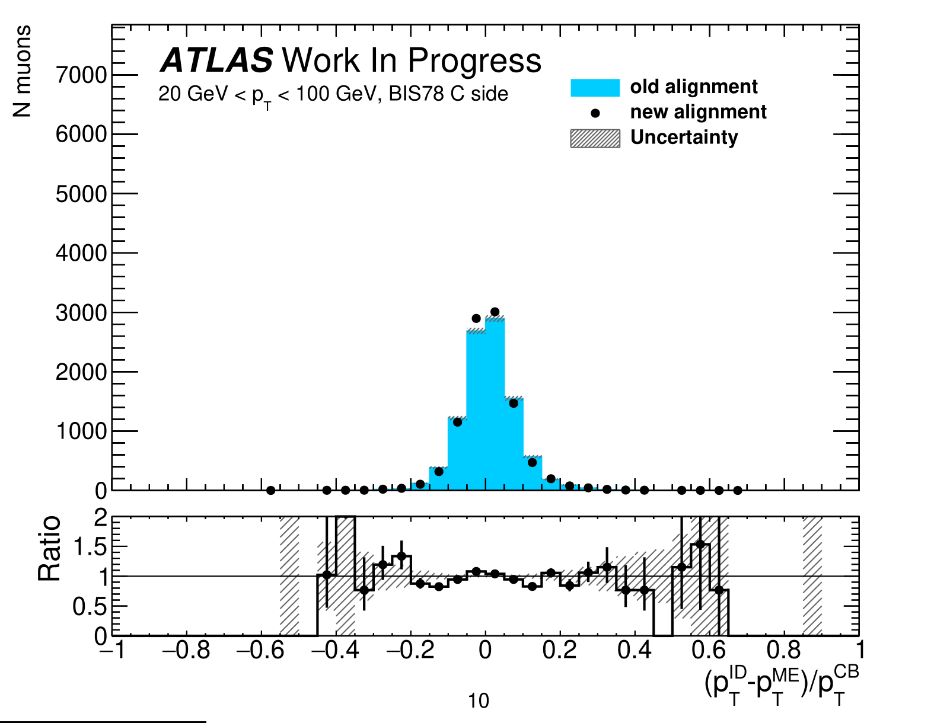
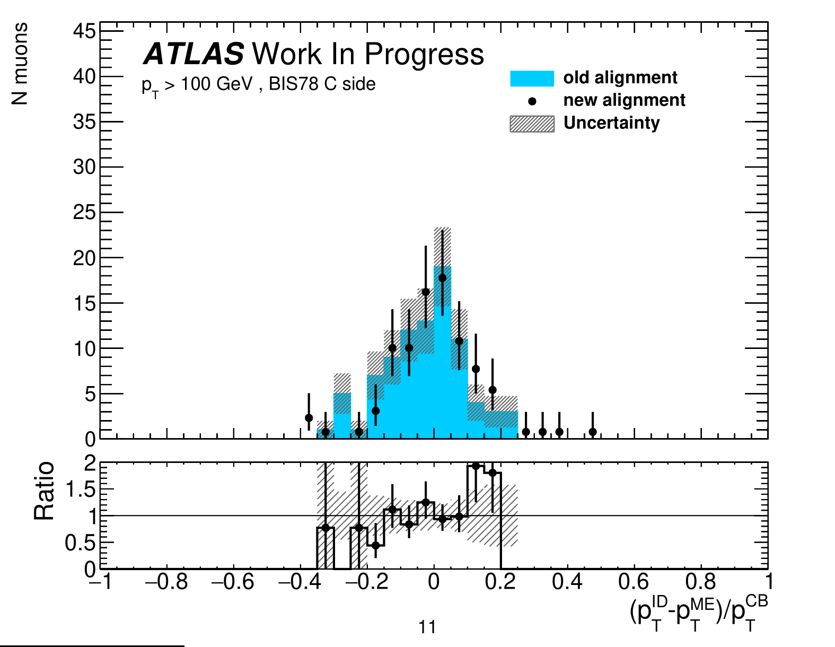
BIS78 Side C
Little change

Slide 10
Comparison
Data 24
Data 23

Slide 11
Part 2 – Tight WP Optimization

Slide 12


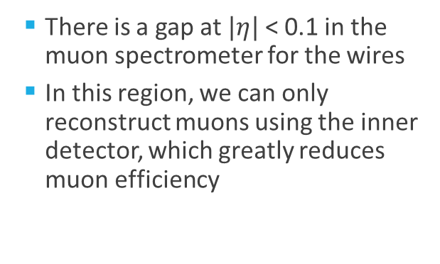
Muon Efficiency
  There is a gap at $|η|$< 0.1 in the muon spectrometer for the wires
  In this region, we can only reconstruct muons using the inner detector, which greatly reduces muon efficiency
Notes:
This is the muon spectrometer again. But this time we are zooming closer in the muon spectrometer. We can see there is a gap …

Slide 13
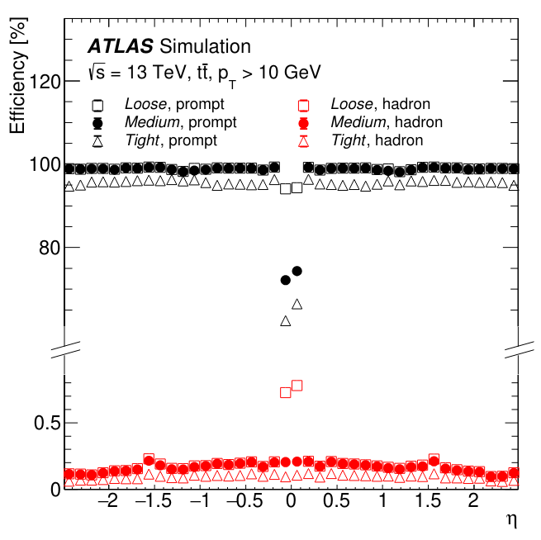

Muon Working Point
  Efficiency for prompt muons drop (especially tight WP), and even worse, fake muons (light flavor) increase
  It has been the goal for the past 16 years to increase the efficiency of this region.
  We want better signal efficiency or lower background.
Notes:
The different WP have different cuts on rho, q/p, chi^2 fit, and the muons used in the process. One way to increase the efficiency of a WP is to apply cuts with better signal efficiency or lower background.

Slide 14
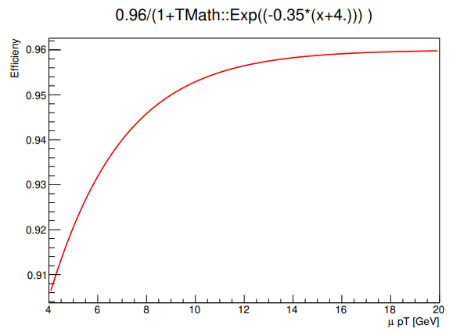
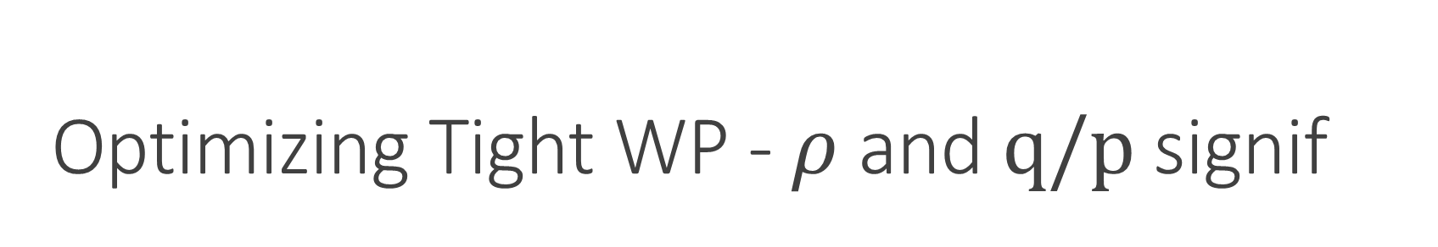
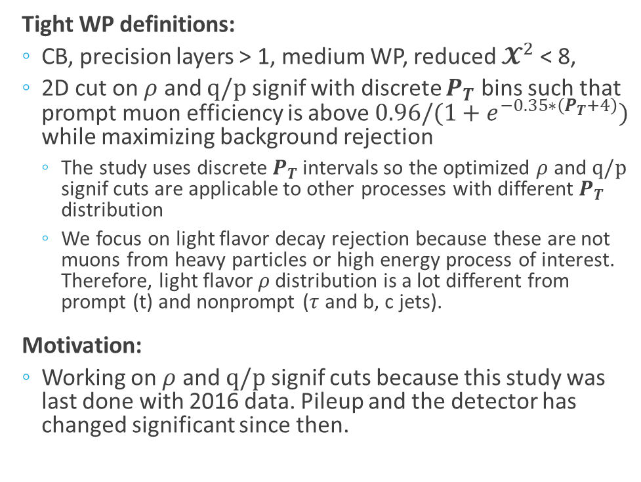
Optimizing Tight WP - $ρ$ and $q/p \text{signif}$
  Tight WP definitions:
  CB, precision layers > 1, medium WP, reduced $𝓧^{2}$ < 8,
  2D cut on $ρ$ and $q/p$ signif with discrete $P_{T}$ bins such that prompt muon efficiency is above $0.96/(1+e^{−0.35∗\left(P_{T}+4\right)})$ while maximizing background rejection
    The study uses discrete $P_{T}$ intervals so the optimized $ρ$ and $q/p$ signif cuts are applicable to other processes with different $P_{T}$ distribution
    We focus on light flavor decay rejection because these are not muons from heavy particles or high energy process of interest. Therefore, light flavor $ρ$distribution is a lot different from prompt (t) and nonprompt ($τ$ and b, c jets).
  Motivation:
  Working on $ρ$ and $q/p$ signif cuts because this study was last done with 2016 data. Pileup and the detector has changed significant since then.
From WP internal note

Slide 15
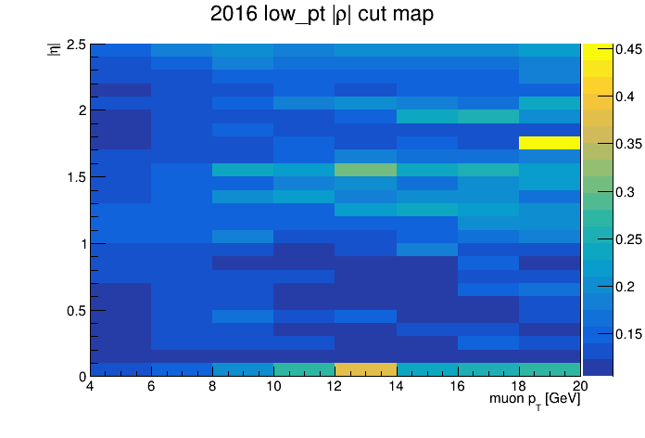
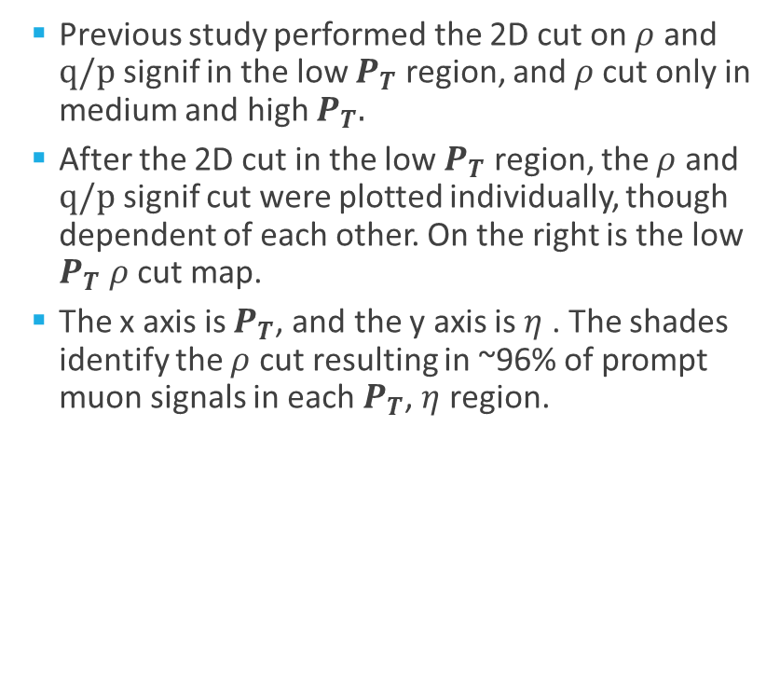

Previous $ρ$ and $q/p$Cut Study
  Previous study performed the 2D cut on $ρ$ and $q/p$ signif in the low $P_{T}$ region, and $ρ$cut only in medium and high $P_{T}.$
  After the 2D cut in the low $P_{T}$ region, the $ρ$ and $q/p$ signif cut were plotted individually, though dependent of each other. On the right is the low $P_{T}$ $ρ$ cut map.
  The x axis is $P_{T}$, and the y axis is $η$ . The shades identify the $ρ$ cut resulting in ~96% of prompt muon signals in each $P_{T}$, $η$ region.

Slide 16
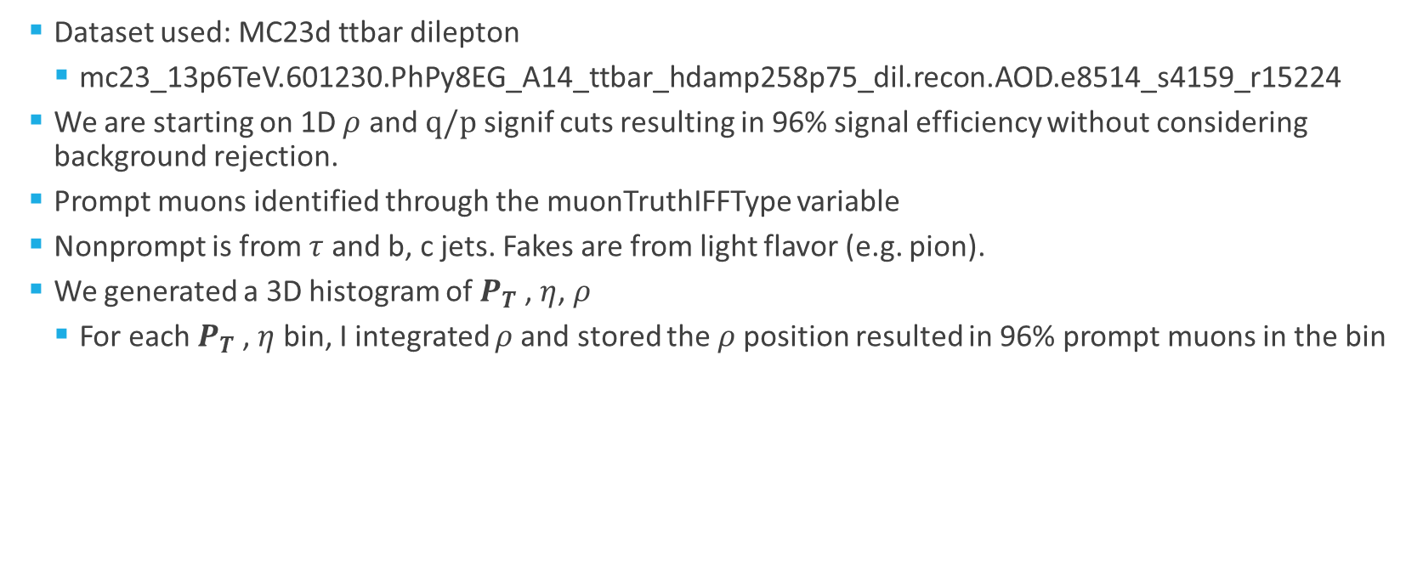
Method
  Dataset used: MC23d ttbar dilepton
    mc23_13p6TeV.601230.PhPy8EG_A14_ttbar_hdamp258p75_dil.recon.AOD.e8514_s4159_r15224
  We are starting on 1D $ρ$ and $q/p$ signif cuts resulting in 96% signal efficiency without considering background rejection.
  Prompt muons identified through the muonTruthIFFType variable
  Nonprompt is from $τ$ and b, c jets. Fakes are from light flavor (e.g. pion).
  We generated a 3D histogram of $P_{T}$, $η$, $ρ$
    For each $P_{T}$, $η$ bin, I integrated $ρ$and stored the $ρ$position resulted in 96% prompt muons in the bin

Slide 17

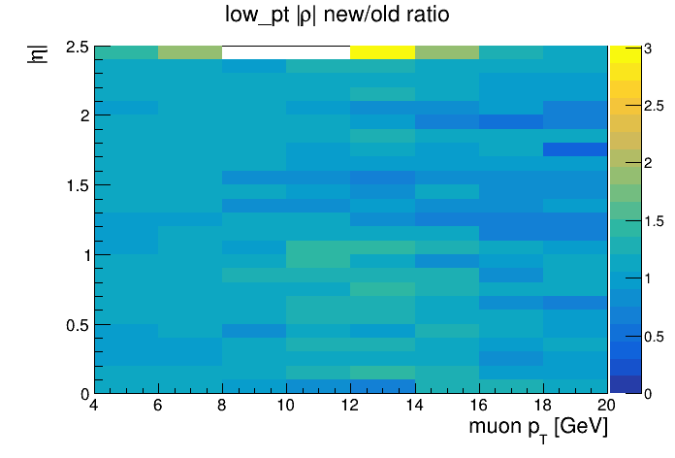
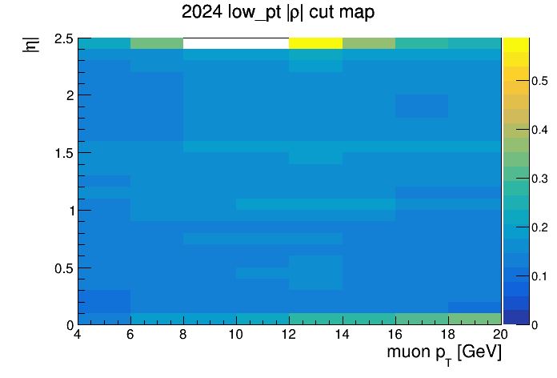

Low $P_{T}$ - $ρ$ Map
  Got similar results as the 2016 study

Slide 18
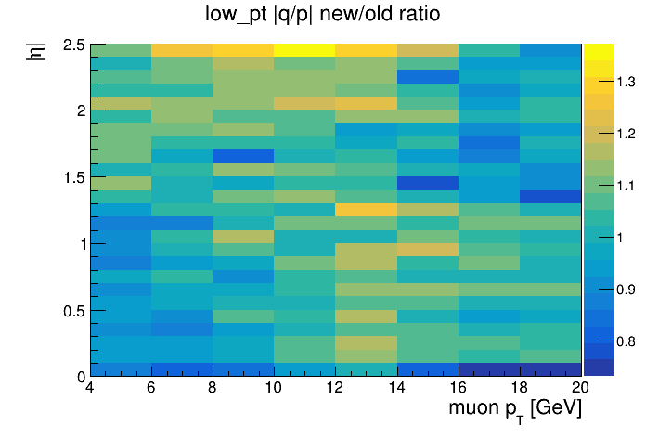
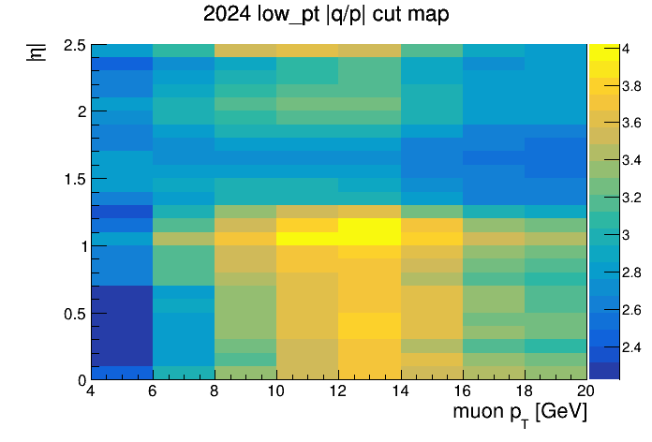
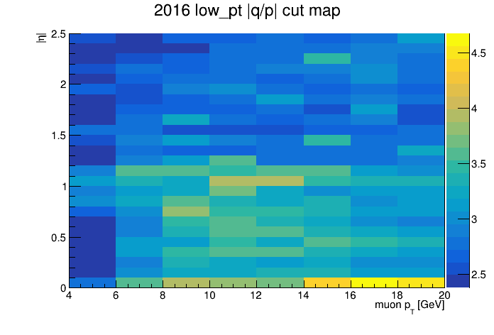

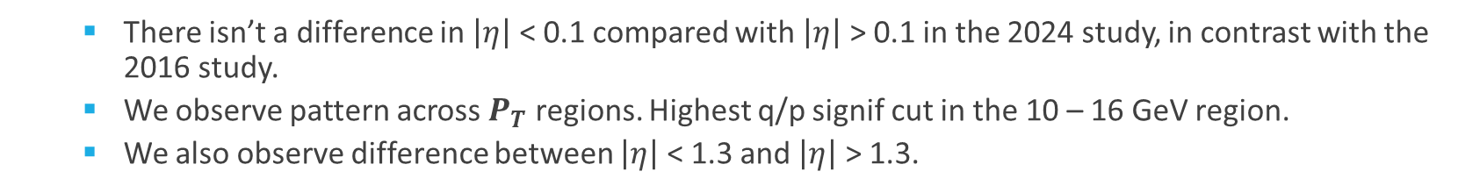
Low $P_{T}$ - q/p significance Map
    There isn’t a difference in $\left|η\right|$ < 0.1 compared with $\left|η\right|$ > 0.1 in the 2024 study, in contrast with the 2016 study.
    We observe pattern across $P_{T}$ regions. Highest q/p signif cut in the 10 – 16 GeV region.
    We also observe difference between $\left|η\right|$ < 1.3 and $\left|η\right|$ > 1.3.

Slide 19
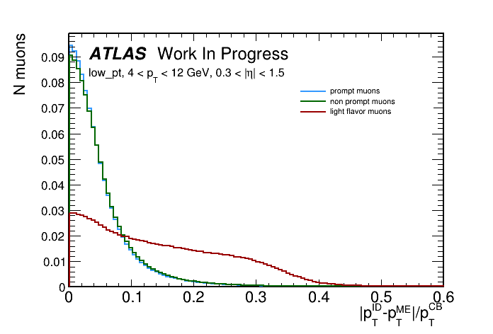
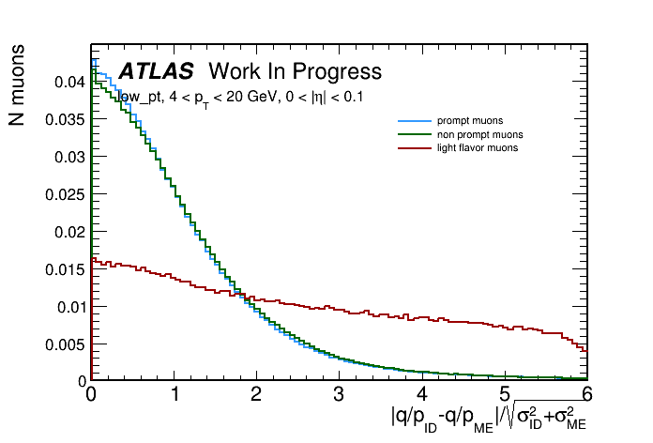
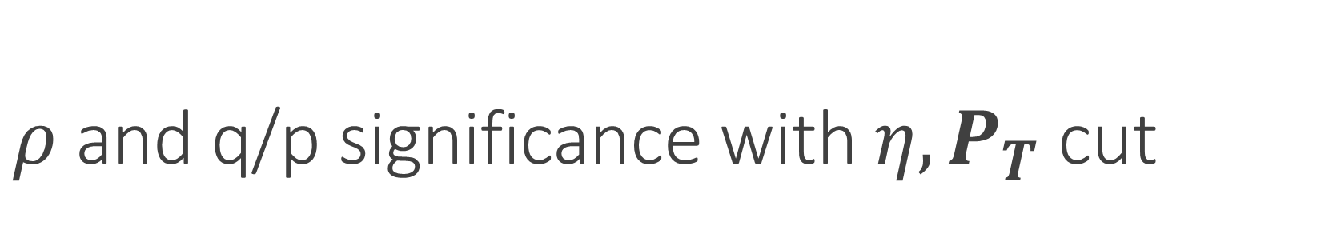
$ρ$ and q/p significance with $η,P_{T}$ cut
Cut around 0.15 – 0.2
Cut around 3.2 – 3.6
Notes:
Here is a plot of rho with eta and pt cut. You can see the distribution for prompt and nonprompt is quite similar, but very different compare with light flavor.

Slide 20
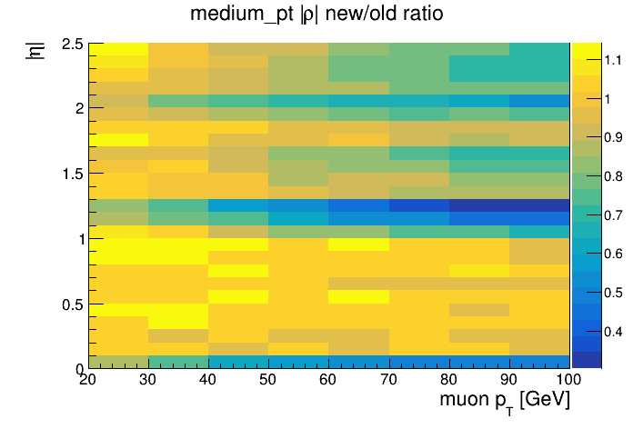
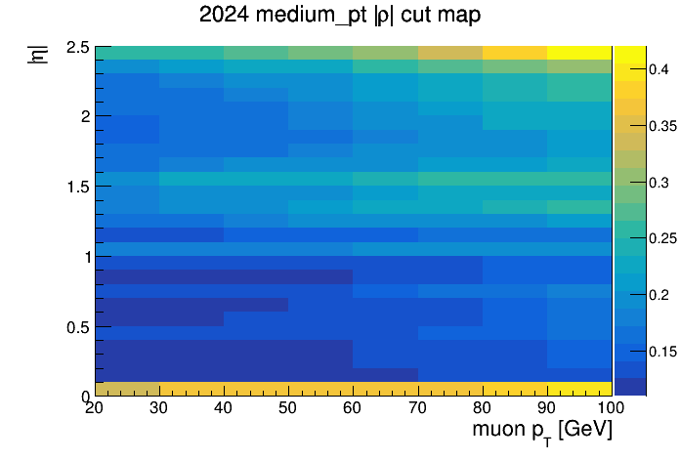
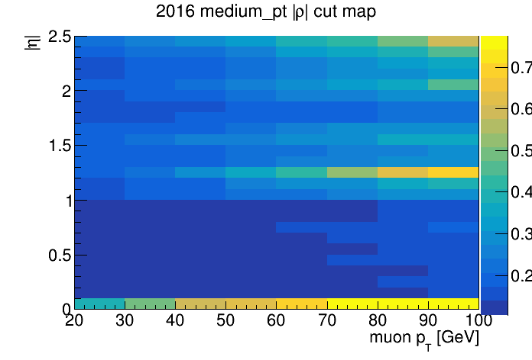

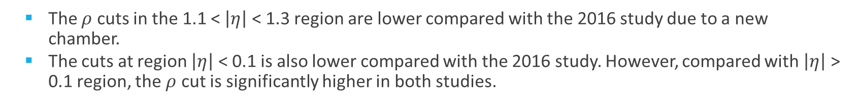
Medium $P_{T}$ - $ρ$ Map
  The $ρ$ cuts in the 1.1 < $\left|η\right|$ < 1.3 region are lower compared with the 2016 study due to a new chamber.
  The cuts at region $\left|η\right|$ < 0.1 is also lower compared with the 2016 study. However, compared with $\left|η\right|$ > 0.1 region, the $ρ$ cut is significantly higher in both studies.

Slide 21
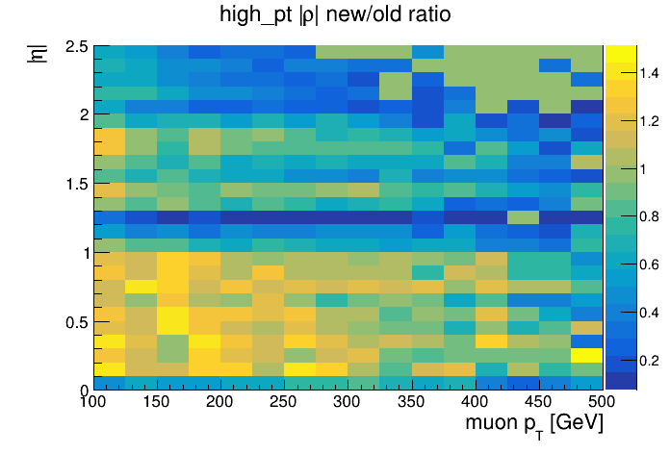
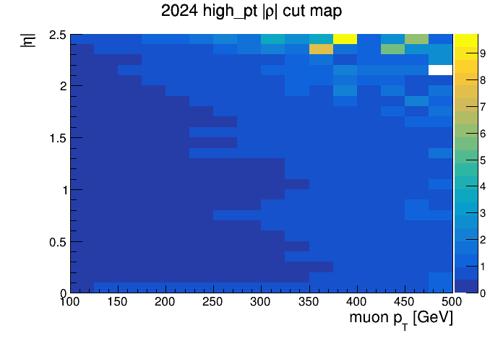
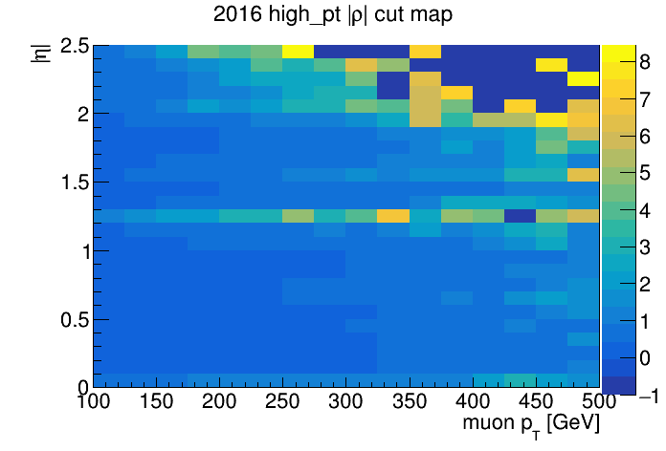

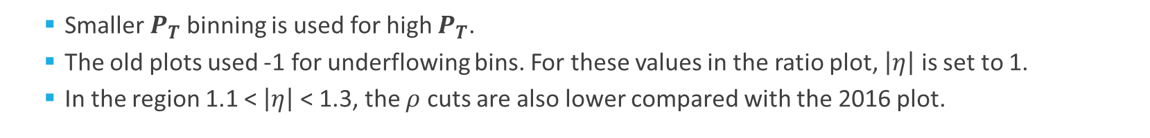
High $P_{T}$ - $ρ$ Map
    Smaller $P_{T}$binning is used for high $P_{T}$.
    The old plots used -1 for underflowing bins. For these values in the ratio plot, $\left|η\right|$ is set to 1.
    In the region 1.1 < $\left|η\right|$ < 1.3, the $ρ$ cuts are also lower compared with the 2016 plot.

Slide 22



Next Steps
  Compare the efficiency of the 2024 1D $ρ$ and $q/p$ signif cut with the 2016 cuts.
  If necessary, complete 2D optimization for low pt regime.
  Validate and release WP recommendations using mcp-pipeline code (Developed by Kevin).
ETH main building
Kunsthaus Zürich

Slide 23
  Higgs coupling to 2nd generation particle

