Slide 1

Status of RF parameters in RLA2
Leonard Thiele (University of Rostock, CERN), Fabian Batsch
A. Aksoy, D. Amorim, R. Calaga, H. Damerau, M. Gast, A. Grudiev, I. Karpov, U. van Rienen

Slide 2
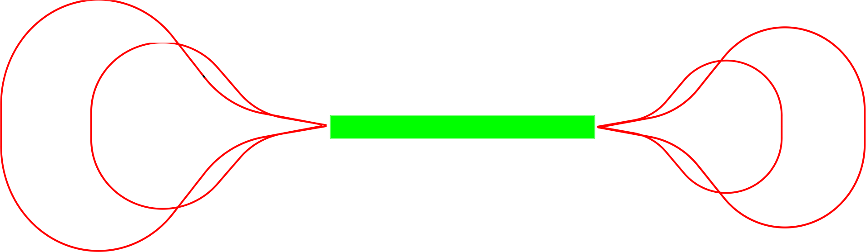
Assumptions for RLA2
Parameter | Unit | Value
Number of LINAC passes | [-] | 5
Energy gain per pass | [GeV] | 11.5
Energy loss from linearizers per pass | [GeV] | 1.4
LINAC length | [m] | 1600
Cavity frequencies | [MHz] | 352, 1056
Arc lengths | [m] | 426, 560, 709, 710?
Acceleration time | [μs] | 34
Number of 352 MHz accelerating cavities | [-] | 512
Number of 1056 MHz linearizer cavities | [-] | 98
Cavity gradients | [MV/m] | 15 @ 352 MHz 24 @ 1056 MHz
μ+
μ+
28.0 GeV
51.0 GeV
16.5 GeV
μ-
μ-
39.5 GeV
5-pass RLA 5-63 GeV
All accelerator data was taken from Avni’s talk at the 24th HEMAC meeting: https://indico.cern.ch/event/1382603/

Slide 3
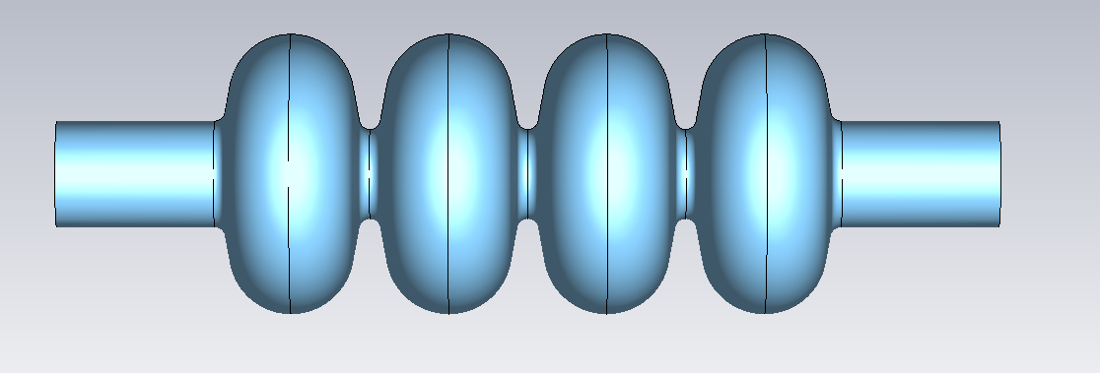
Cavity parameters for LEP2 cavity
Parameter | Unit | Value
Operating Frequency | [MHz] | 352
Longitudinal R/Q | [Ω] | 232
Active length | [m] | 1.7
Operational gradient | [MV/m] | 6
E_pk/E_acc | [1] | 2.3
LEP2 SC cavity (352 MHz)
Parameter | Unit | Value
Operating Frequency | [MHz] | 1056
Longitudinal R/Q | [Ω] | 232
Active length | [m] | 0.56
Operational gradient | [MV/m] | -
E_pk/E_acc | [1] | 2.3
Scaled LEP2 SC cavity (1056 MHz)

Slide 4
Acceleration parameters for RLA2
Parameter | Unit | RLA2 acceleration | RLA2 linearizer
Repetition frequency | [Hz] | 5
Total length | [m] | 10400
Bunch population at injection | [1 x 10¹²] | 3.32
Acceleration time | [μs] | 34
Combined avg. beam current (μ⁺ and μ⁻) | [mA] | 153
Assumed existing cavity type | [-] | LEP2 | Scaled LEP2
Cavity frequency | [MHz] | 352 | 1056
Designed bunch phase | [°] | 95 | 275
External Q-factor | [1 x 10⁶] | 0.33 | 0.18
Optimal cavity detuning | [kHz] | 0.05 | 0.24

Slide 5
RF parameters for RLA2
Parameter | Unit | RLA2 acceleration | RLA2 linearizer
Beam acceleration time | [μs] | 34
Cavity filling time | [μs] | 300 | 55
RF pulse length | [ms] | 0.33 | 0.09
RF duty factor | [%] | 0.16 | 0.05
FPC peak power | [kW] | 3900 | 2100
FPC average power | [kW] | 6.24 | 1.05
Average total RF power (incl. power distribution losses) | [MW] | 4.44 | 0.12
Average total wall plug power (incl. klystron eff.) | [MW] | 6.83 | 0.19
Number of cavities | [-] | 510 | 98

Slide 6
Conclusion and Outlook
All accelerator data was taken from Avni’s talk at the 24th HEMAC meeting: https://indico.cern.ch/event/1382603/
Arc lengths for arcs 3 and 4 seem inconsistent.
  But are consistent with the plots he showed.
Parameters for both the linearizer and acceleration cavity seem to be feasible from a powering perspective.
Transient beam loading needs to be studied in detail.
  Will depend on the cavity location for each pass (cavities towards the end of the LINAC are more affected by transients than the ones in the middle).
The design for RLA1 or the Pre-accelerator is not done yet.
Power sources for 352MHz as well as 1056MHz need to be determined
→ LEP2 like as well?

Slide 8
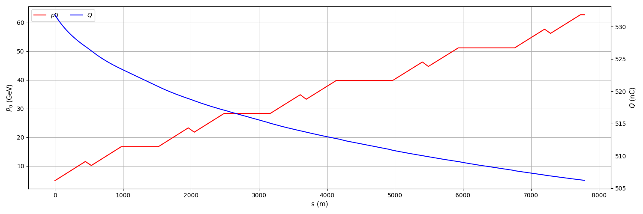
Energy profile RLA2
Plot from Avnis talk at the 25th HEMAC meeting: https://indico.cern.ch/event/1382603/

Slide 9
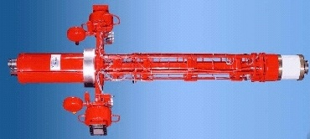
RF parameters in the high-energy chain
Klystron assumptions
Klystron and distribution losses are assumed to be the same as for the ILC DKS (Distributed Klystron Scheme) [2]
In this scheme, the klystrons are located underground next to the accelerator tunnel and close to the cavities
Repetition rate and fundamental frequency are equal to muon collider RCS chain
Klystron Parameter | Value
Max. power [MW] | 10
Wall plug efficiency [%] | 65
Repetition rate [Hz] | 5
RF pulse length [ms] | 1.65
RF duty factor [%] | 0.83
Power distribution losses in DKS [%] | 32
Output frequency [GHz] | 1.3
Thales TH1801, picture from [3],
parameter values from [2]

Slide 10
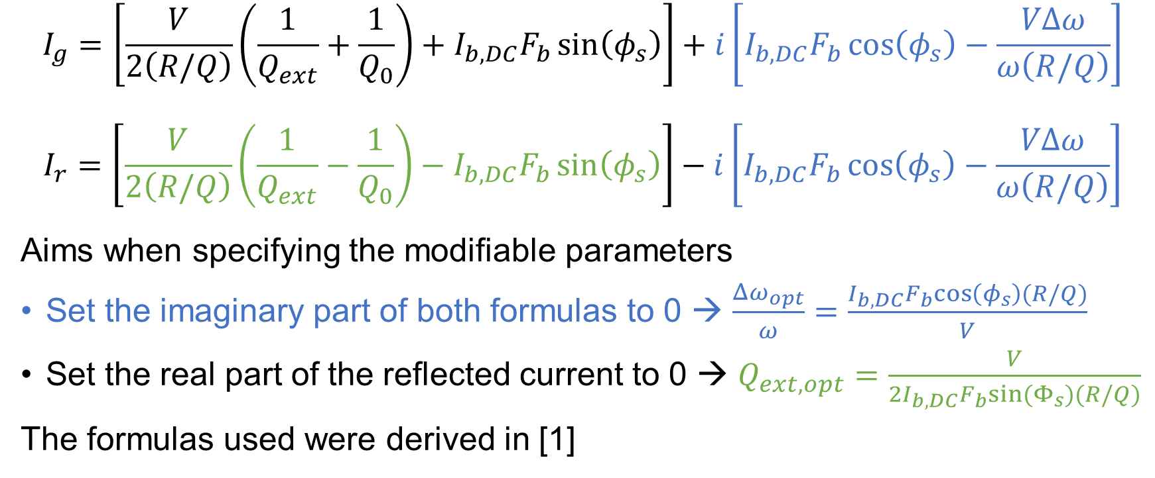
Appendix
Generator and reflected current
$$I_{g}=\left[\frac{V}{2\left(R/Q\right)}\left(\frac{1}{Q_{ext}}+\frac{1}{Q_{0}}\right)+I_{b,DC}F_{b}\sin\left(φ_{s}\right)\right]+i\left[I_{b,DC}F_{b}\cos\left(φ_{s}\right)−\frac{VΔω}{ω\left(R/Q\right)}\right]$$
$$I_{r}=\left[\frac{V}{2\left(R/Q\right)}\left(\frac{1}{Q_{ext}}−\frac{1}{Q_{0}}\right)−I_{b,DC}F_{b}\sin\left(φ_{s}\right)\right]−i\left[I_{b,DC}F_{b}\cos\left(φ_{s}\right)−\frac{VΔω}{ω\left(R/Q\right)}\right]$$
Aims when specifying the modifiable parameters
Set the imaginary part of both formulas to 0 → $\frac{Δω_{opt}}{ω}=\frac{I_{b,DC}F_{b}cos\left(φ_{s}\right)(R/Q)}{V}$
Set the real part of the reflected current to 0 → $Q_{ext,opt}=\frac{V}{2I_{b,DC}F_{b}sin⁡(Φ_{s})(R/Q)}$
The formulas used were derived in [1]

Slide 11
References
[1]: Cavity-Beam-Transmitter Interaction Formula Collection with Derivation: http://cds.cern.ch/record/1323893/files/CERN-ATS-Note-2011-002%20TECH.pdf
[2]: ILC TDR: https://linearcollider.org/files/images/pdf/Acceleratorpart2.pdf
[3]: https://www.desy.de/xfel-beam/mlin_klyst.html

