Slide 1
PHOTON ABSORBERS AND SHIELDING ACTIVATION IN THE FCCee ARC SECTION
Giacomo Lavezzari, Markus Widorski - CERN HSE-RP
17/07/2024
EDMS 3134526

Slide 2
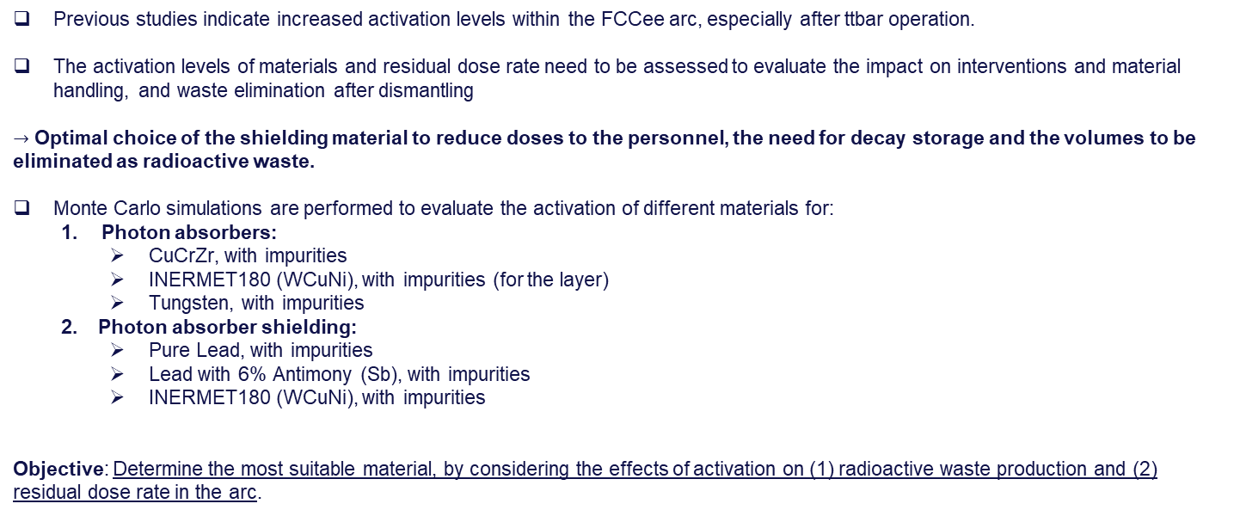
Introduction and objective
Previous studies indicate increased activation levels within the FCCee arc, especially after ttbar operation.
The activation levels of materials and residual dose rate need to be assessed to evaluate the impact on interventions and material handling, and waste elimination after dismantling
$→$ Optimal choice of the shielding material to reduce doses to the personnel, the need for decay storage and the volumes to be eliminated as radioactive waste.
Monte Carlo simulations are performed to evaluate the activation of different materials for:
  Photon absorbers:
    CuCrZr, with impurities
    INERMET180 (WCuNi), with impurities (for the layer)
    Tungsten, with impurities
  Photon absorber shielding:
    Pure Lead, with impurities
    Lead with 6% Antimony (Sb), with impurities
    INERMET180 (WCuNi), with impurities
Objective: Determine the most suitable material, by considering the effects of activation on (1) radioactive waste production and (2) residual dose rate in the arc.

Slide 3
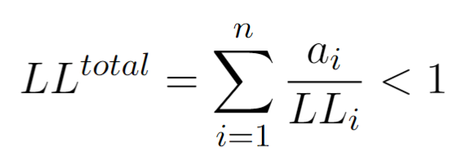
Figures of merit
FOM for the residual radiation: Residual dose rate (uSv/h)
The residual dose rate are computed directly through FLUKA Monte Carlo simulations for different decay times, following the respective irradiation scenario.
FOM for the activation: LL (Limit de Libération)
According to [1], the following sum rule is applied to determine if the removal from regulatory control of radioactive materials containing a mixture of artificially produced radionuclides is possible:
The sum rule states that the sum of the specific activities of each radionuclide in the material, divided by their respective clearance limits must be less than 1. In general, if the sum is below 1, the material can be removed from regulatory control, given that some further usually less restrictive criteria are met (dose rate, contamination level).
LL values are calculated with Actiwiz3 Creator, utilizing spectra computed through FLUKA Monte Carlo simulation within specific regions, folding with production cross sections for radionuclides and considering the respective buildup and radioactive decay.
When LL < 1, the material can be considered as non-radioactive
[1] Clearance Limits for Radioactive Material at CERN, S. Roesler and C. Theis, EDMS 942170

Slide 4
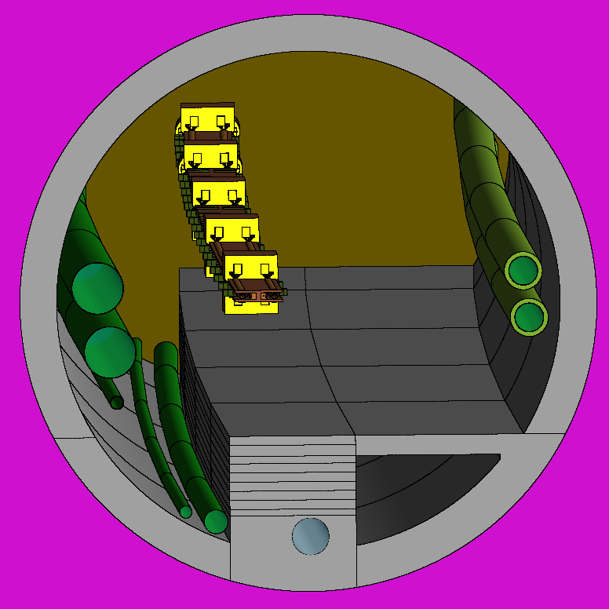
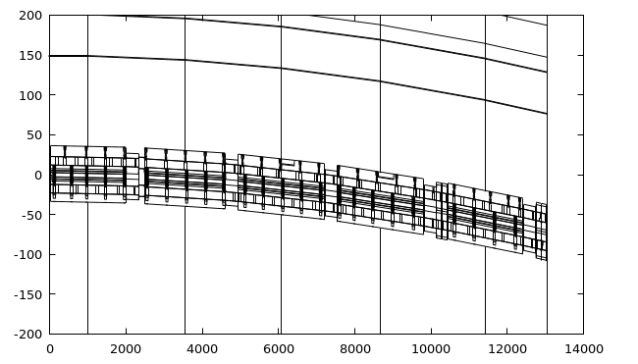
FLUKA geometry
Representative periodic arc cell of 130 m: electron beam (clockwise) outside, positron (counter-clockwise) inside.
25 photon absorbers + shielding per beam.
Optics file updated to 17/10/23.
X axis
Z axis

Slide 5
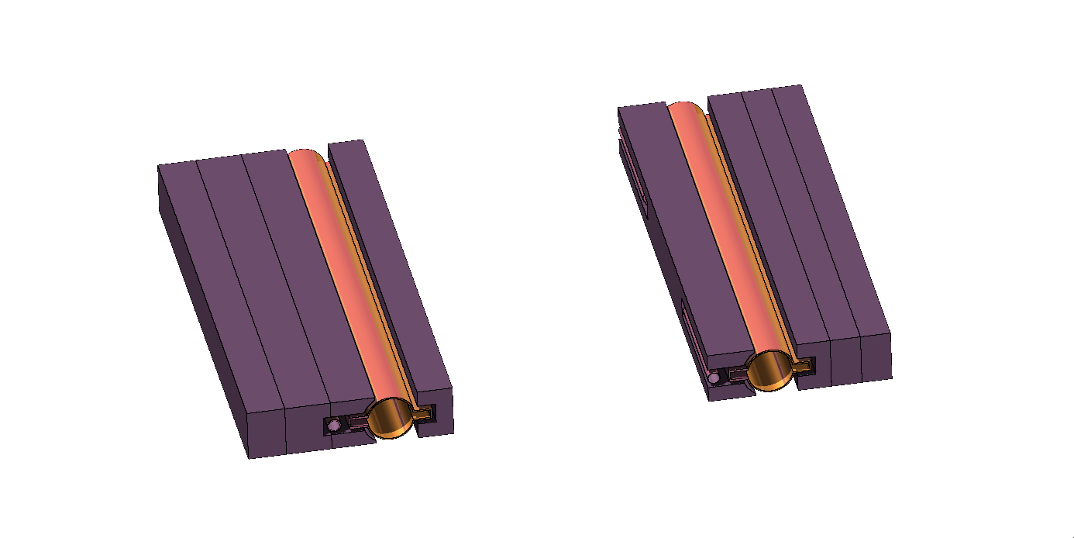
Shielding geometry and nomenclature
The geometry of the shielding is divided into four regions to evaluate the activation in different volumes. The reason for this is that within the high-density materials, the particle fluences can vary considerably within a few cm.
POS-0
POS-1
POS-2
EL-1
EL-0
POS-3
EL-2
e+ line
EL-3
62.0 cm
e- line
24.2 cm
27.1 cm

Slide 6
Materials composition – Shielding
Three materials were examined and compared in this study, including their impurities:
ρ = 18.00 g/cm3
ρ = 11.36 g/cm3
ρ = 11.36 g/cm3
INERMET180 ( W 95% -Cu 1.5 % - Ni 3.5 % ) [2]
 | Mass fractions
W | 9.48E-01
C | 3.56E-04
S | 2.59E-04
P | 9.74E-05
K | 4.87E-05
Na | 9.74E-05
Al | 9.74E-05
Cu | 1.49E-02
Cr | 9.74E-05
Co | 9.74E-05
Fe | 2.43E-04
Mo | 2.44E-04
Ni | 3.47E-02
Si | 1.95E-04
Ti | 2.92E-04
Ca | 9.74E-05
Pb | 4.80E-05
Mn | 2.40E-05
Pure lead – Pb
 | Mass fractions
Ag | 3.000E-06
As | 9.000E-06
Bi | 4.000E-06
Cd | 1.000E-06
Cu | 1.000E-06
Fe | 1.000E-07
Pb | 9.999E-01
Sb | 5.100E-05
Sn | 1.000E-06
Zn | 2.000E-06
PbSb alloy ( Sb 6% )
 | Mass fractions
Ag | 3.000E-06
As | 9.000E-06
Bi | 4.000E-06
Cd | 1.000E-06
Cu | 1.000E-06
Fe | 1.000E-07
Pb | 9.399E-01
Sb | 6.000E-02
Sn | 1.000E-06
Zn | 2.000E-06
[2] Thermal Characterization of Inermet 180, Dr. Ing. Wolfgang Hohenauer

Slide 7
Materials composition – Photon absorbers
Three materials were examined and compared in this study, including their impurities:
ρ = 18.00 g/cm3
ρ = 19.30 g/cm3
ρ = 11.36 g/cm3
INERMET180 ( W 95% -Cu 1.5 % - Ni 3.5 % ) [2]
 | Mass fractions
W | 9.48E-01
C | 3.56E-04
S | 2.59E-04
P | 9.74E-05
K | 4.87E-05
Na | 9.74E-05
Al | 9.74E-05
Cu | 1.49E-02
Cr | 9.74E-05
Co | 9.74E-05
Fe | 2.43E-04
Mo | 2.44E-04
Ni | 3.47E-02
Si | 1.95E-04
Ti | 2.92E-04
Ca | 9.74E-05
Pb | 4.80E-05
Mn | 2.40E-05
Pure Tungsten
 | Mass fractions
W | 9.98E-01
C | 1.54E-04
S | 5.13E-05
P | 1.03E-04
K | 5.13E-05
Na | 1.03E-04
Al | 1.03E-04
Cu | 5.13E-05
Cr | 1.03E-04
Co | 1.03E-04
Fe | 2.05E-04
Mo | 2.56E-04
Ni | 1.03E-04
Si | 2.05E-04
Ti | 3.08E-04
Ca | 1.03E-04
PbSb alloy ( Sb 6% )
 | Mass fractions
Ag | 3.000E-06
As | 9.000E-06
Bi | 4.000E-06
Cd | 1.000E-06
Cu | 1.000E-06
Fe | 1.000E-07
Pb | 9.399E-01
Sb | 6.000E-02
Sn | 1.000E-06
Zn | 2.000E-06
[2] Thermal Characterization of Inermet 180, Dr. Ing. Wolfgang Hohenauer

Slide 8
Results – Shielding
Irradiation scenario:
- 5 years ttbar operation (182.5 GeV, 3.1e16 p/s)
- 185 days of operation + 180 days of technical stop
Cool down times:
- From 1 hour to 30 years

Slide 9
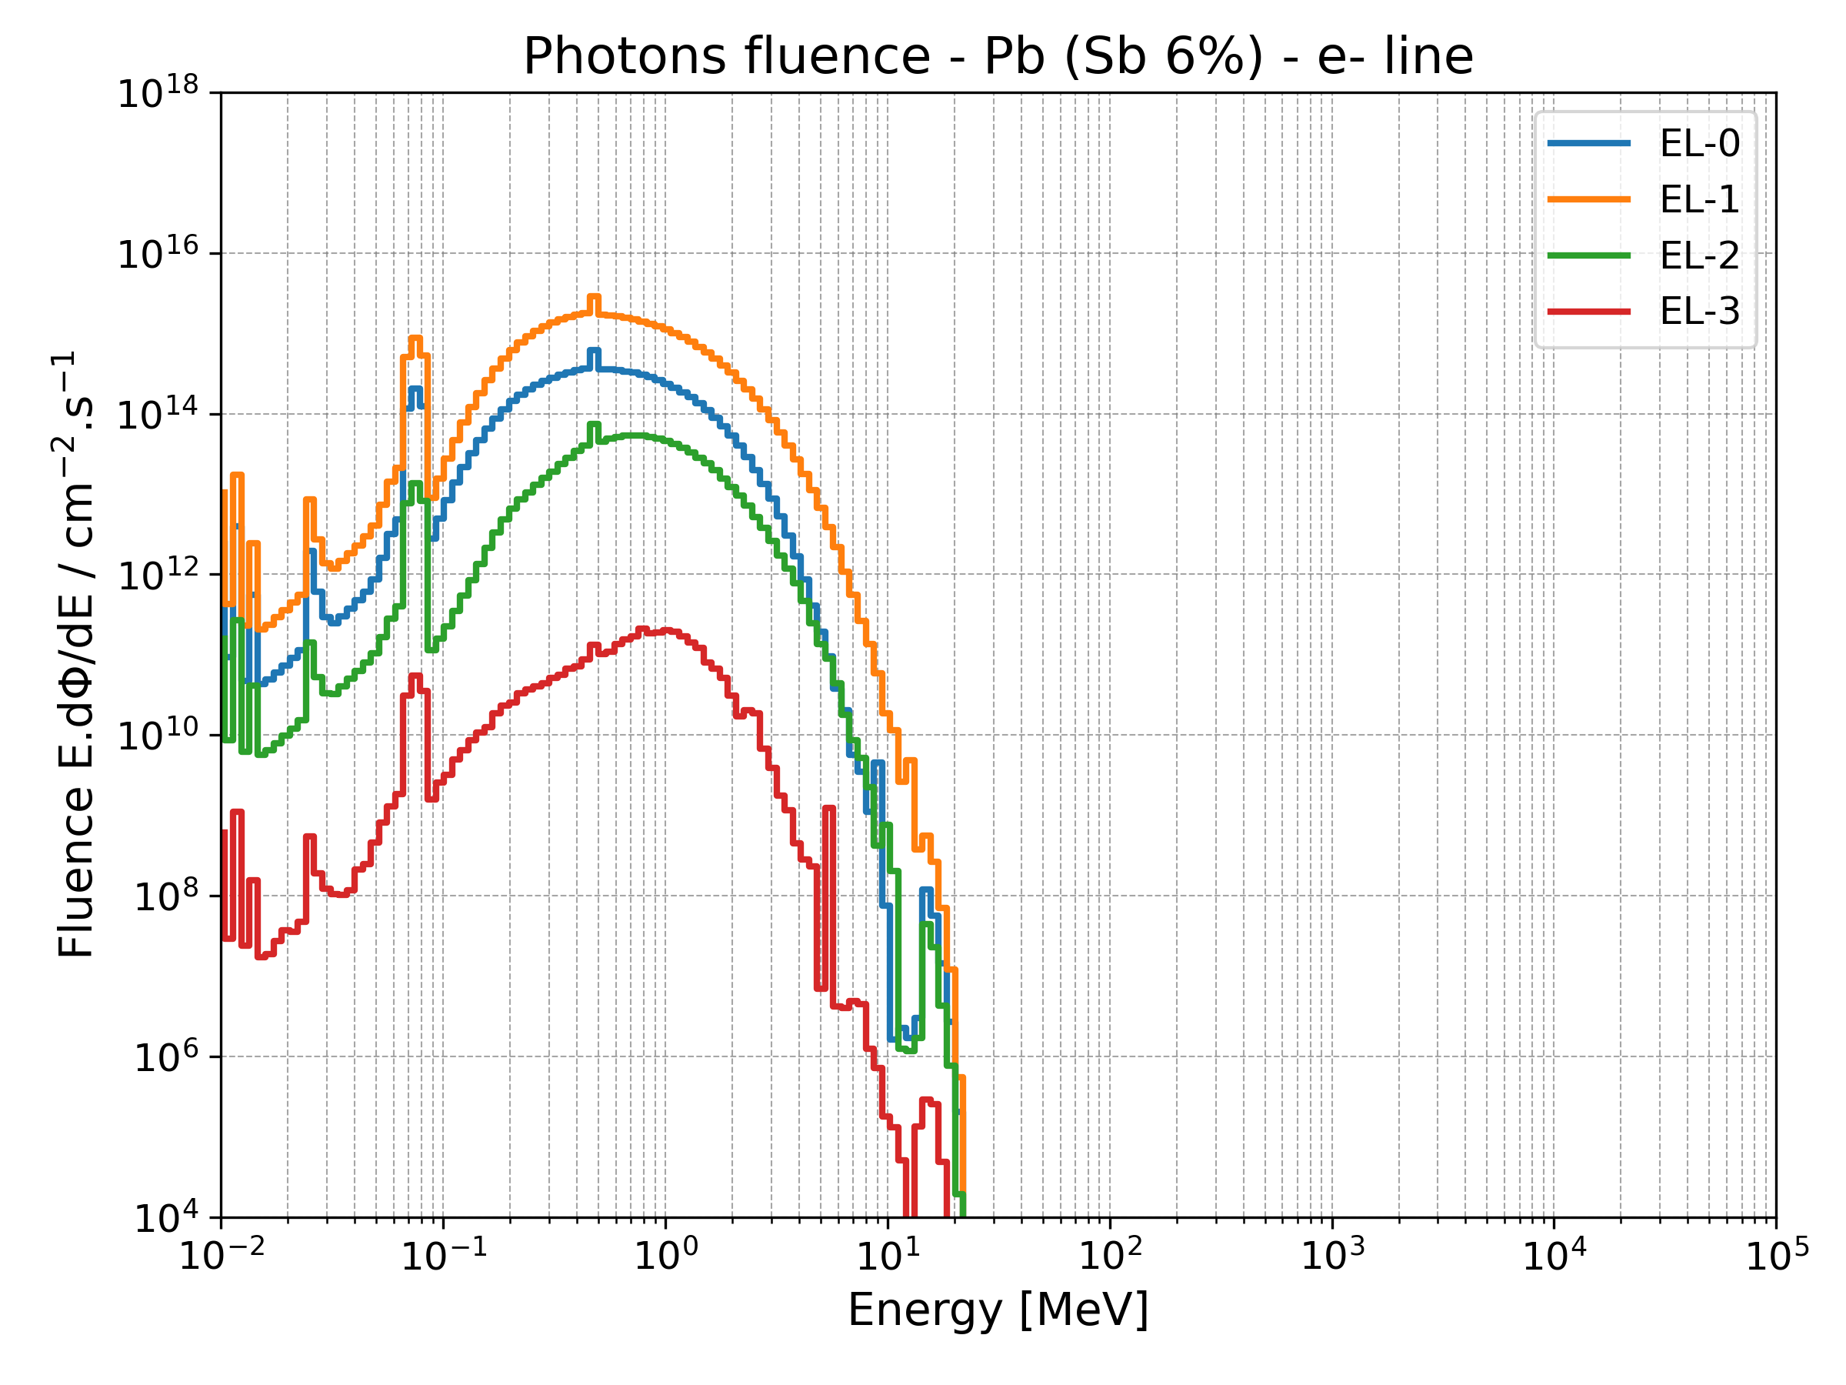
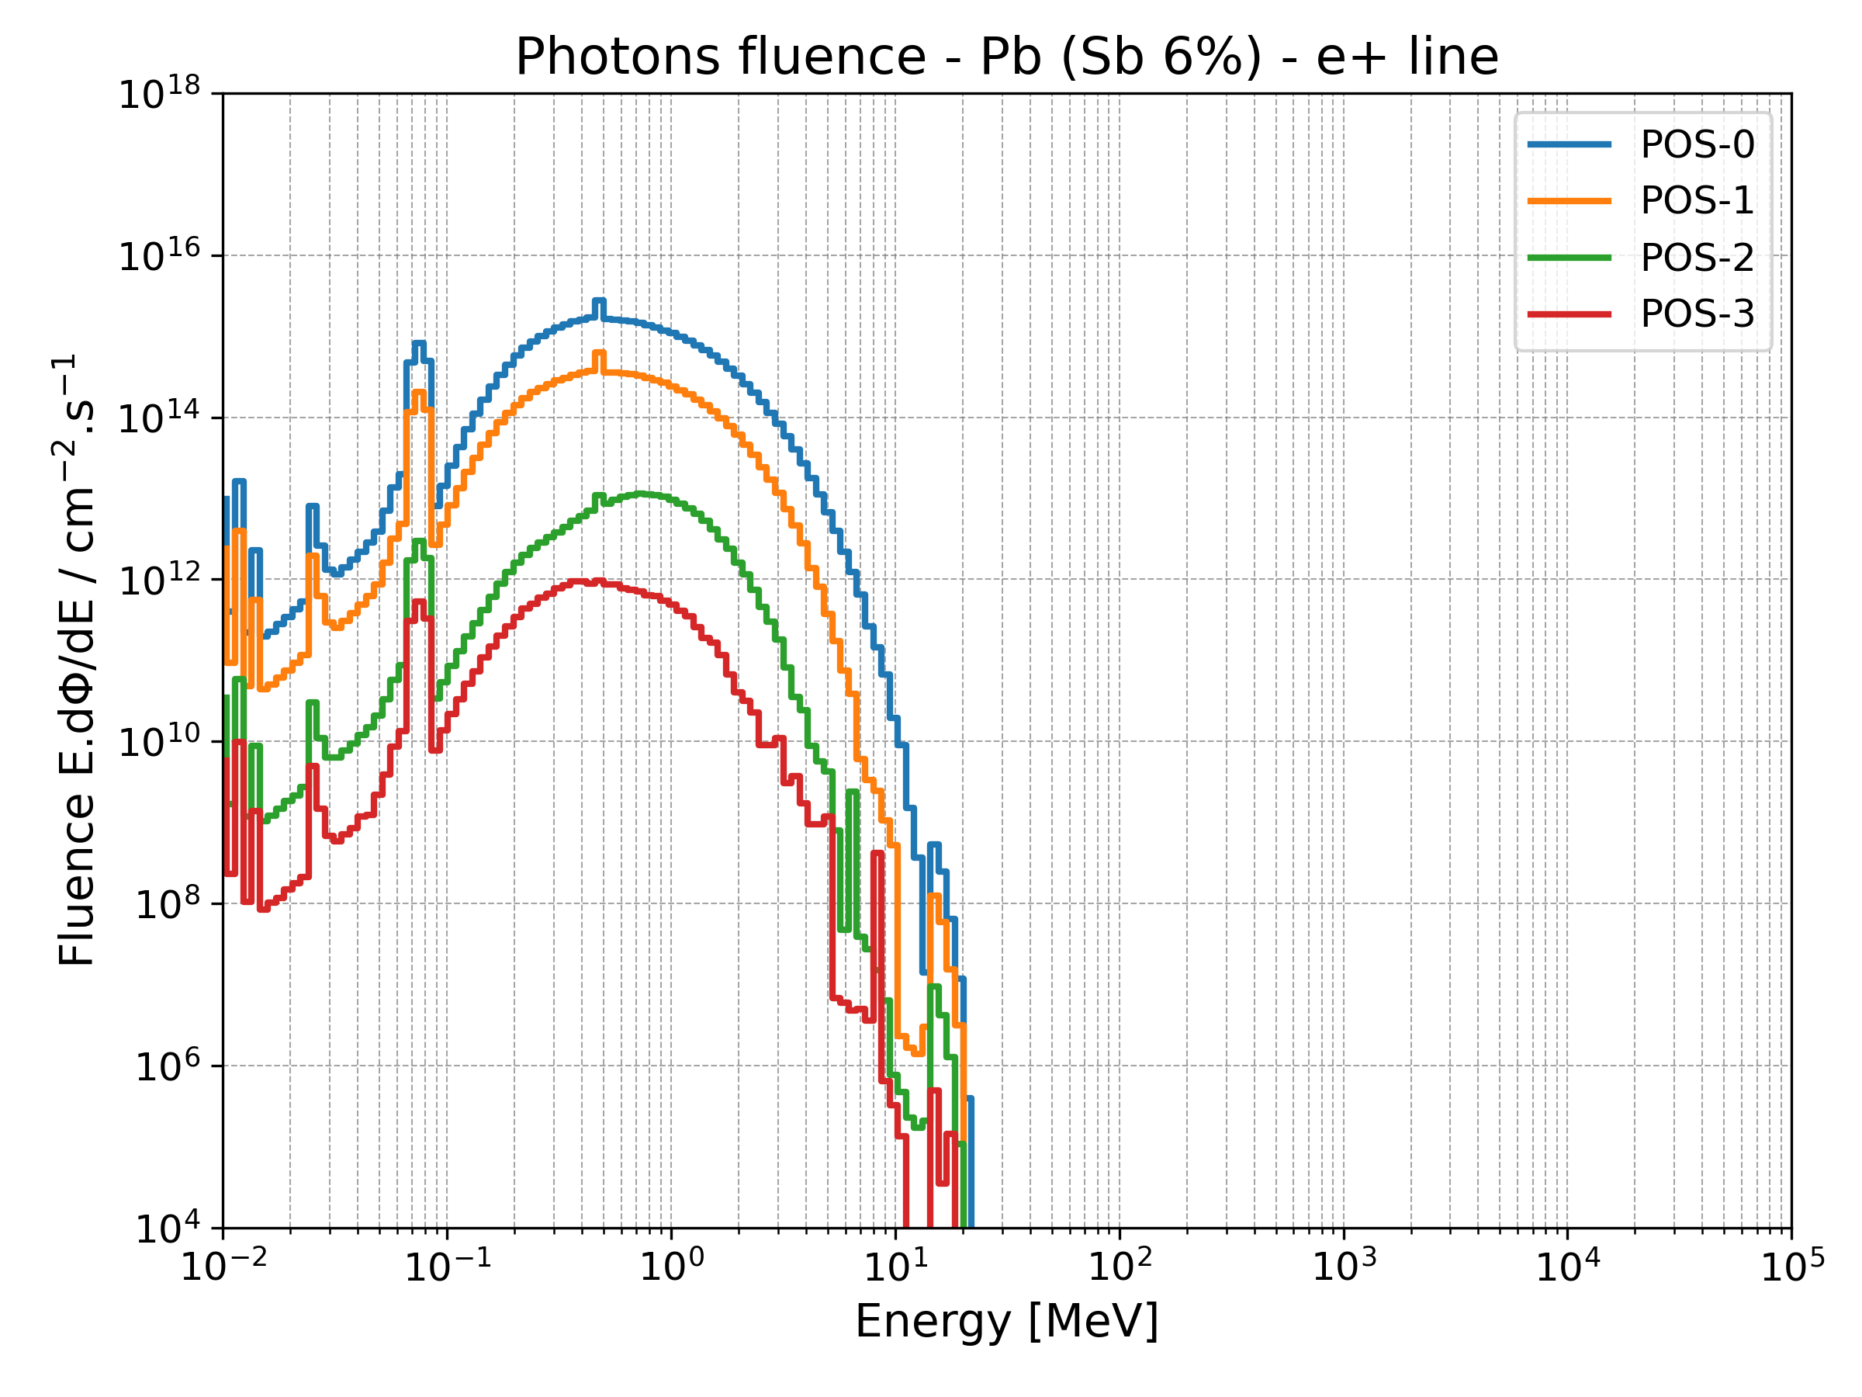
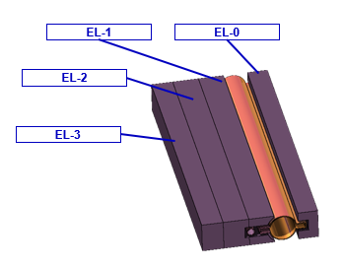
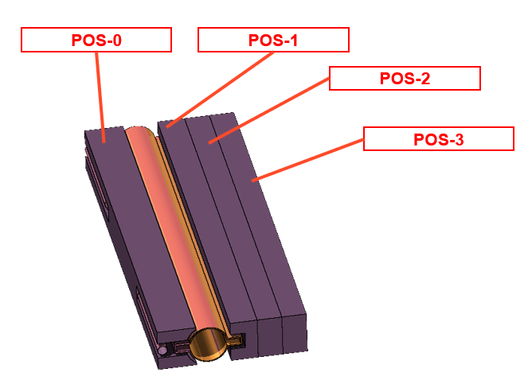
Particle spectra
By scoring the particle fluences in the different regions, we can identify the parts of the shielding that are more exposed to activation. This allows us to focus the rest of the study solely on the most impacted shielding part.

Slide 10
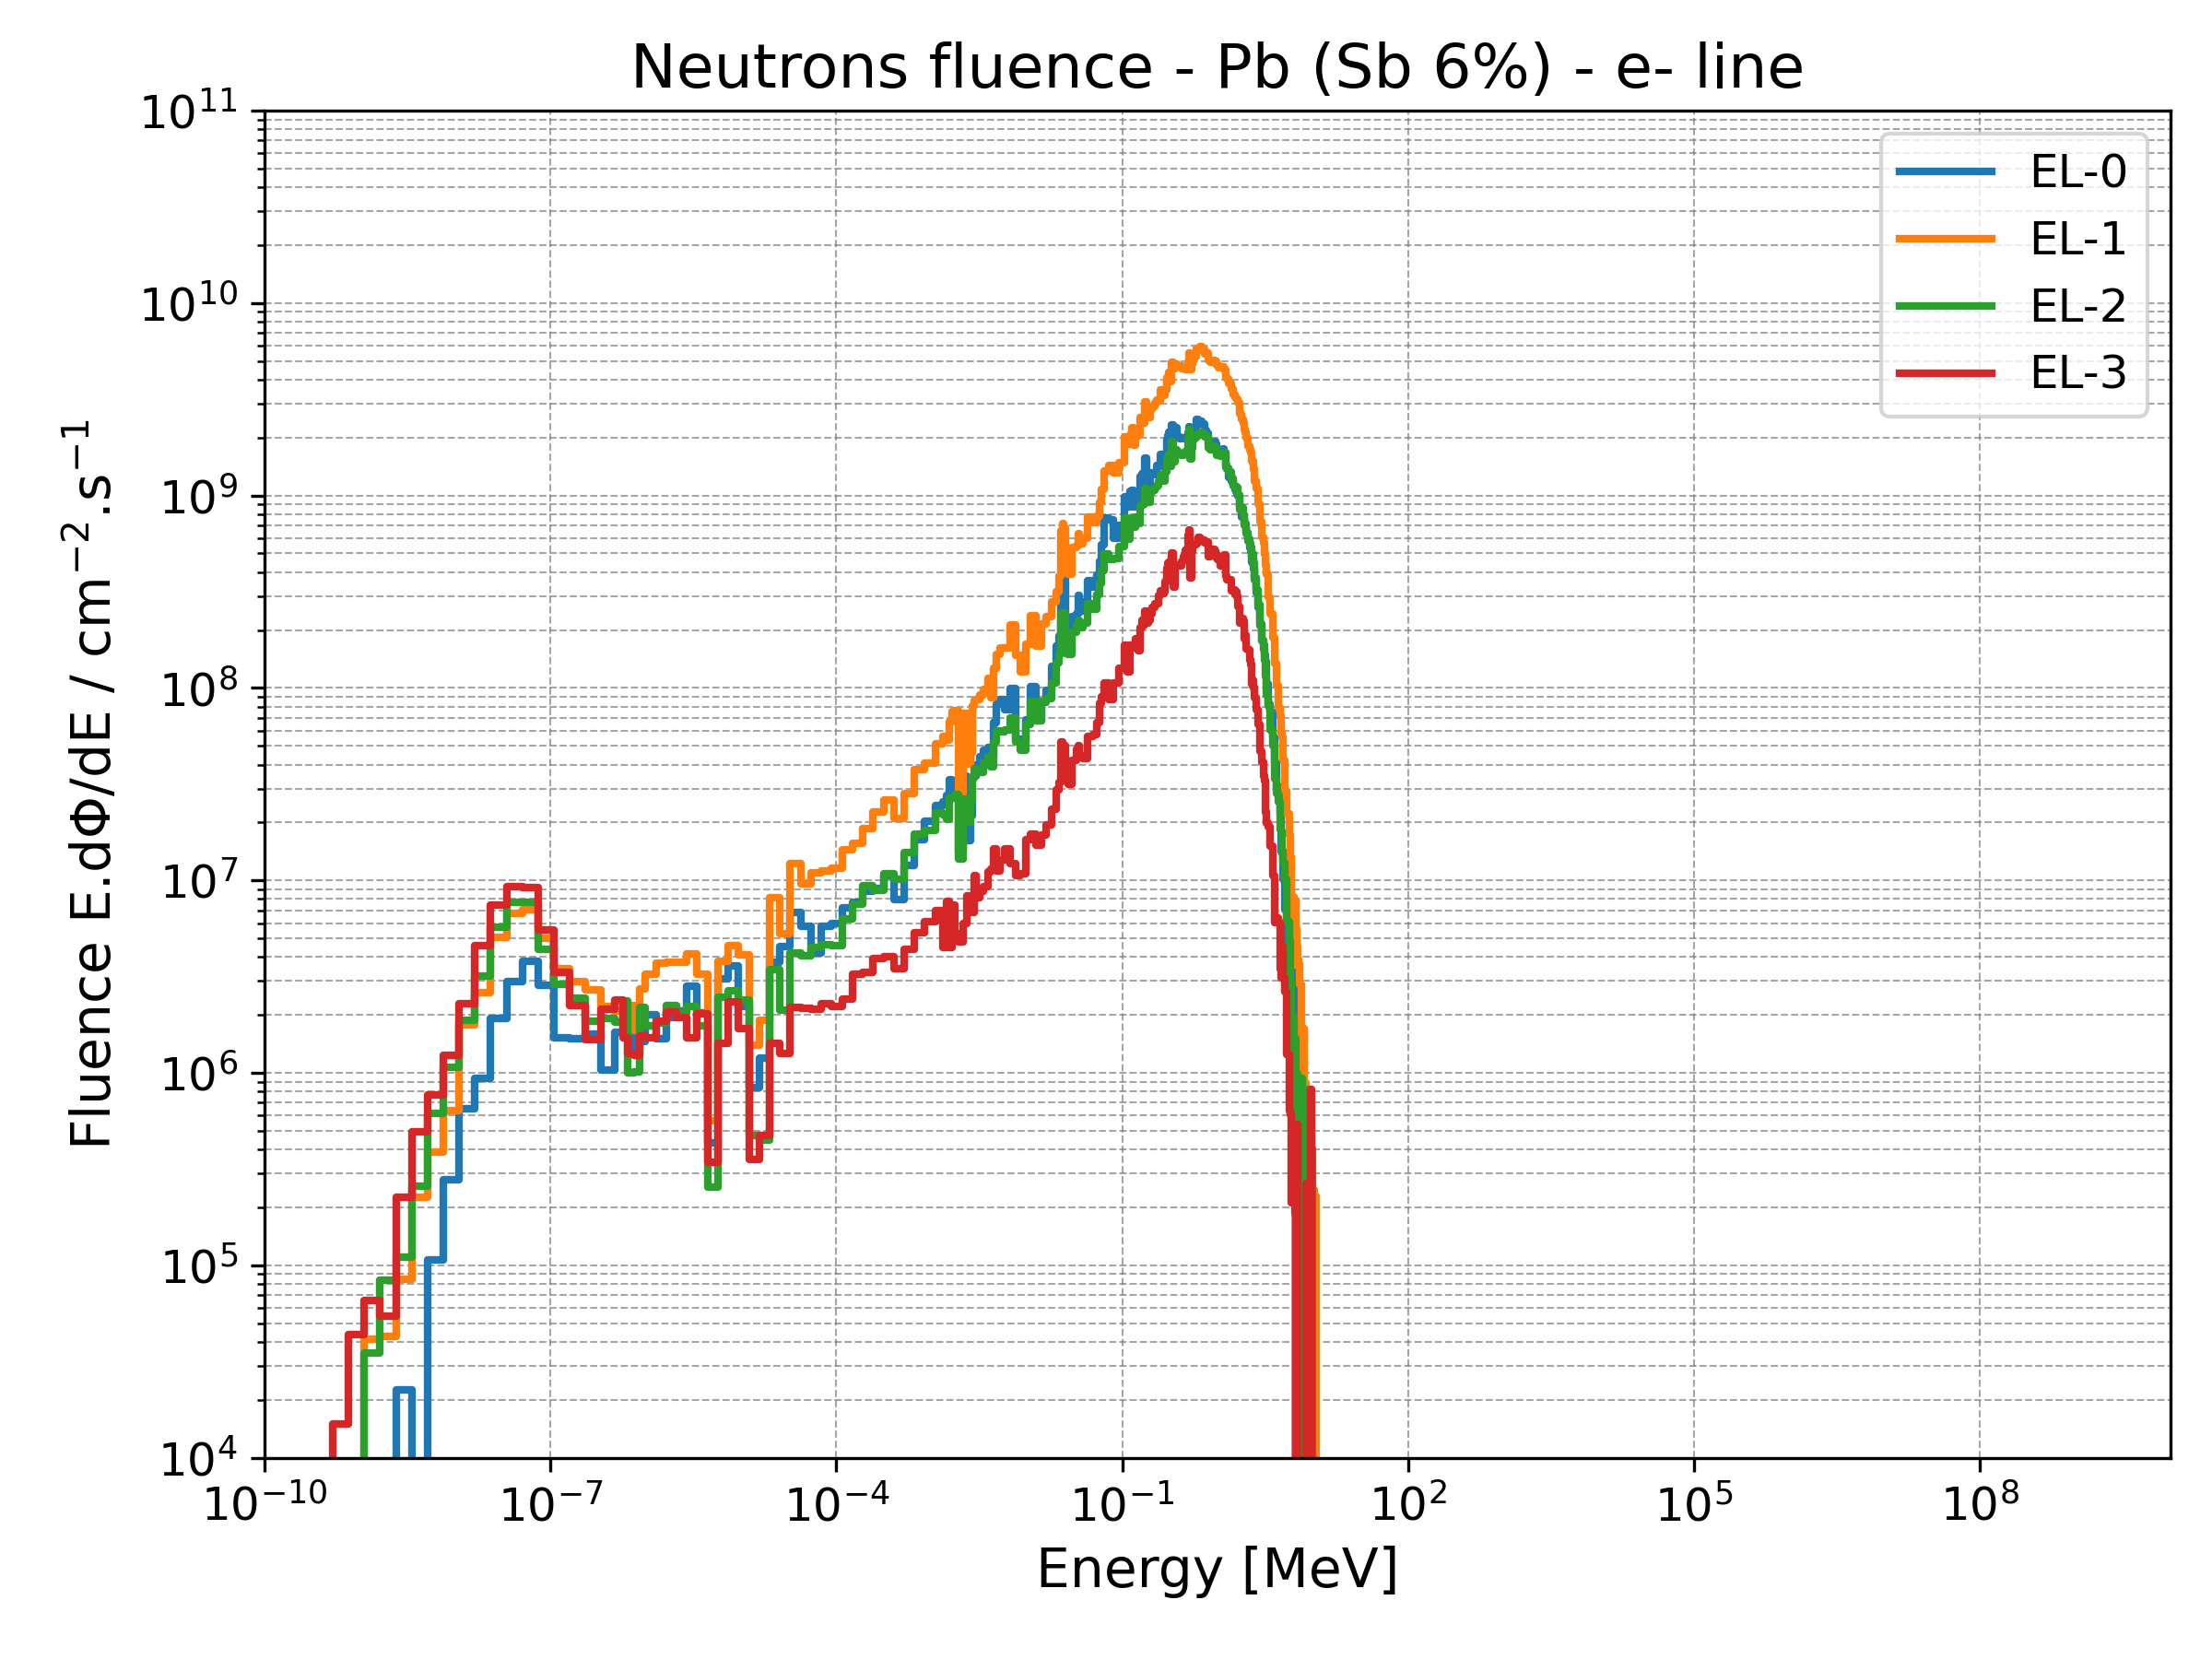
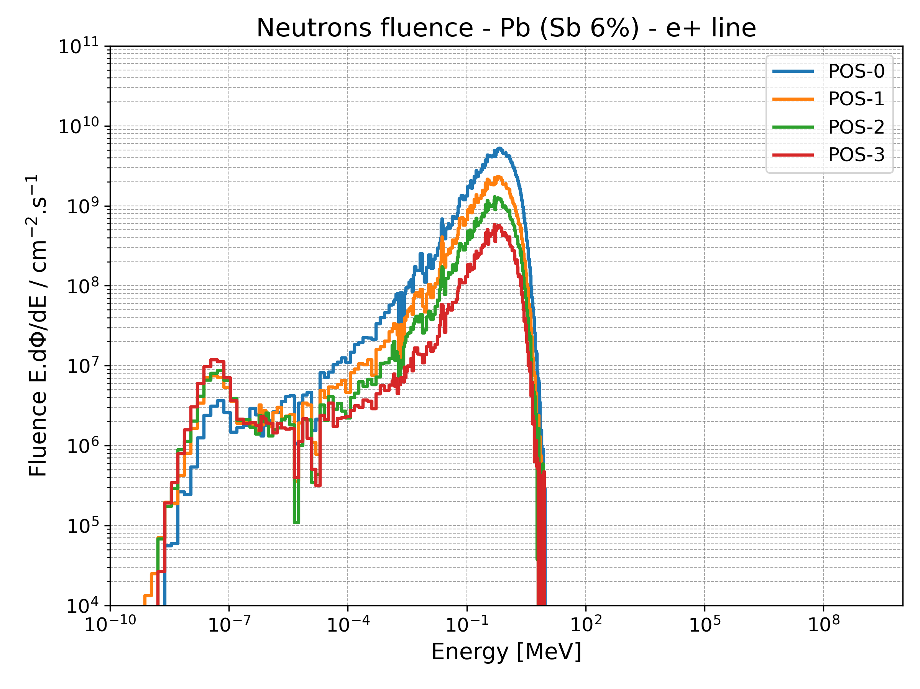
Particle spectra
EL-1 and POS-0 are the regions with the highest activation within the total shielding.
By scoring the particle fluences in the different regions, we can identify the parts of the shielding that are more exposed to activation. This allows us to focus the rest of the study solely on the most impacted shielding part.
EL-1 and POS-0 are the regions with the highest fluences within the total shielding.

Slide 11
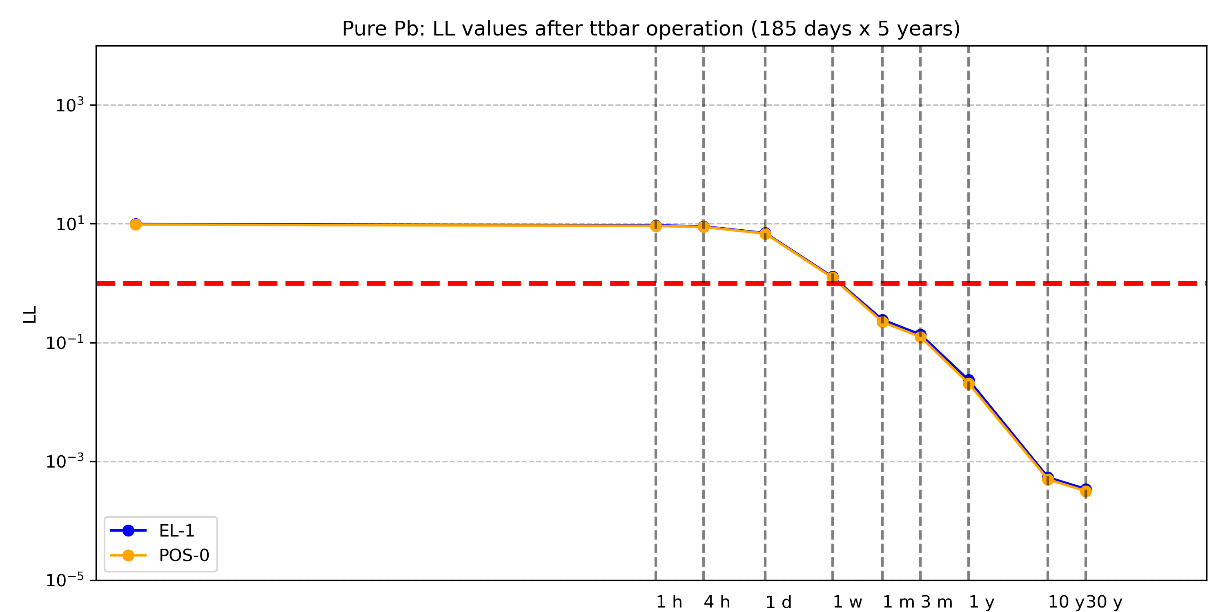
LL time evolution – Pure Pb
innermost shielding layer
~ 1 week decay required to fall below 1 LL

Slide 12
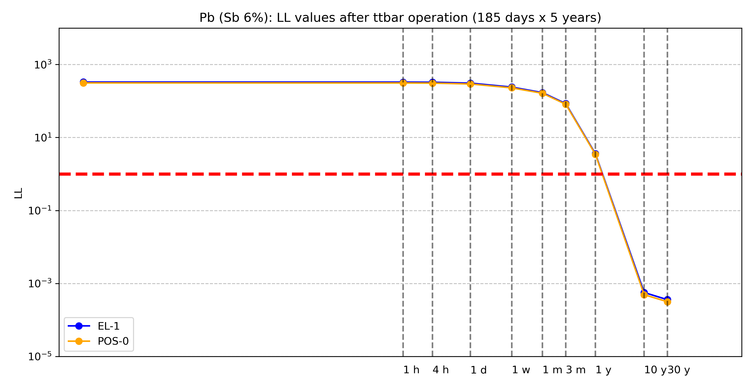
LL time evolution – Pb (6% Sb )
innermost shielding layer
~ 1-2 years decay required to fall below 1 LL

Slide 13
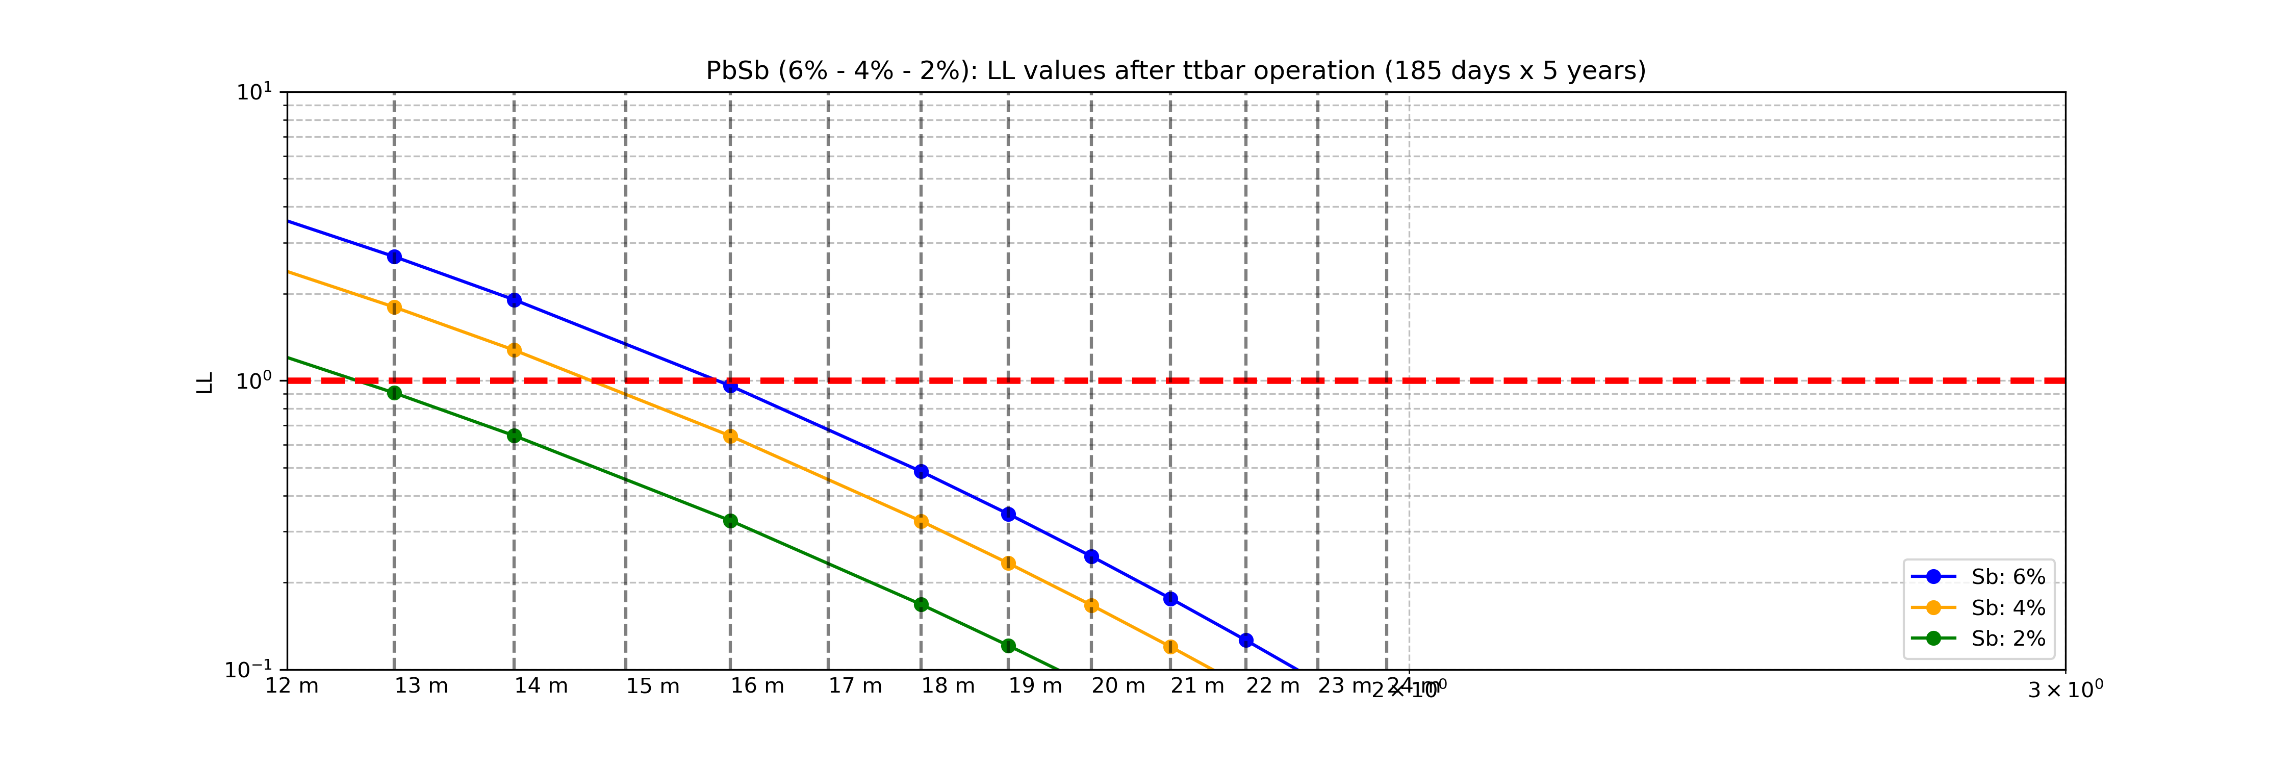
LL time evolution – PbSb: Sb from 2% to 6%
PbSb (Sb 2%): below 1 LL after 13 months.
PbSb (Sb 4%): below 1 LL after 14.5 months.
PbSb (Sb 6%): below 1 LL after 16 months.

Slide 14
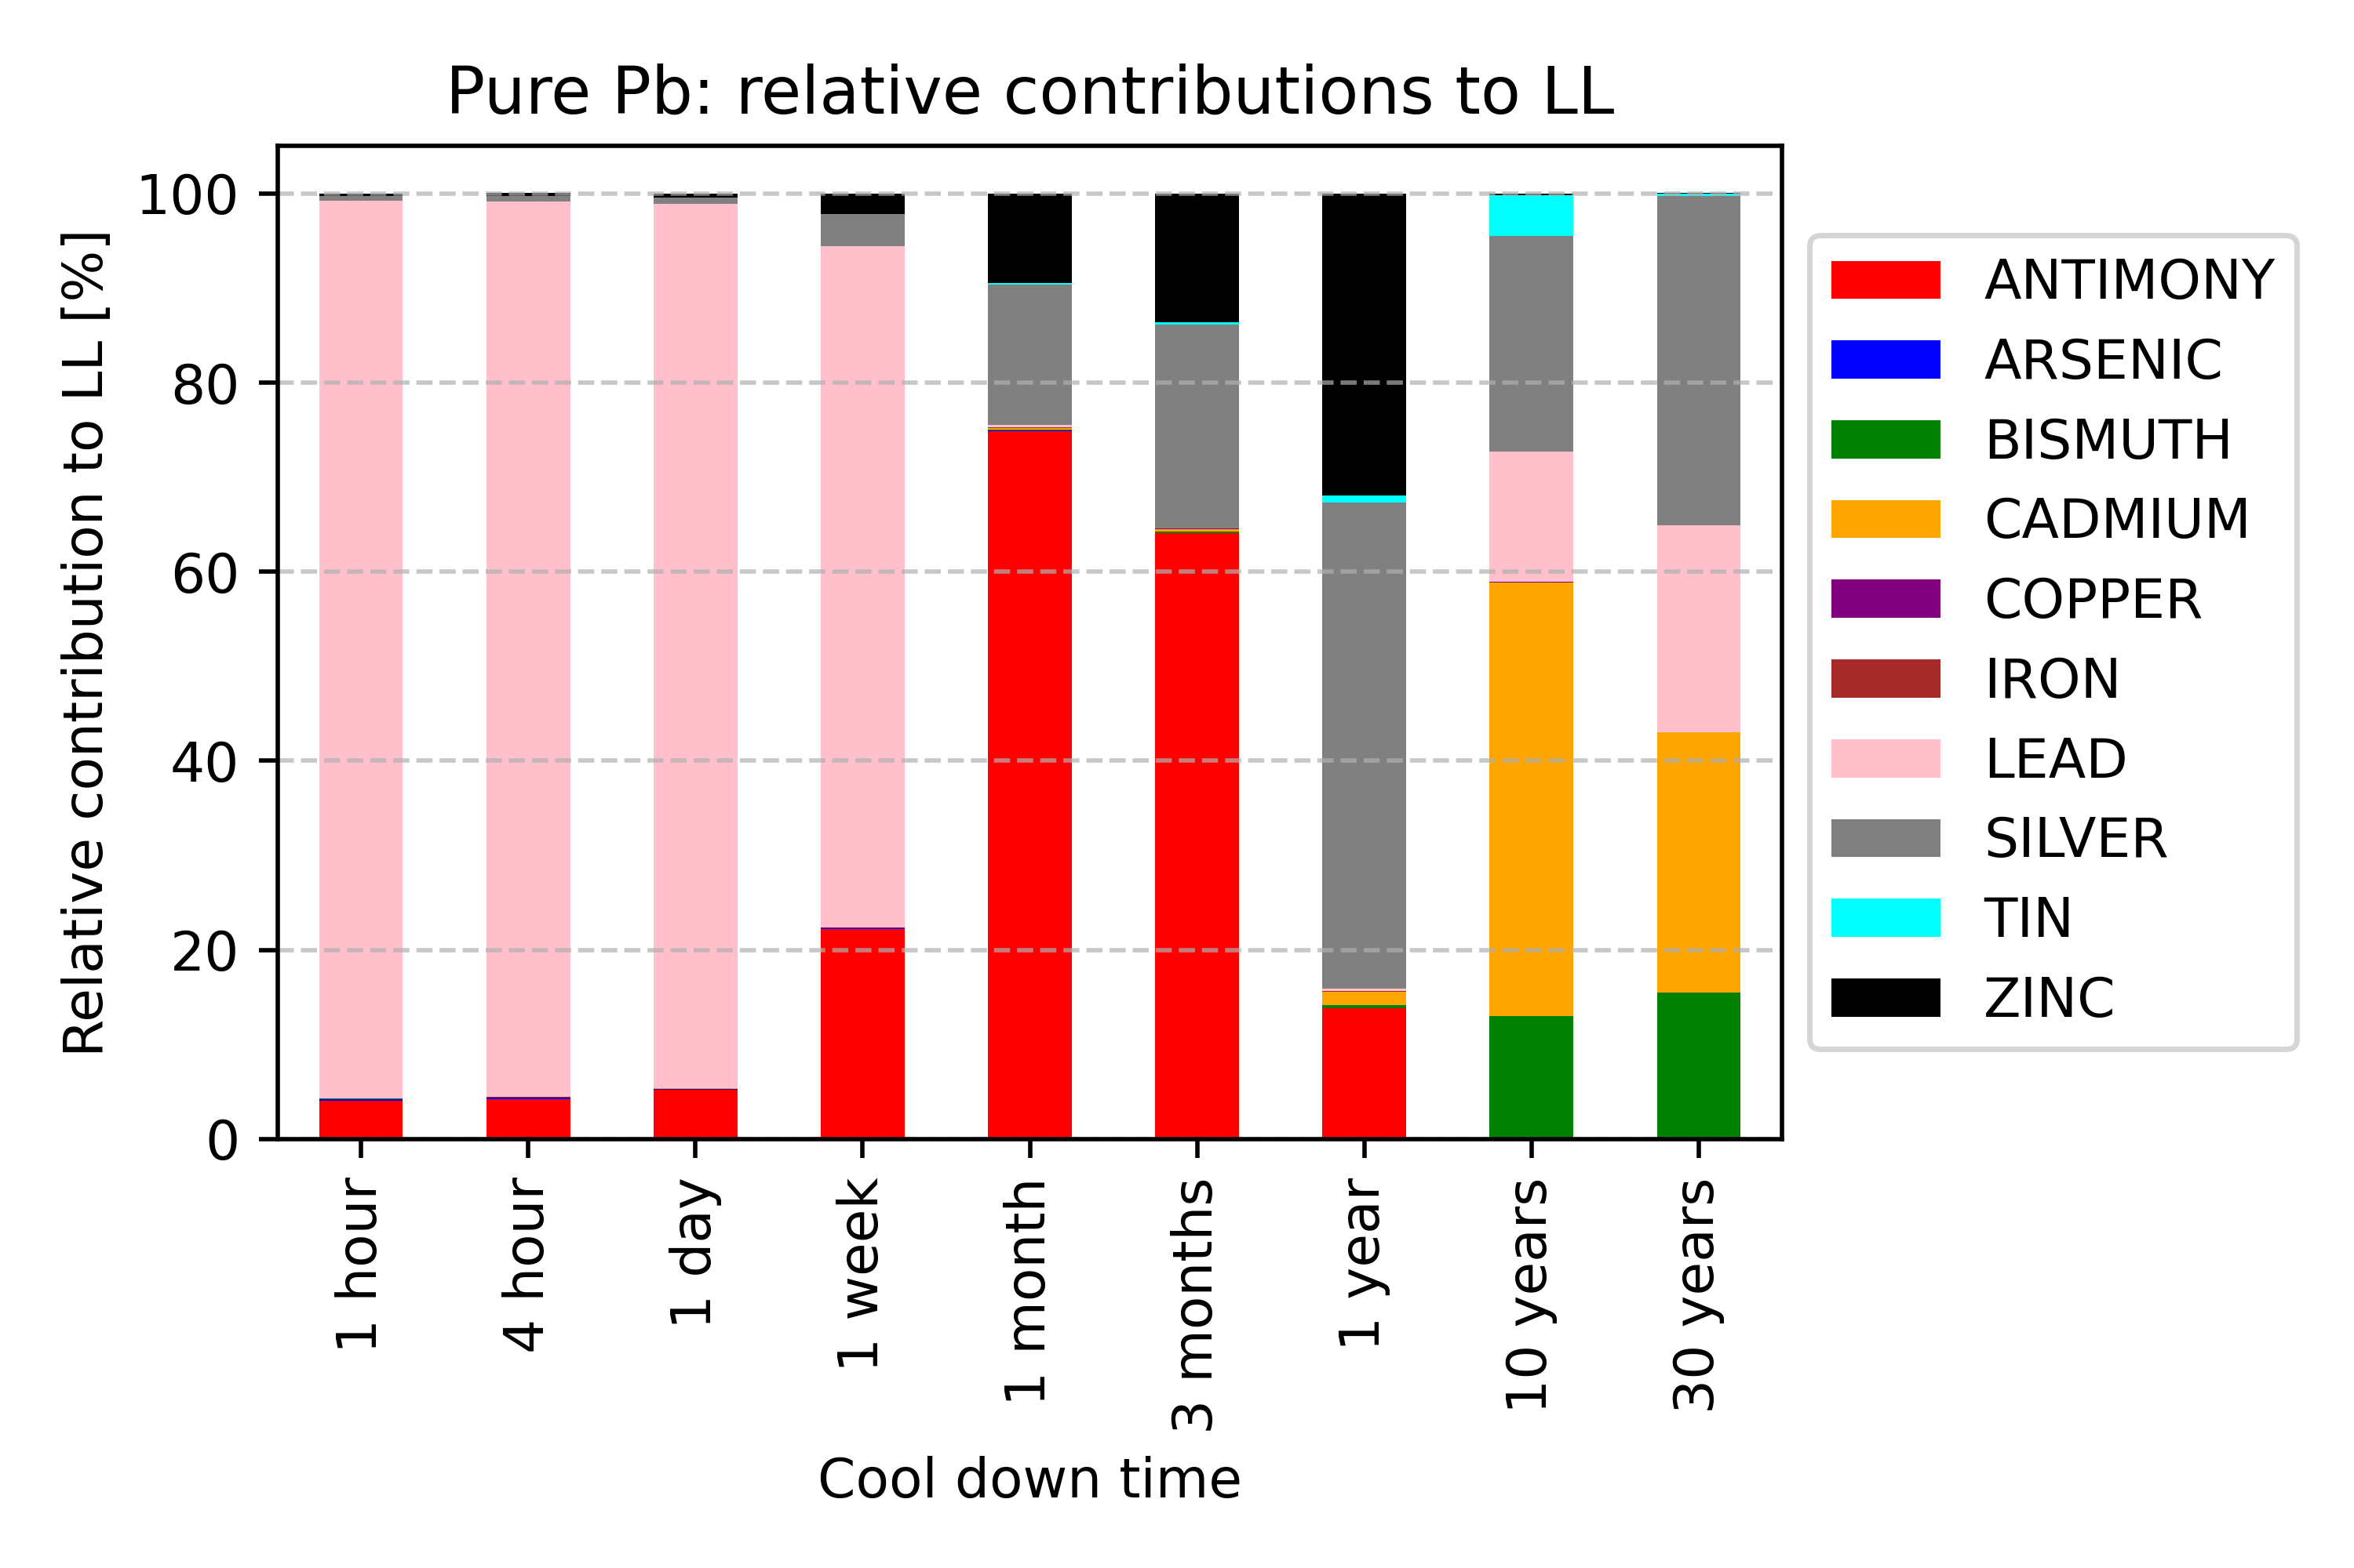
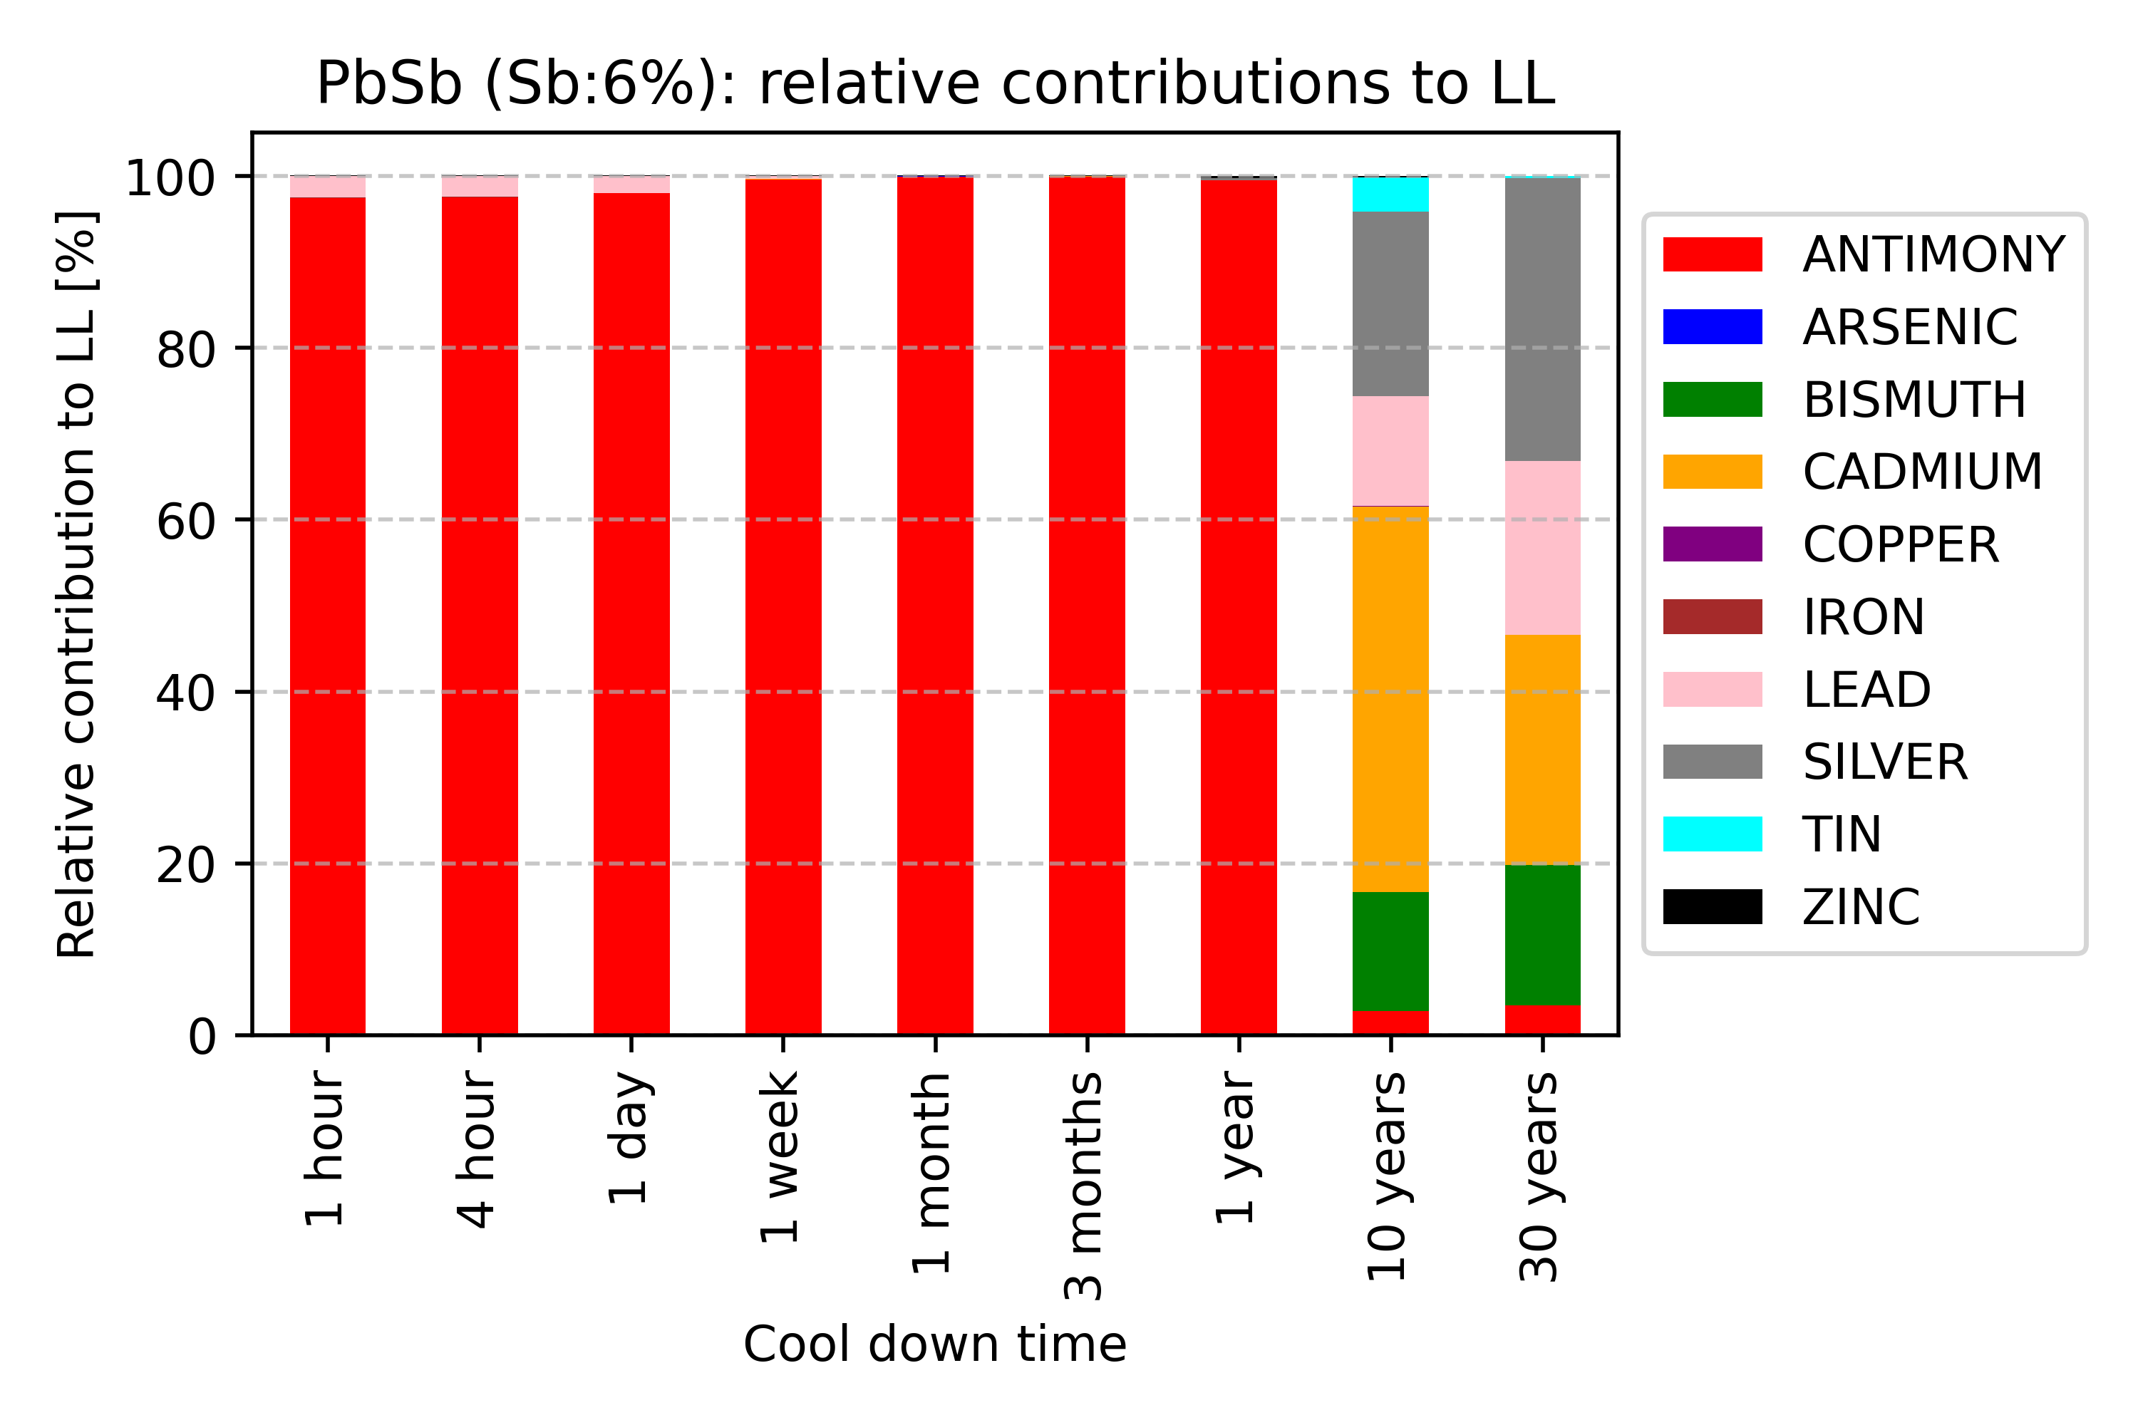
Relative contribution to LL: Pb and PbSb
Pure Lead and Lead-Antimony alloy (Sb:6%)

Slide 15
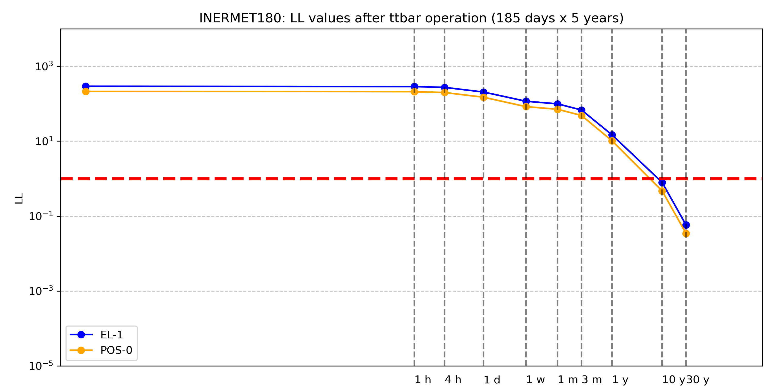
LL time evolution – INERMET180
innermost shielding layer
~ 10 years decay required to fall below 1 LL

Slide 16
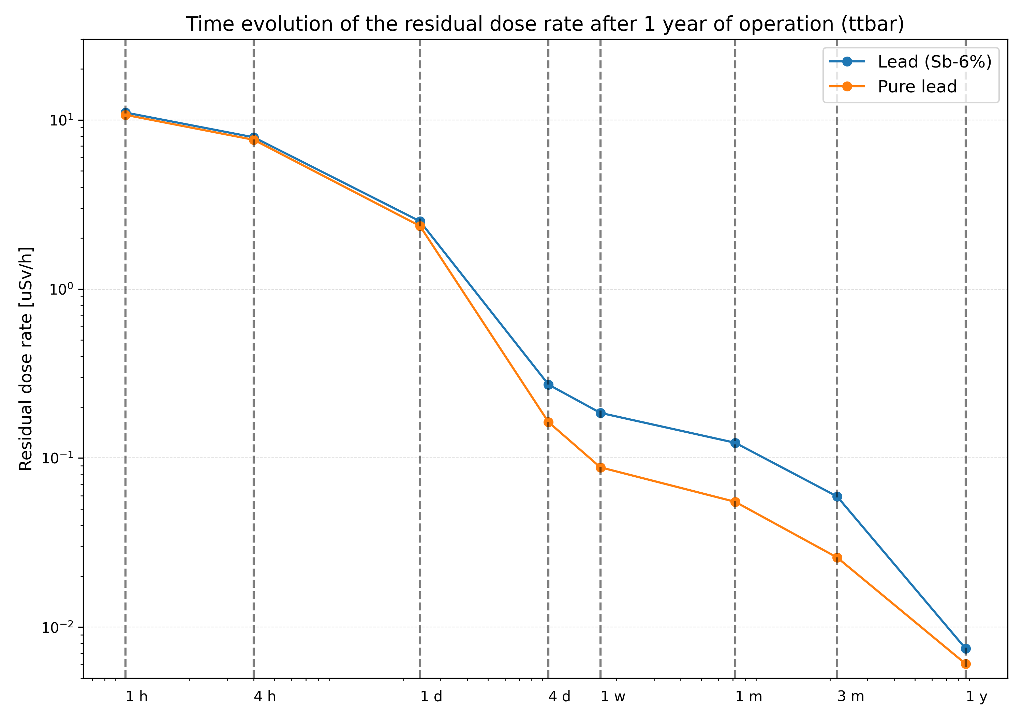
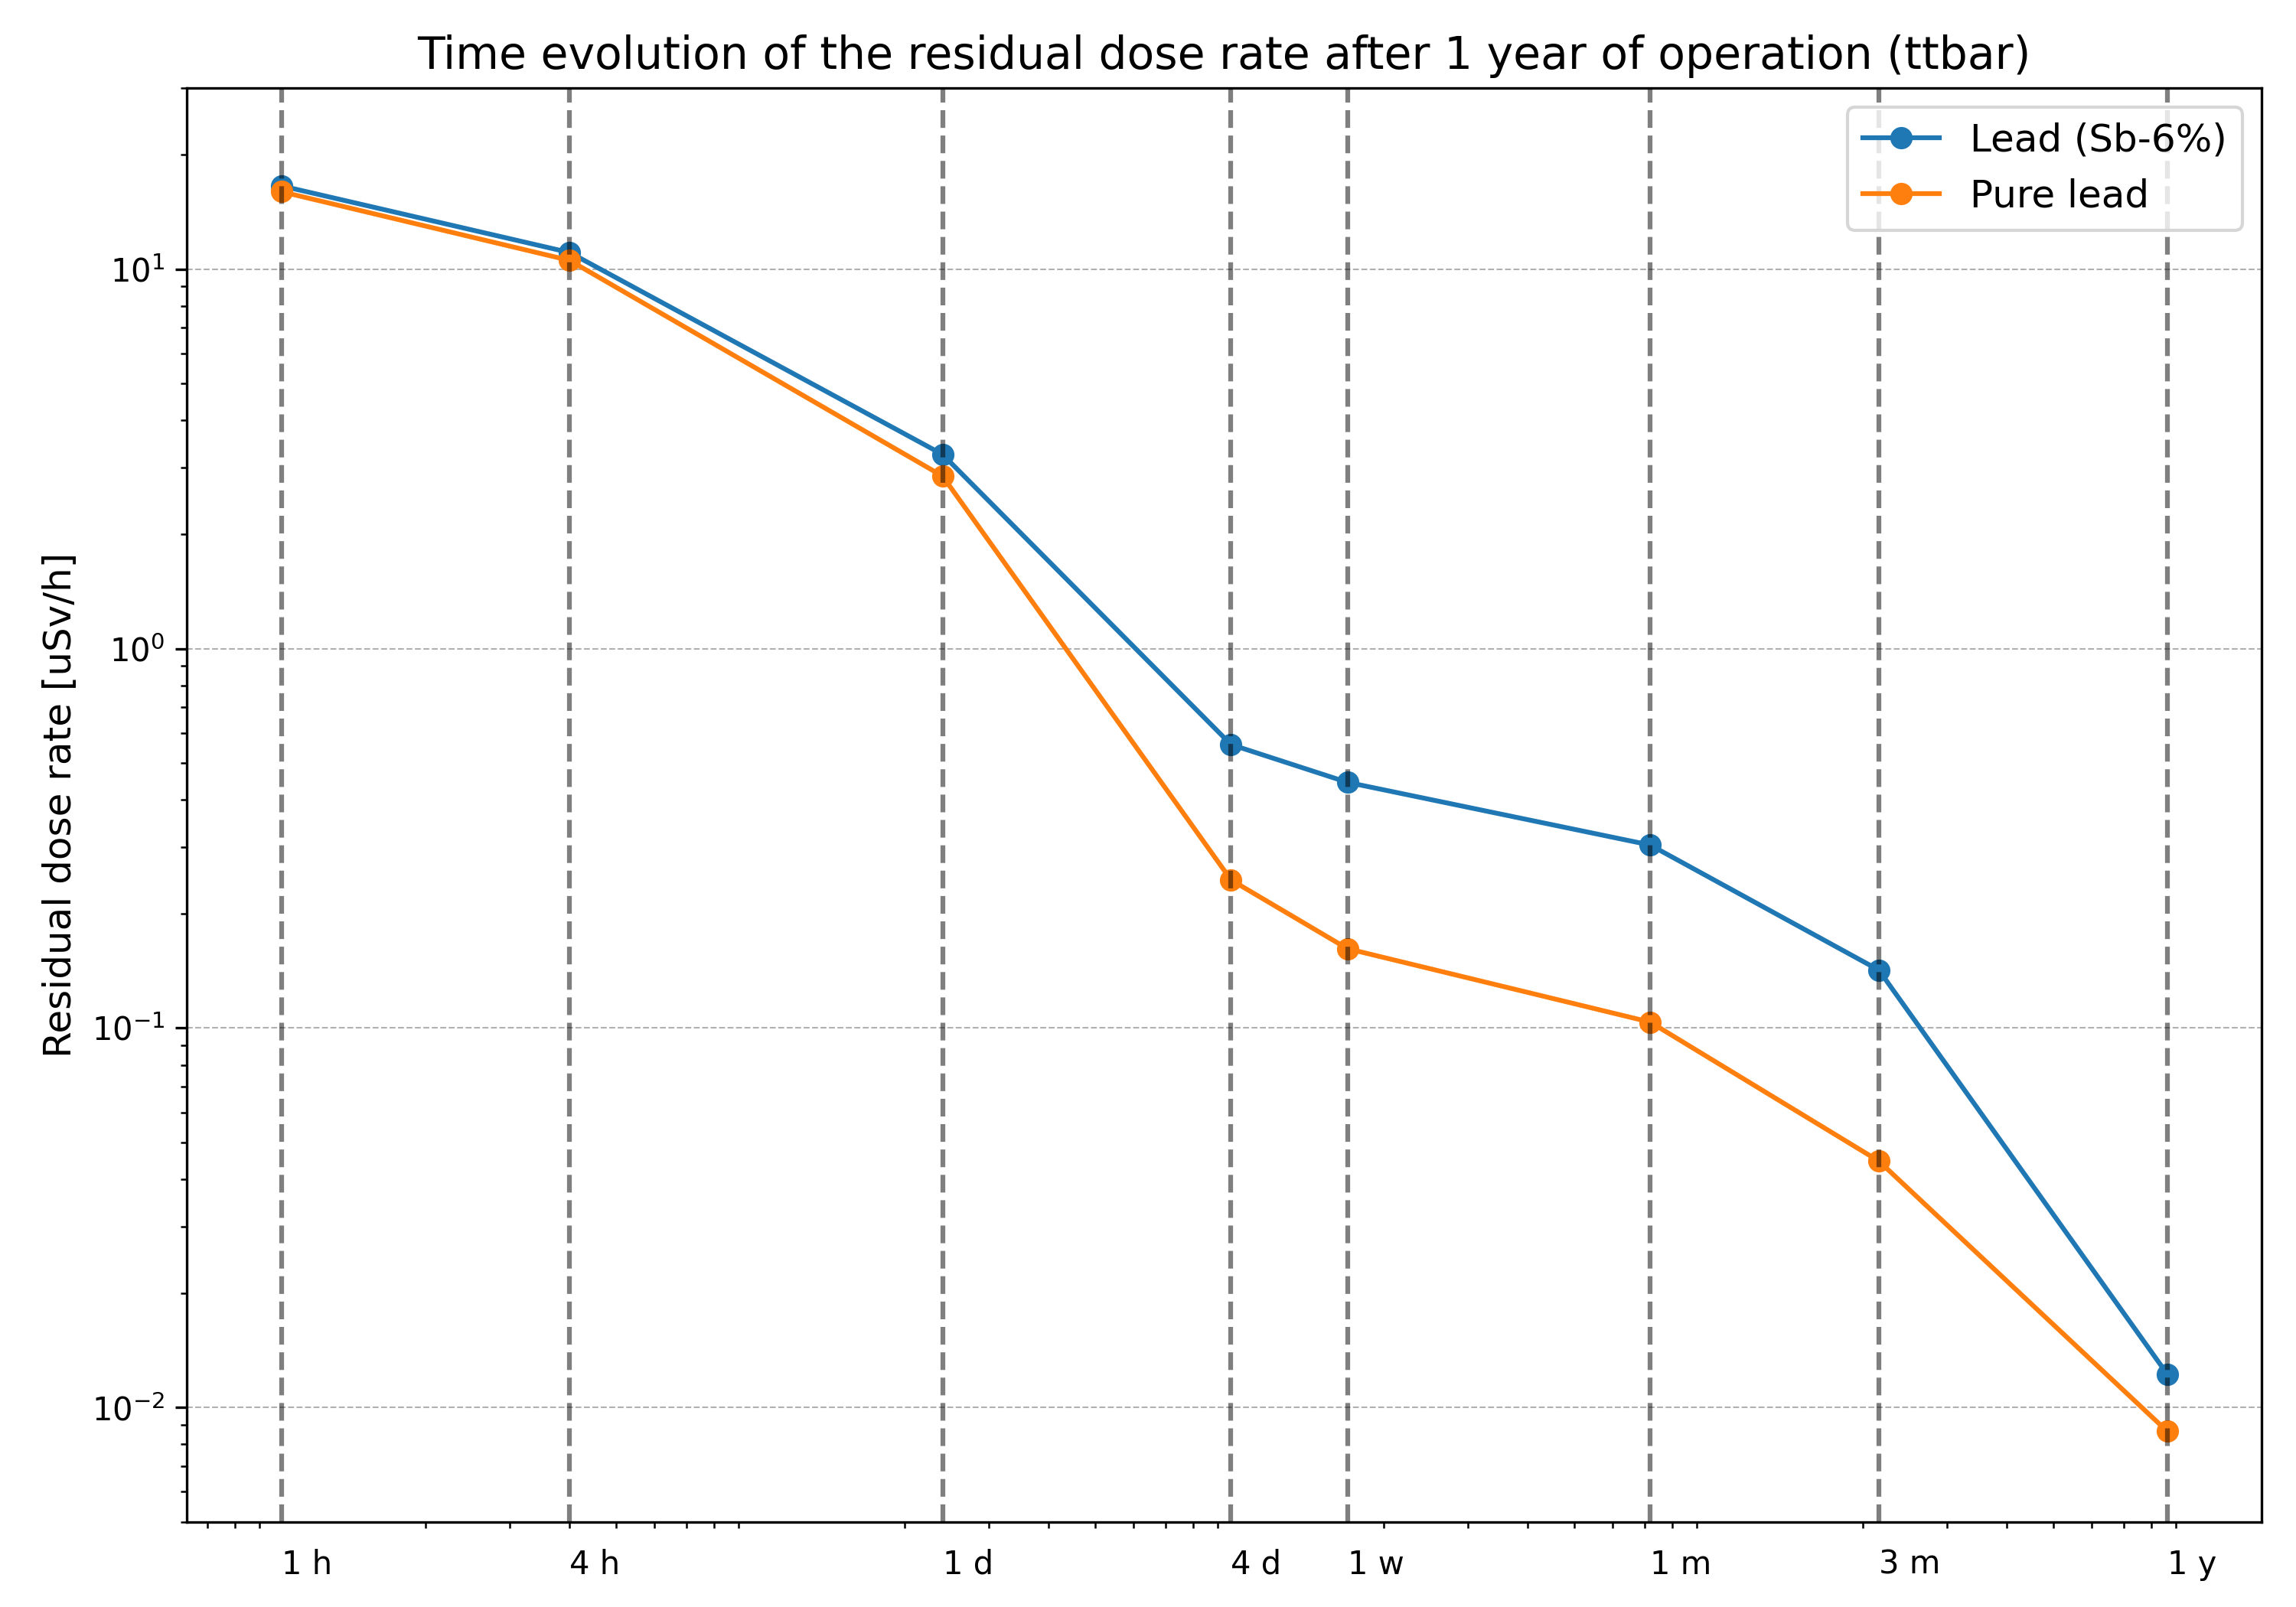
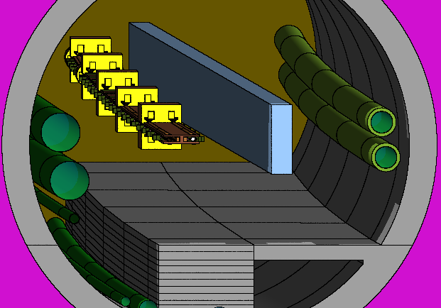
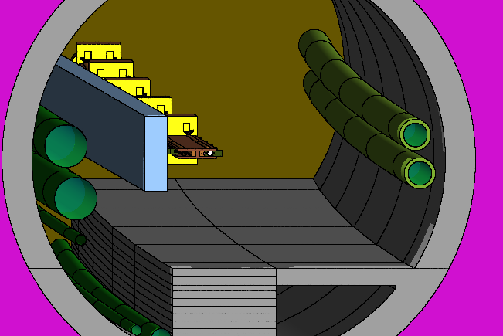
Residual dose rate
~ natural background level on the surface
AVERAGED-VOLUME
AVERAGED-VOLUME
The profiles show the average residual dose rate within the sampled volumes on either side of the line, comparing pure Pb with Pb(Sb-6%).
Antimony in the lead base gives an additional contribution to the residual dose rate after > 1 day throughout the first year of cool-down.
Despite the low absolute dose rate, the objective should be to minimize the dose rate as this will affect 80 km of tunnel !

Slide 17
Conclusions – Shielding
The following conclusions are made for the materials analyzed:
  Pure Lead: considered non-radioactive after ~1 week. This timeframe is ideal considering the necessary timeline for the dismantling phase of FCCee, before FCChh operation, as intermediate decay storage before elimination can be avoided. However, the activation of the casing/support material needs to be assessed.
  INERMET180: considered non-radioactive after ~10 years. Costs increase due to the need to store this material over a longer period. Should be excluded.
  Lead (Sb 6%): the increase in antimony in the alloy leads to two effects
    It extends the time to 1-2 years before the material can be considered non-radioactive. This is should be optimized because after FCCee, the shielding must be removed, and if they are still radioactive, they will need to be stored (logistics and costs for storage area).
    It increases the residual dose rate in the arc. Although the absolute dose rate remains low , exposure during accesses could be minimized.
Conclusions: Sb content in lead should be minimized as much as feasible in a compromise to:
  simplify the mechanical construction (no support frame required)
  avoid decay storage after dismantling
  reduce residual dose rate levels

Slide 18
Results – Photon absorbers
Irradiation scenario:
- 5 years ttbar operation (182.5 GeV, 3.1e16 p/s)
- 185 days of operation + 180 days of technical stop
Cool down times:
- From 1 hour to 30 years

Slide 19
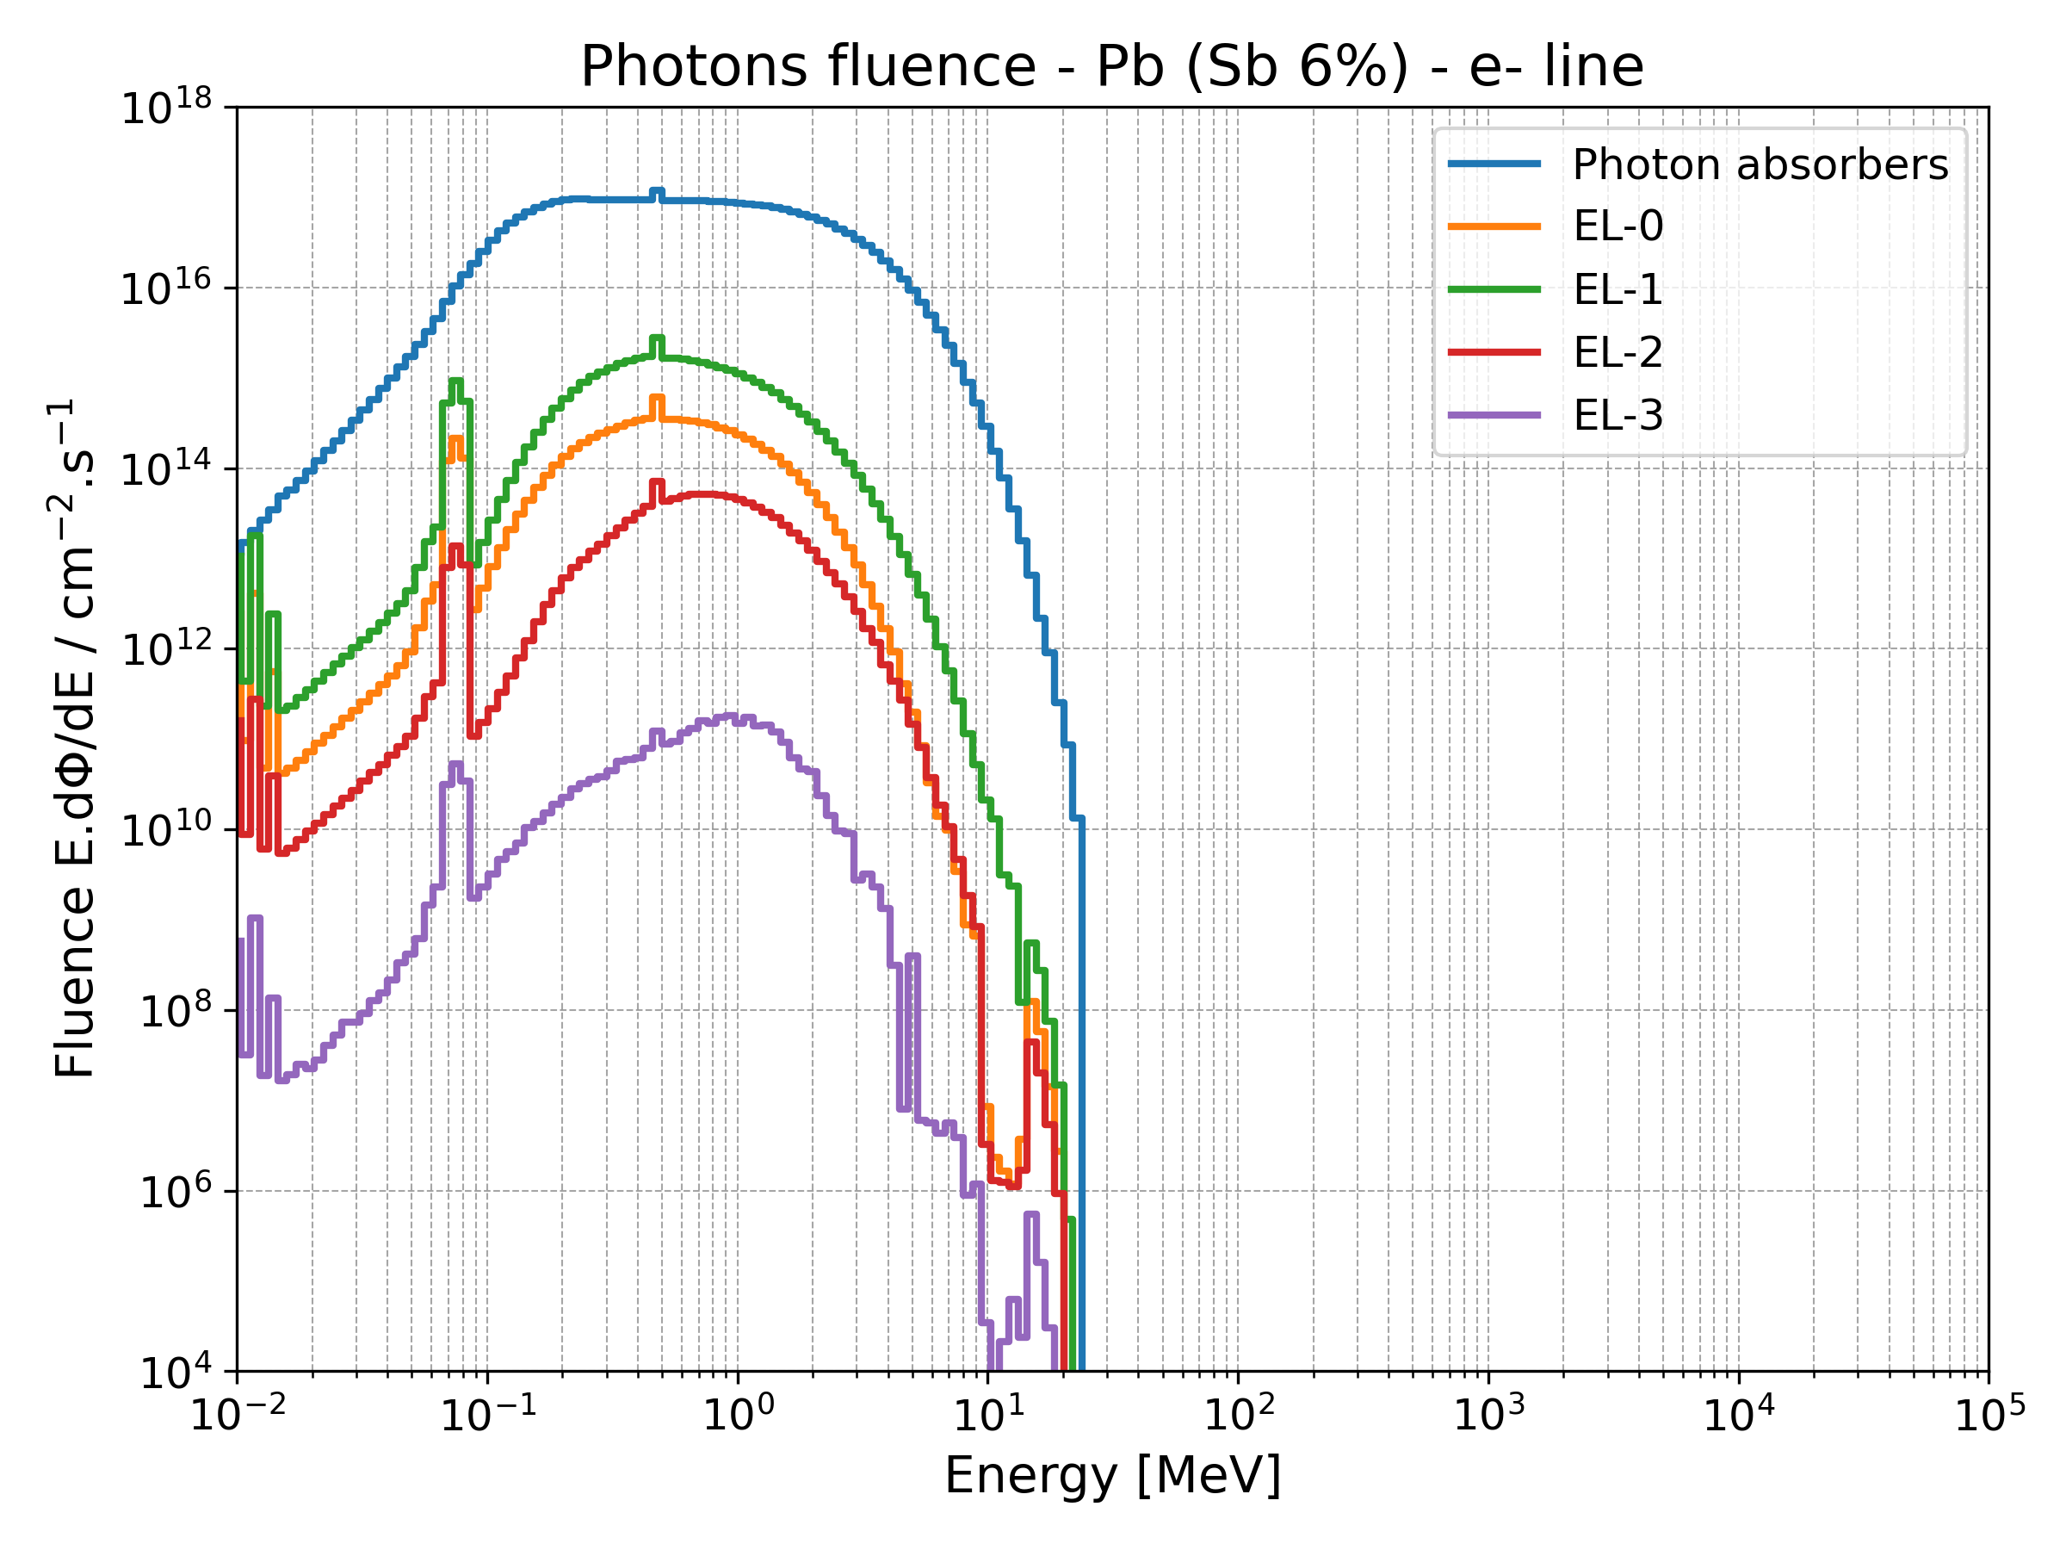
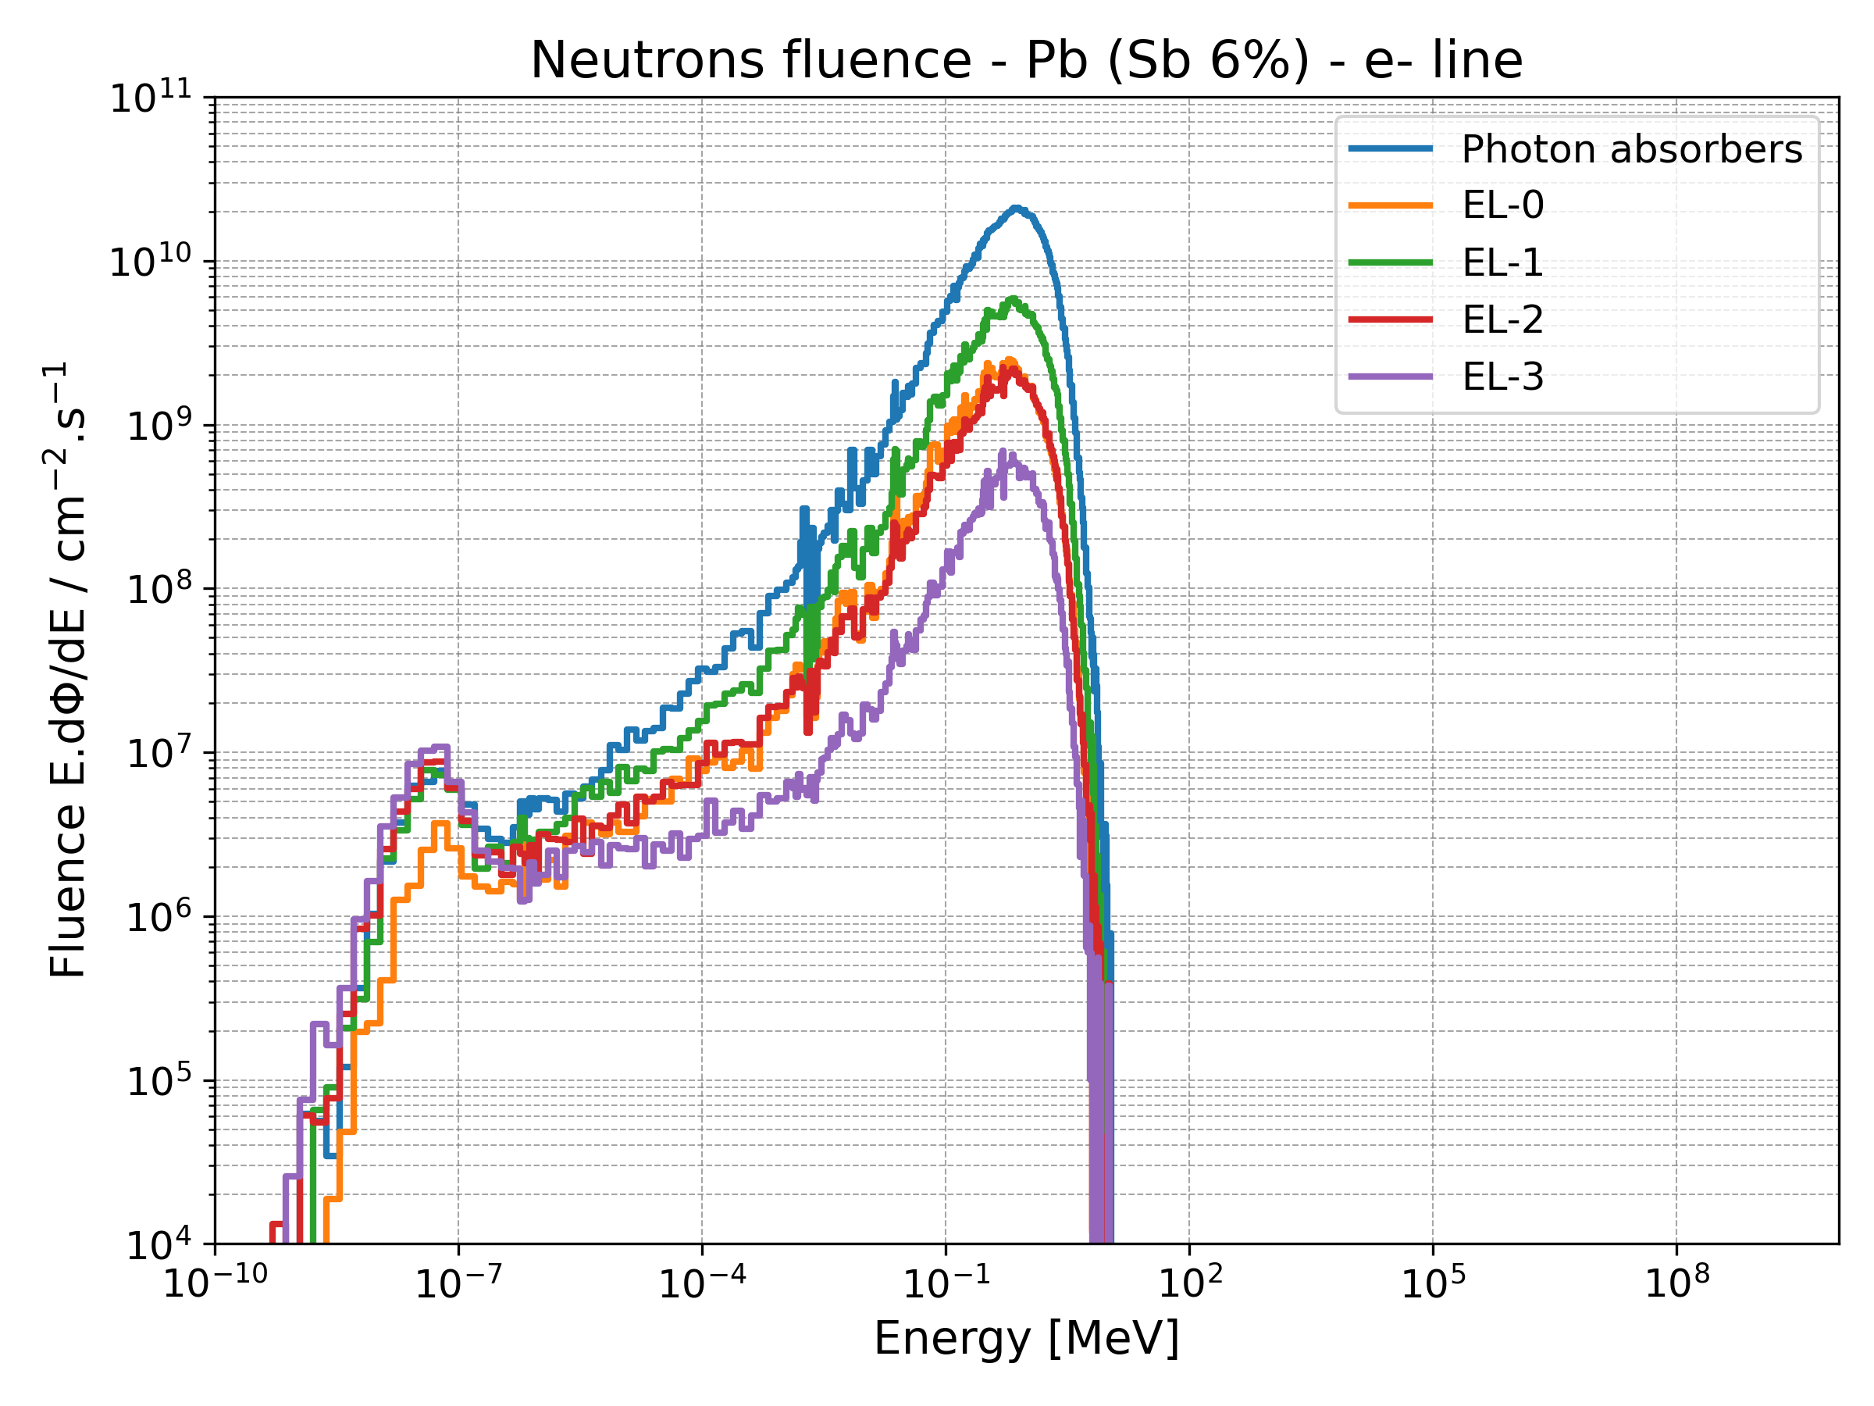
Particle spectra
The neutron and photon fluences are significantly higher in the photon absorbers, particularly for photons, where the fluence is nearly 2 orders of magnitude greater than that observed in the first shielding layer.

Slide 20
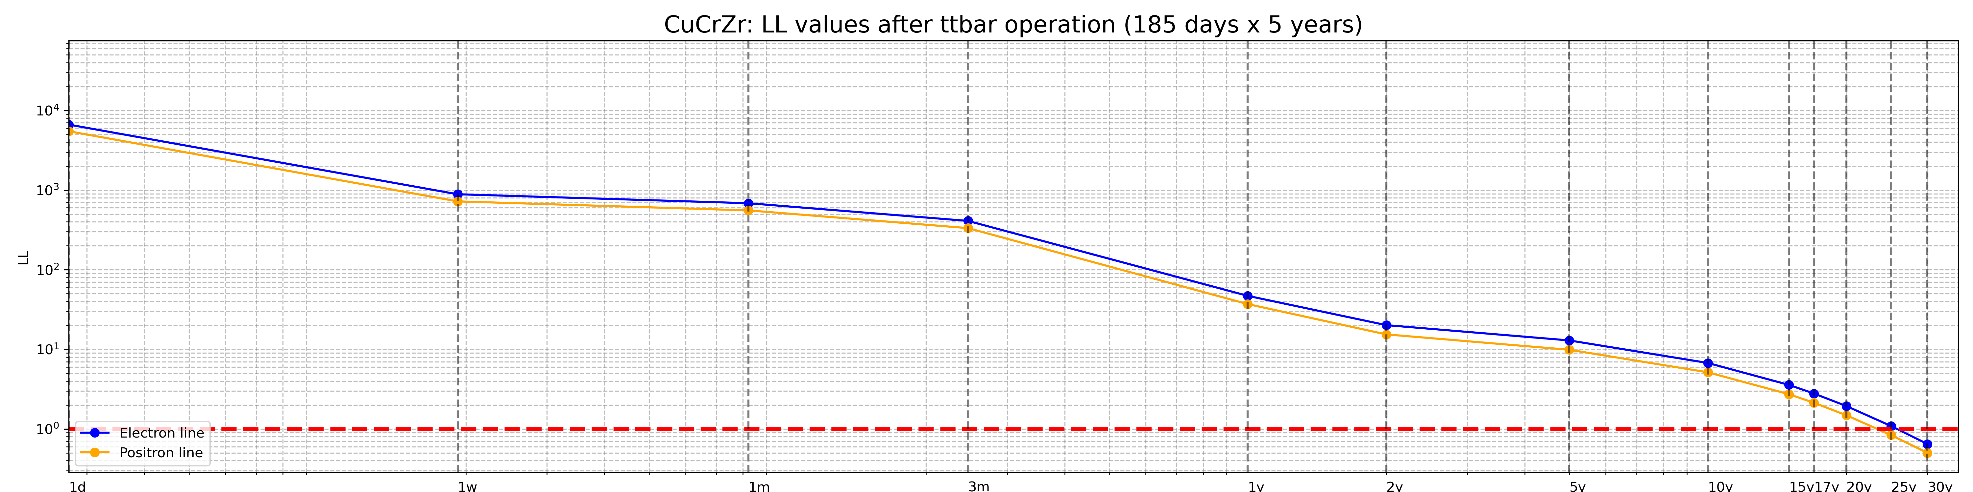
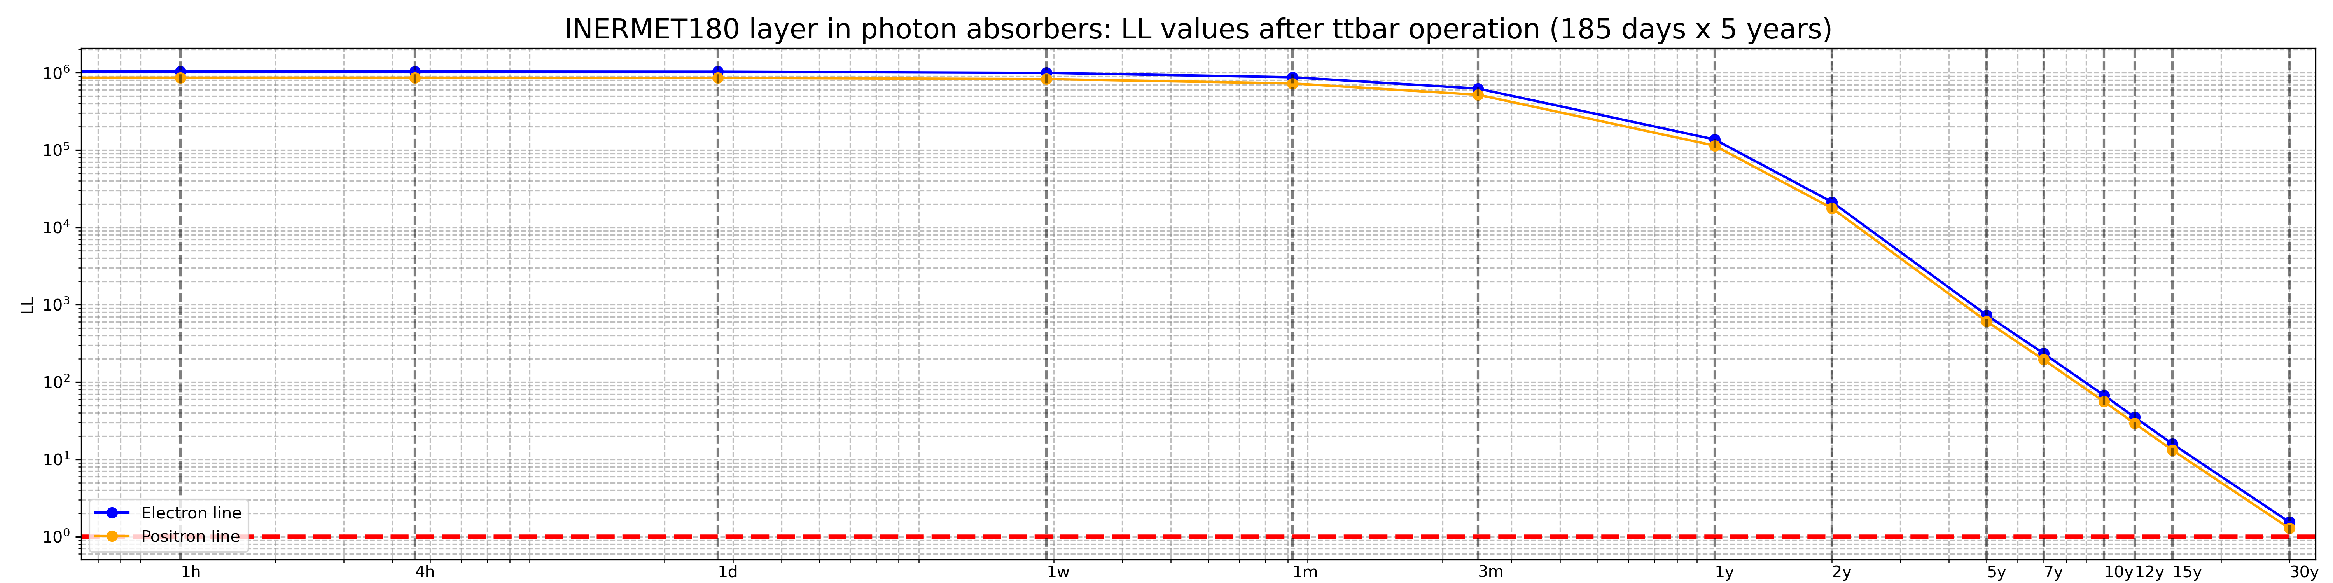
Photon absorber: CuCrZr
CuCrZr: below 1 LL after ~25 years..

Slide 21
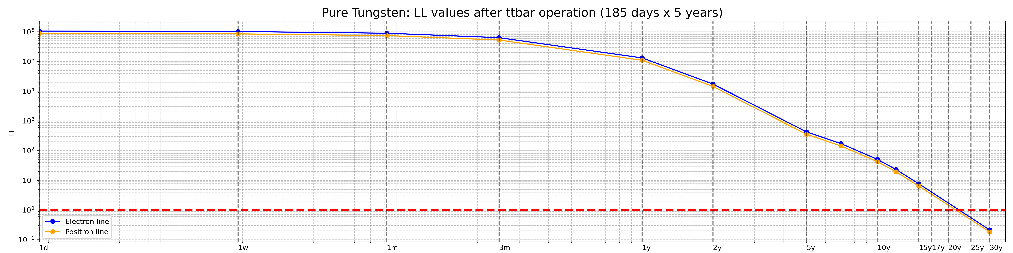
Photon absorber: INERMET180 and Tungsten
INERMET180: below 1 LL after > 30 years.
Tungsten: below 1 LL after > 22 years.

Slide 22
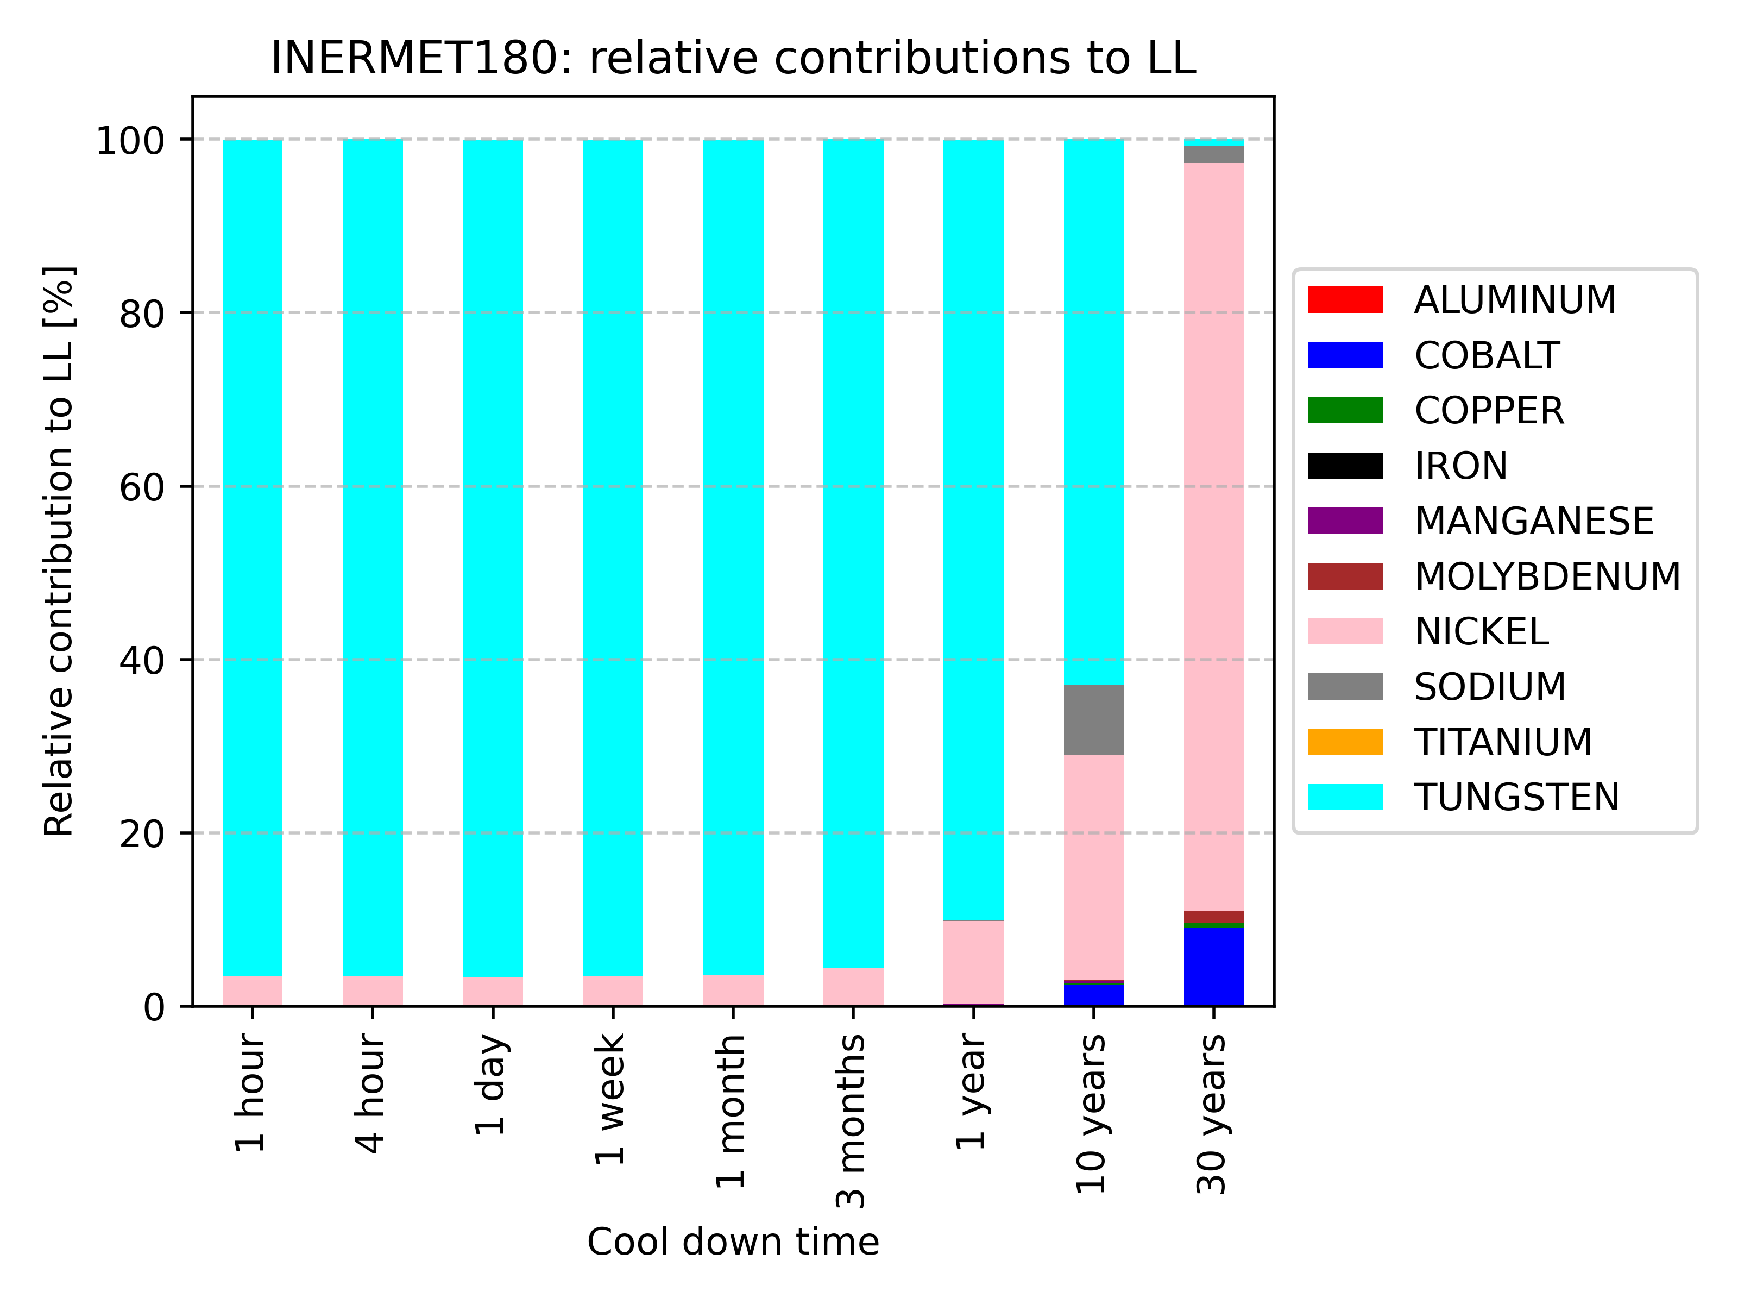
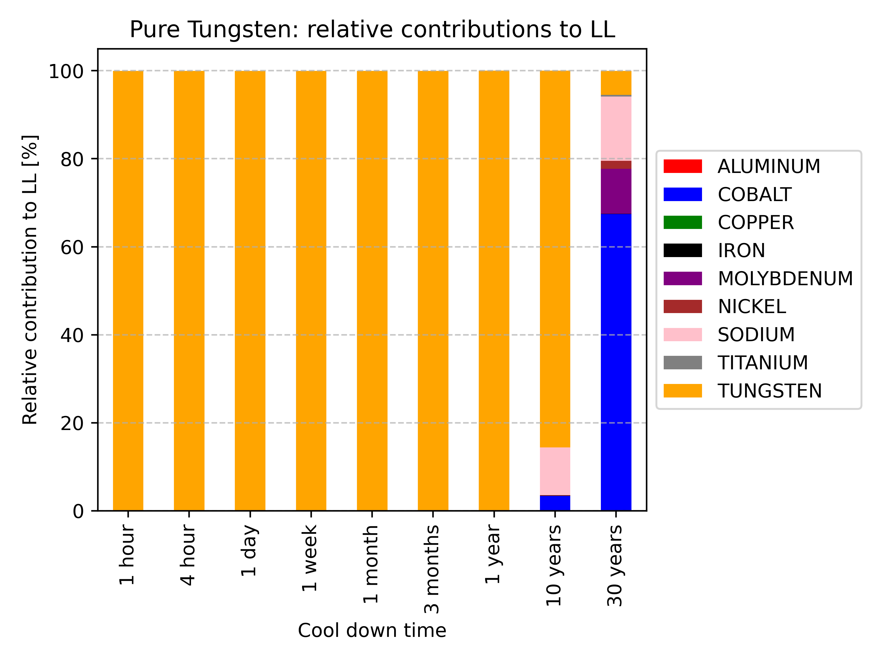
Relative contribution to LL
INERMET180 and pure Tungsten
The graphs show that in the short to medium term (1 to 10 years), LL is dominated by tungsten. In the long term, up to 30 years, other impurities become more prevalent: in INERMET180, nickel dominates, while in pure tungsten, cobalt dominates.

Slide 23
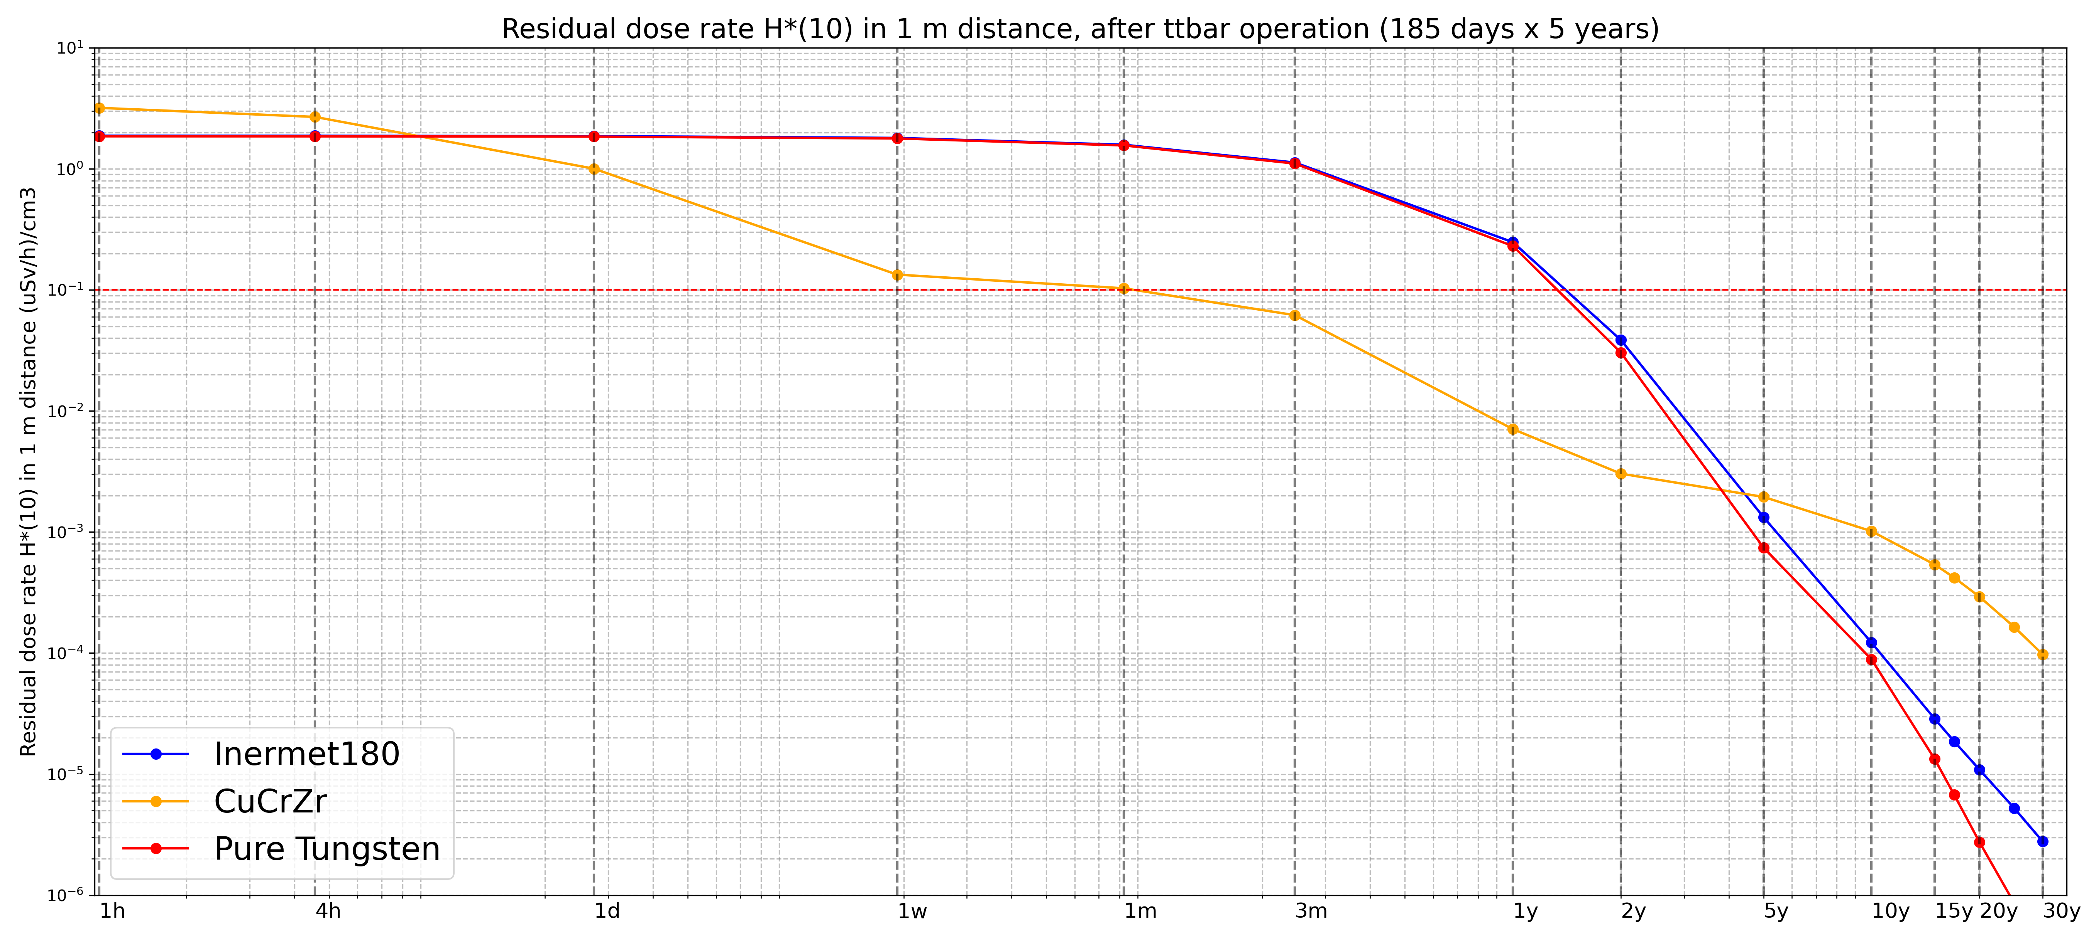
Residual dose rate
The plot displays the residual dose rate values at a distance of 1 m, normalized per unit volume, following ttbar operation for cooldown times ranging from 1 hour to 30 years, for INERMET180, CuCrZr and pure Tungsten. This plot allows to compare the three materials on their residual dose rate impact.
CuCrZr would contribute more significantly immediately after the shutdown, but it would start to decrease after a few hours. In contrast, the contributions of INERMET180 and Tungsten remain dominant for the rest of the time, up to approximately 5 years of cooldown time.

Slide 24
Conclusions – Photon absorbers
The activation of photon absorbers is significantly higher compared to that of the shielding.
The results indicate that the time required for photon absorbers made of CuCrZr to be removed from any regulatory control and considered as non-radioactive is in the order of 25 years.
INERMET is not recommended for the photon absorbers in this high-fluence region, as the time required for removal from regulatory control can exceed 30 years. INERMET would generate a higher dose rate compared to CuCrZr, which may have an operational impact in handling the photon absorbers.
Pure tungsten can be removed from any regulatory control and considered non-radioactive after about 22 years, which is similar to the timescale for CuCrZr. Therefore, it is more suitable compared to INERMET180. The reason is that in pure tungsten, Nickel, which significantly contributes to activation over long cool down times, is present only as an impurity. However, the residual dose rate during the first period is nearly equal to that produced by INERMET, but then decreases after one year of cool down time.
Potential statistical uncertainties (due to simulations) and systematic uncertainties (due to the parameters used) must be considered.

Slide 25
THANK YOU FOR YOUr
ATTENTION !

Slide 26
Backup slides

Slide 27
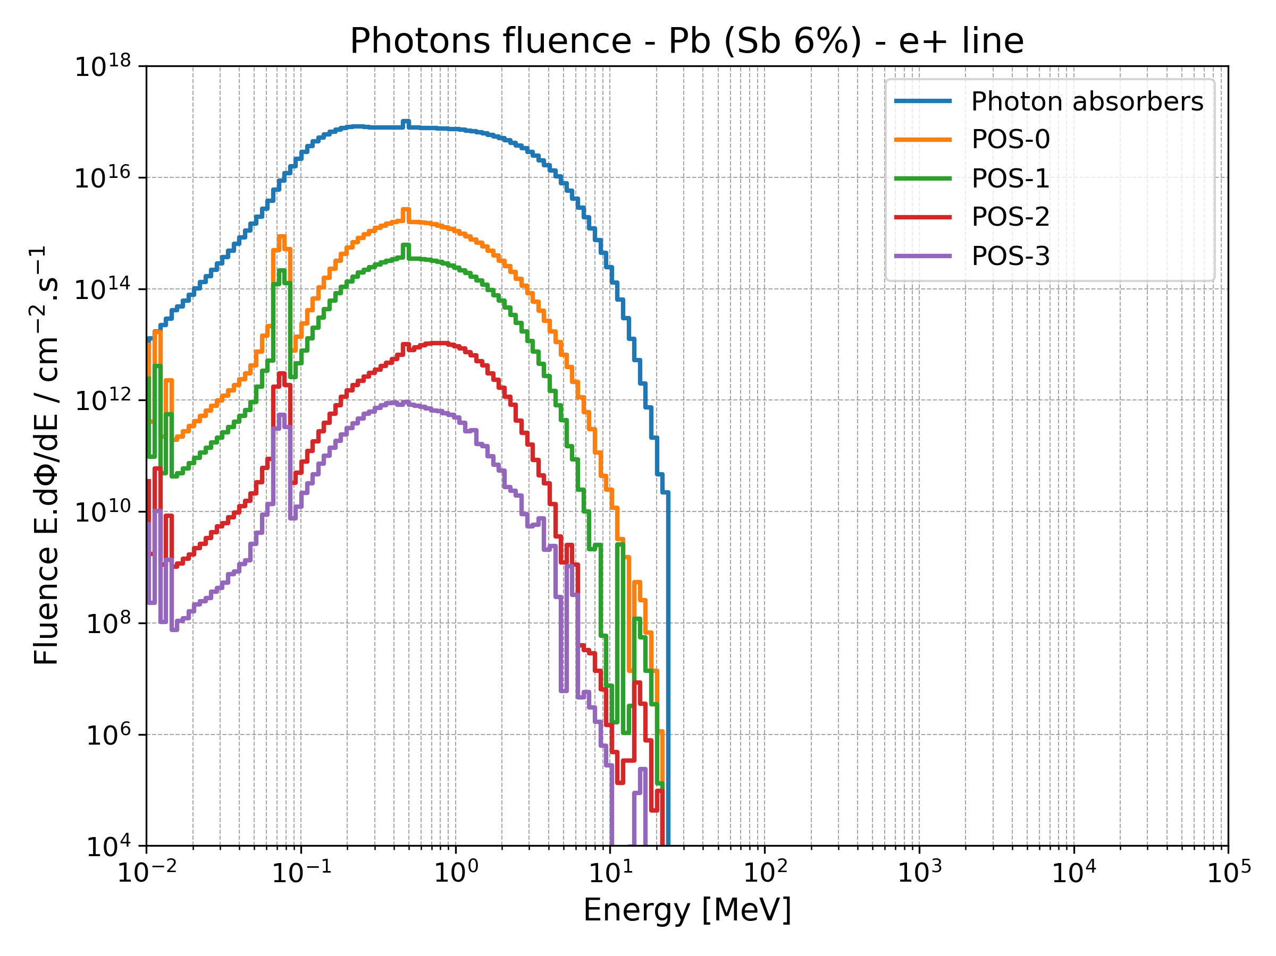
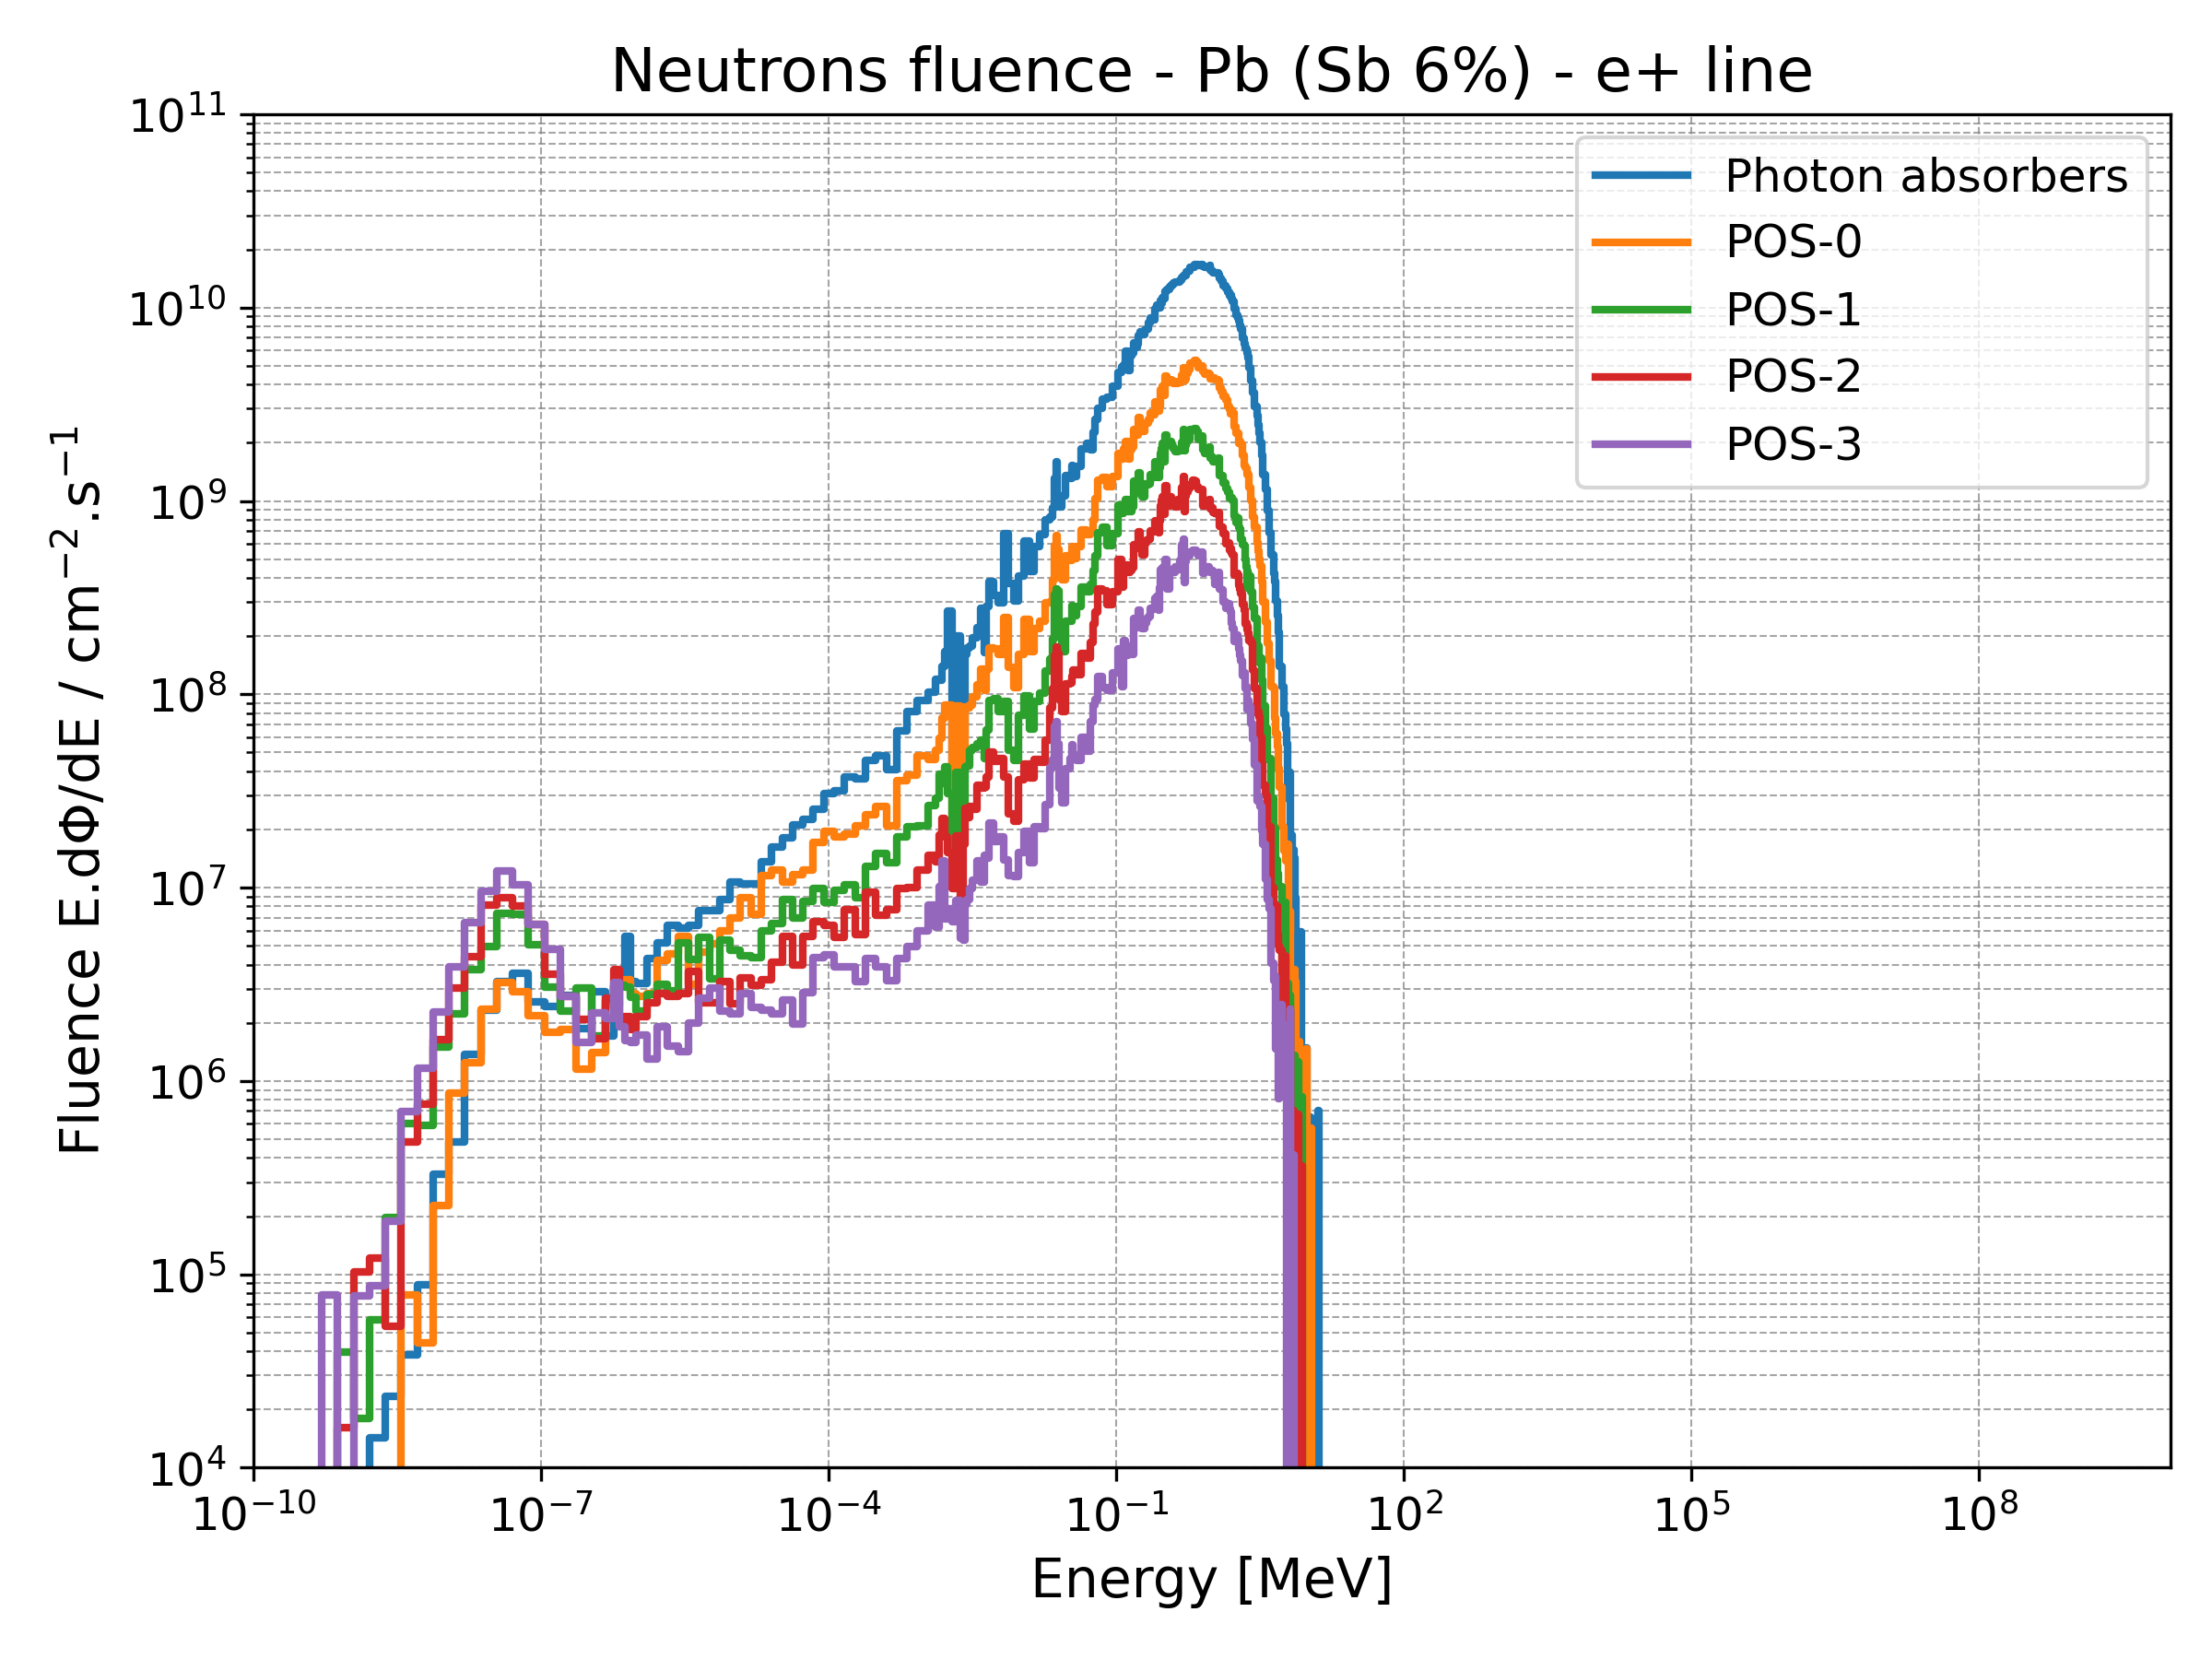
Particle spectra

