Slide 1
SR in the FCC-ee arcs: updated layout and improved shielding
A. Lechner, B. Humann
Thanks to M. Marrone, G. Roy, A. Perillo-Marcone, R. Kersevan, J. Bauche, C. Jaemyr Eriksson, F. Carra, A. Piccini

Slide 2
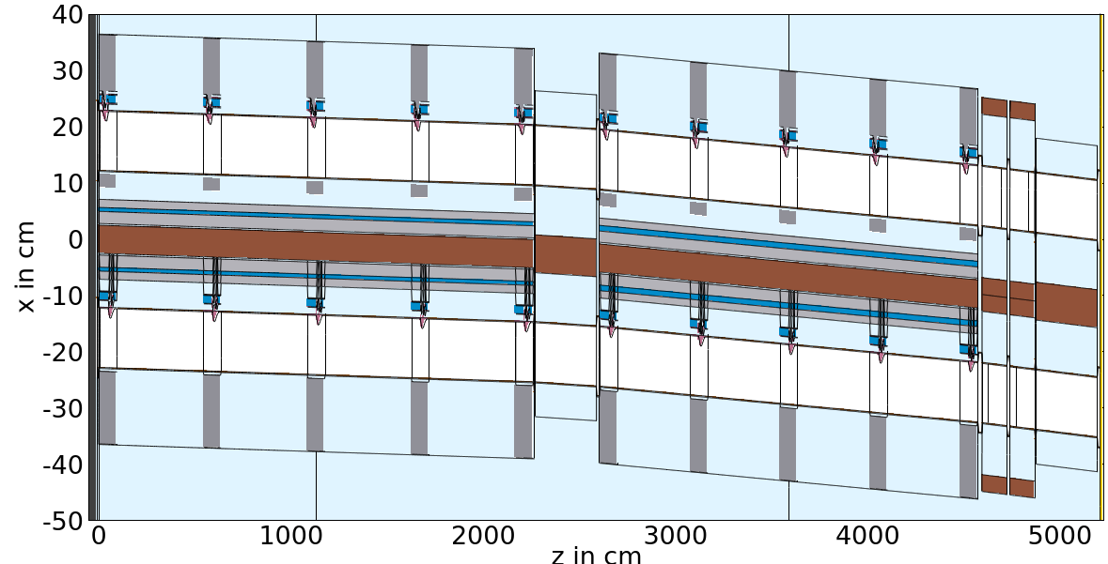
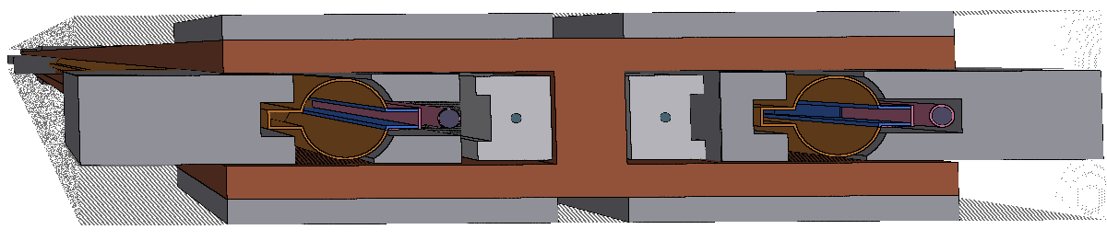
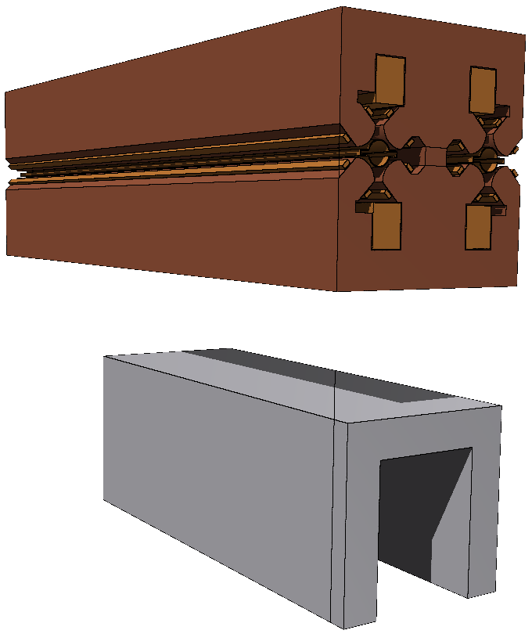
Simulation setup
One FODO cell: 22m MB, MQ, 19m MQ, 2 MS, MQ
  Shorter cell is beneficial for obtaining good statistics
10 absorbers per dipole – equally distributed along the magnet
  Preliminary design to test different absorber and shielding configurations. The final positions then still need to be optimized.
e-
e+
90cm
Al
10cm
Below the quadrupoles, a conceptual concrete shielding with a thickness of 10cm on each side for electronics equipment has been implemented. It stretches over a length of 150cm.
(No results for “electronics region” yet, as better statistics are required)
Several changes in the dipole, absorber and shielding design:
Aluminium busbars
Shielding on the internal side is extending 10cm (same as external)
Longitudinally, shielding extends 90cm (15cm upstream of abs., 45cm downstream of abs.) → 3450kg/Dipole
3 different absorber designs tested: fully CuCrZr, fully Inermet180 (tungsten alloy), 2mm Inermet180 layer on CuCrZr bulk

Slide 3
Absorbed power in machine components in one FODO cell
Different choice of materials leads to different distribution of absorbed power in components.
Photon stoppers are more efficient if fully made from Inermet180. As most of the power is absorbed in the photon stoppers, the radiation shielding is less impacted.
The solution with using a thin Inermet180 layer applied to the photon stopper surface also proves to be efficient, as most of the power is deposited in the surface.
In this case, the radiation shielding takes more than for the full Inermet180 solution as the photon stoppers are less efficient.
The Pb plates at the top and the bottom of the dipole only absorb around <10W, while the horizontal shielding absorbs up to 700W.
 | CuCrZr | Inerm180 | Inerm180 layer
Photon stoppers | 69.2% | 88.4% | 82.5%
Radiation shielding | 22.4% | 7.1% | 12.4%
Vacuum chambers | 3.4% | 2.4% | 2.6%
Dipoles | 4.2% | 2% | 2.4%
Quadrupoles | 0.03% | 0.01% | 0.01%
Environment | 0.22% | 0.13% | 0.16%
As the version with using a thin Inermet180 layer looks promising, studies are ongoing to assess the mechanical feasibility etc.

Slide 4
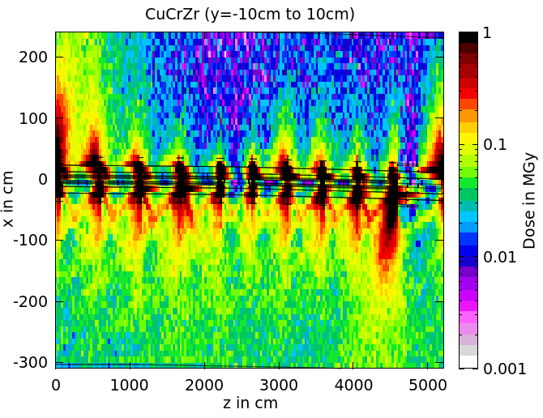
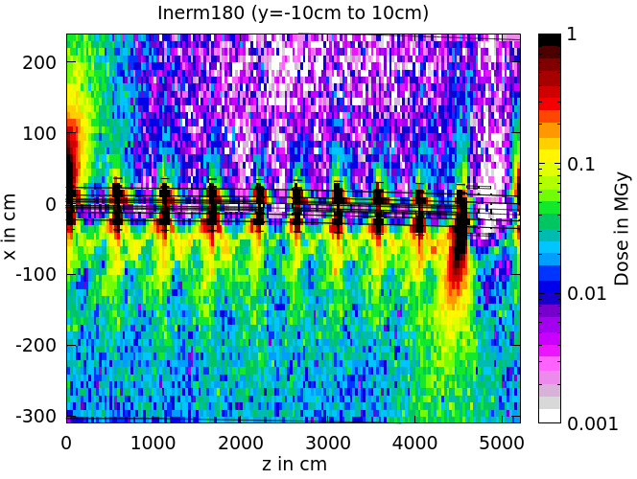
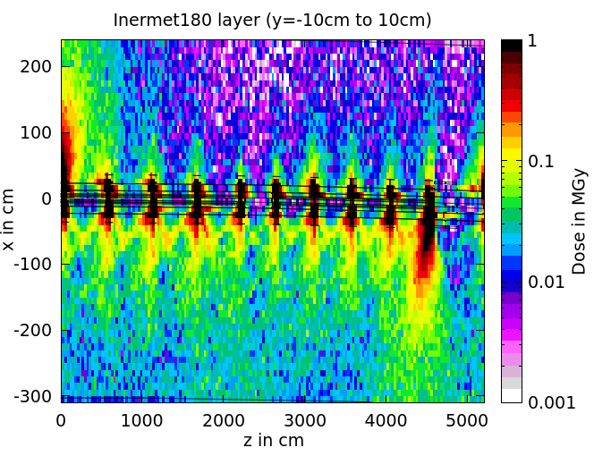
Ionizing dose levels in the tunnel – top views at beam level
N.B.: due to the lower dose levels, the scale has changed compared to presentations shown in previous meetings.
More massive shielding is improving the situation of the CuCrZr photon stopper situation.
Both solutions using tungsten as/in their photon stoppers reduce the radiation load significantly.
The hotspots at the beginning and the end of the cell are due to the non-optimized positions of the absorbers next to the SSS with two sextupoles and a quadrupole. In the upcoming weeks, this issue will be tackled.

Slide 5
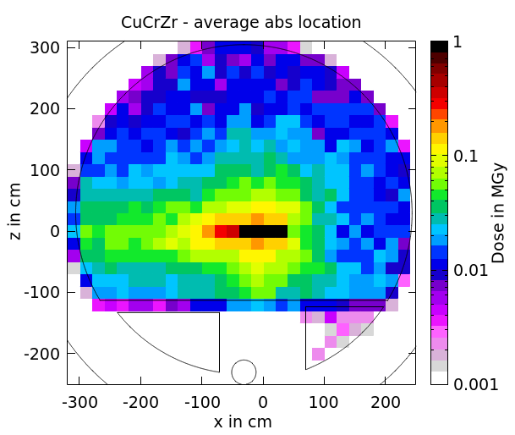
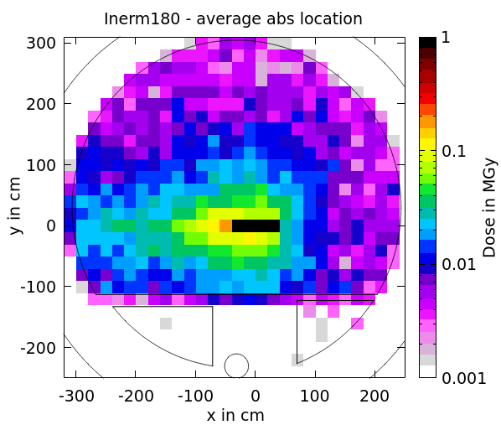
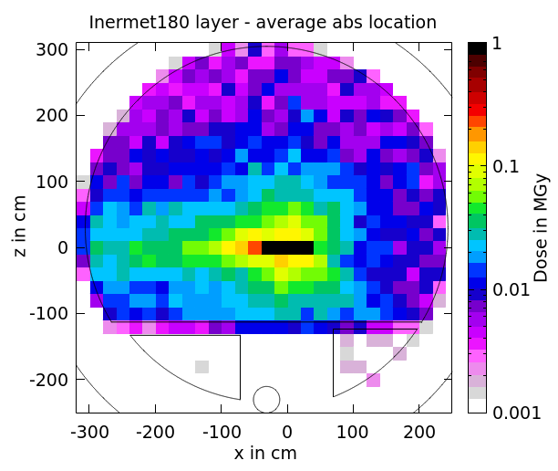
Ionizing dose levels in the tunnel – cross sections
N.B.: due to the lower dose levels, the scale has changed compared to presentations shown in previous meetings.
The cross sections at an average photon stopper location show the strong reduction of dose levels if Inermet180 is used.
Inermet180 cases: at the cable trays, well below 10kGy/year
Feasibility has to be assessed: manufacturing, impedance issues, cost assessment, exact material choice…
Next steps: refining the geometry model for the photon stoppers (larger volume, more cooling pipes) and provide radiation load information for the electronics shielding region

