Slide 1
GIF++ test of BIL2 pack

Slide 2
Overall information
Test performed up to now to 3 packages
2 BIL and 1 BIS
Test system to be finalized to avoid manual scanning which can introduce systematic problems
Gregorio is preparing a WINCC automatic procedure
System used also as (supervised!) training of young RPC experts
Atmospheric pressure effect can be automatically corrected or maybe better corrected ex post
Data will be stored in a shared folder and inserted in the DB
Expected data:
  Initial and final scan with 3 sources + off
  Monitoring of the currents
  Measurement of plates resistance
Today: report on the last BIL package made of 21 gas gaps

Slide 3
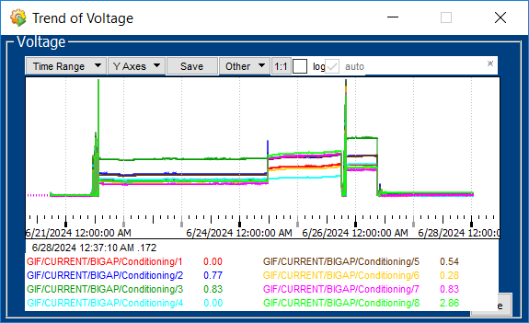
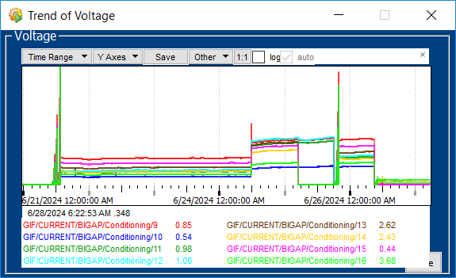
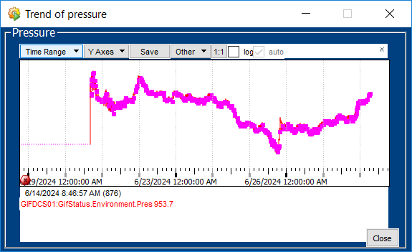
Conditioning trends
Small effect of the pressure between initial (959 mbar) and final (953 mbar)
Equivalent to about 0.6 % of the full voltage (36V)

Slide 4
Initial vs. final (first 16 gas gaps) source off
21st gap BIL-1B-34/24
4th gap BIL-1B-05/24
11th gap BIL-1B-20/24

Slide 5
Comparison source off @6kV
The higher tagged initial currents lowered
A few increased, to be investigated in BB5
The initial worst (21) was not properly monitored. To be retested in BB5
We are still in the learning curve → we need to improve the standardization of the test performed by different people

Slide 6
Initial vs. final source filter 100 (first 16 gaps)

Slide 7
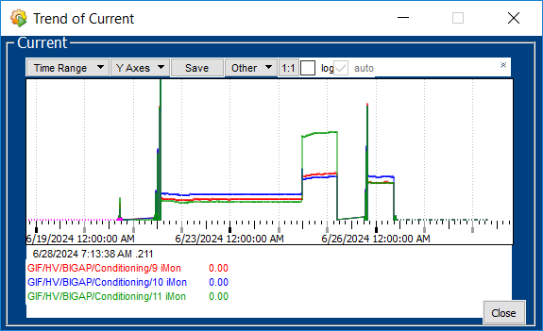
ADC problem for the gaps 17-21→ CAEN
Trends monitored on CAEN currents
Channel 11 is the last gas gap alone
Was set
Final scan to be repeated in BB5

