Slide 1
MG5 report
Liangliang Chen
2024.6.27
Notes:
I am Liangliang Chen, today I will give a report on madgraph5

Slide 2
Outline
Gridpacks generation
Comparison plots
Change Range
Draw with NanoAOD
Notes:
Here is my outline. First I introduce gridpacks generation, followed by NanoAOD, And I will compare the distributions of several variables. Finally, I will give a summary.

Slide 3
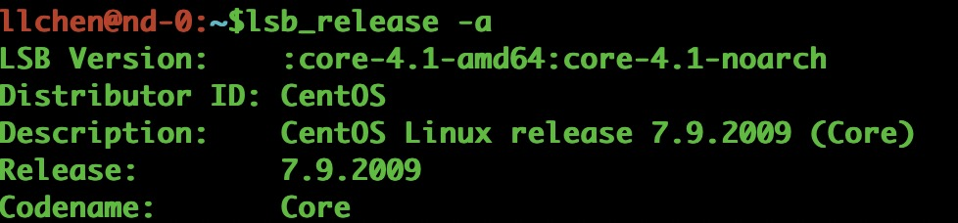
Gridpacks generation
Setup and Environment:
  2 MG version used: MG2.9.18 and MG3.5.2
  scram_arch: slc7_amd64_gcc10
  CMSSW version: CMSSW_12_4_8
Preparation of the cards
  XXX_proc_card.dat (declares the process to be generated)
  XXX_run_card.dat (define how generator run, generate the process, specific kinematic cut values)
  XXX_madspin_card.dat (instructs MadSpin on how to decay specific particles)
https://gitlab.cern.ch/lianglia/lo_mlm_dy_jetbin/tree/master/DY1JetsToLL_M-50_TuneCP5_13TeV-madgraphMLM-pythia8/cards
https://gitlab.cern.ch/lianglia/lo_mlm_dy_jetbin/tree/master/DY2JetsToLL_M-50_TuneCP5_13TeV-madgraphMLM-pythia8/cards
https://gitlab.cern.ch/lianglia/lo_mlm_dy_jetbin/tree/master/DY3JetsToLL_M-50_TuneCP5_13TeV-madgraphMLM-pythia8/cards
https://gitlab.cern.ch/lianglia/lo_mlm_dy_jetbin/tree/master/DY4JetsToLL_M-50_TuneCP5_13TeV-madgraphMLM-pythia8/cards
Notes:
Here are my setup and environment, it is noticed that we use 2 Madgraph version and will compare their distribution. Before generation, cards need to be prepared. First two cards are mandatory.

Slide 4
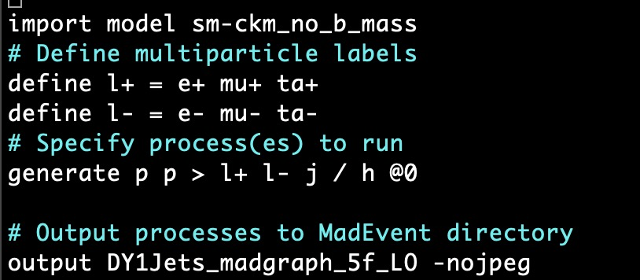
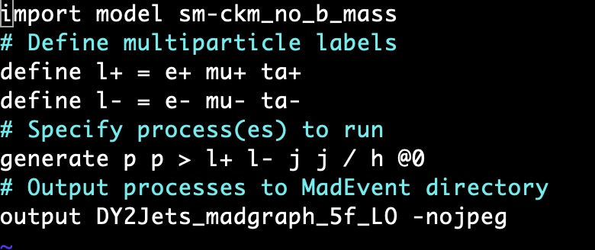
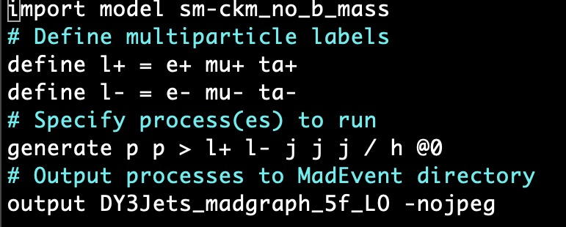
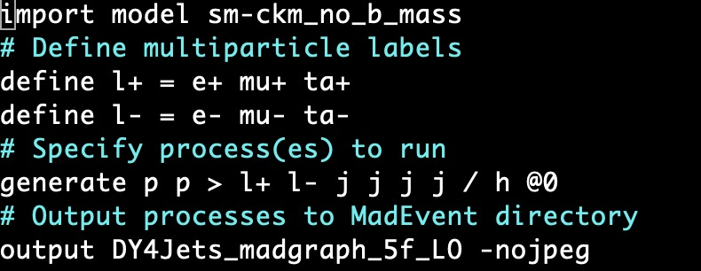
Gridpacks generation
Process cards:
1-Jet
2-Jet
3-Jet
4-Jet
Notes:
Here I need to modify some content in examples of cards. First I need to comment out processes decay to more than 2-jet, and define beam energy as 13.6 TeV

Slide 5
Gridpacks generation
Command lines used:
./gridpack_generation.sh DY1Jets_madgraph_5f_LO cards/LO_MLM_DY_Jetbin/DY1JetsToLL
./gridpack_generation.sh DY2Jets_madgraph_5f_LO cards/LO_MLM_DY_Jetbin/DY2JetsToLL
./gridpack_generation.sh DY3Jets_madgraph_5f_LO cards/LO_MLM_DY_Jetbin/DY3JetsToLL
./gridpack_generation.sh DY4Jets_madgraph_5f_LO cards/LO_MLM_DY_Jetbin/DY4JetsToLL
Only 4 tarball files generated: 1-Jet/2-Jet samples from MGv2/v3
3-Jet/4-Jet samples are still reporting errors
Notes:
After modification, I run command lines and 4 tarball files will be generated.

Slide 6
Gridpacks generation
Here are cross sections about 4 samples:
  DY1Jets_madgraph_5f_LO_mg2: 9.162e+02 +- 1.363e+01 pb
  DY1Jets_madgraph_5f_LO_mg3: 8.624e+02 +- 1.338e+01 pb
  DY2Jets_madgraph_5f_LO_mg2: 3.096e+02 +- 7.166e+00 pb
  DY2Jets_madgraph_5f_LO_mg3: 3.074e+02 +- 7.175e+00 pb
Notes:
Here are cross sections about 4 samples. Similar results are got in different version.

Slide 7
Comparison plots
./genval-run -g /home/storage0/users/llchen/mystorage2/servicework/genproductions-mg2/bin/MadGraph5_aMCatNLO/DY1Jets_madgraph_5f_LO_slc7_amd64_gcc10_CMSSW_12_4_8_tarball.tar.xz -f ../LO_MLM_DY_Jetbin/DY1JetsToLL/Configuration/GenProduction/python/HIG-RunIIFall18wmLHEGS-00350-fragment.py -n 10000 -j 1 -d DY1Jets_madgraph_5f_LO_mg2 -q cmsconnect -m madgraph -b 13000 -a Z
./genval-run -g /home/storage0/users/llchen/mystorage2/servicework/genproductions-mg3/bin/MadGraph5_aMCatNLO/DY1Jets_madgraph_5f_LO_slc7_amd64_gcc10_CMSSW_12_4_8_tarball.tar.xz -f ../LO_MLM_DY_Jetbin/DY1JetsToLL/Configuration/GenProduction/python/HIG-RunIIFall18wmLHEGS-00350-fragment.py -n 10000 -j 1 -d DY1Jets_madgraph_5f_LO_mg3 -q cmsconnect -m madgraph -b 13000 -a Z
./genval-run -g /home/storage0/users/llchen/mystorage2/servicework/genproductions-mg2/bin/MadGraph5_aMCatNLO/DY2Jets_madgraph_5f_LO_slc7_amd64_gcc10_CMSSW_12_4_8_tarball.tar.xz -f ../LO_MLM_DY_Jetbin/DY2JetsToLL/Configuration/GenProduction/python/HIG-RunIIFall18wmLHEGS-00392-fragment.py -n 10000 -j 1 -d DY2Jets_madgraph_5f_LO_mg2 -q cmsconnect -m madgraph -b 13000 -a Z
./genval-run -g /home/storage0/users/llchen/mystorage2/servicework/genproductions-mg3/bin/MadGraph5_aMCatNLO/DY2Jets_madgraph_5f_LO_slc7_amd64_gcc10_CMSSW_12_4_8_tarball.tar.xz -f ../LO_MLM_DY_Jetbin/DY2JetsToLL/Configuration/GenProduction/python/HIG-RunIIFall18wmLHEGS-00392-fragment.py -n 10000 -j 1 -d DY2Jets_madgraph_5f_LO_mg3 -q cmsconnect -m madgraph -b 13000 -a Z
https://gitlab.cern.ch/jixiao/genValidation
Notes:
After samples generation, I compare some distributions – the pt, eta an phi of lepton. And we can find they have similar shape when different Madgraph versions are used.

Slide 8
Comparison plots
export PYTHONPATH=/usr/local/lib/python3.10/site-packages:$PYTHONPATH
singularity exec -B $PWD:$PWD --env LD_LIBRARY_PATH=/usr/local/lib:$LD_LIBRARY_PATH docker://hepstore/rivet python -c "import yoda; print('YODA imported successfully')"
singularity exec -B $PWD:$PWD --env LD_LIBRARY_PATH=/usr/local/lib:$LD_LIBRARY_PATH docker://hepstore/rivet rivet-mkhtml --no-errs /home/storage0/users/llchen/genValidation/DY1Jets_madgraph_5f_LO_mg2/rivet_result.yoda:Title="DY+1j@LO(v2918)" /home/storage0/users/llchen/genValidation/DY1Jets_madgraph_5f_LO_mg3/rivet_result.yoda:Title="DY+1j@LO(v352)" --output=output_DY1Jets_LO_Jun15_test
singularity exec -B $PWD:$PWD --env LD_LIBRARY_PATH=/usr/local/lib:$LD_LIBRARY_PATH docker://hepstore/rivet rivet-mkhtml --no-errs /home/storage0/users/llchen/genValidation/DY2Jets_madgraph_5f_LO_mg2/rivet_result.yoda:Title="DY+2j@LO(v2918)" /home/storage0/users/llchen/genValidation/DY2Jets_madgraph_5f_LO_mg3/rivet_result.yoda:Title="DY+2j@LO(v352)" --output=output_DY2Jets_LO_Jun15_test
https://gitlab.cern.ch/jixiao/genValidation
Notes:
After samples generation, I compare some distributions – the pt, eta an phi of lepton. And we can find they have similar shape when different Madgraph versions are used.

Slide 9
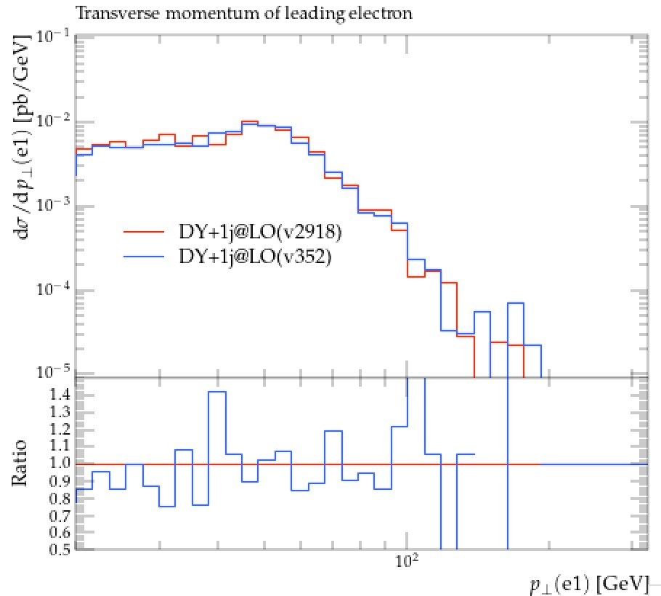
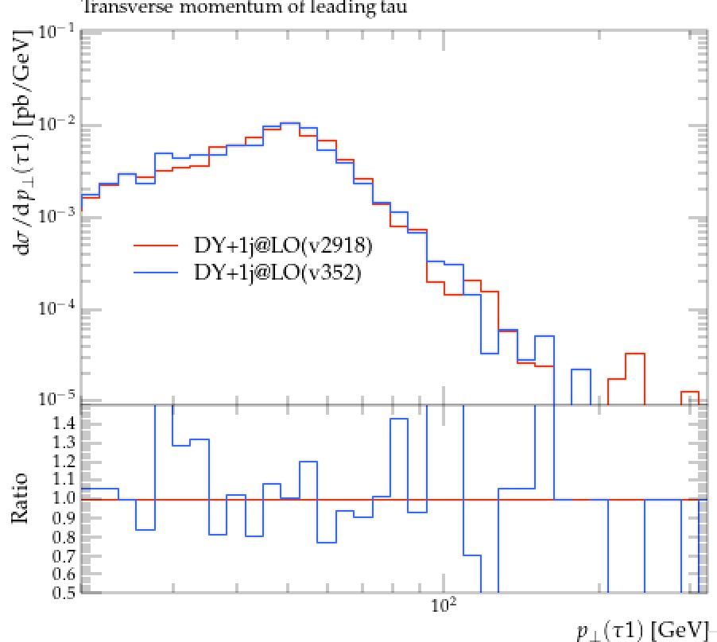
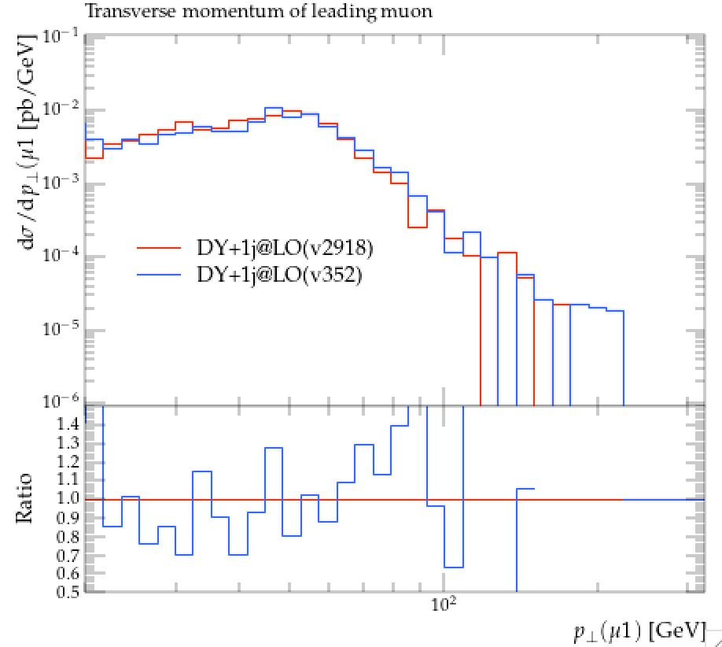
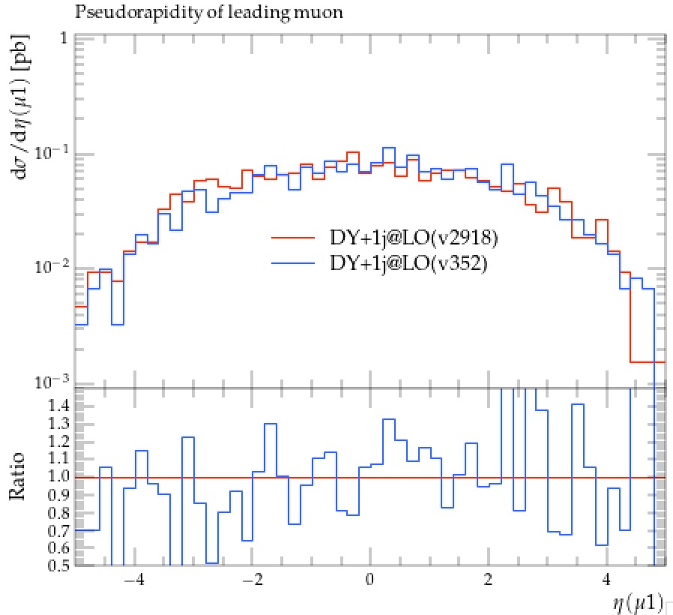
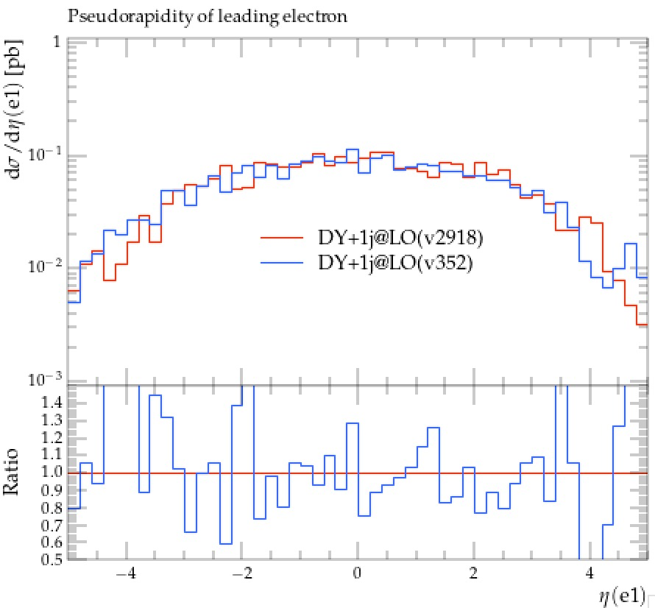
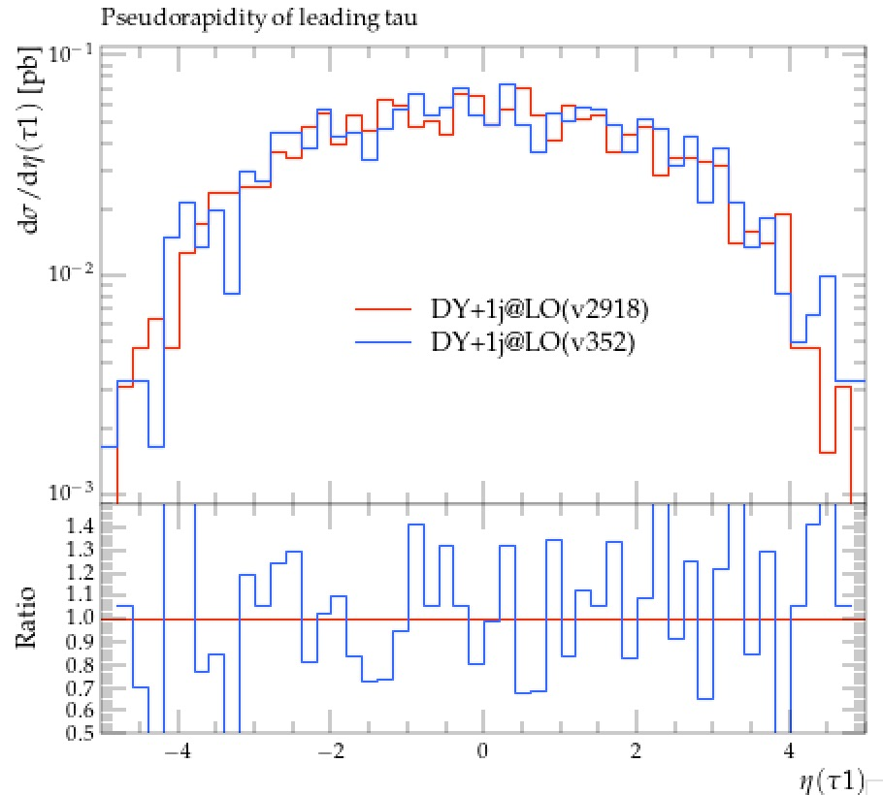
Comparison plots
Here are comparison plots about Lepton pt and eta (1-Jet)
Notes:
After samples generation, I compare some distributions – the pt, eta an phi of lepton. And we can find they have similar shape when different Madgraph versions are used.

Slide 10
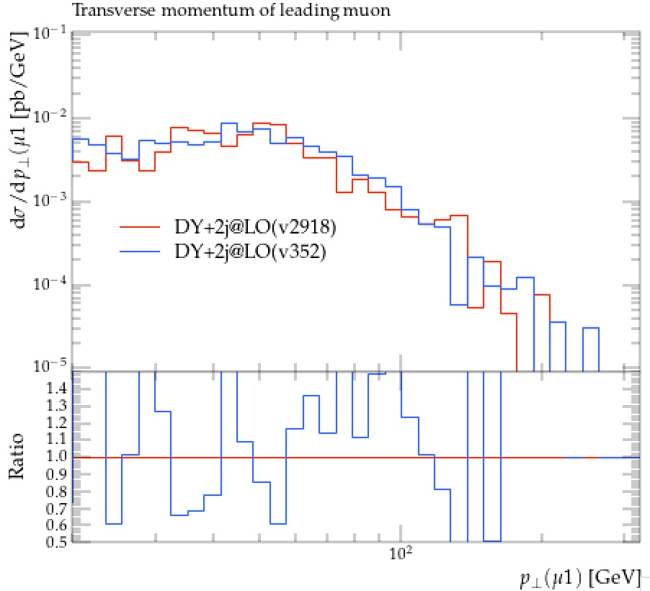
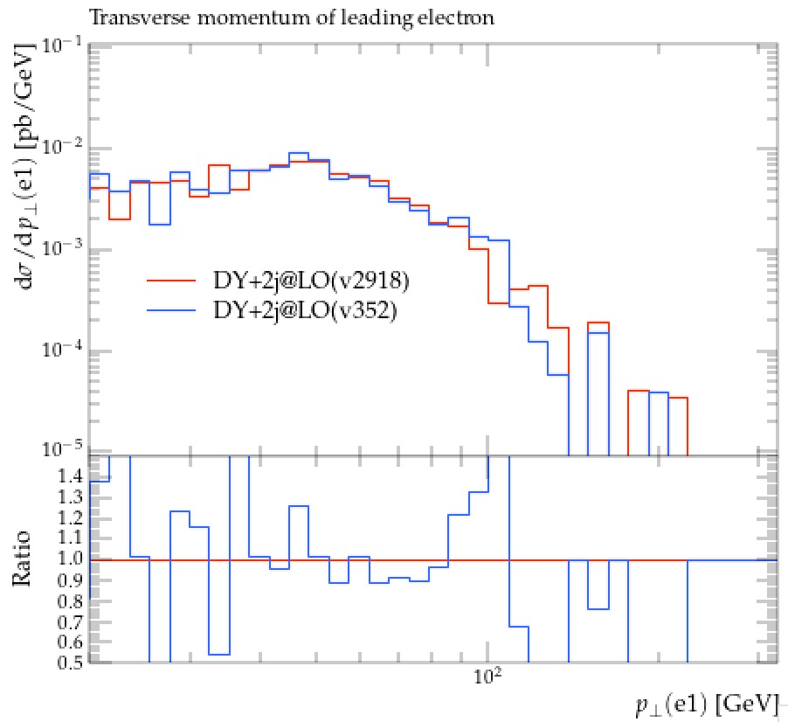
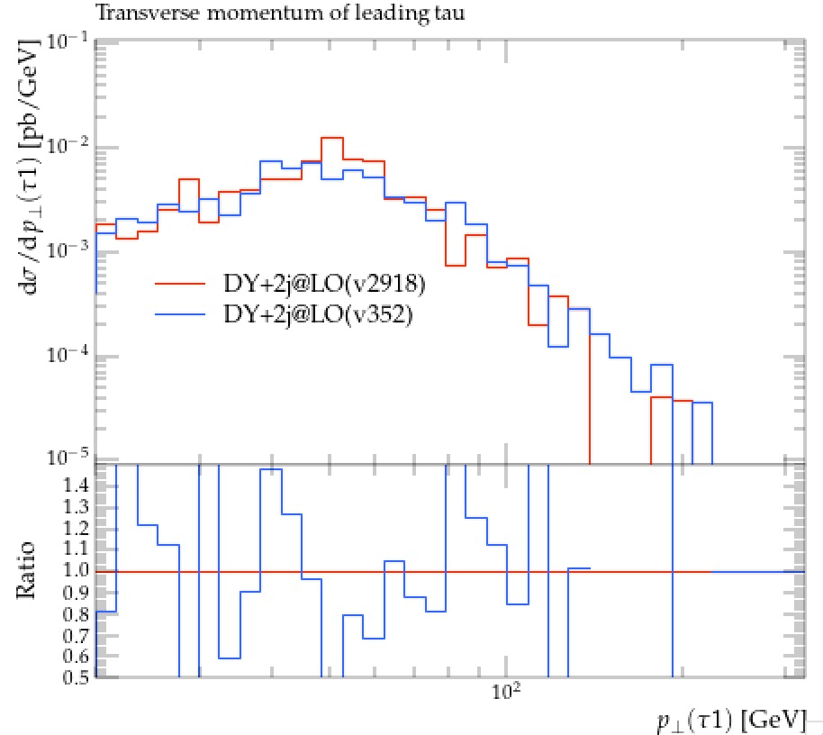
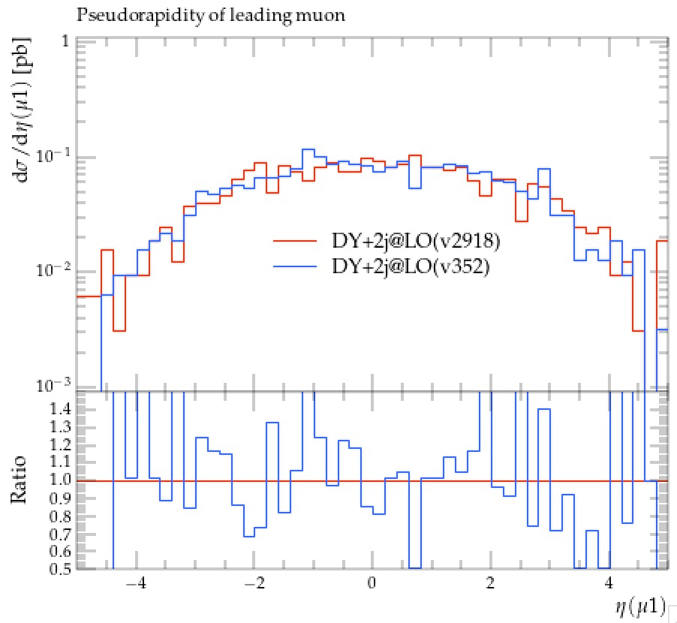
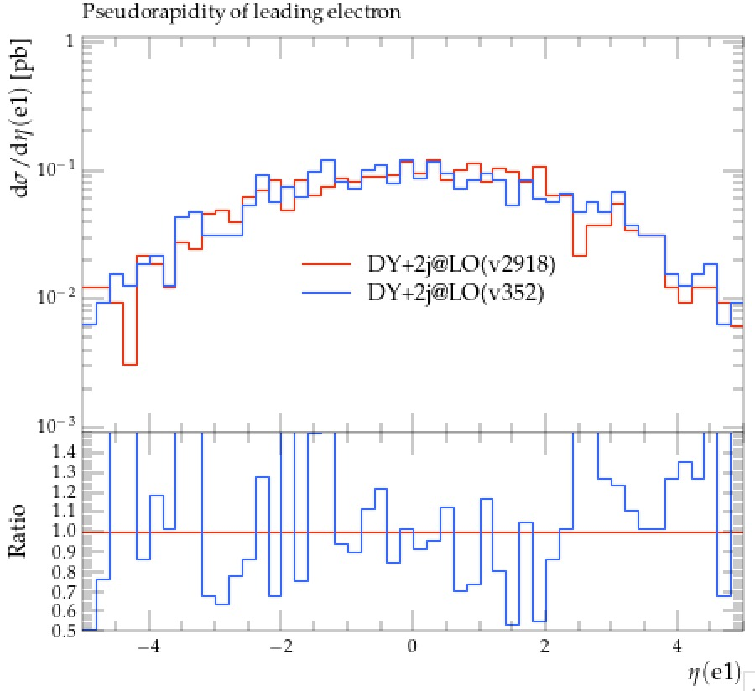
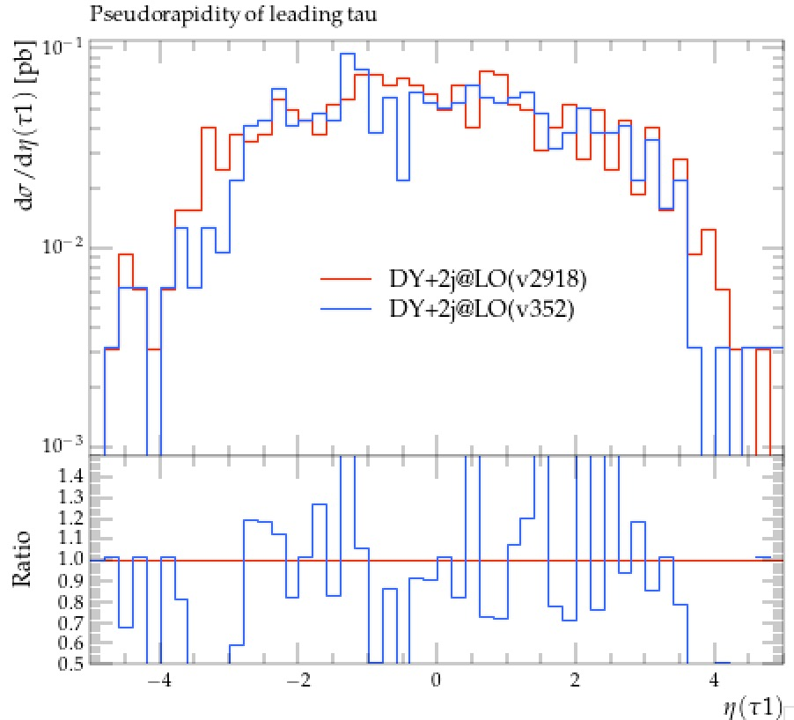
Comparison plots
Here are comparison plots about Lepton pt and eta (2-Jet)
Notes:
After samples generation, I compare some distributions – the pt, eta an phi of lepton. And we can find they have similar shape when different Madgraph versions are used.

Slide 11
Problems
3-Jet/4-Jet report errors
Selections in rivet command are not found yet
Notes:
I choose NanoAOD to generate samples, and here are setup and Environment. The configuration files below will be used.

