Slide 1
LO MLM DY inclusive
(3.5.2 vs 2.9.18)
Update with master branch
Jinjing Gu
June 28
Codes and plots on : https://gitlab.cern.ch/gjinjing/validation_gjj/-/tree/master/LO_DY_inclusive/master_branch

Slide 2
Task: LO MLM DY inclusive (3.5.2 vs 2.9.18)
Madgraph Used:
https://github.com/cms-sw/genproductions.git
(Change version in Line 139 of gridpack_generation.sh)
Samples Used:
https://github.com/cms-sw/genproductions/tree/9adb22e84bea40915d27a7ed94a5a6e740423efc/bin/MadGraph5_aMCatNLO/cards/production/13TeV/DYJets_HT_LO_MLM/DYJets_HT_mll50/DYJets_HT-incl
Fragment Used:
curl -s -k https://cms-pdmv-prod.web.cern.ch/mcm/public/restapi/requests/get_fragment/PPD-RunIISummer17wmLHEGS-00003 --retry 3 --create-dirs -o Configuration/GenProduction/python/PPD-RunIISummer17wmLHEGS-00003-fragment.py
Environment (on THU farm):
System release: Scientific Linux release 7.9 (Nitrogen)
scram_arch: slc7_amd64_gcc10 (CMSSW_12_4_8)

Slide 3
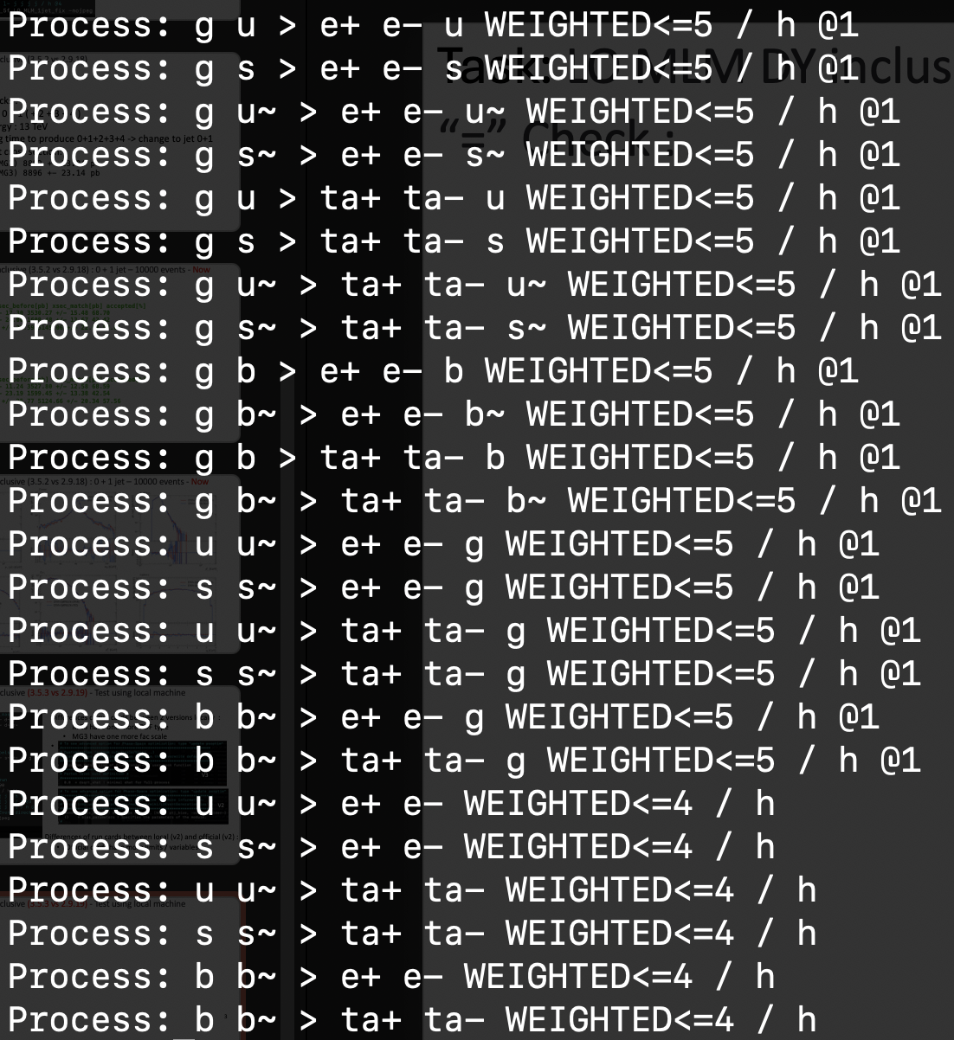
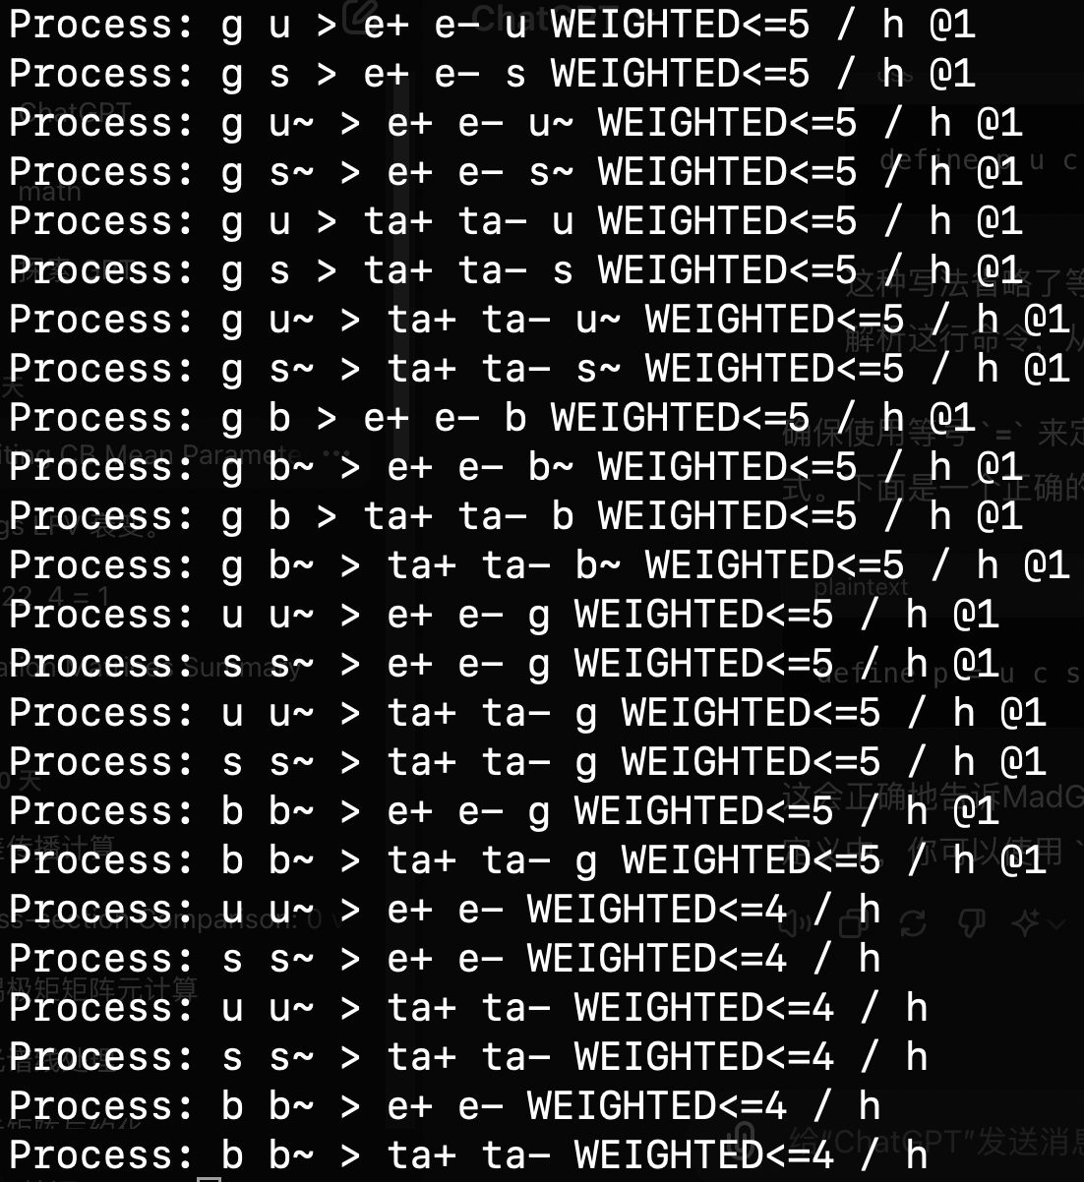
Task: LO MLM DY inclusive (3.5.3 vs 2.9.19) - Test using local machine
“=” Check : MG5 can correct this automatically
V23

Slide 4
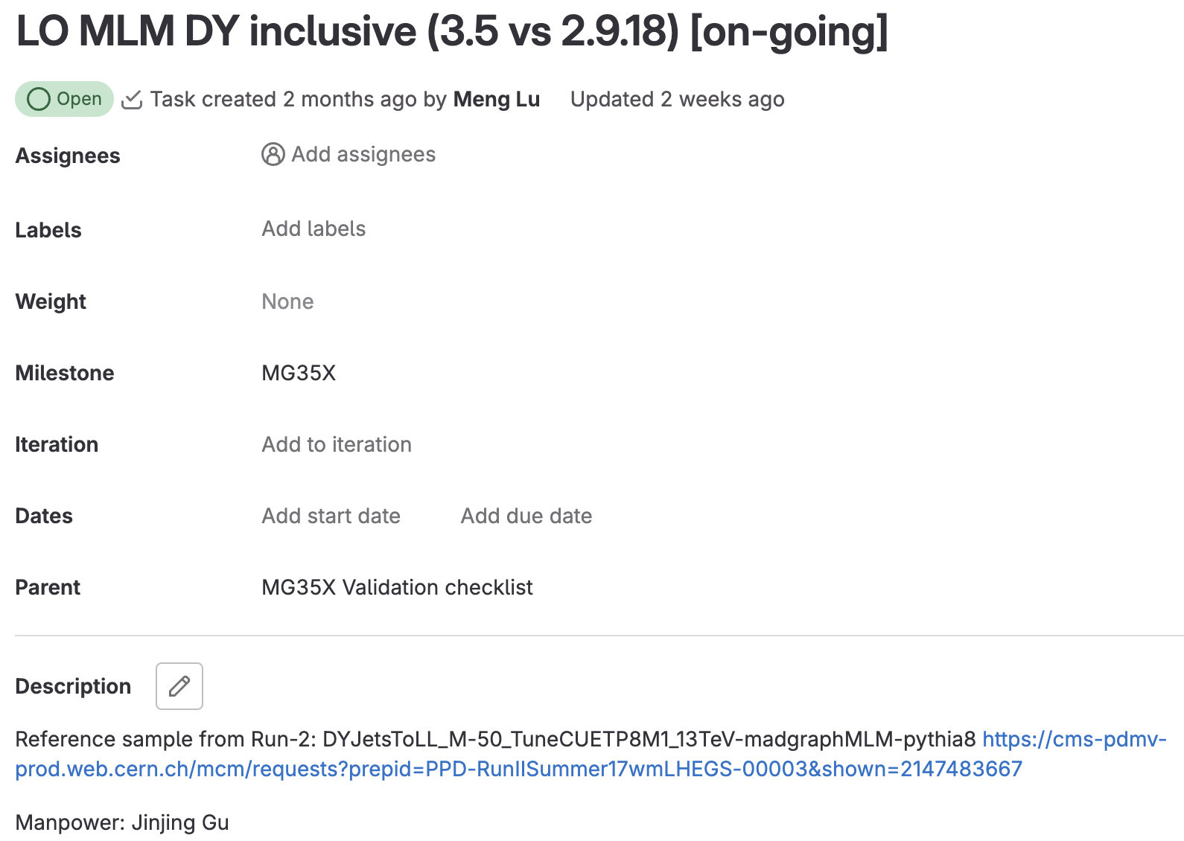
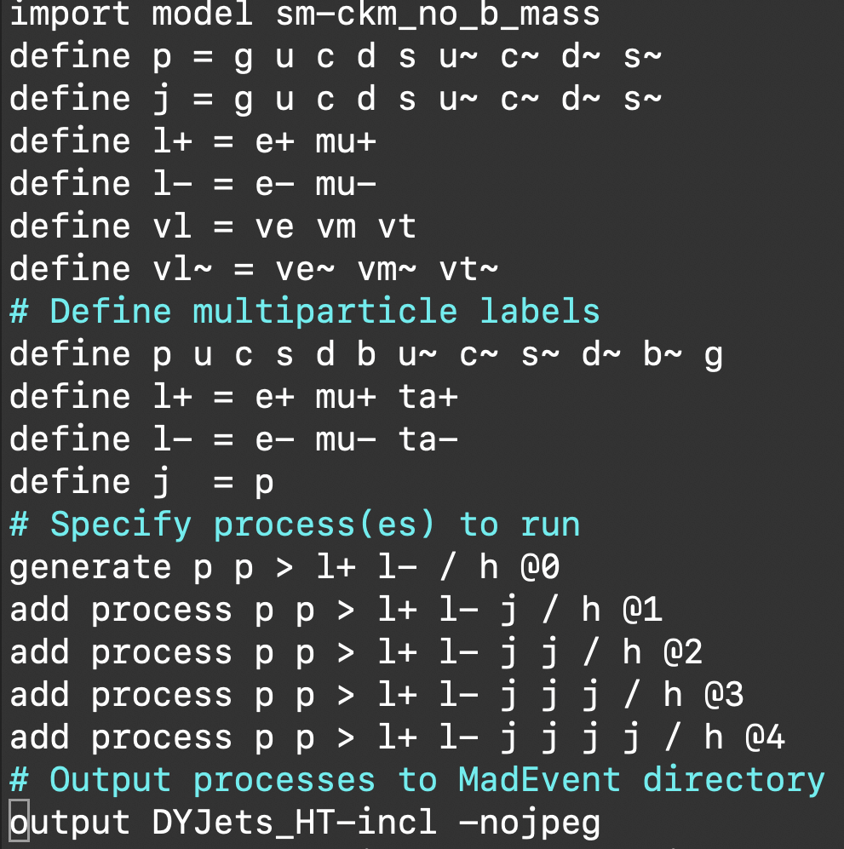
Task: LO MLM DY inclusive (3.5.2 vs 2.9.18)
No effect without “ =”

Slide 5
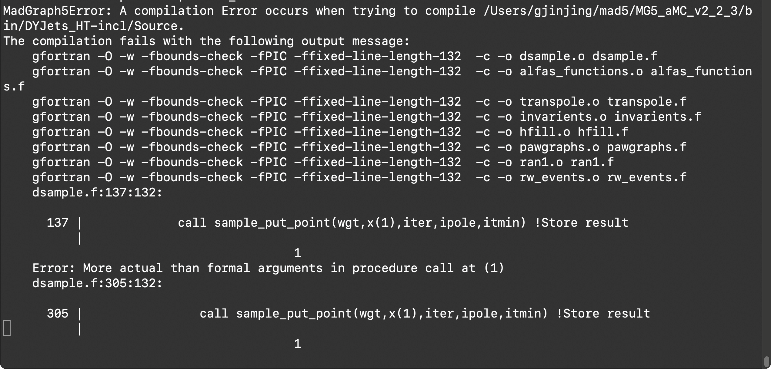
Task: LO MLM DY inclusive (3.5.3 vs 2.9.19) - Test using local machine
Version 2.2.3 Check : MG5 version too old

Slide 6
Task: LO MLM DY inclusive (3.5.2 vs 2.9.18)
Gridpacks :
  Jet: 0 + 1 + 2 + 3 + 4
  Energy : 13 TeV
  Long time to produce 0+1+2+3+4

Slide 7
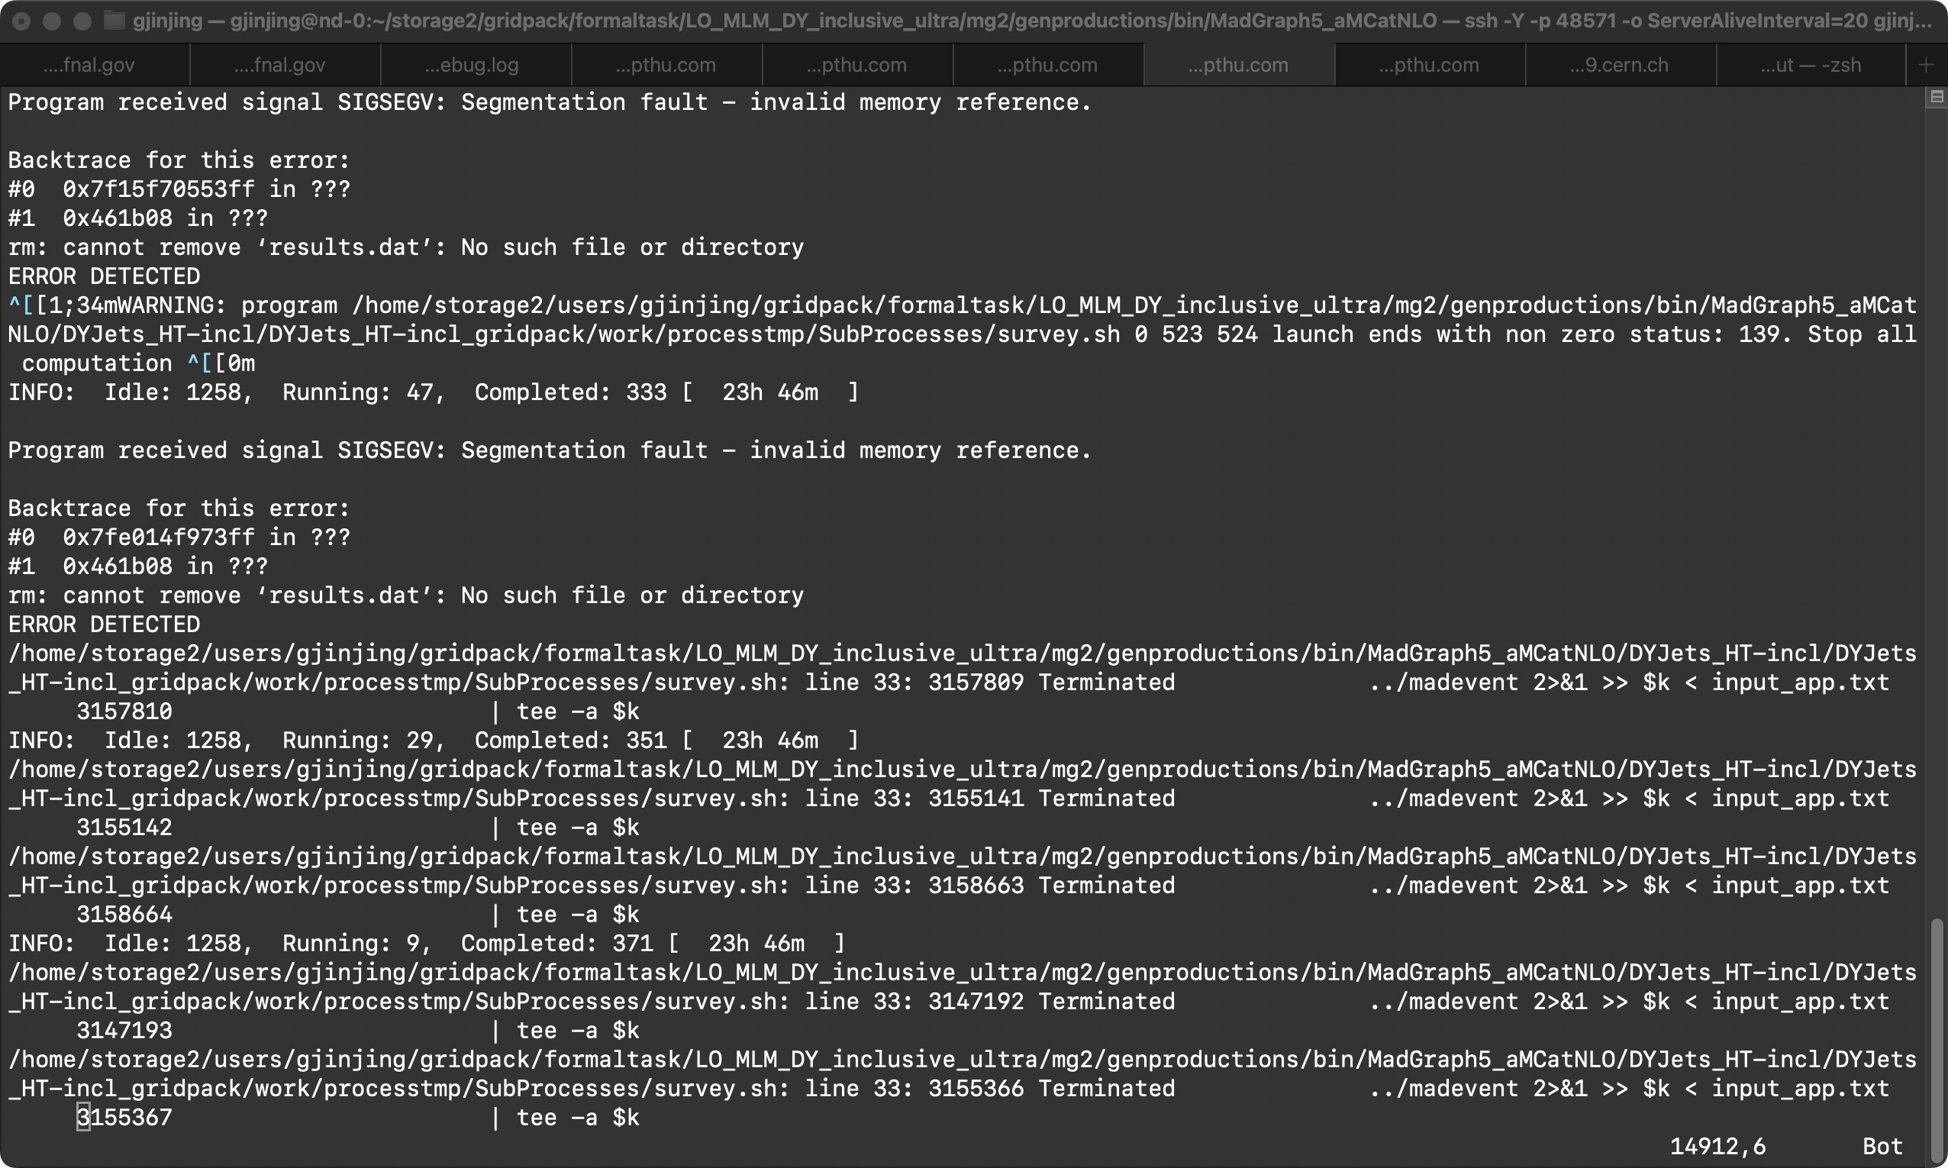
Task: LO MLM DY inclusive (3.5.3 vs 2.9.19)
4-jet error

