Slide 1

Magnetic measurements at ambient temperature on the MBRD2
Lucio Fiscarelli, Mariano Pentella, TM and LMF colleagues
Alessandra Pampaloni, and INFN Genova
WP3 Meeting – 10 July 2024

Slide 2
Outline
Measurement setup
Performed tests
Results
Conclusions

Slide 3
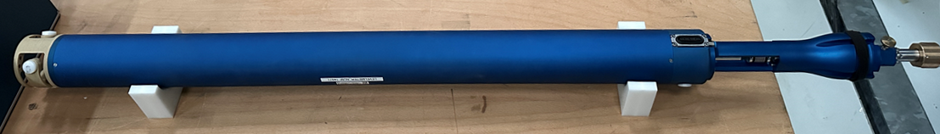
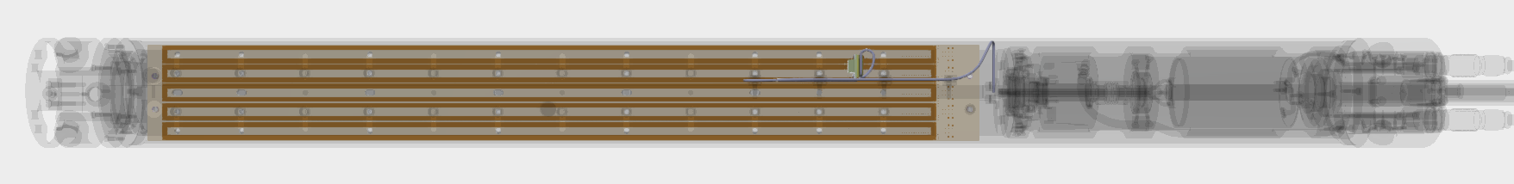
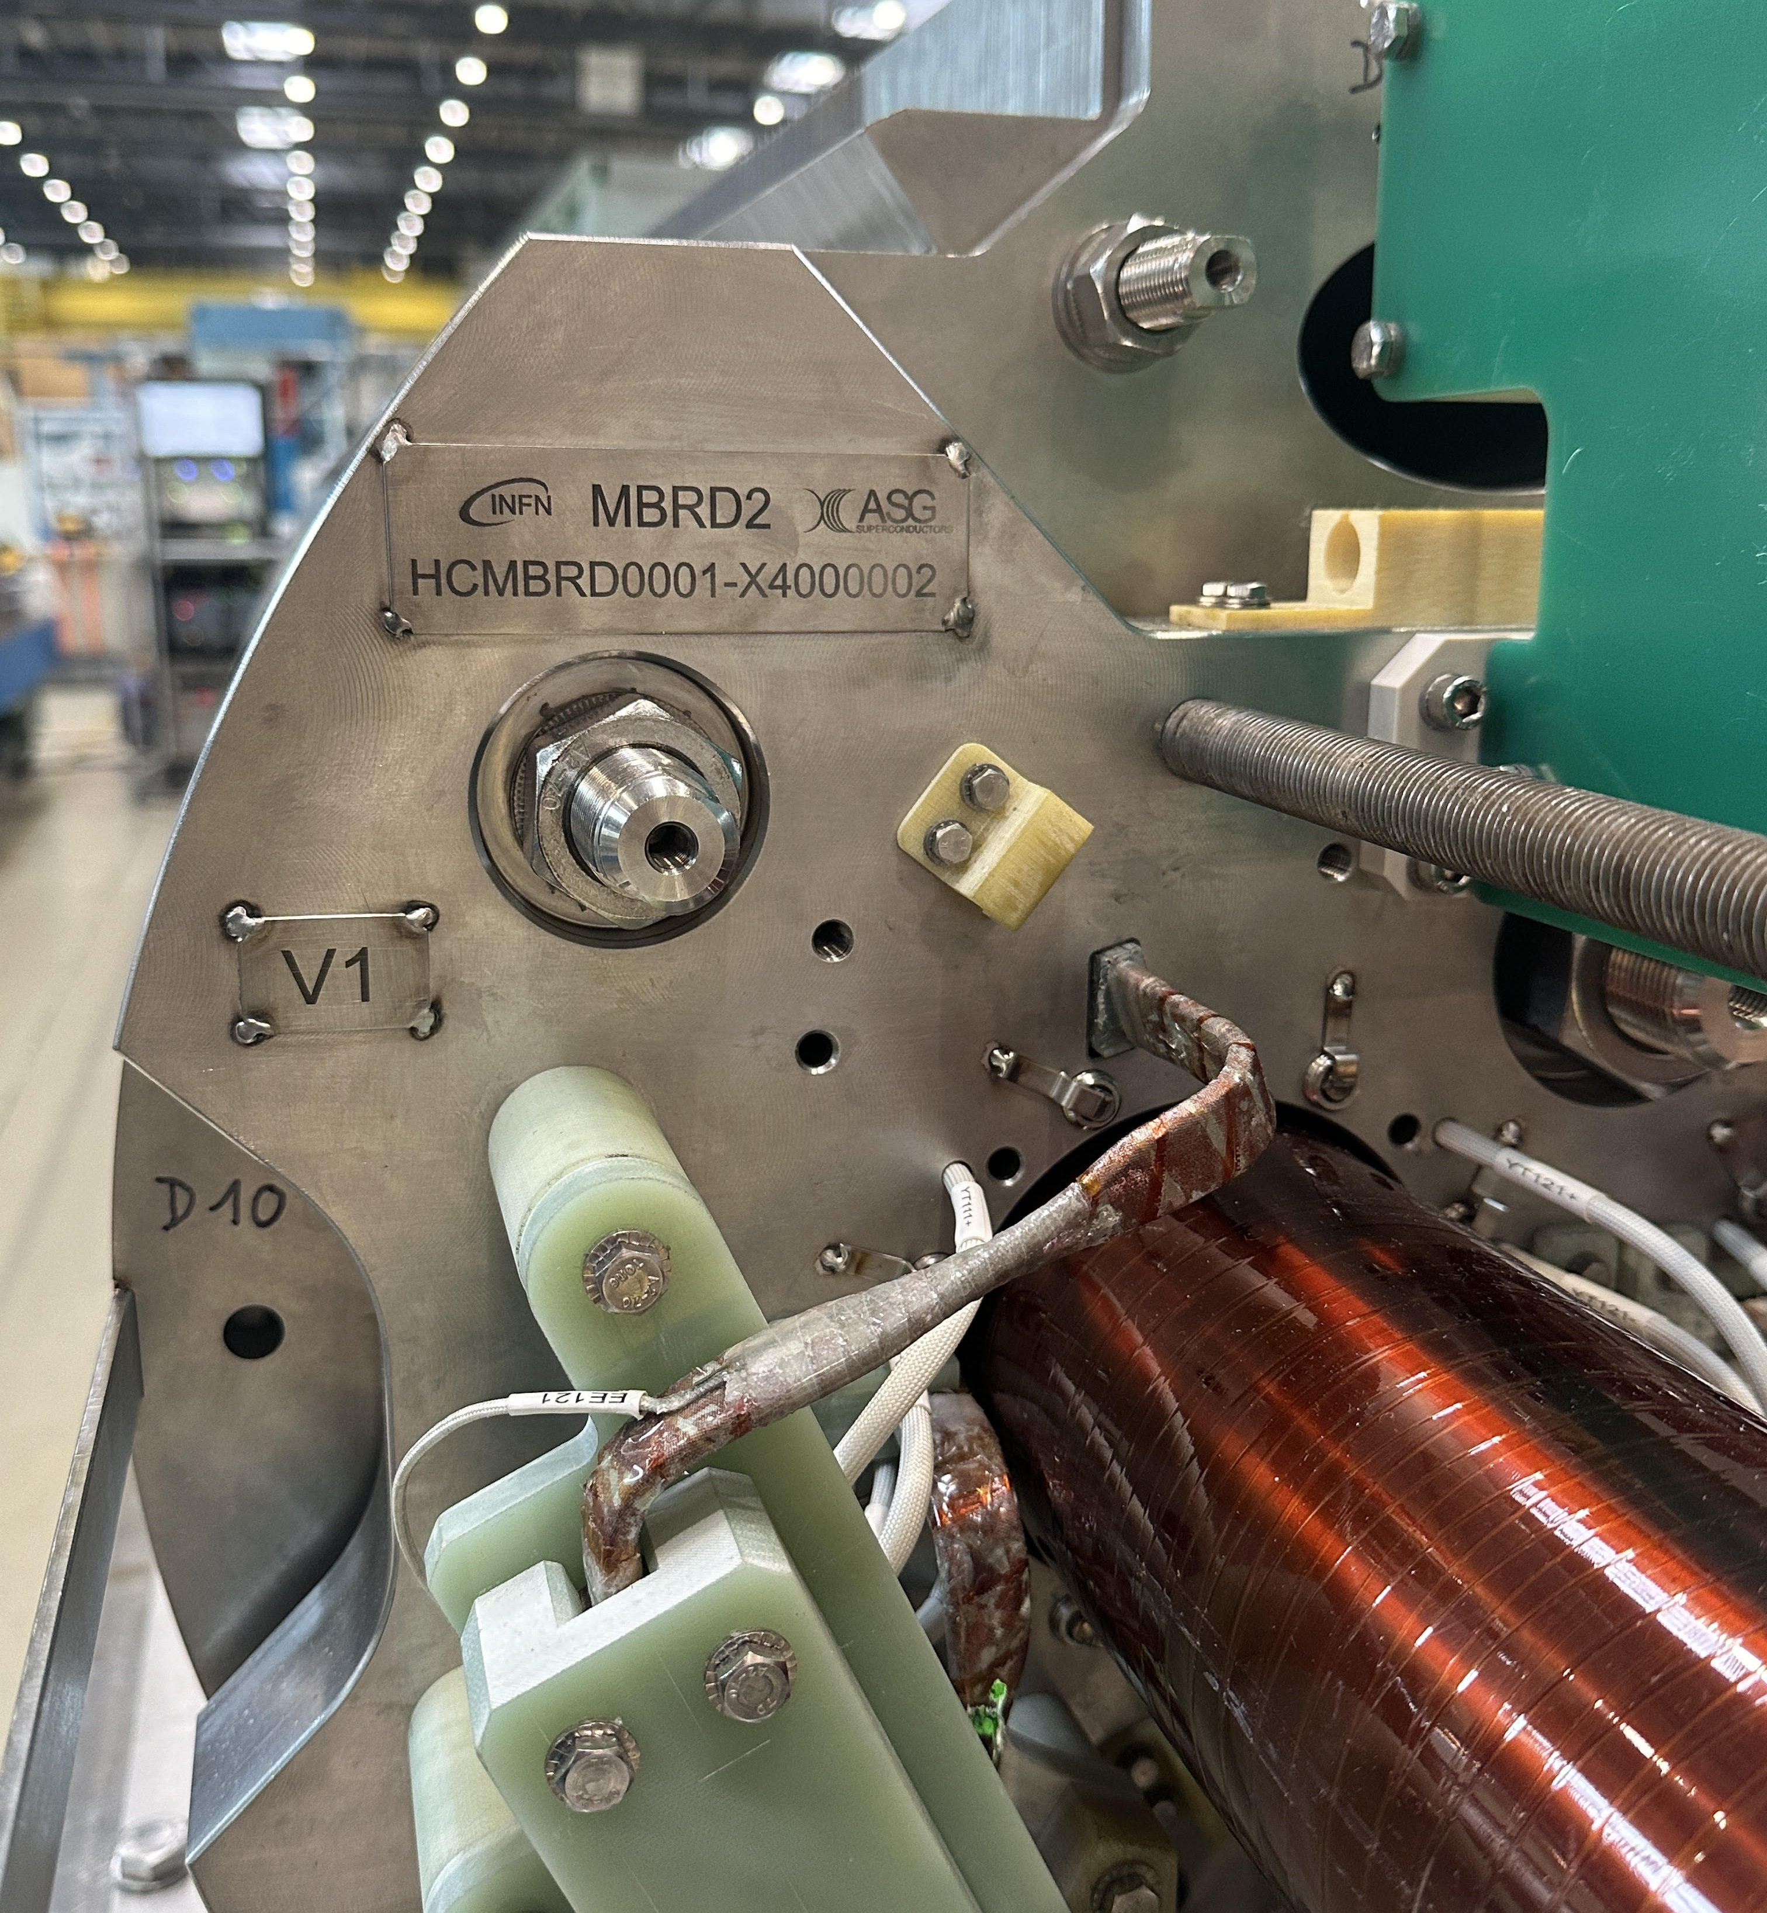
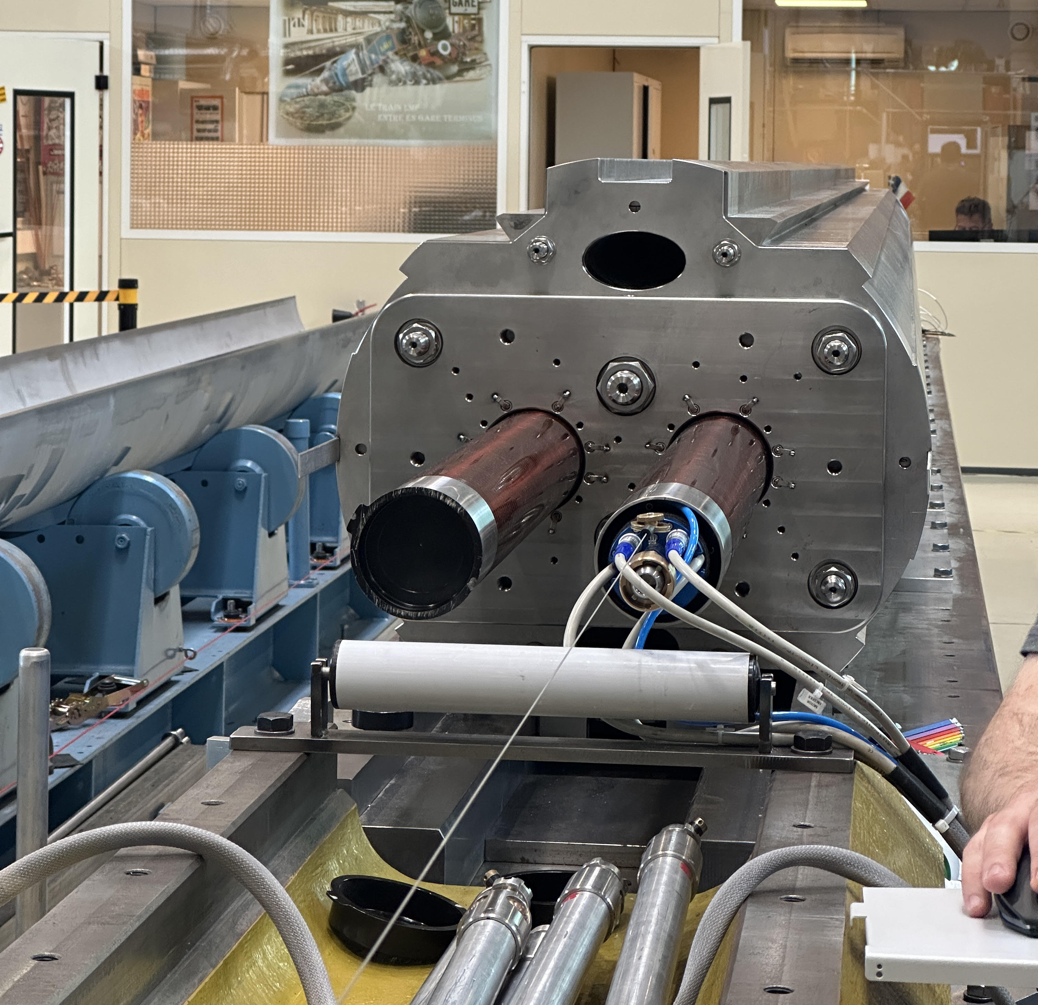
Measurement setup
Measurements in b.180
Rotating coil scanner
  Overall diameter 94 mm
  PCB coils
  Measurement radius 35 mm
  Active length 600 mm
  Positioning accuracy ~0.1 mm
  (wire encoder)
  On board tilt sensor
  14 positions to cover the full length of the MBRD
  Reference radius is 35 mm

Slide 4
Performed tests
Full scan of both apertures at ±15 A
Check at [±5, ±10, ±15, ±18] A on a few positions of V2

Slide 5
Results: main field
 | V1 |  |  |  |  | V2
 | CS | CENTER | NCS | INTEGRAL |  | CS | CENTER | NCS | INTEGRAL
Positions | 1-2 | 3-12 | 13-14 |  |  | 1-2 | 3-12 | 13-14
Current (A) | 15 |  |  |  |  | 15
B1 | 0.0047 | 0.0062 | 0.0047 | 0.0486 |  | 0.0047 | 0.0062 | 0.0047 | 0.0486
TF | 0.3131 | 0.4152 | 0.3120 | 3.2413 |  | 0.3121 | 0.4153 | 0.3126 | 3.2413
30 units more than MBRD1 that was measured at 10 A

Slide 6
Results: bn
 | V1 |  |  |  |  | V2
 | CS | CENTER | NCS | INTEGRAL |  | CS | CENTER | NCS | INTEGRAL
Positions | 1-2 | 3-12 | 13-14 |  |  | 1-2 | 3-12 | 13-14
Current (A) | 15 |  |  |  |  | 15
b2 | -16.19 | -1.80 | -20.51 | -5.63 |  | 22.45 | 3.27 | 22.54 | 7.72
b3 | -3.18 | 2.33 | -5.81 | 0.75 |  | -5.15 | 1.93 | -6.11 | 0.18
b4 | 3.19 | -0.66 | 0.24 | -0.11 |  | -2.07 | 0.90 | 0.37 | 0.49
b5 | 4.11 | 4.51 | -0.55 | 3.88 |  | 3.71 | 4.02 | -1.09 | 3.39
b6 | 1.66 | 0.49 | 0.70 | 0.65 |  | -1.36 | -0.36 | -0.52 | -0.49
b7 | 0.86 | 2.23 | -0.69 | 1.74 |  | 0.87 | 2.11 | -0.85 | 1.63
b8 | 1.40 | 1.12 | 1.19 | 1.16 |  | -1.29 | -1.03 | -1.02 | -1.06
b9 | 0.33 | 1.26 | 0.00 | 1.01 |  | 0.24 | 1.23 | -0.09 | 0.96
b10 | 0.08 | 0.02 | -0.02 | 0.02 |  | 0.04 | -0.03 | 0.11 | 0.00
b11 | -1.40 | -1.43 | -1.67 | -1.45 |  | -1.36 | -1.51 | -1.68 | -1.51
b12 | 1.17 | 1.34 | 1.11 | 1.29 |  | -1.06 | -1.41 | -1.08 | -1.33
b13 | -1.47 | -1.61 | -1.53 | -1.59 |  | -1.45 | -1.68 | -1.56 | -1.64
b14 | 0.62 | 0.71 | 0.59 | 0.69 |  | -0.54 | -0.75 | -0.55 | -0.71
b15 | -0.55 | -0.61 | -0.56 | -0.60 |  | -0.60 | -0.61 | -0.61 | -0.61

Slide 7
Results: an
 | V1 |  |  |  |  | V2
 | CS | CENTER | NCS | INTEGRAL |  | CS | CENTER | NCS | INTEGRAL
Positions | 1-2 | 3-12 | 13-14 |  |  | 1-2 | 3-12 | 13-14
Current (A) | 15 |  |  |  |  | 15
a2 | 0.97 | -0.88 | -0.95 | -0.67 |  | -4.47 | 2.24 | -0.01 | 1.20
a3 | -8.97 | -1.81 | -0.88 | -2.53 |  | -8.97 | -2.18 | -1.46 | -2.88
a4 | 0.39 | -0.70 | 0.21 | -0.47 |  | 0.71 | 0.56 | 0.64 | 0.59
a5 | -1.66 | -0.82 | -0.43 | -0.88 |  | -2.25 | -1.03 | -0.77 | -1.14
a6 | 0.31 | -0.22 | 0.57 | -0.07 |  | 0.20 | -0.06 | -0.02 | -0.02
a7 | -0.21 | -0.31 | -0.14 | -0.27 |  | -0.68 | -0.23 | -0.25 | -0.28
a8 | 0.12 | -0.02 | 0.14 | 0.01 |  | 0.15 | -0.16 | -0.09 | -0.12
a9 | 0.02 | -0.09 | 0.03 | -0.07 |  | -0.21 | -0.14 | -0.06 | -0.14
a10 | 0.06 | 0.02 | 0.18 | 0.05 |  | 0.04 | 0.11 | 0.02 | 0.09
a11 | -0.16 | -0.21 | -0.31 | -0.21 |  | -0.30 | 0.00 | -0.15 | -0.05
a12 | 0.05 | 0.15 | 0.30 | 0.16 |  | -0.01 | 0.08 | -0.08 | 0.05
a13 | -0.02 | -0.19 | -0.21 | -0.17 |  | -0.09 | -0.06 | -0.13 | -0.07
a14 | 0.03 | 0.10 | 0.18 | 0.10 |  | 0.01 | 0.03 | -0.05 | 0.02
a15 | -0.03 | -0.04 | 0.01 | -0.04 |  | -0.12 | -0.12 | -0.12 | -0.12

Slide 8
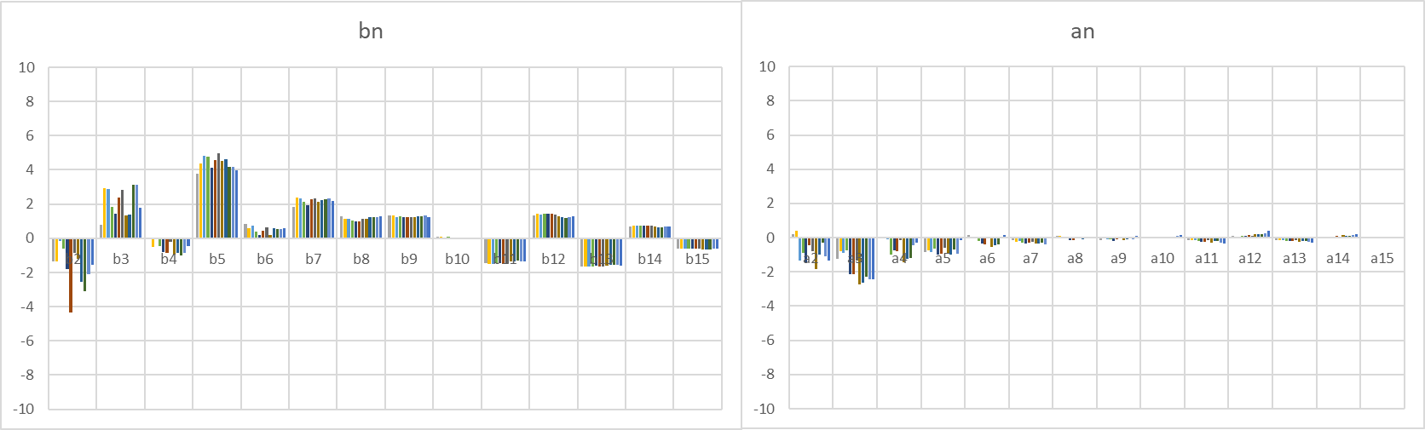
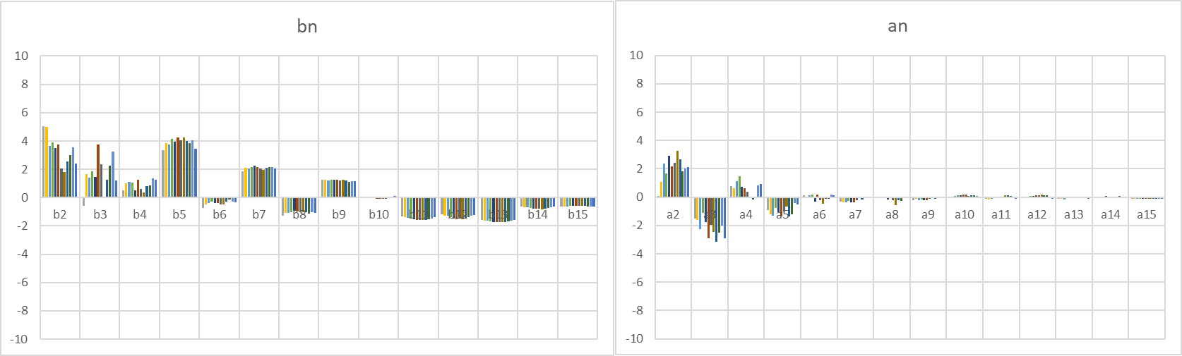
Multipoles versus position
V1
V2

Slide 9
Comparison with measurements from ASG
Differences ASG (18 A) – CERN (15 A)
 | V1 |  |  |  |  | V2
 | CS | CENTER | NCS | INTEGRAL |  | CS | CENTER | NCS | INTEGRAL
Δ b2 | 4.40 | 1.97 | 8.27 | 2.04 |  | -7.03 | -2.16 | -8.09 | -2.36
Δ b3 | 0.78 | -0.35 | 1.86 | -0.46 |  | 1.00 | 0.02 | 2.93 | -0.08
Δ b4 | -0.81 | 0.72 | 0.82 | 0.68 |  | 1.30 | 0.72 | 1.27 | 0.67
Δ b5 | 0.82 | 0.87 | 1.78 | 0.50 |  | 0.49 | 0.79 | 2.47 | 0.55
Δ b6 | -0.18 | 0.19 | 0.76 | 0.23 |  | 0.99 | 0.54 | 0.70 | 0.58
Δ b7 | 0.22 | -0.30 | -0.23 | -0.47 |  | 0.43 | -0.47 | 0.36 | -0.45
Δ b8 | -0.94 | -0.90 | -0.90 | -0.90 |  | -1.66 | -0.96 | -1.11 | -1.00
Δ b9 | -0.35 | -0.41 | -0.59 | -0.56 |  | 0.02 | -0.08 | 0.39 | -0.14
Δ b10 | -0.92 | -0.65 | 1.09 | -0.39 |  | 0.30 | 0.42 | 0.59 | 0.42
Δ b11 | 1.29 | 1.20 | -0.08 | 1.03 |  | 2.73 | 1.76 | 2.20 | 1.97
Δ b12 | 0.83 | 0.83 | 2.78 | 0.98 |  | 2.16 | 1.54 | 1.80 | 1.70
Δ b13 | 1.56 | 1.46 | 0.57 | 1.36 |  | 3.23 | 1.75 | 2.08 | 2.05
Δ b14 | 0.60 | 0.70 | 1.20 | 0.67 |  | 0.58 | 0.40 | 0.28 | 0.44
Δ b15 | 0.03 | 0.16 | 0.03 | 0.15 |  | 0.11 | 0.19 | 0.06 | 0.18

Slide 10
Comparison with measurements from ASG
Differences ASG (18 A) – CERN (15 A)
 | V1 |  |  |  |  | V2
 | CS | CENTER | NCS | INTEGRAL |  | CS | CENTER | NCS | INTEGRAL
Δ a2 | -0.70 | -0.52 | -0.42 | -0.38 |  | 5.48 | -0.52 | 0.60 | 0.14
Δ a3 | 1.90 | -0.43 | -0.73 | -0.25 |  | 0.59 | -0.81 | -0.70 | -0.67
Δ a4 | -1.24 | -1.36 | -0.25 | -0.98 |  | -1.05 | -1.52 | -0.31 | -1.20
Δ a5 | 0.82 | 0.48 | 0.29 | 0.50 |  | 1.13 | 0.74 | 1.06 | 0.83
Δ a6 | 0.66 | 0.17 | 1.09 | 0.44 |  | 0.48 | 0.00 | 1.19 | 0.28
Δ a7 | 0.60 | 0.51 | 0.57 | 0.53 |  | 2.63 | 1.74 | 2.04 | 1.83
Δ a8 | 0.08 | -0.38 | 0.21 | -0.18 |  | 0.11 | -0.65 | -0.21 | -0.41
Δ a9 | -0.25 | -0.39 | -1.36 | -0.48 |  | -1.52 | -0.61 | -0.91 | -0.76
Δ a10 | -0.33 | -0.07 | 0.38 | -0.03 |  | -0.29 | 0.10 | 0.24 | 0.04
Δ a11 | -1.79 | -1.96 | -2.69 | -1.92 |  | -0.83 | 0.39 | 0.24 | 0.14
Δ a12 | 0.41 | 0.60 | 0.86 | 0.57 |  | 0.67 | 1.15 | 1.42 | 1.04
Δ a13 | -0.17 | -0.43 | -0.40 | -0.34 |  | 0.65 | 1.32 | 1.48 | 1.17
Δ a14 | 1.52 | 1.39 | 1.29 | 1.31 |  | 2.58 | 1.70 | 2.02 | 1.79
Δ a15 | 1.34 | 1.16 | 1.29 | 1.15 |  | 0.53 | 1.00 | 1.09 | 0.89

Slide 11
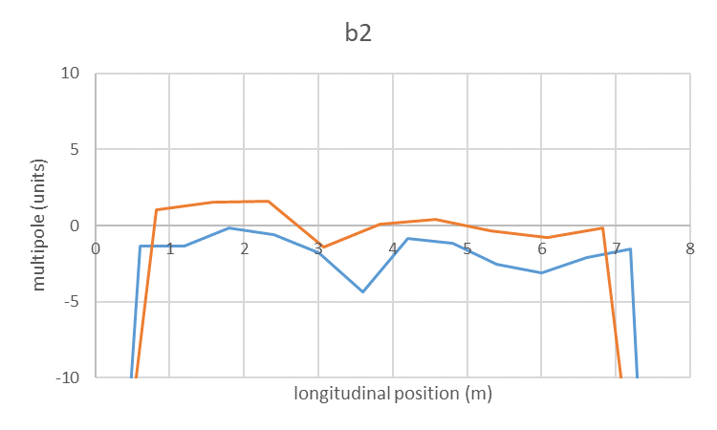
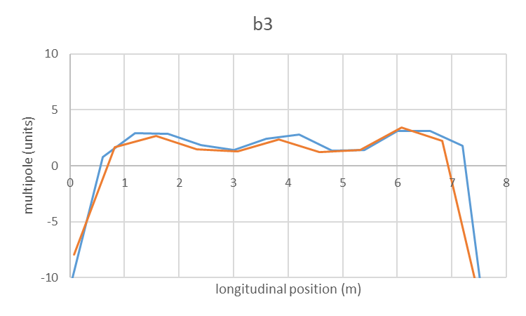
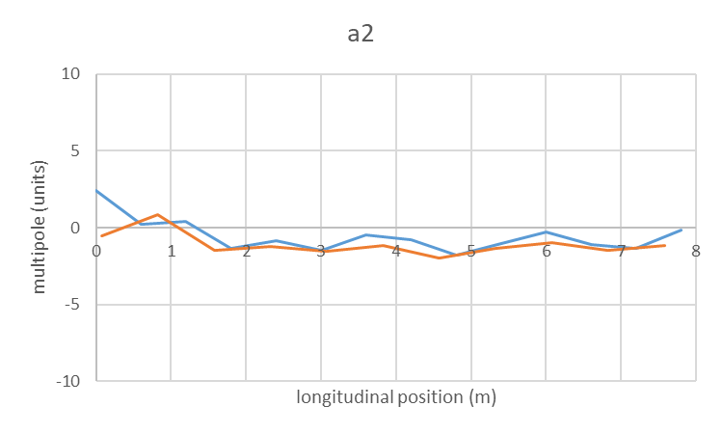
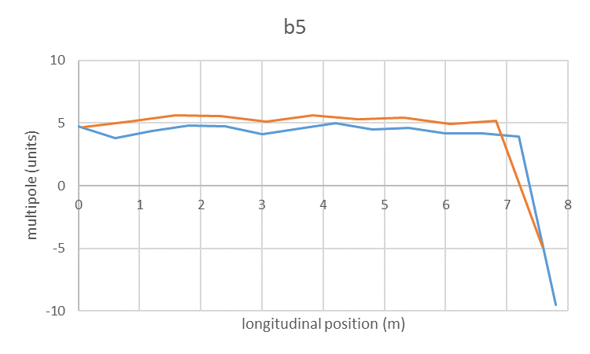
V1
ASG
CERN

Slide 12
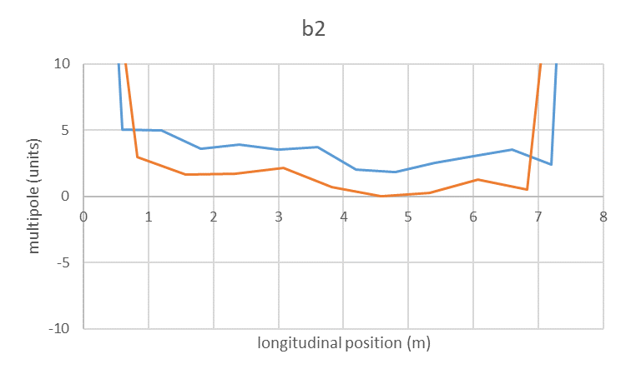
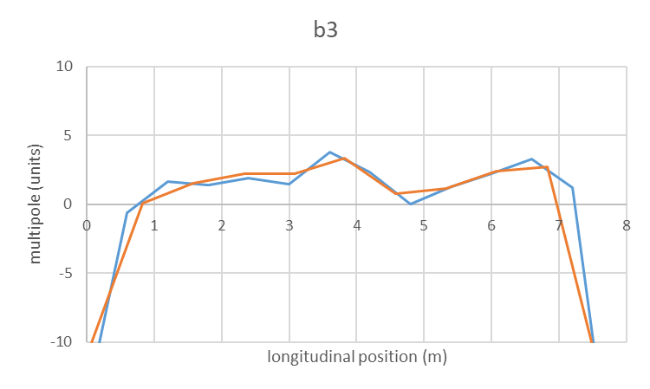
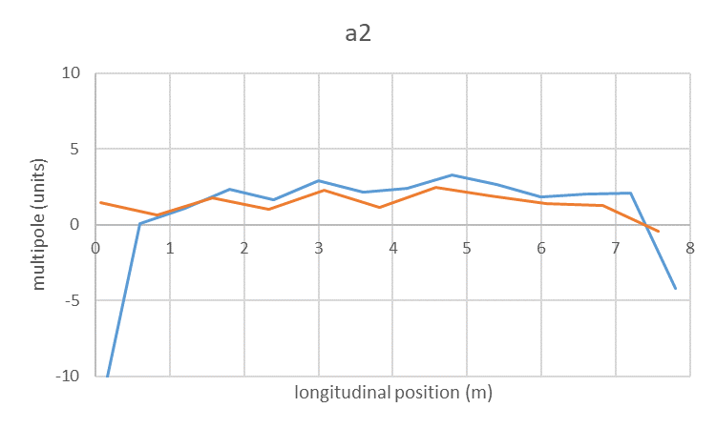
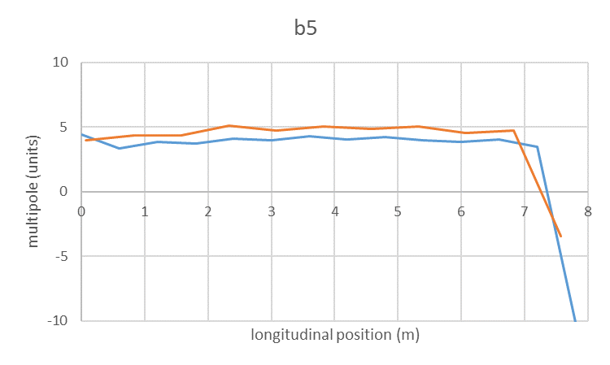
V2
ASG
CERN

Slide 13
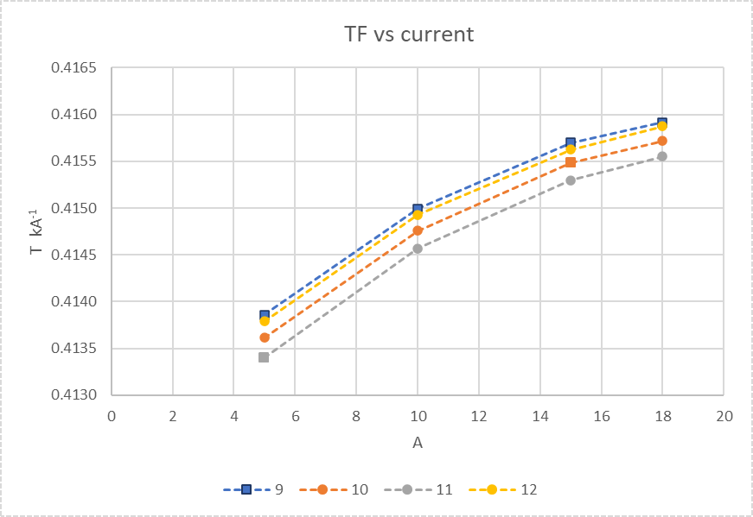
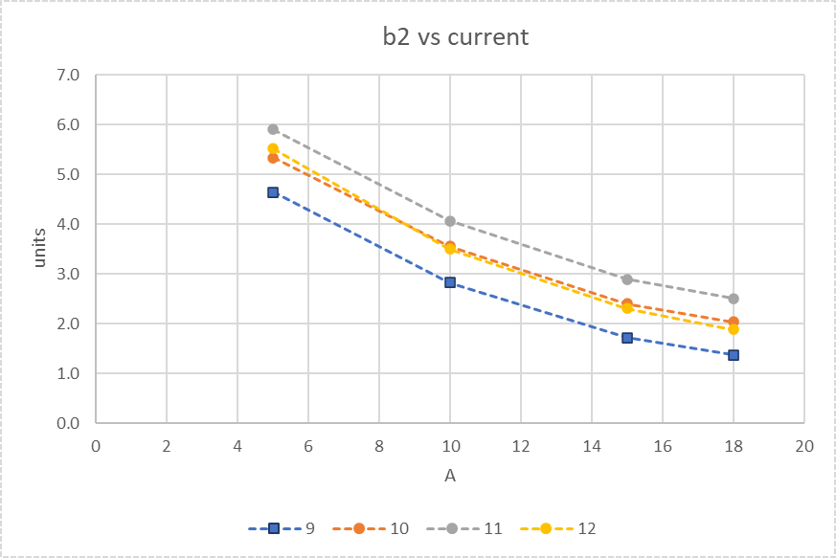
Change of TF and b2 versus current
35 units

Slide 14
Conclusions
  MBRD2 measured at CERN, before integration in the cold-mass, at ambient temperature
  Main results
    Transfer function in line with MBRD1
    b2 is -5.6 / 7.7 units
    b3 is 0.8 / 0.2 units
    b5 is 3.9 / 3.4 units
    General agreement with measurements performed at ASG
    Change of TF (~30 units) and b2 (~3 units) from 5 A to 18 A
      Same effect already seen on MBRD1

