Slide 1
1
General Information
Frank Zimmermann
FCC-ee Optics Design Meeting #188 & 57th FCCIS WP2.2 meeting, 10 July 2024

Slide 2
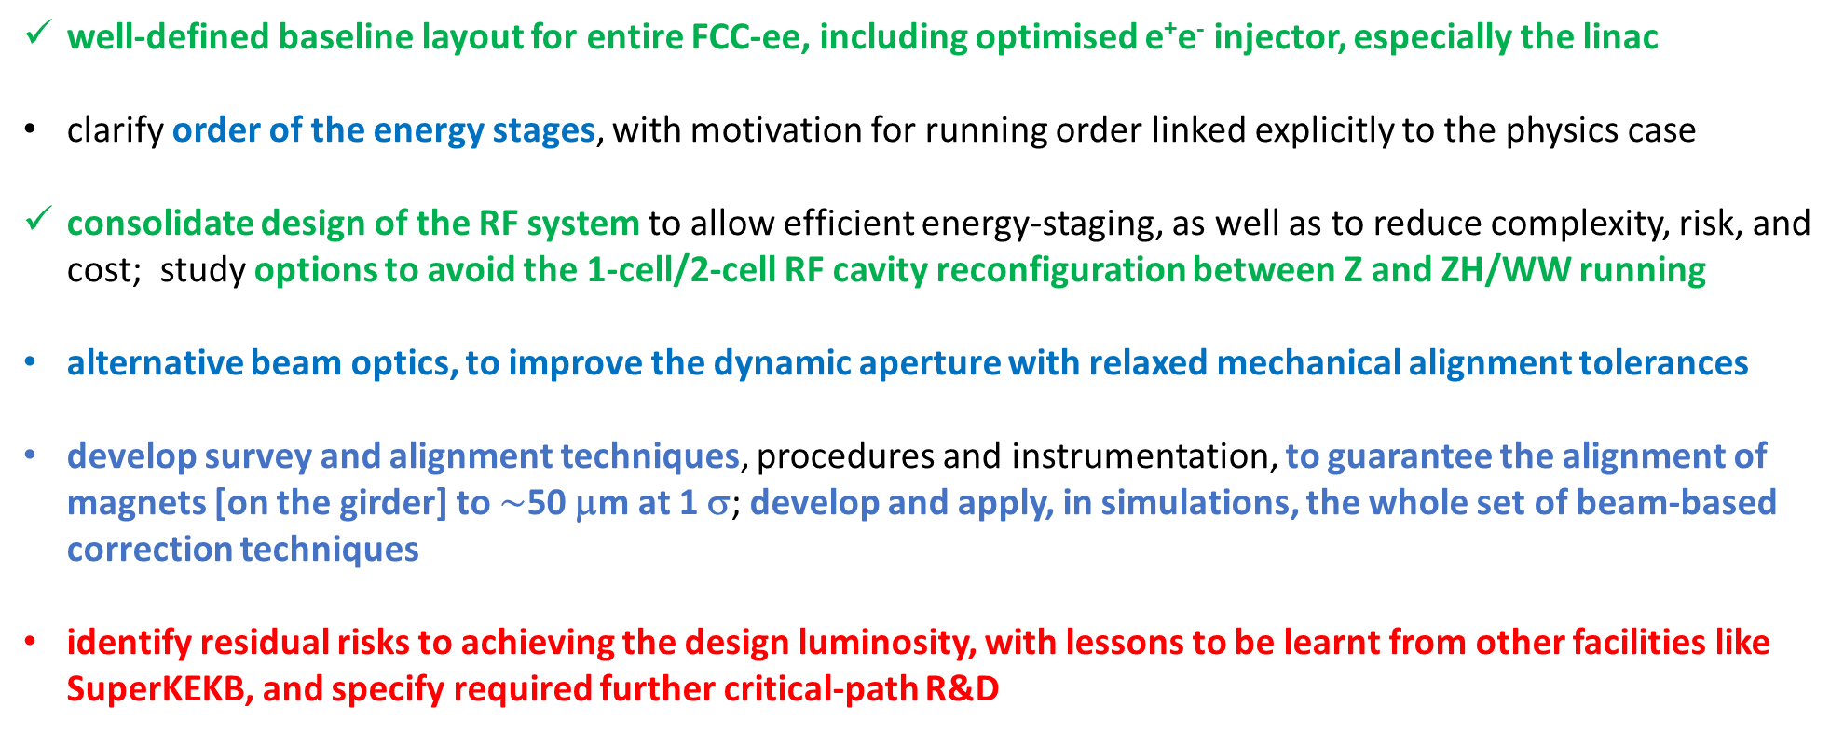
MTR recommendations on FCC-ee machine
from FCC SAC, FCC CRP, CERN SPC, and CERN FC
well-defined baseline layout for entire FCC-ee, including optimised e⁺e⁻ injector, especially the linac
clarify order of the energy stages, with motivation for running order linked explicitly to the physics case
consolidate design of the RF system to allow efficient energy-staging, as well as to reduce complexity, risk, and cost; study options to avoid the 1-cell/2-cell RF cavity reconfiguration between Z and ZH/WW running
alternative beam optics, to improve the dynamic aperture with relaxed mechanical alignment tolerances
develop survey and alignment techniques, procedures and instrumentation, to guarantee the alignment of magnets [on the girder] to $\sim$50 μm at 1 σ; develop and apply, in simulations, the whole set of beam-based correction techniques
identify residual risks to achieving the design luminosity, with lessons to be learnt from other facilities like SuperKEKB, and specify required further critical-path R&D

Slide 3
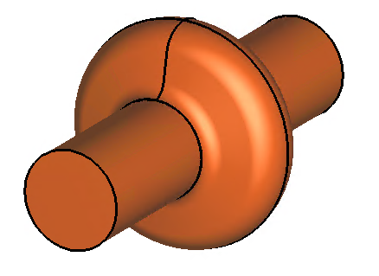
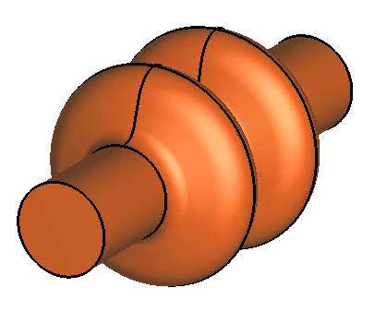
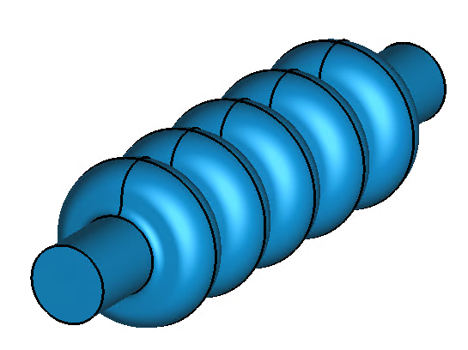
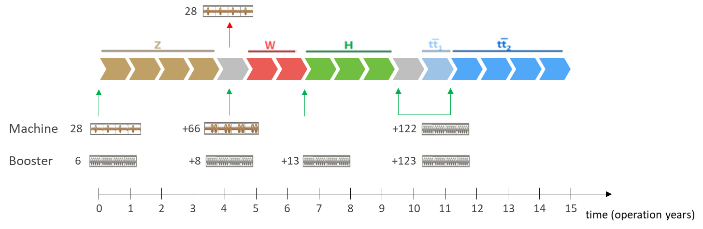
FCC-ee baseline RF configuration so far
  1-cell
  400 MHz,
  Nb/Cu
  2-cell
  400 MHz,
  Nb/Cu
  5-cell
  800 MHz,
  bulk Nb
Z
low R/Q, HOM damping, powered by 1 MW RF coupler and high efficiency klystron
W, H
moderate gradient and HOM damping requirements; 500 kW / cavity, allowing reuse of klystrons already installed for Z
ttbar,
booster
high RF voltage and limited footprint thanks to multicell cavities and higher RF frequency; 200 kW/ cavity
1-cell Nb/Cu
F. Peauger,
O. Brunner
1-cell Nb/Cu
2-cell Nb/Cu
addt’l 5- or 6-cell bulk Nb cavities
O. Brunner

Slide 4

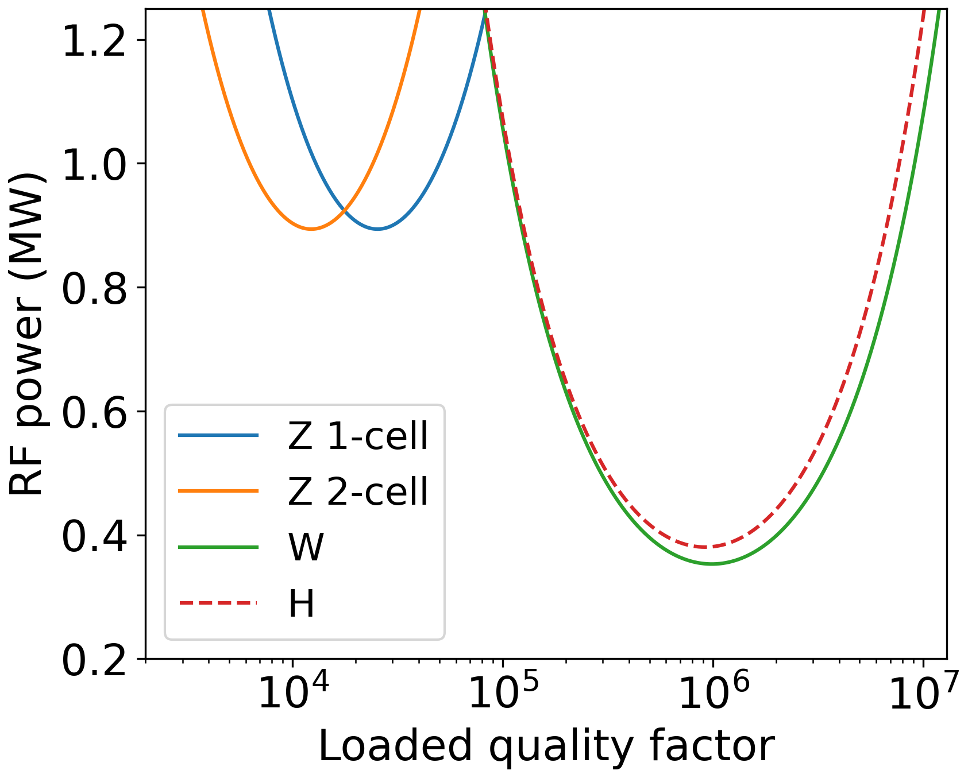
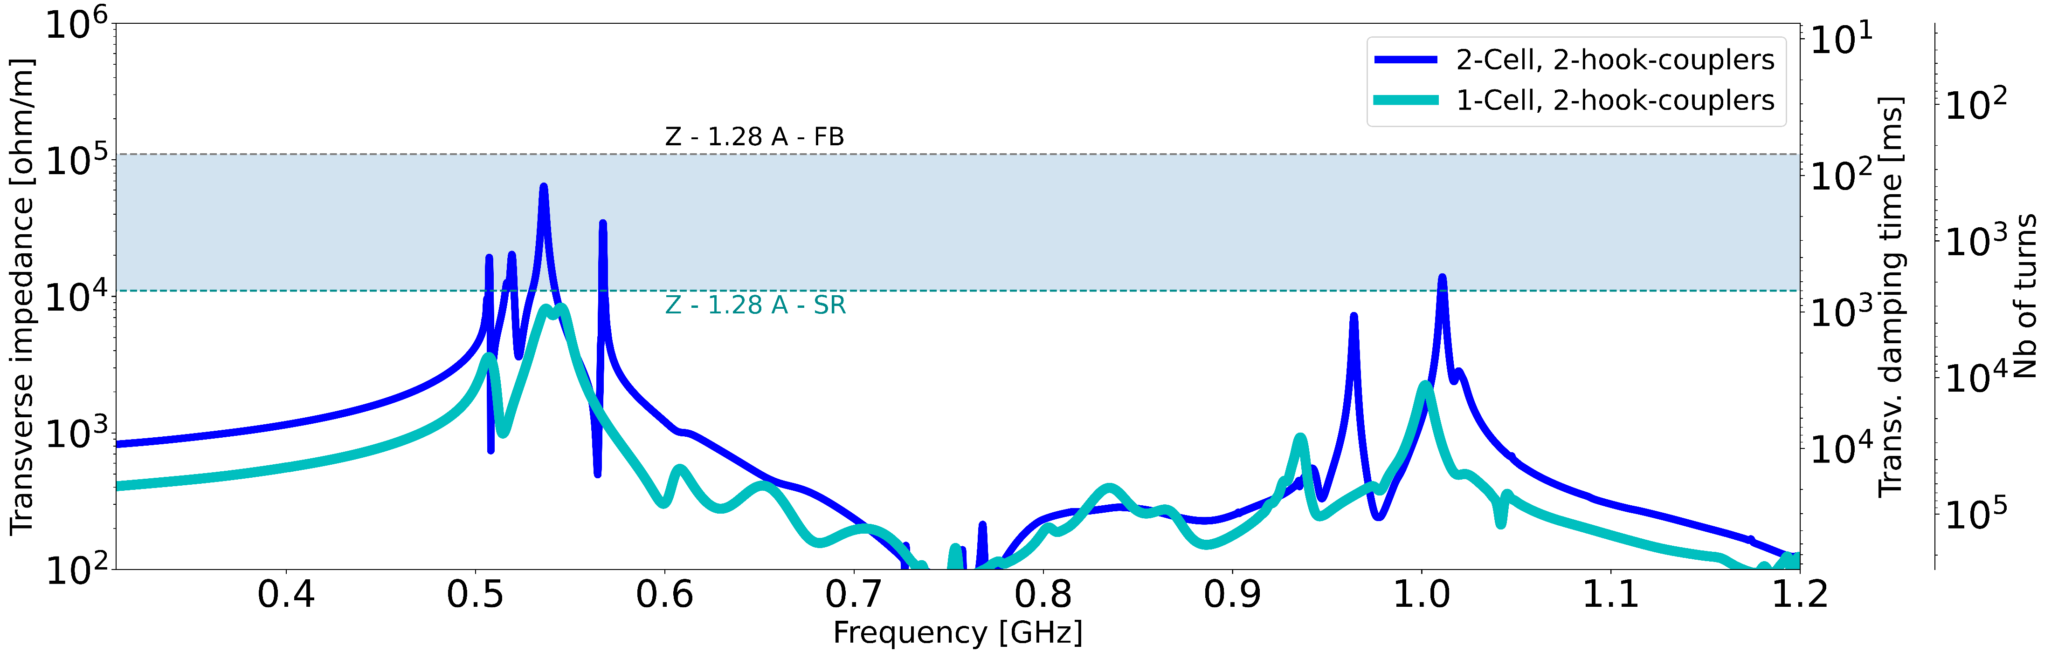
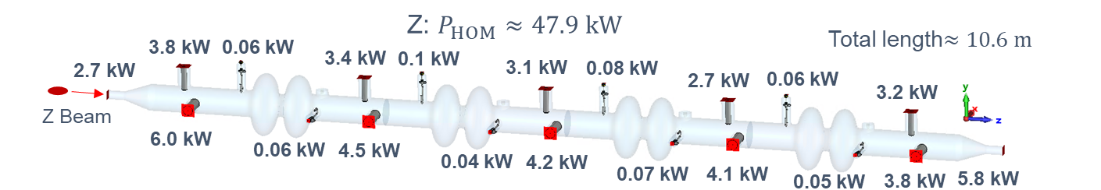
A 2-cell 400 MHz SRF cavity for all energies ?
Input RF power for optimum detuning
I. Karpov, R. Calaga, E. Montesinos, S. Zadeh, F. Peauger, O. Brunner
Need for adjustable/variable fundamental power coupler with wide range of coupling (2 orders of magnitude)
Presence of 0-mode requires additional longitudinal feedback Transverse feedback needed
40%-increase of HOM power / cryomodule → “2-coax concept”

Slide 5
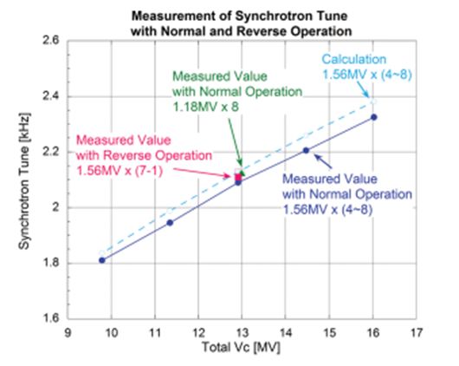
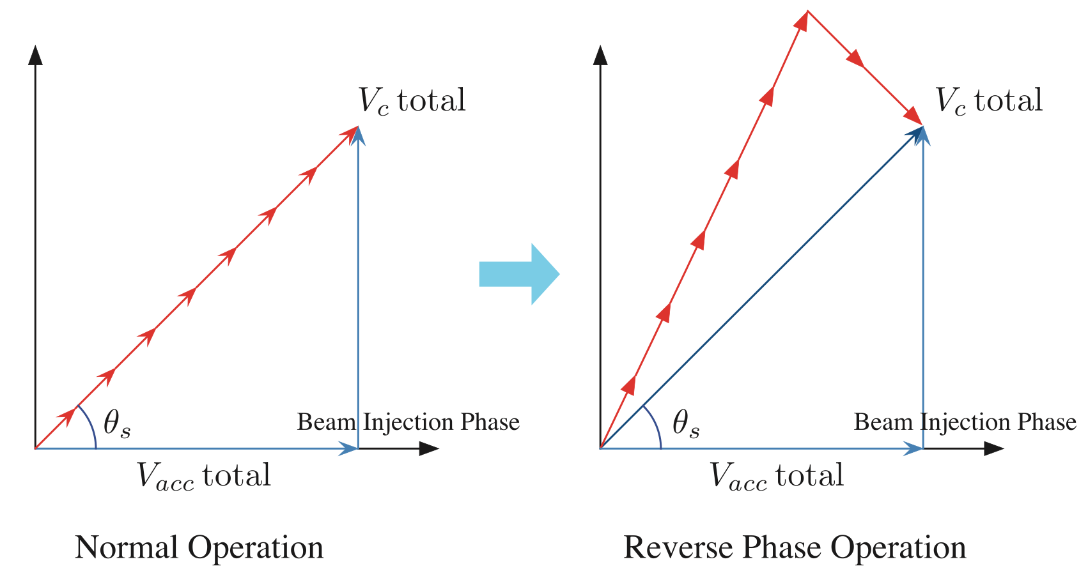
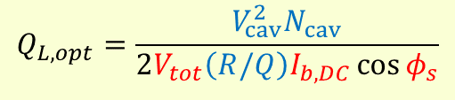
Solution for FCC-ee simplified RF system !
2-cell for all energies
$$Q_{L,opt}=\frac{V_{cav}^{2}N_{cav}}{2V_{tot}\left(R/Q\right)I_{b,DC}\cos{φ_{s}}}$$
Reverse phase operation (RPO) → higher RF cavity voltage (Y. Morita et al., SRF, 2009)
Experimentally verified with high beam loading in KEKB (Y. Morita et al., IPAC, 2010)
Baseline solution for EIC ESR (e.g., J. Guo et al., IPAC, 2022)
T. Abe et al., PTEP, 2013
KEKB HER synchrotron tune measured for several SC cavity configurations. RPO “(7 - 1)” case with1.56 MV/cavity yielded about the same f_{s} as for 8 in-phase cavities with 1.18 MV/cavity [T. Abe et al., 2013]
Advantages:
Rationalize RF resources during the development process (3 → 2 cavity types)
Simplify, shorten the installation sequence (no cryo-module removal)
Great flexibility in physics running modes
Potential savings (cost, manpower, and time)
→ RPO potentially allows same optimal quality factor for Z, W, and H modes
I. Karpov

Slide 6
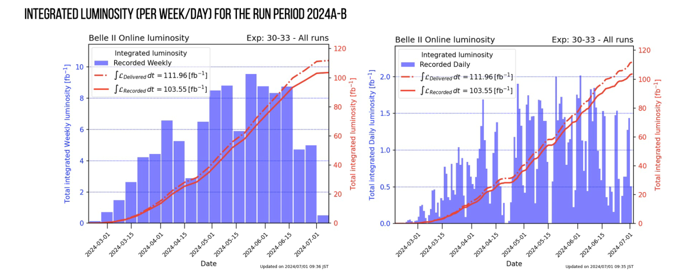
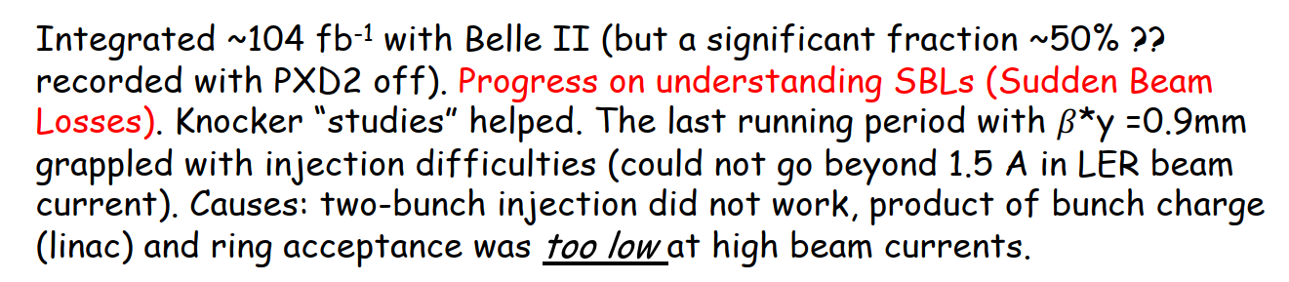
Summary of SuperKEKB spring run from Belle II
For analyses that
do not involve
TDCPV, can add
an extra 100 fb⁻¹
N.B. machine
studies were the
priority during this
running period.
T. Browder

Slide 7
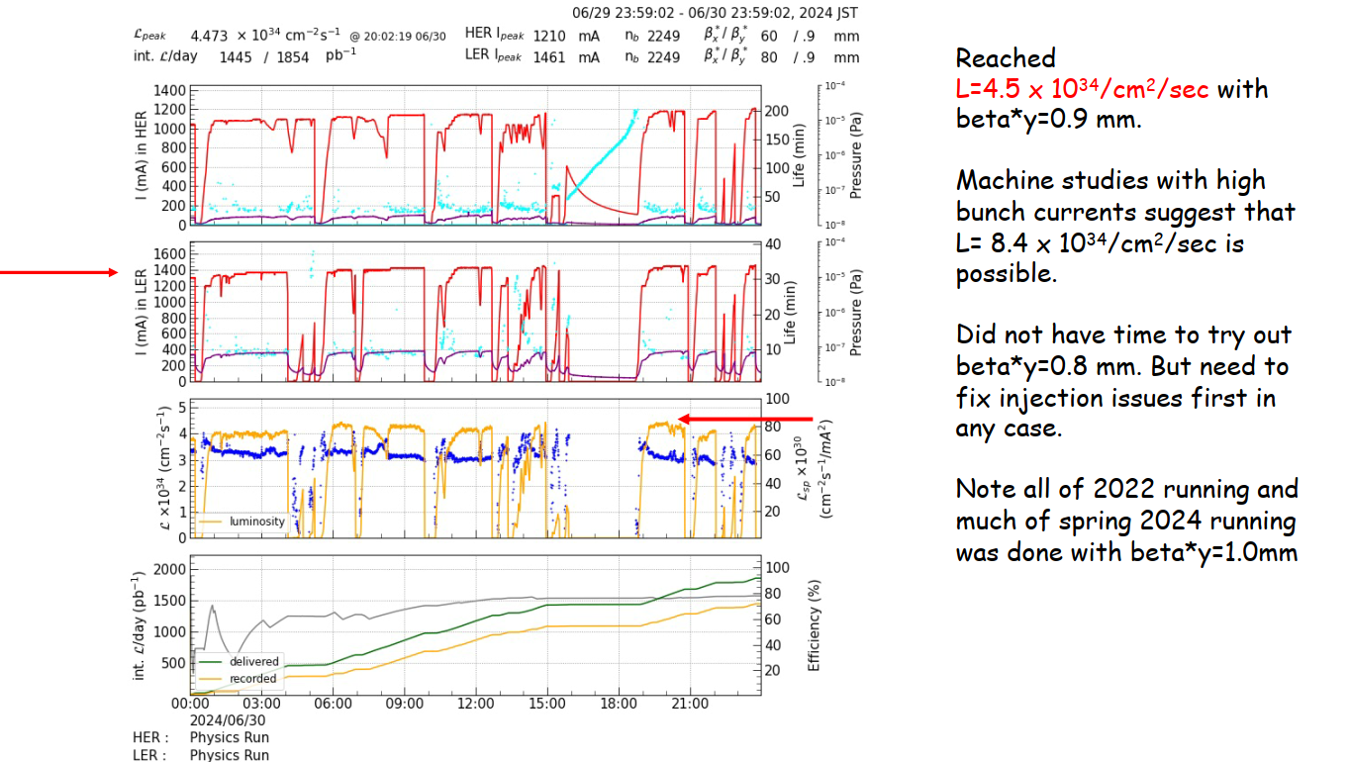
Summary of SuperKEKB spring run from Belle II -2
T. Browder

Slide 8
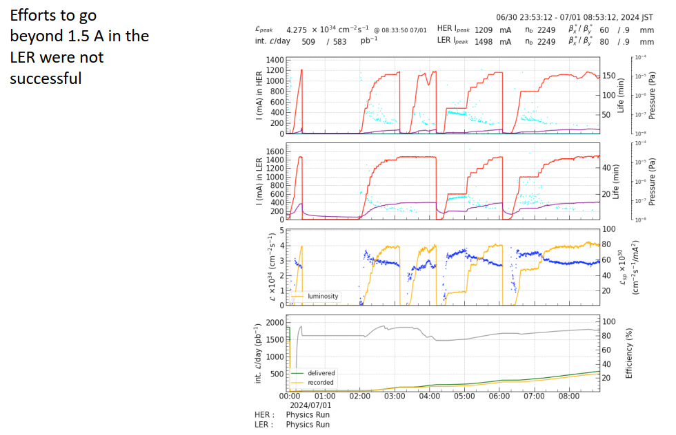
Summary of SuperKEKB spring run from Belle II -3
T. Browder

Slide 9
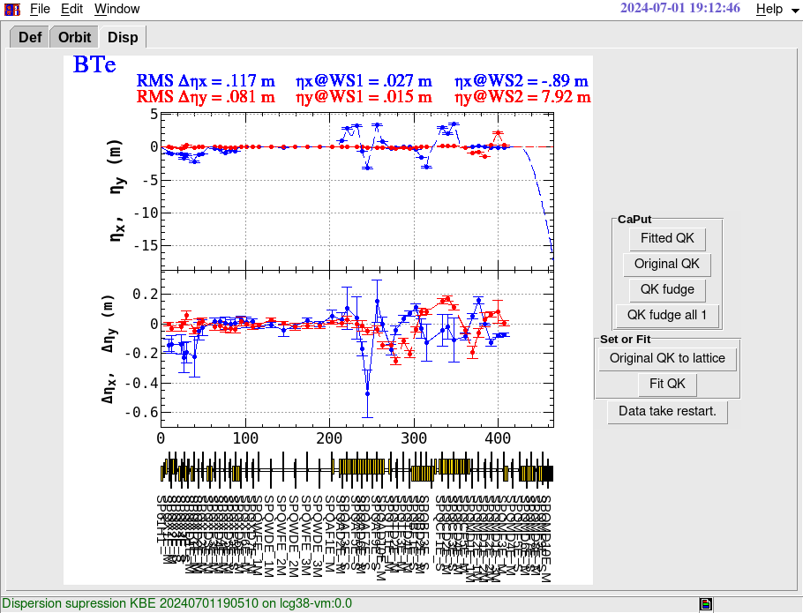
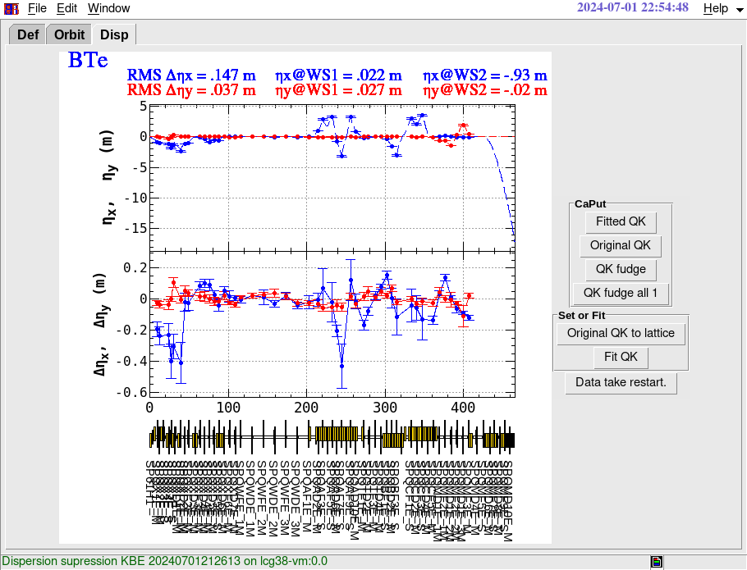
Progress with understanding e- blow up in BT line
N. Iida, T. Yoshimoto, Y. Funakoshi, K. Oide
Bump=0
QAD4EでDY: +12mm
V. Dispersion発生

Slide 10
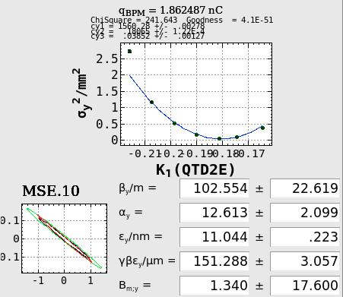
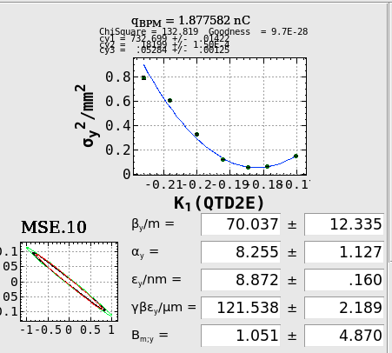
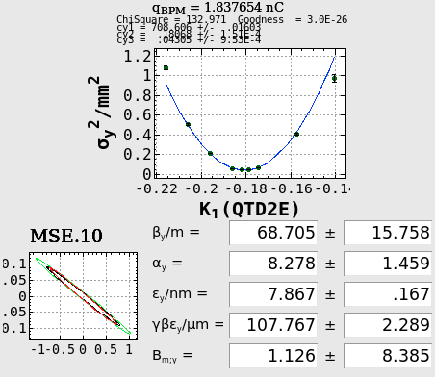
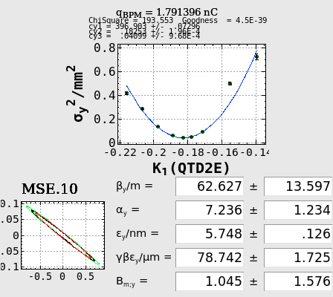
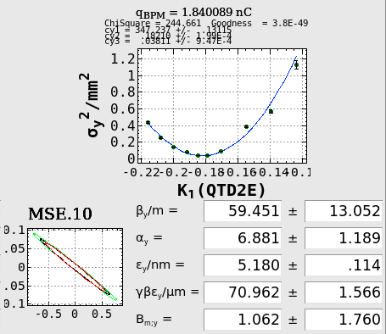
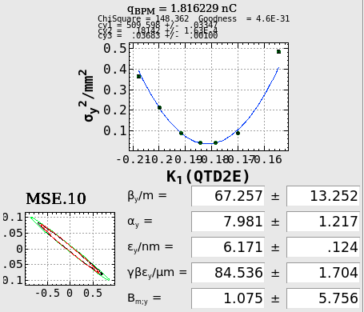
Emittance measurement at MSE.10
Measurement: T. Yoshimoto
2nC
no Bump
QAD4EでDY: +11mm
QAD4EでDY: +12mm
QAD4EでDY: +6mm, QAD6EでDY: +4mm
Tailあり
Tail補正
PY_A1_M
PY_13_5
でMSE.10での
Tailがなくなるように
調整(今井氏)
N. Iida, T. Yoshimoto, Y. Funakoshi, K. Oide

Slide 11
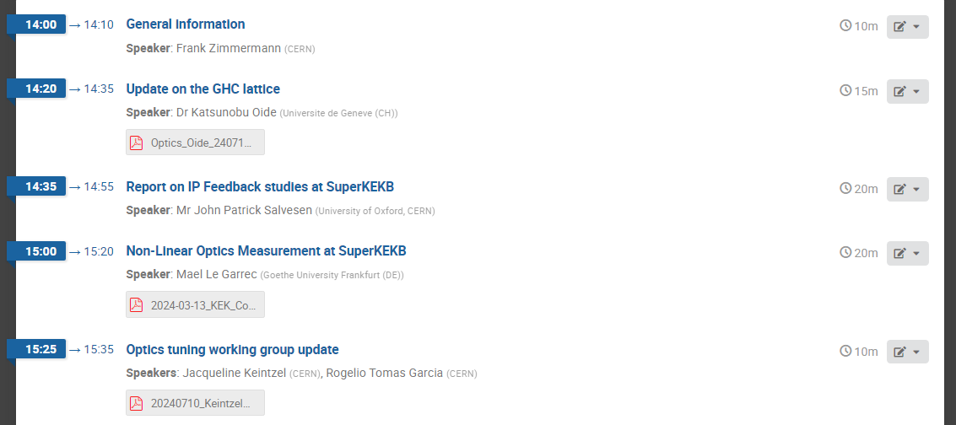
Today’s agenda

