Slide 1
TCDS: Replacement of graphite blocks with CSiC blocks & impact on Ti-6Al-4V block 23
Tristan F. Calvet
3rd June 2024

Slide 2
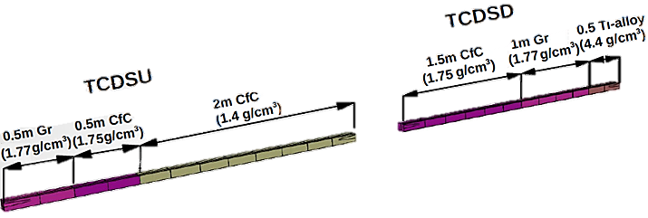
Background
Past studies showed graphite may not survive HL conditions.
  Possible fracture beyond 1.8×10¹¹ p/b BCMS
  Baseline position: graphite blocks to be replaced by C-C composite (of the same density)
C-C blocks considered acceptable based on HRMT studies.
However, Ti is still problematic.
Ti block 23
Graphite blocks 1-2
Graphite blocks 19-22

Slide 3
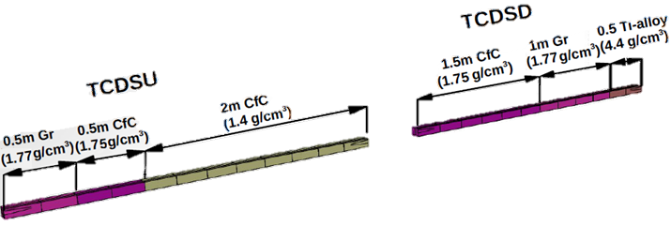
Configurations & simulations
Case 1:
Replacement of 2 Gr blocks by C-SiC blocks
Blocks 1 & 2 unchanged
Blocks 21 & 22 replaced
Case 2:
Replacement of 4Gr blocks by C-SiC blocks
Blocks 1 & 2 unchanged
Blocks 19 to 22 replaced
Ti block 23
Gr blocks 19-22
Replaced Gr blocks 21 & 22 with C-SiC
Gr blocks 1-2
Ti block 23
Gr blocks 19-22
Replaced Gr blocks 19-22 with C-SiC
Gr blocks 1-2

Slide 4
Baseline of simulations
Material: Ti-6AL-4V alloy, elastic-plastic properties, temperature dependent. Retaking model made by Calum.
Boundary conditions: Half symmetric model, application of beam of center of block (XoZ plane is a symmetry plane)
Beam: 1.1us beam impact, sweep of 46 bunches with respective duration of 25 ns; assumption that all bunches hit the same point
Intensity: 2.3E11 p/bunches, 65.3352 bunches: 1.503E13 protons
FLUKA input: either 2 or 4 blocks of graphite replaced by C-SiC blocks (blocks 19 to 22)
Time step: Beam impact: Min. 1.1E-9 s; Max. 2E-7 s (Program controlled); After beam impact
Thermomechanical simulations:
Thermal part: Step 1: 1.1us, beam depositing energy in Ti block, Step 2: 80us, propagation of heat in Ti block (negligible)
Mechanical part: Step 1: 1.1us, transient response to beam impact, Step 2: 80us, transient response after beam impact

Slide 5
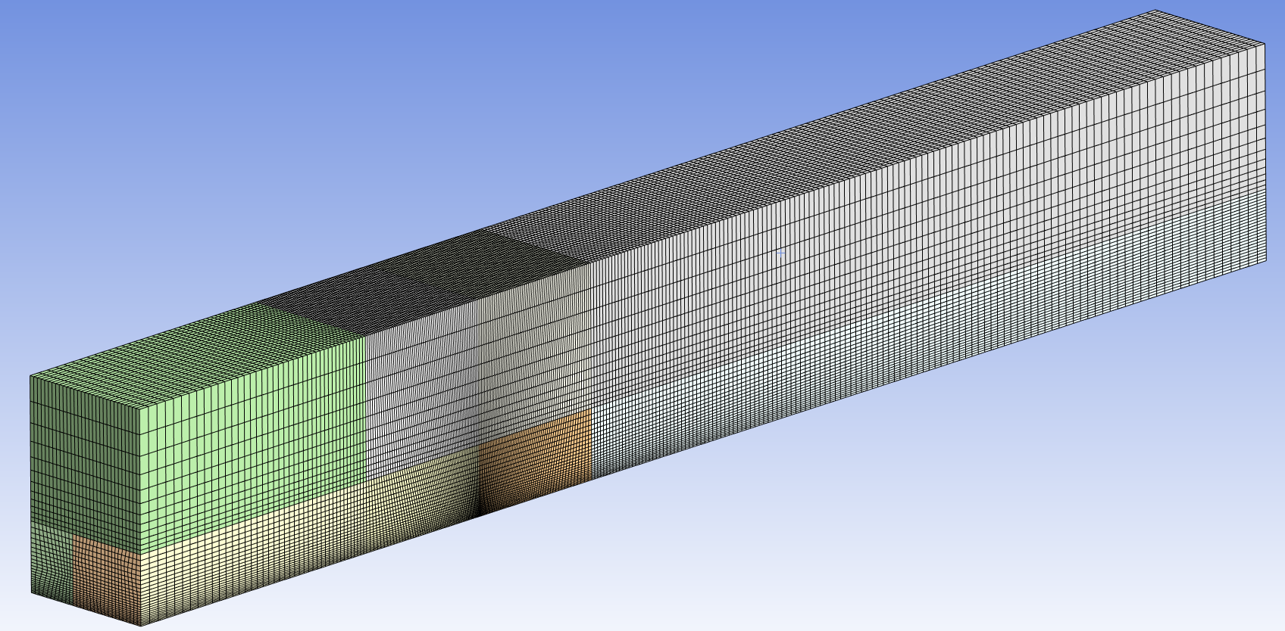
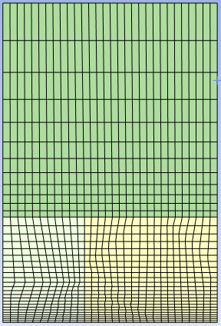
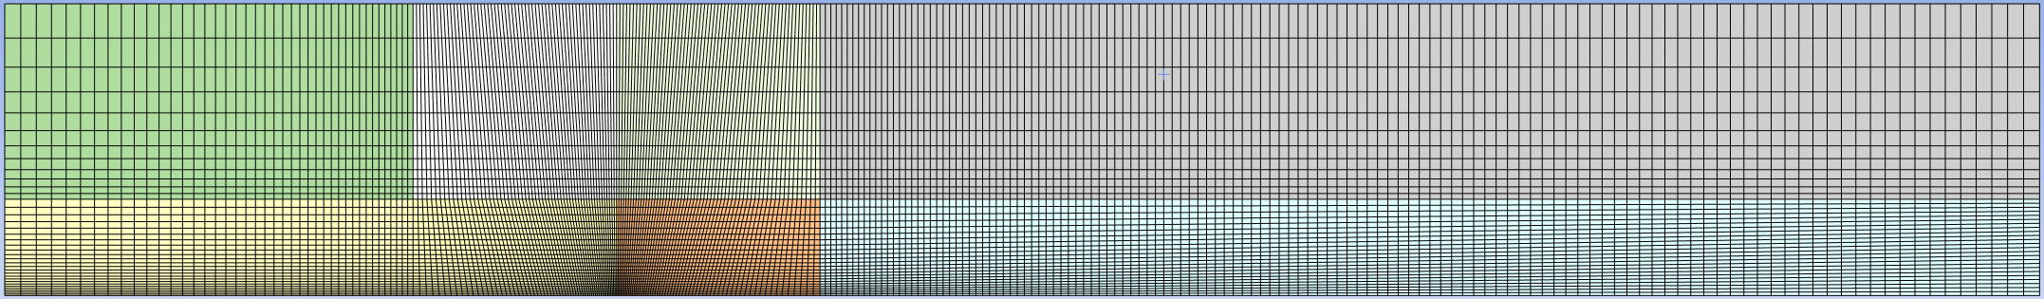
Geometry & Mesh
Ti block 23 dimensions, half-model
Beam is impacting symmetry plane
250 x 24.1 x 35.82 mm^3 (L x w x h) (half model)
Mesh elements: ~310 000 elements
Min. element size: 2E-4 m, 0.2 mm
Max. element size: 4E-3, 4 mm
Beam
Front view
Side view
Beam
Beam
Beam
Bottom view (mid-plane & symmetry plane), view for simulation results

Slide 6
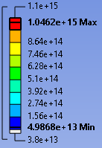
Comparison 2 vs 4 Gr blocks replaced
Beam intensity (FLUKA transfer)
2 graphite blocks replaced by C-SiC blocks
View of symmetry plane
(ie. Bottom surface of model image)
Beam
FLUKA import: Total energy: 48 791 (ANSYS) vs 43 502 (FLUKA) J (12% difference)
Peak power: 1.05 (ANSYS) vs 1.10 (FLUKA) PW/m3 (4.5% difference)
4 graphite blocks replaced by C-SiC blocks
Beam
FLUKA import: Total energy: 32 460 (ANSYS) vs 28 349 (FLUKA) J (14% difference)
Peak power: 662 (ANSYS) vs 688 (FLUKA) TW/m3 (3.7% difference)
Mid-plane view (symmetry plane)

Slide 7
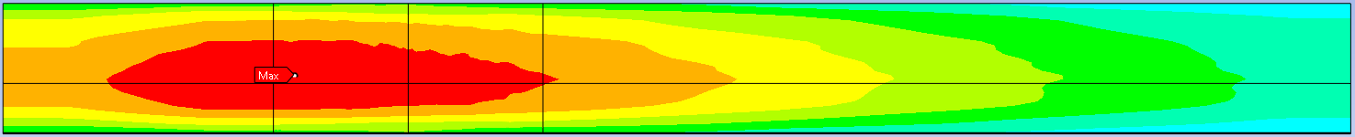
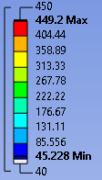
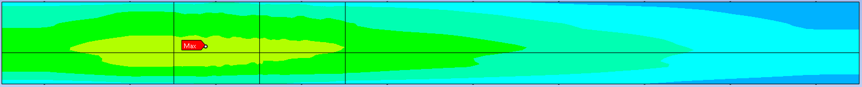
Comparison 2 vs 4 Gr blocks replaced
Temperature maps (end of beam impact, 1.1 us)
View of symmetry plane
(ie. Bottom surface of model image)
2 graphite blocks replaced by CSiC blocks
Beam
4 graphite blocks replaced by C-SiC blocks
Beam
Max. temperature: 449 vs 299 °C
Mid-plane view (symmetry plane)

Slide 8
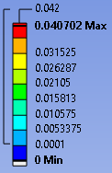
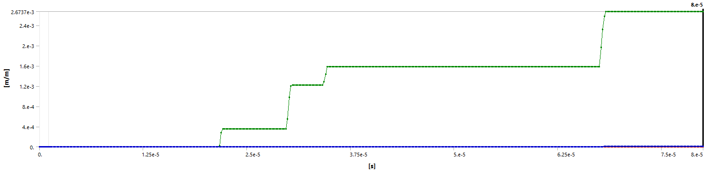
Comparison 2 vs 4 Gr blocks replaced
Plastic deformation: accumulated equivalent plastic strain at 80 us after beam impact
2 graphite blocks replaced by C-SiC blocks
View of symmetry plane
(ie. Bottom surface of model image)
Beam
4 graphite blocks replaced by C-SiC blocks
Beam
Mid-plane view (symmetry plane)
Reduction by half of plastic deformation in case where 4 Gr blocks are replaced
Evolution of maximum accumulated plastic strain versus time (4 Gr blocks replaced).

Slide 10
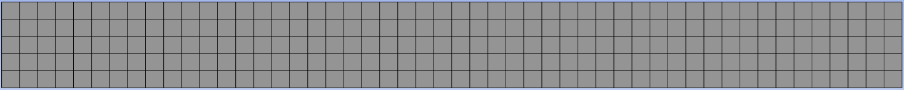
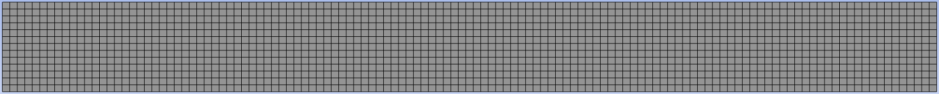
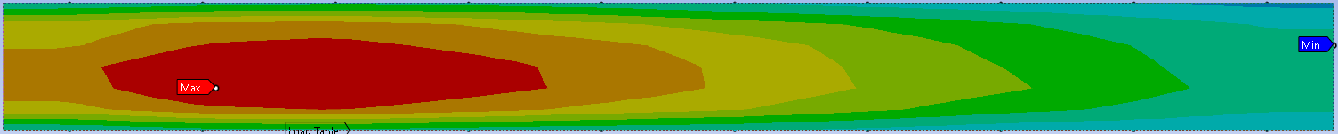
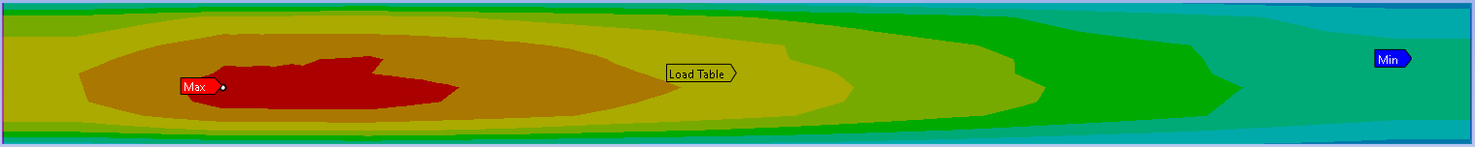
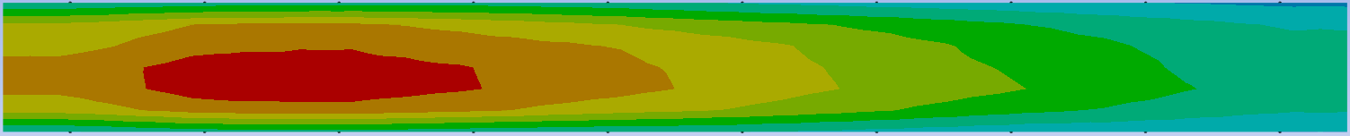
Mesh analysis
Mesh: 300 elements (10 mm size) | Mesh: 2 000 elements (5 mm size) | Mesh: 29 250 elements (2 mm size)
Peak power: 1.00 PW/m^3 Total energy: 50 409 J | Peak power: 1.03 PW/m^3 Total energy: 49 545 J | Peak power: 1.03 PW/m^3 Total energy: 49 266 J
Peak temperature: 441.29 °C | Peak temperature: 452.85 °C | Peak temperature: 450.51 °C
Max. accumulated ε(plastic): 0.11% | Max. accumulated ε(plastic): 0.21% | Max. accumulated ε(plastic): 0.31%
CP time thermal: 4 secs CP time mechanical: 6 mins | CP time thermal: 10 secs CP time mechanical: 33 mins | CP time thermal: 58 secs CP time mechanical: > 7.5h
FLUKA file: Peak power: 1.10 PW/m^3; Total energy: 43 502 J

