Slide 1

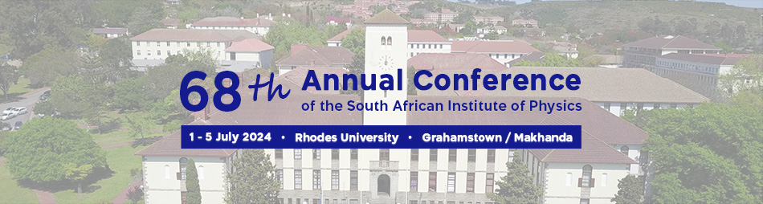


Searches of scalar in association with diphoton and 2-τ tagged leptons at electroweak scale in ATLAS detector at the LHC
Presented by Vuyolwethu Kakancu
02nd of July 2024
vkakancu@cern.ch
Vuyolwethu Kakancu ,Kutlwano Makgetha, Bruce Mellado, Mukesh Kumar

Slide 2
Outline
Introduction
Motivation from previous studies
BSM model considered
Monte Calo studies
Analysis studies
Summary
Ryan Mckenzie
1
Vuyolwethu , University of the Witwatersrand
1

Slide 3
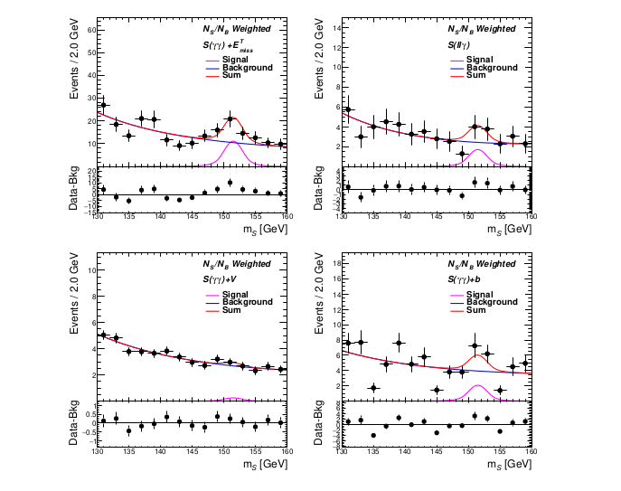
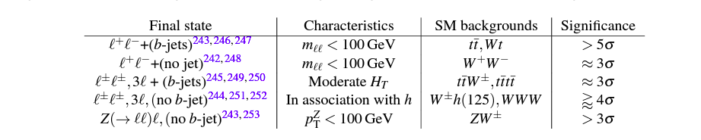
Multi lepton Anomalies at the LHC and the 152GeV Scalar candidate
Multi lepton Anomalies and Higgs like resonant signals
Nature Rev.Phys. 6 (2024) 5, 294-30
Vuyolwethu, University of the Witwatersrand
Phys.Rev.D 108 (2023) 11, 115031
Ryan Mckenzie
1
2

Slide 4
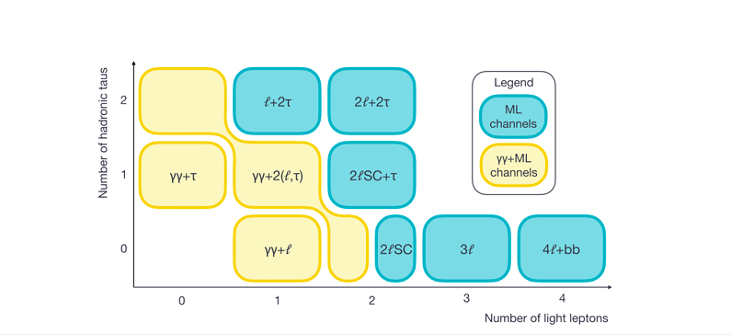
Multi lepton Anomalies at the LHC and possible channels for the search
Multi lepton channels considered by ATLAS for Higgs pair production
Vuyolwethu, University of the Witwatersrand
ATLAS-CONF-2024-005
Ryan Mckenzie
1
2

Slide 5
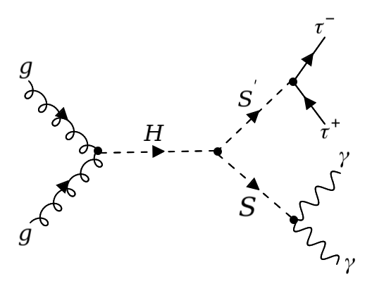
Searches for scalar resonances around 152 GeV
Motivated by the multilepton anomalies we consider the simplified model H→S S’ as the possible BSM model for our search .
In particular for signal process a focus on gluon-gluon fusion is considered
From the model we then postulate two scalars S(151.5GeV) and S’(95.5GeV) which come from an unstable heavy scalar H(250GeV)
Ryan Mckenzie
1
Vuyolwethu, University of the Witwatersrand
3

Slide 6
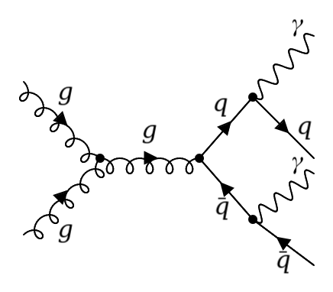
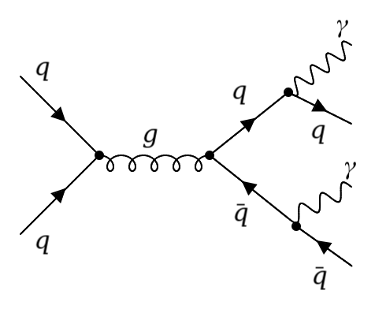
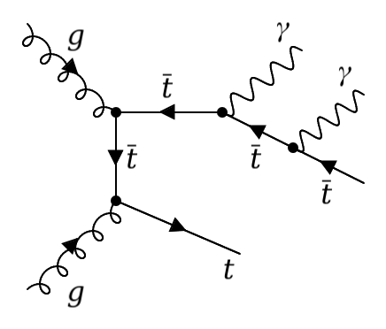
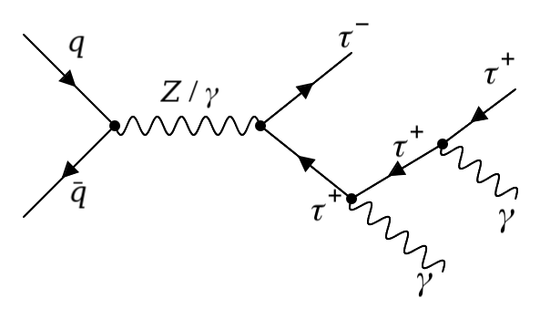
Backgrounds considered for my channel and Monte Calo generation
γγ + j j
γγ + t t~
γγ + (τ+ τ-)
Ryan Mckenzie
1
Vuyolwethu, University of the Witwatersrand
4

Slide 7
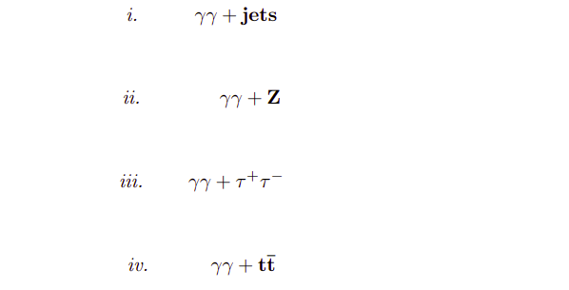
Backgrounds considered in the 𝛾𝛾 + (𝝉+ 𝝉-) signal channel and Monte Calo generation
Event generation is done using Madgraph5 at 13TeV center of mass energy
Events are generated at detector levels using delphes as the fast simulation detector
200000 events for the signal are generated while for background we generate a million events for each of the following backgrounds i),ii) and iv)
After that phythia8 is employed for showering and hadronization of the events
BACKGROUNDS CONSIDERED IN THE ANALYSIS
Ryan Mckenzie
1
Vuyolwethu, University of the Witwatersrand
5

Slide 8
Backgrounds considered in the 𝛾𝛾 + (𝝉+ 𝝉-) signal channel and Monte Calo generation
Baseline = 5fb ⨉ Branching Ratio
= 5fb ⨉ 8.32 %
= 0.416 fb
Baseline = 11.05 fb [𝛾𝛾 + t t~]
Baseline = 11.05 fb [𝛾𝛾 + 𝝉+ 𝝉-]
Baseline = 107000fb [𝛾𝛾 + jj]
BACKGROUNDS CONSIDERED IN THE ANALYSIS
Baseline cross section for the signal process
cross sections for the background processes
Ryan Mckenzie
1
Vuyolwethu, University of the Witwatersrand
6

Slide 9
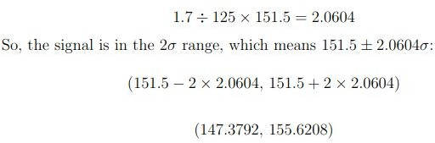
Backgrounds considered in the 𝛾𝛾 + (𝝉+ 𝝉-) signal channel and Monte Calo generation
Resolution for the postulated 151.5GeV Scalar
125GeV ~ 1.7
151.5GeV ~ 2.0604
Range of interest
Ryan Mckenzie
1
Vuyolwethu, University of the Witwatersrand
7

Slide 10
Analysis
Cuts applied for signal optimization
Object definition and event selection
Number of leptons e.g electrons,muons should be zero
Number of B jets must be equal to zero
Leading photon Transverse energy should be greater than 35GeV
Invariant mass cut select events between [105<m(γγ)<160]GeV
PT mass ratio for photon1 should greater 0.35 while for photon2 should be greater than 0.25
Select photons PT>25GeV and
-2.37 < 𝜼 <2.37
Select tau tagged jets with PT>20 and
-2.37< 𝜼 <2.37
Select events with 2 photons and 2 taus only
Ryan Mckenzie
1
Vuyolwethu, University of the Witwatersrand
8

Slide 11
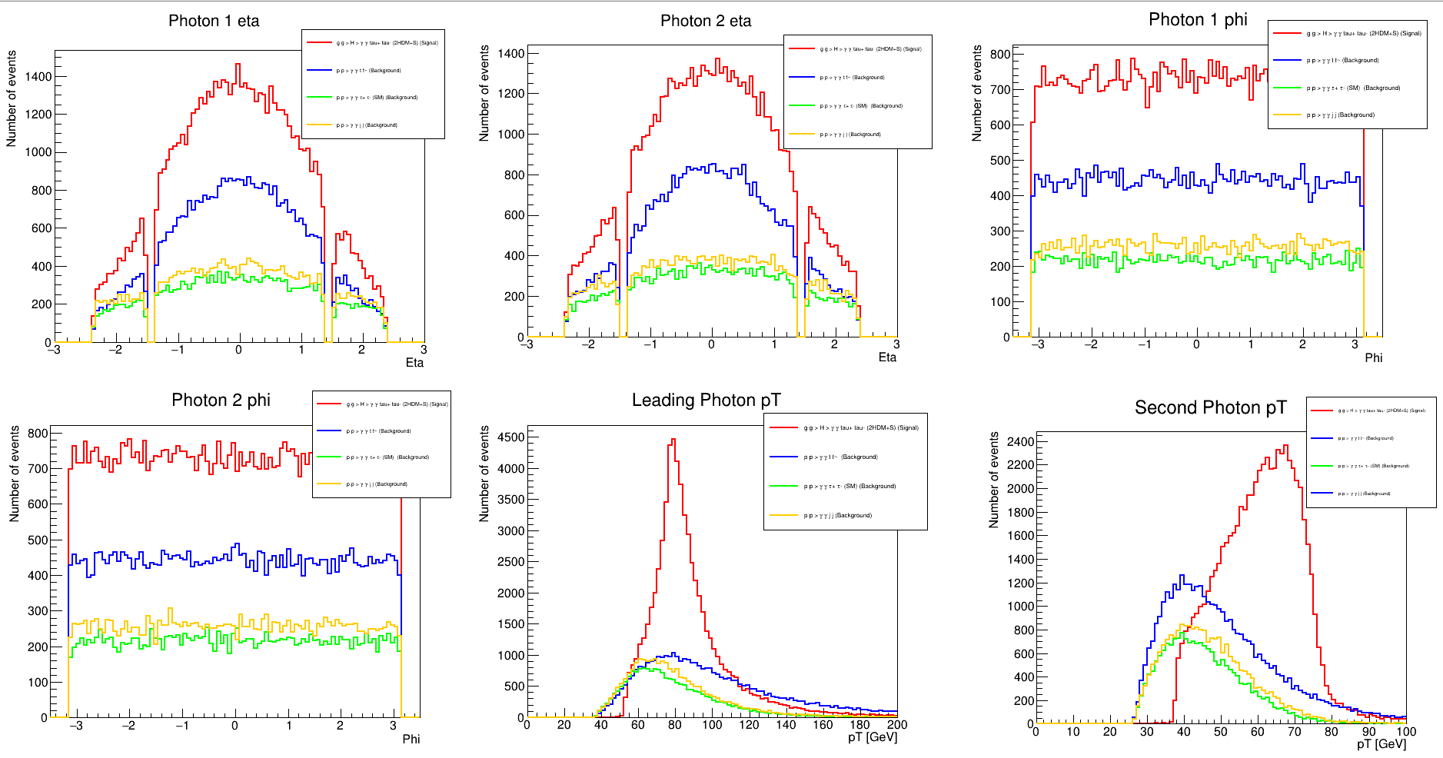
Kinematics after the application of Photonic cuts
Ryan Mckenzie
1
Vuyolwethu, University of the Witwatersrand
9

Slide 12
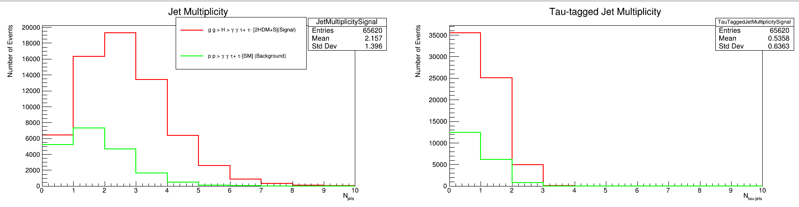
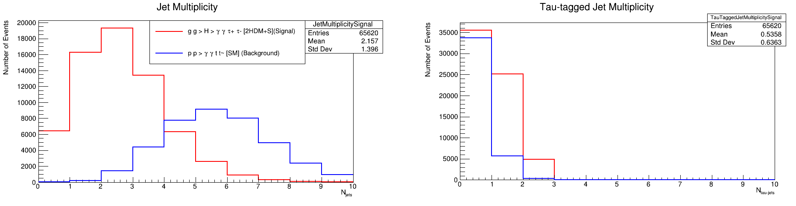
Jet and Tau tag jet Multiplicity after Photonic cuts
Ryan Mckenzie
1
Vuyolwethu, University of the Witwatersrand
10

Slide 13
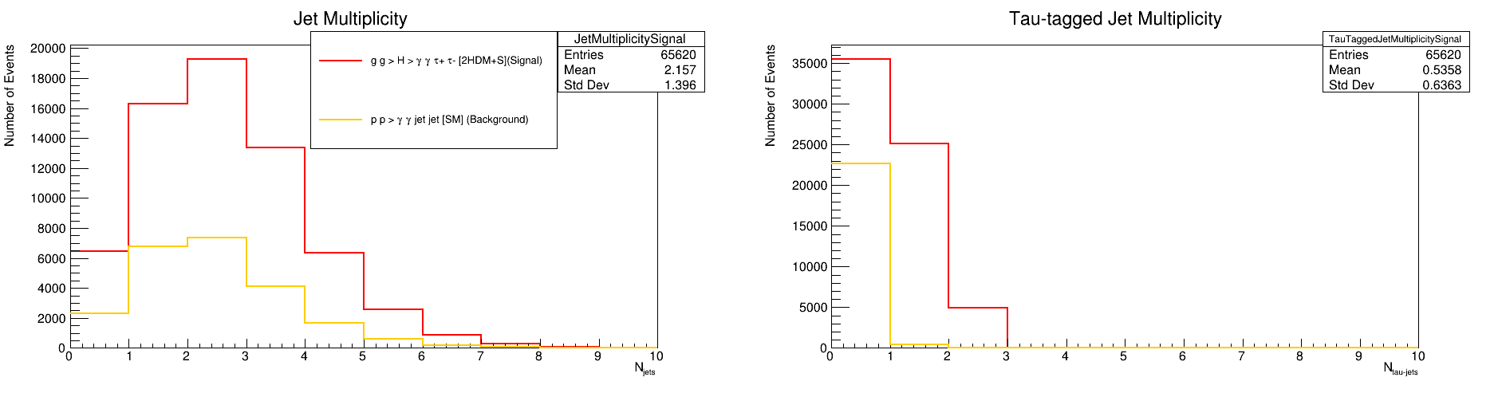
Jet and Tau tag jet Multiplicity after the Photonic cuts
Ryan Mckenzie
1
Vuyolwethu, University of the Witwatersrand
11

Slide 14
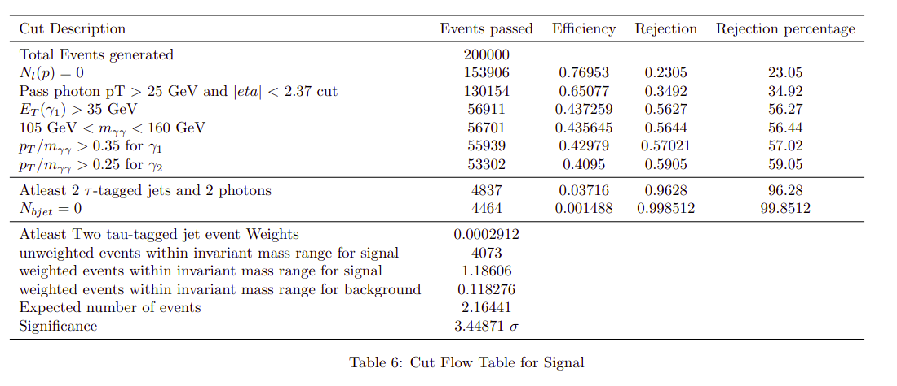
Cutflow table for the signal process
Ryan Mckenzie
1
Vuyolwethu, University of the Witwatersrand
12

Slide 15
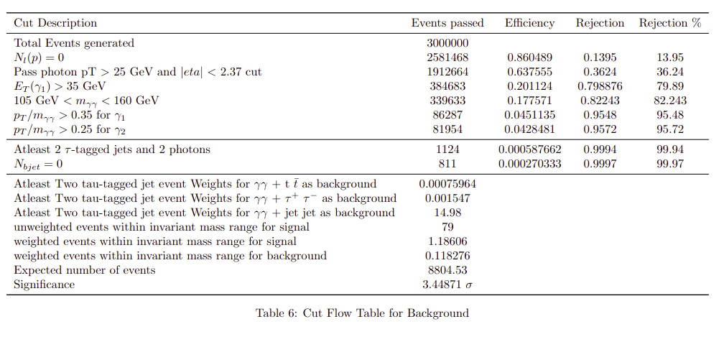
Cutflow table for all the Backgrounds
Ryan Mckenzie
1
Vuyolwethu, University of the Witwatersrand
13

Slide 16
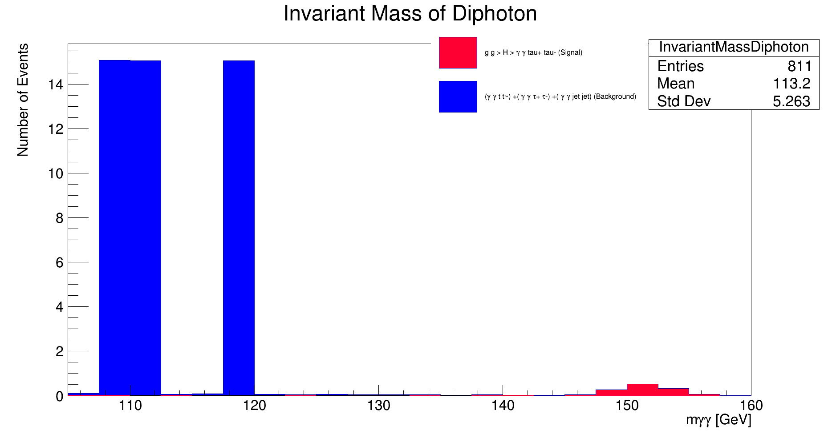
Diphoton invariant mass distribution after Weighting the events
Ryan Mckenzie
1
Vuyolwethu, University of the Witwatersrand
14

Slide 17
Summary
Therefore one can see the importance of this search, this can help in explaining the multi lepton anomalies which so far the SM fails to account for
For this channel significance of 3.44𝝈 is observed
Current status and future plans of the analysis - we are now preparing for the BSM signal generation for the ATLAS analysis in this case real data will be used
Ryan Mckenzie
1
Vuyolwethu, University of the Witwatersrand
14

Slide 18
A WARM THANK YOU TO EVERYONE IN ATTENDANCE DURING MY TALK
Ryan Mckenzie
1
Vuyolwethu, University of the Witwatersrand
15

